Slide 1
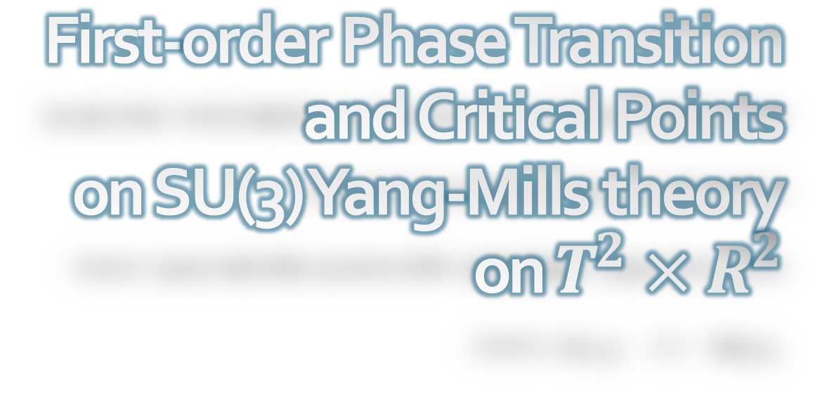
First-order Phase Transition and Critical Points on SU(3) Yang-Mills theory on $T^{2}×R^{2}$
Topology and Dynamics of Magneto-Vortical Matter (Vortex2025), 2025/1/21, YITP, Kyoto
Masakiyo Kitazawa (YITP, Kyoto)
MK, Mogliacci, Kolbe, Horowitz, Phys. Rev. D99 (2019) 094507
Suenaga, MK, Phys. Rev. D107 (2023) 074502
Fujii, Iwanaka, Suenaga, MK, Phys.Rev. D110 (2024) 094016

Slide 2
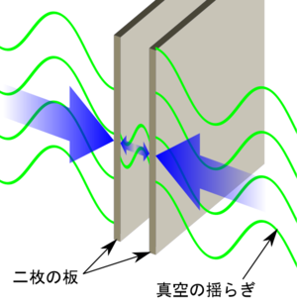
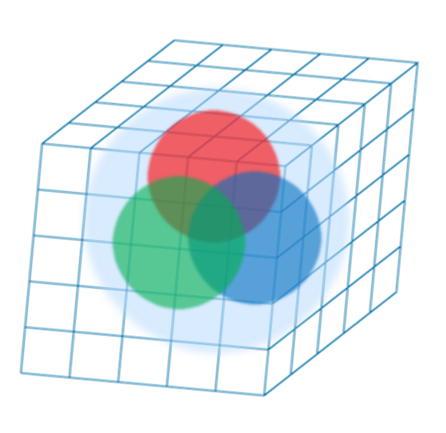
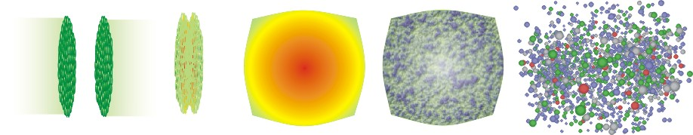

Boundary Conditions in QFT
Many motivations
Casimir effect
Relativistic heavy-ion collisions
Numerical simulations (ex. lattice QCD)
Matsubara formalism for thermal systems
from wikipedia

Slide 3






Our Purpose
Thermal SU(3) YM with PBC along $x$ direction
=
QFT on Euclidean
$T^{2}×R^{2}$
How does thermodynamics behave w.r.t. $T$ and $L_{x}$?
Thermal Casimir effect in a non-perturbative system
QCD phase diagram as a function of $L_{x}$
Anisotropic pressure
2 Polyakov loops will play important roles

Slide 4
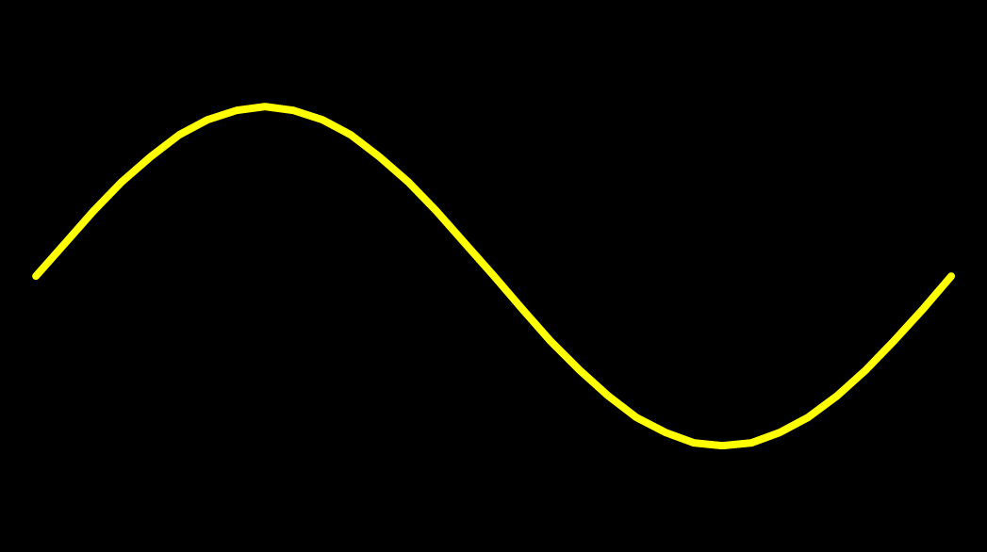
Casimir Effect
attractive force between two conductive plates

Slide 5





Casimir Effect
Brown, Maclay
1969

Slide 6



Casimir Effect
Brown, Maclay
1969

Slide 7
Contents
1. Lattice study
MK+, Phys. Rev. D99 (2019) 094507
2. Model analyses
Suenaga, MK, Phys. Rev. D107 (2023) 074502
Fujii, Iwanaka, Suenaga, MK, Phys. Rev. D110 (2024) 094016

Slide 8




Thermodynamics on the Lattice
Various Methods
Integral, differential, moving frame, non-equilibrium, …
rely on thermodynamic relations valid in V→∞
Not applicable to
anisotropic systems
We employ Gradient Flow (SFtX) Method
Components of EMT are directly accessible!

Slide 9


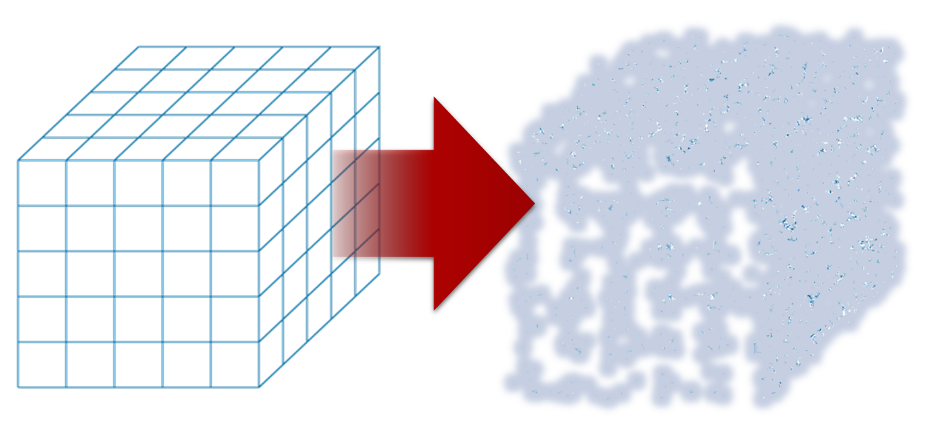

Yang-Mills Gradient Flow
Luscher 2010
Narayanan, Neuberger, 2006
Luscher, Weiss, 2011
t: “flow time”
dim:[length²]
leading
diffusion equation in 4-dim space
diffusion distance
“continuous” cooling/smearing
No UV divergence at t>0

Slide 10
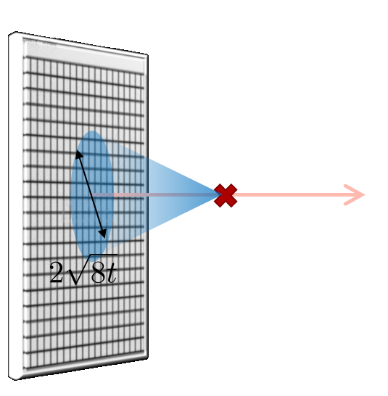

Constructing EMT
Suzuki, 2013
vacuum subtr.
Remormalized EMT
Perturbative coefficient:
Suzuki (2013); Makino, Suzuki (2014); Harlander+ (2018); Iritani, MK, Suzuki, Takaura (2019)

Slide 11
Thermodynamics
Iritani, MK, Suzuki, Takaura, 2019
□: 2-loop
△: Flow2016
Systematic error: μ₀ or μ_{d}, Λ, t→0 function, fit range
Good agreement within 1% level
Our method can deal with the anisotropic pressure

Slide 12
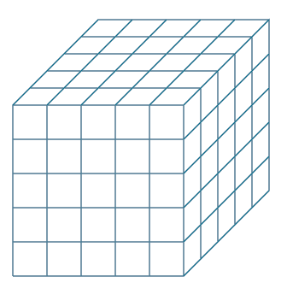

Numerical Setup
SU(3) YM theory
Wilson gauge action
$N_{t}=16, 12$
$N_{z}/N_{t}=6$
$2000\sim 4000$ confs.
Even $N_{x}$
No Continuum extrap.
Same System volume
12x72²x12 ~ 16x96²x16
18x72²x12 ~ 24x96²x16
Simulations on
OCTOPUS/Reedbush

Slide 13
Casimir Effect
Brown, Maclay
1969
T

Slide 14

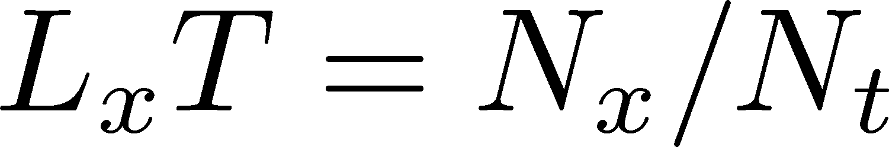


Pressure Anisotropy @ $T≠0$
MK, Mogliacci, Kolbe,
Horowitz (’21)
Free scalar field
L₂=L₃=∞
Periodic BC

Slide 15

Pressure Anisotropy @ $T≠0$
MK, Mogliacci, Kolbe,
Horowitz (’21)
Free scalar field
L₂=L₃=∞
Periodic BC
Lattice result
Periodic BC
Only t→0 limit
Error: stat.+sys.
Medium near T_{c} is remarkably insensitive to finite size!

Slide 16
Pressure Anisotropy @ $T≠0$
MK, Mogliacci, Kolbe,
Horowitz (’21)
Free scalar field
L₂=L₃=∞
Periodic BC
Lattice result
Periodic BC
Only t→0 limit
Error: stat.+sys.
Medium near T_{c} is remarkably insensitive to finite size!

Slide 17
Higher T
High-T limit: massless free gluons
How does the anisotropy approach this limit?
Difficulties
Vacuum subtraction requires large-volume simulations.
Lattice spacing not available → c₁(t), c₂(t) are not determined.

Slide 18


Higher T
High-T limit: massless free gluons
How does the anisotropy approach this limit?
Difficulties
Vacuum subtraction requires large-volume simulations.
Lattice spacing not available → c₁(t), c₂(t) are not determined.
We study
No vacuum subtr. nor Suzuki coeffs. necessary!

Slide 19



T
massless free
$T/T_{c}≃8.1 \left(β=8.0\right)$, $T/T_{c}≃25 (β=9.0)$
Ratio approaches the asymptotic value for large $T$.
But, large deviation exists even at ${T/T}_{c}≃25$.
1st-order phase transition??

Slide 20
Contents
1. Lattice study
MK+, Phys. Rev. D99 (2019) 094507
2. Model analyses
Suenaga, MK, Phys. Rev. D107 (2023) 074502
Fujii, Iwanaka, Suenaga, MK, Phys. Rev. D110 (2024) 094016

Slide 21




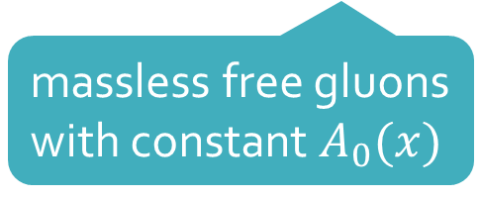

Polyakov-loop Effective Models
Meisinger+, PRD (2003)
General Idea
Constant Polyakov loop $P$ as dynamical variable
: confinement
: deconfinement
Free Energy
massless free gluons
with constant $A_{0}(x)$
Phenomenological
potential term
$⟨P⟩$ is determined to minimize $F(T;P)$.

Slide 22
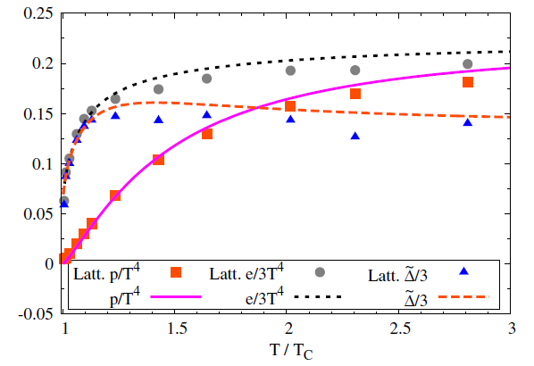

Thermodynamics
Meisinger+, PRD (’03)
Dumitru+, PRD (’12)
Qualitative behavior of lattice thermodynamics near and above $T_{c}$ is well reproduced.

Slide 23









Extension to $T^{2}×R^{2}$
Suenaga, MK (’23); Fujii+ (’24)
2 Polyakov loops along $τ$ and $x$ directions
$S^{1}×R^{3}$ model
Free Energy
symmetric
$S^{1}×R^{3}$ model
Function of 2 Polyakov loops.
Constructed under constraints in various limits and symmetries
perturbative

Slide 24





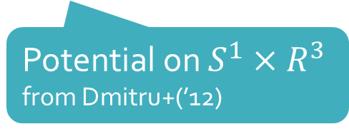
Polyakov-loop Potential Term
Fujii+ (2024)
Potential on $S^{1}×R^{3}$
from Dmitru+(’12)
: parameters in the model

Slide 25

Result
Lattice results for ${T/T}_{c}>1.5$ are well reproduced.
No parameters to fit the results for $T/T_{c}=1.4, 1.12$.
Appearance of discontinuity = 1st-order PT

Slide 26
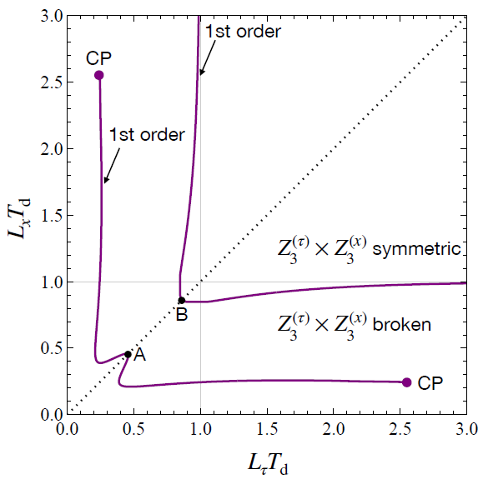

Phase Diagram
2 first-order tranitions!
B: connected to deconf. tr.
on $S^{1}×R^{3}$
A: new phase transition
Novel 1st-tr & CP induced by interplay between 2 Polyakov loops

Slide 27

Summary
Lattice thermodynamics in SU(3) YM on $T^{2}×R^{2}$ has peculiar behaviors:
Medium at 1.4<T/T_{c}<2.1 is remarkably insensitive to the boundary.
Slow approach to the SB limit at small $L_{τ}, L_{x}$.
Model analysis with two Polyakov loops explains the lattice results for $T≥1.5T_{c}$ qualitatively:
Interplay b/w two Polyakov loops plays a crucial role.
Appearance of new 1st-PT & CP is predicted.
Future
More lattice results to confirm the existence of the 1st PT
Anti-periodic / Dirichlet BCs, BC for two directions, below T_{c}, …

Slide 28
backup

Slide 29
Numerical Results

Slide 30



Extrapolations t→0, a→0
O(t) terms in SFTE
lattice discretization
FlowQCD2016
This Study
①Continuum
②Small t extrapol.
strong
discretization
effect
strong
discretization
effect

Slide 31
energy densty / transverse P
Energy Density
Transverse Pressure P_{z}

Slide 32

Small-t Extrapolation
Filled: N_{t}=16 / Open: N_{t}=12
Small-t extrapolation
Solid: N_{t}=16, Range-1
Dotted: N_{t}=16, Range-2,3
Dashed: N_{t}=12, Range-1
Stable small-t extrapolation
No N_{t} dependence within statistics for L_{x}T=1, 1.5

Slide 33
Small-t Extrapolation
Filled: N_{t}=16 / Open: N_{t}=12
Small-t extrapolation
Solid: N_{t}=16, Range-1
Dotted: N_{t}=16, Range-2,3
Dashed: N_{t}=12, Range-1
Stable small-t extrapolation
No N_{t} dependence within statistics for L_{x}T=1, 1.5

