Slide 1
International Workshop on Advances in Lattice QCD, Institute of Modern Physics, Huizhou, China, Oct. 14, 2025
Lee-Yang zeros
near critical points
Masakiyo Kitazawa
(YITP, Kyoto)
In collab. with Tatsuya Wada, Kazuyuki Kanaya
Special thanks to S. Ejiri
Wada, MK, Kanaya, PRL134, 162302 (’25), arXiv:2508. 20422

Slide 2
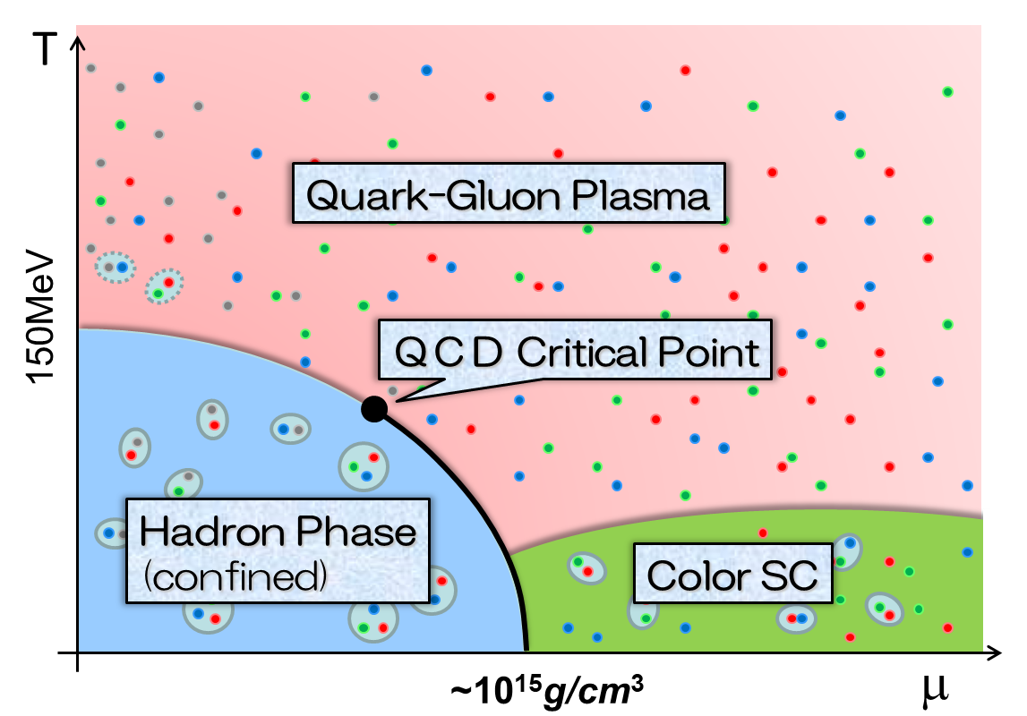
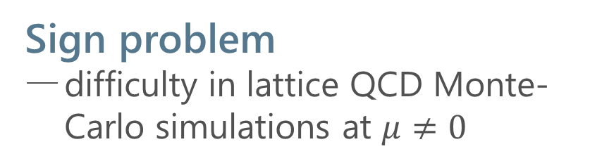
QCD Phase Diagram
Rich phase structure in QCD
QCD critical point(s)
color superconductivity
Sign problem
difficulty in lattice QCD Monte-Carlo simulations at $μ≠0$
Various approaches
Taylor expansion method
Imaginary chem. pot.
Complex Langevin
Lifschetz thimble
Lee-Yang edge singularity
…

Slide 3

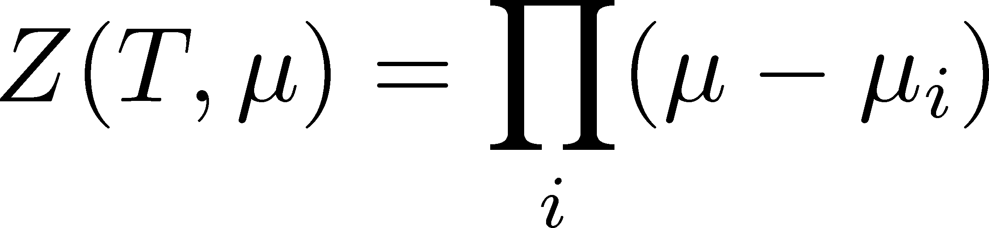




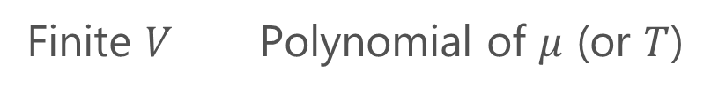
Lee-Yang Zeros
Yang, Lee; Lee, Yang (’52)
Partition Function
Finite $V$ Polynomial of $μ$ (or $T$)
zeros on the complex plane
=Lee-Yang Zeros

Slide 4


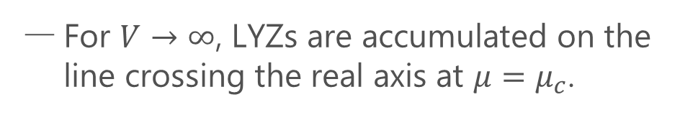
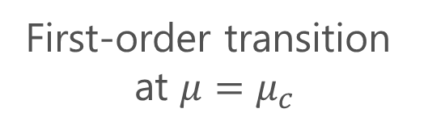
Lee-Yang Zeros
Yang, Lee; Lee, Yang (’52)
Partition Function
Phase Transition & LYZ
Finite $V$ Polynomial of $μ$ (or $T$)
First-order transition
at $μ=μ_{c}$
For $V→∞$, LYZs are accumulated on the line crossing the real axis at $μ=μ_{c}$.
zeros on the complex plane
=Lee-Yang Zeros

Slide 5

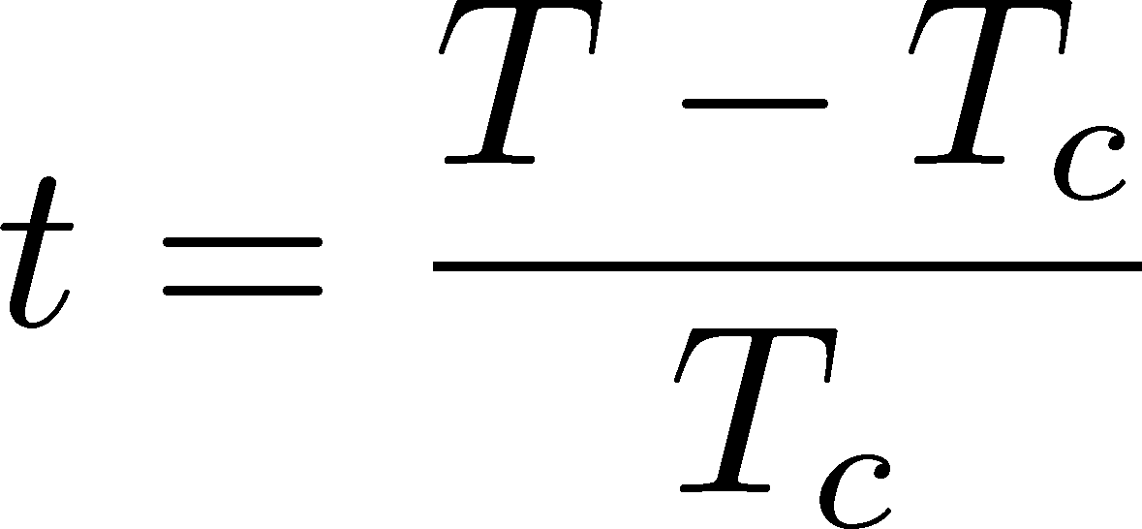

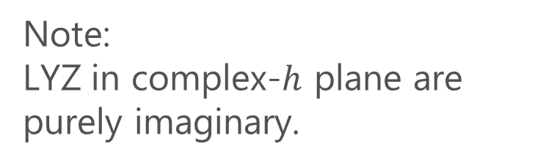

LYZ around a Critical Point in Ising Model
1st-transition
singularity on the real $h$ axis
Crossover
no singularity on the real axis
Note:
LYZ in complex-$h$ plane are purely imaginary.
Lee-Yang, 1952

Slide 6
LYZ around a Critical Point in Ising Model
1st-transition
singularity on the real $h$ axis
Crossover
no singularity on the real axis
Note:
LYZ in complex-$h$ plane are purely imaginary.
Lee-Yang, 1952

Slide 7


LYZ around a Critical Point in Ising Model
$$h_{I}\sim t^{βδ}$$
1st-transition
singularity on the real $h$ axis
Crossover
no singularity on the real axis
LY edge singularity
Starting from the CP
Its behavior is governed by the the scaling function.
$$h_{I}\sim t^{βδ}$$

Slide 8
LYZ around a Critical Point in Ising Model
$$h_{I}\sim t^{βδ}$$
1st-transition
singularity on the real $h$ axis
Crossover
no singularity on the real axis
LY edge singularity
Starting from the CP
Its behavior is governed by the the scaling function.
$$h_{I}\sim t^{βδ}$$

Slide 9

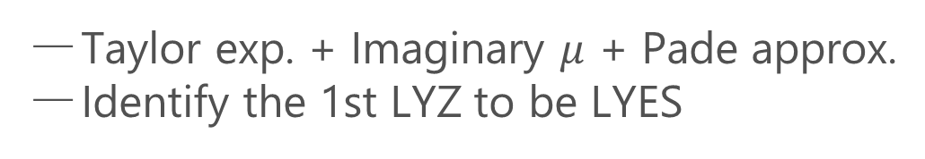
Recent Progress in LYZ/LYES and Lattice
Clarke+, 2405.10196
Analytic Structure
Scaling functions, FRG, …
An, Mesterhazy, Stephanov (’16)
Johnson, Rennecke, Skokov (’23)
Karsch, Schmidt, Singh (‘23)
…
Locating QCD-CP at $μ≠0$ on the lattice?
Clarke+, 2405.10196; Adam+, 2507.13254
Taylor exp. + Imaginary $μ$ + Pade approx.
Identify the 1st LYZ to be LYES

Slide 10

Purpose of This Study
$$h_{I}\sim t^{βδ}$$
On finite volume,
1st LYZ $≠$ LYES
Our Purpose
Understand finite-volume effects of LYZ
Exploit them for the CP searches

Slide 11


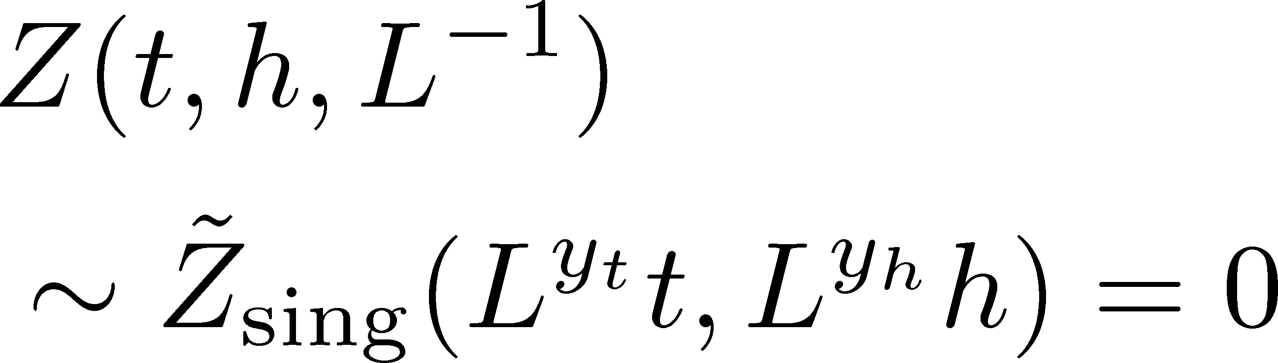
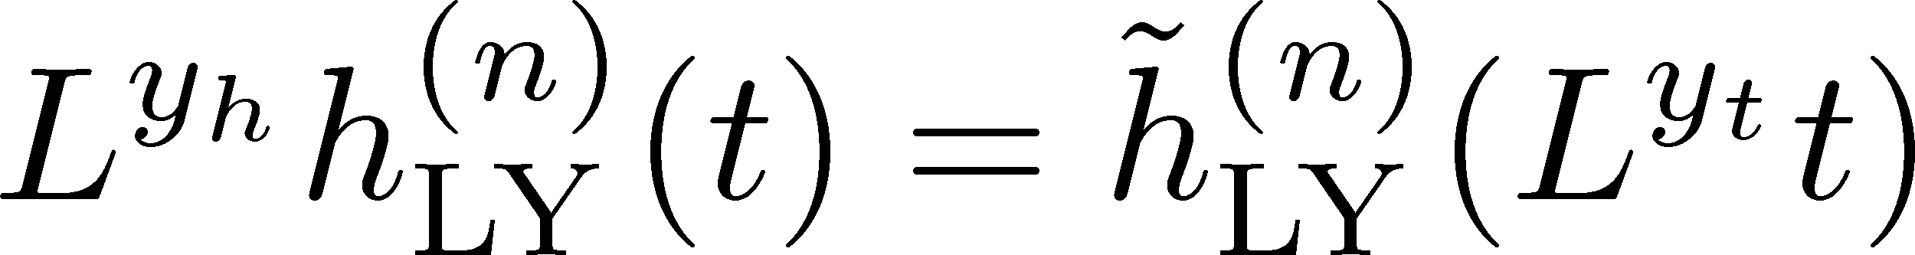
Finite-Size Scaling
Scaling Hypothesis
LYZ in the scaling region on finite volume
Itzykson, Nucl. Phys. 220 (1983)

Slide 12
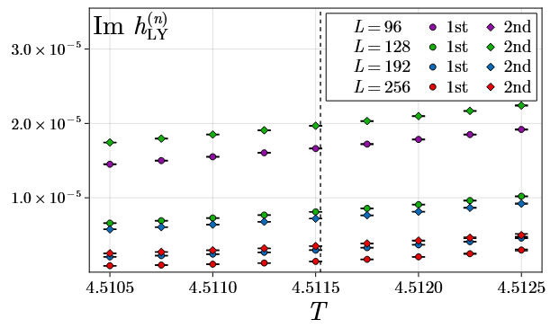
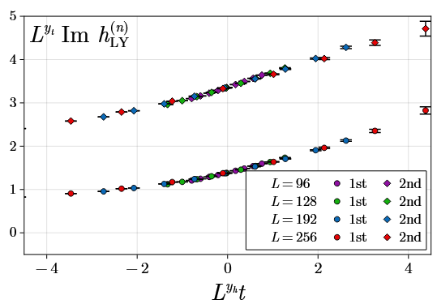
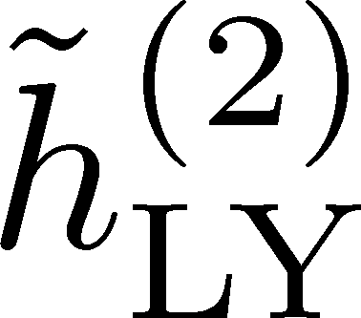
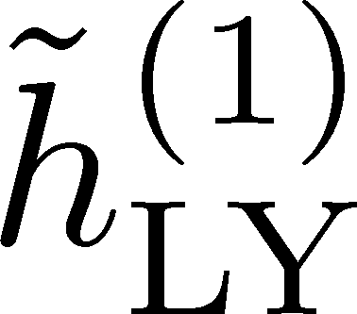
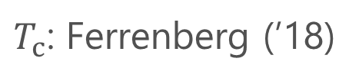
LYZ in 3d Ising Model
Wada, MK, Kanaya, arXiv:2508. 20422
1st & 2nd LYZ
Rescaled
rescale
$T_{c}$: Ferrenberg (’18)

Slide 13

Where is QCD Critical Point?
Ising model
LYZ in QCD
Clarke+, arXiv:2405.10196
CP around here?

Slide 14
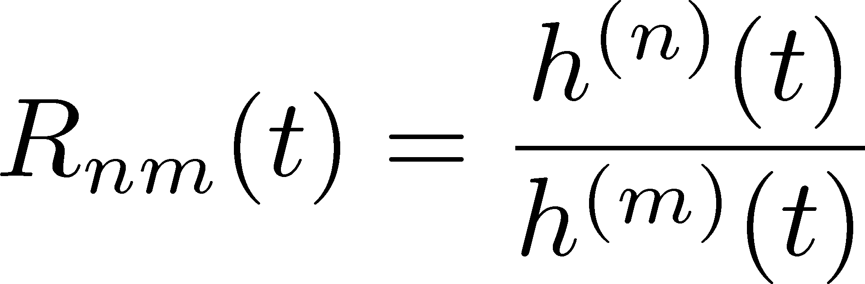
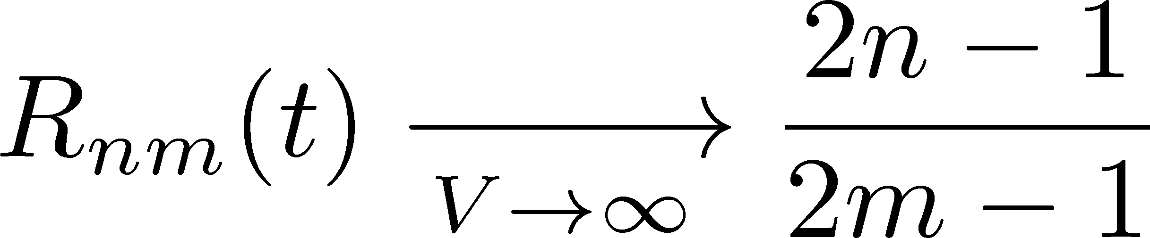
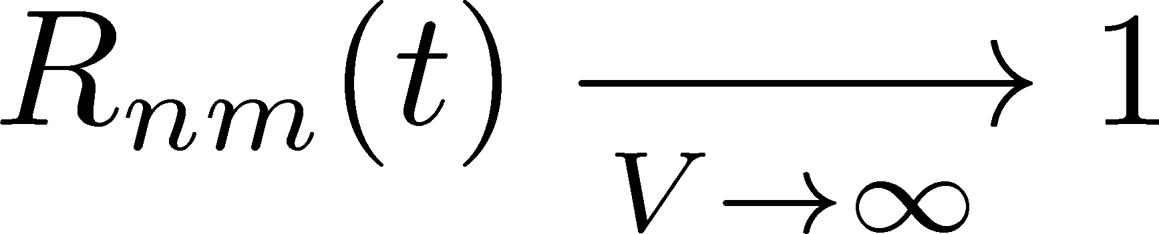
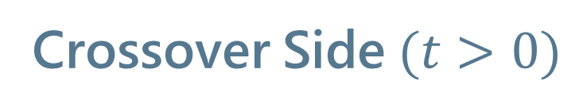
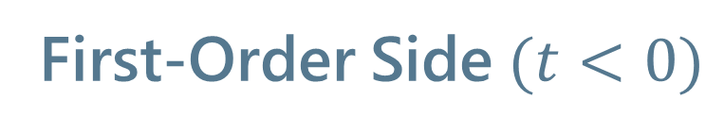
Lee-Yang Zero Ratios
Wada, MK, Kanaya, PRL (’25)
First-Order Side$(t<0)$
Crossover Side$(t>0)$

Slide 15
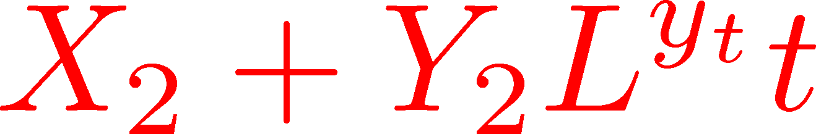
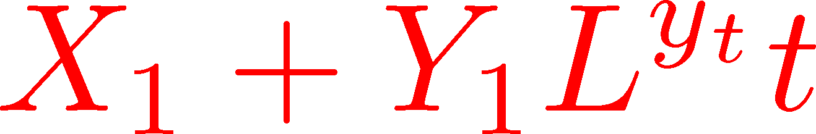
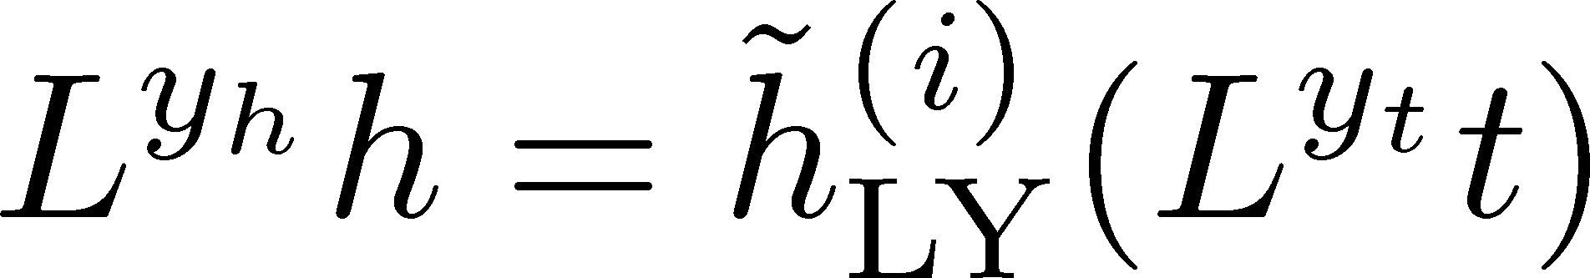
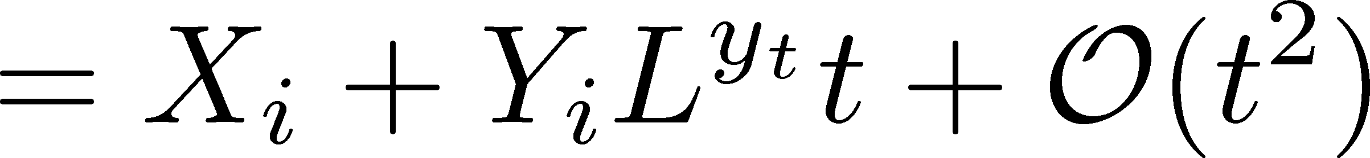
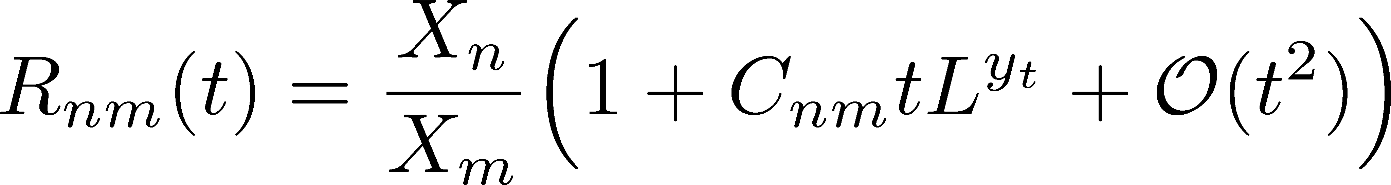


LYZ near $t=0$
Wada, MK, Kanaya, PRL (’25)
Linear Approx. at $t=0$

Slide 16
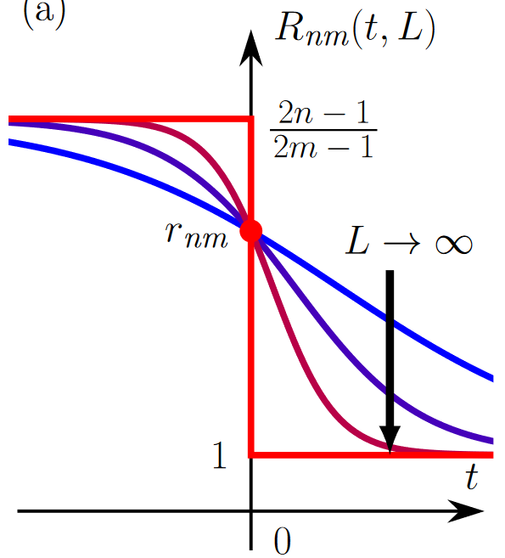
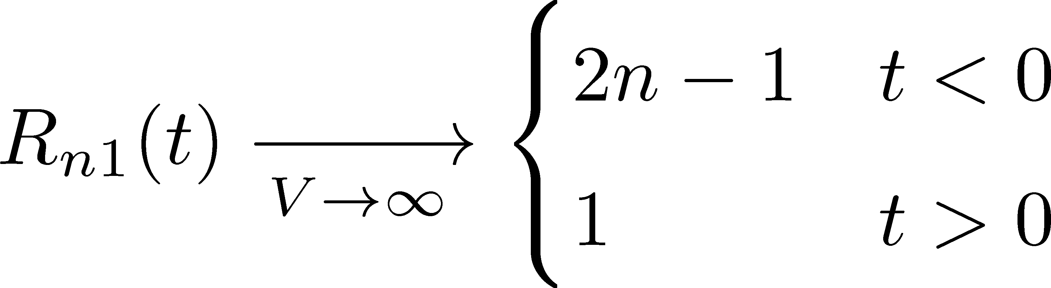
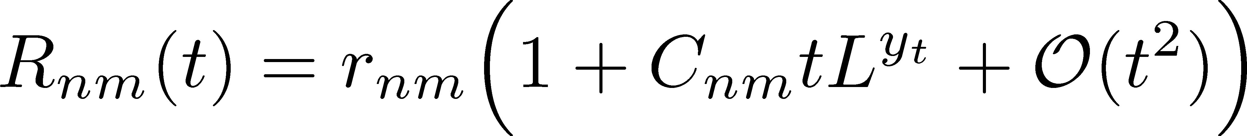
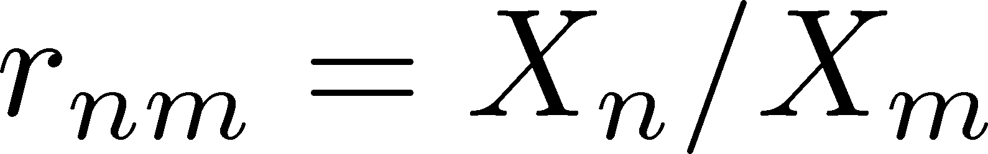
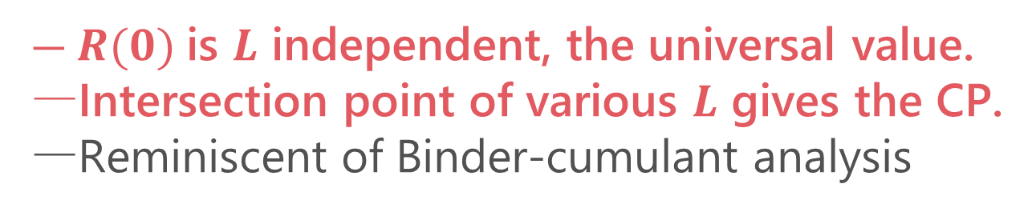
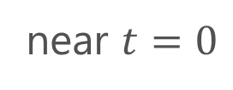
LYZ Ratios
Wada, MK, Kanaya, PRL, ’25
(1st order)
(crossover)
crossing
near $t=0$
$R(0)$is $L$ independent, the universal value.
Intersection point of various $L$ gives the CP.
Reminiscent of Binder-cumulant analysis

Slide 17
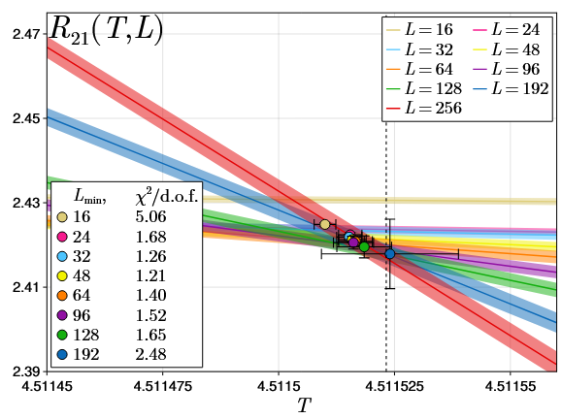
LYZR vs Binder Cumulant in 3d-Ising
LYZR
Wada, MK, Kanaya, arXiv:2508.20422

Slide 18
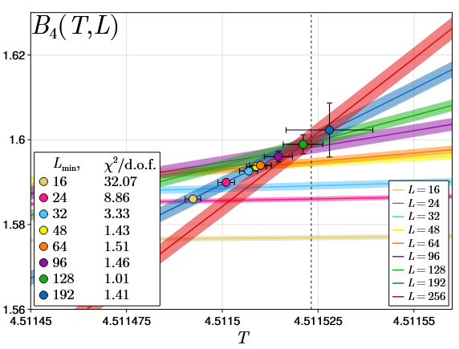
LYZR vs Binder Cumulant in 3d-Ising
LYZR
Binder cumulant
Faster convergence of the violation of FSS in LYZ?
Wada, MK, Kanaya, arXiv:2508.20422

Slide 19
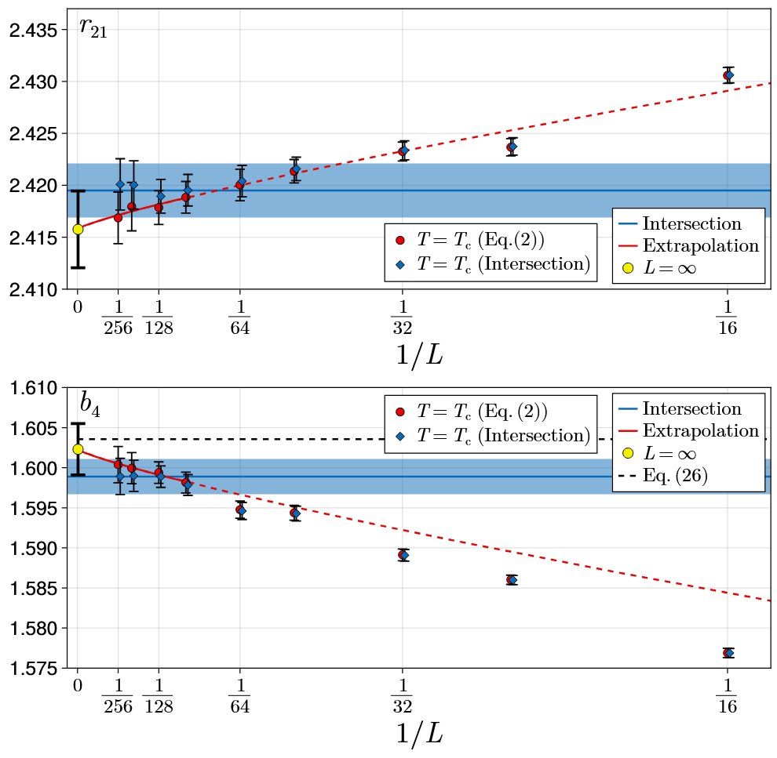

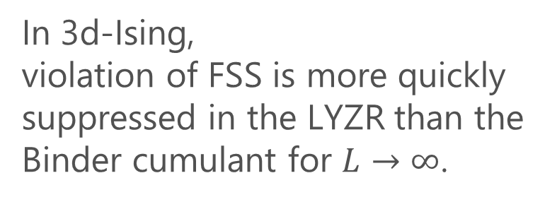
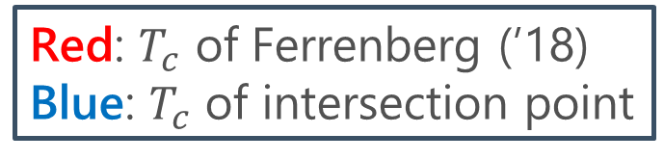
Convergence at $T=T_{c}$
Wada, MK, Kanaya, arXiv:2508. 20422
LYZR
Red: $T_{c}$ of Ferrenberg (’18)
Blue: $T_{c}$ of intersection point
In 3d-Ising,
violation of FSS is more quickly suppressed in the LYZR than the Binder cumulant for $L→∞$.
Binder cumulant

Slide 20


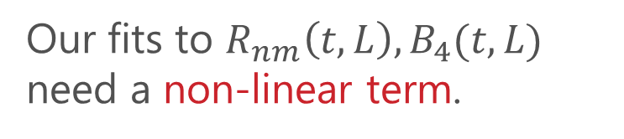
Curvature
Wada, MK, Kanaya, arXiv:2508.20422
Our fits to $R_{nm}\left(t,L\right), B_{4}(t,L)$ need a non-linear term.
Measure of non-linearity

Slide 21
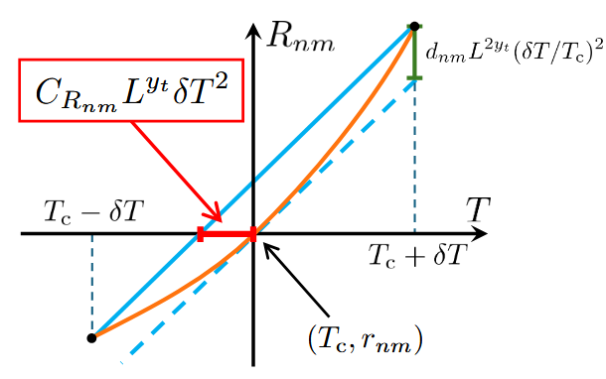
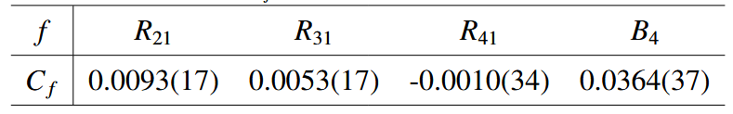
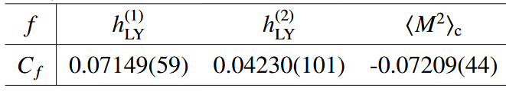
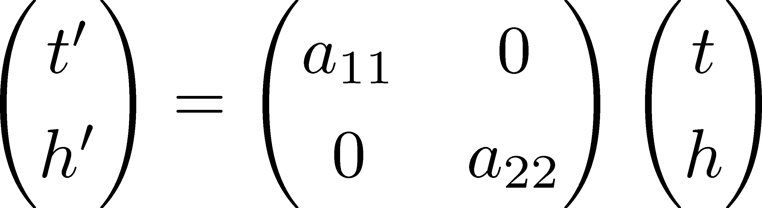
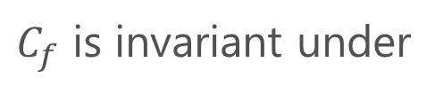
Curvature
Wada, MK, Kanaya, arXiv:2508.20422
Measure of non-linearity
$C_{f}$ is invariant under

Slide 22


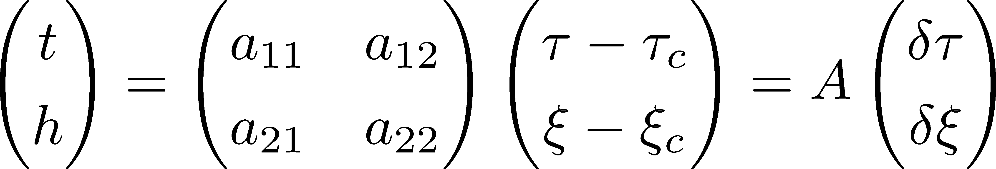

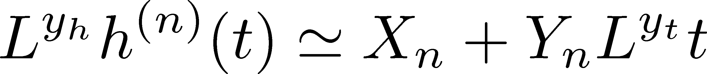


CP in a General System
Wada, MK, Kanaya, PRL (’25)
CP on a $τ−ξ$ plane
LYZ on the complex $ξ$ plane

Slide 23
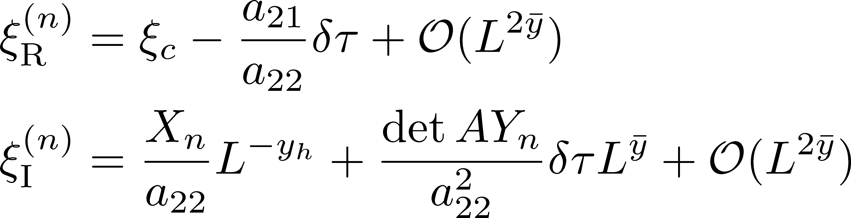
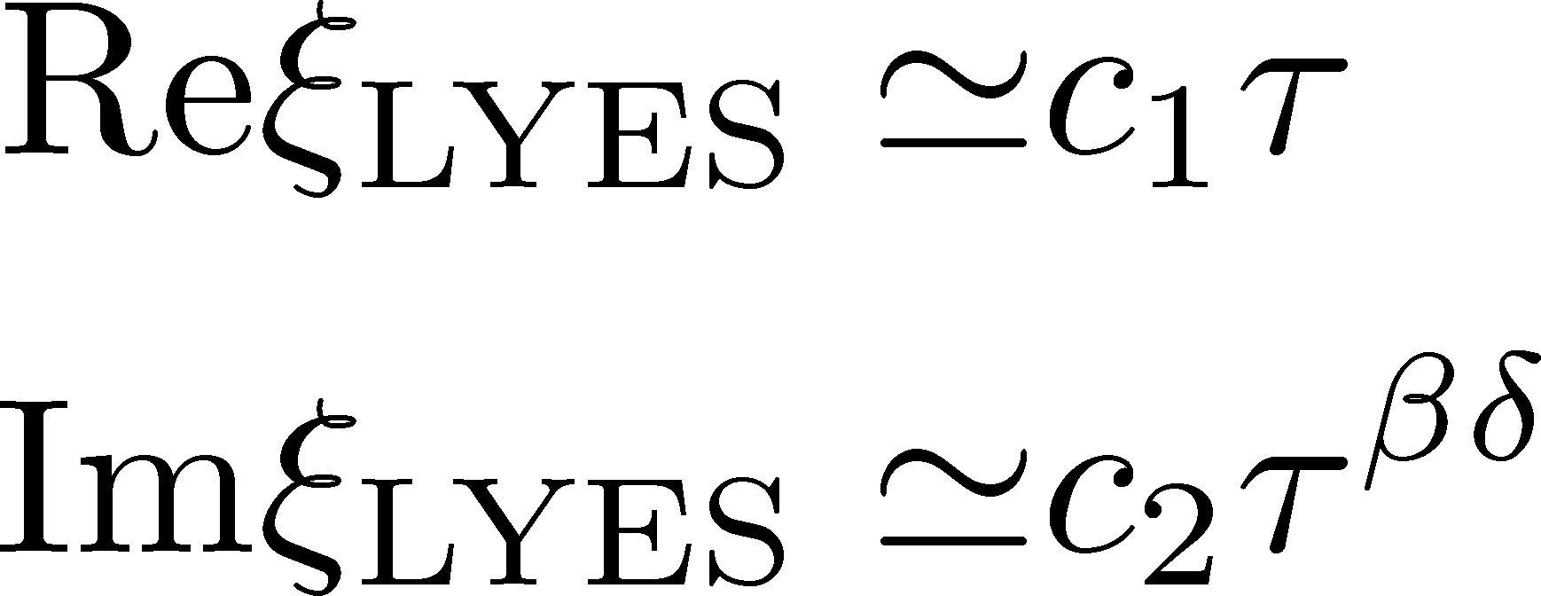


CP in a General System
Wada, MK, Kanaya, PRL (’25)
CP on a $τ−ξ$ plane
LYZ on the complex $ξ$ plane
$$L→∞$$
LY Edge Singularity
generalization
to finite $V$
Stephanov, 2006

Slide 24
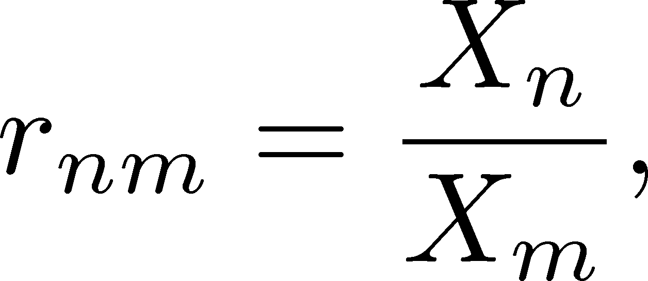

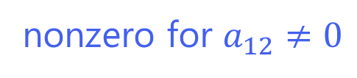
LYZ Ratios for General CP
Wada, MK, Kanaya, PRL (’25)
LYZ Ratio
nonzero for $a_{12}≠0$
$r_{nm}$ are universal constants specific to universality classes.

Slide 25
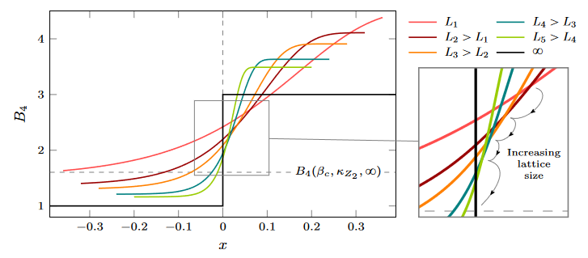



LYZ Ratios vs Binder Cumulant
Wada, MK, Kanaya, PRL (’25)
LYZ Ratio
nonzero for $a_{12}≠0$
Binder cumulant
Jin+, PRD86, 2017
nonzero for $a_{12}≠0$
$r_{nm}$ are universal constants specific to universality classes.
fig from
Cuteri+,
PRD (’21)
Deviation at $t=0$due to $a_{12}≠0$ converges faster in LYZ ratio.

Slide 26







Numerical Analysis: 3d 3-State Potts Model
Monte-Carlo + reweighting
Phase Diagram
Binder-Cumulant Analysis
Z(2) CP
1st-order
Z(3)
Karsch, Stickan, 2000

Slide 27



3d 3-State Potts Model: LYZ Ratio
LYZ Ratio (R₂₁)
Binder Cumulant
Wada, MK, Kanaya, PRL, ’25
$R_{n1}$ and $B_{4}$ give the same value of $τ_{c}$ within statistics.

Slide 28



3d 3-State Potts Model: LYZ Ratio
LYZ Ratio (R₂₁)
Wada, MK, Kanaya, PRL, ’25
Combined use of LYZ can improve statistics!

Slide 29
LYZR in Various Models
CPs in 3d-Z(2) universality class
Ising: 2508.20422
Potts: PRL, ’25
HQ-CP: 2501.18904
LYZR at the intersection point
Heavy-Quark CP
Consistent within statistics
Confirmation of universality

Slide 30



Single-LYZ Method
Wada, MK, Kanaya, arXiv:2508. 20422
LYZ in 3d-Ising
$L^{y_{h}}h^{n}(t)$ for various $L$ intersect at the CP!
Assuming the universality class and the values of $y_{t}, y_{h}$,
the intersection analysis can be performed only with a single LYZ.

Slide 31
Where is the QCD Critical Point?
Single-LYZ analysis for 2+1 flavor QCD
Intersection around $T≃100$ MeV? Yet lower $T$ data are mandatory.

Slide 32

Summary
Lee-Yang-zero ratio method
A new method to utilize the finite-size effects of Lee-Yang zeros for the CP searches.
Works successfully in 3d Ising and Potts models, as well as heavy-quark QCD-CP.
Outlook
Determination of $r_{nm}$ in each universality class
Other quantities: $ξ_{c}$, mixing matrix $A$, etc.
Application to the CP in heavy-quark QCD
QCD-CP

