Slide 1
YITP Lunch Seminar, Kyoto, 2025/11/19
Lee-Yang Zeros
and
Critical Points
Masakiyo Kitazawa
In collab. with Tatsuya Wada, Kazuyuki Kanaya
Wada, MK, Kanaya, PRL (‘25), arXiv:2508.20422

Slide 2
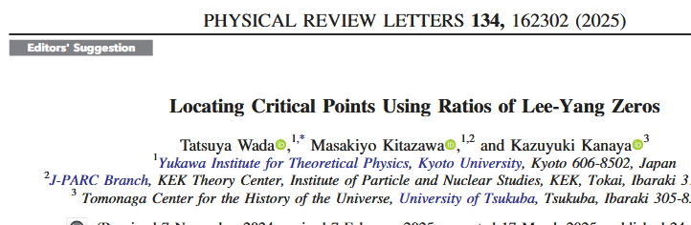
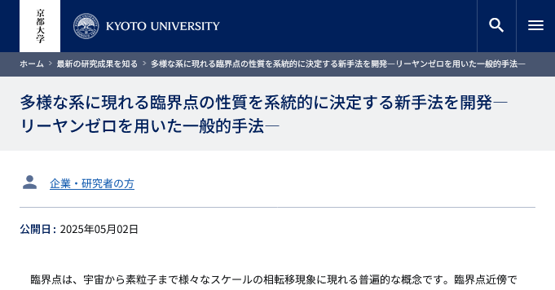
YITP Lunch Seminar, Kyoto, 2025/11/19
Lee-Yang Zeros
and
Critical Points
Masakiyo Kitazawa
In collab. with Tatsuya Wada, Kazuyuki Kanaya
Wada, MK, Kanaya, PRL (‘25), arXiv:2508.20422

Slide 3
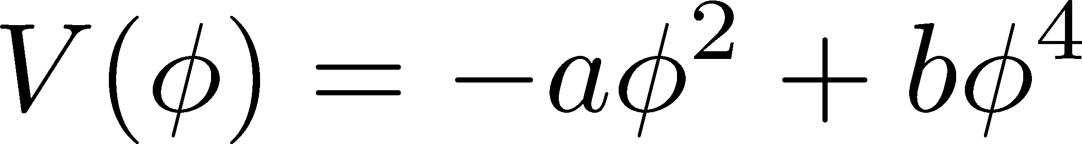
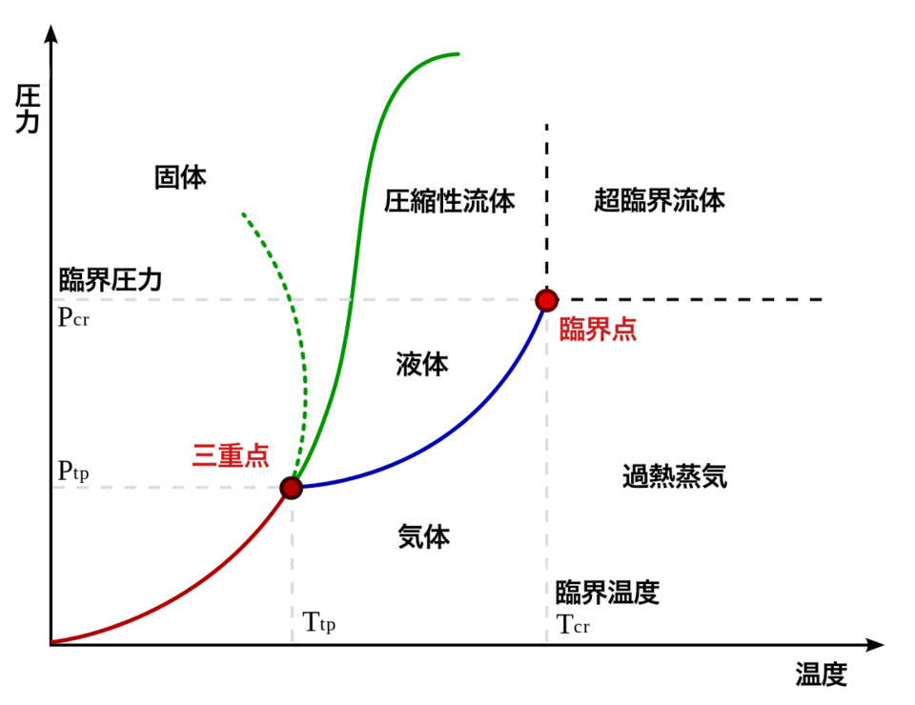

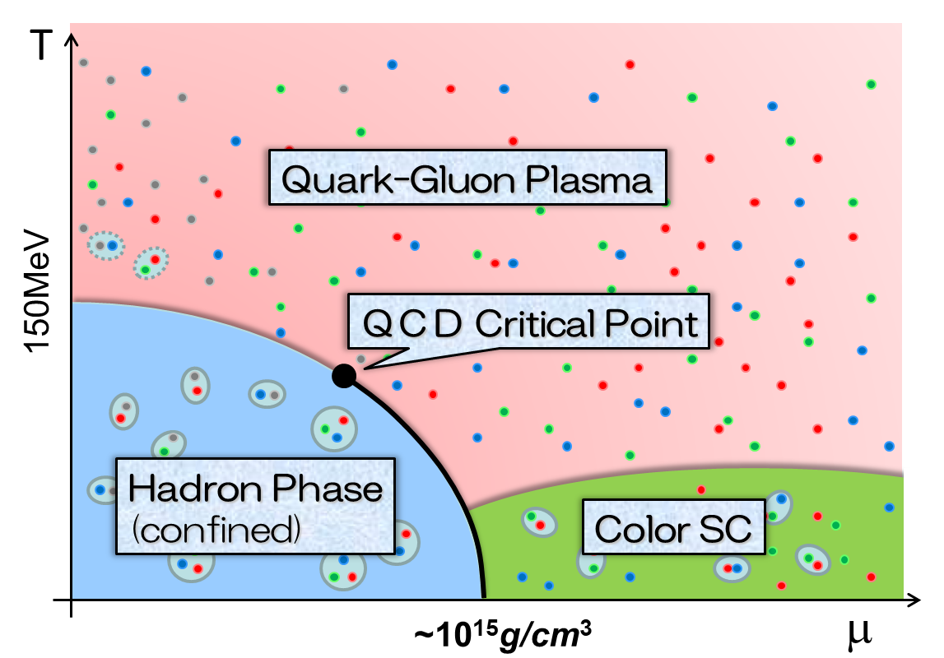
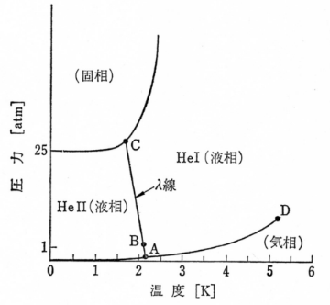

Critical Points Everywhere!
Water
Ising
Liquid Helium
QCD Phase Diagram

Slide 4
Critical Points Everywhere!
Water
Ising
Liquid Helium
QCD Phase Diagram
CPs in completely different systems share
the singularity through the universality class.

Slide 5
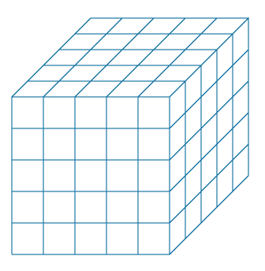
Search for QCD-CP with Lee-Yang Zeros
in Lattice QCD Simulations
…;
Dimopoulos+, PRD (’22);
Clarke+, 2405.10196;
Adam+, 2507.13254; …

Slide 6

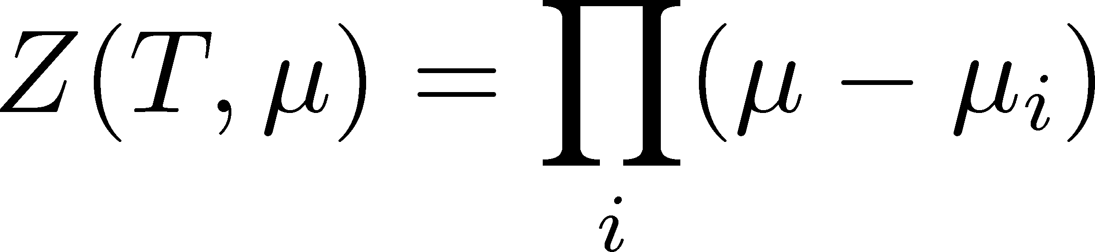




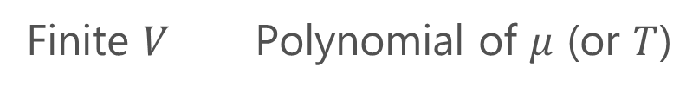
Lee-Yang Zeros
Yang, Lee; Lee, Yang (’52)
Partition Function
Finite $V$ Polynomial of $μ$ (or $T$)
zeros on the complex plane
=Lee-Yang Zeros

Slide 7


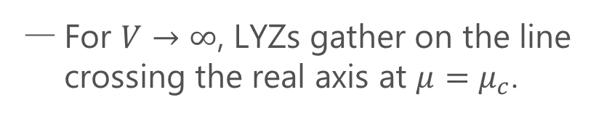
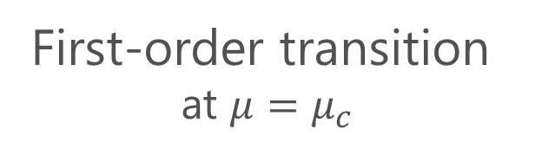
Lee-Yang Zeros
Yang, Lee; Lee, Yang (’52)
Partition Function
Phase Transition & LYZ
Finite $V$ Polynomial of $μ$ (or $T$)
First-order transition
at $μ=μ_{c}$
For $V→∞$, LYZs gather on the line crossing the real axis at $μ=μ_{c}$.
zeros on the complex plane
=Lee-Yang Zeros

Slide 8

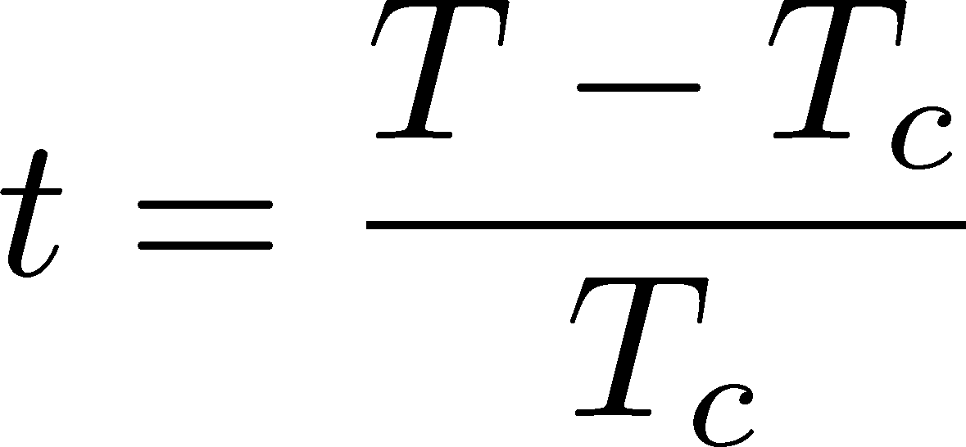

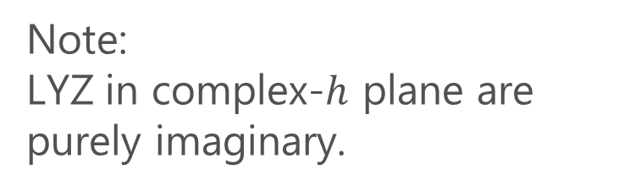

LYZ around a Critical Point in Ising Model
1st-transition
singularity on the real $h$ axis
Crossover
no singularity on the real axis
Note:
LYZ in complex-$h$ plane are purely imaginary.
Lee-Yang, 1952

Slide 9
LYZ around a Critical Point in Ising Model
1st-transition
singularity on the real $h$ axis
Crossover
no singularity on the real axis
Note:
LYZ in complex-$h$ plane are purely imaginary.
Lee-Yang, 1952

Slide 10


LYZ around a Critical Point in Ising Model
$$h_{I}\sim t^{βδ}$$
1st-transition
singularity on the real $h$ axis
Crossover
no singularity on the real axis
LY edge singularity
Starting from the CP
Its behavior is governed by the the scaling function.
$$h_{I}\sim t^{βδ}$$

Slide 11
LYZ around a Critical Point in Ising Model
$$h_{I}\sim t^{βδ}$$
1st-transition
singularity on the real $h$ axis
Crossover
no singularity on the real axis
LY edge singularity
Starting from the CP
Its behavior is governed by the the scaling function.
$$h_{I}\sim t^{βδ}$$

Slide 12
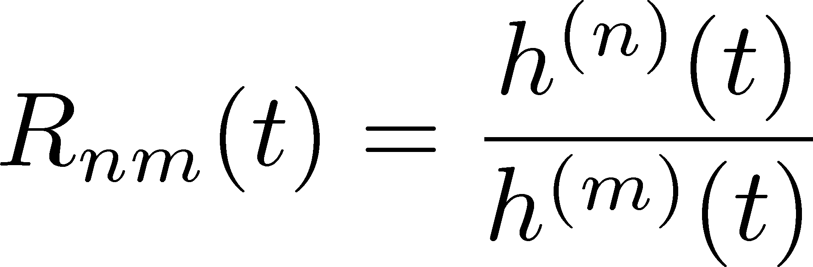
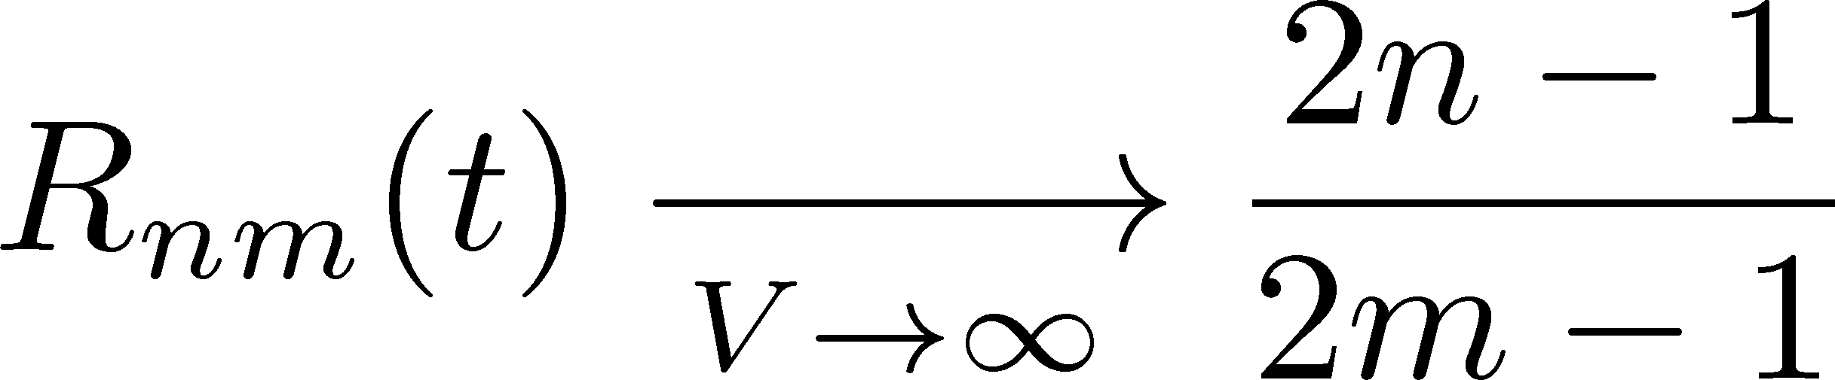
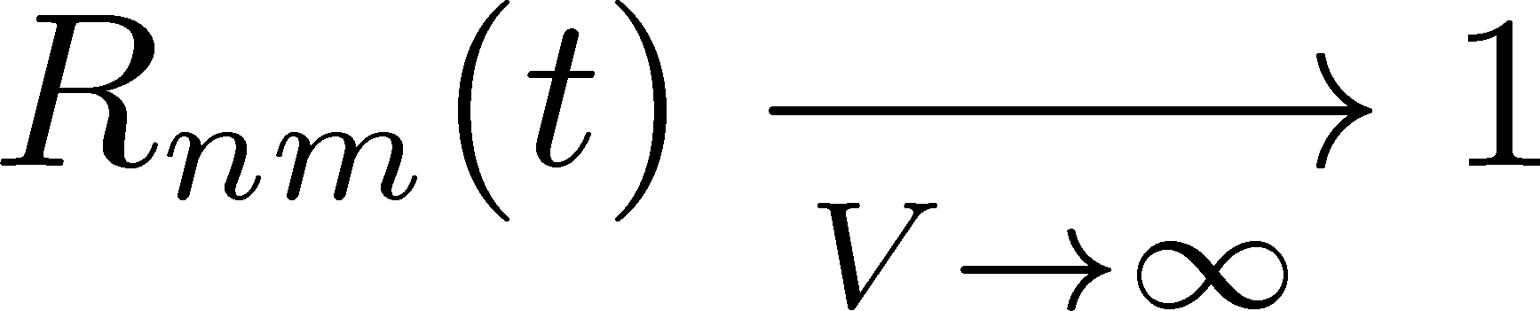
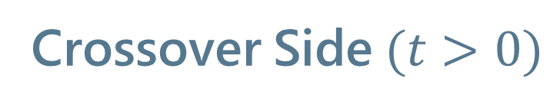
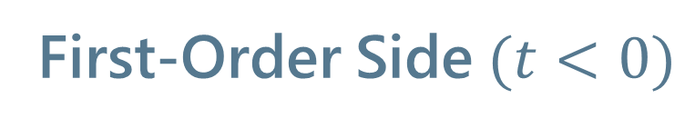
Lee-Yang Zero Ratios
Wada, MK, Kanaya, PRL (’25)
First-Order Side$(t<0)$
Crossover Side$(t>0)$

Slide 13


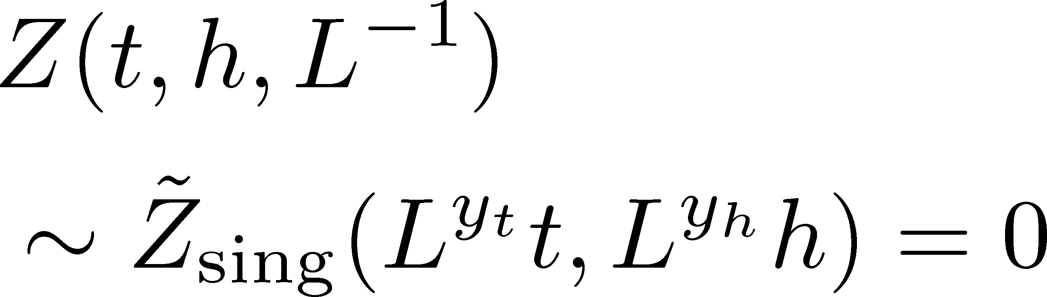
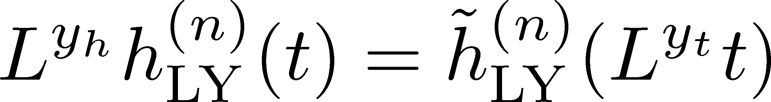
Finite-Size Scaling
Scaling Hypothesis
LYZ in the scaling region on finite volume
Itzykson, Nucl. Phys. 220 (1983)

Slide 14
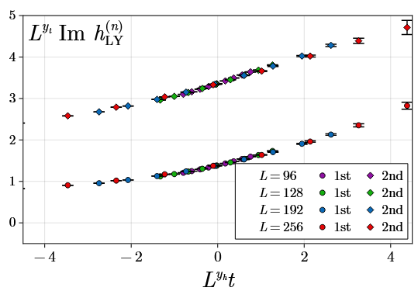
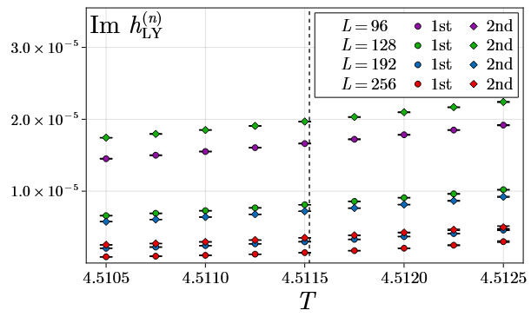
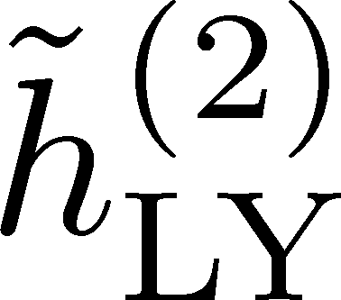
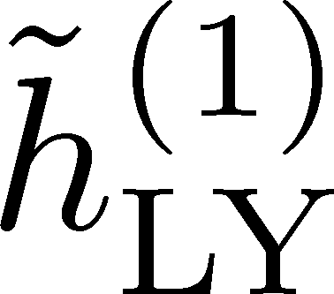

LYZ near $t=0$
Wada, MK, Kanaya, PRL (’25)
rescale

Slide 15
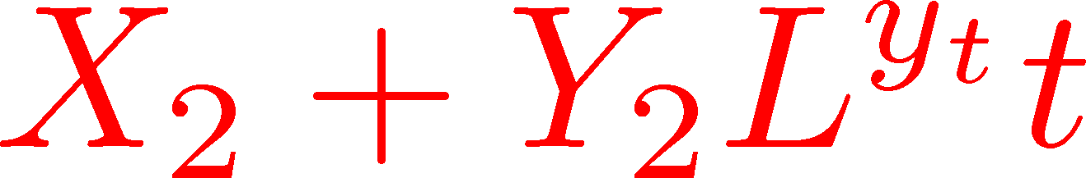
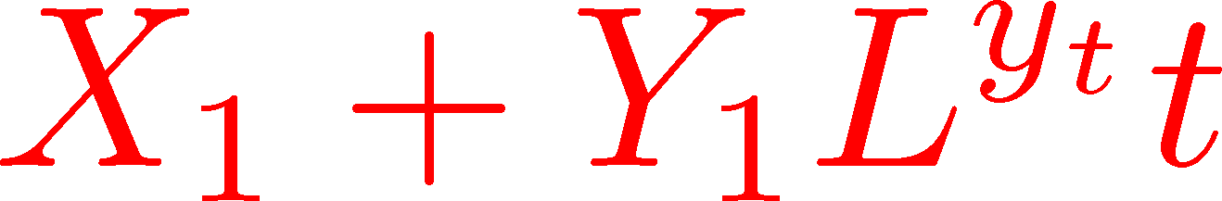
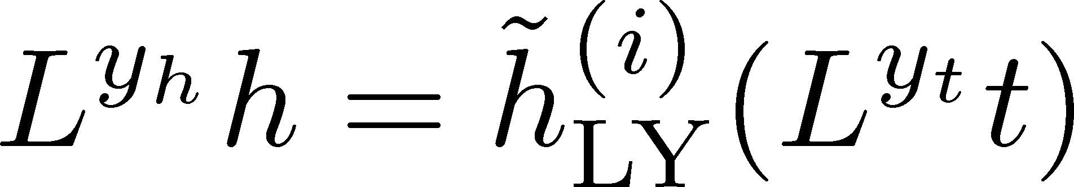
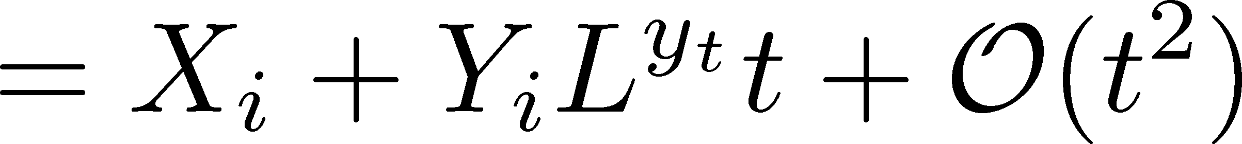
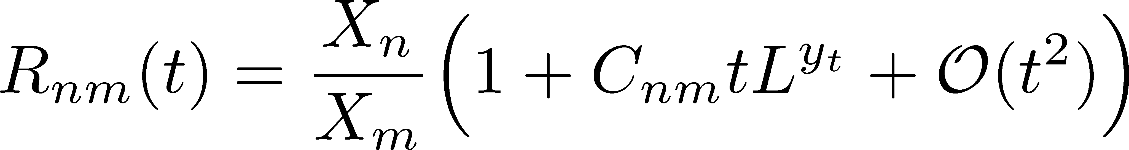

LYZ near $t=0$
Wada, MK, Kanaya, PRL (’25)
Linear Approx. at $t=0$

Slide 16
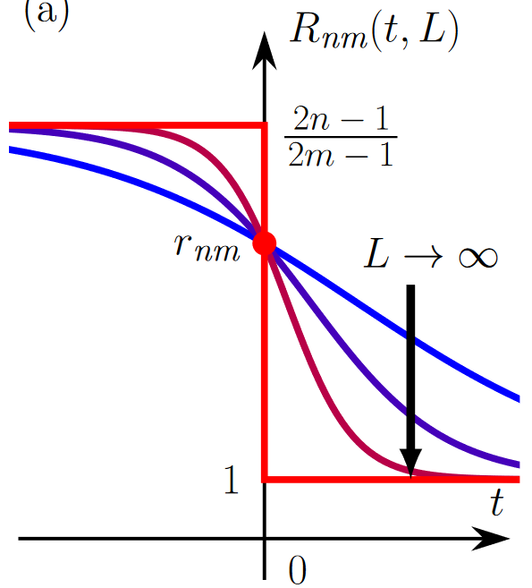
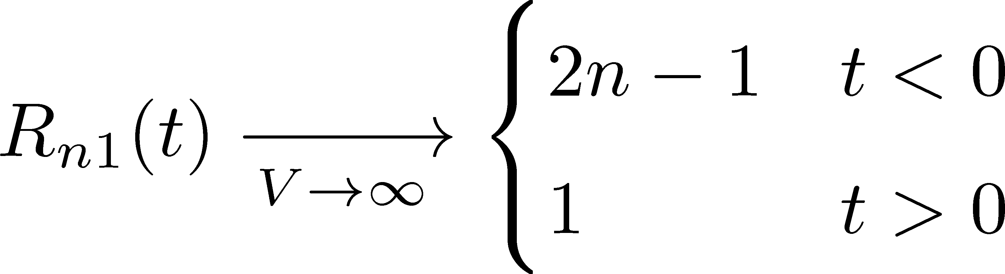
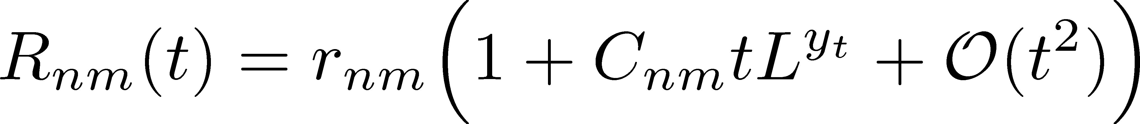
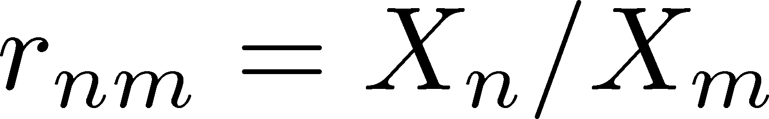
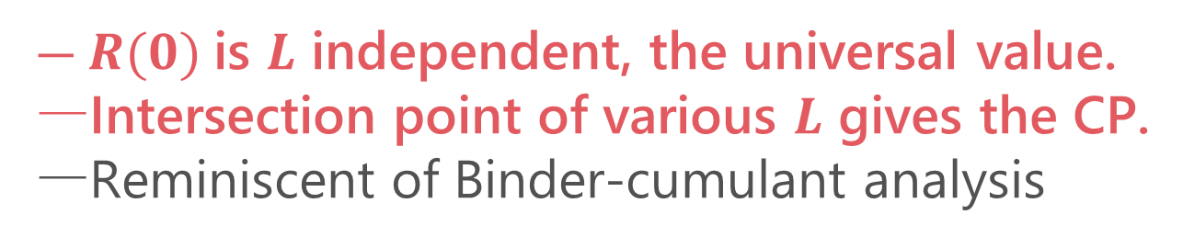
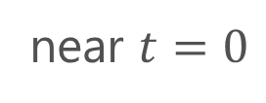
LYZ Ratios
Wada, MK, Kanaya, PRL, ’25
(1st order)
(crossover)
crossing
near $t=0$
$R(0)$is $L$ independent, the universal value.
Intersection point of various $L$ gives the CP.
Reminiscent of Binder-cumulant analysis

Slide 17
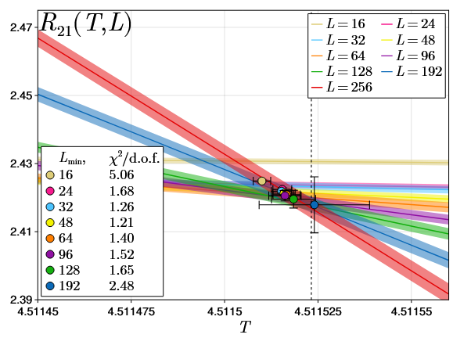
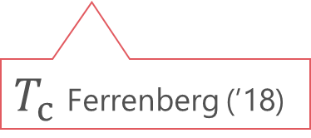
LYZR in 3d-Ising
LYZR
$T_{c}$ Ferrenberg (’18)
Wada, MK, Kanaya, arXiv:2508.20422

Slide 18
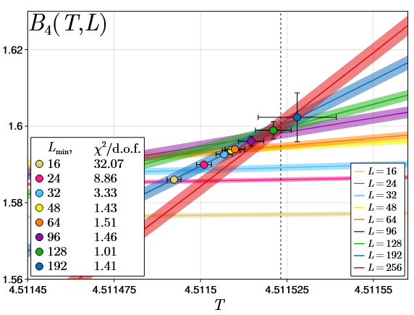
LYZR vs Binder Cumulant in 3d-Ising
LYZR
Binder cumulant
Faster convergence of the violation of FSS in LYZ?
Wada, MK, Kanaya, arXiv:2508.20422

Slide 19
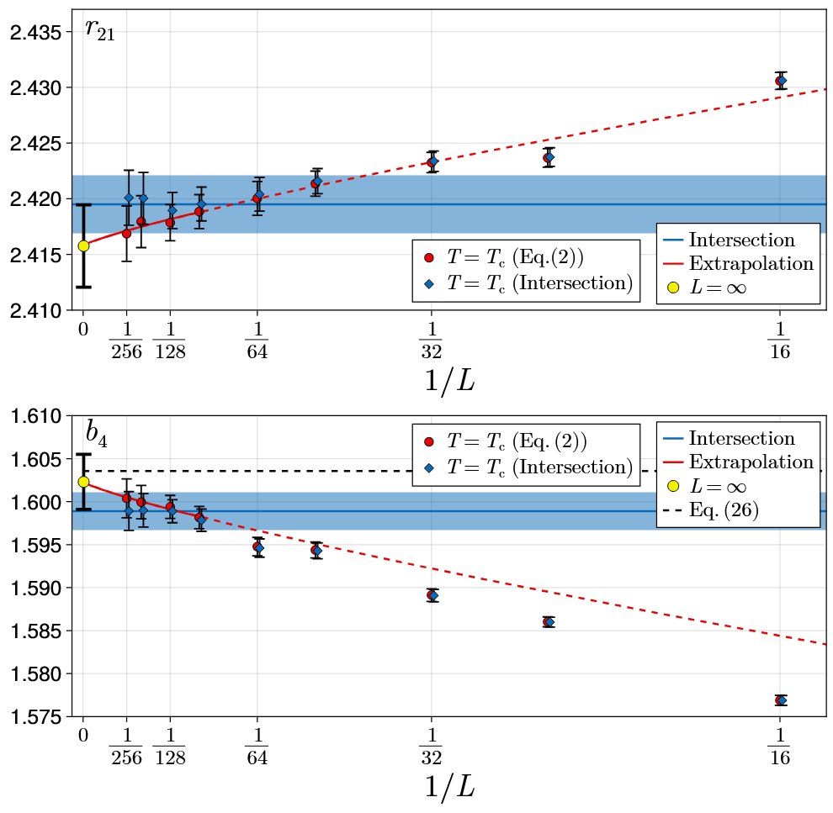

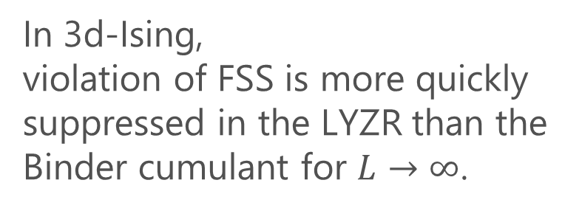
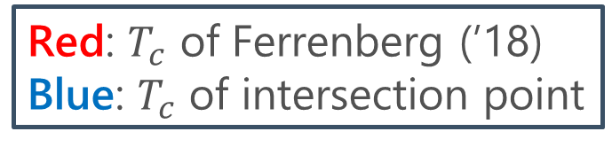
Convergence at $T=T_{c}$
Wada, MK, Kanaya, arXiv:2508. 20422
LYZR
Red: $T_{c}$ of Ferrenberg (’18)
Blue: $T_{c}$ of intersection point
In 3d-Ising,
violation of FSS is more quickly suppressed in the LYZR than the Binder cumulant for $L→∞$.
Binder cumulant

Slide 20


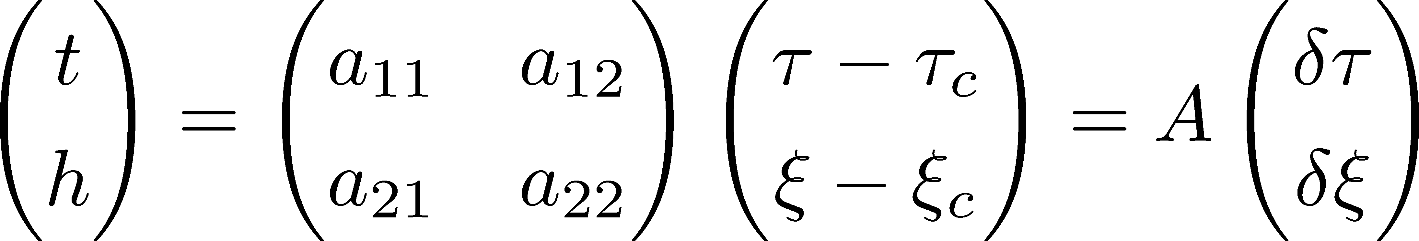

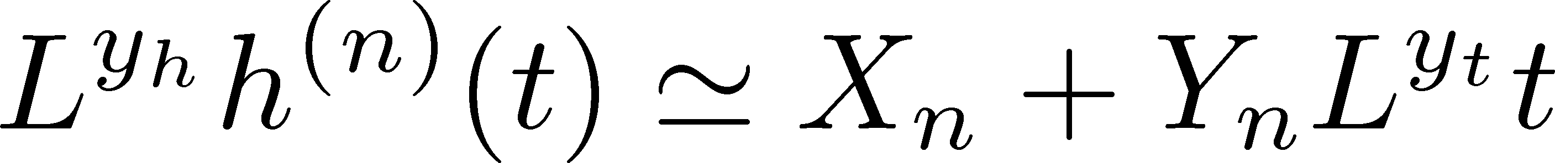


CP in a General System
Wada, MK, Kanaya, PRL (’25)
CP on a $τ−ξ$ plane
LYZ on the complex $ξ$ plane

Slide 21
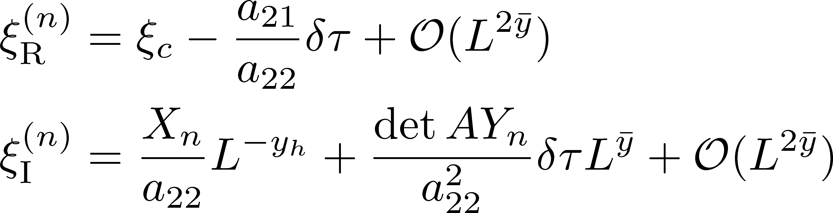
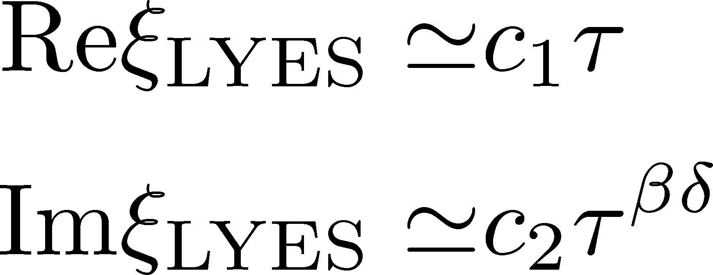


CP in a General System
Wada, MK, Kanaya, PRL (’25)
CP on a $τ−ξ$ plane
LYZ on the complex $ξ$ plane
$$L→∞$$
LY Edge Singularity
generalization
to finite $V$
Stephanov, 2006

Slide 22
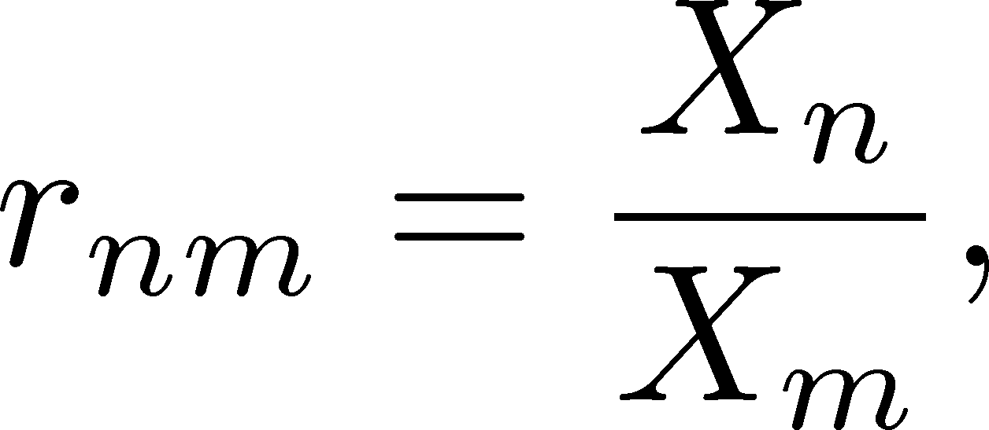

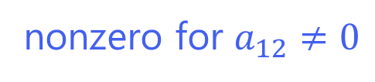
LYZ Ratios for General CP
Wada, MK, Kanaya, PRL (’25)
LYZ Ratio
nonzero for $a_{12}≠0$
$r_{nm}$ are universal constants specific to universality classes.

Slide 23
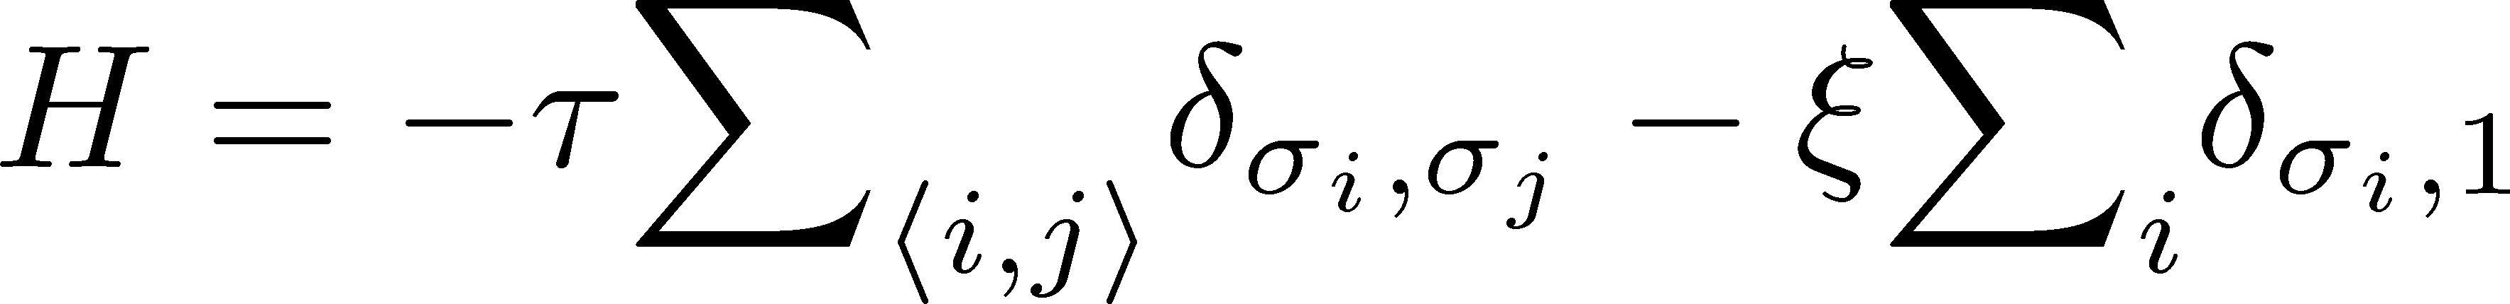
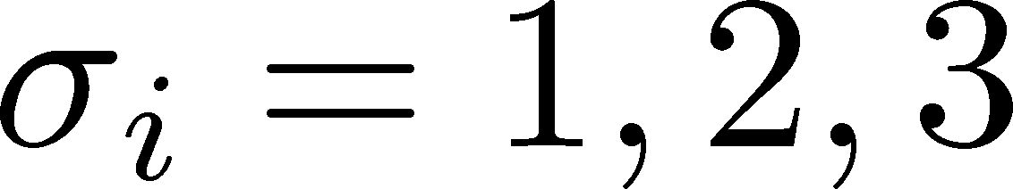


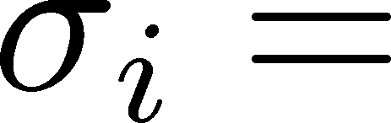


Numerical Analysis: 3d 3-State Potts Model
Monte-Carlo + reweighting
Phase Diagram
Binder-Cumulant Analysis
Z(2) CP
1st-order
Z(3)
Karsch, Stickan, 2000

Slide 24



3d 3-State Potts Model: LYZ Ratio
LYZ Ratio (R₂₁)
Binder Cumulant
Wada, MK, Kanaya, PRL, ’25
$R_{n1}$ and $B_{4}$ give the same value of $τ_{c}$ within statistics.

Slide 25





CP in Heavy-Quark QCD
Columbia Plot
Phase Diagram
This study
critical point
CP in heavy-quark QCD
We study the LYZ around the HQ-QCD-CP.
$μ_{q}=0$ & large $m_{q}$
Easy to handle in lattice simulations!

Slide 26


LYZ Ratio
$N_{t}=4,$ HPE-NLO
Preliminary
Preliminary
Conistent with the Binder-cumulant analysis $β_{c}=5.68578(22)$.

Slide 27
LYZR in Various Models
CPs in 3d-Z(2) universality class
Ising: 2508.20422
Potts: PRL, ’25
HQ-CP: 2501.18904
LYZR at the intersection point
Heavy-Quark CP
Consistent within statistics
Confirmation of universality

Slide 28
Application to QCD Critical Point?
Single-LYZ analysis for 2+1 flavor QCD
Intersection around $T≃100$ MeV? Yet lower $T$ data are mandatory.

Slide 29

Summary
Lee-Yang-zero ratios
A new tool for the CP searches utilizing the finite-size scaling of Lee-Yang zeros.
Outlook
Determination of $r_{nm}$ in each universality class
More sophisticated utilization of $R_{nm}(t,L)$
Other quantities: $ξ_{c}$, mixing matrix $A$, etc.
Application to QCD-CP and other CPs

Slide 30
backup

