Slide 1
Probing nuclear shape and surface vibration in heavy-ion collisions
Workshop on recent developments from QCD to nuclear matter, 2025/12/17-20, Academia Sinica, Taipei, Taiwan
Masakiyo Kitazawa
(YITP, Kyoto)
Hagino, MK, PRC 112 (2025) L041901 [2508.05125];
MK, Esumi, Niida, Nonaka, arXiv:2510.18383.
ATHIC2023, Apr. 27, 2023, Hiroshima
Photo: J-PARC Main Ring

Slide 2
Contents
Probing Shape Fluctuations of Nuclei in HIC
Hagino, MK, PRC112 (2025).
Efficiency Correction of Particle-averaged Quantities
MK, Esumi, Niida, Nonaka, arXiv:2510.18383.

Slide 3
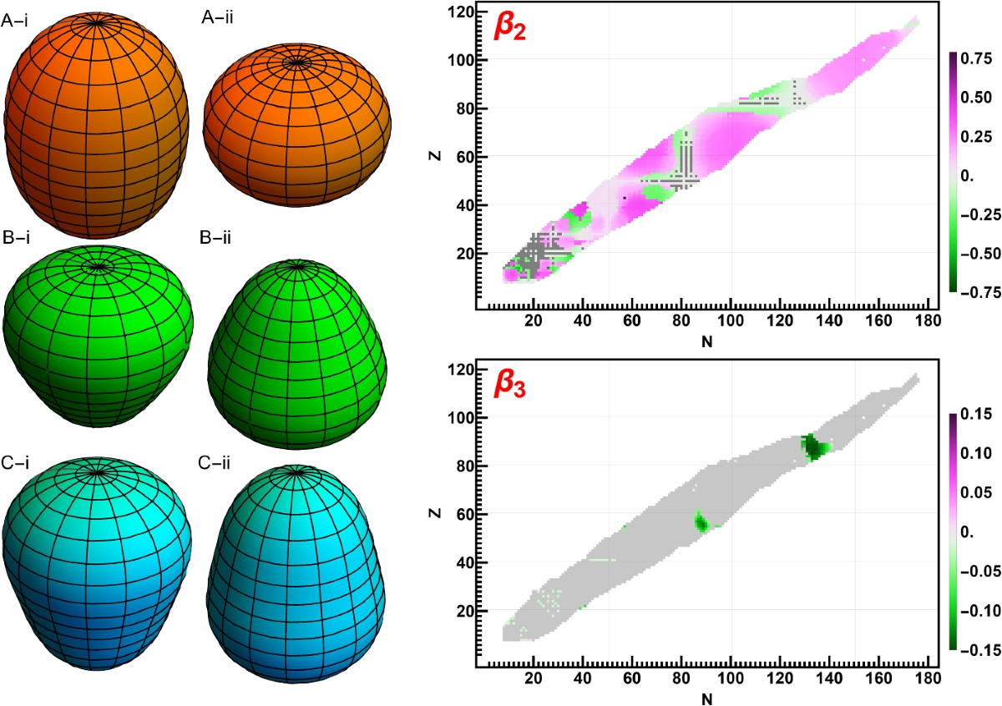
Deformation of Nucleus
doi.org/10.1007/s10751-024-01880-7
Who saw it?

Slide 4
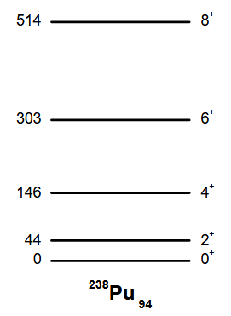
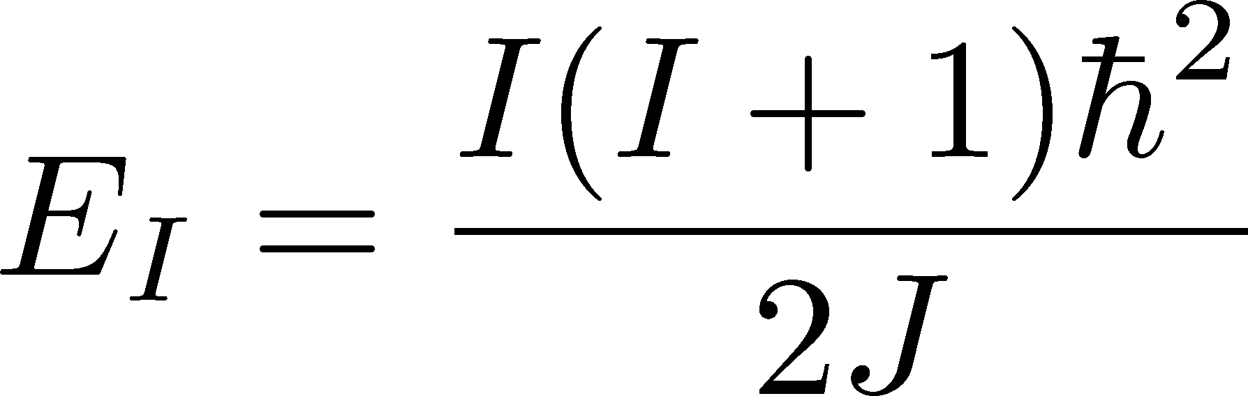
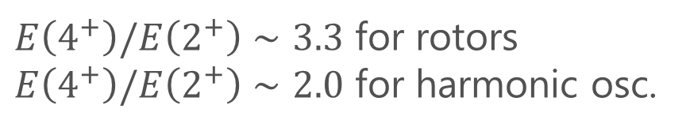
Evidence 1: Rotational Bands
$E\left(4^{+}\right)/E\left(2^{+}\right)∼3.3$ for rotors
$E\left(4^{+}\right)/E\left(2^{+}\right)∼2.0$ for harmonic osc.
Energy spectrum of rigid body rotation → Existence of deformation

Slide 5
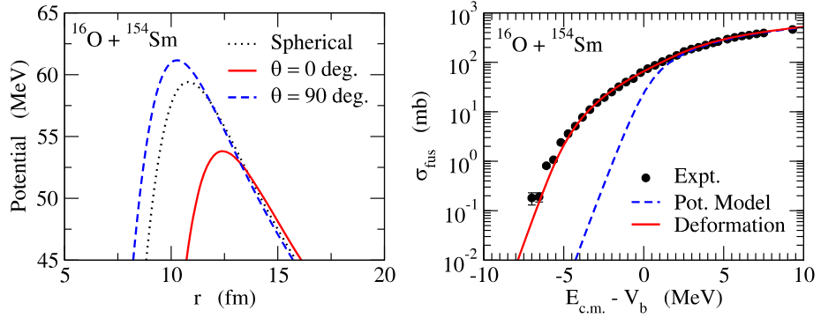
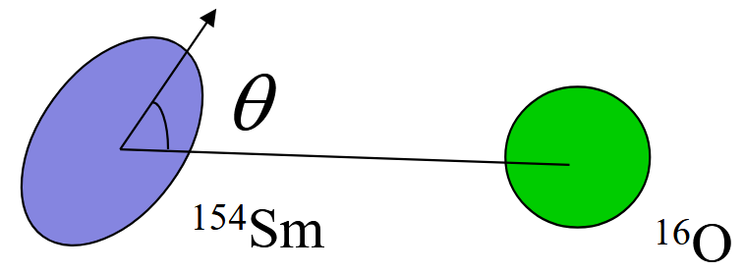
Evidence 2: Nuclear Fusion Reaction
Hagino, Takigawa, PTEP 128, 1061 (2012)
Fission barrier is lowered for deformed nuclei.

Slide 6
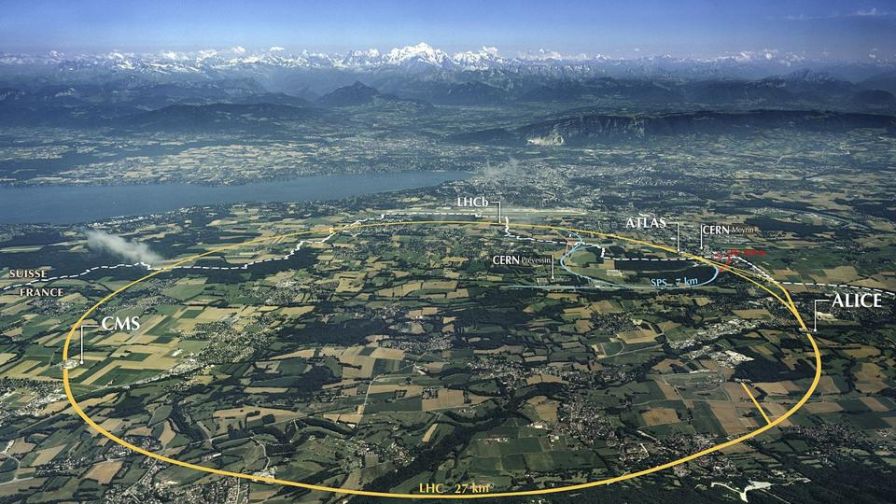
Using Relativistic Heavy-Ion Collisions for nuclear-shape studies?!
ATLAS, PRC 107, 054910 (2023)
STAR, Nature 635, 67 (2024)

Slide 7
Rough Idea
beam axis
Spherical
transverse plane
beam
beam
Deformed
Different transverse shapes for the spherical and deformed nuclei.
Distribution is reflected into anisotropic flows in the final state.
High-energy collisions → snapshot of the overlapping region of intrinsic states

Slide 8
Ultra-Central Collisions (UCC)
UCC ➔ Almost all particles participate in the collisions
Collision of Prolate nuclei
 | mean radius | anisotropy
tip-tip | small | small
body-body | large | large
Giacalone, PRL (‘20)

Slide 9
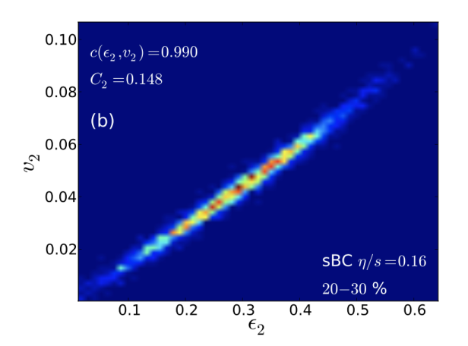
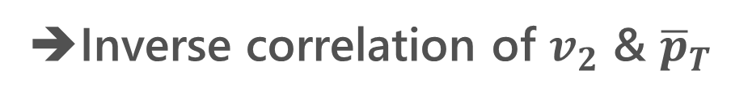
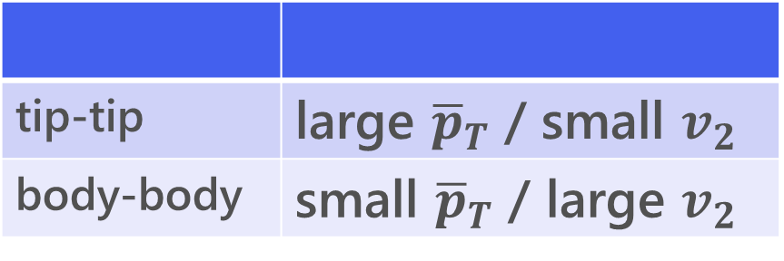
Ultra-Central Collisions (UCC)
UCC ➔ Almost all particles participate in the collisions
Collision of Prolate nuclei
 | mean radius | anisotropy
tip-tip | small | small
body-body | large | large
Giacalone, PRL (‘20)
hydro. evolution
tip-tip | large ${\overline{p}}_{T}$ / small $v_{2}$
body-body | small ${\overline{p}}_{T}$ / large $v_{2}$
Niemi+, PRC87 (‘13)
➔Inverse correlation of $v_{2}$ & ${\overline{p}}_{T}$

Slide 10
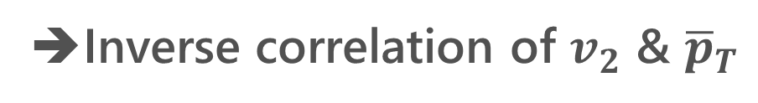

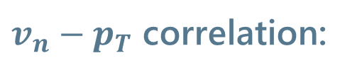
Experimental Result @STAR
tip-tip | large ${\overline{p}}_{T}$ / small $v_{2}$
body-body | small ${\overline{p}}_{T}$ / large $v_{2}$
$v_{n}−p_{T}$ correlation:
➔Inverse correlation of $v_{2}$ & ${\overline{p}}_{T}$
Bozek, PRC 93 (’16)
STAR, Nature 635 (‘24)

Slide 11
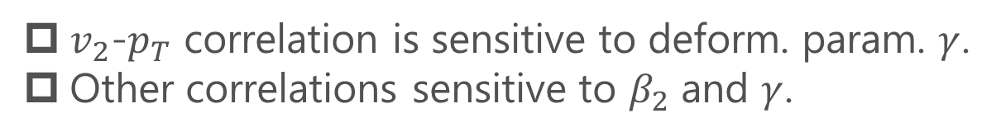
Triaxial Deformation
Fig.: Jia, PRC (‘22)
ATLAS, PRC 107 (2023)
$v_{2}$-$p_{T}$ correlation is sensitive to deform. param. $γ$.
Other correlations sensitive to $β_{2}$ and $γ$.
STAR, Nature 635 (2024)

Slide 12
Further Extension
Probing
Shape fluctuations
Zhao, Xu, Zhou, Liu, Song, PRL (’24); Hagino, MK, PRC (’25);
Liu+, 2509.09376; …
Octupole/hexadecapole deformation
Zhang+, 2504.15245; Xu+, 2504.19644; …

Slide 13
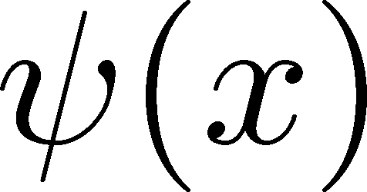

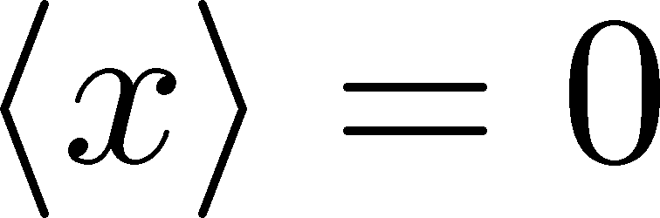
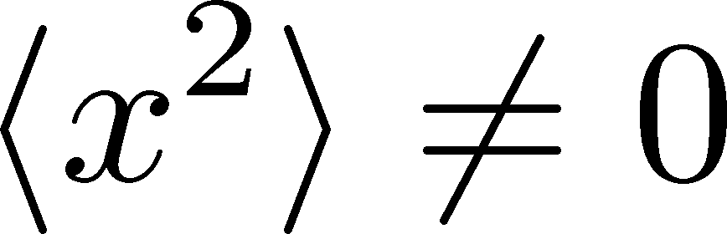
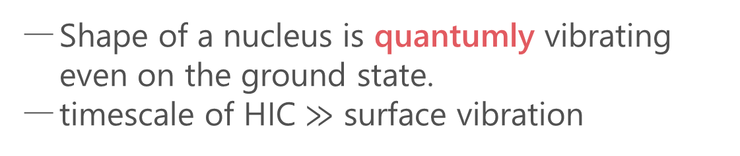
Quantum Surface Vibration
Hagino, MK, PRC (’25)
Harmonic Oscillators
ground state
Shape of a nucleus is quantumly vibrating even on the ground state.
timescale of HIC $≫$ surface vibration
See also
Zhao, Xu, Zhou, Liu, Song (’24)
Xu, Xu, Zhao, Zhao, Song, Wang (’25)
Liu+, 2509.09376
HIC takes a snapshot of shape fluctuation.

Slide 14

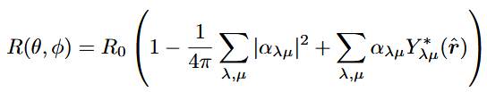

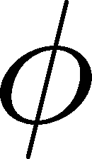



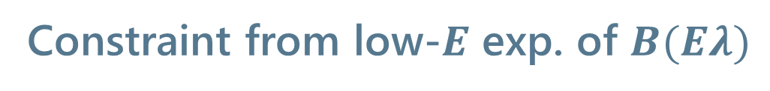
Spherical Nuclei
Hagino, MK, PRC (’25)
Space-fixed coordinates
Harmonic-oscillator model for surface vib.
Constraint from low-$E$ exp. of $B(Eλ)$
More complicated in body-fixed coordinates
Hagino, Takigawa (’12)
Hagino, Ogata, Moro (’22)
Treatment of surface vibration is apparent in the space-fixed coordinates.
Deformation params. $β_{λ}$ can be constrained from transition probability.

Slide 15
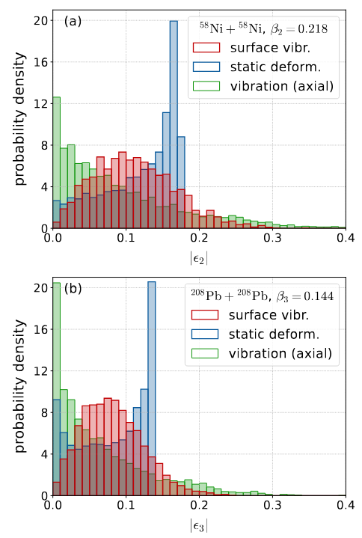


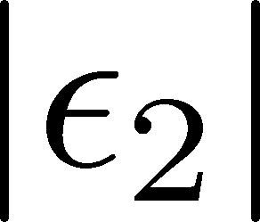
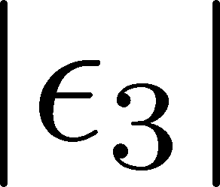
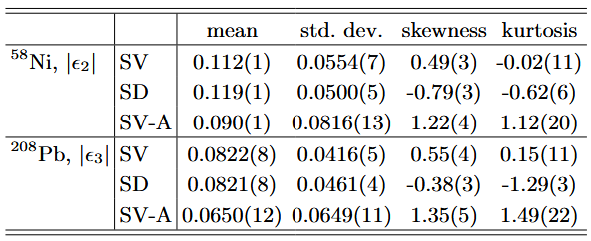


Transverse Distribution
Hagino, MK, PRC (’25)
Initial Transverse Distr.
${}^{58}$Ni, Quadrupole
${}^{208}$Pb, Octupole
droplet full-overlap model
Jia (’22)
Distribution differs significantly between the surface vibration and static deformation.
Axial deformation is insufficient to describe the surface vibration.

Slide 16
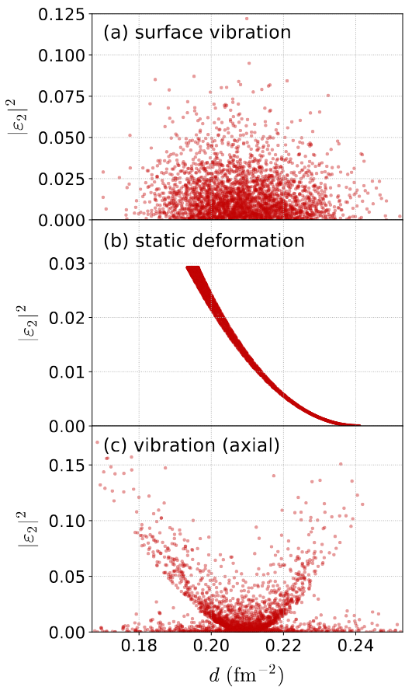
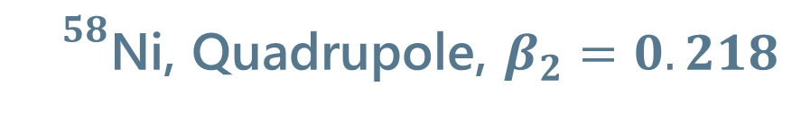
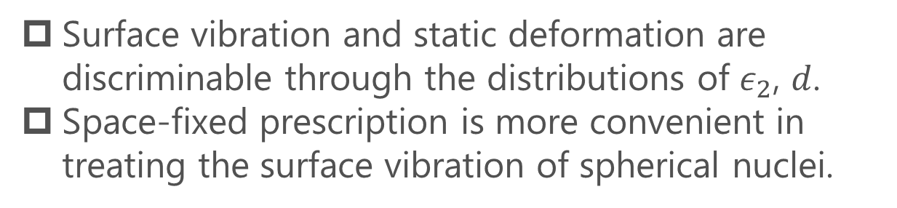
Transverse Distribution 2
Hagino, MK, PRC (’25)
${}^{58}$Ni, Quadrupole, $β_{2}=0.218$
Surface Vibration
Static Deform.
inverse mean radius
Short Summary
Surface vibration and static deformation are discriminable through the distributions of $ε_{2}$, $d$.
Space-fixed prescription is more convenient in treating the surface vibration of spherical nuclei.

Slide 17
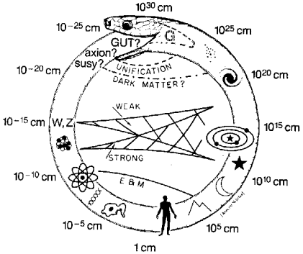
Uroboros in Nuclear Physics
Uroboros of Physics
Glashow (1982)
High-Energy HIC provides us with info. of nuclear structure.
Nuclear structure is necessary for understanding Relativistic HIC.

Slide 18

Uroboros in Nuclear Physics
Uroboros of Physics
Quark-gluon plasma
~1GeV
Nuclear structure
~1MeV
Heavy-ion
Collisions
heavy-ion
collisions
Nuclear reactions
~10MeV
Hadron physics
~100MeV
Glashow (1982)
High-Energy HIC provides us with insights into nuclear structure.
Nuclear structure is necessary for understanding relativistic HIC.
Workshop at YITP, April 2026

Slide 19
Contents
Probing Shape Fluctuations of Nuclei in HIC
Hagino, MK, PRC112 (2025).
Efficiency Correction of Particle-averaged Quantities
MK, Esumi, Niida, Nonaka, arXiv:2510.18383.

Slide 20
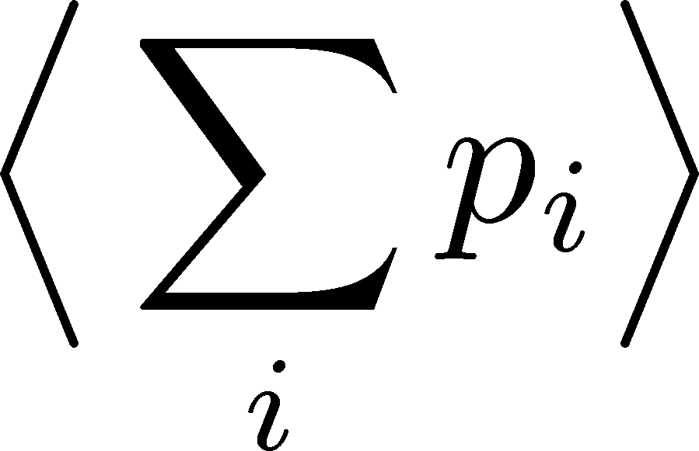
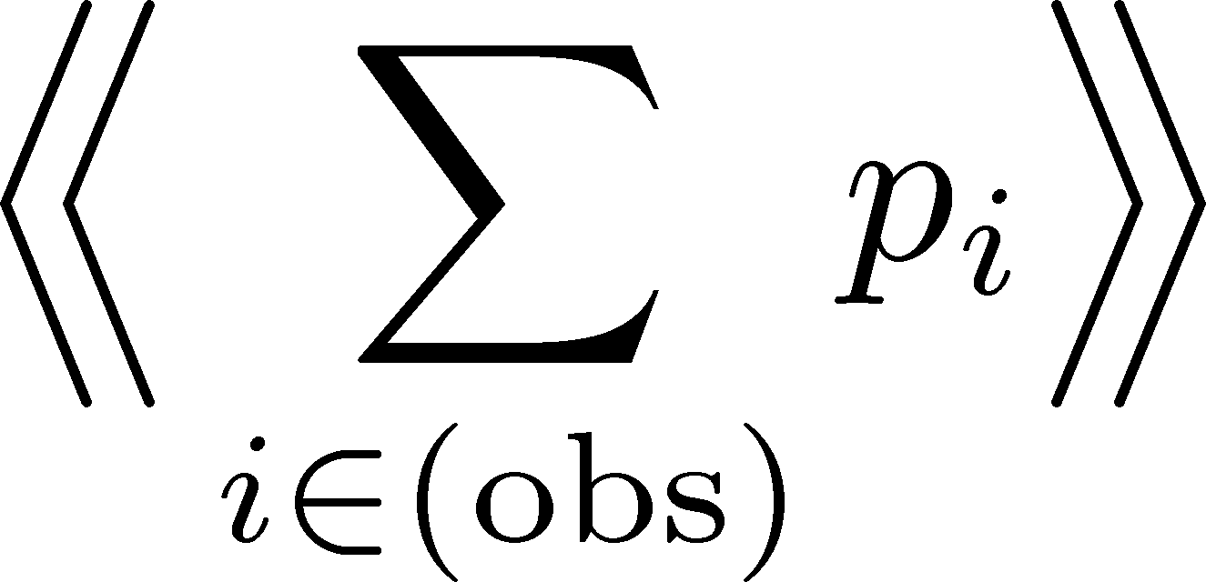
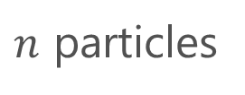




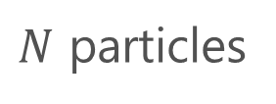

Detector Efficiency
Detector
$$p_{1}$$
$$p_{1}$$
$$p_{2}$$
not
observed
$N$ particles
$n$ particles
‥‥
‥
‥‥
$$p_{N}$$
$$p_{N}$$
modified
true
total value:
observed
total value:
Real detectors lose some particles
Observed results are modified.
Effects must be corrected to obtain the true result.

Slide 21
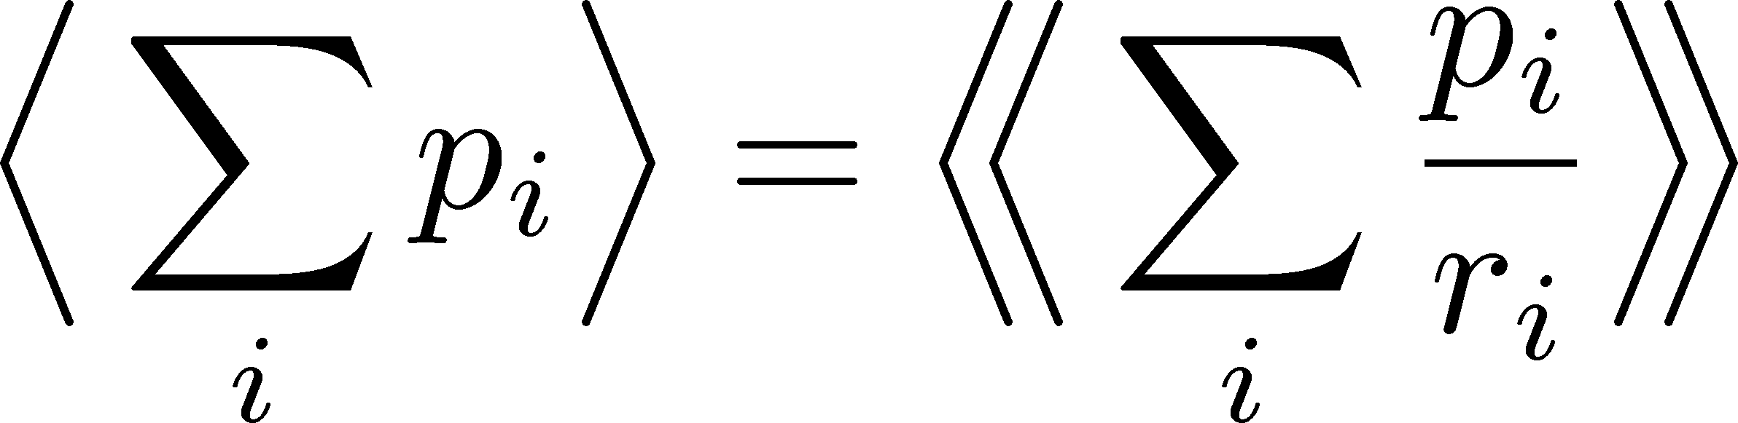



Efficiency Correction: Total Number
Detector
$$p_{1}$$
$$r_{1}$$
$$p_{1}$$
$$p_{2}$$
$$r_{2}$$
$N$ particles
efficiencies
$n$ particles
‥‥
‥
‥‥
‥‥
$$p_{N}$$
$$r_{N}$$
$$p_{N}$$
modified
true
total value:
observed
total value:
Correction Formula:

Slide 22
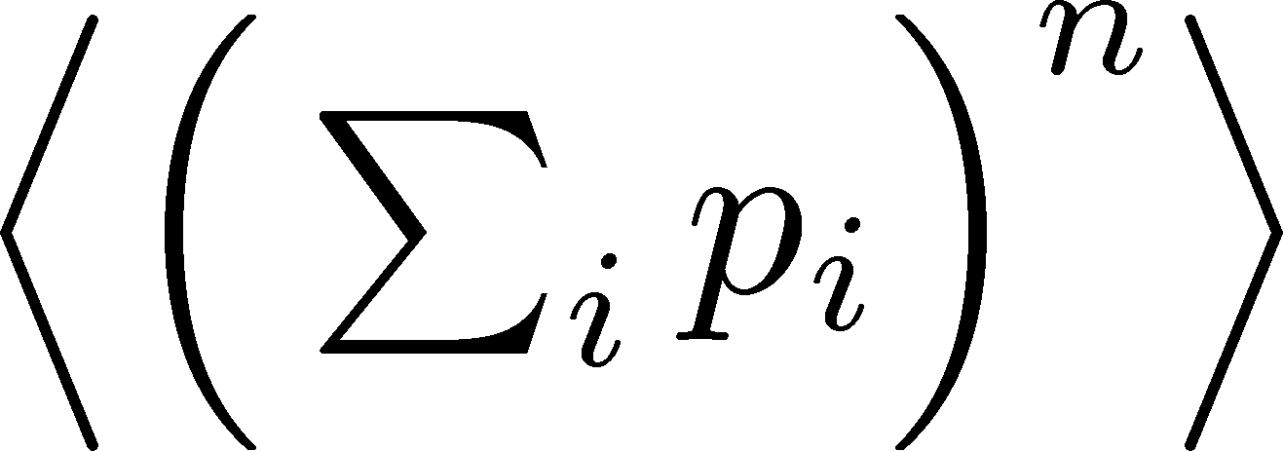
Moments (Cumulants) of Total Number

Slide 23
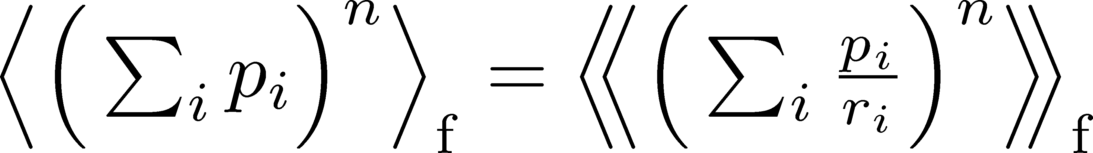
Moments (Cumulants) of Total Number
Correction Procedure:
Use factorial moments/cumulants
Assumption: efficiencies of individual particles are independent
Nonaka, MK, Esumi (’17)
Asakwa, MK, PPNP (’16); MK, Luo (’17)

Slide 24
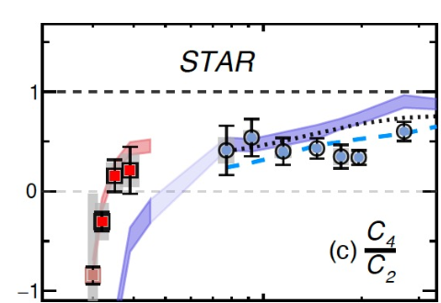
Moments (Cumulants) of Total Number
Note
Search for QCD-CP using conserved-charge fluctuations
Correction Procedure:
Use factorial moments/cumulants
Long history of efficiency correction:
MK, Asakawa (’12); Bzdak, Koch (’12,’15);
Luo (’14); MK (’16); Nonaka+ (’16); Bzdak, Holtzman, Koch (’16); MK, Luo (’17); Nonaka, MK, Esumi (’17); …
Assumption: efficiencies of individual particles are independent
Nonaka, MK, Esumi (’17)
Asakwa, MK, PPNP (’16); MK, Luo (’17)

Slide 25
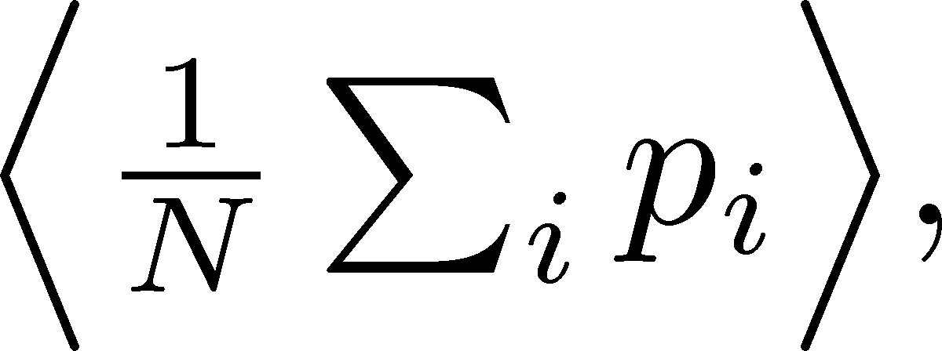
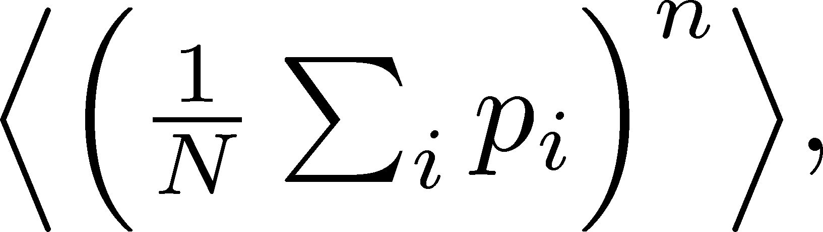
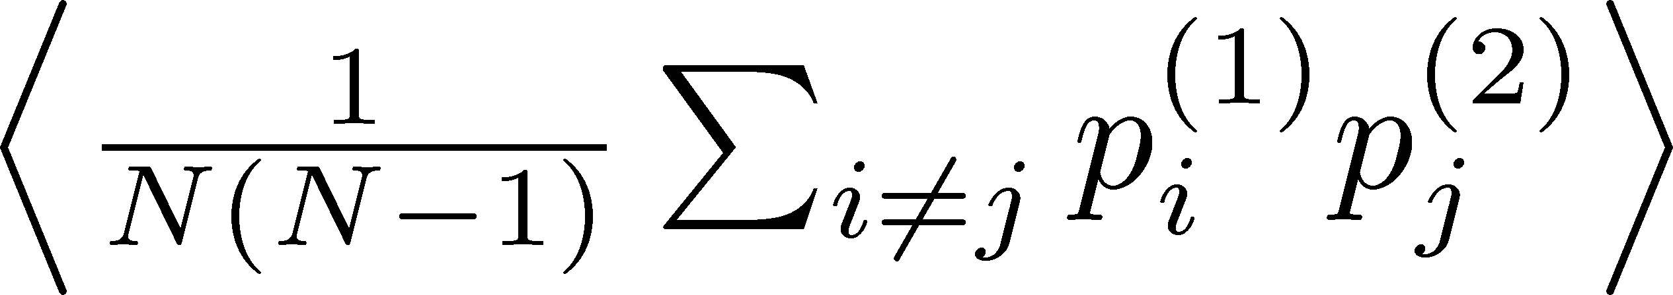
Particle-Averaged Quantities

Slide 26
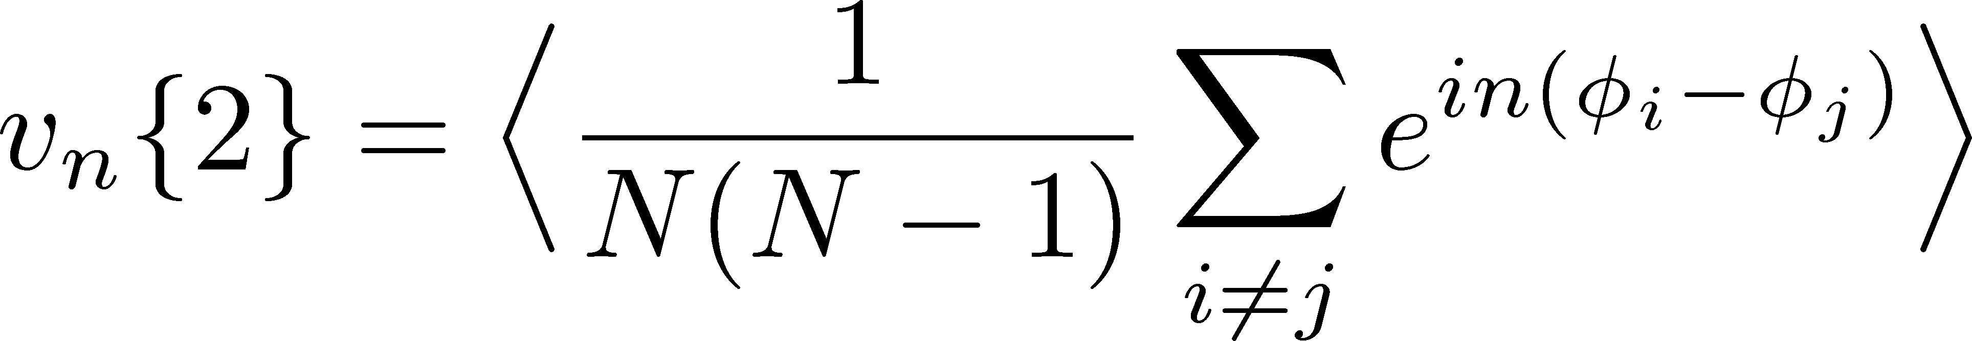

Particle-Averaged Quantities
Many fundamental observables in HIC are of this form!
mean $p_{T}$, flow anisotropy $v_{n}\{m\}$, $v_{2}−p_{T}$ correlation, etc.

Slide 27
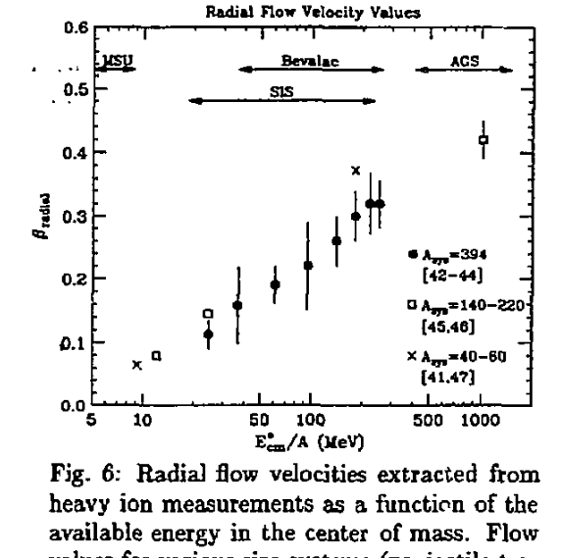
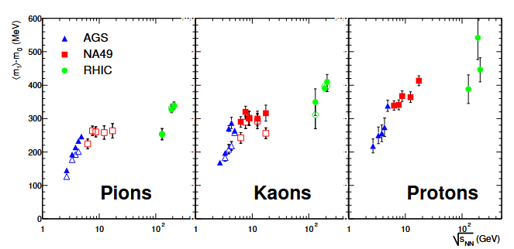
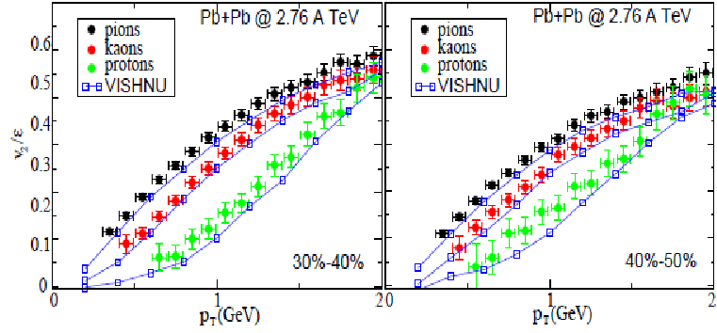
Particle-Averaged Quantities
Many fundamental observables in HIC are of this form!
mean $p_{T}$, flow anisotropy $v_{n}\{m\}$, $v_{2}−p_{T}$ correlation, etc.

Slide 28
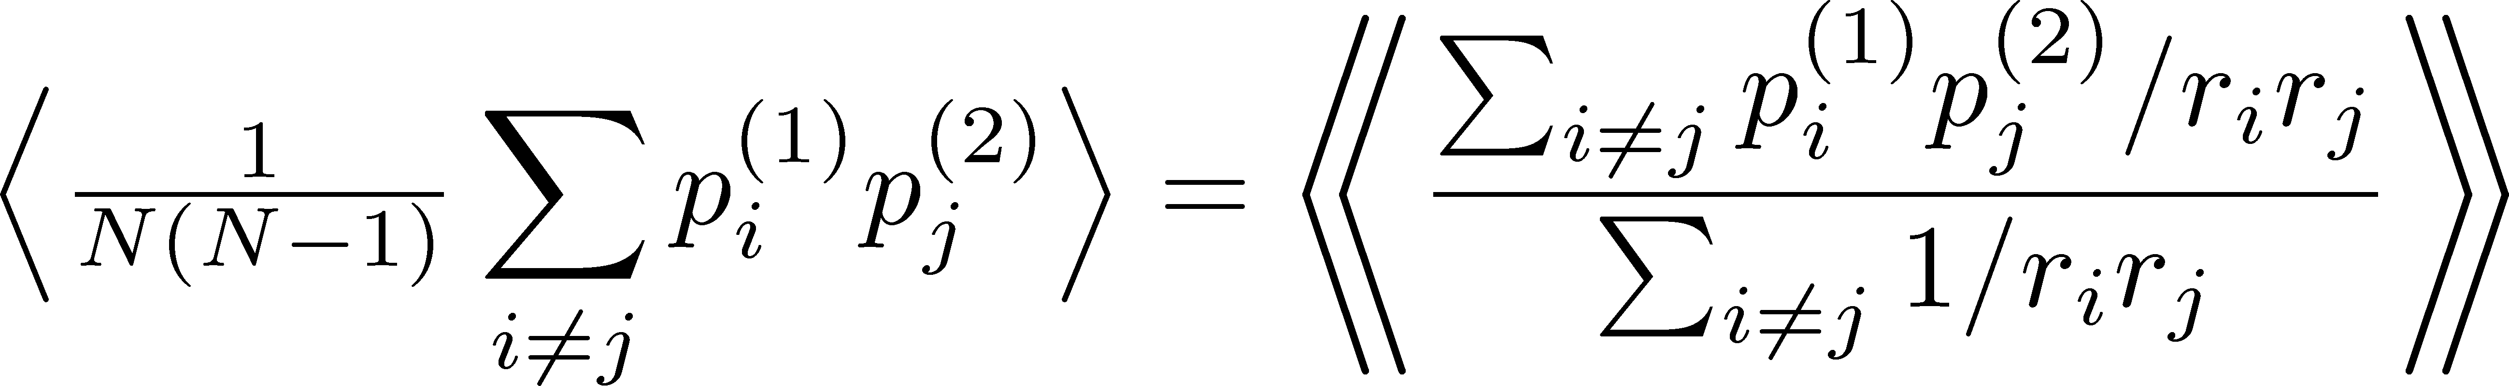
Particle-Averaged Quantities
Many fundamental observables in HIC are of this form!
“Conventional” Correction Formulas
e.g. ATLAS, PRC107, 054910 (‘23); STAR, Nature 635, 67 (‘24)
Question: Are these formulas correct?

Slide 29
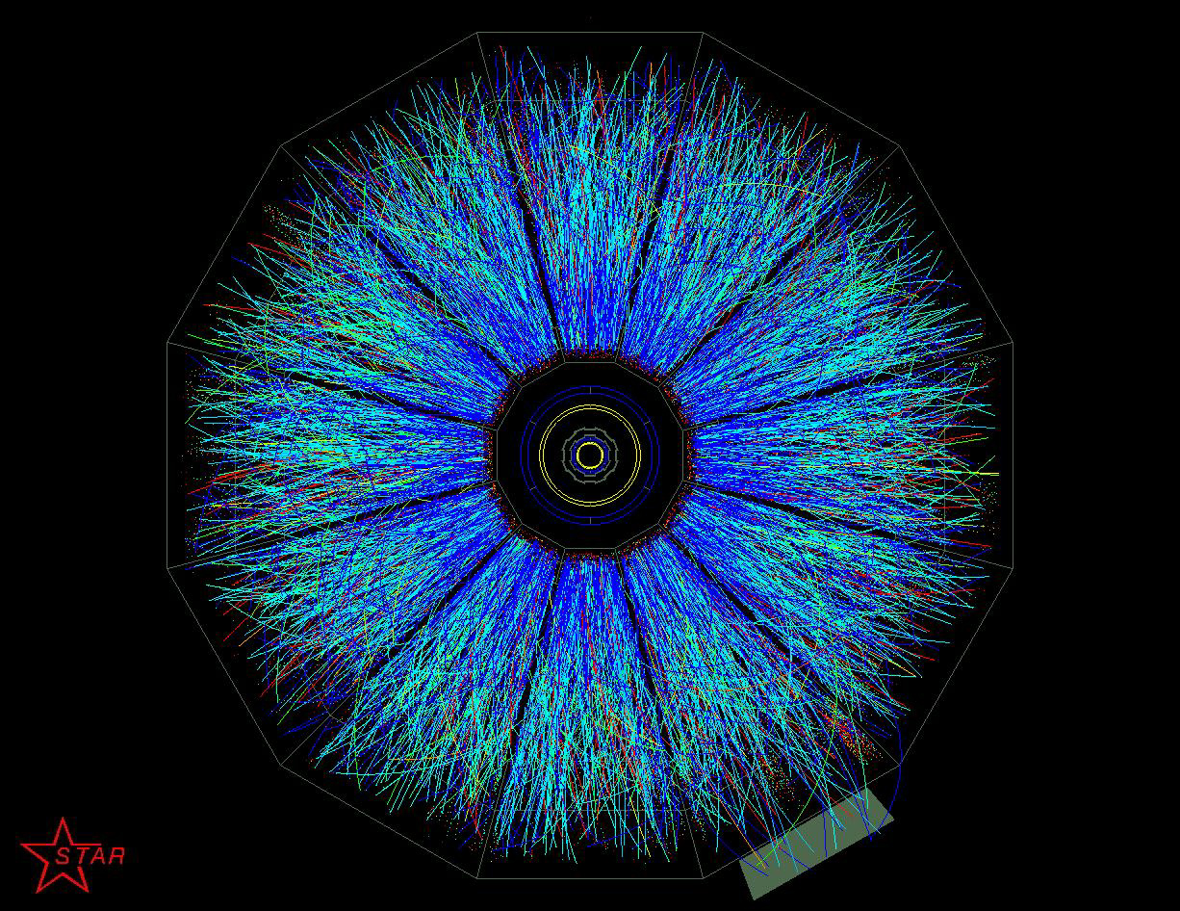
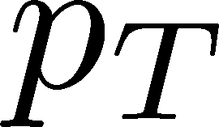
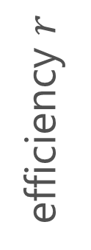

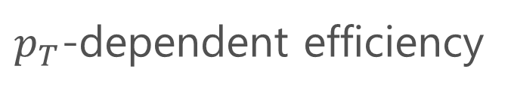
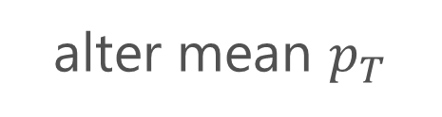
Correction is Necessary!!
efficiency $r$
$p_{T}$-dependent efficiency
Azimuthally nonuniform efficiency
alter mean $p_{T}$
produce unphysical $v_{n}\left\{m\right\}$
More serious effects on higher-order correlations!

Slide 30
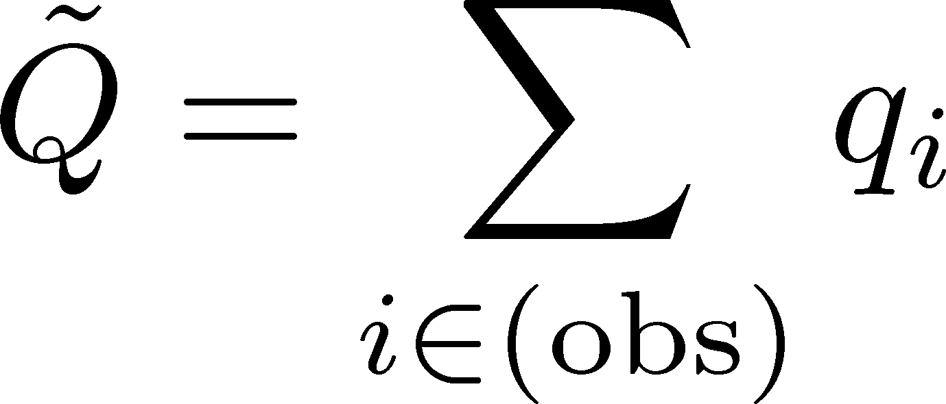










Check in a Simple Model
MK, Esumi, Niida, Nonaka,
arXiv:2510.13838
$2N$: fixed for all events
$$q_{1}=1$$
$N$ particles
efficiency $r=1$
‥
‥
$n$ particles
$$q_{N}=1$$
$$q_{N+1}=−1$$
‥
$N$ particles
efficiency $r=p$
$$q_{2N}=−1$$

Slide 31


Check in a Simple Model
MK, Esumi, Niida, Nonaka,
arXiv:2510.13838
$2N$: fixed for all events
$$q_{1}=1$$
$N$ particles
efficiency $r=1$
‥
‥
$n$ particles
$$q_{N}=1$$
$$q_{N+1}=−1$$
‥
$N$ particles
efficiency $r=p$
$$q_{2N}=−1$$
Mean:
True result
Conventional formula does not reproduce the correct result even for the mean!!
Reconstructed

Slide 32






Derivation of Correction Formulas
Assumptions
Particle production is described by a classical prob. distr. func. $P(N;{\vec{p}}_{T})$.
Probs. to observe individual particles are independent.
For each observed particle, the value of efficiency $r_{i}$ can be specified.
Other detectors’ effects are not considered.
$$ξ_{1}$$
True distr. func.
$$ξ_{2}$$
$N$ particles
‥‥
‥
$$ξ_{N}$$

Slide 33




Connecting True/Observed Distr. Funcs.
True distr. func.
Observed distr. func.
$n$: observed particle number
$q=Σ_{i∈(obs.)}ξ_{i}$: observed sum
Probability Distr. of Observed Quantities (uniform $r$)
$$b_{i}=0,1$$

Slide 34




Generating Function
MK, Esumi, Niida, Nonaka, arXiv:25010.13838
Prob. distr. func:
Generating func:
Represent the quantity that you want to express by the derivative of the generating function.
Then, represent it in terms of the observed variables.
Note:
$α^{n}$ term compensates the $n=0$ contribution.

Slide 35




Results: Correction Formulas
MK, Esumi, Niida, Nonaka, arXiv:25010.13838
Mean
2nd Order
Correction formulas are written in forms including integral.
This formula can reproduce the correct result for the previous simple model.

Slide 36
Summary
Efficiency Correction Formulas
These formulas reproduce the true value in simple models.
They will play crucial roles in experimental studies in HIC.
What I have not Understood
Relation of these formulas with the conventional ones.
More simplified formula / unified understanding of mathematical structure.

Slide 37




Should Self-correlations be Eliminated?
Flow correlations:
The “self correlation” terms are usually neglected. Why?
Argument 1:
Argument 2:
Emission of 2 independent particles
$φ_{ab}$: random
Emission of a particle take away density
$$φ_{ab}$$
suppress probability to emit particles to same direction
$v_{2}>0$ rather $v_{2}=0$

Slide 38






Simpler Example: Particle Number Fluc.
Injected particles $N$
Detector
efficiency $r$
Observed particles $n$
How can we obtain the cumulants of the true distribution
only from observed information on $\tilde{P}(n)$?
MK, Asakawa, 2012

Slide 39




Slot Machine Analogy
MK, Asakawa, 2012;2012
Fixed # of coins
P (N)
P (N)
N
N
P (N)
P (N)
N
N

Slide 40





Reconstructing Total Coin #
P (N )= P (N )B_{1/2}(N ;N )
= +
Example
genuine info.
Poisson noise
Note: Higher order cumulants are more fragile.
MK, Asakawa, 2012;2012

