Slide 1

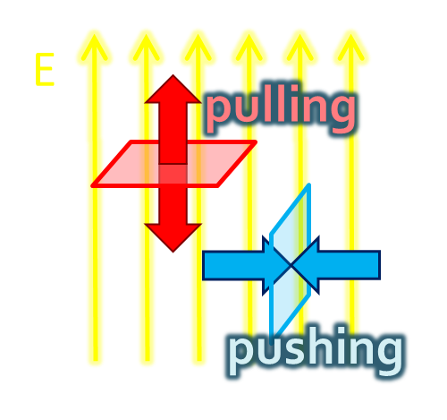
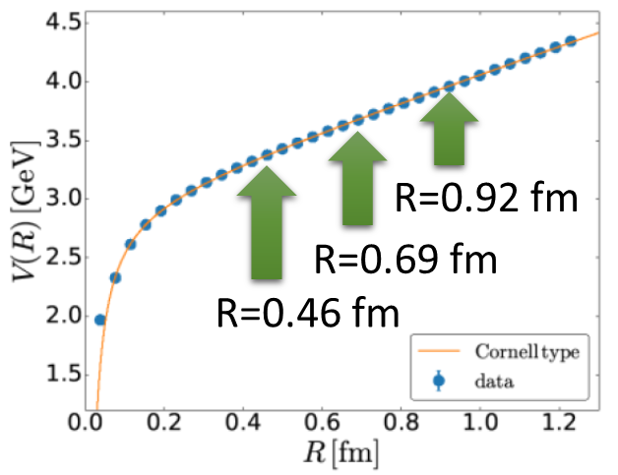
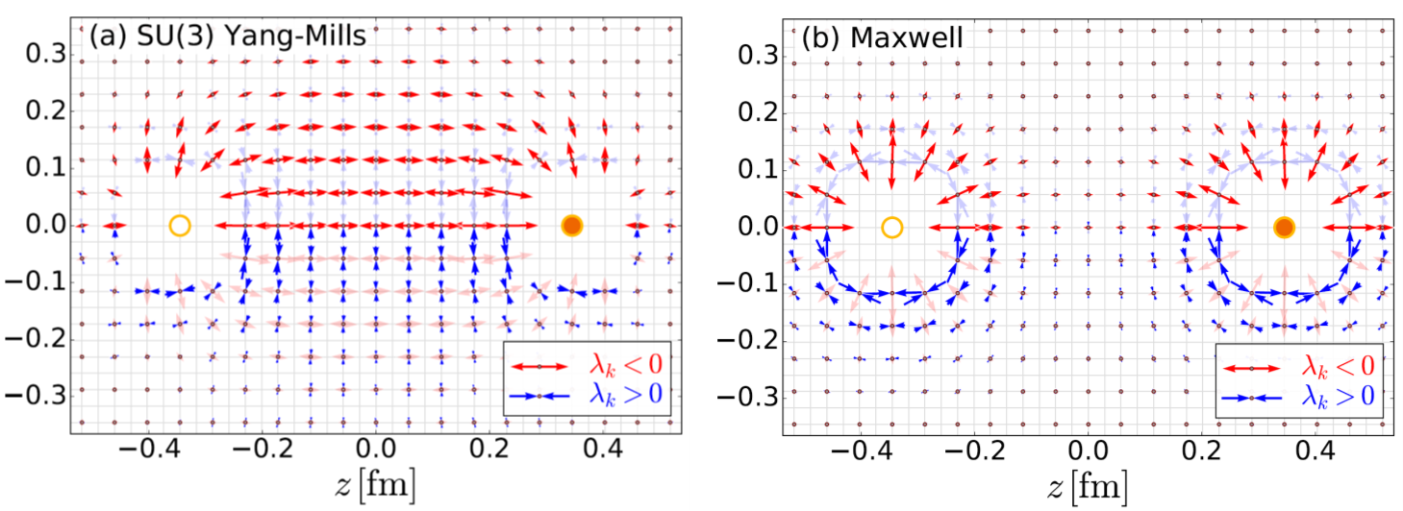

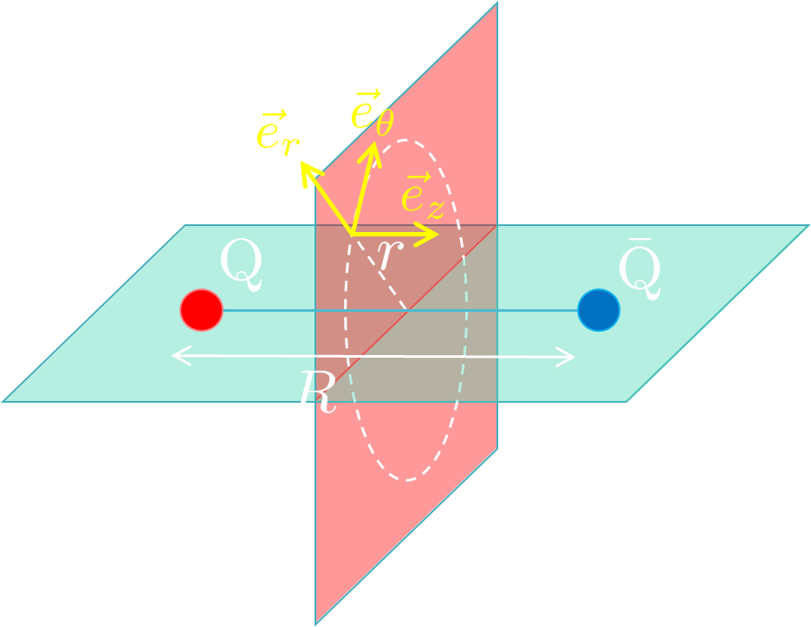
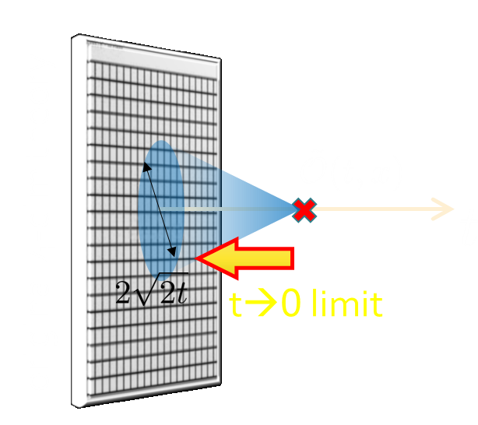

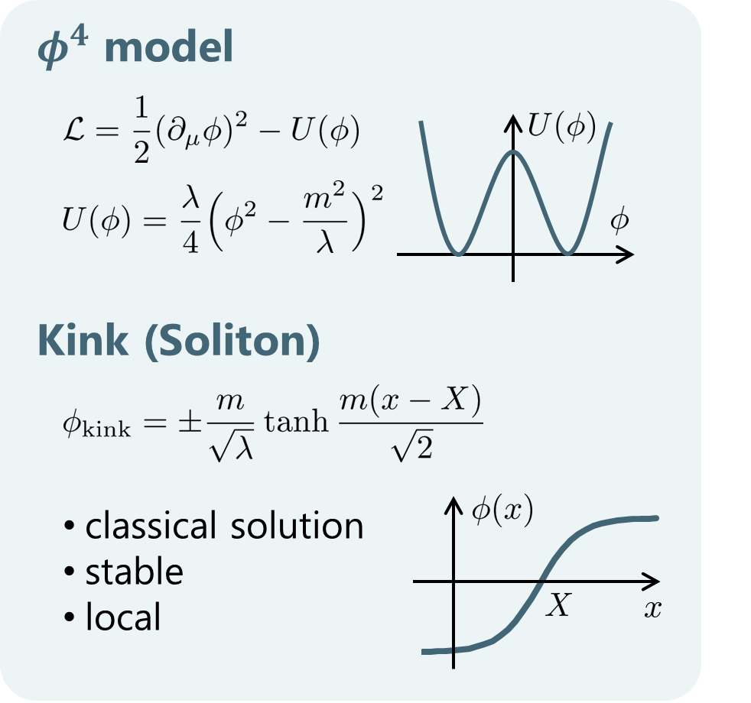
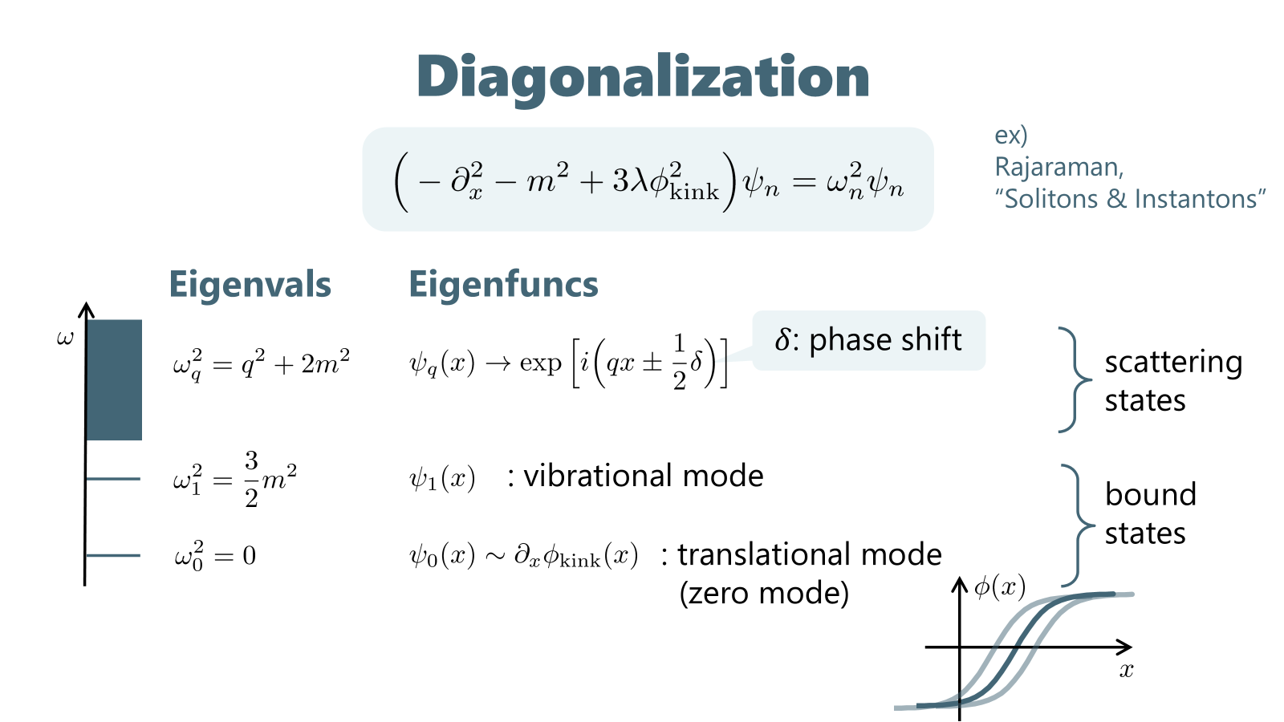
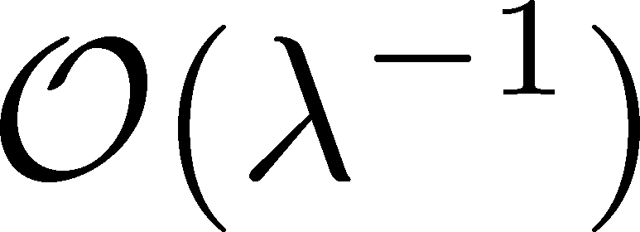
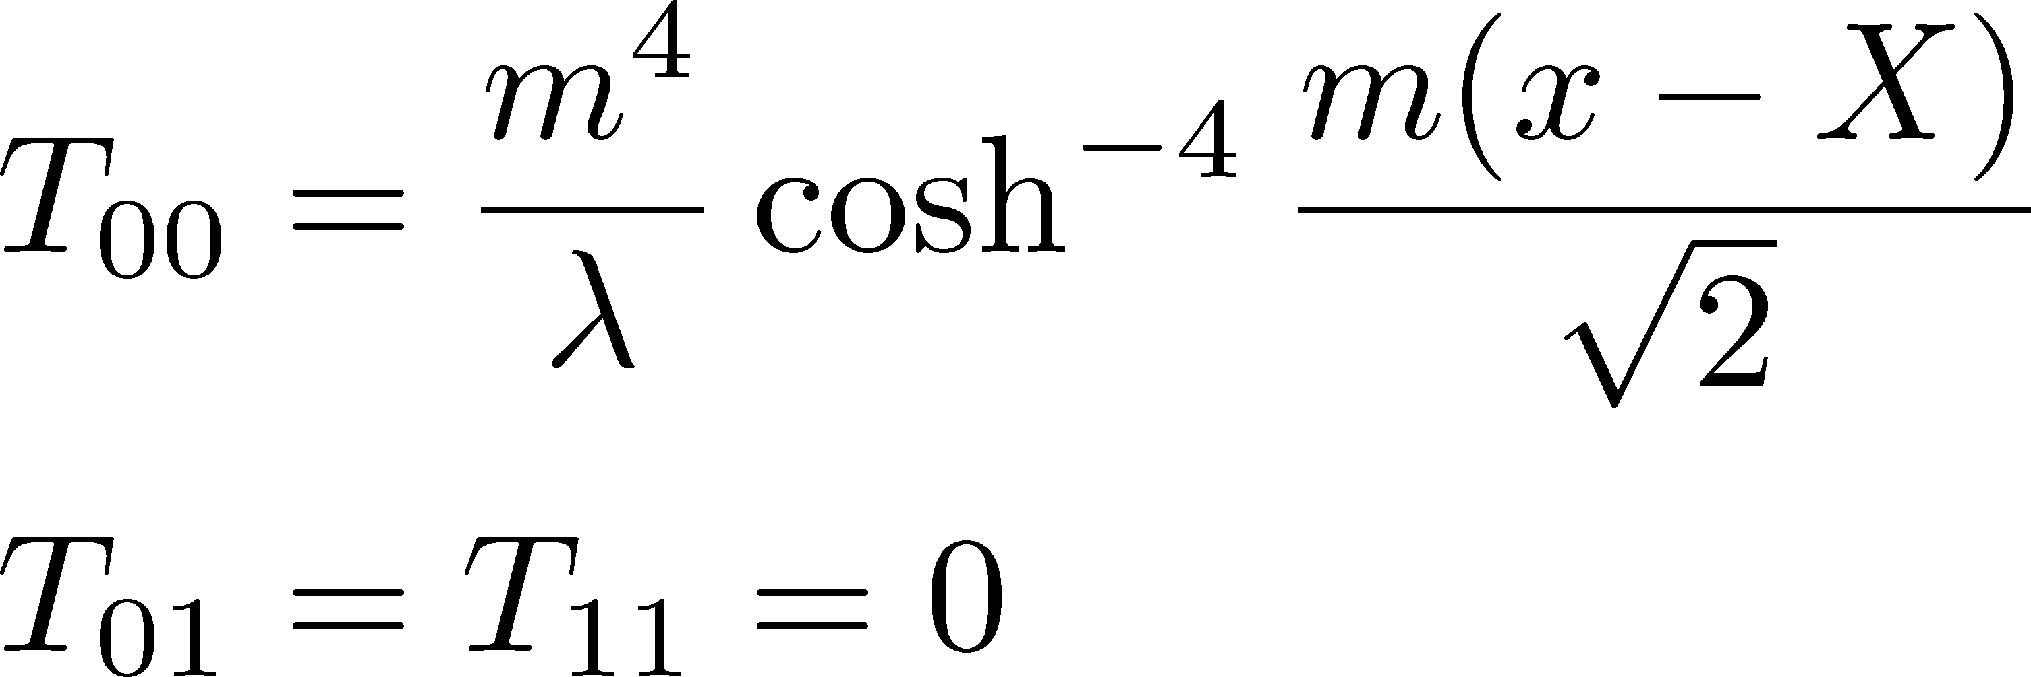
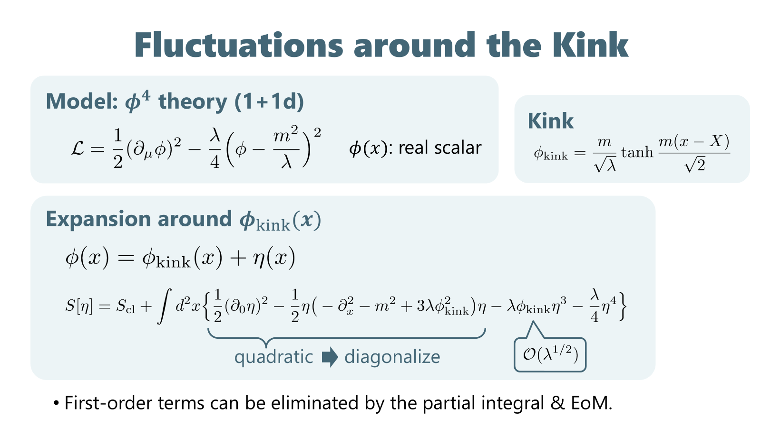
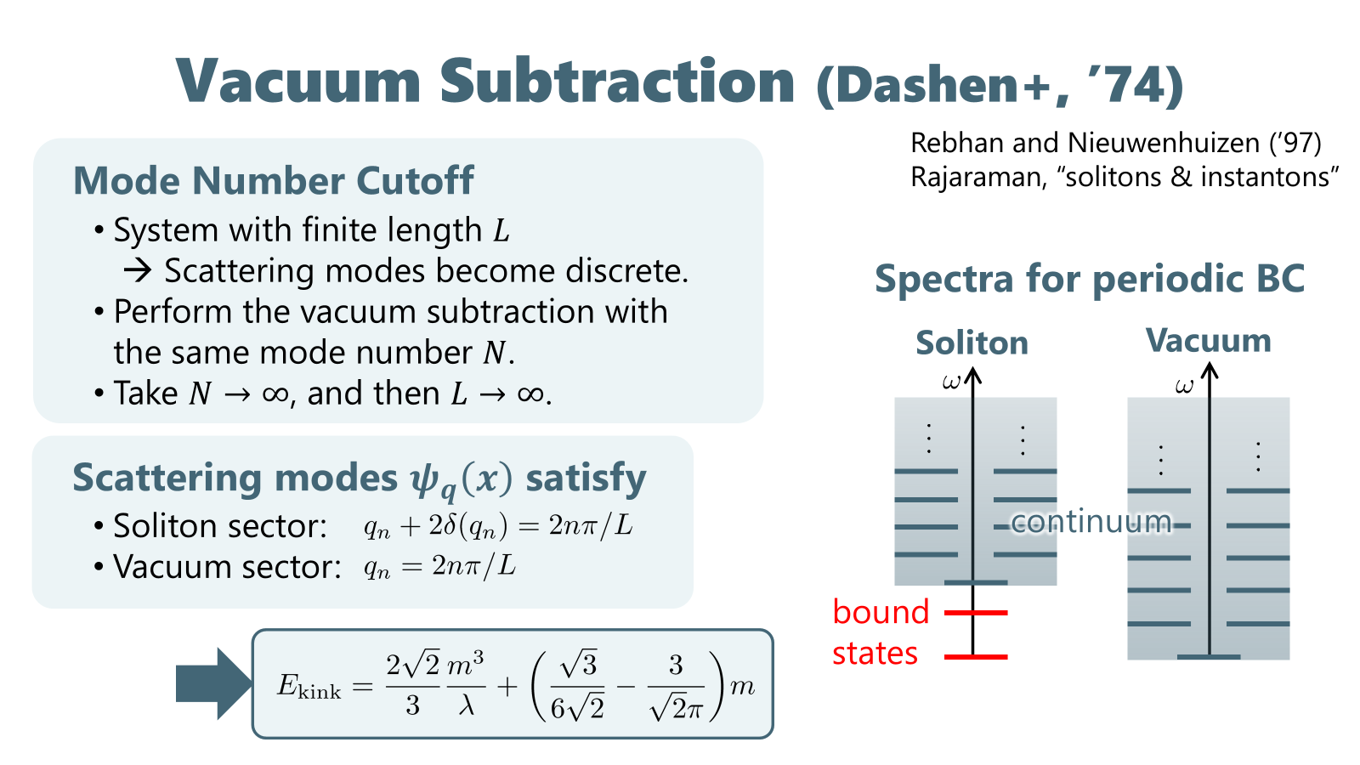
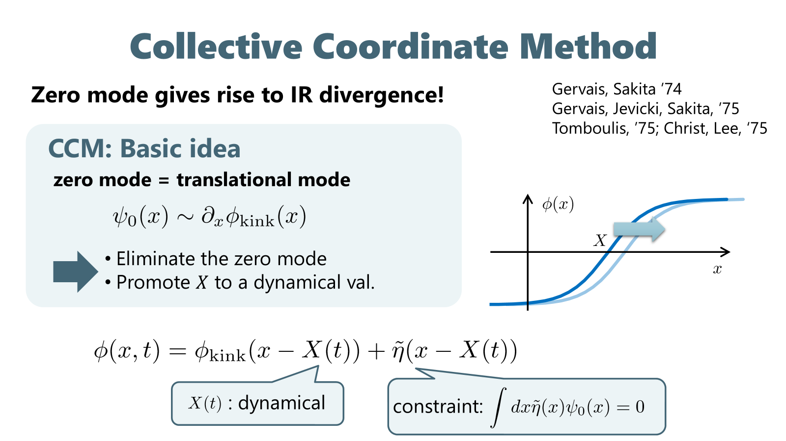
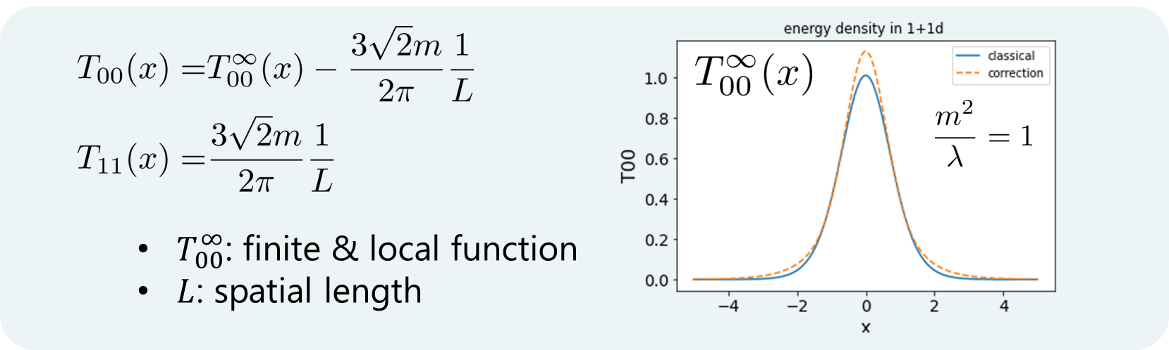

Lattice study of stress-tensor distribution around the flux tube
YITP International School on EIC Physics, Mar 2-13, 2026, YITP, Kyoto
Masakiyo Kitazawa (YITP)
R. Yanagihara+, Phys. Lett. B789 (2019) 210 [arXiv: 1803.05656 ]
Flux tube in QQbar System
Our study
Lattice simulation of the Stress-energy-momentum tensor distribution in pure SU(3) Yang-Mills theory
confinement
Result
Maxwell Stress
SU(3) YM
Maxwell
Distr. on mid-plane
Numerical Technique
Gradient flow and small-$t$ expansion
Energy-momentum tensor around the kink in 1+1d $φ^{4}$ theory
Ito, MK, JHEP08 (2023) 033 [arXiv:2302.08762]
Energy-Momentum Tensor
Classical
Purpose:
quantum correction
Results

