Slide 1
Probing nuclear shapes in relativistic heavy-ion collisions
Advancing physics at next RIBF (ADRIB26), 2026/3/5,6, RIBF, RIKEN
Masakiyo Kitazawa
(YITP, Kyoto)
Hagino, MK, PRC 112 (2025) L041901 [2508.05125];
MK, Esumi, Niida, Nonaka, PTEP (2026) in press, [2510.18383].

Slide 2
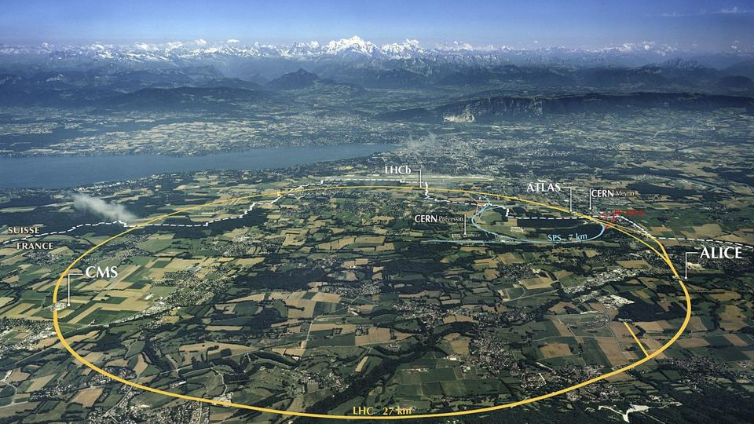
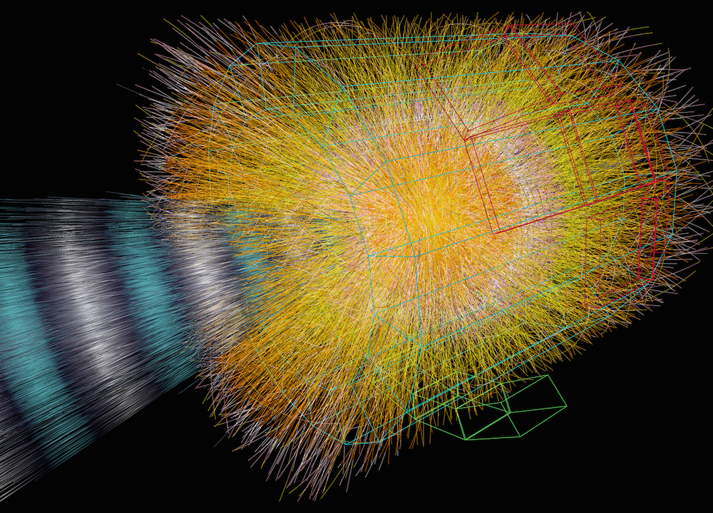

Relativistic Heavy-Ion Collisions
LHC: $\sqrt{s_{NN}}=5.5 TeV$
Creation of hot/dense matter
Study of
quark-gluon plasma
QCD phase diagram
ALICE Collab.

Slide 3
Probing Nuclear Shapes in RelHIC?!
ATLAS, PRC 107, 054910 (2023)
STAR, Nature 635, 67 (2024)

Slide 4
Rough Idea
beam axis
Spherical
transverse plane
Deformed
beam
beam
Different transverse shapes for the spherical and deformed nuclei.
Distribution is reflected into anisotropic flows in the final state.
High-energy collisions → snapshot of the overlapping region of intrinsic states

Slide 5
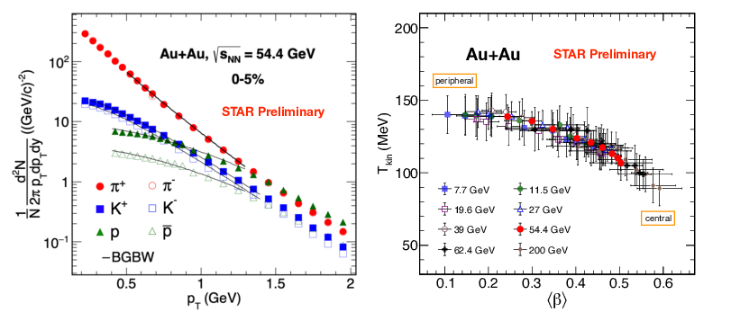
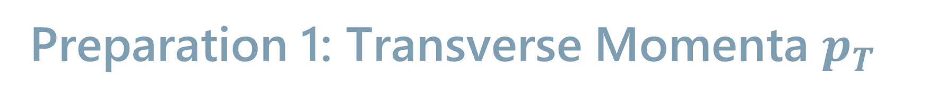
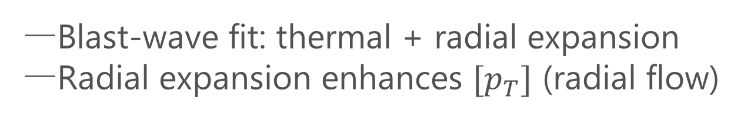
Preparation 1: Transverse Momenta $p_{T}$
Blast-wave fit: thermal + radial expansion
Radial expansion enhances $[p_{T}]$ (radial flow)

Slide 6

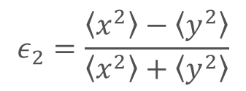
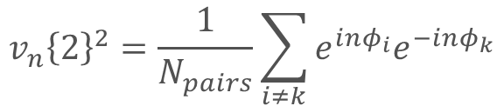

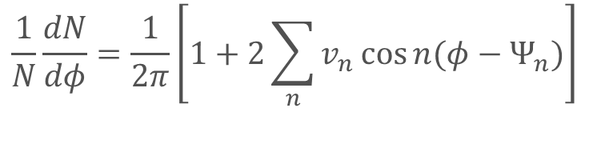
Preparation 2: Elliptic Flow / Eccentricity
transverse
plane
Eccentricity:
(coordinate space)
$$ε_{n}e^{iΦ_{n}}∼−∫d^{2}x_{T}e^{inφ_{s}}w_{n}\left(r_{T}\right)ρ\left(x_{T}\right)$$
$$φ$$
$$ε_{2}=\frac{\left\langle x^{2}\right\rangle −\left\langle y^{2}\right\rangle }{\left\langle x^{2}\right\rangle +\left\langle y^{2}\right\rangle }$$
: eccentricity
Anisotropic Flow:
(momentum space)
$$\frac{1}{N}\frac{dN}{dφ}=\frac{1}{2π}\left[1+2\sum_{n}{v_{n}\cos{n(φ−Ψ_{n}})}\right]$$
Recent definition:
(multi-particle correlations)
$$v_{n}{\left\{2\right\}}^{2}=\frac{1}{N_{pairs}}\sum_{i≠k}{e^{inφ_{i}}e^{−inφ_{k}}}$$
Initial anisotropy in coordinate space is converted into momentum one in the final state.
Evidence of hydrodynamic response

Slide 7
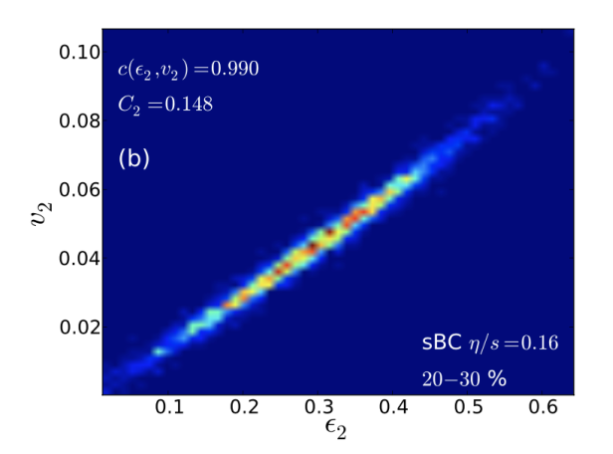
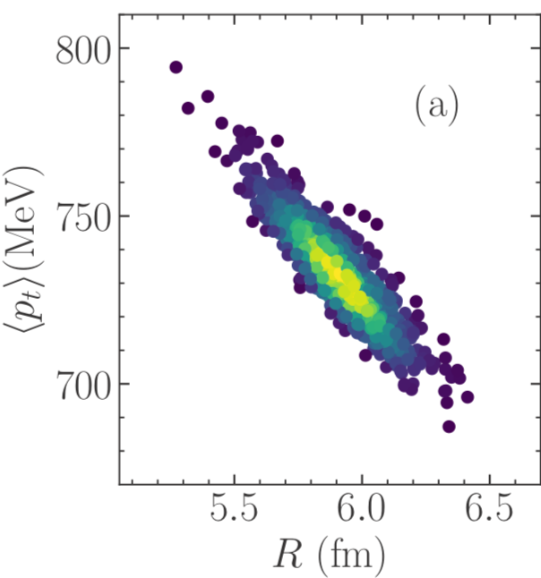
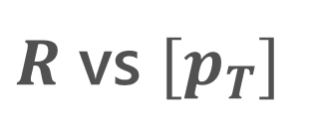
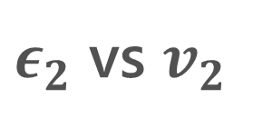
Strong Correlation b/w Initial/Final
$ε_{2}$ vs $v_{2}$
$R$ vs ${[p}_{T}]$
Niemi+, PRC87, 054901(‘13)
Giacalone+, PRC103, 024909
Strong e-v-e correlations between $ε_{2}$ and $v_{2}$ / $R$ and $[p_{T}]$.
Information of the initial shape can be encoded in flow observables!

Slide 8
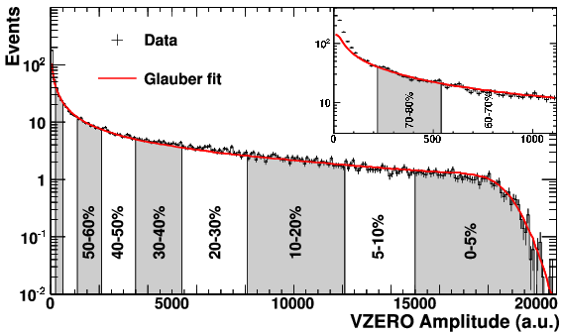
Preparation 3: Centrality
The impact parameter is not observable in HIC.
Centrality: Proxies of impact param., such as particle multiplicities
Notice: no direct connection between impact parameter & centrality

Slide 9
Ultra-Central Collisions (UCC)
UCC ➔ Almost all particles participate in the collisions
Collision of Prolate nuclei
 | mean radius | anisotropy
tip-tip | small | small
body-body | large | large
Giacalone, PRL (‘20)

Slide 10
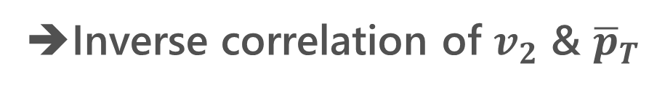
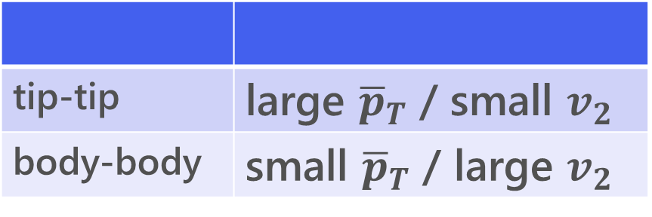
Ultra-Central Collisions (UCC)
UCC ➔ Almost all particles participate in the collisions
Collision of Prolate nuclei
 | mean radius | anisotropy
tip-tip | small | small
body-body | large | large
Giacalone, PRL (‘20)
hydro. evolution
tip-tip | large ${\overline{p}}_{T}$ / small $v_{2}$
body-body | small ${\overline{p}}_{T}$ / large $v_{2}$
➔Inverse correlation of $v_{2}$ & ${\overline{p}}_{T}$

Slide 11
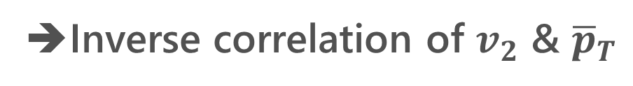

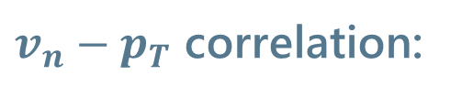
Experimental Result @STAR
tip-tip | large ${\overline{p}}_{T}$ / small $v_{2}$
body-body | small ${\overline{p}}_{T}$ / large $v_{2}$
$v_{n}−p_{T}$ correlation:
➔Inverse correlation of $v_{2}$ & ${\overline{p}}_{T}$
Bozek, PRC 93 (’16)
STAR, Nature 635 (‘24)

Slide 12
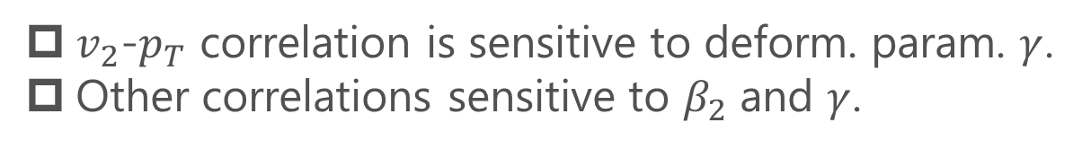
Triaxial Deformation
Fig.: Jia, PRC (‘22)
ATLAS, PRC 107 (2023)
$v_{2}$-$p_{T}$ correlation is sensitive to deform. param. $γ$.
Other correlations sensitive to $β_{2}$ and $γ$.
STAR, Nature 635 (2024)

Slide 13
Further Extension
Probing
Shape fluctuations
  Zhao, Xu, Zhou, Liu, Song, PRL (’24); Hagino, MK, PRC (’25);
  Liu+, 2509.09376; …
Octupole/hexadecapole deformation
  Zhang+, 2504.15245; Xu+, 2504.19644; …

Slide 14
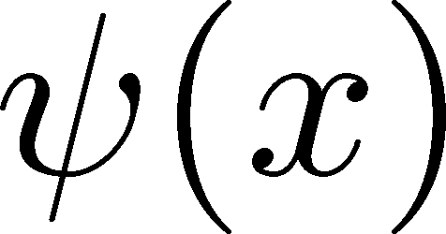

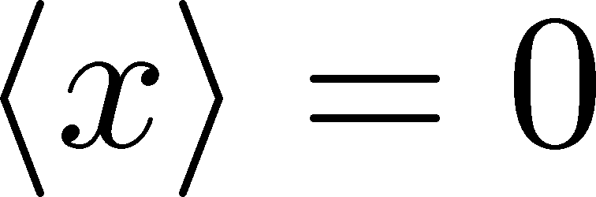
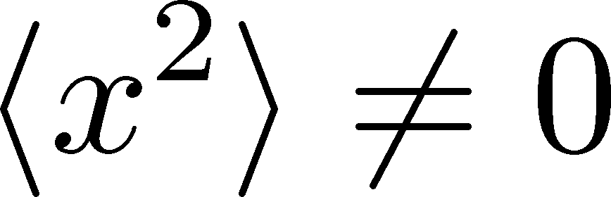
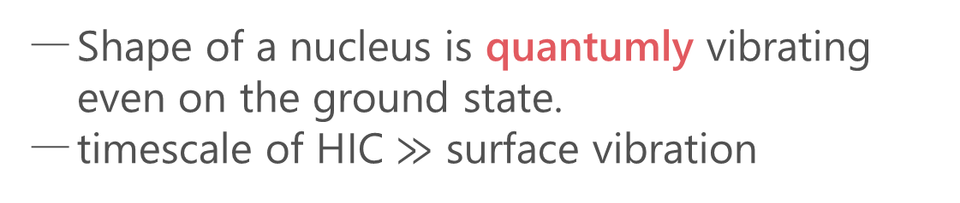
Quantum Surface Vibration
Hagino, MK, PRC (’25)
Harmonic Oscillators
ground state
Shape of a nucleus is quantumly vibrating even on the ground state.
timescale of HIC $≫$ surface vibration
See also
Zhao, Xu, Zhou, Liu, Song (’24)
Xu, Xu, Zhao, Zhao, Song, Wang (’25)
Liu+, 2509.09376
HIC takes a snapshot of shape fluctuation.

Slide 15

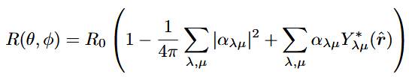

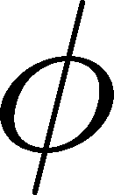



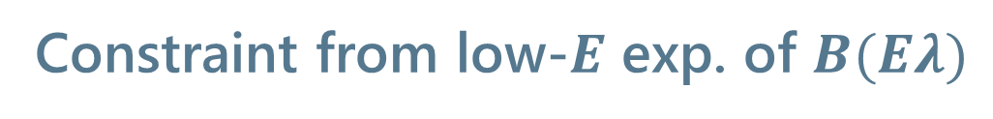
Spherical Nuclei
Hagino, MK, PRC (’25)
Space-fixed coordinates
Harmonic-oscillator model for surface vib.
Constraint from low-$E$ exp. of $B(Eλ)$
More complicated in body-fixed coordinates
Hagino, Takigawa (’12)
Hagino, Ogata, Moro (’22)
Treatment of surface vibration is apparent in the space-fixed coordinates.
Deformation params. $β_{λ}$ can be constrained from transition probability.

Slide 16
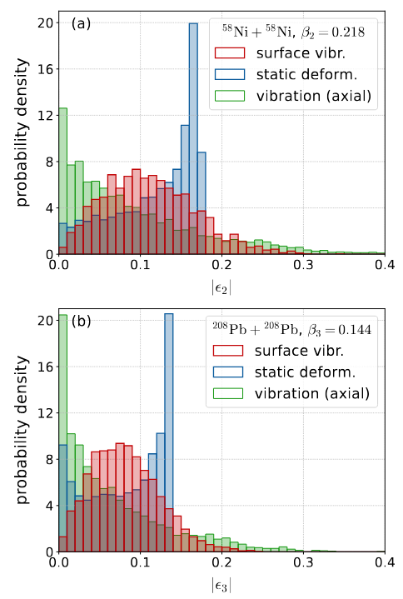


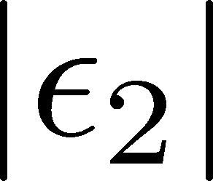
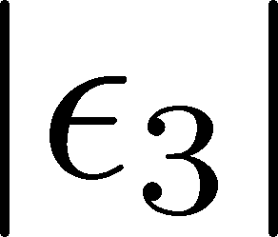
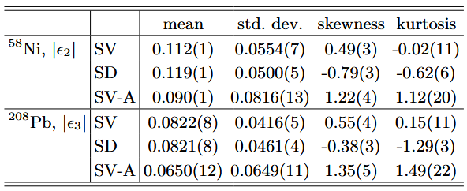


Transverse Distribution
Hagino, MK, PRC (’25)
Initial Transverse Distr.
${}^{58}$Ni, Quadrupole
${}^{208}$Pb, Octupole
droplet full-overlap model
Jia (’22)
Distribution differs significantly between the surface vibration and static deformation.
Axial deformation is insufficient to describe the surface vibration.

Slide 17
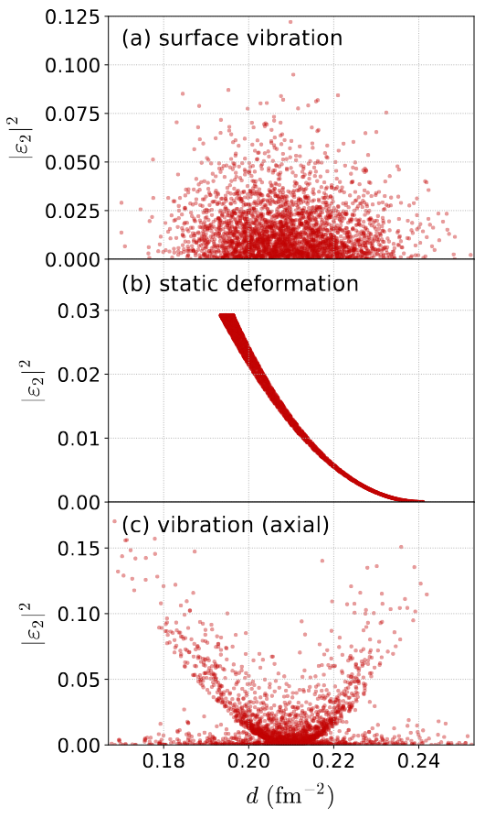
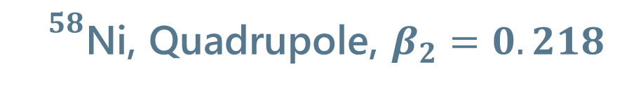
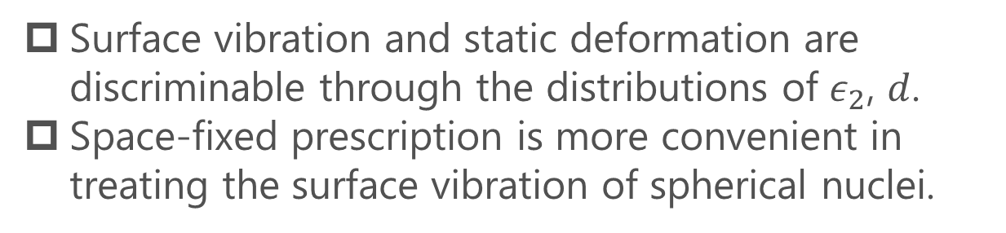
Transverse Distribution 2
Hagino, MK, PRC (’25)
${}^{58}$Ni, Quadrupole, $β_{2}=0.218$
Surface Vibration
Static Deform.
inverse mean radius
Short Summary
Surface vibration and static deformation are discriminable through the distributions of $ε_{2}$, $d$.
Space-fixed prescription is more convenient in treating the surface vibration of spherical nuclei.

Slide 18
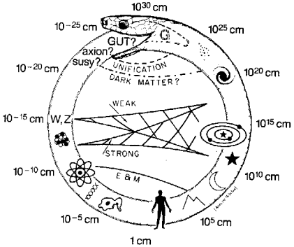
Uroboros in Nuclear Physics
Uroboros of Physics
Glashow (1982)
High-Energy HIC provides us with info. of nuclear structure.
Nuclear structure is necessary for understanding Relativistic HIC.

Slide 19

Uroboros in Nuclear Physics
Uroboros of Physics
Quark-gluon plasma
~1GeV
Nuclear structure
~1MeV
Heavy-ion
Collisions
heavy-ion
collisions
Nuclear reactions
~10MeV
Hadron physics
~100MeV
Glashow (1982)
High-Energy HIC provides us with insights into nuclear structure.
Nuclear structure is necessary for understanding relativistic HIC.

Slide 20
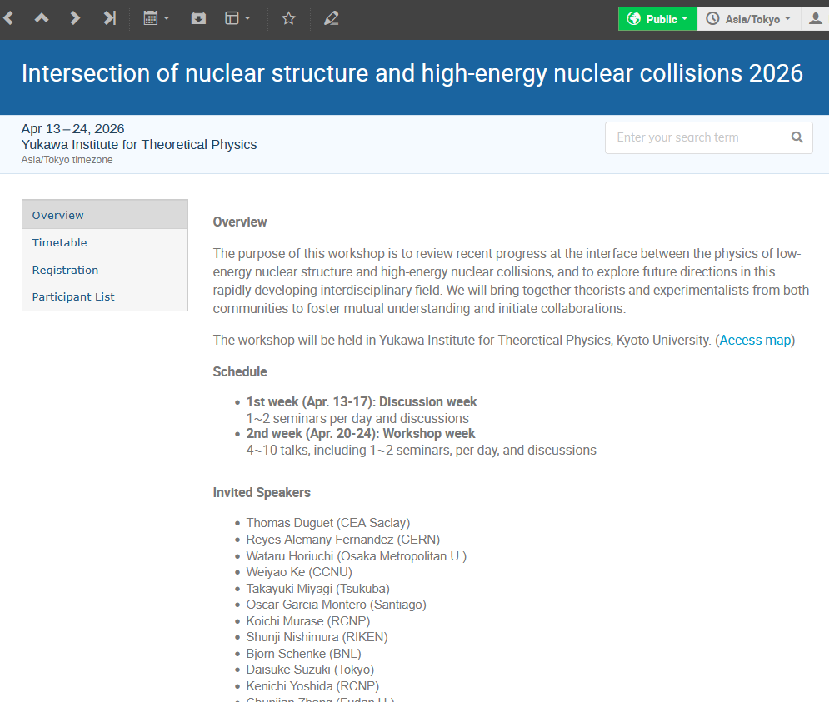

Workshop in April @ Kyoto
Intersection of nuclear structure and high-energy nuclear collisions
April 13-24
YITP, Kyoto University
Deadline: Mar. 13
https://indico.yukawa.kyoto-u.ac.jp/event/75/

Slide 21
Workshop in April
Intersection of nuclear structure and high-energy nuclear collisions
Further investigations
OO, NeNe collision @ LHC, 2025
Motivations for other nuclei?
April 13-24
YITP, Kyoto University
Deadline: Mar. 13
https://indico.yukawa.kyoto-u.ac.jp/event/75/

Slide 22
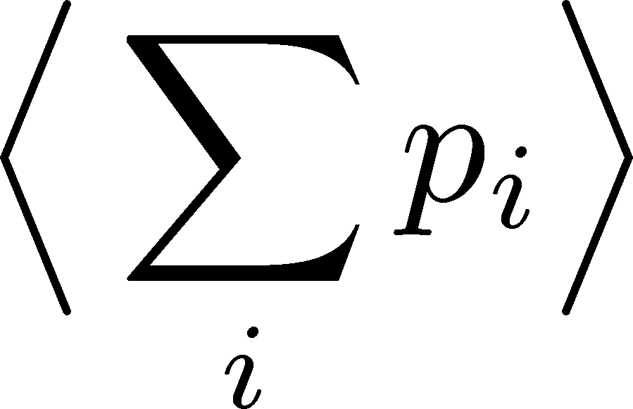
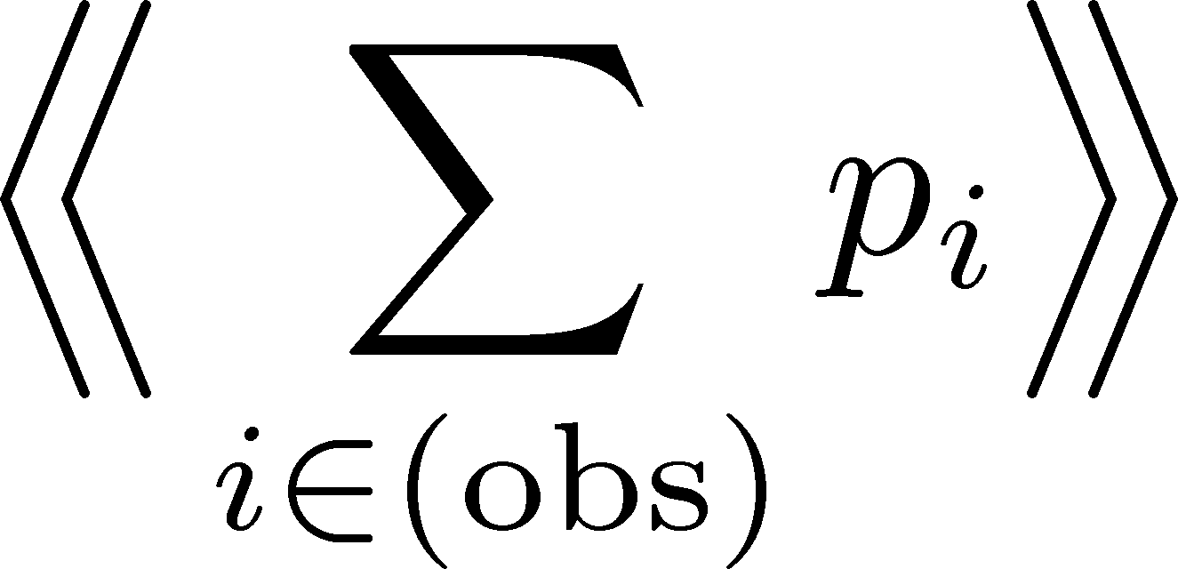
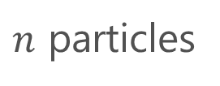




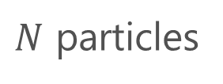

Detector Efficiency
Detector
$$p_{1}$$
$$p_{1}$$
$$p_{2}$$
not
observed
$N$ particles
$n$ particles
‥‥
‥
‥‥
$$p_{N}$$
$$p_{N}$$
modified
true
total value:
observed
total value:
Real detectors lose some particles
Observed results are modified.
Effects must be corrected to obtain the true result.

Slide 23
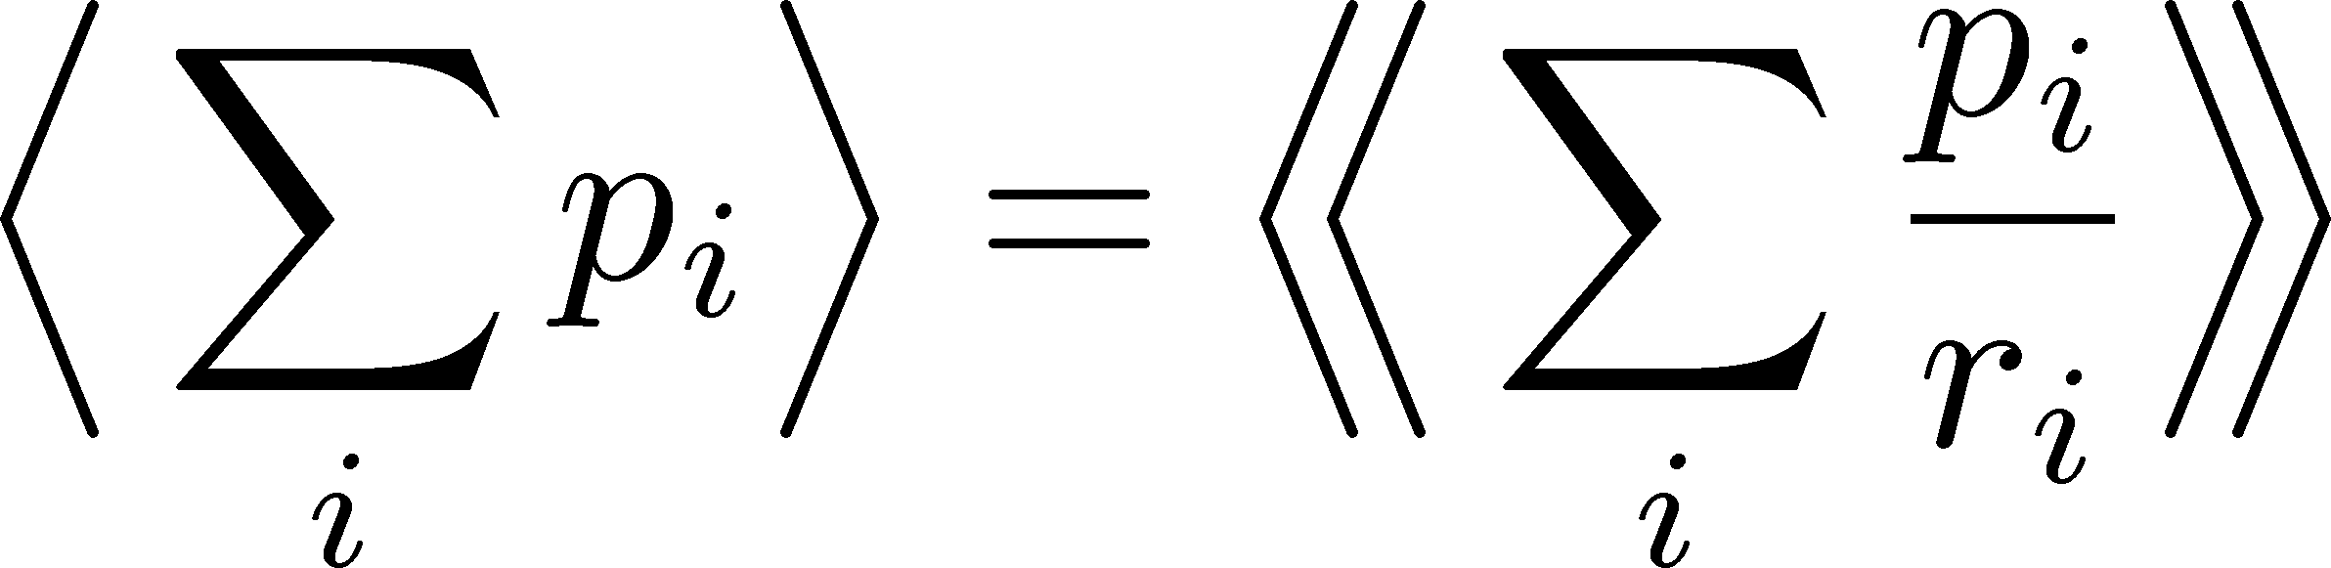



Efficiency Correction: Total Number
Detector
$$p_{1}$$
$$r_{1}$$
$$p_{1}$$
$$p_{2}$$
$$r_{2}$$
$N$ particles
efficiencies
$n$ particles
‥‥
‥
‥‥
‥‥
$$p_{N}$$
$$r_{N}$$
$$p_{N}$$
modified
true
total value:
observed
total value:
Correction Formula:

Slide 24
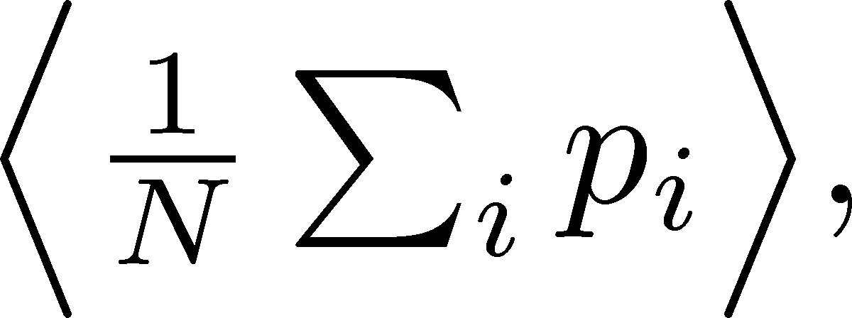
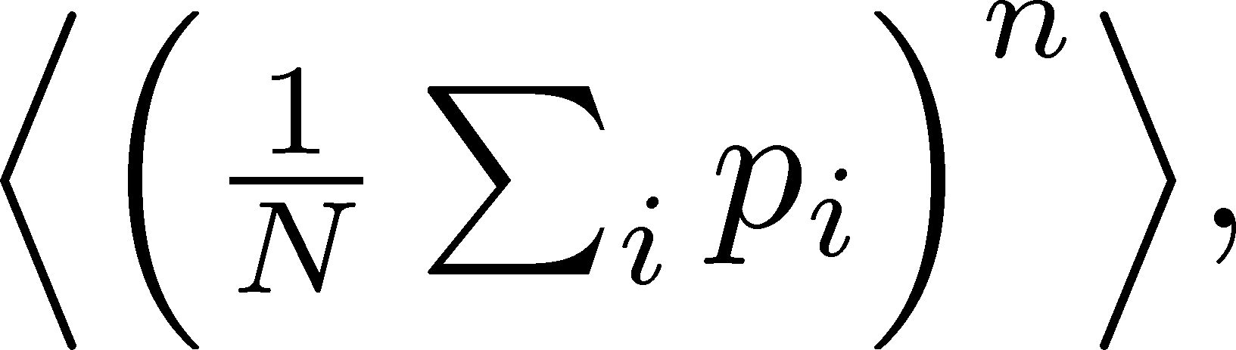
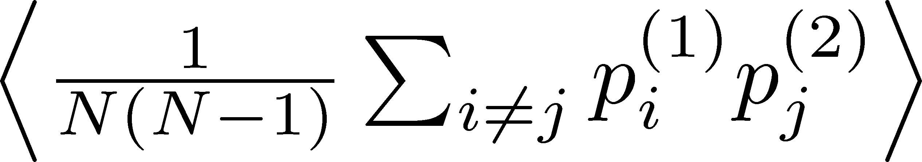
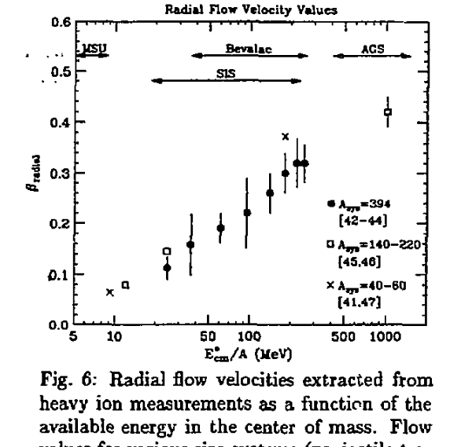
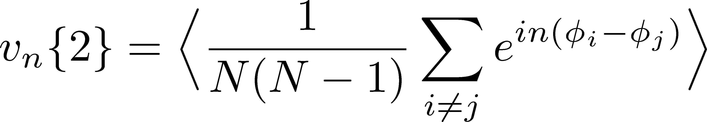
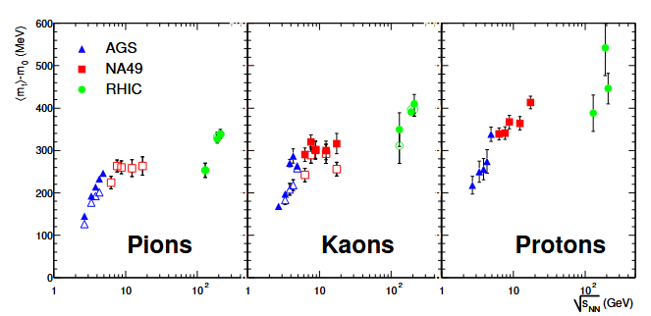
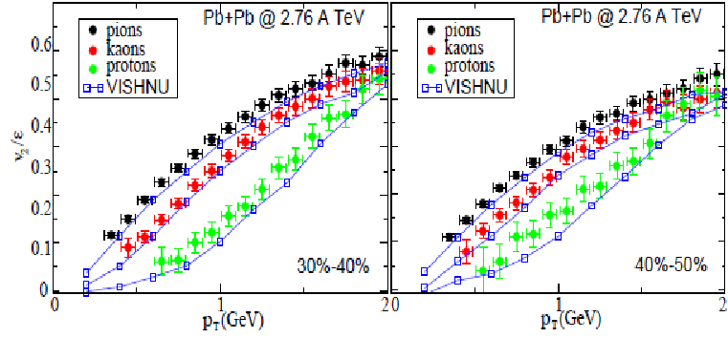
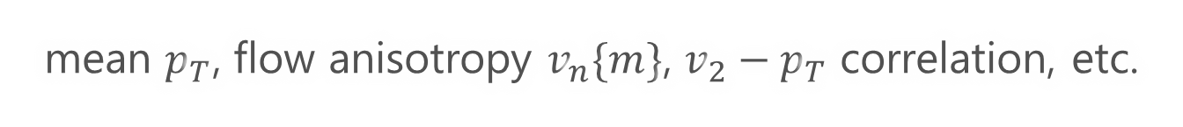
Particle-Averaged Quantities
Many fundamental observables in HIC are of this form!
mean $p_{T}$, flow anisotropy $v_{n}\{m\}$, $v_{2}−p_{T}$ correlation, etc.

Slide 25
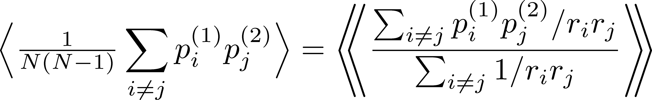
Particle-Averaged Quantities
Many fundamental observables in HIC are of this form!
“Conventional” Correction Formulas
e.g. ATLAS, PRC107, 054910 (‘23); STAR, Nature 635, 67 (‘24)
Question: Are these formulas correct?

Slide 26
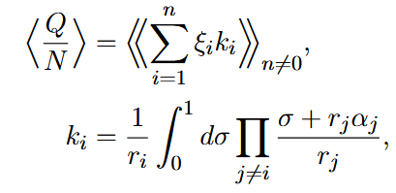
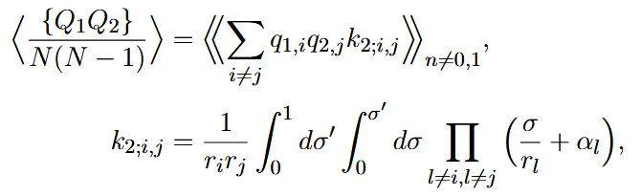


Correct Correction Formulas
MK, Esumi, Niida, Nonaka, arXiv:25010.13838
Mean
2nd Order
Correction formulas are written in forms including integral.
This formula can reproduce the correct result for the previous simple model.

Slide 27


Beam-Energy Scan
STAR, 2012
High E
Low E
Baryon stopping

Slide 28





J-PARC-HI = J-PARC Heavy-Ion Project
LINAC
$E_{lab}=400MeV$
New HI injector + existing accelerators (RCS, MR)
Heavy-ion beams with world highest luminosity
Realize various new experiments at J-PARC
$\sqrt{s_{NN}}<4.9$GeV
RCS
$E_{lab}=3GeV$
Main Ring
$E_{lab}=30GeV$
Hadron hall

Slide 29
J-PARC-HI = J-PARC Heavy-Ion Project
LINAC
$E_{lab}=400MeV$
New HI injector + existing accelerators (RCS, MR)
Heavy-ion beams with world highest luminosity
Realize various new experiments at J-PARC
$\sqrt{s_{NN}}<4.9$GeV
HI
injector
RCS
$E_{lab}=3GeV$
Main Ring
$E_{lab}=30GeV$
Hadron hall

Slide 30


Further Utilization of Deformation at low collision-energy region
Violation of hydro. picture /
EOS Change @ 1st-order tr.
Creating the highest
baryon density medium
MK’s conjecture
$$\overline{p}$$
How is this behavior modified?
high-E
Tip-tip collisions are obviously suitable to create denser matter!
low-E
$$v_{2}$$
Softening of EOS suppresses tip-tip side??
How to measure it?

Slide 31


Physics of Heavy-Ion Collisions
Various physical picture / research purposes / theoretical methods
depending on the collision E
Low collision-E
High collision-E
Nuclear liquid-gas transition
Nuclear reaction
compressed
baryonic matter
QGP
Fragmentation
Quark
deconfinement
Nuclear Deformation
Heavy elements
EOS
TDHF
Langevin
hydro. models
BUU
AMD
hadron cascade
RIBF
J-PARC-HI

Slide 32



Summary
High-energy heavy-ion collisions provide a novel experimental probe for studying nuclear structure.
Extraction of $β, γ,$ shape fluctuations, etc.
There are many more usage of nuclear deformation in HIC, especially at intermediate energies.
Let’s promote interdisciplinary discussions in terms of the keyword, “nuclear deformation” and “heavy-ion collisions”.
drawn by ChatGPT

Slide 33













Check in a Simple Model
MK, Esumi, Niida, Nonaka,
arXiv:2510.13838
$2N$: fixed for all events
$$q_{1}=1$$
$N$ particles
efficiency $r=1$
‥
‥
$n$ particles
$$q_{N}=1$$
$$q_{N+1}=−1$$
‥
$N$ particles
efficiency $r=p$
$$q_{2N}=−1$$
Mean:
True result
Conventional formula does not reproduce the correct result even for the mean!!
Reconstructed

Slide 34



Moments (Cumulants) of Total Number
Note
Search for QCD-CP using conserved-charge fluctuations
Correction Procedure:
Use factorial moments/cumulants
Long history of efficiency correction:
MK, Asakawa (’12); Bzdak, Koch (’12,’15);
Luo (’14); MK (’16); Nonaka+ (’16); Bzdak, Holtzman, Koch (’16); MK, Luo (’17); Nonaka, MK, Esumi (’17); …
Assumption: efficiencies of individual particles are independent
Nonaka, MK, Esumi (’17)
Asakwa, MK, PPNP (’16); MK, Luo (’17)

Slide 35





Connecting True/Observed Distr. Funcs.
True distr. func.
Observed distr. func.
$n$: observed particle number
$q=Σ_{i∈(obs.)}ξ_{i}$: observed sum
Probability Distr. of Observed Quantities (uniform $r$)
$$b_{i}=0,1$$

Slide 36




Generating Function
MK, Esumi, Niida, Nonaka, arXiv:25010.13838
Prob. distr. func:
Generating func:
Represent the quantity that you want to express by the derivative of the generating function.
Then, represent it in terms of the observed variables.
Note:
$α^{n}$ term compensates the $n=0$ contribution.

Slide 37






Correction is Necessary!!
efficiency $r$
$p_{T}$-dependent efficiency
Azimuthally nonuniform efficiency
alter mean $p_{T}$
produce unphysical $v_{n}\left\{m\right\}$
More serious effects on higher-order correlations!

Slide 38





Derivation of Correction Formulas
Assumptions
Particle production is described by a classical prob. distr. func. $P(N;{\vec{p}}_{T})$.
Probs. to observe individual particles are independent.
For each observed particle, the value of efficiency $r_{i}$ can be specified.
Other detectors’ effects are not considered.
$$ξ_{1}$$
True distr. func.
$$ξ_{2}$$
$N$ particles
‥‥
‥
$$ξ_{N}$$

