Slide 1
A Few Topics in
Nuclear Deformation and High-energy Physics
Intersection of nuclear structure and high-energy nuclear collisions 2026, 2026/4/13-24, YITP, Kyoto
Masakiyo Kitazawa
(YITP, Kyoto)
Hagino, MK, PRC 112 (2025) L041901 [2508.05125];
MK, Esumi, Niida, Nonaka, PTEP (2026) in press, [2510.18383];
Gubler, MK, Minato, Nara, Taya, in progress.

Slide 2
Contents
Probing Surface Vibrations in high-E Heavy-ion Collisions
      Hagino, MK, PRC 112 (2025) L041901 [2508.05125]
Efficiency Correction of Flow Correlations
      MK, Esumi, Niida, Nonaka, PTEP (2026) in press, [2510.18383]
      ]
Exploiting Nuclear Deformation for searching for QCD Phase Structure
      Gubler, Minato, Nara, Taya, MK, in progress

Slide 3
Contents
Probing Surface Vibrations in high-E Heavy-ion Collisions
      Hagino, MK, PRC 112 (2025) L041901 [2508.05125]
Efficiency Correction of Flow Correlations
      MK, Esumi, Niida, Nonaka, PTEP (2026) in press, [2510.18383]
      ]
Exploiting Nuclear Deformation for searching for QCD Phase Structure
      Gubler, Nara, Minato, Taya, MK, in progress

Slide 4
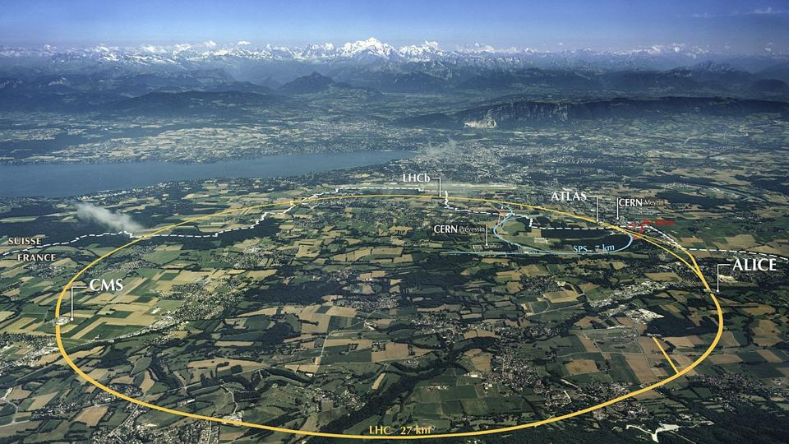
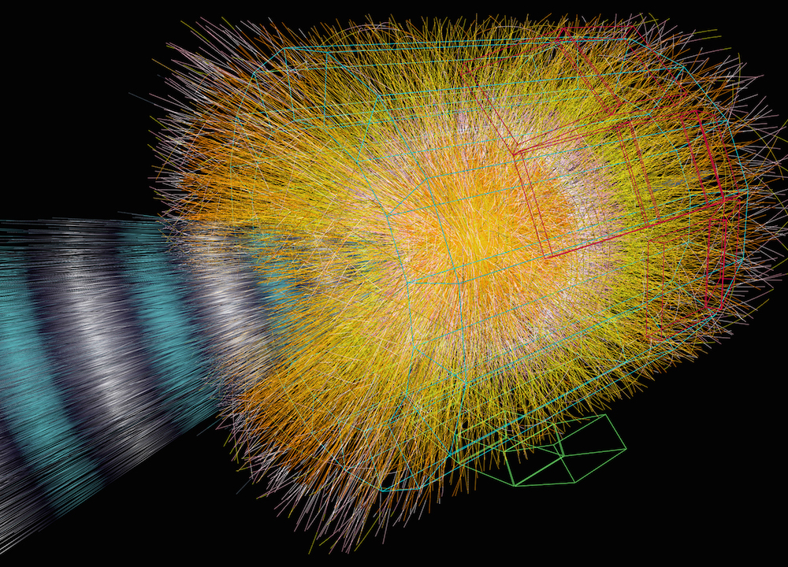

Relativistic Heavy-Ion Collisions
LHC: $\sqrt{s_{NN}}=5.5 TeV$
Creation of hot/dense matter
Study of
quark-gluon plasma
QCD phase diagram
ALICE Collab.

Slide 5
Probing Nuclear Shapes in RelHIC?!
ATLAS, PRC 107, 054910 (2023)
STAR, Nature 635, 67 (2024)

Slide 6
Rough Idea
beam axis
Spherical
transverse plane
Deformed
beam
beam
Different transverse shapes for the spherical and deformed nuclei.
Distribution is reflected into anisotropic flows in the final state.
High-energy collisions → snapshot of the overlapping region of intrinsic states

Slide 7
Ultra-Central Collisions (UCC)
UCC ➔ Almost all particles participate in the collisions
Collision of Prolate nuclei
 | mean radius | anisotropy
tip-tip | small | small
body-body | large | large
Giacalone, PRL (‘20)

Slide 8
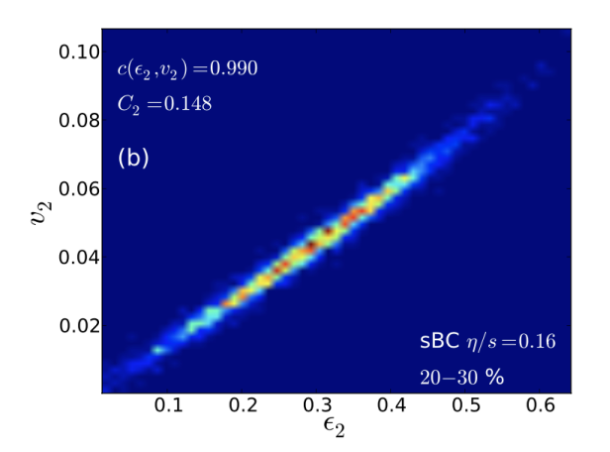
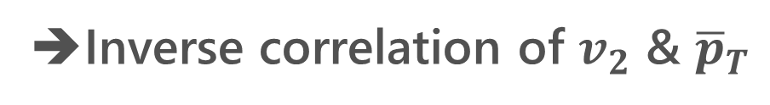
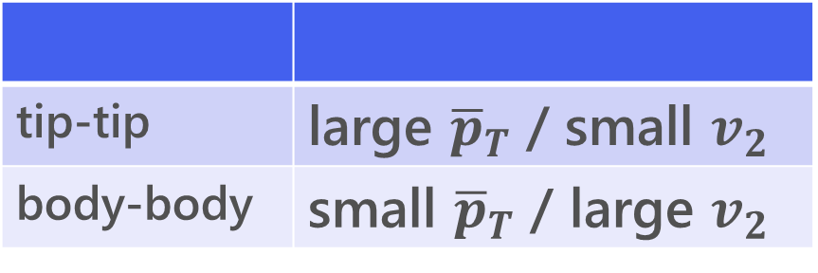
Ultra-Central Collisions (UCC)
UCC ➔ Almost all particles participate in the collisions
Collision of Prolate nuclei
 | mean radius | anisotropy
tip-tip | small | small
body-body | large | large
Giacalone, PRL (‘20)
hydro. evolution
tip-tip | large ${\overline{p}}_{T}$ / small $v_{2}$
body-body | small ${\overline{p}}_{T}$ / large $v_{2}$
➔Inverse correlation of $v_{2}$ & ${\overline{p}}_{T}$

Slide 9
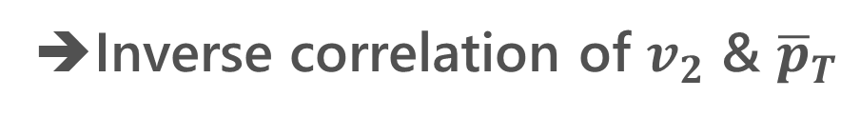

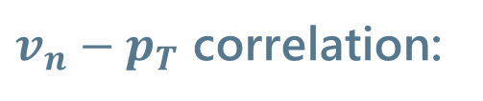
Experimental Result @STAR
tip-tip | large ${\overline{p}}_{T}$ / small $v_{2}$
body-body | small ${\overline{p}}_{T}$ / large $v_{2}$
$v_{n}−p_{T}$ correlation:
➔Inverse correlation of $v_{2}$ & ${\overline{p}}_{T}$
Bozek, PRC 93 (’16)
STAR, Nature 635 (‘24)

Slide 10
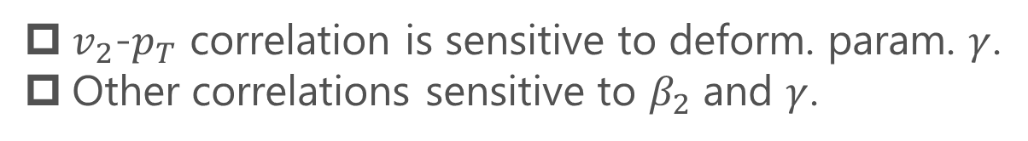
Triaxial Deformation
Fig.: Jia, PRC (‘22)
ATLAS, PRC 107 (2023)
$v_{2}$-$p_{T}$ correlation is sensitive to deform. param. $γ$.
Other correlations sensitive to $β_{2}$ and $γ$.
STAR, Nature 635 (2024)

Slide 11
Further Extension
Probing
Shape fluctuations
  Zhao, Xu, Zhou, Liu, Song, PRL (’24); Hagino, MK, PRC (’25);
  Xu+, 2504.19644; Liu+, 2509.09376; …
Octupole/hexadecapole deformation
  Zhang+, 2504.15245; Xu+, 2504.19644; …

Slide 12
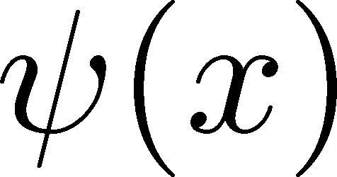

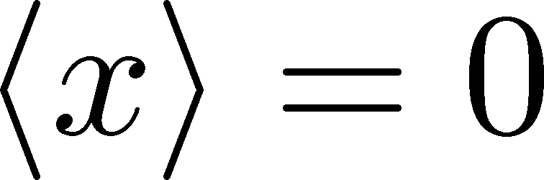
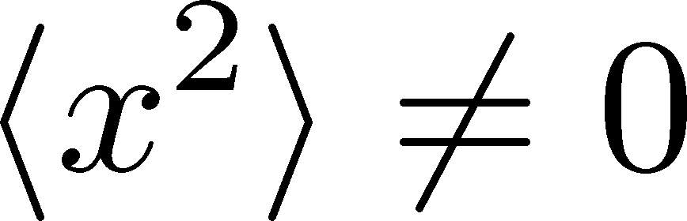
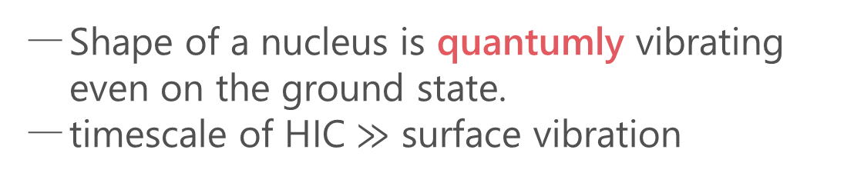
Quantum Surface Vibration
Hagino, MK, PRC (’25)
Harmonic Oscillators
ground state
Shape of a nucleus is quantumly vibrating even on the ground state.
timescale of HIC $≫$ surface vibration
See also
Zhao, Xu, Zhou, Liu, Song (’24)
Xu, Xu, Zhao, Zhao, Song, Wang (’25)
Liu+, 2509.09376
HIC takes a snapshot of shape fluctuation.

Slide 13

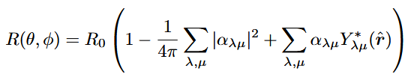

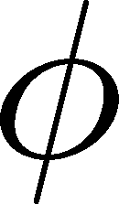



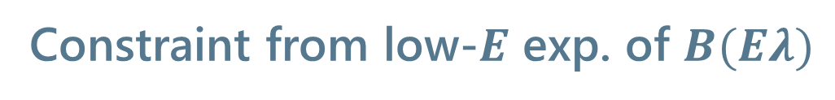
Spherical Nuclei
Hagino, MK, PRC (’25)
Space-fixed coordinates
Harmonic-oscillator model for surface vib.
Constraint from low-$E$ exp. of $B(Eλ)$
More complicated in body-fixed coordinates
Hagino, Takigawa (’12)
Hagino, Ogata, Moro (’22)
Treatment of surface vibration is apparent in the space-fixed coordinates.
Deformation params. $β_{λ}$ can be constrained from transition probability.

Slide 14
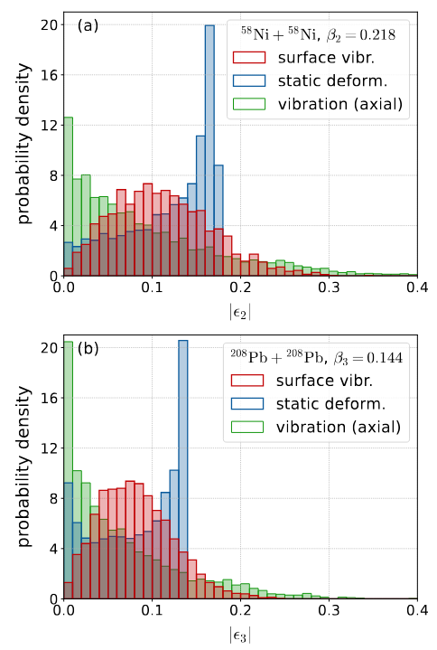


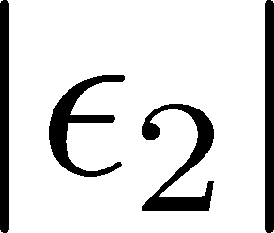
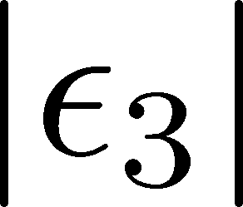
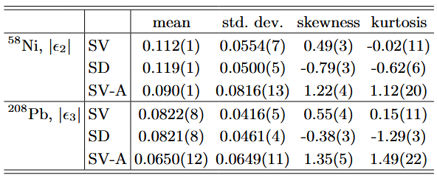


Transverse Distribution
Hagino, MK, PRC (’25)
Initial Transverse Distr.
${}^{58}$Ni, Quadrupole
${}^{208}$Pb, Octupole
droplet full-overlap model
Jia (’22)
Distribution differs significantly between the surface vibration and static deformation.
Axial deformation is insufficient to describe the surface vibration.

Slide 15
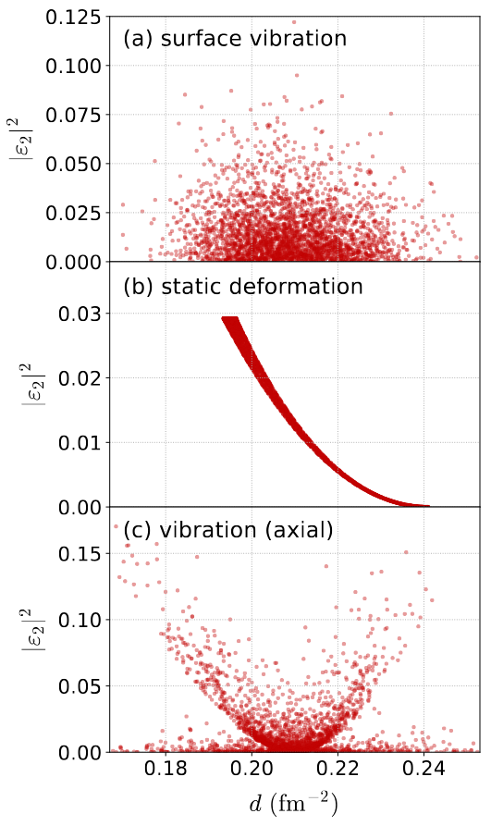
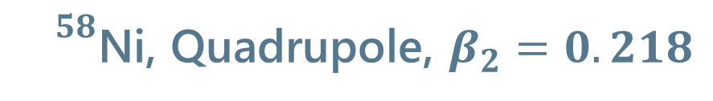
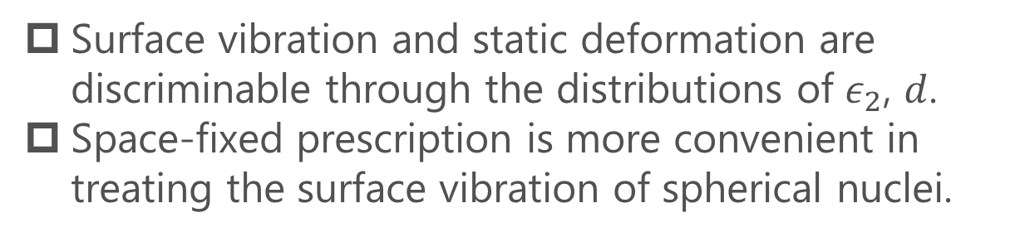
Transverse Distribution 2
Hagino, MK, PRC (’25)
${}^{58}$Ni, Quadrupole, $β_{2}=0.218$
Surface Vibration
Static Deform.
inverse mean radius
Short Summary
Surface vibration and static deformation are discriminable through the distributions of $ε_{2}$, $d$.
Space-fixed prescription is more convenient in treating the surface vibration of spherical nuclei.

Slide 16
Contents
Probing Surface Vibrations in high-E Heavy-ion Collisions
      Hagino, MK, PRC 112 (2025) L041901 [2508.05125]
Efficiency Correction of Flow Correlations
      MK, Esumi, Niida, Nonaka, PTEP (2026) in press, [2510.18383]
      ]
Exploiting Nuclear Deformation for searching for QCD Phase Structure
      Gubler, Nara, Minato, Taya, MK, in progress

Slide 17
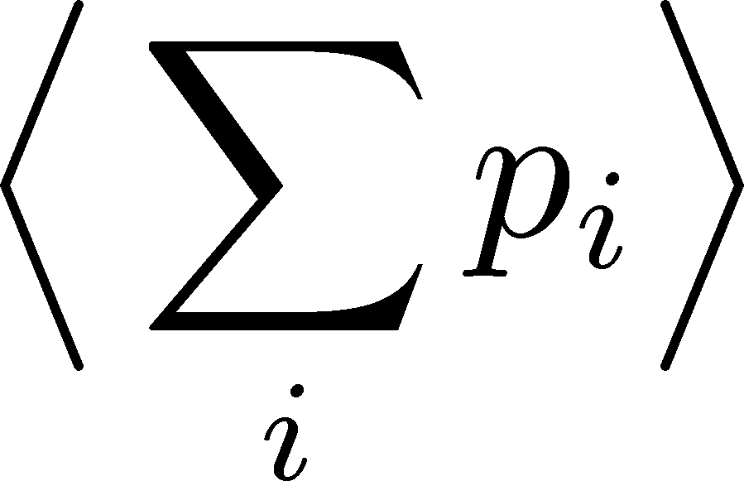
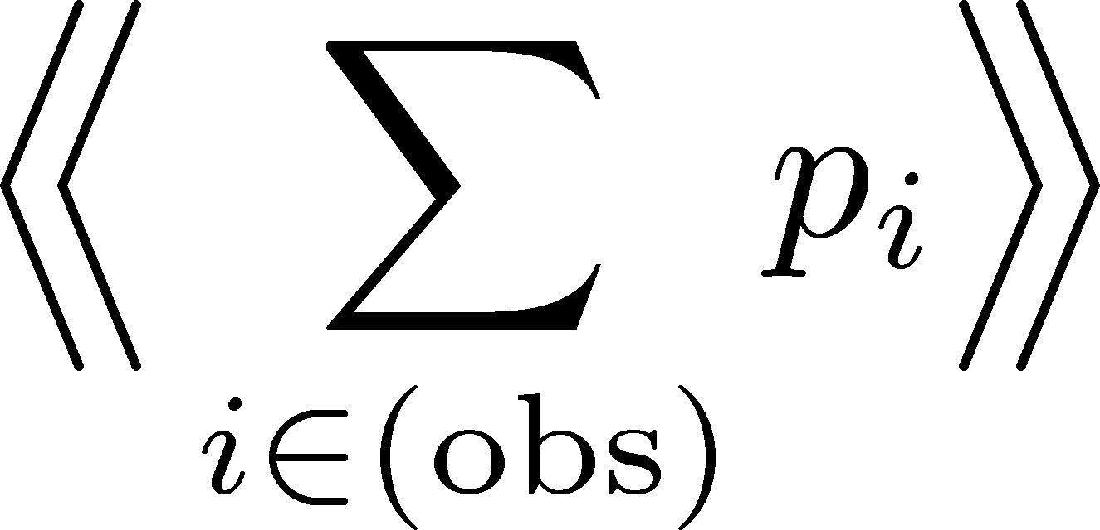
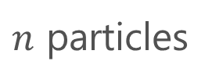




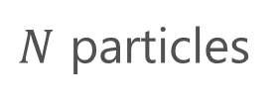

Detector Efficiency
Detector
$$p_{1}$$
$$p_{1}$$
$$p_{2}$$
not
observed
$N$ particles
$n$ particles
‥‥
‥
‥‥
$$p_{N}$$
$$p_{N}$$
modified
true
total value:
observed
total value:
Real detectors lose some particles
Observed results are modified.
Effects must be corrected to obtain the true result.

Slide 18
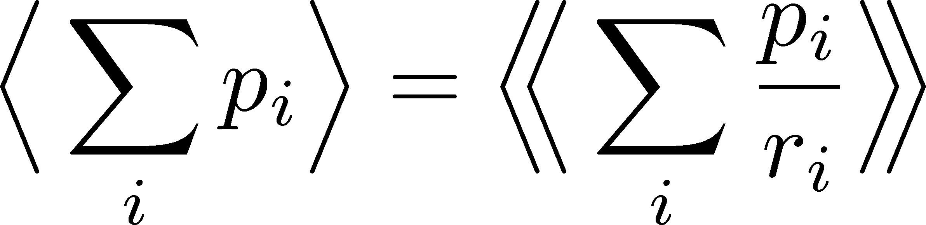



Efficiency Correction: Total Number
Detector
$$p_{1}$$
$$r_{1}$$
$$p_{1}$$
$$p_{2}$$
$$r_{2}$$
$N$ particles
efficiencies
$n$ particles
‥‥
‥
‥‥
‥‥
$$p_{N}$$
$$r_{N}$$
$$p_{N}$$
modified
true
total value:
observed
total value:
Correction Formula:

Slide 19
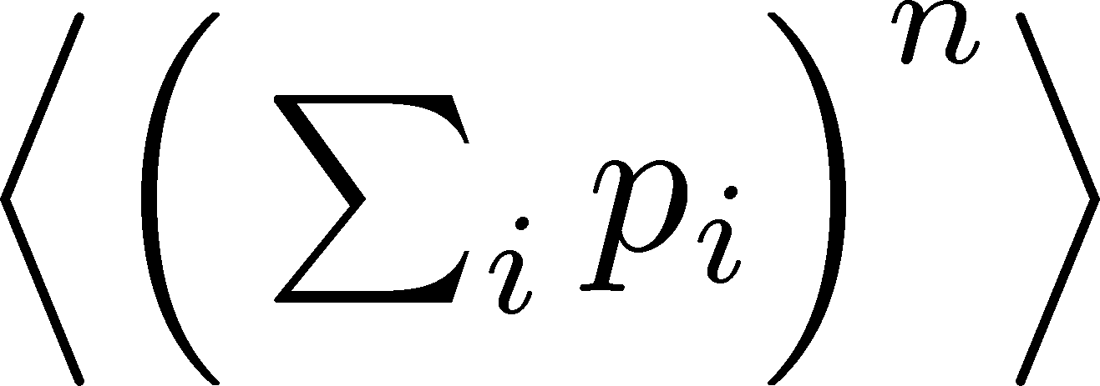
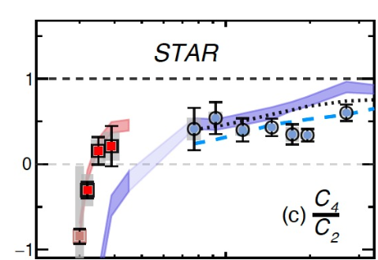
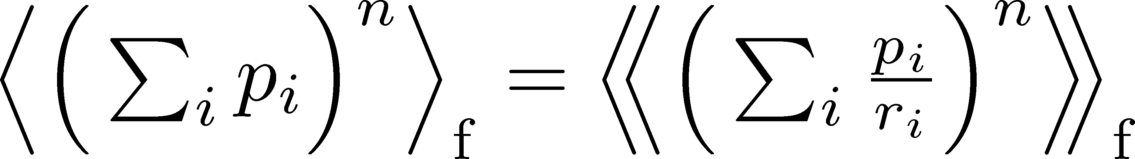
Moments (Cumulants) of Total Number
Note
Search for QCD-CP using conserved-charge fluctuations
Correction Procedure:
Use factorial moments/cumulants
Long history of efficiency correction:
MK, Asakawa (’12); Bzdak, Koch (’12,’15);
Luo (’14); MK (’16); Nonaka+ (’16); Bzdak, Holtzman, Koch (’16); MK, Luo (’17); Nonaka, MK, Esumi (’17); …
Assumption: efficiencies of individual particles are independent
Nonaka, MK, Esumi (’17)
Asakwa, MK, PPNP (’16); MK, Luo (’17)

Slide 20
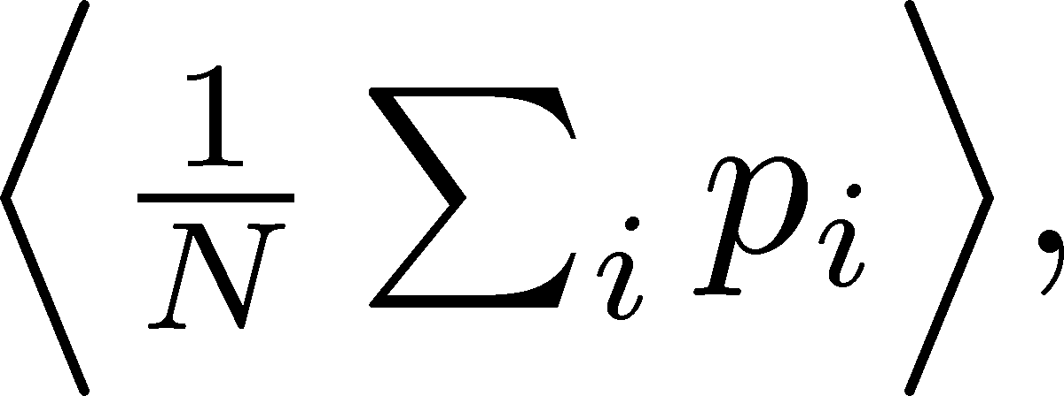
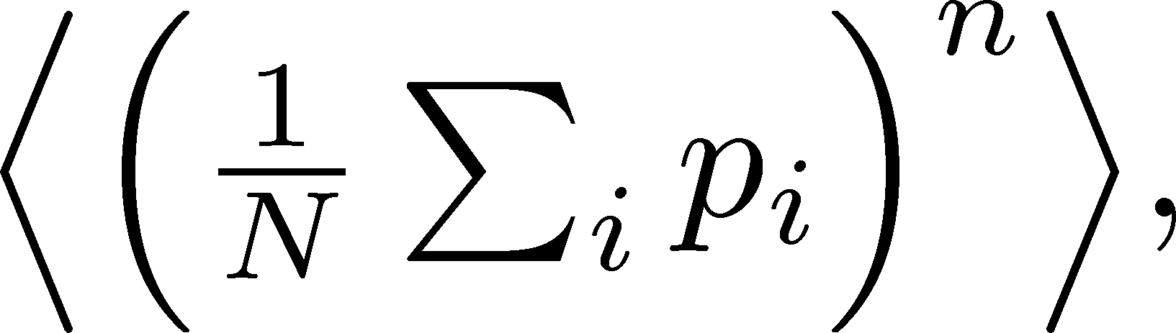
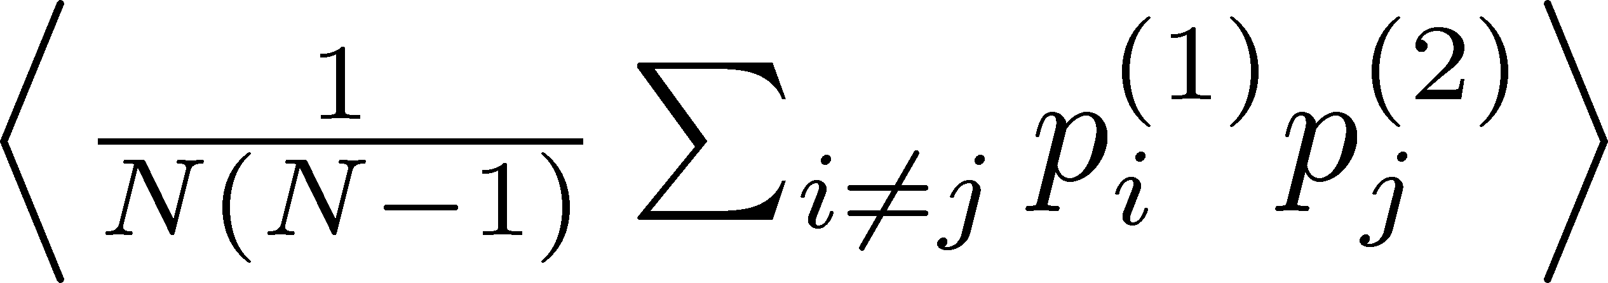
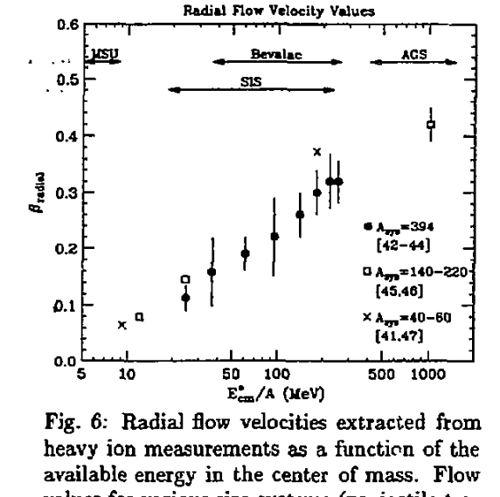
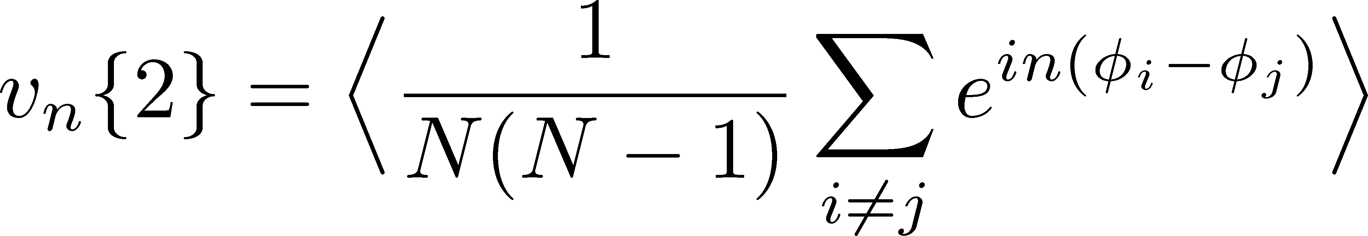
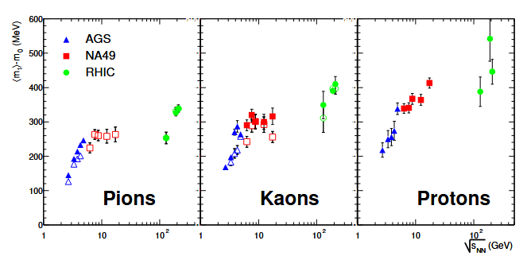
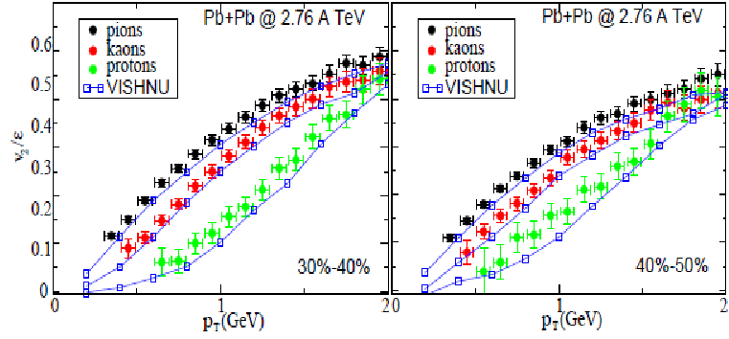

Particle-Averaged Quantities
Many fundamental observables in HIC are of this form!
mean $p_{T}$, flow anisotropy $v_{n}\{m\}$, $v_{2}−p_{T}$ correlation, etc.

Slide 21
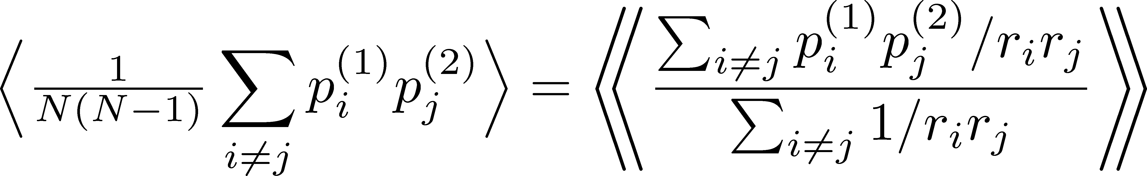
Particle-Averaged Quantities
Many fundamental observables in HIC are of this form!
“Conventional” Correction Formulas
e.g. ATLAS, PRC107, 054910 (‘23); STAR, Nature 635, 67 (‘24)
Question: Are these formulas correct?

Slide 22
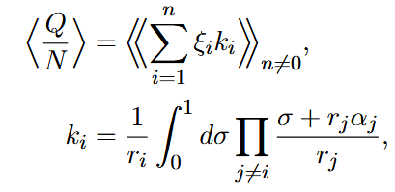
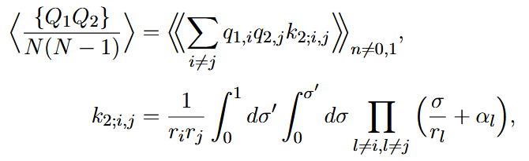

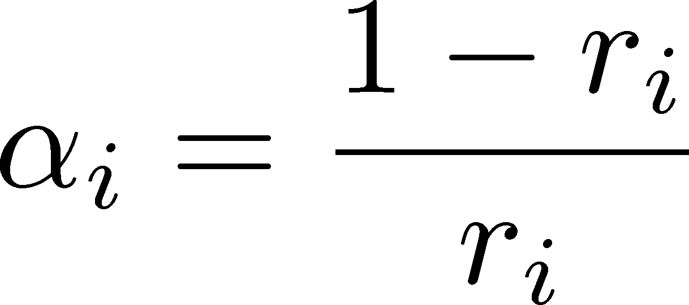
Correct Correction Formulas
MK, Esumi, Niida, Nonaka, arXiv:25010.13838
Mean
2nd Order
Correction formulas are written in forms including integral.
This formula can reproduce the correct result for the previous simple model.

Slide 23
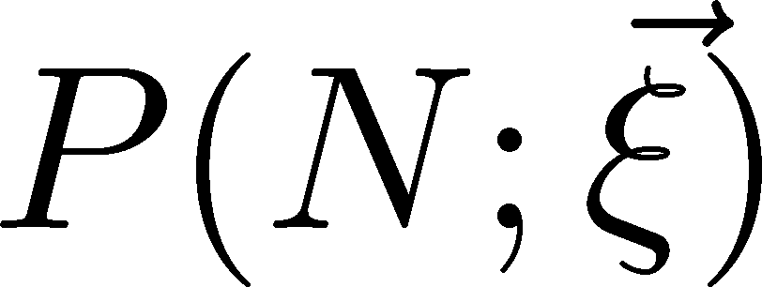

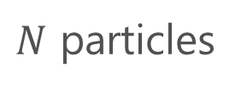

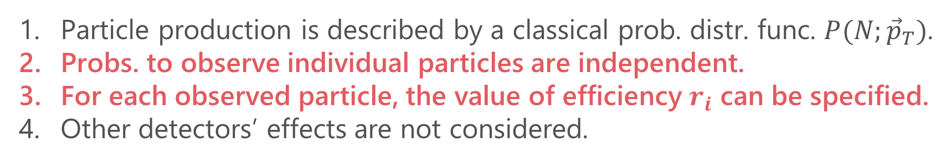

Derivation of Correction Formulas
Assumptions
Particle production is described by a classical prob. distr. func. $P(N;{\vec{p}}_{T})$.
Probs. to observe individual particles are independent.
For each observed particle, the value of efficiency $r_{i}$ can be specified.
Other detectors’ effects are not considered.
$$ξ_{1}$$
True distr. func.
$$ξ_{2}$$
$N$ particles
‥‥
‥
$$ξ_{N}$$

Slide 24
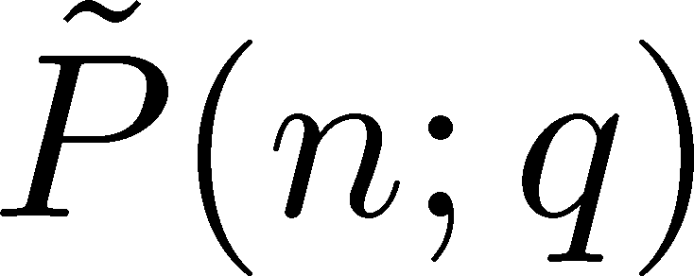
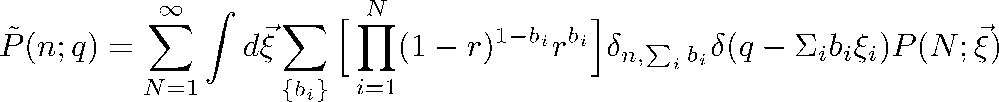

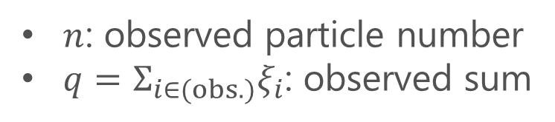
Connecting True/Observed Distr. Funcs.
True distr. func.
Observed distr. func.
$n$: observed particle number
$q=Σ_{i∈(obs.)}ξ_{i}$: observed sum
Probability Distr. of Observed Quantities (uniform $r$)
$$b_{i}=0,1$$

Slide 25
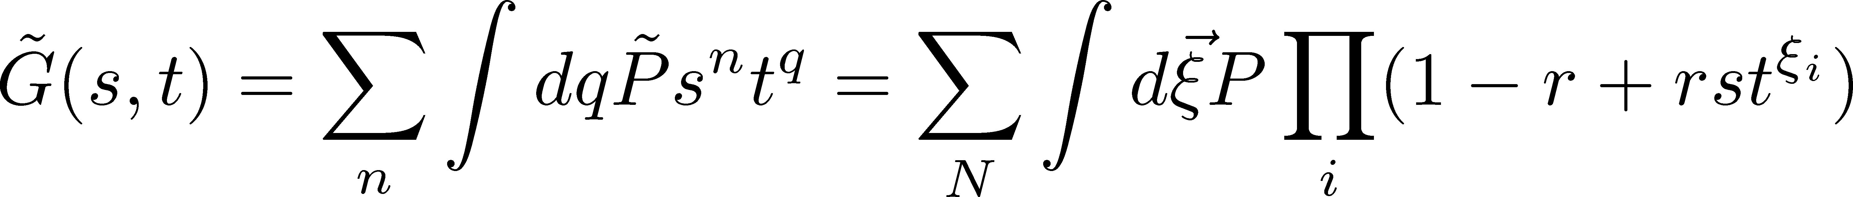
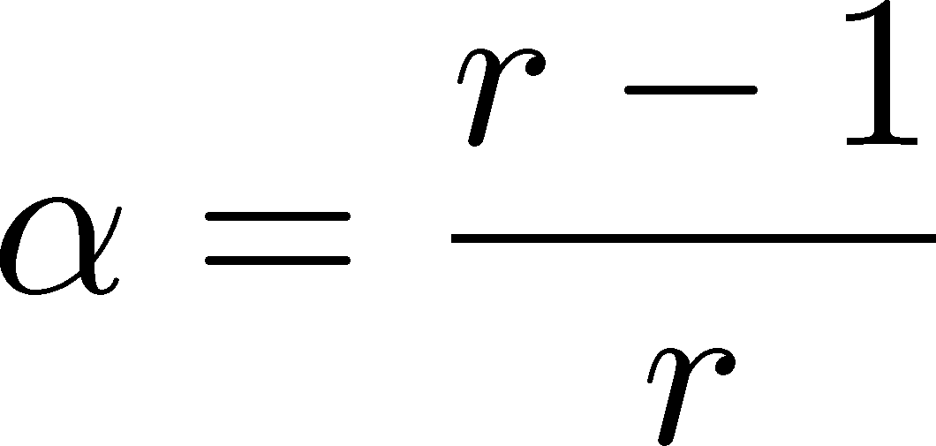
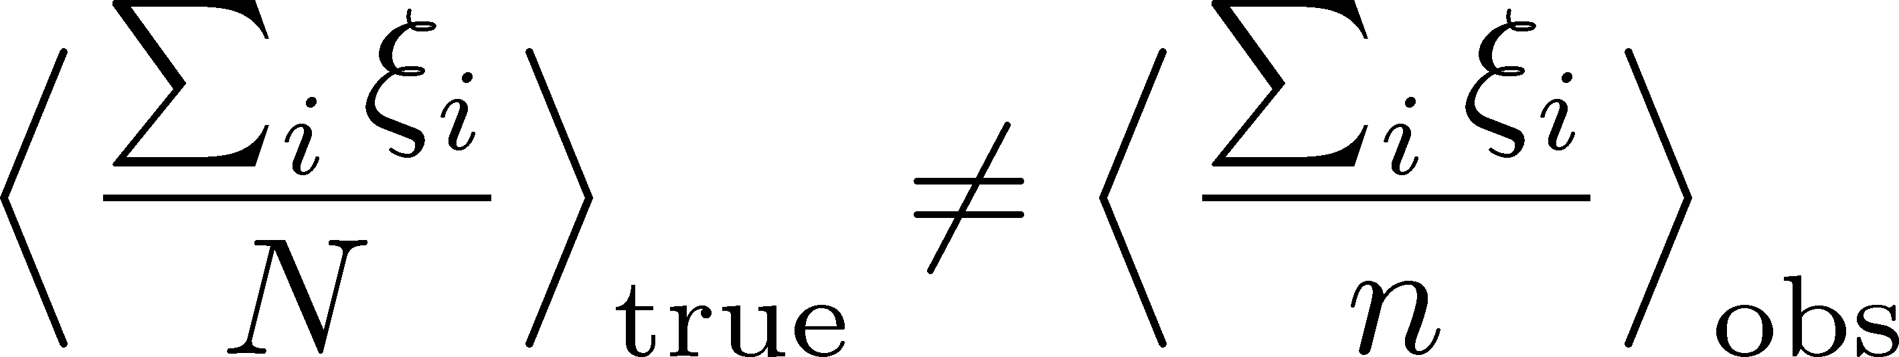

Generating Function
MK, Esumi, Niida, Nonaka, PTEP2026
Prob. distr. func:
Generating func:
Represent the quantity that you want to express by the derivative of the generating function.
Then, represent it in terms of the observed variables.
Note:
$α^{n}$ term compensates the $n=0$ contribution.

Slide 26






Correction is Necessary!!
efficiency $r$
$p_{T}$-dependent efficiency
Azimuthally nonuniform efficiency
alter mean $p_{T}$
produce unphysical $v_{n}\left\{m\right\}$
More serious effects on higher-order correlations!

Slide 27






Test in Toy Models
Nonaka+, in prep.
Simulation Procedure
Results (mean $p_{T}$)
Generate
$p_{T}$ distr.
“Observation”
with
$p_{T}$ dependent
efficiency
Large effect in higher order correlations
“Conventional” formulas cannot reproduce the correct value

Slide 28

Short Summary
Correct Efficiency Correction Formulas
They will play crucial roles in experimental studies in HIC.
e.g. flow ($dv_{1}/dy$, $v_{n}\left\{m\right\}$, $v_{2}$-$p_{T}$ correlation, etc.)
Further Development
General “unbiased estimator” that is applicable for any observables
Murase, MK, in prep.

Slide 29
Contents
Probing Surface Vibrations in high-E Heavy-ion Collisions
      Hagino, MK, PRC 112 (2025) L041901 [2508.05125]
Efficiency Correction of Flow Correlations
      MK, Esumi, Niida, Nonaka, PTEP (2026) in press, [2510.18383]
      ]
Exploiting Nuclear Deformation for searching for QCD Phase Structure
      Gubler, Nara, Minato, Taya, MK, in progress

Slide 30


Beam-Energy Scan
STAR, 2012
High E
Low E
Baryon stopping

Slide 31

Further Utilization of Deformation at low collision-energy region
Creating the highest
baryon density medium
Violation of hydro. picture /
EOS Change @ 1st-order tr.
Tip-tip is obviously more suitable to create denser matter!
How is this behavior modified?
Li, nucl-th/9910030

Slide 32




Signal for First-order Phase Transition?
Event-by-event distribution
First-order
transition
weakens the expansion?
$$v_{2}$$
body-body
$$v_{2}$$
body-body
tip-tip
tip-tip
$$p_{T}$$
$$p_{T}$$
Gubler, Nara, Minato, Taya, MK, in progress
Short Summary
Let’s consider how the nuclear deformation can be utilized in the search for the QCD phase structure!

Slide 33


Physics of Heavy-Ion Collisions
Various physical picture / research purposes / theoretical methods
depending on the collision E
Low collision-E
High collision-E
Nuclear liquid-gas transition
Nuclear reaction
compressed
baryonic matter
QGP
Fragmentation
Quark
deconfinement
Nuclear Deformation
Heavy elements
EOS
TDHF
Langevin
hydro. models
BUU
AMD
hadron cascade
RIBF
J-PARC-HI

Slide 34













Check in a Simple Model
MK, Esumi, Niida, Nonaka,
arXiv:2510.13838
$2N$: fixed for all events
$$q_{1}=1$$
$N$ particles
efficiency $r=1$
‥
‥
$n$ particles
$$q_{N}=1$$
$$q_{N+1}=−1$$
‥
$N$ particles
efficiency $r=p$
$$q_{2N}=−1$$
Mean:
True result
Conventional formula does not reproduce the correct result even for the mean!!
Reconstructed

