Slide 1
KEK Journal Club, KEK, 2026/06/08
Lee-Yang zeros and
edge singularity in QCD
Masakiyo Kitazawa
(YITP, Kyoto)
In collab. with
Tatsuya Wada, Gyozo Kovacs, Takahiro M. Doi, Kazuyuki Kanaya
Wada, Kovacs, MK, Doi, arXiv:2605.19964 [hep-ph]
Wada, MK, Kanaya, PRL134, 162302 (’25); ibid. JPSJ 95, 024002 (’26)

Slide 2
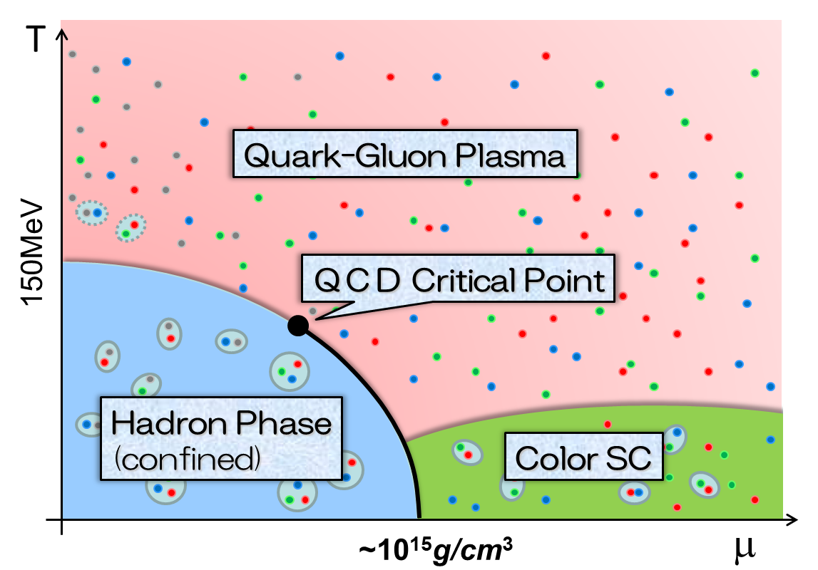
QCD Phase Diagram
Rich phase structure in QCD
QCD critical point(s)
color superconductivity
Quest by heavy-ion collisions
Difficulty in lattice simulations due to sign problem
Importance of
effective-model studies
NJL(-like) model, functional RG, …
Phase structure
Interpreting HIC/lattice results

Slide 3

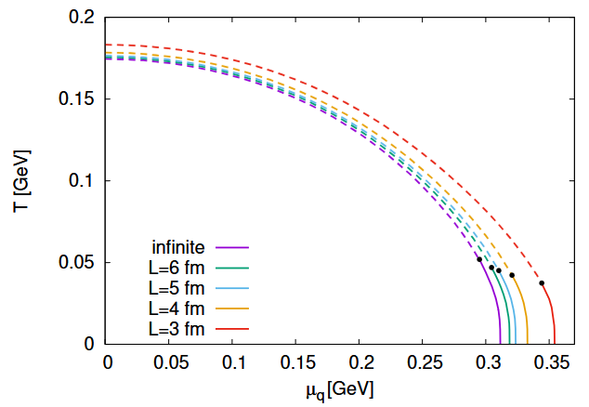
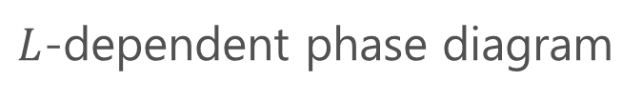
Finite-Size Effects
Why are they important?
Heavy-ion collisions create FS systems
Monte-Carlo simulations only for FS systems
FS effects in effective models
$L$-dependent phase diagram
Caution
No phase transitions in FS systems.
Inconsistency with the FS scaling near the critical point.
Lee-Yang zeros
Kovacs+, PRD (’23)

Slide 4

Lee-Yang Zeros and QCD Phase Diagram
Locating QCD-CP using Lattice data
Clarke+, 2405.10196; Adam+, 2507.13254; …
Procedure
Determine 1st LYZ numerically
Identify it as the LY edge singularity
Extrapolate to the CP
Imaginary $μ$ + Pade approx.
A similar analysis in an effective model should be useful for a better understanding of this procedure.
Clarke+, 2405.10196

Slide 5

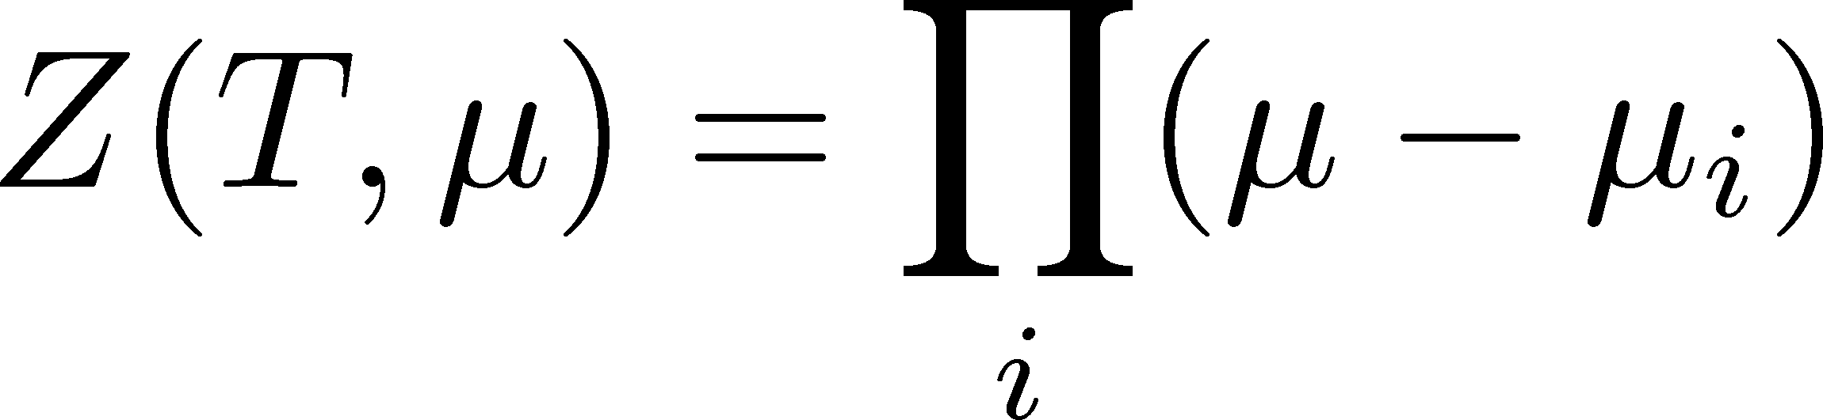




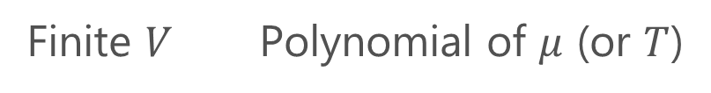
Lee-Yang Zeros
Yang, Lee; Lee, Yang (’52)
Partition Function
Finite $V$ Polynomial of $μ$ (or $T$)
zeros on the complex plane
=Lee-Yang Zeros

Slide 6


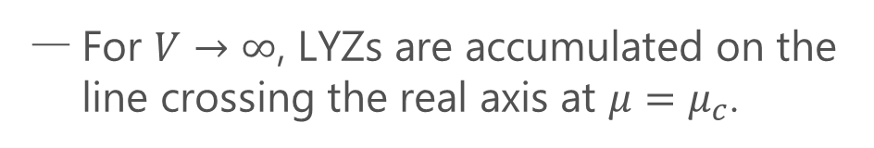

Lee-Yang Zeros
Yang, Lee; Lee, Yang (’52)
Partition Function
Phase Transition & LYZ
Finite $V$ Polynomial of $μ$ (or $T$)
First-order transition
at $μ=μ_{c}$
For $V→∞$, LYZs are accumulated on the line crossing the real axis at $μ=μ_{c}$.
zeros in the complex plane
=Lee-Yang Zeros

Slide 7
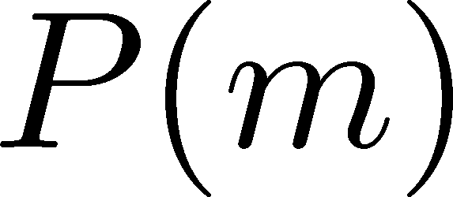



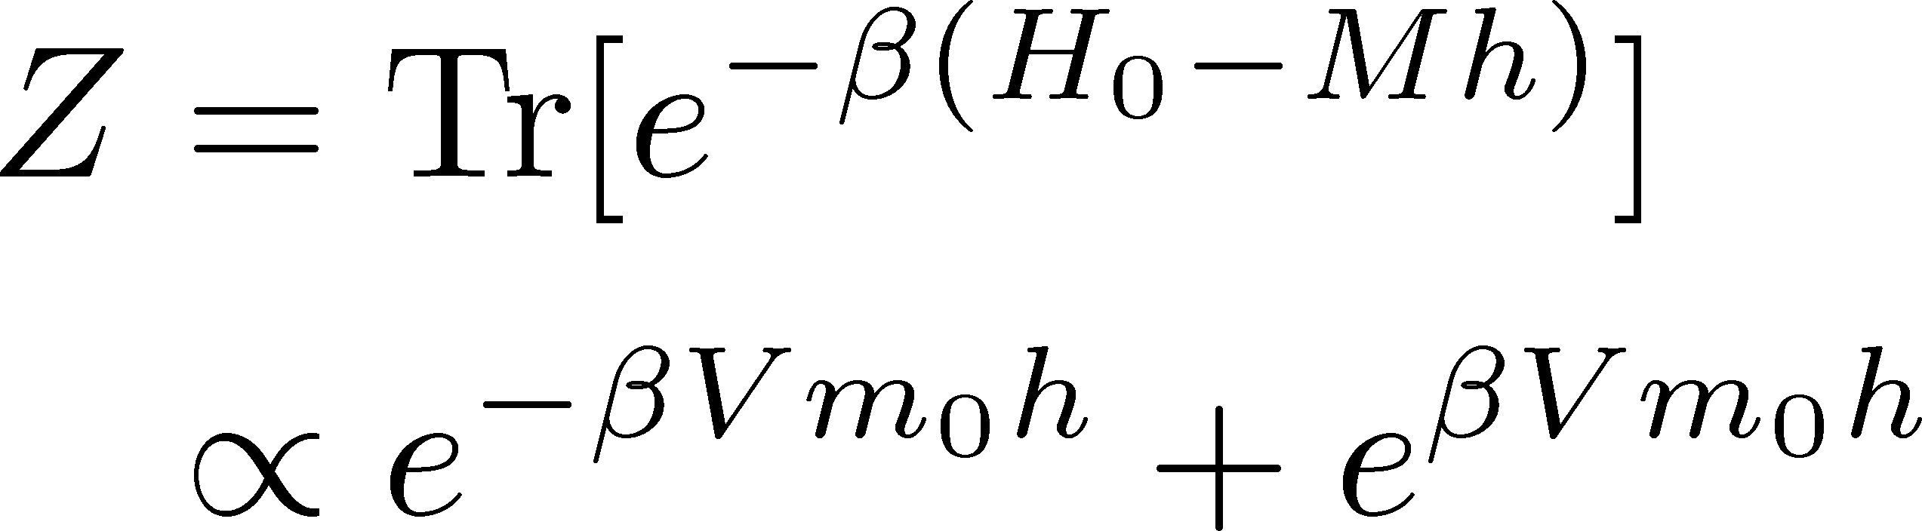

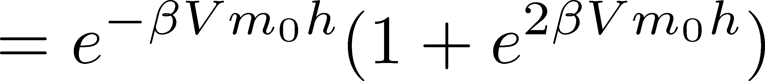

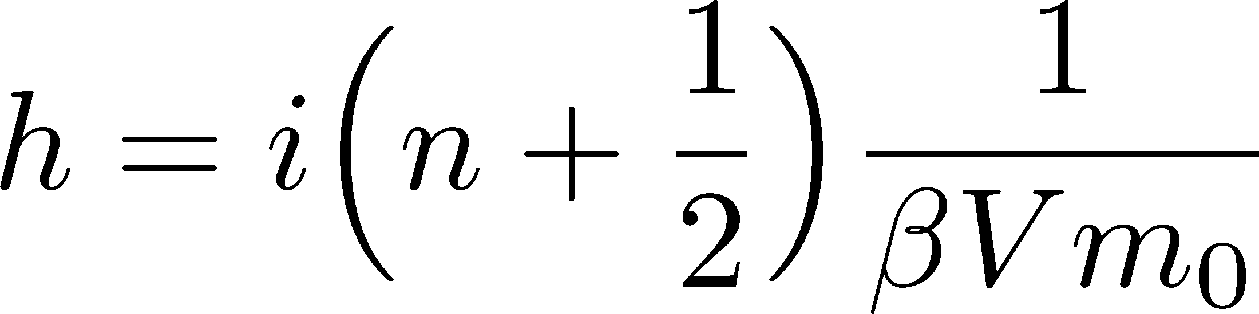
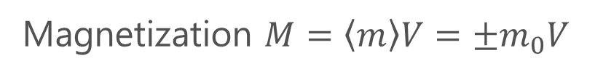
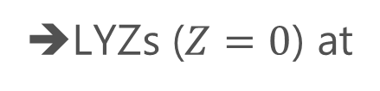

LYZ and 1st-Order Phase Transitions
1st PT ➔ coexistence of two phases
Magnetization $M=\left\langle m\right\rangle V=±m_{0}V$
Partition function
➔LYZs ($Z=0$) at
Note: LYZs become continuous for $V→∞$.

Slide 8

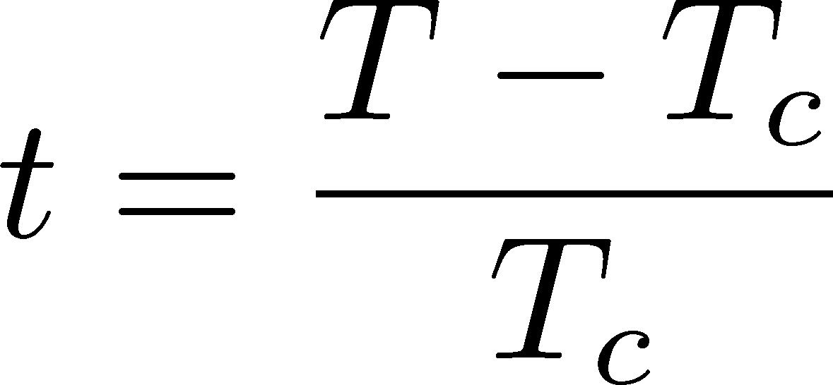
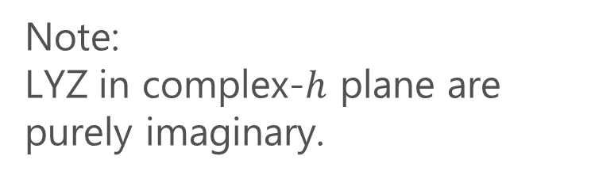

LYZ around a Critical Point in Ising Model
1st-transition
singularity on the real $h$ axis
Crossover
no singularity on the real axis
Note:
LYZ in complex-$h$ plane are purely imaginary.
Lee-Yang, 1952

Slide 9
LYZ around a Critical Point in Ising Model
1st-transition
singularity on the real $h$ axis
Crossover
no singularity on the real axis
Note:
LYZ in complex-$h$ plane are purely imaginary.
Lee-Yang, 1952

Slide 10


LYZ around a Critical Point in Ising Model
$$h_{I}\sim t^{βδ}$$
1st-transition
singularity on the real $h$ axis
Crossover
no singularity on the real axis
LY edge singularity
Starting from the CP
Its behavior is governed by the the scaling function.
$$h_{I}\sim t^{βδ}$$

Slide 11
LYZ around a Critical Point in Ising Model
$$h_{I}\sim t^{βδ}$$
1st-transition
singularity on the real $h$ axis
Crossover
no singularity on the real axis
LY edge singularity
Starting from the CP
Its behavior is governed by the the scaling function.
$$h_{I}\sim t^{βδ}$$

Slide 12

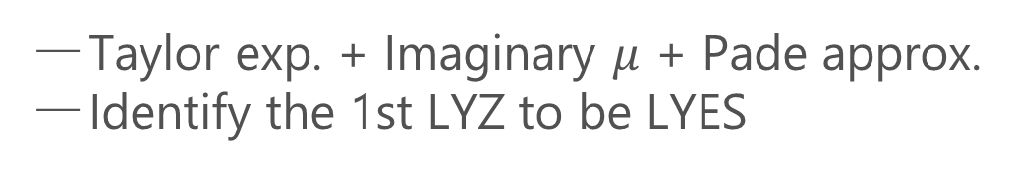
Recent Progress in LYZ/LYES and Lattice
Clarke+, 2405.10196
Analytic Structure
Scaling functions, FRG, …
An, Mesterhazy, Stephanov (’16)
Johnson, Rennecke, Skokov (’23)
Karsch, Schmidt, Singh (‘23)
…
Locating QCD-CP at $μ≠0$ on the lattice?
Clarke+, 2405.10196; Adam+, 2507.13254
Taylor exp. + Imaginary $μ$ + Pade approx.
Identify the 1st LYZ to be LYES

Slide 13

Caveat
$$h_{I}\sim t^{βδ}$$
On finite volume,
1st LYZ $≠$ LYES

Slide 14
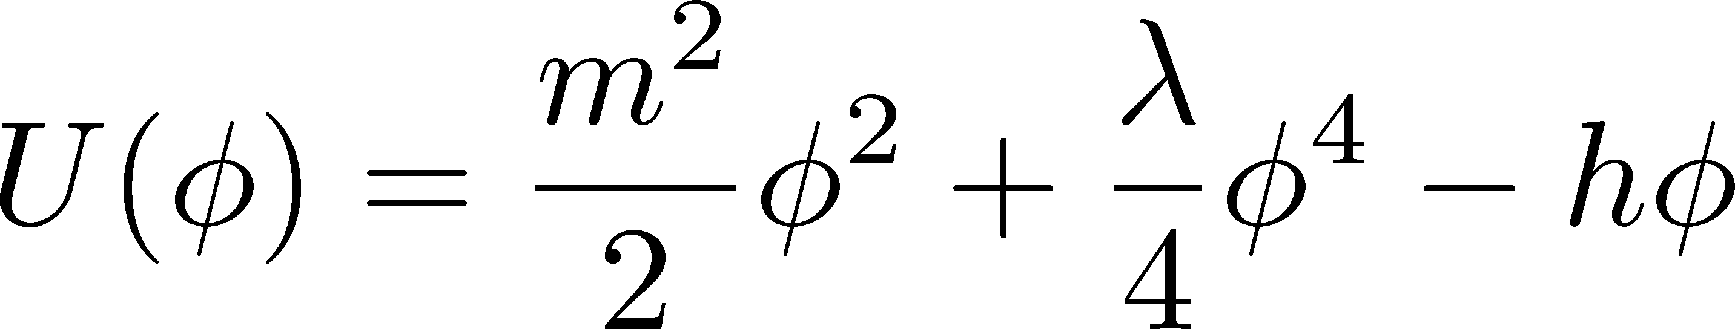
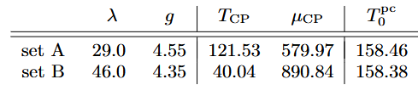
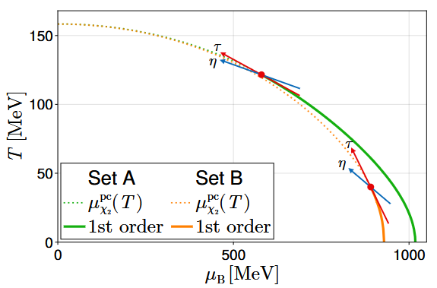
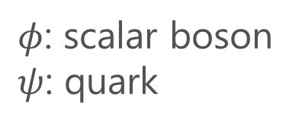

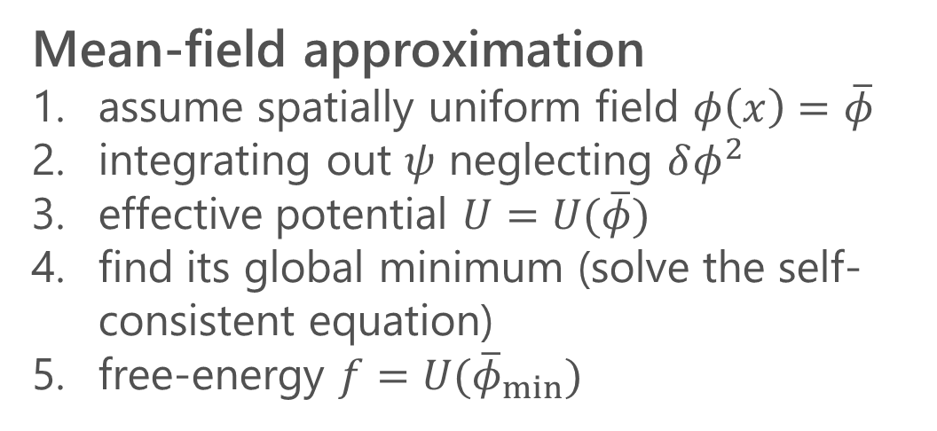
Linear Sigma Model ($N_{c}=3, N_{f}=1$)
$φ$: scalar boson
$ψ$: quark
Mean-field approximation
assume spatially uniform field $φ\left(x\right)=\overline{φ}$
integrating out $ψ$ neglecting $δφ^{2}$
effective potential $U=U(\overline{φ})$
find its global minimum (solve the self-consistent equation)
free-energy $f=U({\overline{φ}}_{min})$

Slide 15
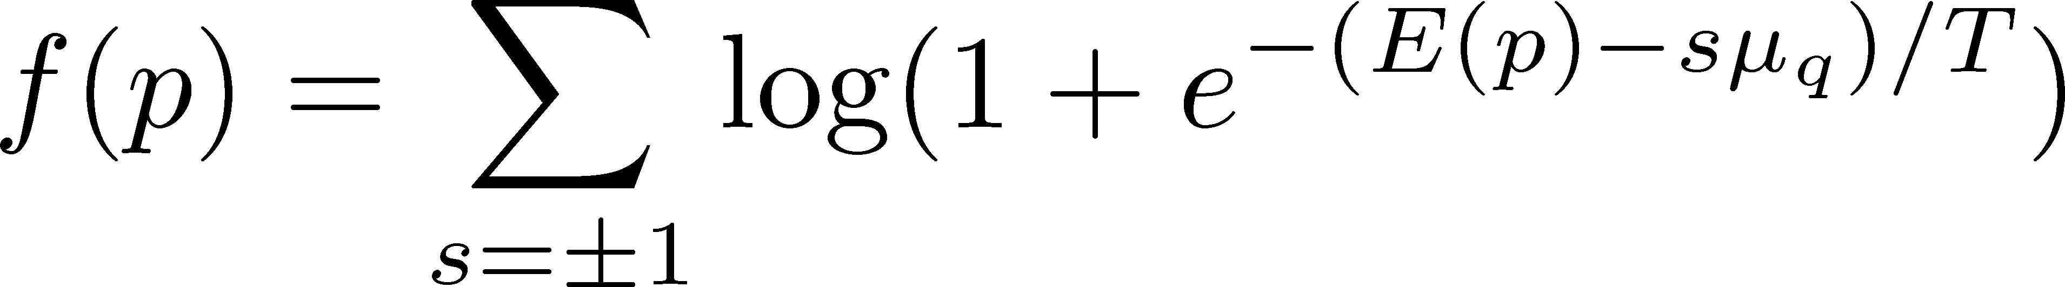
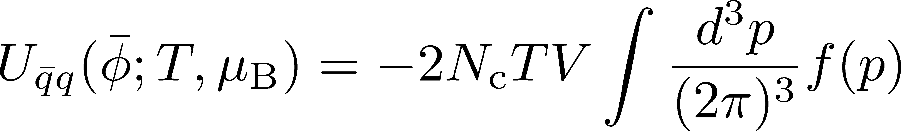
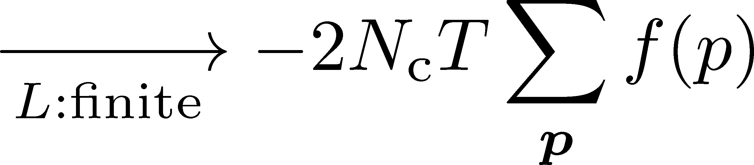
FS Effects in Mean-Field Approach
Old Ideas: Momentum Discretization
Taking the same procedure as before, we obtain thermodynamics in finite volume.
Problems
Sharp phase transition appears even in FS systems.
LYZs do not appear in this approach.
Kovacs+, PRD (’23)

Slide 16
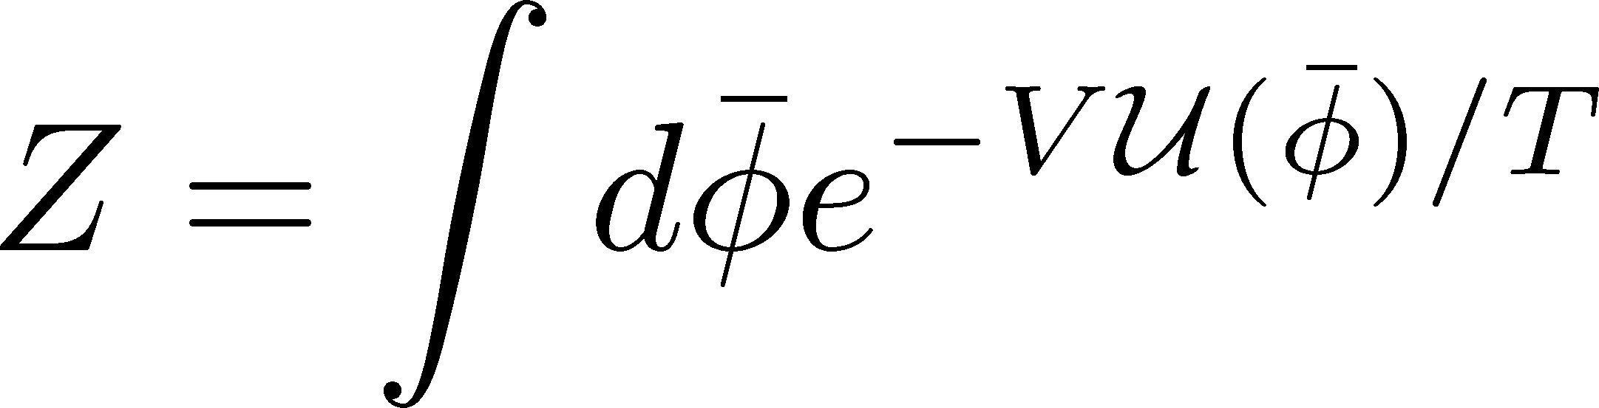
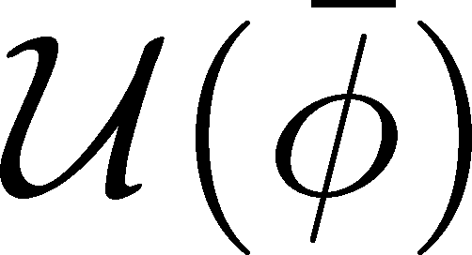
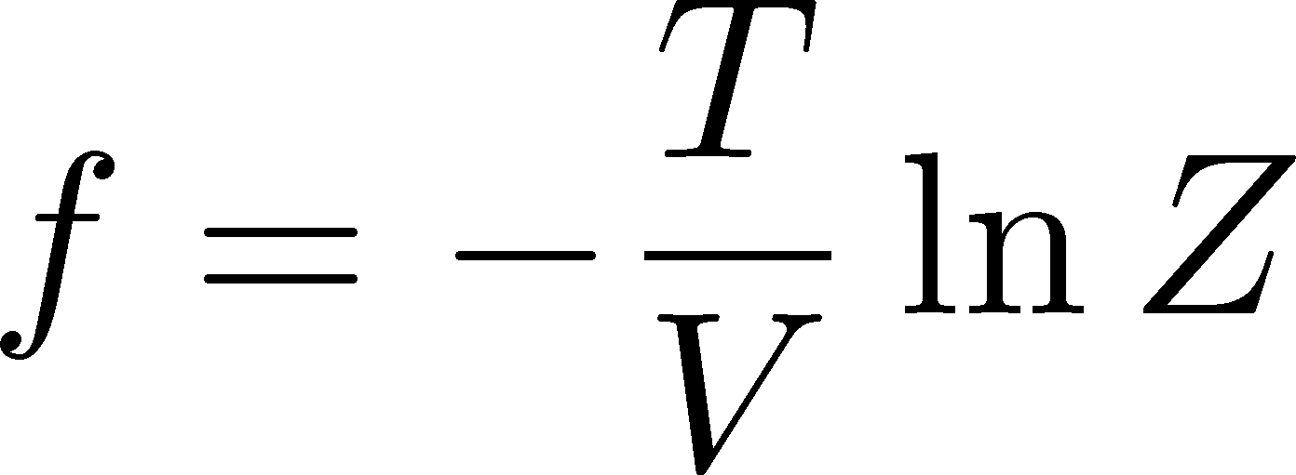

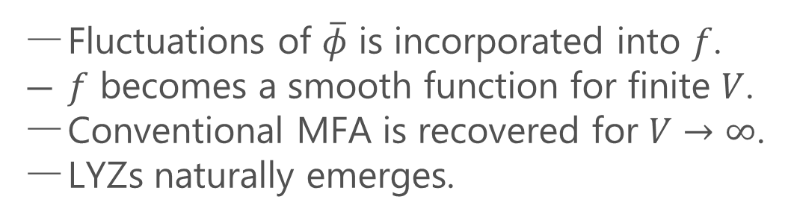

Finite-Size MF Approach
Kovacs+, 2510.24507
Incorporate fluctuations of $\overline{φ}$
Fluctuations of $\overline{φ}$ is incorporated into $f$.
$f$ becomes a smooth function for finite $V$.
Conventional MFA is recovered for $V→∞$.
LYZs naturally emerges.
Let’s apply this method to the study of LYZs in this model!
Wada, Kovacs, MK, Doi (’26)

Slide 17
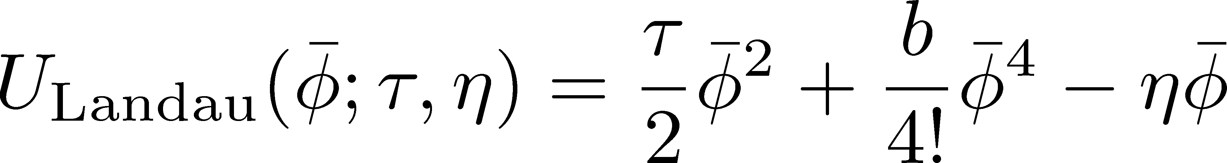
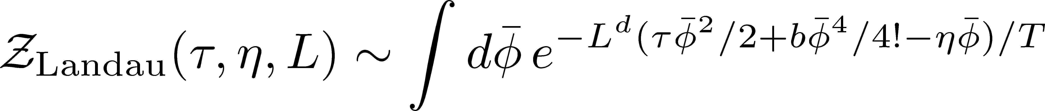
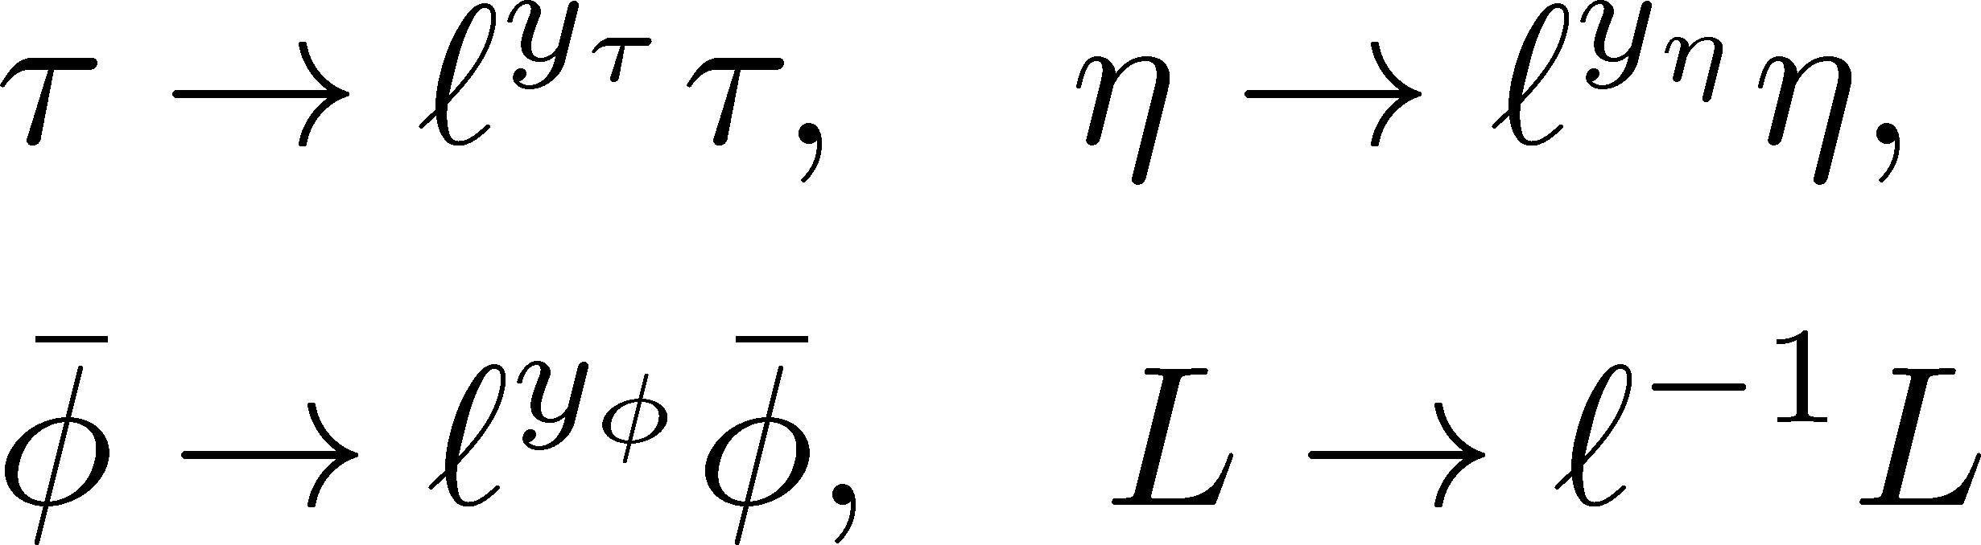
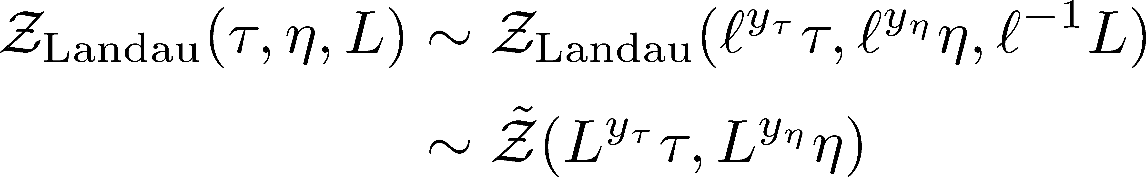
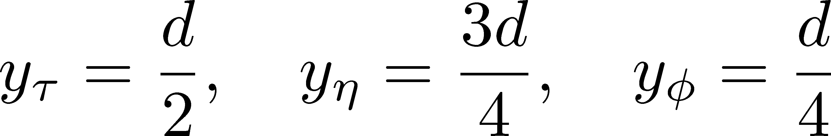
Finite-Size Scaling (FSS)
Landau potential
Scaling Transformation
:FSS
MF scaling exponents:
FSS in MF near a CP is obtained
in FS-MF approach.

Slide 18
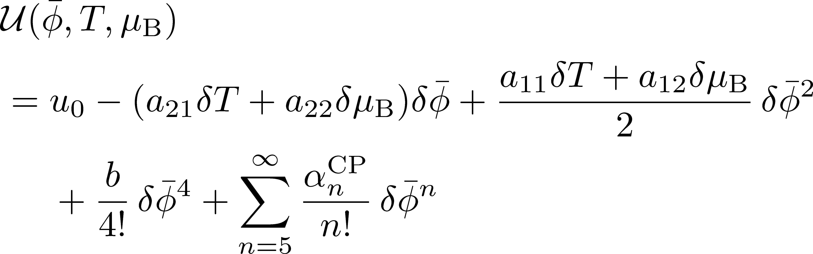
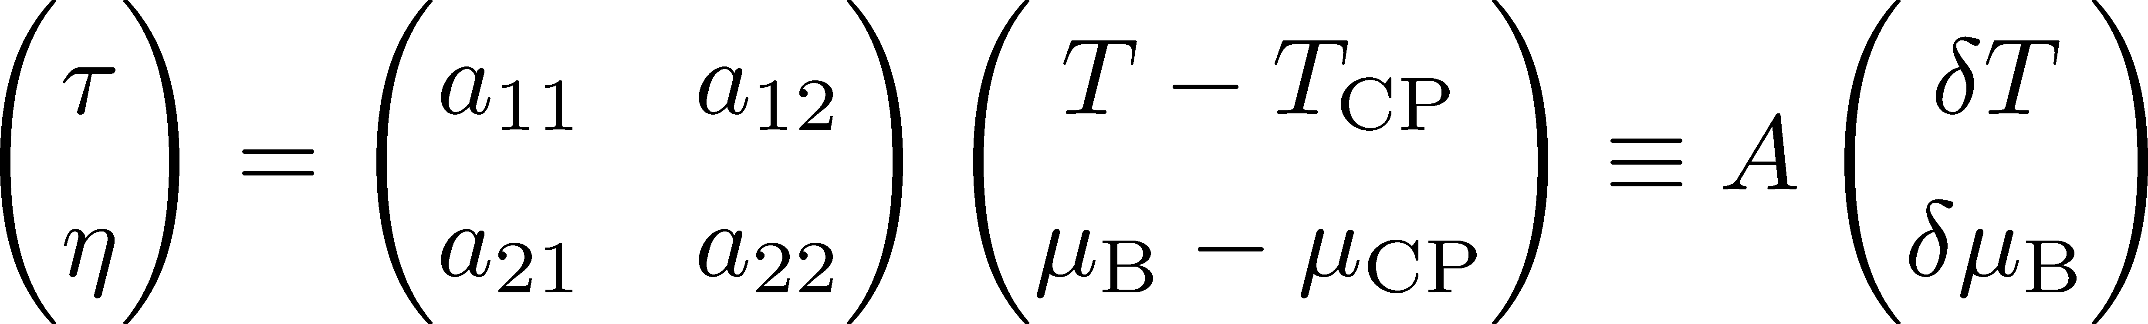
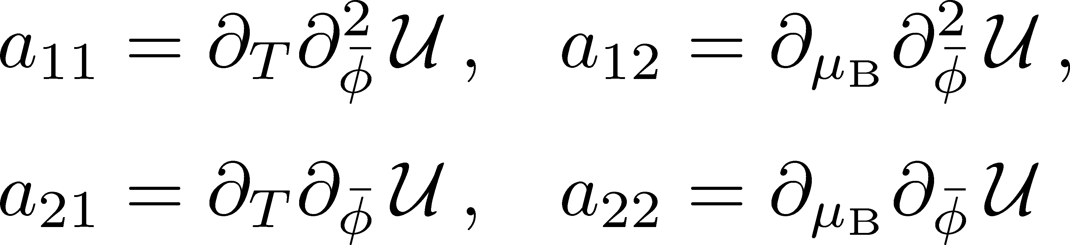

FSS in General Systems
Expansion of $U(φ)$ around the CP
Linear-mapping relation to Landau potential

Slide 19
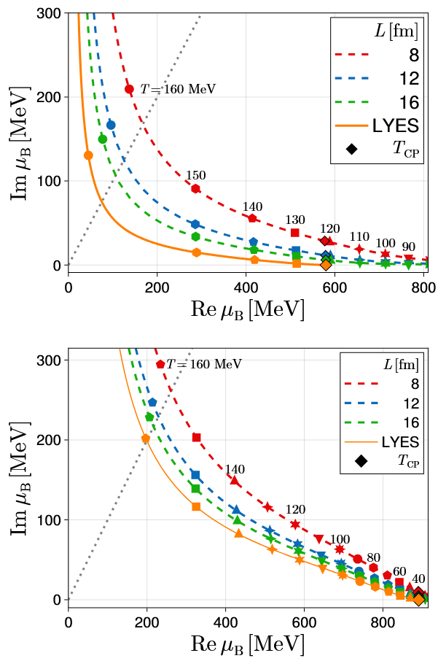

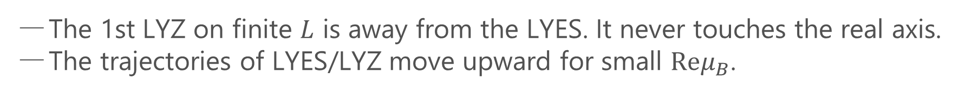
1st LYZ in the complex-$μ_{B}$ plane
Set A
Set B
The 1st LYZ on finite $L$ is away from the LYES. It never touches the real axis.
The trajectories of LYES/LYZ move upward for small $Reμ_{B}$.

Slide 20
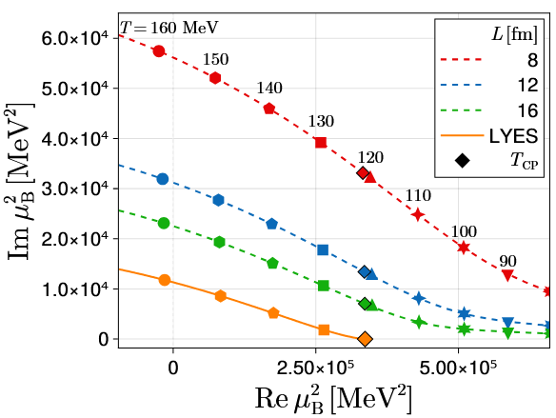
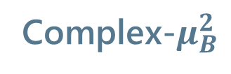

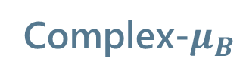
1st LYZ: complex-$μ_{B}$/$μ_{B}^{2}$ planes: Set A
Complex-$μ_{B}$
Complex-$μ_{B}^{2}$
Charge conjugation symmetry leads to $Z\left(μ\right)=Z(−μ)$ ➔ $Z$ is an even function.
Better scaling behavior in the complex $μ_{B}^{2}$ plane.

Slide 21
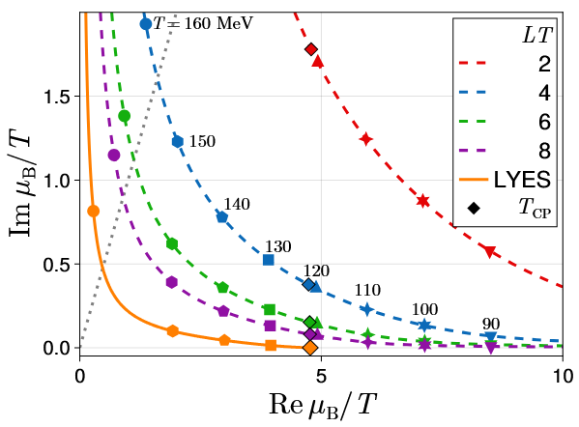
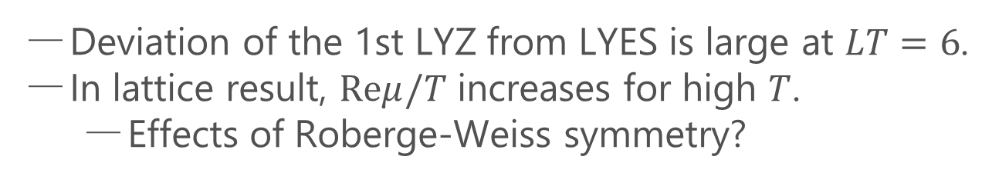
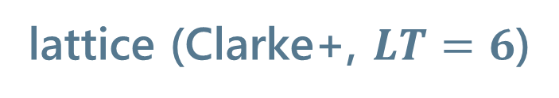
Comparison with Lattice Results
our result
lattice (Clarke+, $LT=6$)
Deviation of the 1st LYZ from LYES is large at $LT=6$.
In lattice result, $Reμ/T$ increases for high $T$.
  Effects of Roberge-Weiss symmetry?

Slide 22
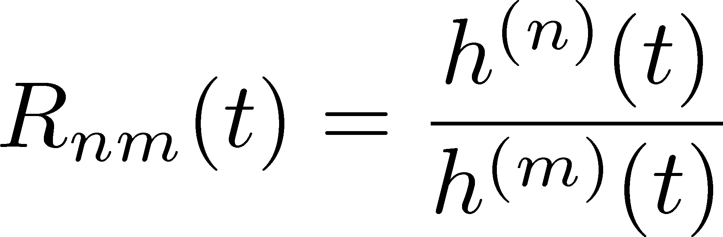
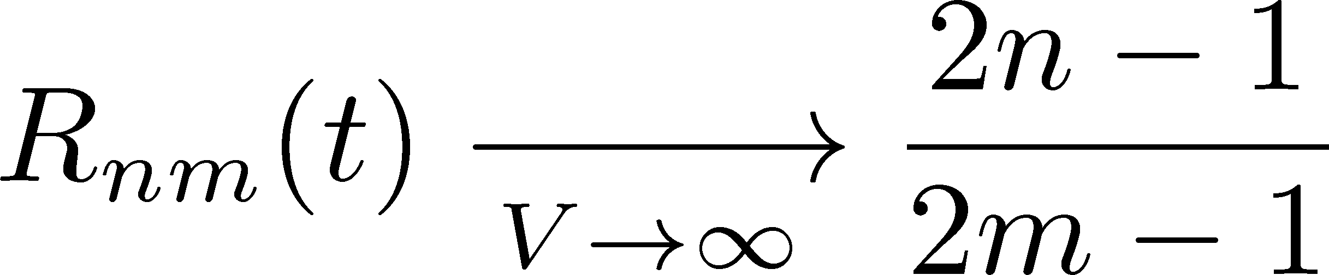
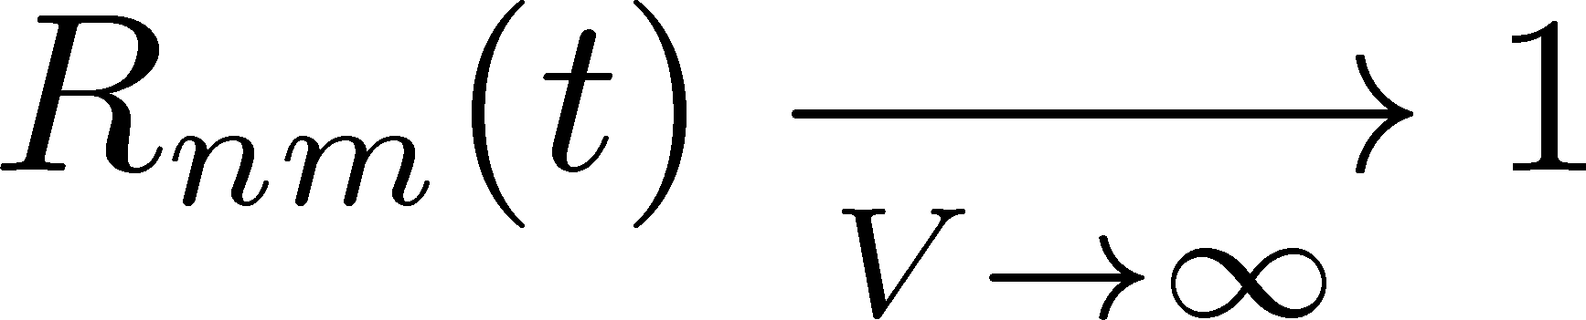
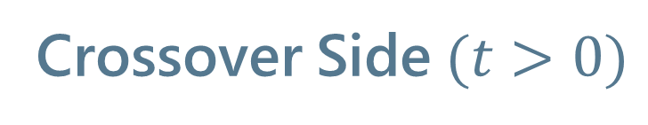
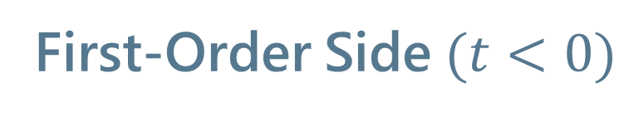
Lee-Yang Zero Ratios
Wada, MK, Kanaya, PRL (’25)
First-Order Side$(t<0)$
Crossover Side$(t>0)$

Slide 23


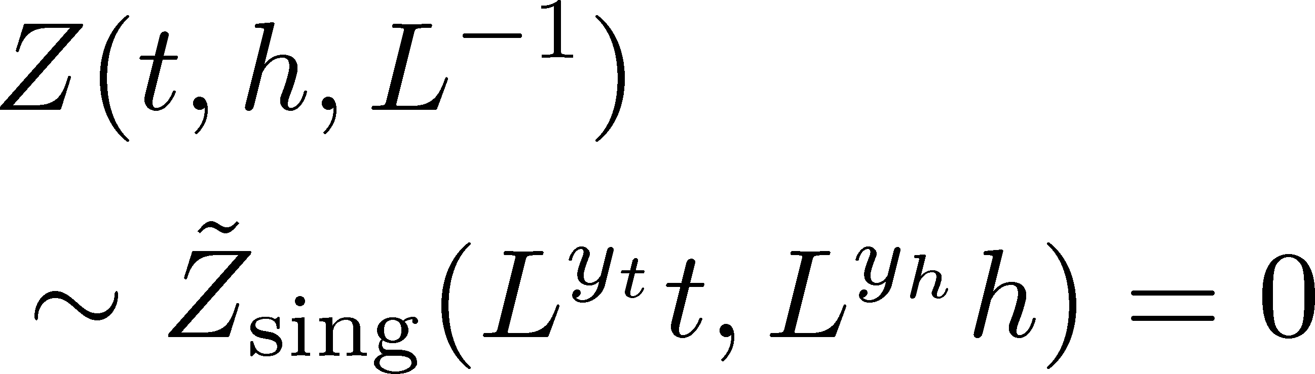
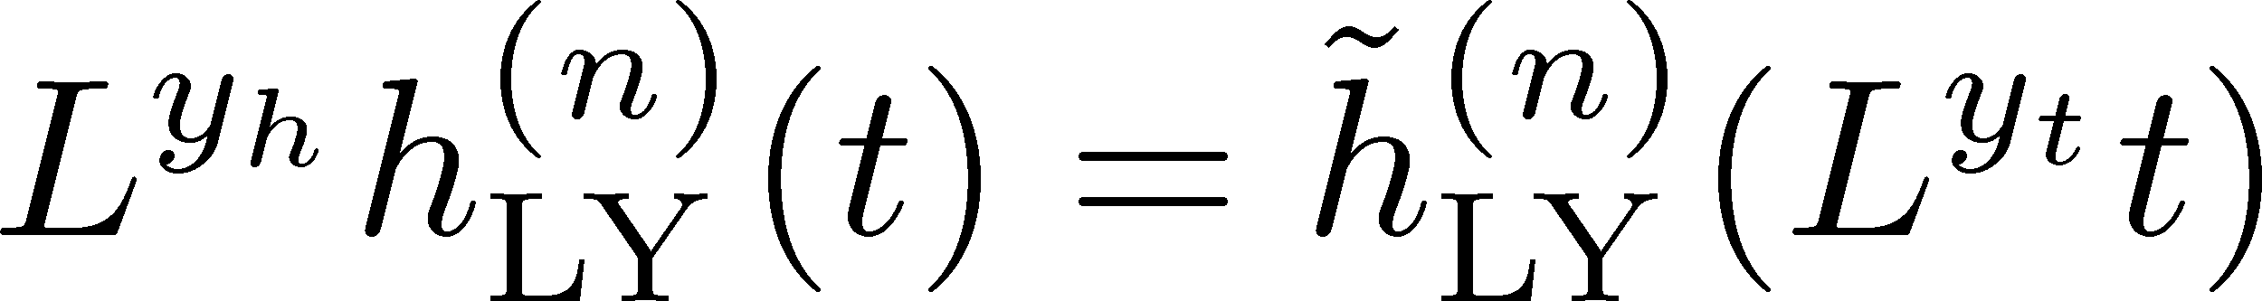
Finite-Size Scaling
Scaling Hypothesis
LYZ in the scaling region on finite volume
Itzykson, Nucl. Phys. 220 (1983)

Slide 24










LYZ near $t=0$
Wada, MK, Kanaya, PRL (’25)
Linear Approx. at $t=0$

Slide 25






LYZ Ratios
Wada, MK, Kanaya, PRL, ’25
(1st order)
(crossover)
crossing
near $t=0$
$R(0)$is $L$ independent, the universal value.
Intersection point of various $L$ gives the CP.
Reminiscent of Binder-cumulant analysis

Slide 26

LYZR vs Binder Cumulant in 3d-Ising
LYZR
Wada, MK, Kanaya, arXiv:2508.20422

Slide 27

LYZR vs Binder Cumulant in 3d-Ising
LYZR
Binder cumulant
Faster convergence of the violation of FSS in LYZ?
Wada, MK, Kanaya, arXiv:2508.20422

Slide 28




Convergence at $T=T_{c}$
Wada, MK, Kanaya, arXiv:2508. 20422
LYZR
Red: $T_{c}$ of Ferrenberg (’18)
Blue: $T_{c}$ of intersection point
In 3d-Ising,
violation of FSS is more quickly suppressed in the LYZR than the Binder cumulant for $L→∞$.
Binder cumulant

Slide 29







CP in a General System
Wada, MK, Kanaya, PRL (’25)
CP on a $τ−ξ$ plane
LYZ on the complex $ξ$ plane

Slide 30




CP in a General System
Wada, MK, Kanaya, PRL (’25)
CP on a $τ−ξ$ plane
LYZ on the complex $ξ$ plane
$$L→∞$$
LY Edge Singularity
generalization
to finite $V$
Stephanov, 2006

Slide 31



LYZ Ratios for General CP
Wada, MK, Kanaya, PRL (’25)
LYZ Ratio
nonzero for $a_{12}≠0$
$r_{nm}$ are universal constants specific to universality classes.

Slide 32




LYZ Ratios vs Binder Cumulant
Wada, MK, Kanaya, PRL (’25)
LYZ Ratio
nonzero for $a_{12}≠0$
Binder cumulant
Jin+, PRD86, 2017
nonzero for $a_{12}≠0$
$r_{nm}$ are universal constants specific to universality classes.
fig from
Cuteri+,
PRD (’21)
Deviation at $t=0$due to $a_{12}≠0$ converges faster in LYZ ratio.

Slide 33
LYZR in Various Models
CPs in 3d-Z(2) universality class
Ising: 2508.20422
Potts: PRL, ’25
HQ-CP: 2501.18904
LYZR at the intersection point
Heavy-Quark CP
Consistent within statistics
Confirmation of universality

Slide 34



Single-LYZ Method
Wada, MK, Kanaya, arXiv:2508. 20422
LYZ in 3d-Ising
$L^{y_{h}}h^{n}(t)$ for various $L$ intersect at the CP!
Assuming the universality class and the values of $y_{t}, y_{h}$,
the intersection analysis can be performed only with a single LYZ.

Slide 35



LYZR in Linear Sigma Model
$R_{21}(T,L)$: 2nd/1st
$R_{31}(T,L)$: 3rd/1st
Intersection point converges toward $T_{c}$ for $L→∞$.
Good accuracy for $L>10$ fm.

Slide 36
Single Scaled LYZ
Intersection point converges toward $T_{c}$ for $L→∞$.
Good accuracy for $L>10$ fm.

Slide 37
Where is the QCD Critical Point?
Single-LYZ analysis for 2+1 flavor QCD
Intersection around $T≃100$ MeV? Yet lower $T$ data are mandatory.

Slide 38

Summary
Using a new mean-field approach incorporating finite-size effects, we investigated the LYZs at nonzero $T,μ_{B}$ in the linear-sigma model.
The study of LYZs and its relation to LYES are investigated.
Large deviation at LT values employes in lattice simulations.
The LYZR method works well.
Outlook
Roverge-Weiss symmetry/transition
Better interpretation of lattice results

Slide 39
Outlook
Roverge-Weiss symmetry/transition
Better interpretation of lattice results

Slide 40





Convergence of LYZR
The origin of Higher order terms
Parameter mixing
Lowest order
LYZR : $2\overline{y}=2\left(y_{τ}−y_{η}\right)=−3/2$
Binder : $\overline{y}=2\left(y_{τ}−y_{η}\right)=−3/4$
Irrelevant operator
Fitting function
Exponent : $y_{5}=−3/4,{ y}_{6}=−3/2…$

