Slide 1
Formation Channels of
Compact Object Binaries
And Observational
Diagnostics
Rosalba Perna
(Stony Brook University)

Slide 2

10 BH-BH mergers and 1 NS-NS merger in
LIGO/Virgo runs O1+O2
33 Public Alerts in run O3 (just concluded)

Slide 3
Debated questions since the first event:
How are the binaries formed?
What are the distinctive features and
prediction of each formation channel?
Are the current data strongly favoring
any particular channel?

Slide 4
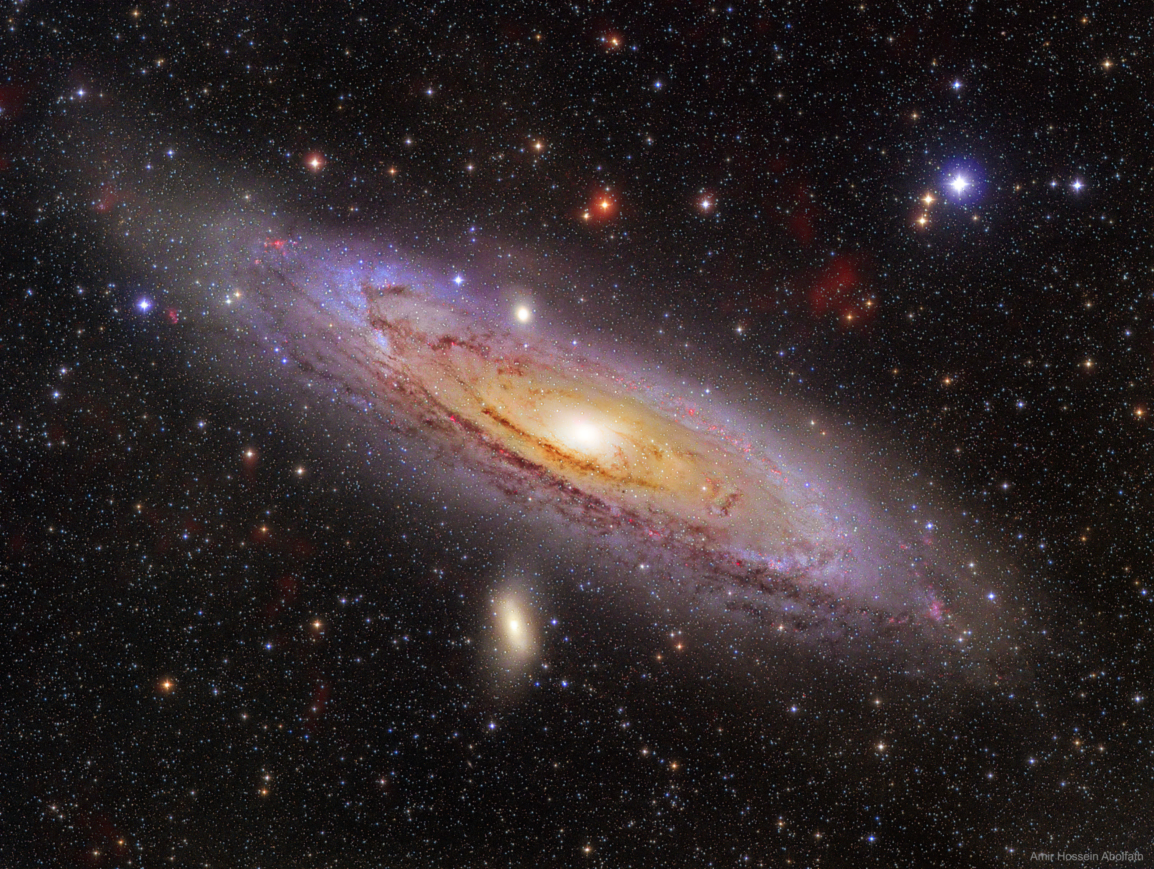
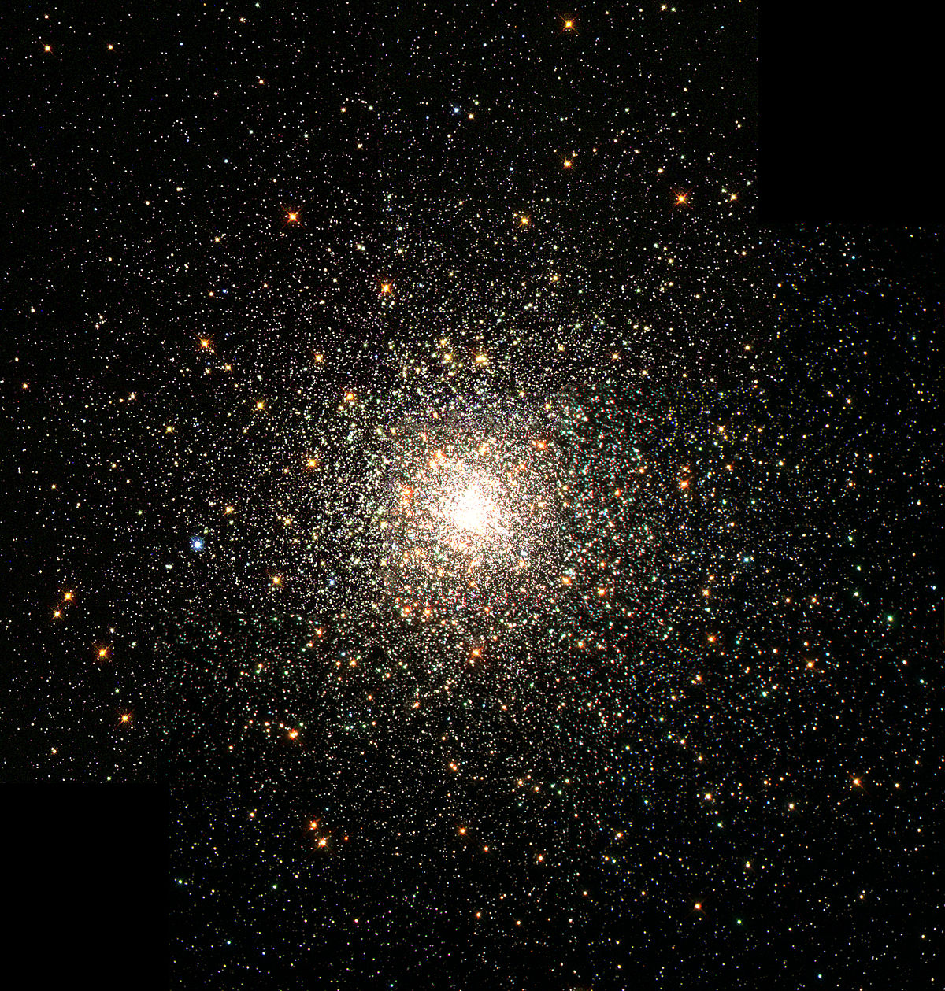
Stars are the starting point…. (in most models)
Isolated binaries Dynamical interactions
Spirals, ellipticals, dwarf
galaxies
- stellar/binary evolution
Globular, nuclear, star
clusters, AGN disks
Dynamics + stellar/binary
evolution
[Images credit: NASA]
Notes:
Two main channels. By isolated case I mean the one where the two CO where the end state of a binary star which evolved under no other influence than the other companion star.
By dynamical channel, I encompass everything which has an external influence of dynamical nature. That encompasses cases in which binaries are almost entirely formed by dynamical interactions, to cases in which binaries are formed via the death of two massive stars, but then dynamical interactions influence their fate prior to merger.
AGN disk: talk by Hiromichi Tagawa
Non-star models involve primordial BHs, which were formed as a result of fluctuations in the early Universe. They had no progenitor star.

Slide 5
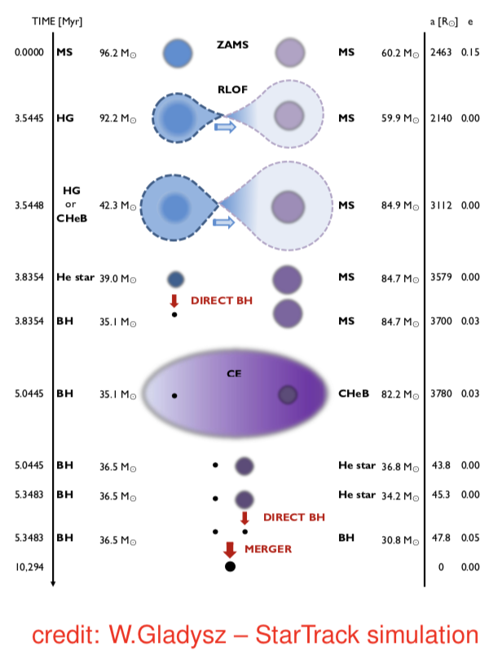
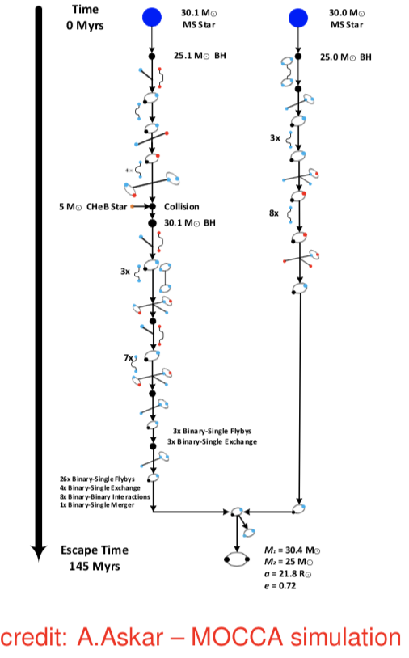
TWO MAIN FORMATION CHANNELS (broadly speaking):
Dynamical (globular clusters,
star clusters, AGN, AGN disks)
Isolated binary evolution
Notes:
Here diagrams showing examples of binary BH formation in each of these channels.
Note: in order to form a double BH binary which mergers within the Hubble time, CE evolution has to happen, since it removes angular momentum and hence shrinks the binary.

Slide 6
Population synthesis codes in a nutshell
Monte-Carlo based codes coupling single stellar evolution (including
the prescription for the outcomes of SN explosions) with a treatment
of binary-evolution processes.
3 approaches:
Adopting polynomial fitting formulas to describe the evolution of the fundamental stellar parameters (luminosity, radius, mass, temperature and chemical composition) as a function of time. Computationally very fast, but fitting formulas hard to update (i.e. SEBA [Portegies Zwart et al.1996], BSE [Hurley et al., 2002], BRUSSELS CODE [De Donder et al., 2004], STARTRACK (Belczynski et al. 2008), COMPAS (Barrett et al., 2017;], MOBSE [Mapelli et al. 2017])
Integration of stellar evolution on the fly: more computationally expensive than the fitting formulas, but provide a more detailed stellar evolution impossible to achieve with the fitting formulas (i.e. BPASS [Eldrige et al. 2016], MESA [Paxton et al. 2011,2013])
Use look-up tables: Contain grids of stellar evolution models that are read and interpolated by BPS codes on the fly. Computationally convenient and versatile. Stellar models can be updated by changing the tables (i.e. SEVN [Spera et al. al 2019]; COMBINE [Kruckow et al. 2018])

Slide 7
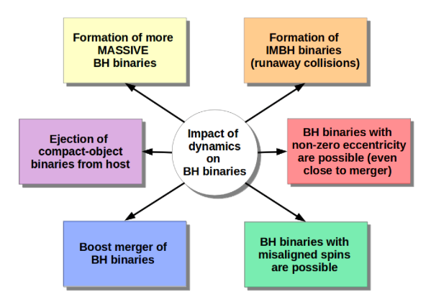
Dynamics: studied via N-body codes - Dynamical
effects can influence binary population, in addition
to forming new binaries
[Mapelli 2018]

Slide 8
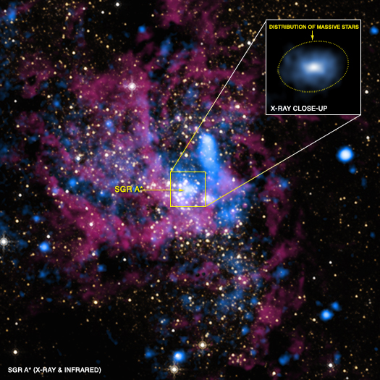
Dynamical interactions can induce mergers of binaries (formed via any channel): the case of binaries in galactic nuclei interacting with the SMBH
Sag A★
(the known closest SMBH
at the center of our Galaxy)
SMBHs are ubiquitous in galactic centers

Slide 9
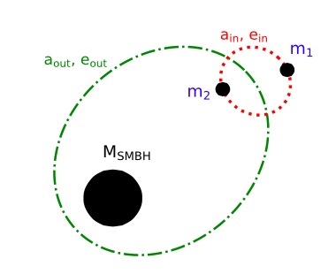
Interactions of compact object (CO) binaries with the
SMBHs in galactic nuclei [Fragione, Grishin, Leigh, Perets, Perna 2019]
An interesting area of investigation since:
Observations show that
the number of XRBs per
stellar mass in the GC is 3
orders of magnitude larger
than in the field [i.e. Strader
et al. 2012; Generov et al. 2018]
(b) SMBHs can induce Lidov-
Kozai oscillations on CO
binaries orbiting in their
vicinity, thus enhancing
their merger probability

Slide 10
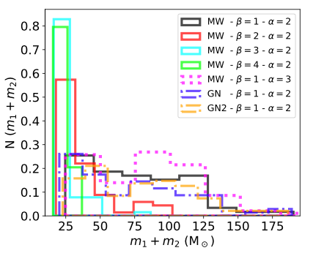
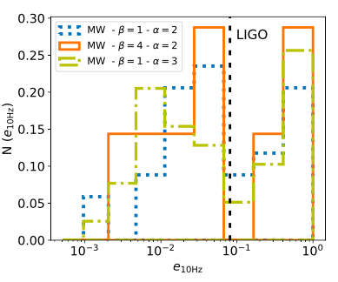

BH-BH mass distribution,
and eccentricity distribution
at the time of entering the
LIGO band for a variety of
models
[Fragione, Grishin, Leigh, Perets, Perna 2019]
Notes:
Alpha: slope of the outer semi-major axis distribution
We draw the initial mutual inclination i0 between the inner and outer orbit from an isotropic distribution (i.e. uniform in cos i). The other relevant angles, such as the arguments of pericentre, nodes and mean anomalies, are drawn randomly.
Bottom figure: Distribution of eccentricities at the moment the binaries enter the LIGO frequency band (10 Hz) for BH-BH mergers in a Milky Way-like nucleus, for di↵erent values of and ↵. The vertical line shows the minimum e10Hz = 0.081 where LIGO/VIRGO/KAGRA network may distinguish eccentric sources from circular sources. A significant fraction of binaries have a significant eccentricity in the LIGO band.

Slide 11


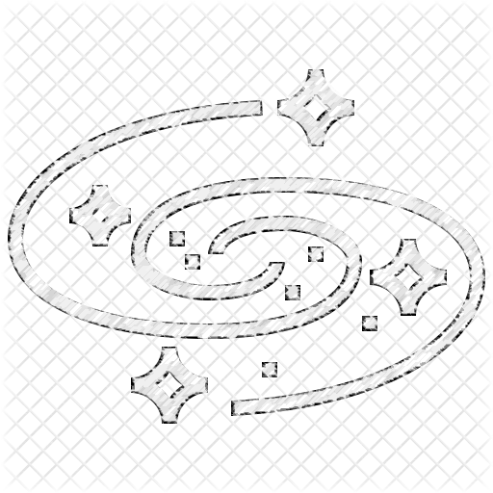


One step further: SMBH binaries in Galactic centers?
Theory
Observations
Almost every massive galaxy hosts at least one SMBH
Low z
Multiple SMBHs
SMBH binaries
Merger+ accretion
High z
[Slide credit: T. Ryu]
Notes:
.

Slide 12
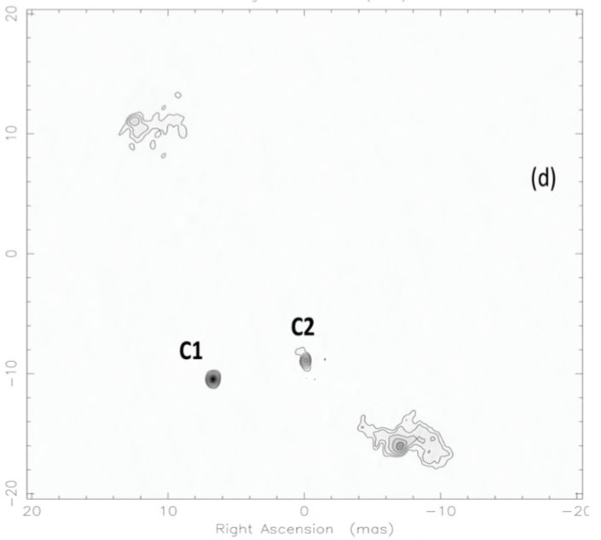
Observational evidence for multiple SMBH systems
SMBH binaries
(Rodriguez et al. 2006, Bansal et al. 2017)
5 GHz Very Long Baseline Interferometry (VLBI)
- The radio galaxy 0402+379
- z ~ 0.055
- M ~ 10⁸ -10¹⁰ M⦿
- Projected separation ~ 7 pc
[Rodriguez et al. 2006]

Slide 13
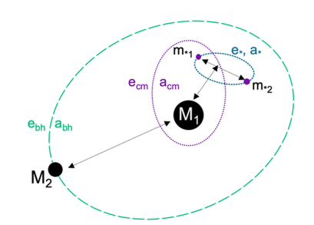
Dynamically-induced mergers from interactions
with SMBH binaries in galactic centers
[Wang, Leigh, Sesana, Perna 2019]
Dynamics more complex:
for stability analysis, the 4-body system can be studied as being composed of two triples: an inner one (M₁, m₁, m₂) and an outer one
(M₂, M₁, (m₁, m₂) )
Stability of each triple system studied in terms of the
stability parameter ‘S ‘ [i.e. Kiseleva et al. 1996]
Notes:
SMBH binary separation: ~0.8 (M1/M6)^1/2 pc.

Slide 14
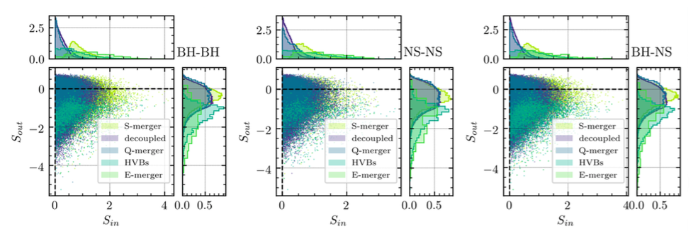
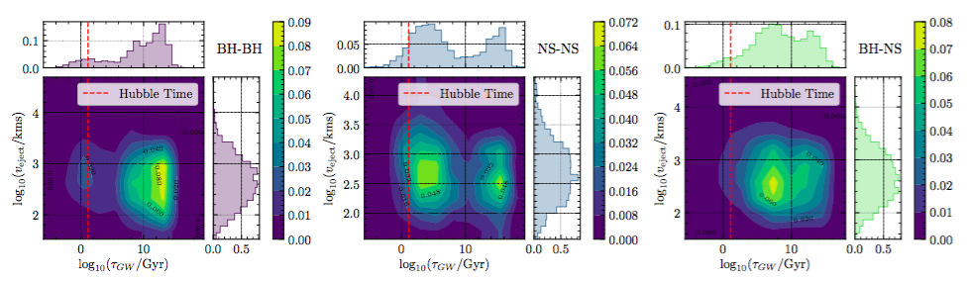
A variety of outcomes from the scatterings
inclusive of the production of high velocity binaries...
[Wang, Leigh, Sesana, Perna 2019]
Notes:
E-merger: the outer triple is unstable, indicating that the influence of M2 severely perturbs the orbit of the centre of mass of the CO binary. In fact, in this case the CO binary can be significantly ejected by close encounters with M2, causing its ejection from the SMBHB sphere of influence with high velocity. E-mergers are a subset of HVBs with t_GW<t_Hubble.
Quick mergers (i.e. collisions): In the inner triple system, LK cycles can directly create collisions between the components of the compact object binary if the eccentricity becomes sufficiently high.
Slow mergers: Some CO binaries neither experience ejections by M2 nor are subject to strong LK cycles. This occurs for a subset of systems located within the stable region in our stability map where Sin > 0 and Sout > 0. These would merger by CE in the standard isolated binary scenario (and would circularize at merger).
Decoupled: indicates binary disruption from interaction with the secondary massive BH

Slide 15
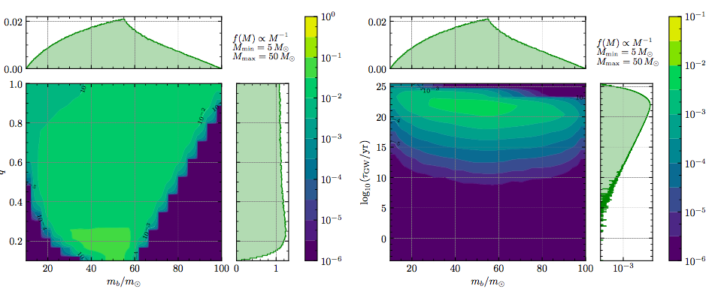
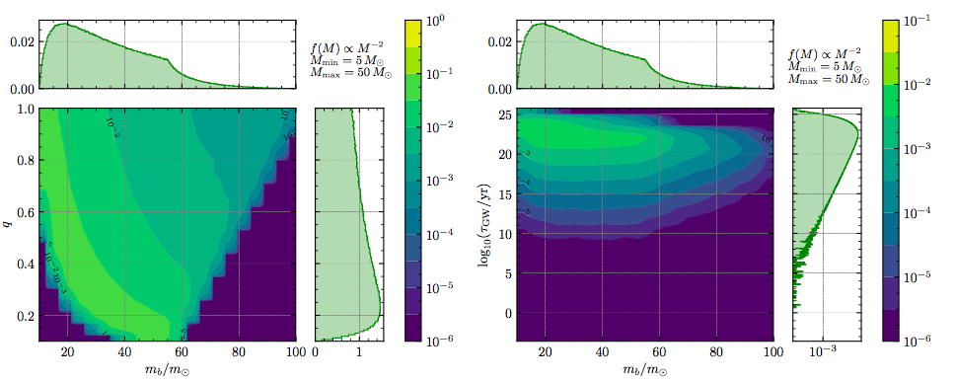
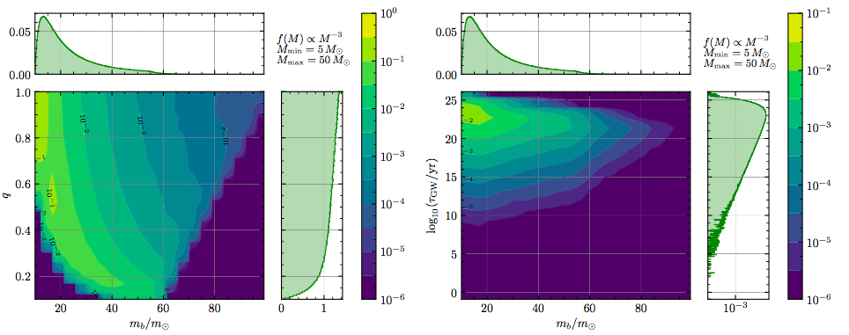
A dynamical formation scenario: BH-BH binaries
in star clusters
Distributions of M,q,t_{merg}
for BH-BH binaries
formed via dynamical
interactions in a young
star cluster, as a function
of the mass function
of the isolated BH
population
[Perna, Wang, Farr, Leigh
& Cantiello 2019]
Notes:
Here we studied the dynamical interactions of a cluster of BH remnants of a dense star cluster, like in a OB association. More specifically, we explored the binary mass function that results from a variety of initial mass functions of the isolated BHs.
The relative fraction of those binaries which merge within the Hubble time is 0.092%, 0.069%, and 0.048% for α = 1, 2, 3, respectively.
Volume: 0.1pc

Slide 16
Distinctive Features and Predictions
of each Formation Channel
Mass Spectrum
Spin distribution
Eccentricity distribution
Merger Locations
Redshift distribution and total event rate

Slide 17
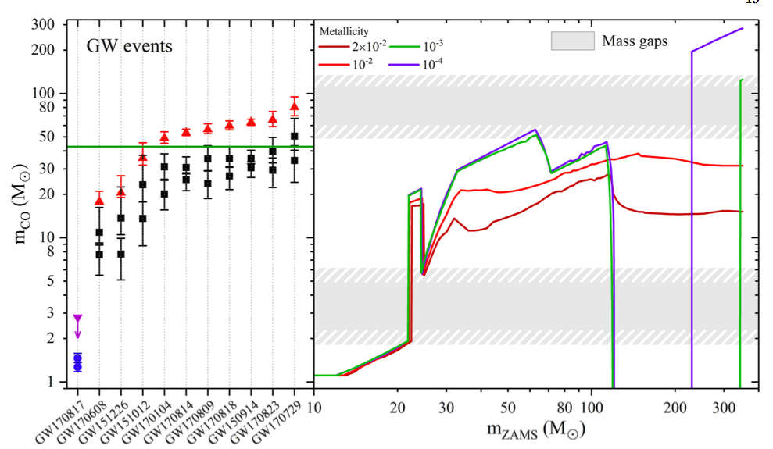
CO masses from runs O1 + O2
[Abbott et al 2019]
Notes:
A pair-instability supernova occurs when pair production, the production of free electrons and positrons in the collision between atomic nuclei and energetic gamma rays, temporarily reduces the internal pressure supporting a supermassive star's core against gravitational collapse.^{[1]} This pressure drop leads to a partial collapse, which in turn causes greatly accelerated burning in a runaway thermonuclear explosion, resulting in the star being blown completely apart without leaving a stellar remnant behind.[

Slide 18
Taken at face value: distributions of GW-detected BHS
and BHs in X-ray binaries appear distinct
Typically larger
BHs when detected
via GWs than when
detected via their
presence in X-ray
binaries

Slide 19
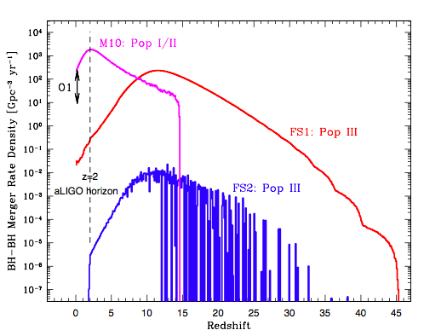
Could there be a contribution at the high-mass end
from mergers of BHs from Pop III stars?
[i.e. Bond & Carr 1984, Kulczyncki et al. 2006, Kinugawa et al. 2014,
Hartwig et al 2016, Belczynski et al. 2017]
FS1: binary formation
in moderately large gas
clouds (~2000AU [Stacy &
Bromm2013]
FS1: binary formation in
small gas clouds (~10-20AU
[Greif et al 2012])
Binary evolution with
StarTrack code
Not a significant
contribution, but
very model-dependent
[Belczynski, Ryu, Perna, et al. 2017]

Slide 20
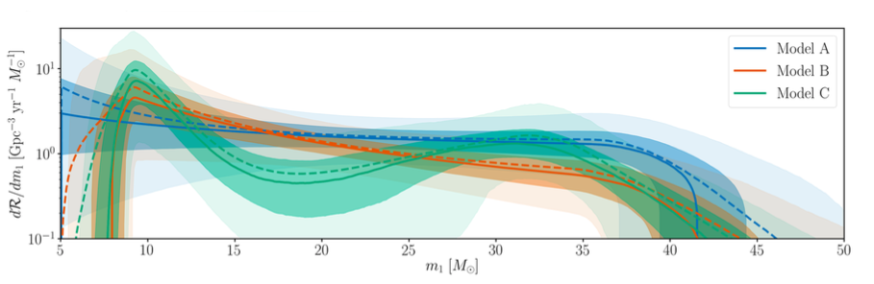
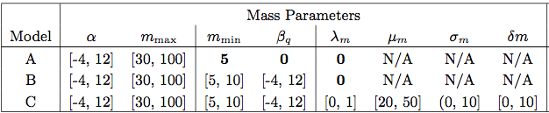




Examining the mass distribution from O1+O2 runs:
emphirical parametrization by LIGO/Virgo
[Abbott et al. 2019]
C:
$$α$$
A:
$α=0.4(+1.3/−1.9$)
B: $α=1.6(+1.5/−1.7)$
$$=7.3(+4.2/−4.6)$$
Notes:
In model C a second population with a gaussian mass distribution is added to the mix, with fraction lambda_m (best =0.4). In B, m_min=7.9. M_max around 42

Slide 21
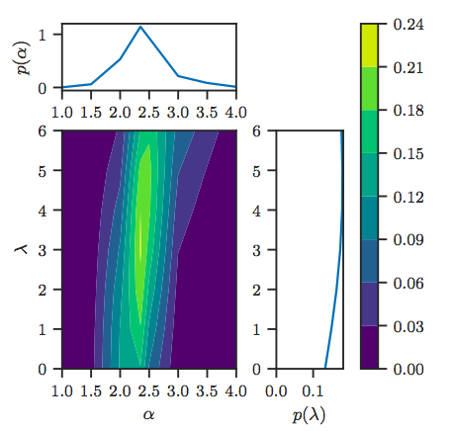
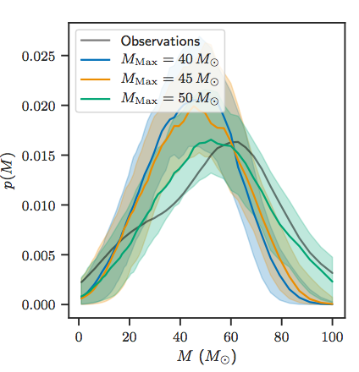

Mass spectrum of binaries formed in star clusters
against O1+O2 BBH data
[Perna, Wang, Farr, Leigh, Cantiello 2018]
Observations favor an IMF slope
and (weakly) a merger rate
which increases rapidly with
redshift:
Model with and within
from observations
Notes:
What is interesting and will be even more so with larger data sets, is to be able to reproduce the observed data with a model. We did this with our BBH population dynamically produced by interaction of BHs in a star cluster. Our model has very little parametrization (slope and Mmax). Interesting the best match with a Salpeter IMF…
Left: Two dimensional posterior on α (slope of the black hole mass function) and λ (slope of the merger rate versus redshift) inferred from the 10 LIGO/Virgo BBH detections
and the one-dimensional marginal posteriors for α and λ. We impose a flat prior density in α and λ.
Fractions that become binaries: varying between ~ 0.05% and 0.1% depending on alpha.

Slide 22
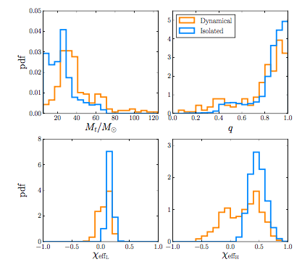

Coupling Pop synthesis calculations (MOBSE) with N-body
integrations to study binary mass distributions for
isolated evolution and dynamical formation
[Boufannais, Mapelli et al.
2019]
When considering masses
and spin together, data
are found to prefer the
dynamical channel to the
level
3.4$σ$
Mixing fraction of the two
channels will require a few
hundreds of detections to
be constrained to a fraction
error of 10-20%

Slide 23
Electromagnetic counterparts
in connection to binary formation
channels
But firstly: when do we expect to see
electromagnetic counterparts, and what
do these counterparts look like?
Notes:
The topic to discuss next is whether detection of electromagnetic counterparts contains any information on various formation channels, meaning whether its expectations can be different depending on the formation channel. But in order to address properly this questions, let’s first discuss…

Slide 24
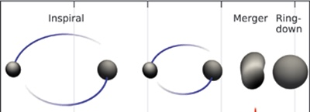
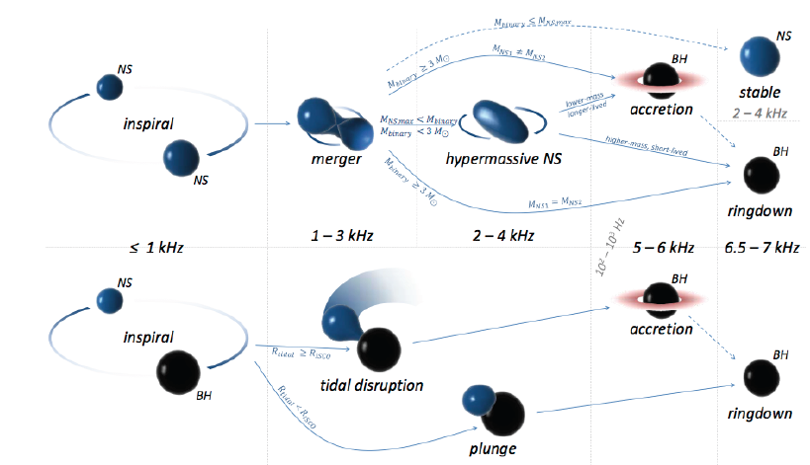
[Abbott et al. 2016]
BH-BH
Two types
of compact
objects,
several
possible
outcomes
NS-NS
NS-BH
[Bartos et al. 2013]
Notes:
NS-BH: tidal disruption for mass ratios <~3-5, with precise values depending on the EOS.
Tidal radius (where tidal force on a body of mass m and radius R, f= 2GMmR/r_t=self gravity = gm^2/R^2).
r_t = (2M/m)^1/3 R. As the mass of the BH grows, the Sch radius grows faster than the tidal radius.
Tidal disruption with the formation of an accretion disk can occur if the tidal radius is larger than the radius of the innermost stable orbit.

Slide 25
EM counterparts to these mergers:
theoretical expectations
BH-BH merger
None
[though ideas exist..]
[remnant compact object = BH]
NS-BH merger
Short Gamma-Ray Burst,
Afterglow, Kilonova for
mass ratios q <~ 3-5
None for higher q
[remnant compact object = BH]
NS-NS merger
Short Gamma-Gay Burst,
Afterglow, Kilonova
[remnant compact object = BH or NS]

Slide 26
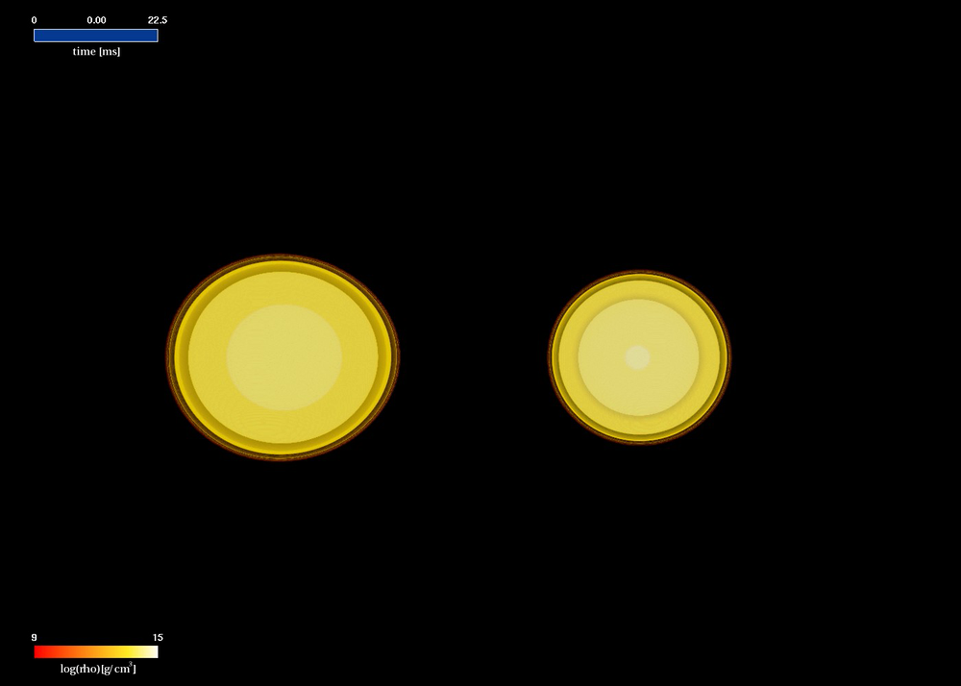
[Rezzolla et al. 2010; Visualization by Giacomazzo]

Slide 27
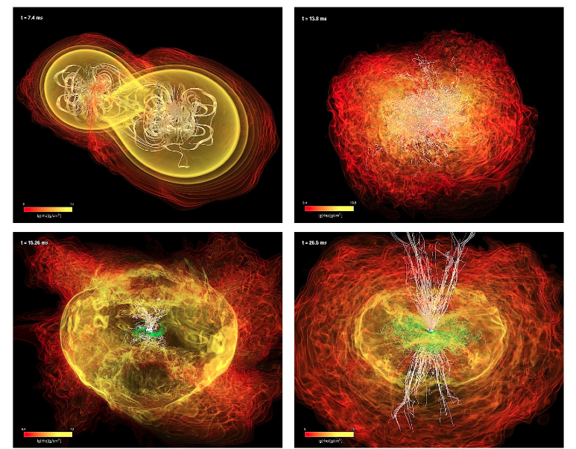
Evidence for possible formation of a jet [Rezzolla et al. 2011]

Slide 28
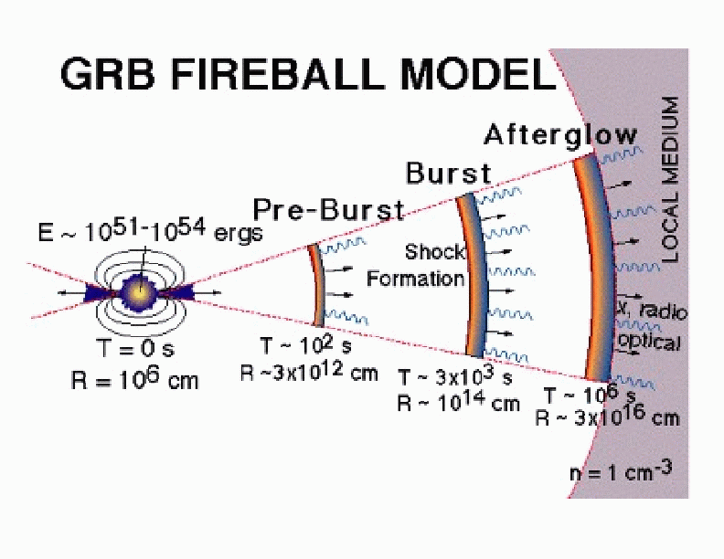
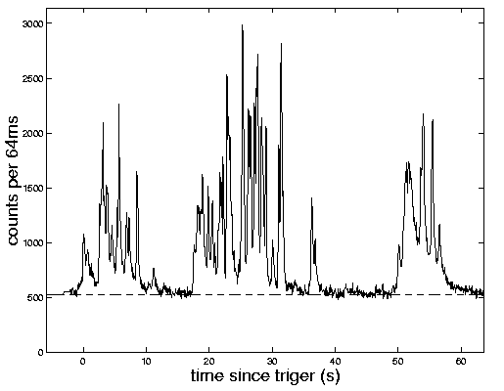
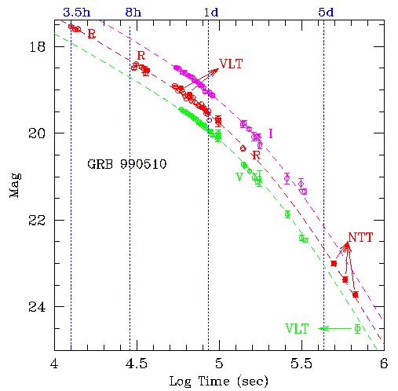
Jet propagation → Shock Formation
Afterglow: density-dependent →
location-dependent

Slide 29
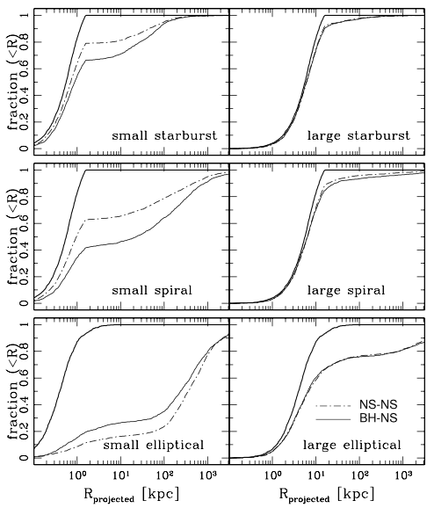
For field binaries,
predictions for
locations made
via Population
Synthesis
calculations
Non-neglibile fraction
to merge outside host
Galaxy (with dependence
on galaxy type and size)
→ dim afterglows
[Belczynski, Perna et al.
2006, using StarTrack]
Notes:
For starburst galaxies we use the same potential model as for spirals, although starbursts are mostly irregular. We consider a large and a small starburst modeled by the large and small spiral galaxies. Only binaries with delay times shorter than 1 Gyr are considered since starbursts are young, star-forming galaxies. On the other hand, only binaries with delay times greater than 1 Gyr are considered for ellipticals, since these galaxies contain only old populations.

Slide 30
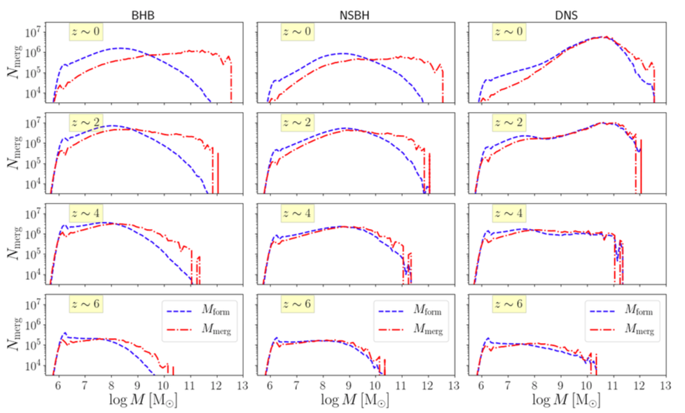
Galaxy hosts at different redshifts (coupling results
from Pop. Synth with input from Illustris simulation)
[Toffano, Mapelli et al. 2019]
Not a large number in massive galaxies → large fraction of escapes →
likely dim afterglows

Slide 31
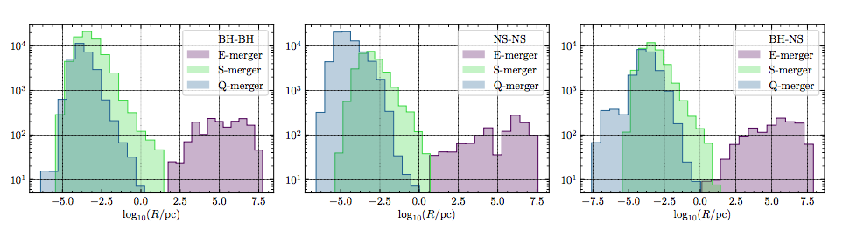
Merger locations for compact object mergers from
dynamical interactions with SMBH binaries in galactic
centers (coupling N-body scattering experiments with
input from Illustris simulations)
[Wang, Leigh, Sesana & Perna 2019]
Relative number dominated by events near the
galactic centers → higher densities → brighter
afterglows

Slide 32
SUMMARY
The discovery of binary BHs via gravitational waves has raised the question of what is the the origin of these binaries.
No definitive answer to date, and it will likely take several hundred detections before putting strong constraints on models
Meanwhile, they have triggered lots of interesting research

