Slide 1
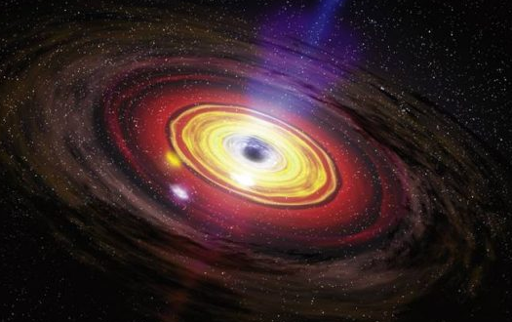
Formation and evolution of compact object binaries in active galactic nuclei
15/10/19 MMGW19
© NASA/Dana Berry, SkyWorks Digital
Hiromichi Tagawa (Eötvös University)
Zoltan Haiman (Columbia University), Bence Kocsis (Eötvös University)
Notes:
Recent findings suggest that this pathway can be a major origin of the BH merger events. I will explain about it.

Slide 2
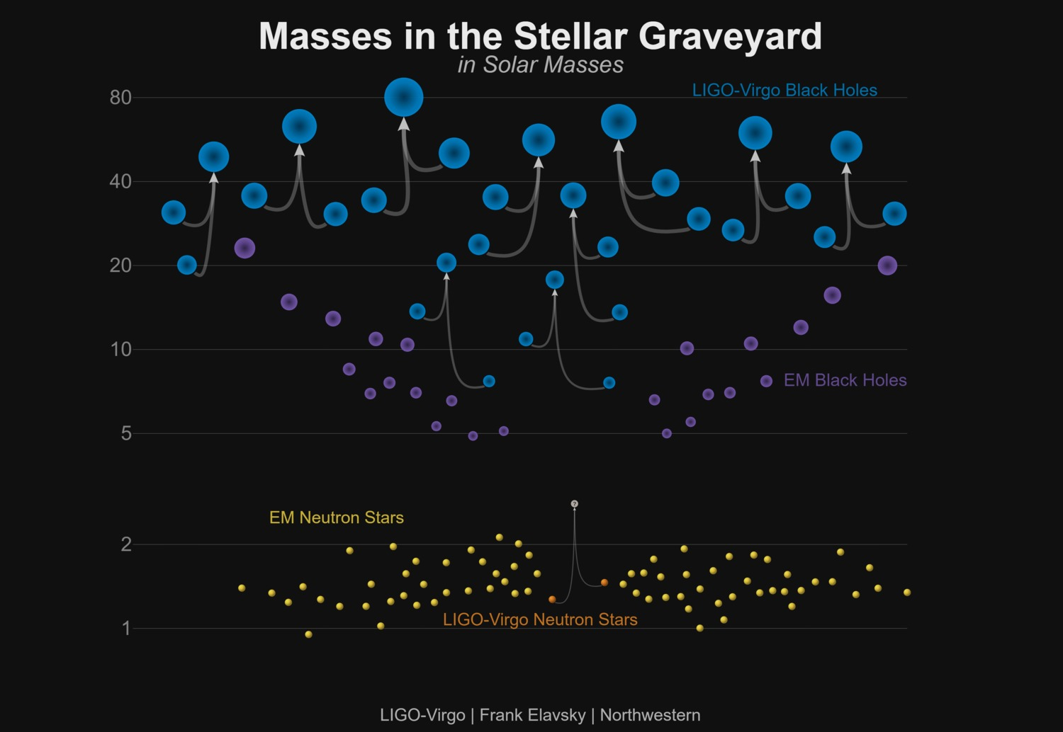
Observed GW events
Notes:
The important question would be “what can we learn from these events?”. To answer this question, it is a straightforward way to determine astrophysical models.

Slide 3
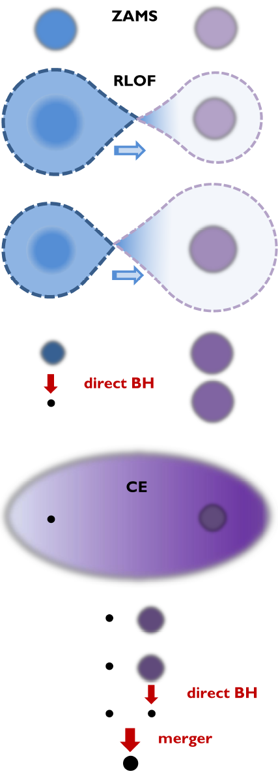
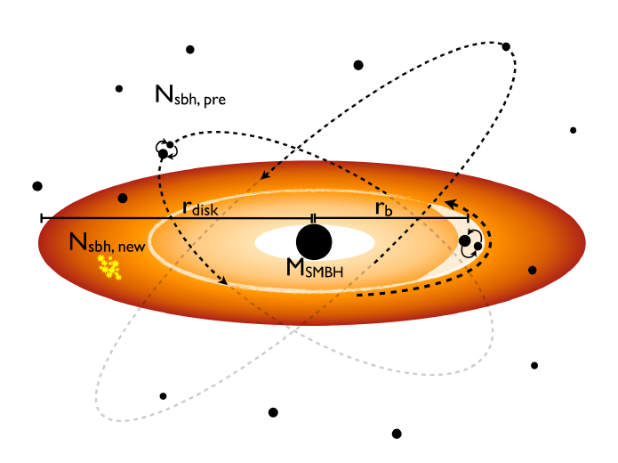
Astrophysical models
Isolated binary evolution
Evolution in globular clusters
Evolution in AGN disks
2-20 Gpc⁻³yr⁻¹
e.g. Samsing+14; Rodriguez+16; O’Leary+16; Askar+17; Fragione & Kocsis 18; Choksi+18; Rodriguez & Loeb 18; Hong+18
~10⁻⁴ - 10³ Gpc⁻³yr⁻¹
Bellovary+16; Bartos+17; Stone+17; McKernan+17;
Leigh+18; Tagawa & Umemura 18; Secunda+18; Yang+19a, b; Mckernan+19; Yi+19
7-1300 Gpc⁻³yr⁻¹
e.g. Dominik+12;
Kinugawa+14;
Belczynski+16;
De Mink & Mandel 16;
Mandel & de Mink 16;
Marchant+16;
Tagawa+18
Triple system
0.3-3 Gpc⁻³yr⁻¹
e.g. Antonini+17
GW capture
0.01-0.1 Gpc⁻³yr⁻¹
e.g. Rasskazov+19
primordial BHs
e.g. Sasaki+16
Notes:
However, the merger rate is accompanied by huge uncertainties. This is because previous studies only did rough estimates. To improve this, we performed detailed calculations, and could largely reduce the uncertainties.

Slide 4
Contents
Binary evolution in AGN disks
I. Evolution and mergers
Mergers processes and rates (13 slides)
Implication for X-ray binaries (2 slides)
II. Discrimination of astrophysical models
Effective spin parameter distribution (7 slides)
Binary eccentricity distribution (4 slides)
Other signatures (2 slides)
Notes:
Observational information to distinguish models

Slide 5
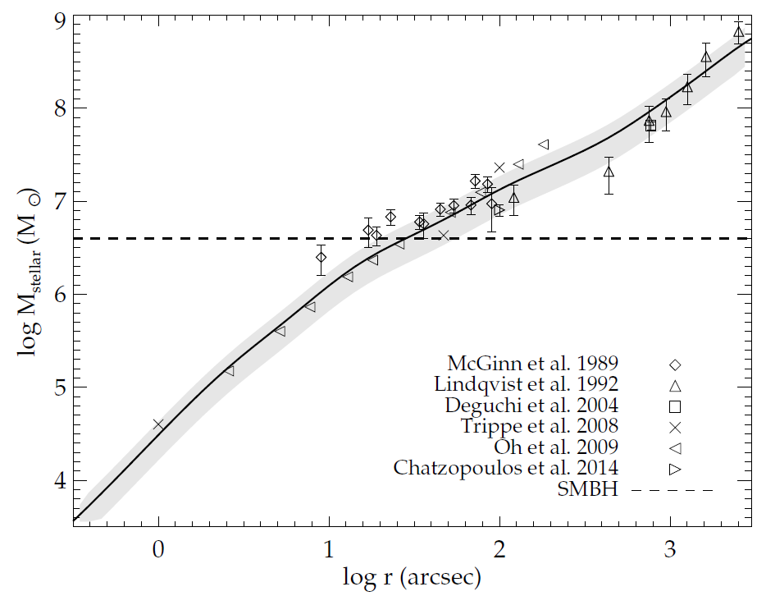
BH and stellar distribution
0.1 pc
1 pc
10 pc
Top heavy IMF? (Nayakshin+04)
dm/dN = m^{-1.7} (Lu+13)
dm/dN = m^{-0.45} (Bartko+09)
~ 2×10⁴ BHs (Salpeter)
~ 10⁵ BHs (Lu+13)
within 3 pc
Feldmeier+14

Slide 6
BH capture to an AGN disk
Alignment:
- gas dynamical friction - accretion torque
v_{BH}
Notes:
In gas dynamical friction, a BH receives a drag force by gravitationally interacting with a density wake behind the BH.
In accretion torque, a BH gains a momentum of captured gas, which usually decelerate the BH.

Slide 7
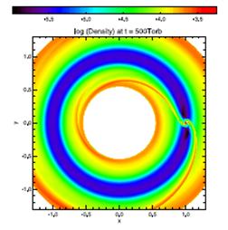
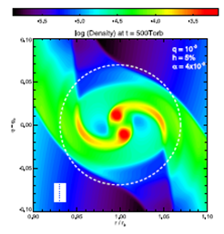
Binary evolution in an AGN disk
Baruteau+11
Binary hardening:
- gas dynamical friction from an AGN disk
- torque from a circumbinary disk (CBD)
- binary-single (BS) interaction

Slide 8
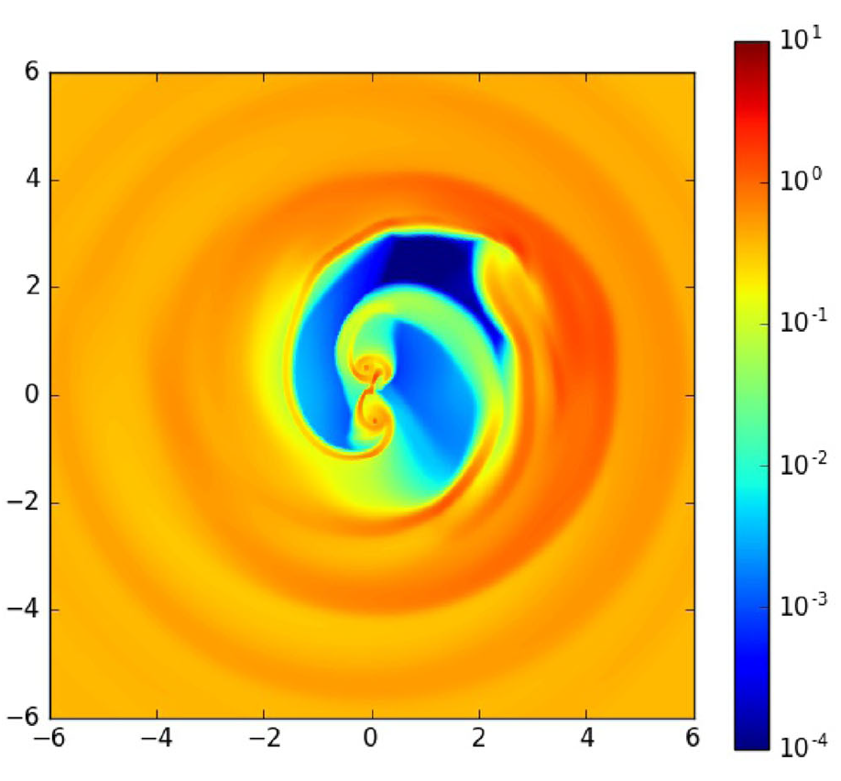
Torque from a circumbinary disk
Tang+17
Binary hardening:
- gas dynamical friction from an AGN disk
- torque from a circumbinary disk (CBD)
- binary-single (BS) interaction

Slide 9
Binary-single interaction
Binary-single interaction
Softening
E_{kin} > E_{bin}
E_{kin} < E_{bin}
Hardening
Binary hardening:
- gas dynamical friction from an AGN disk
- torque from a circumbinary disk (CBD)
- binary-single (BS) interaction

Slide 10
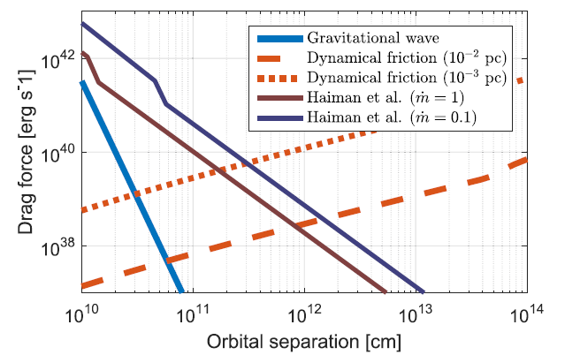
Pathway to mergers in AGN disks
Bartos, Kocsis, Haiman, Marka 17
Alignment by gaseous torque
→ binary-single interaction (Stone+17)
→ hardening by DF → torque from circum binary disk → GW

Slide 11
Event rate
$$R_{vol}=\int{{dM}_{SMBH}} (AGN mass function)×(BH number crossing AGN disk)×\left(\frac{f_{mer,BH}}{t_{AGN}}\right)$$
$$\sim 30 {Gpc}^{−3}{yr}^{−1}\left(\frac{f_{mer/BH}\text{ / }t_{AGN}}{2×{10}^{−8} {yr}^{−1}}\right)\left(\frac{η_{n,BH}}{0.005 {M_{☉}}^{−1}}\right)\left(\frac{r_{AGN,MW}}{0.1 pc}\right)$$
$$\sim {10}^{−4}−{10}^{3} {Gpc}^{−3}{yr}^{−1}$$
$f_{mer/BH}$ / $t_{AGN}$ ~ (5 – 3 × 10⁶) × 10⁻¹³ yr⁻¹ (McKernan+17)
due to uncertainties in f_{bin}, f_{disk}, f_{merge}, t_{AGN}
$η_{n,BH}$~ 0.002 – 0.02 ${M_{☉}}^{−1}$ : The number of BHs per mass in galactic centers (Lu+13)
$r_{AGN,MW}$ ~ 0.03 – 0.1 pc : The size of AGN disks for the SMBH with 4 ×10⁶ $M_{☉}$(Burtscher+13)

Slide 12
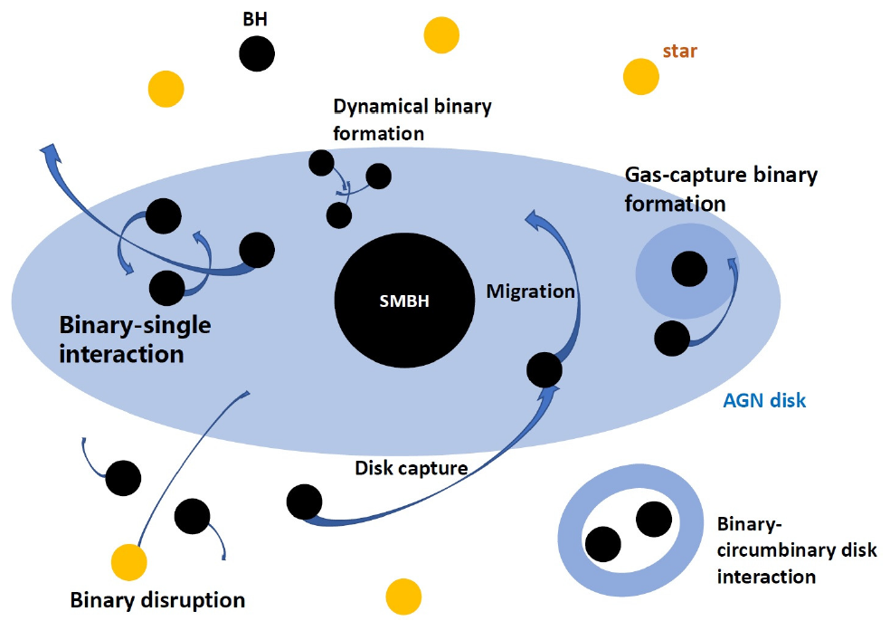
Semi-analytical model
N–body particles （BH）
Radial grid
Velocity
Gaseous torque
+ Binary-single (BS) interaction
+ Weak scattering
Radial position
Gaseous torque
Binary separation
Gaseous torque + BS interaction + GW
Binary formation
Gas-capture + three-body encounter
Disk BH density
Average BH velocity

Slide 13
Binary formation
Three-body encounter
ΔE_{kin}
Contribution was not obvious
~
Δ|Φ|
Gas-capture (Goldreich+02)
This has been missed

Slide 14
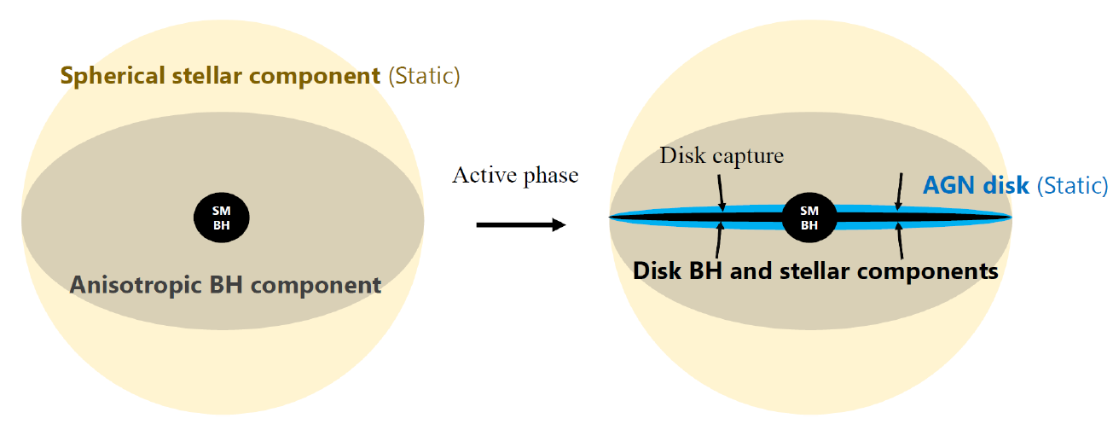
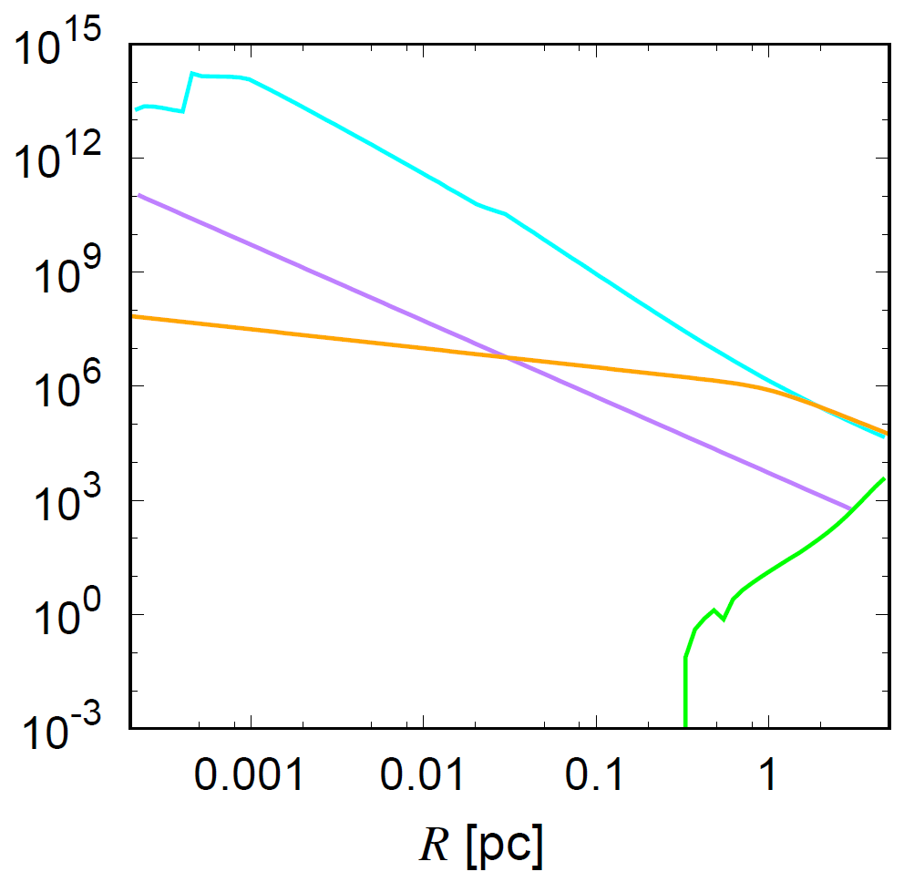
Models for AGN and BH distribution
(Units: pc, M_{sun}, Myr)
$$ρ_{gas}$$
$$ρ_{BH,ini}$$
$$ρ_{star}$$
AGN disk (Thompson et al. 05)
$\dot{M}$_{AGN} = 0.008 M_{sun}/yr,
M_{SMBH} = 4×10⁶ M_{sun}
$${\dot{ρ}}_{sf}$$

Slide 15
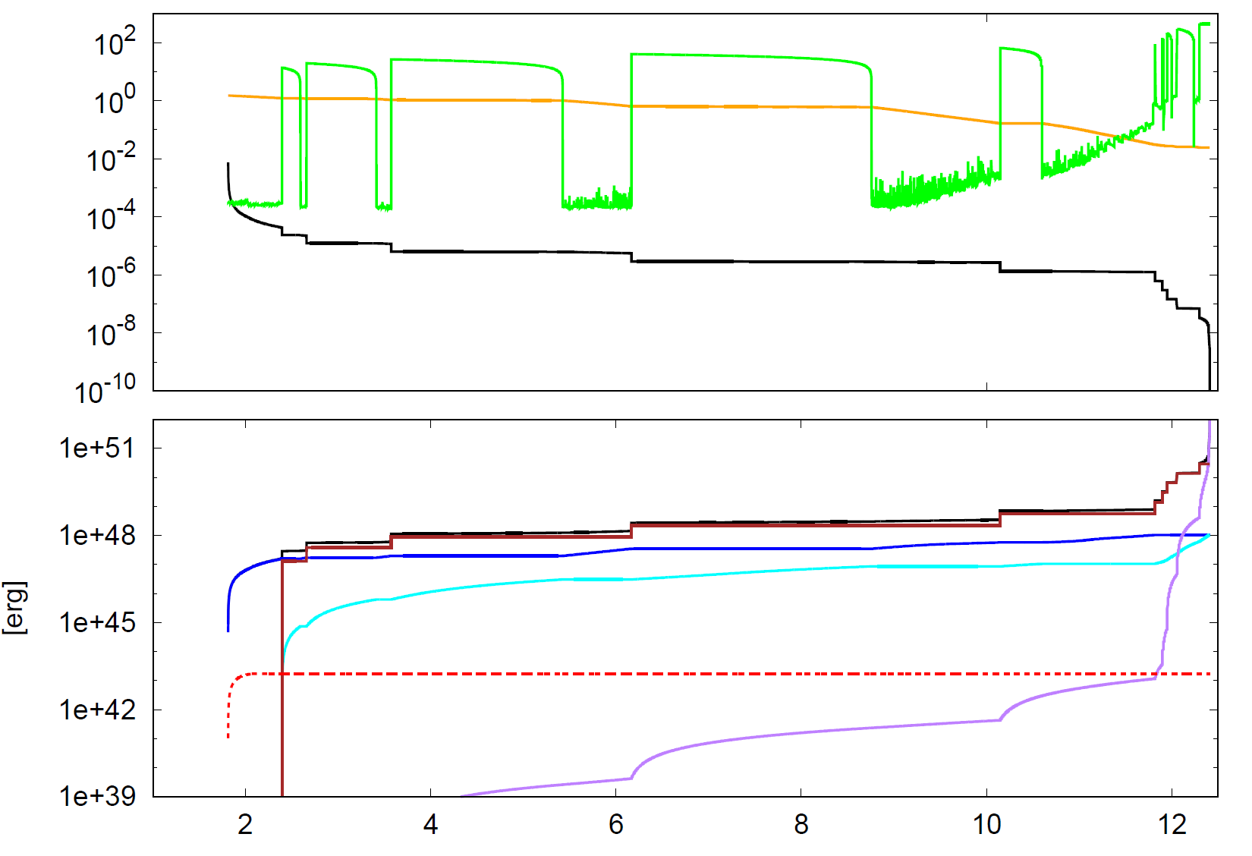
Example of binary evolution
Velocity [km/s]
Radial position [pc]
Binary separation [pc]
Frequent
before
merger
Binding energy
Hard BS interaction
Gas dynamical friction
Torque from a CBD
Soft BS interaction
GW
[Myr]

Slide 16
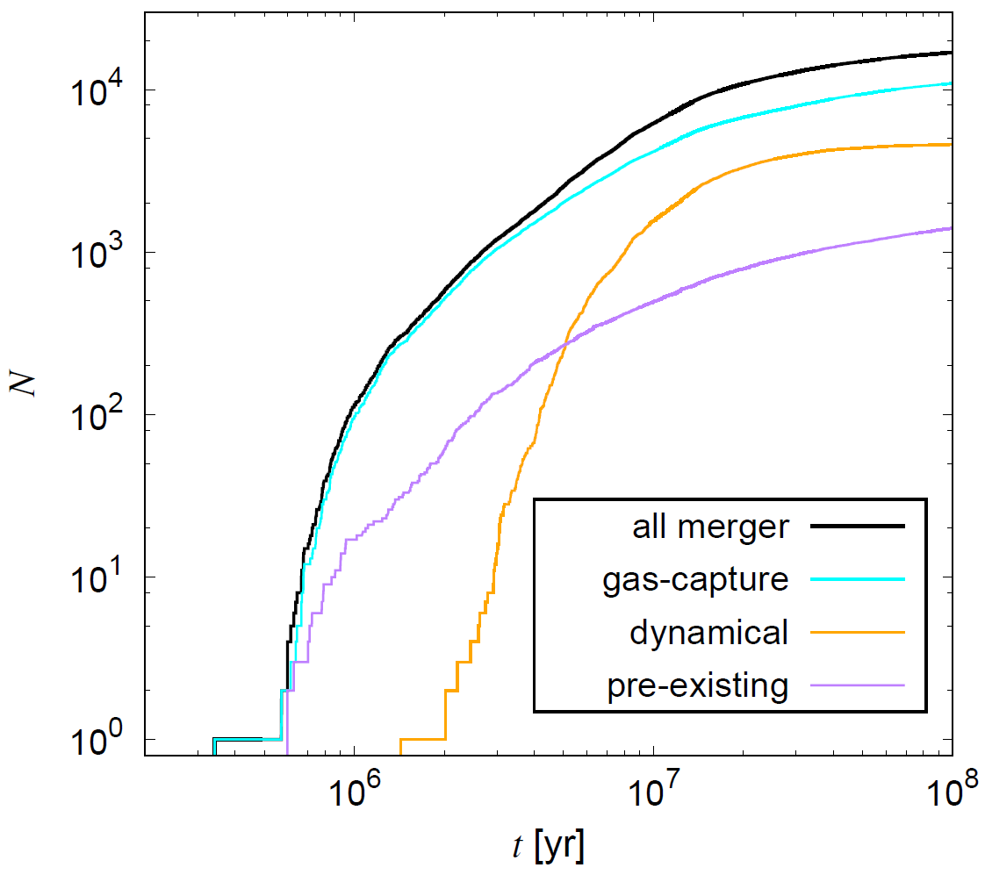
Mergers and formation mechanisms
$f_{mer/BH}$ $∝$ $\sim t_{AGN}$
The merger rate is increased by ~13
$f_{mer/BH}$ /${ t}_{AGN}$ is not so influenced by uncertainties of ${ t}_{AGN}$

Slide 17
Event rate
$$R_{vol} \sim 30 {Gpc}^{−3}{yr}^{−1}\left(\frac{f_{mer/BH}\text{ / }t_{AGN}}{2×{10}^{−8} {yr}^{−1}}\right)\left(\frac{η_{n,BH}}{0.005 {M_{☉}}^{−1}}\right)\left(\frac{r_{AGN,MW}}{0.1 pc}\right)$$
$$\sim 0.2−300 {Gpc}^{−3}{yr}^{−1}$$
$f_{mer/BH}$ / $t_{AGN}$ ~ (5 – 3 × 10⁶) × 10⁻¹³ yr⁻¹ (McKernan+17)
→ $f_{mer/BH}$ / $t_{AGN}$ ~ (1 - 40) × 10⁻⁹ yr⁻¹
due to reduced uncertainties in f_{bin}, f_{disk}, f_{merge}, t_{AGN}
$η_{n,BH}$~ 0.002 – 0.02 ${M_{☉}}^{−1}$ : The number of BHs per mass in galactic centers (Lu+13)
$r_{AGN,MW}$ ~ 0.03 – 0.1 pc : The size of AGN disks for the SMBH with 4 ×10⁶ $M_{☉}$(Burtscher+13)

Slide 18
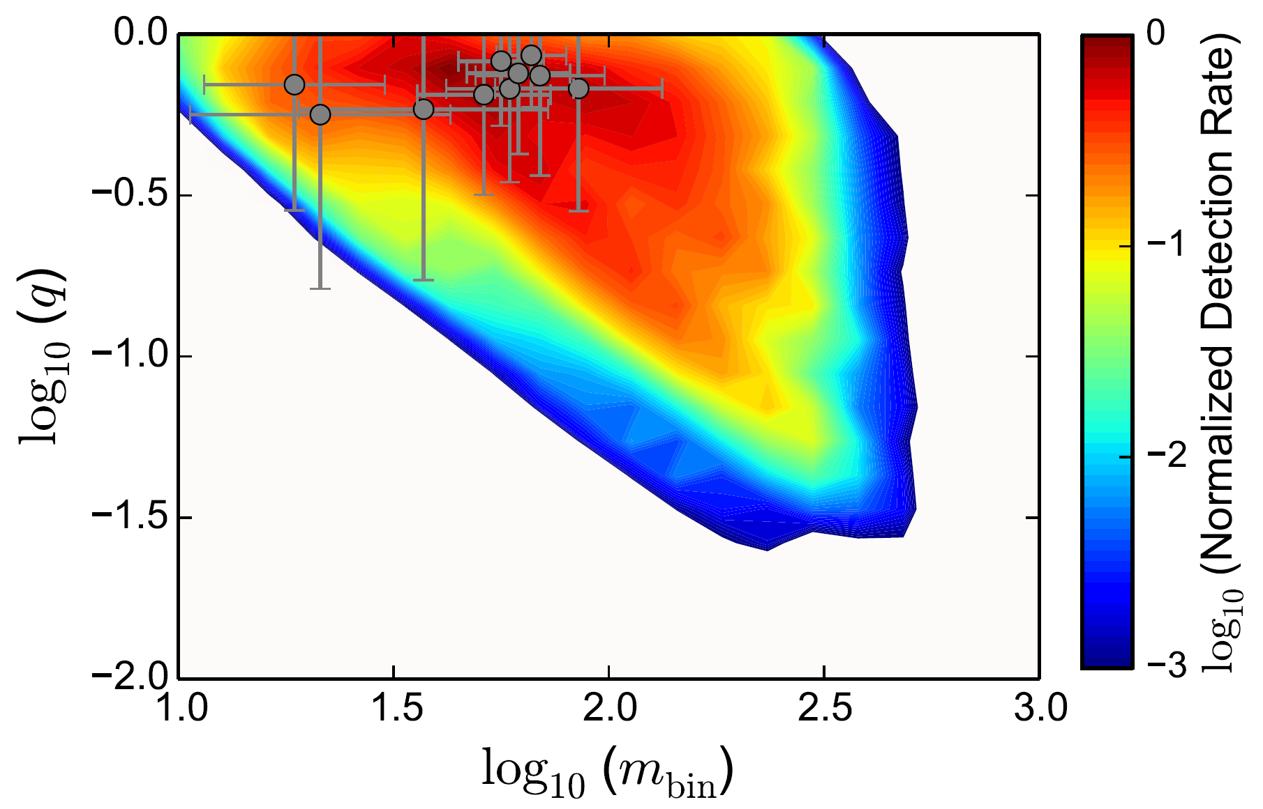
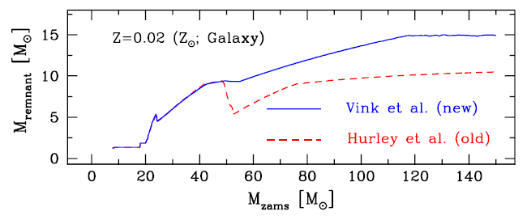
Mass ratio and mass distribution
t = 10 Myr
Initial BH masses
Mergers with massive mass BHs are expected
Belczynski+10

Slide 19
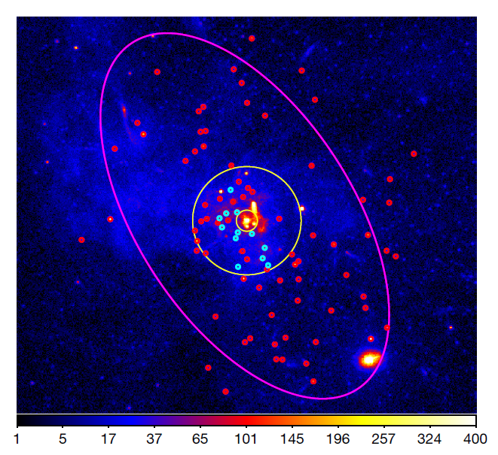
BH low-mass X-ray binaries
12 LMXB candidates
in r ≲ 1 pc
1 pc
BH-LMXBs
Tidal capture?
(Generozov+18)
What causes the cut-off at ~ 1 pc?
Hailey+18

Slide 20
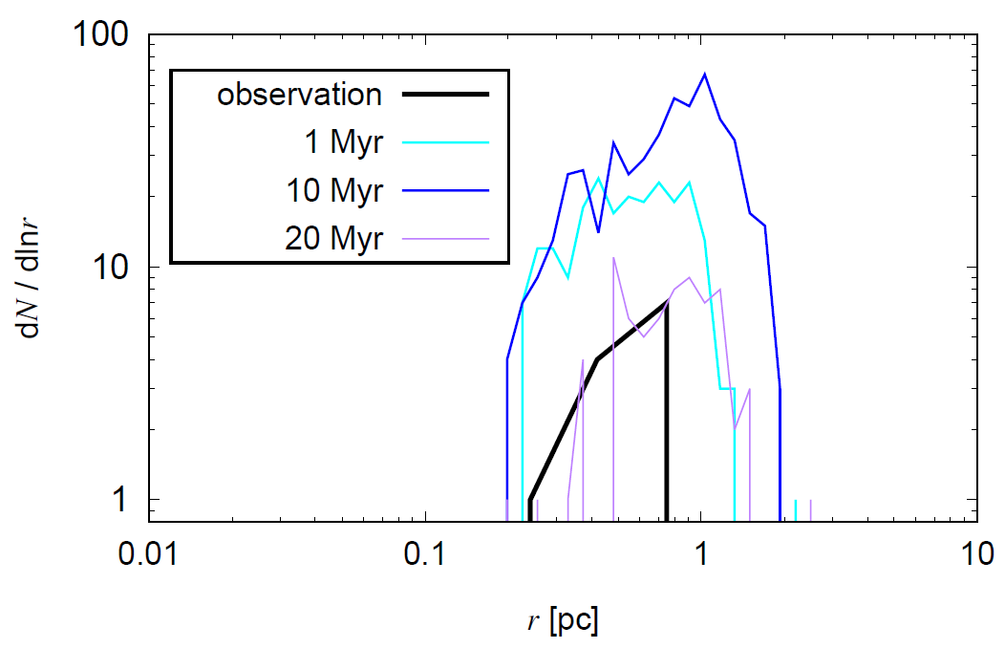
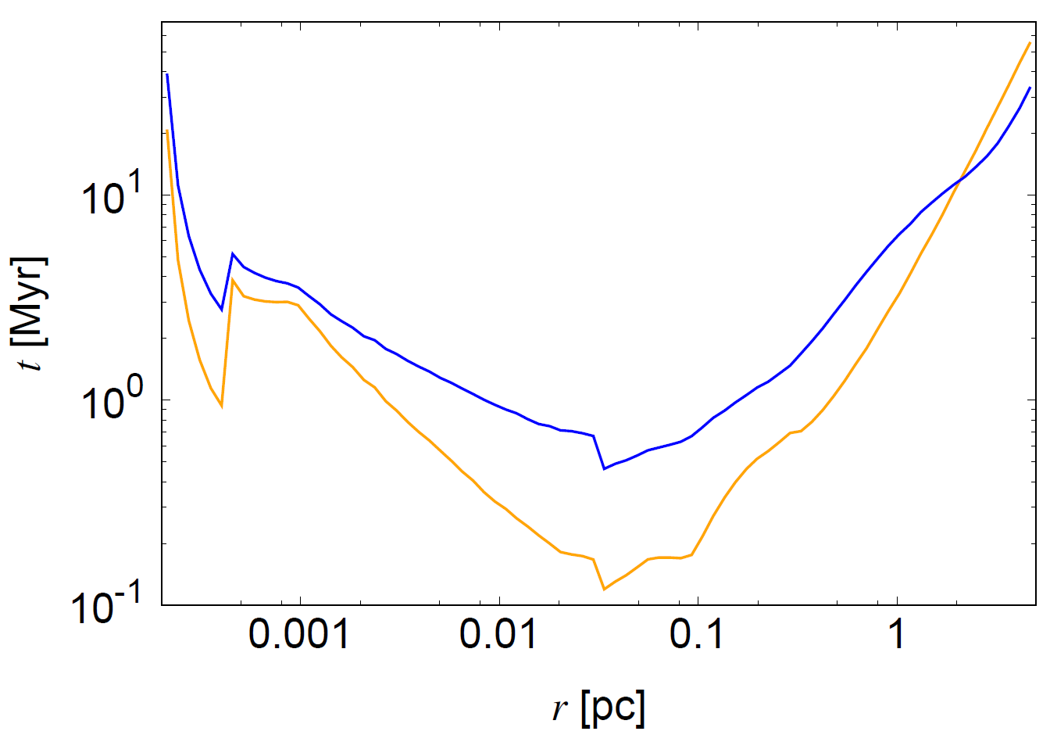
Final binary distribution
Gas-capture binaries
Low-mass X-ray binaries
(Hailey+18)
$$t_{mig}$$
Gas-capture binary can reproduce the X-ray binary distribution including the cutoff
$$t_{hard}$$

Slide 21
Contents
Binary evolution in AGN disks
I. Evolution and mergers
Mergers processes and rates (13 slides)
Implication for X-ray binaries (2 slides)
II. Discrimination of astrophysical models
Effective spin parameter distribution (7 slides)
Binary eccentricity distribution (4 slides)
Other signatures (2 slides)
Notes:
Observational information to distinguish models

Slide 22
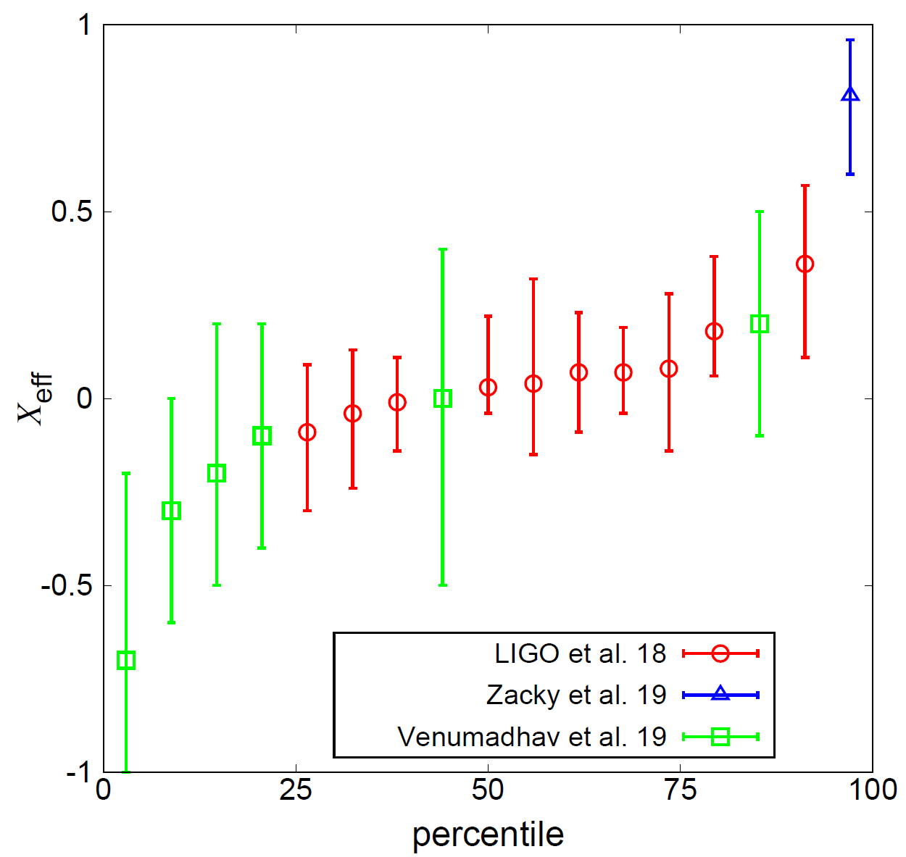
The effective spin parameter
$$X_{eff}=\frac{m_{1}a_{1}+m_{2}a_{2}}{m_{1}+m_{2}}∙{\hat{L}}_{bin}$$

Slide 23
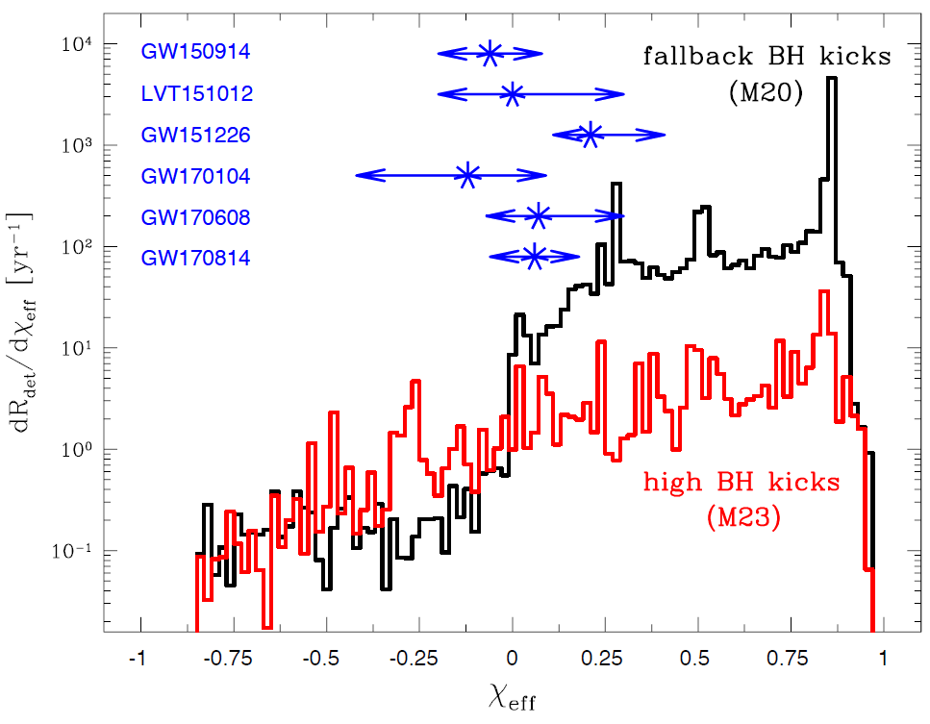
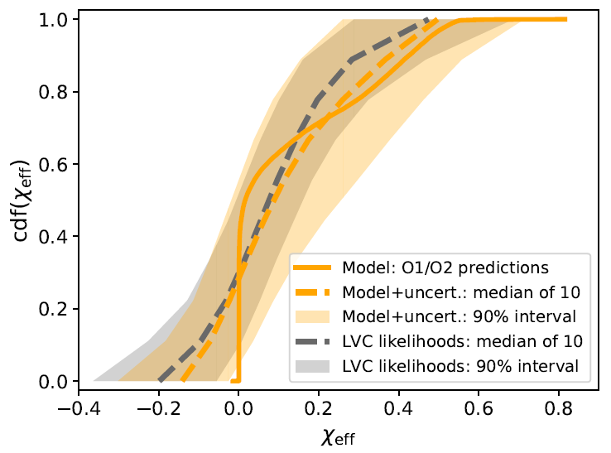
X_{eff} for isolated binaries
Belczynski+17
Bavera+18
The X_{eff} distribution highly depends on the efficiency of angular momentum transport

Slide 24
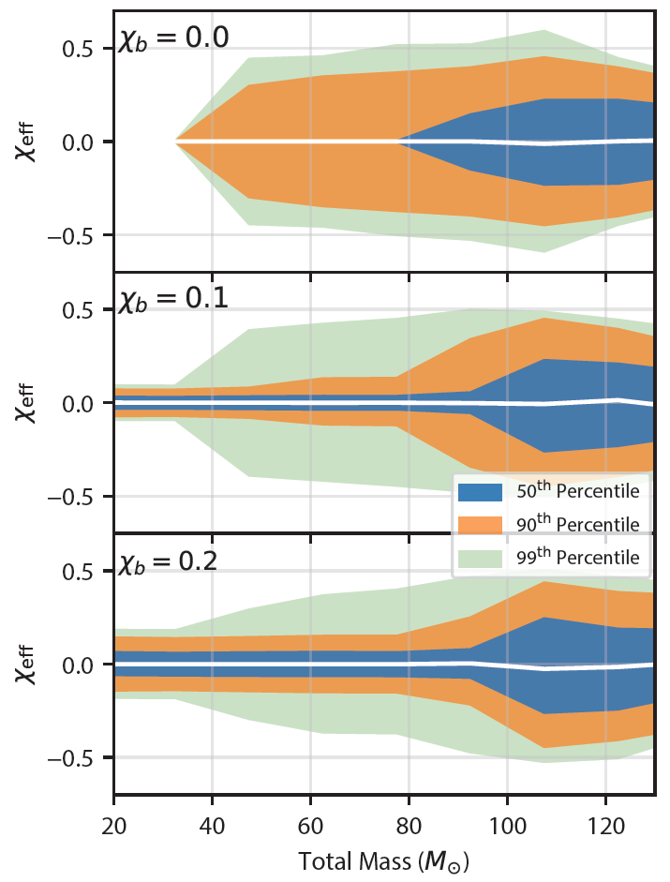
X_{eff} for binaries in globular clusters
The angle between a_{BH} and L_{bin} is isotropic, so X_{eff} is symmetric to 0
(e.g. Rodriguez+18; Arca-Sedda+18)
Rodriguez+18

Slide 25
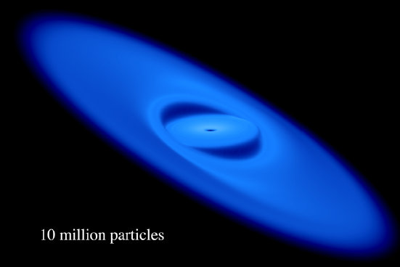
BH spin evolution in AGN disks
${\hat{L}}_{warp}$ = ${\hat{a}}_{BH}$
BH spins evolve via
- Gas accretion
t_{align} $≪$t_{acc}
Bardeen-Petterson effect
(Bardeen & Petterson 75)
BH mergers
(e.g. Buonanno+07; Rezzolla08)
${\hat{L}}_{CBD}$ (= ${\hat{L}}_{bin}$)
Nealon+15
$S_{BH1}+$ $S_{BH2}$
$S_{f}$ $≡$ $a_{f} {m_{f}}^{2}$
$$L_{bin}$$
Notes:
In this effect, inner regions of a CBHD warp due to Lense-Thirring effect, and the warp is rapidly dissipated by viscosity. So Lwarp=aBH. Due to the AM conservation, torque operates onto the BH spin toward the AM direction of a CBHD. Hence the alignment of the BH spins is rapid. (Also, a CBD aligns to the binary plane due to a viscousity. )

Slide 26
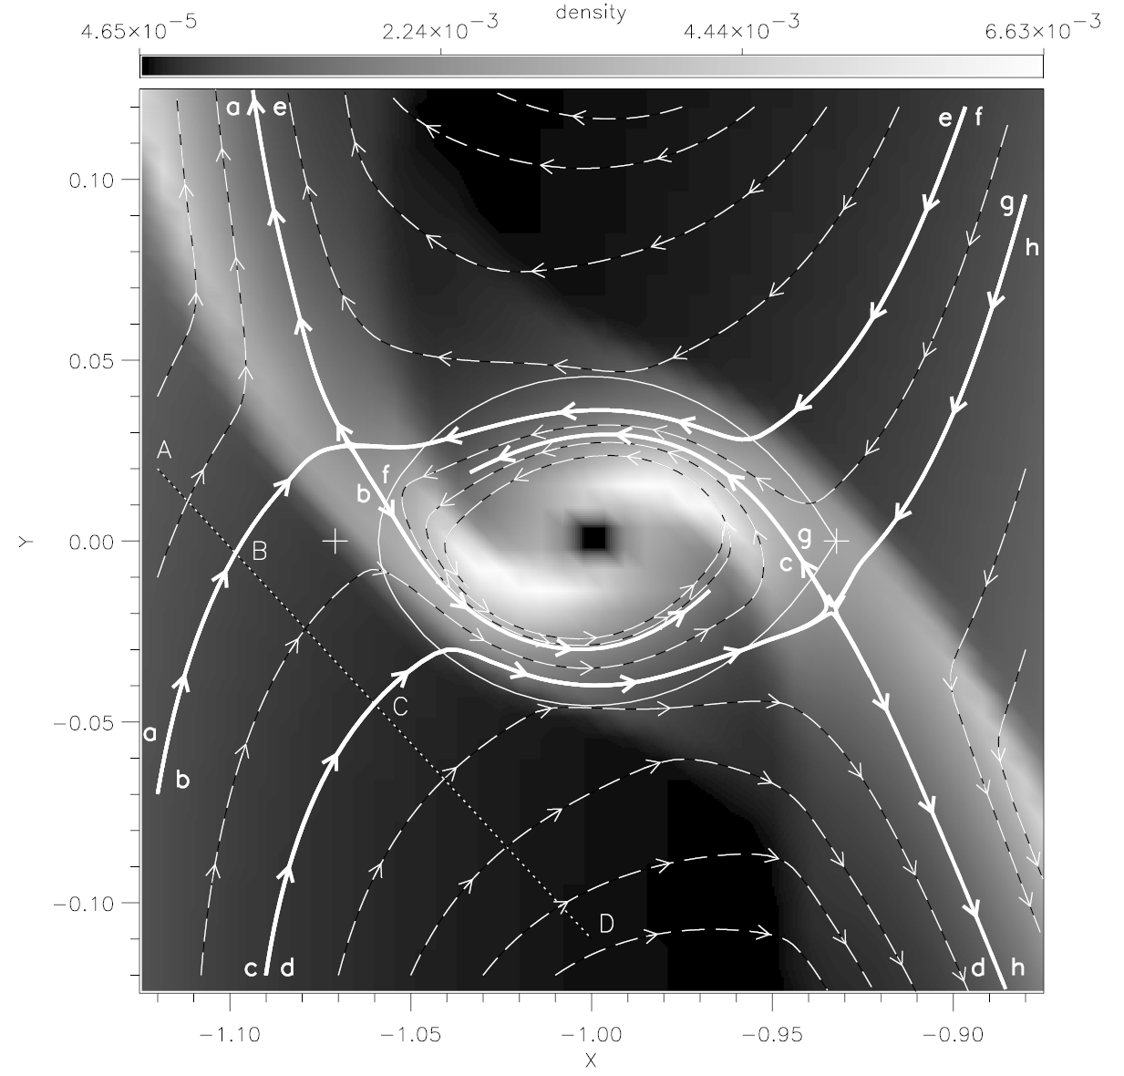
Binary angular momentum evolution
in AGN disks
Binary angular momentum evolves via
- Binary-single interaction
- Torque from an AGN disk
Central
object
Lubow+99
Notes:
Previous study for a proto-planetary disk found that the AM direction of gas around a planet is same to the AM direction of the disk around a central star. Due to gas accretion, the binary AM gradually aligns to the AM direction of the AGN disk.

Slide 27
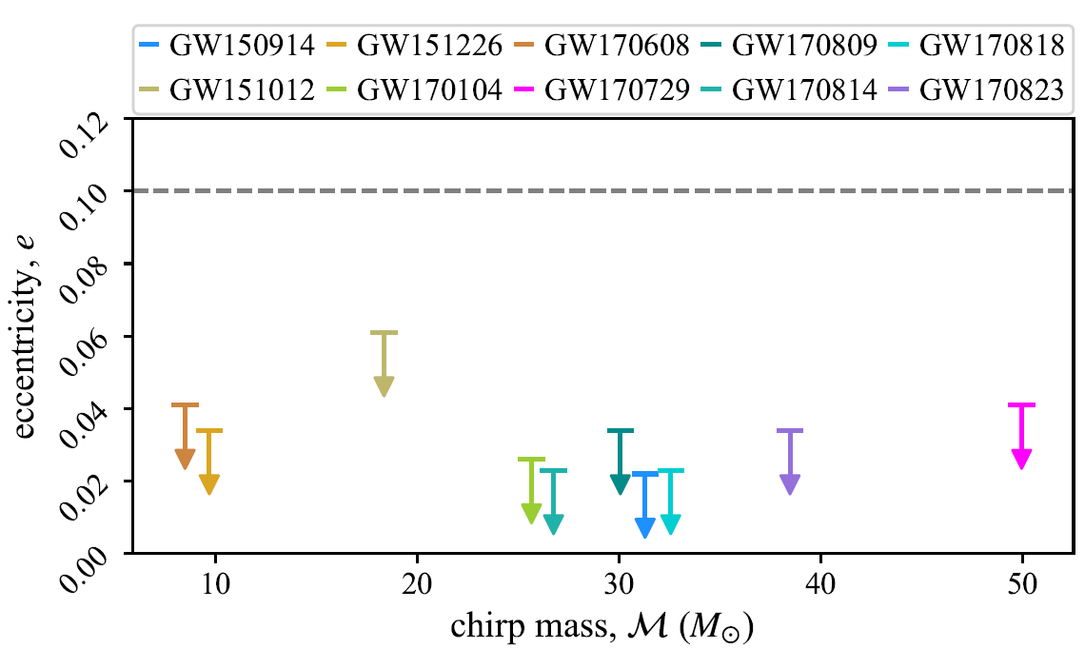
Binary eccentricity distribution
LIGO/Virgo can detect e for e ≳ 0.03 at 10 Hz (Lower+18; Romeo-Shaw+19; Brown & Zimmerman 10)
LISA will detect e for e ≳ 0.01 at ~ 0.01 Hz (Nishizawa+16)
(corresponds to e ≳ 2×10⁻⁷ at 10 Hz)
Romeo-Shaw+19
Notes:
Note that LIGO/Virgo can detect mergers with e<~0.1 at 10 Hz since data analysis uses template for circulary rotating binary

Slide 28
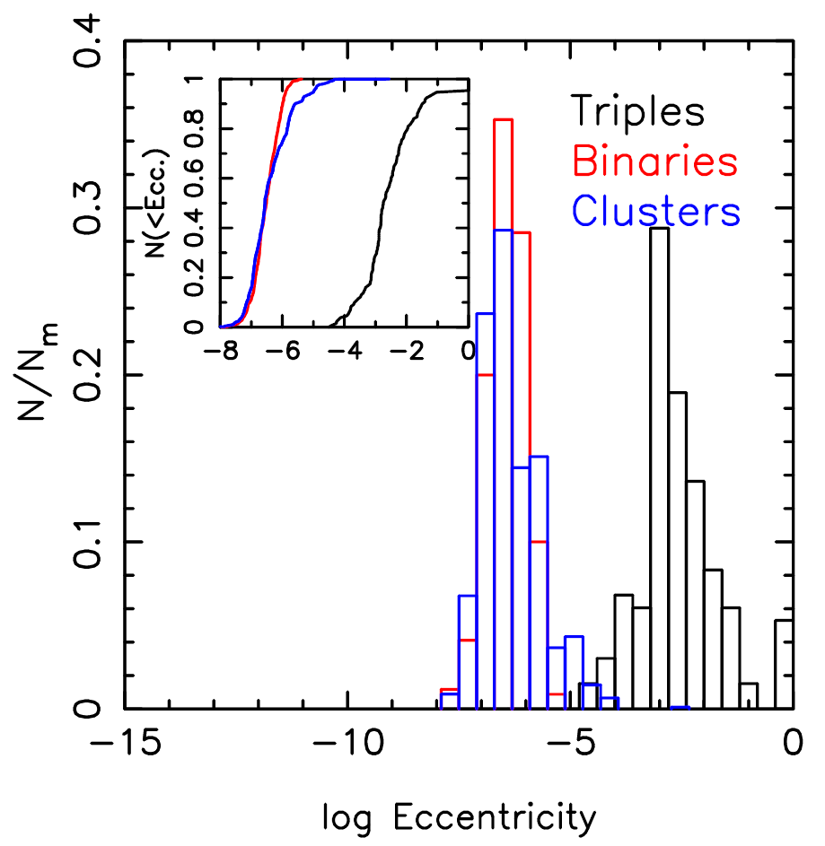
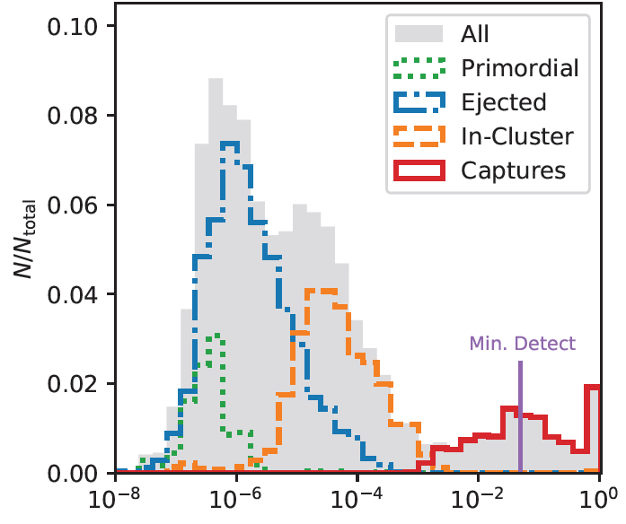
Binary eccentricity distribution
for several models
$f_{GW}$ = 10 Hz
64%
25%
1%
10%
Eccentricity
Antonini+17; Breivik+16
Rodriguez+18

Slide 29
Eccentricity evolution in AGN disks
Eccentricity evolution
- Binary-single interaction f (e) = 2ede
(e.g. Jeans 1919; Heggie 75; Geller+19)
- Torque from a circumbinary disk
(e.g. Lubow & Artymowicz 96; Roedig+11; Munoz+19)
- GW radiation (Peters 64)
Binary formation by GW capture
(e.g. Samsing+14)
- binary-single interaction
- single-single encounter
GW
Highly eccentric binary

Slide 30
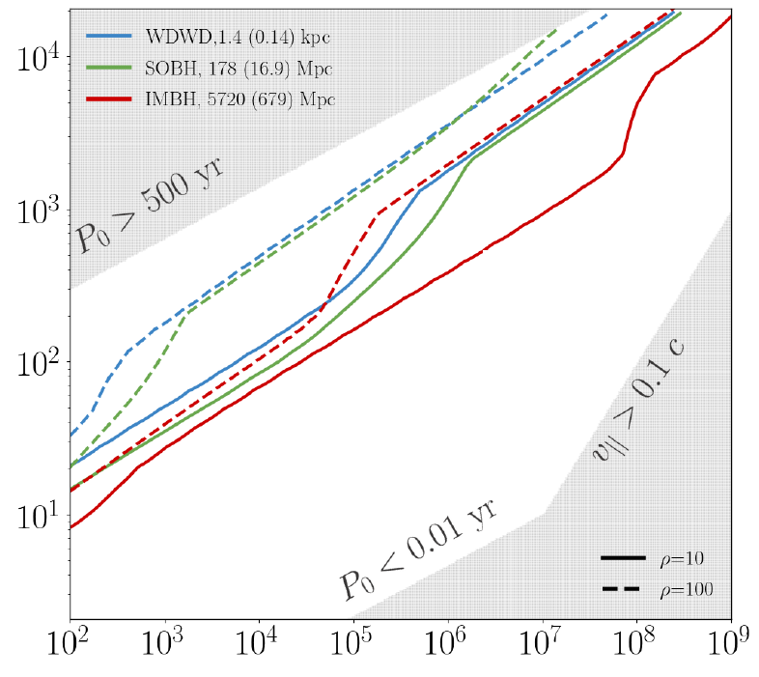
Doppler acceleration
Wong+19
Meiron+17; Inayoshi+17; Wong+19
0.6 M_{sun} ~30 M_{sun} 10³ M_{sun}
observable
r sin(inclination) [AU]
P₀ and v// are measured
with ≤ 10 % uncertainties
by 4 yr of observations of LISA
Lensing (D’Orazio+19)
$$M_{SMBH} [M_{sun}]$$
9-80% of mergers occur in ~2000 AU
from a SMBH depending on models

Slide 31
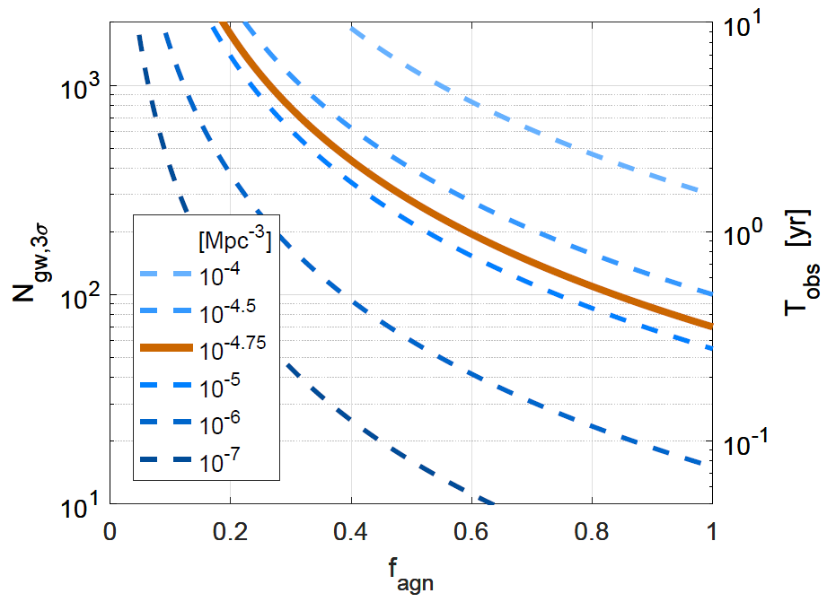
Localization
GW localization volume:
7.4×10⁶ Mpc³
LIGO-Virgo at design for 10-10Msun
Chen & Holz 16
Bartos+17
Compare the AGN catalogue
and GW sources
~100 events are required to test null contribution

Slide 32
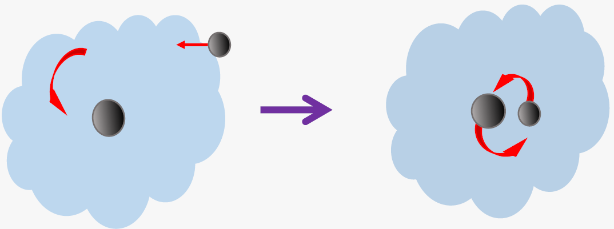
Summary
Mergers in AGN disks are still possible pathway for the major origin of the BH merger events.
The merger rate, binary mass, mass ratio, and effective spin distribution match to the observed distribution
X-ray binary distribution can be reproduced by the gas-capture mechanism
The binary eccentricity, the Doppler acceleration and localization are smoking gun signatures

