Slide 1
Instability in Neutrino-Dominated Accretion Flows and Its Application to Gamma-Ray Bursts
Ref. NK & Masada 2019, ApJ, 881, 138 (arXiv:1902.08624)
Masada, NK, Sano & Shibata 2007; NK & Mineshige 2007; NK & Kohri 2012; NK, Piran & Krolik 2013; NK, Mineshige & Piran 2013; Liu, Gu, NK & Li 2015; Kimura, Mineshige & NK 2015
Norita Kawanaka (Kyoto University)
Youhei Masada (Aichi University of Education)
Multi-Messenger Astrophysics in the Gravitational Wave Era 24/10/2019

Slide 2
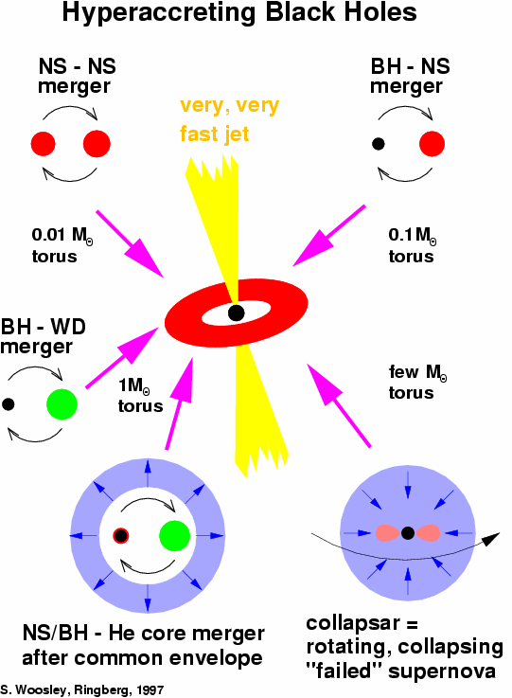
Central Engine of Gamma-ray Bursts
most likely：a massive accretion disk around a stellar-mass black hole
the outcome of the collapse of a massive star or a merger of compact objects
Accretion rate >~ 0.01M_{sun} s⁻¹
>~ 10¹² × Eddington
Photons are trapped in the accretion flow (Advection-Dominated Accretion Flow; ADAF).
When is large enough, neutrino emission becomes efficient.

Slide 3
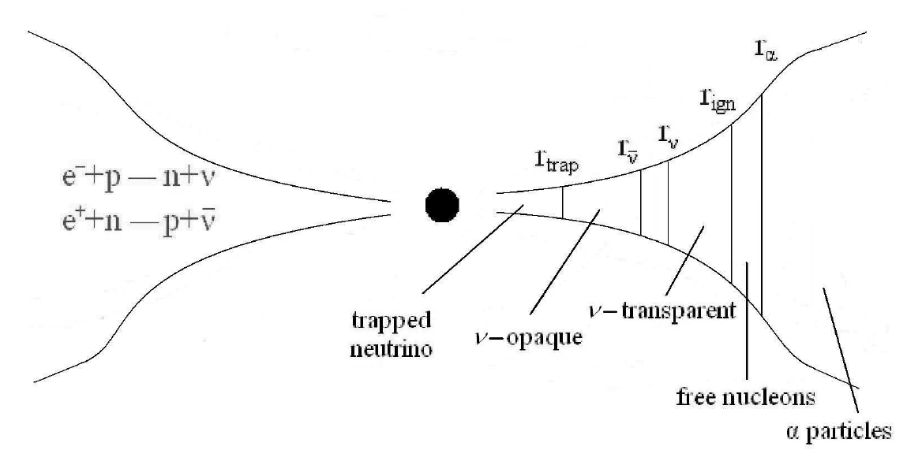
Neutrino-Dominated Accretion Flow (NDAF)
cools via neutrino emission
appears above ~0.01M_{sun} s⁻¹; ρ ~ 10⁹⁻¹¹ g cm⁻³, T ~ 10¹⁰⁻¹¹ K
URCA processes (e⁻ + p → n + ν_{e} / e⁺ + n → p + ) are dominant
Analytical studies
Popham+ 99; Narayan+ 01; Kohri & Mineshige 02, Di Matteo+ 03; Kohri+ 05; Chen & Beloborodov 07; NK & Mineshige 07; Masada, NK+07; Liu+ 07; NK & Kohri 12; NK, Piran & Krolik 13; NK, Mineshige & Piran 13; Liu, Gu, NK & Liu 15; Kimura, Mineshige & NK 15 etc.
Simulation studies
Lee & Ramirez-Ruiz 02; Lee+ 03; Setiawan+ 04; Shibata+07; Metzger+ 08; Sekiguchi & Shibata 11; Siegel & Metzger 17; Kyutoku+ 18 etc.
Chen & Beloborodov 2007

Slide 4
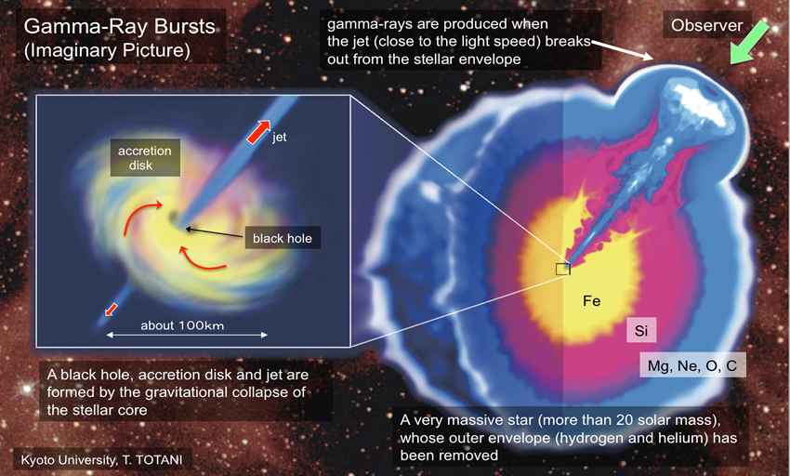
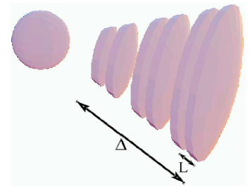
Problems to be solved
Jet launching mechanism
Neutrino pair annihilation?
(Eichler+89; Asano & Fukuyama 00, 01; Birkl+ 07; Zalamea & Beloborodov 11 etc.)
Magnetic field-driven?
(Blandford & Znajek 1977; Barkov & Komissarov 2008; NK et al. 2013 etc.)
Origin of short-term variability ← This talk
internal shock, magnetic reconnection, etc.
… a jet ejected from the NDAF should be spatially inhomogeneous
What mechanism makes a highly variable jet?

Slide 5
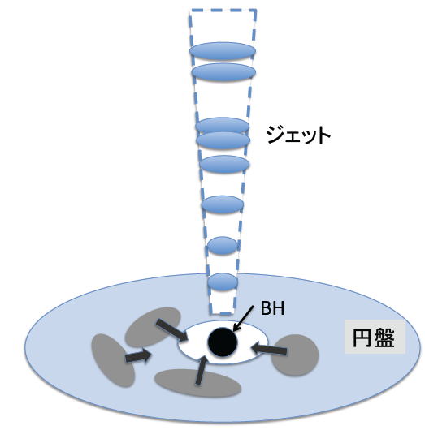
Origin of short-term variability in GRBs?
The disk instability may drive the intermittent mass accretion
→ inhomogeneous jet?
often discussed in the context of X-ray binaries (Lightman & Eardley 74; Shibazaki & Hōshi 75; Shakura & Sunyaev 76; Piran 78)
Some instabilities of NDAFs have been found
jet
disk
thermal instability: Janiuk+07
viscous instability: Masada, NK +07; NK & Kohri 12; NK+ 13b; Kimura, Mineshige & NK 15
Most of these works are based on the α-viscosity model

Slide 6
Q. Is the α-viscosity parameter always constant in an NDAF?
A. No!

Slide 7
Origin of shear viscosity in an accretion disk
… turbulence driven by MagnetoRotational Instability (MRI; Velikhov 1959; Chandrasekhar 1960; Balbus & Hawley 1991)
Necessary condition: Ω decreases as the distance from the rotation center increases
unstable no matter how weak the magnetic field is
fastest growing mode: λ ~ v_{A}/Ω
Growth timescale ~ Ω⁻¹
Hung et al. 2019, Nature

Slide 8
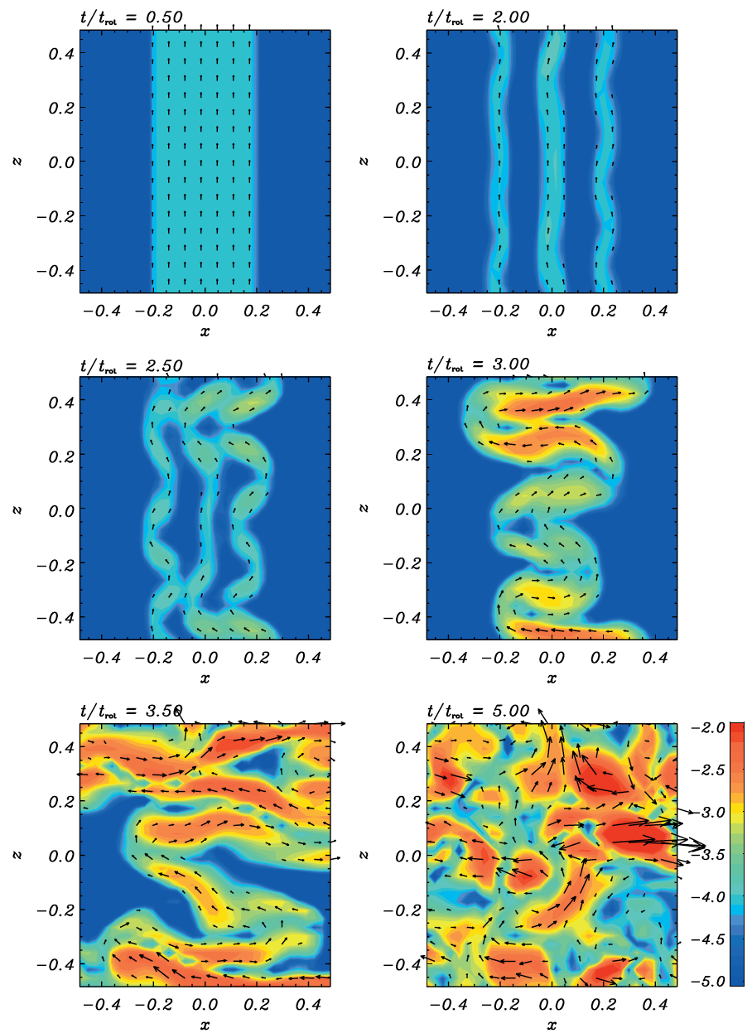
turbulent viscosity
... ν_{turb} ~ v_{t} λ
(v_{t}: turbulent velocity,
λ: turbulence scale)
N.B. In the α prescription,
ν ~ αc_{s}H with α<~1
(c_{s}: sound speed,
H: disk scale height)
∴ If the growth of MRI is boosted (suppressed), α becomes larger (smaller).
Sano et al. 2004

Slide 9
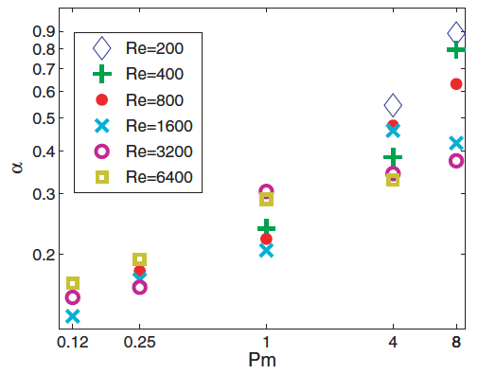
Magnetic Prandtl number effect
Recent MHD simulations show that P_{m} could influence the saturated state of the MRI turbulence
(Fromang et al. 2007; Lesur & Longaretti 2007; Simon & Hawley 2009 etc.)
ν: microscopic viscosity
η: resistivity
α
Lesur & Longaretti 07

Slide 10
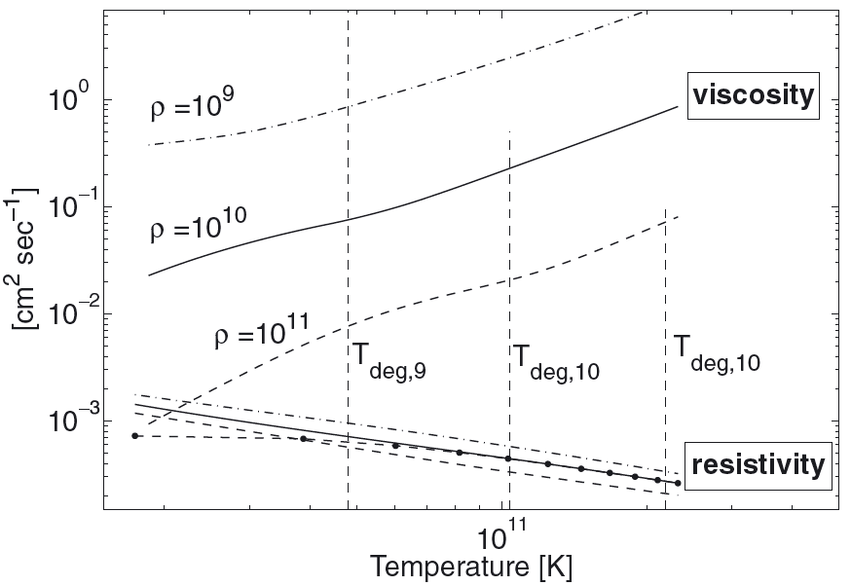
What happen to an NDAF?
NK & Masada 2019
Cooling: neutrino
viscosity, resistivity: Coulomb scattering of relativistically degenerate electrons
Rossi et al. 2008

Slide 11
Fundamental Equations of an NDAF
mass conservation
ang. mom. conservation
α-viscosity prescription
energy balance
hydrostatic balance
EoS
← New!
Pm-dependence of α
One can evaluate the equilibrium solution for ρ, T, v_{R}, H, p_{disk}, and α as functions of

Slide 12
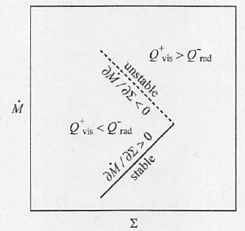
Viscous Instability (Secular Instability)
: mass accretion rate
: surface density of a disk
thermal equilibrium curve
unstable condition
∵ Σ(r) grows
→ less inward mass accretion
→ Σ(r) grows further
unstable, clump formation etc.
Kato, Fukue & Mineshige 2008 “Black-hole Accretion Disks – Towards a New Paradigm –”

Slide 13
Instability criterion in an NDAF
NK & Masada 2019
General condition for viscous instability:
(1) Optically thin :
ν cooling
(2) Optically thick :
assuming α∝Pm^{β}
(1)
With such β, an NDAF is always viscously unstable!
(2)

Slide 14
1-d simulation of an NDAF
NK & Masada 2019
Equation for the surface density
Σ(r,t) : surface density
ν = αc_{s}H : kinetic viscosity
Energy conservation
χ = p_{gas}/p
Assumption:
α_{min}=10⁻⁴, α_{max}=0.1, Pm_{c}=10

Slide 15
What occurs in a viscously unstable disk
viscously unstable
mass accumulation
gravitationally unstable
non-axisymmetric patterns
intense mass accretion
lower surface density
mass accumulation again
…
BH
viscously unstable: small α
episodic accretion
effective viscosity due to gravitational instability: α_{grav}
… determined by Toomre’s Q parameter (Zhu et al. 2010 etc.)
BH
gravitationally unstable: α_{grav}
Notes:
redistribution of the matter through the secularly unstable region

Slide 16
Results

Slide 17
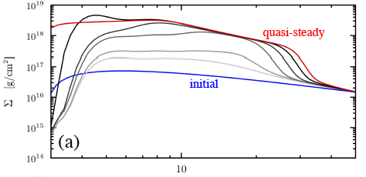
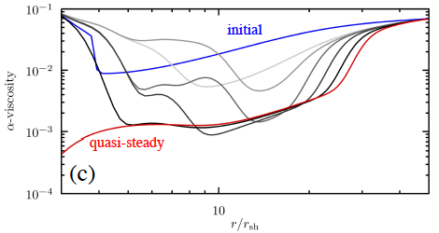
Time evolutions of disk properties
NK & Masada 2019
initial state: steady solution with a constant α
neutrino cooling
→ Turbulent viscosity due to MRI is suppressed
Infalling matter is accumulated
The disk becomes gravitationally unstable
surface density
α due to MRI
Notes:
t ~ 4 sec (just before the initial spike)

Slide 18
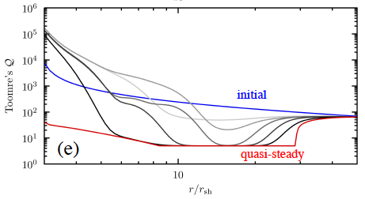
Toomre’s Q
NK & Masada 2019
When Q < Q_{crit}=5, the disk becomes gravitationally unstable
non-axisymmetric patterns
effective viscosity: α_{grav}
Intense mass accretion

Slide 19
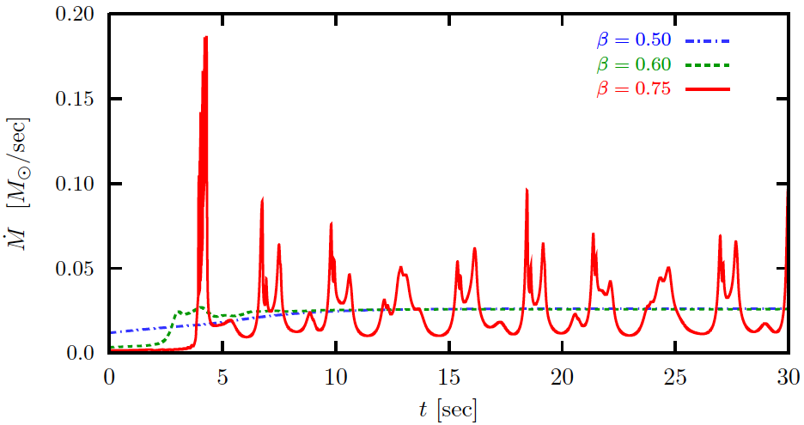
mass accretion variability
NK & Masada 2019
β<∼ 0.60 → stable accretion
β>∼ 0.75 → highly variable accretion

Slide 20
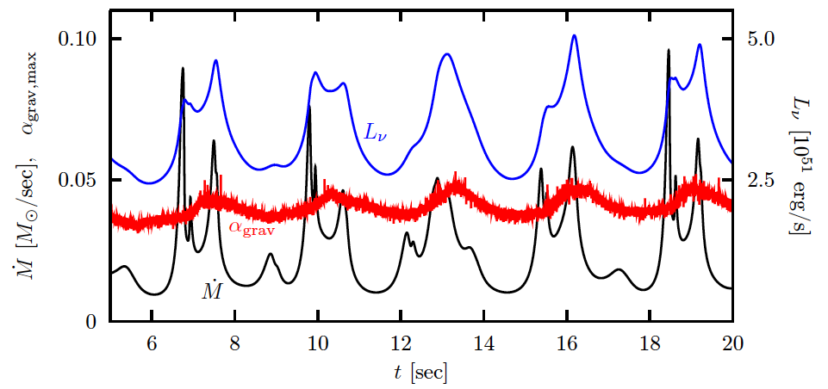
Accretion Rate, ν luminosity, and α_{grav}
t_{cycle} ~ 3 sec ( ⇔ t_{vis} ~ r_{ISCO}² /ν_{turb}(α_{min}) )
shorter timescale variability (<~ 0.1-1 sec)
A GRB lightcurve contains two components with different timescales? (e.g.:Vetere et al. 2006)
Notes:
In addition to the longer period mass accretion cycle, we can find the shorter time-variability with a duration 􏰎<~0.1-1 sec in Mdot.
Mdot and L_nu changes following the modulation of alpha_grav

Slide 21
What is the origin of the shorter timescale variability?
1. Shorter wavelength mode of the viscous instability
Growth timescale: t_{grow,VI} ~ t_{vis} (λ/r)²
→ Perturbations with shorter wavelengths can grow within shorter timescale
2. Thermal instability
Growth timescale: t_{grow,TI} ~ 1/(αΩ) << t_{vis}
When a disk is optically-thick with respect to neutrinos and viscously unstable, it is also thermally unstable.

Slide 22
Summary
Hyperaccretion flows as a central engine of GRBs
→ Neutrino-Dominated Accretion Flow (NDAF)
Viscous instability: the origin of the short-term variability of GRBs?
α-parameter is not always constant in an NDAF.
An NDAF may become viscously unstable and mass accretion may be highly variable due to degenerate electrons’ viscosity/resistivity.
Our simulations show that the mass accretion in a viscously unstable NDAF would be intermittent, which may account for the short-term variability observed in the prompt emission of GRBs.

Slide 23
Backup slides

Slide 24
MRI in a ν-thick NDAF?
Masada, NK, Sano & Shibata 2007
→ innermost region may be neutrino-opaque
energy/momentum transport due to neutrino diffusion is effective
The growth of MRI would be suppressed
α would become locally smaller
Dead Zone?

Slide 25
Fundamental Equations of an NDAF
mass conservation
ang. mom. conservation
ν_{t}: kinematic viscosity
α-viscosity prescription
energy balance
(Q ⁻_{adv}:advection, Q ⁻_{ν}:neutrino)
hydrostatic balance
EoS
One can evaluate ρ, T, v_{R}, H, and p_{disk} as functions of

Slide 26
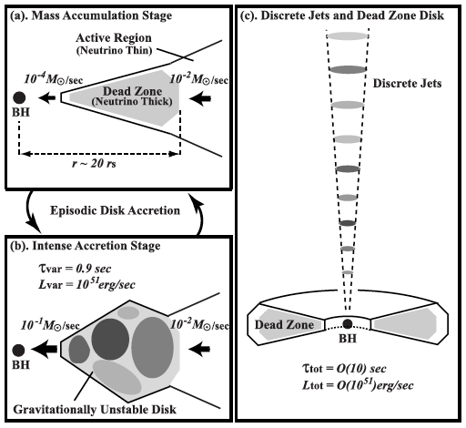
Schematic picture

Slide 27
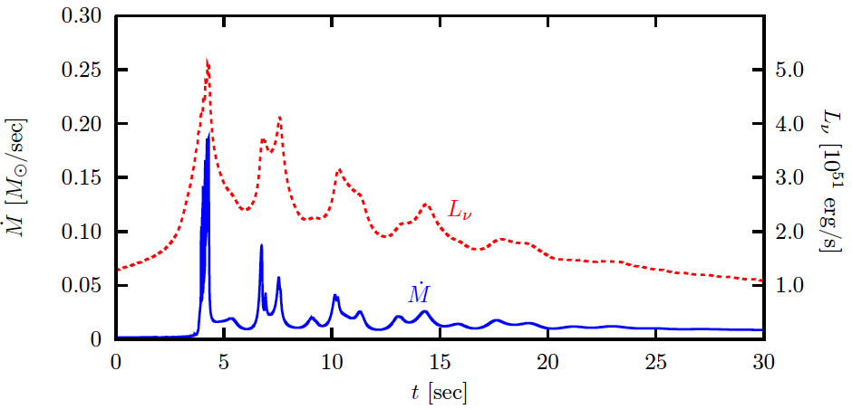
With decaying mass injection
Mass injection rate ∝ t^{-5/3}

Slide 28
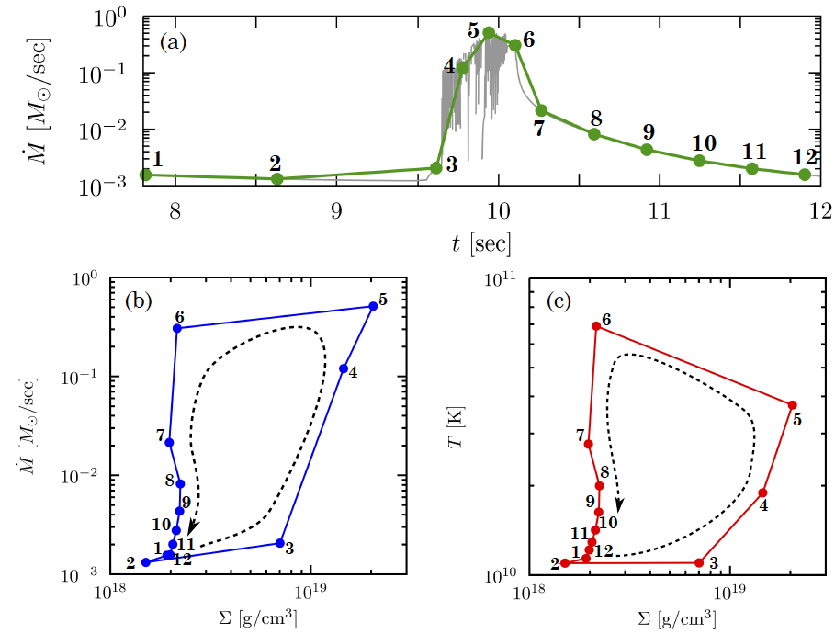
Evolution paths on the Mdot-Σ and T-Σ planes
Limit cycle behavior?

