Slide 1
ブラックホール時空で運動する弦のカオスの普遍性
棚橋典大
[九州大学 マス・フォア・インダストリ研究所]
based on
Chaos of Wilson Loop from String Motion near Black Hole Horizon
橋本幸士、村田佳樹、棚橋典大 [arXiv:1803.06756]
Universality in Chaos of Particle Motion near Black Hole Horizon
橋本幸士、棚橋典大 [arXiv:1610.06070]

Slide 2


Classical particle moving near BH horizon
Gravity
External force: electric, scalar, ...
String moving near AdS BH horizon
  Particle & string motion become chaotic due to BH gravity
  Lyapunov exponent 𝜆 of the chaos is bounded by surface gravity 𝜅

Slide 3


Motivation:
A bound on chaos in QFT at temperature T :
  [Maldacena-Shenker-Stanford '15]
Probing the effect of temperature T to chaos in QFT.
We study effect of temperature to chaos in classical gravity.
To probe effect of 𝜅, we look at trajectories very close to BH.
Use BH surface gravity instead.

Slide 4
Contents
Chaos bound for particle near BH
Chaos bound for AdS string
  Perturbative motion
  Nonlinear time evolution & chaos
Summary

Slide 5
Contents
Chaos bound for particle near BH
Chaos bound for AdS string
  Perturbative motion
  Nonlinear time evolution & chaos
Summary

Slide 6


Classical chaos
Diagnostics of classical chaos
  Poincaré plot
  = Section of orbits in phase space
  non-chaotic → regular shaped plot
  chaotic → scattered plot
  Lyapunov exponent 𝜆 = Separation growth rate of nearby orbits

Slide 7
Derive the bound
To realize a particle moving very close to BH horizon,
put a particle in a trapping harmonic potential
r
θ
Integrable system:
2 degrees of freedom
Conserved quantities: Energy, angular momentum
→ No Chaos: Trajectories fully specified by conserved quantities

Slide 8
Derive the bound
To realize a particle moving very close to BH horizon,
put a particle in a trapping harmonic potential
(← no chaos)
r
θ
take it close to a BH horizon
r

Slide 9
Derive the bound
To realize a particle moving very close to BH horizon,
put a particle in a trapping harmonic potential
(← no chaos)
r
θ
take it close to a BH horizon & look at the separatrix
Gravity
r
Potential force
r₀
Effective potential
for particle motion

Slide 10

Derive the bound
To realize a particle moving very close to BH horizon,
put a particle in a trapping harmonic potential
Head-on view:
r₀
r
(← no chaos)
r
θ
take it close to a BH horizon & look at the separatrix
Gravity
r
Potential force
r₀
Effective potential
for particle motion

Slide 11




Derive the bound
Gravity
r
Potential V(r)
r₀
Focus on slow radial motion near potential maximum

Slide 12
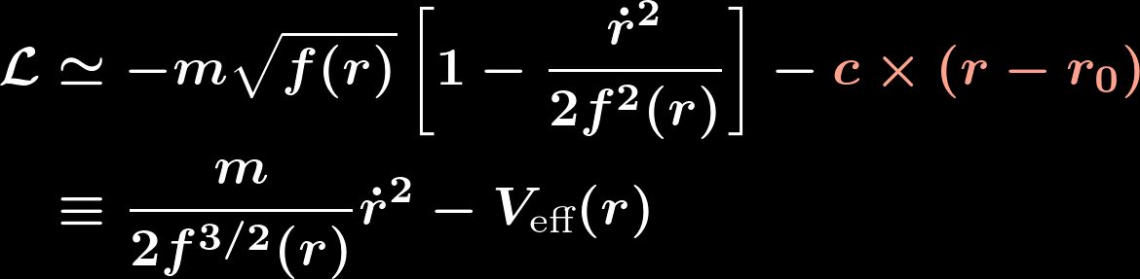
Derive the bound
Gravity
r
Potential V(r)
r₀
Taylor expand V(r) near the potential maximum

Slide 13
Derive the bound
Gravity
r
Potential V(r)
r₀
Taylor expand V(r) near the potential maximum

Slide 14

Derive the bound
Gravity
r
Potential V(r)
r₀
Move the potential maximum r = r₀ toward BH horizon

Slide 15




Derive the bound
Gravity
r
Potential V(r)
r₀
Expanding around r = r₀ for small distance, we get

Slide 16


Derive the bound
Gravity
r
Potential V(r)
r₀
⇒
⇒ Lyapunov exponent 𝜆 = 𝜅
Head-on view:
r₀
r

Slide 17
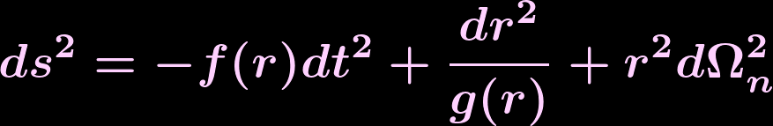
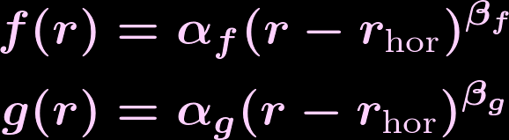

Derive the bound
Gravity
r
Potential V(r)
r₀
⇒
⇒ Lyapunov exponent 𝜆 = 𝜅
This 𝜆 is independent of particle mass, strength & species of potential force, metric form, cosmological constant and dimensions
𝜆 averaged over trajectory ⇒ generic trajectory will obey
with

Slide 18

Summary: Derive the bound
Gravity
r
Potential V(r)
r₀
Slow motion near unstable maximum r = r₀
Near-horizon limit r₀ → r_{horizon}
Linear approximation for V(r) ~ (slope) ⨉ (r − r_{horizon})
⇒ A generic trajectory would obey

Slide 19


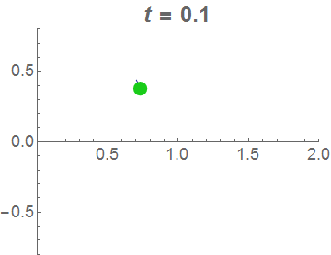
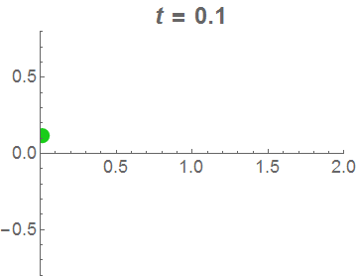

Numerical check
Particle near Potential Minimum
Particle near BH Horizon

Slide 20
Numerical check
Particle near Potential Minimum
Particle near BH Horizon
Periodic motion, no chaos
Chaotic motion

Slide 21


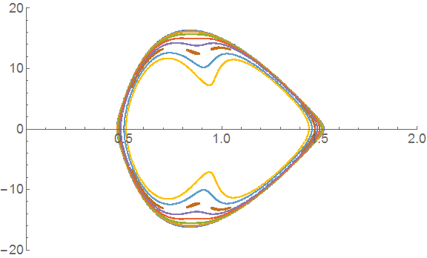
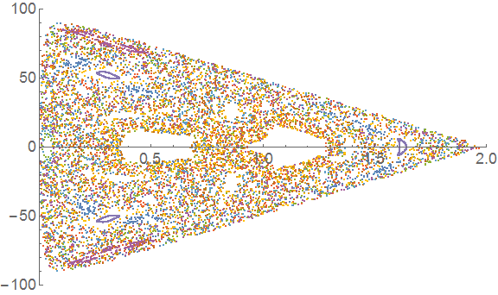


Poincaré plot at
Particle near Potential Minimum
Particle near BH Horizon
Regular KAM tori, no chaos
Lyapunov exponent 𝜆 ~ 0.2 𝜅
Satisfies the bound 𝜆 $≤$ 𝜅

Slide 22
Contents
Chaos bound for particle near BH
Chaos bound for AdS string
  Perturbative motion
  Nonlinear time evolution & chaos
Summary

Slide 23
Chaos Bound for AdS String
Gravity
Potential V(r)
r
r₀
Gravity
String tension
r₀
Fundamental string in AdS = “quark-anti quark pair”
Maldacena ‘98
Rey & Yee ‘98

Slide 24
STRING IN AdS
Three shapes of static Nambu-Goto string in AdS
straight strings
unstable
stable
BH
L
r
effective potential
r

Slide 25



STRING IN AdS
“Square-shaped string” approximation
L
r

Slide 26
STRING IN AdS
“Square-shaped string” approximation
Gravitation
L
r
String tension
→ Linear potential

Slide 27



STRING IN AdS
“Square-shaped string” approximation
L
r
When the string is on the potential maximum near horizon,
⇒
⇒

Slide 28



Perturbative string motion
r
L/2
x
Truncate (l) up to lowest 2 modes
r=∞
l
(l)
r₀
Then expand up to 3rd order in c_{i}(t)
r_{H}
ex.) For r₀ = 1.1 r_{H} ,

Slide 29

Perturbative string motion
Poincaré plot
Truncate (l) up to lowest 2 modes
Then expand up to 3rd order in c_{i}(t)
ex.) For r₀ = 1.1 r_{H} ,
Chaotic (scattered plot) in near-horizon region
λ ~ 0.04×2πT / ℏ

Slide 30
Contents
Chaos bound for particle near BH
Chaos bound for AdS string
  Perturbative motion
  Nonlinear time evolution & chaos
Summary

Slide 31
Chaos Bound for AdS String
Nonlinear dynamics of string
Shake the string end points
by amplitude
→ Nonlinear string motion
x⊥
r
x//
Shake the quark－quark pair
→ Nonlinear flux tube dynamics

Slide 32
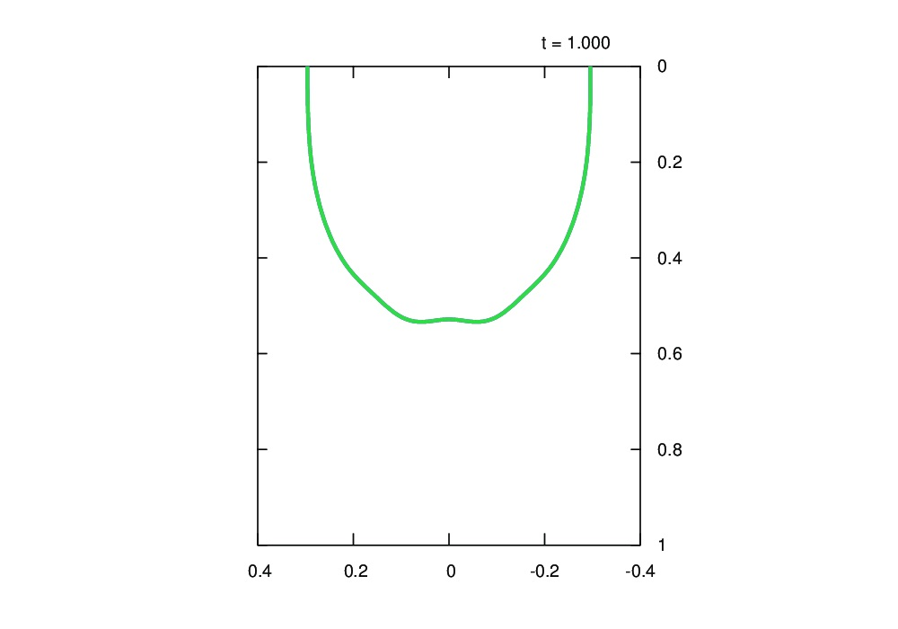


Chaos Bound for AdS String
Nonlinear dynamics of string for slightly different
x⊥
r
x//

Slide 33
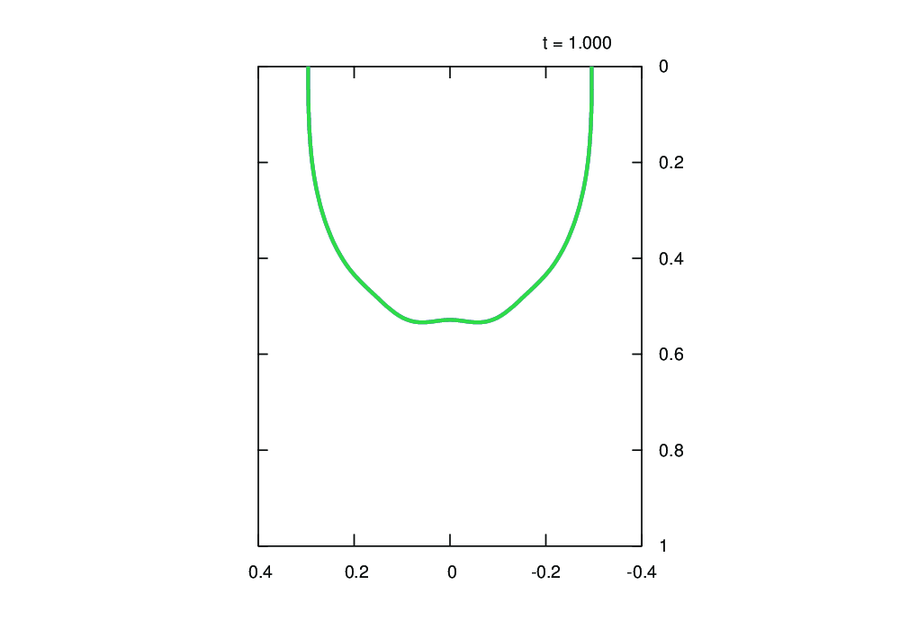
Chaos Bound for AdS String
Nonlinear dynamics of string for slightly different
x⊥
r
x//

Slide 34



Chaos Bound for AdS String
Nonlinear dynamics of string for slightly different
String position difference
x⊥
|δr(t)|
r
x//
t

Slide 35



Chaos Bound for AdS String
Nonlinear dynamics of string for slightly different
Inter-quark force
x⊥
r
x//
t

Slide 36
Cusp formation on the string
[Ishii, Murata ‘15]

Slide 37
Chaos Bound for AdS String
Nonlinear dynamics of string for slightly different
When the string is
not close to the horizon,
x⊥
r
|δr(t)|
x//
t
λ grows just by power-law,
not exponentially.

Slide 38
Setup:
Fundamental String moving near AdS BH horizon
= Dynamics of “quark-anti quark pair” at finite temperature
Maldacena ‘98
Rey & Yee ‘98
Results:
  String motion become chaotic due to BH gravity
  ⇔ Force between the quarks becomes chaotic when T ≠ 0.
  Lyapunov exponent 𝜆 is smaller than surface gravity 𝜅
  [Maldacena-Shenker-Stanford '15]
?: Generalization to different background, motion of brane, field theory side, …

Slide 40

chaos
Classic chaos in deterministic dynamical systems
= Non-periodic bounded orbits sensitive to initial conditions
Diagnostics of chaos
  Poincaré plot = Section of orbits in phase space
  Lyapunov exponent 𝜆 = Separation growth rate of nearby orbits
Notes:
必要ならスライドを足す
JGRG posterを見ながら作成

Slide 41
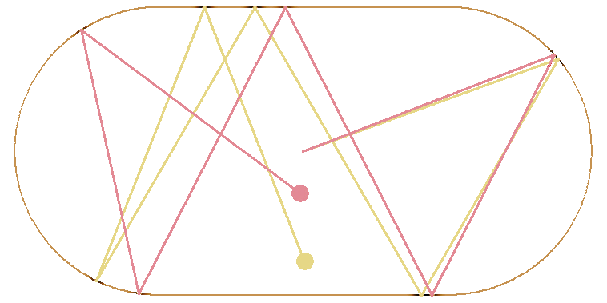
Quantum chaos
?
Definition of Quantum Chaos?
  Chaos arises from nonlinear dynamics,
  but Schrodinger eq. = Linear eq. of wave function.
  Quantum effect washes out small scale 𝛥x 𝛥p ≲ ℏ.
Other probes of “quantum chaos”
  Chaos in semi-classical regime: Quantum billiard
  Energy spectrum of excited atoms
  Chaos in QFT and AdS/CFT
→ No chaos?
Notes:
余計なことを書きすぎか？後ほど調整する
長引きそうだし、A bound on chaosに関連しないことは除くべきかもしれない

Slide 42

Quantum chaos
Chaos in QFT and AdS/CFT
  Look at Out-of-Time-Ordered Correlator
Conjecture [Maldacena-Shenker-Stanford ‘15]
  In a QFT with temperature T , Lyapunov exponent 𝜆 obeys
[Kitaev ‘14]
[Maldacena-Shenker-Stanford ‘15]
: Dependence of q(t) on initial condition q(0)
  [Larkin, Ovchinnikov ‘69]
Notes:
Definition and interpretation of OTOC

Slide 43

a bound on chaos
Background story:
A bound on chaos in QFT at temperature T :
  [Maldacena-Shenker-Stanford '15]
They focused on effect of temperature to chaos in QFT.
We want to study effect of temperature to chaos in classical gravity.
To probe effect of 𝜅, we look at trajectories very close to BH horizon.
Use BH surface gravity instead.

