Slide 1
“Novel Quantum States in Condensed Matter 2022”
Quantum geometry and anomalous Landau levels of flat bands
Bohm-Jung Yang
Department of Physics and Astronomy
Seoul National University
Notes:
Thank you very much for introduction. I am BJY from Seoul National University and IBS center for correlated electron systems. It is my great honor to have a chance to talk about my recent work. Today I am going to talk about quantum distance and anomalous Landau levels of flat bands.

Slide 2




Collaborators
Prof. Jun-Won Rhim
(Ajou University)
Yoonseok Hwang
(SNU=> UIUC)
Dr. Kyoo Kim
(KAERI)
Junseo Jung
(SNU)
Reference
J.-W. Rhim and BJY, “Classification of flat bands according to the band-crossing singularities of Bloch wave functions”, Physical Review B 99, 045107 (2019)
J.-W. Rhim, K. Kim, and BJY, “Quantum distance and anomalous Landau levels of flat bands”, Nature 584, 59-63 (2020)
J.-W. Rhim, and BJY, “Singular flat bands”, Advances in Physics X, 6:1, 1901606 (2021).
Y. Hwang, J. Jung, J.-W. Rhim, and BJY, “Wave function geometry of band crossing points in two-dimensions”, Physial Review B 103, L241102 (2021)
Y. Hwang, J.-W. Rhim, and BJY, “Flat bands with band crossing enforced by symmetry representation”, Physial Review B 104, L081104 (2021)
Y. Hwang, J.-W. Rhim, and BJY, “General construction of flat bands with and without band crossings based on the wave function singularity”, Physial Review B 104, 085144 (2021)
Y. Hwang, J.-W. Rhim, and BJY, “Geometric characterization of anomalous Landau levels of isolated flat bands”, Nature Communications (2021)
Notes:
Let me first introduce my colleagues. The key player of this project is Prof. Junwon Rhim, who recently moved to Aju university as a faculty member. The first principles calculations are done by Dr. Kyoo Kim. Also my student, Yoonseok Hwang and Junseo Jung made important contributions. My talk is based on these recent publications. Also I would like to thank the funding support from various funding agencies listed here. IBS in Korea, NRF of Korea, Samsung Science and Technology Foundation, and US Army research office and Asian office of Aerospace research and development.

Slide 3
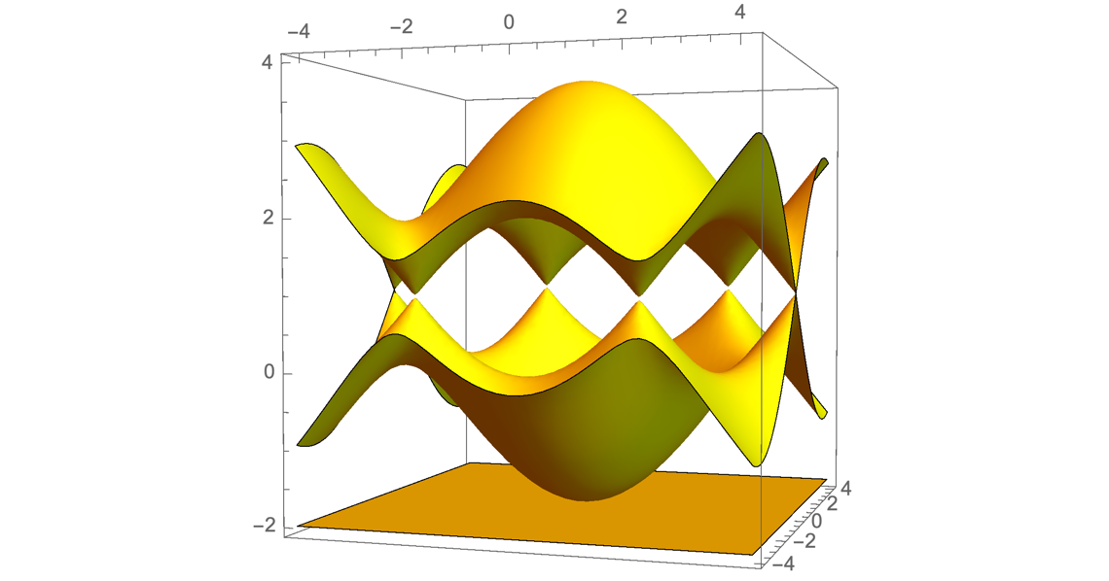
Flat band model
A dispersionless electronic band structure
Kagome lattice
Lieb lattice
E
ky
kx
Band touching
Band touching
Notes:
Flat band indicates a dispersionless electronic band structure which was found in various model Hamiltonian. One famous example is the kagome lattice. When only the nearest neighbor hopping is considered, we obtain the following energy band structure. Here the bottom band is flat and shows no energy dispersion. Interestingly, here the flat band is touching with another parabolic band at a single point. Another famous example is Lieb lattice shown here. When we consider nearest neighbor hopping, we obtain this band structure. Here we again have a flat band which is not crossing with another two bands at a single point. In this system, by tuning the hopping process, an isolated flat band can also be obtained.

Slide 4
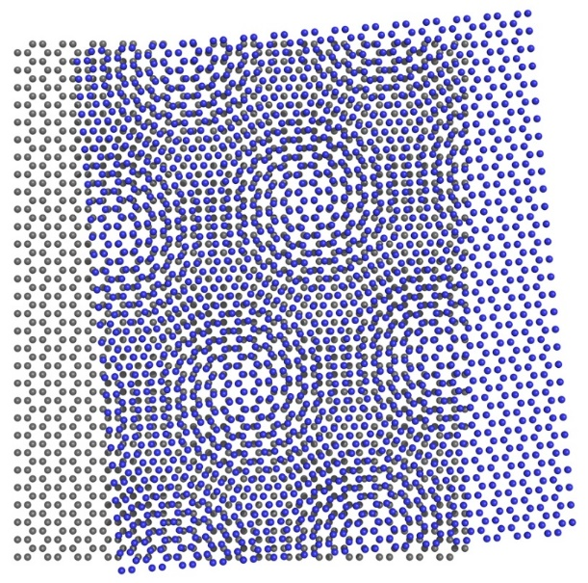

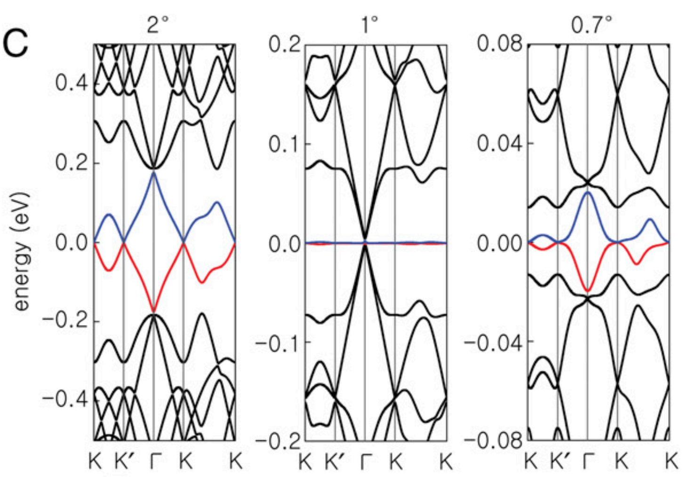
Flat band materials
Twisted Bilayer Graphene (TBG)
Kagome metal FeSn, CoSn
Kang, Ye, Comin, Checkelsky (2018)
Bistritzer and MacDonald (2011);
Cao et al. (Nature, 2018)
K. Kim et al PNAS 114 3364 (2017)
Notes:
Recently, several materials hosting flat bands are discovered. One famous example is twisted bilayer graphene. In this system, depending on the rotation angle between two graphene layers, the low energy dispersion changes significantly. In particular, when the rotation angle takes specific values called the magic angle, flat bands appear at the Fermi level. Another famous example is Kagome metal such as FeSn, CoSn, which are discovered by MIT group led by Checkelsky and Comin. In this system, Fe atoms form kagome lattice and the flat band dispersion predicted in the kagome lattice model is confirm by recent ARPES measurement.

Slide 5
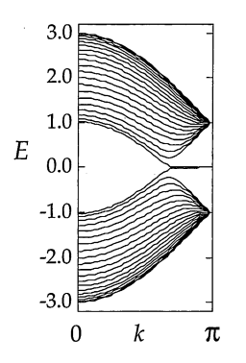
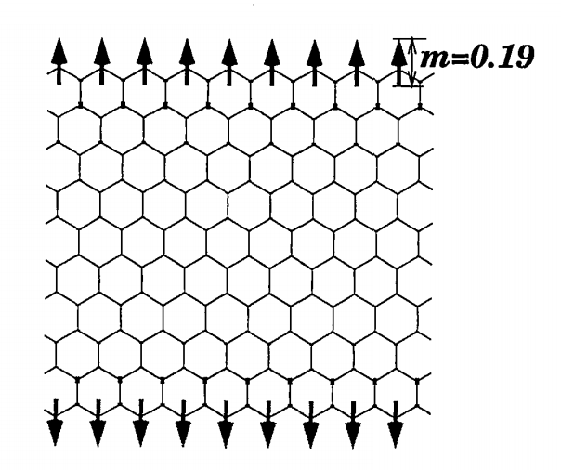
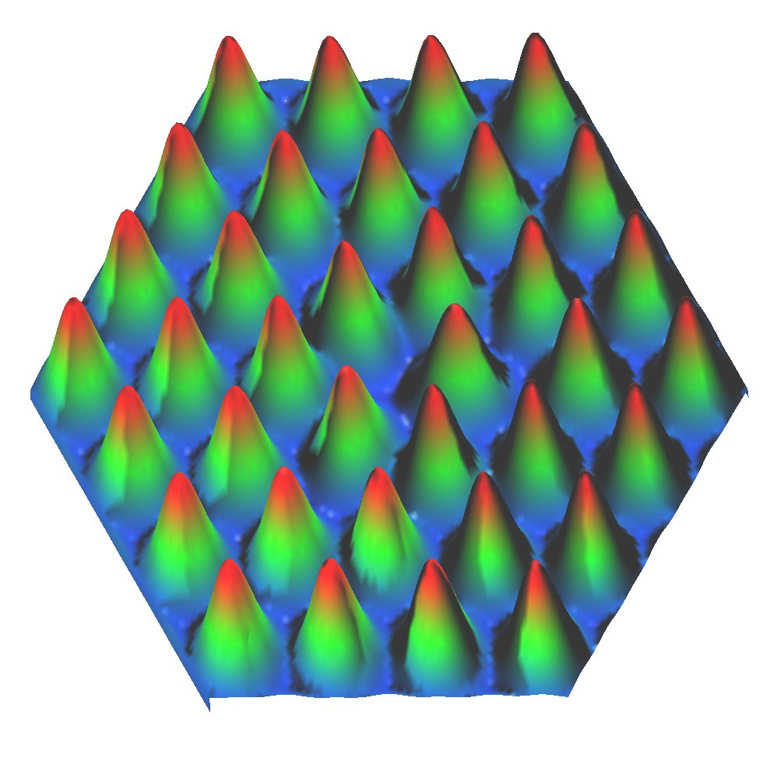
Why is flat band interesting?
Strong correlation effect: Coulomb interaction >> Kinetic energy (bandwidth)
Stoner Ferromagnetism
Wigner crystal
Mott physics and superconductivity
Flat band wave function
Quantum geometric response?

Slide 6
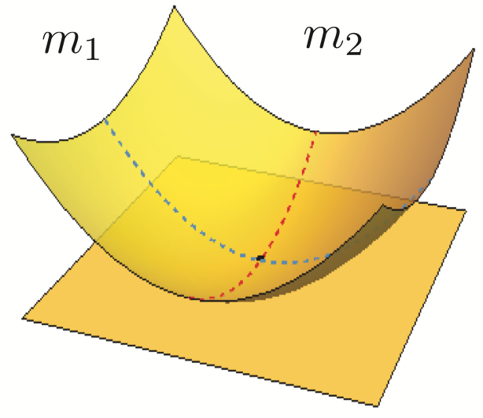
Geometric properties of flat bands
1. Why geometry matters in flat band?
E
ky
kx
2. What is the singular flat band?
Singular flat band
3. Geometry and Landau levels of
singular flat band?
4. Geometry and Landau levels of
isolated flat band?
Nonsingular, isolated
flat band
Notes:
The main topic I am going to discuss in this talk is about the geometric properties of flat bands. In particular, I am interested in a particular class of flat bands, which we call singular flat bands, whose precise definition will be given later. Here is the band structure that I am interested in. One peculiar property of this band structure is that there is a band touching between the flat band and another parabolic band at a single point, which can actually appear in kagome lattice shown before. The presence of such a band crossing is a key property of the singular flat band. I am going to tell you what is the singular flat band, why geometry matters in flat bands, and the how the flat band geometry and Landau levels are related.

Slide 7
Why geometry matters in flat bands?
1. Why geometry matters in flat band?
E
ky
kx
2. What is the singular flat band?
Singular flat band
3. Geometry and Landau levels of
singular flat band?
4. Geometry and Landau levels of
isolated flat band?
Nonsingular, isolated
flat band
Notes:
The main topic I am going to discuss in this talk is about the geometric properties of flat bands. In particular, I am interested in a particular class of flat bands, which we call singular flat bands, whose precise definition will be given later. Here is the band structure that I am interested in. One peculiar property of this band structure is that there is a band touching between the flat band and another parabolic band at a single point, which can actually appear in kagome lattice shown before. The presence of such a band crossing is a key property of the singular flat band. I am going to tell you what is the singular flat band, why geometry matters in flat bands, and the how the flat band geometry and Landau levels are related.

Slide 8
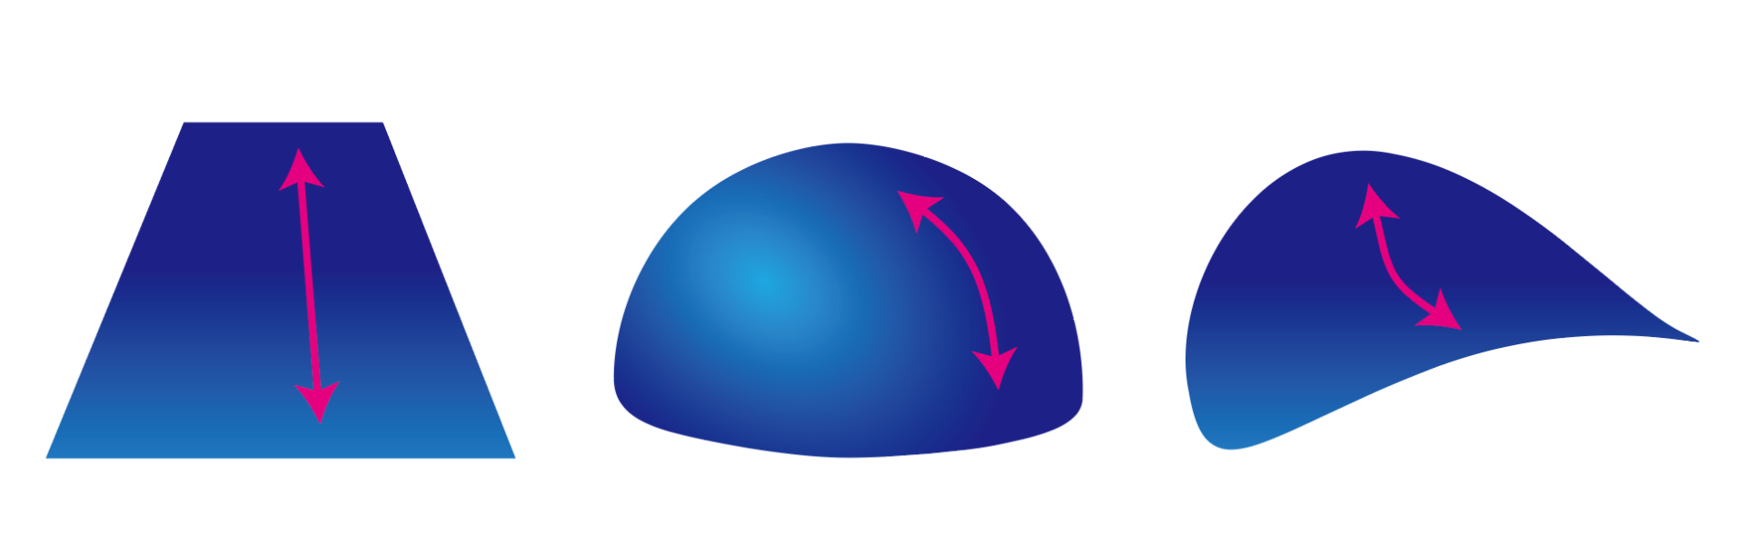
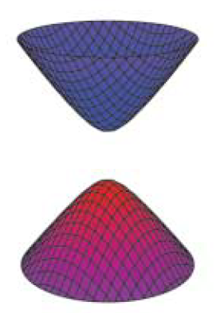
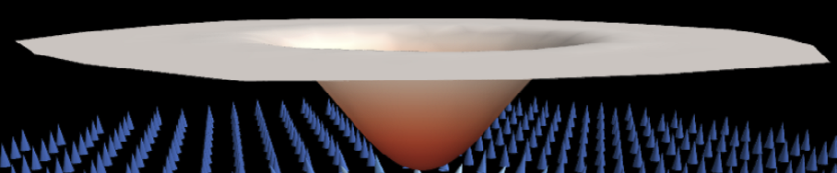


What is geometry?
Geometry of 2D manifolds: curvature and distance
Plane
Sphere
Hyperboloid
Geometrical properties of Bloch wave functions
Band structure
Wave function
of valence band
Normal
insulator
Topological
insulator
E
$$k_{y}$$
$$k_{x}$$
Fig. from Fernandes et al. (2018)
Notes:
For this, Let me first briefly remind you what is geometry. Geometry is a branch of mathematics that studies the sizes, shapes, dimensions of things. Here I’ve shown you three different types of 2D manifolds. You can easily figure out that they have different geometry. For more mathematical description of geometry of the manifold, there are two central notions we can use. That is the curvature and the distance. Namely, one can mathematically distinguish these manifolds by measuring the local curvature or by describing how the distance between two points are defined. Interestingly, such a geometric concept is also important when we describe quantum states. For instance, here I’ve shown you a gapped band structure of a 2D insulator. To fully understand the nature of this insulator, just showing the energy band dispersion is not enough. Additionally, we have to understand how the wave function of the valence band changes over the momentum space. For example. I’ve plotted how the wave function changes in the momentum space. Here each arror is a vector representing the wave function at each momentum. In general, the wave function of a band forms particular structure in the momentum space, the structure of the wave function reflects the physical properties of the system. For example, here are the structure of the wave functions in the momentum space for normal insulator and topological insulator. In the case of normal insulator, the vectors have no particular structure and just point to the same direction. On the other hand, in the case of topological insulators, one can clearly see the winding structure of the arrows, which form a so-called skyrmion texture. If we connect the head of the arrows, in the case of normal insulators, we see that the vectors form a flat 2D manifold. On the other hand, in topological insulators, the head of the arrows form a curved 2D manifold. This clearly show that the collection of the wave functions have a particular geometric structure in the momentum space. This geometry of the wave functions indicates the physical property of the system.

Slide 9
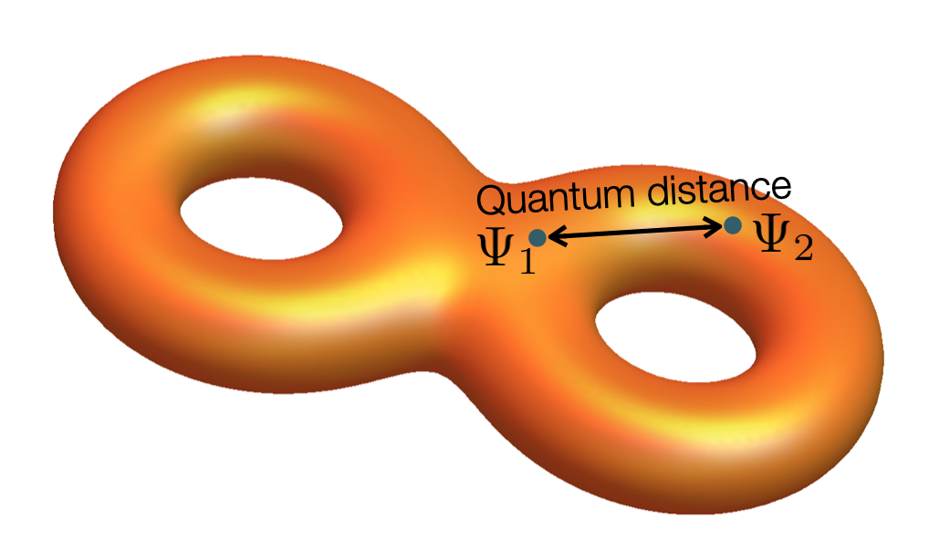
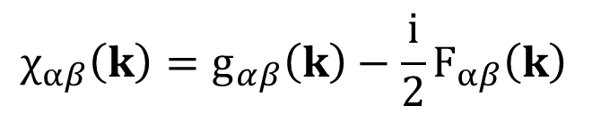
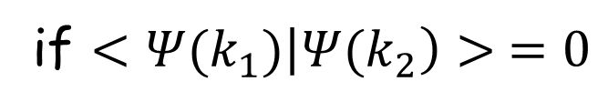

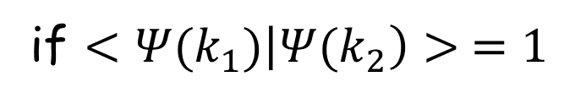


Geometry of quantum states
Quantum geometric tensor: Berry curvature and Quantum metric
The geometry of quantum states can be characterized by the quantum geometric tensor $χ_{αβ}$
(Hilbert-Schmidt) quantum distance:
How similar two states are?
$${ds}^{2}≡1−{|<{Ψ(k}_{1})|{Ψ(k}_{2})>|}^{2}$$
$${ds}^{2}=0$$
if $<{Ψ(k}_{1})\left|{Ψ(k}_{2}\right)> =1$
$${ds}^{2}=1$$
if $<{Ψ(k}_{1})\left|{Ψ(k}_{2}\right)> =0$
$${ds}^{2}≡1−{|<Ψ_{0}(k)|Ψ_{0}(k+dk)>|}^{2}={dk}_{α}χ_{αβ}(k){dk}_{β}$$
$$χ_{αβ}\left(k\right)=g_{αβ}\left(k\right)−\frac{i}{2}F_{αβ}\left(k\right)$$
Berry curvature $F_{αβ}=−F_{βα}$: imaginary part of $χ_{αβ}$
Quantum metric $g_{αβ}=g_{βα}:$ real part of $χ_{αβ}$
Notes:
In general, the geometry of quantum states can be characterized by the quantum geometric tensor chi, which can be defined using the concept of Hilbert-Schmidt quantum distance. The HS quantum distance is defined in the following way. Here psi1, psi2 indicate two wave functions at two different points in the parameter space, such as the momentum space. When two wave functions are identical, their quantum distance is zero. On the other hand when two wave functions are orthogonal, their distance takes the largest value, 1. So this means that the quantum distance measures how similar two quantum states are. The more they are similar, the shorter their distance. In particular, when two parameters where the wave functions are defined are infinitesimally close, the quantum distance can be expanded up to quadratic order as here. Here we obtain the quantum geometric tensor. The imaginary part of the quantum geometric tensor is called the Berry curvature while its real part is called the quantum metric. Therefore, the quantum metric and Berry curvature are two central concepts determining the local geometry of wave functions.

Slide 10
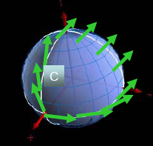
Quantum geometry and physical properties
Influence of Berry curvature on physical phenomena in solids
Berry phase and parallel transport
Anomalous velocity and Hall effects
Geometric phase (Berry, 1980)
Adiabatic process
Berry curvature integral
Anomalous velocity
Berry curvature: origin of intrinsic anomalous Hall effect (1995)
Spin/orbital/valley Hall effect
Charge polarization
and Orbital magnetization
Topological phases of matter
Electronic contribution to polarization and magnetization
From Berry connection and curvatures
First-principles calculation
Chern number and quantum Hall effect
Quantum anomalous/spin Hall insulators
Topological crystalline phases
Notes:
Geometry of quantum states is important because there are various physical phenomena which are determined by the wave function geometry. Especially, the importance of Berry curvature is already well-established, and there are various interesting physical properties of solids determined by the Berry curvature such as the geometric phase related responses, the anomalous Hall effect, charge polarization. Also the Berry curvature is one of the central notion related to the topological properties of matter.

Slide 11
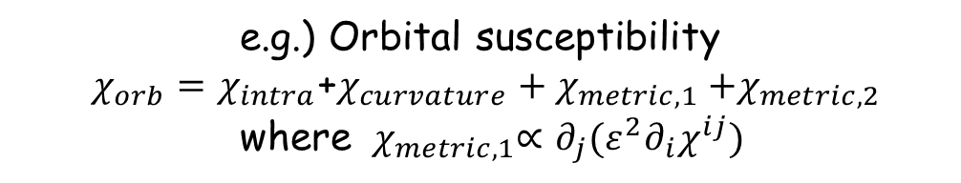
How much is quantum metric studied?
Quantum metric related physical phenomena ?
: Not many things are known compared to Berry curvature physics
List of proposals in solids
Proposals in other fields
Partial contribution to orbital susceptibility, correction to anomalous Hall effect, Lamb shift like transitions in excitons, current noise in insulator, superfluidity, etc.
Direct measurement was done
superconducting circuits
exciton-polaritons in planar microcavity.
Relevance to condensed matter?
e.g.) Orbital susceptibility
$χ_{orb}=χ_{intra}$+$χ_{curvature}{+ χ}_{metric,1}{+χ}_{metric,2}$
where ${ χ}_{metric,1}∝∂_{j}(ε^{2}∂_{i}χ^{ij})$
Central questions
In what physical observables of solids, quantum metric directly manifests?
In which material can we observe enhanced response related to quantum metric?
Notes:
However, how much do we know about the quantum metric, especially in the context of physical properties of solids. Of course, there are various intriguing theoretical ideas proposed up to now, which show how the quantum metric can affect the physical properties of solids. However, compared to what we know about the Berry curvature, the current understanding of the quantum metric is still incomplete. Especially, what I think important in this context, the questions such as in what physical observable of solids, quantum metric directly manifest? Also in what materials, can we observe enhanced response related to quantum metric?

Slide 12

Why is flat band system?
Ideal systems for studying quantum metric
Maximum quantum metric and minimum Berry curvature
(1) Perfect flat bands in periodic systems have zero Chern number
(see Chen et al. J. Phys. A (2014))
(2) Flat band models with zero Berry curvature under symmetry constraint
e.g.) PT symmetric spinless systems (P:inversion, T:time-reversal)
P: (t,x,y) → (t,-x,-y)
F(k_{x},k_{y})=F(-k_{x},-k_{y})
T: (t,x,y) → (-t,x,y)
F(k_{x},k_{y})=-F(-k_{x},-k_{y})
Space-time inversion I_{ST} = PT : (x,y,t) → (-x,-y,-t)
F(k_{x},k_{y})=0
$$χ_{αβ}\left(k\right)=g_{αβ}\left(k\right)$$
Quantum geometry of ψ is solely determined by quantum metric!
Notes:
In this respect, I think flat band systems can play a very important role. Actually, flat bands are ideal system to study quantum metric. This is because as the band structure has zero curvature, the relevant wave function geometry often has zero Berry curvature. For example, it is known that perfect flat band cannot have finite Chern number. Also in many lattice models, flat band can be realized under particular symmetry constraint such as the PT symmetry, which enforces the Berry curvature to be strictly zero at every momentum. In this respect, the flat dispersion minimize the role of Berry curvature and at the same time maximizes the role of the quantum metric. Back to this flat dispersion with a single band crossing point, one can show that Berry curvature of this band structure is strictly zero while the quantum metric takes a finite value. Here I plotted the distribution of quantum metric in momentum space, which takes finite value. Interesting, in this system, the quantum metric distribution determine the Berry phase around the band crossing point as shown in our recent work.

Slide 13

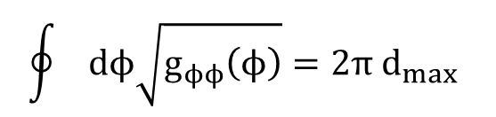





Quantum metric of a singular flat band
Y. Hwang, J. Jung, J.W.Rhim, BJY, Physial Review B 103, L241102 (2021)
Zero Berry curvature
Finite quantum metric
Quantum metric determines quantum distance & Berry phase of 2D semimetals
$d_{max}$=max $d_{HS}(ϕ_{i},ϕ_{j})$
$$\oint{dϕ\sqrt{g_{ϕϕ}\left(ϕ\right)}}=2π d_{max}$$
$$\left|u\left(ϕ_{2}\right)\right\rangle$$
$$\left|u\left(ϕ_{1}\right)\right\rangle$$
Touching point
Berry phase $=2π {\left(1−d_{max}^{2}\right)}^{1/2}$
$$\left|u\left(ϕ_{i}\right)\right\rangle$$
$$\left|u\left(ϕ_{N}\right)\right\rangle$$
Notes:
In this respect, I think flat band systems can play a very important role. Actually, flat bands are ideal system to study quantum metric. This is because as the band structure has zero curvature, the relevant wave function geometry often has zero Berry curvature. For example, it is known that perfect flat band cannot have finite Chern number. Also in many lattice models, flat band can be realized under particular symmetry constraint such as the PT symmetry, which enforces the Berry curvature to be strictly zero at every momentum. In this respect, the flat dispersion minimize the role of Berry curvature and at the same time maximizes the role of the quantum metric. Back to this flat dispersion with a single band crossing point, one can show that Berry curvature of this band structure is strictly zero while the quantum metric takes a finite value. Here I plotted the distribution of quantum metric in momentum space, which takes finite value. Interesting, in this system, the quantum metric distribution determine the Berry phase around the band crossing point as shown in our recent work.

Slide 14

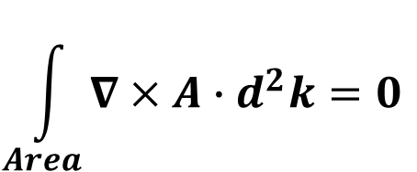
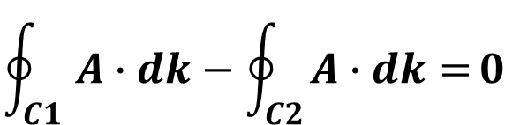
Quantum metric and Berry phase in semimetals
Y. Hwang, J. Jung, J.W.Rhim, BJY, Physial Review B 103, L241102 (2021)
Pi-Berry phase of a Dirac point
= -1
For any closed C loop encircling DP
Quantization of Berry phase requires vanishing Berry curvature
C₁
$$\oint_{C1}{A∙dk−\oint_{C2}{A∙dk=}0}$$
C₂
Area
$$\int_{Area}{∇×A∙d^{2}k=0}$$
F(k_{x},k_{y})=0
$$χ_{αβ}\left(k\right)=g_{αβ}\left(k\right)$$
Quantum geometry of ψ is solely determined by quantum metric!
Notes:
In this respect, I think flat band systems can play a very important role. Actually, flat bands are ideal system to study quantum metric. This is because as the band structure has zero curvature, the relevant wave function geometry often has zero Berry curvature. For example, it is known that perfect flat band cannot have finite Chern number. Also in many lattice models, flat band can be realized under particular symmetry constraint such as the PT symmetry, which enforces the Berry curvature to be strictly zero at every momentum. In this respect, the flat dispersion minimize the role of Berry curvature and at the same time maximizes the role of the quantum metric. Back to this flat dispersion with a single band crossing point, one can show that Berry curvature of this band structure is strictly zero while the quantum metric takes a finite value. Here I plotted the distribution of quantum metric in momentum space, which takes finite value. Interesting, in this system, the quantum metric distribution determine the Berry phase around the band crossing point as shown in our recent work.

Slide 15
What is the singular flat band?
1. Why geometry matters in flat band?
E
ky
kx
2. What is the singular flat band?
Singular flat band
3. Geometry and Landau levels of
singular flat band?
4. Geometry and Landau levels of
isolated flat band?
Nonsingular, isolated
flat band
Notes:
The main topic I am going to discuss in this talk is about the geometric properties of flat bands. In particular, I am interested in a particular class of flat bands, which we call singular flat bands, whose precise definition will be given later. Here is the band structure that I am interested in. One peculiar property of this band structure is that there is a band touching between the flat band and another parabolic band at a single point, which can actually appear in kagome lattice shown before. The presence of such a band crossing is a key property of the singular flat band. I am going to tell you what is the singular flat band, why geometry matters in flat bands, and the how the flat band geometry and Landau levels are related.

Slide 16
Singular flat band in kagome lattice
Band touching
Origin of the band crossing?
Symmetry protection v.s. topological protection
Flatness enforced semimetal: degeneracy protected by band flatness
[D. Bergmann and L. Balents; J.W.Rhim and B.J.Yang]
Notes:
A representative example of a singular flat band is the flat band on the kagome lattice. Here we see the band crossing between the flat band and a parabolic band. Thanks to the rapid progress in the study of topological semimetal, whenever we observe a band crossing, we ask its origin. Normally, a band degeneracy is protected either by symmetry or topology. Interestingly, the band degeneracy in singular flat band has completely different origin, not related to either symmetry or topology. Here the degeneracy is protected by the fact that the flat band is dispersionless. In this respect, this type of band structure can be called a flatness enforced semimetal.

Slide 17
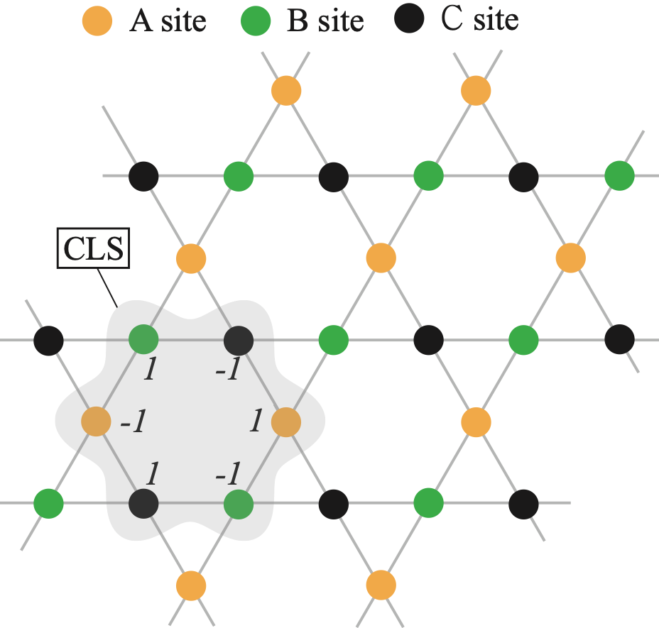
Origin of flatband: compact localized state (CLS)
Flat in momentum space ⬄ Localized in real space
Notes:
Flat dispersion in momentum space indicates the presence of localized state in real space. In the kagome lattice, this eigenstate localized within a hexagon is an eigenstate that has the same energy as the flat band. Here +1, -1 indicate the wave function amplitude at each lattice site. Such a localized eigenstates with wave function spread within finite region is called a compact localized state.

Slide 18
Origin of flatband: compact localized state (CLS)
Cancellation of hopping amplitudes
Notes:
Because of the sign alternation of the wave function, the hopping amplitude from the hexagon to neighboring sites are cancelled.This makes the hexagonal states to be spatially localized.

Slide 19
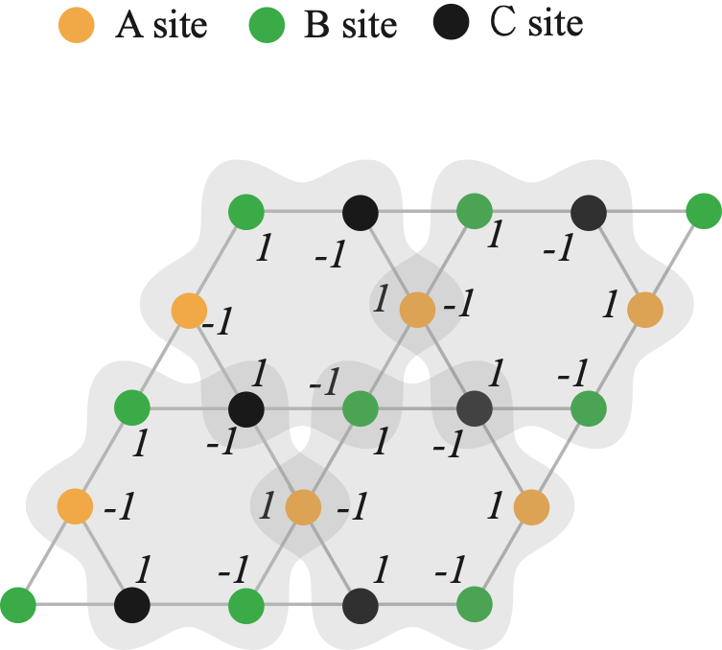
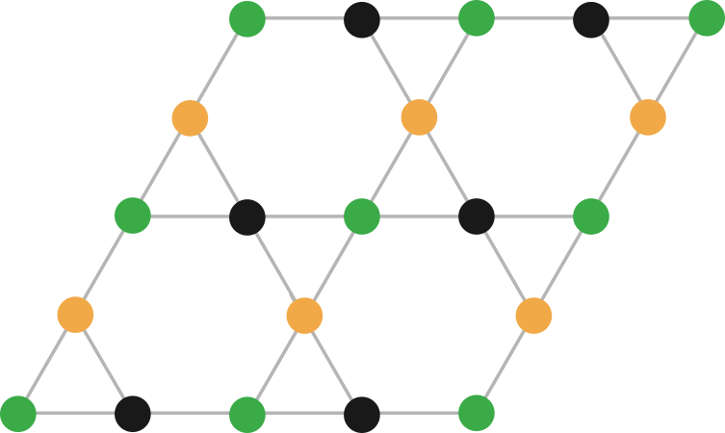
Incompleteness of CLS
Spanning a flat band: number of independent CLS ≥ number of unitcells
Periodic boundary condition (torus)
=
Sum of all the CLSs = 0
When the number of unitcells is N, only (N-1) CLSs are linearly independent.
D. Bergman, et al PRB 78 125104 (2008)
Notes:
Once we find a compact localized states, translating it by lattice vectors, we can fully cover the whole system with CLS. In this situation, if we compute the wave function amplitude at a lattice site, we obtain zero due to the sign alternation of the wave function. Since similar cancellation occurs at every lattice site, we see that the total sum of CLS become zero. This means that when the number of unit cell is equal to N, only (N-1) CLS are linearly, independent. so that the flat band cannot be fully spanned by using the CLSs only.

Slide 20
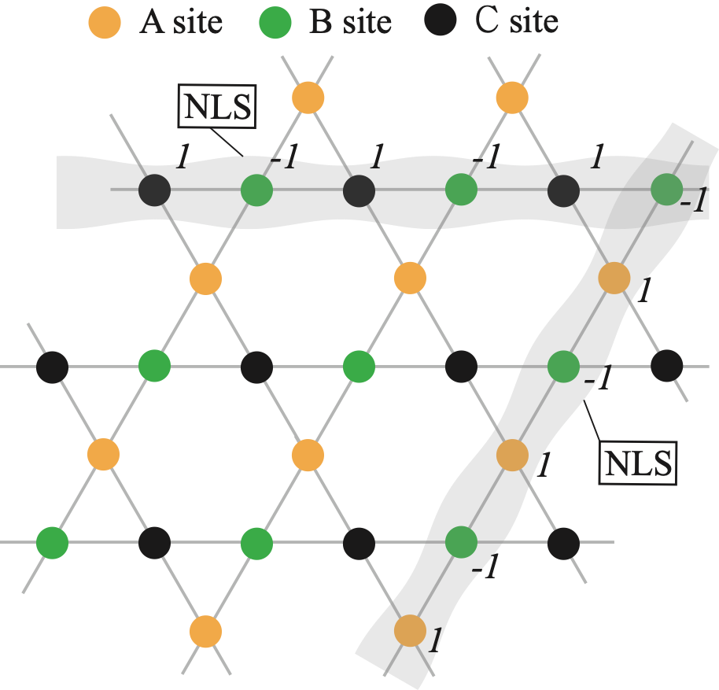
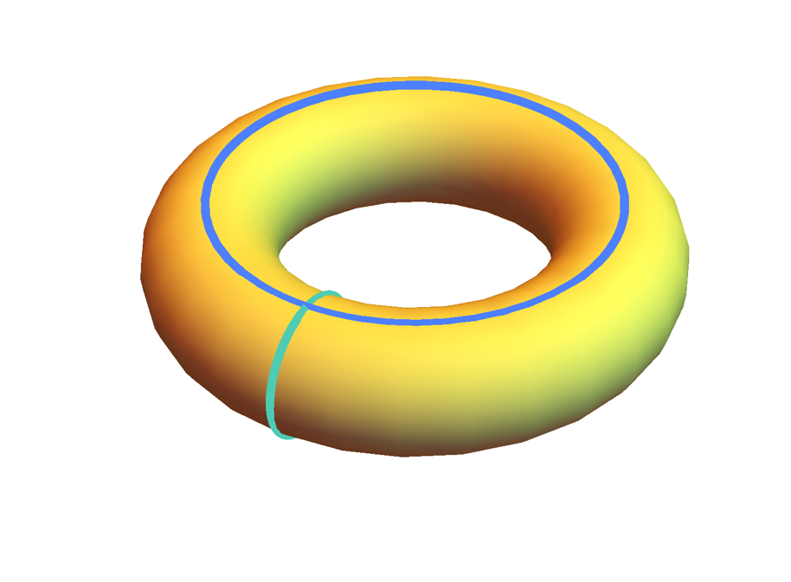
Non-contractible loop states
Kagome lattice on a torus
(periodic boundary condition)
Non-contractible loop states (NLSs)
D. Bergman, et al PRB 78 125104 (2008)
Notes:
The missing degree is provided by another type of eigenstate which is extended in one direction and localized along another direction. Such a state is called a non-contractible loop state. Again, due to the sign alternation, this eigenstate can be localized. When the system is prepared in periodic boundary condition, we can find two independent non-contractible loop states.

Slide 21
Overcomplete basis and singular flat band
Doubly degenerate
Number of independent localized eigenstates
(N-1)+2=N+1
D. Bergman, L. Balents, PRB 78 125104 (2008)
Notes:
Then if we count the total number of independent localized eigenstates, we find (N-1) CLS and 2 non-contractible loop states, so in total we have (N+1) states. Since a flat band be completely spanned by N independent states, we have overcomplete basis. Since This extra degree of freedom should be provided by another band, this means that there should be a band degeneracy between the flat band and another dispersive band at a single point. This nice real space idea proposed by Bergmann and Leon Balents clearly explain the meaning of flatness enforced band crossing.

Slide 22
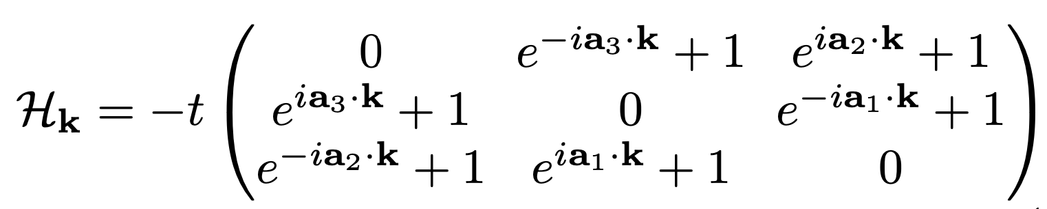
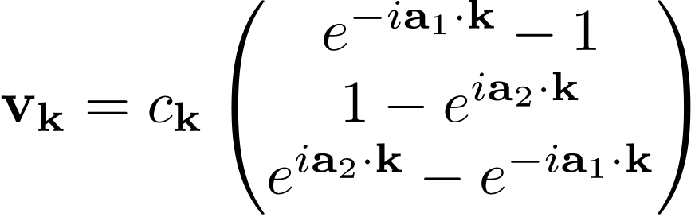


Momentum space approach to band crossing
Extra degeneracy: encoded in the singularity of Bloch function
J.-W. Rhim and B.-J. Yang, PRB 99 045107 (2019)
Eigenvector for
the flat band
A-site
B-site
C-site
Unit cell
Singularity at the band crossing point at k=0 !
Notes:
The meaning of the singularity can be understood more clearly by looking at the property of the momentum space eigenstate. In our recent work, we found that the information about the extra degeneracy is encoded in the singularity of Bloch wave functions. Let me explain what this means. The momentum space Hamiltonian of the kagome lattice with nearest-neighbor hopping can be written in this way. And the eigenstate of the flat band is like this, here c_k indicates the normalization constant. One interesting property of this eigenstate is that all three components become zero at the Gamma point where the band degeneracy exists. This means that the normalization constant has to be divergent at the Gamma point. This indicates that the wave function is singular at the Gamma point.

Slide 23

Singularity of the Bloch function
ky
BZ
kx
Notes:
To understand the meaning of singularity more clearly, let’s look at how the wave function changes as we approach the Gamma point in different directions.

Slide 24
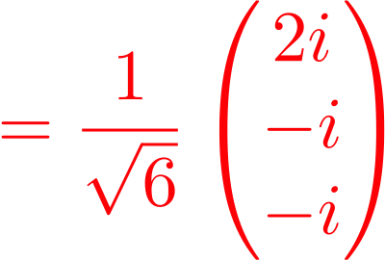
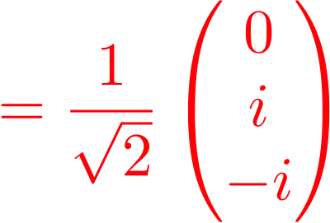
Singularity of the Bloch function
B
ky
A
BZ
kx
along A
Discontinuous
at the crossing point!
along B
Notes:
You can easily show that depending on the path we approach the degeneracy point, we obtain different wave function. This means that the wave function is discontinuous at the band crossing point. This is what we mean by singular band touching.

Slide 25
Singular flat band: definition
If the flat band’s eigenvector has a singularity (or zero) in the BZ,
The complete set of the CLSs cannot be found.
Kagome lattice
ky
kx
J.-W. Rhim and B.-J. Yang, PRB 99 045107 (2019)
Notes:
In general, we can show that if the flat band’s eigenvector has a singularity in the BZ, the complete set of CLS cannot be found. So that we have to introduce non-contractible loop states, which give extra degeneracy.

Slide 26
Continuum model and flatness enforced crossing
The most general continuum two-band model with a quadratic band crossing
Band flatness condition:
J.-W. Rhim and BJY, PRB (2019)
Wave function singularity
Adding a mass perturbation
Notes:
But does the symmetry play no role on the band degeneracy of the singular flat band? Actually, in our recent work, we found that the symmetry also plays a nontrivial role in the singular flat bands. For instance, let us consider a hexagonal eigenstate in the kagome lattice. The kagome lattice has a 6-fold rotation symmetry. The sign-alternative hexagonal state is an eigenstate of C_6 rotation with eigenvalue -1. But this eigenvalue of the CLS is not compatible with any of the band representation of atomic insulators. This means that the CLS cannot be spanned by atomic orbitals. This means that the flat should be either topological or has band crossing. As the perfect flat band cannot have a Chern number, the band degeneracy is the only possible physical consequence consistent with the symmetry representation of the CLS.

Slide 27
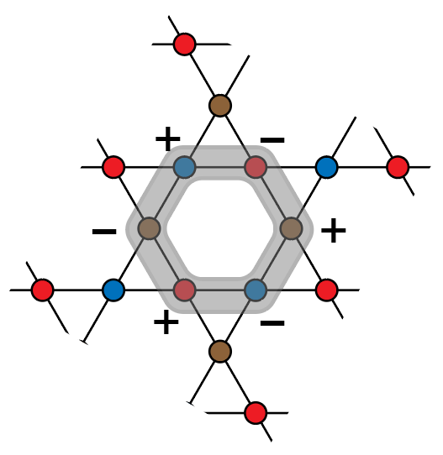
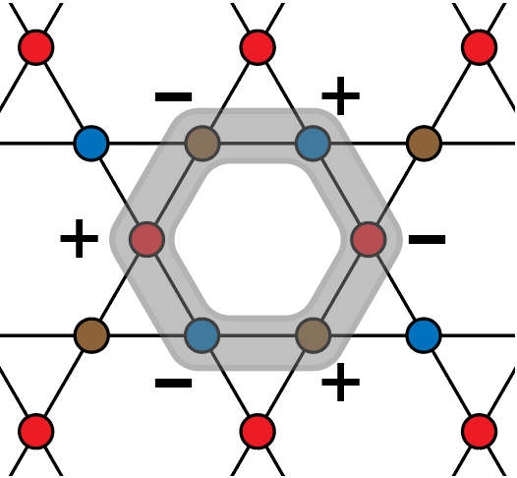
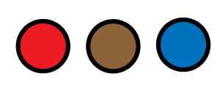
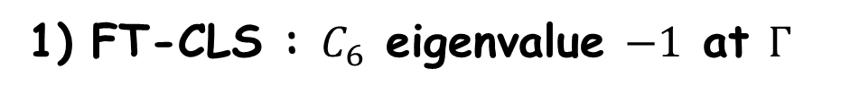




Role of symmetry representation of CLS
Band crossing enforced by the symmetry representation of CLS
(Y. Hwang, J.-W. Rhim, and BJY, arXiv: 2105.15919, arXiv:2106.13057)
CLS : $C_{6}$ eigenvalue $−1$
Fourier transform (FT) of CLS
$$C_{6}$$
$$|\hat{u} (k)〉$$
Fourier transform
1) FT-CLS : $C_{6}$ eigenvalue $−1$ at $Γ$
$$C_{6}|\hat{u}(Γ)〉=−|\hat{u}(Γ)〉$$
2) Constituent atomic orbitals span eigenstates with $C_{6}$eigenvalues
$e^{−2πi/3}$, $e^{2πi/3}$, and $+1$.
3) FT-CLS cannot be spanned by the constituent atomic orbitals
$−1∉\left\{1,e^{−2πi/3},e^{2πi/3}\right\}→|{\hat{u}}_{2}\left(Γ\right)〉=(0,0,0)$
Vanishing of FT-CLS = singularity= degeneracy at Γ
Abelian rotation symmetry + band flatness => band degeneracy !
Notes:
But does the symmetry play no role on the band degeneracy of the singular flat band? Actually, in our recent work, we found that the symmetry also plays a nontrivial role in the singular flat bands. For instance, let us consider a hexagonal eigenstate in the kagome lattice. The kagome lattice has a 6-fold rotation symmetry. The sign-alternative hexagonal state is an eigenstate of C_6 rotation with eigenvalue -1. But this eigenvalue of the CLS is not compatible with any of the band representation of atomic insulators. This means that the CLS cannot be spanned by atomic orbitals. This means that the flat should be either topological or has band crossing. As the perfect flat band cannot have a Chern number, the band degeneracy is the only possible physical consequence consistent with the symmetry representation of the CLS.

Slide 28
Nearly flat Chern band from singular FB
Gap opening by symmetry preserving perturbation
If gapped flat band is topologically trivial, it should be a band representation
Incompatibility with the band representation means that the nearly flat band should carry nonzero Chern number
General mechanism giving a nearly flat Chern band
Y. Hwang, J.-W. Rhim, and BJY, arXiv: 2105.15919, arXiv:2106.13057
See also Calugaru, Bernevig et al., arXiv:2106.05272
Notes:
But does the symmetry play no role on the band degeneracy of the singular flat band?

Slide 29
Geometry and Landau levels of singular FB
1. Why geometry matters in flat band?
E
ky
kx
2. What is the singular flat band?
Singular flat band
3. Geometry and Landau levels of
singular flat band?
4. Geometry and Landau levels of
isolated flat band?
Nonsingular, isolated
flat band
Notes:
The main topic I am going to discuss in this talk is about the geometric properties of flat bands. In particular, I am interested in a particular class of flat bands, which we call singular flat bands, whose precise definition will be given later. Here is the band structure that I am interested in. One peculiar property of this band structure is that there is a band touching between the flat band and another parabolic band at a single point, which can actually appear in kagome lattice shown before. The presence of such a band crossing is a key property of the singular flat band. I am going to tell you what is the singular flat band, why geometry matters in flat bands, and the how the flat band geometry and Landau levels are related.

Slide 30
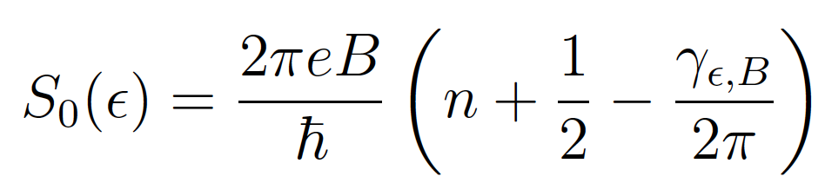

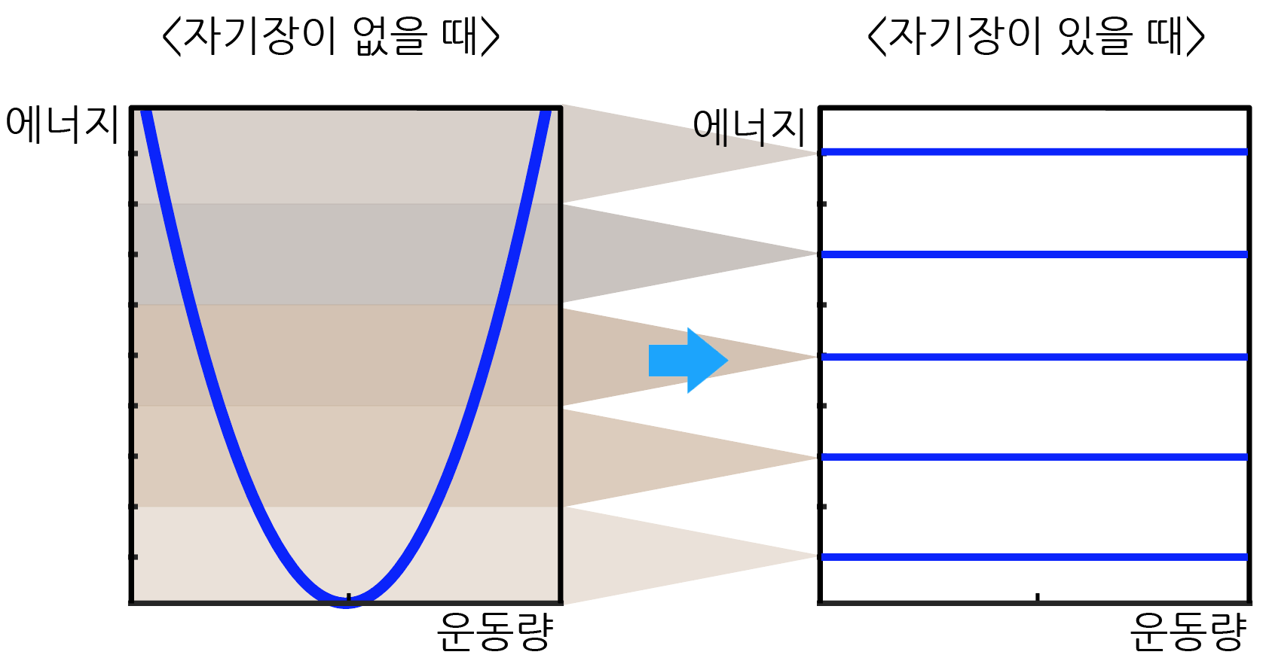
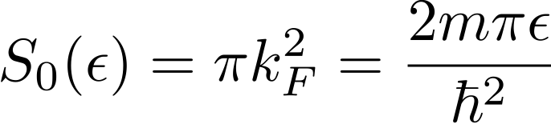


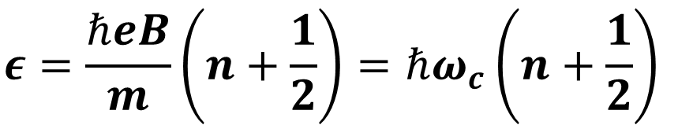
Onsager’s semiclassical theory
L. Onsager, Philos. Mag. 43, 1006 (1952)
S0: k-space area of the closed semiclassical orbit at energy ε
: Quantum corrections (Berry phase, magnetic susceptibility, etc)
Semiclassical orbit
B=0
B≠0
E
E
$$ε=\frac{ℏeB}{m}\left(n+\frac{1}{2}\right)=ℏω_{c}\left(n+\frac{1}{2}\right)$$
Quadratic
band
k
k
k
Landau level appears in the energy region with finite DOS at zero field
Notes:
Here let me briefly remind you Onsager’s semiclassical theory which is widely used to describe Landau levels of bands. In this semiclassical formula, S_0 indicates the k-space area of the closed semiclassical orbit at energy E, Gamma indicates quantum correction arising from Berry phase, magnetic susceptibility, etc. For instance, let us consider a simple parabolic band as shown here. For give energy, the corresponding Fermi surface has a circular form, from which we find that S_0 is pi kF^2. Pugging this information, and the fact that Berry phase is zero, to this formula, we obtain the well-known Landau level with equal spacing. Basically, what this semiclassical result means that when magnetic field is applied, a continuum of states within a certain energy interval merges into a single energy level, which gives discrete Landau level. In this picture, Landau level can appear only within the energy region where finite density of states exist when magnetic field is zero.

Slide 31
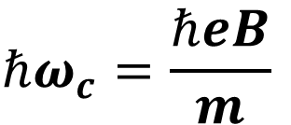


Semiclassical orbit of a flat band ?
S0 is not well-defined: infinite number of semiclassical orbits for a given energy.
C3
E
Dispersionless
C2
ky
C1
k
kx
Flat band
$$ℏω_{c}→0$$
$$m→∞$$
No Landau level splitting !
Parabolic band
$$ℏω_{c}=\frac{ℏeB}{m}$$
Notes:
However, when we apply this semiclassical approach to flat band, we encounter a problem. As the all states are degenerate at the energy of the flat band, we cannot uniquely specify the semiclassical orbit. One way to understand the Landau level of a flat band is to consider a parabolic band with finite mass and takes its infinite mass limit. Since the Landau level spacing of parabolic band is inversely proportional to the mass, in the infinite mass limit, hbar omega c becomes zero. This means that flat band remains intact under magnetic field and there is no Landau level formation.

Slide 32

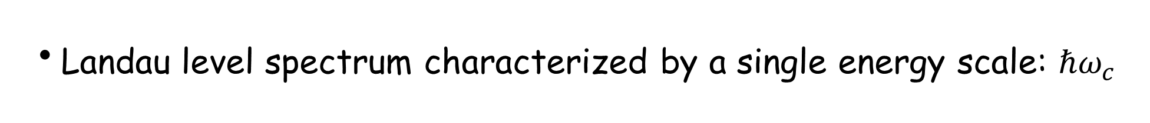
Flat band touching with a quadratic band
?
From quadratic band
Magnetic field
E=0
From flat band
Landau level spectrum characterized by a single energy scale: $ℏω_{c}$
Notes:
Then what happens when magnetic field is applied to singular flat band. Naively, one may apply the semiclassical picture to each of the two bands. So the parabolic band forms equally spaced Landau levels while the flat band remains invariant. If this is true, the Landau level spectrum can be characterized by a single energy scale hbar omega c,

Slide 33
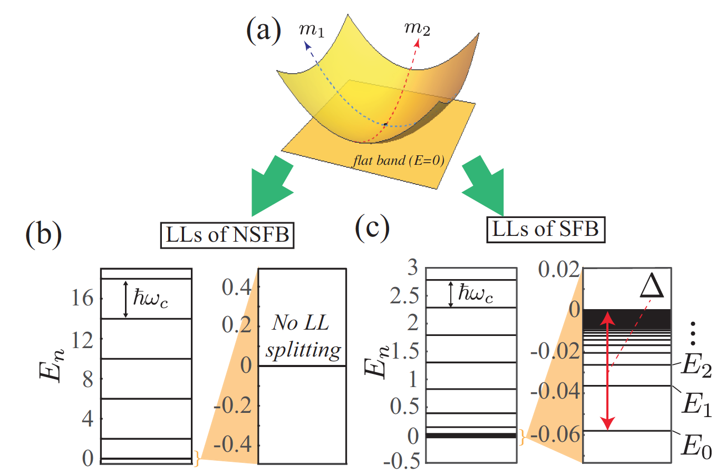
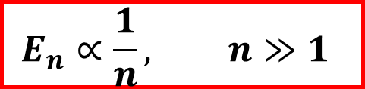
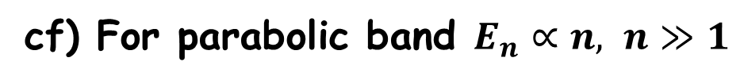
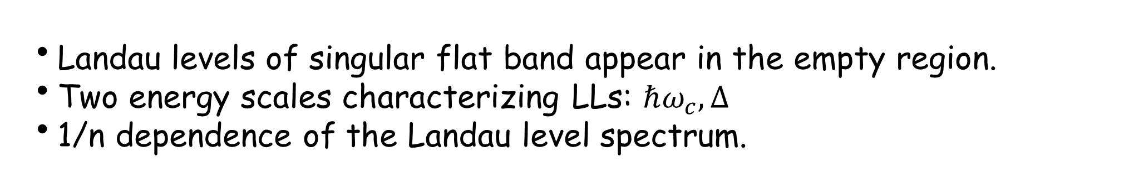
Anomalous Landau levels
Non-singular flat band
Singular flat band
Landau levels of singular flat band appear in the empty region.
Two energy scales characterizing LLs: $ℏω_{c}, ∆$
1/n dependence of the Landau level spectrum.
$$E_{n}∝\frac{1}{n}, n≫1$$
cf) For parabolic band $E_{n}∝n, n≫1$
Notes:
We found that the Landau level spectrum of singular flat band is pretty interesting. Even for the same band structure, depending on the singularity of the wave function at the degeneracy point, the Landau level spectrum is very different. Namely, in the case of non-singular flat band, the semiclassical picture is satisfied so that there is no Landau level splitting in the flat band. On the other hand, in the case of singular flat band, we observe Landau level spreading of the flat band. What is particularly interesting here is that the Landau level appears in the energy range below the flat band energy where there is available state in the absence of magnetic field. So this type of Landau level spreading cannot be explain using the conventional semiclassical picture. Moreover, assigning the Landau level index from the bottom in this way, we find that the energy of nth Landau level is inversely proportional to the Landau level index, which is sharply distinct from the case of parabolic band where the energy is proportional to n.

Slide 34
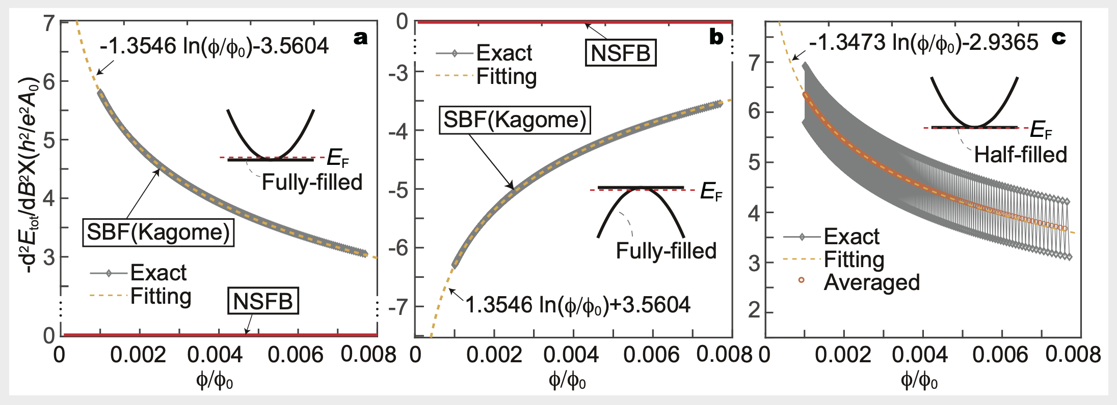
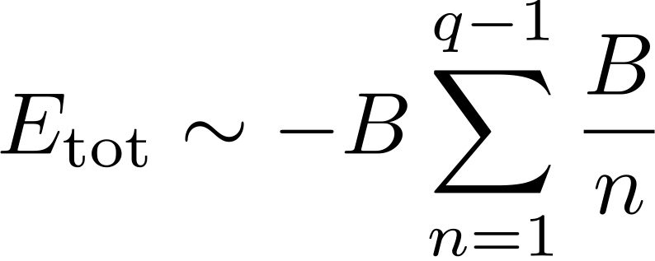
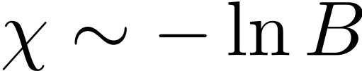
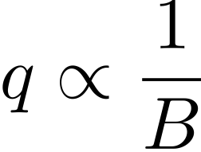
Diverging orbital magnetic susceptibility
LL spacing
LL degeneracy
New mechanism for diverging orbital susceptibility!
Notes:
As a consequence of this unusual dependence of the Landau level on the Landau level index, the orbital magnetic susceptibility shows logarithmic divergence in weak field.

Slide 35
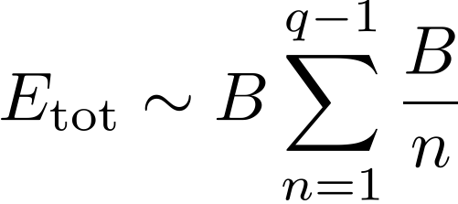

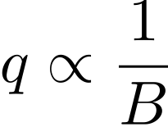
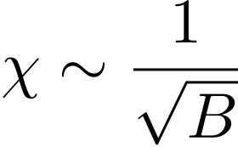

Diverging orbital magnetic susceptibility
graphene
SFB semimetal
LL degeneracy
LL spacing
LL degeneracy
LL energy is proportional to B
Notes:
Let me note that this log divergence is different from the power law divergence expected in Dirac materials.

Slide 36
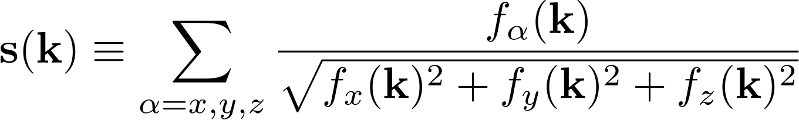


Pseudospin canting and wave function singularity
Pseudo-spin
Non-singular FB
Singular FB
Singular FB
The pseudo-spin structure is always topologically trivial.
The canted structure is due to the Bloch wave function’s singularity.
The strength of the singularity is quantified by the maximum pseudo-spin canting angle.
Notes:
The unusual Landau level spreading of singular flat band is actually a manifestation of the nontrivial wave function geometry of the flat band. To understand the nontrivial wave function geometry of the singular flat band, let me show you how the pseudo-spin changes around the band crossing point. Here we consider a circle encircling the band crossing point, and examine how pseudospin changes on it. Interestingly, we find that although the band structure is the same, depending on the singularity at the crossing point, the pseudospin texture around the circle is very different. In the case of nonsingular flat band, we see that the pseudospin is always pointing to the same direction. On the other hand, once singularity develops at the crossing point, we observe the canting of pseudospins along the circle. In some case, the pseudospin makes a 4pi rotation along the circle. This suggests that we can quantify 0the strength of singularity in terms of the maximum canting angle of pseudo spin along the circle.

Slide 37



Pseudospin canting and LL spreading
Maximum canting angle
Landau level spreading
Pseudo spin
Notes:
Moreover, we found that the total Landau level spreading of singular flat band is correlated with the maximum canting angle of the pseudo spin. Namely, when there is no canting of pseudo spins, we do not see the Landau level spreading. On the other hand, when the pseudospin canting exists, we observe the Landau level spreading. As the maximum canting angle becomes larger, the total spreading of the Landau level also becomes bigger.

Slide 38





Pseudospin canting and quantum distance
Hilbert-Schmidt quantum distance: d_{HS}
k
k’
Larger canting of pseudospins
⬄ Larger d_{HS} of wave functions
Notes:
The pseudospin canting is actually a manifestation of the wave function geometry of the flat band. The geometric meaning of the pseudospin canting can be understood from the definition of the Hilbert Schmit quantum distance discussed before. Basically, the idea is that two pseudospin with larger canting angle indicates that their wave functions are more different. There is a very simple relation between the canting angle and the Hilbert Schmidt quantum distance, given here. So larger canting angle means larger quantum distance.

Slide 39



Landau level spreading and quantum distance
J.-W. Rhim, K. Kim, and BJY, Nature (2020)
The Landau level spreading and the maximum quantum distance has a universal relationship independent of the model parameters.
Two energy scales characterizing LL:
Quantum distance can be measured !
Notes:
Back to this Landau level spreading problem, now we can see the relation between the Landau level spreading and the maximum quantum distance. Interestingly, we found that the ratio between the two energy scales, delta and hbar omega c, is soley given by a single function that depends only on the quantum quantum distance. For instance, in this figure, diamond symbols indicate the numerically obtained data from various flat band model Hamiltonian. We see that all the data points are sitting on a single red curve. This means that once we measure the Landau level spreading, we can extract the maximum quantum distance.

Slide 40

Kagome lattice model
Described by the maximally singular flat band model
Notes:
We applied our theory to various lattice Hamiltonian, including kagome lattice

Slide 41

Checkerboard lattice model
Described by the maximally singular flat band model
Notes:
And also checkerboard lattice. We confirmed that the singular flat band in these models are maximally singular and show the anomalous Landau level spreading.

Slide 42

Candidate materials
Small spin orbit coupling and small long range hopping
~200 meV
~0.2 meV
~0.04 meV
See also Y. Chen et al (2018), J.Y.You et. al (2019)
Notes:
Before I conclude, let me briefly mention candidate materials. One way to see the singular flat band is to use materials with kagome lattice structure with small spin orbit coupling and small longer range hopping. In this respect, carbon based materials with kagome structure are good candidate. Here we compare the band structure of cyclic graphene, cyclic graphyne, cyclic graphdiyne. Especially, in the case of cyclic graphdiyne, we see almost perfect singular flat band.

Slide 43
Geometry and Landau levels of isolated FB
1. Why geometry matters in flat band?
E
ky
kx
2. What is the singular flat band?
Singular flat band
3. Geometry and Landau levels of
singular flat band?
4. Geometry and Landau levels of
isolated flat band?
Nonsingular, isolated
flat band
Notes:
The main topic I am going to discuss in this talk is about the geometric properties of flat bands. In particular, I am interested in a particular class of flat bands, which we call singular flat bands, whose precise definition will be given later. Here is the band structure that I am interested in. One peculiar property of this band structure is that there is a band touching between the flat band and another parabolic band at a single point, which can actually appear in kagome lattice shown before. The presence of such a band crossing is a key property of the singular flat band. I am going to tell you what is the singular flat band, why geometry matters in flat bands, and the how the flat band geometry and Landau levels are related.

Slide 44


Landau levels of isolated flat band
Y. Hwang, J.-W. Rhim, and BJY, Nat. Comm. (2021)
Nonsingular, isolated flat band
Any Landau level spreading (LLS)?
Is geometry important?
Our Results
Symmetry | LLS
Space-time inversion ($I_{ST}$) | $$∝B^{2}$$
Chiral symmetry ($C$) | $$0$$
Otherwise | $$∝B$$
$∎$ The LLS exists in general.
$∎$ Symmetry constrains the LLS:
$∎$ The upper and lower bounds of LLS are determined by geometric quantities, “fidelity” tensor.
Notes:
Before I conclude, let me briefly mention candidate materials. One way to see the singular flat band is to use materials with kagome lattice structure with small spin orbit coupling and small longer range hopping. In this respect, carbon based materials with kagome structure are good candidate. Here we compare the band structure of cyclic graphene, cyclic graphyne, cyclic graphdiyne. Especially, in the case of cyclic graphdiyne, we see almost perfect singular flat band.

Slide 45














Example: Spin-orbit coupled Lieb model
$φ$: magnetic flux per unit cell
$φ_{0}$: flux quantum
2
$$E$$
$$0$$
-2
Lieb lattice
$$0$$
$$4$$
$$8$$
$$B$$
$$φ/φ_{0}$$
$$∝B$$
Landau levels
The upper and lower
bounds
Landau levels
of flat band
Band structure at $B=0$
Landau levels in the weak field
Notes:
먼저 모델 하나를 보겠습니다.
Lieb lattice라고 불리는 격자 구조에서 몇 개의 hopping interaction들을 고려하면, [A] zero energy flat band가 있는 band 구조를 얻게 됩니다.
여기에 자기장을 걸어, [A] Landau level spectrum을 얻었습니다.
Y축은 에너지, X축은 자기장에 비례하는 양입니다.
자기장이 생기면, 에너지 0에 있던 flat band에서 Landau level들이 형성이 되면서 원래 gap이 있었던 부분들을 채워나간다는 것을 볼 수 있습니다.

Slide 46



















Modified band structure
$$E_{n,B}\left(k\right)=ε_{n}\left(k\right)+μ_{n}\left(k\right) B+O(B^{2})$$
$$ε_{4}\left(k\right)$$
Orbital magnetization (Q. Niu et al.)
$$ε_{4}\left(k\right) χ_{xy}^{24}(k)$$
$$ε_{3}\left(k\right)$$
For flat band, $ε_{n}\left(k\right)=0$
$$B$$
$$ε_{3}\left(k\right) χ_{xy}^{23}(k)$$
$$E_{2,B}\left(k\right)$$
$$μ_{n}\left(k\right)∝$$
$$ε_{2}\left(k\right)$$
$$ε_{1}\left(k\right) χ_{xy}^{21}(k)$$
Energy $×$ fidelity tensor
$$ε_{1}\left(k\right)$$
$$χ_{ij}^{nm}\left(k\right)=A_{i}^{nm}{\left(k\right)}^{∗} A_{j}^{nm}(k)$$
Band structure
Fidelity tensor
$$A_{i}^{nm}\left(k\right)=i 〈u_{n}(k)|∂_{i}|u_{m}(k)〉$$
Berry-Wilczek-Zee connection
$$|Δ_{LLS}|$$
$$\left|Δ_{LLS}\right|=\max{E_{n,B}\left(k\right)}−\min{E_{n,B}\left(k\right)}$$
Landau level
spreading
$$E_{2,B}\left(k\right)$$
Landau levels
$\max{E_{n,B}\left(k\right)}$: upper bound of LLS
$\min{E_{n,B}\left(k\right)}$: lower bound of LLS
Modified band structure of flat band “2”
Notes:
지금까지의 내용을 그림으로 정리해보겠습니다.
여기에 flat band가 있고, 자기장이 걸리면 [A] 다른 band들과의 상호작용에 의해 [A] band 구조가 변하게 됩니다.
이렇게 수정된 band 구조에서는 Landau level들이 원래의 flat band 에너지를 벗어나서 생길 수 있습니다. 그리고 Landau level energ의 최대값과 최소값은 수정된 band 구조의 최대값과 최소값으로 예측할 수 있습니다.
따라서 저희는 Landau level의 spreadin의 크기를 수정된 band 구조의 최대값과 최소값의 차이로 정하였습니다.

Slide 47






Spin-orbit coupled Lieb model revisited
$$B$$
Upper bound
$$+$$
fb
$$−$$
Lower bound
Modified band structure
Band structure at $B=0$
The upper and lower
bounds
Landau levels
of flat band
Fidelity tensor
Landau level spectrum
Notes:
아까 봤던 모델을 다시 들여다보겠습니다.
[A] Flat band와 dispersive band 사이의 fidelity tensor가 0 아니기 때문에, 자기장이 걸리면 [A] flat band의 band 구조가 변하게 됩니다.
이 수정된 band 구조의 극값들로부터 [A] Landau level spreading의 upper bound와 lower bound를 예상할 수 있습니다.
이 bound들을 자기장을 걸어 얻은 Landau level spectrum과 겹쳐보면, 아주 잘 들어맞네요.

Slide 48









I_{ST} symmetric model on square lattice
I_{ST} symmetry imposes a reality condition to the Bloch wave functions:
$$|u_{n}\left(k\right)〉={|u_{n}\left(k\right)〉}^{∗} \& χ_{xy}^{nm}\left(k\right)=χ_{xy}^{nm}{\left(k\right)}^{∗}$$
$$μ_{n}\left(k\right)∝Im χ_{xy}^{nm}\left(k\right)=0$$
$$E_{n,B}\left(k\right)=ε_{n}\left(k\right)+μ_{n}\left(k\right) B+O\left(B^{2}\right)=O\left(B^{2}\right)$$
$|Δ_{LLS}|$ $∝O\left(B^{2}\right)$
$$B$$
Decorated square lattice:
Band structure at $B=0$
LLS $∝B^{2}$
Landau level spectrum
Notes:
Fidelity tensor들이 symmetry에 의해 어떻게 변하는지 분석해보면, 몇가지 의미 있는 결과들을 이끌어낼 수 있습니다.
시공간 반전 대칭이 있으면 Bloch wave function은 실수값을 가지게 됩니다.
이 때문에 fidelity tensor도 실수가 되고, [A] 자기 모멘트를 만들어내는 각각의 interband 효과가 사라진다는 것을 알 수 있습니다.
[A] 따라서 B-linear term이 사라지기 때문에, [A] 수정된 band 구조와 이에 따른 LLS는 자기장의 제곱에 비례하게 될 것입니다. [A]
이를 model 계산으로도 확인해볼 수 있습니다.
[A] 사각 격자에서 flat-band system을 만들고, [A] Landau level spectrum을 구해보았습니다.
[A] 자기장이 약한 영역에서, Landau level들이 자기장에 아주 약하게 의존하는 것이 보이는데, Landau level들의 upper bound와 lower bound가 실제로 자기장의 제곱에 비례함을 확인할 수 있습니다.

Slide 49









Chiral symmetry system
$$b$$
Band index $(n)$ | $$ε_{n}(k)$$ | $$χ_{ij}^{nm}(k)$$
fb | $$0$$
$$a$$ | $$ε_{a }(k)$$ | $$χ_{a}(k)$$
$$α$$ | $$−ε_{a }(k)$$ | $$χ_{a}(k)$$
$$b$$ | $$ε_{b}(k)$$ | $$χ_{b}(k)$$
$$β$$ | $$−ε_{b}(k)$$ | $$χ_{b}(k)$$
$$a$$
$C$: Chiral symmetry
fb
$$α$$
$$β$$
Band structure
$$E_{fb,B}\left(k\right)∝Σ_{m≠fb} ε_{m}\left(k\right) χ_{xy}^{fb,m}(k)$$
$$=ε_{a}\left(k\right) χ_{a}\left(k\right)+ε_{α}\left(k\right) χ_{α}\left(k\right)+ε_{b}\left(k\right) χ_{b}\left(k\right)+ε_{β}\left(k\right) χ_{β}\left(k\right)$$
$$=ε_{a}\left(k\right) χ_{a}\left(k\right)−ε_{a}\left(k\right) χ_{a}\left(k\right)+ε_{b}\left(k\right) χ_{b}\left(k\right)−ε_{b}\left(k\right) χ_{b}\left(k\right)$$
$$=0+O(B^{2})$$
Moreover, we show that $E_{fb,B}\left(k\right)=0$.
No Landau level spreading!
Notes:
마지막으로 Chiral symmetry가 있는 경우를 보겠습니다.
이런 system은 에너지 0의 위아래로 대칭적인 band 구조를 가집니다.
a와 alpha, b와 beta band들은 chiral symmetry에 의한 짝을 이루게 되는데,
이 짝들은 에너지는 반대로, fidelity tensor는 같은 부호, 같은 값을 가집니다.
따라서 [A] 각각의 band들은 flat band와 상호작용하지만, [A] 서로 상쇄가 되어, B-linear term이 사라지게 됩니다.
[A] 저희는 더 나아가 spreading이 아예 생기지 않음을 보였습니다.

Slide 50



Twisted bilayer graphene in chiral symmetric limit
Two degenerate flat bands
Ten band model for twisted bilayer graphene
proposed in [H. C. Po et al. (PRB,2019)]
LLS$=0$ before a gap closing !
Notes:
사실, 이 결과는 여러 개의 flat band가 겹쳐있을 때에도 유효하기에, 2개의 flat band가 겹쳐있는 twisted bilayer graphene의 Landau level spectrum을 계산해보았습니다.
앞서 예상한 것처럼, spreading이 생기지 않네요.
다만 이렇게 중간에 gap closing이 생기면, 그 이후부터는 spreading이 생긴다는 점도 확인할 수 있었습니다.

Slide 51
Summary
Singular flat band (SFB) is a new kind of semimetallic phase whose quadratic band-crossing is protected by the band flatness.
The anomalous Landau levels of singular band-crossing is a direct manifestation of the quantum geometry of flat band.
Singular flat bands are promising systems where the quantum geometry related to quantum metric or quantum distance can be studied.
Landau level spreading of isolated flat bands is determined by the fidelity tensor and the symmetry of the system

