Slide 1


Precision measurements of the the ²⁴Mg(α,pγ)²⁷Al and ²⁷Al(p,αγ)²⁴Mg cross sections
Tan Ahn
University of Notre Dame
OMEG 15
Kyoto, Japan
July, 2 2019

Slide 2
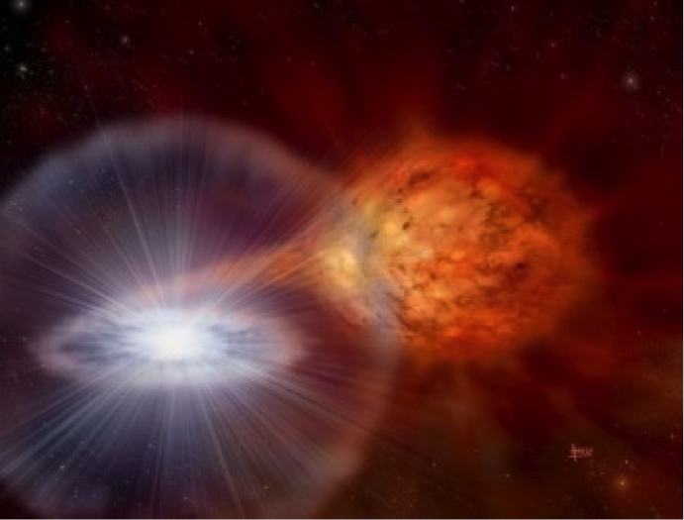
X-ray burst energy generation
Sensitivity study Parikh et al. ApJ 178 110 (2008)
  Peak temperature, duration, initial composition
²⁴Mg(α,p)²⁷Al reaction impacts energy generation
²⁷Al(p,α)²⁴Mg inverse reaction was used in study;
  Iliadis et al. ApJ Supp. 134 151 (2001)
Distinction was not made between ²⁷Al(p,α₀)²⁴Mg and ²⁷Al(p,α₁)²⁴Mg
David Hardy and PPARC
Notes:
More than 5% and at least 1 isotope

Slide 3
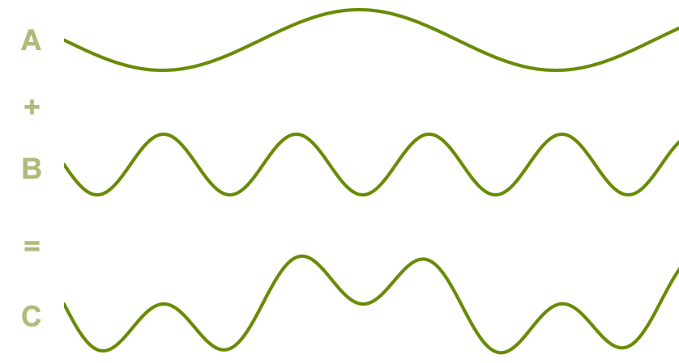
Measure direct reaction ²⁴Mg(α,pγ)²⁷Al
Final State System
(particle bound)
a + X
C*
²⁴Mg(α,p₁γ)²⁷Al and ²⁴Mg(α,p₂γ)²⁷Al had never been measured directly
  Large branch?
Advantages of measuring γ rays instead of particles
Currently no publically available R-matrix code can calculate the angular distributions of secondary γ rays
Implemented in AZURE2 open source code
  azure.nd.edu
  C. Brune (Ohio U.), R. J. DeBoer (Notre Dame)
b₃ + Y*
a,b,X, and Y
are particles
b₂ + Y*
b₁ + Y*
Compound
System
γ-ray decays

Slide 4
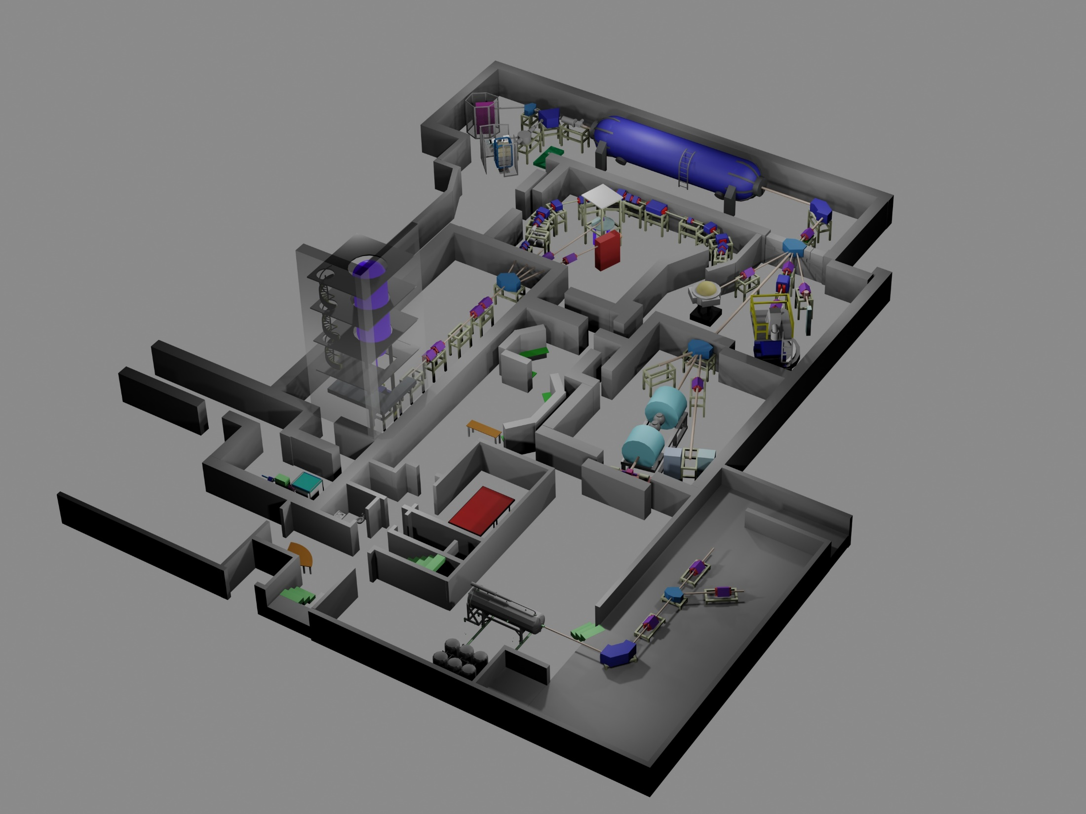
• Santa Ana 5MV Single-Ended Accelerator
University of Notre Dame
Nuclear Science Laboratory

Slide 5
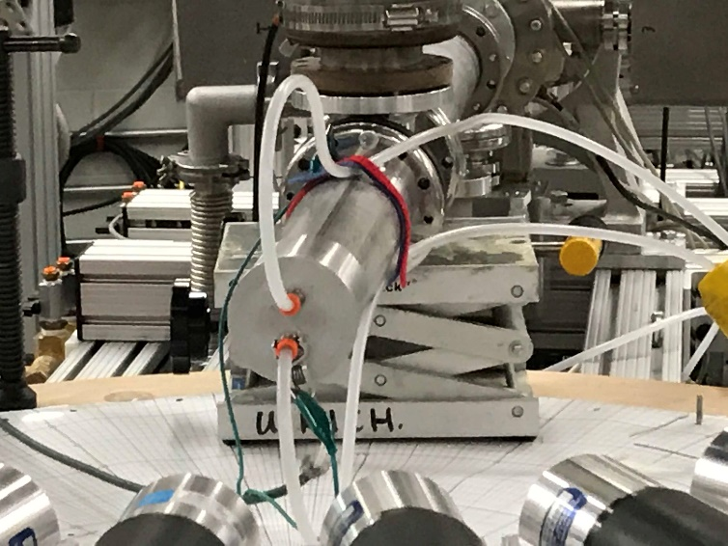
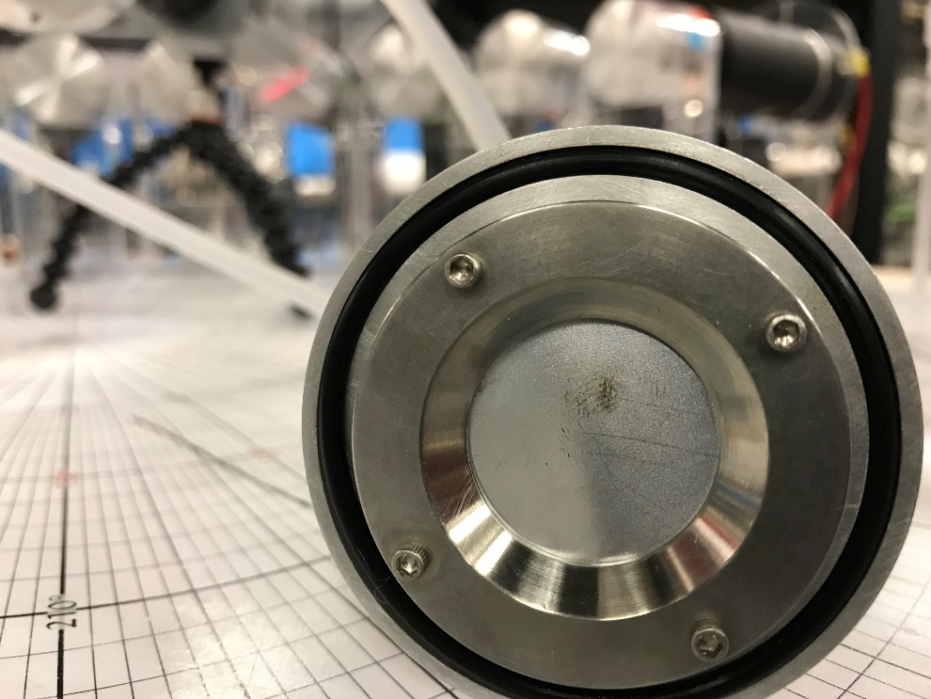
Experiment
Target, 25 ug/cm² evaporated onto a Ta backing, water-cooled
~10 uA of He beam, beam rasterized
Scanned through energies 3 – 5 MeV (alphas), 2 – 3 MeV (protons)
Energy resolution: accelerator and thin target

Slide 6
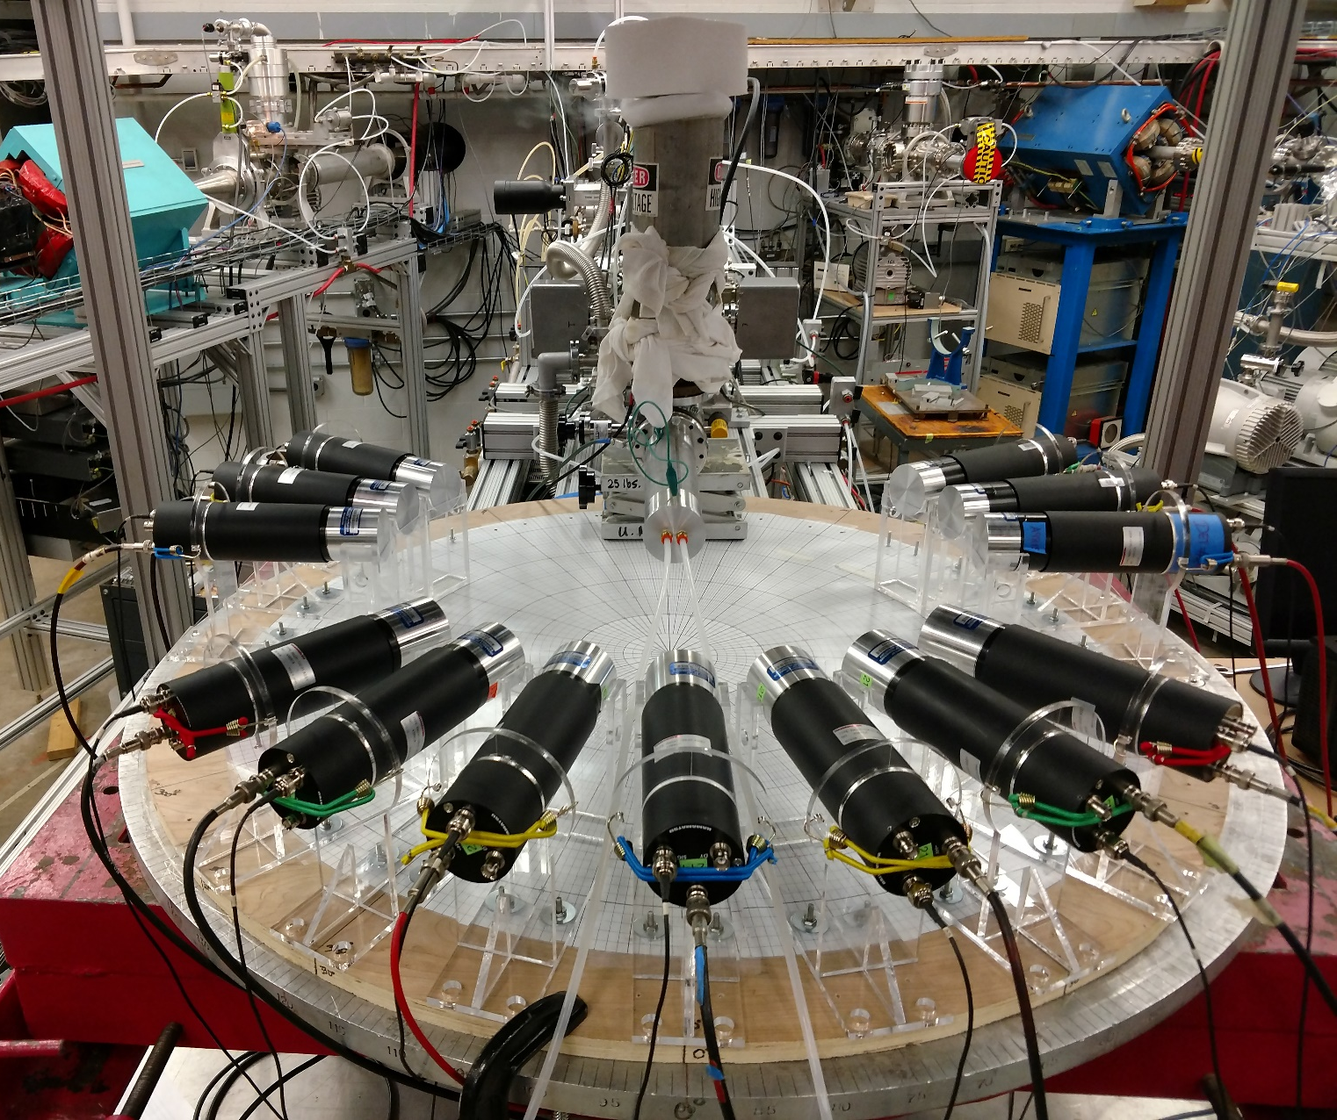
Hybrid Array of Gamma Ray Detectors (HAGRiD)
13 LaBr₃ detectors
7 unique angles
Good angular resolution
Kate Jones (UT)
Kevin Macon
Axel Boeltzig

Slide 7
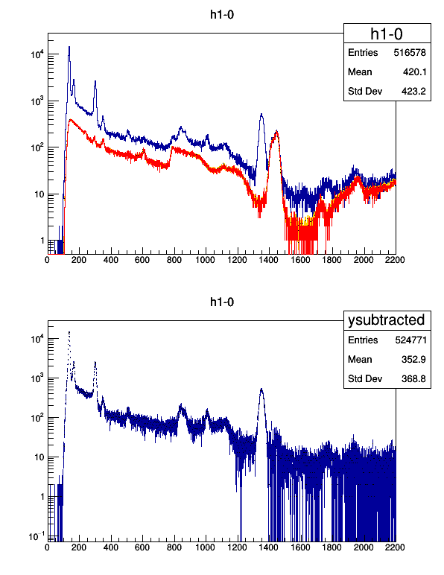
LaBr₃ γ-ray spectrum
Notes:
868 alpha induced reaction on C or O

Slide 8
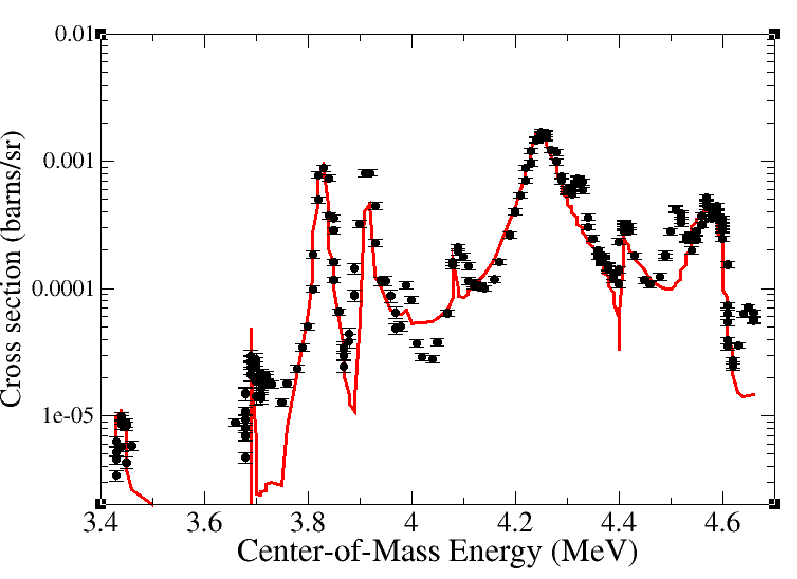
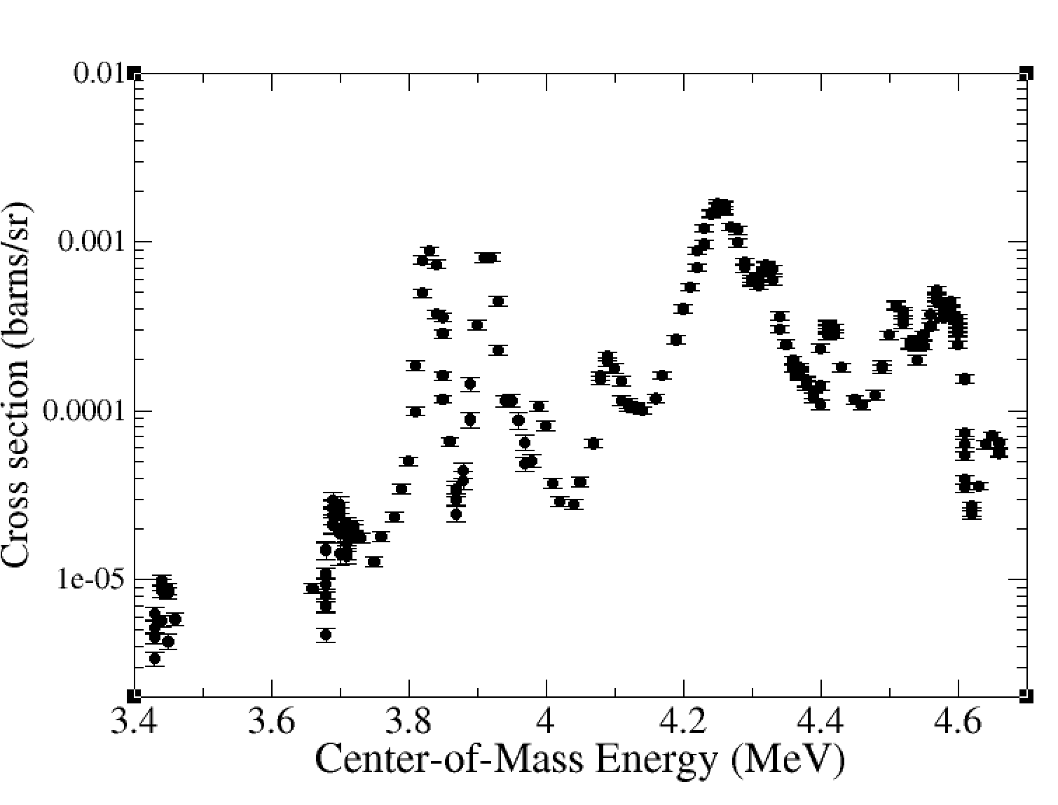
²⁴Mg(α,p₁γ)²⁷Al cross section
p₁
²⁸Si
²⁷Al

Slide 9
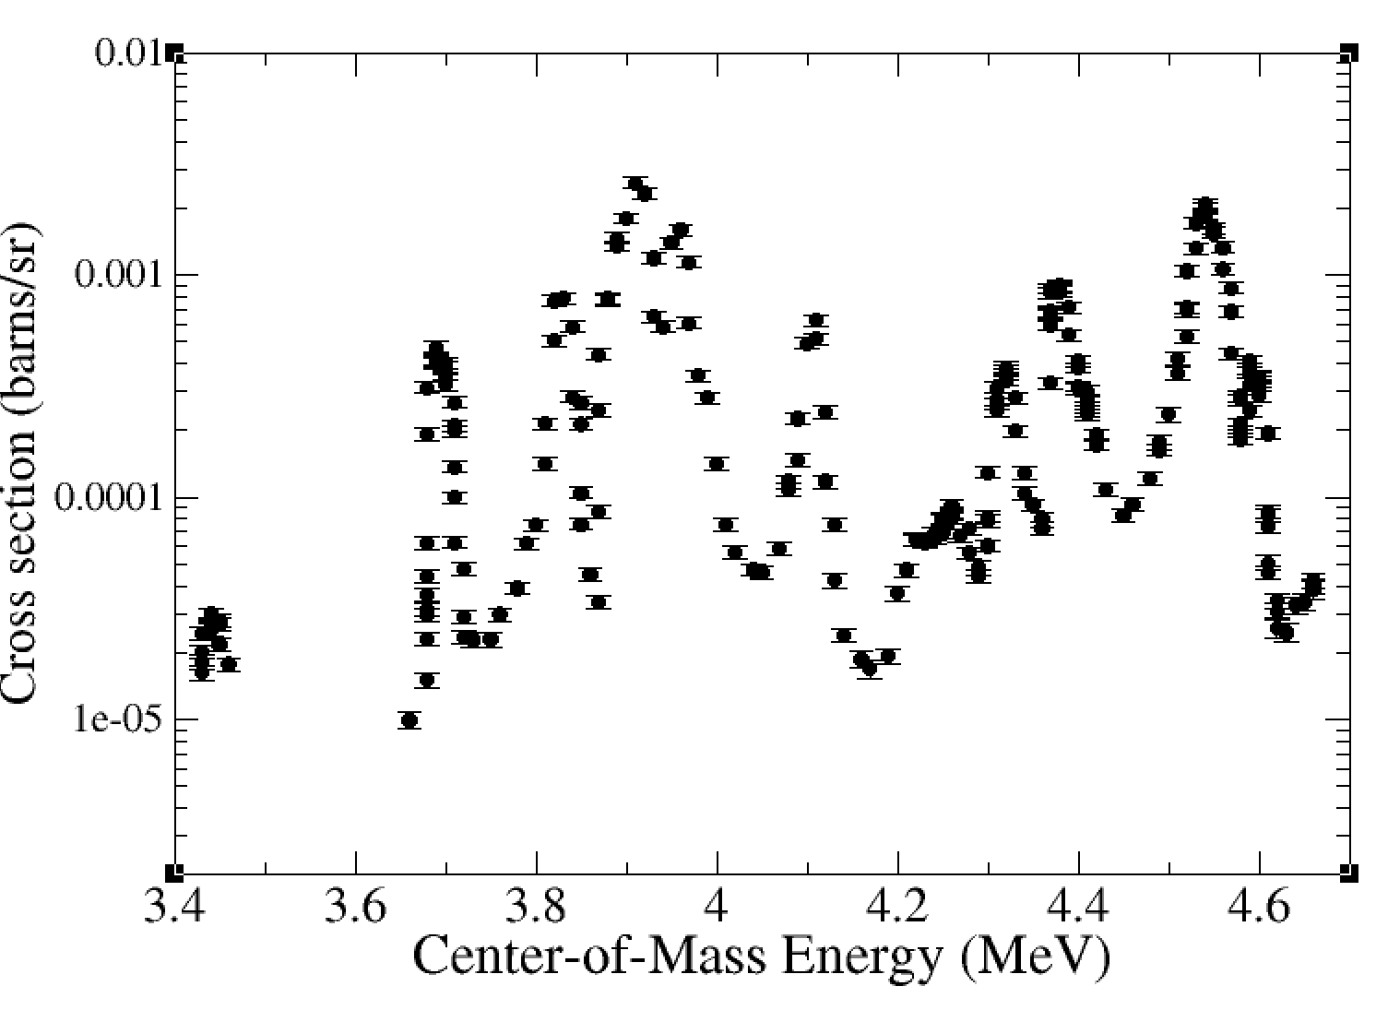
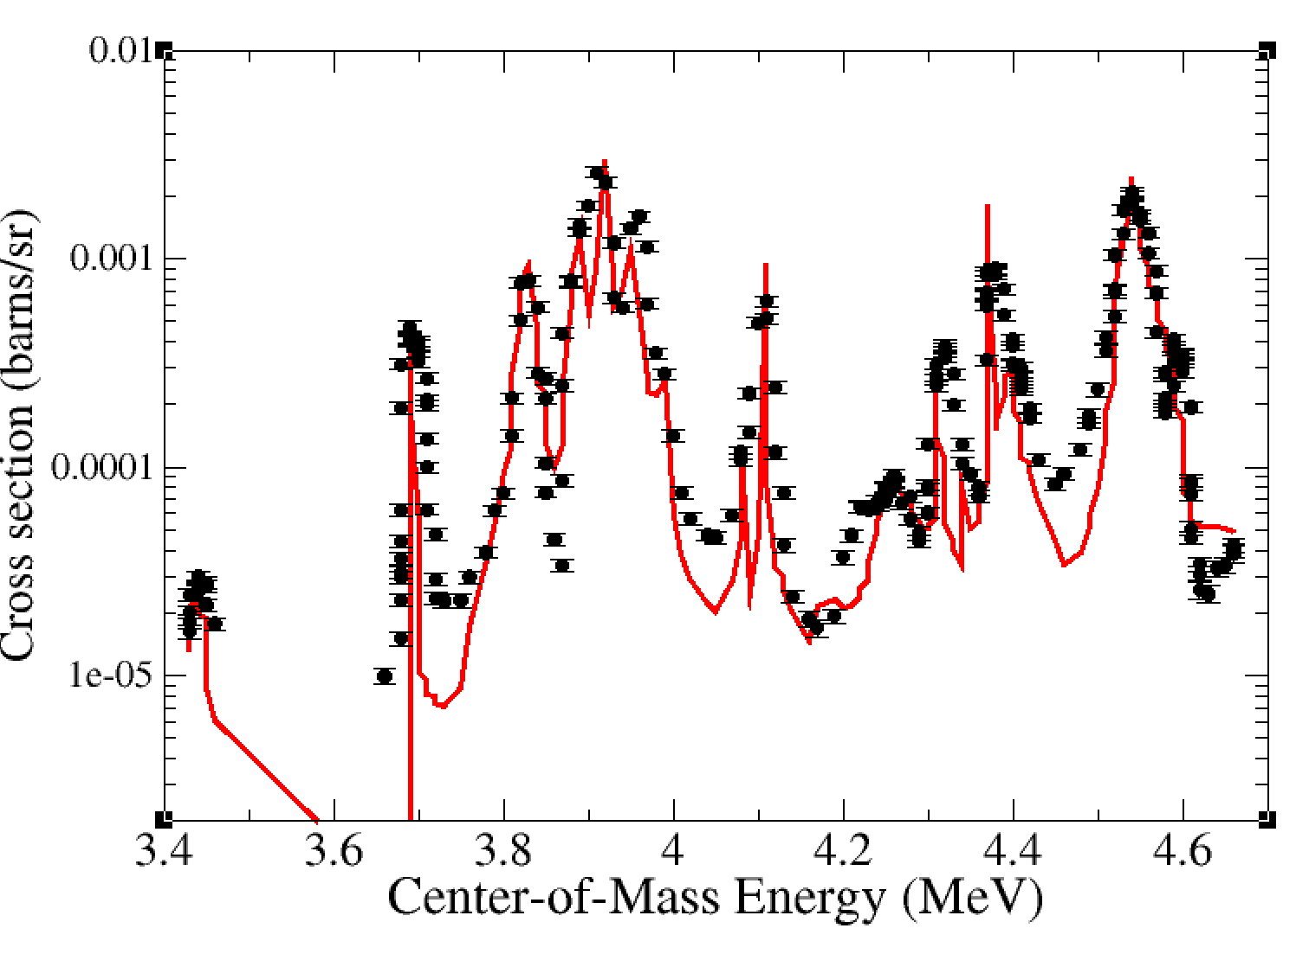
²⁴Mg(α,p₂γ)²⁷Al cross section
p₂
²⁸Si
²⁷Al

Slide 10
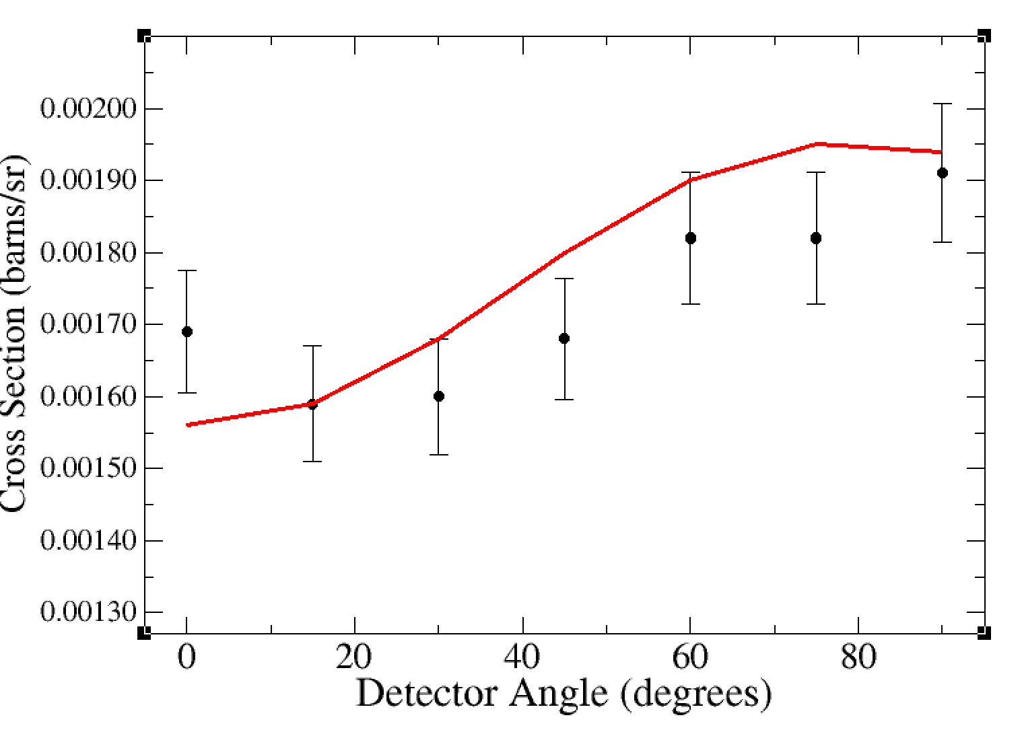
Angular distributions
For 14.235 MeV energy measurement
Strong constraint for R-matrix fit

Slide 11
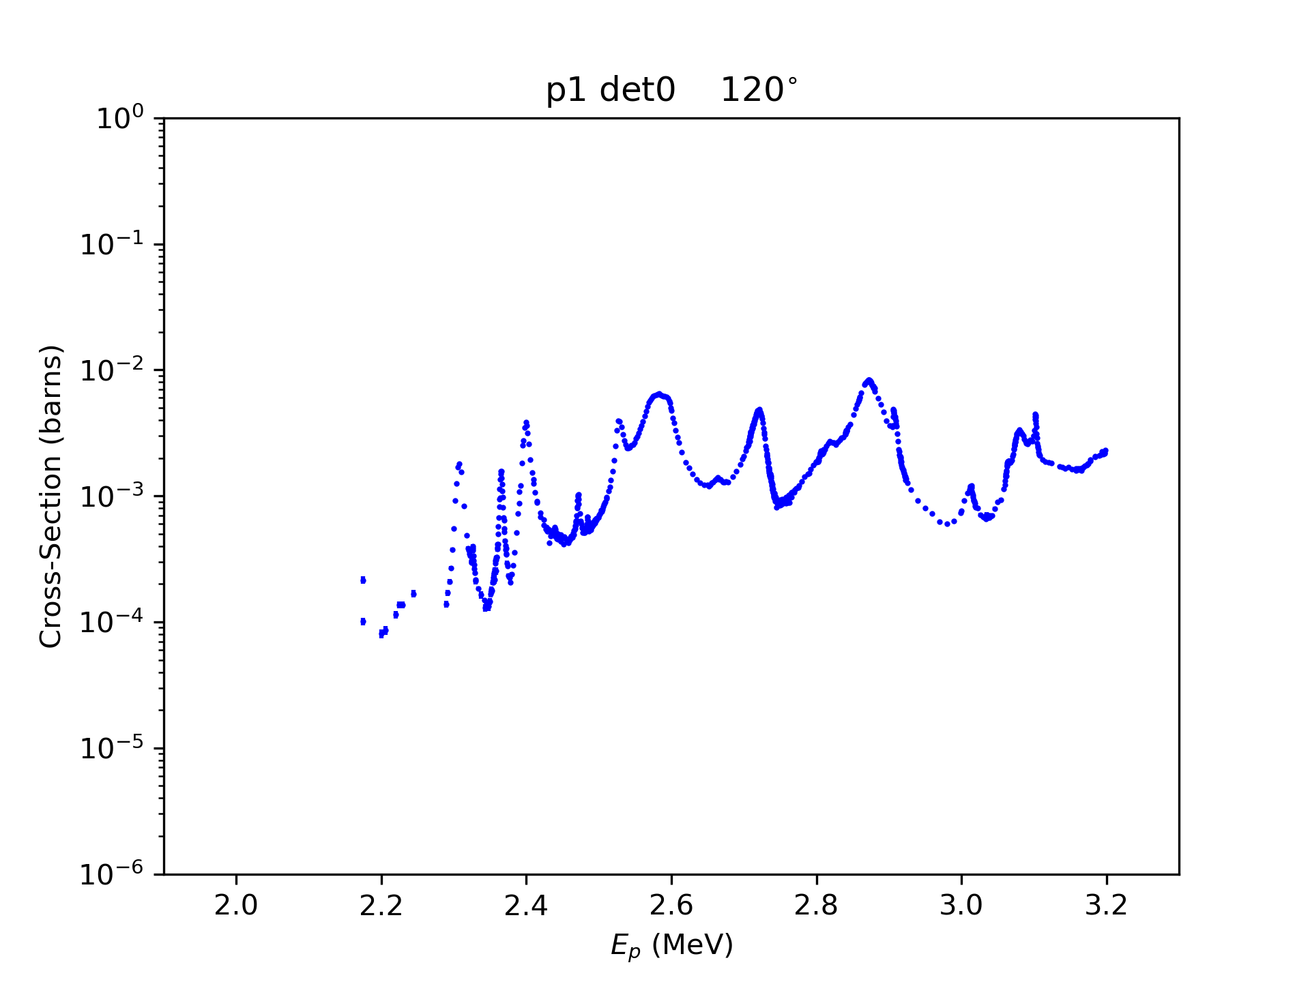
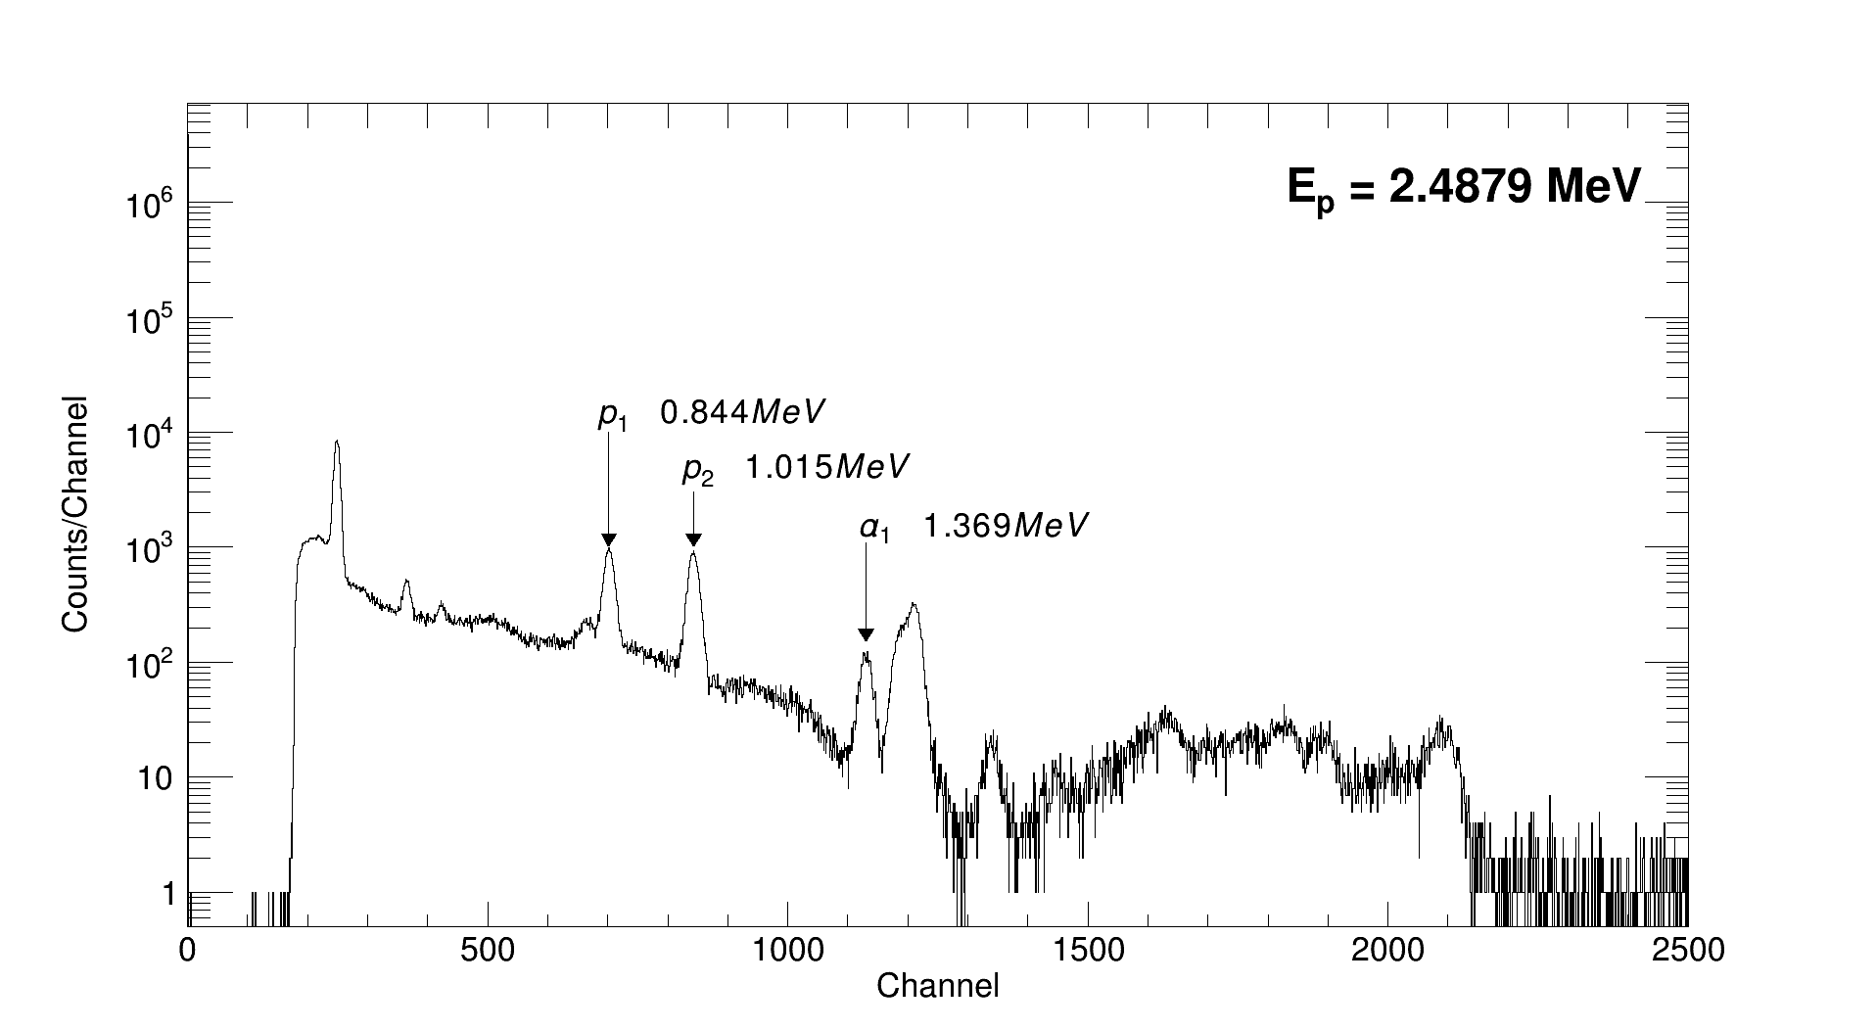
Measured Cross Sections ²⁷Al(p,α₁γ)
Preliminary
Energy range 2.1 – 3.2 MeV protons
~1200 energy measurements over 1 week

Slide 12
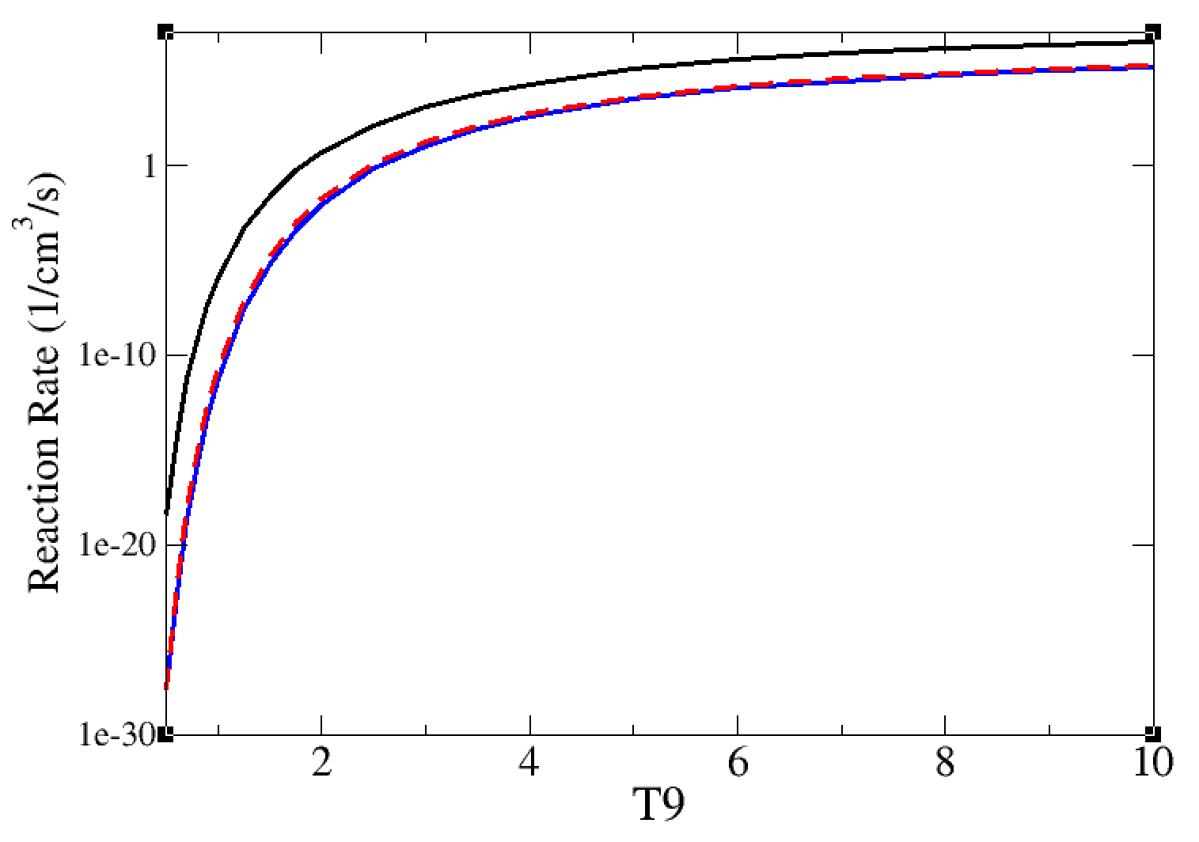
Preliminary Reaction Rates
-black: (α,p₀)
-blue: (α,p₁)
-red-dashed: (α,p₂)

Slide 13
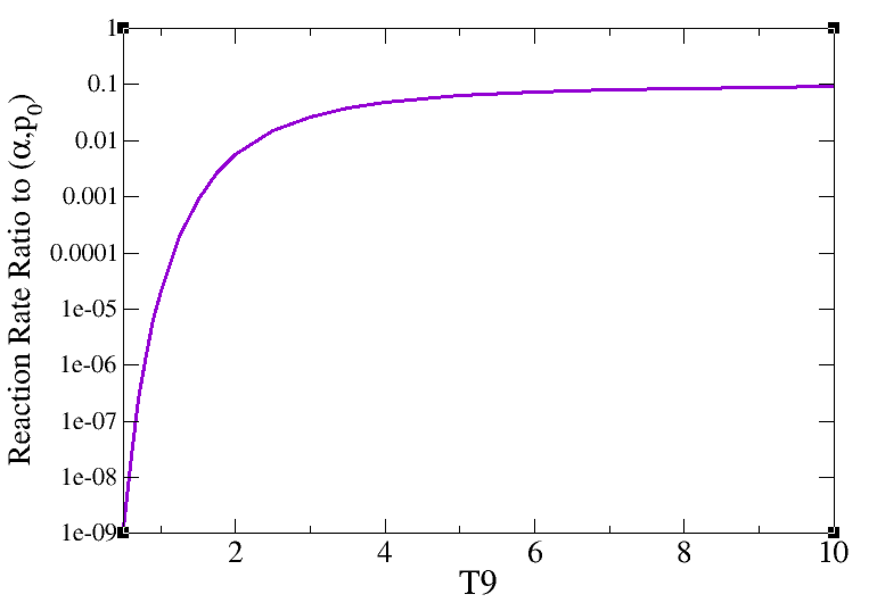
Contribution of Inelastic Channel
On the order of a percent at around 1 – 3 MeV
Approaches 10% at 10 GK

Slide 14
Summary and Outlook
Measured ²⁴Mg(α,p₁γ)²⁷Al and ²⁴Mg(α,p₂γ)²⁷Al reaction cross sections for the first time
  Enabled by high-resolution, thin target, high-intensity, high-efficiency, angular coverage
²⁷Al(p,α₁), ²⁷Al(p,p₁), ²⁷Al(p,p₂) cross sections measured with high energy resolution
  Ion beam analysis community
Used secondary γ-ray angular distributions in the R-matrix framework
Small effect (~percent) for resonance strengths at X-ray burst energies
  May be relevant for high-temperature environments (10% for 10 GK)
  Perhaps other interesting reactions
Other reactions (α,nγ)
Future measurements using HPGe detectors from the GEANIE array

Slide 15







Collaborators
James De Boer (ND)
Kate Jones (UTK)
Kevin Macon (ND)
Axel Boeltzig (ND)
Patrick O’Malley (ND)
Michael Wiescher (ND)
Carl Brune (OU)
Sebastian Aguilar (ND)
Bryce Frentz (ND)
Rebeka Kelmar (ND)
Khachatur Manukyan (ND)
Chris Seymour (ND)
Shea Mosby (LANL)
Karl Smith (LANL)
Sean Burcher (UTK)
Samuel Henderson (ND)
Maxime Renaud (ND)
Bryant Van de Kolk (ND)
Drew Blankstein (ND)
Jerome Kovoor (UTK)
Kyungyuk Chae (SKK)
Thank you!

