Slide 1

Fluorine destruction in stellar environments
Rosario Gianluca Pizzone
INFN – LNS Catania

Slide 2
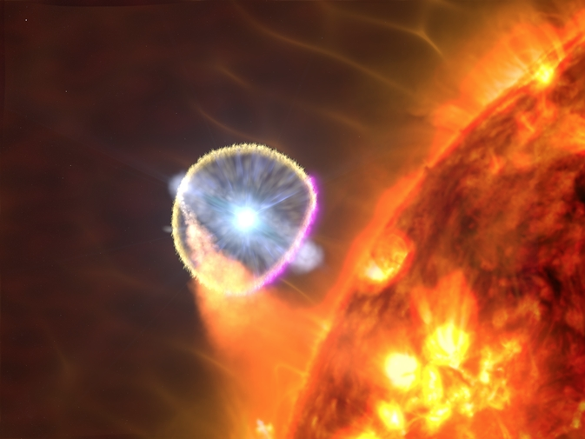
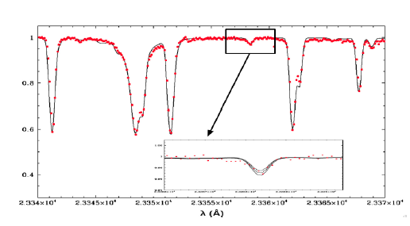
Fluorine in the Universe
¹⁹F is the lone stable isotope of Fluorine and the least abundant element with 12<A<56.
He-burning in AGB stars (2 ÷ 4 M) (ONLY OBSERVATIVE DATA AVALIABLE)
Supernovae SNe II
H-burning in Wolf Rayet stars

Slide 3
19F production and destruction
Three production pathways:
14N(α,γ)18F(β+ν)18O(p,α)15N(α,γ)19F (prevalent)
14N(n,γ)15N(α,γ)19F
14N(α,γ)18F(β+v)18O(n,γ)19O(β⁻ v)19F
Three destruction pathways:
19F(n,γ)20F
19F(p,α)16O
19F(α,p)22Ne
H-burning shell [La Cognata et al., 2011, Apj. Lett;
[Indelicato et al., 2017, Apj]
He- burning shell in AGB stars
[Pizzone et al 2017 APJ, D’Agata et al 2018 APJ]

Slide 4
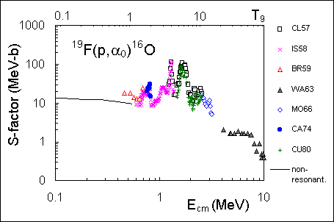
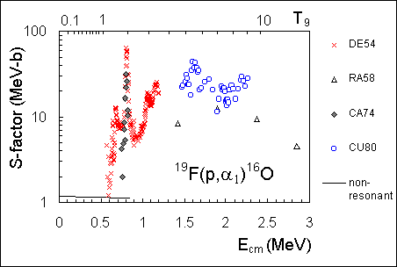
The ¹⁹F(p,α₀)¹⁶O reaction is the main fluorine destruction channel but no data are available around ~100 keV (energy of astrophysical interest)
d
n
p
α
¹⁹F
²⁰Ne*
¹⁶O
Possible
THM measurement
Non resonant approximation
α1 is even more uncertain!

Slide 5
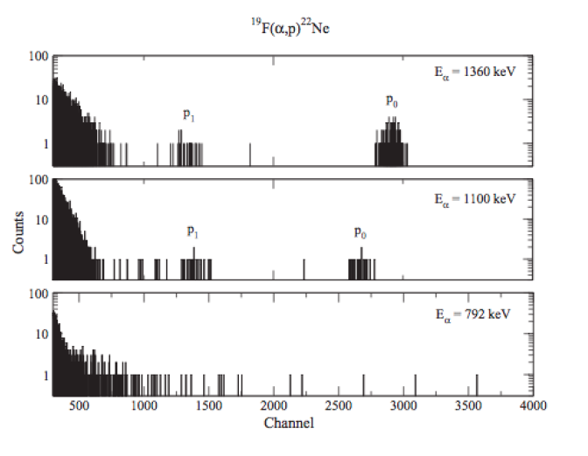
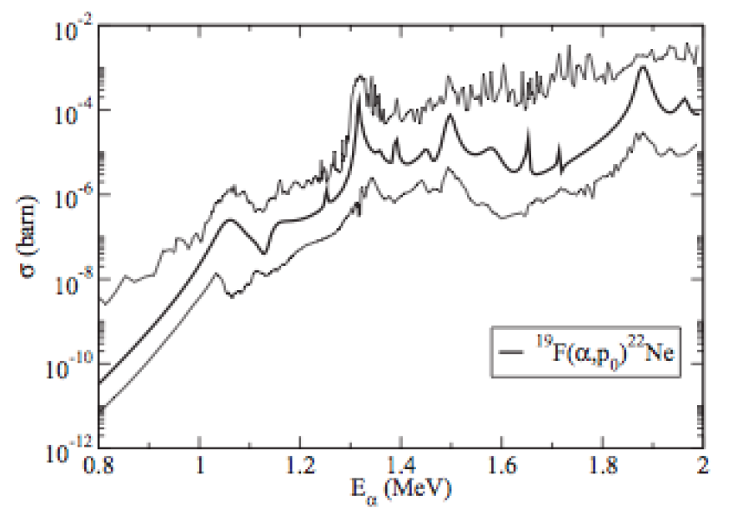
State of the art ¹⁹F(a,p)²²Ne
Direct measurements were performed down to 1100 keV
Extrapolation
Experimental
[Ugalde et al., 2008, Nuclear Physics A]
There were evidences for the p₀ and p₁ channel at 1.1 MeV
Gamow window ( if 2•10⁸ K<T<4•10⁸ K)
150÷1200 keV
Extrapolation at lower is again energy necessary!

Slide 6
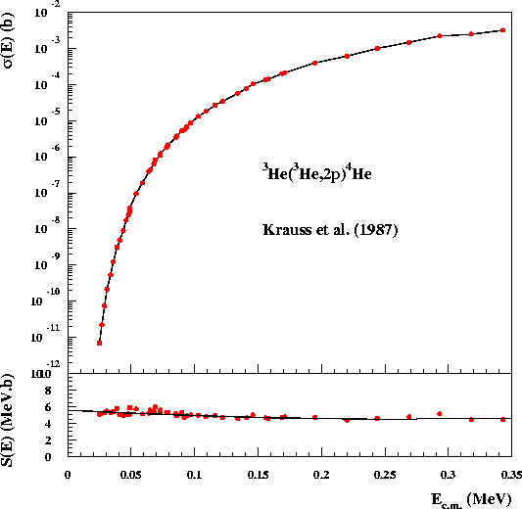
Nuclear Astrophysics difficulties
Astrophysics Energies
Picobarn/nanobarn cross sections
Solutions: underground
Measurements, extrapolations
With RIB’s (important in several
astrophysical environments) this
Sounds extremely difficult
Possible Solution: Indirect METHODS
Trojan Horse Method
Once Coulomb barrier is overcome by TH nucleus the astrophysical reaction can take place without any evident suppression

Slide 7
Trojan Horse Method (outlook)
Quasi-Free mechanism
Basic idea:
It is possible to extract the astrophysically relevant two-body cross section σ
B + x → C + D
from quasi- free contribution
of an appropriate three-body reaction
A + B → C + D + S
Main application:
Charged particle bare nucleus cross section measurements at astrophysical energies
-The A nucleus present a strong cluster structure: A = x ⊕ S clusters
x
C
-The x cluster (participant) interacts with the nucleus B
B + x → C + D
B
D
A
S
x
-The S cluster acts as a spectator
(it doesn’ t take part to the reaction)
C
B
D

Slide 8
See for introduction the talk by S. Cherubini
We can extract astrophysically relevant
two-body cross section σ
B + x → C + D
x
C
B
D
from quasi- free contribution of an appropriate three-body reaction
A + B → C + D + S
A
S
x
C
B
D
E_{A} > (E_{AB})_{Coulomb Barrier}
Coulomb effects and electron screening are negligible

Slide 9
Applications of THM
p,α and α,p reactions (stellar nucleosynthesis + BBN);
n,p and n,α α,n reactions (neutron poisons and production e.g. ¹³C(α,n)¹⁶O);
Electron screening effect;
Stellar & BBN Nucleosynthesis of stable/unstable nuclei investigated.
CNS – INFN collaboration
⁷Li(p,a)⁴He
¹⁸F(p,a)¹⁵O

Slide 10
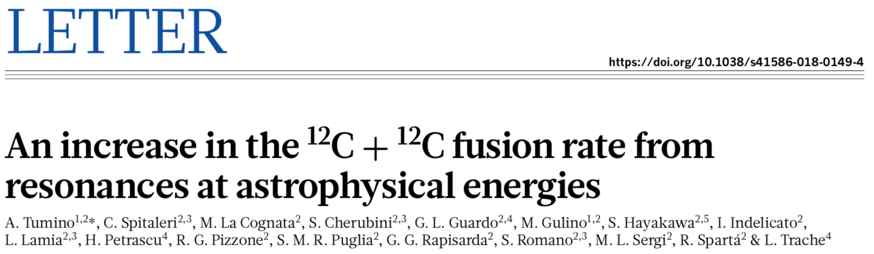
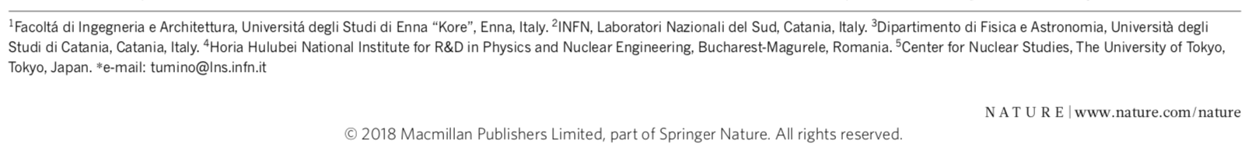
THM for Resonant Reactions: Unveiling C12+C12 reaction @ astrophysical energies
Very powerful approach: see our recent Letter on Nature:
Tumino et al., Nature volume 557, pages687–690 (2018) Published: 23 May 2018
Independent PRELIMINARY confirmation from direct
measurement by the STELLA collaboration
Presented @ NSD Venice by Stella collaboration, Jenkins

Slide 11
A previous indirect experiment using the THM has observed three resonances in the energy regions below E_{cm} ~450 keV implying a significant increase in the reaction rate.
A new experiment has been performed to verify the measured TH astrophysical factor and to perform more accurate spectroscopy of the involved resonances.
The main result of the present work is the estimate of the contribution of the 0.251 MeV level => Astrophysical Implication

Slide 12
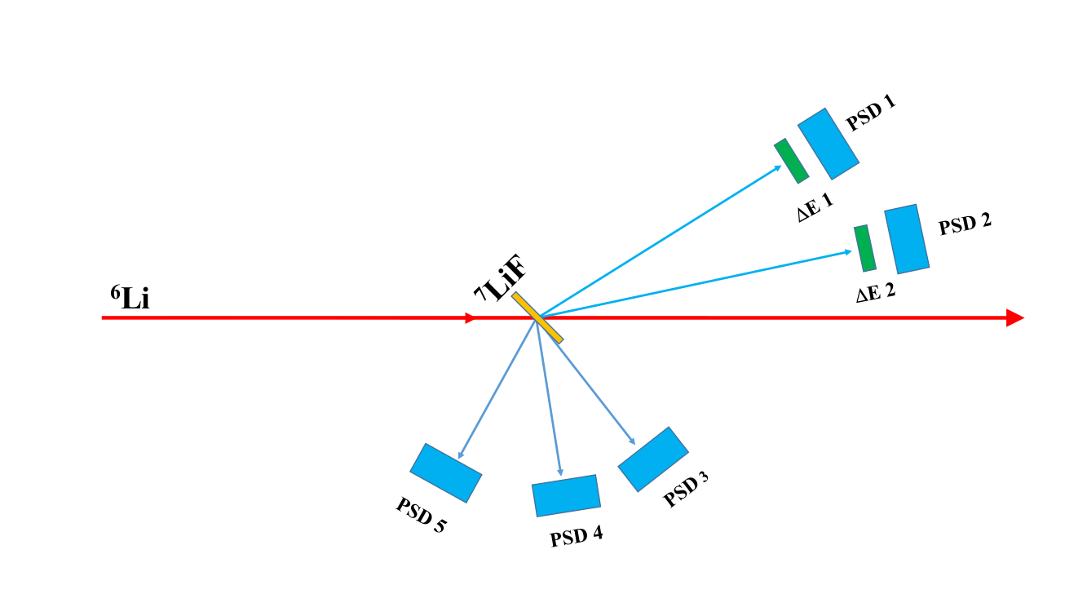
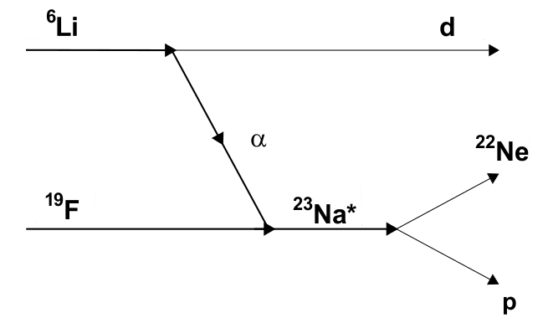
¹⁹F(a,p)²²Ne
Experimental THM approach
19F(α,p)22Ne was studied using Trojan Horse Method applied to 6Li(19F,p22Ne)d
V_{coul}=5.41 MeV
6Li has a cluster structure α+d, E_{B}=1.47 MeV
Experiment @ Rudjer Boskovic Institute
⁶Li beam, E_{beam}=6 MeV (i=5nA)
Target ⁷LiF 100 μg/cm²
Two ΔE-E telescopes (ΔE 9 μm, E 500 μm) + 3 PSDs (500 μm)

Slide 13
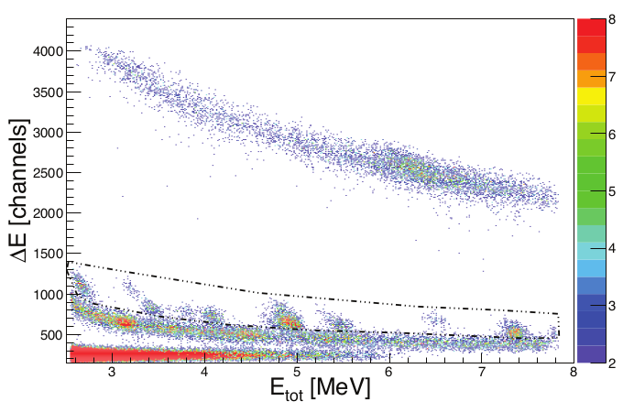
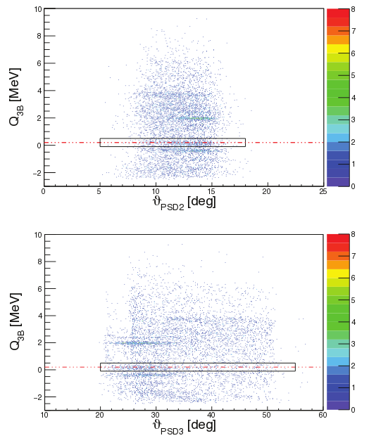
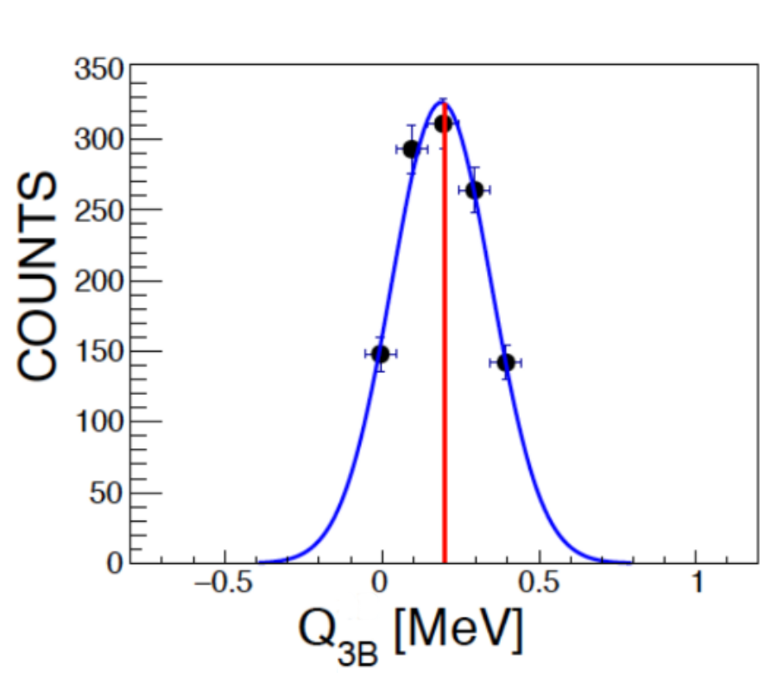
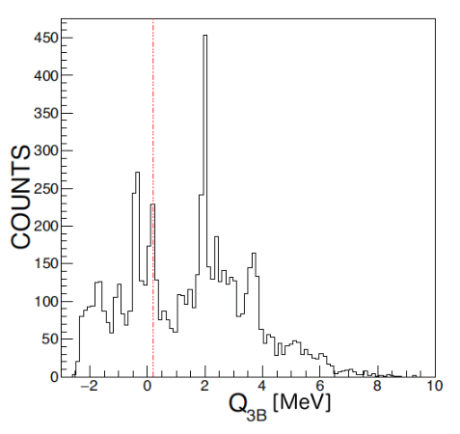
Channel Selection
Z=1
Q_{value} after selection. In blue a Gaussian fit, with centroid at 0.19 and σ=0.16 MeV
Q_{value}- kinematical variable are indipendent from each other

Slide 14
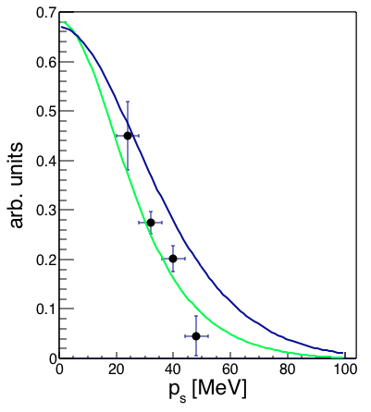
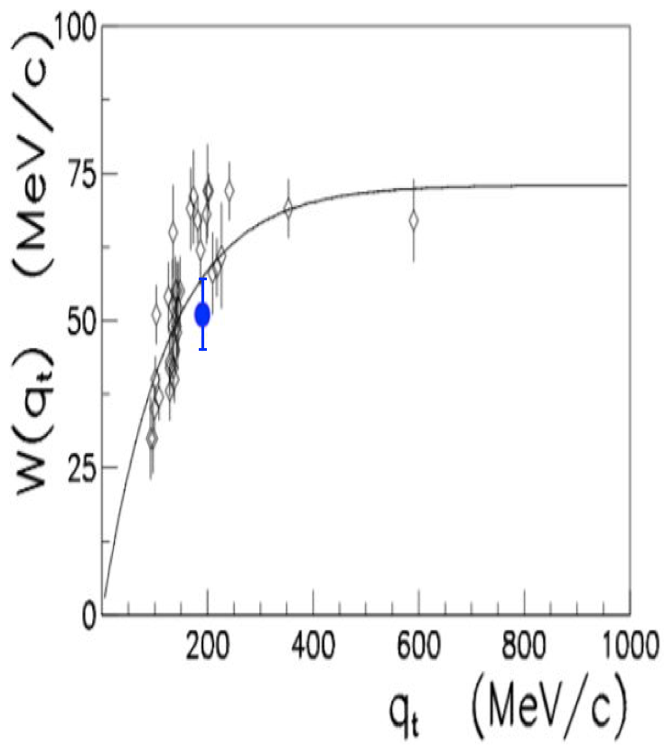
Quasi-free Selection
Deuteron momentum distribution inside ⁶Li follows the square modulus of a Hankel function (green line) [see Pizzone et al., 2009 Phys. Rev. C, 80]:
In this case the FWHM, W(q_{t}), is equal to
W(q_{t}) ≈ 53 ± 7 MeV/c
Trend with transferred momentum
Notes:
controllare il raggio di cutoff

Slide 15
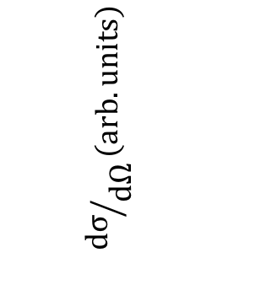
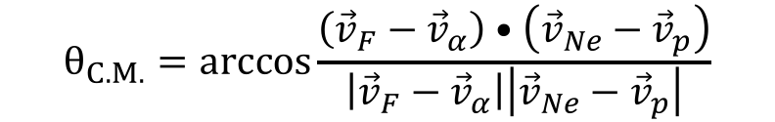
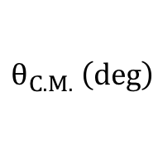
Angular Distribution
The experimental set-up allows to obtain data between 120° and 160° in the C.M. system
$$θ_{C.M.}=arccos\frac{\left({\vec{v}}_{F}−{\vec{v}}_{α}\right)•\left({\vec{v}}_{Ne}−{\vec{v}}_{p}\right)}{\left|{\vec{v}}_{F}−{\vec{v}}_{α}\right|\left|{\vec{v}}_{Ne}−{\vec{v}}_{p}\right|}$$
[Slaus et al, 1977, Nucl. Phys. A, 286]
$${dσ}/{dΩ}\left(arb. units\right)$$
Now it is possible to proceed with angular integration
$$θ_{C.M.} \left(deg\right)$$
[Pizzone, D’Agata et al. 2017, Apj]
Notes:
proceed
Mettere il segno di vettore, togliere il punto sotto
Aggiungere reference

Slide 16
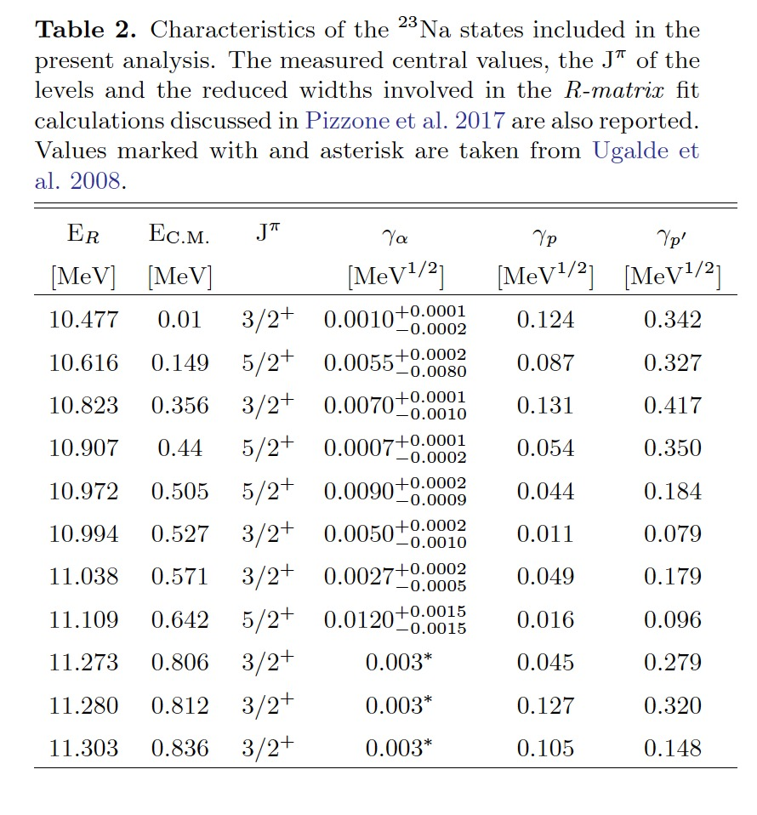
Cross section
Using the modified R-Matrix approach we are able to
Retrieve the binary cross section since the 3-body one is measured.
Solid black extrapolation by Ugalde.
Solid black points THM
Pink shaded area R-Matrix fit + uncertainties

Slide 17
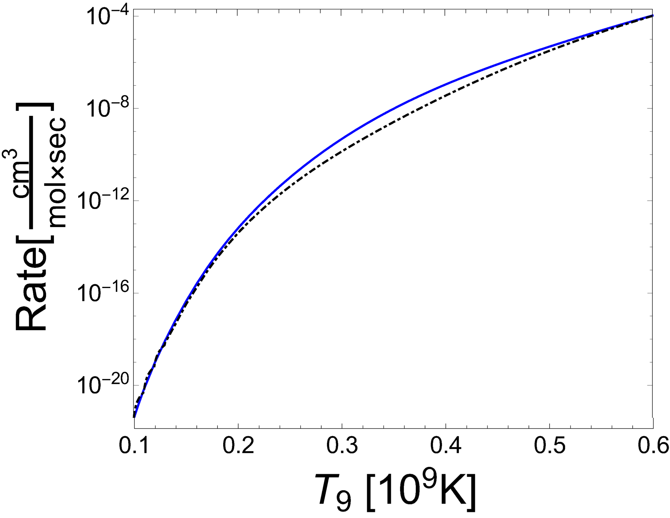
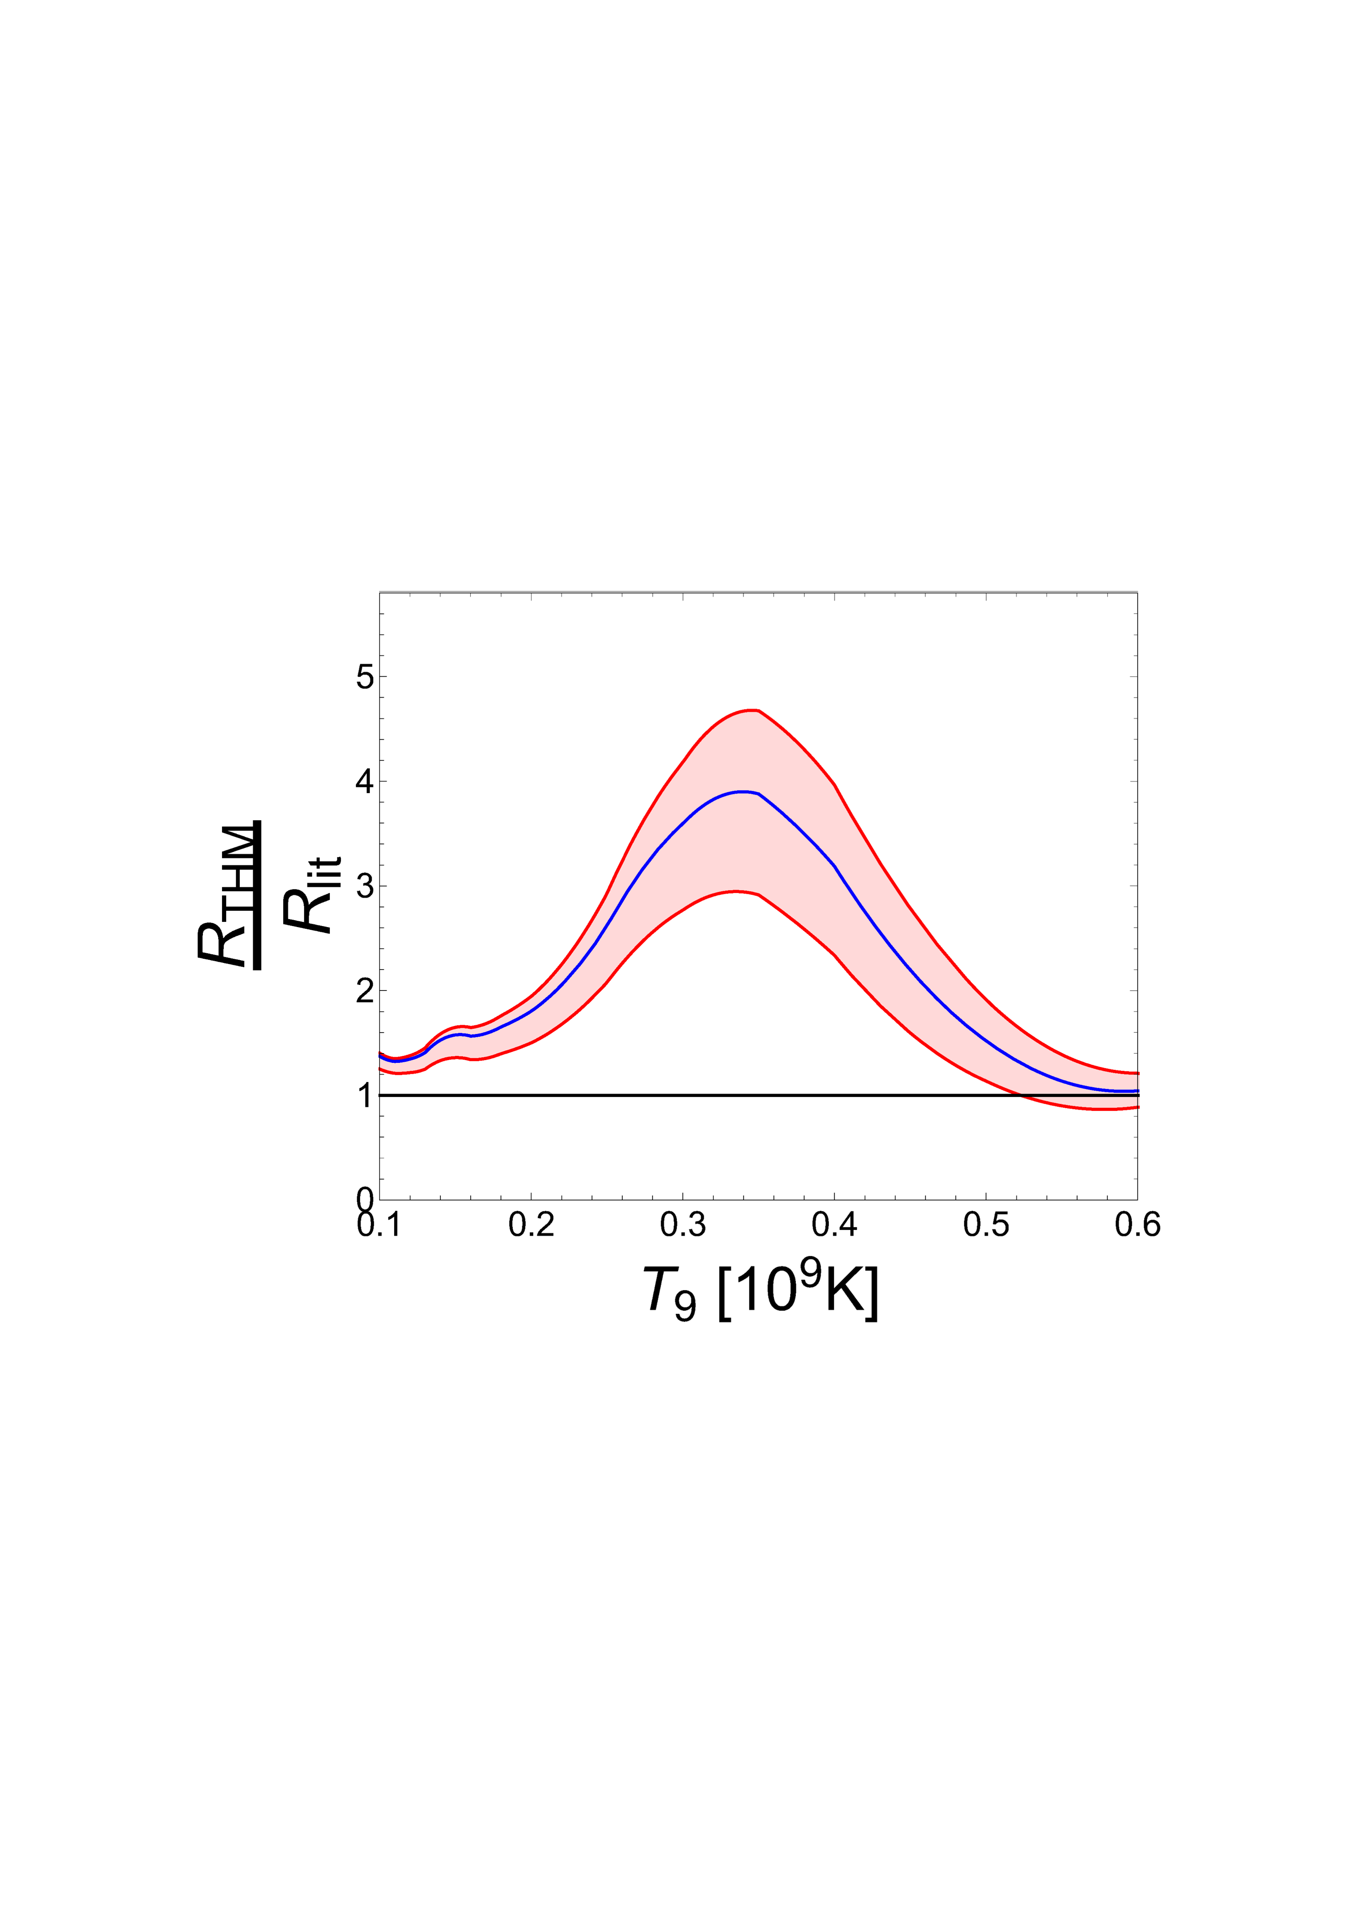
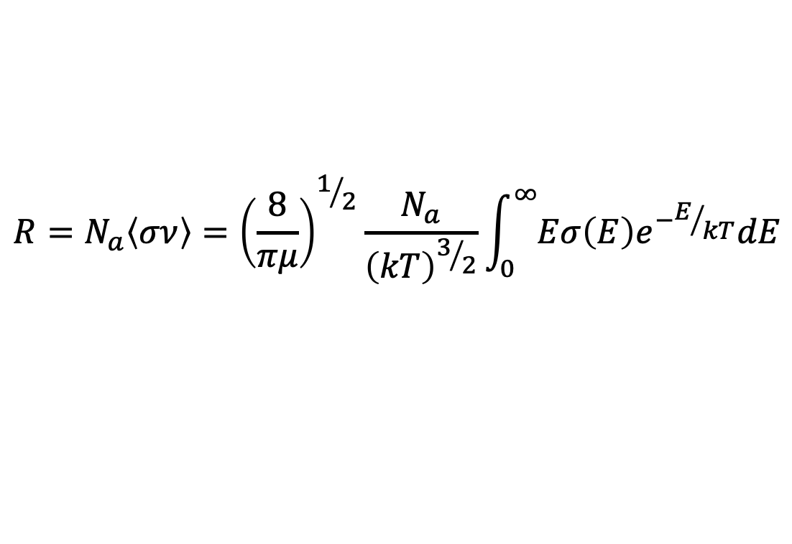
Reaction Rate
$$R=N_{a}\left\langle σν\right\rangle ={\left(\frac{8}{πμ}\right)}^{1/2}\frac{N_{a}}{{\left(kT\right)}^{3/2}}\int_{0}^{∞}{Eσ\left(E\right)e^{−E/{kT}}dE}$$
Reaction rate inside the Gamow window at AGB temperatures
(2•10⁸ K< T < 4•10⁸ K) → astrophysical implication under evaluation S. Palmerini @PG
Notes:
----- Meeting Notes (11/07/14 17:32) -----
Aggiungere n° Avogadro

Slide 18
Conclusions
It was possible to study ¹⁹F(α,p)²²Ne reaction using ⁶Li(¹⁹F,p²²Ne)d at astrophysical energies (0÷1 MeV) [Pizzone, D’Agata et al. 2017, Apj]
Structures in the two-body cross-section corresponding to ²³Na peaks were identified
For the first time it was possible to obtain information about the cross-section, the S(E)-factor and the reaction rate of the reaction of interest at astrophysical energies [D’Agata, Pizzone et al., 2018 , Apj]
Notes:
----- Meeting Notes (11/07/14 17:32) -----
Mettere le due referece

Slide 19












The AsFin Group
@Catania C. Spitaleri, A. Anzalone, A. Bonasera, S. Cherubini, G. D’Agata, A. di Pietro, P. Figuera, G.L. Guardo, M. Gulino, I. Indelicato, M. Lattuada, M. La Cognata, L. Lamia, G.G. Rapisarda, S. Romano, M.L. Sergi, R. Spartà, A. Tumino
@Perugia M. Busso, S. Palmerini, O. Trippella, M. Limongi, A. Chieffi, M.C. Nucci
Thanks for your attention
Collaborations
  Cyclotron Institute, Texas A&M, USA: R. Tribble, V. Goldberg
  C.N.S. Riken, Wako, Japan: S. Kubono, H. Yamaguchi, S. Hayakawa
  University of Taskent: B. Irgaziev, R. Yarmukhanmedov
  CIAE, Beijing, China: S. Zhou, C. Li, Q. Wen
  Nuclear Physics Institute, ASCR, Rez, Czech Rep.: V. Kroha, V. Burjan, J. Mrazek
  Texas A&M Commerce USA: C. Bertulani
  Nipne IFIN Bucharest: L. Trache
  ELI-NP Bucharest: C. Matei, D. Balabanski
  Atomki, Debrecen, Hungary: G. Kiss
  CSNSM, Orsay, France : A. Coc , F. Hammache, N. De Sereville
  Florida State University USA: I. Wiedenhofer
  Notre Dame University USA: M. Wiescher, M. Couder
  University of Catalunya: J. Jose
  Rudjer Boskovic Institute Zagreb Croatia: N. Soic, M. Milin
  INFN Sez. Padova e UniPD: M. Mazzocco
  INFN Sez. Napoli e UniNA: M. La Commara, D. Pierroutsakou, C. Parascandolo
  University of Pisa: S. Degl’Innoccenti, P. Prada Moroni

Slide 21
La ‘Decima’

Slide 22
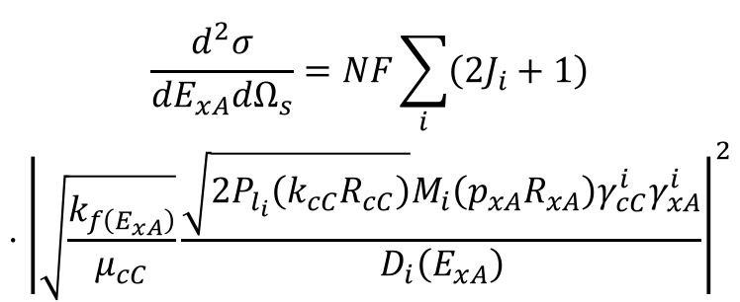
THM for resonant reactions
Using The Modified R-matrix [Lane & Thomas 1958, Rev. Mod. Phys; La Cognata et al. 2011,ApjL] formalism, In the case of a resonant THM reactionthe cross section takes the form
$$\begin{matrix}\frac{d^{2}σ}{dE_{xA}dΩ_{s}}=NF\sum_{i}{\left(2J_{i}+1\right)} \\ ⋅{\left|\sqrt{\frac{k_{f\left(E_{xA}\right)}}{μ_{cC}}}\frac{\sqrt{2P_{l_{i}}\left(k_{cC}R_{cC}\right)}M_{i}\left(p_{xA}R_{xA}\right)γ_{cC}^{i}γ_{xA}^{i}}{D_{i}\left(E_{xA}\right)}\right|}^{2}\end{matrix}$$
From the fitting of the experimental THM data, those can be obtained and used to deduce the ¹⁹F(α,p)²²Ne cross-section
NF is a normalization factor
J_{i} the spin of the i−th resonance
(Q is the reaction Q-value,E_{xA} the x − A relative energy)
P_{li} the penetration factor
R_{xA} and R_{cC} the channel radii
M_{i}(E) is the amplitude of the transfer reaction (upper vertex) that can be calculated
Di(E_{xA}) is the standard R-matrix denominator

Slide 23

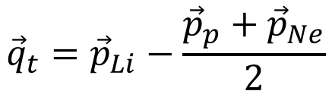
Quasi-free Selection/2
The W(q_{t}) must follow the trend [Barbarino et al. 1980 PhRvC; Pizzone et al., 2009 Phys. Rev. C]:
$$W\left(q_{t}\right)=f_{0}\left(1−e^{{q_{t}}/{q_{0}}}\right)$$
where
$${\vec{q}}_{t}={\vec{p}}_{Li}−\frac{{\vec{p}}_{p}+{\vec{p}}_{Ne}}{2}$$
f₀=73 MeV/c
q₀= 324 MeV/C
In our case q_{t}=190 MeV/c
Notes:
Aggiungere Barbarino 1980, aggiungere un segno di vettore

Slide 24
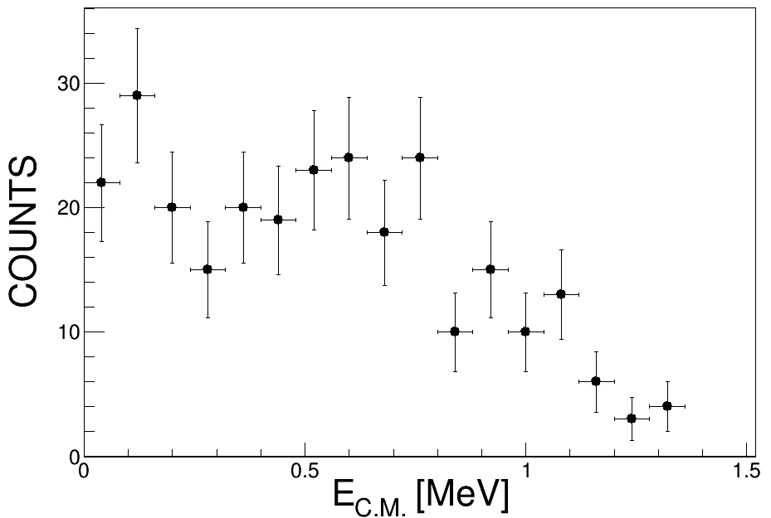
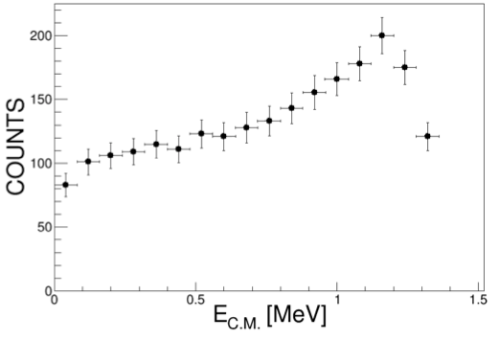
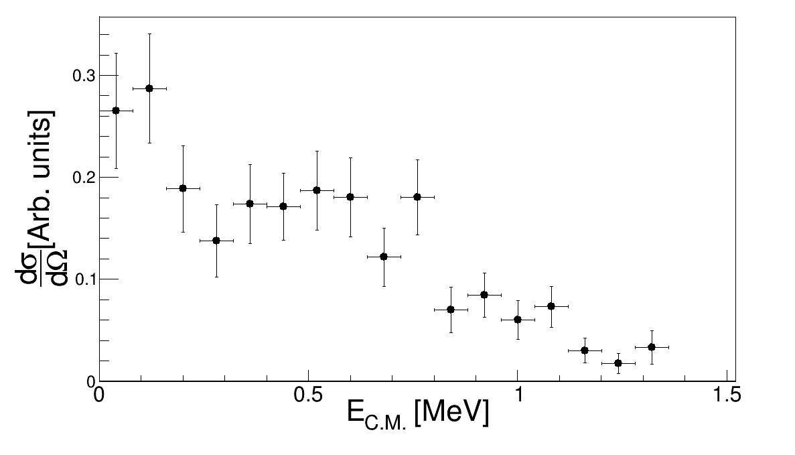
Cross section/1
We know that , so it is
possible to extract the two-body differential cross-section

