Slide 1



暗黒物質直接探索の現状
Aug 28, 2023
基研研究会 素粒子物理学の進展2023（PPP2023）
身内賢太朗
(神戸大学)
暗黒物質
暗黒物質直接探索
最近の話題

Slide 2

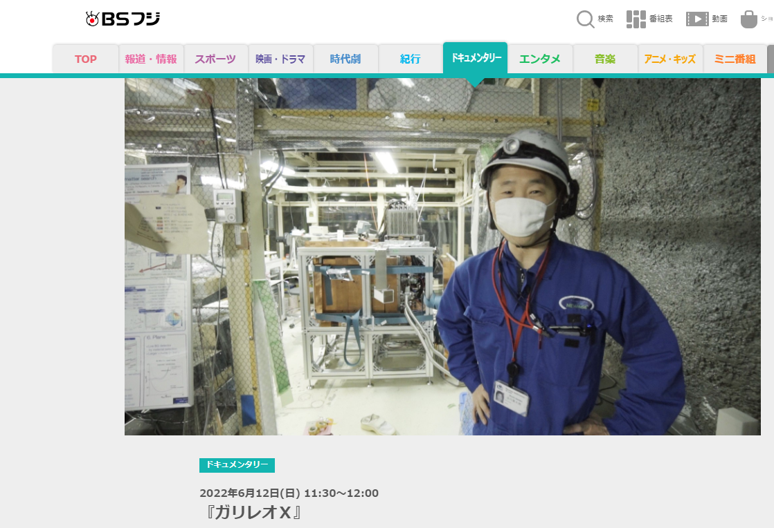
はじめまして/お久しぶりです 身内賢太朗です
  いまのところずっと 暗黒物質直接探索 ⇄ 見つからない
  そろそろ 見つけて 性質解明 と行きたい
  D論 東大物理 みのわ研 LiFボロメータ
  PD～助教 京大物理 宇宙線研究室 ガスTPC
  准教授 神戸大 粒子物理研究室 +=液体キセノン検出器 その他
2022年6月12日放映
「ガリレオX」

Slide 3
暗黒物質
see also
日本物理学会誌 第75巻
(2020年) 第2号 68-76頁 交流
coming soon...
some results will updated this week in TAUP 2023

Slide 4
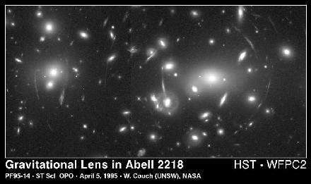
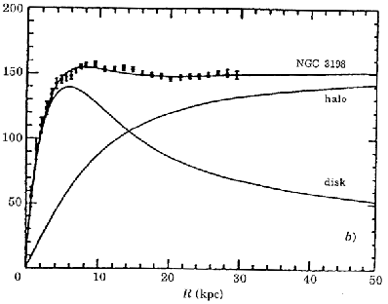
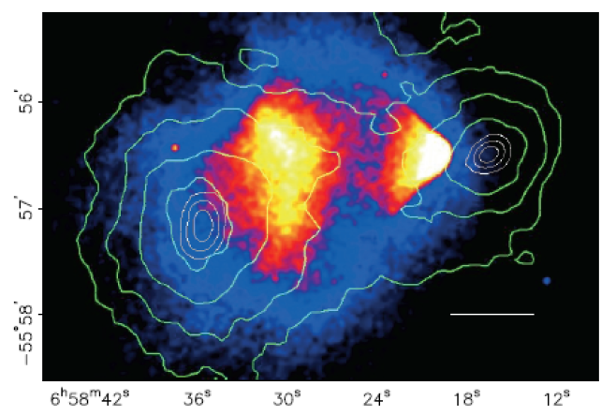
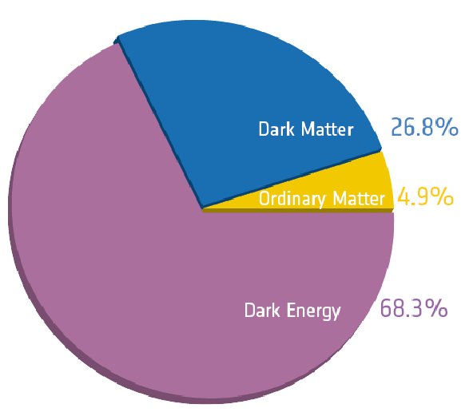
DM: seen in various scales in the universe
  @ galaxy: rotation curves（1970～）
  @ cluster of galaxies: collision of
  galaxy clusters (2007～)
  @ universe: CMB and other observations
  (2002~)
GR !
rotation curve
cluster collision
pie chart of the universe
mass
(dark matter)
plasma
(baryon)
Annu. Rev. Astron. Astrophys. 29(1991)409
Plank team

Slide 5
WIMP⇔SM
DM candidates: thousands of them
  “good”candidates would solve other problems
    AXION (CP problem in QCD)
    Primordial black hole (BHs are there!)
    WIMPs (Weakly Interacting Massive Particles)
  WIMPs
    Produced in the early universe
    Annihilate
    rate ∝ cross section × velocity
    Freeze out at some point
    abundance is fixed
    σ～weak scale explains present abundance
    ⇒WIMP miracle !
annihilate
対消滅
DM
SM
DM
SM
WIMP abundance evolution
対生成
WIMP存在量の時間変化
production
small σv
log(WIMPの存在量)
σv 小
log (WIMP abundance )
observed
観測値
σv 大
large σv
i )
ii )
iii )
誕生
現在
start
present
log(宇宙の進化)
log (history of the universe )

Slide 6
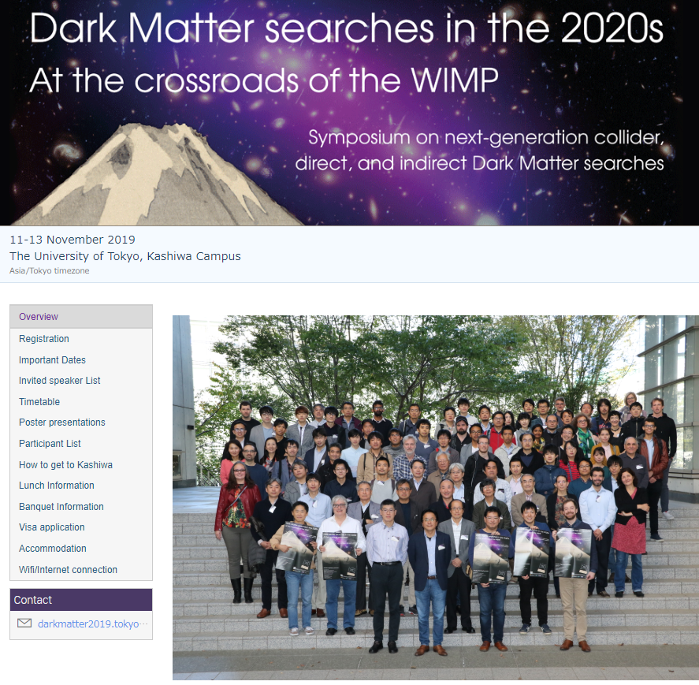
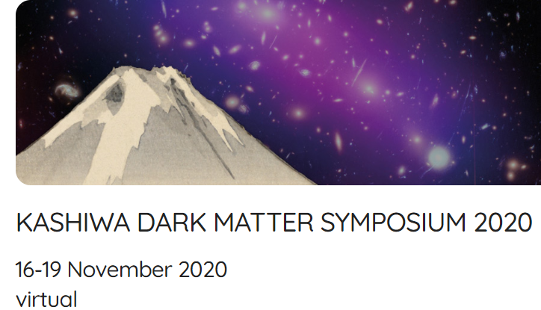
WIMP hunting
  WIMP-SM(standard model particle, i.e. quarks) particle interaction
    Direct search
    Indirect search
    Collider
complementary, synergy
WIMP hunting
対消滅
indirect
DM
SM
direct
DM
SM
対生成
collider

Slide 7
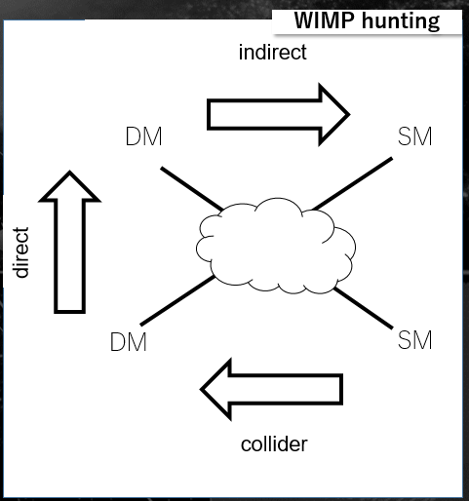
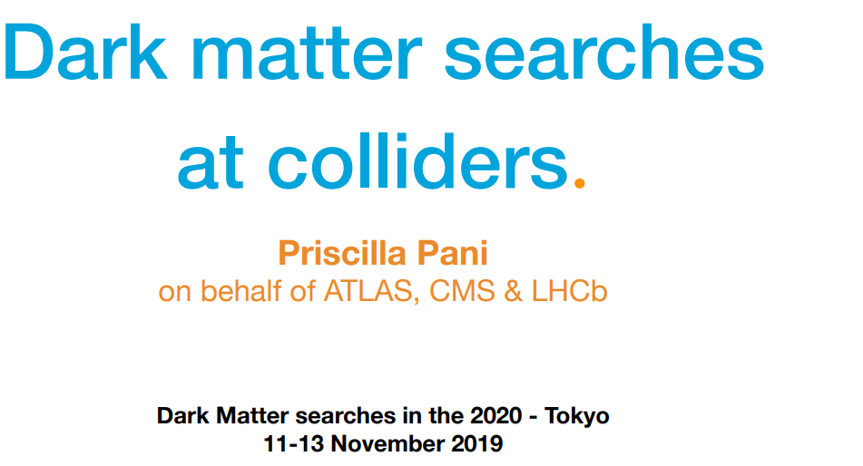
Collider
  LHC @ CERN
  Missing E signal
  Searches with various ways
  No hint so far
simulation

Slide 8
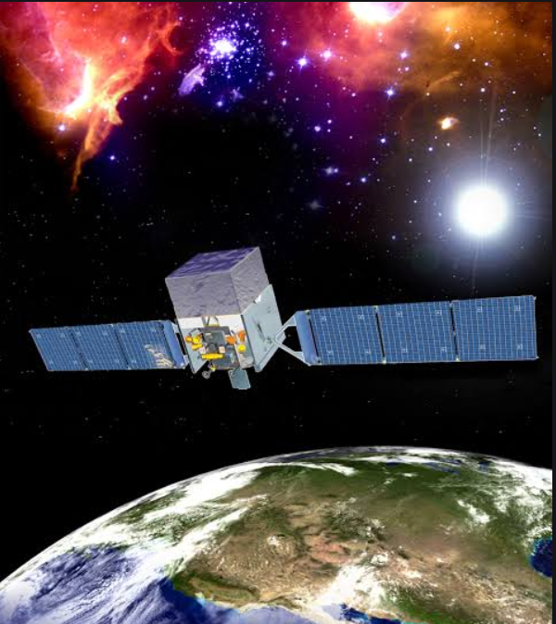
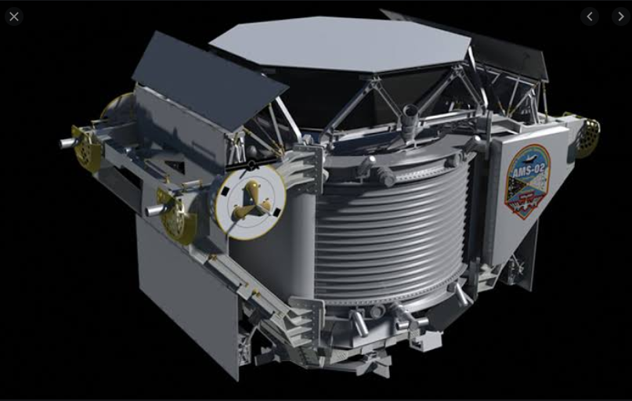
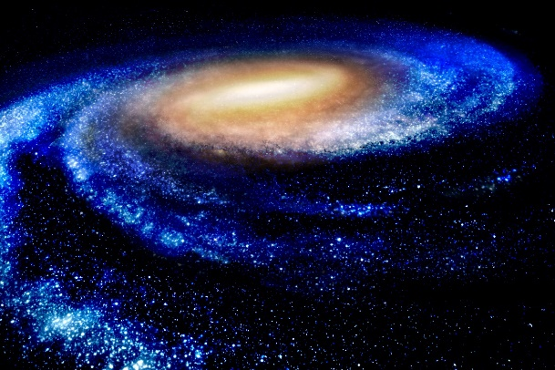
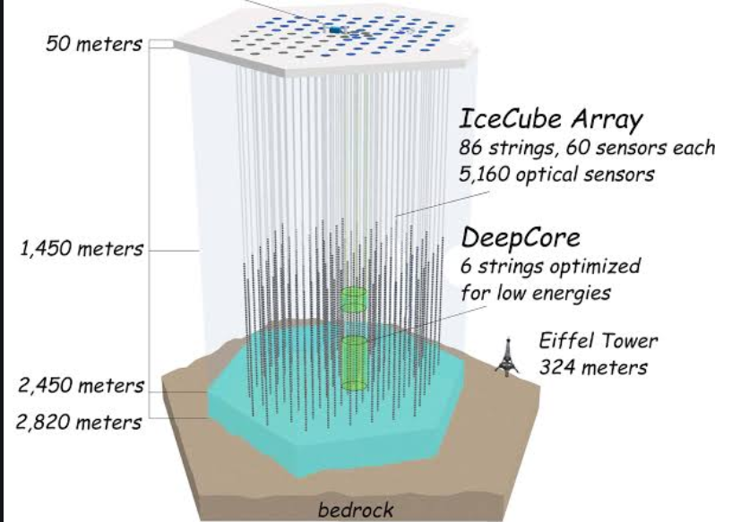
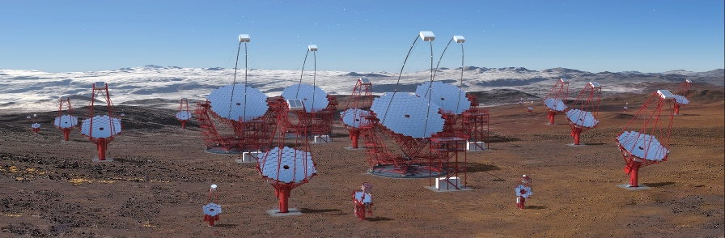
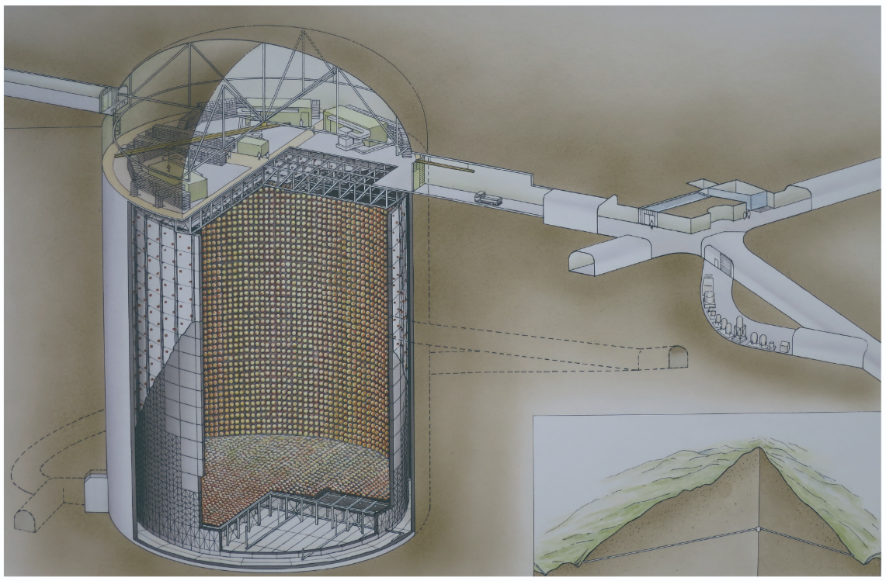
Indirect Search
  WIMPｓ annihilate @ Galactic Center, Dwarf Galaxy, sun…
  No conclusive result yet
e+/e-
FERMI
AMS
anti-particle
DM
DM
NASA/AMS
γ
NASA/FERMI
ICECUBE
ν
CTA
SUPER-KAMIOKANDE
CTA
ICECUBE
ICRR

Slide 9
Direct Search

Slide 10
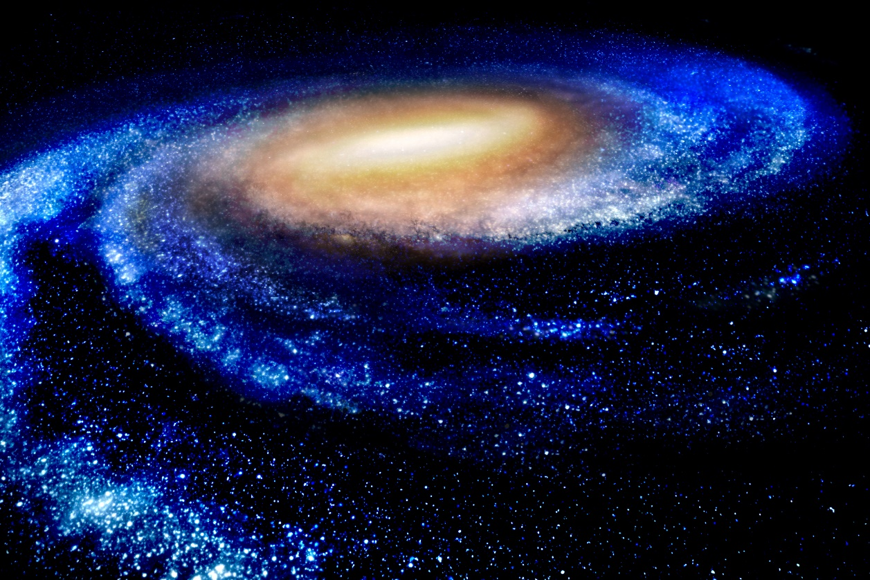
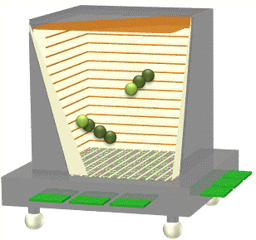
DM HALO
Direct Detection
v₀=220km/s
G. C.
Solar System
CYGNUS
v☉=230km/s
Dec.
Jun.
nuclear recoil
WIMP signal
  nuclear recoil: elastic scattering
  energy
  nucleus dependence
  seasonal modulation
  direction
@ LAB
nucleus
1

Slide 11
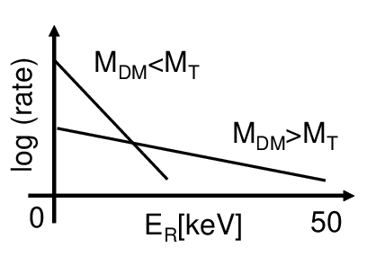
DM HALO
Direct Detection
v₀=220km/s
G. C.
Solar System
CYGNUS
v☉=230km/s
Dec.
Jun.
nucleus dependence
@ LAB
WIMP signal
  nuclear recoil: elastic scattering
  energy
  nucleus dependence
  seasonal modulation
  direction
target
nucleus
target
1

Slide 12
DM HALO
Direct Detection
v₀=220km/s
G. C.
Solar System
CYGNUS
v☉=230km/s
Dec.
Jun.
seasonal modulation
@ LAB
WIMP signal
  nuclear recoil: elastic scattering
  energy
  nucleus dependence
  seasonal modulation
  direction
target
Jun.
nucleus
target
Dec.
1

Slide 13
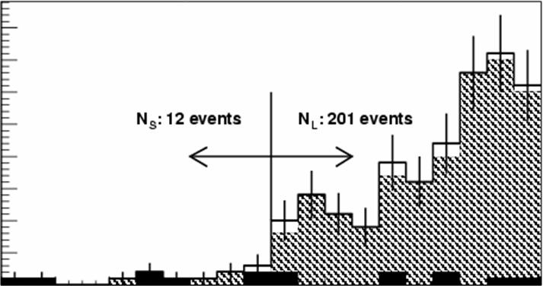
DM HALO
Direct Detection
v₀=220km/s
G. C.
direction
M=80GeV
σ=0.1pb
Solar System
CYGNUS
v☉=230km/s
Dec.
-1
cosθ
1
Kentaro Miuchi
（θ：angle between the nuclear recoil direction and constellation CYGNUS）
Jun.
@ LAB
WIMP signal
  nuclear recoil: elastic scattering
  energy
  nucleus dependence
  seasonal modulation
  direction
nucleus
1

Slide 14
ｚ
DM HALO
Direct Detection
v₀=220km/s
G. C.
Solar System
CYGNUS
v☉=230km/s
Dec.
Jun.
direction
@ LAB
WIMP signal
  nuclear recoil: elastic scattering
  energy
  nucleus dependence
  seasonal modulation
  direction
target
Jun.
nucleus
target
Dec.
1
second half of this talk

Slide 15
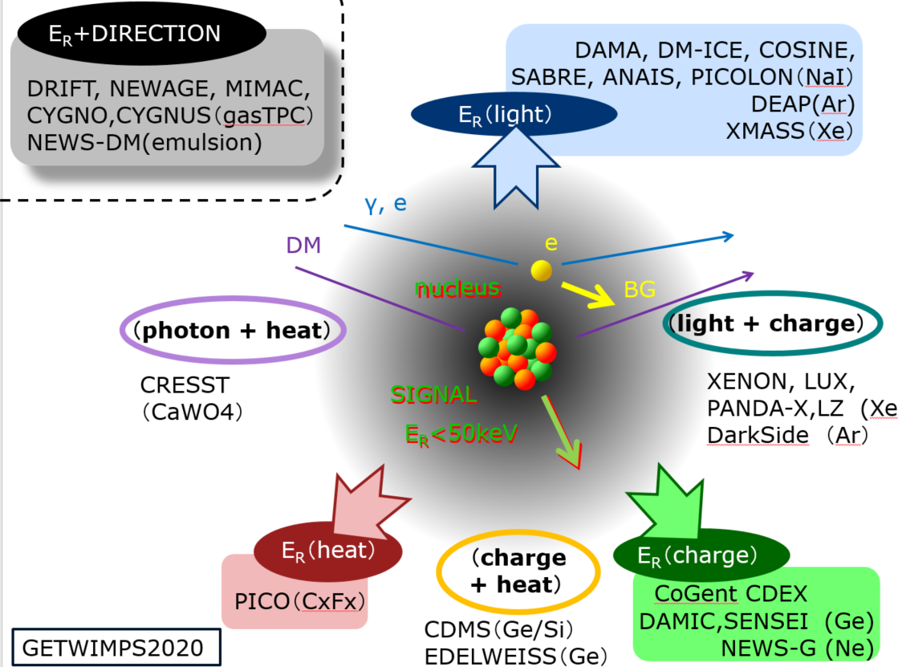
Technologies
  Ordinary radiation detectors
  Background: electron recoil
  more than two info
  ⇒ reject electron BGs

Slide 16
History
Direct search history
leading technologies
  semiconductor ⇒ scintillators
  ⇒ cryogenic detectors (bolometers) ⇒liquid noble gas
limit

Slide 17
２．直接探索の現状

Slide 18
Direct Search Review
1. Mainstream : Large Detectors

Slide 19
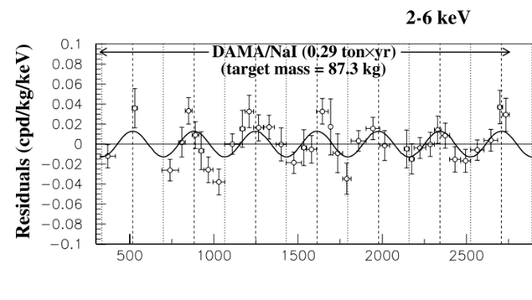

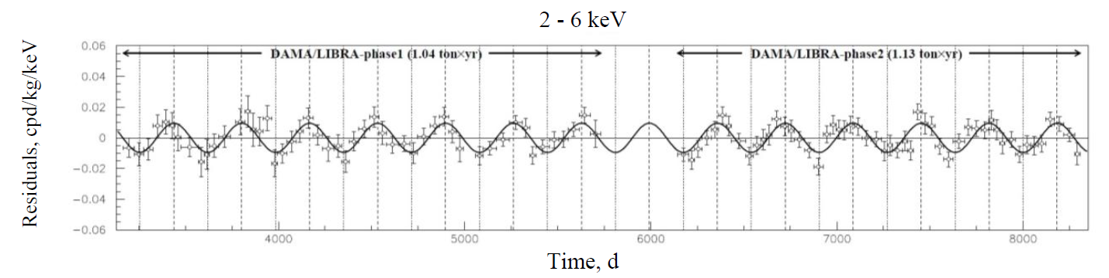
DAMA (NaI)
  250kg NaI scintillators
  Annual modulation were reported：1998～
  Latest 2.46 ton year 12.9 σ
  SOMETHING is detected
DAMA
DAMA/LIBRA
  No BG explains this modulation
  No natural DM model explains, either…

Slide 20
Explaining DAMA with BG
  Long discussion on BG modulation
  Muon?
  Muon & neutrinos
    Solar neutrino has largest flux in winter. (Sun closer.)
Eur. Phys. J. C (2012) 72:2064
  No, muon comes later
MUON
DAMA
PRL 113, 081302 (2014)
  No, not enough neutrinos
  None worked so far ...
  So the right way is to ...
Eur. Phys. J. C (2014) 74:3196

Slide 21
Other NaI detectors
  COSINE(～100kg):
    3 years’measurement completed
    Consistent with null and DAMA.
    upgrading (low threshold, mass ×2)
  ANAIS (112kg)
    3 years’measurement
    incompatible with DAMA
    2 more years to test by 5σ
  SABRE
    North and South inpreparation
  PICOLON
    Pure crystal
  COSINUS
    bolometer technique
PRD 106, 052005 (2022)
Phys. Rev. D 103, 102005 (2021)
vs DAMA
3.3σ
2.6σ
Need to be stay tuned.

Slide 22
DAMA：Strong tension with other nuclei
  Recent papers don’t show DAMA’s area.
  It doesn't mean DAMA signal is gone...
SD
SI

Slide 23
Liquid Xe/Ar：double-phase (liquid+gas)
  XENONnT, LZ, PandaX-II (Xe) , DARKSIDE(Ar)
  Several 100kg ～ 1ton
  z position can be known
  Electron background can be discriminated
Double phase detector principle
XENON nT detector
PMT
time
gas Xe
liquid Xe
light yield
PMT

Slide 24
日本グループの貢献

Slide 25
  結果
    ER ：radon neutron：neutrons from α particle
    AC : accidental coincidence
    Some events in ROI consistent with BG → upper limit
LZ
XEONnT
BG
37Ar
NR
WIMPs (30GeV)
PRL 131, 041002 (2023)
PRL 131, 041003 (2023)
PRL 131, 041003 (2023)
CEvNS

Slide 26
1ton year
  最新結果
    LZ : 0.9 ton・year 9.2e-48 cm² for 36 GeV WIMPs
    XENON : 1.1ton・year 2.6e-47 cm² for 28 GeV WIMPs
    (blind analysis + power constraint limit setting)
dashed : w/o power constraint
PRL 131, 041002 (2023)
PRL 131, 041002 (2023)
PRL 131, 041003 (2023)

Slide 27
この先
  観測継続 & upgrade
XEONnT

Slide 28
論文では強調されない苦労話
  LZ
半分くらいdead
4ケ月くらいデータ取得
不純物の影響で
出てくるS2を殺すためのvetoが長い。
今後の液純化が必用

Slide 29
論文では強調されない苦労話
  XENONnT
電極切れて電場が
デザイン通りには作れない。
やや影響はあるが、
観測継続

Slide 30
今後
  5年程度の観測
  その後 DARWINなどさらに大型化
1.4×10⁻⁴⁸cm@40GeV
1.4×10⁻⁴⁸cm@50GeV

Slide 31
Direct Search Review
2. New Trend : Low Mass DM

Slide 32
Bolometers
  Leading technology before Xe detectors
  First “DAMA killer”
  Shift to low energy WIMPs
Direct search history
limit

Slide 33
Bolometers
  Low energy threshold ⇒ low mass DM
CRESST-III detector
CRESST-III result

Slide 34
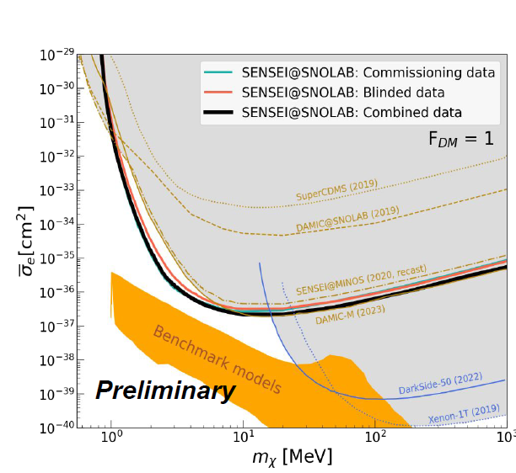
CCD
  DAMIC
    pioneer of low threshold
  SENSEI
    skipper CCD
    sensitive to single electron
    DM-electron channel and other
PRL 125, 171802 (2020)
DAMIC
PLB 711 (2012) 264–269
DAMIC
0.5g
threshold 40eV
CRESST
XENON 10
共同の将来計画「OSCURA」

Slide 35
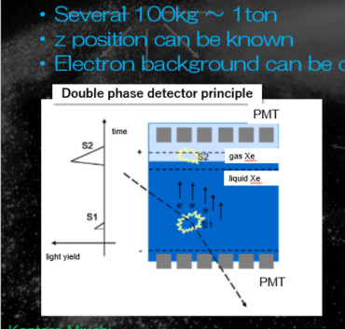
Liq. noble gas: S2 only analysis
  can lower threshold ⇒ low mass WIMPs
  DARKSIDE（Ar）
PRL 121, 081307 (2018)
PRL 121, 081307 (2018)

Slide 36
  XENON S2 only
    Improved 4-7 GeV limits
    note: lighter nucleus (Ar) is better for low mass WIMPs
PRL 123, 251801 (2019)
PRL 123, 251801 (2019)
nucleus dependence
target
target

Slide 37
Direct Search Review
3. Others

Slide 38
Bubble chamber
  PICO
    Superheated chamber
    Threshold-type detector
    Best SD sensitivity
PRD 100, 022001 (2019)
C₃F₈ 52kg
1167kgdays
2.45keV threshold
3 events remained

Slide 39
  Fluorine advantage
    SD search
    different “Neutrino floor”from
    xenon

Slide 40
直接探索の現状
DAMA, Xenon(SI), Fluorine (SD)
PRD 100, 022001 (2019)
PRD 100, 022001 (2019)

Slide 41
3. 最近の話題

Slide 42
Topics
1. MIGDAL

Slide 43
And still lower: MIGDAL
  Low mass search with“MIGDAL effect”
  Ordinary nuclear recoil : ionization along the track
  Low energy recoil : ionization efficiency is low
  ⇒ cannot be detected
  Very rare case electrons are emitted
PRL123, 241803 (2019)
PRL123, 241803 (2019)
PRL123, 241803 (2019)

Slide 44
MIGDAL effect ?
  A. B. Migdal J. Phys. USSR 4(1941)449
    calculated (predicted)
    nuclear recoil ⇒ excitation / ionization
    caused by a sudden change of the nuclear velocity
    small probability
  Ibe et. al. 2018
    reformulated
      energy momentum conservation
      probability conservation
    can be used for DM search

Slide 45
Low mass WIMP search by MIGDAL effect
LUX: PRL 122(2019)131301
EDELWEISS: PRD 99(2019)082003
CDEX: PRL 123 (2019) 161301
XENON: PRL 123 (2019) 241803
SENSEI: arXiv:2004.11378v1
PRL123, 241803 (2019)
Standard WIMP detector down to 100MeV
CAVEAT: Migdal effect itself is yet to be observed.
loose 3orders of magnitude if we use Bremsstrahlung only.

Slide 46
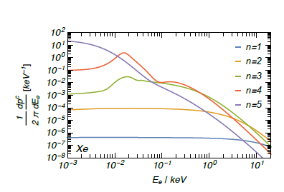
Why MIGDAL observation is difficult?
  Neutron beam for nuclear recoil
  Standard elastic scattering (Nuclear Recoil): huge background
  Signal: NR + electron track ～0.1 keV
    << energy resolution
    << spatial resolution
n

Slide 47
  MIGDAL探し
    2相式キセノン検出器
    14MeV中性子 → 7keV nuclear recoil S2超過事象を探す
    観測されず 原因を調査中
arXiv:2307.12952v1

Slide 48
  Migdal探し：MIGDAL実験
    Straightforward method
    Nuclear track +electron track with gaseous detector
    Demonstrations OK for
    nuclear recoil / electron recoil each.
    Hard to discriminate from standard nuclear recoil
Astroparticle Physics 151 (2023) 102853

Slide 49
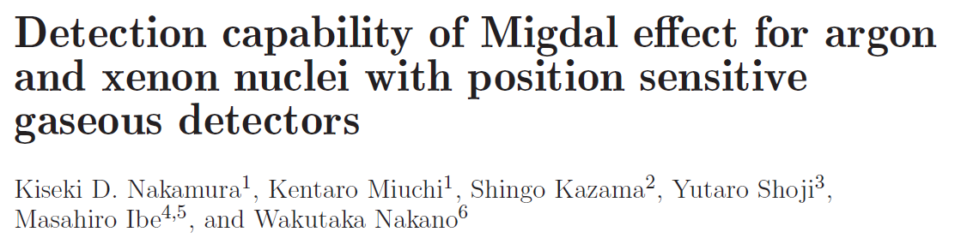
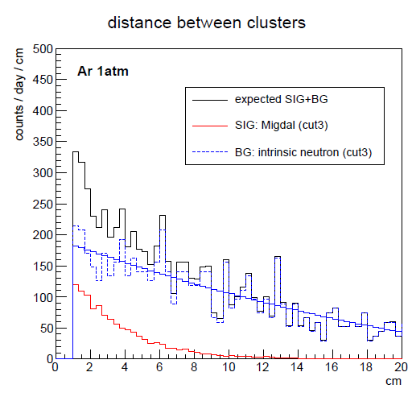
  Migdal探し MIRACLUE実験
    Detect characteristic signal
    “two-cluster” events
    Help to reduce huge background
PTEP(2020)ptaa162
金崎奎修士論文（2023年神戸大学）
金崎気鋭
    検出器準備中

Slide 50
Topics
2. Directionality

Slide 51
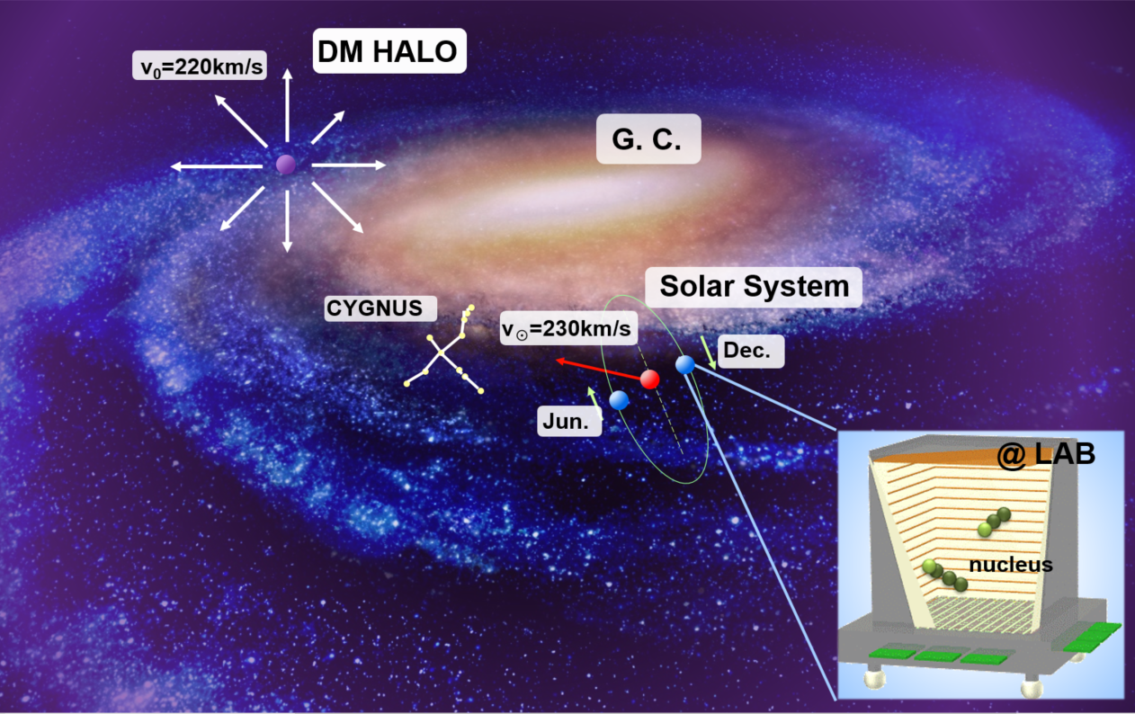
Directional search：concept “CYGNUS”
  More robust evidence than annual modulation
  Study the DM nature after discovery
expected anguler distribution
M=80GeV
σ=0.1pb
clear forward scattering
-1
cosθ
1
（θ：angle between the nuclear recoil direction and constellation CYGNUS）

Slide 52
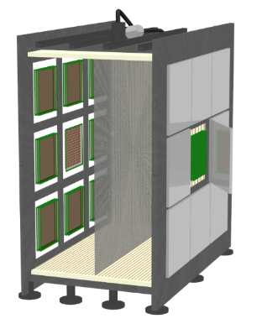

World-wide CYGNUS
2020 J. Phys.: Conf. Ser. 1468 012044
NEWAGE/CYGNUS-KM
Kamioka, Japan
SF6 / CF4
Strip readout
CYGNUS-10
Boulby, UK
10m³ He:SF₆
GEM + wire readout
40cm
CYGNUS-HD10
SURF, USA
He:CF₄:C₄H₁₀
Strip readout
CYGNO-Initium
Gran Sasso, Italy
He CF₄ (SF₆)
sCMOS+PMT readout
CYGNUS-OZ
Stawell, Australia
R&D leading to 1 m³
Long-term plan 10 m³
multi-site observatory
Notes:
In order to get nuclear track, it is usual to use Time Projection Chamber (TPC).
This is schematic image of TPC.
First, dark matter interact to nuclear.
And then, nuclear run in the gas ionizing around gas molecular.
Ionized electrons are dragged to MPGD by electric field.
MPGD detect 2-dimensional projection of track.
And using the time electron reached to MPGD, we can get another 1-dimensional information.
Thus, TPC detect 3-dimensional nuclear track.
Typical length of nuclear track scattered by dark matter is about 1cm.
So, MPGD is suitable for direction-sensitive dark matter search.
By the way, information of nuclear track have another advantage.
The length of nuclear event is short but electron events recoiled by Compton scattering is long.
If we know track length, we can discriminate gamma-ray event from nuclear event.
This graph is detection efficiency of electron events.
Using MPGD, detector have gamma ray rejection power.

Slide 53
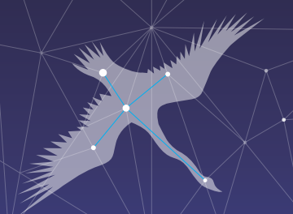
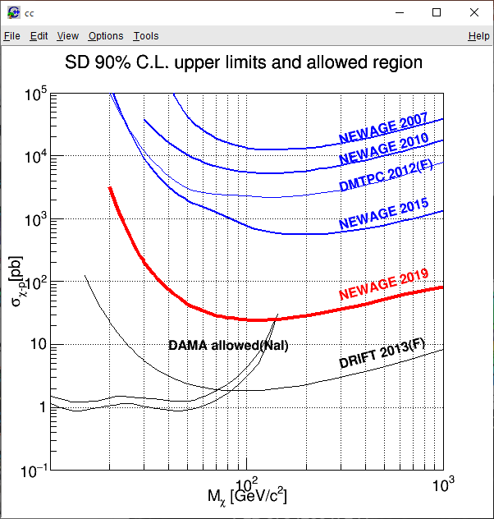
SKYMAP (measured DATA)
NEWAGE(Kobe+)
  3D tracking
    μ-PIC
    SKYMAP
  CF₄ gas
    High spatial resolution
    Spin-Dependent search
  Proposal
  First directional search
  Underground measurements
NEWAGE limits
PLB 578 (2004) 241
PLB 654 (2007) 58
PLB 686 (2010) 11, PTEP (2015) 043F01S, TAUP2019
PTEP (2020) ptaa147
T.Ikeda TAUP2019

Slide 54
arXiv 2008.12587
Realistic simulation (strip readout)
even 10m³ detector
can start exploring Xe neutrino floor

Slide 55
Toward discovery
Potential to search beyond the “neutrino floor” where large detectors are reaching.
expected
^{WIMPS}
⁸B ν’s
⁸B
WIMPs
ecliptic coordinate
solar
atmospheric
  distinguishable

Slide 56
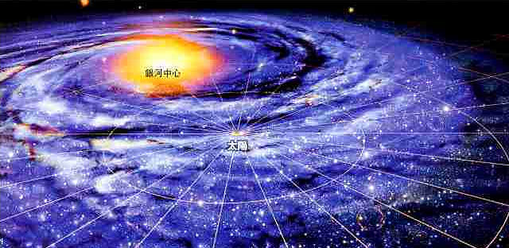
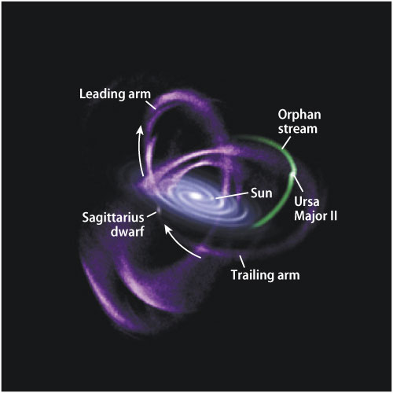
  CYGNUS After Discovery: astronomy/cosmology
    Test the HALO model
    （ex）Sagittarius stream
Our GALAXY
expected
standard HALO
GC
Sagittarius stream
SUN
constellation
“CYGNUS”
standard HALO + stream
galactic coordinate
  streams, debris…

Slide 57
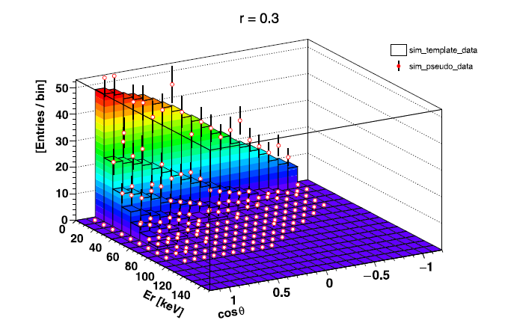
  Halo model test (w/長尾さん)
    isotropic (1-r) + co-rotating(r) DM HALO model indicated by n-body simulation (r～0.3)
    main observables: energy + direction(θ) ⇒2D fitting
    know r value by directionality

Slide 58
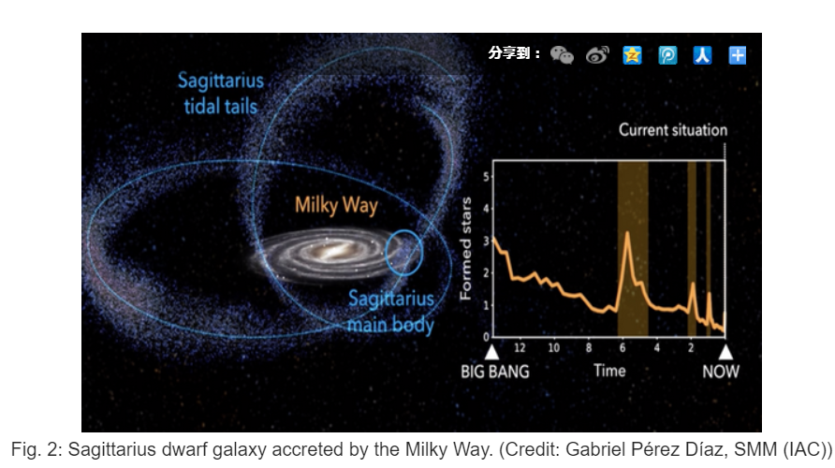
  （いい意味で）気になるはなし
    co-rotating halo成分：Sagitarius streamの形にも影響
    directionalな観測との合わせ

Slide 59
  CYGNUS After Discovery : particle physics
    Some interaction provide characteristic angular distributions
angular distribution
operator
SI
SD

Slide 60
  CR boosted DM (w/長尾さん)
    keV～MeV程度のWIMP
    銀河中心で高エネルギー宇宙線（陽子）に蹴られる
    方向感度を持つWIMP検出器
    （ガスや原子核乾板）で見ると銀河中心が明るいはず
    観測量は必用だが、原理的には見える。
JCAP07(2023)061
到来方向
反跳角分布
銀河中心エクセスの有意度

Slide 61
最近の話題 まとめ
MIGDAL
  Observation
Directional Detectors：gas detectors
  Clear evidence
  DM nature study

Slide 62
Thank you!

