Slide 1
XMASS実験における 暗黒物質探索
東大宇宙線研 平出克樹
2011年3月7日
基研研究会 素粒子物理学の進展2011

Slide 2
Contents
Introduction
The XMASS detector
Current status of XMASS

Slide 3
Introduction

Slide 4
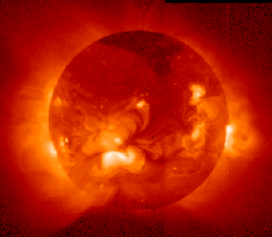
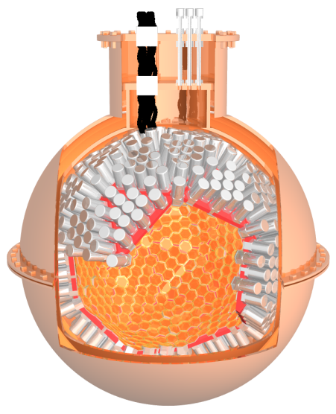
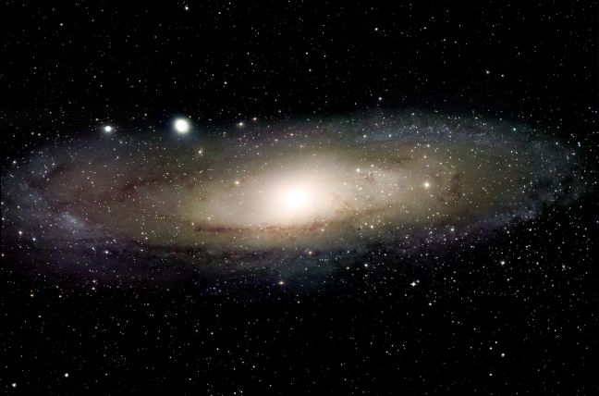
XMASS experiment
What is XMASS?
Multi purpose low-background and low-energy threshold experiment with liquid Xenon
Xenon detector for Weakly Interacting MASSive Particles (DM search)
Xenon MASSive detector for solar neutrino (pp/⁷Be)
Xenon neutrino MASS detector (ββ decay)
Solar neutrino
Dark matter
Double beta
4
Notes:
.

Slide 5
XMASS Collaboration
Kamioka Observatory, ICRR, Univ. of Tokyo：
Y. Suzuki, M. Nakahata, S. Moriyama, Y. Kishimoto, M. Yamashita, Y. Koshio,
A. Takeda, K. Abe, H. Sekiya, H. Ogawa, K. Kobayashi, K. Hiraide,
K. Ueshima, A. Shinozaki, H. Nishiie, S. Hirano
IPMU, University of Tokyo： K. Martens, J.Liu
Kobe University: Y. Takeuchi, K. Otsuka
Saga University: H. Ohsumi
Tokai University: K. Nishijima, D. Motoki
Gifu University： S. Tasaka
Waseda University： S. Suzuki
Yokohama National University： S. Nakamura, I. Murayama, K. Fujii
Miyagi University of Education： Y. Fukuda
STEL, Nagoya University： Y. Itow, K. Masuda, H. Uchida, Y. Nishitani
Seoul National University： S.B. Kim
Sejong University： Y.D. Kim
KRISS: Y.H. Kim, M.K. Lee, K. B. Lee, J.S. Lee

Slide 6
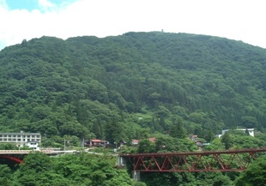
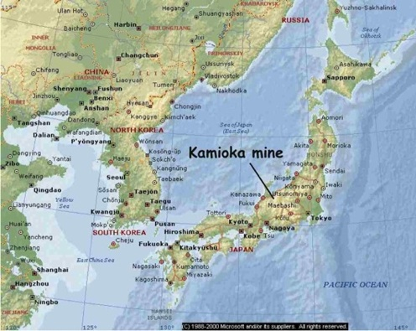
Kamioka observatry
Dormitory
Underground Lab
Office

Slide 7
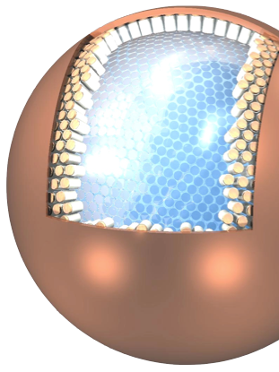
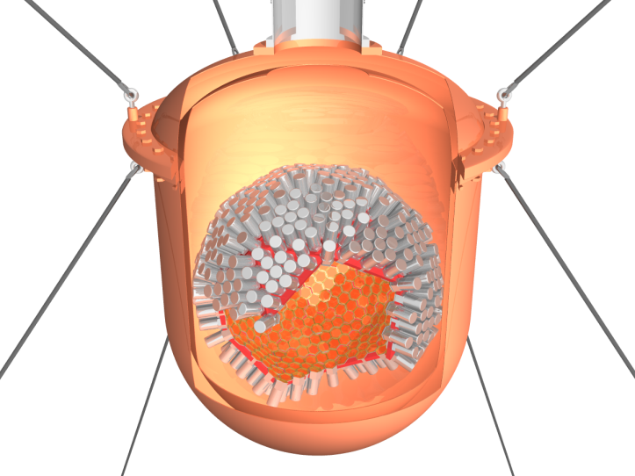
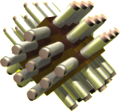
Three phases of the XMASS experiment
20ton Detector
（FV:10ton, ~2.5m）
100kg Prototype
（FV:30kg, ~30cm）
800kg Detector
（FV:100kg, 80cm）
Completed
Solar Neutrino
Dark Matter
R&D
Dark Matter
2007 : Project was funded.
2010 Sep. : Detector construction was completed
2010 Oct.-: Commissioning
7
Notes:
7

Slide 8
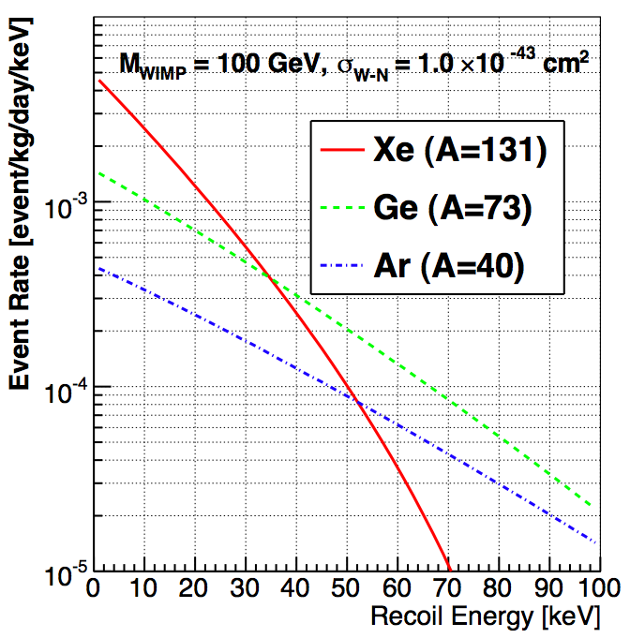
WIMP search in XMASS
Expected recoil energy spectra for different target nuclei
Dark Matter
（WIMP）
Deposit Energy
10⁻³
50GeV, σ_{χp}=3x10⁻⁴⁴ cm²
Expected total event rate
for spin independent case
Counts/day/kg/keV
10⁻⁴
10⁻⁵
μ: reduced mass
Xenon has an advantage
due to its large A
10⁻⁶

Slide 9
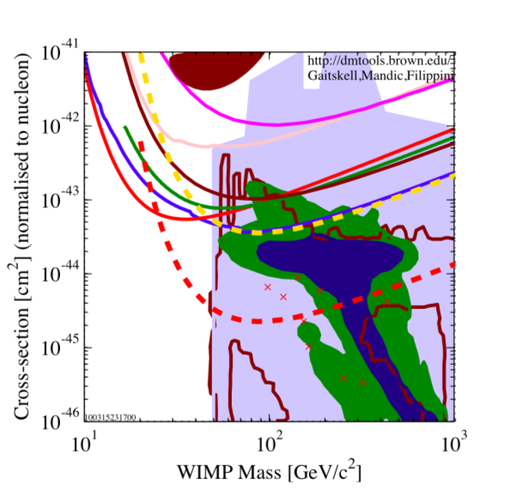
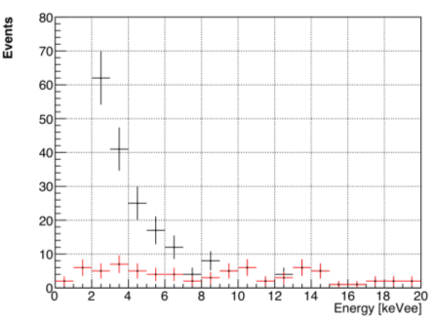
Expected sensitivity
σ_{χp}>2x10⁻⁴⁵ cm²
for 50-100GeV WIMP, 90%C.L.
1yr exposure, 100kg FV,
BG: 1x10⁻⁴ /keV/d/kg
Scintillation efficiency: 0.2
Spin Independent Case
XENON10
CDMSII
Expected energy spectrum
1 year exposure
σ_{χp}=10⁻⁴⁴ cm²
50GeV WIMP
XMASS 1yr
Black:signal+BG
Red:BG
MC

Slide 10
The XMASS detector

Slide 11
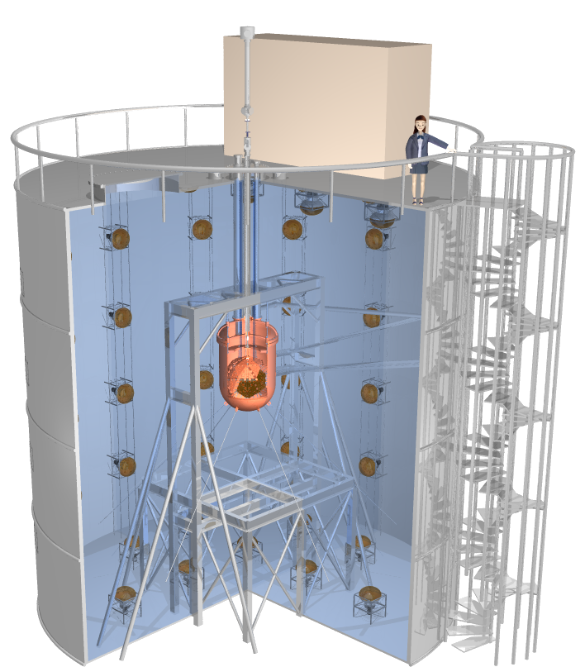
The XMASS 800kg detector
Xenon detector
Liquid Xenon 857kg
642 PMTs (Hamamatsu R10789)
64.2% photo coverage
Water cherenkov detector
shield of gamma, neutrons
used for cosmic-ray veto
72 PMTs (20-inch)
11m
10m

Slide 12
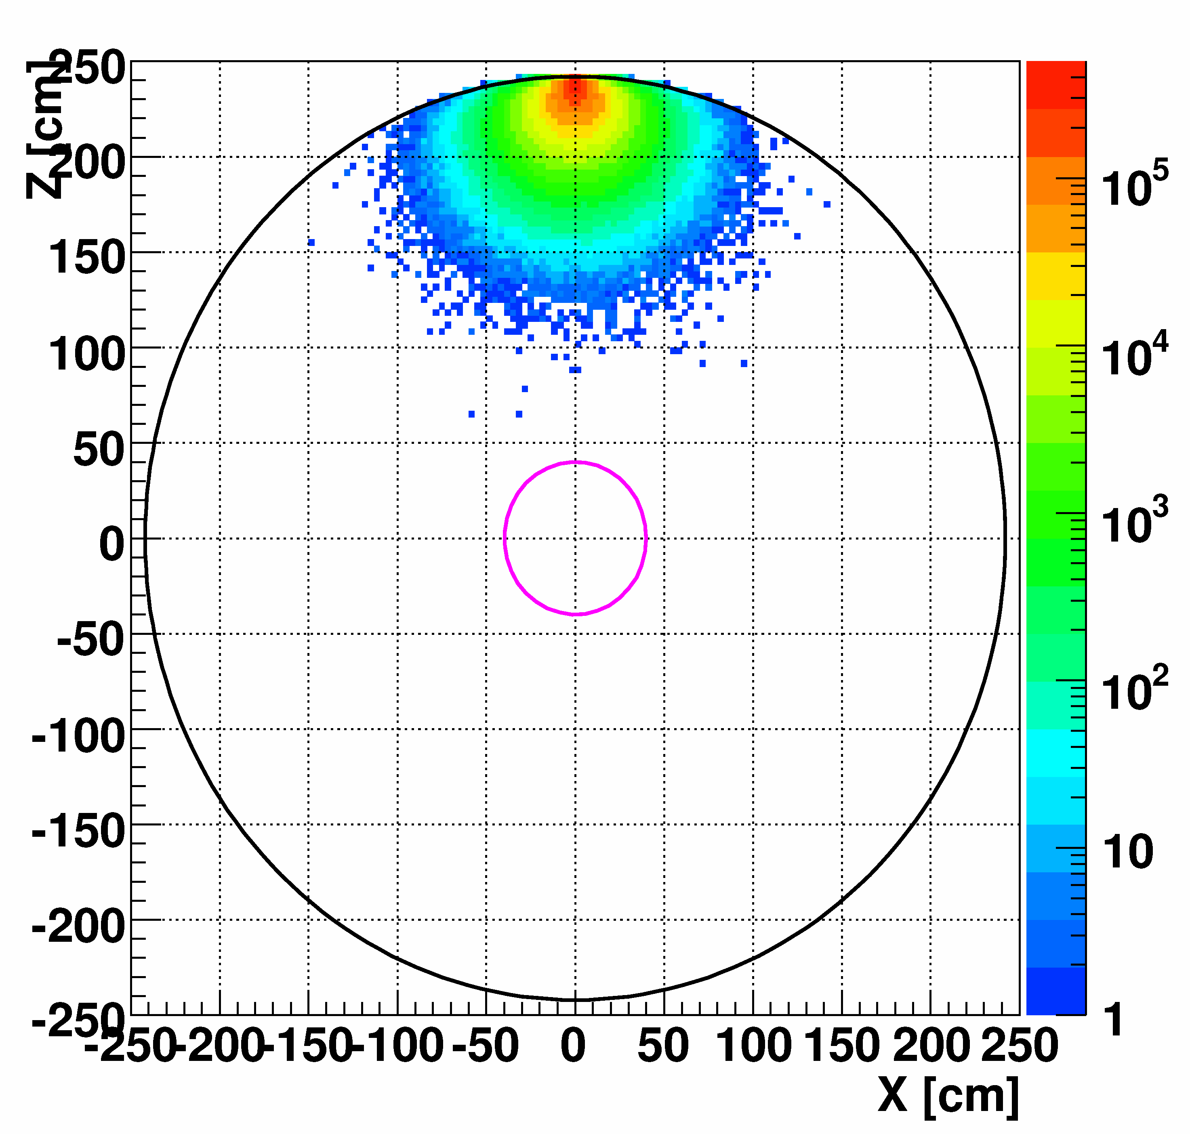
Water shield for fast neutrons
water: 200cm, energy: 10MeV
Fast n flux @Kamioka mine:
(1.15+0.12) x10⁻⁵ /cm²/sec
-
water
Z [cm]
Liq. Xe
< 2 x 10⁻⁴ counts/day/kg
200cm of water is enough
to reduce the fast neutron
MC
X [cm]

Slide 13
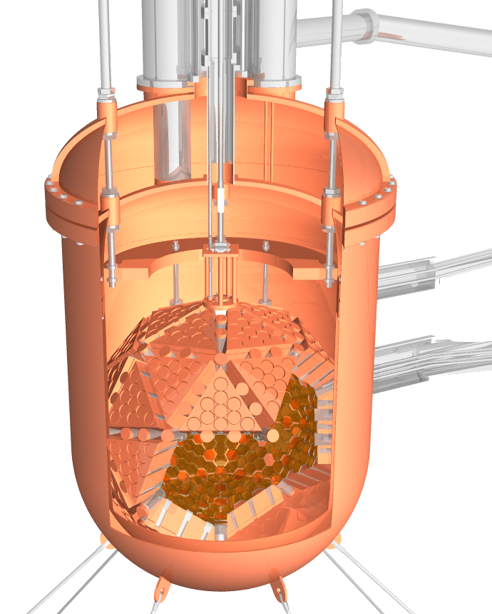
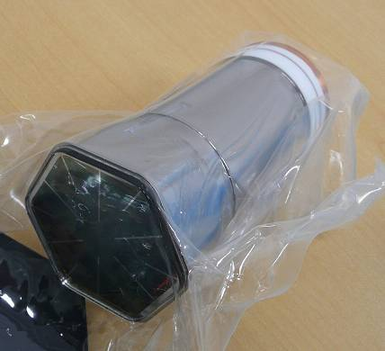
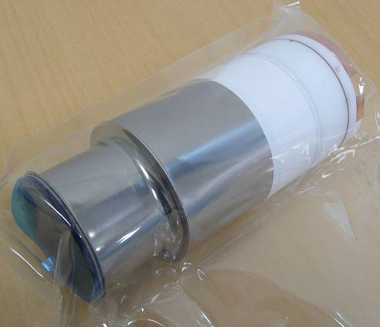
Liquid Xenon detector (main detector)
※We developed new ultra low
RI PMT with Hamamatsu.
(1/100 of ordinary one).
OFHC copper
vessel
Hex : R10789-11
126.6
857kg
xenon
Round: R10789-11MOD
642
PMTs
Φ47
126.6
~ 1.2m

Slide 14
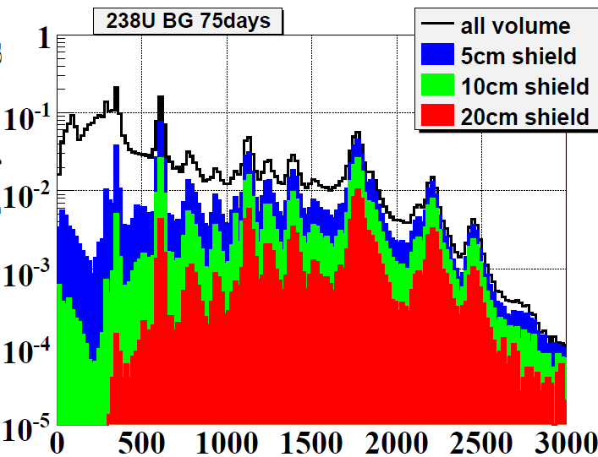
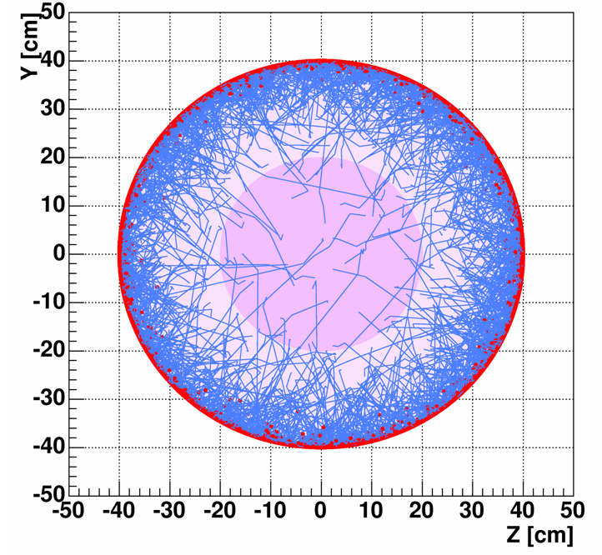
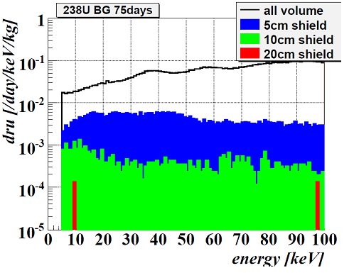
Self-shielding for BG from PMTs (MC)
MC
 | BG/PMT [mBq]
U chain | 0.70 +/- 0.28
Th chain | 1.51 +/- 0.31
40K | < 5.10
60Co | 2.92 +/- 0.16
Counts/day/kg/keV
PMT
PMT
keV
MC
γ tracking
Counts/day/kg/keV
< 10⁻⁴ /keV/day/kg (100kg F.V.)
n contribution < 2.2x10⁻⁵/d/kg
keV

Slide 15
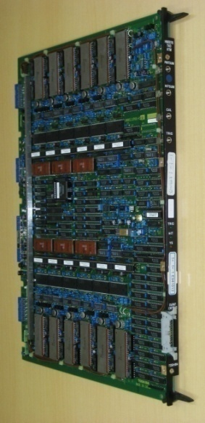
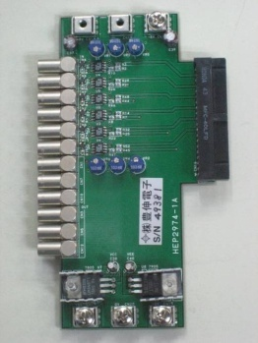
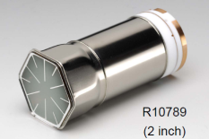
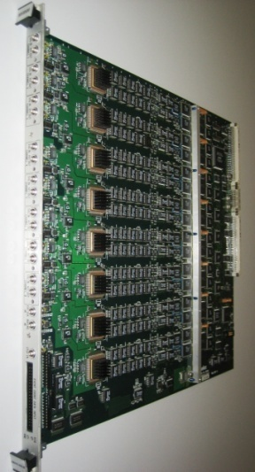
Readout electronics
12bit ADC/TDC (ATM)
To cover large energy range
Pre-amplifier card
TKO module
ADC dynamic range : 0~400 pC
TDC dynamic range : 0~1 usec
PMT
8bit Flash ADC
For pulse shape discrimination
in low energy
dynamic range: 0~-1 V
sampling rate : 500 MS/s
sample number: 8,160
time span : 16.32 usec

Slide 16
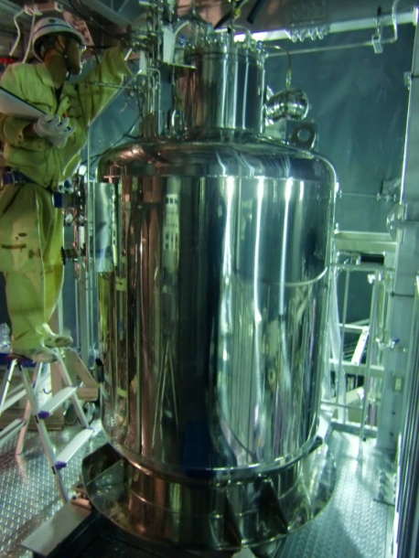
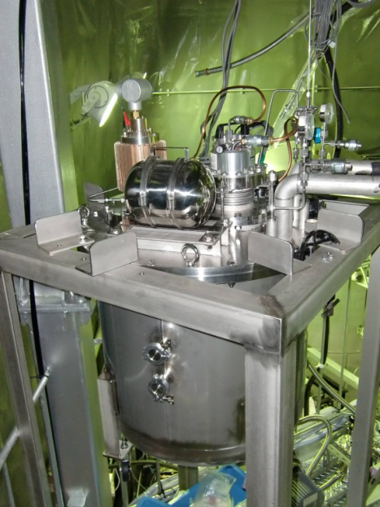
Cryogenic apparatus
Gas phase: < 30 L/min
Liquid phase: ~ 5 L/min
700L liq.storage
Gas circulation <30L/min
gas pump
emergency gas pump
100L/min
Cable line
Calibration line
getter
getter
Water tank
10 m³
x 2
gas
storage
evaporator
Liquid pump
Condenser
360W
857kg
filters
Outer vacuum
liquid pump
700L
Liq. Storage
Liquid circulation ~5L/min

Slide 17
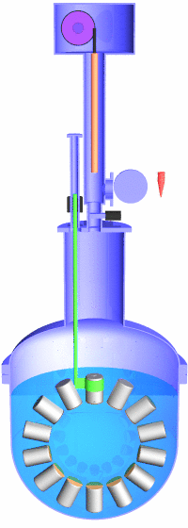
Calibration system
Source introduce machine
RI sources
RI | energy [keV] | Intensity [Hz] | φ [mm] | package
(1) Fe-55 | 5.9 | 350 | 5 | brass
(2) Cd-109 | 22, 25, 88 | 800 | 5 | brass
(3) Am-241 | 59.5 | 485 | 0.15 | SUS
(4) Co-57 | 122 | 100 | 0.21 | SUS
Top PMT moving
machine
Gate valve
Xenon gas area
~5m
Source rod
OFCu
Top PMT
(removed between calibration)
RI source with holder
adaptor(SUS304)

Slide 18
Detector construction Nov. 2009 - Sep. 2010

Slide 19
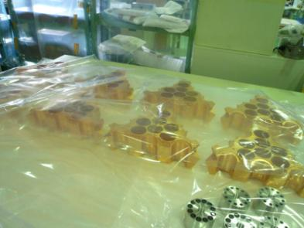
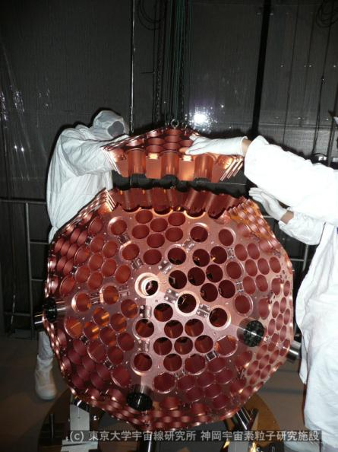
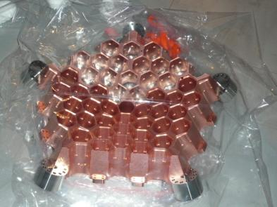
Construction of the PMT holder: Nov. 2009

Slide 20
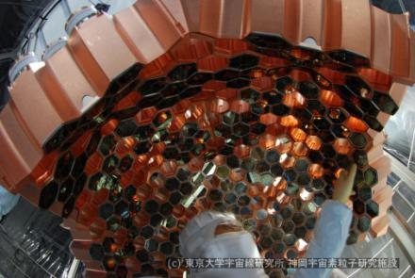
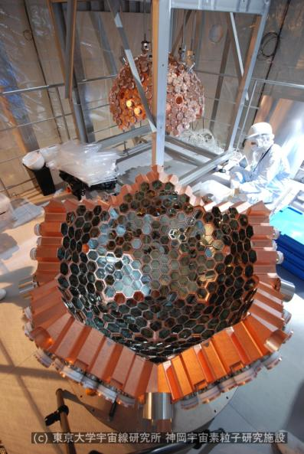
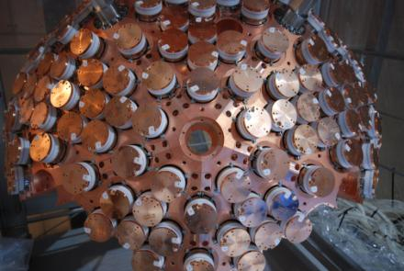
PMT installation: Dec. 2009- Jan. 2010

Slide 21
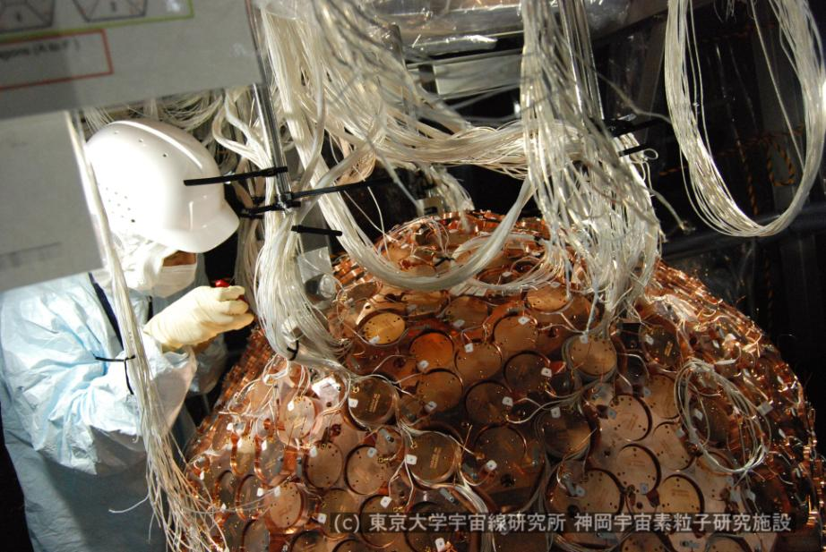
Cabling

Slide 22
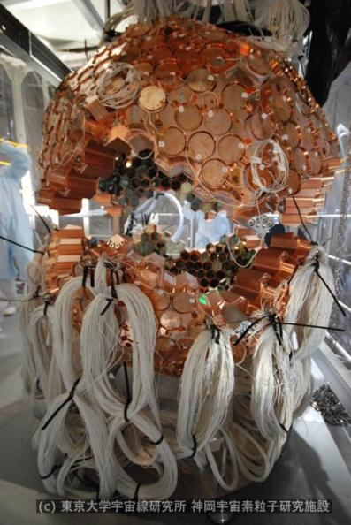
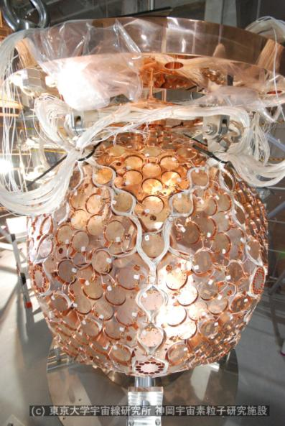
Jointing two hemispheres: Feb. 2010

Slide 23
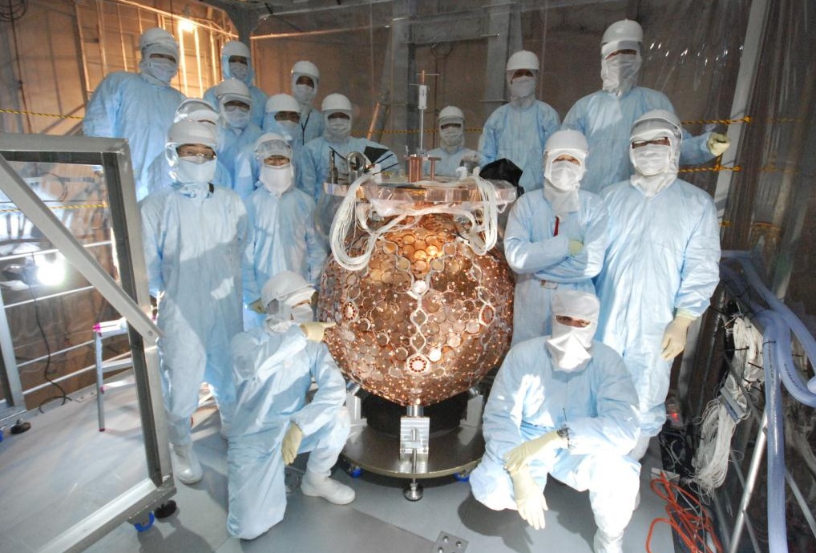

Slide 24
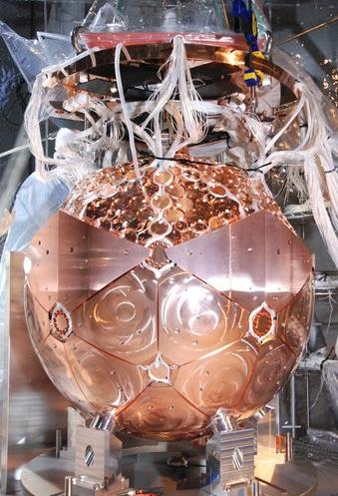
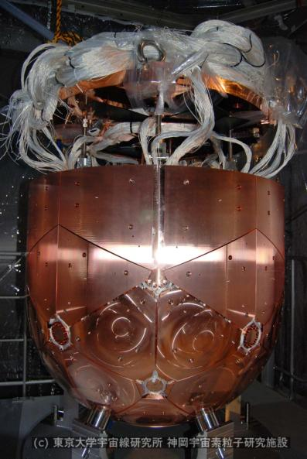
Attaching filler: end of Feb. 2010

Slide 25
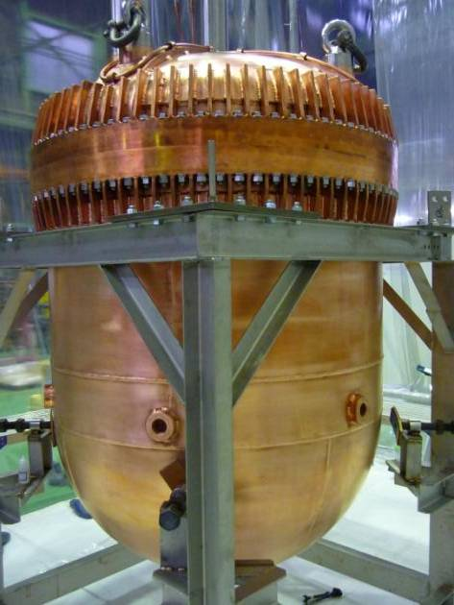
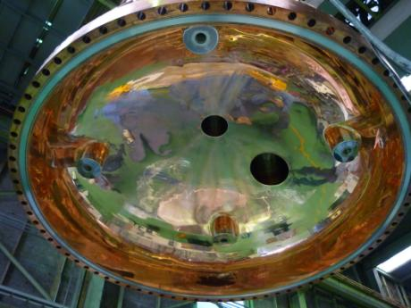
Manufacturing detector vessel
A challenge: Manufacturing a large flange with soft OFHC copper
Due to insufficient strength of its neck part, it needed to be reinforced by adding ribs.

Slide 26
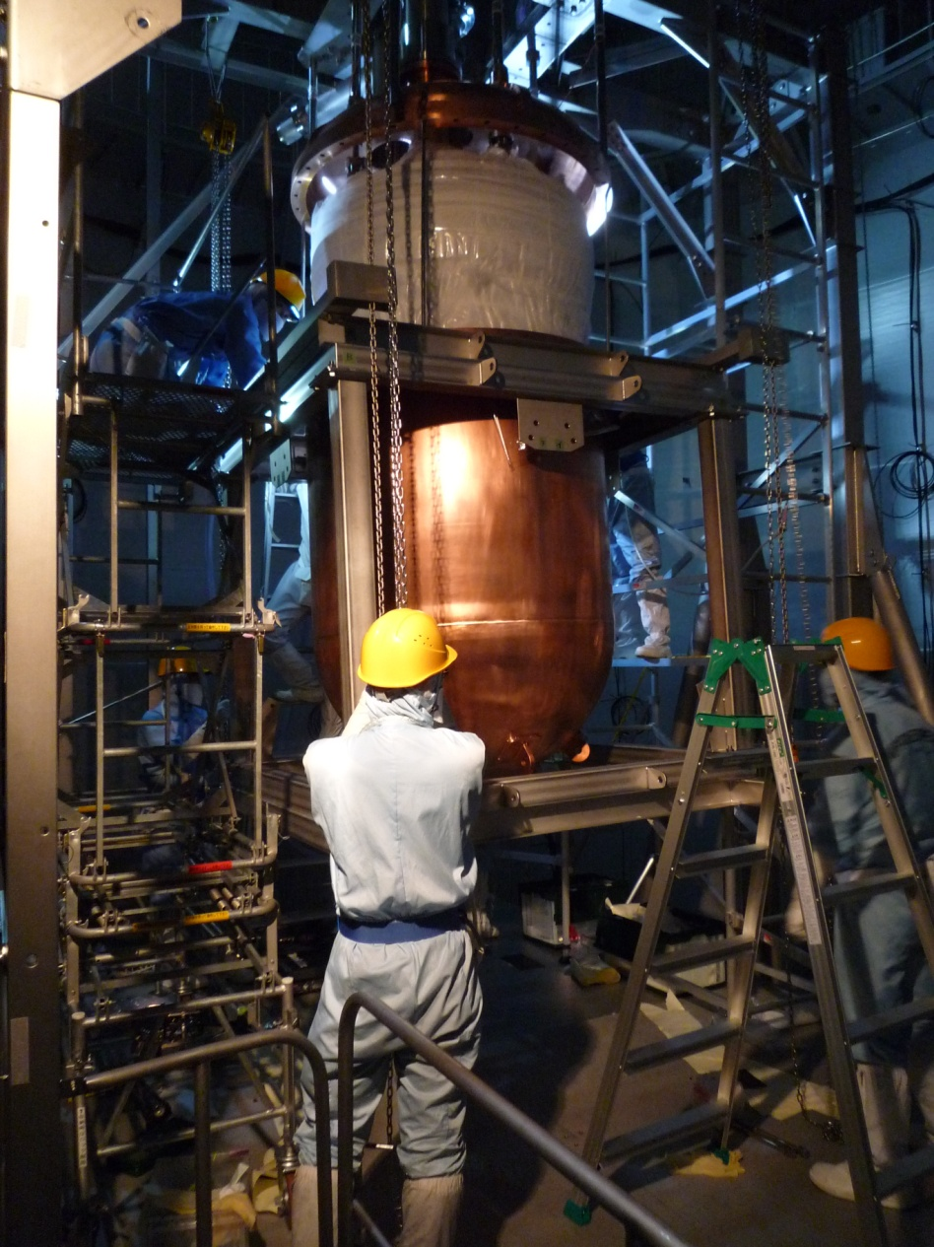
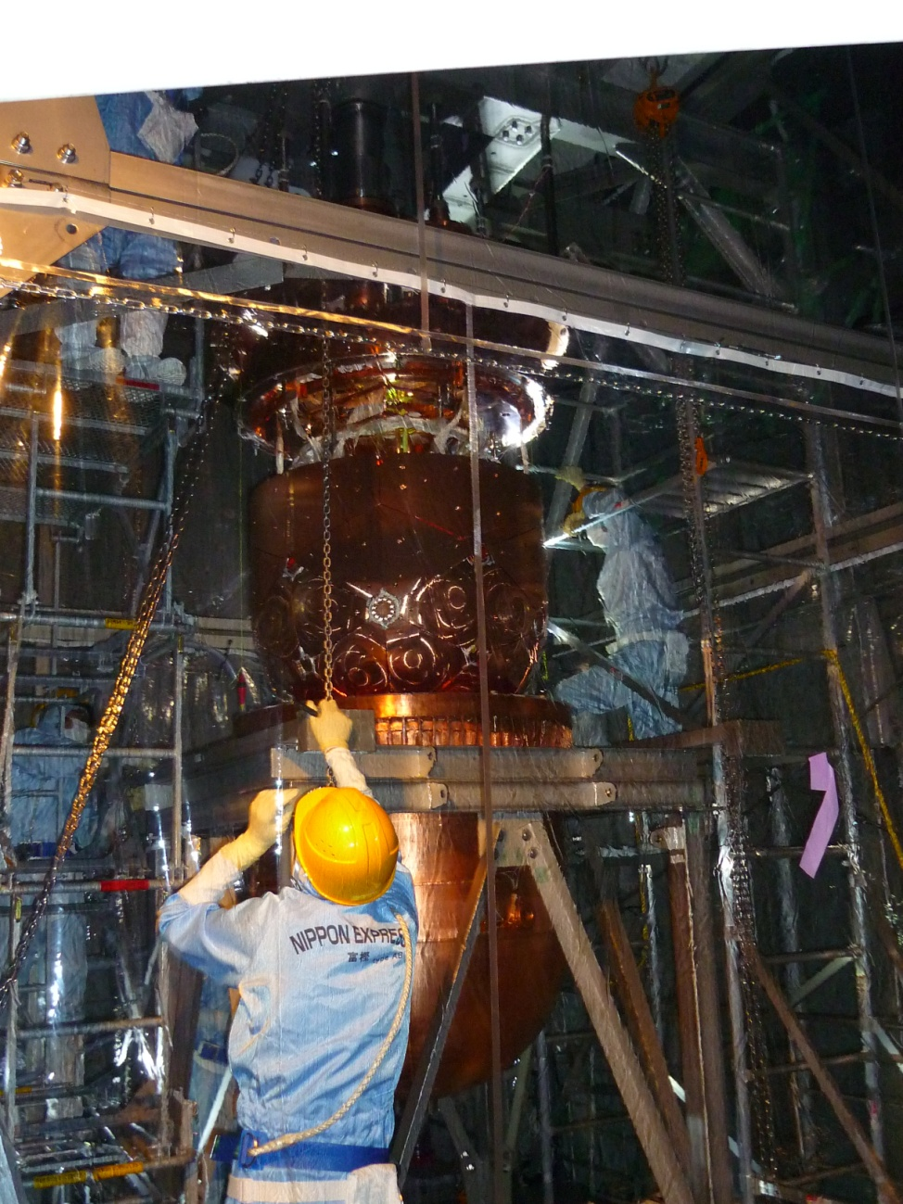
Closing the detector vessel: Aug. 2010

Slide 27
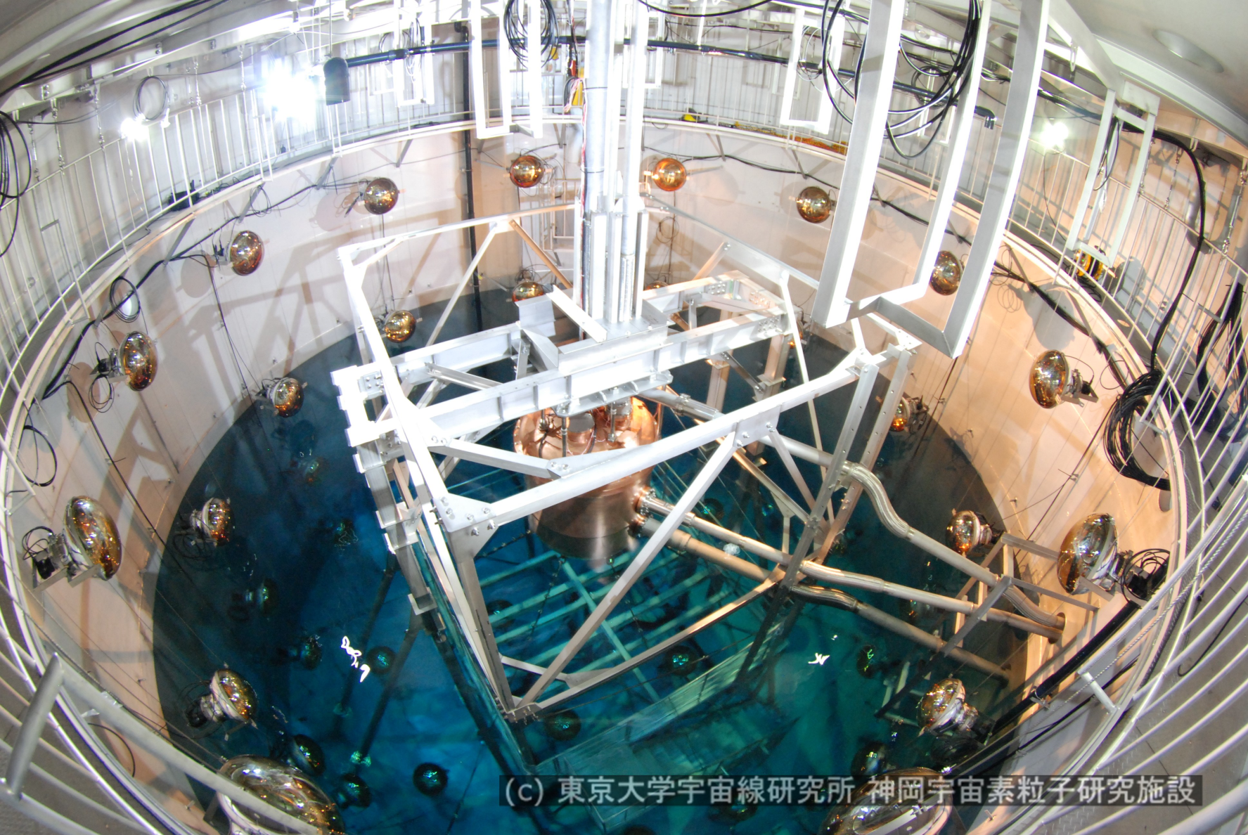
Xenon vessel in the water tank

Slide 28
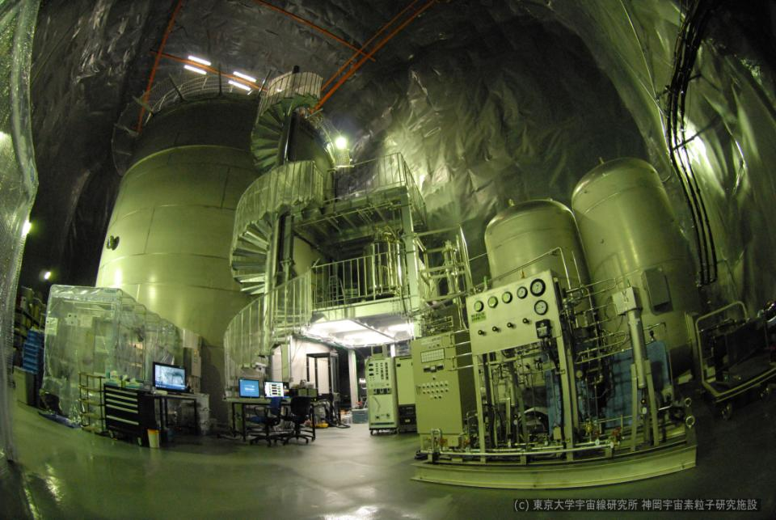
Detector construction was completed in Sep. 2010
Calibration system
Electronics hut
GXe buffer tank
10m3 x 2, <10bar
Distillation
Tower
LXe tank
Clean booth
at the entrance
GXe compressor

Slide 29
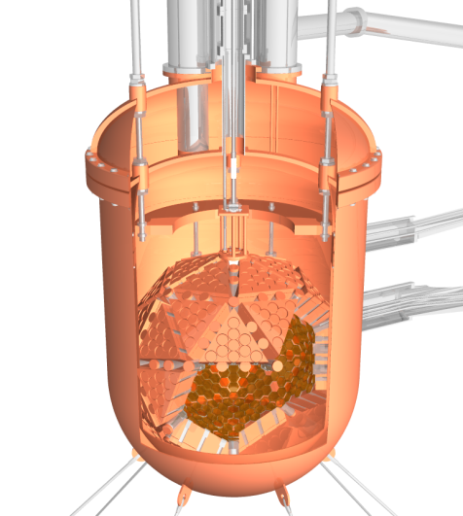
Xenon purification
Kr <1ppt
Distillation
H2O <1ppb(target)
baking
Molecular sieves
Getter
Xenon draining
Particle <mg/all(target)
Particle filter
Xenon draining
Radon
<1.2mBq/all(target)
Charcoal
Light absorption background
Target transparency >>m
N2,O2,CO2, CO etc
<1ppb(target)
MS, getter
H2 <0.16ppbw
Room temp.Getter
※device has been already worked
U/Th <10⁻¹⁴g/g(target)
Getter
evaporation
※All values are our target value
RI background

Slide 30
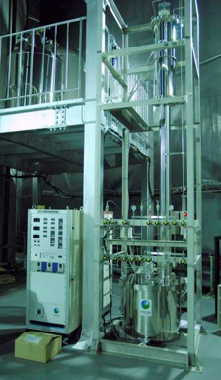
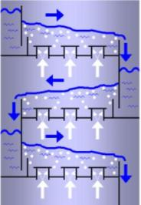
Internal BG (1): Kr
Completed in Sep. 2010
Kr (⁸⁵Kr: Q_{β}=687keV, τ=10.8y) can be reduced by distillation.
Our goal: Kr < 1ppt ( <10⁻⁵ /day/keV/kg)
5 order of magnitude reduction with 4.7kg/hr processing time
was achieved.
Target value can be achieved
in 10 days for 1ton xenon.
(0.1ppm 1ppt)
K. Abe et al. for XMASS collab., Astropart. Phys. 31 (2009) 290
Distillation tower
commercial
LXe
intake
GKr
outlet
4m
 | Boiling point (@0.2MPa)
Xe | 178 K
Kr | 140~150 K
Kr
LXe
outlet
Kr

Slide 31
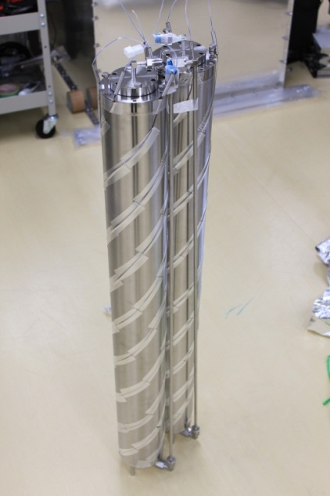
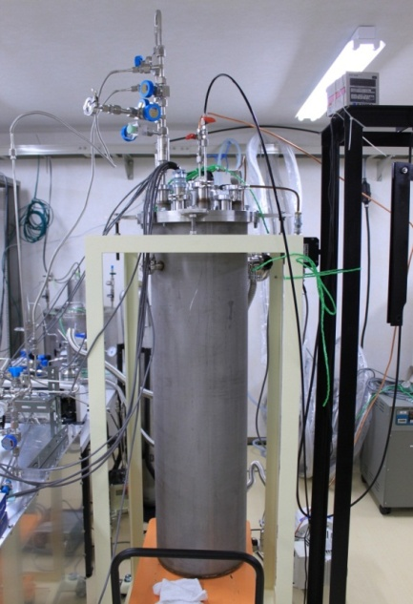
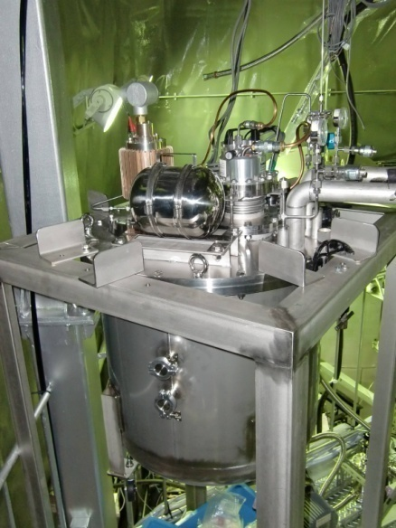
Internal BG (2): Rn
Under study
Measured Rn emanation rate from all materials is < 15mBq
Our goal: ²²²Rn < 1.2 mBq/ton (<2x10⁻⁵ dru (/kev/day/kg))
Continuous Rn removal with xenon circulation is needed.
Gas phase removal :
Cooled charcoal can take Rn.
Rn removal system are mounted in gas line
liquid phase removal :
Liquid circulator and filter will be used.
Removal method is under study.

Slide 32
Detector cleaning using xenon: Oct. 2010
６）liquefy the xenon
5)Make gas and passing getter
getter
Xenon condence
Valve station
Liquid xenon storage tank
circulator
2) Liquid xenon transfer using
Circulator.
Filter housing
２F
１）impurity take to xenon
３）take dust by
all SUS particle filter
４）xenon collects to
liq.xenon tank
Dust /impurity in the detector were removed using xenon.
By this work, light yield increased about 16% (form 57Co source data)

Slide 33
Current status
Xenon filling was completed in Nov. 2010.
Now in the commissioning stage
Detector calibration using RI source and LED
Event reconstruction study
Radon rate measurement etc.

Slide 34
Event displays (calibration data)
Co57
Z=0cm (detector center)
Co57
Z=-30cm

Slide 35
Summary
The XMASS project aims to observe
pp solar neutrinos
neutrino-less double beta decay
dark matter
The 800kg detector is dedicated to a dark matter search.
Expected to have low background of 1x10⁻⁴ /keV/day/kg in the 100kg FV
Sensitivity for SI down to 2x10⁻⁴⁵cm² with one year operation.
Detector construction was completed in Sep. 2010. We are now in the commissioning stage.

Slide 36
Backup slides

