Slide 1
D-term Dynamical Supersymmetry Breaking
with N. Maru (Keio U.)
arXiv:1109.2276, extended in July 2012
I) Introduction and punchlines
spontaneous breaking of SUSY
is much less frequent compared with that of internal symmetry
most desirable to break SUSY dynamically (DSB)
In the past, instanton generated superpotential e.t.c. ${\left\langle F\right\rangle }_{nonpt}→\left\langle D\right\rangle ≠0$
In this talk, we will accomplish DSB triggered by $\left\langle D^{0}\right\rangle ≠0$, DDSB, for short
based on the nonrenormalizable D-gaugino-matter fermion
coupling and appears natural in the context of SUSY gauge theory
spontaneous broken to ala APT-FIS
metastability of our vacuum ensured in some parameter region
requires the discovery of scalar gluons in nature, so that distinct from
the previous proposals
no messenger field needed in application

Slide 2
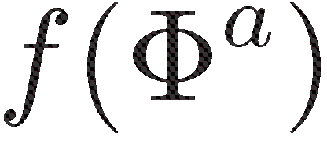
II) Basic idea
Start from a general lagrangian
: a Kähler potential
: a gauge kinetic superfield of the chiral superfield in the adjoint representation
: a superpotential.
bilinears:
where .
no bosonic counterpart
assume is the 2nd derivative of a trace fn.
: holomorphic and nonvanishing part of the mass
the gauginos receive masses of mixed
Majorana-Dirac type and are split.

Slide 3
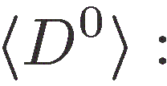
Determination of
stationary condition to
where is the one-loop contribution
and
supersymmetric counterterm
condensation of the Dirac bilinear is responsible for
In fact, the stationary condition is nothing but the well-known gap equation of
the theory on-shell which contains four-fermi interactions.

Slide 4
Theory with vacuum at tree level
U(1) case: Antoniadis, Partouche, Taylor (1995)
U(N) case: Fujiwara, H.I., Sakaguchi (2004)
where the superpotential is
which are electric and magnetic FI terms.

Slide 5
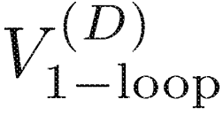
The rest of my talk
Contents
III) and subtraction of UV infinity
IV) gap equation and nontrivial solution
V) finding an expansion parameter
VI) non-vanishing F term induced by $\left\langle D^{0}\right\rangle ≠0$
and fermion masses
VII) context & applications

Slide 6
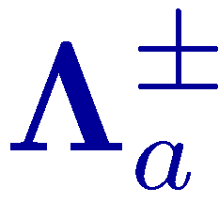
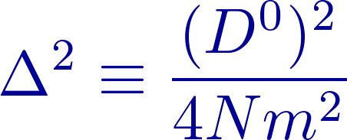
III)
back to the mass matrix:
the two eigenvalues for each $a$ are
${{|m}_{a}|}^{2}$ are the masses of the scalar gluons
at tree level
( cf. in APT-FIS)
the entire contribution to the 1PI vertex function is
the part of the one-loop effective potential which contains
where

Slide 7
both the regularization & the c. t. are supersymmetric,
unrelated. So
where $c$ is a fixed non-universal number.
is now expressible in terms of $A\left(d\right), c, β$ as
Our final expression for is
where

Slide 8
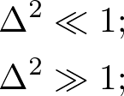
IV)
gap equation:
Q: the nontrivial solution $∆≠0$ exists or not
approximation solution

Slide 9
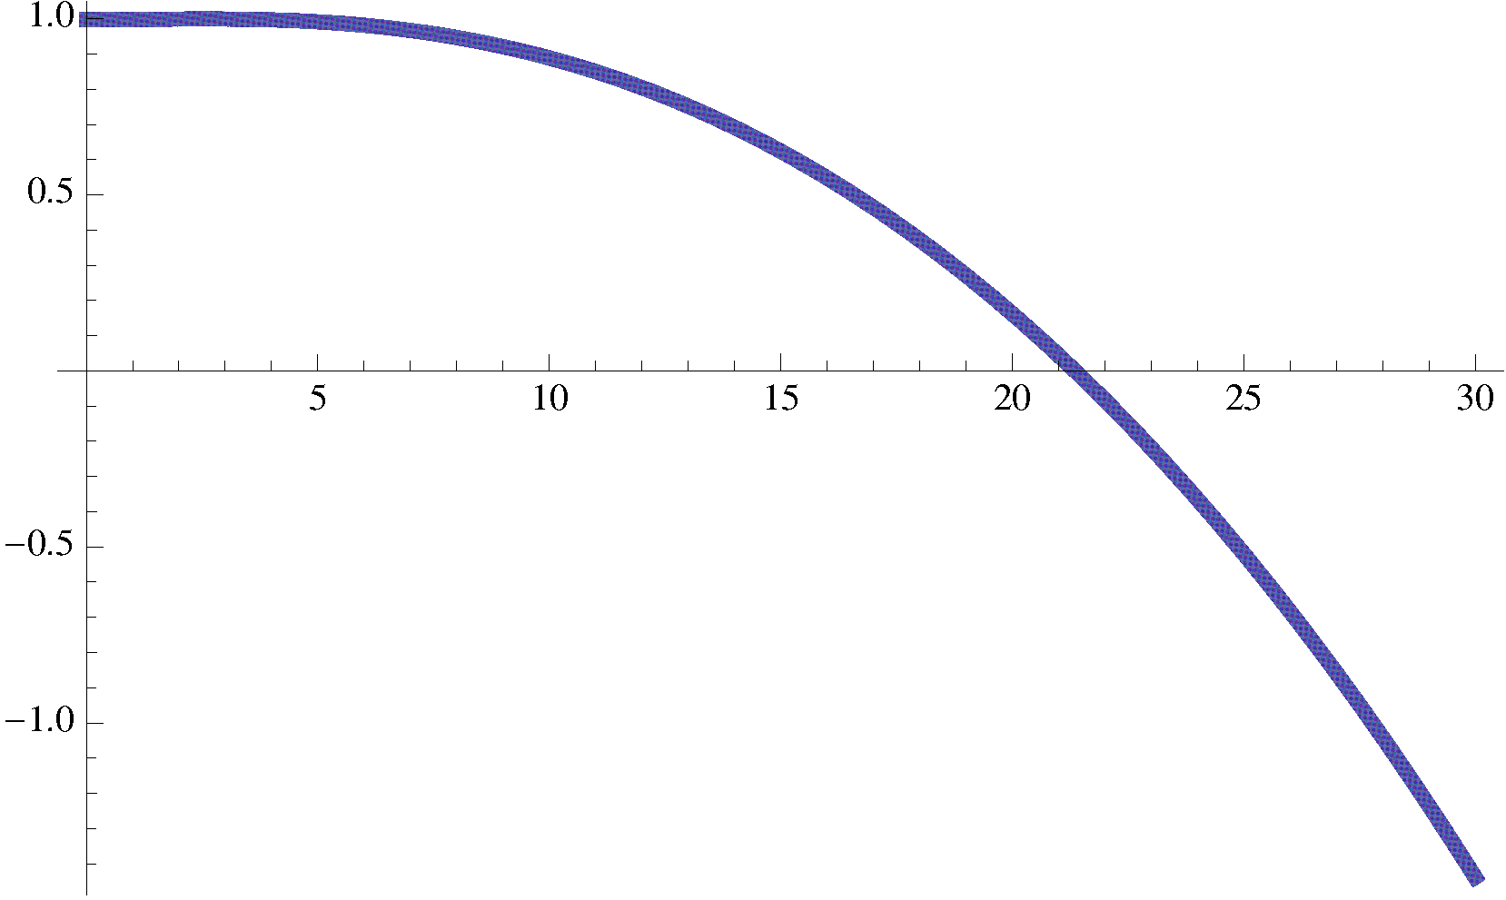
more generically
The plot of the quantity as a function of $∆$.
as an illustration.
susy is broken to .
$∆=0$ vac. not lifted in our treatment.
our vac. is metastable
can be made long lived by choosing ${m/Λ}^{2}$ small.

Slide 10
V)
In the gap eq. tree $\sim$ 1-loop
desirable to have an expansion parameter which replace
Let be $O(N^{2})$
all three terms in the action have $N^{2}$ in front,
so that $1/N^{2}$ replaces
In fact, the unbroken phase of the U(N) gauge group,
the gap eq. reads

Slide 11
VI)
Let us see $\left\langle D^{0}\right\rangle ≠0$ induces nonvanishing $\left\langle F^{0}\right\rangle$
The entire effective potential up to one-loop
The vacuum condition $\left\langle δV\right\rangle =0$
with $\left\langle δV\right\rangle =0$, we further obtain
These determine the value of non-vanishing F term.

Slide 12
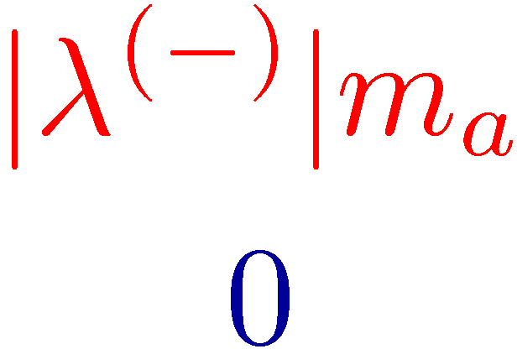
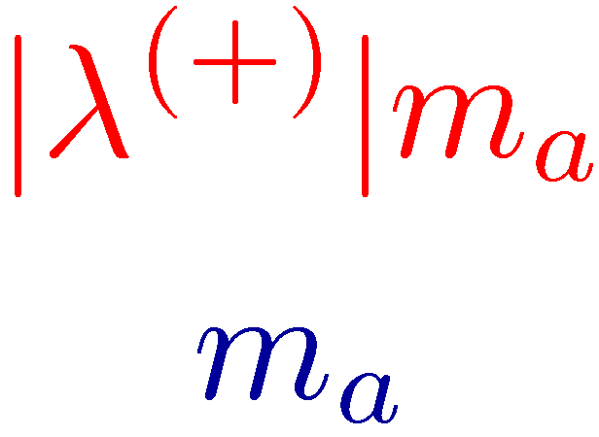
fermion masses
SU(N) part:
U(1) part:
schematic view of SU(N) sector, ignoring $\left\langle F^{0}\right\rangle ≠0$
mass
mass
$$ψ′$$
massive fermion
scalar gluon
$$λ′$$
gluino
gluon
$$h$$
$$S_{z}$$
-1 -1/2 0 1/2 1
-1/2 0 1/2
NGF, which is ensured by the theorem, is an admixture of $λ^{0}$ and $ψ^{0}$.

Slide 13
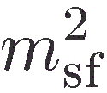
VII)
Symbolically
vector superfields, chiral superfields, their coupling
extend this to the type of actions with s-gluons and adjoint fermions
so as not to worry about mirror fermions e.t.c.
gauge group , the simplest case being
Due to the non-Lie algebraic nature of
the third prepotential derivatives, or ,
we do not really need messenger superfields.
transmission of DDSB in to the rest of the theory by higher order
loop-corrections
the sfermion masses
Fox, Nelson, Weiner, JHEP(2002)
the gaugino masses of
the quadratic Casimir of representation

