Slide 1
Primordial black hole formation
in an axion-like curvaton model
北嶋直弥
東京大学 / 宇宙線研究所
M. Kawasaki, N.K. and T. T. Yanagida, arXiv:1207.2550 [hep-ph]
素粒子物理学の進展 2012 / 基研研究会

Slide 2
Outline
Introduction
The axion-like curvaton model
Primordial black hole formation
Summary

Slide 3
1. Introduction

Slide 4
I. Introduction : Dark matter
The cosmic microwave background (CMB) observation
Dark matter candidates
WIMP, axion, primordial black hole (PBH), …
[ WMAP collaboration ]

Slide 5
I. Introduction : Primordial black hole (PBH)
Primordial BH is formed at the very early stage of the universe
through the collapse of the extremely high density region
primordial large density (curvature) perturbation
( Stellar BH is formed through the gravitational collapse of a star )

Slide 6
I. Introduction : Curvature perturbation
during inflation
horizon
classical motion
horizon exit
&
perturbation
is conserved
quantum fluctuation
overdense
underdense

Slide 7
I. Introduction : Curvaton model
Single inflaton scenario
driving inflation
inflaton
producing the density perturbation
Curvaton scenario
inflaton
driving inflation
producing the density perturbation
curvaton
(additional subdominant scalar field)

Slide 8
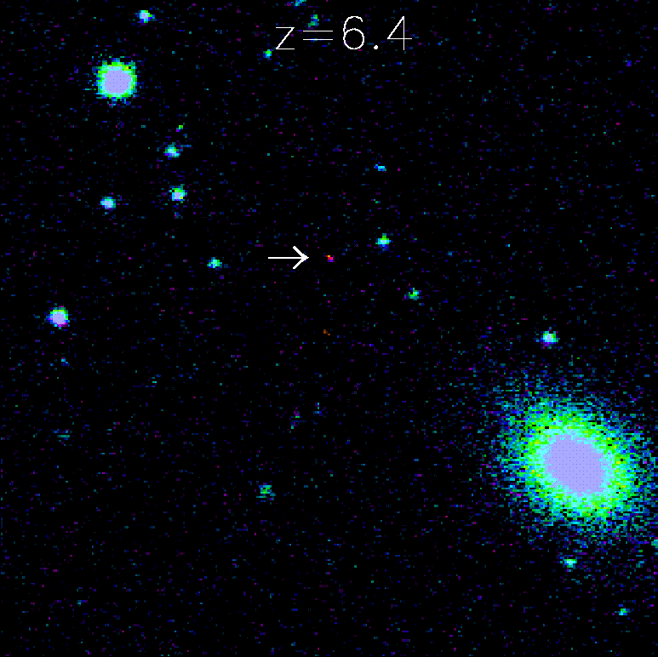
I. Introduction : supermassive black hole (SMBH)
http://www.sdss3.org/

Slide 9
2. The axion-like curvaton model

Slide 10
2.1 The potential of the curvaton
global SUSY limit
flat direction
(They do not feel the potential)

Slide 11
2.1 The potential of the curvaton
flat direction is lifted

Slide 12
2.1 The potential of the curvaton
Let’s decompose the complex scalar fields as
We follow the dynamics of

Slide 13
2.1 The potential of the curvaton

Slide 14
The history of the universe
inflaton
oscillation
radiation dominated
inflation

Slide 15
2.2 Generating the curvature perturbation
The power spectrum of curvature perturbation :
PBH
formation
WMAP
no constraint from observation
large scale
small scale

Slide 16
2.2 Generating the curvature perturbation
The power spectrum of curvature perturbation :
PBH
formation
WMAP
large scale
small scale

Slide 17
2.2 Generating the curvature perturbation
PBH
formation
WMAP
large scale
small scale

Slide 18
3. The PBH formation

Slide 19
3. The primordial black hole formation
PBHs are formed by collapse of overdense regions
in radiation dominated universe
overdense
horizon
collapse!
density perturbation
underdense
BH formation!

Slide 20
[ Carr, Kohri, Sendouda & Yokoyama (2010) ]

Slide 21
Constraints from β
are needed
for the PBH to be the dominant CDM

Slide 22
The mass spectrum

Slide 23
PBH mass and reheating temperature
(i) The case of PBH dark matter
lower limit from the tensor-to-scalar ratio
(allowed regions are inside the contours)

Slide 24
Model parameters
(i) The case of PBH dark matter
upper limit
upper limit

Slide 25
PBH mass and reheating temperature
(ii) The case of supermassive BH

Slide 26
Model parameters
(ii) The case of supermassive BH

Slide 27
4. Summary

Slide 30
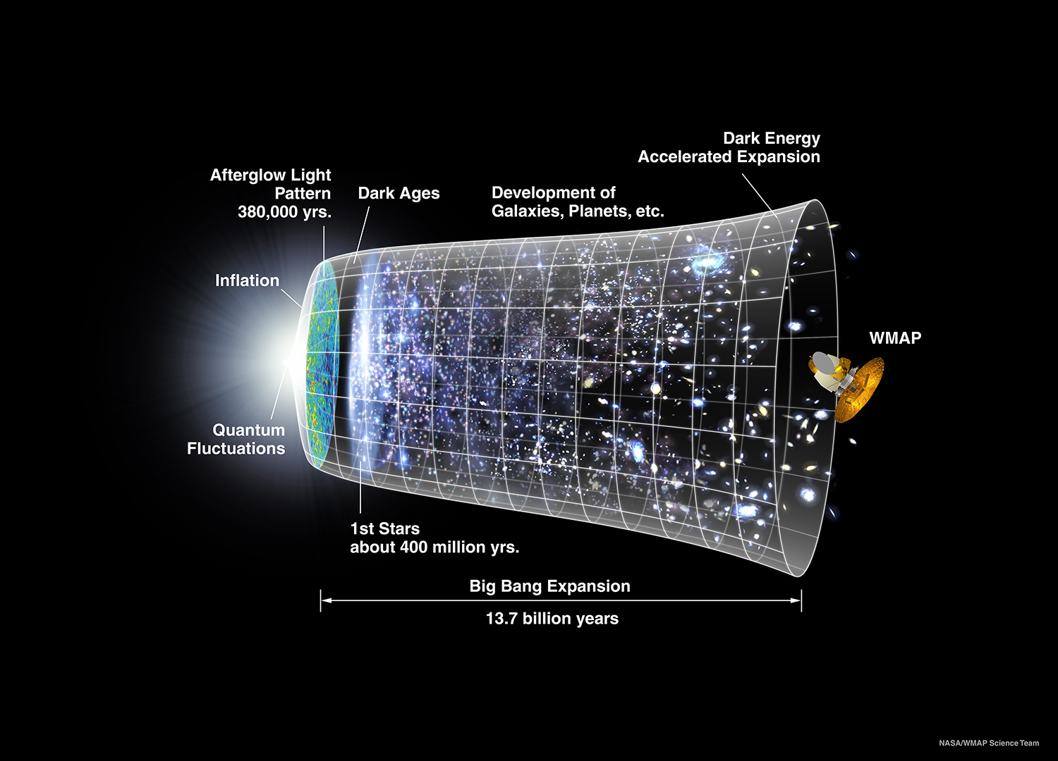
I. Introduction
Credit: NASA / WMAP Science Team

Slide 31
The dynamics of the curvaton

Slide 32
2.2 Generating the curvature perturbation
The power spectrum of curvature perturbation :
Requirement

Slide 33
2.2 Generating the curvature perturbation
PBH
formation

Slide 34
The spectral index of the curvaton

Slide 35
3. The primordial black hole formation

