Slide 1
A Modern View of Perturbative QCD
and Crossings with Mathematics
Y. Sumino
(Tohoku Univ.)

Slide 2
☆Plan of Talk
2. Foundation by asymptotic expansion of diagrams
3. Nature of radiative corrections in individual parts
1. Formulation of pert. QCD
Factorization, Effective Field Theories, OPE
Theory of multiple zeta values
Relation to singularities in Feynman diagrams
4. Summary and future applications

Slide 3
Formulation of pert. QCD
Develop methods on how to decompose and systematically organize radiative corrections.
Elucidate nature of radiative corrections in individual parts of
the decomposition (which are simplified by the decomposition).
Factorization, EFT, OPE
Singularities in amplitudes play key roles.

Slide 4


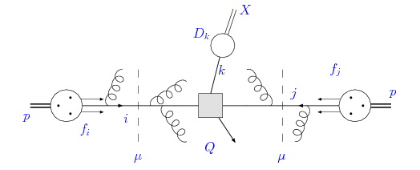
Formulation of pert. QCD
Develop methods on how to decompose and systematically organize radiative corrections.
Elucidate nature of radiative corrections in individual parts of
the decomposition (which are simplified by the decomposition).
Factorization, EFT, OPE
Separation of scales

Slide 5
Formulation in pert. QCD
Develop methods on how to decompose and systematically organize radiative corrections.
Factorization, EFT, OPE
Separation of scales

Slide 6





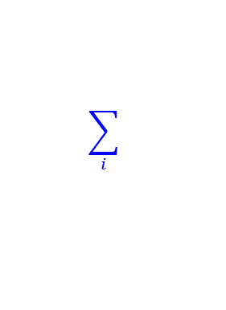







$$E$$
Wilsonian EFT
integrate
out
in terms of light quarks and IR gluons
$$μ$$
$$ℒ_{QCD}$$
$$ℒ$$
$$\sum_{i}{ }$$
$$𝒪$$
$$(q_{n}, {\overline{q}}_{n},G_{μ})$$
$$\left(μ\right)= { g}_{i i}$$
EFT
$$\left(μ\right)$$
UV
IR
less d.o.f.
Determine Wilson coeffs $g_{i}\left(μ\right)$ such that physics at $E<μ$ is unchanged,
via pert. QCD.

Slide 7




$$E$$
OPE in Wilsonian EFT multipole expansion
integrate
out
Observable which includes a high scale
$$μ$$
light quarks and IR gluons
non-pert. parameters
$$k/P≪1$$

Slide 8
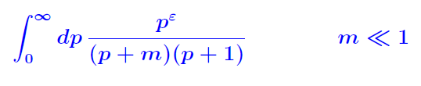
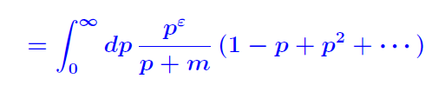
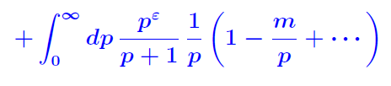



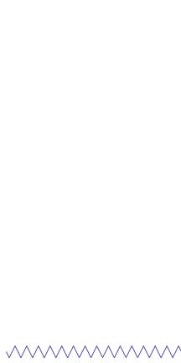

Asymptotic Expansion of Diagrams
Simplified example:
$$(=M)$$
Contribution of each scale
given by contour integral
around singularity

Slide 9








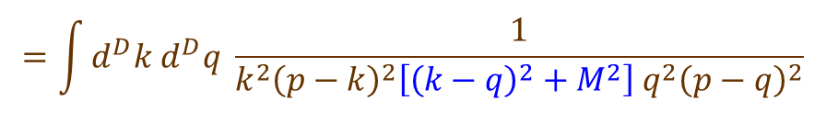
Asymptotic expansion of a diagram and Wilson coeffs in EFT
$$k$$
$$q$$
$$p$$
$$p$$
$$=\int{d^{D}k d^{D}q }\frac{1}{k^{2}{\left(p−k\right)}^{2}\left[{\left(k−q\right)}^{2}+M^{2}\right]{ q}^{2}{\left(p−q\right)}^{2}}$$
$$k−q$$
$$p−k$$
$$p−q$$
in the case ${ p}^{2}≪M^{2}$

Slide 10








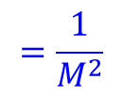

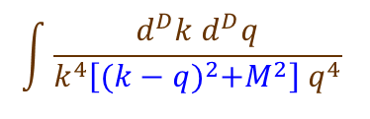








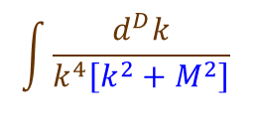


Asymptotic expansion of a diagram and Wilson coeffs in EFT
$$k$$
$$q$$
$$p$$
$$p$$
$$=\int{d^{D}k d^{D}q }\frac{1}{k^{2}{\left(p−k\right)}^{2}\left[{\left(k−q\right)}^{2}+M^{2}\right]{ q}^{2}{\left(p−q\right)}^{2}}$$
$$k−q$$
$$p−k$$
$$p−q$$
in the case ${ p}^{2}≪M^{2}$
L
L
H
L
H
H
$$\text{L}$$
$$\text{L}$$
$$\text{L}$$
$$\text{L}$$
$$\text{L}$$
$$\text{L}$$
$$\text{L}$$
$$\text{H}$$
$$\text{H}$$
$$\text{L}$$
$$\text{L}$$
$$\text{H}$$
$$\text{L}$$
$$\text{H}$$
$$\text{H}$$
$$p,k,q≪M$$
$$p,q≪k,M$$
$$p≪k,q,M$$
$$=\frac{1}{M^{2}}$$
$$\int{\frac{d^{D}k}{k^{4}\left[k^{2}+M^{2}\right]} }$$
$$\int{\frac{d^{D}k d^{D}q}{k^{4}\left[{(k−q)}^{2}+M^{2}\right]{ q}^{4}} }$$
=
=
=
=
=
Operators and Wilson coeffs in EFT

Slide 11
Formulation of pert. QCD
Develop methods on how to decompose and systematically organize radiative corrections.
Elucidate nature of radiative corrections in individual parts of
the decomposition (which are simplified by the decomposition).
Factorization, EFT, OPE
Numerical and analytical methods

Slide 12
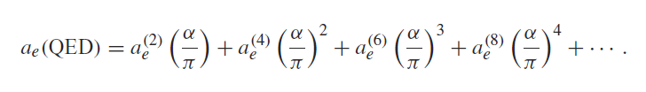
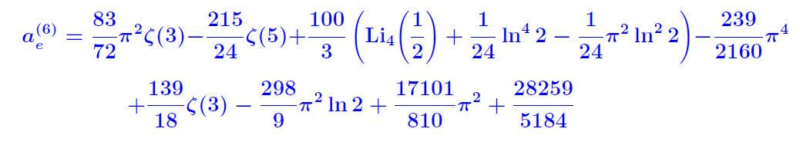

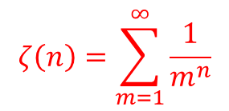
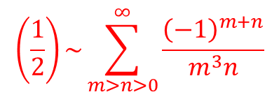
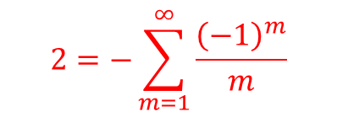
Radiative Corrections and Theory of Multiple Zeta Values
Example: Anomalous magnetic moment of electron ($g_{e}−2$)
terms omitted
$$ζ\left(n\right)=\sum_{m=1}^{∞}{\frac{1}{m^{n}}}$$
$$2=−\sum_{m=1}^{∞}{\frac{{\left(−1\right)}^{m}}{m}}$$
$$\left(\frac{1}{2}\right)\sim \sum_{m>n>0}^{∞}{\frac{{\left(−1\right)}^{m+n}}{m^{3}n}}$$
ln
Li₄

Slide 13
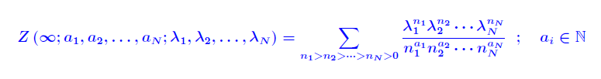
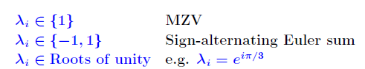

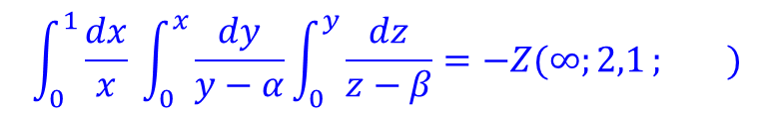
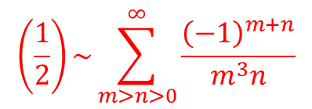

$$ζ\left(n\right)=\sum_{m=1}^{∞}{\frac{1}{m^{n}}}$$
$$2=−\sum_{m=1}^{∞}{\frac{{\left(−1\right)}^{m}}{m}}$$
$$\left(\frac{1}{2}\right)\sim \sum_{m>n>0}^{∞}{\frac{{\left(−1\right)}^{m+n}}{m^{3}n}}$$
ln
Li₄
☆ Generalized Multiple Zeta Value (MZV)
Given as a nested sum
$,$ $a_{1}≥2$
Can also be written in a nested integral form
e.g.
$$\int_{0}^{1}{\frac{dx}{x} \int_{0}^{x}{\frac{dy}{y−α}}\int_{0}^{y}{\frac{dz}{z−β}=−Z(∞;2,1}}; )$$
$$\frac{1}{α},\frac{α}{β}$$

Slide 14
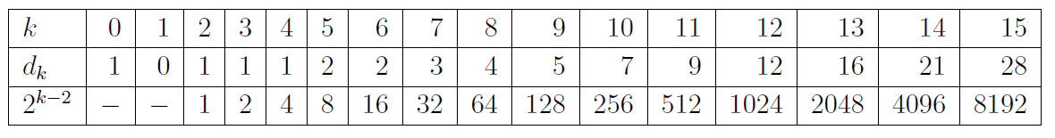




MZVs can be expressed by a small set of basis (vector space over $ℚ$)
$,$ $a_{1}≥2$
weight ${=a}_{1}+⋯+a_{N}$
For $λ_{i}∈\{1\}$:
$$\sum_{m>n>0}^{∞}{\frac{1}{m^{2}n}=\sum_{m=1}^{∞}{\frac{1}{m^{3}}}=ζ\left(3\right)}$$
e.g. Dimension=1 at weight 3: $d_{3}=1$.
weight
dim
#(MZVs)
Relations to reduce MZVs. (Probably shuffle relations are sufficient for $λ_{i}∈\{1\}$.)
New relations for $λ_{i}∈Roots of unity$: Anzai,YS
MZV as a period of cohomology, motives

Slide 15
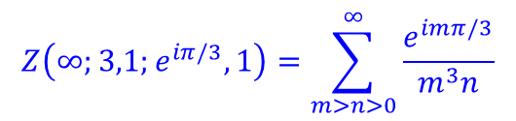
Relation between topology of a Feynman diagram and MZVs?
What kind of MZVs are contained in a diagram? Which $λ_{i}$s ?
$$Z\left(∞;3,1;e^{iπ/3},1\right)=\sum_{m>n>0}^{∞}{\frac{e^{imπ/3}}{m^{3}n}}$$

Slide 16

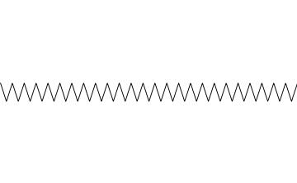








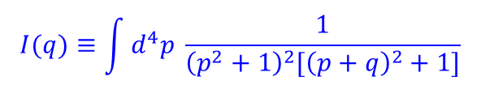
Singularities in Feynman Diagrams
$$p$$
Complex $q$-plane
$$q$$
$$q$$
cuts
$$+2i$$
$$0$$
$$−2i$$
$$p+q$$
also log singularity at
$$I(q)≡\int{d^{4}p \frac{1}{{\left(p^{2}+1\right)}^{2}[{\left(p+q\right)}^{2}+1]}}$$

Slide 17





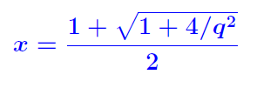




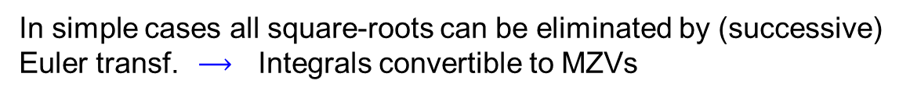



What kind of MZVs are contained in a diagram? Which $λ_{i}$s ?
$$m=1$$
$$=$$
$$\int{d^{4}q \frac{1}{{\left(q^{2}+1\right)}^{2}} I(q)}$$
$$q$$
$$m=1$$
$$q$$
$$m=1$$
Singularities map
In simple cases all square-roots can be eliminated by (successive)
Euler transf. $⟶$ Integrals convertible to MZVs

Slide 18



Diagram Computation: Method of Differential Eq.
Analytic evaluation of Feynman diagrams:
Many methods but no general one
Glue-and-cut
Mellin-Barnes
Differential eq.
Gegenbauer polynomial
Unitarity method
.
.
.
.
☆ Evaluation of Cat’s eye diagram
$$m=1$$
$$m=0$$

Slide 19
☆ Evaluation of Cat’s eye diagram
$$m=1$$
$$m=0$$

Slide 20
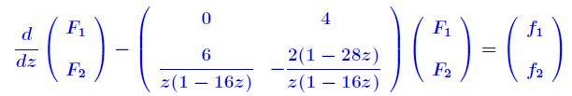


☆ Evaluation of Cat’s eye diagram
$$m=1$$
$$m=0$$
Some of the lines of Cat’s eye diag. are pinched.

Slide 21
☆ Evaluation of Cat’s eye diagram
Some of the lines of Cat’s eye diag. are pinched.

Slide 22




☆ Evaluation of Cat’s eye diagram
Solution:
; , etc. : sol. to homogeneous eq.
Using this method recursively, a diagram can be expressed
in a nested integral form.
(often MZV as it is.)

Slide 23
Summary
A unified view in terms of singularities in physical amplitudes.
Scale separation in Factorization, EFT, OPE by asymptotic exp.
Contour integrals around singularities of amplitudes
(2) Unsolved questions in analytic results of individual rad. corr.
Resolution of singularities,
Theory of MZVs, singularities and topology of diagrams

Slide 24

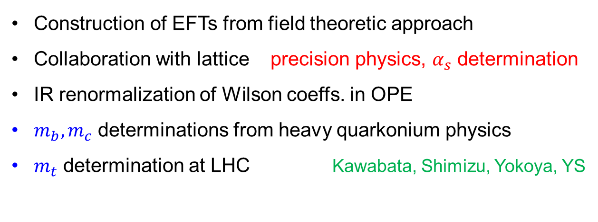

Applications in scope
(personal view)
Construction of EFTs from field theoretic approach
Collaboration with lattice precision physics, $α_{s}$ determination
IR renormalization of Wilson coeffs. in OPE
$m_{b}, m_{c}$ determinations from heavy quarkonium physics
$m_{t}$ determination at LHC Kawabata, Shimizu, Yokoya, YS
$⋮$
$⋮$

Slide 25





OPE of QCD potential in Potential-NRQCD EFT
Brambilla,Pineda,Soto,Vairo
$$E$$
IR gluons and quarks
integrate
out
$$r≪Λ_{QCD}^{−1}$$
$λ>r$
$$μ$$

Slide 26




OPE of QCD potential in Potential-NRQCD EFT
Brambilla,Pineda,Soto,Vairo
$$E$$
IR gluons and quarks
integrate
out
$$r≪Λ_{QCD}^{−1}$$
$λ>r$
$$μ$$
QCD potential
= Self-energy of singlet bound-state in pNRQCD:
$$V_{UV}(r)$$
singlet
singlet
$$V_{QCD}\left(r\right)=V_{UV}(r)+E_{IR}(r)$$
UV contr.
IR contr.
IR gluon
$$E_{IR}\left(r\right) \sim g_{OS}^{ 2} \left\langle \vec{r}∙{\vec{E}}^{a} \vec{r}∙{\vec{E}}^{a}\right\rangle \sim O\left( Λ_{QCD}^{ 3}{ r}^{2}\right)$$
singlet octet singlet

Slide 27

OPE of QCD potential in Potential-NRQCD EFT
Brambilla,Pineda,Soto,Vairo
UV gluons
$$λ<r$$
pert. QCD
QCD potential
= Self-energy of singlet bound-state in pNRQCD:
$$V_{UV}(r)$$
singlet
singlet
$$V_{QCD}\left(r\right)=V_{UV}(r)+E_{IR}(r)$$
UV contr.
IR contr.
IR gluon
$$E_{IR}\left(r\right) \sim g_{OS}^{ 2} \left\langle \vec{r}∙{\vec{E}}^{a} \vec{r}∙{\vec{E}}^{a}\right\rangle \sim O\left( Λ_{QCD}^{ 3}{ r}^{2}\right)$$
singlet octet singlet
Non-pert. Matrix element

Slide 28


✩ Empirically $V_{QCD}(r)$ is approximated well by a Coulomb+linear form.
UV contr.
IR contr.
$$V_{QCD}\left(r\right)=V_{UV}(r)+E_{IR}(r)$$
$\sim +c_{1}r+c_{2} r^{2}+…$ at $r≲Λ_{QCD}^{−1}$
$$\frac{c_{−1}}{r}$$
(naive expansion of $V_{QCD}(r)$ at short-distance)
A ‘Coulomb+Linear potential’ is obtained by resummation of logs in pert. QCD

Slide 29
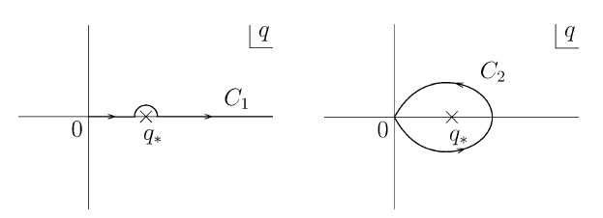
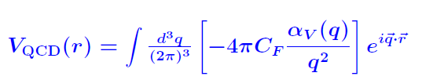

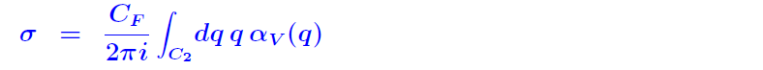

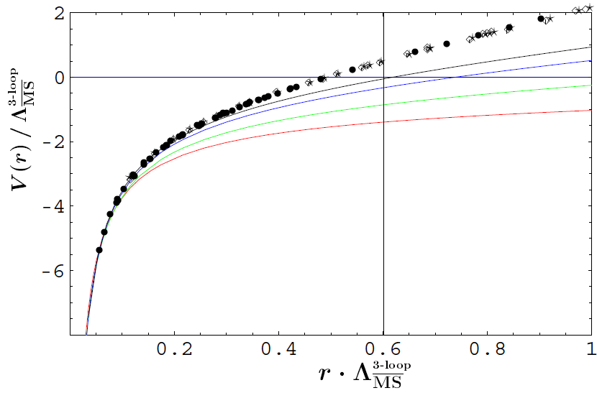

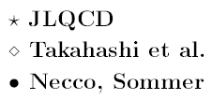

Formulas for
Key: separate and subtract IR contr.
Define via
then
Comparison of $V_{C}\left(r\right)+σ r$ and lattice comp.

Slide 30
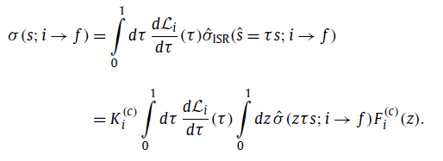


(1) To develop a method on how to decompose and systematically organize the radiative corrections.
(2) to elucidate the nature of the radiative corrections contained in the individual parts of the decomposition (which are simplified by the decomposition).
Singularities in amplitudes play key roles in both of these issues.
Factorization, EFT, OPE

Slide 31

Review of Pert. QCD (Round 1, Quick overview)
What’s Pert. QCD?
3 types of so-called “pert. QCD predictions” :
(Confusing without properly distinguishing between them.)
(i) Predict observable in series expansion in $α_{s}$
IR safe obs., intrinsic uncertainties $\sim {(Λ}_{QCD}/{E)}^{n}$
(ii) Predict observable in the framework of Wilsonian EFT
OPE as expansion in ${(Λ}_{QCD}/{E)}^{n}$,
uncertainties of (i) replaced by non-pert. matrix elements
Do not add these non-pert. corr. to (i).
(iii) Predict observable assisted by model predictions
High-energy experiments hadronization models, PDFs.
To compare with experimental data

Slide 32
• $O(Λ)$ physics in the heavy quark mass and interquark force
$Λ=μ exp⁡\left[−\frac{2π}{β_{0}α_{s}(μ)}\right]$ cannot appear in series expansion in $α_{s}(μ)$ ?

Slide 33
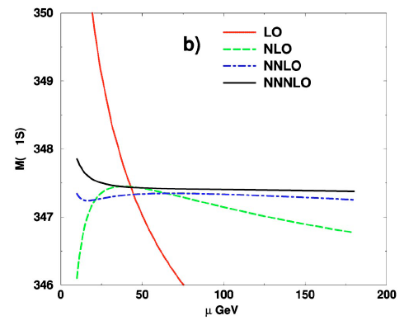

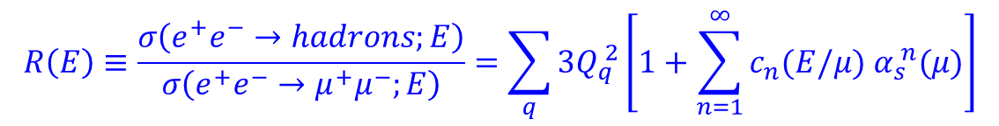

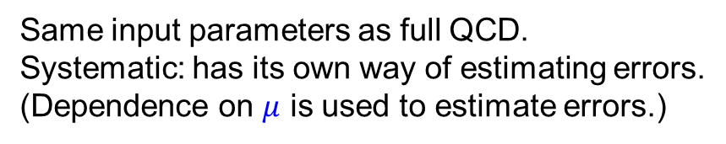
Pert. QCD
renormalization scale
$$ℒ_{QCD}(α_{s},m_{i};μ)$$
Theory of quarks and gluons
Same input parameters as full QCD.
Systematic: has its own way of estimating errors.
(Dependence on $μ$ is used to estimate errors.)
$$μ$$
Differs from a model
Predictable observables
testable hypothesis
(i) Inclusive observables (hadronic inclusive) $⋯$ insensitive to hadronization
$$R\left(E\right)≡\frac{σ\left(e^{+}e^{−}→hadrons;E\right)}{σ\left(e^{+}e^{−}→μ^{+}μ^{−};E\right)}=\sum_{q}{3Q_{q}^{ 2}}\left[1+\sum_{n=1}^{∞}{c_{n}(E/μ) α_{s}^{ n}(μ)}\right]$$
e.g. $R$-ratio:
(ii) Observables of heavy quarkonium states (the only individual hadronic states)
• spectrum, decay width, transition rates

Slide 34
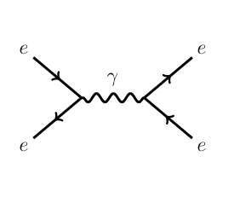



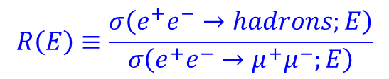









IR sensitivity at higher-order
Renormalon uncertainty
${(Λ}_{QCD}/{E)}^{n}$
$$R\left(E\right)≡\frac{σ\left(e^{+}e^{−}→hadrons;E\right)}{σ\left(e^{+}e^{−}→μ^{+}μ^{−};E\right)}$$
$R$-ratio:
$$q$$
$$\overline{q}$$
$$q$$
Quark self-energy diagrams
omitted
$$k$$
$$α_{s}^{ }(μ)$$
$$\overline{q}$$
$$q$$
$$k$$
$$α_{s}^{ }\left(μ\right){×b}_{0}α_{s}^{ }\left(μ\right)\log{(\frac{μ}{k})}$$
$$\overline{q}$$
$$q$$
$$k$$
$$α_{s}^{ }(μ)×b_{0}^{2}α_{s}^{2 }\left(μ\right)\log^{2}{(\frac{μ}{k})}$$
$$\overline{q}$$

Slide 35
$$q$$
$$k$$
$$α_{s}^{ }(μ)$$
$$\overline{q}$$
$$q$$
$$k$$
$$α_{s}^{ }\left(μ\right){×b}_{0}α_{s}^{ }\left(μ\right)\log{(\frac{μ}{k})}$$
$$\overline{q}$$
$$q$$
$$k$$
$$α_{s}^{ }(μ)×b_{0}^{2}α_{s}^{2 }\left(μ\right)\log^{2}{(\frac{μ}{k})}$$
$$\overline{q}$$

Slide 36
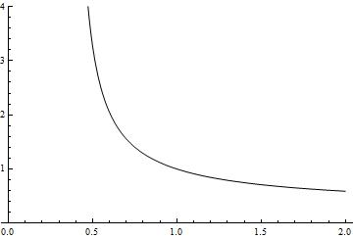
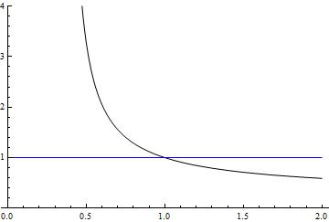
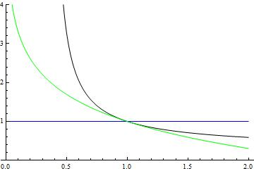
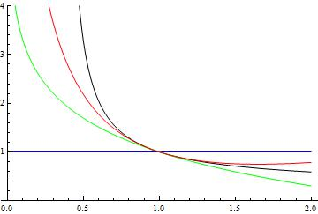
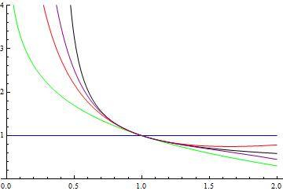


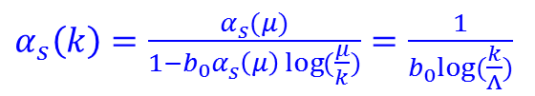



$$q$$
$$k$$
$$α_{s}^{ }(μ)$$
$$\overline{q}$$
$$q$$
$$k$$
$$α_{s}^{ }\left(μ\right){×b}_{0}α_{s}^{ }\left(μ\right)\log{(\frac{μ}{k})}$$
$$\overline{q}$$
$$q$$
$$k$$
$$α_{s}^{ }(μ)×b_{0}^{2}α_{s}^{2 }\left(μ\right)\log^{2}{(\frac{μ}{k})}$$
$$\overline{q}$$
Infinite sum
$α_{s}^{ }\left(k\right)=\frac{α_{s}^{ }(μ)}{1−b_{0}α_{s}^{ }\left(μ\right)\log{(\frac{μ}{k})}}=\frac{1}{b_{0}log⁡(\frac{k}{Λ})}$
$$Λ$$
$$k$$

Slide 37
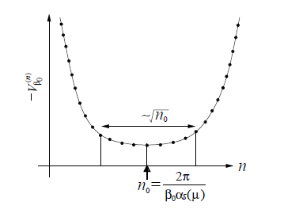


$$q$$
$$k$$
Consequence
$$\overline{q}$$
Renormalon uncertainty
$$q$$
$$k$$
$$c_{n}\left(E/μ\right){ α}_{s}^{ n}\left(μ\right)$$
$$\overline{q}$$
$$q$$
$$k$$
$$\overline{q}$$
∼${\left(Λ/E\right)}^{P}$
Asymptotic series
(Empirically good estimate of true corr.)
Limited accuracy
$$Λ$$
$$k$$

Slide 38
Remarkable progress of computational technologies in the last 10-20 years
(i) Higher-loop corrections
Resolution of singularities in multi-loop integrals
Numerical and analytical methods
Intersection with frontiers of mathematics
(ii) Lower-order (NLO/NLL) corrections to complicated processes
Cope with proliferation of diagrams and many kinematical variables
Motivated by LHC physics
(iii) Factorization of scales in loop corrections
Provide powerful and precise foundation for constructing Wilsonian EFT
Dim. reg.: common theoretical basis
Essentially analytic continuation of loop integrals
Contrasting/complementary to cut-off reg.

Slide 39





A ‘Coulomb+Linear potential’ is obtained by resummation of logs in pert. QCD:
YS
IR contributions
(absorbed into non-pert. matrix elem.)
at
UV contributions

Slide 40
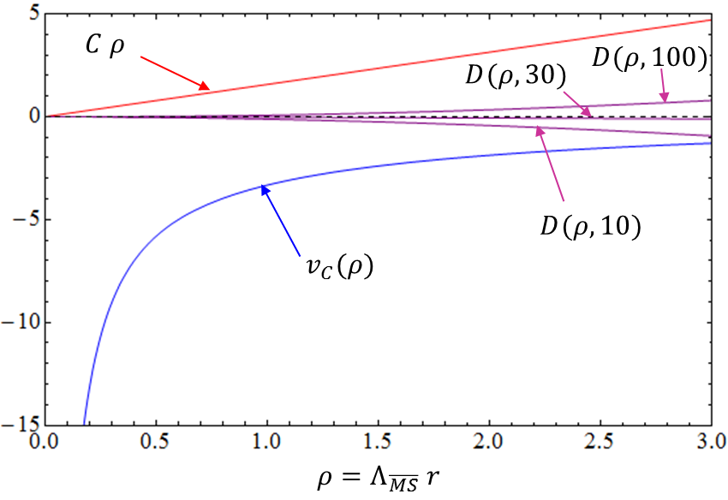


A ‘Coulomb+Linear potential’ is obtained by resummation of logs in pert. QCD:
YS
UV contributions
$$×$$
Expressed by param. of pert. QCD

Slide 41
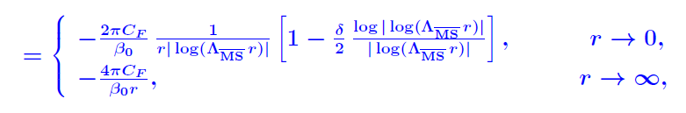
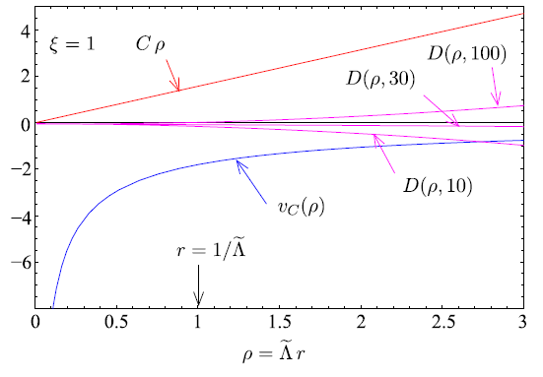

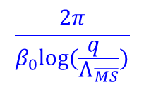

Formulas for
Define via
then
In the LL case $α_{V}\left(q\right)=$
$$\frac{2π}{β_{0}log⁡(\frac{q }{Λ_{\overline{MS}}})}$$
Coulombic pot. with log corr. at short-dist.
Coefficient of linear potential (at short-dist.)
$$σ_{LL}=\frac{2πC_{F}}{β_{0}} {\left(Λ_{\overline{MS}}^{}\right)}^{2}$$

Slide 42








Messages:
(1) One should carefully examine, from which power of
$Λ=μ exp⁡\left[−\frac{2π}{β_{0}α_{s}(μ)}\right]$ non-pert. contributions start,
and to which extent pert. QCD is predictable.
(as you approach from short-distance region)
$$\frac{α_{s}^{ }\left(μ\right)}{r}\left[1+{\{b}_{0}^{}α_{s}^{ }\left(μ\right)\log\left(μr\right)+\#\}+\left\{b_{0}^{2}α_{s}^{2 }\left(μ\right)\log^{2}\left(μr\right)+⋯\right\}+⋯\right]$$
$→$
(2) IR renormalization of Wilson coeffs.
$$q$$
$$r^{−1}$$
$$μ_{f}$$

Slide 43


OPE of QCD potential in Potential-NRQCD EFT
Brambilla,Pineda,Soto,Vairo
IR gluon
singlet
octet
singlet
octet
$$E$$
IR gluons and quarks
$$r≪Λ_{QCD}^{−1}$$
integrate
out
$λ>r$
$$μ$$

Slide 44

OPE of QCD potential in Potential-NRQCD EFT
Brambilla,Pineda,Soto,Vairo
IR gluon
singlet
octet
singlet
octet
UV gluons
$$λ<r$$
pert. QCD

Slide 45




OPE of QCD potential in Potential-NRQCD EFT
Brambilla,Pineda,Soto,Vairo
IR gluon
singlet
octet
singlet
octet
UV gluons
$$λ<r$$
pert. QCD
QCD potential = Self-energy of $S$ in pNRQCD:
$$\frac{g_{S}\left(r\right)}{r}$$
$$1=\left\langle S | S^{†}S | S\right\rangle$$
singlet
singlet
$$V_{QCD}\left(r\right)=\frac{g_{S}\left(r\right)}{r} +E_{IR}(r)$$
IR gluon
UV contr.
IR contr.
$$E_{IR}\left(r\right) \sim g_{OS}^{ 2} \left\langle \vec{r}∙{\vec{E}}^{a} \vec{r}∙{\vec{E}}^{a}\right\rangle \sim O\left( Λ_{QCD}^{ 3}{ r}^{2}\right)$$
singlet octet singlet

Slide 46

Formulas for
Key: separate and subtract IR contr.
Define via
then
$$\frac{2π}{β_{0}log⁡(\frac{q }{Λ_{\overline{MS}}})}$$
In the LL case $α_{V}\left(q\right)=$ ($q_{∗}=Λ_{\overline{MS}}$)
Coulombic pot. with log corr. at short-dist.
Coefficient of linear potential (at short-dist.)
$$σ_{LL}=\frac{2πC_{F}}{β_{0}} {\left(Λ_{\overline{MS}}^{}\right)}^{2}$$

Slide 47
Comparison of $V_{C}\left(r\right)+σ r$ and lattice comp.

Slide 48
Summary
Today pert. QCD is subdivided and specialized into a wide variety of
research fields: jets, DIS, B-physics, quarkonium,…
A unified view in terms of singularities in physical amplitudes.
Scale separation in Factorization, EFT, OPE.
Contour integrals around singularities of amplitudes
(2) Unsolved questions in analytic results of individual rad. corr.
Resolution of singularities,
Theory of MZVs, singularities and topology of diagrams

