Slide 1
The Cutkosky rule of three dimensional noncommutative field theory in Lie algebraic noncommutative spacetime
Yuya Sasai
(Yukawa Institute for Theoretical Physics, Kyoto University)
in collaboration with N. Sasakura (YITP)
JHEP 0906, 013 (2009) [arXiv:0902.3050]
基研研究会「場の理論と弦理論」
July 9, 2009

Slide 2
1. Introduction
Why noncommutative field theory?
Quantum spacetime
Planck scale physics
Effective field theory of open string theory
in constant B background
Seiberg, Witten (1999), etc
(
: an antisymmetric constant )
Classical solutions of matrix models
Ishibashi, Kawai, Kitazawa, Tsuchiya (1996),etc
However, it is not clear that these noncommutative space arise from quantum gravity effect.

Slide 3
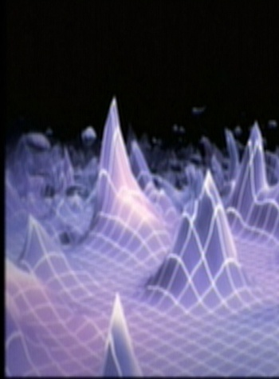
Effective field theory of Ponzano-Regge model with
which spinless massive particles are coupled
Freidel, Livine (2005)
In three dimensions, a massive particle is represented as a conical singularity.
Deser, Jackiw, ‘t Hooft (1984)
The 3D noncommutative field theory might give a field theory of conical singularities.
Related with 3D gravity
Not depend on globally flat background space!

Slide 4
Ponzano-Regge model
Ponzano, Regge (1968)
3D lattice gravity theory
Triangulate 3D manifold with tetrahedra
Partition function of 3D pure gravity with
: SU(2) spin
: Dimension of spin-j rep.

Slide 5
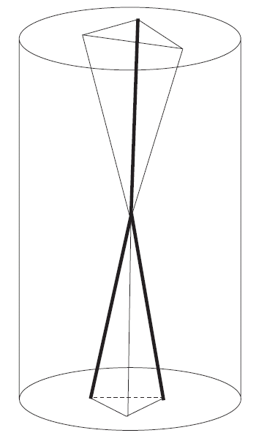
Inserting spinless massive particles on the graph ,
particle insertion
Freidel, Louapre(2004)
: Character of

Slide 6
After some manipulations,
propagator
vertex
Freidel, Livine (2005)
: SO(3) group element
Star product

Slide 7
Except the propagators, this expression has the same structure as
Feynman amplitudes of noncommutative scalar field theory, whose
action is
where the scalar field is defined by
.
Commutation relation of coordinates is found to be
.
The three dimensional noncommutative field theory is derived from
three dimensional quantum gravity theory with particles.

Slide 8
How about the Lorentzian case?
We can construct the Lorentzian version of this noncommutative field theory.
Imai, Sasakura (2000)
Naively, we can expect that the 2+1 dimensional noncommutative field theory will represent the 2+1 dimensional quantum gravity theory with which massive particles are coupled?

Slide 9
However,
Noncommutative field theory in the Moyal plane
( : antisymmetric constant)
breaks the unitarity due to the existence of the nonplanar amplitudes if the timelike noncommutativity does not vanish.
Gomis, Mehen (2000)
However, if we impose the braiding, which is a kind of nontrivial statistics, the nonplanar amplitudes becomes the same as the corresponding planar amplitudes if they exist.
Oeckl (2000), Balachandran, et.al (2005), etc
with braiding

Slide 10
Unlike the Moyal case, even the planar amplitudes are nontrivial because of the SL(2,R)/Z_2 group momentum space.
It is a nontrivial issue to check the unitarity in the noncommutative field theory in the Lie algebraic noncommutative spacetime.
In our paper,
We have checked the Cutkosky rule of the one-loop self-energy
amplitudes in the noncommutative theory with the braiding.
As a result, this theory will not be unitary even when we impose
the braiding.
This is caused by the periodic property of the SL(2,R)/Z_2
group momentum space.

Slide 11
Contents
1.Introduction
2. 2+1 dimensional noncommutative field theory in
3. One-loop self-energy amplitude of the noncommutative
theory and the Cutkosky rule
4. Summary

Slide 12
2. 2+1 dimensional noncommutative field theory in
This noncommutative field theory possesses
group momentum space if we assume the commutative
momentum operators and the Lorentz invariance.
Imai, Sasakura (2000)
Start with
(i,j,k=0,1,2)
Lorentz covariance
Jacobi identity
,
up to
, where is an arbitrary function.

Slide 13
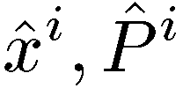
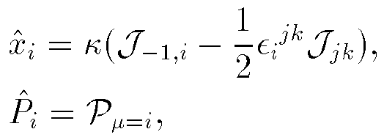
The
are identified with ISO(2,2) Lie algebra,
SL(2,R)/Z_2 momentum space
with the constraint
where
with
ISO(2,2) Lie algebra
where

Slide 14
Action of the noncommutative theory in the momentum representation is
where .
Imai, Sasakura(2000), Freidel, Livine (2005)
To consider the identification
, we impose
This noncommutative field theory possesses a nontrivial momentum
conservation (Hopf algebraic translational symmetry) due to the
group momentum space at classical level.

Slide 15
In order to possess the nontrivial momentum conservation in
the noncommutative field theory at quantum level, we have to
impose the braiding on fields such that
: braiding map
Freidel, Livine (2005), Y.S., Sasakura (2007)

Slide 16
3. One-loop self-energy amplitude of the noncommutative
theory and the Cutkosky rule
Feynman rules
Propagator:
3-point vertex:
Braiding:

Slide 17
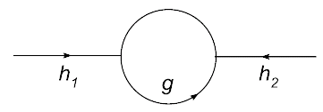
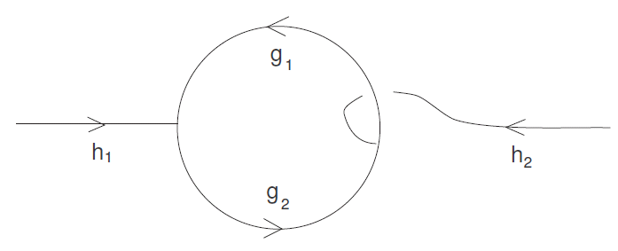
One-loop self-energy diagrams in the noncommutative theory
Planar
Nonplanar
Same as the planar!

Slide 18
For simplicity, we set .
Since SL(2,R) group space is equivalent to AdS_3 space, we can take
where
In the center-of-mass frame,
we can take the external
momentum as

Slide 19
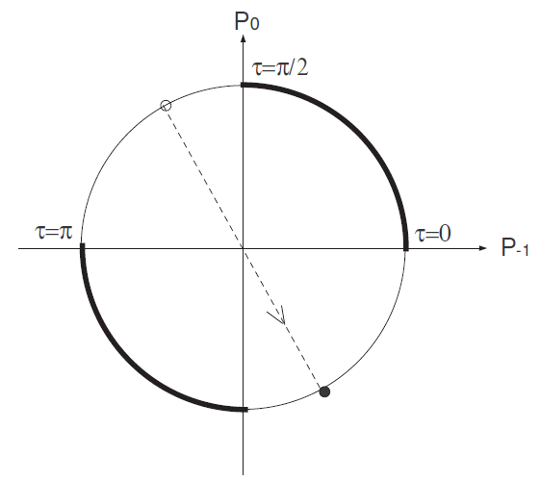
Considering
,
it is enough to take the range
of as
for the positive energy external leg.
As a result of calculation,
where
Imai, Sasakura (2000)

Slide 20
Cutkosky rule of the one-loop self-energy diagram
Cutkosky rule
if
=
0
otherwise

Slide 21
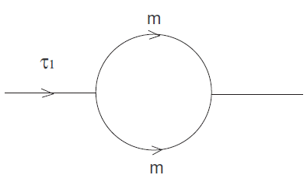
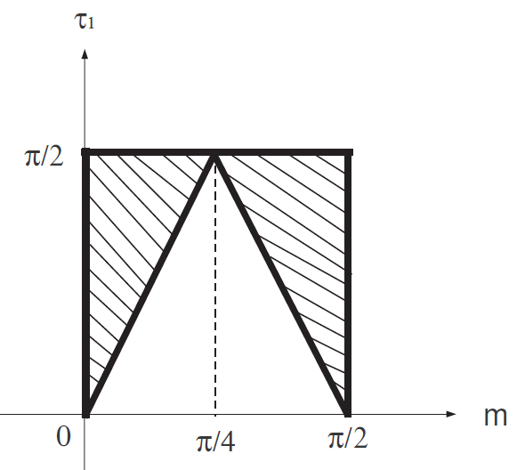
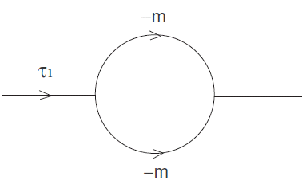
Physical interpretation
Physical process
Unphysical process!
In the range of , the RHS of the
Cutkosky rule will vanish.

Slide 22
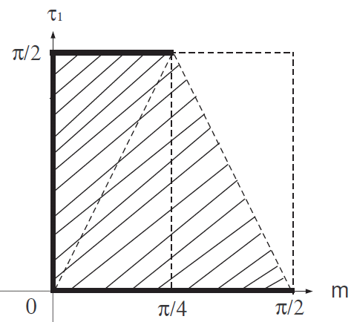
In fact, we have shown by explicit calculations that
if
0
otherwise
Thus, the Cutkosky rule is satisfied in the shadow region.
is only allowed in any !

Slide 23
However, this result does not imply that the theory is unitary
when the mass is smaller than .
Let us consider multi-loop amplitudes.
The Cutkosky rule will be violated when
is in the positive energy
regions.
Even if , the Cutkosky rule will be
violated.
If we consider more complicated diagrams, we will see that
the Cutkosky rule is violated for any values of the mass.

Slide 24
4. Summary
We have checked the Cutkosky rule of the one-loop self-energy
amplitudes in the noncommutative theory with the braiding.
We have found that the Cutkosky rule is satisfied at the one-loop
level when the mass is less than .
However, this theory will not be unitary because if we consider
more complicated diagrams, the Cutkosky rule will be violated
for any values of the mass.
This disastrous result is caused by the periodic property of
the SL(2,R)/Z_2 group momentum space!
The extension of the momentum space to the “universal covering
of SL(2,R)” may remedy the unitarity property of the theory.
What should we learn from this result?

Slide 25
By the way,
If the 2+1 dimensional noncommutative field theory gives a
2+1 dimensional quantum gravity theory with massive particles,
why isn’t the arbitrary negative energy included?
Y.S., Sasakura (2009)
One-particle solution in 2+1 dimensional Einstein gravity
Deficit angle =
can be arbitrary negative!
Deser, Jackiw, ‘t Hooft (1984)
“Universal covering of SL(2,R) group momentum space” will possess
arbitrary negative energy.
This extension may give a hint of 2+1 dimensional
quantum gravity with massive particles.

