Slide 1

Near-Extremal Black Holes and the
Jackiw-Teitleboim Model
Sandip Trivedi, TIFR

Slide 2
Outline
Introduction
Thermodynamics
Low-energy response
Concluding Comments

Slide 3
Based on:
1) P. Nayak, A. Shukla, R. Soni,
V. Vishal and ST, hep-th/1802.09547
2) U. Moitra, M. Vishal and ST hep-th/1808.08239
3) U. Moitra, S. Sake, ST and V. Vishal hep-th/1905.10378

Slide 4


M. V. Vishal
Upamanyu Moitra
Sunil Sake

Slide 5
Introduction
Extremal Black holes have been a rich and rewarding subject of study.
Success in State counting: Susy and Non-Susy
Attractor Mechanism: Near horizon geometry:
Moduli and drawn to fixed values at horizon determined by charges.

Slide 6
Introduction
Can be understood by extremising an Effective potential or Entropy Function
Works for Susy and Non-susy cases.
Ferrara, Kallosh, Strominger Phys. Rev. D 52, R5412 (1995), ...,
A. Sen, JHEP 09 (2005) 038
Goldstein, Iizuka, Jena and ST, PRD 72 (2005) 124021

Slide 7
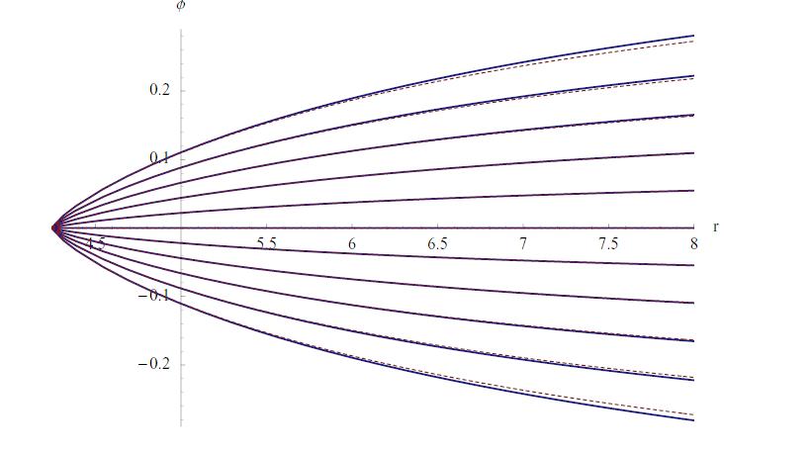
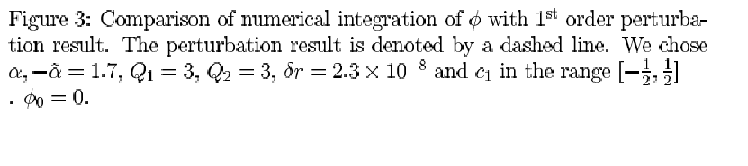
Goldstein, Iizuka, Jena and ST, PRD 72 (2005) 124021

Slide 8
Introduction
E.g.: Extremal Kerr in 4- Dim
Near-horizon geometry can be understood as an attractor obtained by extremising the entropy function.
Bardeen Horowitz, PRD 60 (1999) 104030;
Astefanesci, Goldstein Jena, Sen, ST, JHEP 10 (2006) 058

Slide 9
Beyond Extremality?
Here the situation for black holes, unlike extended black branes, has been less clear until recently.
For black branes at small temperatures or low frequencies the response can be understood as arising from the near horizon region.
The celebrated AdS/CFT correspondence

Slide 10
Beyond Extremality?
For Black Holes situation has been less clear until recently.
It has been known for some time that deviations from the attractor solution must be included.

Slide 11
Physically this is because :
The backreaction in the near-horizon
geometry to any probe is singular since internal volume is fixed in size
(e.g. )
The energy does not have ``enough space” to dissipate in. (analogy: Electromagnetism)
But how to incorporate the corrections in a precise way was not understood until recently.
(Internal space: , etc).

Slide 12
The question from Ryoanji Temple:
Are we satisfied with counting ? Or is there more to ``It”

Slide 13
In a seminal paper, Maldacena, Stanford and Yang (MSY) showed in a particular model of 2 dimensional gravity, the Jackiw-Teitleboim (JT) model, that once the leading corrections to the near horizon solution is incorporated, the finite energy response is well controlled.
Teitleboim, Phys. Lett., 126B (1983) 41.
Jackiw, NPB 252 (1985) 343,
Almheiri, Polchinski, JHEP 11 (2015) 014,
Maldacena Stanford and Yang, Phys. Rev. D94 (2016) 106002

Slide 14
They were motivated by earlier work on condensed matter systems by Sachdev, Ye and Kitaev ( many subsequent follow-ups by now).
Sachdev and Ye, Phys. Rev. Lett. 70 (1993) 3339
A. Y. Kitaev, Talk at KITP
………………………………………………………………
……………………………………………………………….
………………………………………………………………..
(Many important follow ups !).

Slide 15
Beyond Extremality?
The physical argument suggests that corrections to the attractor value of the Volume of the internal space must be incorporated
But other components of the metric also deviate from their attractor values at the same order, so at first sight it is not clear how to truncate to a near horizon region consistently.

Slide 16
Introduction
The purpose of this talk is to show that the JT model in fact correctly reproduces the behaviour of a wide class of extremal black holes.
In higher dimensions, at low temperatures and low frequencies.

Slide 17
MSY studied the Jackiw- Teitleboim (JT) model of 2 dim gravity.
- Dilaton can be thought of as volume of internal space
Boundary terms are important.

Slide 18
System admits an solution:
Boundary at
The ``rolling” dilaton breaks the SL(2,R) symmetry of .
This breaking, characterised by scale J, is extremely important.

Slide 19
Model has three parameters:
: Two Dimensional Newton’s Constant
J : Scale of breaking of conformal invariance
: Radius of

Slide 20
The result for the dynamics of this system that MSY got was very elegant.
The response of the system arises due to the fluctuations of the boundary. These fluctuations can be characterised in terms of time reparametrisations:
u – proper time along boundary.
With action involving Schwarzian derivative:

Slide 21
Boundary at
The fluctuations can be thought of as arising from diffeomorphisms which are asymtpotically isometries of . These diffeomorphisms do not leave the boundary invariant.

Slide 22
Thermodynamics:
Correctly reproduced by this action near extremality.
Entropy:

Slide 23
Response to a probe :
Arises by coupling Schwarzian action to the probe. The coupling is determined by symmetries.

Slide 24
Gives rise to a four point function :
Breaking of conformal invariance important.
Enhancement by a factor of

Slide 25
Our analysis
The JT model, with a suitable identification of parameters, is a good approximation for a wide class of extremal and near-extremal black holes
At low temperatures and small frequencies
True for spherically symmetric black holes.
Shown to be true for the thermodynamics of rotating black holes as well.

Slide 26
Our analysis
The dilaton is related to the volume of the internal space (more correctly the deviation of this volume from its attractor value).
E.g.:

Slide 27
Our analysis
The key point is that many other fields (e.g., components of the higher dimensional metric) besides the dilaton, also deviate from their attractor values, at the same order in
These deviations are not captured correctly in the JT model.
However these deviations lead to sub-leading contributions at low-temperatures and low-frequency response and can therefore be neglected.

Slide 28
Our analysis
E.g., In spherically symmetric case, dimensional reduction to 2 dim. Gives rise to additional term at quadratic order:
Removed by change of frame
Goes like

Slide 29
It is important to note that the corrections cause other components of the metric, besides the dilaton, to deviate from their attractor values to the same order in 1/J
However, these corrections can still be neglected at low temperature and frequencies. Since they lead to contributions suppressed
by ,

Slide 30
The boundary needs to be located in the ``Asymptotic region”
Where the effects of finite temperature have died away, while the deviation from the attractor solution are still small.
Far Region
Near Region
Horizon
Boundary

Slide 31
Our Analysis:
The final conclusion is therefore very simple and elegant.
We expected the deviations in the volume of the internal space to be important to allow the back reaction to be tamed.
This is the only deviation we need to include at leading order. Others are not as important.
The JT model keeps track of this deviation, via the dilaton, and is therefore describes, universally, extremal and near-extremal black holes with a near-horizon AdS2 (more checks needed in rotating case).

Slide 32
Thermodynamics
Why is the JT Model a good approximation for low temperatures?
Consider the temperature dependence of the Free energy (at fixed charge)
The Free energy is given by the on-shell action.
Start with extremal solution and consider the change in metric due to ``turning on” a small temperature

Slide 33
Thermodynamics
Small perturbation in far region
Since is a solution to the equations of motion, first order change in on-shell action vanishes in far region
Remaining contribution in near region correctly given by the JT model.

Slide 34
More correctly, action in far region vanishes after adding boundary terms at boundary (locus of constant dilaton)
JT Model
Vanishes

Slide 35
This is true of rotating case as well.
In near region, after carrying out integral over angular coordinates one gets the JT model in remaining 2 dimensions.
We have checked checked explicitly in many cases, 4 and 5 dim. Rotating black holes, including Kerr in 4 Dim.
Determined by the deviation of the transverse sphere’s volume from attractor value
Horizon area

Slide 36
Response to Low-frequency probes:
Worked out for Non-rotating case so far.
Response arises from Near-horizon region.
Break up Analysis into different partial waves.

Slide 37
L,m
S-wave exchange, when allowed, dominates
Gravity effects in S-wave arise as analogue of Coulomb effects in Electromagnetism. Described by Schwarzian action. Dominate at low energies.
Agreement with Schwarzian contribution checked by direct calculation in
Higher partial waves suppressed at low energies. Their effects can be cumulatively significant at intermediate energies. Breaking of Conformal invariance not important for these.
.

Slide 38
Four Point Function
S-wave
Higher Partial Wave

Slide 39
Important Comment:
The S-wave exchange due to a gauge field also give an enhanced contribution, due to Coulomb effects.
One can show that an extra phase mode arises from a gauge field.
Arises due to deviation of scalars, which determine the gauge coupling, from their attractor values

Slide 40
This phase mode can be intuitively thought of as a Wilson line which extends from the horizon to the boundary of the near -in a spherically symmetric way. (Maldacena)
Its coupling to the matter field can be determined from gauge invariance.
More generally for a general isometry group G:
Phase Mode in SYK models and JT:
Davison, Fu, Georges, Gu, Jensen, Sachdev, Phys. Rev. B95 (2017).
Cherns Simons theory:
Gaikwad, Joshi, Mandal,Wadia, arXiv:1802.07746.
(Many more references)

Slide 41
Response to low frequency probes
In this way the JT model augmented with phase modes gives rise to the leading low frequency response.
For higher partial wave exchange breaking of conformal invariance is not important. These can be included in standard ways based on AdS/CFT.
For rotating case, details (beyond thermodynamics) are still being worked out. Isometries of give rise to gauge fields in . . Suggests that rotation can be incorporated also in a near horizon description.

Slide 42
Near AdS2 Near CFT1
Our results suggest that the microscopy theory describing a near-extremal black hole should flow at low energies to a near-CFT1 governed by a Schwarzian action and phase modes.
This should be universally true.
It would be good to check this on the field theory side.

Slide 43
Summary and Conclusions
Behaviour of extremal and non-extremal black holes is correctly described by the JT model at low temperatures and low frequencies.
Leading corrections only require that the internal volume be allowed to change from its attractor value. (Plus phase modes).
Results suggest that an approximate CFT1 described by a Schwarzian action arises at low-energies in all CFTs which have extremal black hole gravity duals. Would be worth understanding in the CFTs directly.

Slide 44
Summary and Conclusions
Can a fluid-gravity correspondence for the near-extremal fluid be formulated ? Valid when
L: length scale of variation, : Chemical Potential
Results suggest that the JT model could be useful in studying near-extremal Kerr black holes found in nature (The approximation would be valid at time scales longer than the horizon light crossing time).

Slide 45
Not It,
But at least a Bit.
More secrets lie,
Beyond our count.

Slide 46
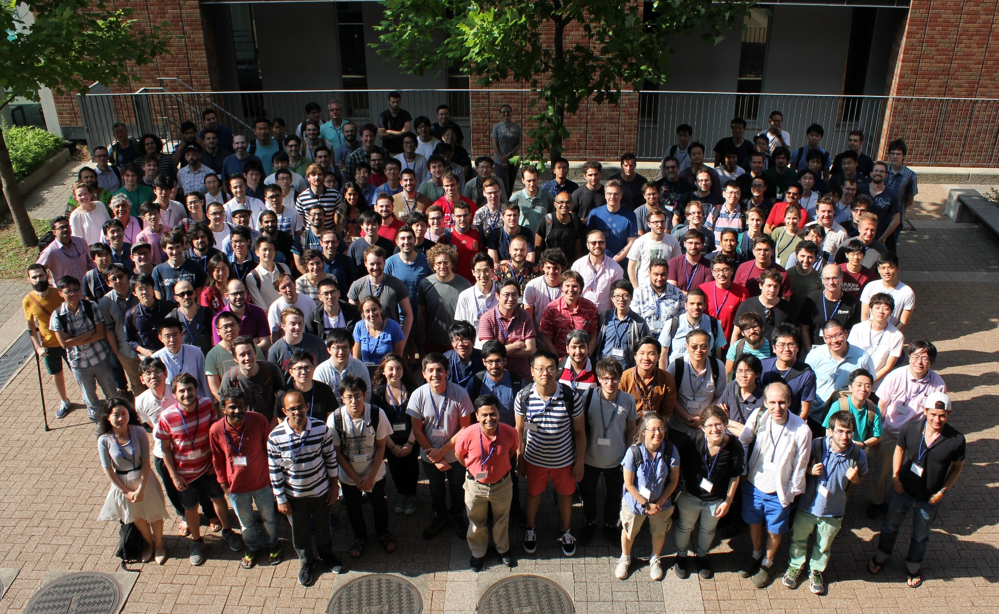
Group Photo (June 20)

Slide 47
ありがとうございます
Thank You Very Much!!

Slide 48







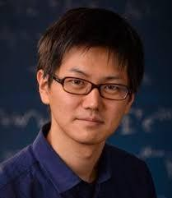
Organizers
Pawel Caputa (YITP) Keisuke Fujii (Osaka)
Yasuaki Hikida (YITP) Tomoyuki Morimae (YITP)
Tatsuma Nishioka (Tokyo) Tadashi Takayanagi (YITP)
Yu Watanabe (YITP) Beni Yoshida (Perimeter)

Slide 49
Supporting Staffs (Post-doc and Students)
Yutaro Akahoshi Ryu Hayakawa
Hayato Kanno Taigen Kawano
Kazutaka Kimura Naokata Kubo
Yuya Kusuki Kotaro Murakami
Hidetoshi Omiya Teppei Shimaji
Tatsuya Sugimoto Yuki Suzuki
Kotaro Tamaoka Koji Umemoto
Zixia Wei Takuya Yoda

Slide 50
Supporting Staffs (Administrations)
Atsushi Watanabe (Program Coordinator)
Asako Ando (Workshop Secretary)

Slide 51
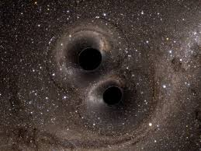
Thank you

Slide 52
Next consider a background gauge field.
In this case the phase mode which arises also couples to the time reparametrisation mode.
R.~A.~Davison, W.~Fu, A.~Georges, Y.~Gu, K.~Jensen and S.~Sachdev, Phys. Rev. B95 no. 15, 155131 (2017)

Slide 53
Cumulative contribution:
No. of KK modes
For
Higher partial wave channels can be neglected.
For
Higher partial waves are important. Their contribution can be obtained from region neglecting breaking of conformal invariance
determined by requirement that the response arises from near horizon geometry.

Slide 54
Introduction
The low-energy behaviour of near-extremal systems has proved to be a rich and rewarding area of study.
For black branes (as opposed to black holes) the situation is now quite well understood.
The near-horizon region is often
with

Slide 56
Near AdS2 Near CFT1
The behaviour of near-extremal black holes, at low frequencies, arises from the near horizon region after incorporating some effects due to the breaking of conformal invariance.
The bulk dynamics itself reduces to that of the boundary.

Slide 57
long throat
Boundary fluctuations described by Schwarzian action, along with phase modes, give rise to response.

