Slide 1
Content
1. Introduction
2. Theoretical framework for heavy hadrons
2.1 Heavy quark symmetry
2.2 Heavy hadron effective theory
3. Heavy exotic hadrons -X, Y, Z hadrons-
3.1 What does “exotic” mean?
3.2 X(3872)
3.3 Y(4260)
3.4 Z_{c}(3900)
3.5 Z_{b}(10610) and Z_{b}(10650)
3.6 P_{c}(4380) and P_{c}(4450): charm pentaquark
3.7 T_{cc} -new possible exotic hadrons-
3.8 Brief summary
4. Heavy hadrons at extreme conditions
4.1 Productions in relativistic heavy ion collisions
4.2 Properties of heavy hadrons in nuclear matter
5. Summary

Slide 2


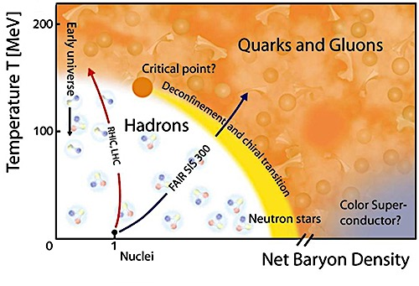

4. Heavy hadrons at extreme conditions
Fundamental 4 Questions in Hadron Physics
① Why are quarks confined?
② What is hadron interaction?
Confined quarks
Nuclear force
③ Why is chiral symmetry broken?
④ What is phase diagram?

Slide 3
4. Heavy hadrons at extreme conditions
④ What is phase diagram?
① Finite temperature
② Finite density

Slide 4
4. Heavy hadrons at extreme conditions
c
c
B⁽*⁾
B⁽*⁾
u
d
Compact multiquark
Hadronic molecule
gluonic excitation modes
c
c
“string excitation”
Σ, Π, Δ, Φ, ...
(S, P, D, F, ...)
Kinematic effect

Slide 5
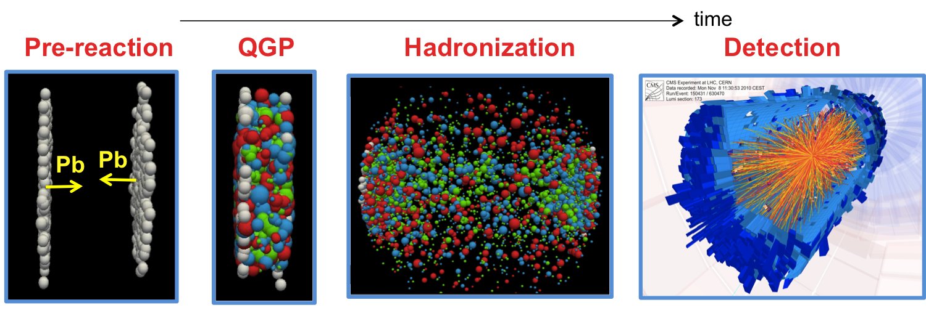
4. Heavy hadrons at extreme conditions
Production of exotic hadrons?
Larger quark number than e⁺e⁻ and pp→ Rare events?
20 cc^{bar} (Pb+Pb, LHC) !
- Production Mechanism?
- Yields？
S. Cho et al. (ExHIC Collaboration), PR106, 212001 (2011), PRC069410 (2011),
arXiv:1702.00489 [nucl-th] (review)

Slide 6
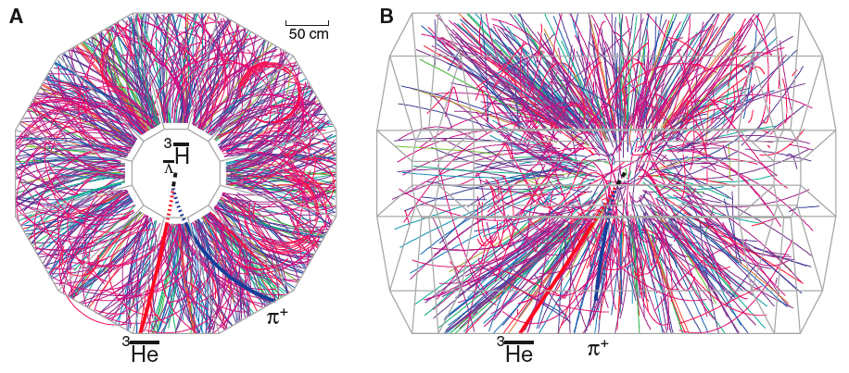
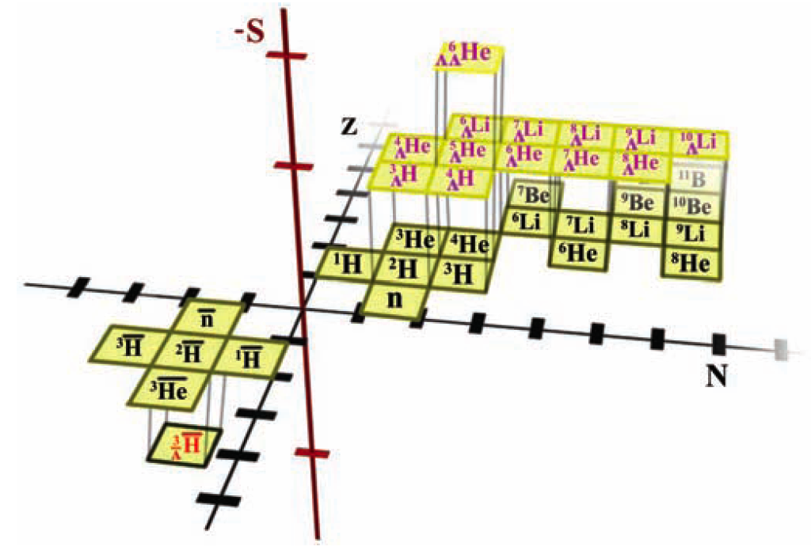
4. Heavy hadrons at extreme conditions
Observation of “anti-hypernuclei”
STAR, Science 328, 58 (2010)
Possible to produce quark many-body systems?

Slide 7
4. Heavy hadrons at extreme conditions

Slide 8
4. Heavy hadrons at extreme conditions
Production process of exotic hadrons
Temperature
Compact multiquark
coalescence
Hadron
statistical
model
Hadron
Multiquark formation
Resonance
Molecular structure formation
Hadron
molecule
coalescence
T_{C}
=
T_{H}
Critical (hadronization) temperature
Freeze-out
temperature
T_{F}
time
QGP
Hadron phase
1 fm/c
5 fm/c
7 fm/c
17 fm/c
Free quark gas, First order, Evolution with entropy conservation, ...
L. W. Chen, V. Greco, C. M. Ko, S. H. Lee, W. Liu, PLB 601, 34 (2004)

Slide 9

4. Heavy hadrons at extreme conditions
Exotic hadrons
Weak decay; some decays
outside the fireball.
weak decay
weak decay
weak decay
weak decay
weak decay
weak decay
weak decay
weak decay
weak decay

Slide 10
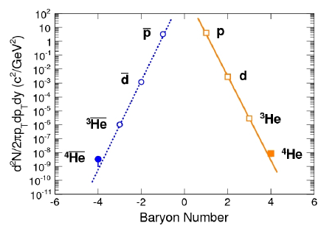
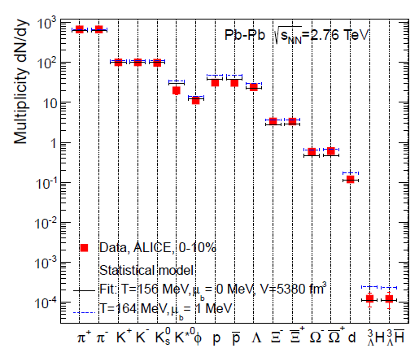
4. Heavy hadrons at extreme conditions
Statistical model
Andronic et al.,
Nucl. Phys. A772, 167 (2006)
RHIC/STAR antimatter
LHC/ALICE

Slide 11
4. Heavy hadrons at extreme conditions
Coalescence model
V. Greco, C. M. Ko, P. Levai, PRL90, 202302 (2003)
L. W. Chen et al., PLB 601, 34 (2004)
L. W. Chen et al., PRC 76, 014906 (2007)
① distribution function f(x_{i}, p_{i})
② Wigner function
Harmonic oscillator wave function (frequency ω) is used.

Slide 12
4. Heavy hadrons at extreme conditions
Numerical result
Normal hadrons (non-exotic)
10-100
ω fixed
1-10
ω_{s} fixed
<1
ω_{c}, ω_{b} fixed
* includes feed-down effects
from excited states.

Slide 13
4. Heavy hadrons at extreme conditions
Numerical result
Exotic hadrons
u
u
two quark (p-wave)
s
s
u
u
Compact multiquark
K
K
Hadronic molecule

Slide 14
4. Heavy hadrons at extreme conditions
Numerical result
Exotic hadrons
Statistical model

Slide 15
4. Heavy hadrons at extreme conditions
Numerical result
Exotic hadrons
uu^{bar}+dd^{bar} (p wave)
Coalescence model
(angular momentum excitation)
u
u
two quark (p-wave)

Slide 16
4. Heavy hadrons at extreme conditions
Numerical result
Exotic hadrons
(uu^{bar}+dd^{bar})ss^{bar}
Coalescence model
(multiquark)
Factor by adding one quark
x 0.36 for s wave
x 0.093 for p wave
x 0.029 for d wave
s
s
u
u
Compact multiquark

Slide 17
4. Heavy hadrons at extreme conditions
Numerical result
Exotic hadrons
KK^{bar}
Coalescence model
(hadron molecule)
Frequency of harmonic oscillator
K
K
with reduce mass μ_{R}
and binding gnergy
Hadronic molecule

Slide 18
4. Heavy hadrons at extreme conditions
Numerical result
Exotic hadrons
qq^{bar} (p wave)
qq^{bar}ss^{bar}
KK^{bar}
q=u,d

Slide 19
4. Heavy hadrons at extreme conditions
Numerical result
Exotic hadrons
Enhanced (extended w.f.)
qq^{bar} (p wave)
qq^{bar}ss^{bar}
KK^{bar}
Reduced
suppression by quark number
Same order
(cf. normal hadrons)
Different yields depending on inner quark structure
↓
Knowing internal structure
by experiments!

Slide 20
4. Heavy hadrons at extreme conditions
Numerical result
Exotic hadrons
←Normal hadrons
(0.2-2)
c
c
D
D
u
u
Compact multiquark
Hadronic molecule
coalescence model < statistical model
coalescence model > statistical model

Slide 21
4. Heavy hadrons at extreme conditions

Slide 22
4. Heavy hadrons at extreme conditions
④ What is phase diagram?
① Finite temperature
② Finite density

Slide 23
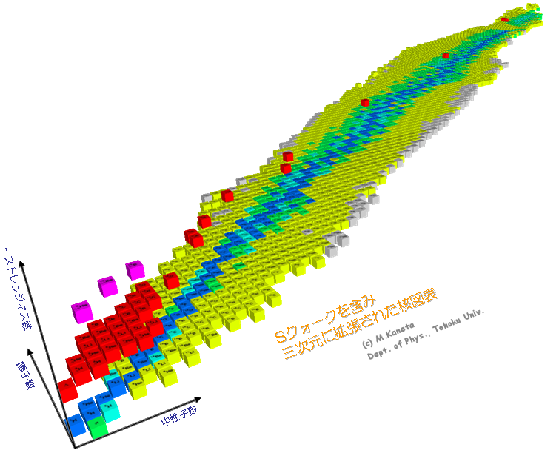
4. Heavy hadrons at extreme conditions
(Hyper)Nuclear chart
extended to strangeness
✔︎ General nuclear force
✔︎ Neutron stars
✔︎ Heavy ion collisions
Anti-K mesic nuclei
Strangeness
Further extension to
charm/bottom?
proton number
neutron number

Slide 24
4. Heavy hadrons at extreme conditions
・Heavy mass of charm hadron
m_{c}=1.3 GeV and m_{b}=4.7 GeV
・Heavy Quark Symmetry (HQS)
Hadron spin = light quark spin x heavy quark spin

Slide 25
4. Heavy hadrons at extreme conditions
A. Hosaka, T. Hyodo, K. Sudoh, Y. Yamaguchi, S. Yasui, arXiv:1606.08685 [hep-ph]
1. Hadron-nucleon interaction
→ Flavor symmetry, chiral symmetry, heavy quark symmetry
2. Hadron in medium
→ Chiral symmetry breaking, quark confinement
3. Nuclear structure
→ Spin-isospin correlations, high density state (ρ>ρ₀ )

Slide 26
4. Heavy hadrons at extreme conditions
Prog. Part. Nucl. Phys. 96, 88 (2017)

Slide 27
4. Heavy hadrons at extreme conditions

Slide 28
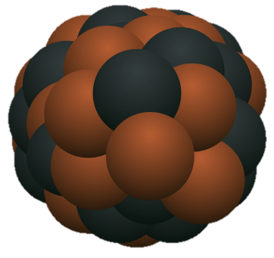
4. Heavy hadrons at extreme conditions
Heavy hadron + Nucleon
H
Inter-hadron
interaction
u
u
d
Heavy hadron
Nucleon
1. Interaction between heavy hadron and nucleon
2. Many-body problem
H
nuclear medium effect
nuclear structure change
Fermi surface problems
...
nucleus
① Quarkonium
② Heavy-light meson
③ Heavy baryon

Slide 29
4. Heavy hadrons at extreme conditions
① Quarkonium + Nucleon
c
Inter-hadron
interaction
u
u
c
No Pauli repulsion!
d
Charmonium
Nucleon
c
u
u
c
d
Compact state

Slide 30
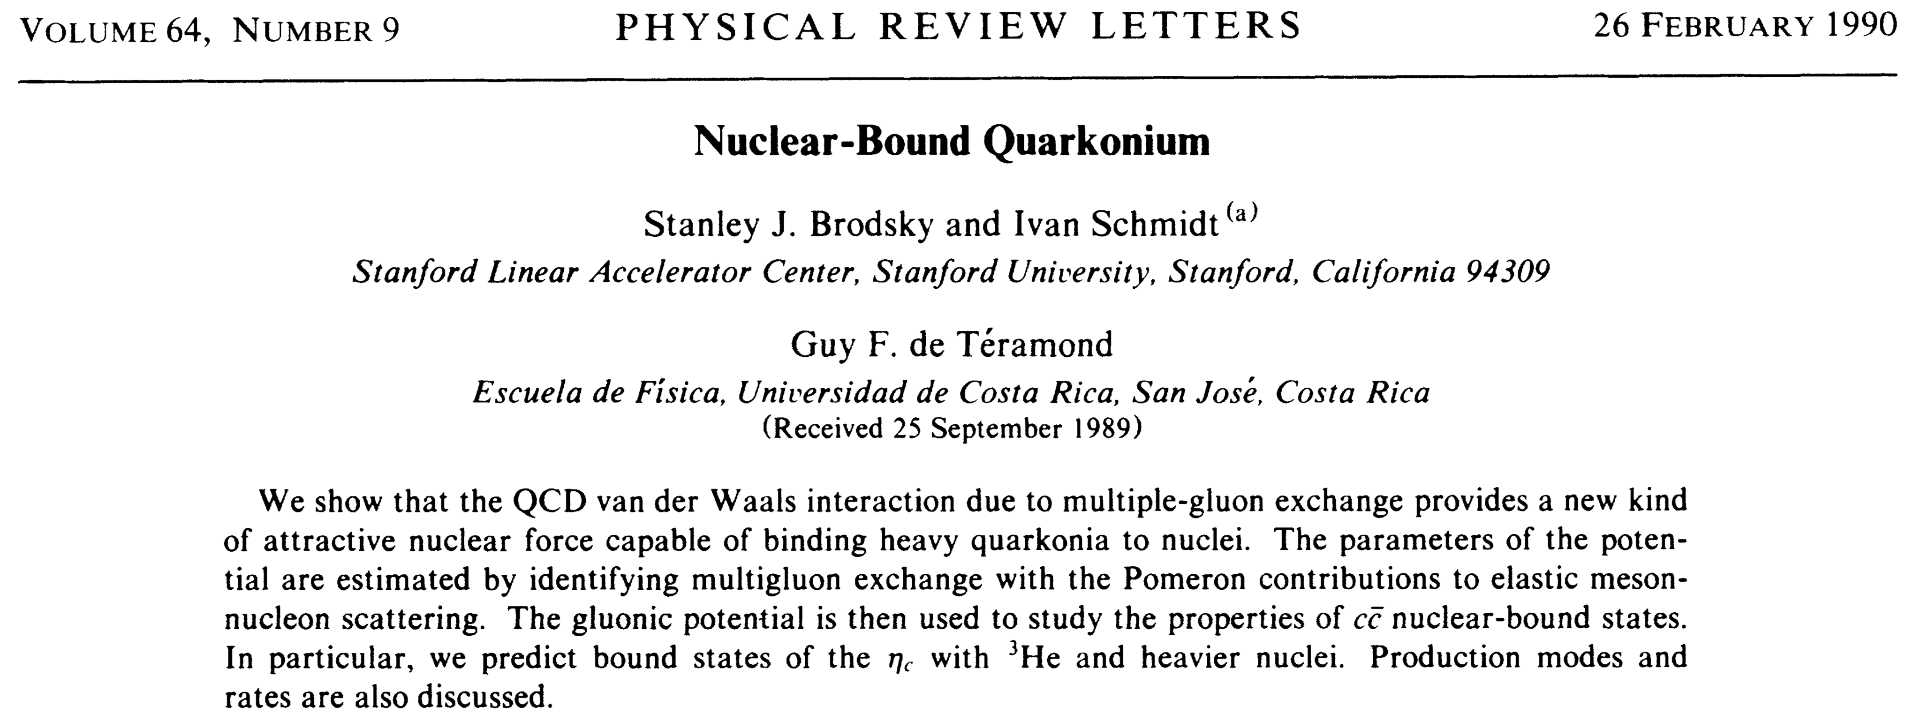
4. Heavy hadrons at extreme conditions
① Quarkonium + Nucleon
c
c^{bar}
gluon exchange dominant?
u
u
d

Slide 31
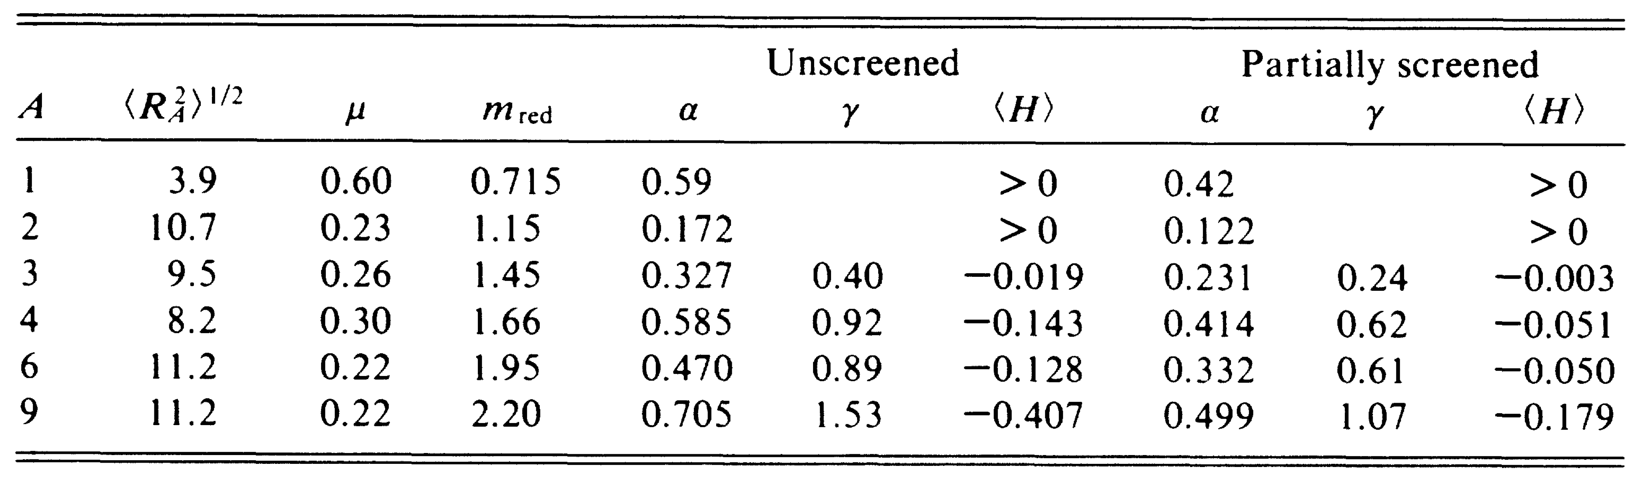
4. Heavy hadrons at extreme conditions
① Quarkonium + Nucleon

Slide 32
4. Heavy hadrons at extreme conditions
① Quarkonium + Nucleon
QCD sum rules
M.A. Shifman, A.I. Vainshtein, V.I. Zakharov, Nucl. Phys. B147, 385 (1979), ibid. 448 (1979)
L. J. Reinders, H. Reubinstein, S. Yazaki, Phys. Rep. 127, 1 (1985)
Correlation function
ρ(s)
peak
continuum state
s
Gluon condensate (@ρ nuclear matter density)
second moment of gluon distribution
ρ₀ normal nuclear matter density
F. Klingl, S.-S. Kim, S. H. Lee, P. Morath,
W. Weise, Phys. Rev. Lett. 82, 3396 (1999)

Slide 33
4. Heavy hadrons at extreme conditions
① Quarkonium + Nucleon
Lattice calculation
T. Kawanai, S. Sasaki, Phys. Rev. D82, 091501 (2010)
u
u
c
d
c
No repulsion at r=0
Small dependence on pion mass (η_{c}N)

Slide 34
4. Heavy hadrons at extreme conditions
① Quarkonium + Nucleon
Lattice calculation
[164] K. Yokokawa, S. Sasaki, T. Hatsuda, and A. Hayashigaki, Phys. Rev. D74, 034504 (2006)
[165] L. Liu, H.-W. Lin, and K. Orginos, PoS LATTICE2008, 112 (2008)
[166] T.KawanaiandS.Sasaki,Phys.Rev.D82,091501(2010)
[167] T.KawanaiandS.Sasaki,PoSLATTICE2010,156(2010)
[fm]
u
u
c
d
c
@ normal nuclear matter
Mass shift of hadron H in nuclear matter
(Tρ approximation (ρ_{N}:density, a_{HN}:scattering length))

Slide 35
4. Heavy hadrons at extreme conditions
② Heavy-light meson + Nucleon
u
Inter-hadron
interaction
u
u
Qq
c
d
D, D*
Nucleon
mixing
DN system may be complex due to coupling to (excited) charm baryon.
cf. Λ_{c}(2595), Λ_{c}(2625), ..., Σ_{c}(2800), ...
u
c
d
Λ_{c}, Σ_{c}, Σ_{c}*

Slide 36
4. Heavy hadrons at extreme conditions
② Heavy-light meson + Nucleon
u
Inter-hadron
interaction
u
u
Qq
c
d
D, D*
Nucleon
Very simple system!
mixing
See later discussions
u
c
No quark-antiquark annihilation
d
Λ_{c}, Σ_{c}, Σ_{c}*

Slide 37
4. Heavy hadrons at extreme conditions
③ Heavy baryon + Nucleon
u
Inter-hadron
interaction
u
u
c
d
d
Λ_{c}, Σ_{c}, Σ_{c}*
Nucleon
A.A. Tyapkin, Yad. Fiz. 22, 181 (1975)
A.A. Tyapkin, Sov. Journ. Nucl. Phys. 22, 89 (1976)
S. Iwao, Lett. NuovoCim.19, 647 (1977)
C. B. Dover, S. H. Kahana, T. L. Trueman, Phys. Rev. D16, 799 (1977)
C.B. Dover, S.H. Kahana, Phys. Rev. Lett. 39, 1506 (1977)
R. Gatto, F. Paccanoni, NuovoCim. A46, 313 (1978)
...

Slide 38
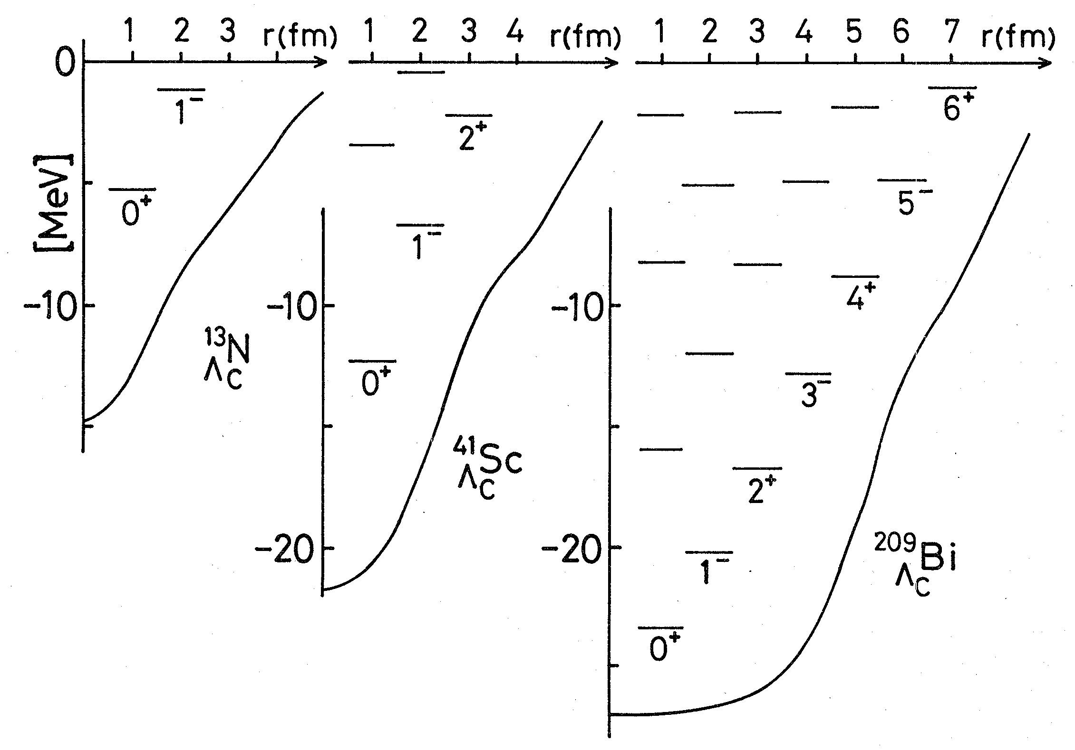
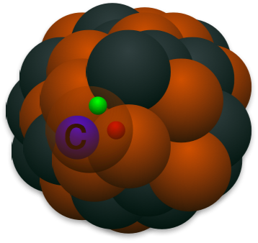
4. Heavy hadrons at extreme conditions
③ Heavy baryon + Nucleon
Strangeness
Charm
Λ(uds) → Λ_{c}(udc)
SU(4)
Charm baryon Λ_{c}(udc)
H.Bando, “Flavor Nuclei”, PTP Suppl. 81, 197 (1985)

Slide 39
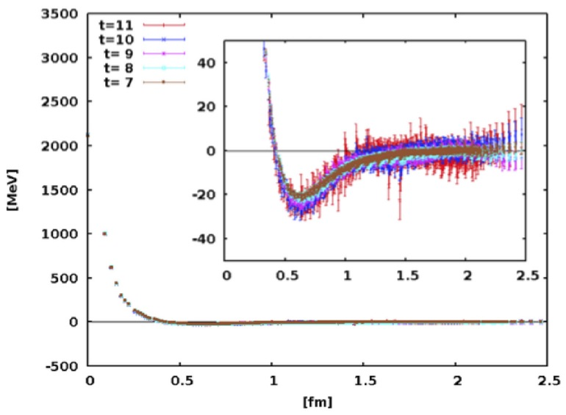
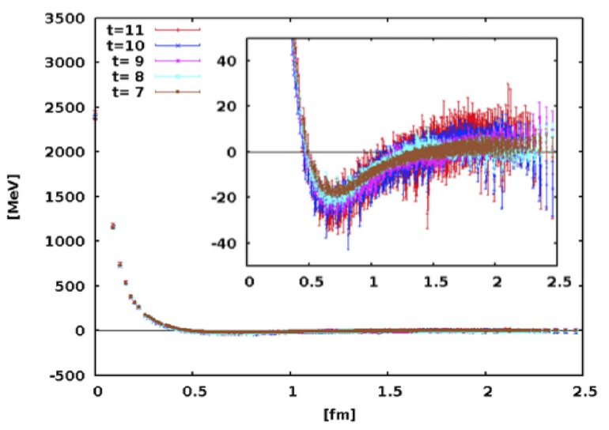
4. Heavy hadrons at extreme conditions
③ Heavy baryon + Nucleon
Λ_{c}N potential (¹S₀)
Lattice QCD
T. Miyamoto (HAL collaboration), PoS LATTICE 2015, 090 (2016)
m_{π}=700 MeV
m_{π}=570 MeV
1. Attraction at middle range (r~0.5-1.5 fm)
2. Repulsion at short distance (r<0.5fm)

Slide 40
4. Heavy hadrons at extreme conditions
③ Heavy baryon + Nucleon
QCD sum rules
Λ_{c} mass in nuclear matter
K. Ohtani et al., arXiv:1704.04902 [hep-ph]
ρ(s)
peak
continuum state
Known result
(factorization ansatz)
s
New result
ΔM=-20 MeV
(attraction)

Slide 41
4. Heavy hadrons at extreme conditions
Charm/bottom “light” nuclei
J/ψNN
η_{c} N N
Λ_{c} N N
A. Yokota, E. Hiyama, M. Oka,
Pog. Ther. Exp. Phys. 2013, 113D01
S. Maeda, M. Oka, A. Yokota, E. Hiyama, Y-R. Liu, Pog. Ther. Exp. Phys. 2016, 023D02
D^{(*)}NN
DNN
BNN
M. Bayer, C. W. Xiao, T. Hyodo, A. Dote, M. Oka, E. Oset, Phys. Rev. C86, 044004 (2012)
Y. Yamaguchi, S.Y., A. Hosaka, Nucl. Phys. A927, 110 (2014)

Slide 42
4. Heavy hadrons at extreme conditions
Charm/bottom “light” nuclei
Example
u
u
u
Qq
c
d
D, D*
Nucleon
What is the interaction?

Slide 43
4. Heavy hadrons at extreme conditions
Charm/bottom “light” nuclei
Example
u
u
u
Qq
c
π, ρ, ω,σ, ... meson exchange
d
D, D*
Nucleon
What is the interaction?
Notice
We adopt π meson exchange for demonstration^{(*)}. But other meson exchanges and quark-exchange should be also considered for reality.
^{(*)} T. D. Cohen, P. M. Hohler, R. F. Lebed, Phys. Rev. D 72, 074010 (2005)
S.Y., K. Sudoh, Phys. Rev. D80, 034008 (2009)

Slide 44
4. Heavy hadrons at extreme conditions
Charm/bottom “light” nuclei
Example
Yesterday’s review
q
q
Q
spin
q
π,ρ,ω,...
q
HQS (S=1/2)
conserved
spin J
conserved
Light spin j
conserved!
→ mass degeneracy for J=j±1/2
j=0: HQS singlet
j≥1: HQS doublet

Slide 45
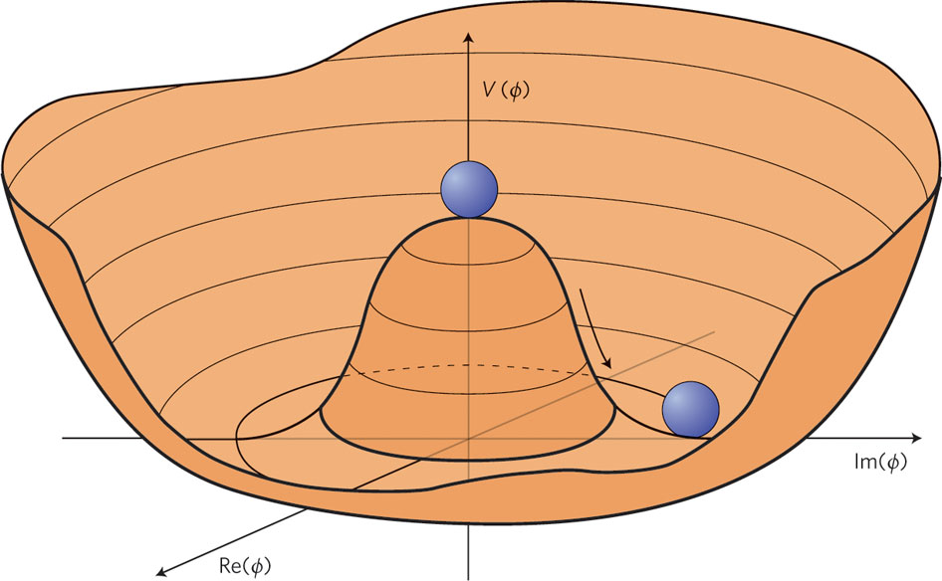
4. Heavy hadrons at extreme conditions
Yesterday’s review
② Constructing effective Lagrangian (leading order of m_{Q}→∞)
chiral covariant derivative:
invariant under HQS
and chiral symmetry
Non-linear chiral transformation
Non-linear rep. of π field:
Vector current:
Axial-vector current:
(even # of π)
(odd # of π)
Example of vertex structure (axial-vector coupling)
We will see details later.
D*
D
D*
time
π
π
π
D
D*
D*

Slide 46
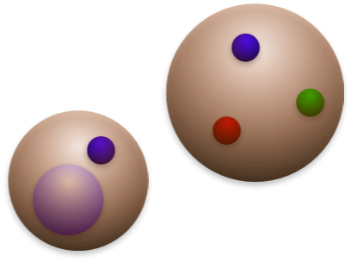
4. Heavy hadrons at extreme conditions
Example
Qq
=P⁽*⁾
•
•
•
q
q
P
S-wave
N
π
π
q
P*
S-wave
N
Time
q
π
π
Q
P*
D-wave
N
D⁽*⁾ meson
Nucleon
π
P
S-wave
N
Hadronic molecule
J^{P}=1/2⁻ case
Tensor force and ...
(mixing of S-wave and D-wave, like in deuteron)
P(0⁻)-P*(1⁻) mixing are important !

Slide 47


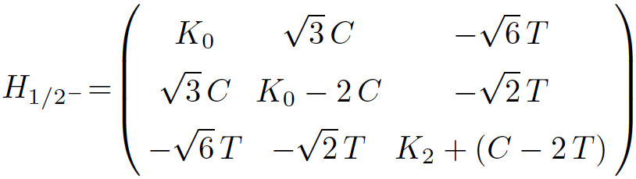
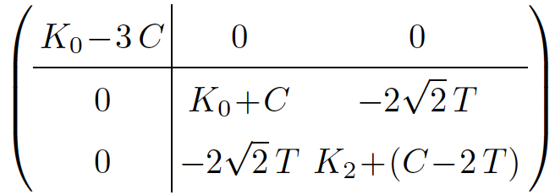
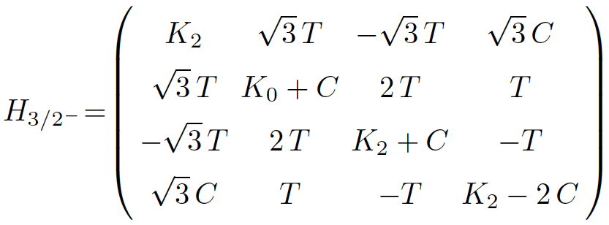
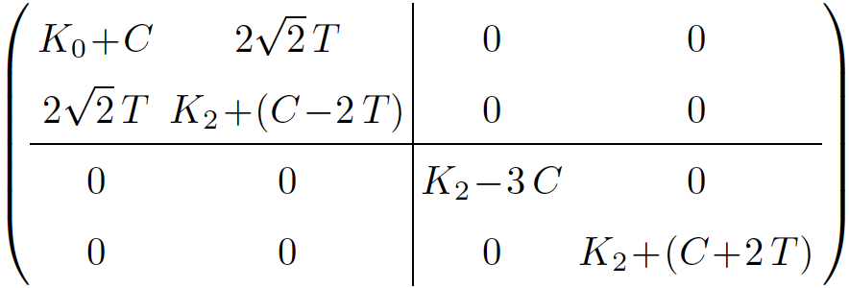
4. Heavy hadrons at extreme conditions
Example
J^{P}=1/2⁻, 3/2⁻
{P⁽*⁾N(^{2S+1}L_{J})}
N
J^{P}=1/2⁻ : {PN(²S_{1/2}), P*N(²S_{1/2}), P*N(⁴D_{1/2})}
P⁽*⁾
π exchange
HQS singlet
Unitary transformation
(Heavy quark + Light spin)
HQS doublet
(tensor potential)
J^{P}=3/2⁻ : {PN(²D_{3/2}), P*N(⁴S_{3/2}), P*N(⁴D_{3/2}), P*N(²D_{3/2})}
Unitary transformation
(Heavy quark + Light spin)
K_{L}: kinetic term
(angular momentum L)
C: central potential
T: tensor potential
1/2⁻ and 3/2⁻ are degenerate in mass.
HQS doublet

Slide 48
4. Heavy hadrons at extreme conditions
Example
Mass
D*N
N
142 MeV
P⁽*⁾
π exchange
isospin 0
B*N
46 MeV
DN
BN
PN, P*N
0 MeV
0 MeV
0 MeV
Charm
Bottom
m_{Q}→∞

Slide 49
4. Heavy hadrons at extreme conditions
Example
Mass
N
142 MeV
P⁽*⁾
π exchange
isospin 0
46 MeV
P⁽*⁾N
0 MeV
0 MeV
0 MeV
3/2⁻
1/2⁻
Charm
Bottom
m_{Q}→∞

Slide 50
4. Heavy hadrons at extreme conditions
Example
Mass
D⁽*⁾N
N
142 MeV
3/2⁻
P⁽*⁾
π exchange
B⁽*⁾N
isospin 0
Feshbach resonance (Γ=18 MeV)
46 MeV
J^{P}=3/2⁻ : {PN(²D_{3/2}), P*N(⁴S_{3/2}), P*N(⁴D_{3/2}), P*N(²D_{3/2})}
P⁽*⁾N
3/2⁻
0 MeV
0 MeV
0 MeV
1/2⁻
1/2⁻
HQS doublet
3/2⁻
1/2⁻
Charm
Bottom
m_{Q}→∞

Slide 51
4. Heavy hadrons at extreme conditions
Charm/bottom “light” nuclei
Example
N
AV8’
π
(HQS)
π (HQS)
N
P⁽*⁾
isospin 1/2

Slide 52
4. Heavy hadrons at extreme conditions
Charm/bottom “light” nuclei
Example
N
AV8’
Feshbach resonance
π
(HQS)
π (HQS)
N
P⁽*⁾
isospin 1/2
bound state
HQS doublet
(0⁻, 1⁻)
D^{(*)}NN
B^{(*)}NN
Y. Yamaguchi, S.Y., A. Hosaka, Nucl. Phys. A927, 110 (2014)

Slide 53
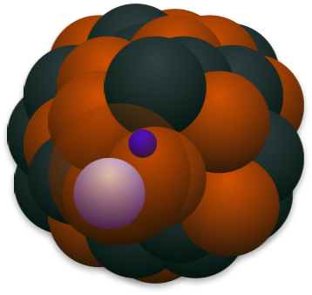
4. Heavy hadrons at extreme conditions
Heavy hadron in nuclear matter
D, D*
(cq)
q
c
nuclear matter

Slide 54
4. Heavy hadrons at extreme conditions
D (B) meson in nuclear matter
Quark-meson coupling model, QCD sum rules, hadronic interactions (mean-field approach, channel coupling, pion interaction), ...
K. Tsushima, D. H. Lu, A. W. Thomas, K. Saito, R. H. Landau, A. Hayashigaki, T. Hilger, R. Thomas, B. Kampfer, K. Azizi, N. Er, H. Sundu, D. Blaschke,
P. Costa, Y. L. Kalinovsky, Z. G. Wang, K. Suzuki, P. Gubler, M. Oka , M. F. M. Lutz, C. L. Korpa. L. Tolos, A. Ramos, T. Mizutani, C. Gracia-Recio,
J. Nieves, A. Mishra, E. L. Bratkovskaya, J. Schaffner-Bielich, S. Schramm, H. Stocker, A. Kumar, A. Mishra, S.Y., K. Sudoh, M. Harada, Y. L. Ma,
D. Suenaga, ...
D. Suenaga, S.Y., M. Harada, arXiv:1703.02762 [nucl-th] (to appear in PRC)

Slide 55
4. Heavy hadrons at extreme conditions
D (B) meson in nuclear matter
Quark-meson coupling model, QCD sum rules, hadronic interactions (mean-field approach, channel coupling, pion interaction), ...
Heavy quark symmetry
DN ⇄ D*N
Hadronic model
C. Garcia-Recio, J. Nieves, L. L. Salcedo,
L. Tolos, Phys. Rev. C 85, 025203 (2012)

Slide 56
4. Heavy hadrons at extreme conditions
D (B) meson in nuclear matter
Quark-meson coupling model, QCD sum rules, hadronic interactions (mean-field approach, channel coupling, pion interaction), ...
Heavy quark symmetry
DN ⇄ D*N
Hadronic model
S. Y. , K. Sudoh, Phys Rev. C87, 015202 (2013)
π meson exchange between D (D*) and N
D, B
D*, B*
ρ₀
ρ₀

Slide 57
4. Heavy hadrons at extreme conditions
D (B) meson in nuclear matter
Quark-meson coupling model, QCD sum rules, hadronic interactions (mean-field approach, channel coupling, pion interaction), ...
QCD sum rule
K. Suzuki, P. Gubler, M. Oka, arXiv:1511.04513 [hep-ph]
Cf. Quark confinement picture
A. Park. P. Gubler, M. Harada, S. H. Lee, C. Nonaka, W. Park, arXiv:1602.01250 [nucl-th]

Slide 58
4. Heavy hadrons at extreme conditions
D (B) meson in nuclear matter
Quark-meson coupling model, QCD sum rules, hadronic interactions (mean-field approach, channel coupling, pion interaction), ...
PNJL model
D. Blaschke, P. Costa, Y-L. Kalinovsky, Phys. Rev. D85, 034005 (2012)

Slide 59
4. Heavy hadrons at extreme conditions
D (B) meson in nuclear matter
Quark-meson coupling model, QCD sum rules, hadronic interactions (mean-field approach, channel coupling, pion interaction), ...
Heavy-light chiral model
D. Suenaga, S.Y., M. Harada,
Phys. Rev. C96, 015204 (2017)
D(0⁻)
D₀(0⁺)
D(0⁻) mass up
D₀(0⁺) mass down

Slide 60

4. Heavy hadrons at extreme conditions
Is there really
stable charm
nucleus？

Slide 61
4. Heavy hadrons at extreme conditions
S.Y., K.Sudoh, Phys. Rev. C89, 015201 (2014)
1/m_{Q} expansion
LO
+
NLO

Slide 62
4. Heavy hadrons at extreme conditions
S.Y., K.Sudoh, Phys. Rev. C89, 015201 (2014)
Coupling to magnetic gluon at 1/m_{Q}
Heavy hadron mass “parametrization”
1/m_{Q} expansion
ρ: nuclear matter density
at NLO
NLO in 1/m_{Q} expansion
spin-flip
M.Neubert, Phys. Lett.
B322, 419 (1994)
Color electric gluon
1/m_{Q}
gluon
(magnetic)
Color magnetic gluon
Q
“Non-perturbative” gluon

Slide 63
4. Heavy hadrons at extreme conditions
with breaking of HQS
P⁽*⁾ in nuclear matter
g_{P*P*π} = g + (g₁+g₂)/M
≠ g_{P*Pπ} = g + (g₁-g₂)/M
P⁽*⁾
π
M_{P*} = M-2λ/M
≠ M_{P} = M+6λ/M
P⁽*⁾
particle-hole
NN⁻¹
π
P⁽*⁾

Slide 64
4. Heavy hadrons at extreme conditions
Yesterday’s review (HMET)
③ Including NLO of 1/M (cont’d)
“covariant” transformation
Lorentz boost:
✓ construction of interaction term
invariant under velocity rearrangement
Possible form of current:
: Gamma matrices
Example of axial-vector current
LO:
unknown coupling
Lattice QCD (m_{Q}→∞)
D*→Dπ decay width
unknown couplings
NLO:
← HQS breaking term (g₂)

Slide 65
4. Heavy hadrons at extreme conditions
S.Y., K.Sudoh, Phys. Rev. C89, 015201 (2014)
λ₁(ρ)
“Color electric gluon enhanced”
λ₂(ρ,m_{c})
“Color magnetic gluon suppressed”
λ₂(ρ,m_{b})
vacuum
normal nuclear matter

Slide 66


4. Heavy hadrons at extreme conditions
D, D*
q
c
HiggsTan.com
Nucleus
D, D* meson
Probing gluon fields

Slide 67
Special section: Kondo effect

Slide 68
Special section: Kondo effect
Momentum space
Superconductivity
nucleon
“pairing”
nucleon

Slide 69
Special section: Kondo effect
Momentum space
S.Y., K.Sudoh, Phys. Rev. C88, 015201 (2013)
S.Y., Phys. Rev. C93, 065204 (2016)
S.Y., K. Sudoh, Phys. Rev. C95, 034204 (2017)
Superconductivity
Kondo effect
nucleon
nucleon
“pairing”
“pairing”
nucleon
nucleon
D meson
↑↓
“pairing”
→ Change of Fermi surface
(Thermodynamic property/transport coefficient)

Slide 70
Special section: Kondo effect
・Heavy mass of charm hadron
m_{c}=1.3 GeV and m_{b}=4.7 GeV
・Heavy Quark Symmetry (HQS)
Hadron spin = light quark spin x heavy quark spin
Kondo effect

Slide 71
Special section: Kondo effect
What’s “Kondo effect” ?
Jun Kondo
(1930-)

Slide 72
Special section: Kondo effect

Slide 73
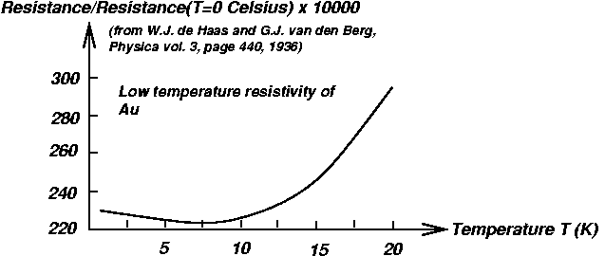


Special section: Kondo effect
Original Work: J. Kondo (Prog. Theor. Phys. 32, 37 (1964))
Impurity atom with spin ½
with Tª・Tª interaction
electron
T²
(e⁻e⁻ scattering)
metal
Log T/T_{K}
(quantum)
T¹, ..., T^{n^2-1}: generators of SU(n)
(n=2 for spin ½)
T_{K}: Kondo temperature
Low
T_{K}
High
“bound”
B.E. ≈ T_{K}
Energy scale
(temperature)
impurity
spin
electron
spin
“not bound”

Slide 74
Special section: Kondo effect
Original Work: J. Kondo (Prog. Theor. Phys. 32, 37 (1964))
impurity
fermion
Scattering amplitude:
electron
l
k
impurity atom
j
i
k, l, i, j=↑, ↓ in SU(n) (n=2 for spin ½)
T¹, ..., T^{n^2-1}: generators of SU(n)
(Tª)_{kl}(Tª)_{ij} interaction

Slide 75
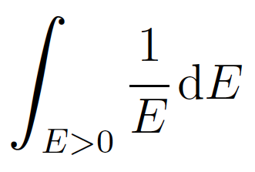
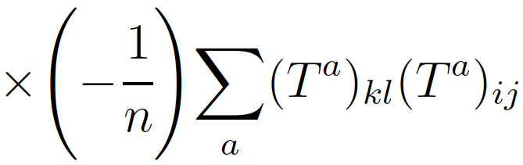
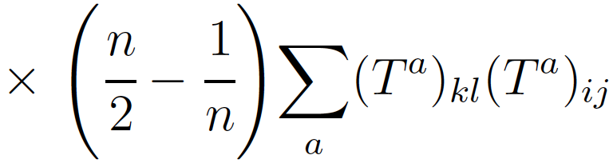
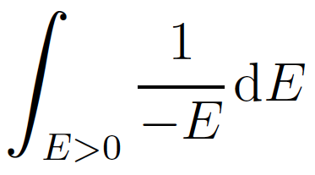
Special section: Kondo effect
Original Work: J. Kondo (Prog. Theor. Phys. 32, 37 (1964))
impurity
fermion
Scattering amplitude:
electron
l
k
impurity atom
j
i
k, l, i, j=↑, ↓ in SU(n) (n=2 for spin ½)
T¹, ..., T^{n^2-1}: generators of SU(n)
(Tª)_{kl}(Tª)_{ij} interaction
electron
l
k
l
k
+
+
j
i
j
i
E: energy from Fermi surface
hole
Log E divergence for infrared limit (E→0) for any small coupling
→ Logarithmic divergence in scattering amplitude
(large electric resistance at low temperature)

Slide 76
Special section: Kondo effect
Original Work: J. Kondo (Prog. Theor. Phys. 32, 37 (1964))
impurity
fermion
Heavy impurity
1
Fermi surface
(degenerate state)
2
Loop effect
(particle-hole creation)
3
Non-Abelian int.
(SU(n) symmetry)

Slide 77
Special section: Kondo effect
impurity
fermion
Application of Kondo effect to
Hadron/nuclear physics
Fermi gas
electron gas
nuclear matter
(p,n)
quark matter
(u,d,s)
Heavy impurity
spin-atoms
D/B mesons
c/b quarks
Fermi surface
(degenerate state)
✔︎
✔︎
✔︎
Loop effect
(particle-hole creation)
electron-hole︎
nucleon-hole︎
quark-hole︎
Non-Abelian int.
(SU(n) symmetry)
SU(2)_{spin}
SU(2)_{HQS}×SU(2)_{isospin}
SU(3)_{color}
1. NJL-type: S.Y., K.Sudoh, Phys. Rev. C88, 015201 (2013)
2. QCD Kondo: K. Hattori, K. Itakura, S. Ozaki, S.Y., Phys. Rev. D92, 065003 (2015)
3. Magnetic catalysis QCD Kondo effect: S. Ozaki, K. Itakura, Y. Kuramoto, Phys. Rev. D94, 074013 (2016)
4. Kondo effect in atomic nucleus: S.Y., Phys. Rev. C93, 065204 (2016)
5. Kondo effect of Ds meson: S.Y., K. Sudoh, Phys. Rev. C95, 034204 (2017)]
6. QCD Kondo phase: S.Y., K. Suzuki, K. Itakura, arXiv:1604.09229 [hep-ph]
7. Single heavy-quark QCD Kondo cloud, S.Y., arXiv:1608.06450 [hep-ph]
8. Conformal theory, T. Kumura, S. Ozaki, arXiv:1611.07284 [cond-mat] (J. Phys. Soc. Jpn. 86, 084703 (2017))
9. QCD Kondo effect and color superconductivity, T. Kanazawa, S. Uchino, Phys. Rev. D94, 114005 (2016)
10. Topology and stability of QCD Kondo phase, S.Y., K. Suzuki, K. Itakura, arXiv:1703.04124 [hep-ph] (to appear in PRD)

Slide 78
Special section: Kondo effect
D⁰(cu)
D⁻(cd)
D_{s}⁻(cs)
Kondo

Slide 79
Special section: Kondo effect
Ds/Ds*
D/D*
(cs)
(cu,cd)
Electric charge
(Coulomb-assisted bound state)
-1
0, -1
< 2.1 MeV,
0.834 MeV
Long life-time of
vector-meson
< 1.9 MeV
Short-distance
repulsion
No (maybe)
Yes
Non-Abelian
interaction
SU(2)_{HQS}
SU(2)_{HQS}×SU(2)_{isospin}

Slide 80
Special section: Kondo effect
S.Y., K.Sudoh, Phys. Rev. C95, 034204 (2017)
1 Interaction of Ds (Ds*) meson and nucleon
: nucleon field
spin-nonexchange term
spin-exchange term
Modified by Kondo effect
Heavy quark spin symmetry
(m_{Q}→∞)
(Shown in the next page)
⇄
vector
pseudoscalar
⇧ ↑ ⇧ ↓
c quark
spin
s quark
spin
c quark
spin
s quark
spin

Slide 81
Special section: Kondo effect
S.Y., K.Sudoh, Phys. Rev. C95, 034204 (2017)
2 Renormalization group equation
N
N
N
Ds, Ds* dressed by
nucleon/hole
bare Ds, Ds*
nucleon
Λ~Λ＋dΛ
Ds, Ds*
Ds, Ds*
Λ~Λ＋dΛ
nucleon (hole)

Slide 82
Special section: Kondo effect
S.Y., K.Sudoh, Phys. Rev. C95, 034204 (2017)
2 Renormalization group equation
nucleon
momentum space
Λ~Λ＋dΛ
Ds, Ds*
Ds, Ds*
Λ~Λ＋dΛ
nucleon (hole)
spin-nonexchange term
(Λ: loop momentum)
spin-exchange term

Slide 83
Special section: Kondo effect
S.Y., K.Sudoh, Phys. Rev. C95, 034204 (2017)
2 Renormalization group equation
nucleon
momentum space
Λ~Λ＋dΛ
Ds, Ds*
Ds, Ds*
Λ~Λ＋dΛ
nucleon (hole)
spin-nonexchange term
(Λ: loop momentum)
spin-exchange term
c_{t}>0
Kondo scale
(infrared singularity)

Slide 84
Special section: Kondo effect
S.Y., K.Sudoh, Phys. Rev. C95, 034204 (2017)
2 Renormalization group equation
Strong coupling
breakdown of perturbation
spin-flipping int.
c_{t}>0
high energy
low energy (Λ→0)
Fermi surface
0
c_{t}<0
Weak coupling
no transition for
D_{s}⁻ ⇄ D_{s}*⁻

Slide 85

Special section: Kondo effect
S.Y., K.Sudoh, Phys. Rev. C95, 034204 (2017)
2 Renormalization group equation
How does HQS play?
N↑
N↓
s quark
spin
N↑
c quark
spin
Ds, Ds*
N↑
N↓
N↓

Slide 86
Special section: Kondo effect
S.Y., K.Sudoh, Phys. Rev. C95, 034204 (2017)
2 Renormalization group equation
How does HQS play?
N↑
N↓
s quark
spin
N↑
c quark
spin
Heavy quark spin symmetry: The s quark spin is a conserved quantity due to the decoupling from the c quark spin.
Ds, Ds*
Spin-flip interaction
(non-Abelian SU(2))
N↑
N↓
N↓

Slide 87
Special section: Kondo effect
S.Y., K.Sudoh, Phys. Rev. C95, 034204 (2017)
3 Mean-field approach
(c_{t}>0)
Kondo scale → non-perturbative treatment
s quark field
(σ: light-spin, i:heavy-quark spin)
c quark spin
i = ± 1/2
gap: mixing of s quark and nucleon
s quark spin
σ = ± 1/2
N↑
N↓
N↑
Ds, Ds*
N↑
N↓
N↓

Slide 88
Special section: Kondo effect
S.Y., K.Sudoh, Phys. Rev. C95, 034204 (2017)
3 Mean-field approach
(c_{t}>0)
Kondo scale → non-perturbative treatment
s quark field
(σ: light-spin, i:heavy-quark spin)
c quark spin
i = ± 1/2
gap: mixing of s quark and nucleon
s quark spin
σ = ± 1/2
N↑
N↓
φ_{1↑}
N↑
mixing
mixing
φ_{2↑}
Ds, Ds*
ψ↓↑
mixing
N↑
φ_{3↑}
N↓
N↓

Slide 89
Special section: Kondo effect
S.Y., K.Sudoh, Phys. Rev. C95, 034204 (2017)
3 Mean-field approach
(c_{t}>0)
Kondo scale → non-perturbative treatment
s quark field
(σ: light-spin, i:heavy-quark spin)
c quark spin
i = ± 1/2
gap: mixing of s quark and nucleon
s quark spin
σ = ± 1/2
Spectral function ρ(ω)
“Kondo resonance”
gap Δ^{i}
energy
“Ds” “Ds*”
→ Research spectral function of D_{s}^{bar} meson in nucleus!

Slide 90
5. Summary
1. Exotic heavy hadrons (XYZ and P_{c}) are new
objects to be studied in hadron physics.
2. Hadron spectroscopy provides us with basic
tools to study internal structure of exotic hadrons.
3. Cooperation between experiments and theory
is important (RHIC, LHC, GSI-FAIR, BES, KEK, J-PARC, ...).

Slide 91
Keywords
Tetraquark
Exotic
Spectroscopy
Heavy quark symmetry
Charm
XYZ
Heavy hadron effective theory
Bottom
Spin
Pentaquark

