Slide 1
Developing Trispectrum Estimators to measure non-Gaussianity in the CMB
Dominic Galliano
Supervisors: Rob Crittenden & Kazuya Koyama
YITP, Kyoto, Monday 21st March 2011

Slide 2
Outline
Answer the question; “Why use the trispectrum?”
Summarise the current local g_{NL} estimators and WMAP results of these estimators.
Give a brief overview on building en estimator for local g_{NL} using the fast statistic method.
Shown how we calculate the variance for estimators, and detail practical issues of doing this calculation using numerical methods for Planck.
Give a summary of how we can use the numerical code and extend to a greater number of estimators.

Slide 3
Why use the trispectrum?
From a statistical perspective, why not? Thanks to Planck, we can get significant improvements on the bounds.
The set of all possible contains different information to that of . Introduces two new parameters, g_{NL} and τ_{NL}.
From a theoretical perspective, there are now early universe models which have g_{NL} predictions which are larger than f_{NL}:
In some local models, terms in f_{NL} are very small or non-existant due to cancellation.
Cosmic strings predict a stronger g_{NL} signal than f_{NL} due to some symmetry arguments.

Slide 4
Current g_{NL} estimates
Initial work involved building estimators for g_{NL} for local type inflation. This uses the following non-Gaussian primordial potential:
Since starting the project there have been a few estimates for the local g_{NL.} -7.4 < g_{NL} / 10⁵ < 8.2 (Smidt et al. 1004.1409v2) – Not optimal -5.4 < g_{NL} / 10⁵ < 8.6 (Fergusson et al. 1012.6039v1) – Optimal
This term was chosen due to it’s similarity to previous work carried out on f_{NL}.
Fergusson et al. used a mode decomposition to get WMAP result, we will use the fast statistics method. Same estimator different method of applying it to the data.
Notes:
It was chosen due to simplicity
The results could ne particularly large, but this is only start. Other type of inflation models could give larger g_NL signals. Link back to examples on the previous slide

Slide 5
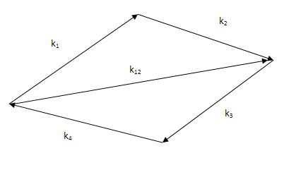
Building the 4 Point Function
The Fourier transform of the curvature perturbation and the 4 point expectation value is calculated. The connected term of which is:
T_{τ}(k₁,k₂,k₃,k₄,k₁₂,k₁₄) contains the term built from the first order non linear term in Φ(k).
T_{g}(k₁,k₂,k₃,k₄) contain the terms built from the second order correction in Φ(k).
Notes:
Mention delta function ensures the shape is quadilateral.
All models split to two components
Unconnected terms, Taunl and fnl in local
Take Taunl to 0 -> Introduce concept of correlation

Slide 6
Building the CMB Trispectrum
The trispectrum for the CMB is defined as follows:
This decomposition into a geometrical and physical component is possible if we assume statistical isotropy. is known as the reduced trispectrum.
Not all combination of l’s and m’s make a trispectrum. The angular component determines what combinations are possible.
The signal of one possible trispectrum is too small to detect, so we can’t do a direct comparison between theory and data, hence why we build an estimator to measure g_{NL} the parameter for the non-Gaussian component.
Notes:
The geometrical component can be expressed in terms of Legendre Polynomials and Wigner 3j symbols

Slide 7
The estimator
For a general case, using a matched template approach, the estimator becomes:
The variance of the trispectrum, is made up of a largely Gaussian component, it is then decomposed to a combinations of C_{l}’s.
Assuming homogeneous and isotropic data this also reduced the number of l’s and m’s we sum from 8 to 4.
depends on the values of l’s. When 2 or more l’s are identical, they weighting reflects the number of possible pairs due to Wick’s theorem.

Slide 8
The estimator
All together
The above is not practical to compute. Instead we use a fast statistic introduced by Komatsu Spergel and Wandelt ( astro-ph/0305189 ).
This only works when .

Slide 9
Fast Statistics
We introduce some CMB maps defined as follows:
The estimator is now simply a product of maps:
The estimator is only optimal when used on ideal data. Otherwise correction terms need to be introduced.

Slide 10
The Optimal Estimator
Creminelli et al. (JCAP 05 (2006) 04) introduced a linear term to correct for anisotropic noise for the bipectrum estimator.
This linear correction term can also be derived by deriving the estimator from the Edgeworth expansion of the probability distribution function of the a_{lm}’s. This work for small levels of non-Gaussianity:
This gives:
Here

Slide 11
Normalisation
Going back to the derivation of the estimator, it is possible to show that the Signal to Noise is proportional to the normalisation.
The trispectrum is then split into it’s angular dependence and the reduced trispectrum:
Here the angular component now depends on L. It is made up of
Notes:
Deriving this term we can see how strong the signal is going to be. Any noise arising here comes from the fact we’re estimating from a sample of the data. This is the optimal bound at 1 σ significance.
It’s not instrumentation noise, this is accounted later. For now assume the instrumentation is perfect.
The angular component ensures wht trispectra are possible and add geometrical weighting.
Physics is contain within T

Slide 12
Signal to Noise
All the physics is contained in . For the local model:
Where the functions are defined:
The range of the l summation depends on which instrument is used. For WMAP, l is summed to a maximum of 500. With Planck it is hoped to reach 1500. The larger the range of l, the more trispectra you have, the stronger the signal will be.
Current variance on our Estimator, using WMAP on our local g_{NL} is: Δg_{NL} =3.92 x 10⁵
Of same order as Δg_{NL} = 5.35 x 10⁵ (Fergusson et al.)
Notes:
As the physics is in the term T, the numerical code we’ve developed can be used for any trispectrum estimator.

Slide 13
Adding this up….
CMB Fast is used to generate bessel and transfer functions. These functions are then used to calculate and .
These are combined to . All these integral step sizes, and the range of the k integral have been tested for convergence and optimisation.
New code for generating the Wigner-3j symbols has been written.
New loops for summing all the l’s and L have been developed to take into account any symmetries we can use from l-space. It has been tested against some analytical result for low l using Sach’s Wolfe approximations.
The code can run on a dual core processor for an l_{max} of about 500. As it scales at about l⁵ , a super computer is required. SCIAMA has just been installed in Portsmouth. SCIAMA has 1008 cores.
The code is currently being rewritten and tested using OpenMPI to run on SCIAMA.

Slide 14
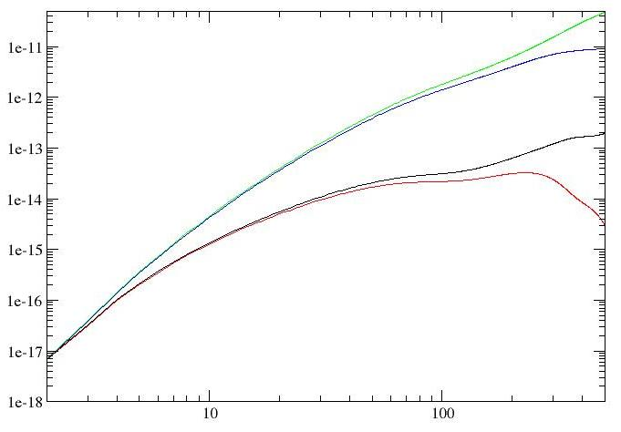
Signal to Noise

Slide 15
Future Work
Finish off technical bugs on SCIAMA and generate the variance for the g_{NL} local estimator for Planck. (Back of the envelopes calculations suggest an order of magnitutde improvement)
Analyse WMAP data and generate a g_{NL} local estimate using Fast Statistic Maps and compare against Fergusson et al.’s mode decomposition estimate.
Correlate different local trispectrum estimators, such as one for τ_{NL} and the connected terms.
Calculate the variance for other current g_{NL} estimators, such as Shuntaro’s and Kazuya’s estimator for an equilateral g_{NL.} This estimator correlates with DBI inflation prediction.
Start work correlating estimators from different theories, such as the local g_{NL} estimator and the equilateral g_{NL} estimator..
Correlation functions:

Slide 16
Conclusions
I have justified the use of analysis of trispectrum in the CMB to constrain early universe theories.
Summarised the current local g_{NL} estimators and results of these estimators.
Given a brief overview on how we can build en estimator for g_{NL} using the fast statistic method.
Shown how we calculate the variance for estimators, and mentioned the practical issues when doing this calculation using numerical methods.
Given a summary of how we can use the numerical code we have to extend to give a greater number of results.

