Slide 1

Quantifying nonlinear contributions to the CMB bispectrum in Synchronous gauge
Guido W. Pettinari
Institute of Cosmology and Gravitation
University of Portsmouth
Under the supervision of Robert Crittenden
YITP, CPCMB Workshop, Kyoto, 21/03/2011

Slide 2
Outline
  Why non-Gaussianities?
  Why go to 2nd order?
  Why do it in Synchronous gauge?
  Some details & first results

Slide 3
Gaussian perturbations
  At 1st perturbative order, the CMB anisotropies take over the non-Gaussianity, if any, from the primordial fluctuations
  ... which implies that the CMB angular bispectrum vanishes for Gaussian primordial perturbations
  ... thus leading to a nice Gaussian CMB map for simple inflationary scenarios:
Notes:
DEFINE alm, phi, gl!
alm thus takes over the non-Gaussianity, if any, from Phi(k) (Komatsu & Spergel, 2001, pag. 3)

Slide 4
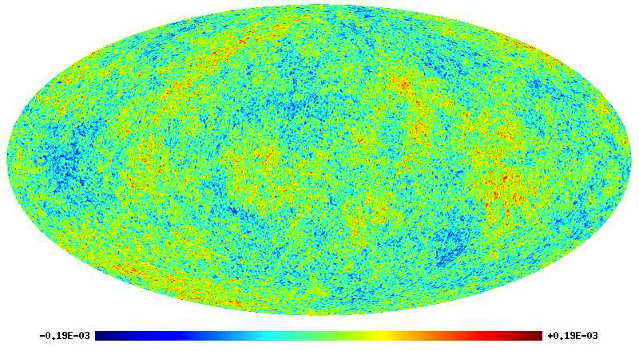
Gaussian perturbations
  ~ 1 million pixels
Notes:
RADICAL COMPRESSION FROM MILLIONS OF PIXELS TO A FEW HUNDRED NUMBER

Slide 5
Gaussian perturbations
  ~ 1 thousand numbers
Notes:
RADICAL COMPRESSION FROM MILLIONS OF PIXELS TO A FEW HUNDRED NUMBER

Slide 6
Non-Gaussianities
  Many models of the early Universe produce non-Gaussian perturbations. Here is a very incomplete list:
Linde & Mukhanov, 1997
Lyth, Ungarelli & Wands, 2003
  Curvaton scenario
Bernardeau & Uzan, 2002, 2003
Lyth & Rodriguez, 2005,
Naruko & Sasaki, 2009
  Multi-scalar field inflaton models
  DBI inflation
Alishahiha, Silverstein & Tong 2004
Chambers & Rajantie, 2008
Enqvist & al., 2005
  Inflationary models with pre-heating
Khoury, Ovrut, et al., 2001
Steinhardt & Turok, 2002
  Ekpyrotic universe
  These models produce quite different non-Gaussian distributions. We shall focus on those that admit a simple local parametrisation:
Quadratic correction
Notes:
K-Inflation, G-Inflation, Galileon inflation, String inflation
LIST OF MODELS: Komatsu 2010 (Hunting for...), Liguori et al 2010
LOCAL PARAM. PARTICULARLY IMPORTANT BECAUSE ALL SINGLE FIELD & SIMPLE MULTIFIELD MODELS PRODUCE THAT KIND OF NON-GAUSSIANITY

Slide 7
Non-Gaussianities
  Measurements so far are consistent with Gaussianity, but still leave room for some non-Gaussianities:
WMAP7 :
Komatsu et al., AJS (2011)
SDSS :
Slosar et al., JCAP (2008)
  The upcoming PLANCK experiment promises to reduce the error bars by a factor 4, down to
PLANCK :
  f_{NL} is very difficult to measure!

Slide 8
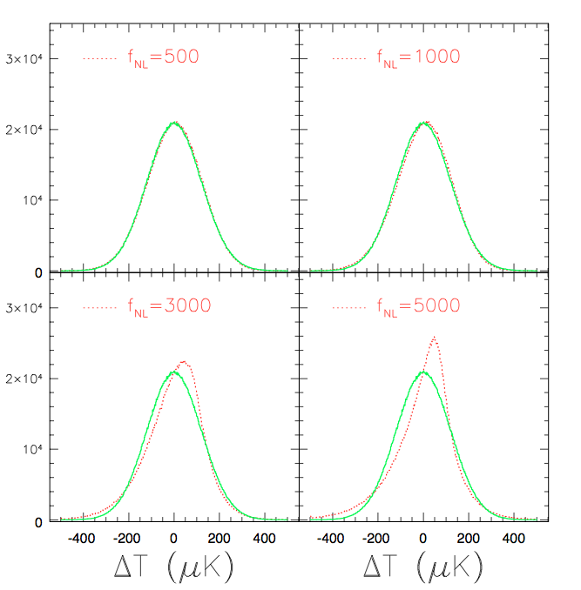
The effect is very small
  Unnoticeable by eye unless f_{NL} > 1000
Liguori, Sefusatti, Fergusson, Shellard, 2010

Slide 9
The effect is very small
  Gaussian realization of a CMB temperature map
Liguori, Sefusatti, Fergusson, Shellard, 2010

Slide 10
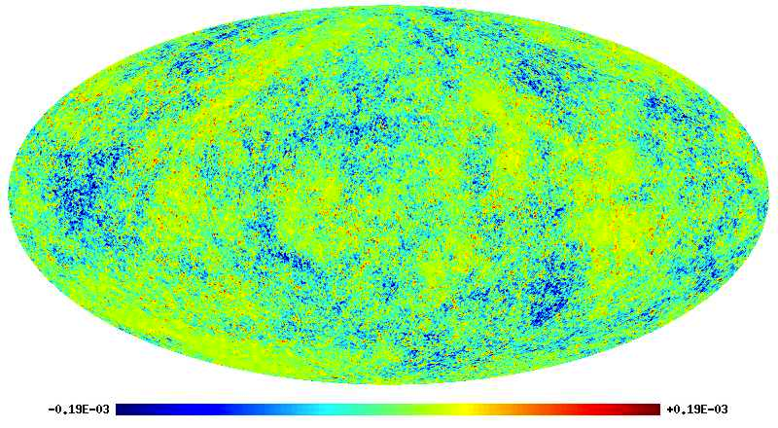
The effect is very small
  Gaussian realization with a local f_{NL} = 3000 superimposition
Liguori, Sefusatti, Fergusson, Shellard, 2010

Slide 11
Non-Linearities
  Any non-linearities can make initially Gaussian perturbations non-Gaussian
  Galactic foregrounds
  Unresolved point sources
  etc ...
  Lensing – ISW correlation
  Detector-induced noise
e.g. Komatsu, CQG, 2010
Liguori et al., AiA 2010
We shall focus on how non-linearities in Einstein equations affect the CMB bispectrum by going to second perturbative order
Notes:
WE HAVE TEMPLATE FOR THOSE
Any non-linearities can make initially Gaussian perturbations non-Gaussian (Nitta, Komatsu, Bartolo, Matarrese, Riotto, 2009)
END OF THE SLIDE: I will now be more quantitative

Slide 12
Non-Linearities

Slide 13
Non-Linearities
Term quadratic in the primordial fluctuations
e.g. Komatsu, CQG, 2010
Nitta et al., 2009
Second-order transfer function
The initial conditions are propagated nonlinearly into the observed CMB anisotropies
Notes:
The initial conditions are propagated nonlinearly into the observed CMB anisotropies (Liguri, Sefusatti, Fergusson & Shellard 2010)

Slide 14
Non-Linearities
  Both primordial & late time evolution can generate NG. In particular :
  Above linear order, it is not true that Gaussian initial conditions imply Gaussianity of the CMB
  The shape of the second order bispectrum is determined by the shape of the second-order radiation transfer function
  Example: If
  then, even with primordial NG of the local type,
  the contribution to f_{NL} would be small
It is crucial to predict the shape and amplitude of second-order effects, in order to subtract them from the data
Notes:
The shape of the second order bispectrum <alm alm alm> is determined by the shape of the second-order radiation transfer function (Komatsu 2010, Hunting ..., pag. 14)

Slide 15
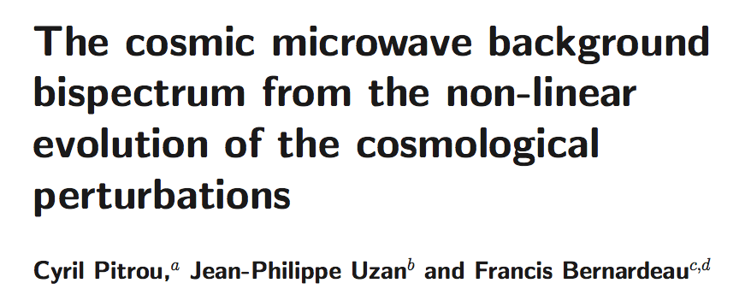
Previous results
  So far, the only full numerical calculation of F ⁽²⁾ was made in Newtonian gauge:
  Pitrou, Uzan & Bernardeau, JCAP, 2010

Slide 16
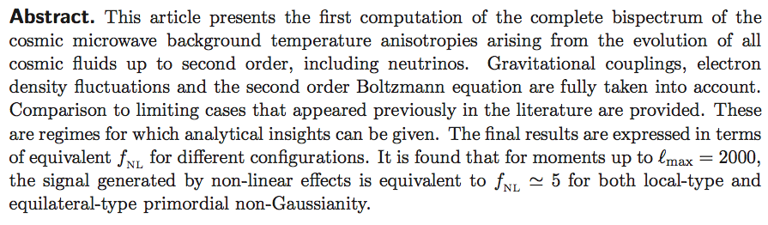
Previous results
  So far, the only full numerical calculation of F ⁽²⁾ was made in Newtonian gauge:
  N.B. For a treatment of only the quadratic terms, please refer to Nitta, Komatsu, Bartolo, Matarrese, Riotto, 2009
Notes:
EXPLAIN WHAT THEY MEAN BY EQUIVALENTà\
N.B. For a treatment of only the quadratic terms, please refer to Nitta, Komatsu, Bartolo, Matarrese, Riotto 2009

Slide 17
Previous results
  Some details on the numerical computation by Pitrou et al.:
  They adopt Newtonian gauge
  The code, CMBQuick, is made with Mathematica and it is publicly available
  Non-parallel code, it takes two weeks to calculate the full bispectrum
Notes:
CMBQuick publicly available at http://icg.port.ac.uk/~pitrouc/

Slide 18
Our purpose
  The result by Pitrou et al. implies that late-time non-Gaussianities are important, and lay right on Planck’s detection threshold
  If the result is confirmed, the CMB maps from Planck and other experiments need to be cleaned of these second-order effects via the construction of templates
Komatsu, CQG, 2010
  It is therefore crucial to double-check the computation by Pitrou et al, possibly in an independent way

Slide 19
Our purpose
  In collaboration with Cyril Pitrou, we aim to confirm and improve the above mentioned results by :
  Writing from scratch a low-level 2nd order Boltzmann code to derive the full radiation transfer function
  Performing the calculations in Synchronous gauge
  Making the code parallel, object-oriented and flexible, in order to allow easy customizations (e.g. add another gauge or model)
  Using open-source libraries (GSL, Blas, Lapack...)

Slide 20
Why Synchronous gauge?
  Difficult to have the same errors using different gauges
  Synchronous gauge is more apt to numerical solving
  e.g. COSMICS, CMBFast, CAMB, CMBEasy
  Comparing results of two different gauges may help detect possible gauge artifacts
  Nobody has done it yet

Slide 21
Structure of the code-to-be
  Two main components:
  Mathematica package to derive the equations
  powerful symbolic algebra system
  C++ code to solve them numerically
  fast, supports object oriented programming
  Both can be used independently, but will be able to communicate
  Example :
  Input the (long!) equations to be solved numerically from within Mathematica
Notes:
... in order to avoid typos

Slide 22
Structure of the code-to-be
  The Mathematica package is (almost) complete, and includes original sub-packages designed to perform :
  Tensor manipulation
  allows for natural input of tensor operations
  Metric Perturbations
  derive geometrical quantities in any gauge, at any order
  Fourier transformation of equations
  e.g. accounts for convolutions arising from non-linear terms
  Collection of terms
  spot terms such as
Notes:
Metric perturbations: just input
The terms collection is particularly useful in Synchronous gauge since there are loads of derivatives

Slide 23
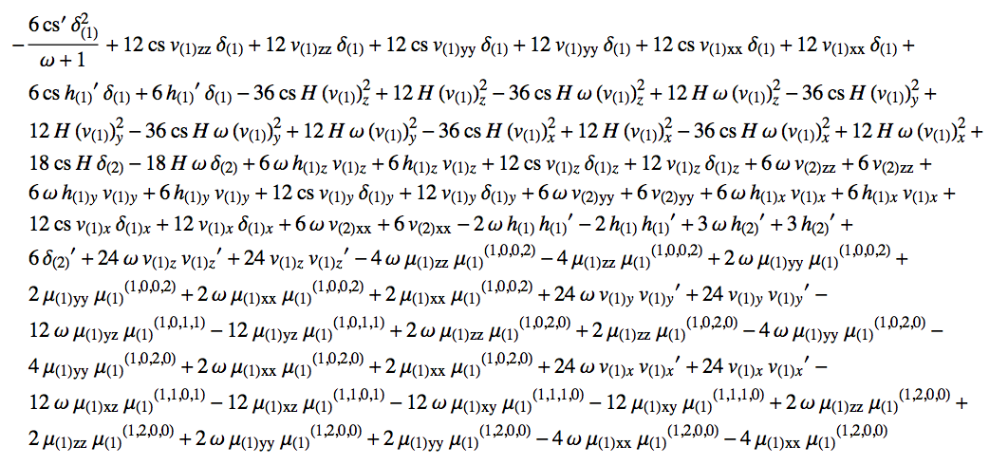
A taste of 2nd order PT
  Continuity equation in Synchronous gauge (only scalar DOF)
  76 terms, and it is one of the simplest equations

Slide 24
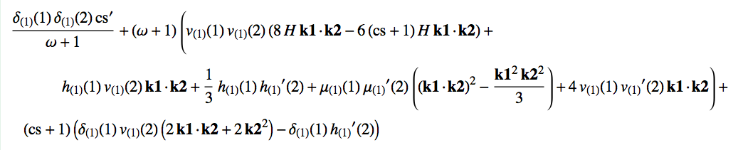
A taste of 2nd order PT
  Fourier space + term collection...
  Similarly, we derived Einstein & Euler equations, and checked them against Tomita (1967)
  We also found equations in Newtonian gauge, and checked them against Pitrou et al. (2008, 2010)

Slide 25
Conclusions
  We need to adopt a 2nd order perturbative approach to quantify contamination to primordial f_{NL} from late non-linear evolution
  The full second order transfer function F ⁽²⁾ is needed to properly subtract the effect (non-trivial!!!)
  Synchronous gauge is suitable to perform the computation, and will lead to an independent confirmation of Pitrou et al. results (f_{NL} ~ 5 for both squeezed and equilateral shapes)
  We already derived most relevant equations, and will integrate them numerically by means of a parallel, object-oriented, low-level code

Slide 26
Thank you!

Slide 27
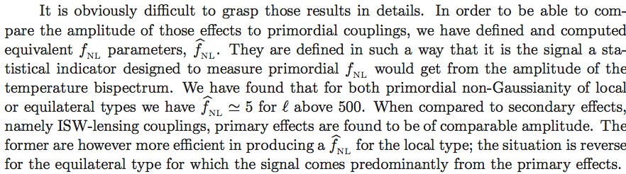
Equivalent f_{NL} in Pitrou’s paper

Slide 28
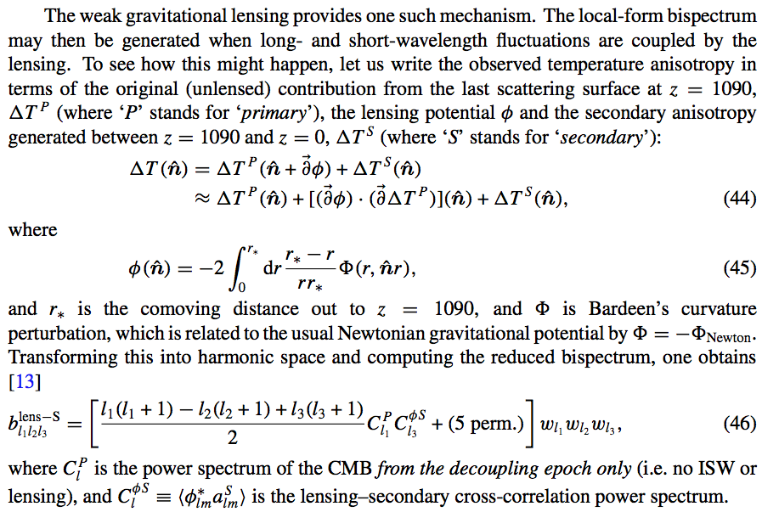
Lensing-ISW correlation
Komatsu, CQG, 2010

Slide 29
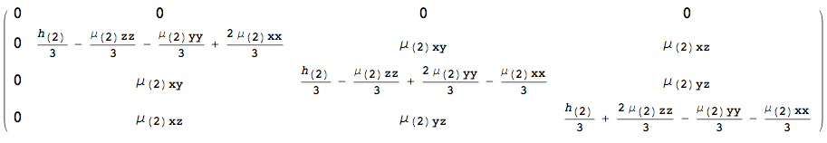
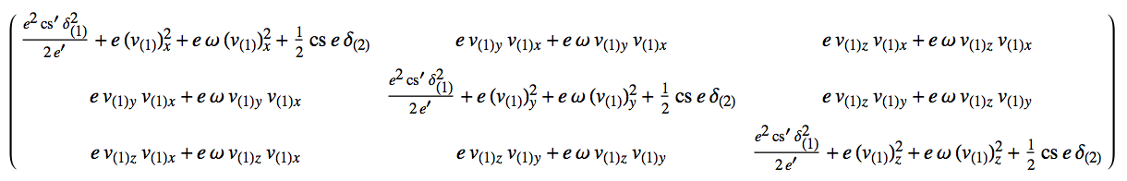
Synchronous scalar perturbations
  Metric perturbations at second order
  Energy-momentum tensor perturbations at second order (space part)

Slide 30
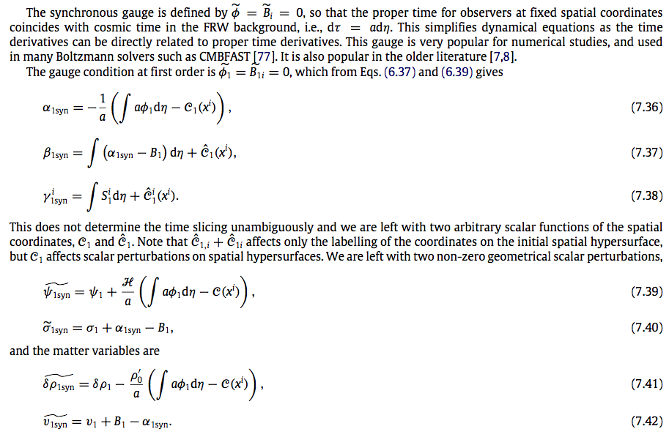
Synchronous gauge fixing 1
Malik & Wands, 2009

Slide 31
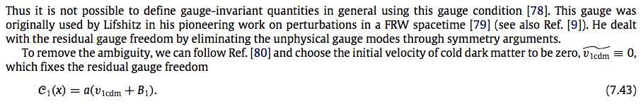
Synchronous gauge fixing 2
Malik & Wands, 2009
M. Bucher, K. Moodley, N. Turok, Phys. Rev. D 62 (2000)

