Slide 1
Temporal enhancement of super-horizon scale curvature perturbations from decays of two curvatons and its cosmological implications.
Teruaki Suyama (Research Center for the Early Universe, The University of Tokyo)
Jun’ichi Yokoyama (Research Center for the Early Universe, The University of Tokyo)

Slide 2
What is the origin of the primordial perturbation?
Inflaton fluctuations
Curvaton mechanism (Enqvist&Sloth 2001, Lyth&Wands 2001, Moroi&Takahashi 2001)
Modulated reheating scenario (Dvali et al. 2001, Kofman 2001)
And many others
In those scenarios, the curvature perturbations, once produced, remain constant until we observe them.

Slide 3
time

Slide 4
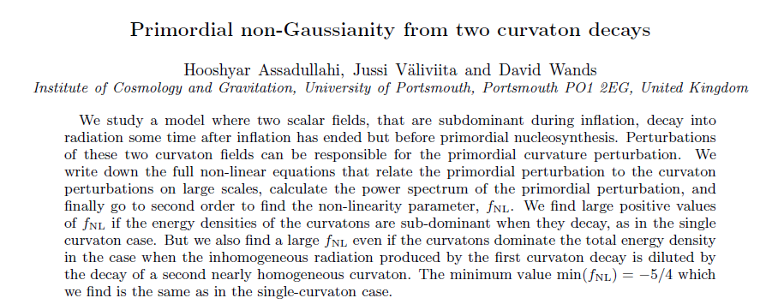
Temporal enhancement from two curvaton decays
My work is motivated by this paper
(PRD 76, 103003, 2007)

Slide 5
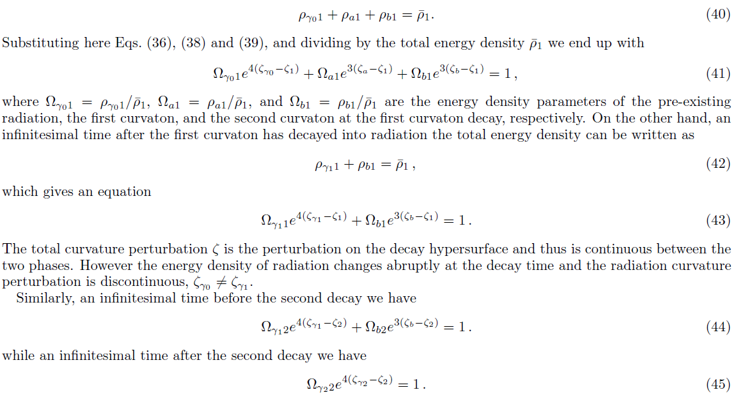
With a help of the sudden decay approximation,
(H. Assadullahi et al., 2007)
The final curvature perturbation zeta_2 is a function of zeta_a and zeta_b.

Slide 6
Our interesting case
Both two curvaton fields start their oscillations in the first radiation dominated epoch.
Radiation dominated
a-field
dominated
Radiation dominated
b-field
dominated
Radiation dominated

Slide 7
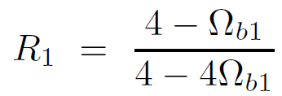
(H. Assadullahi et al., 2007)
Curvature perturbation at the time when the first decaying curvaton decays
Final curvature perturbation
In our case,
enhancement
Suppression factor
Temporal enhancement occurs in this case.

Slide 8
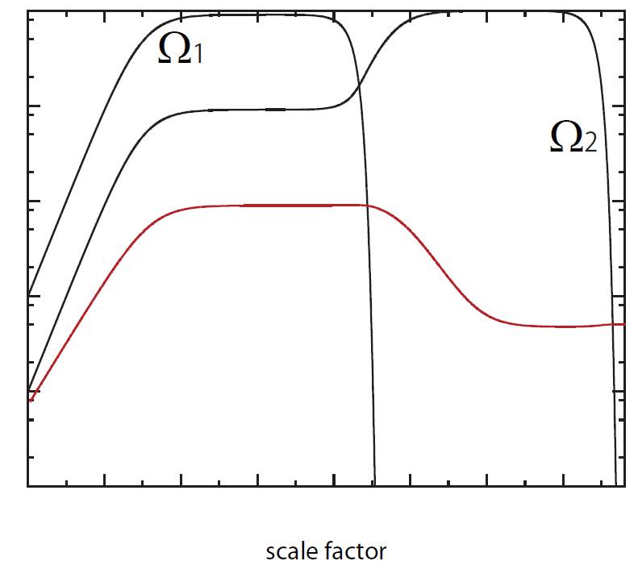
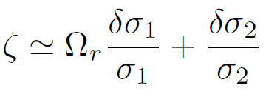
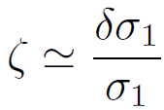
Evolution of curvature perturbation in two curvaton model
(obtained by solving the linear perturbation equations numerically)
: dilution factor
The curvature perturbation is enhanced from the time when the first decaying curvaton starts dominating the universe to the time when the secondly decaying curvaton starts dominating the universe.

Slide 9
Does such an enhancement also happen for the single curvaton model?
As it is well-known, the answer is no.
Suppose large amplitude of curvature perturbation is generated from inflaton fluctuations and the universe is followed by a domination of the curvaton which acquired little fluctuations during inflation.
The large amplitude of the adiabatic perturbation is taken over by the curvaton because the time when the curvaton starts its oscillations is perturbed by the existing adiabatic perturbation.
The existence of more than a single curvaton is essential to realize the temporal enhancement of the curvature perturbation.

Slide 10
Is such a temporal enhancement observationally interesting?
Yes !!
At a first glance, it seems the temporal enhancement has little effect on observables since the enhancement occurs much before the observation time.
However, this is true only for the power spectrum. The traces of the enhancement are left at least in
Higher order correlation functions (bispectrum and trispectrum)
Stochastic gravitational waves produced by mode-mode couplings
Mini-black holes produced by the gravitational collapse of the high dense region

Slide 11
Our achievements
Without using the sudden decay approximation , I derived analytic full-order curvature perturbation which is exact when both two curvatons dominates the universe at different times.
I derived analytic expressions for the non-linearity parameters fnl, taunl and gnl and also derived a unique (free from free parameters) consistency relation between taunl and gnl without using fnl.
Using the second order perturbation theory, I numerically evaluated the power spectrum of the gravitational waves produced by the mode-mode couplings.
It is shown that cold dark matter can be mini black holes produced in the two curvaton model.

Slide 12
The final curvature perturbation (without the sudden decay approximation)
By using the delta-N formalism (Starobinsky 1985, Sasaki&Stewart 1996, Sasaki&Tanaka 1998, Malik, Lyth&Sasaki 2004), it can be shown
linearize

Slide 13
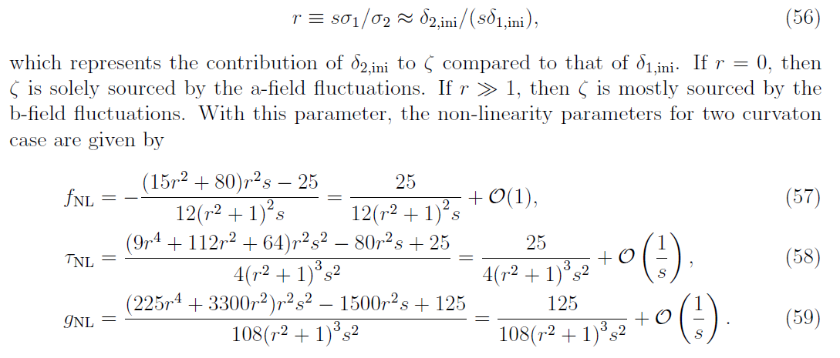
The non-linearity parameters
(Byrnes et al. 2006)

Slide 14
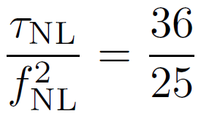
Importance of the trispectrum
Two curvaton model
Single curvaton model
If r is large, taunl is enhanced more than the case of the single curvaton case.
This allows a possibility that fnl=O(1), but taunl and gnl >>1.
In such a case, first detection of non-gaussianity comes from the trispectrum, rather than from the bispectrum.

Slide 15
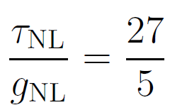
A unique consistency relation between taunl and gnl
If this relation is confirmed in future, then it will be a strong sign of the two curvaton model.

Slide 16
Stochastic gravitational waves
At the second order, tensor type and scalar type perturbations are no longer decoupled.
Metric perturbation
2nd order tensor perturbations
(Ananda et al. 2007, Baumann et al. 2007)

Slide 17
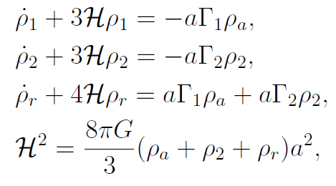
Stochastic gravitational waves
Background equations
1st order perturbation equations

Slide 18
Stochastic gravitational waves
Setup
We only consider a case where the first decaying curvaton immediately decays soon after it dominates the universe.
Radiation
dominated
a-field originated radiation dominated
b-field
dominated
Radiation
dominated
Temporal enhancement

Slide 19
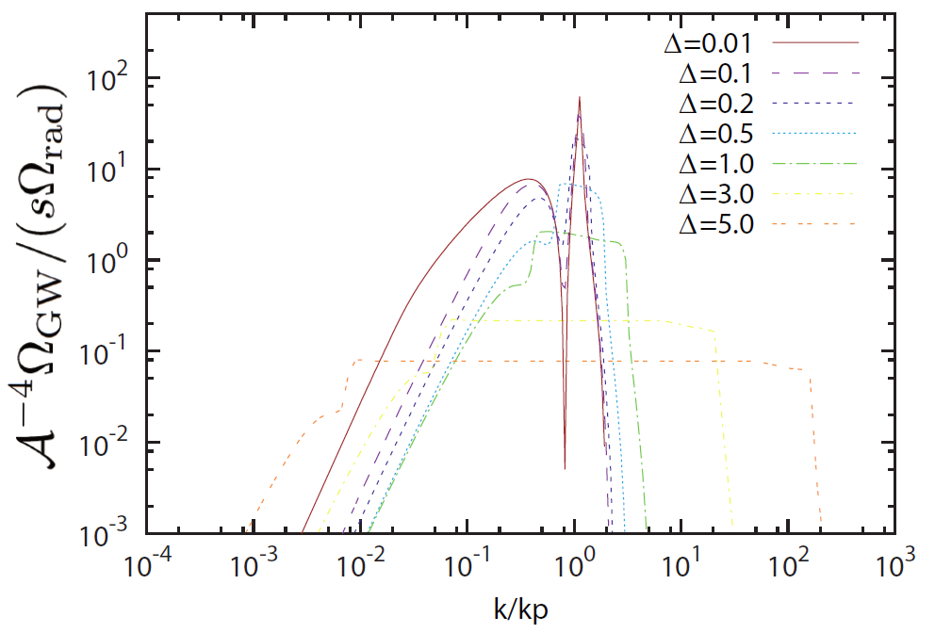
Stochastic gravitational waves-(results)

Slide 20
Stochastic gravitational waves-(results)
The factor s represents dilution of GWs during the b-field dominated epoch.
Imposing the WMAP normalization and BH abundance constraint yields

Slide 21
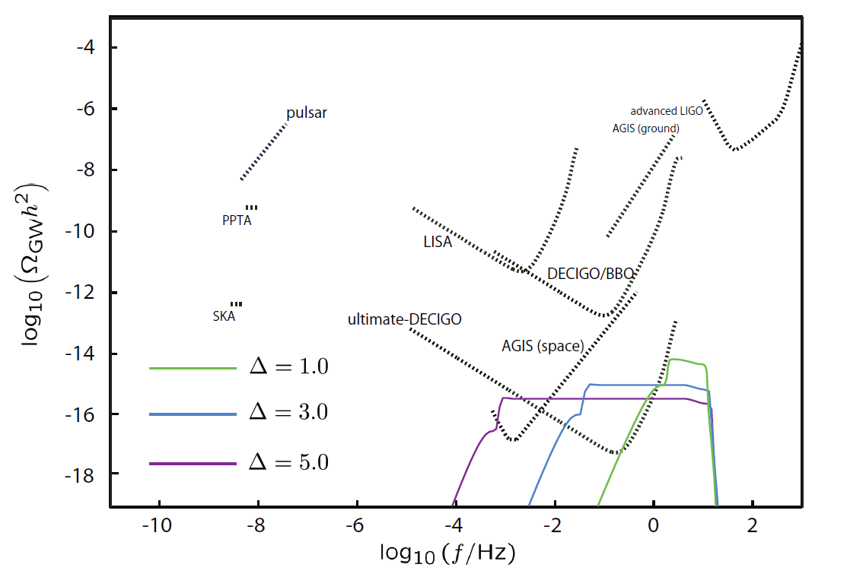
Stochastic gravitational waves-(results)

Slide 22
Primordial black holes
BH mass
BH mass range
Fraction of BH abundance
(Saito&Yokoyama, 2009)

Slide 23
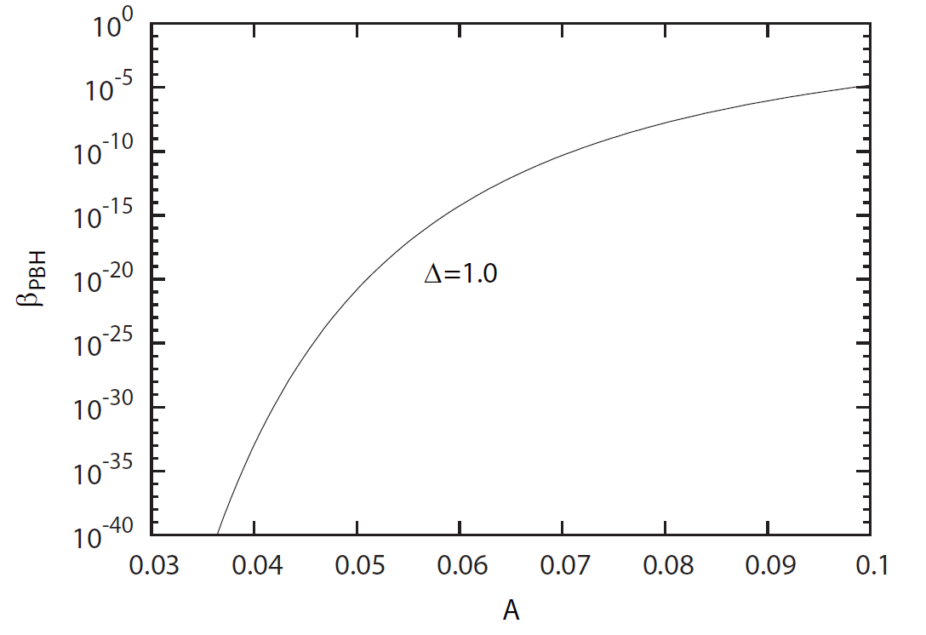
Primordial black holes
It is even possible that BHs produced in the two curvaton model are CDMs.

Slide 24
Summary
Temporal enhancement of the curvature perturbation in two curvaton model.
Exact full order curvature perturbation without sudden decay approximation.
Non-linearity parameters and a unique consistency relation between taunl and gnl.
Evaluation of GW power spectrum.
Constraint on the enhanced amplitude from the constraint on BHs.

Slide 26
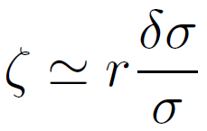
Standard curvaton scenario
There is a light scalar field (curvaton) other than the inflaton. The curvaton behaves like a test field during inflation and acquires quantum fluctuations of H/(2$π)$.
The curvaton fluctuations turn into the curvature perturbations when the curvaton decays into radiation. Magnitude of the resulting curvature perturbation is
: fraction of curvaton energy density when the curvaton decays.
The curvature perturbation remains constant once it is generated.

Slide 27
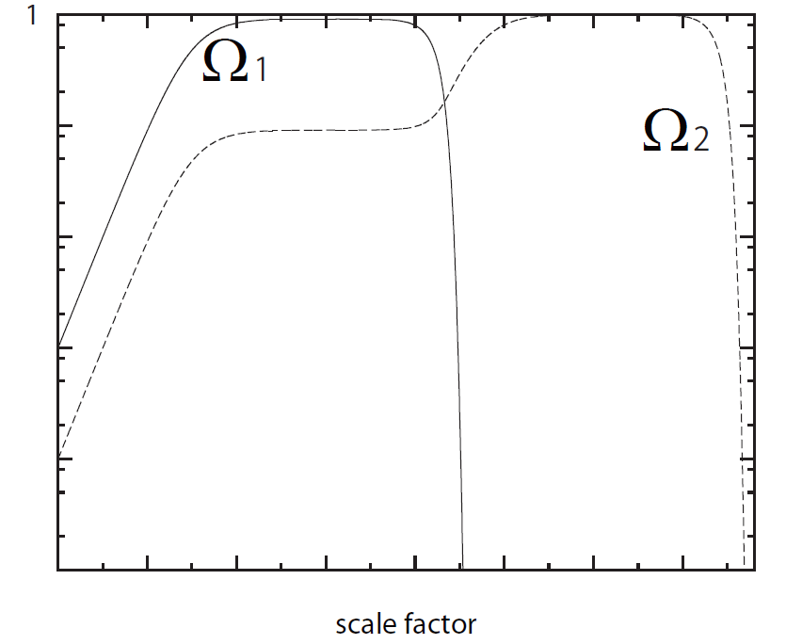
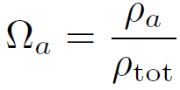
Cosmic evolution in two curvaton model
Two light fields
We assume .
Both fields acquire fluctuations during inflation.
Both fields start oscillations when the universe is filled by radiation from inflaton decay.
Time evolution of energy fraction of each curvaton .

Slide 28
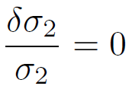
Is it really possible to make the curvature perturbation decay?
Yes
To make the curvature perturbation decay, the isocurvature perturbation must be correlated with the adiabatic perturbation.
Let us consider an ideal case where .
Adiabatic and isocurvature perturbations are fully correlated in two curvaton model, which makes it possible to realize the temporal enhancement.

