Slide 1
The anisotropic inflation and its imprints on the CMB
CPCMB@YITP
Kyoto University
Masaaki WATANABE
Ref: MW, Sugumi Kanno, and Jiro Soda
[1] 2009, arXiv: 0902.2833 PhysRevLett.102.191302
[2] 2010, arXiv: 1003.0056 ProgTheoPhys.123.1041
[3] 2011, arXiv: 1011.3604 MNRAS.412L.83

Slide 2
Outline
0. What the anisotropic inflation is
1. Evolution of homogeneous anisotropic background
2. Features of the induced primordial fluctuation (applying linear perturbation)
3. Its possible imprints on the CMB

Slide 3
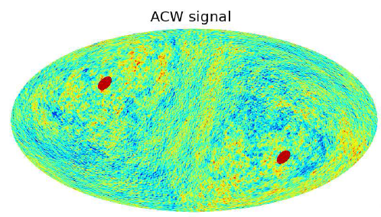
0-1.motivation of the study
Standard inflation theory
Primordial fluctuation: statistically homogeneous &isotropic …but is it really so in our Universe? Test it!
Statistical anisotropy (e.g. direction dependence of p.s.)
“tentative detection” in the CMB (Groeneboom et al, 2009)
Assuming above ”ACW signal” , WMAP5 temp. map (W band, L=2-400) is analyzed
Percent-level violation of statistical isotropy
has become an observational target!
Groeneboom et al, 2009
Inflationary model w/ anisotropy deserves to be considered

Slide 4
0-2.idea of anisotropic inflation
Introduce vector field
（& privileged direction）to inflation
Generate primordial fluctuation that is statistically anisotropic
problem
Vector field・・・ “rarefied” by expansion during inflation
e.g.)
Solution we propose
Consider coupling (function f) between vector field and scalar inflaton field
Is there any solution(initial condition, form of coupling function) in which the energy density doesn’t decay?
Then, how will the anisotropy in generated fluctuation become?
What can we expect as the characteristic signal in the CMB?

Slide 5
1-1.evolution of homogeneous background：setup
ansatz
“electric” component of vector field in the direction of x-axis (privileged direction)
anisotropic metric
“Maxwell” eq. is readily solved:
Energy density is given by

Slide 6
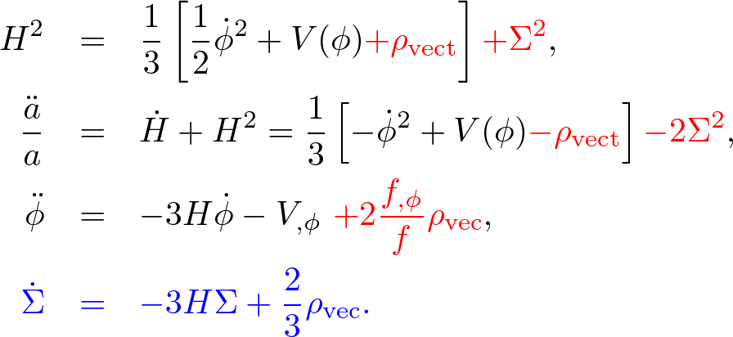
1-2.EoM and scaling solution
Basic eqs.
If Modifications are negligible(*) ⇒
as usual, then
balance
scaling solution:
*

Slide 7
1-3. tracking&scaling solution
extension: overcritical case
Energy density
Inflaton field
Slow-roll eq. can be modified
Vector field
Energy ratio has a contribution
opposite to potential gradiant
c=2
e-folding number
There exists scaling solution s.t.

Slide 8
2-1.Analysis of fluctuation: perturbation in anisotropic background
mode mixing
 | 2d-Scalar | 2d-Vector
3d-Scalar | curvature perturbation
3d-Vector | “//”linear polarization | “⊥” linear polarization
3d-Tensor | “+”gravitational wave(GW) | “×” graviational wave
in isotropic (FL) universe
5 d.o.f are decoupled
in this anisotropic universe,
2 and 3 d.o.f. are respectively coupled
3 modes
2 modes

Slide 9
2-2.perturbative analysis: setup
homogeneous background：assuming anisotropic inflation, and parameterize as:
slow-roll parameters:
density ratio (const. assumed):
Conformal time
EoM of curvature perturbation:
Θ: angle between k vector & x-axis
And for the others:

Slide 10
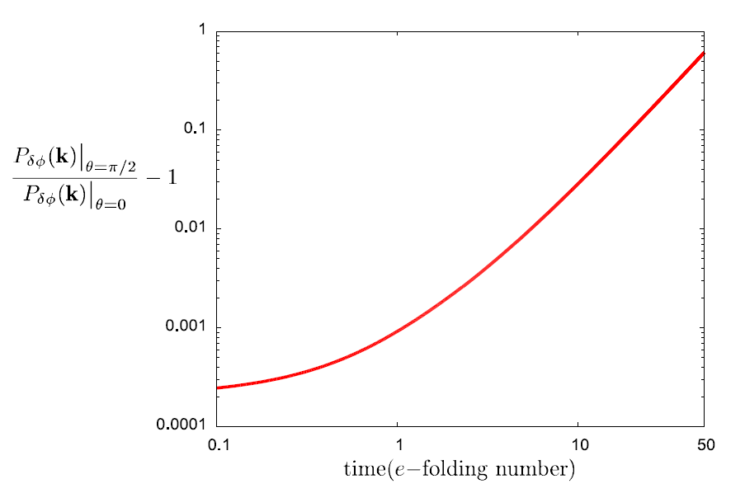
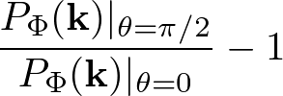
2-3.evaluation of anisotropy
evolution of direction dependence of curvature fluctuation
energy ratio: 10⁻⁷
:e-folding number from horizon exit to inflation end

Slide 11
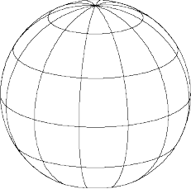
3-1. statistical anisotropy of primordial fluctuations
direction dependence of curvature power spectrum
direction dependence of GW p.s.
iii. cross correlation between curvature & + mode GW
iv. linear polarization of GW
Privileged direction
I:density ratio, N(k):e-folds, θ:angle between k & privileged direction
ε:slow-roll parameter of inflation
+ mode pol.

Slide 12
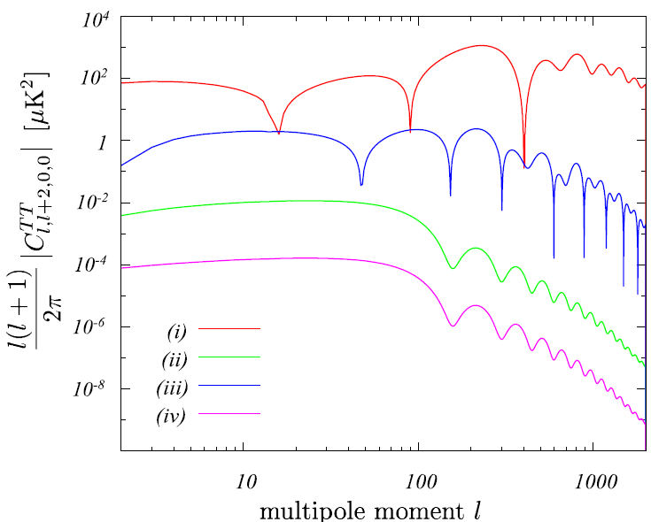
3-2.hierarchy of anisotropy: off-diagonal(l≠l’) TT spectrum
amplitude : set by observational upper bound (24IN² ~ 0.3 ), r~0.3
i.curvature (direction dependence)
iii.cross correlation
ii.GW(d. d.)
iv. linear polarization
multipole moment l

Slide 13
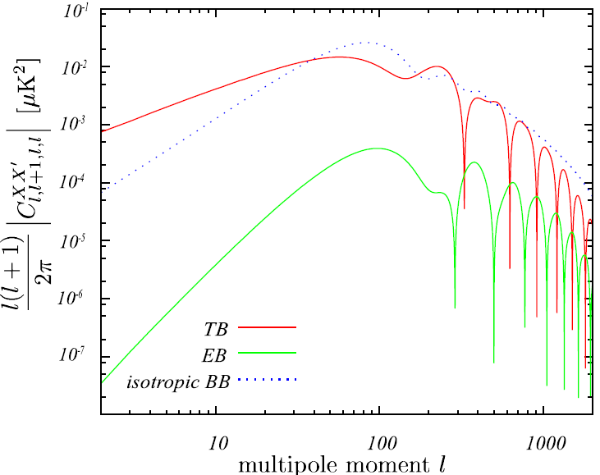
3-3. characteristic signal: off-diag TB/EB by (iii) cross correlation
Ref. of magnitude:
conventinal isotropic BB(C^{BB}_{l} ) induced by GW
TB
EB
multipole moment l
With most optimistic anisotropy, TB signal has amplitude comparable to conventional isotropic BB induced by GW (regardless of tensor-to-scalar ratio; both are O(ε))

Slide 14
Summary
introducing vector field that is coupled to inflaton, possibility of generation of statistical anisotropy in primordial fluctuation is studied
There exists scaling solution according to the form of coupling function
In that case, the generated fluctuation has statistical anisotropy set by energy of vector field & scale
There’s hierarchy in components of anisotropy:
direction dependence of curvature >> cross correlation >> d. d. of GW >> linear polarization of GW
If gravitational wave is to be found in CMB, off-diag TB by cross correlation may also be detectable.
Thank you for attention!

