Slide 1

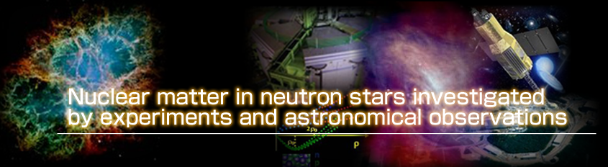
Probing W-Nucleon Interaction in Relativistic Heavy Ion Collisions
Kenji Morita
(YITP, Kyoto)
In Collaboration with
Akira Ohnishi (YITP) and Tetsuo Hatsuda (RIKEN)

Slide 2





Motivation
Baryon-Baryon Interaction incl. strangeness
  Exotic hadrons (non-qq, non-qqq)
  Possible hyperonic matter in a neutron star core
Inputs from theory
  Lattice QCD : physical point results coming soon?
  Hadronic EFT : low energy constants ?
u
?
s
s
d
u
d
Notes:
The motivation of this work is to probe baryon-baryon interactions, particularly those including strangeness degrees of freedom.
They are relevant for possible existence of exotic hadrons and dense matter in neutron star.
In these applications, baryon interactions are crucial inputs.
As Aoki san talked, recently lattice QCD becomes feasible to extract baryon-baryon interaction, but results at physical point are not yet available and hadronic effective theory needs experimental data to fix low-energy constants. This is not easy task for unstable hadrons.

Slide 3
NW channel : Dibaryon Candidate?
Goldman et al ‘87
No Pauli Blocking in NW (S=-3, J^{P}=2⁺, I=1/2)
S-wave (J=2) state may be stable
Lattice QCD : bound state in ⁵S₂ channel
  (HAL QCD Coll., ’14, Single channel calc.)
u
s
May form a compact bound state
u
d
s
s
8_{f}, 10_{f}-10_{f}:
8_{f}-8_{f} : D-wave – decay will be suppressed
How to prove N-W interaction experimentally?
Notes:
Here I would like to pick up

Slide 4
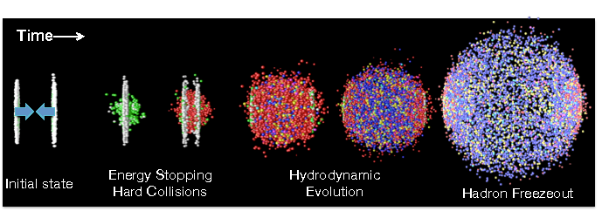
HIC as a Hyperon Factory
Pb+Pb 2.76ATeV@LHC
×10⁷ events
QGP : u,d,s
Deconfined
c symmetric
p
N
(60-80%)
(0-5%)
p
L
p
W
X
Enhanced pair creation of ssbar:
Particularly useful for multistrangeness particles
p
p
N
p
p
Particle yields : equilibrium
Rare particles also produced
p
p
Hadronization
(ex. antihypertriton@ALICE)
~5-10 fm/c, ~160MeV
time

Slide 5
Particle Correlation in HIC
(Relative momentum)
C
p
N
p
k_{A}
L
D
p
W
X
Uncorrelated
p
p
Interaction
Interference (HBT)
etc
N
p
p
p
k_{B}
p
Hadronization
B
Hadronization
~5-10 fm/c, ~160MeV
time

Slide 6
Formulation
Formula (Gong et al., ‘91)
Relative Wave Func.
Source function (phase space distribution)
|S| > 1 : Mostly from phase boundary
W
p
p
Zhu et al., Takeuchi et al., ‘15
N
Thermal freeze-out
Decay contribution
N
N
S
L
EM decay (not subtracted)
Weak decay (can be subtracted)
T_{c}
p

Slide 7
NW Interaction (⁵S₂) Potential
Lattice data (HAL QCD ‘14): heavy N, W – extrapolation to m_{phys}
100
“Loosely bound”
“Tightly bound” (Fix a₀ , r_{eff})
“Not bound”
0
-100
-200
HAL QCD data
-300
V(r) [MeV]
-400
V
HAL
"loosely bound"
-500
V
TB
, "tightly bound"
-600
V
NB
, "not bound"
-700
Coulomb
-800
0
0.2
0.4
0.6
0.8
1
1.2
1.4
1.6
r [fm]

Slide 8
Wave Function
Assumption : only S-wave is modified
V from lattice QCD
w/ Coulomb
w/o Coulomb
S-wave scattering w.f.
Coulomb interaction : a_{bohr} = 45 fm and m = 601 MeV

Slide 9
Wave Function
Assumption : only S-wave is modified
Decay into 8_{f}-8_{f} S-wave : Coupled channel problem
Assuming absorption
w/ Coulomb
w/o Coulomb
S-wave scattering w.f. with absorption
r₀ is taken to be 2 fm
Coulomb interaction : a_{bohr} = 45 fm and m = 601 MeV

Slide 10
nW Correlation (w/o Coulomb)
Source : Spherically symmetric Gaussian
2
ρ
=3 fm, Loosely Bound
2
ρ
=3 fm, Loosely Bound
1.8
Tightly Bound
1.8
Tightly Bound
Not Bound
Not Bound
1.6
ρ
=7 fm, Loosely Bound
1.6
ρ
=7 fm, Loosely Bound
Tightly Bound
Tightly Bound
1.4
Not Bound
1.4
Not Bound
C(Q)
1.2
Static Gaussian Source
C(Q)
1.2
Static Gaussian Source
1
1
0.8
0.8
0.6
0.6
+Absorption
0.4
0.4
0
20
40
60
80
100
120
140
0
20
40
60
80
100
120
140
Q=|m
N
k
Ω
-m
Ω
k
N
|/M [MeV/c]
Q=|m
N
k
Ω
-m
Ω
k
N
|/M [MeV/c]
Clear interaction dependence / Absorption modifies low Q behavior

Slide 11
pW Correlation (w/ Coulomb)
2
ρ
=3 fm, Loosely Bound
2
ρ
=3 fm, Loosely Bound
1.8
Tightly Bound
Tightly Bound
Not Bound
1.8
Not Bound
ρ
=7 fm, Loosely Bound
ρ
=7 fm, Loosely Bound
1.6
Tightly Bound
1.6
Tightly Bound
Not Bound
Not Bound
1.4
1.4
C(Q)
C(Q)
1.2
Static Gaussian Source
1.2
Static Gaussian Source
1
1
0.8
0.8
+Absorption
0.6
0.6
0
20
40
60
80
100
120
140
0
20
40
60
80
100
120
140
Q=|m
N
k
Ω
-m
Ω
k
N
|/M [MeV/c]
Q=|m
N
k
Ω
-m
Ω
k
N
|/M [MeV/c]
Coulomb interaction dominates low Q behavior
Less affected by absorption
Stronger correlation for small source size : size dependence ?

Slide 12
Looking at Source Size Dependence
Coulomb dominated
p
p
Strong int. dominated
p
p
Large source : Coulomb dominant in charged pairs
Relatively small influences from strong int.
W
p
p
p
Comparison may inform the interaction
p
Smaller source : stronger effect of strong interaction
Substantial modification even in charged pairs
W
p
p

Slide 13
Small-Large Correlation Function Ratio
No Coulomb
No Absorption
Coulomb
Absorption
+
Loose : Enhancement at low Q
Tight : C(Q) < 1
No Bound : Slightly above 1
Same tendency remains

Slide 14
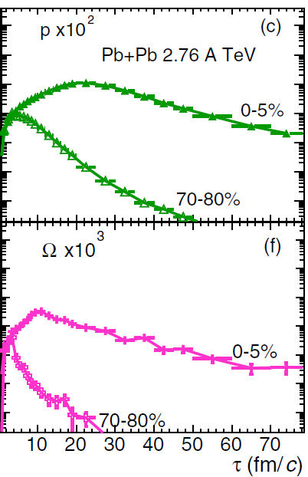
Expanding Source
Hybrid model calculations : different freeze-out btw. p and W
(Zhu et al., Takeuchi et al., ’15)
1d Boost-Invariant Source Model
(VISHNU+UrQMD,
Zhu et al.,PRC’15)
Non-significant difference from Static source : lack of HBT
Relative source function only

Slide 15
Concluding Remarks
HIC : enhanced strangeness production
B-B Interaction from Correlation Measurements
  cf. p-p and L-L @STAR
NW may have a bound state (from Lattice QCD)
Effect of strong interaction : source size dependent
Ratio of C(Q) : Small / Large system
Complementary to bound state searches
Loose : Enhancement at low Q
Tight : C(Q) < 1
No Bound : Slightly above 1
(for attracting potentials)

Slide 16
Backup

Slide 17
Explanation : wave function
≫ 0
> 0
< 0
5
V
HAL
Suppressed by Source function
V
TB
V
NB
4
Contribute to C(Q)
Free
Q=31MeV
3
(r)|
χ
Q
|
2
1
0
0
2
4
6
8
10
r [fm]

Slide 18
Explanation : wave function
≫ 0
> 0
60
< 0
ρ=3
fm, V
HAL
]
w/ Coulomb
V
2
V
TB
[fm
40
ρ=7
NB
fm, V
HAL
2
V
ρ
TB
/2
20
V
2
NB
-r
(r)) e
0
0,Q
2
χ
(r)-
-20
2
Q
χ
(
2
r
-40
Q=11MeV
-60
0
5
10
15
20
r [fm]

Slide 19
Source Size Dependence
20
Coulomb
3
,
ρ
=1 fm
20
3
ρ
S
1
Coulomb
S
1
,
=1 fm
ρ
=3 fm
ρ
=3 fm
ρ
=5 fm
ρ
=5 fm
15
ρ
=7 fm
15
Absorbed
3
S
1
,
ρ
=1 fm
Absorbed
3
S
1
,
ρ
=1 fm
ρ
=3 fm
ρ
=3 fm
=7fm
ρ
=5 fm
ρ
=5 fm
ρ
C(Q)
10
ρ
=7 fm
10
V=V
+V
, m=m
C(Q)/C(Q)|
HAL
coul
phys
V=V
HAL
+V
coul
, m=m
phys
5
(Loosely Bound)
5
(Loosely Bound)
0
0
0
50
100
150
200
0
50
100
150
200
Q=|m
p
k
Ω
-m
Ω
k
p
|/M [MeV/c]
Q=|m
p
k
Ω
-m
Ω
k
p
|/M [MeV/c]

Slide 20
Source Size Dependence
2
Coulomb
,
ρ
=1 fm
3
ρ
3
Coulomb
S
1
,
=1 fm
1.4
S
1
ρ
=3 fm
1.8
ρ
=3 fm
ρ
=5 fm
1.6
ρ
=5 fm
Absorbed
3
S
1
,
ρ
=1 fm
ρ
=7 fm
1.2
ρ
=3 fm
3
ρ
ρ
=5 fm
1.4
Absorbed
S
1
,
=1 fm
=7fm
ρ
=3 fm
ρ
1
1.2
ρ
=5 fm
C(Q)
ρ
=7 fm
1
C(Q)/C(Q)|
0.8
0.8
0.6
0.6
V=V
+V
0.4
V=V
TB
+V
coul
0.4
TB
coul
0.2
(Tightly Bound)
0.2
(Tightly Bound)
0
50
100
150
200
0
50
100
150
200
Q=|m
p
k
Ω
-m
Ω
k
p
|/M [MeV/c]
Q=|m
p
k
Ω
-m
Ω
k
p
|/M [MeV/c]

Slide 21
Source Size Dependence
2
2
3
ρ
Free
3
,
ρ
=1 fm
Coulomb
S
1
,
=1 fm
S
1
ρ
=3 fm
ρ
=3 fm
1.8
ρ
=5 fm
1.8
ρ
=5 fm
ρ
=7 fm
Absorbed
3
S
1
,
ρ
=1 fm
3
ρ
ρ
=3 fm
1.6
Absorbed
S
1
,
=1 fm
=7fm
1.6
ρ
=3 fm
ρ
ρ
=5 fm
ρ
=5 fm
V=V
+V
C(Q)
1.4
ρ
=7 fm
1.4
nobs
coul
V=V
+V
C(Q)/C(Q)|
(Not Bound)
nobs
coul
1.2
(Not Bound)
1.2
1
1
0.8
0.8
0
50
100
150
200
0
50
100
150
200
Q=|m
p
k
Ω
-m
Ω
k
p
|/M [MeV/c]
Q=|m
p
k
Ω
-m
Ω
k
p
|/M [MeV/c]

