Slide 1
YN and YY Interactions from Heavy Ion Collisions
Kenji Morita (YITP, Kyoto)
Ref: KM, T.Furumoto, A.Ohnishi, PRC91, 024916 (‘15)
KM, A.Ohnishi, F.Etminan, T.Hatsuda, PRC94, 031901(R) (‘16)
A. Ohnishi, KM, K.Miyahara, T.Hyodo, NPA954, 294 (‘16)
EXHIC Collaboration, to appear in PPNP, arXiv:1702.00486
T.Hatsuda, KM, A.Ohnishi, K.Sasaki, to appear in NPA (QM’17) / 1704.05225.

Slide 2
Outline
Introduction
Pair Momentum Correlation in HIC
  Final State Interaction
  Quantum Statistics (a.k.a. HBT/GGLP effect)
Applications : Dibaryon Candidates
  ΛΛ correlation
  pΩ correlation
  pΞ correlation
Concluding Remarks

Slide 3



Hadron-Hadron Interaction
u
?
s
u
d
s
s
Testing Ground for QCD at Low Energy
  Foundation of Nuclear Physics
  Baseline for many-body physics
    Exotic hadrons / finite T, ρ
Chiral Symmetry
Confinement
H-Dibaryon
NΩ Dibaryon
Λ(1405)etc
Heavy Ion Collisions
Compact Stars
Hypernuclei

Slide 4
How HIC Can Tell Us Interaction?
HIC at Relativistic Energies@RHIC, LHC
Production of Quark-Gluon Plasma
Crossover Transition Into Hadron Particle Abundance – Thermal Eq.
Incl. Rare Particles
Measuring Pair Correlation
→Constrain Pairwise Interaction
No Correlation
Interaction
Interference etc

Slide 5
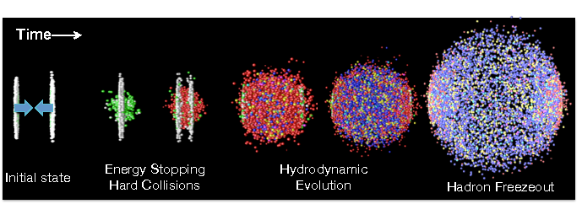
Heavy Ion Collisions as Hyperon Factory
Pb+Pb 2.76ATeV@LHC
×10⁷ events
QGP : u,d,s
Deconfined
Chirally symmetric
π
N
(60-80%)
(0-5%)
π
Λ
π
Ω
Ξ
Enhanced pair creation of s-quarks
π
K
N
π
p
K
π
Hadronization
Hadronization
~5-10 fm/c, ~160MeV
time

Slide 6
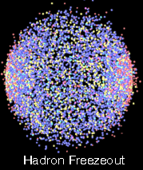

Counting Correlated Pairs
Freeze-out:
  Independent (chaotic) production from thermal source : $S_{A}(x_{1},k_{1})S_{B}(x_{2},k_{2})$
  dilute after FO - pairwise interaction only
  State of pairs – evaluated in the pair-rest frame * $k_{1}+k_{2}=0$
  Scattering w.f. $ψ(Q^{∗},r^{∗})$

Slide 7
Counting Correlated Pairs
Distant pairs:
  Uncorrelated because
  Distance < int. range
  (~ System size)

Slide 8

Counting Correlated Pairs
Close pairs:
  Correlated through FSI
  Distance < int. range
  FSI : $ψ(Q^{∗},r^{∗})$
  Input from V(r)
  (phenomenological / Lattice)

Slide 9

Counting Correlated Pairs
Close but large Q pairs:
  Correlated through FSI
  Distance < int. range
  Oscillating $|ψ\left(Q^{∗},r^{∗}\right)|^{2}$ washes out correlation

Slide 10

Counting Correlated Pairs
Close and small Q pairs:
  Correlated through FSI
  Distance < int. range
  $|ψ\left(Q^{∗},r^{∗}\right)|^{2}$ leads enhance or reduction of # of pairs

Slide 11
System Size?
Small System:
  Most of observed pairs with small Q correlated
Large System:
  Less pairs coming from close distance
Important Remark:
  Coulomb FSI for charged pairs!
Conclusion : measure small Q pairs coming from small region!

Slide 12
Effect of Collectivity
Collective Expansion:
  More particles produced along the expanding direction
  Emission region deformed to smaller one
  Faster pairs more concentrated

Slide 13
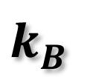
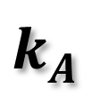
Quantum Statistics (HBT/GGLP)
Random Emission + Symmetrization
$$k_{A}^{}$$
Indistinguishable!
$$k_{B}^{}$$
2
Symmetric
1.5
~1/R
R=5 fm
C(Q)
1
0.5
Anti-symmetric
Q [MeV]
0
0
20
40
60
80
100
120
140
Fourier tr. of the emission func.

Slide 14
ΛΛ: Interacting Identical Fermion
Quantum Statistics:
  Symmetric – 1/4 enhance
  Asymmetric – 3/4 reduction
R=2fm, V
]
60
V
I
2
Unitary regime
V
II
) [fm
III
2
(r)|
40
Q=20MeV
0
-|j
2
(r)|
20
sc
Weak attraction
χ
2
(|
/4R
0
2
-r
e
2
Bound state
r
-20
0
2
4
6
8
10
r [fm]

Slide 15
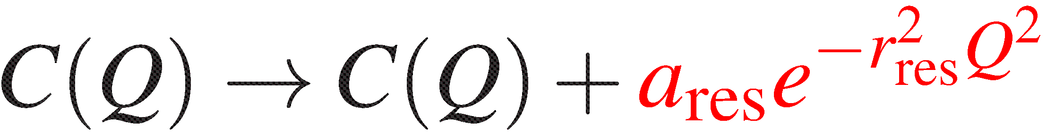
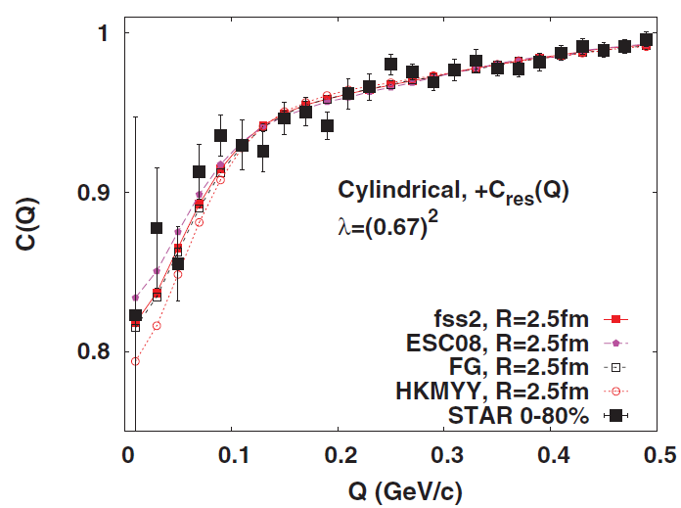
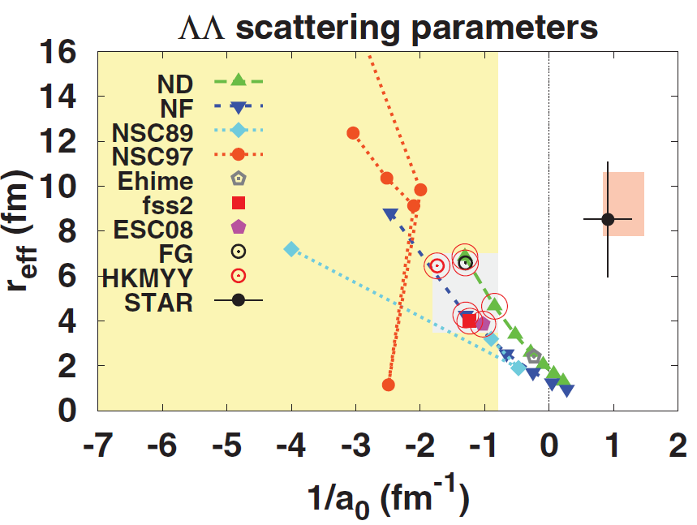

Comparison with STAR data (RHIC)
Expansion
Σ⁰ decay
1/a₀ < -0.8 [fm⁻¹]
No constraint on r_{eff}
Mapping onto scattering param.
2
Long tail in data – 2 components structure? Weakly attracting potential can fit data (Consistent w/ Nagara event)

Slide 16
NΩ potential (⁵S₂) : motivated by LQCD
0
Pot | a₀ [fm] | r_{eff} [fm] | E_{B} [MeV]
V_{I} | -1.0 | 1.15 | N/A
V_{II} | 23.1 | 0.95 | 0.05
V_{III} | 1.6 | 0.65 | 24.80
w/Coulomb
V_{I}+V_{c} | -1.12 | 1.16 | N/A
V_{II}+V_{c} | 5.79 | 0.96 | 6.3
V_{III}+V_{c} | 1.29 | 0.65 | 26.9
-200
V(r) [MeV]
HAL QCD data
-400
Increasing b₅→
V
I
Fit to data→
V
II
-600
Decreasing b₅→
V
III
Coulomb
-800
0
0.2
0.4
0.6
0.8
1
1.2
1.4
1.6
!
r [fm]
Caveat : data obtained from heavy quark mass (Etminan+ ‘14)
Following calculations use the physical baryon masses

Slide 17
pΩ Correlation : Strong int. Only
2.5
Static Source
Solid:
5
S
only
V
2
II
5
3
R
p
=R
=2.5fm
Dashed:
S
+
S
2
Ω
2
1
Weakly attractive：C(Q) > 1
Close to unitary limit：C(Q) >> 1
Bound state：C(Q) < 1
1.5
V
C(Q)
I
1
0.5
V
³S₁ Absorption : not significant
III
0
20
40
60
80
100
120
140
Q=|m
k
-m
k
|/M [MeV/c]
p
Ω
Ω
p

Slide 18
C(Q) vs Scattering Length
Strong Variation near Unitary Limit
7
5
Q=20MeV,
S
only
2
V
6
5
S
3
II
2
+
S
1
Static source
5
Q=40MeV,
S
only
5
2
5
S
3
No Coulomb
2
+
S
1
4
5
R
=R
=2.5fm
Q=60MeV,
S
only
p
Ω
C(Q)
2
5
S
3
2
+
S
3
1
V
I
2
V
III
1
0
-1.5
-1
-0.5
0
0.5
1
1/a
-1
[fm
]
0

Slide 19
Small-Large Ratio C_{SL}(Q)
Taking ratio of C(Q) for small and large systems
Resemble the ideal case
Even with expansion
Coulomb!

Slide 20
pΞ⁻ Correlation at Physical Point
Potential from HAL QCD
(parametrized by Gauss+Yukawa)
Notable enhancement by FSI

Slide 21
Concluding Remarks
Correlation measurement in HIC can constrain low energy scattering param.
  New opportunity for multistrange systems
  Useful technique : Comparing small and large systems via C_{SL}(Q)
ΛΛ : weakly attractive
  Feed-down effects needs to be considered
pΩ : Exp. Data coming soon!
pΞ : unitary regime ¹S₀ – notable enhancement should be observed

Slide 22
Backup

Slide 23

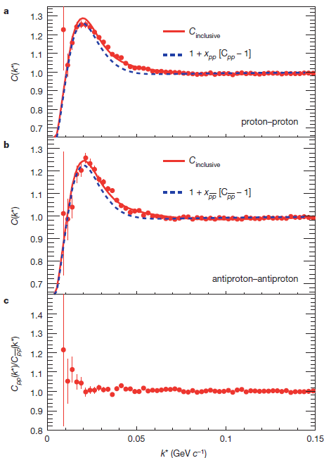
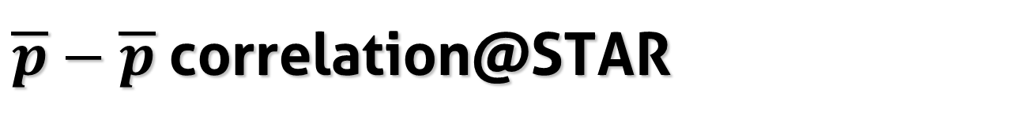
$\overline{p}−\overline{p}$correlation@STAR
Nature 527, 345 (‘15)
Attractive FSI
=r_{eff}
Coulomb + HBT (Fermion)
=－a₀

Slide 24
Spin-2 NΩ Dibaryon?
S=-3 States
No Pauli Blocking
Σ⁺*Ξ⁻*
u
s
Σ⁰*Ξ⁰*
u
d
s
s
Σ⁰Ξ⁰*~Σ⁺Ξ⁻*
Σ⁻*Ξ⁺
Σ⁰*Ξ⁰
(Goldman+ ‘87)
ΛΞ⁰*
NΩ
Spin-2 : D-wave only - suppressed
Spin-1 : Strongly Coupled
ΣΞ
ΛΞ
8_{f}-10_{f}, 10_{f}-10_{f}
8_{f}-8_{f}
Lattice QCD : NΩ bound state at heavy π mass (HAL QCD)
(Etminan+ ‘14)

Slide 25

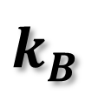
Theoretical Description
Random Emission + Final State Int.
$$k_{A}^{}$$
Single-particle Distribution
$$k_{B}^{}$$
Small Q
(# of pair) = integration of (emission probability x weight factor)
Random emission : no correlation btw. emission probability of A and B
Scattering wave function (← Schrödinger eq.)
  FSI and symmetrization (for identical pairs)
  ~ Equal-time Bethe-Salpeter amplitude in the pair rest frame*
Lednicky+,’82

Slide 26
Final State Interaction
$$k_{A}^{}$$
Single-particle Distribution
$$k_{B}^{}$$
For simplicity, spherical and static thermal source is considered.
Small Q － Low energy scattering → S-wave dominant
Replacing S-wave component of the wave func.
Asymptotic form

Slide 27
Koonin-Pratt Formula
In pair-rest frame
Relative emission function : emission probability for pairs with distance r

Slide 28
Correlation vs Wave function: Interaction
Static/Spherical Source
R=2fm, V
V_{I} : Weak attraction
V_{II}: Stronger attraction
(close to unitary limit）
V_{III}: Strong attraction
（w/ bound state）
]
60
V
I
2
II
) [fm
V
III
2
(r)|
40
0
Q=20MeV
-|j
2
(r)|
sc
20
χ
(|
2
/4R
2
0
-r
e
2
r
-20
0
2
4
6
8
10
r [fm]

Slide 29
Correlation vs Wave function: Q
Static/Spherical Source
2
R=2fm, V
V_{I} : Weak attraction
V_{II}: Stronger attraction
(close to unitary limit）
V_{III}: Strong attraction
（w/ bound state）
]
I
2
V
V
II
) [fm
Q=200MeV
III
2
1
(r)|
0
-|j
2
(r)|
0
sc
χ
(|
2
/4R
-1
2
Difference in Small Q
-r
e
2
r
-2
0
2
4
6
8
10
r [fm]

Slide 30
Correlation vs Wave function: Size
Static/Spherical Source
]
9
-1
R=2fm, V
Large R: outside int. range
→determined by a₀, r_{eff}
(Lednicky+’82)
C(Q) ~ 1/R³
[fm
II
8
3
R=5fm, V
)/R
7
II
2
6
(r)|
Q=20MeV
0
5
-| j
2
4
(r)|
sc
3
χ
(|
2
2
Difference in Small Q
→ Enhanced in Small R
/4R
1
2
-r
e
0
2
r
j
0
-1
0
5
10
15
20
r [fm]

Slide 31
Coulomb Interaction
=45fm
Coulomb int. dominates C(Q) near Q～0

Slide 32
Expanding System : no difference
1-dim Boost-invariant expansion
LHC Pb+Pb 2.76AGeV
Central : τ_{p} = 20 fm/c, τ_{Ω} = 10 fm/c
T_{p} = 120 MeV, T_{Ω} = 164 MeV
R_{p} = R_{Ω} = 5fm
k_{t} = 1.25 GeV ( = <k_{t}>)
Peripheral : τ_{p} = 3 fm/c, τ_{Ω} = 2 fm/c
T_{p} = T_{Ω} = 164 MeV
R_{p} = R_{Ω} = 2.5fm
k_{t} = 1 GeV (= <k_{t}>)

Slide 33
Outlook
RHIC/LHC may infer possible existence of dibaryons
  NΩ / NΞ : Already measured, analyses ongoing
J-PARC HI : more Λ w/ less feed-down
Applicable to various pairs
  Heavier particle needs more statistics
  Ex. <N_{Ω}> ~ 0.6 (0-10%)→ P(N_{Ω} ≧2) ~ 0.12

Slide 34
Role of ΛΛ Interaction
“H” (Jaffe ‘77)
  B=2, S=-2, J^{P}=0⁺, I=0
  Lattice QCD (HAL QCD, NPLQCD)
    Bound “H” in SU(3)_{f} limit
    Physical point : shallow bound NΞ?
  Deep “H” ruled out by double hypernuclei
(2231)
(2386)
(2259)
would be ΛΛ bound state if strong attraction btw ΛΛ
No quark Pauli blocking

Slide 35
Role of ΛΛ Interaction
“Hyperon Puzzle” in Neutron Star
ΛN : constrained by hypernuclei
Repulsive at high density?
3-body interaction?

Slide 36
How to disentangle Coulomb / Strong?
Coulomb dominated
p
p
Strong int. dominated
p
p
Large R : many pairs are from long-distance - Coulomb-dominated
Ω
p
p
p
Difference informs about Strong int.
p
Small R : most of pairs are from short-distance - Strong-int. dominated
Ω
p
p

Slide 37
NΩ Final State Interaction
Ω
k_{Ω}
p
k_{p}
Ξ
Λ, Σ
Wave func. : modification in S-wave
Coupled to ΛΞ (2430) and ΣΞ(2507)
Calculating from V(r)
³S₁：Absorption of S-wave component
⁵S₂ interaction
Taken from Lattice
(HAL QCD)

Slide 38
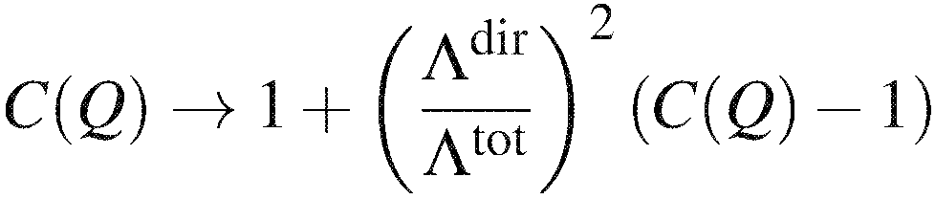
Feed-Down Contribution
Short-lived (Σ*, N* etc) : absorbed into R
Ξ →Λ+π : (partly) subtracted
Σ⁰→Λ+γ
Σ⁰/Λ =0.278 (p+Be data), Ξ/Λ = 0.15 (RHIC)→ Λ^{dir}/Λ^{tot} = 0.67
Λ
(0.67)²
Λ
modification of R
(0.52 if including Ξ)
R≫1/Q
- Uncorrelated
cannot be resolved
Λ
Counted

