Slide 1
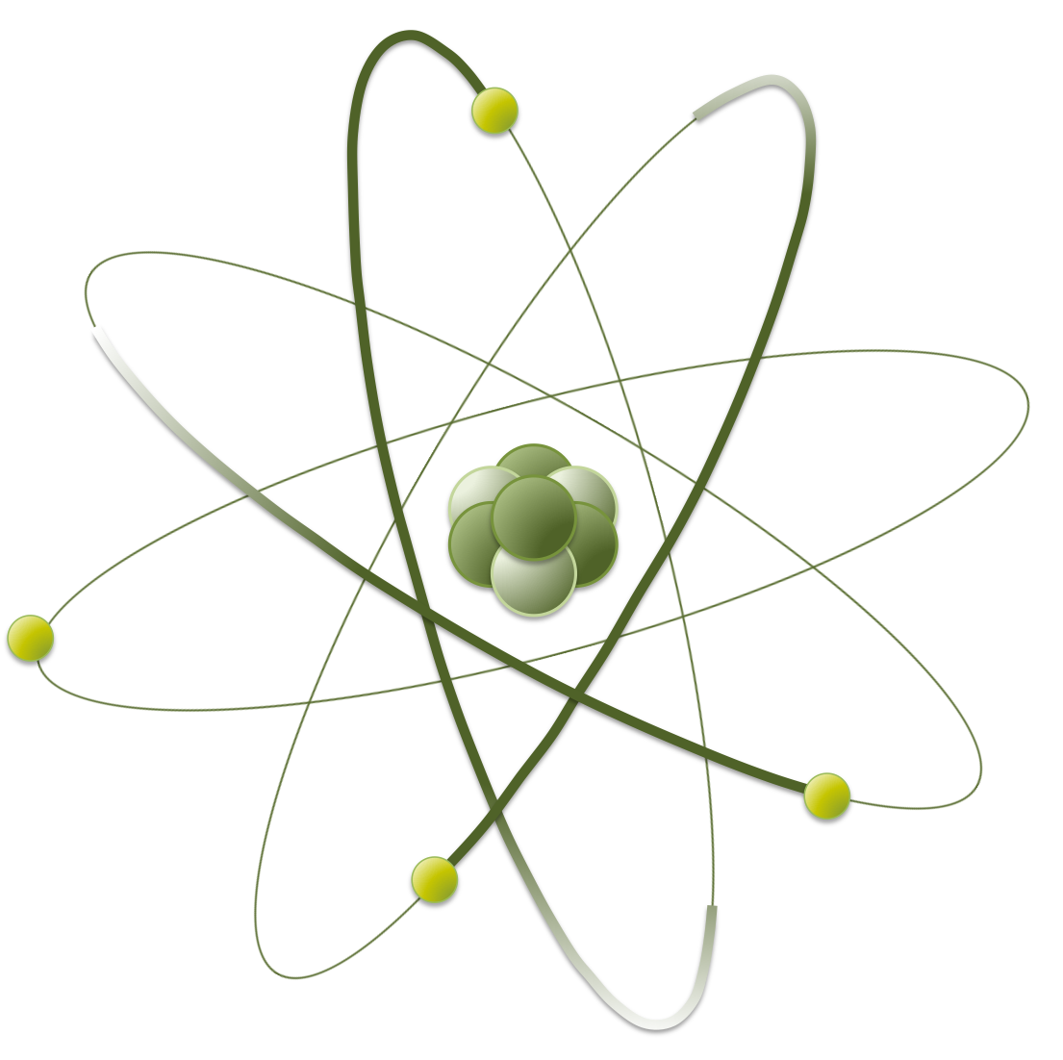
z
Spectral function for excited anti- meson in nuclear matter with partial restoration of chiral symmetry
Nagoya Univ.
Daiki Suenaga
Masayasu Harada
Shigehiro Yasui
In collaboration with

Slide 2
Contents
1. Introduction
- Chiral symmetry
- Chiral partner structure for mesons
- Main motivation of our study
2. Model construction
- Heavy Meson Effective Theory
3. Calculations and results
4. Conclusions

Slide 3
Contents
1. Introduction
- Chiral symmetry
- Chiral partner structure for mesons
- Main motivation of our study
2. Model construction
- Heavy Meson Effective Theory
3. Calculations and results
4. Conclusions

Slide 4
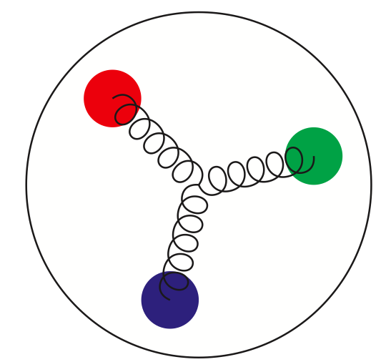
1. Introduction I
・The nature of QCD
＝
nucleon
bound state of three quarks
(bound by QCD dynamics)
- QCD is not perturbative in low energy region
- We cannot solve QCD by hand !
( big problem !)

Slide 5
1. Introduction
・Nucleons and chiral symmetry
- Nucleon is composed of three valence quarks, however . . .
three quarks
a nucleon
- There is a quite large mass gap between a nucleon and a quark
- How can we explain ?

Slide 6
1. Introduction
・Nucleons and chiral symmetry
- Nucleon is composed of three valence quarks
three quarks
a nucleon
- Quark is (approximately) regarded as a massless particle
- QCD has the chiral symmetry (approximately)

Slide 7
1. Introduction
・Nucleons and chiral symmetry
- Nucleon is composed of three valence quarks
three quarks
a nucleon
- It is natural to explain the mass of nucleon by the
spontaneous breakdown of chiral symmetry

Slide 8
1. Introduction
・The origin of mass of nucleons
- I explained nucleon mass is generated by the spontaneous
breakdown of chiral symmetry
M. Gell-Mann and M. Levy, Nuovo Cim. 16. 705 (1960)
J. S. Schwinger, Annals Phys. 2. 407 (1957)

Slide 9
1. Introduction
・The origin of mass of nucleons
- I explained nucleon mass is generated by the spontaneous
breakdown of chiral symmetry
M. Gell-Mann and M. Levy, Nuovo Cim. 16. 705 (1960)
J. S. Schwinger, Annals Phys. 2. 407 (1957)
However . . .
- It is possible to explain that nucleon mass is originated from
chiral symmetry breaking partially
C. E. DeTar and T. Kunihiro, Phys. Rev. D 39, 2805 (1989)
D. Jido, M. Oka, and A. Hosaka, PTP 106, 873 (2001)

Slide 10
1. Introduction
・The origin of mass of nucleons
- The value of is not understood well...
How much ?
- We need to change the environment to get clues to
answer this question
(eg. temperature, density, etc)

Slide 11
1. Introduction
・The origin of mass of nucleons
- The value of is not understood well...
How much ?
- We need to change the environment to get clues to
answer this question
(eg. temperature, density, etc)

Slide 12
1. Introduction
・Chiral symmetry at density
- Chiral condensate can decrease at density
decreasing
decreasing
・・・
T. D. Cohen, R. J. Furnstahl, D. K.
Griegel, PRC. 45. 1881 (1992)
M.C. Birse, J.Phys. Nucl. Part.
Phys. 20. 1537 (1994)

Slide 13
1. Introduction
・Chiral symmetry at density
- Chiral condensate can decrease at density
decreasing
decreasing
・・・
- chiral symmetry is expected to be partially
restored in nuclear matter

Slide 14
1. Introduction
・How can we explore chiral sym in medium ?
- mesons can be good probes because…
quark
mesons
- expansion is applicable
(Heavy quark spin symmetry)
quarks
- We can extract the information of
chiral symmetry

Slide 15
1. Introduction
・Meson mass spectral
mass
・
・
・
・

Slide 16
1. Introduction
・Chiral partner structure
mass
・
・
・
・
Chiral partner structure
mass difference between opposite parity state
comes from chiral symmetry breaking

Slide 17
1. Introduction
・Chiral partner structure
mass
・
・
・
・
M. A. Nowak, M. Rho, and I. Zahed, PRD 48 (1993)
W. A. Bardeen and C. T. Hill, PRD 49 (1994).
Chiral partner structure
mass difference between opposite parity state
comes from chiral symmetry breaking

Slide 18
1. Introduction
・At chiral restored point
mass
・
・
・
・
M. A. Nowak, M. Rho, and I. Zahed, PRD 48 (1993)
W. A. Bardeen and C. T. Hill, PRD 49 (1994).
Chiral partner structure
mass difference between opposite parity state
comes from chiral symmetry breaking

Slide 19
1. Introduction
Mass change of mesons in medium includes
information of chiral symmetry

Slide 20
1. Introduction
Mass change of mesons in medium includes
information of chiral symmetry
However . . .
Mass of mesons in medium ?
How can we observe it ?
Is it possible ...?

Slide 21
1. Introduction
・Decay of in vacuum
- meson can easily decay into meson
by emitting a pion in the vacuum
mass
decay
◎
vacuum

Slide 22
1. Introduction
・Decay of at lower density
- Chiral symmetry is expected to be partially restored
in the nuclear matter
mass
decay
but weakened
○
vacuum
in medium

Slide 23
1. Introduction
・Decay of at higher density
- Chiral symmetry is expected to be partially restored
in the nuclear matter
mass
×
decay
×
if
vacuum
in medium

Slide 24
1. Introduction
・What should we calculate ?
- It is worth calculating spectral function for meson
because . . .
(I) The shape of spectral function reflects the imaginary
part from decay of
(II) The spectral function includes information of off-shell
and reads the decay rate, cross section, and so on . . .

Slide 25
1. Introduction
We calculate mass of and mesons
and also spectral function for meson

Slide 26
Contents
1. Introduction
- Chiral symmetry
- Chiral partner structure for mesons
- Main motivation of our study
2. Model construction
- Heavy Meson Effective Theory
3. Calculations and results
4. Conclusions

Slide 27
2. Model construction
・Heavy meson effective Lagrangian
- Lagrangian should be invariant under the . . .
(I) chiral symmetry
(II) heavy quark spin symmetry
(III) parity

Slide 28
2. Model construction
・Heavy meson effective Lagrangian
- Lagrangian should be invariant under the . . .
(I) chiral symmetry
(II) heavy quark spin symmetry
(III) parity

Slide 29
2. Model construction
・Heavy meson effective Lagrangian
- Lagrangian should be invariant under the . . .
(I) chiral symmetry
(II) heavy quark spin symmetry
(III) parity
( ``heavy quark spin’’ is conserved )

Slide 30
2. Model construction
・Heavy meson effective Lagrangian
- Lagrangian should be invariant under the . . .
(I) chiral symmetry
(II) heavy quark spin symmetry
(III) parity

Slide 31
2. Model construction
・Heavy meson effective Lagrangian
- Lagrangian reads

Slide 32
2. Model construction
・How can we introduce matter effect ?
- Nuclear matter is constructed by the linear sigma model
with nucleon one loop
with
- The effective potential with a uniform
is obtained
- Gap equation determines density dependence of

Slide 33
2. Model construction
・How can we introduce matter effect ?
- Nuclear matter is constructed by the linear sigma model
with nucleon one loop
with
- The second functional derivative yields
the two-point function of fields

Slide 34
Contents
1. Introduction
- Chiral symmetry
- Chiral partner structure for mesons
- Main motivation of our study
2. Model construction
- Heavy Meson Effective Theory
3. Calculations and results
4. Conclusions

Slide 35
3. Calculations and results
・Self energy of meson
- We calculate (mean field ) + ( one loops)
×
(mean field)

Slide 36
3. Calculations and results
・Self energy of meson
- We calculate (mean field ) + ( one loops)
×
(mean field)
(Hartree-type one loop)

Slide 37
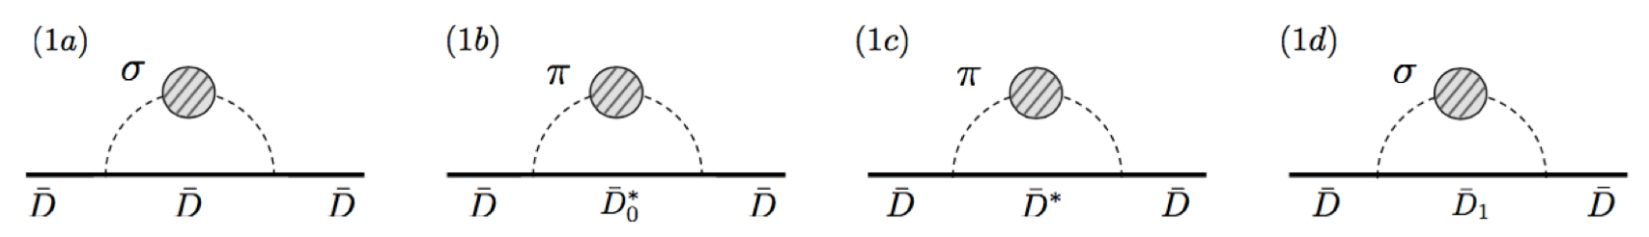
3. Calculations and results
・Self energy of meson
- We calculate (mean field ) + ( one loops)
×
(mean field)
(Hartree-type one loop)
(Fock-type one loop)

Slide 38
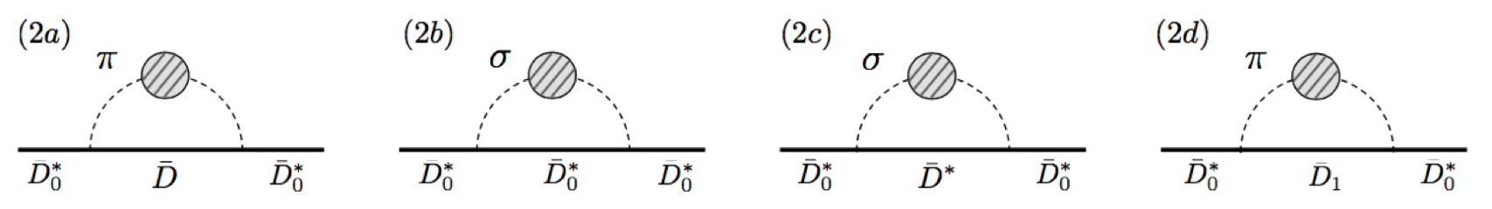
3. Calculations and results
・Self energy of meson
- We calculate (mean field ) + ( one loops)
×
(mean field)
(Hartree-type one loop)
(Fock-type one loop)

Slide 39
3. Calculations and results
・Masses of meson and meson
- Density dependence of masses
: mass with mean field
: mass with all one loops
: mass with mean field
: mass with all one loops
- Mean field contributions are dominant
- Mass difference gets small as density increases
- Reflects the partial restoration of chiral symmetry

Slide 40
3. Calculations and results
・Masses of meson and meson
- Density dependence of mass difference
: with mean field
: with all one loops
- Mean field contributions are dominant
- Mass difference gets small as density increases
- Reflects the partial restoration of chiral symmetry

Slide 41
3. Calculations and results
・Spectral function for channel
- Spectral function at several densities
- Dashed curve is the spectral function in vacuum
- Vertical dotted line is threshold of with mean field level
- We find three peaks

Slide 42
3. Calculations and results
・Spectral function for channel
- Spectral function at several densities
- The first peak from right corresponds to
the decay process of
- As density increases, this peak shifts to
left, and gets broadened (collisional broadening)

Slide 43
3. Calculations and results
・Spectral function for channel
- Spectral function at several densities
- The second peak from right corresponds to
the threshold enhancement
- As density increases, this peak shifts to right and
gets remarkably enhanced (can be a good probe？)

Slide 44
3. Calculations and results
・Spectral function for channel
- Spectral function at several densities
- The third peak from right corresponds to
the scattering process of
- As density increases, the peak shifts to right
and grows gradually

Slide 45
Contents
1. Introduction
- Chiral symmetry
- Chiral partner structure for mesons
- Main motivation of our study
2. Model construction
- Heavy Meson Effective Theory
3. Calculations and results
4. Conclusions

Slide 46
4. Conclusions
・Conclusions
- We investigate the mass of mesons with the
chiral partner structure
- Mass difference between mesons gets small
as density increases by partial restoration of chiral symmetry
- Mean field contribution is dominant and one loop
contributions are rather suppressed

Slide 47
4. Conclusions
・Conclusions
- We also compute the spectral function for meson
channel in the nuclear matter
- We find three peaks which corresponds as
(I) decay process
(II) threshold enhancement
(III) scattering process
- The peak of (II) are remarkably enhanced as density increases
(a good probe to see partial restoration of chiral symmetry ?)

Slide 48
4. Conclusions
・Experiments
- (Density averaged) spectral function for can be seen in
double differential cross section of
where is spectral function
O. Morimatsu and K. Yazaki, NPA.435 (1985) 727
in

Slide 49
Thank you

Slide 50
Back up

Slide 51
Back up
・Hartree-type diagrams

