Slide 1

Theory of Low-Energy Nuclear Reactions
History
Elementary nuclear theory
What is interesting in HI collisions
Theoretical concepts
Phenomenology
New applications
and many others ...

Slide 2
Timeline
Year | 1970 | 1975 | 1980 | 1985 | 1990 | 1995 | 2000 | 2005 | 2010 | 2015
Nuclear Fission
Hydrodynamic Model
TDHF
Collective Model
Fusion, Plasma Physics
Climate?

Slide 3
What is a heavy-ion reaction?
c.m. energy
Impact parameter
b
A, Z (Projektil)
A=mass number
Z=charge number
A, Z (Target)
Problems:
Impact parameter not measurable, though most important theoretical quantity
For non-spherical nuclei, many more parameters

Slide 4
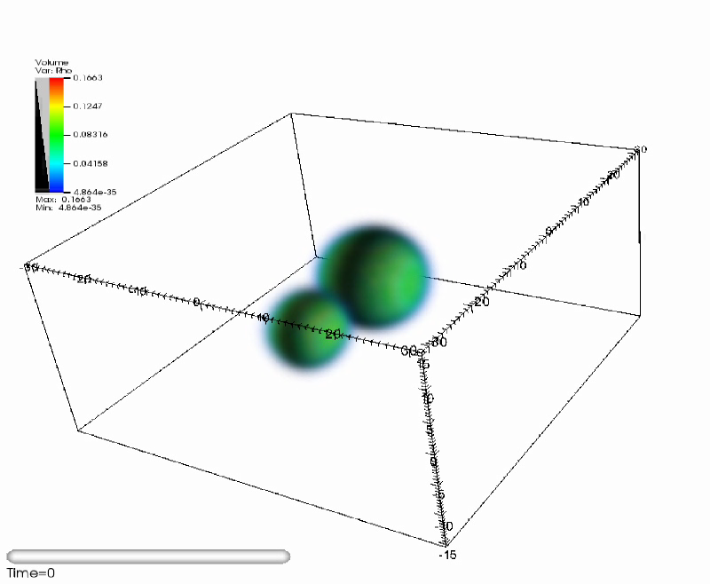
Heavy Ion Physics
Beginning of experimental programs early `70s
„heavy ion“ changed from ¹⁶O to ²³⁸U
Many theorists switched from fission theory to heavy ion physics, then to higher energies ...
Nuclear fission is a related process
with large-scale collective motion
and still not well understood!
Theoretical approaches were
also originated in the early `70s:
had to learn many new things
Look at some TDHF simulations
to get ideas ... (time-dependent
Hartree Fock)
Simulation! May not happen in reality!

Slide 5
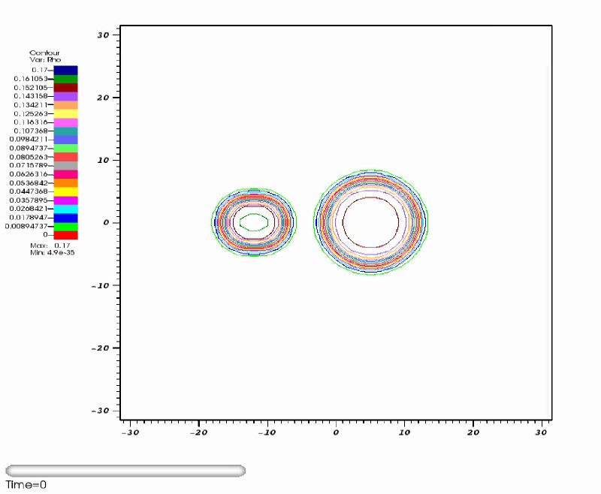
Peripheral Reaction
Nuclei reseparate, possibly exchanging some nucleons

Slide 6

Deep Inelastic Reaction
Large energy loss and exchange of particles. Characteristic measurables:
final masses and charges, final energy and scattering angle.

Slide 7

Central Reactions
Nuclei remain in a „compound system“. Will it survive? Cool down by emitting particles and γ-rays? Or split up later? Only time will tell!

Slide 8
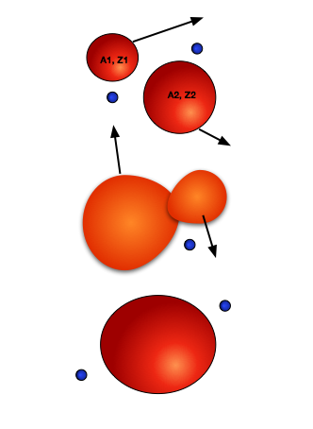
Principal Problems for Theory
Intrinsically three-dimensional problem
Geometric shapes difficult to describe
Pauli principle
Which are the correct degrees of freedom? Coordinates of nucleons? Nuclear centers of mass with deformation parameters?
The final state can be one nucleus, two nuclei, two nuclei plus lighter particles.
Loss of relative motion energy into
internal excitation

Slide 9
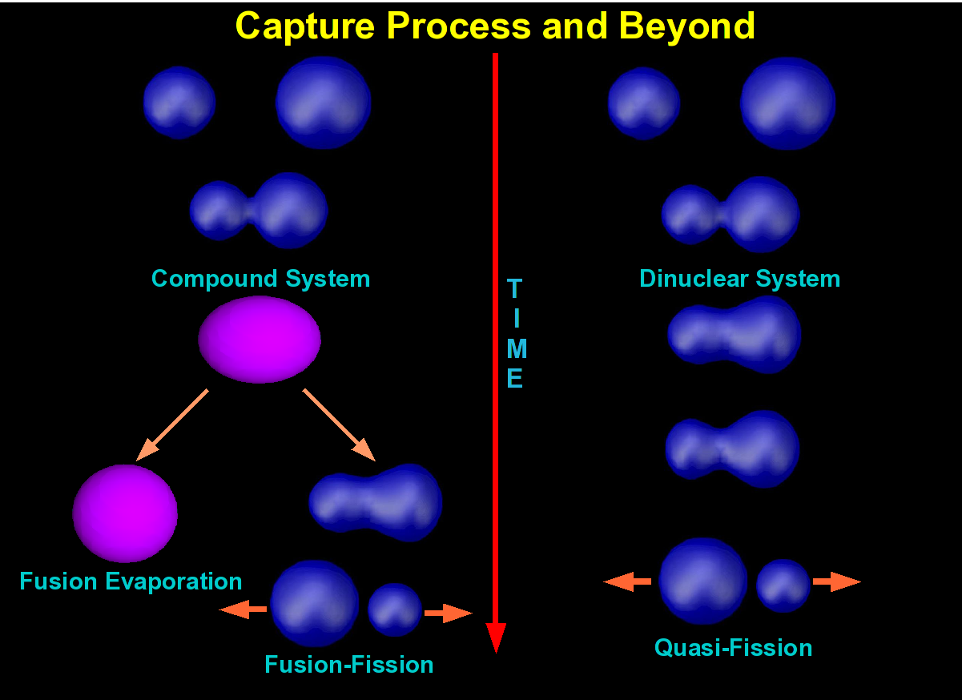
Long-term behaviour needs different description

Slide 10
Experience from Fission
The phenomenological shell model
Model potential like oscillator or Yukawa
Use a number of shape parameters
Earliest deformed model: Nilsson model with β-deformation only
To describe breakup, had to develop 2-center models
Application in fission
Fission was usually treated using time-independent formulations
The potential energy surface (PES) yields barriers including asymmetry and deformations
Adding collective mass parameters, tunneling can be calculated (in simple approximation)
To explain the final kinetic energies, friction had to be considered for the descent from the barrier exit to the scission point

Slide 11
Do nuclei behave like water drops?
The Liquid Drop Model is highly successful
Water drop collisions
Melissa Orme, Progress in Energy and Combustion Science Vol. 23, pp. 65-79, 1997
Water drops are also incompressible
(not at higher energies) and
surface effects are important
But: in nuclei the particles have long mean free path
There was a long discussion about transparency

Slide 12
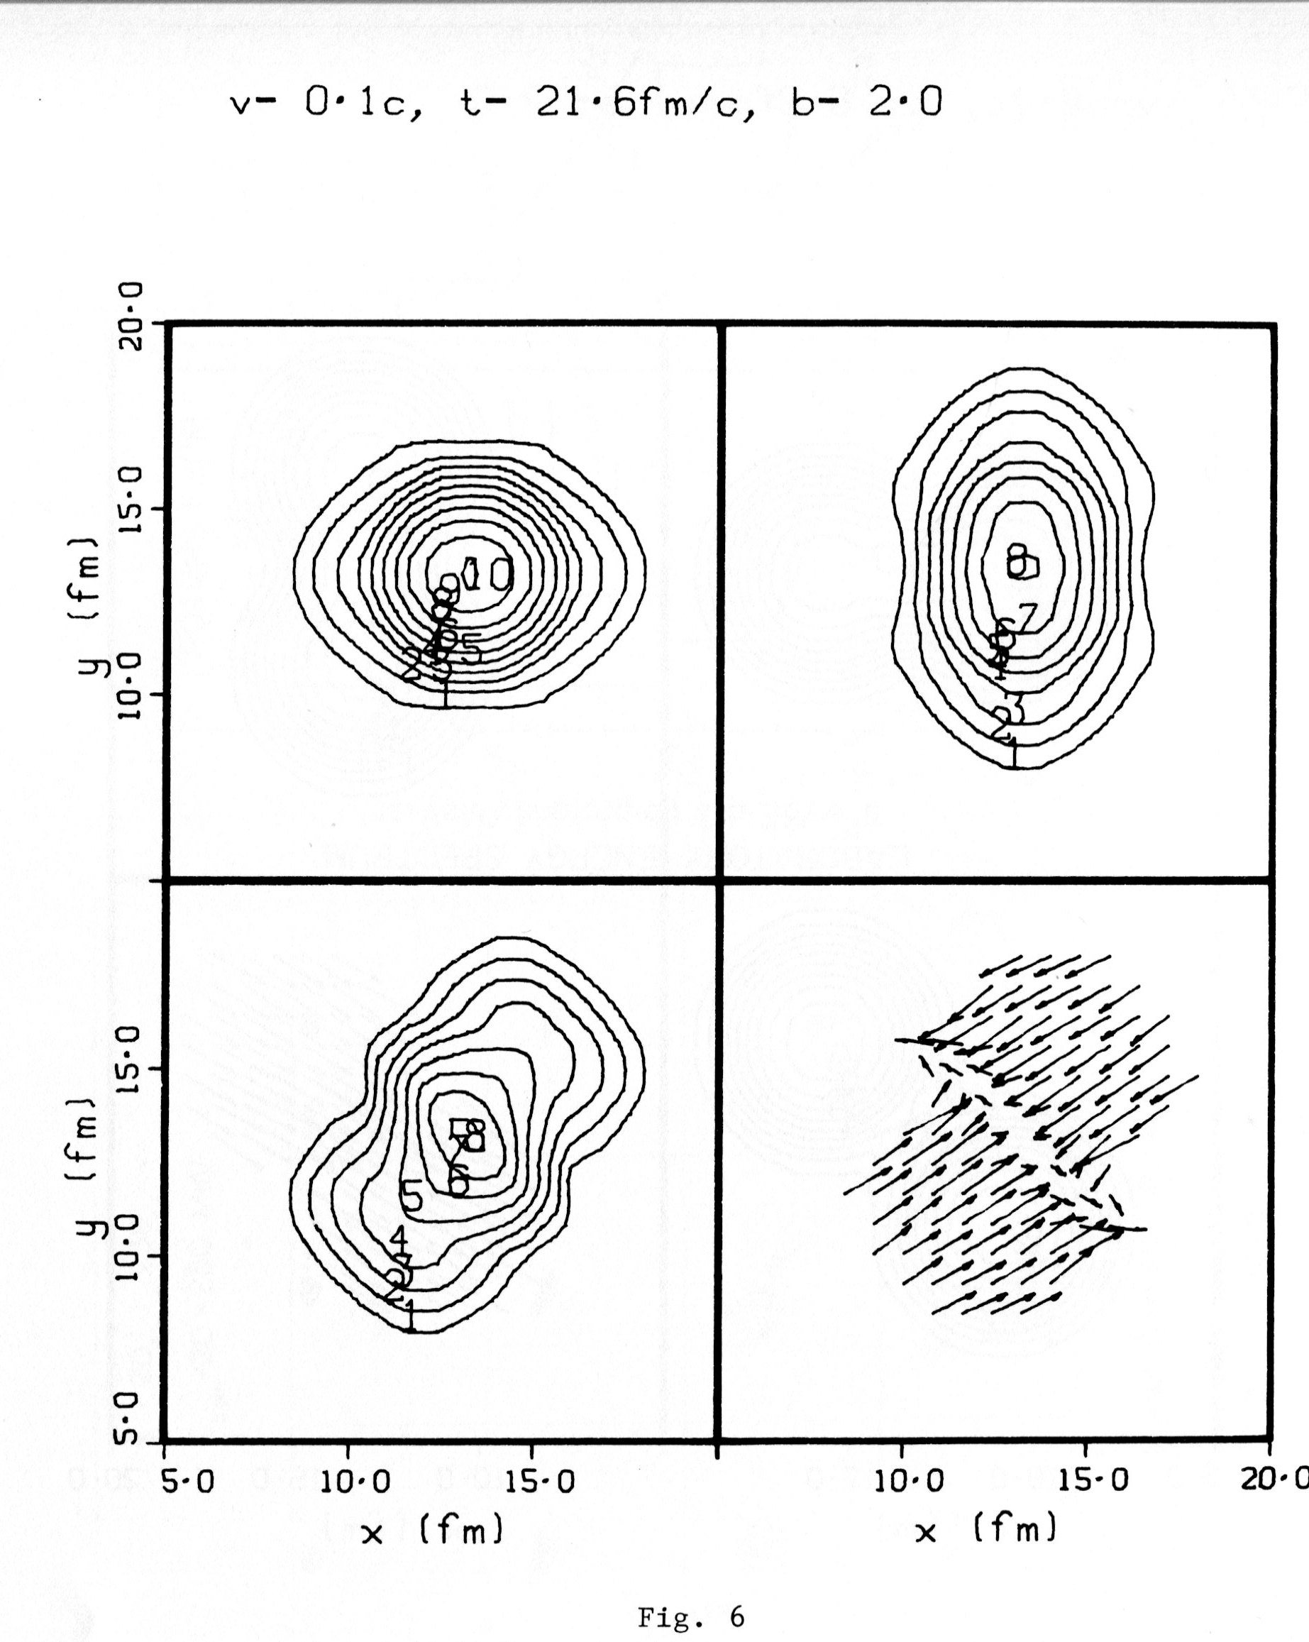
Hydrodynamic Model
Liquid drop model: nuclei are treated as charged fluid drops. Behavior dominated by surface energy and Coulomb repulsion. Bethe-Weizsäcker formula.
For collisions this can be made into a dynamic fluid model: hydrodynamic equations + special nuclear equation of state.
The fluid is always in thermal equilibrium
locally (LTE).
Characteristic: short mean free path of
the nucleons between collisions, local
equilibrium lead to compression effects
like shock waves
Appears reasonable only for higher energies
Variations developed to allow partial
transparency
Fall Creek Falls Conference, 1977
First 3-dimensional calculations

Slide 13
Hydrodynamic Model
Liquid drop model: nuclei are treated as charged fluid drops. Behavior dominated by surface energy and Coulomb repulsion. Bethe-Weizsäcker formula.
For collisions this can be made into a dynamic fluid model: hydrodynamic equations + special nuclear equation of state.
Fall Creek Falls Conference, 1977irst 3-dimensional calculations
M.T. Collins and J.J. Griffin,
Nucl. Phys. A348, 63 (1980)

Slide 14
Models: Classical
Quantum Molecular Dynamics (QMD)
Vlasov Uehling-Uhlenbeck (VUU)
Treat nucleons as classical particles moving in a mean field with added direct random collisions
Nuclear ground state problematic: in classical physics it would be a crystal
Pauli principle is simulated but does not work well at low energies
Also problems with spin properties
Attractive point: contain fluctuations

Slide 15
Fusion (Wang Nan 王楠)

Slide 16
Non-Fusion (Wang Nan 王楠)

Slide 17
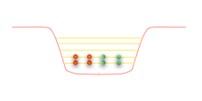
Microscopic Quantal Models
The nucleons are treated as quantum-mechanical particles moving in an average potential generated by the total density. Shell structure!
This potential can be based on an assumed surface shape of the nucleus with a prescribed function (phenomenological model). The potential can e.g. be of oscillator type or Woods-Saxon
or generated from the density, which itself is calculated from the particle wave functions (self-consistent model, Hartree-Fock)
The time-dependent version TDHF was proposed for nuclei by Bonche, Koonin, and Negele

Slide 18
Explanation of asymmetric fission
The two-centre shell model (1972)
Holzer, Scharnweber, Mosel, Greiner, JAM
The density is assumed constant inside the
nuclear surface: leptodermous“
Shape Parameters
R center distance
(or length λ)
ε neck barrier
ξ asymmetry
β₁, β₂: fragment deformations

Slide 19
Scission is difficult to describe
Constant density inside a sharp surface becomes unrealistic when the neck snaps.
This can be made better by assuming asmooth density
Compare how naturally the neck breaks up in TDHF
TCSM shape near the scission point

Slide 20
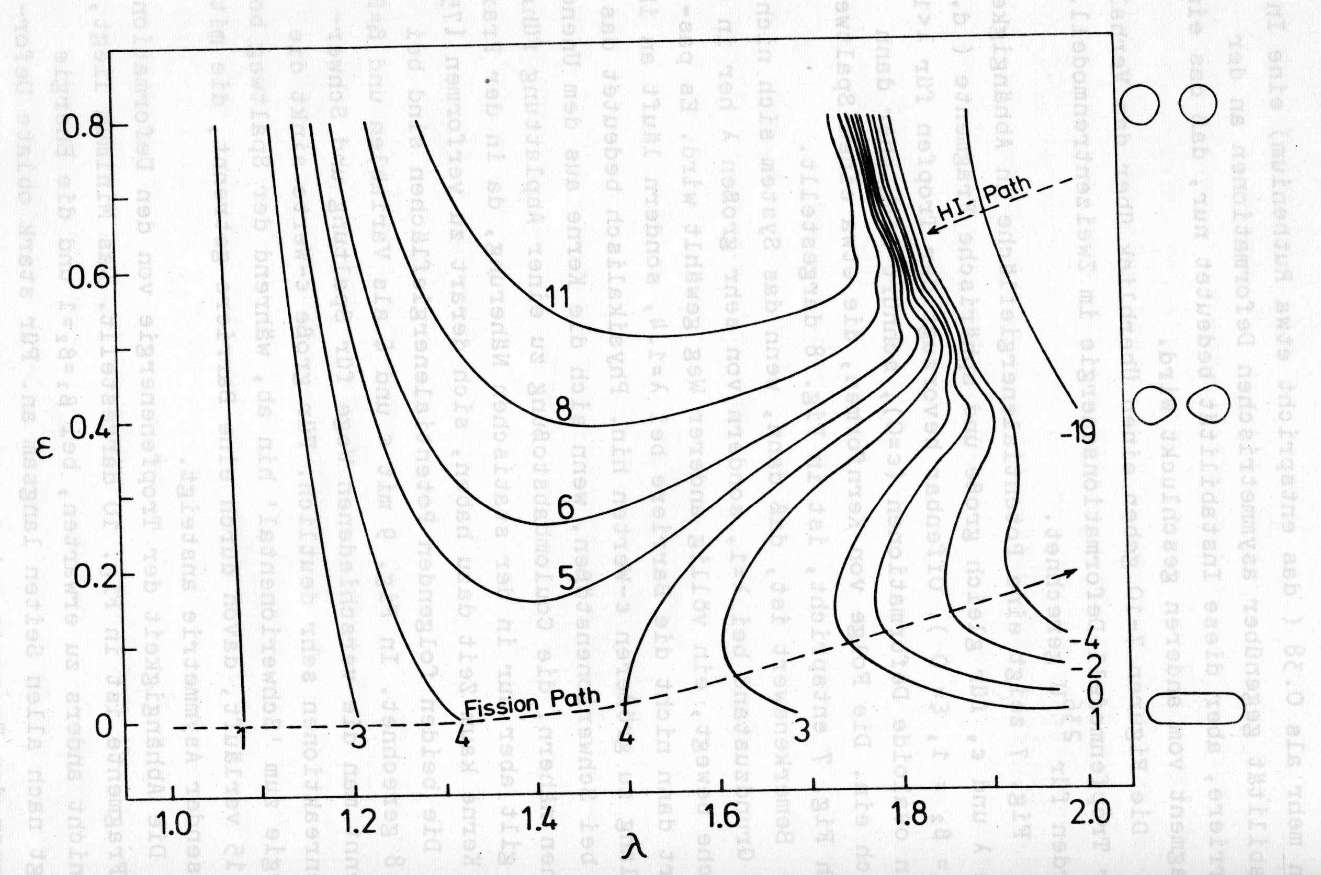
Fission is not inverse process

Slide 21
Microscopic-macroscopic model
The total energy calculated as the sum over the particle energies is not correct, therefore use liquid drop (or similar) model + shell corrections (Strutinsky)
Pairing correction also needed
For time-dependent calculations:
  Make the shape parameters depend on time
  Calculate mass parameters (cranking, Werner-Wheeler):
  these form a tensor because the collective coordinates can be coupled in the kinetic energy; distort the visual interpretation of the PES
Thus we get a collection of loosely related ingredients, which together constitute the microscopic-macroscopic model:
Mic-Mac
With well-fitted parameters the physics of ground-state nuclei and fission is described quite well (Möller & Nix)

Slide 22
Principal Physical Mechanisms
Initially we have two „bags“ filled with nucleons and enclosed by a potential well
Upon contact, a passage (neck) opens between the two bags, nucleons can cross over
This leads to an exchange of mass, charge, momentum, kinetic energy, and angular momentum
How rapid is this process? This depends on the mean free path
Short mean free path: hydrodynamics, compression, shock waves
Long mean free path: physics dominated by mixing, particles get scattered on the outer boundary (single-particle viscosity)
In classical gases, there are two mechanisms:
  Viscosity and thermoconductivity increase with the m.f.p.
  Collisions establish local equilibrium (LTE)

Slide 23
Liquid-drop Barrier
The liquid drop energy is dominated by the surface + Coulomb energy,
which both depend on deformation
Fission isomer
The shell correction δU oscillates but is in the range of
± 10 MeV. It can produce a deformed ground state and a fission isomer; also asymmetric fission
Deformed ground state

Slide 24
The adiabatic basis
In Mic-Mac, for each deformation there is an internal energy
The adiabatic single particle wave functions are calculated using the stationary Schrödinger equation for each deformation
This yields a set of deformation-dependent single-particle energies and wave functions, which correspond to the static solution inside this potential
If the lowest states are occupied, there is no excitation: adiabatic potential
The time-dependence arises from the variation of the deformation parameters; it is not reflected in the wave functions: there is no probability current

Slide 25
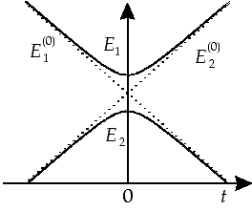
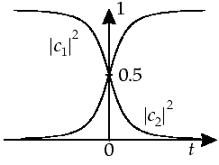
The Landau-Zener Effect
To descibe the collision, the collective coordinates are made time-dependent: α_{k}(t), ...
If all quantum numbers are the same, s.p. levels never cross as functions of deformation: „avoided level crossings“ (Wigner). This is due to the small residual coupling that must be present
In this region the wave functions exchange their character, so if a particle remains in the lower state, its distribution has to be rearranged considerably
As the motion get faster, there will be more probability for going into the excited state (if it is empty): dissipation is also largest near such crossings
When the motion is so fast that the particle always goes to the higher level, we get the sudden potential
The sudden case is also reversible: no rearrangement effect
β
β

Slide 26
The adiabatic basis (c‘td)
To descibe the collision, the collective coordinates are made time-dependent: α_{k}(t), ...
An equation of motion may then be set up,
e.g., with a mass parameter B_{kl}(R) e.g.
from the cranking model
or from a hydrodynamic model (Werner-Wheeler)
If the nucleons always stay in the lowest levels, there is no internal excitation
Internal excitation is provided by exciting the nucleons into higher wave functions through the time-dependent potential, leading to a friction force
In practice, instead a parametrized friction force is used proportional to the collective velocities and the energy dissipated is used to calculate a temperature
This means thermal equilibrium, but it is global: there is no local temperature like in hydrodynamics, but only one for the total nucleus
The shell corrections and pairing energies are assumed to decrease with temperature

Slide 27
Mass Parameters
The cranking model (inglis)
assumes that the system stays almost adiabatic
For an unpaired state
which has singularities at level crossings
With pairing
where the quasiparticle energies
avaoid singularities
Alternative: Werner-Wheeler hydodynamic model

Slide 28
Example
A 4-dimensional Langevin approach to low-energy nuclear fission of ²³⁶U
(Chikako Ishizuka, Mark D. Usang, Fedir A. Ivanyuk, Joachim A. Maruhn, Katsuhisa Nishio, and Satoshi Chiba)
Use 4 shape parameters: center distance, asymmetry, and two fragment deformations
Potential based on micmac model, plus mass parameters and friction coefficients
Random forces (Langevin) provide fluctuations

Slide 29
Typical results
One typical trajectors, plotted in elongation vs. asymmetry
Resulting mass distribution of fission fragments averaged over many trajectories

Slide 30
Models: TDHF
Time-Dependent Hartree-Fock
Method originally proposed by
P. Bonche, S. E. Koonin, and J. W. Negele,
Phys. Rev. C13, 1226 (1976)
Many calculations in the `70s and `80s with limited physics
(axial symmetry, simplified forces, no spin)
  K. T. R. Davies, V. Maruhn-Rezvani, K. R. Sandhya-Devi,
  S. J. Krieger, J. A. M.
  R. Y. Cusson, J. A. M.
  H. Flocard, M. S. Weiss
Interest was renewed with improved computing later

Slide 31
Derivation
The time-dependent variational principle
with the restriction to a single Slater determinant
leads to the TDHF equations in coordinate space
practical only for zero-range (usually Skyrme) interaction
for realistic nuclei, derivative terms, spin- and isospin dependence are added
Caution: Variational principle implies optimal approximation to time derivative: solution may still deviate arbitrarily as time goes on

Slide 32



Density matrices and HF
For a Slater determinant the one-body density matrix
reduces to
and the two-body density matrix
decomposes into
showing that the particles are uncorrelated

Slide 33
Independent Particles?
Uncorrelated particles: observing one does not give information about others
The probability for two observations is just the product of the individual probabilities
A product wave function fulfills this, but for fermions there is a trivial correlation: observing two fermions in the same state has zero probablity
A mean-field model has product wave functions, but the particles are correlated through the mean field, for example in the α-particle

Slide 34
Interactions
Most calculations use Skyrme forces. They include delta-interactions, derivative terms, and spin-orbit couplings.
The single-particle Hamiltonian h thus acts on the wave functions with:
  multiplicative terms (local mean field),
  derivative terms (momentum dependence)
  spin operators and derivatives combined (spin-orbit coupling)
The Skyrme force originally contained a three-body term leading to a mean field of ρ² character. Later (SkM*) this was replaced by a non-integer power, so that it cannot be derived from a force. Thus instead of a force, a density functional has to be used as the basis. This also applies to terms like spin-spin coupling, tensor forces, etc.
There are many Skyrme-force parametrizations fitted to static nuclei, not yet to dynamic properties.
Coulomb is included with a Slater exchange term.

Slide 35
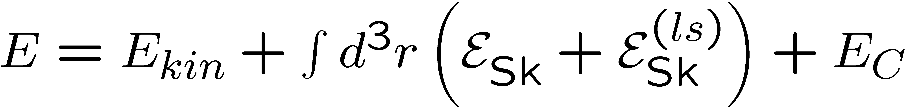
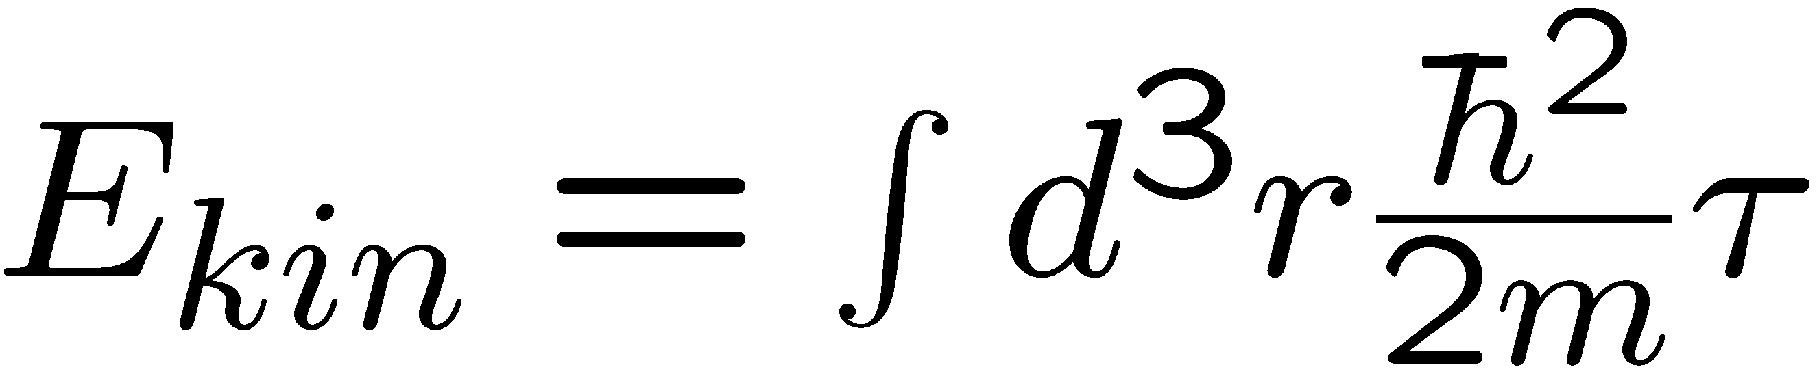
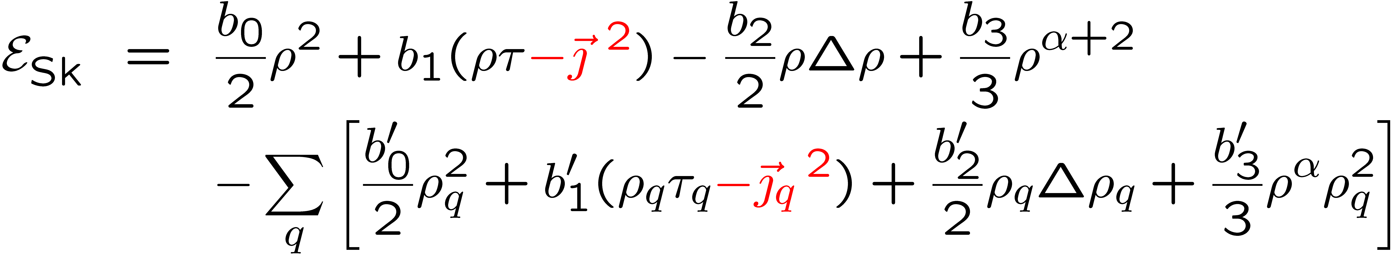
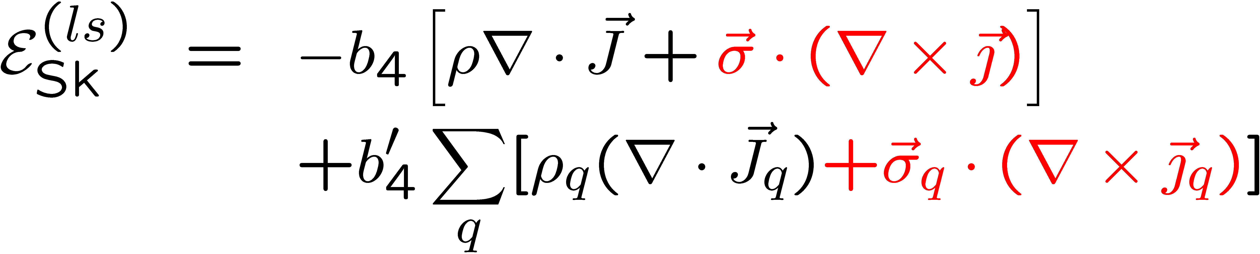
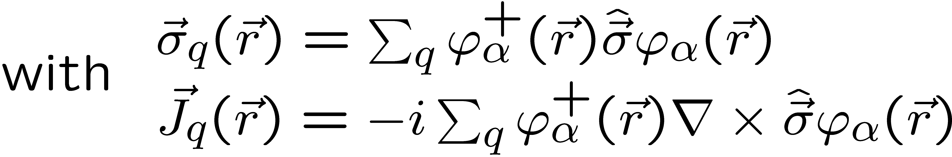
The Skyrme Energy Functional

Slide 36
Remarks on the approximation
The particles only interact through the mean field. In classical transport theory the corresponding approach is the Vlasov Equation from plasma physics
which is the basis of some classical models of heavy-ion collisions
is the single-particle phase-space density.
Here ρ is the density in phase space (x,p), which in the quantum case has an analogue in the Wigner function.
Collisions between particles, as included in the Boltzmann Equation are not treated. TDHF thus describes a collision-free gas in a mean field.

Slide 37
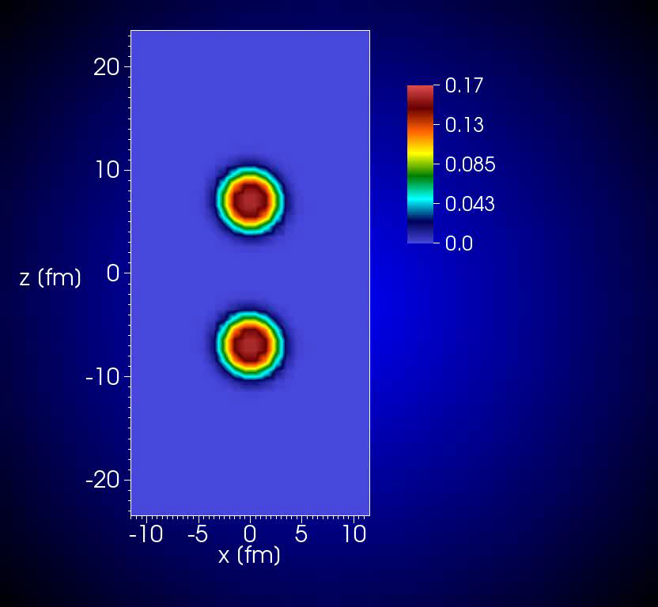
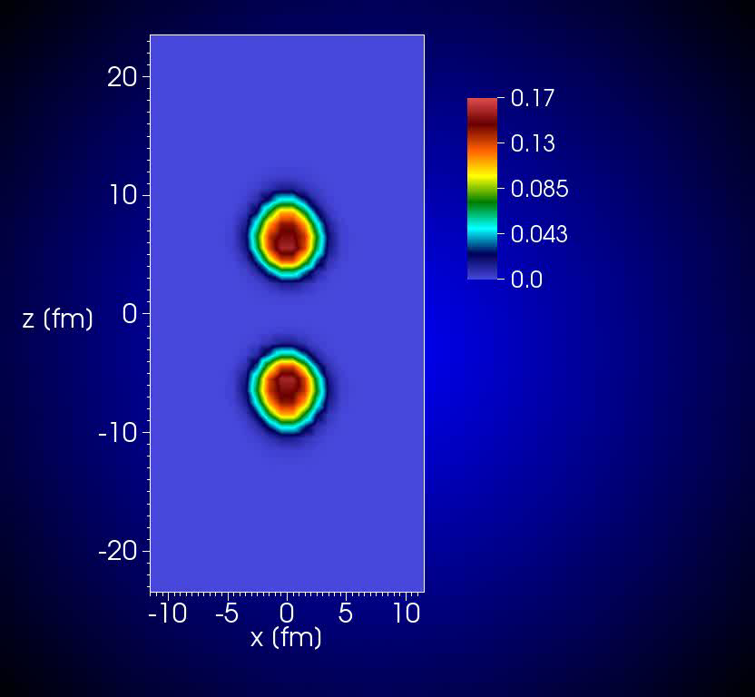
Present Code
The TDHF Code „Sky3D“
J. A. Maruhn, P.-G. Reinhard (Erlangen),
P. D. Stevenson (Surrey), A. S. Umar (Vanderbilt)

Slide 38
Strange Features of TDHF
Vibrations are not quantized
Orbital motion of free nuclei shows no spreading: the mean field keeps the wave functions localized
Thus TDHF appears as semiclassical
In a collision the final state is unique, no fluctuations in relative energy and angular momentum
The number of nucleons in nuclei is not integer & not a good quantum number; if the wave functions extend into both fragments (always true, except for initial state)
This appears like an entanglement
All mass splits coupled by the mean field

Slide 39
Classical Behavior of TDHF
Vibrations are not quantized
Orbital motion of free nuclei shows no spreading: the mean field keeps the wave functions localized
The number of nucleons in nuclei is
not integer & not a good quantum
number if the wave functions extend
into both fragments (always true,
except for initial state)
The probability for n particles in the region x<0 can be written as
can be writte in terms of the single-particle partial overlaps

Slide 40
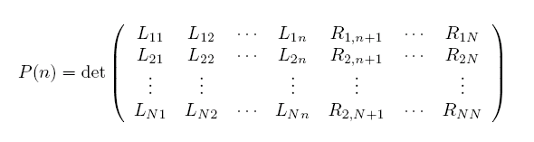
Nonlinear Effects: Spurious Cross-Channel Coupling
The expression is:
TDHF does not describe final
mass distributions: they turn
out too narrow
Reason: all possible mass divisions, though present in the wave function, are coupled by the mean field, leading to suppression if they deviate much from the average.
The same reason prevents spreads in orbital angular momentum, kinetic energy, etc.
Cure: Balian-Vénéroni theory
¹⁶O + ¹⁶O
¹²C + ²⁰Ne

Slide 41
Fluctuations in TDDFT and Mic-Mac
Semiclassical, what does it mean?
Balian-Vénéroni theory allows fluctuation calculations but at large computational
expense
In Mic-Mac, use
Langevin approach to
generate randomness.

Slide 42
Relation to RPA
The TDHF equations can also be formulated in the density matrix:
Assuming small oscillations around the ground state
leads to the familiar RPA equations, that can also be obtained by adding 2p2h correlations to the ground state
Note that in TDHF there are no correlations; here they come in by superposing the states over a period of the oscillation
Also note that TDHF behaves classically: the amplitude δρ and the excitation energy can be any size and RPA gets a quantized energy by assuming that the periodic motion is associated with

Slide 43
Relation to Micmac Models
The TDHF wave functions have a totally different meaning: they include excitations and correspond to a complicated sum over adiabatic states
For details see: Lu Guo, J. A. Maruhn, P.-G. Reinhard, "Boost-invariant mean field and the nuclear Landau-Zener effect", Phys. Rev. C76, 014601 (2007).
A comparison of TDHF with the adiabatic state at the same deformation should tell us about the excitation? See: density constraint

Slide 44
TDHF vs. TCSM Shapes
⁶⁸Ni+²⁰⁸Pb at 290 MeV
Five parameters:
Center separation
Neck potential height
Asymetry
Fragment deformations
Least-squares fit to reproduce TDHF isodensity line
Axial symmetry limits
usefulness.
with Wang Nan (Shenzhen)

Slide 45
Numerical Methods
For nuclear collisions, the wave functions are discretized on a 3D Cartesian grid with uniform spacing Δ in all 3 direction.
This they are numerical arrays of dimension
The single-particle Hamiltonian then becomes a difference operator acting on the wave functions. The spatial derivatives can be expressed by
  finite differences (5-th order)
  B-spline expansion
  Fourier techniques (Sky3D)
The boundary condition for the wave functions can be
  zero
  periodic
Special care is needed for the long-range Coulomb potential
Some codes allow symmetries, like reaction-plane reflection symmetry
For vibrational states, a harmonic-oscillator expansion is also useful

Slide 46
Fourier calculation of potential for isolated charge distributions
The wave functions have periodic boundary conditions, but for the Coulomb filed interaction with images must be avoided
The solution constructed via
with two FFToperations in the enlarged region with periodic boundary conditions fulfills the boundary condition for an isolated charge distribution in the physical region
J.W. Eastwood and D.R.K. Brownrigg, J. Comp. Phys. 32, 24 (1979)
(fictitious) empty space

Slide 47
Damped-Gradient Iteration
For the static problem the procedure is to follow the negative gradient in wave-function space:
This has to be damped to avoid faster development of high-lying states;
practically the inverse kinetc energy is used. Also orthonormalization is approximated by diagonal terms. In summary the procedure is
The damping operator is approximated by a separable expression.
A standard numerical diagonalization of the wave function set is also done nd speeds up convergence

Slide 48
Time Integration
The TDHF equations are discretized also in time steps t=m Δt
The integration from one step to the next is approximated by
where the half-step Hamiltonian is estimated in the same way.
The exponential function in turn is approximated by
so that the Hamiltonian just has to be applied repeatedly to the wave functions.
Note that this procedure is non-unitary, so orthonormality and energy conservation are not guaranteed (works quite well in practice).
Alternative: higher order predictor-corrector or using
which is unitary but requires matrix inversion.

Slide 49
Practical Considerations
Problem size (typical heavy-nuclei collision)
  nx=ny=nz=64 (for 1fm grid spacing), 2 spin components
  U+U: each 238 wave functions
  complex values: each 16 bytes
  Total is
Clearly, memory is not a problem
Collisions take up to few 1000 time steps of typically 0.2 fm/c: storing results not so easy
Computation times range from 1 h (O+O collision) to weeks (U+U).
Codes:
  Code by Paul Bonche (published)
  Oak Ridge code (S. Umar and M.R. Strayer, rewritten in Fortran 95 by J. Maruhn), will be published as „Sky3D“
  Simplified BKN 3D code, in J. Maruhn, P.-G. Reinhard, and E. Suraud, „Finite Fermi Systems“ (Springer, 2010)
  1D BKN code in K. Langanke, J. A. Maruhn, S. E. Koonin, „Computational Nuclear Physics 2“, Springer 1993.

Slide 50
Computing Enhancements
A larger TDHF problem needs:
  Mesh size 64²×32. One complex number for each of two spin components
  ⁴⁰Ca+²³⁸U: 278 wave functions
  Total: 278×64×64×32×2×8 Bytes ≈ 1.166 GB
  Plus some smaller arrays for mean fields
  Computing time ≈ 1 week for a collision on a PC
  Parallel systems can be used
Graphics tools: very good 3D graphics now affordable

Slide 51
Advances in Computing Languages
Fortran 66
306 G1=UV(NBL)-AN
G4=G1*G1+DEL2
G5=SQRT (G4)
G3=G3-DEL2/(G4*G5)
G2=G2+G1/G5
133 IF(ABS (ZN-G2)-EPSY2)10,10,118
118 IF(ZN-G2)150,150,151
150 IP=1
ANP=AN
AAP=ZN-G2
GO TO 152
151 ZL=1.
ANM=AN
AAM=ZN-G2
152 AN=AN+ (ZN-G2)/G3
IF(IP)134,134,153
153 IF(ZL)134,134,154
154 IF(AN-ANM)155,155,156
156 IF(AN-ANP)134,155,155
155 AN=(AAP*ANM-AAM*ANP)/(AAP-AAM)
GO TO 134
What does it mean? Who knows!
Fortran 95
! Step 1: 3-body contribution to upot.
DO iq=1,2
ic=3-iq
upot(:,:,:,iq)=(rho(:,:,:,1)+rho(:,:,:,2))**f%power * &
((b3*(f%power+2.D0)/3.D0-2.D0*b3p/3.D0)*rho(:,:,:,iq) &
+b3*(f%power+2.D0)/3.D0*rho(:,:,:,ic) &
-(b3p*f%power/3.D0)*(rho(:,:,:,1)**2+rho(:,:,:,2)**2)/ &
(rho(:,:,:,1)+rho(:,:,:,2)+epsilon))
ENDDO
Stands for
where all densities depend on space and isospin

Slide 52
Physics: Pauli Principle
The Pauli principle is essential for nuclear structure.
In collisions it has two consequences:
It prohibits many collisions between nucleons (at low energies), because the final states are already occupied
  This implies a long mean free path and leads to very large viscosity and thermoconductivity.
  In practice the enclosing mean field determines the effectiveness
On the other hand, collisions are responsible for local equilibrium
It also leads to an excitation, because wave functions cannot share the same phase space („kinematic Pauli principle“). In TDHF this is fulfilled exactly because the wave functions remain orthogonal.

Slide 53
Dissipation in TDDFT
A single Slater determinant is a pure state: entropy zero?
There are no NN-collisions. Dissipation?
Yet TDHF shows strong internal excitation and damping of collective motion
Solution:
In classical transport there are two effects:
  Viscosity and thermoconductivity proportional to mean free path
  Collisions establish local equilibrium distribution (LTE)
In TDHF heavy-ion collision:
  Large dissipation of relative motion due to exchange of particles through the neck joining the two nuclei, see window formula (Swiatecki)
  Inside the fragment, relaxation to an equilibrium state is extremely slow

Slide 54
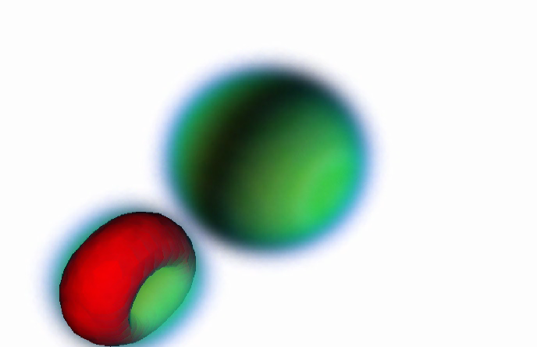
Wave function in a peripheral collision

Slide 55
Problem Setup
Get wave functions for any number of nuclei from static Hartree-Fock solution
Heavy-Ion collisions:
  Set up the fragments at a finite distance
  Boost wave functions in fragment j by phase factors
  The boost vectors k have to be determined from the initial kinetic energy of relative motion and the angular momentum by calculating the Coulomb trajectory up to the initialization point
  A boosted single nucleus then has an unaccelerated motion and no wave packet spread.
Collective motion (like giant resonances): perturb wave function by
  initial phase factor with the right symmetry
  a time-dependent external potential

Slide 56
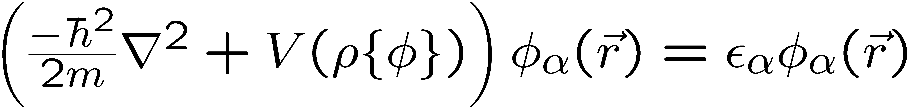
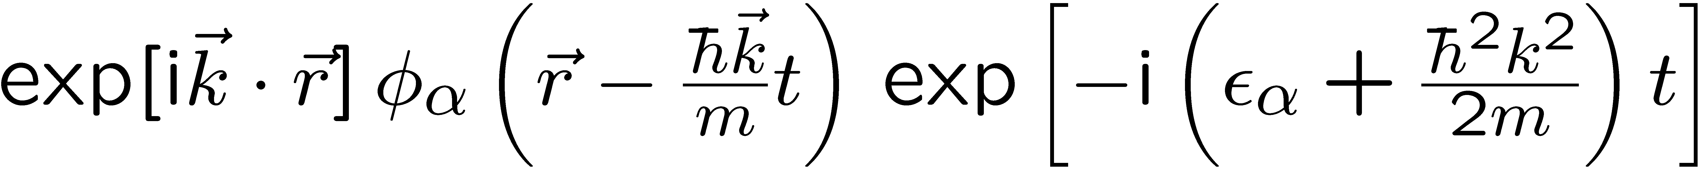
Galilei Invariance of TDHF
In TDHF the wave functions themselves carry the motion
A ground state nucleus with s.p. wave functions fulfilling
leads to a propagating stationary solution with a common phase factor
This solves the time-dependent equation (i.e., produces a uniformly translating nucleus), if the s.p. Hamiltonian is Galilei invariant
This is trivial for pure density dependence, but requires adding terms involving currents and spin currents to the density functional
(Y. M. Engel, D. M. Brink, K. Goeke, S. J. Krieger, and D. Vautherin,
Nucl. Phys. A249, 215 (1975)).
When derived from two-body forces, this leads to additional terms; a phenomenological density functional can be corrected just with the minimum of terms
Note that in reality, a nucleus with good momentum should have a spreading wave function.

Slide 57
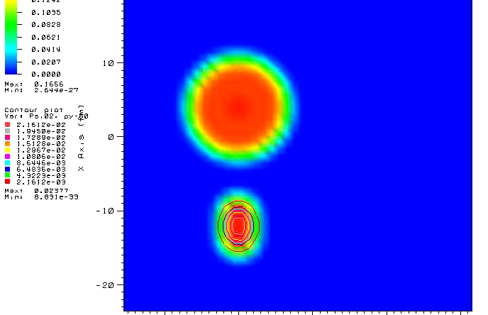
More detail ...

Slide 58
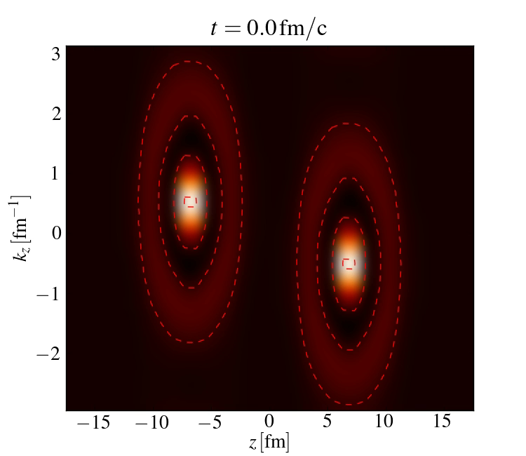
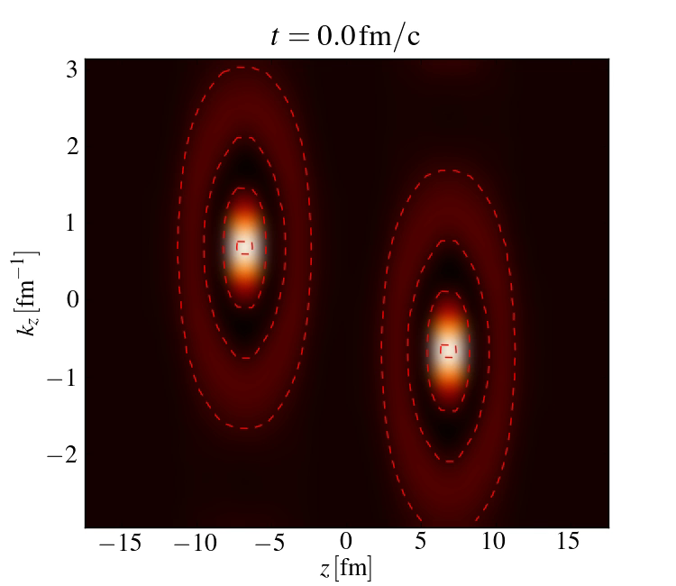
The Wigner Function
Is obtained from the one-particle density function as
and is similar to the phase-space distribution function
Should approach a thermal Fermi distribution for LTE
N. Loebl, J.A. Maruhn, and P.-G. Reinhard, Phys. Rev. C84, 034608 (2011).
Ca + Ca, 160 MeV Ca+Ca, 240 MeV

Slide 59
Example: ⁶⁴Ni+²⁰⁸Pb at 280 MeV
Fianl c.m. energy and scattering angle as functions of b

Slide 60
Transfer
Charge equilibration
Numbers transferred

Slide 61
Angular momenta
Final relative angular momentum
Internal angular momenta
of the fragments

Slide 62
TDHF vs. Mic-Mac
Nuclear properties like binding energies and deformations well described - no need for shell corrections
No prescribed shapes: density distribution can be arbitrarily changed
Easy to do in 3D, whereas Mic-Mac is usually constrained to alignment along an axis
New effects are not suppressed, like the distribution pf protons vs. neutrons or a hollow nucleus
For a PES HF need constraints, which are ambiguous
Computing times very large:
  One collision of Ni+Pb takes several weeks on a standard PC
  TCSM: calculate 4D PES in a few hours
Nothing fitted for heavy-ion collisions
The dissipation in TDHF cannot be varied

Slide 63
Why is pairing so important?
For non-magic nuclei, it influences the deformation
The mass parameters are affected strongly
The wave functions can be repopulated more effectively: this is very important in fission
Pure TDHF without pairing cannot describe fission at low energy, although the reseparation after a collision works well. It appears that the excitation in a collision is sufficiently high

Slide 64
BCS vs. HFB
In the simple Bardeen-Cooper-Schrieffer pairing, pairs of states are paired which are time-reversal conjugate and Kramers-degenerate
This becomes difficult in a dynamic situation
The solution is Hartree-Fock-Bogolyubov, which does not assume special pairs and has been extended to a time-dependent version
Unfortunately the need to consider a huge number of states makes it very difficult computationally;
See recent work by
G. Scamps, K. Hagino, Y. Hashimoto, T. Nakatsukasa,
A. Bulgac ...
Conservation laws fulfilled when levels are reoccupied? The particle number certainly fluctuated, but angular momentum?

Slide 65
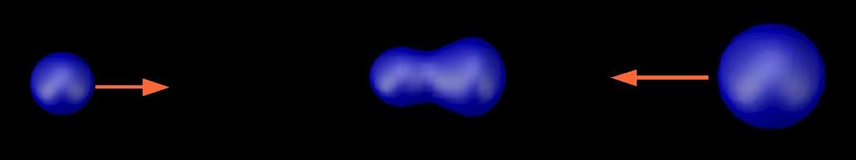

TDHF with Density Constraint
TDHF is used to generate shapes during the reaction. The wave functions are then cooled down to the lowest energy compatible with these shapes: defines potential energy
ρ_{TDHF} (r,t)‏
E*(R(t))‏
Quasi-Static Energy Surface
Cusson, Reinhard, Maruhn, Strayer, Greiner, Z. Phys. A320, 475 (1985)‏

Slide 66
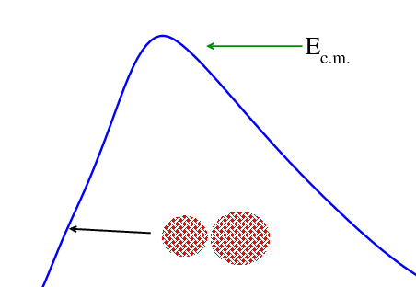
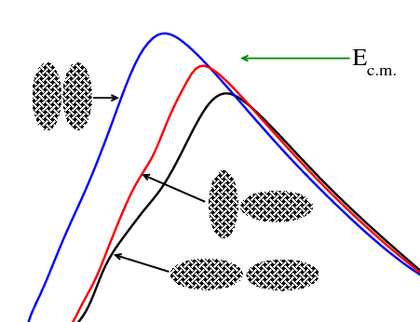
Potentials depend on energy and orientation
Nuclear deformation poses additional problems
Spherical nuclei → single barrier
Deformed nuclei → barrier distribution

Slide 67
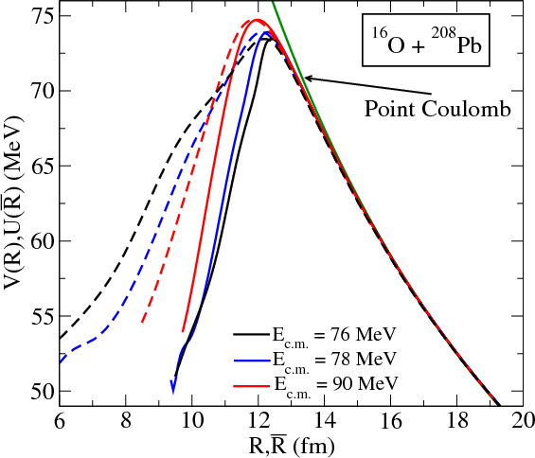
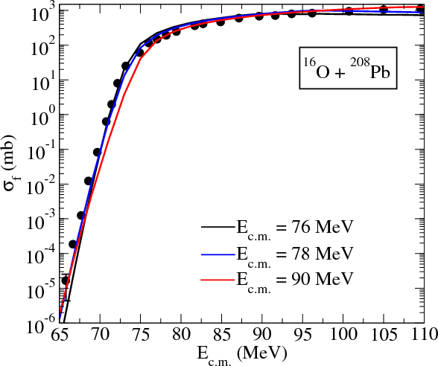
¹⁶O + ²⁰⁸Pb Fusion Cross-Section
Even below-barrier processes can be described quantitatively
Umar, Oberacker, EPJA 39, 243 (2009)‏

Slide 68
Pasta Formation
Principal investigators: B. Schuetrumpf, Kei Iida (Kochi), M. Klatt and K. Mecke (Erlangen).
Simulation of the “pasta”phase of nuclear matter: lower density than in nuclei, neutron-rich extended matter
Where does it happen?
Pasta Variations Neutron stars (also in core collapse
(Oyamatsu et al.) supernovae) (Watanabe et al.)

Slide 69
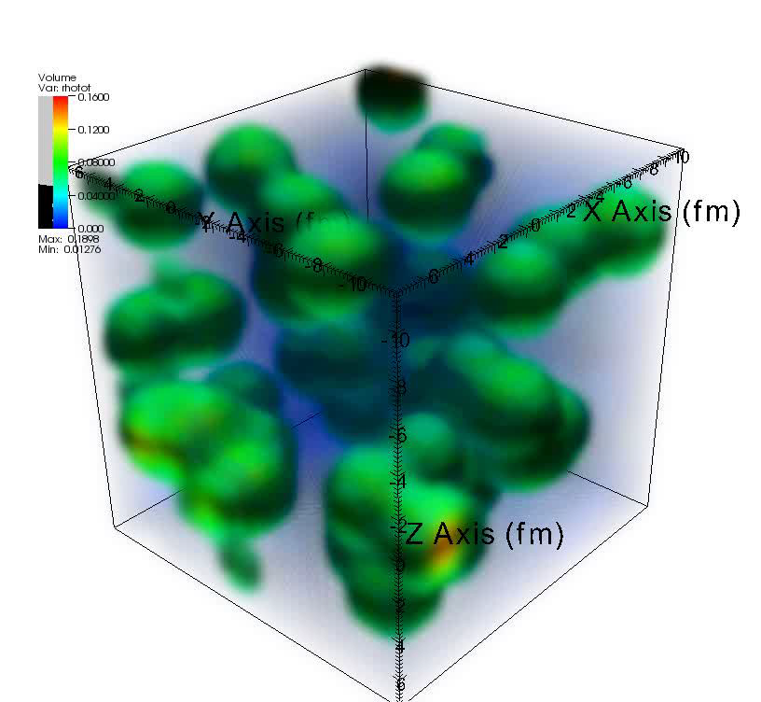
Example
Periodic cubic box
filled with α-particles
and a neutron background
“Thermal” excitation
through initial velocities
for the particles
A relatively rapid
thermalization is observed,
leading to the different
pasta structures depending
on initial density and
temperature

Slide 70
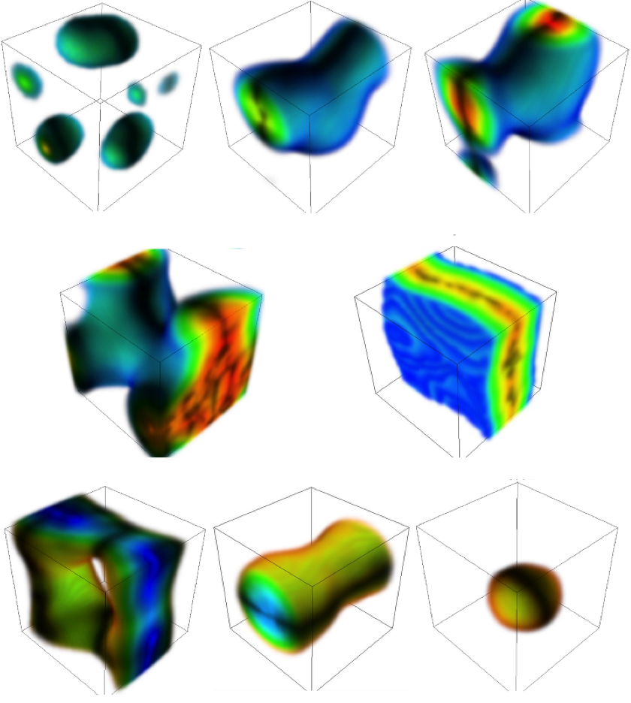
Many types of pasta seen

Slide 71
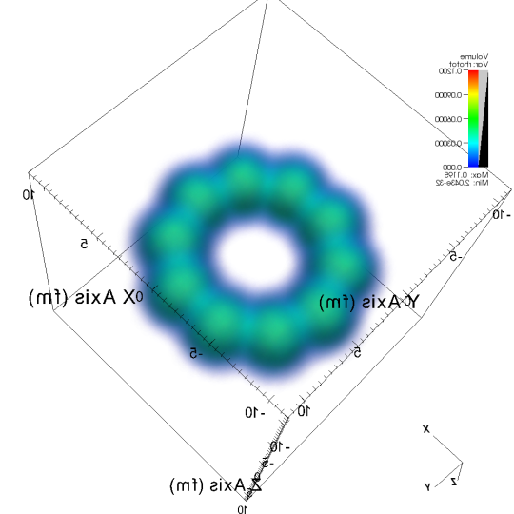
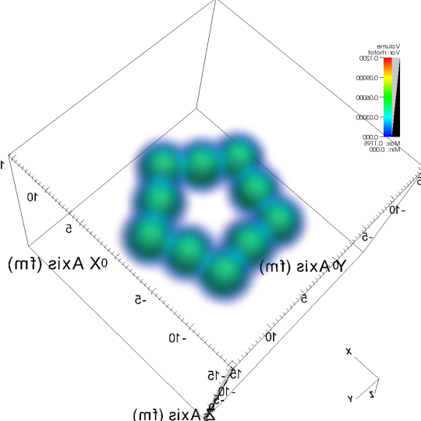

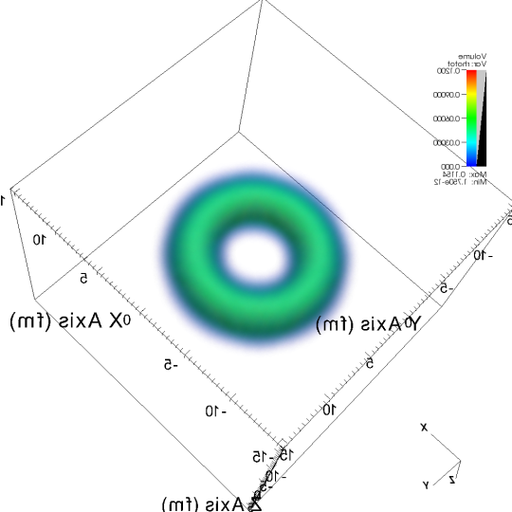
Toroidal Nuclei
T. Ichikawa, J. A. Maruhn, N. Itagaki, K. Matsuyanagi, P.-G. Reinhard, and S. Ohkubo, Phys. Rev. Lett. 109, 232503 (2012).
Originally proposed by C. Y. Wong Phys. Lett. B41, 446 (1972)
Also studied stability against rotation and “sausage” deformations in a liquid-drop approach
Also seen in constrained calculations by Funaki et al. J. Phys. G: Nucl. Part. Phys. 37 (2010) 064012
The 10-α Torus
Static HF with cranking constraint around symmetry axis
No clustering seen
Starting with an initial distorted configuration also leads to a smooth ring.
The final results is a quantal system with collective rotation about a symmetry axis, which can be seen only in a dynamic calculation
Angular momentum quantized at 60ħ

Slide 72
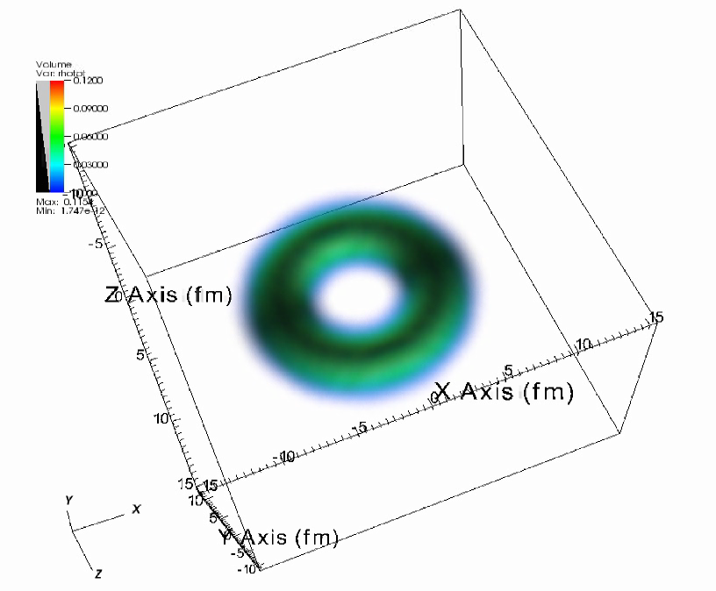
Cutting up the Ring
A time-dependent Gaussian potential is applied at the positive x-axis side.
V=30MeV
V=50MeV

Slide 73
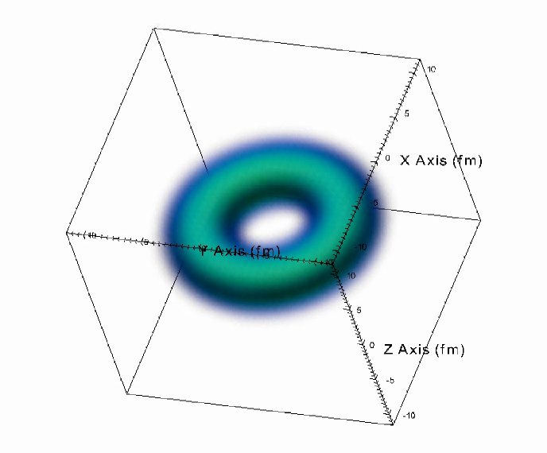
A Spinning Top
The torus is excited with a velocity field containing a rotation
T. Ichikawa, K. Matsuyanagi, J. A. Maruhn, and N. Itagaki, Phys. Rev. C89, 011305 (2014).

