Slide 1
Turbulent Crystal and idealized glass
Shin-ichi Sasa （Kyoto University)
2013/07/19

Slide 2
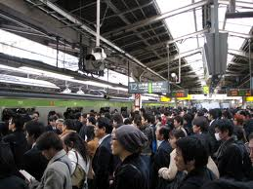

Tokyo life (every morning)
Kyoto life (every morning)

Slide 3
Do turbulent crystals exist?
David Ruelle,
Physica A 113, (1982)

Slide 4
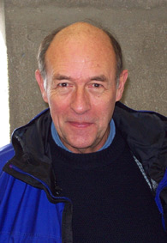
Who is David Ruelle ?
Statistical Mechanics
David Ruelle,
Benjamin, New York, 1969. 11+219 pp.
Cited by 2689
On the nature of turbulence
D Ruelle, F Takens - Communications in mathematical physics, 1971 - Springer
Cited by 2634
Abstract
A mechanism for the generation of turbulence and related phenomena in dissipative systems is proposed.

Slide 5
Do turbulent crystals exist?
David Ruelle, Physica A 113, (1982)
Abstract
We discuss the possibility that, besides periodic and quasiperiodic crystals, there exist turbulent crystals as thermodynamic equilibrium states at non-zero temperature. Turbulent crystals would not be invariant under translation, but would differ from other crystals by the fuzziness of some diffraction peaks. Turbulent crystals could appear by breakdown of long range order in quasiperiodic crystals with two independent modulations.

Slide 6
Part I
Turbulent crystal

Slide 7
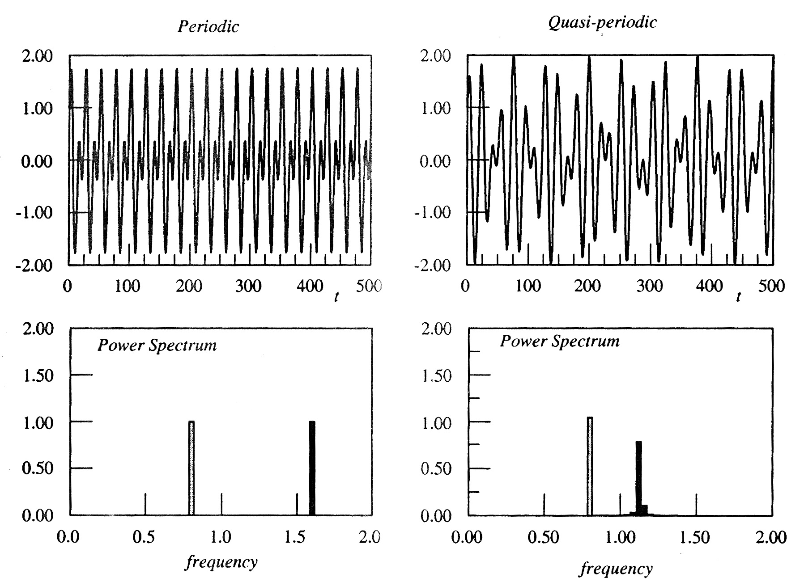
Regular time series
Periodic
Quasi-periodic
Time series
Power-Spectrum

Slide 8
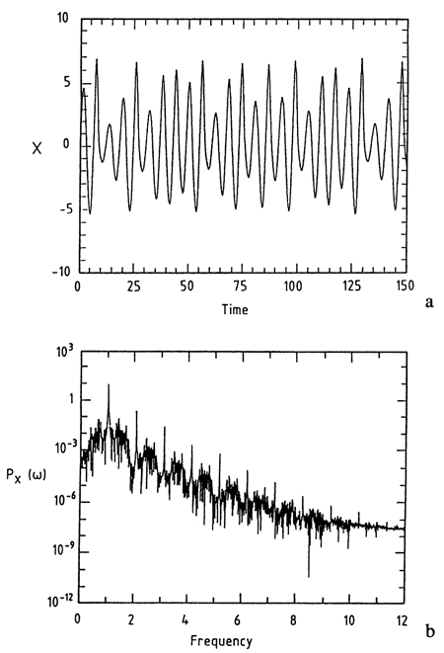
Irregular but deterministic time series
Chaos
Time series
It can be distinguished from
“noise” in experiments !
Power-Spectrum

Slide 9
From time series to patterns
Periodic motion
Periodic pattern
Quasi-periodic motion
Quasi-periodic pattern
Chaotic motion
Chaotic pattern
Replace “time” by “space coordinate”
Example:
Stationary solution:
Standard map

Slide 10
From patterns
to equilibrium phases

Slide 11
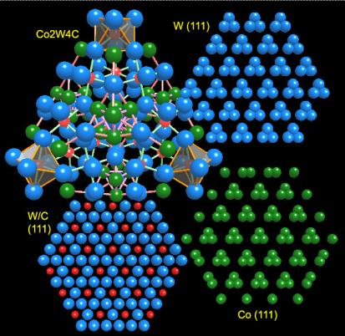
From periodic patterns to crystal phase
Crystal
1) Ground states are generated by periodic
repetition of a unit
2) Long-range positional order
(Bragg Peak)
3) Translational symmetry
breaking occurs in statistical measure with finite temperature

Slide 12
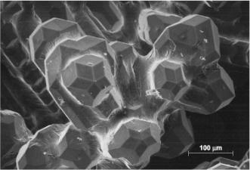
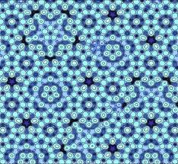
From quasi-periodic patterns to quasi-crystals phase
1) Ground states are generated by
non-periodic repetition of two units
2) Long-range positional order
(Bragg Peak)
3) Translational symmetry
breaking in statistical measure
with finite temperature
Mathematical study of tiling
(1961～ 1975):
Regular but aperiodic tiling !
Experiments (1984)

Slide 13
Thermodynamic phase associated with chaotic patterns?
Ground states are described as
some irregular patterns
1) No long-range positional order
(No Bragg Peak)
2) Translational symmetry
breaking in statistical measure
with finite temperature
2) They are generated by a rule, and robust with respect to thermal noise
(irregularly frozen patterns
at finite temperature)
No Bragg peak, while
Translational symmetry breaking

Slide 14
Do turbulent crystals exist?
David Ruelle, Physica A 113, (1982)
Abstract
We discuss the possibility that, besides periodic and quasiperiodic crystals, there exist turbulent crystals as thermodynamic equilibrium states at non-zero temperature. Turbulent crystals would not be invariant under translation, but would differ from other crystals by the fuzziness of some diffraction peaks. Turbulent crystals could appear by breakdown of long range order in quasiperiodic crystals with two independent modulations.

Slide 15
Current status of Ruelle’s question
Some constructed “chaotic patterns” with forgetting the stability against thermal noise
The heart of the problem is
to find the compatibility between the two:
1) No long-range positional order
(No Bragg Peak)
2) Translational symmetry
breaking in statistical measure
with finite temperature
Is it possible ?

Slide 16
A possible landscape picture
Typical configurations are classified into several groups each of which consists of configurations with macroscopic overlaps with some special irregular configuration
Irregular
irregular
irregular
irregular
irregular
irregular
irregular
Irregular
irregular
irregular
How to find this phenomenon ?

Slide 17
The concept of overlap
i) Divide the space into boxes each of which can have at most one particle
ii) Define the occupation variable for each site
if a particle exists
otherwise
Particle configuration
iii) Prepare two independent systems
iv) Define the overlap between the two:
v) Look into the distribution function of the overlap:
for the phase without symmetry breaking (like liquid)

Slide 18
Overlaps in “turbulent crystals”
Typical configurations are classified into
several groups each of which consists of
configurations with macroscopic overlaps
with some special irregular configuration
when two samples belong to the same
group, there is correlation between them
when two samples belong to different
groups, there is no correlation between them

Slide 19
Spin glass terminology
One step
replica symmetry breaking
(1-RSB)

Slide 20
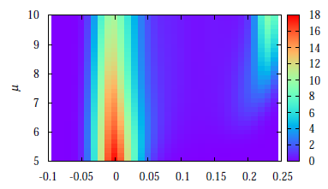
Example of the 1RSB phase
Hard-constraint particles on random graphs
References: Biroli and Mezard, PRL 88, 025501 (2002) and others
The contact number of each particle
is less than 2
( Hukushima and Sasa, 2010)
Consistent with the cavity method
(Krzakala, Tarzia, Zdeborova, 2007)

Slide 21
This model was proposed as
a lattice model describing the idealized glass in statistical mechanical sense
In order to distinguish it from
idealized glass in the sense of MCT,
and idealized glass in the sense of KCM,
I call the idealized glass “Pure glass”.

Slide 22
This means …
“Turbulent crystal” by Ruelle may be given by
“pure glass in finite dimensions. “
We know many models that exhibit “pure glass” in the mean-field type description
No finite-dimensional model that exhibits
“pure glass” has been proposed
(But, recall Bethier’s talk yesterday.)

Slide 23
Problem we would like to solve
Construct
a finite-dimensional model
that exhibits “pure glass”
Artificial Glass Project

Slide 24
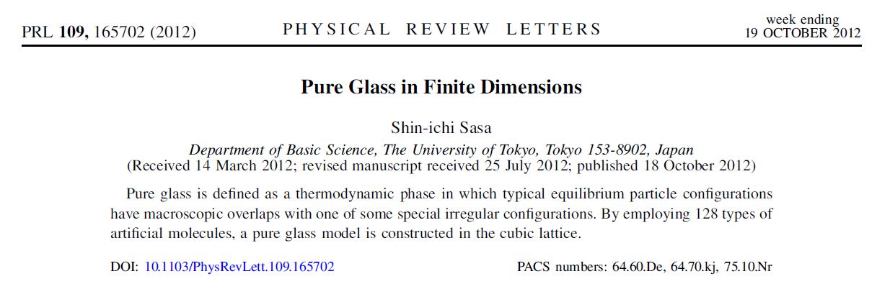
Our first step result:
S. Sasa, Pure Glass in Finite Dimensions, PRL arXiv:1203.2406
20 minutes

Slide 25
Part II
MODEL

Slide 26
Guiding principle of model construction
An infinite series of
“irregular” local minimum configurations
generated by a deterministic rule
Irregular
irregular
irregular
irregular
irregular
irregular
irregular
Irregular
irregular
irregular
Statistical behavior of the model
on the basis of an energy landscape of LMCs

Slide 27
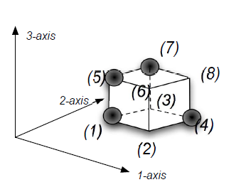
１２８-states molecule
Molecule
a unit cube in the cubic lattice
State of molecule
７-spins
例：
An irregular function
mark configuration in a unit cube

Slide 28
Hamiltonian
Cubic lattice
Molecule configuration
Hamiltonian
NN-pair
A mark configuration in the positive k surface of
is different from that in the negative k surface of
A mark configuration in the positive k surface of
is different from that in the negative k surface of
Irregular function
(choose it with probability ½ and fix it ）

Slide 29
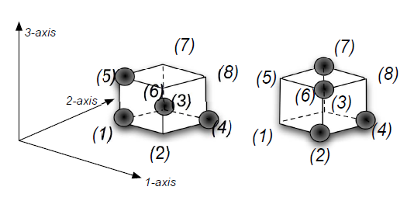
Example of interaction potential
Choose it with probability ½ and fix it

Slide 30
Statistical mechanics
Hamiltonian
--- nearest neighbor interaction
--- translational invariant (PBC)
Canonical distribution

Slide 31
Perfect matching configuration (PMC)
（construction of mark configurations）
(0) put randomly
in the surface
(1) iteration (cellular automaton)
put if
PMC

Slide 32
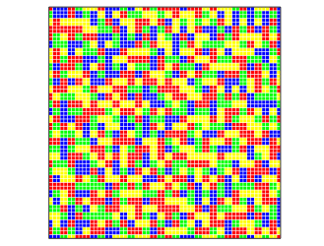
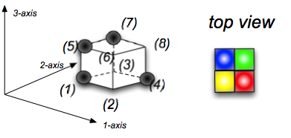
Properties of PMCs
#1 typically irregular ！
（not yet proven）
Molecule configuration
in the surface
#2 PMCs are local minimum ！
(trivial)

Slide 33
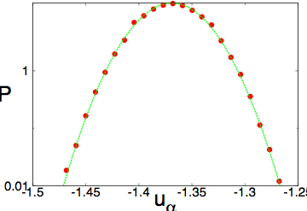
Energy distribution of LMCs
LMCs are irregular
The energy density obeys a Gaussian distribution with dispersion O(1/N)
（central limiting theorem） N >>1

Slide 34
Low temperature limit
A set of configurations that reach the LMC by zero-temperature dynamics
Random Energy Model
Condensation transition to a
The minimum of energy density
In the thermodynamic limit

Slide 35
Part III
Numerical experiments

Slide 36
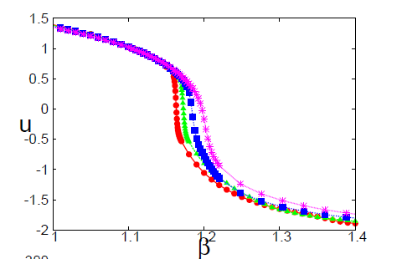
Energy density
Free BC

Slide 37
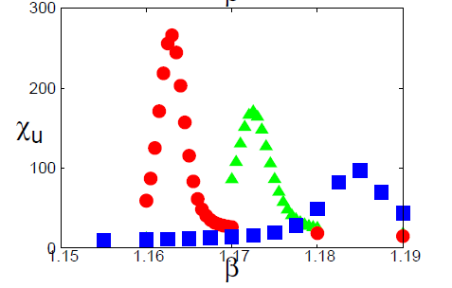
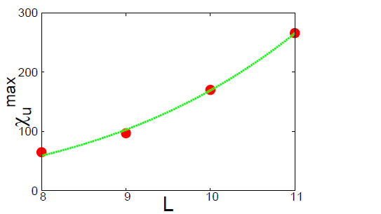
Energy fluctuation

Slide 38
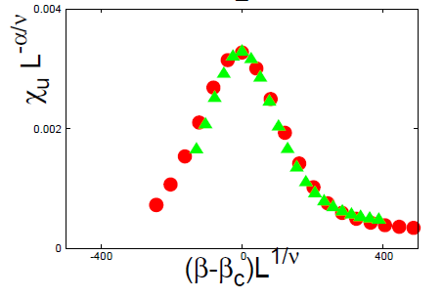
Energy fluctuation
A scaling relation:

Slide 39
Thermodynamic transition
Latent heat
First order transition

Slide 40
Nature of the low temperature phase
No Bragg peak
No internal symmetry breaking (e.g. Ising)
Condensation transition :

Slide 41
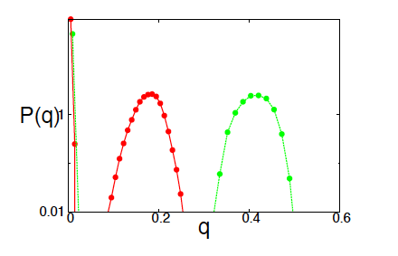
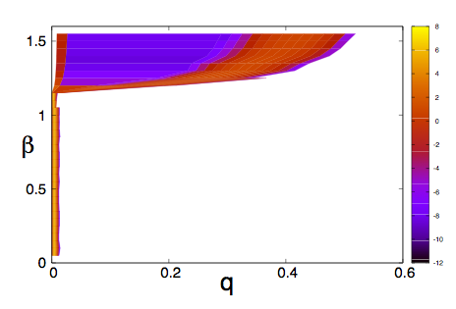
Distribution of overlap
Two independent systems
The overlap between the two
Distribution function
Free boundary condition (FBC)

Slide 42
Part V
Summary

Slide 43
Summary
Review:
Turbulent crystals (by Ruelle)
1-RSB (for spin glasses)
Question:
Pure glass in finite dimensions
Result:
Proposal of a 128-state model

Slide 44
Future problems
Complete theory
Simpler model ?
Further numerical evidences
Molecular Dynamics simulation model
Laboratory experiments

Slide 46
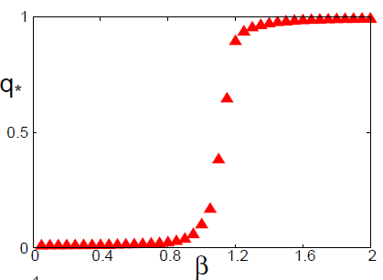
Selection by a boundary configuration
Equilibrium configuration
in a low temperature
Fix a boundary configuration

Slide 47
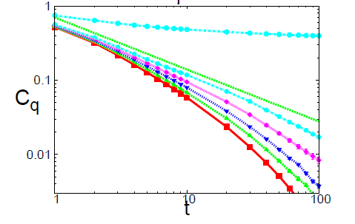
Dynamics

