Slide 1
Formation of orientational glass and double glass in mixtures of anisotropic particles
Kyohei Takae and Akira Onuki
Department of Physics, Kyoto University

Slide 2
Orientational glass (glassy crystal) in anisotropic molecular systems
positionally ordered crystal with random molecular orientation (plastic crystals)
frozen orientational disorder: orientation glasses (glassy crystals)
K. Adachi, H. Suga, and S. Seki, Bull. Chem. Soc. Jpn. 41, 1073 (1968).
R. Brand, P. Lunkenheimer, and A. Loidl, J. Chem. Phys. 116, 10386 (2002).

Slide 3
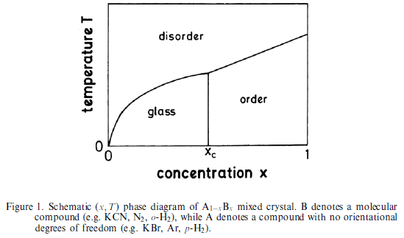
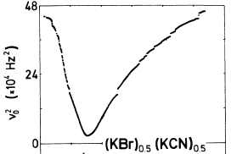
Orientational glass in mixed molecular crystals
orientationally disordered crystal (plastic crystal)
orientationally
ordered crystal
orientational glass
(glassy crystal)
softening of shear modulus
near the transition temperature
(anisotropic)x(isotropic)1-x
e.g. (KCN)_{x}(KBr)_{1-x}
K. Knorr et al., PRL 57, 2544 (1986).
U. T. Höchli, K. Knorr and A. Loidl, Adv. Phys. 39, 405 (1990).
mesoscopic picture ?
stress induced phase ordering in orientational glasses ?

Slide 4
Purpose of this work
propose a simple microscopic model exhibiting orientational glass behaviour in mixtures of anisotropic and isotropic particles
  direct (proper) orientation-strain coupling
  impurity anchoring mesoscale heterogeneity
  stress induced phase ordering in orientational glasses, leading to large mechanical response
  slow dynamics of molecular rotation
construct a minimal model based on Lennard-Jones model (two dimensions in this talk, similar in 3D)

Slide 5
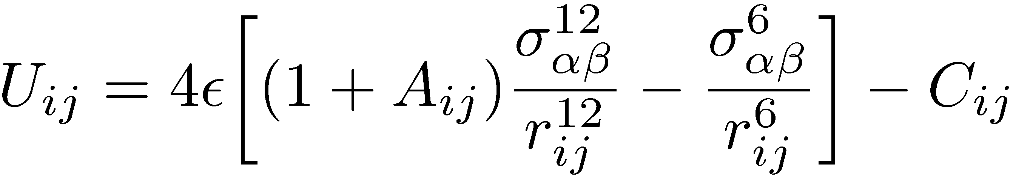
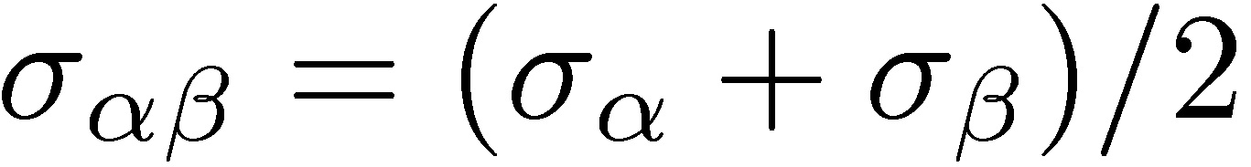
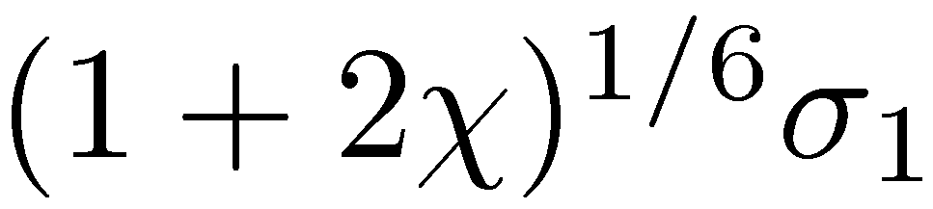
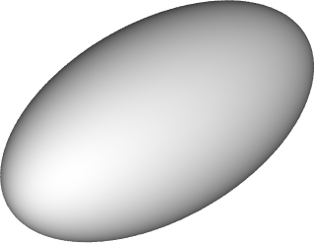


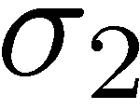
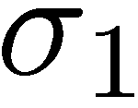
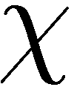
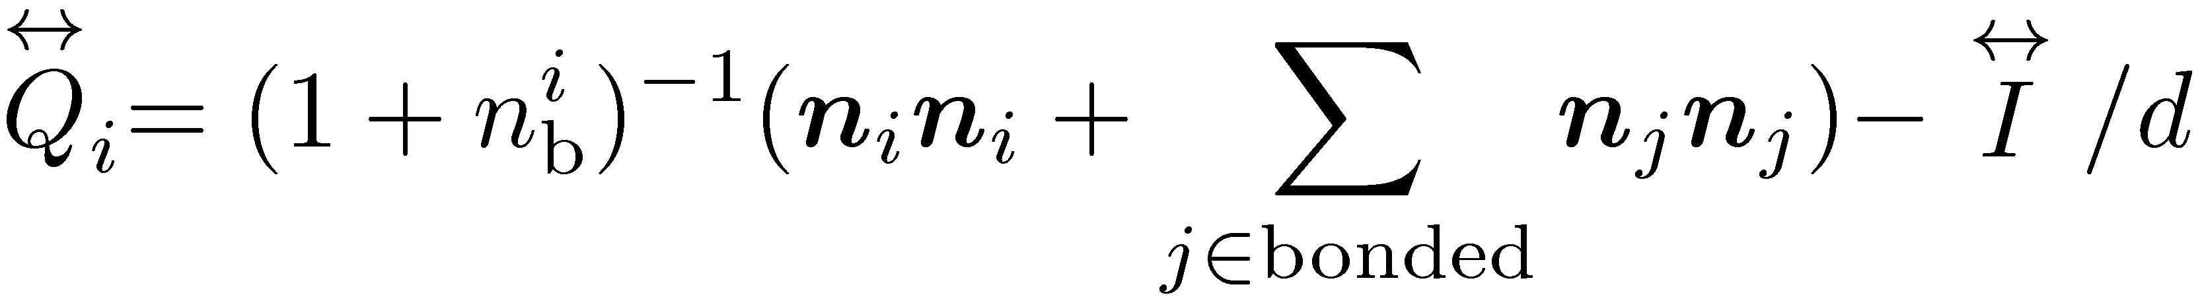
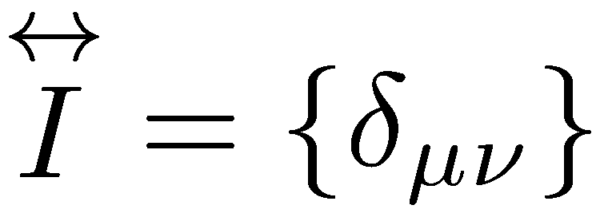
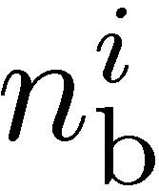
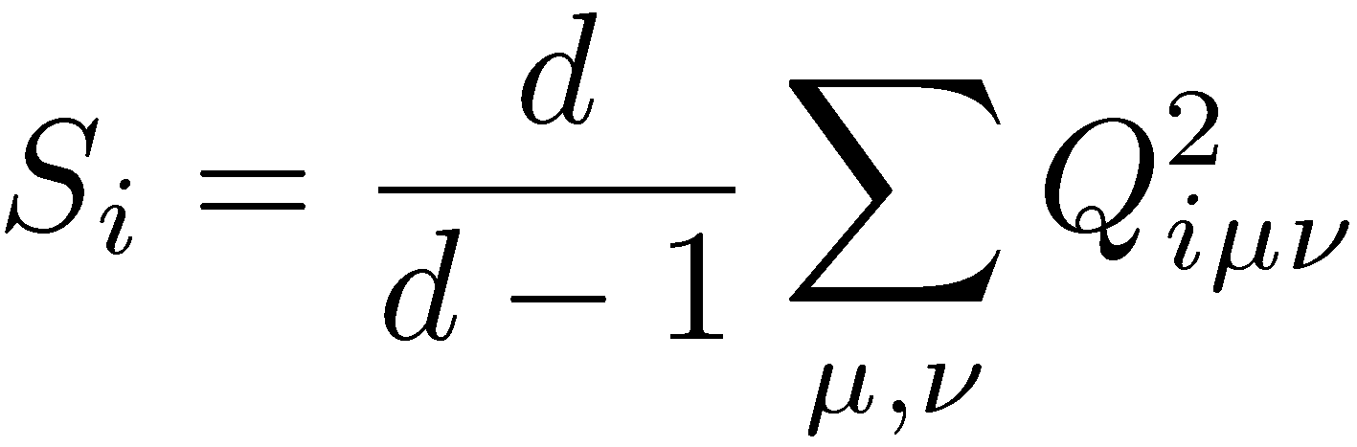
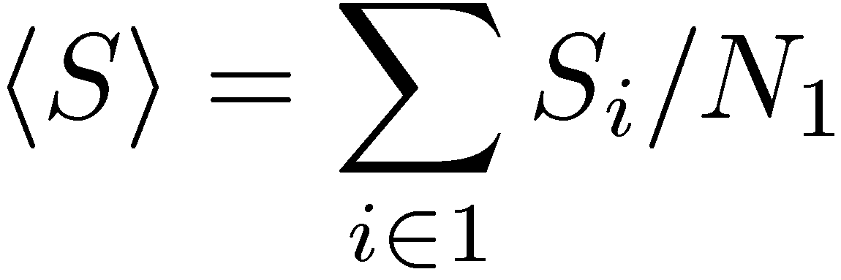
Molecular dynamics
Angle-dependent Lennard-Jones mixture
Orientational order parameter
species 1: ellipse with angle-dependent diameter
species 2: isotropic particle (impurity), diameter =
for small
spatial dimension
summation is take over the first species with nearest neighbours
: number of bonded particles (first species)
: amplitude of orientation order
of the first species

Slide 6
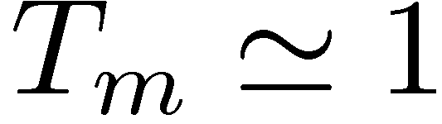
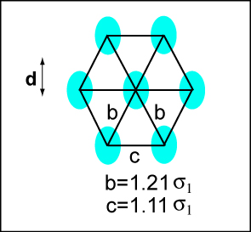
One-component systems: orientation-structural transitions
One component: melting temperature
orientation phase transition at low temperature (far below solid-liquid transition temperature) on hexagonal crystal lattice
three martensitic variants
direct (proper) orientation-lattice coupling
equilateral isosceles triangle
fixed volume simulations
(NVT-ensemble)

Slide 7
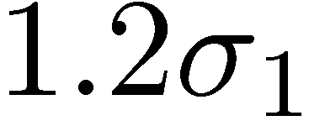
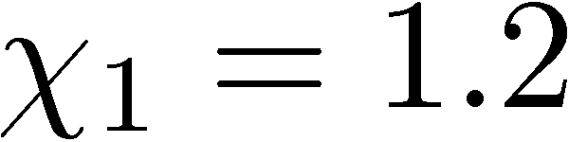
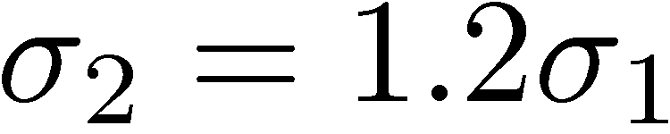
Binary mixtures
binary mixtures of anisotropic particles and isotropic impurities
In this case, crystallization occurs at
: aspect ratio ∼1.2

Slide 8
Orientational disorder with isotropic impurity
positionally ordered crystals in all the figures
orientational disorder is enhanced by
increasing the impurity concentration
c: concentration of circular particles
black circles: circular particles

Slide 9
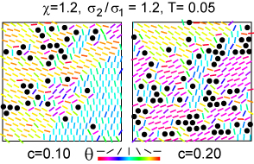
Mesoscopically heterogeneous distribution of ordered domains
disorder is enhanced near impurities
  planar anchoring (parallel to impurity surface)
ordered domains develop not near impurities
probability distribution of orientation order
nearest neighbour
of the impurities
otherwise

Slide 10
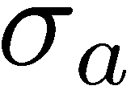
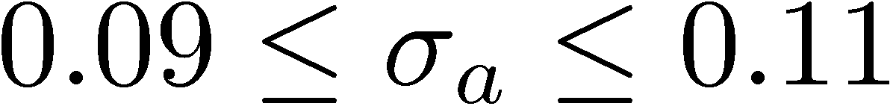
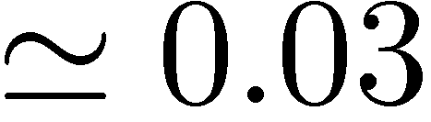
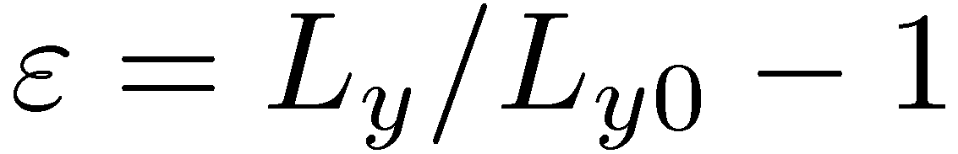
Large mechanical response
: external uniaxial stress (stretching for positive )
large mechanical response for
stress induced ordering in glass (the favored variant is selected)
remnant strain vanishing upon heating
reversible cycle:
apply stress -> release -> heating -> cooling (no dislocation formation)
: strain
stretching

Slide 11
More increasing impurities
hysteresis loop disappears at high concentration
unstretched states

Slide 12
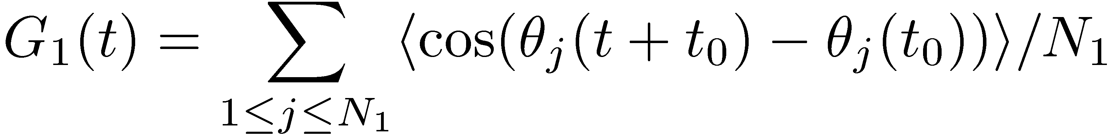
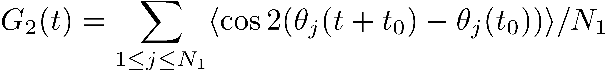
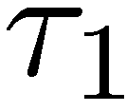
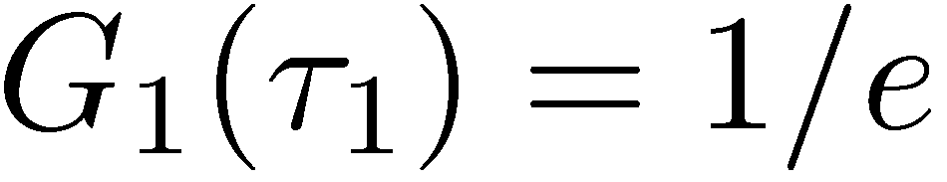
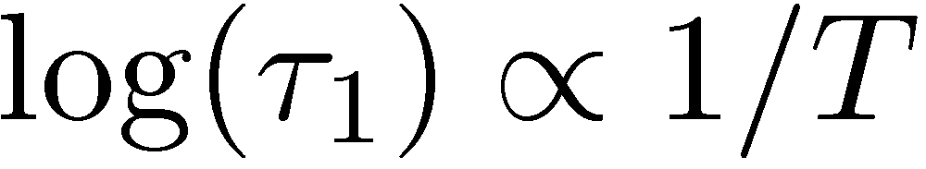
Rotational dynamics
angle relaxation function in 2D
relax due to turnover motions
relax due to orientational configuration change
(relaxation time of G1)
def.:
Arrhenius

Slide 13
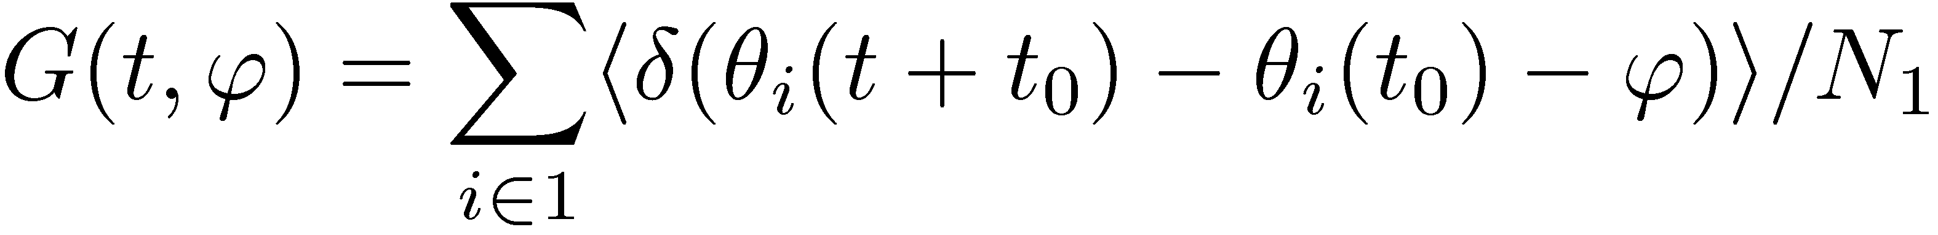
Rotational dynamics
ellipses sometimes flip 180 relaxation of G1(t)
G2(t) does not relax in this process

Slide 14
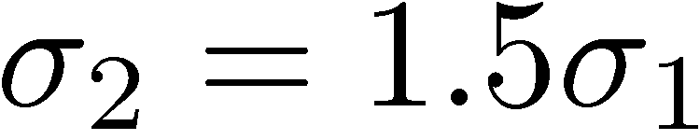
Double glass
Up to now, the size of the impurities is nearly the same as that of anisotropic particles
Translational disorder is developed when adding large (or small) impurities
This time:
mesoscopic picture ?
translation-orientation coupled relaxation ?

Slide 15

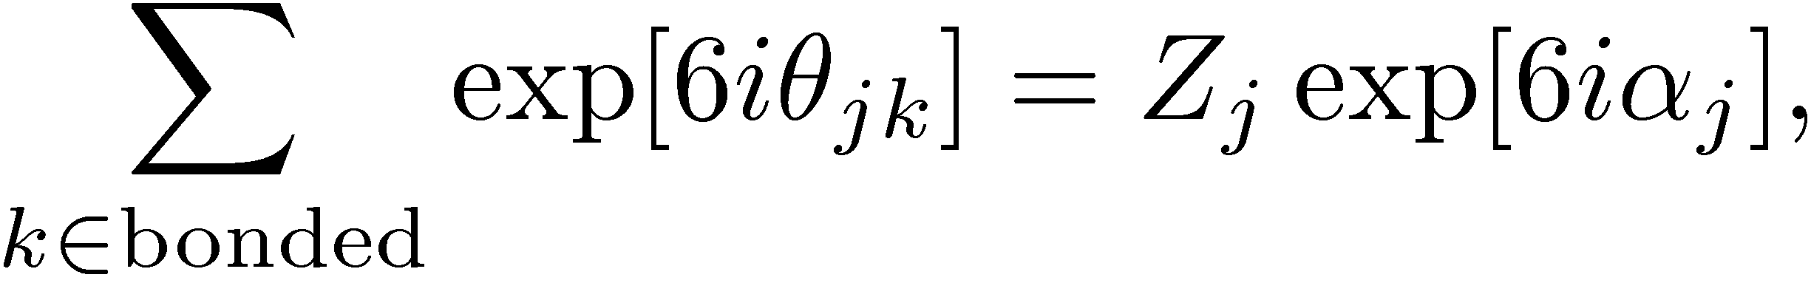
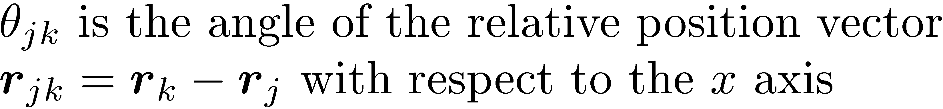
Positional disorder and orientational disorder
particle orientation
bond orientation angle
def. of

Slide 16
Expanded snapshots
left: particle orientations
right: crystalline order (Delaunay triangulation with cutoff)
Delaunay triangulation: measure coordination number (nz) of each particle.
Particles with nz=6 are crystal-like, whereas those with nz=5 or 7 are defects
Orientationally ordered domains are finer than meso-crystalline grains.

Slide 17
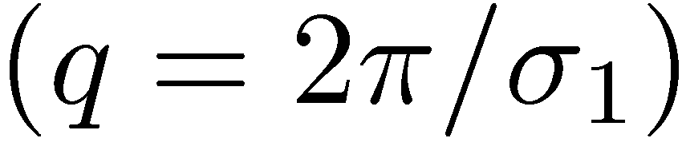
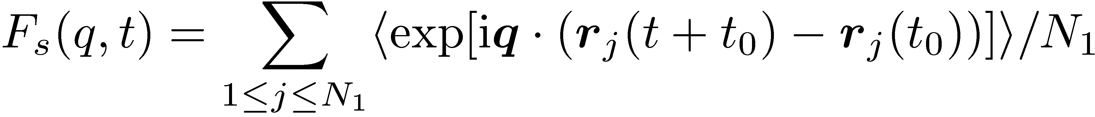
Relaxation dynamics
Three different relaxation functions (self-part)
  first order orientation time correlation function
  second order orientation time correlation function
  translational time correlation of the first species
ellipses sometimes flip 180
relaxation of G1(t)
G2(t) does not relax in this process

Slide 18
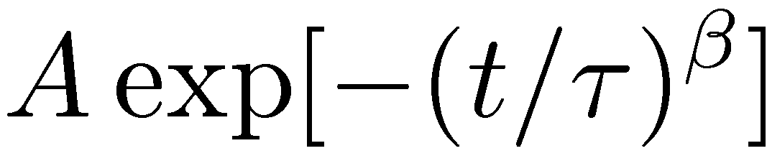
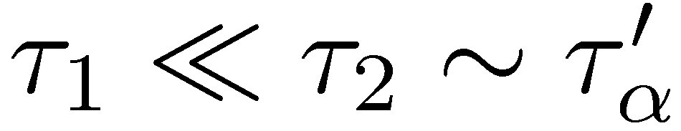
Translational and rotational relaxation
As lowering temperature…
・late stage: fitting by the stretched
exponential function
・relaxation time of G1 :Arrhenius
at low temperature
(relaxation of G1 is much faster than
that of G2 and Fs)
At low temperature, turnover motion
is conspicuous (leading to relaxation of G1),
G2 and Fs relaxes mainly due to
configuration rearrangement at the late stage.

Slide 19
Summary
Molecular dynamics model of orientational glass and double glass with one anisotropy parameter
Anchoring of particle orientation by impurities leads to heterogeneous distribution of ordered and disordered domains
Phase ordering induced large mechanical response in the nonlinear regime
translation-rotation coupled relaxation
Kyohei Takae and Akira Onuki, arXiv: 1203.2425; EPL 100, 16006 (2012);
arXiv: 1305.4244.

