Slide 1

Femtoscopy for flavored hadron-hadron interactions
Akira Ohnishi (YITP, Kyoto U.)
The 59th International Winter Meeting
on Nuclear Physics, Bormio, Italy,
Jan. 23 to 27, 2023
Introduction
Femtoscopy Basics
  Interaction dep. of the correlation function
Hadron-Hadron Interactions and Bound States with Strangeness
  S=-1 ~ -6 BB pairs, Bound state candidates
Homeworks
Summary

Slide 2
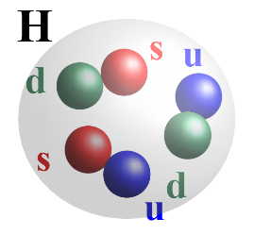


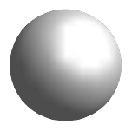


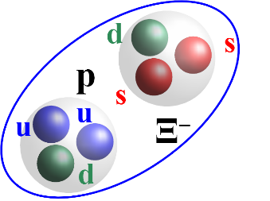
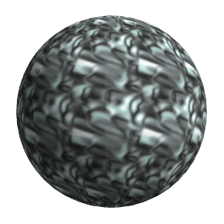
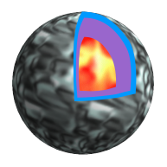



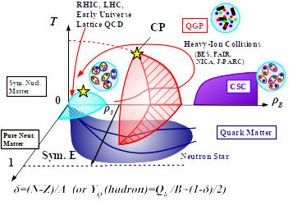
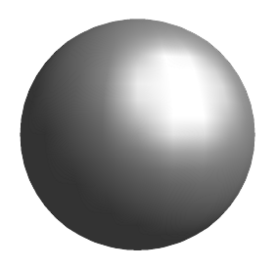



Hadron-Hadron Interactions
Hadron
Molecule
Dibaryon
Neutron
Stars
Exotic
Hadrons
YN & YY Int.
Hadron-Hadron
Interactions
Phase
diagram
medium mass
modification
Nuclei,
Hypernuclei
HHIs are the basic inputs
for hadron many-body systems
c
c
c
c

Slide 3
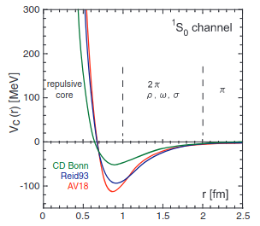
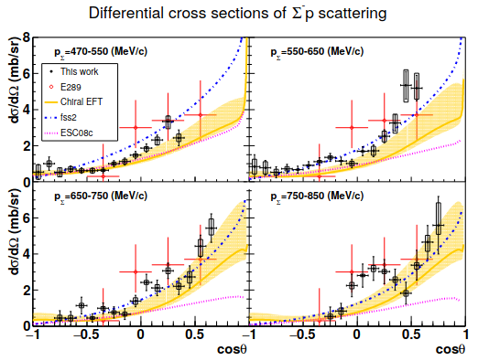
But info. is limited on flavored hadron int.
Nucleon-Nucleon (NN) Interactions
  Based on rich NN phase shift data,
  high-quality potentials are obtained.
Scattering experiments
  Targets need to be stable (p, nuclei)
  Beam particles need to fly a few cm or more.
  NN, πN, K⁺N, K–N, YN (Hyperon-N)
  E.g. J-PARC E40 (ΣN scattering)
Hypernuclei, Exotic Nuclei
  Interactions from bound states
  Exotic atoms (π, K–, Σ–),
  Hypernuclei (Λ, Σ, Ξ, ΛΛ).
Femtoscopy
  Correlation function contains info.
  on Scattering via Final State Interaction
  Any pair is accessible if PID is possible.
Ishii, Aoki, Hatsuda (‘07)
Miwa+[J-PARC E40](‘21)

Slide 4
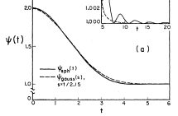
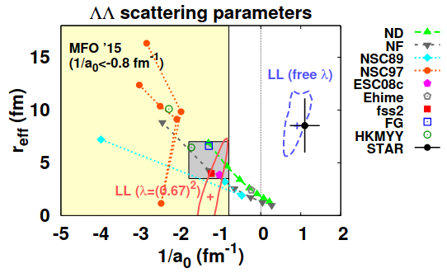
Femtoscopy
Correlation Function
Koonin('77), Pratt+('86), Lednicky+('82)
Source size (HBT)
Hadron-Hadron Interaction
Hanbury Brown & Twiss,
Nature 10 (1956), 1047;
Goldhaber, Goldhaber, Lee, Pais,
Phys. Rev. 120 (1960), 300.
Lednickey, Lyuboshits (‘82); Lednicky, Lyuboshits, Lyuboshits (‘98); Heidenbauer (‘19); C. Greiner,
B. Muller, PLB219('89)199; AO+ ('00); Morita+(‘15~); Kamiya+(‘20~); STAR (‘15~); ALICE (‘19~)
1/R
q (relative momentum)
AO+(‘16)

Slide 5
… and it works
Prediction
Measurements
STAR(‘06)
(nucl-ex/0511003)
Wang, Pratt (‘99, PRL,
nucl-th/9907019)
ALICE (2104.04427)
Extracted scattering parameters ~ Known values

Slide 6
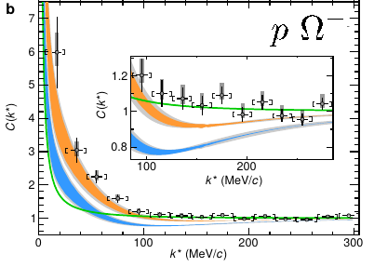
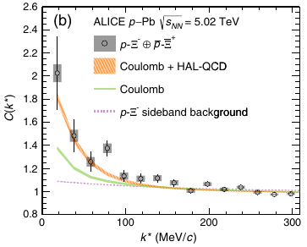
Measured Flavored Hadron CFs (examples)
Adamczyk+[STAR],
PRL114(‘15)022301
ALICE, Nature588
(‘20)232.
STAR, PLB790 ('19) 490 [1808.02511].
Acharya+(ALICE),
Nature (‘20)
ALICE, 2105.05578
S. Acharya+[ALICE],
PRL124(‘20)092301

Slide 7
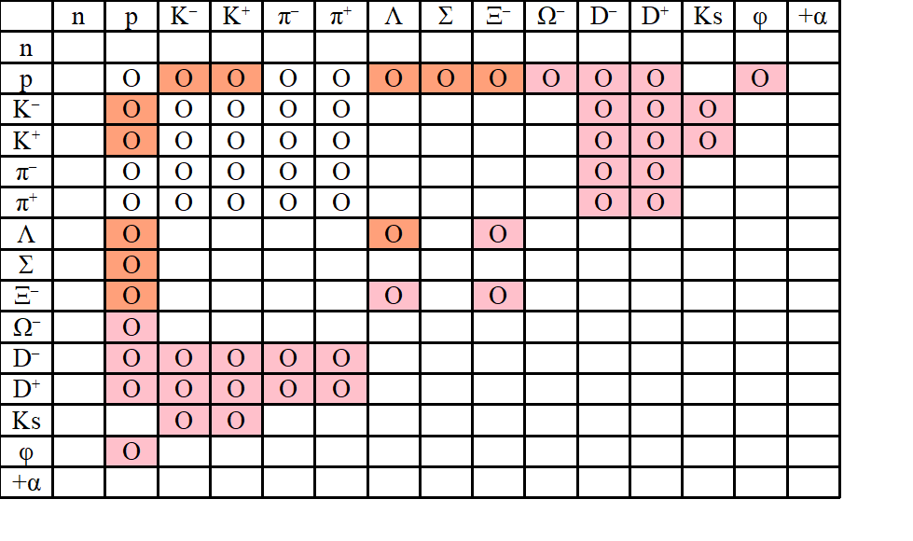
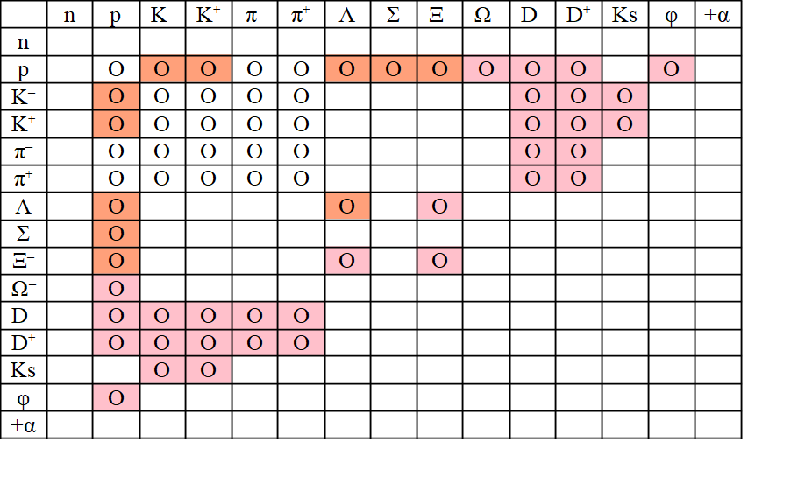
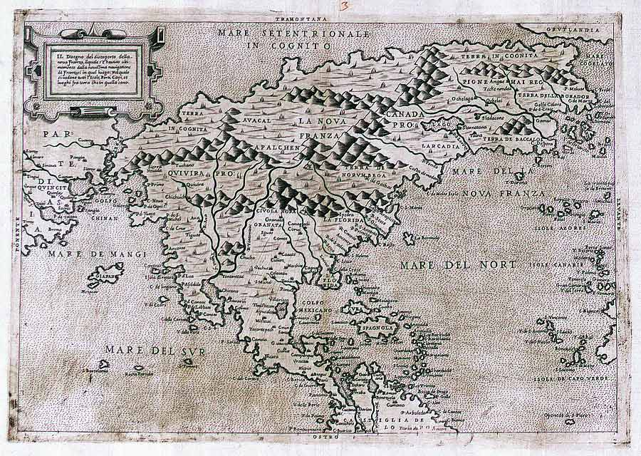
Scope of Femtoscopic study of HHI
pD±
Chamed hadron-nucleon interaction
Bound state ?
pφ → a₀ (Lattice pot. ?)
pK–
Chiral CC pot.
(examined)
Bound state
(favored)
pΞ–
Lattice QCD CC
pot. (examined)
Bound state
(disfavored)
K±K⁰_{s}
Tetraquark
component
in a₀ meson
pΩ
Lattice QCD pot.
J=2 (examined)
Bound state
(favored)
ΛΛ
Scattering pars. (a₀ , r_{eff} )
(constrained)
Bound state (disfavored)
100マス計算(by 慈道)
が急速に進んでいる。
terra
incognita
Paolo Forlani (?-1577)

Slide 8
Contents
Introduction
Femtoscopy Basics
  Koonin-Pratt formula, Lednicky-Lyuboshits formula
  Interaction dependence of the correlation function
Hadron-Hadron Interactions and Bound States with Strangeness
  S=-1, -2, -3, -4, -5, -6 (pΛ, pΞ, pΩ, ΞΞ, ??, ΩΩ) BB pairs
  Bound state candidates (NΩ, K–p, D–p)
Homeworks
Summary

Slide 9

Femtoscopy Basics
– Interaction Dependence
of Correlation Functions –

Slide 10

Two-particle momentum correlation function
Emission function of one particle
Two-particle momentum distribution
  Assumption: Particles are emitted independently. Correlation is made by final state interaction (or quantum statistics).
Correlation Function (CF) from the Koonin-Pratt formula
  Integrate over CM coordinates, normalized Source function is used.
  Koonin('77), Pratt('86), Lednicky+('82)
Relative w.f.
(pair rest frame)
source fn.
relative w.f.

Slide 11
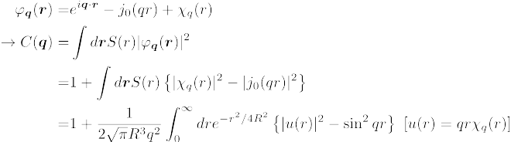
S-wave contribution to the Correlation Function
Effects of Hadron-Hadron Interactions on C(q)
  Only the S-wave w.f. is assumed to be modified.
  (C(q) deviates from 1 at low q (q<200 MeV/c) → S-wave dominance
  Cases with non-identical particle pair and Gaussian source
L>0
C(q) shows enhancement of S-wave |w.f.|² from | j₀(qr)|².
Solve 1D Schrodinger Eq. and Integrate in 1D.

Slide 12
Square-Well Potential in 3D (1)
Square well potential
S-wave wave function
Scattering length and Effective range
E.Braaten, H.-W.Hammer, Phys.Rept. 428 (‘06) 259.
(continuity of logarithmic derivatives)

Slide 13
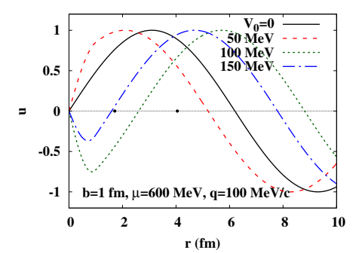
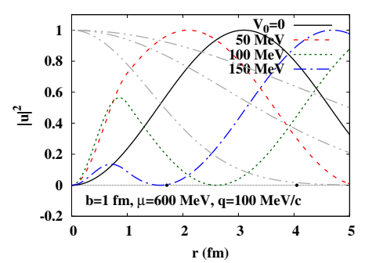
Square-Well Potential in 3D (2)
Weakly attractive pot. (no bound state)
→ |w.f.|² is enhanced at small r → C(q) > 1
Strongly attractive pot. (w/ bound state)
→ |w.f.|² is suppressed at small r → C(q) < 1
  With a bound state (a₀>0), w.f. has a node around r~ a₀

Slide 14
Square-Well Potential in 3D (3)

Slide 15
Correlation function from square-well potential
One dimensional integral (Combination of complex error fn.)
Non-monotonic dep. on the potential strength
  V₀ < 80 MeV (no bound state) → C(q) increases with V₀
  V₀ > 80 MeV (with bound state) → C(q) is suppressed with large R
Agrees with Lednicky-Lyuboshits analytical model results

Slide 16
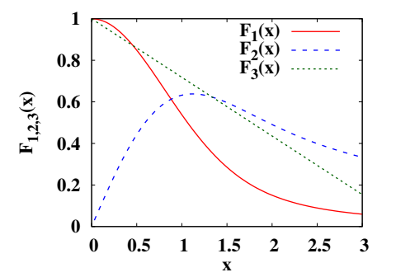
Analytic model of correlation function
Correlation function in Lednicky-Lyuboshits (LL) formula
(asymptotic w.f., non-identical particle pair, short range int. (only s-wave is modified), single channel, no Coulomb pot., static Gaussian source, real δ) (Lednickey, Lyuboshits (‘82))
If you have a₀ , r_{eff} and R,
you can draw C(q) !
AO,Morita,Mihayara,Hyodo, NPA 954 (‘16)294.

Slide 17
Hadron-Hadron Interactions
and Bound States
with Strangeness using Femtoscopy
c.f. Talk by Harald Appelshauser (Mon)

Slide 18
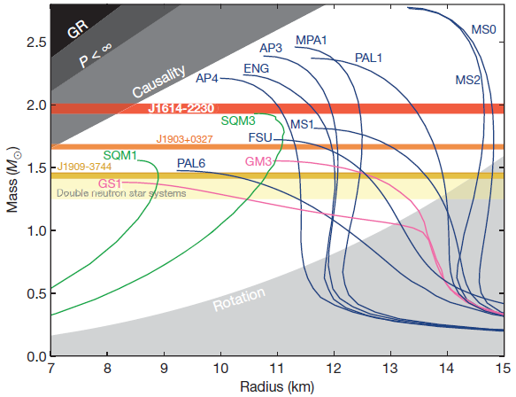
Hadron-Hadron Interactions with Strangeness
Hyperonic matter EOS with empirical Hyperon-Nucleon (YN) interactions cannot support 2 solar mass neutron stars
(Hyperon Puzzle).
  YN interaction details ? YNN 3-body int. ? Many-body theories ?
  Gradual transition to quark matter ? Modified gravity ?
Anti-kaon Nucleon interaction predicts a bound state Λ(1405),
which is the starting point of “Hadronic Molecule”.
Demorest et al., Nature 467 (2010)
1081 (Oct.28, 2010).

Slide 19
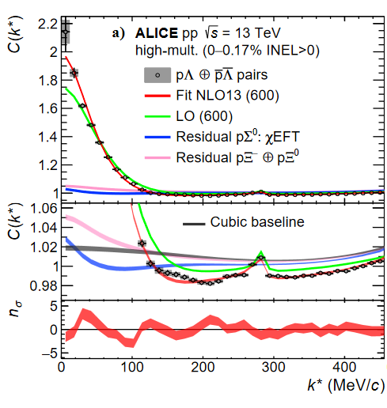
S=-1: ΛN interaction
Scattering data exist, but only at high momenta (q>200 MeV/c).
Constrained by hypernuclear spectroscopy, but indirect.
Femtoscopy
  High precision data including
  low momentum region.
  NΣ cusp is clearly seen.
  NLO chiral EFT better explains
  the data than LO.
S. Acharya+[ALICE],
PLB 833(‘22)137272
Femtoscopy would be
valid alternative
to scattering experiments
(at least at low energies).
– Laura Fabbietti,
ExHIC2016 @ YITP –

Slide 20
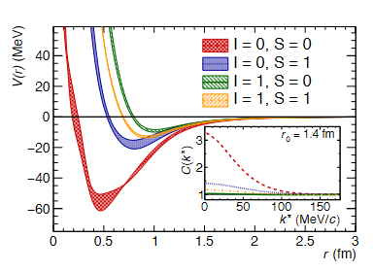
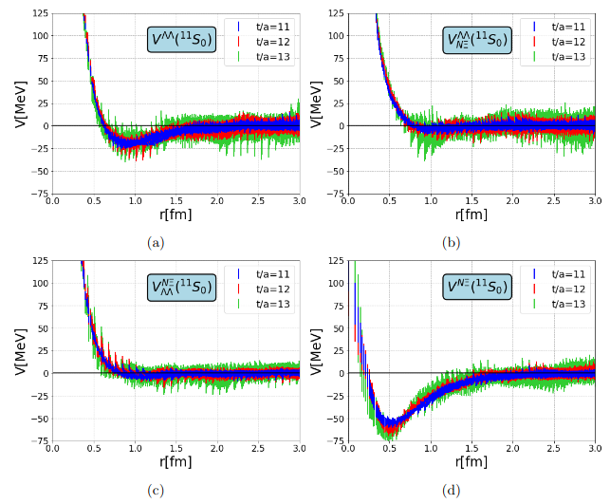
S=-2: ΞN interaction
Lattice S=-2 BB interaction K. Sasaki+[HAL QCD], NPA 998 (‘20) 121737.
Corr. Fn. data (from pp collisions) S. Acharya+ [ALICE] (Nature, ‘20)
Lattice QCD S= –2 BB potential is examined!
Acharya+(ALICE),
Nature (‘20)
K. Sasaki+ [HAL QCD](‘20)
Taken from L. Fabbietti+,
Ann. Rev. Nucl. Part. Sci. 71 (‘21) 377.

Slide 21
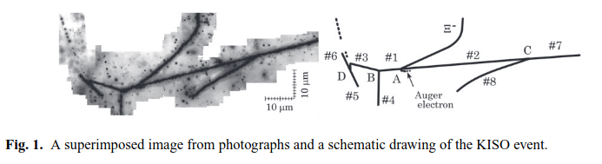
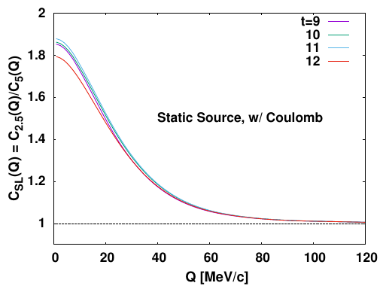
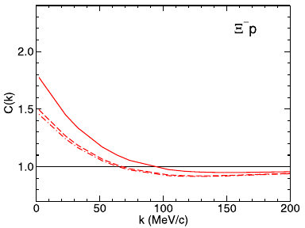
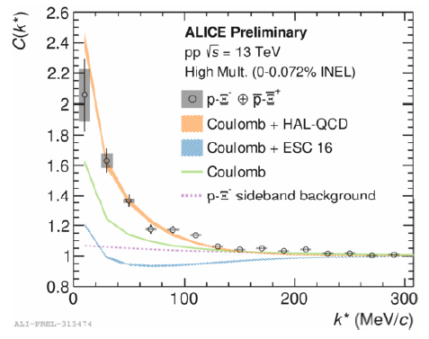
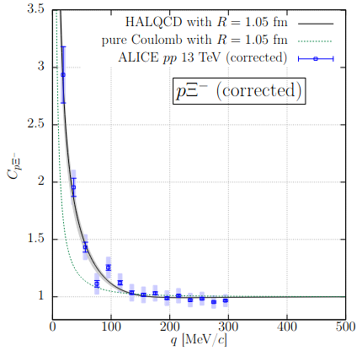
Comparison with other results
K.Nakazawa+, PTEP2015(‘15)033D02. Ξ hypernucleus (2015)
T. Hatsuda, K. Morita, AO, K. Sasaki,
NPA967(‘17)856. (heavier quark mass)
J. Haidenbauer, NPA981(‘19)1.
(NLO(600), w/ CC effects, w/o Coulomb)
(w/ Coulomb, it will be comparable with data.)
Kamiya+(‘22)
(w/ Lattice BB pot. at phys. mq
and CC effects with ΛΛ)
D. L. Mihairov+[ALICE], NPA1005(‘21)121760
(QM2019). (Nijmegen pot.
does not explain the data.)
K. Mi+(STAR, preliminary),
Au+Au 200 AGeV, APS2021.
(No Dip at larger R)

Slide 22
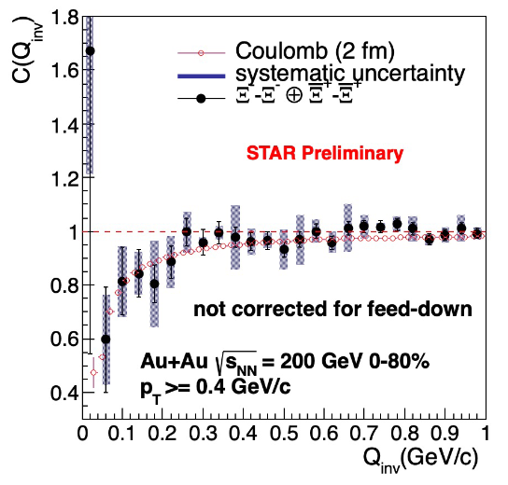
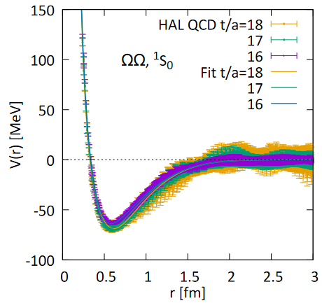
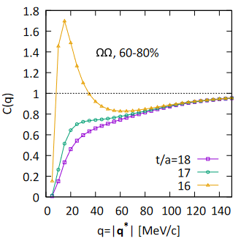
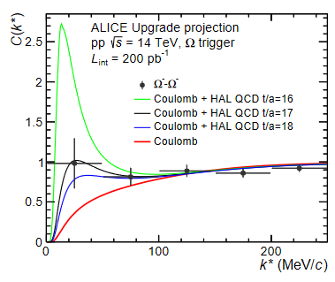
S ≤-4 BB interactions: How far can we go?
S=–4 (ΞΞ)
  Chiral EFT and Lattice QCD predict
  attraction (no bound state)
  J. Haidenbauer+(‘15); T. Doi+(‘18)
  STAR preliminary data seems to
  agree with pure Coulomb results.
  (Attraction compensate quantum statistics)
S=-6 (ΩΩ, most strange BB pair)
  Lattice QCD predicts a bound state (J=0) S. Gongyo+[HAL QCD](‘18)
  Prediction of the correlation function Morita+(‘20)
  To be measured in LHC Run3 L.Fabbietti+(‘21)
Morita+(‘20)
Gongyo+(‘18)
Fabbietti+(‘21)

Slide 23
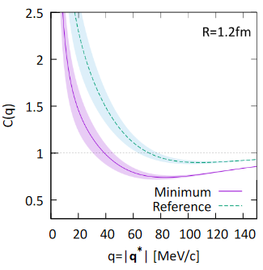
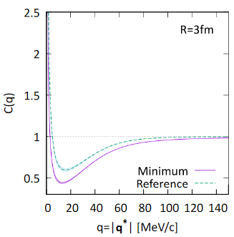
S=-3: ΩN interactions
Ω : quark content=sss, J^{π}=3/2+, M=1672 MeV
ΩN bound state as a S= –3 dibaryon ? T.Goldman+(‘87); M.Oka(‘88).
(No Pauli blocking, Attractive one gluon exch. pot)
Lattice QCD potential (HAL QCD, J=2) F.Etminan+(‘14);T.Iritani+(‘19)
pΩ correlation functions STAR(‘19); ALICE(‘20)
  Prediction using lattice potential Morita+(‘16, ‘20)
  Lattice NΩ potential (J=2) seems reasonable.
  J=1 component will fill the dip.
  Source size dependence → Bound state?
ALICE (‘20)
R=1.2 fm
R=3 fm
Morita, Gongyo (‘20)
STAR (‘19)

Slide 24
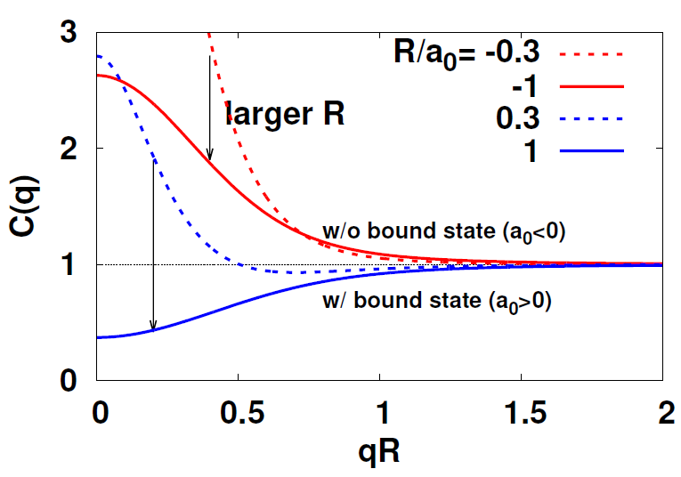
R Dependence of Correlation Function
With a bound state, |w.f.|² is suppressed at r ~ |a₀|
→ C(q) is suppressed at small q when R ~ |a₀|
Morita+(‘16, ‘20), Kamiya+(‘20, ‘22)
One can guess the existence of a bound state from R dep. of C(q)
K.Morita+(‘20)
Y.Kamiya+(‘22)

Slide 25
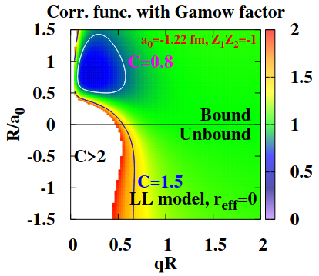
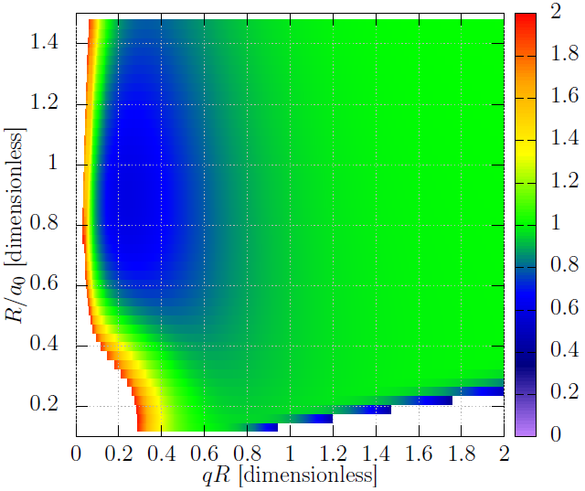
R Dependence of Correlation Function
LL model with Coulomb
(r_{eff}=0)
Realistic NΩ potential
(J=2, HAL QCD, a₀=3.4 fm)
+ Coulomb, Coupled-channel
Courtesy of Y. Kamiya
Qualitative feature remains
with realistic interactions
(and coupled-channel effects)

Slide 26
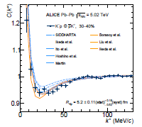
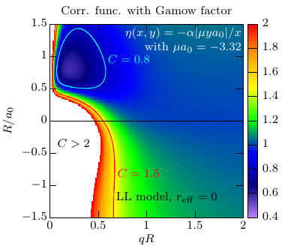
Bound State Dip
Acharya+
[ALICE], PLB822(‘21),
136708
[2105.05683]
AA (Au+Au, Pb+Pb)
STAR (‘19)
ALICE (‘20)
Au+Au
pp (High-Multiplicity)
Siejka+[STAR, preliminary],
NPA982 (‘19)359.
ALICE(‘20)
Kamiya+(‘20)
Scattering length a0(ΩN)=3.4 fm (Iritani+(‘19, HAL QCD)
a0(K- p)=-0.65 + 0.80i fm (SIDDHARTA)

Slide 27
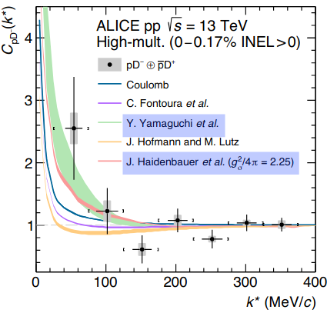
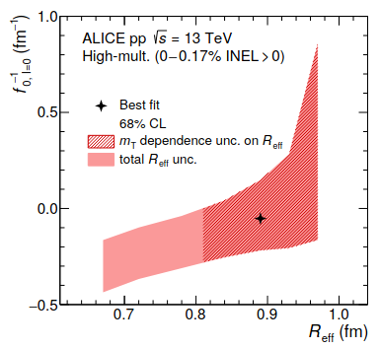
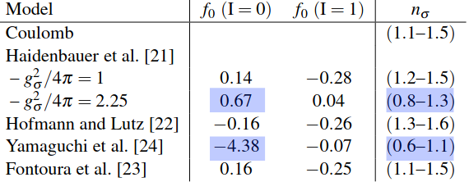

How about D⁻ p ?
“First study of the two-body scattering involving charm hadrons”
Acharya+[ALICE] (2201.05352)
  Enhanced CF from Coulomb → attractive potentials are favored
  If bound, $Θ_{c}(=\overline{c}uudd)$ is a bound hadronic molecule
ALICE (‘22)
Unbound
Bound
Fontoura+(1208.4058) (weakly attractive (I=0)) n_{σ}=(1.1-1.5)
Yamaguchi+ (1105.0734) (att., w/ bound state (I=0))n_{σ}=(0.6-1.1)
Hofmann, Lutz (hep-ph/0507071) (repulsive (I=0)) n_{σ}=(1.3-1.6)
Haidenbauer+(0704.3668) (weakly / mildly attractive (I=0)) n_{σ}=(1.2-1.5 / 0.8-1.3)

Slide 28

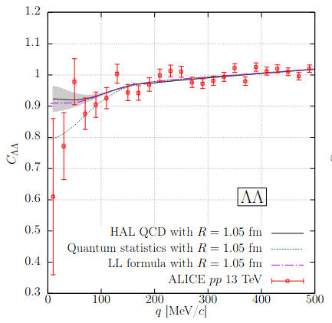
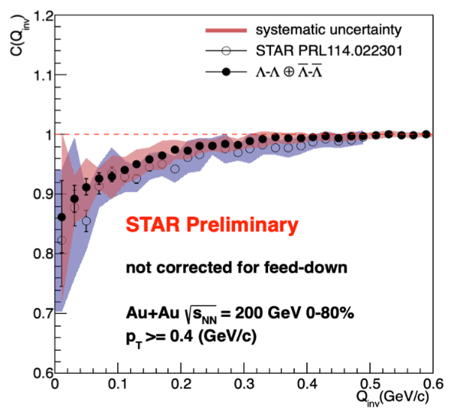
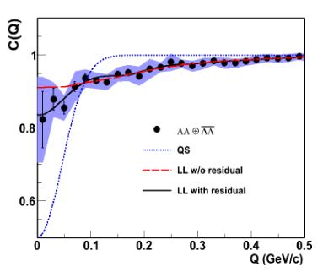
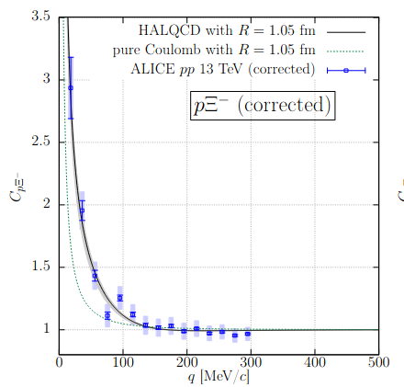
Case without a bound state
ΛΛ and NΞ seem to be unbound from lattice QCD calculation !
Sasaki+ [HAL], NPA998 (‘20)121737 [1912.08630]
Source size dependence of ΛΛ and pΞ– correlation functions
→ No dip or suppressed behavior in AA collisions.
pp
Au+Au
ALICE
[1805.12455]
Moe Isshiki+ (STAR, prelim., 2109.10953).
STAR, PRL(‘15) [1408.4360]
ALICE
Nature (‘21)
[2005.11495]
K. Mi+ (STAR,
preliminary),
Au+Au,
APS2021.
Kamiya+
[2108.09644]

Slide 29
Homeworks to hadron physicists
from femtoscopy

Slide 30
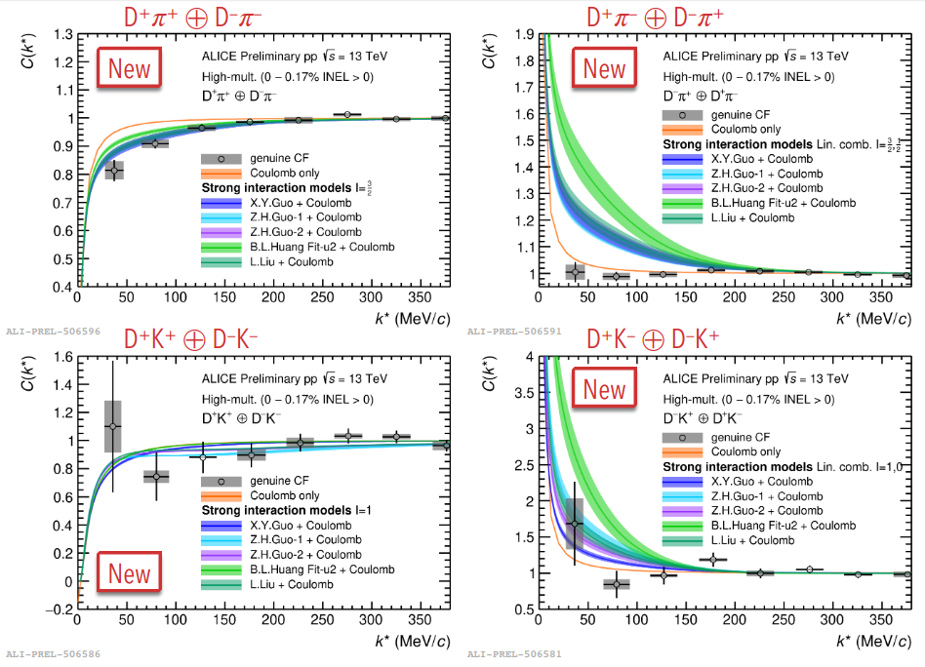
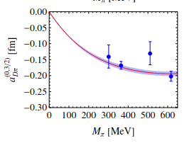

Homework to Hadron Physics (1)
Present chiral models do not explain correlation.
  Overestimate C(D⁺π–) → Mystery ? Extrapolation to phys. mass ?
  Leading order = Weinberg-Tomozawa (vector exch., repulsive)
  Further repulsive interaction ?
  Overestimate C(D⁺K–) → Further repulsion or bound state ?
Fabrizio Grosa@QM2022

Slide 31
Homework to Hadron (Nuclear) Physics (2)
Proton-Deuteron Correlation function c.f. Bhawani Singh (Fri)
  K⁺d C(q) is well explained with f₀ ~ -0.5 fm Haidenbauer, Hyodo
  Other hd corr. fn. are also described approximately by two-body potential S.Mrowczynski, P.Słon, Acta Phys.Pol.B51(‘20),1739; J.Haidenbauer, PRC102(‘20)034001; F.Etminan, M.M.Firoozabadi, (1908.11484); K.Ogata, TFukui, Y.Kamiya, AO, PRC103(‘21),065205.
  pd correlation function cannot be explained by using LL formula or potential model with known f₀. One needs to solve Faddeev Eq.
  Michael Viviani’s talk (Wed)
  Rearrangement?
  Anti-sym. of
  two protons?
K⁺d and pd correlation function
from ALICE.
To be reported.

Slide 32


Homework to Hadron (Nuclear) Physics (3)
Three-body correlation function (c.f. Bhawani Singh (Fri))
  Cumulant
  Can we extract three-baryon repulsion ?
  (important to solve the hyperon puzzle)
  → One needs to solve continuum three-body w.f.
  with Coulmb potential.
Theoretical challenge
ALICE [2206.03344] (Raffaele Del Grande @QM2022)

Slide 33


Homework to Hadron Physics (4)
Correlation function including vector mesons
  Femtoscopy ALICE (PRL, 2105.05578)
  Contradiction with the photo production ?
  scattering length is O(0.1 fm)
  E.g. Strakovsky, Pentchev, Titov (2001.08851)
  Smaller than lattice QCD result (J=3/2) ?
  Lyu, Doi, Hatsuda, Ikeda (2205.10544)
  Bound state in J=1/2 channel
  E. Chizzali, Y. Kamiya, R. Del Grande, T. Doi, L. Fabbietti, T. Hatsuda, Y.Lyu (2212.12690).
ALICE, 2105.05578

Slide 34


Homework to Hadron Physics (5)
K– p Correlation function
  AA collisions → consistent with atomic data and the potential from chiral SU(3) dynamics ALICE(‘21)
  pp collisions → C(q) can be explained with the potential from chiral SU(3) dynamics by tuning the source weight of πΣ
  ALICE(‘20), Kamiya+(‘20)
  pA collisions → Source weight of K⁰n needs to be doubled!
  ALICE (2205.15176)
KN potential
needs update.
(Transition pot.
should be 1.4 times
larger.)

Slide 35

Summary
Femtoscopy has doubled the number of experimentally accessible hadron-hadron interactions in 8 years (2015–2023).
  The number is still growing rapidly.
Some of the hadron-hadron interactions have been constrained.
  First-principles methods in QCD, chiral EFT and lattice QCD (HAL QCD), have been found to be successful in femtoscopy.
Source size dependence of the correlation function is helpful to guess the existence of a bound state.
  KN (→ Λ(1405)), ΩN (=sssqqq), D–p (= $\overline{c}uud$)(marginal), $Nφ$(J=1/2) may have a bound state.
High-precision data now requires higher quality theoretical results and/or updates.
It may be the time (for me) to consider (go back to) dynamical sources (hydro / transport) in femtoscopy.
  Scott Pratt and STAR are working on it!

Slide 36
Thank you for your attention !

Slide 37
Correlation function with coupled-channel effects
KPLLL formula = CC Schrodinger eq.
under Ψ⁽⁻⁾ boundary cond. + channel source
Koonin('77), Pratt+('86), Lednicky-Lyuboshits-Lyuboshits (‘98),
Heidenbauer (‘19), Kamiya, Hyodo, Morita, AO, Weise (‘20).
No Coulomb
With Coulomb
j=1

Slide 38

Discriminating Coupled-Channel Effects
Source size dependence again !
  Unmeasured coupled-channel wave functions disappear soon.
  → CFs with large source is dominated
  by the measured channel wave function !
  Scattering parameters from CFs with large source
  Coupled-channel effects from CFs with small source.
R=1 fm
R=5 fm
w.f. Kamiya+,arXiv:1911.01041v1

Slide 39
Source Size Dependence of C(pK –)
Coupled-channel effects are suppressed when R is large,
and “pure” pK– wave function may be observed in HIC.
Y. Kamiya, T. Hyodo, K. Morita, AO, W. Weise, PRL124(‘20)132501.
pp
dip
Pb+Pb
Au+Au
S. Acharya+[ALICE],
PRL124(‘20)092301
S. Acharya+[ALICE],
2105.05683
Siejka+[STAR, preliminary],
NPA982 (‘19)359.
STAR(prel.) & new ALICE data show a dip at small q.

Slide 40


Scattering length from K –p correlation function
LL model fit (w/ Coulomb) to the correlation function data
S. Acharya+[ALICE], PLB 822 (‘21) 136708 [2105.05683] (δ ~ +a₀q, HEP convention)
Consistent with SIDDHARTA (kaonic atom) data, and errors are comparable to previous dedicated experiments.
M. Bassi et al. [SIDDHARTA], NPA 881 (‘12) 88 [1201.4635]
Femtoscopy reconfirmed bound state nature of Λ(1405)
SIDDHARTA

Slide 41







Exotic Hadrons including
Main play ground of exotic hadron physics
  X(3872) Belle (‘03)
  Many X,Y,Z states
  Belle, CDF, BaBar, LHCb, CMS, BESIII, ...
  Charmed pentaquark Pc LHCb (‘15, ‘19)
  Doubly charmed tetraquark state Tcc
  LHCb (‘21) $cc\overline{q}\overline{q}$
Structure of exotic hadrons
  Compact multiquark states
  → “good” [ud] diquark gains energy
  Hadronic molecules
  → Many exotic states around thresholds
  Their mixture...
Beijing Spectrometer
X(3872)
S.K.Choi+[Belle],
PRL91, 262001 (‘03)
R. Aaji+ [LHCb], Phys. Rev. Lett.
122, 222001 (2019).
R. Aaji+ [LHCb], 2109.01038, 2109.01056

Slide 42

Compact Tetraquarks or Hadronic Molecules
Tcc = Compact Tetraquark ?
Good diquark gains energy
S. Zouzou+(‘86), ZPC30,457.
X(3872)
  component ? production
  cross section Bignamini+ (0906.0882)
  Large yield in Pb+Pb → Molecule?
  Sirunyan+ [CMS] (2102.13048)
  c.f. Δr/Δp is similar in HIC and molecule.
  ExHIC (‘11,’11,’17)
Hadronic Molecule Conditions
  Appears around the threshold → OK
  Have large size → Yield
  Described by the hh interaction
How can we access
hh int. with charm ?
→ Femtoscopy

Slide 43

Femtoscopic study of charmed hadron int.
correlation functions. Kamiya, Hyodo, AO (2203.13814)
  Related with Tcc and X(3872)
  ALICE run3 can measure the correlation functions.
Model interaction
  Range = one pion exchange Yasui, Sudoh (0906.1452)
  Strength is fitted to the pole mass.
  Isospin dep.
    I=0: One range gaussian, strength fitted to the mass
    I=1: ignored
D*
D
D
D*

Slide 44

Correlation Functions
Features of C(q) with a bound state
  Enhancement at small source, Dip at large source.
  Modification of potential
  (Changing the range,
  V(I=1)=0 or ± V(I=0)/3)
  does not change C(q)
  significantly.
  (dominated by the pole)
  Measurement in Run3
  is awaited.

Slide 45
Tcc and X(3872) structure
Hadronic molecule structure is assumed
→ Eigenmomentum
What happens when multiquark state mixes ?
→ Deviation from weak binding relation (X=compositeness)
Weinberg, Phys. Rev. 137, B672 (1965), Hyodo, Jido, Hosaka (1108.5524),
Kunigawa, Hyodo (2112.00249)
  Hadronic molecule assumption → X=1
  Pure multiquark state → X=0
  Smaller scattering length in DD* may signal
  the genuine tetraquark nature of Tcc.
(High-energy phys. convention)

Slide 46


We are sorry, but we use a Gaussian Source !
Calculating HBT radius in dynamical models is not easy
M.A.Lisa, S.Pratt, R.Soltz, U.Wiedemann, Ann.Rev.Nucl.Part.Sci.55(‘05)357 [nucl-ex/0505014]; S. Pratt, PRL102(‘09)232301 [0811.3363].
and a Gaussian source seems to work
at the current precision of hh interaction studies.
S. Acharya+[ALICE], PLB811(‘20)135849.
  primary (universal ?)+ decay of short-lived resonances
  ~ eff. Gaussian
  Flow and source geometry
  effects are seen in CF,
  but the uncertainty of
  hh int. is the largest.

Slide 47

Toward dynamical source
Calculating HBT radius in dynamical models is not easy
(HBT puzzle).
M.A.Lisa, S.Pratt, R.Soltz, U.Wiedemann, Ann.Rev.Nucl.Part.Sci.55(‘05)357 [nucl-ex/0505014];
But carefully constructed hydrodynamic model may answer.
S. Pratt, PRL102(‘09)232301 [0811.3363].
How about afterburner effects ?

Slide 48
Wave function around threshold (S-wave, attraction)
a₀ =scatt. length
r_{eff} =eff. range
Low energy w.f. and phase shift
  Wave function grows rapidly at small r with attraction.
  With a bound state (a₀>0), a node appears around r=a₀
  → Suppressed |w.f.|² on average
Nucl. and Atomic Phys.
convention
r χ
r χ
r χ
sin qr
sin qr
R
sin qr
R
R
b.s.w.f
r
r
r
No b.s.
loose b.s.
a₀
a₀
V
V
deep b.s.
a₀ < 0 < R
a₀ > R
V
0 < a₀ < R

Slide 49

Interaction Dependence of C(q)
Repulsive interaction → C(q) is suppressed.
Attractive interaction
  Wave function grows rapidly at small r with attraction.
  → C(q) is enhanced for small source.
  Without a bound state (a₀ < 0)
  → C(q) > 1
  With a bound state (a₀ >0)
  → Region with C(q) < 1 appears
Why is C(q) suppressed
when there is a bound state ?
Do we really see
enhanced C(q) for small R
and suppressed C(q) for large R
when there is a bound state ?
LL model
Morita+(‘20)

Slide 50
Discriminating Coupled-Channel Effects
Source size dependence again !
  Unmeasured coupled-channel wave functions disappear soon.
  → CFs with large source is dominated
  by the measured channel wave function !
  Scattering parameters from CFs with large source
  Coupled-channel effects from CFs with small source.
R=1 fm
R=5 fm
w.f. Kamiya+,arXiv:1911.01041v1

Slide 51

Examples of Enhanced C(q) from small source
High-Multiplicity events from pp
S. Acharya+[ALICE],
PRL124(‘20)092301
S. Acharya+[ALICE],
PRL123(‘19)112002.
S. Acharya+[ALICE],
2005.11495 [nucl-ex]
(pp 13 TeV)
ALICE, 2105.05578
Acharya+[ALICE] (2201.05352)

Slide 52






Theoretical femtoscopic study of hh int. (examples)
(chiral SU(3))
(lattice)
(covariant χEFT, S=-2)
Z.-W. Liu, K.-W. Li, L.-S. Geng (2201.04997)
Kamiya+(1911.01041)
Y.Kamiya, K.Sasaki,
et al., (2108.09644)
(lattice)
(chiral EFT)
Morita, Gongyo et al.,(1908.05414),
Morita, AO, Etminan, Hatsuda (1605.06765)
Mrówczyński, Słón (1904.08320, K–d), Haidenbauer (2005.05012, Λd),
Etminan, Firoozabadi (1908.11484, Ωd), K.Ogata+ (Ξ– d,2103.00100)
Haidenbauer(1808.05049),
Morita+(1408.6682)

Slide 53

High-Energy Heavy-Ion Collisions
Main Goal of HIC physics = Discovery and Properties of QGP
HIC as a playground / tool
  Development of dynamical models
  Physics of extreme conditions and/or strong field
  Hadron physics
Hadron Physics using HIC as Hadron Factories
Simultaneous Prod. of many hadrons statistically
Nearly 4π detectors & Vertex detectors

