Slide 1
Revolutionize our understanding of the transient universe: 20 years of discovery in Swift
T. Sakamoto (AGU)

Slide 2
Outlines
Swift for dummies
Neil Gehrels
Swift’s discoveries
Unique capabilities of Swift
High redshift GRBs
[Smallsat development at AGU]
Future of Swift

Slide 3
Swift for dummies

Slide 4
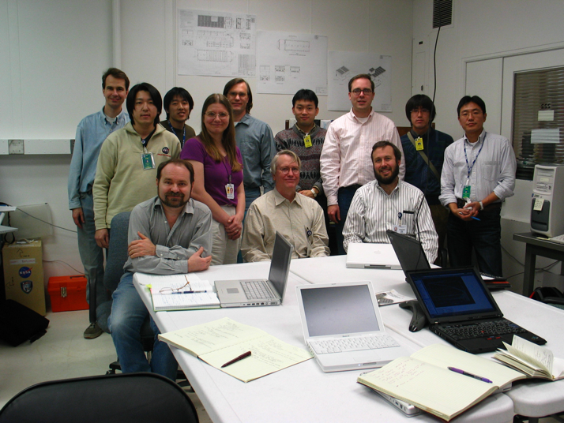
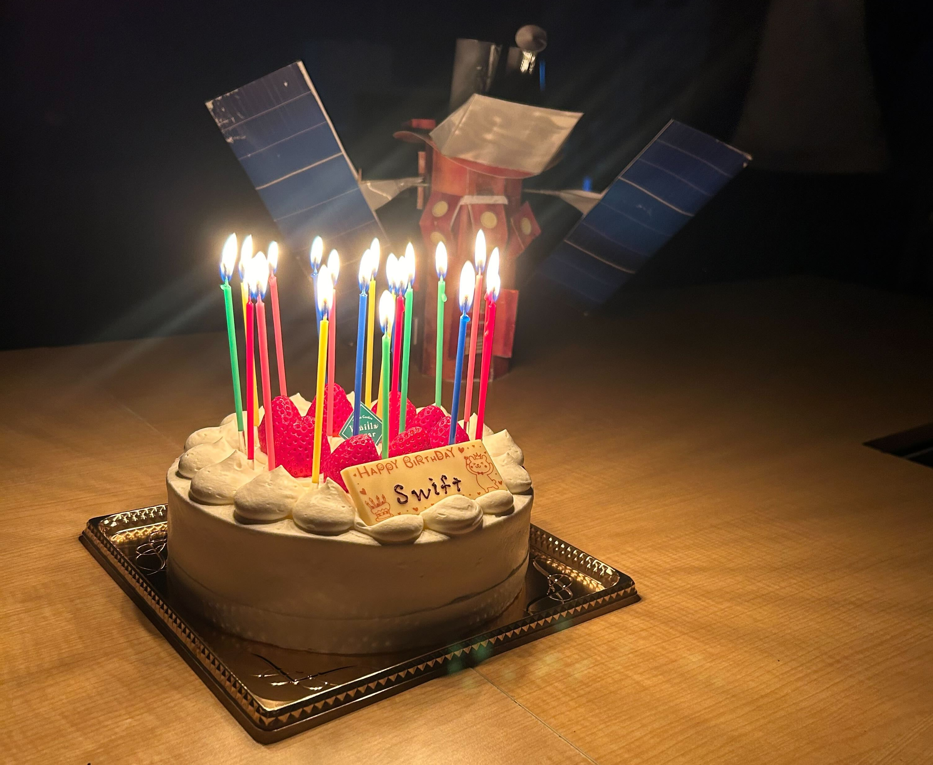
Breaf history of Swift
NASA’s Medium-class Explorer (MIDEX)
January 1999: Selection for phase-A study
October 1999: Mission selection
November 2004: Launch
Swift/BAT team (around 2005?)
Nakazawa-san
Derek
Masaya
Goro
Jay
Craig
20 years and still counting ….
Ann
Me
Jack
Hans
Scott

Slide 5
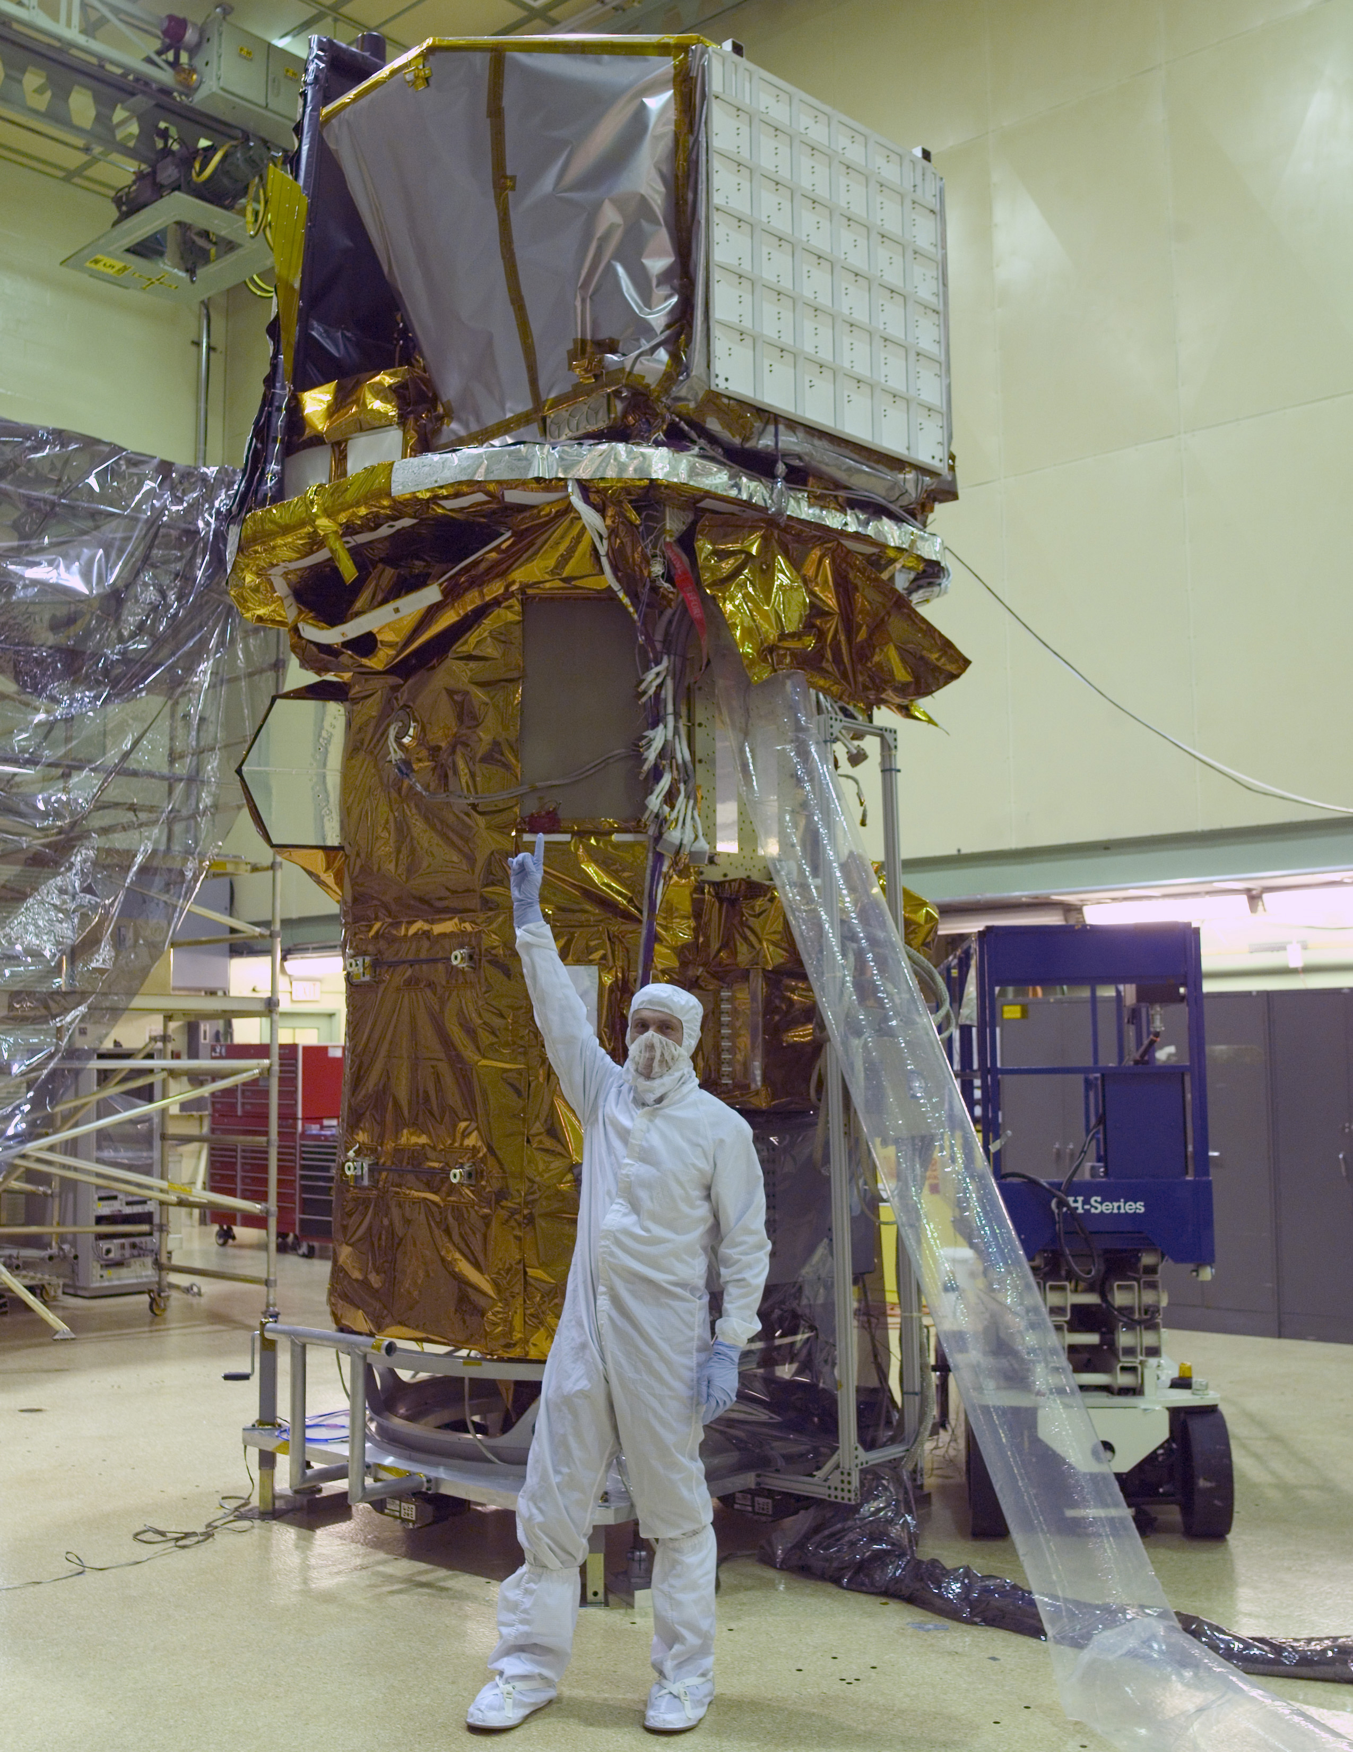
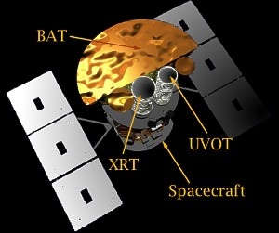
Swift satellite
Burst Alert Telescope (BAT)
GRB detection and localization (~1 – 4 arcmin)
UV/Optical Telescope (UVOT)
UV/optical afterglow (~0.5“)
Detection of UV/optical afterglow for ~60% of GRBs
X-Ray Telescope (XRT)
X-ray afterglow (~5 arcsec)
Detection of X-ray afterglow for ~90% of GRB
Altitude : 600 km
Mass : 1270 kg
Boeing Delta II rocket: November 20, 2004

Slide 6
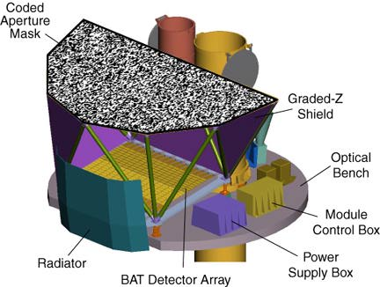
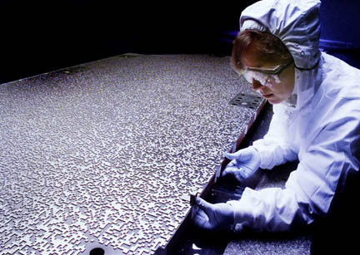
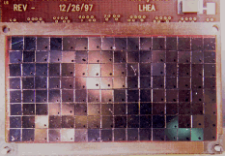
BAT (Burst Alert Telescope)
Energy range: 15-150 keV
Energy resolution: 6.2 keV (FWHM) @ 122 keV
Optics: Coded-mask (open fraction of 50%), size 2.7 m²
Detection area: 5240 cm²
Detector: CdZnTe (4 x 4 x 2 mm³)
# of detectors: 32,768 (256 module x 128 set)
Field of view: 120º x 90º
Localization accuracy: 1-4 arcmin
GRB detection: ~100 GRBs / year
128 CdZnTe

Slide 7
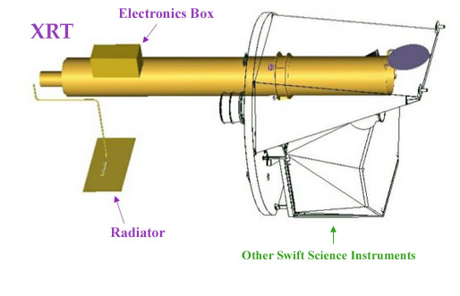
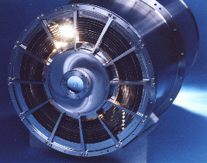
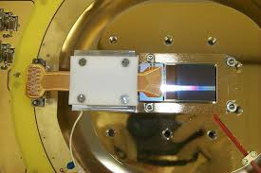
XRT (X-ray telescope)
X-ray mirror
Optics: JET-X Wolter I (flight spare)
Focal length: 3.5 m
Effective area: 110 cm² @ 1.5 keV
Detector: e2V CCD-22
Field of view: 23’ x 23’
Localization accuracy: ~ 5 arcsec
Energy range: 0.2 – 10 keV
Energy resolution: 190 eV @ 10 keV,
50 eV @ 0.1 keV
Sensitivity: 2 x 10⁻¹⁴ erg cm⁻² s⁻¹ @ 1000 s
X-ray CCD

Slide 8
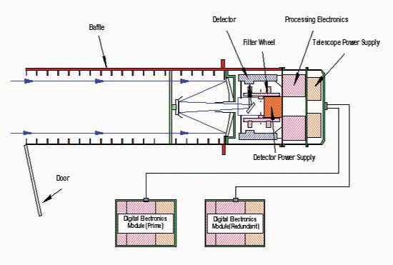
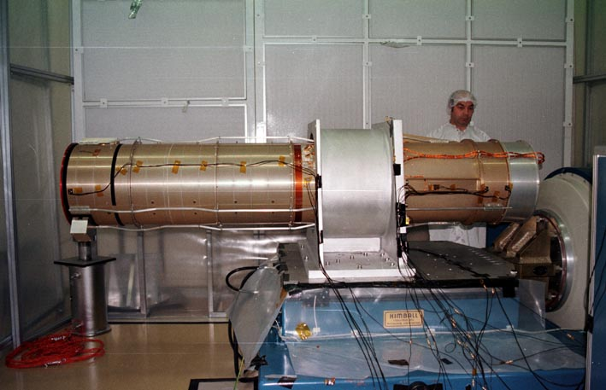
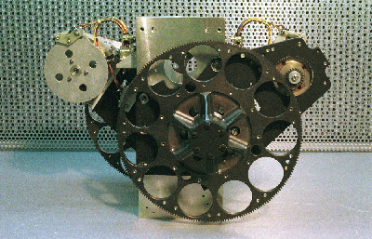
UVOT (Ultraviolet/Optical Telescope)
Optics: Aperture 30 cm (XMM OM’s spare)
Detector: MCP + CCD (same design as XMM OM)
Field of view: 17‘ x 17’
PSF: 0.9’ FWHM @ 350 nm
Observable wavelength: 170 – 600 nm
Filters: 7 filters + 2 grism
Sensitivity: 22.3 mag (white, 1000s)
Pixel size: 0.5 arcsec
V, B, U, UVW1, UVM2,
UVW2, White, UV-grism,
Optical-grism

Slide 9
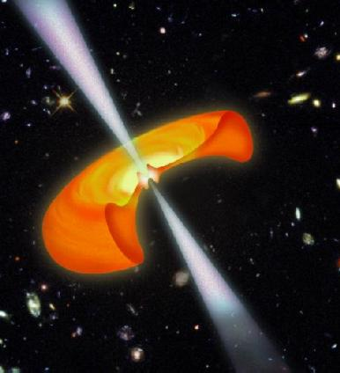
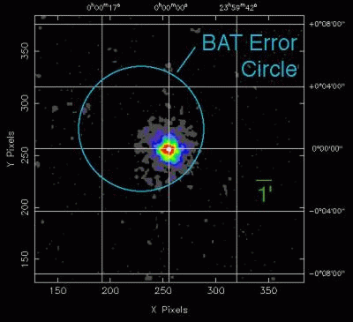
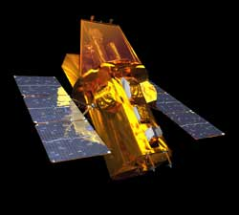
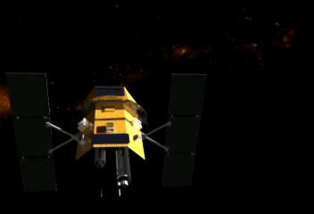
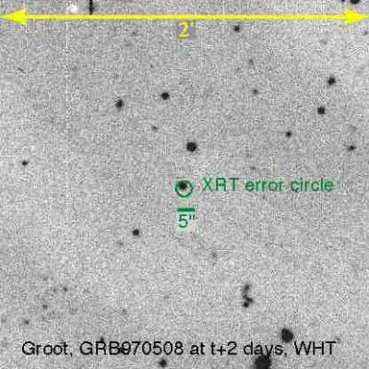
Swift autonomous GRB observation
X-ray image
Prompt detection (BAT)
Localization: 1-5 arcmin
X-ray afterglow (XRT)
Localization: ~2-5 arcsec
BAT GRB detection: T₀
GRB alert notice : T₀ < 20 s
1’
T₀ < 90 s
Slew the spacecraft to
the GRB location:
T₀ + (20 – 75 s)
Optical image
UV/optical afterglow (UVOT)
Localization: 0.5 arcmin
T₀ < 300s

Slide 10
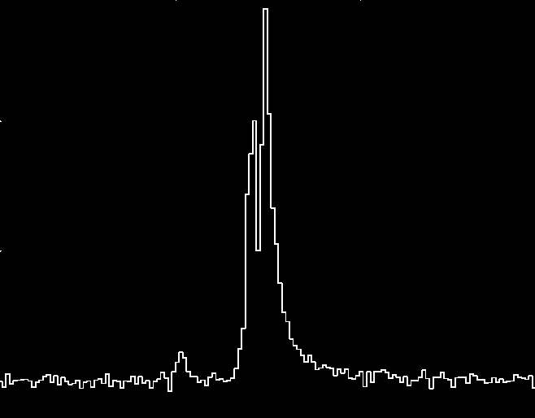
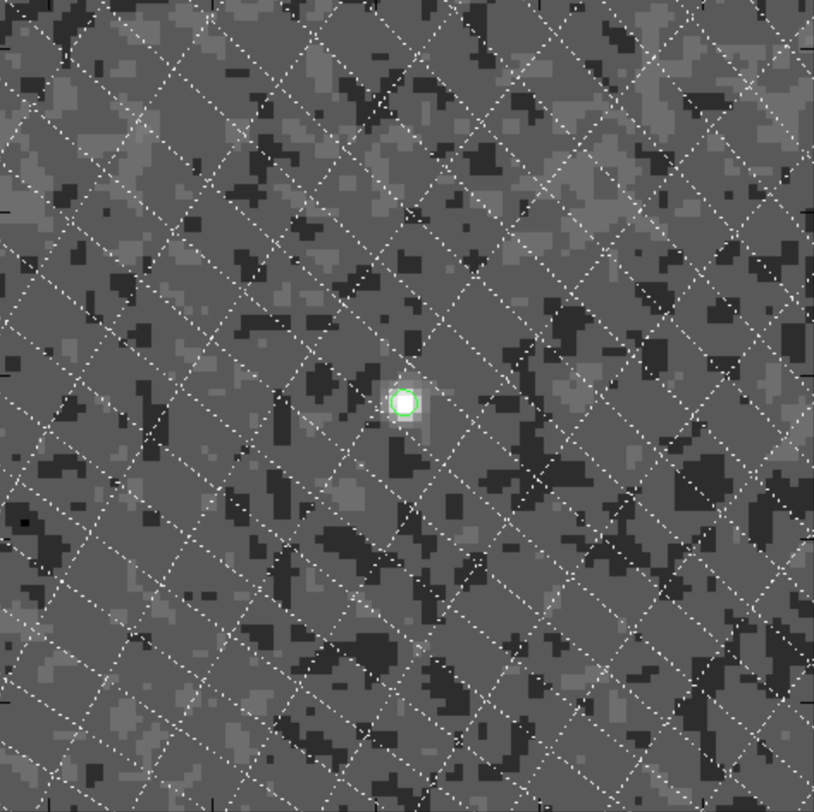
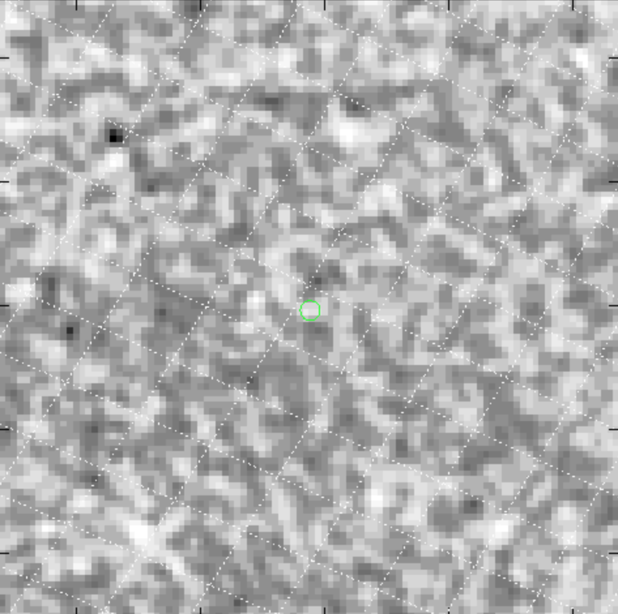
BAT on-board trigger
Rate trigger
Light curve
Sky image
bg
fg
- 674 trigger criteria
- Each trigger criterion has a different trigger threshold
- ~80 triggers per day
+
Trigger!
Image significance ≧ 6.5
- Event data (~10 s) capture (low priority)
- Subthreshold triggers (available through GCN; require regular data downlink)
Successful triggers:
Real time alert
Autonomous spacecraft slew
Event data capture: T₀-250s –T₀+1000s (high priority)
Image trigger
- Every 64 s
- 15-50 keV band only
- All the images are downloaded (high priority)
- Used in the BAT transient monitor (Krimm et al.)
Sky image
Trigger!
Image significance ≧ 7.0

Slide 11
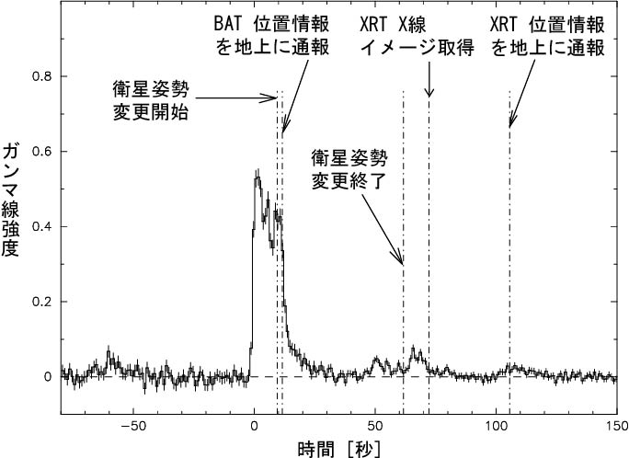
Example of GRB 050713a
0.5 s exposure image
11 sigma detection

Slide 12
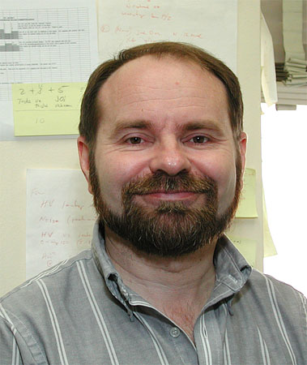
GCN: Gamma-ray Coordinates Network
GCN Notices
Distribution of GRB detection information by various spacecrafts
Receiving and automatically distributing to the GRB community prose-style e-mail messages about follow-up observations on various GRBs
GCN Circulars
PI: S. Barthelmy (NASA/GSFC)
Operation: since 1990s -
99.7% livetime
>500 GCN Notice recipients
2127 GCN Circular recipients (2022/7)

Slide 13
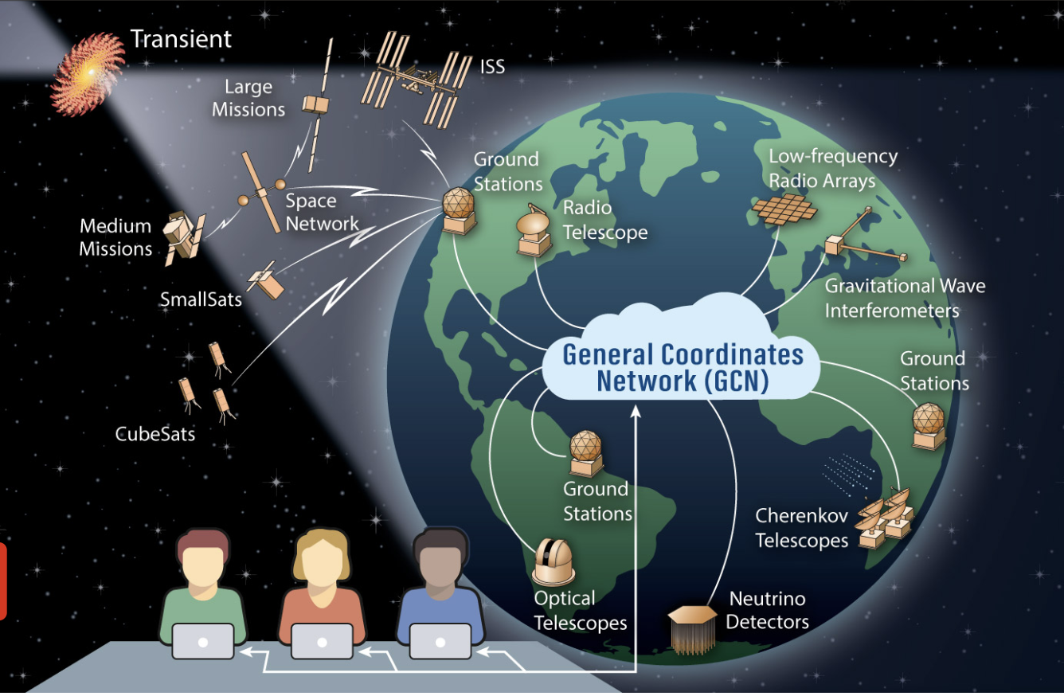
New GCN
GSFC: Judy Racusin, Leo Singer, … (after Scott’s retirement)

Slide 14
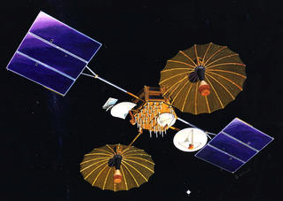
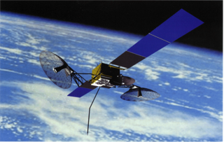
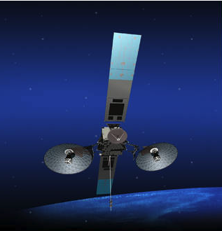
Tracking and Data Relay Satellite System - TDRSS -
First generation TDRS
(launched: 1983-1995)
Second generation TDRS
(launched: 2000-2002)
Third generation TDRS
(launched: 2013-2017)
(TDRS-6, TDRS-7)
(TDRS-8, TDRS-9, TDRS-10)
(figures and information from NASA TDRS webpage: https://www.nasa.gov/directorates/heo/scan/services/networks/tdrs_main)
(TDRS-11, TDRS-12, TDRS-13)
Swift uses the 1 kbps DAS (Demand Access System) for the alert downlink and the ToO upload.
~70% of the time in orbit has a real-time communication between ground and space.
TDRSS will retire around 2025. NASA is aiming for transferring to a commercial communication service.

Slide 15
Swift’s TDRSS data products
All available through the GCN Notice
BAT
GRB BAT position notice
4 channel light curves (variable time scales)
‘Extended’ 4 channel light curves
ACS data
Scaled map (+ACS data)
XRT
XRT position notice
XRT light curve and image
Single pixel event (E > 0.5 keV; central 200 x 200 pixel in PC mode)
UVOT
UVOT 2x2 binned image
(“GeNi” image; 2 cycles of V and white filter)

Slide 16
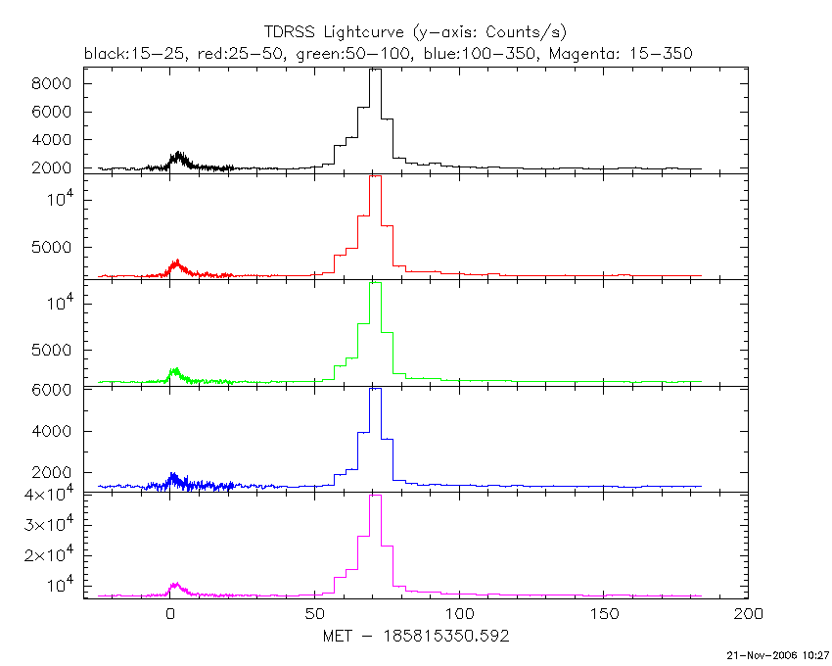
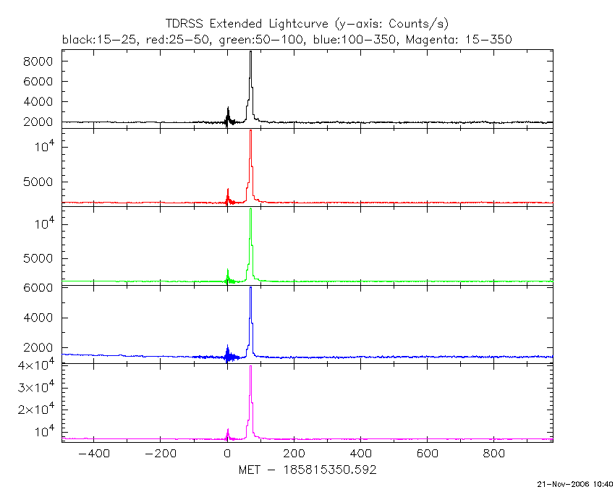
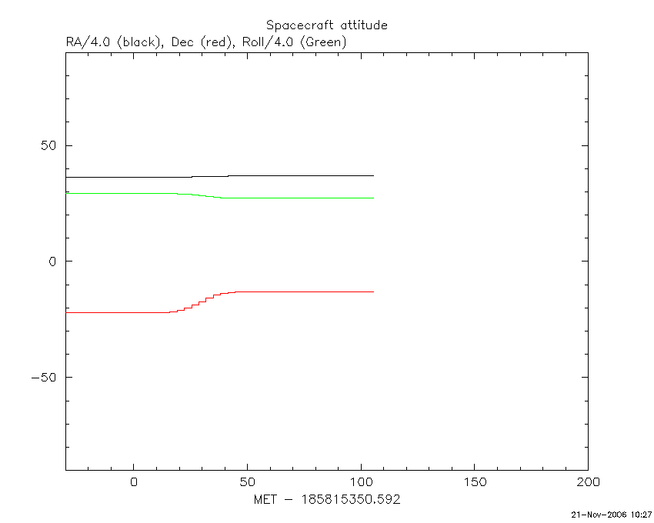
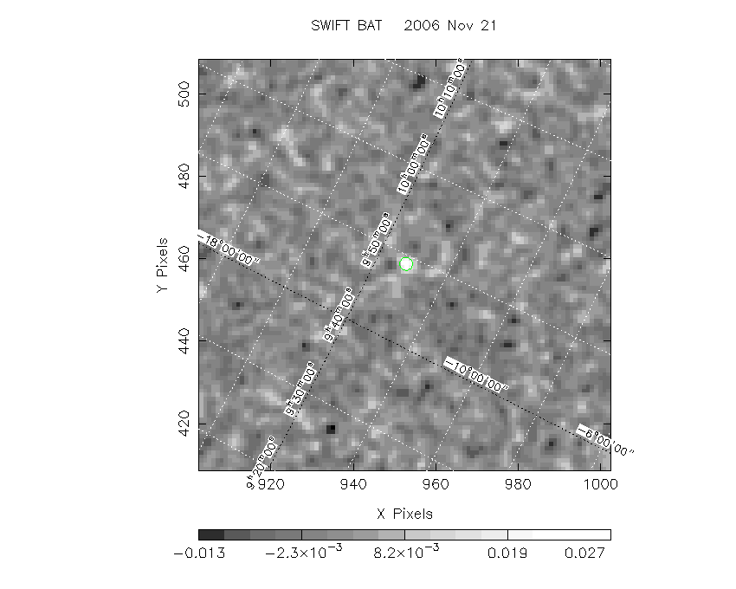
BAT TDRSS data (GRB 061121)

Slide 17
Swift’s TDRSS data products
All available through the GCN Notice
BAT
GRB BAT position notice
4 channel light curves (variable time scales)
‘Extended’ 4 channel light curves
ACS data
Scaled map (+ACS data)
XRT
XRT position notice
XRT light curve and image
Single pixel event (E > 0.5 keV; central 200 x 200 pixel in PC mode)
UVOT
UVOT 2x2 binned image
(“GeNi” image; 2 cycles of V and white filter)

Slide 18
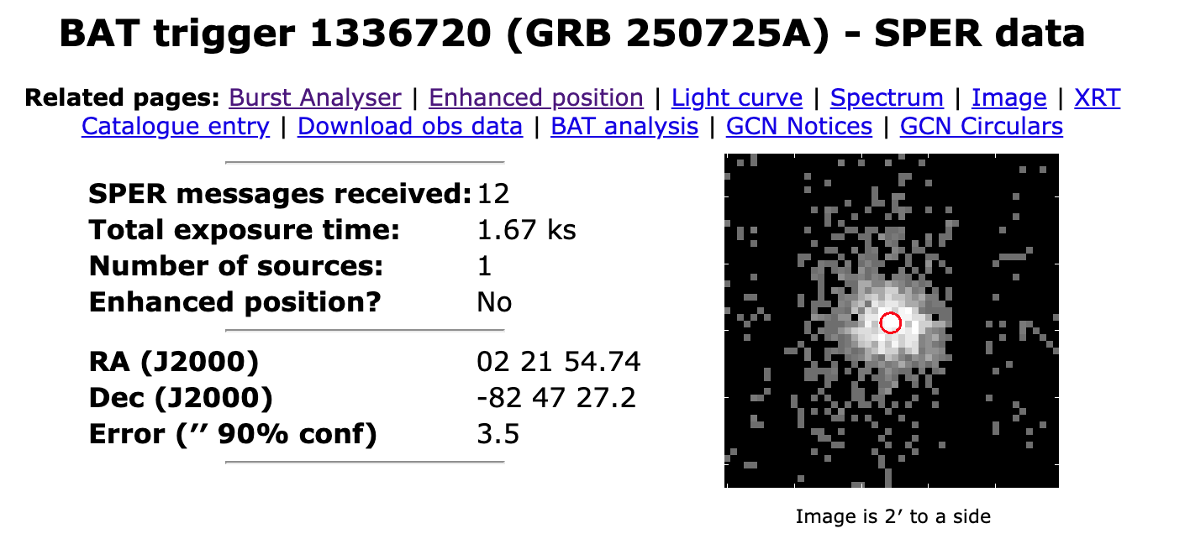
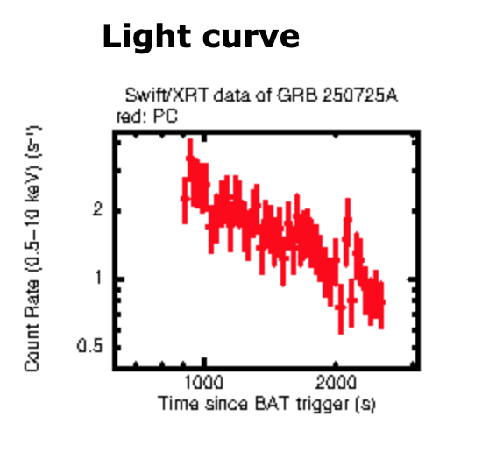
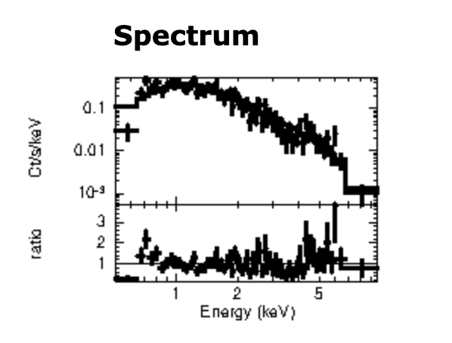
XRT Single Pixel Event Report (SPER) data
(https://www.swift.ac.uk/sper/)

Slide 19
Swift’s TDRSS data products
All available through the GCN Notice
BAT
GRB BAT position notice
4 channel light curves (variable time scales)
‘Extended’ 4 channel light curves
ACS data
Scaled map (+ACS data)
XRT
XRT position notice
XRT light curve and image
Single pixel event (E > 0.5 keV; central 200 x 200 pixel in PC mode)
UVOT
UVOT 2x2 binned image
(“GeNi” image; 2 cycles of V and white filter)

Slide 20
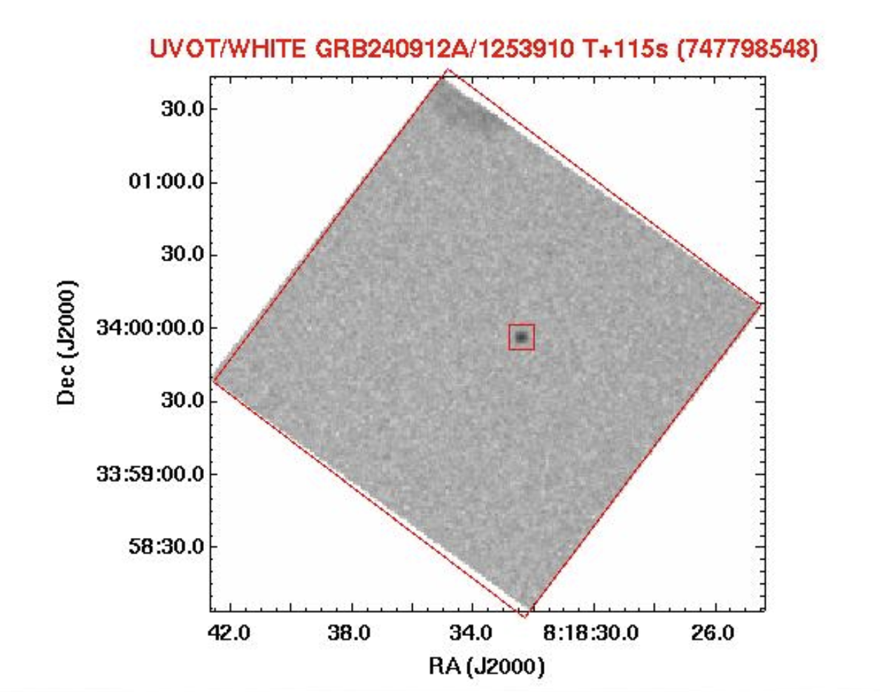
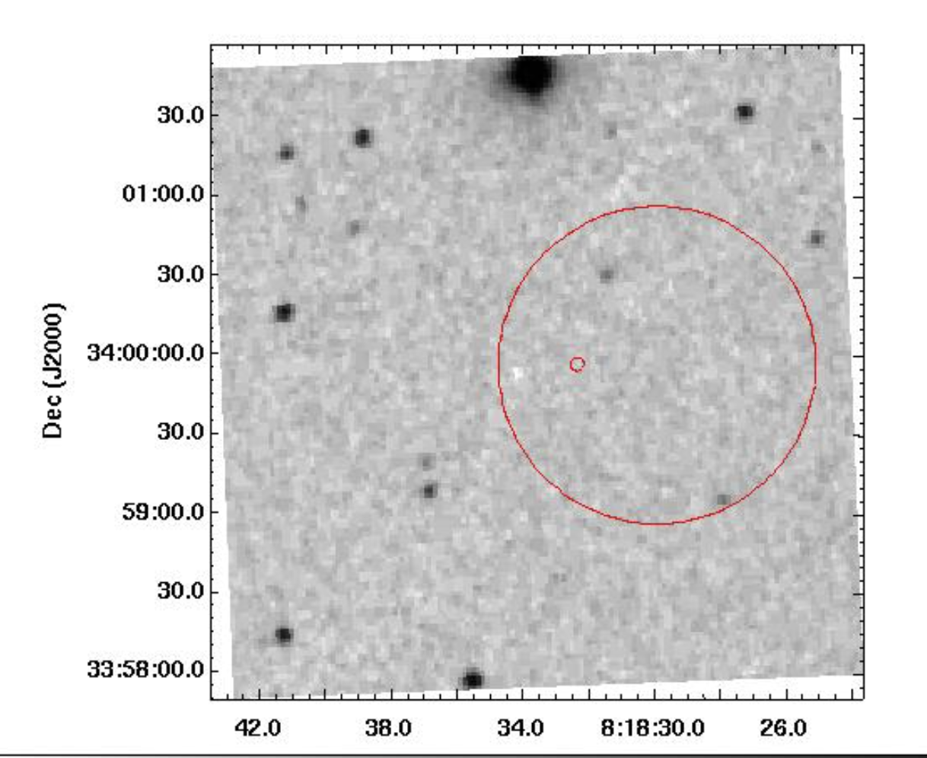
UVOT TDRSS images
UVOT white
DSS image

Slide 21
Neil Gehrels

Slide 22
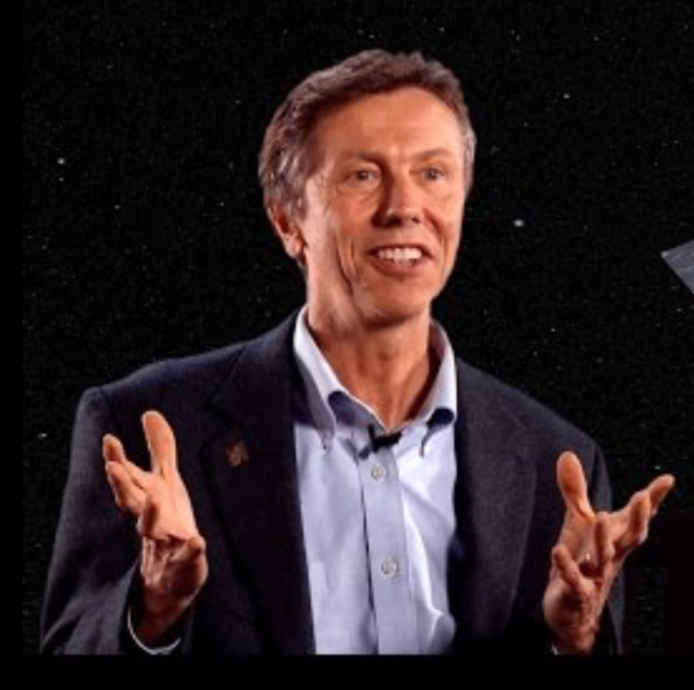
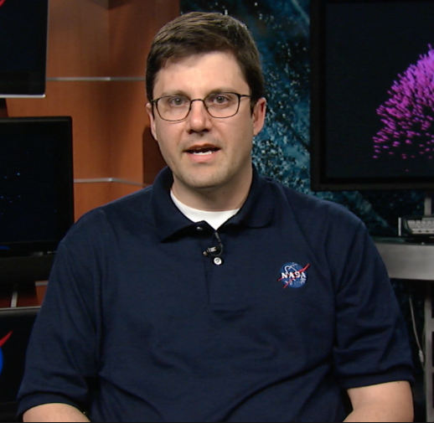
The Neil Gehrels Swift Observatory
The Swift Gamma-Ray Burst Explorer has officially been renamed the Neil Gehrels Swift Observatory
Neil Gehrels (1952-2017)
Brad Cenko: Swift PI
Notes:
Of course the primary purpose is to honor the leadership and vision of Neil. But the name was also chosen to reflect the fact that Swift does so much more than just gamma-ray bursts these days (indeed this is perhaps one of Neil’s most significant legacies).

Slide 23
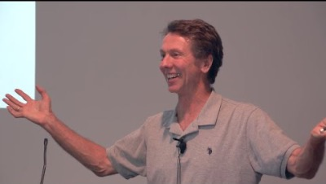
The very first story of Swift by Neil
around 36:26

Slide 24
Swift’s discoveries

Slide 25
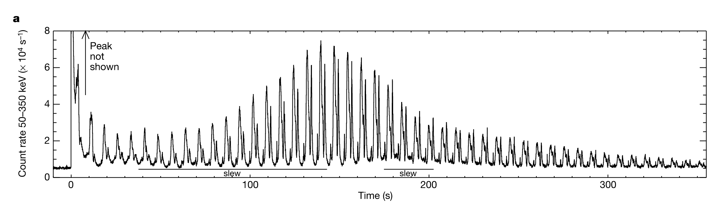
2004: Giant flare from SGR 1806-20
(Palmer et al. 2005)
December 27, 2004
- Swift was in the commitioning phase.
- Only BAT was operating (no XRT/UVOT)

Slide 26
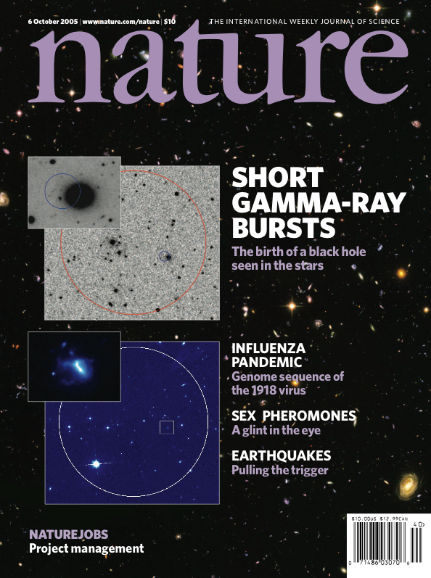
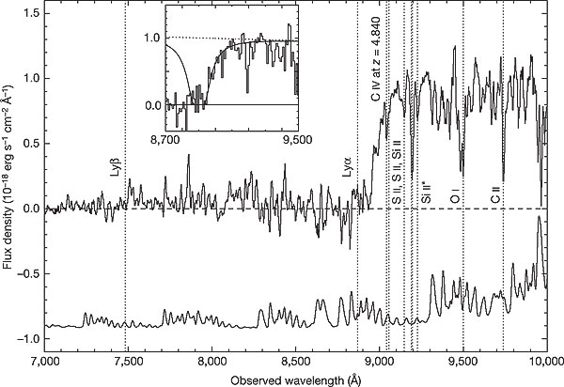
2005: Short GRB Afterglow & High-z GRB
GRB 050509B: X-ray afterglow detection from a short GRB (Gehrels et al. 2005)
GRB 050904: Detection of a high redshift GRB (z=6.29) (Kawai et al. 2006)
The primary science objectives of Swift were detection of
an afterglow of a short GRB and,
a high redshift GRB.
Swift achieved those two primary science objectives within a year!

Slide 27
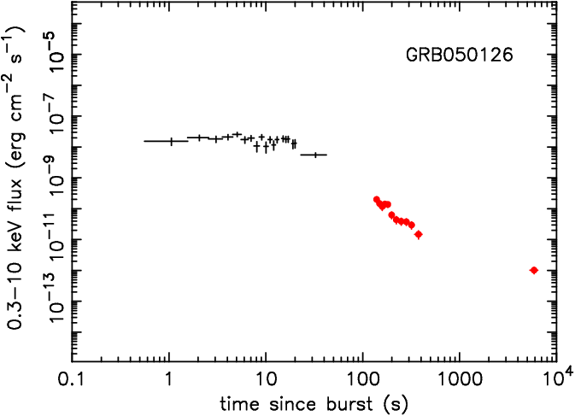
2005-2025: Mysterious X-ray afterglow lightcurve
(O’Brien et al. 2006)

Slide 28
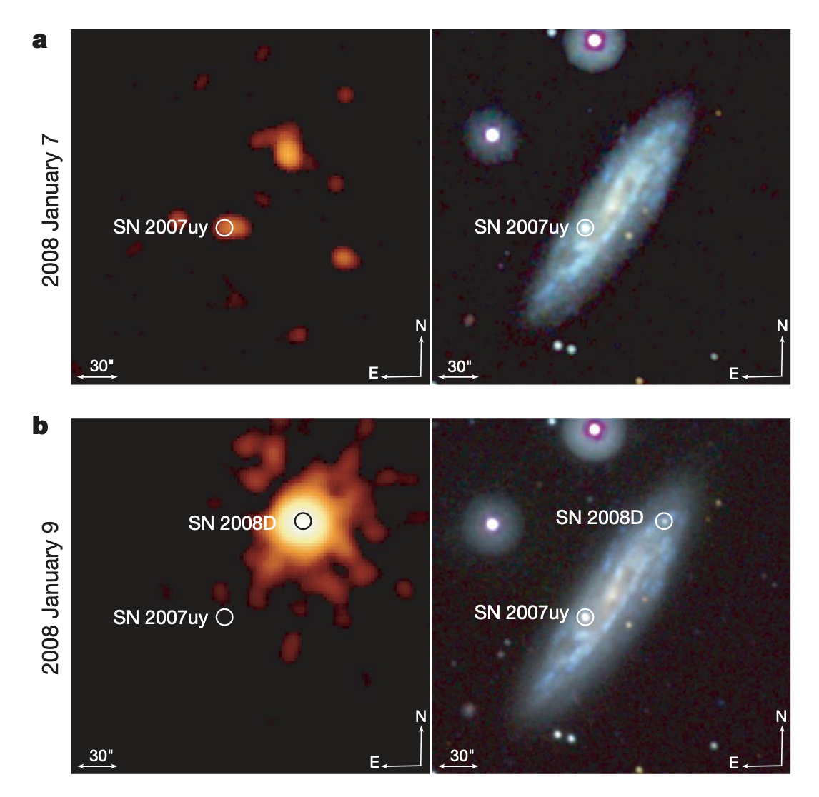
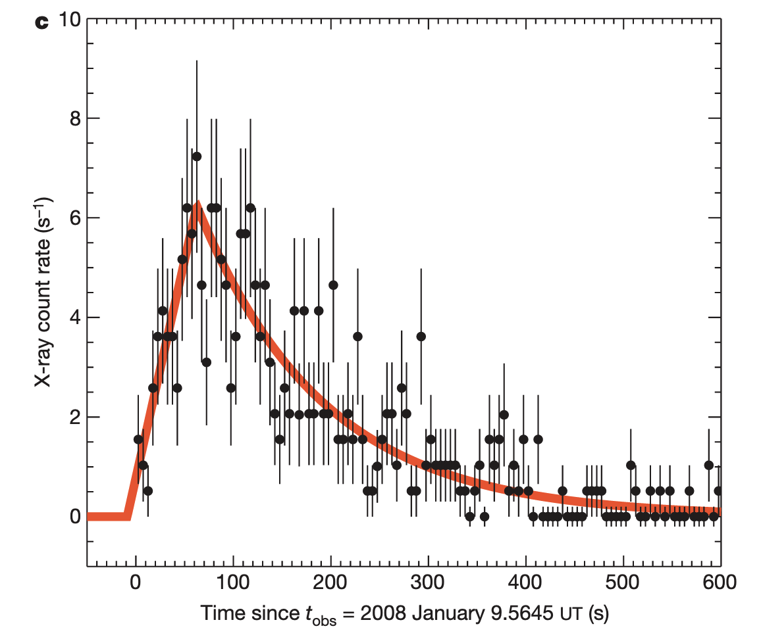
2008: Supernova shock breakout in SN 2008D
(Soderberg et al. 2008)
FRED-like X-ray outburst (~400 s) at the onset of SN 2008D.
Total X-ray energy of the outburst: 2 x 10⁴⁶ erg.

Slide 29
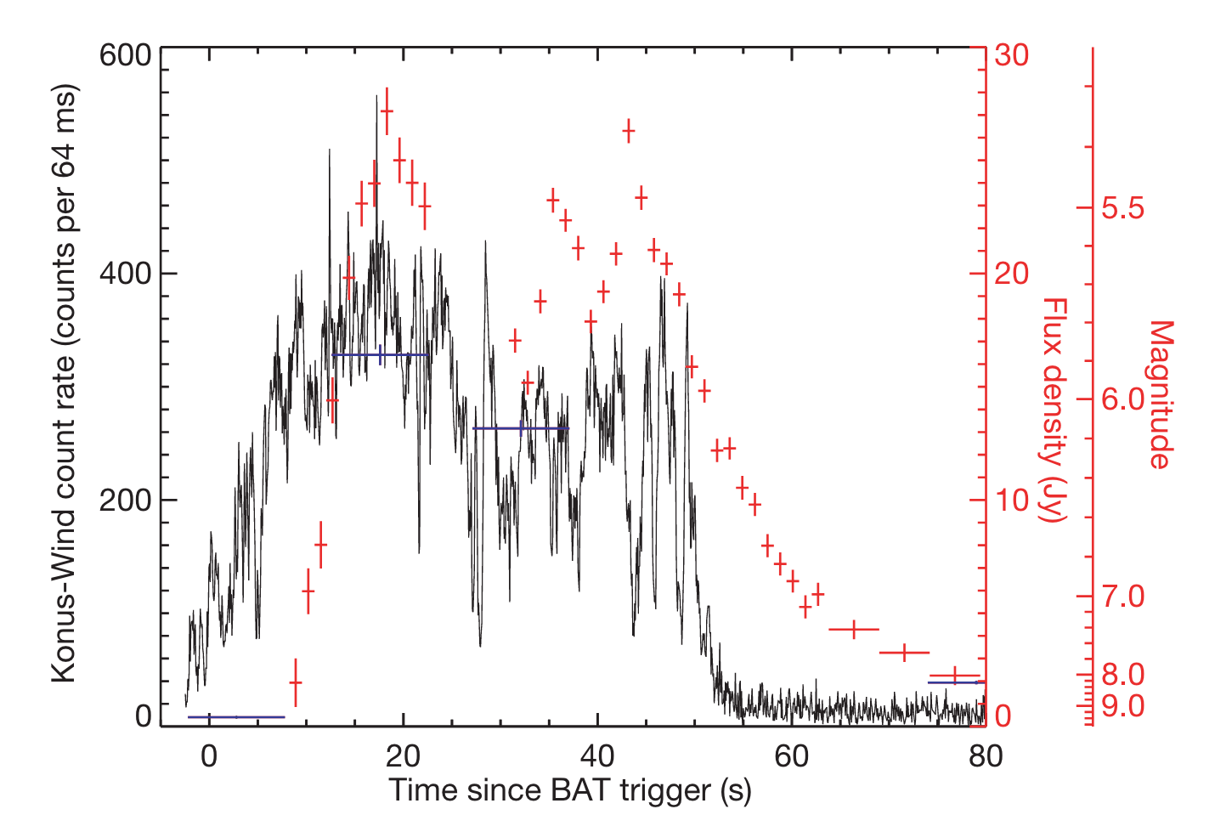
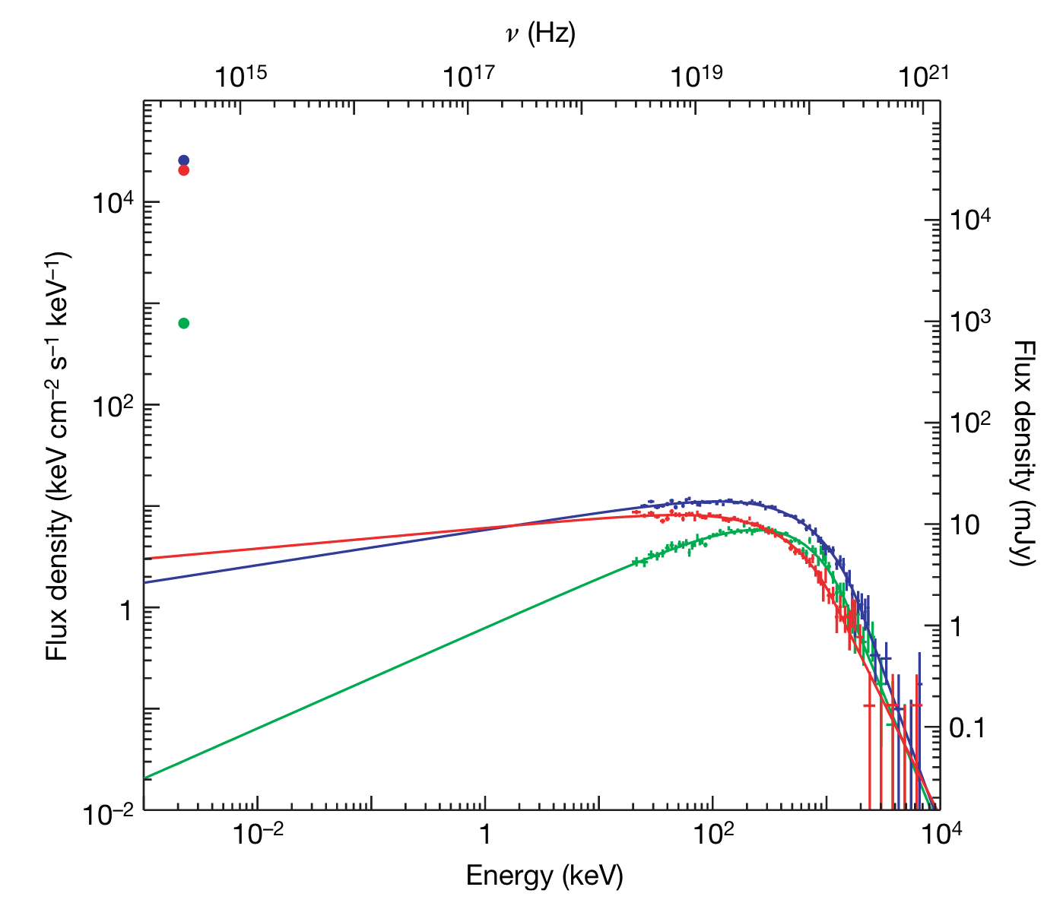
2008: Naked-eye burst GRB 080319B
(Racusin et al. 2008)

Slide 30
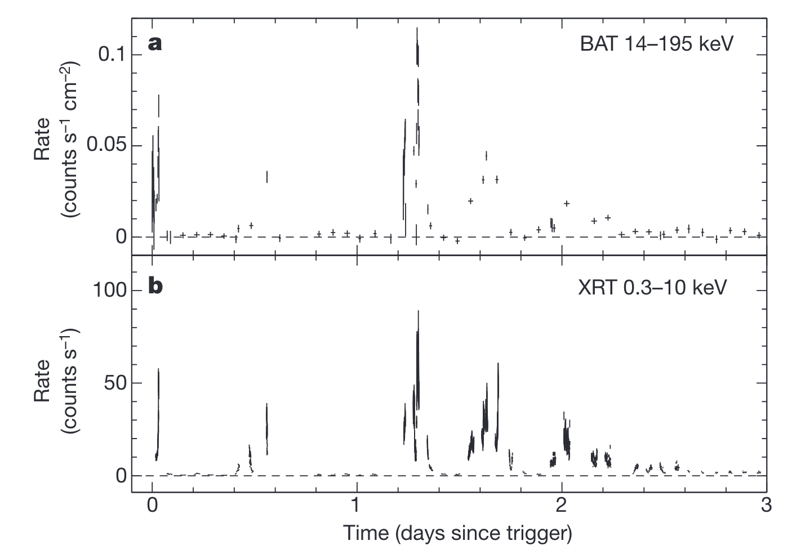
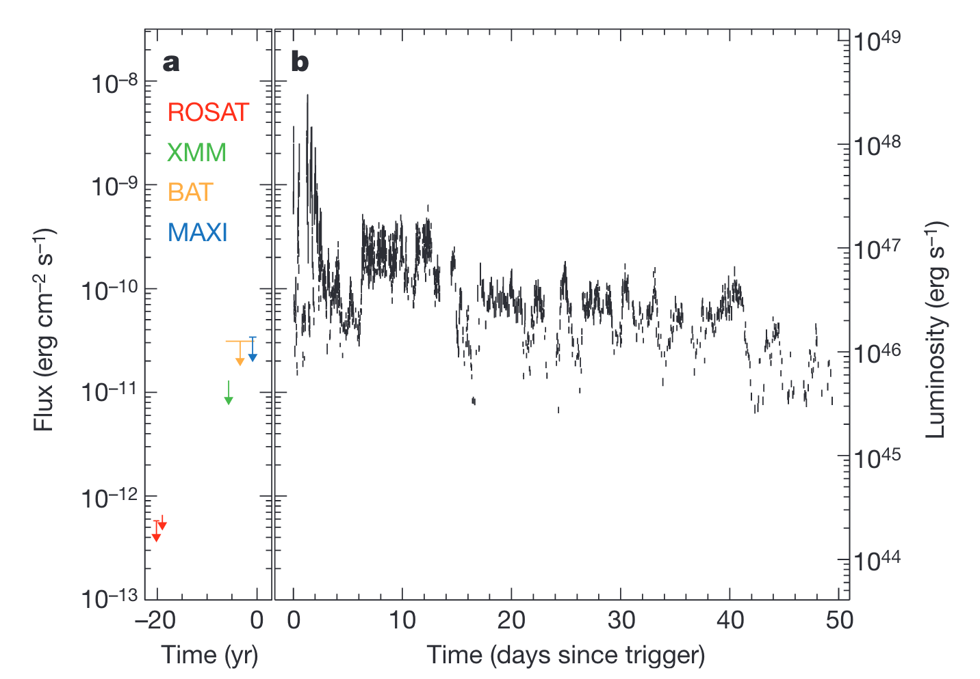
2011: Tidal disruption SwiftJ164449.3+573451
(Burrows et al. 2011)

Slide 31
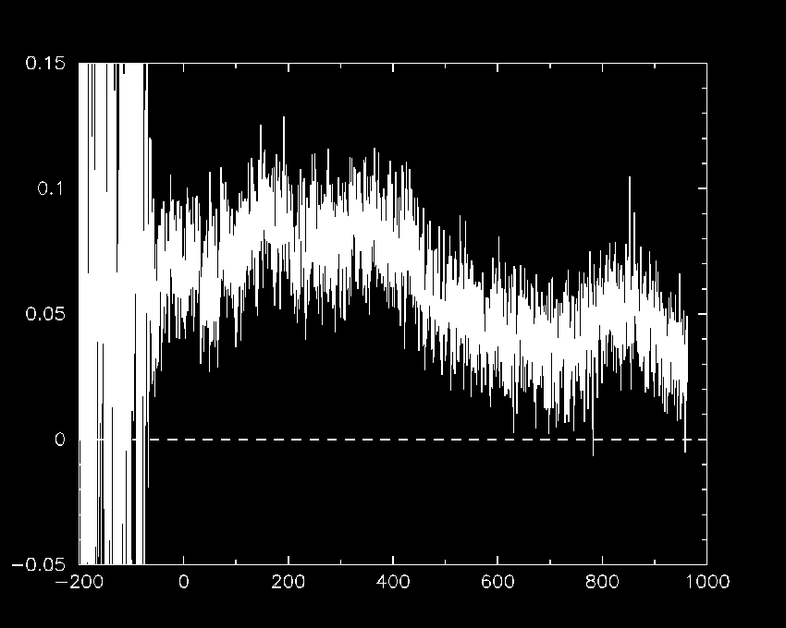

2011: Ultra-long GRB 111209A
BAT triggered twice (trigger ID: 509336 & 509337).
(Stratta et al. 2013)
Time [s]
Prompt emission lasted for ~4 hours!

Slide 32


2017: Blue kilonova from GW 170817
(Evans et al. 2017)

Slide 33
“Unique” capabilities of Swift

Slide 34
Target of opportunity (ToO)
Failier of the thermal electric cooler
GRB
Swift needs to passively cool the focal plane of XRT.
Many slews with short durations by the pre-planned schedule.
Can’t heat the radiator by the earth and the sun to cool XRT
~90º
Swift
day
night
Sun
Earth
What if a GRB happens?
Need a rapid schedule change.
HETE-2/SVOM
ToO
Swift GRBs are tend to be closer to the Sun.
GRB

Slide 35




Various ToO capabilities
Easy to request a ToO
Tiled observation
Many pointing
David Palmer
Those additions required a flight software change. But they are done promptly because the software was written by the BAT team scientist, David Palmer.

Slide 36

BAT flight software log file

Slide 37
All the data are publicly available immediately
All the data became publicly availale around mid April 2005 (~5 months after the launch).
Instrument calibration (Crab observations)
Validation of the data (cross-calibration)
Science software (debugging)
Documentation (try not the users doing a supid thing)
Swift team members were unhappy:
- many scooped articles were published…
The immediate public data produce a lot more science!

Slide 38
High redshift GRBs

Slide 39
Swift known-z GRB samples
BAT GRB catalog
Total # of GRBs: 1668 (from GRB 041217 to GRB 250605A)
Total # of known-z GRBs: 531
z > 6 GRBs
GRB 050904: z=6.295
GRB 060116: z=6.6
GRB 080913: z=6.733
GRB 090423: z=8.26
GRB 090429B: z=9.38
GRB 100905A: z=7.88
GRB 120923A: z=7.84
GRB 140515A: z=6.33
GRB 210905A: z=6.318
GRB 240218A: z=6.782

Slide 40


BAT light curve (15-350 keV) of z>6 GRBs
GRB 050904: z=6.295
GRB 100905A: z=7.88
GRB 060116: z=6.6
GRB 120923A: z=7.84
GRB 080913: z=6.733
GRB 140515A: z=6.33
GRB 090423: z=8.26
GRB 210905A: z=6.318
GRB 090429B: z=9.38
GRB 240218A: z=6.782
Time since the BAT trigger [s]
Time since the BAT trigger [s]

Slide 41


Prompt duration/fluence vs. redshift
T₉₀ [s]
S(15-150 keV) [erg/cm²]
Redshift
Redshift

Slide 42

Empirical spectral models of GRBs
Band function
(Band et al. 1993)
(α ~ -1)
David Band (1957-2009)
dN/dE
E^{α} exp (−E/E₀)
E₀ = E_{peak} / (2 + α)
E^{β}
(β ~ -2.5)
E_{break} = (α − β) E₀
Energy

Slide 43


Photon index α / 1-s peak flux vs. redshift
α
P_{1s} (15-150 keV) [erg/cm²/s]
Redshift
Redshift

Slide 44


BAT on-board trigger v.s redshift
50-350 keV
Foreground trigger duration [s]
25-100 keV
15-50 keV
Redshift
Redshift

Slide 45

GRB X-ray afterglow light curve
0.3-10 keV energy flux [erg/cm²/s]
Time since the BAT trigger [s]

Slide 46
Smallsat development at AGU

Slide 47



ARICA-2: AGU Remote Innovative Cubesat Alert System-2
(天体の“ありか”を速報する)
ARICA-2 FM
7/28-8/2 Thermal-vac
Delivery: November 2025
Launch: FY 2025

Slide 48


SEAGULL: SEArching origin of Gravitational wave source by cube sateLLite
(Sei-san’s poster)
- Dedicated X-ray counterpart search for GW sources
- Target launch around GW O5

Slide 49


Future of Swift
Swift orbit
NASA’s “stupid” presidental budget
Altitude < 300 km
-> just before year 2028
Altitude [km]
Time since 2025 [yr]

Slide 50
Summary
Swift revolutionalized our understanding of transient universe.
Swift marked 20 years, and still counting. More operation, more discovery.
Flexible (software oriended) design saved the Swift operation.
z > 6 GRBs are very rate in the Swift sample. The hard X-ray band is probabliy not the best wavelength to hunt high-z GRBs.
The Swift hardwares are working well. Either the orbit or the budget will limit the operation.

Slide 52




The Swift Song
(Words and music by Padi Boyd)

Slide 53
My relationship to Neil
2004 | March | Received Ph.D. (Tokyo Tech)
2004 | October | NRC postdoc at GSFC/NASA (Supervisor: Neil)
2004 | November | Swift launch
2004 | December | Marriage
2007 | October | Research associate at CRESST/UMBC/GSFC
2007 | November | Mayuko’s birth
2010 | October | Yuiko’s birth
2012 | September | Assistant professor at Aoyama Gakuin U. (non tenure)
2017 | April | Associate professor at Aoyama Gakuin U. (tenure)
2004-2012 (8 years at GSFC): Neil was my mentor during
an initial post-doc period and a starting of my new family life.

Slide 54
In orbit issues

Slide 55


BAT: Issues
Numbers of enabled detectors
Gain change of CdZnTe detectors
Lien et al. 2014
²⁴¹Am spectrum: array averaged
1.5 (early) - 0.4 (current) keV/yr shift in 59.5 keV line (array averaged).
The pulse width seems getting wider.
~15800 detectors enabled (as of Aug 4, 2025)
Reduce the sensitivity (smaller effective area)
Implimented in the BAT ground softwares (CALDB).

Slide 56

XRT: Issues
Failier of the thermal electric cooler
Micro-meteorite strike (May 2005)
GRB
Kennea et al. 2020
Can’t heat the radiator by the earth and the sun to cool XRT
~90º
Swift
day
night
Sun
Earth
HETE-2/SVOM
5 hot columns were formed (the two in the middle of the detector)
Swift GRBs are tend to be closer to the Sun.
Care is needed if your source is in the dead column.
GRB

Slide 57

Neil as a mentor
E-mail from Neil on December 21, 2016:
Neil:
Always supported and encouraged my works.
Always gave me the best environment to focus on the works.
Never let me involved in a (dirty) political work.
Always concerned about my family.
Notes:
I start to have my own small research group at AGU and supervise students. I will never forget Neil’s attitude as a mentor, and I will try my best for the students to have a similar feeling what I received from Neil.

