Slide 1
2D PIC Simulations of Synchrotron Maser Instability in Relativistic Shocks
YITP International Molecule-type Workshop
Fast Radio Bursts: A Mystery Being Solved?
Masanori Iwamoto¹,
Takanobu Amano², Yosuke Matsumoto³, Shuichi Matsukiyo¹, Masahiro Hoshino²
[1] Kyushu University; [2] University of Tokyo; [3]Chiba University

Slide 2
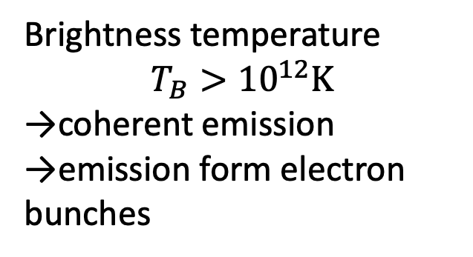
Brightness Temperature of FRBs
Coherent emission
[Pietka+ 2015]
Brightness temperature
$$T_{B}>{10}^{12}K$$
→coherent emission
→emission form electron bunches
FRBs
$$L_{ν}\text{[}\text{Jy}\text{・}\text{kpc}\text{2}\text{]}$$
How is the bunch generated in astrophysical objects?
${10}^{12}$K
$ν ×\frac{r}{c}$ [GHz・s]

Slide 3


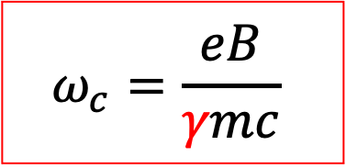




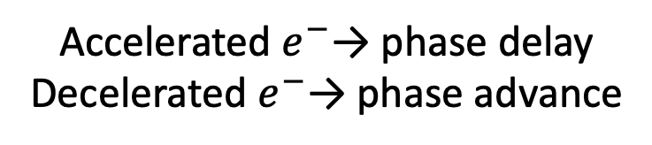

Synchrotron Maser Instability (SMI)
$$B_{0}$$
Phase bunch
$$B_{0}$$
phase delay
$$δE$$
phase advance
$$δE$$
$$e^{−}$$
$$ω_{c}$$
$$ω_{c}$$
$$ω_{c}=\frac{eB}{γmc}$$
Accelerated $e^{−}$→ phase delay
Decelerated $e^{−}$→ phase advance
electron bunches are naturally formed
Notes:
At the shock front, the magnetic field is enhanced and incoming plasma flow begins to gyrate. This cyclotron motion corresponds to ling distribution in phase space and such distribution can induce a wave, in this case, x-mode electromagnetic wave. This x-mode wave is resonant with cyclotron motion and cause synchrotron maser instability.

Slide 4



SMI in Relativistic Shocks
Particles begin to gyrate at the shock front
→induce SMI (Hoshino & Arons 1991)
Previous 1D simulations demonstrated that Intense coherent electromagnetic waves are excited in relativistic shocks (e.g., Langdon+ 1988; Gallant+ 1992; Hoshino+ 1992)
downstream
shock front
upstream
$$y$$
$$B_{2}$$
$$B_{1}$$
$$e^{−}$$
coherent
emission
$$z$$
$$x$$
SMI

Slide 5
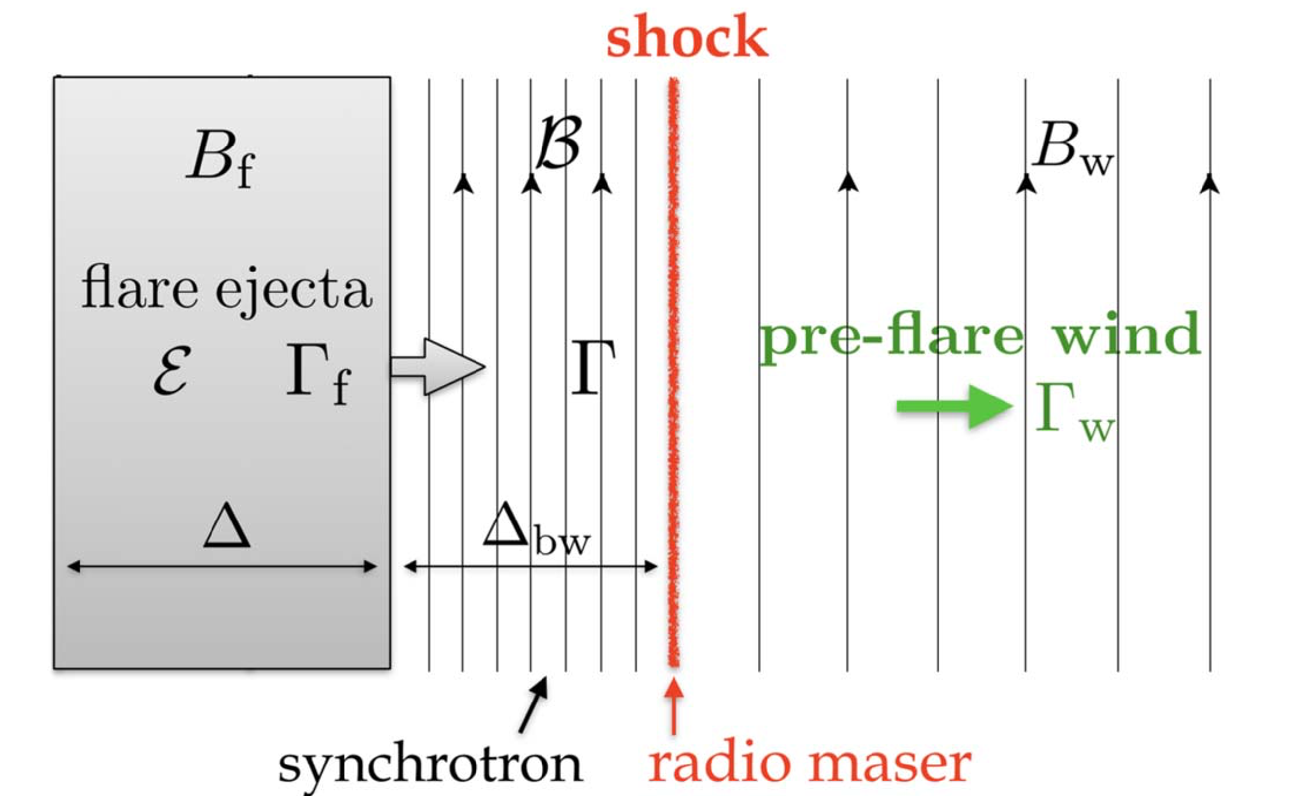


FRB Models Based on SMI
Magnetar flares induces relativistic shocks which radiates coherent radio waves via SMI
pair plasma
Beloborodov 2017; 2020
Ion-electron plasma
Metzger+ 2019; Margalit+ 2020
[Beloborodov 2020]
[Metzger+ 2019]
Upstream magnetization:
$$σ>1$$
Upstream magnetization:
$$σ∼0.1−1$$

Slide 6
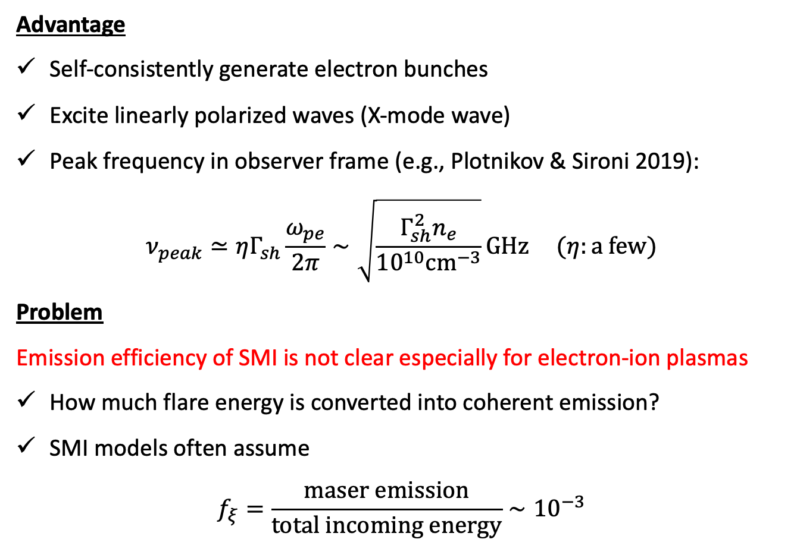
Properties of SMI Model
Advantage
Self-consistently generate electron bunches
Excite linearly polarized waves (X-mode wave)
Peak frequency in observer frame (e.g., Plotnikov & Sironi 2019):
$ν_{peak}≃ηΓ_{sh}\frac{ω_{pe}}{2π}∼\sqrt{\frac{Γ_{sh}^{2}n_{e}}{{10}^{10}cm^{−3}}}GHz (η:a few)$
Problem
Emission efficiency of SMI is not clear especially for electron-ion plasmas
How much flare energy is converted into coherent emission?
SMI models often assume
$f_{ξ}=\frac{maser emission}{total incoming energy}∼{10}^{−3}$

Slide 7
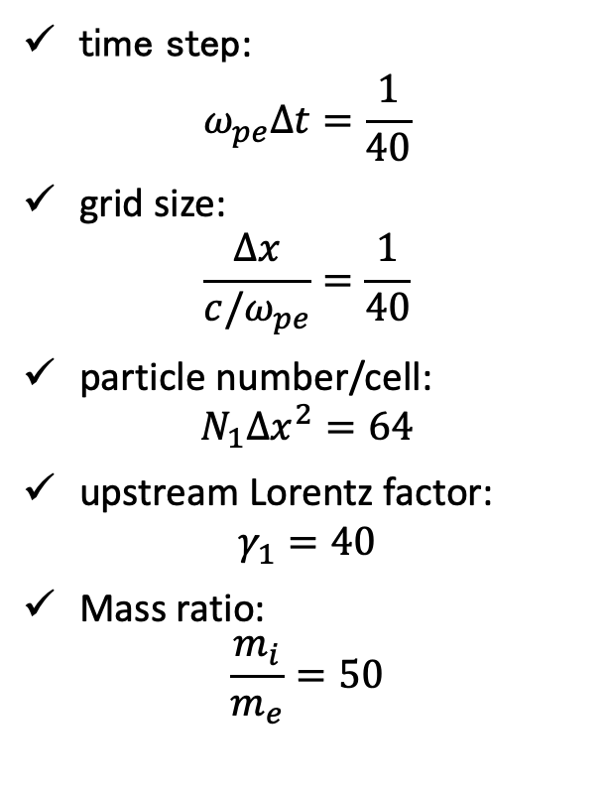
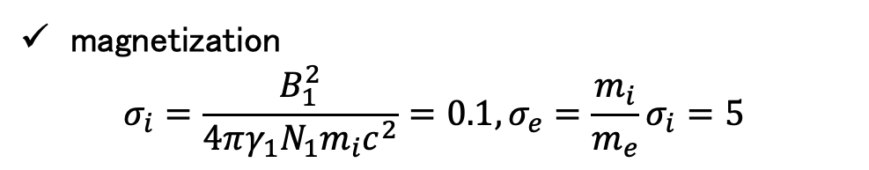

Simulation Setting
time step:
$$ω_{pe}∆t=\frac{1}{40}$$
grid size:
$$\frac{∆x}{c/ω_{pe}}=\frac{1}{40}$$
particle number/cell:
$N_{1}∆x^{2}=64$
upstream Lorentz factor:
$γ_{1}=40$
Mass ratio:
$\frac{m_{i}}{m_{e}}=50$
Coordinate system and geometry
$$γ_{1}$$
magnetization
$σ_{i}=\frac{B_{1}^{2}}{4πγ_{1}N_{1}m_{i}c^{2}}=0.1, σ_{e}=\frac{m_{i}}{m_{e}}σ_{i}=5$

Slide 8
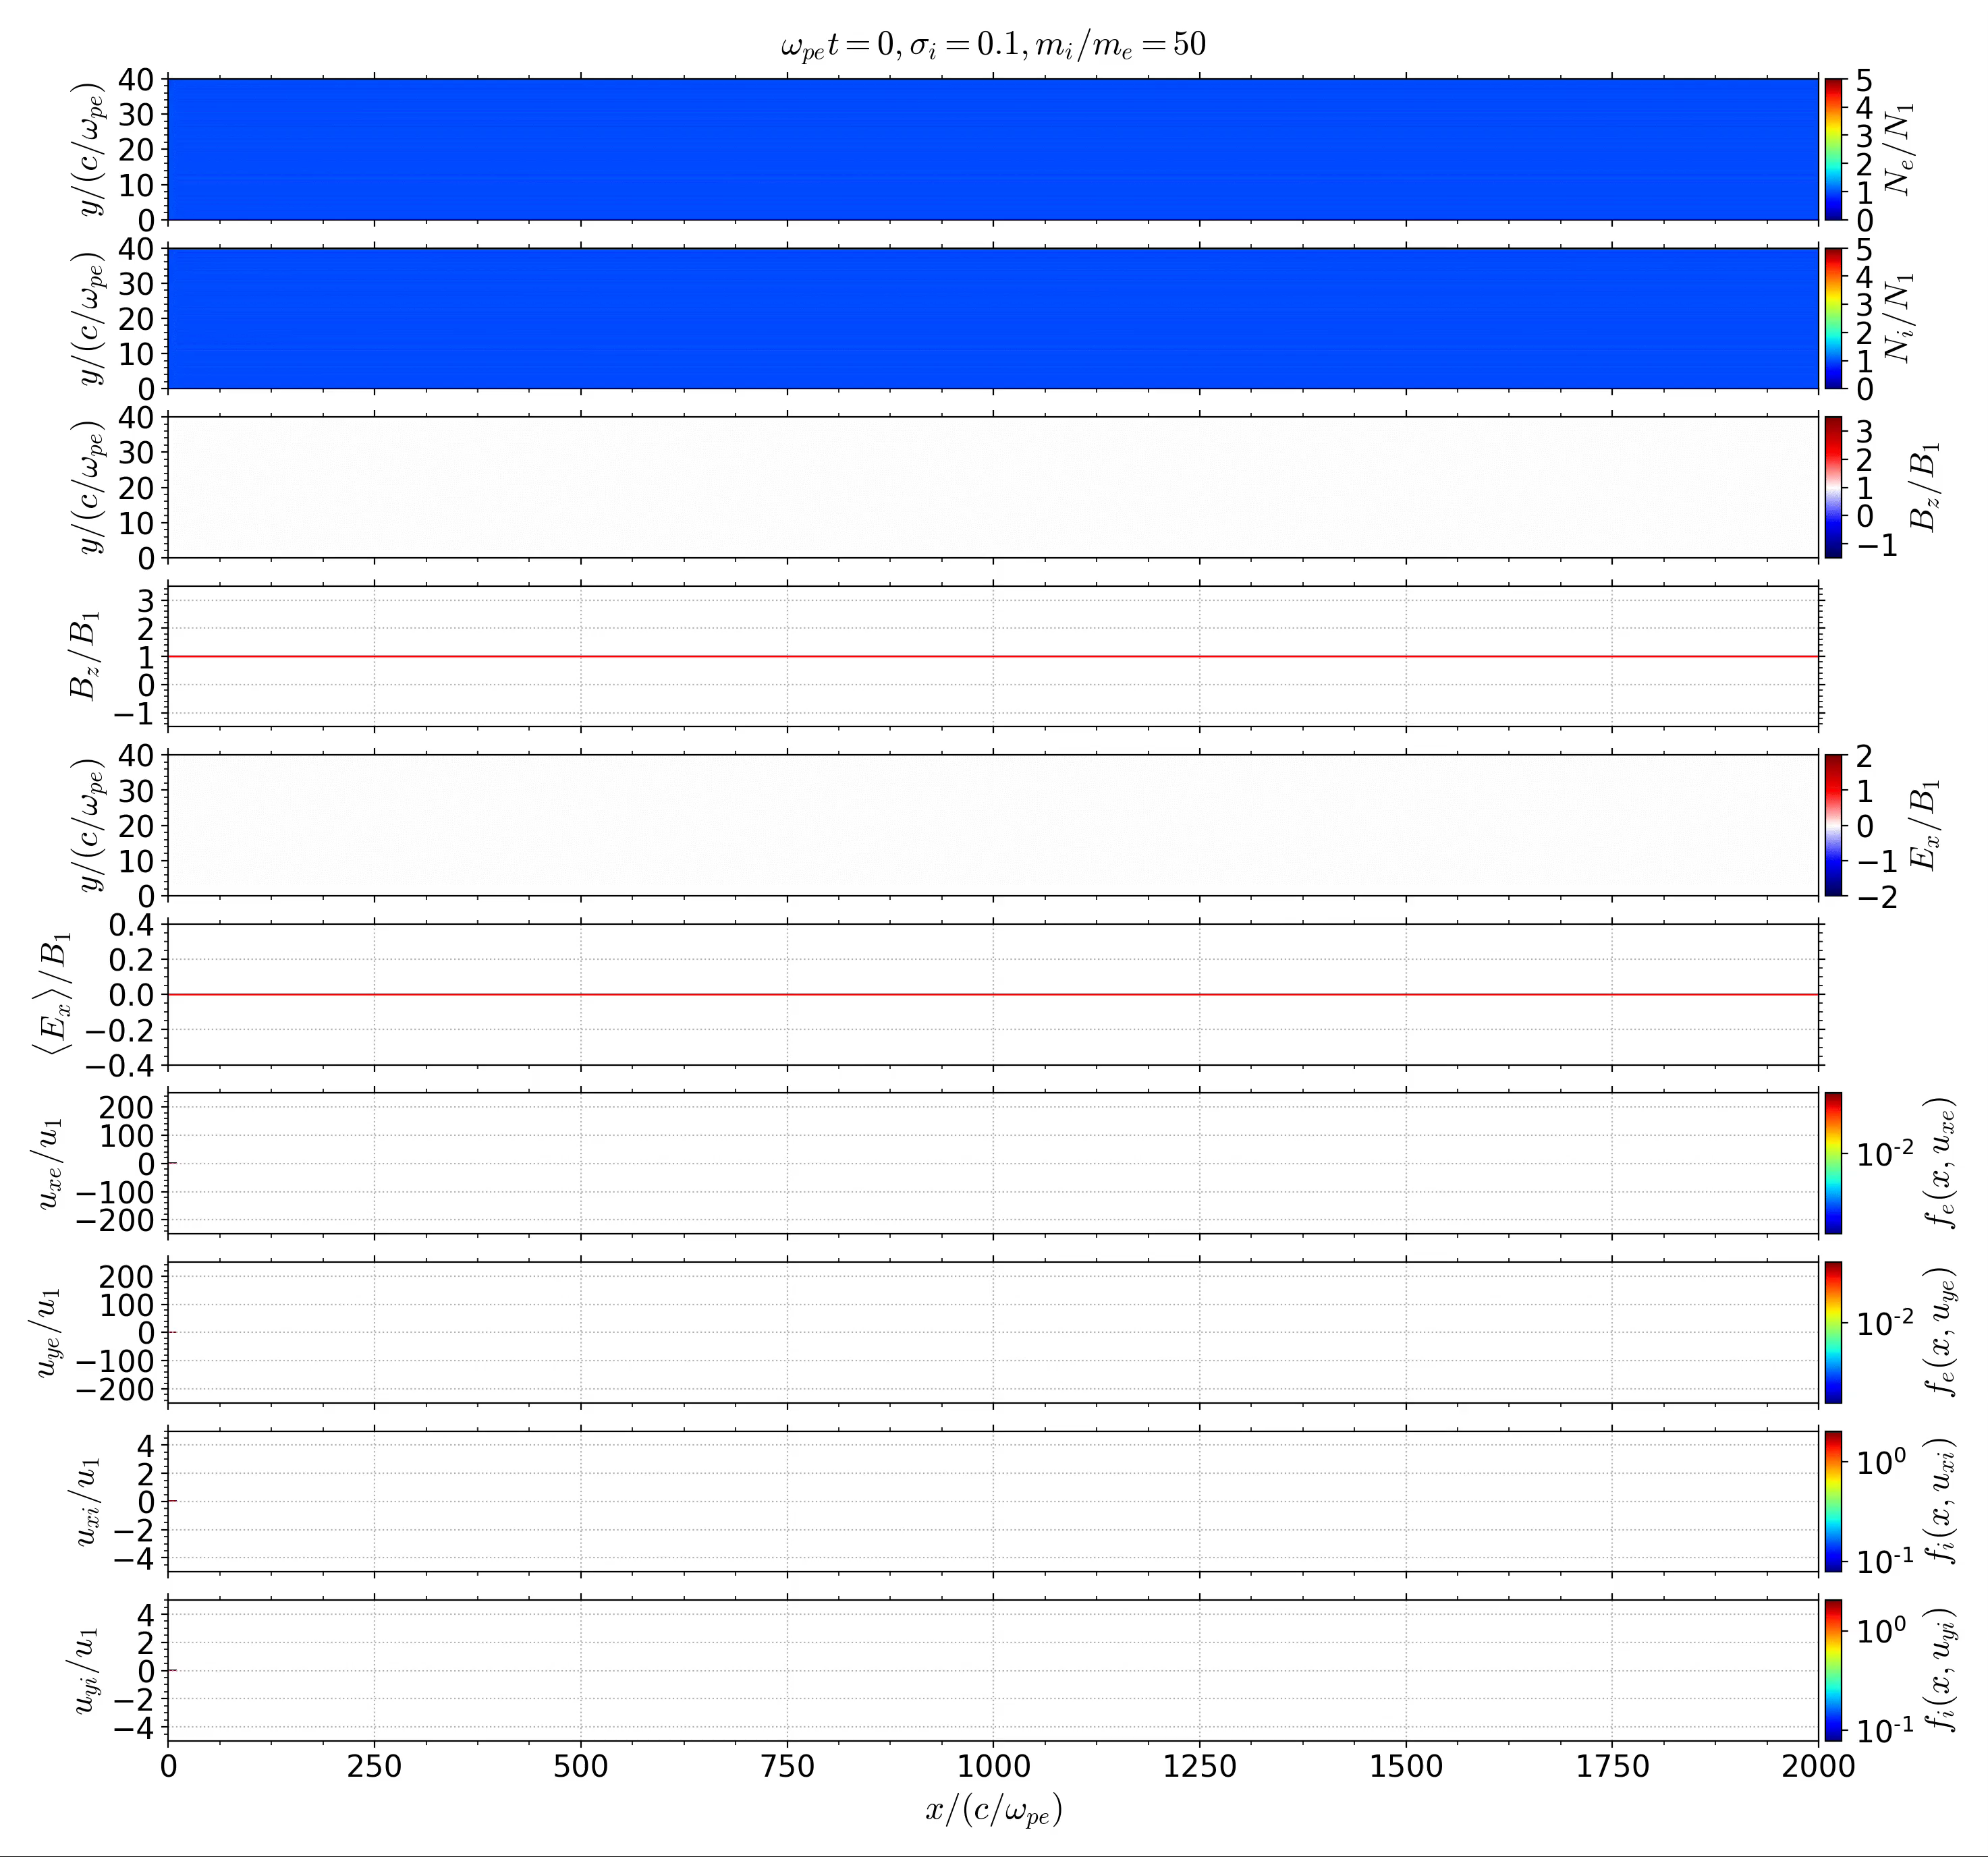




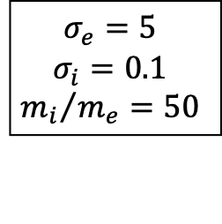







Global Structure
[Iwamoto+ 2019]
$$σ_{e}=5$$
$$σ_{i}=0.1$$
$${m_{i}}/{m_{e}}=50$$
$$N_{e}$$
Plasma flow
$$N_{i}$$
$$B_{z}$$
$$B_{z}$$
$$E_{x}$$
$$\left\langle E_{x}\right\rangle$$
$$u_{xe}$$
$$u_{ye}$$
$$u_{xi}$$
$$u_{yi}$$
$$x/(c/ω_{pe})$$

Slide 9
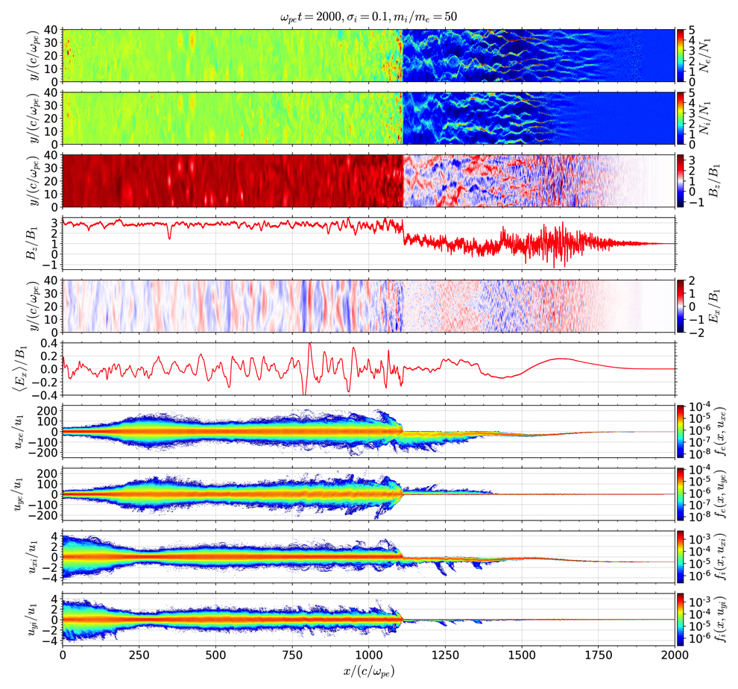







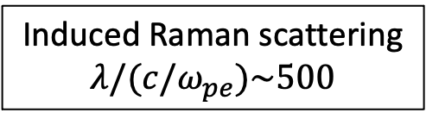




Global Structure
[Iwamoto+ 2019]
$$σ_{e}=5$$
$$σ_{i}=0.1$$
$${m_{i}}/{m_{e}}=50$$
$$N_{e}$$
Filamentation Instability
Plasma flow
$$N_{i}$$
$$B_{z}$$
$$B_{z}$$
Induced Raman scattering
$$λ/(c/ω_{pe})\sim 500$$
$$E_{x}$$
$$\left\langle E_{x}\right\rangle$$
$$u_{xe}$$
$$u_{ye}$$
Accelerated particles
$$u_{xi}$$
$$u_{yi}$$
$$x/(c/ω_{pe})$$

Slide 10
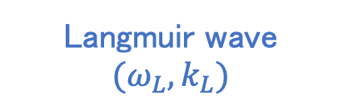
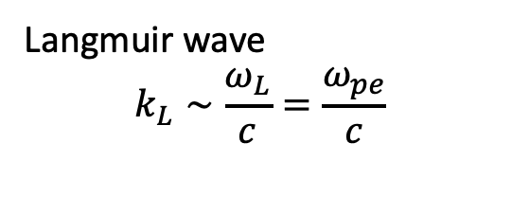

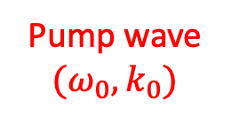
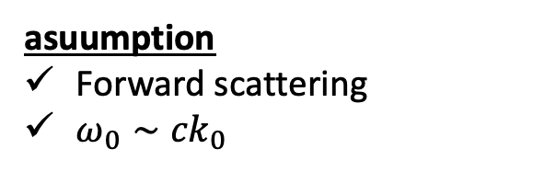
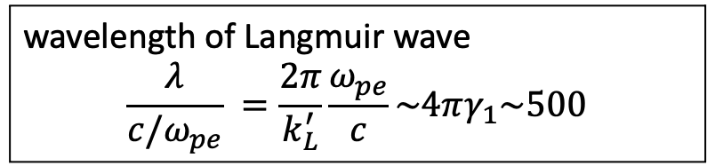
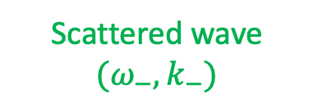
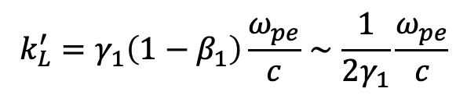
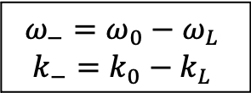
Induced Raman Scattering
Inelastic scattering process of photon
photon→ scattered photon + plasmon
asuumption
Forward scattering
$ω_{0}∼{ck}_{0}$
$$ω$$
$$ω^{2}=ω_{pe}^{2}+c^{2}k^{2}$$
$$ω_{−}=ω_{0}−ω_{L}$$
$$k_{−}=k_{0}−k_{L}$$
Langmuir wave
$$k_{L}∼\frac{ω_{L}}{c}=\frac{ω_{pe}}{c}$$
Scattered wave
$$(ω_{−},k_{−})$$
Pump wave
$$(ω_{0},k_{0})$$
Lorentz transform
$$ω=ω_{pe}$$
$$ω_{pe}$$
Langmuir wave
$$(ω_{L},k_{L})$$
$$k_{L}^{′}=γ_{1}\left({1−β}_{1}\right)\frac{ω_{pe}}{c}∼\frac{1}{2γ_{1}}\frac{ω_{pe}}{c}$$
$$k$$
wavelength of Langmuir wave
$$\frac{λ}{c/ω_{pe}} =\frac{2π}{k_{L}^{′}}\frac{ω_{pe}}{c}\sim 4πγ_{1}\sim 500$$

Slide 11
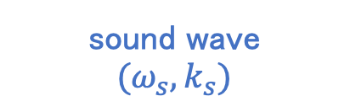



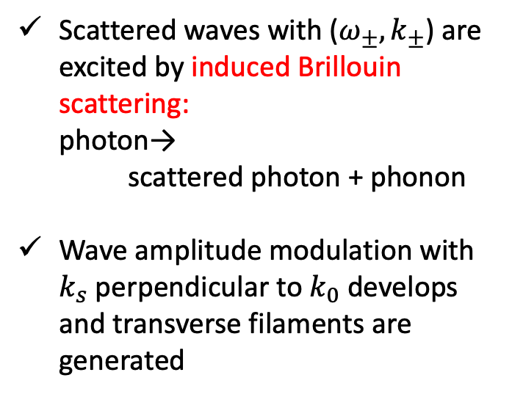
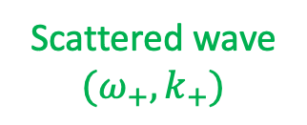
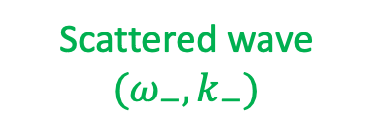
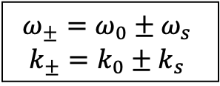
Filamentation Instability
Self-modulation due to the beating of sideband waves
(Kaw+ 1973; Drake+ 1974; Max+ 1974; Sobacchi+ 2020)
$$ω$$
$$ω_{±}=ω_{0}±ω_{s}$$
$$k_{±}=k_{0}±k_{s}$$
$$ω^{2}=ω_{pe}^{2}+c^{2}k^{2}$$
Scattered waves with ($ω_{±},k_{±}$) are excited by induced Brillouin scattering:
photon→
scattered photon + phonon
﻿Wave amplitude modulation with $k_{s}$ perpendicular to $k_{0}$ develops and transverse filaments are generated
Pump wave
$$(ω_{0},k_{0})$$
Scattered wave
$$(ω_{−},k_{−})$$
Scattered wave
$$(ω_{+},k_{+})$$
$$ω_{pe}$$
$$ω=C_{s}k$$
sound wave
$$(ω_{s},k_{s})$$
$$k$$

Slide 12
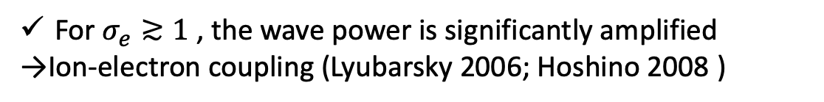
Emission Efficiency: Pair vs Ion-Electron
For $σ_{e}≳1$ , the wave power is significantly amplified
→Ion-electron coupling (Lyubarsky 2006; Hoshino 2008 )

Slide 13



Positive Feedback Process
Wave intensity
$$E_{x}$$
$e^{−}$ velocity
$γ_{e}$↑
$E_{x}$↑
Free energy ↑
Wave intensity↑

Slide 14





Particle Energy Spectra
plasma rest frame
﻿Electron energy achieves equipartition with the ion
﻿SMI indirectly consumes the ion energy due to the feedback process
$$\left\langle E_{x}\right\rangle$$
$$u_{xe}$$
$$u_{ye}$$
$$u_{xi}$$
$$u_{yi}$$

Slide 15


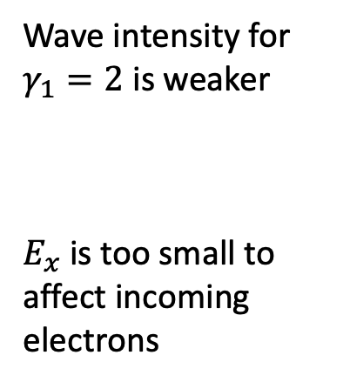




Lorentz Factor Dependence
$$γ_{1}=2$$
$$\left\langle E_{x}\right\rangle /B_{1}$$
[Ligorini+ 2020]
Wave intensity for $γ_{1}=2$ is weaker
$E_{x}$ is too small to affect incoming electrons
$$B_{z}/B_{1}$$
downstream
$$γ_{1}=40$$
$$\left\langle E_{x}\right\rangle /B_{1}$$
[Iwamoto+ 2019]
$$B_{z}/B_{1}$$

Slide 16
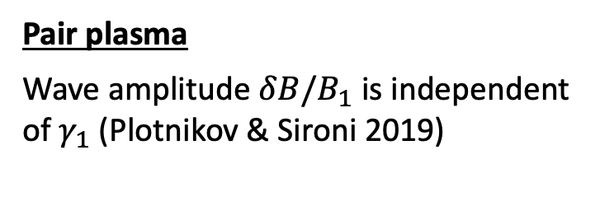
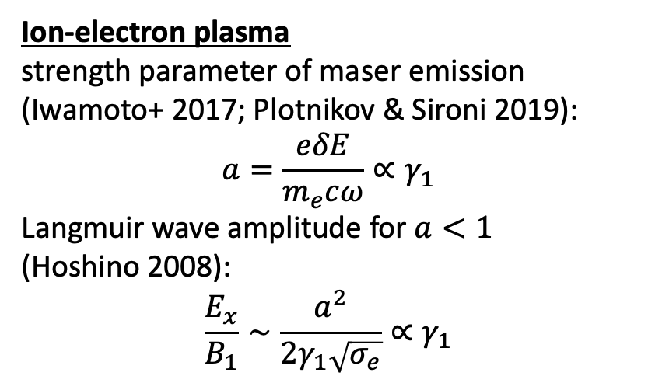
Lorentz Factor Dependence
Pair plasma
Wave amplitude $δB/B_{1}$ is independent of $γ_{1}$ (Plotnikov & Sironi 2019)
[Plotnikov & Sironi 2019]
Ion-electron plasma
strength parameter of maser emission (Iwamoto+ 2017; Plotnikov & Sironi 2019):
$$a=\frac{eδE}{m_{e}cω}∝γ_{1}$$
Langmuir wave amplitude for $a<1$
$\text{(}\text{Hoshino}\text{ 2008)}$:
$$\frac{E_{x}}{B_{1}}∼\frac{a^{2}}{2γ_{1}\sqrt{σ_{e}}}∝γ_{1}$$
→ large $γ_{1}$ is required for the strong ion-electron coupling

Slide 17
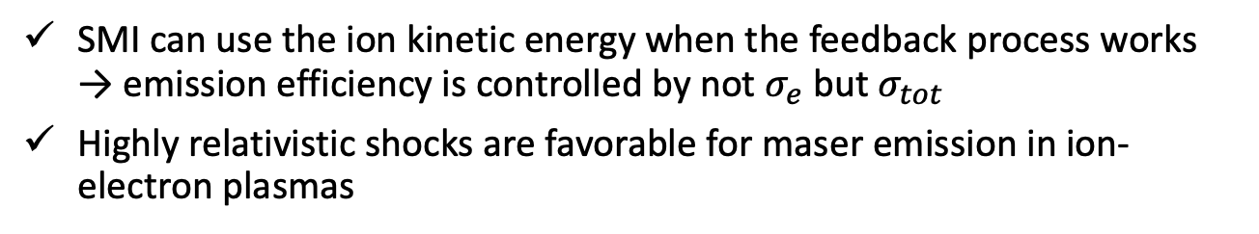
Emission Efficiency in Observer Frame
SMI can use the ion kinetic energy when the feedback process works
→ emission efficiency is controlled by not $σ_{e}$ but $σ_{tot}$
Highly relativistic shocks are favorable for maser emission in ion-electron plasmas

Slide 18
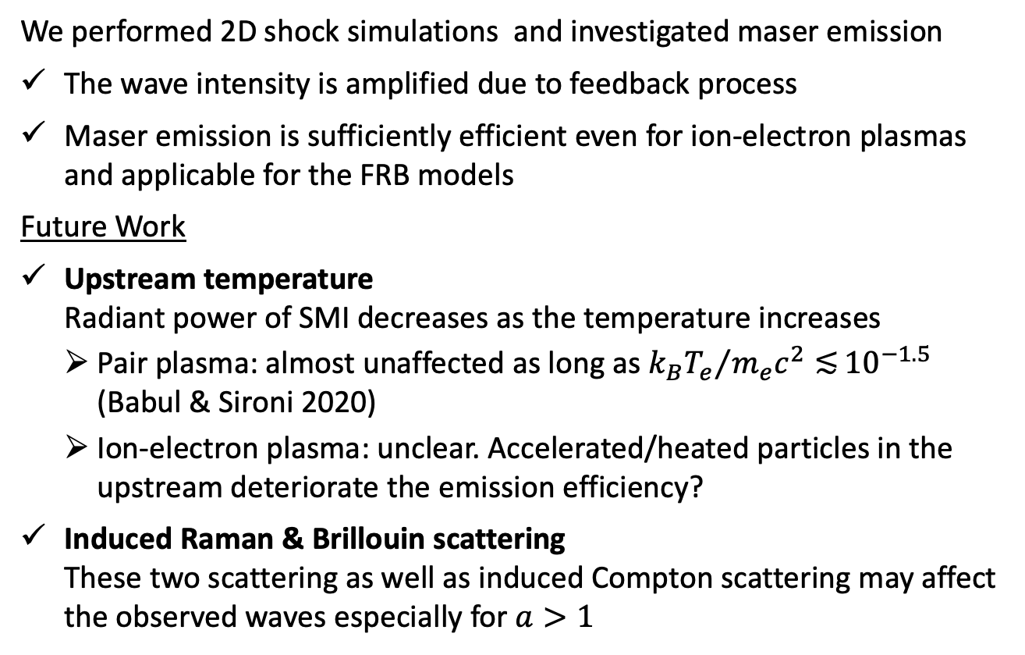
Summary
We performed 2D shock simulations and investigated maser emission
The wave intensity is amplified due to feedback process
Maser emission is sufficiently efficient even for ion-electron plasmas and applicable for the FRB models
Future Work
Upstream temperature
Radiant power of SMI decreases as the temperature increases
  Pair plasma: almost unaffected as long as ${k_{B}T_{e}}/{m_{e}c^{2}≲}{10}^{−1.5}$ (Babul & Sironi 2020)
  Ion-electron plasma: unclear. Accelerated/heated particles in the upstream deteriorate the emission efficiency?
Induced Raman & Brillouin scattering
These two scattering as well as induced Compton scattering may affect the observed waves especially for $a>1$

