Slide 1
An overview of Fast Radio Bursts
Pawan Kumar
Outline†
•
A brief summary of relevant observations
•
FRB radiation mechanism – general constraints & a specific model
†Wenbin Lu, Paz Beniamini (FRB physics)
Kyoto, June 6, 2022

Slide 2
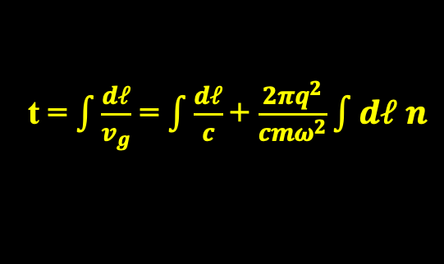



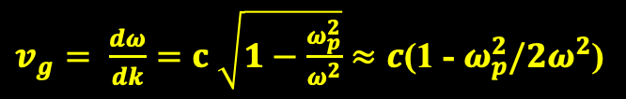




Dispersion relation of EM waves in plasma:
$$c^{2}k^{2}= ω^{2}−ω_{p}^{2}$$
c: speed of light
k: wavenumber; k = $\frac{2π}{λ}$ ($λ$: wavelength)
$ω=2π ν; ν$: wave frequency
Plasma density
$ω_{p}$: plasma frequency; $ω_{p}^{2}=4πq^{2}$n/m
e⁻ charge and mass
Group speed of EM waves in plasma and frequency dependent arrival time
$v_{g}= \frac{dω}{dk}=c \sqrt{1−\frac{ω_{p}^{2}}{ω^{2}}}≈c$(1 - $ω_{p}^{2}/2ω^{2}$)
Arrival time of signal of frequency $ω$
t = $\int{\frac{dℓ}{v_{g}}}$ = $\int{\frac{dℓ}{c}}$+ $\frac{2πq^{2}}{cmω^{2}}\int{dℓ n}$
$δt\left(ν\right)=\left(4.4 ms\right)$ $υ_{GHz}^{−2}$ DM
DM $≡$ $\int{dℓ n}$
(Unit of DM: pc cm⁻³)

Slide 3
Recent review articles on fast radio bursts (FRBs)
Bing Zhang, 2020, Nature 587, 45
Petroff et al. 2021, arXiv:2107.10113
Di Xiao, Fayin Wang, and Zigao Dai, 2022, arXiv:2203.14198
Maura Pilia, 2022, arXiv:2203.04890
Bing Zhang, 2022, very comprehensive article due to appear in PR

Slide 4

Fast Radio Bursts (FRBs)
(a brief history)
Discovered in 2007 – Parkes 64m radio telescope at 1.4 GHz
Only points to make are
(3º from SMC)
1. Discovered in archival data of 2001
Duration (δt) = 5ms
Flux = 30 ± 10 Jy
(3x10⁻²² erg s⁻¹cm⁻² Hz⁻¹)
2. EM waves in plasma travel faster at higher frequencies and arrive a bit earlier than waves of lower frequencies’. The “delay” is proportional to 1/nu^2 and the proportionality constant is propotional to electron column density between the source and us or DM.
V_{EM}(ν) in plasma increases with ν:
Unit: pc cm⁻³
Lorimer et al. (2007)
DM = 375 cm⁻³ pc
(DM from the Galaxy 25 cm⁻³pc
–– high galactic latitude)
3. The DM for this first FRB was 375 cm⁻³ pc , which is much larger than the contribution from the Galaxy (Dm =25), and thus it was speculated by Lorimer et al. that the burst was at a histance of 500 Mpc.
Estimated distance ~ 500 Mpc
(if DM = 350 from IGM)
Luminosity ~ 5x10⁴² erg s⁻¹
δt(λ) λ^{4.4}
(Consistent with pulse broadening due to ISM/IGM turbulence)
Notes:
EM waves in plasma travel faster at higher frequencies and arrive a bit earlier than waves of lower frequencies’. The “delay” is proportional to 1/nu^2 and the proportionality constant is propotional to electron column density between the source and us or DM.
The DM for this first FRB was 375 cm⁻³ pc , which is much larger than the contribution from the Galaxy (Dm =25), and thus it was speculated by Lorimer et al. that the burst was at a distance of 500 Mpc.
Discovered 12 years ago. A very bright, flash (100 times above the threshold detection), that lasted for 5 ms. Higher frequency EM waves travel a bit faster than lower frequency waves in the ionized ISM and IGM. And the signal arrived a little earlier at higher frequencies as seen in the diagonal band here. The arrival time difference depends on electron column density.
The first FRB, the Lorimer Burst FRB 010724, was discovered in 2007 when Duncan Lorimer assigned his student David Narkevic to look through archival data taken in 2001 by the Parkes 64m telescope at 1.4GHz of the Magellanic clouds. Analysis of the survey data found a 30-Jy burst (100 times above the threshold flux) which occurred on 24 July 2001, less than 5 milliseconds in duration, and 3-degree from the SMC. The survey consisted of 209 telescope pointings, each lasting 2.3 hr and each covering 9 degree² of sky. During each pointing, the multibeam receiver collected independent signals from 13 different positions (beams) on the sky. No bursts were seen in 90 hours of additional data.

Slide 5
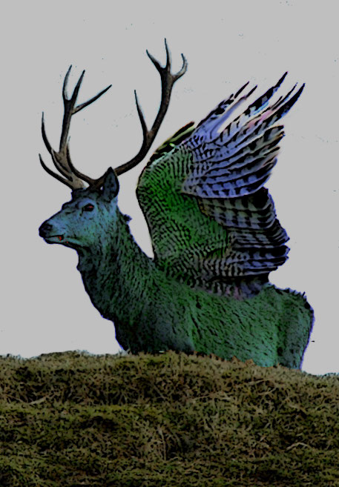
A Brief history (8 years of confusion and then a breakthrough)
16 more reported in 2010 (archieval data of Parkes in all 13 beams and hence almost certainly terristrial).
2015, Emily Petroff showed that these are produced when microwave oven is opened prematurely – the turning off of the magnetron.
Most people assumed that the “Lorimer burst was also a peryton.
Things changed dramatically when Arecibo detected a burst in 2012 and repeat acivity found in 2015.
•
First burst discovered in 2007 by Lorimer et al.
(5 ms; DM = 375 cm⁻³ pc $→$extra-galactic (500 Mpc); L_{radio} ~ 10⁴³ erg s⁻¹)
•
16 more bursts detected (2010) in Parkes archival data by Bailes & Burke-Spolaor
These bursts were detected in all 13 beams of the telescope, i.e. most likely terrestrial in origin.
Many people suspected that the Lorimer burst was also not cosmological.
These bursts were dubbed Peryton – after the mythical winged stag.
•
Emily Petroff et al. (2015) established the origin of Perytons (microwave oven!).
Arecibo detects a burst in 2012; repeat activity found in 2015 (Spitler et al. 2016). Accurate localization led to distance measurement & confirmation that this event was cosmological and not catastrophic.
Notes:
The DM for this first FRB was 375 cm⁻³ pc , which is much larger than the contribution from the Galaxy (Dm =25), and thus it was speculated by Lorimer et al. that the burst was at a distance of 500 Mpc.
Discovered 12 years ago. A very bright, flash (100 times above the threshold detection), that lasted for 5 ms. Higher frequency EM waves travel a bit faster than lower frequency waves in the ionized ISM and IGM. And the signal arrived a little earlier at higher frequencies as seen in the diagonal band here. The arrival time difference depends on electron column density.
The first FRB, the Lorimer Burst FRB 010724, was discovered in 2007 when Duncan Lorimer assigned his student David Narkevic to look through archival data taken in 2001 by the Parkes 64m telescope at 1.4GHz of the Magellanic clouds. Analysis of the survey data found a 30-Jy burst (100 times above the threshold flux) which occurred on 24 July 2001, less than 5 milliseconds in duration, and 3-degree from the SMC. The survey consisted of 209 telescope pointings, each lasting 2.3 hr and each covering 9 degree² of sky. During each pointing, the multibeam receiver collected independent signals from 13 different positions (beams) on the sky. No bursts were seen in 90 hours of additional data.

Slide 6
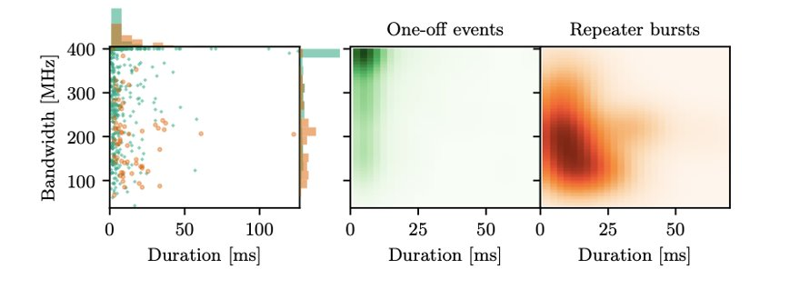
Summary of Observational Properties of FRBs​
Total number of bursts discovered ~600. Of these 492 were discovered by CHIME in the 1st year of operation (CHIME 1st catalog); 18 of these are repeaters (~3% of the population)
Repeaters and “non-repeater” are isotropic with Euclidean fluence distribution, which is steeper than Euclidean for high DM events as expected when DM is correlated with z.
The DM, fluence, and flux distributions for repeaters (the 1st measurement) are consistent with “non-repeaters”
Pleunis et al. 2021)
Repeaters have longer duration (on average) and smaller bandwidth compared to one-off FRBs​
However, the distributions of scattering widths are the same, i.e. similar local medium.

Slide 7
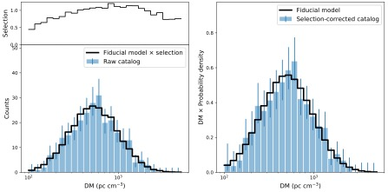


DM distribution (important for high-z cosmology): CHIME catalog
Amiri et al. 2021
Amiri et al. 2021
$$←$$
Beniamini et al. 2021
Selection bias against bursts with DM > 2x10³ might be underestimated
DM vs. z for two different reionization histories
~
$$←$$
CHIME 1st catalog claims that there might be a sub-population of FRBs with DM_{host} > 400 pc cm⁻³

Slide 8
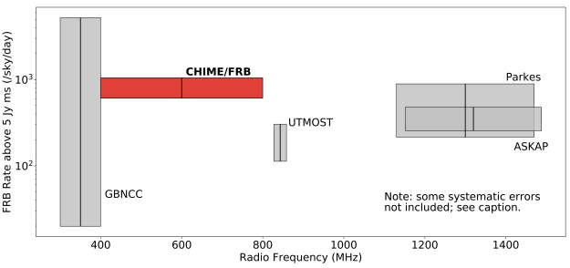
FRB rates at different frequencies (Amiri et al. 2021)
The rate does not seem to have a strong frequency dependence
GBNCC: Green Bank North Celestial Cap survey

Slide 9
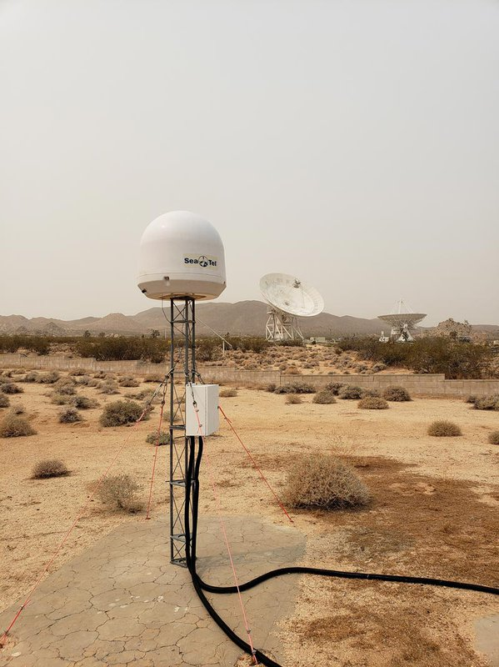
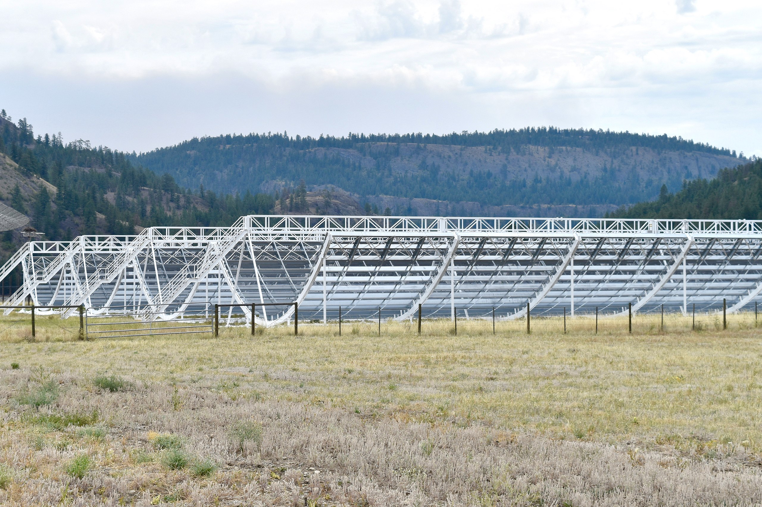
FRB in our Galaxy (FRB200428)
(At least one FRB produced by a magnetar)
STARE-2 (Survey for Transient Astronomical Radio Emission 2)
CHIME (Canadian Hydrogen Intensity Mapping Experiment) – four antennas, 100x20 meter² cylindrical parabolic reflectors.
(Bockenek et al. 2020; Caltech)
A STARE2 radio receiver at the Goldstone Deep Space Communications Complex operated by NASA's Jet Propulsion Laboratory
Radio detector (1.4 GHz) is size of a large bucket
Notes:
Three telescopes of STARE2 spotted the burst – 3 locations are: OVRO, Goldstone (CA) and Delta (Utah) which are seperated by 0.86ms, 1.8 & 1.94ms.

Slide 10

FRB in our Galaxy! FRB200428
Magnetar: B=2.2x10¹⁴ G; P=3.2s;
$\frac{P}{\dot{P}}$ ~ 4x10³ yrs
STARE-2
(Bochenek et al. 2020)
Two CHIME bursts separated by 30 ms
Burst duration = 0.61 at 1.4 GHz
Peak luminosity: 3x10³⁸ erg s⁻¹
Energy in radio bands: 2x10³⁵ erg
CHIME
Anderson et al. 2020
Energy in X-ray flare: 8x10³⁹ erg (~0.2 s)
[f_{xν} α ^{-0.6}]
Distance: 6.6 – 10 kpc
The peak flux: 2.5 MJy at 1.4 GHz
Notes:
The magnetar Distance: 6.6 – 10 kpc; observed flux at 1.4 GHz: 2.5 MJy

Slide 11

Properties of FRBs (summary)
FRBs are more luminous by a factor >10⁶ than radio sources in our galaxy; Crab pulsar giant pulses (of duration ~ns) have luminosity ~ 10³⁷ erg s⁻¹.
In fact, FRBs are more luminous by a factor ~10² compared to long-GRBs at ~GHz!
Points to make:
Duration and time variability imply the source size ~ km * Gamma
11 repeters out of ~ hundred or so.
Birth rate (before beaming correction) is 10⁴/day – quote from Kulkarni (2015)…
Or if they repeat like 121102 then the rate is 10⁻³ core collapse SNe.
Energetics for the repeater → B > 10¹³ G.
•
Duration:
1 ms < t_{frb} < 20 ms NS or BH
~
~
Flux variation time < 10 μs
source region size < 10⁵ Γ cm
•
FRBs detected between 110 MHz (LOFAR; 180916B) & 8 GHz (Breakthrough Listen; 121102)
•
Energetics:
The total energy release by the repeater – FRB 121102 – in 6 yrs
~ 2x10⁴³ erg
magnetic field strength > 10¹³ G
~
(for NS & 100% efficiency for B $→$GHz radiation; if the efficiency were to be 10⁻⁴ – as suggested by the Galactic FRB – then B > 10¹⁵ G)
•
Periodicity: 180916B has a period of 16.3 d (5-day activity window) – narrower window at higher $υ;$ perhaps 160 d period for 121102.
•
Host galaxies: 19 localized FRBs with host galaxy identified
No difference between repeating & non-repeating FRB hosts both of which have moderate star formation rate; hosts are consistent with CC SN & sGRBs.
One burst is in a globular cluster in M81 (200120), another found in massive old-galaxy with low star formation rate (190523).
Notes:
The total number of FRBs detected as of 7/2018 is 36. The highest DM to date (7/5/2018) is 2596 for a FRB detected in 2016 corresponding to a redshift of about 3. The distribution of FRBs is isotropic in the sky.

Slide 12
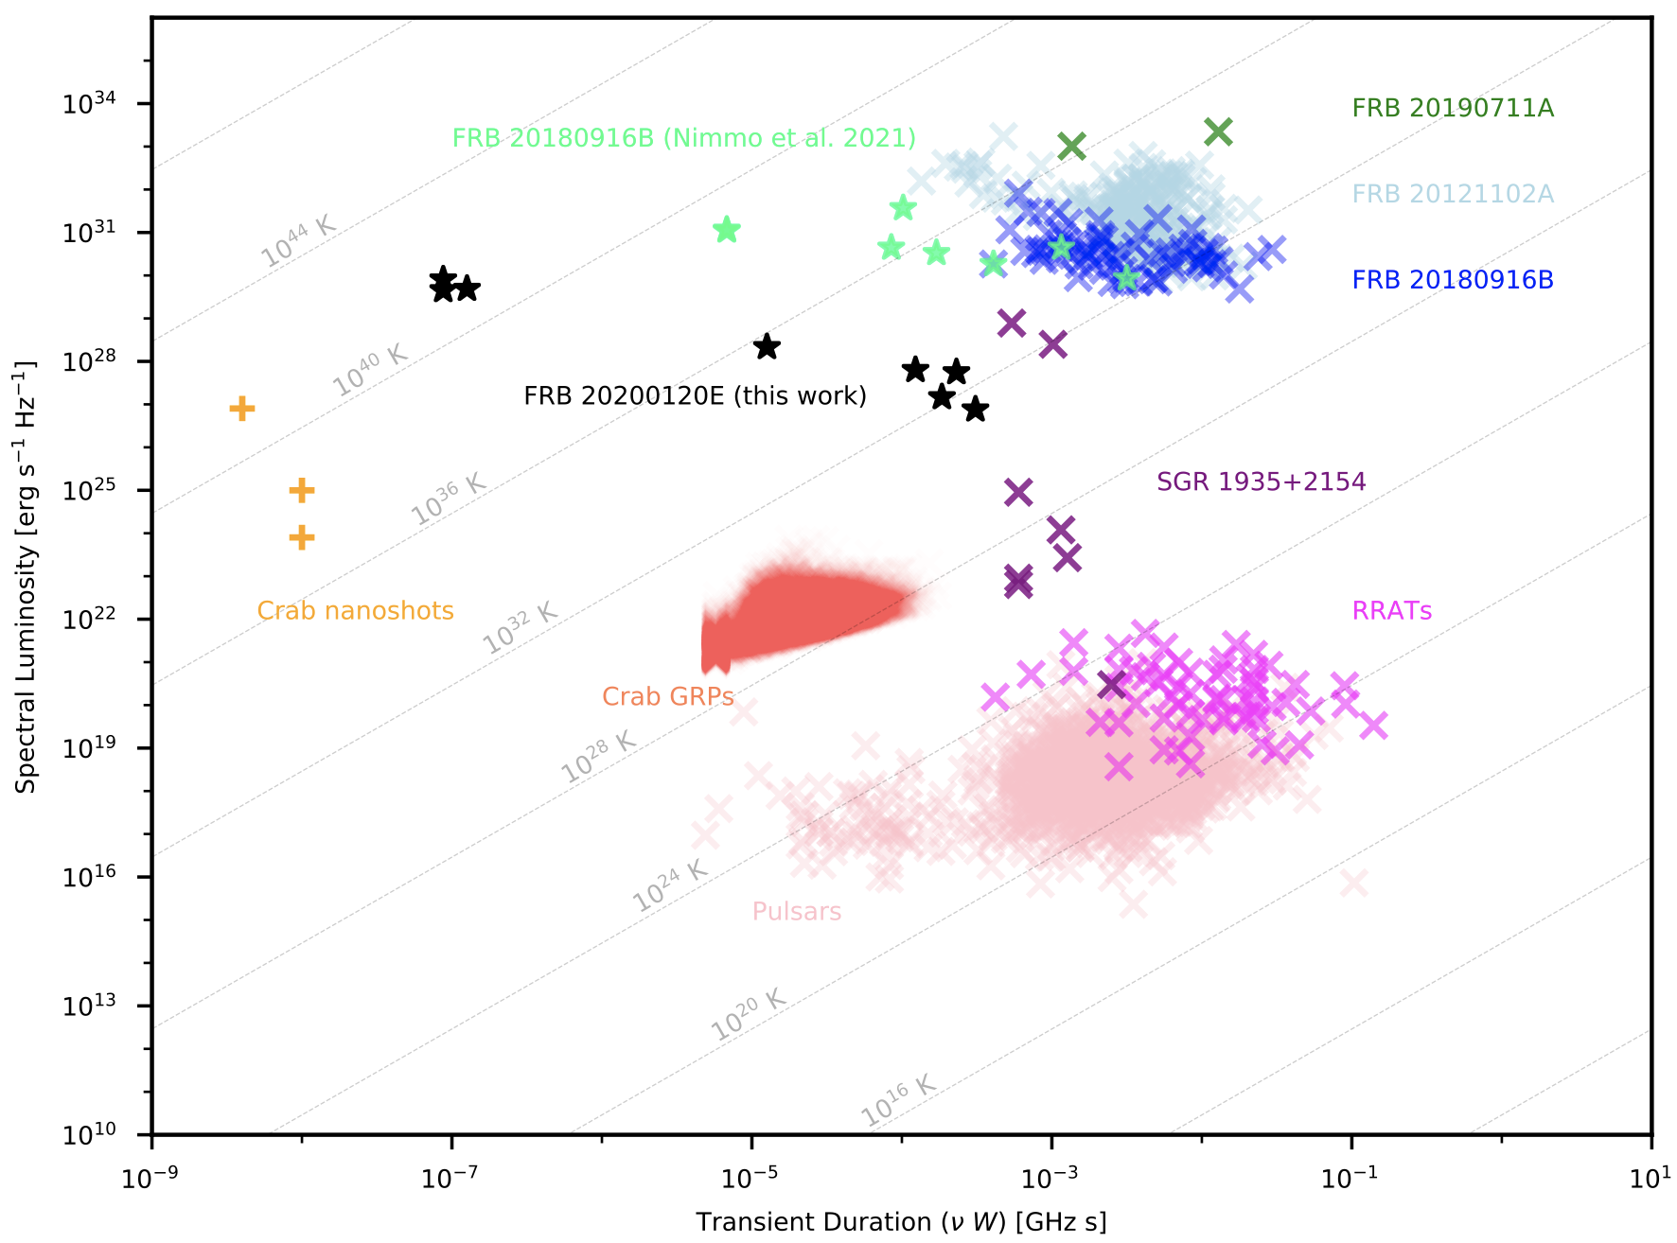
Radio Luminosity for NS based sources (Nimmo et al. 2021)
Nimmo+2021, arXiv:2105.11446

Slide 13
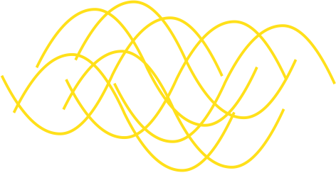





FRB radiation mechanism
$$f_{ν}∝N$$
For incoherent radiation
the FRB brightness temperature
$\vec{E}$(x,t)
is unphysical
$$f_{ν}∝ N^{2}$$
$∴$ FRB radiation must be coherent
How is the coherent radiation produced?

Slide 14
Many FRB mechanisms have been proposed and broadly speaking they fall into two categories:
Radiation produced inside the magnetosphere – near-field model
Radiation produced near or outside the light cylinder (far-away model)
10⁹cm < R < 10¹⁴ cm
Maser in shocks
This model has been developed extensively by Metzger, Sironi and collaborators

Slide 15
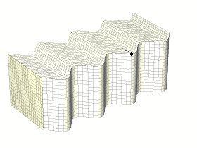
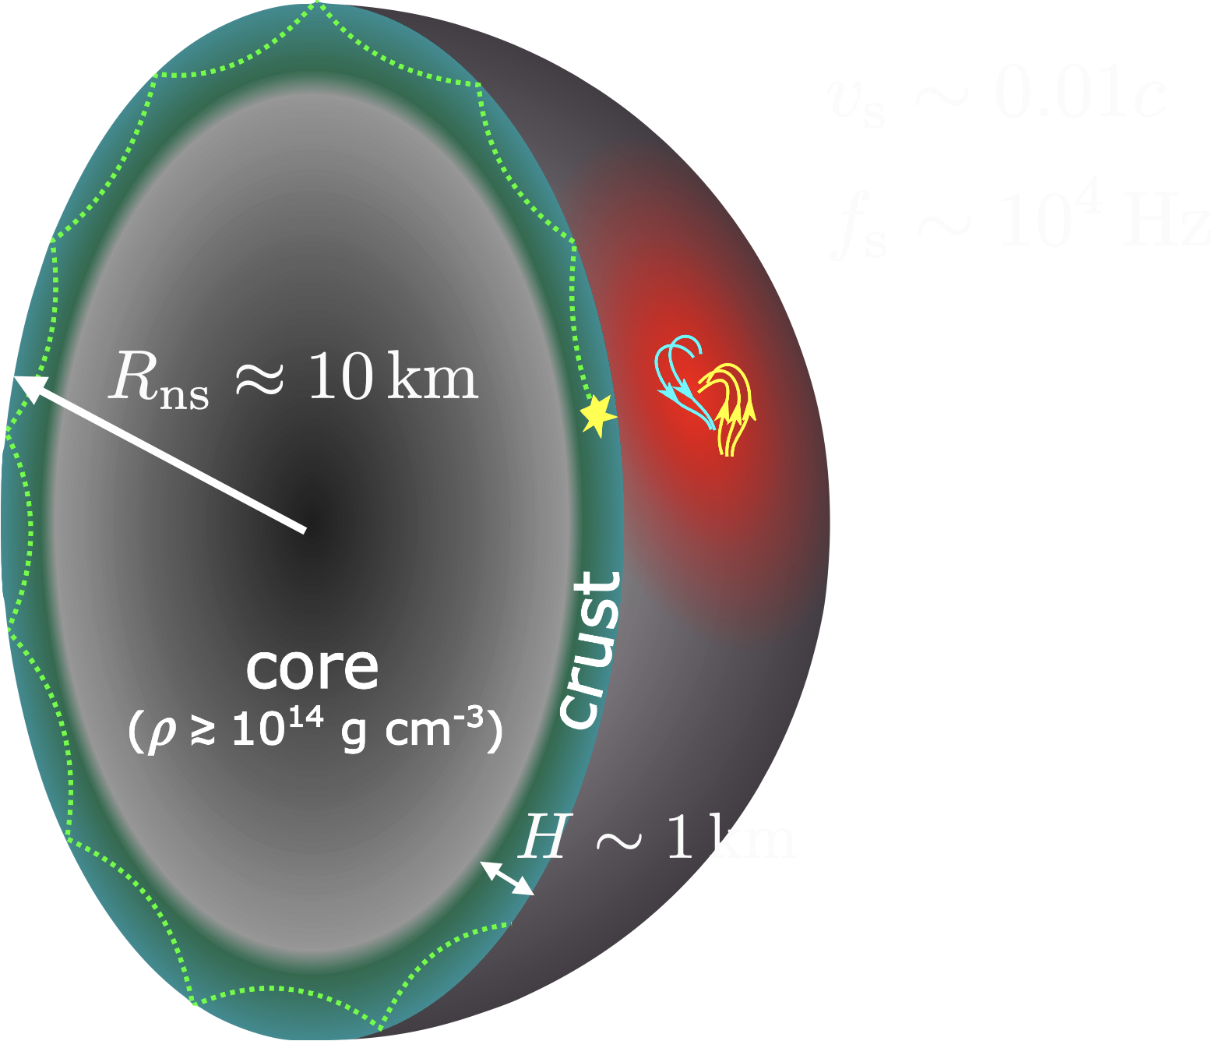
Near-field model: Alfven Wave Decay
Step 1: horizontal shear waves excited in the NS crust
Refs: Kumar, Lu & Bhattacharya (2017);
Lu & Kumar (2018), Yang & Zhang (2018);
Kumar & Bosnjak (2020), Lu, Kumar & Zhang (2020);
Katz (2020), Yang & Zhang (2021)
Alternative model by Lyubarsky (2020): magnetic reconnection
near or beyond light cylinder

Slide 16
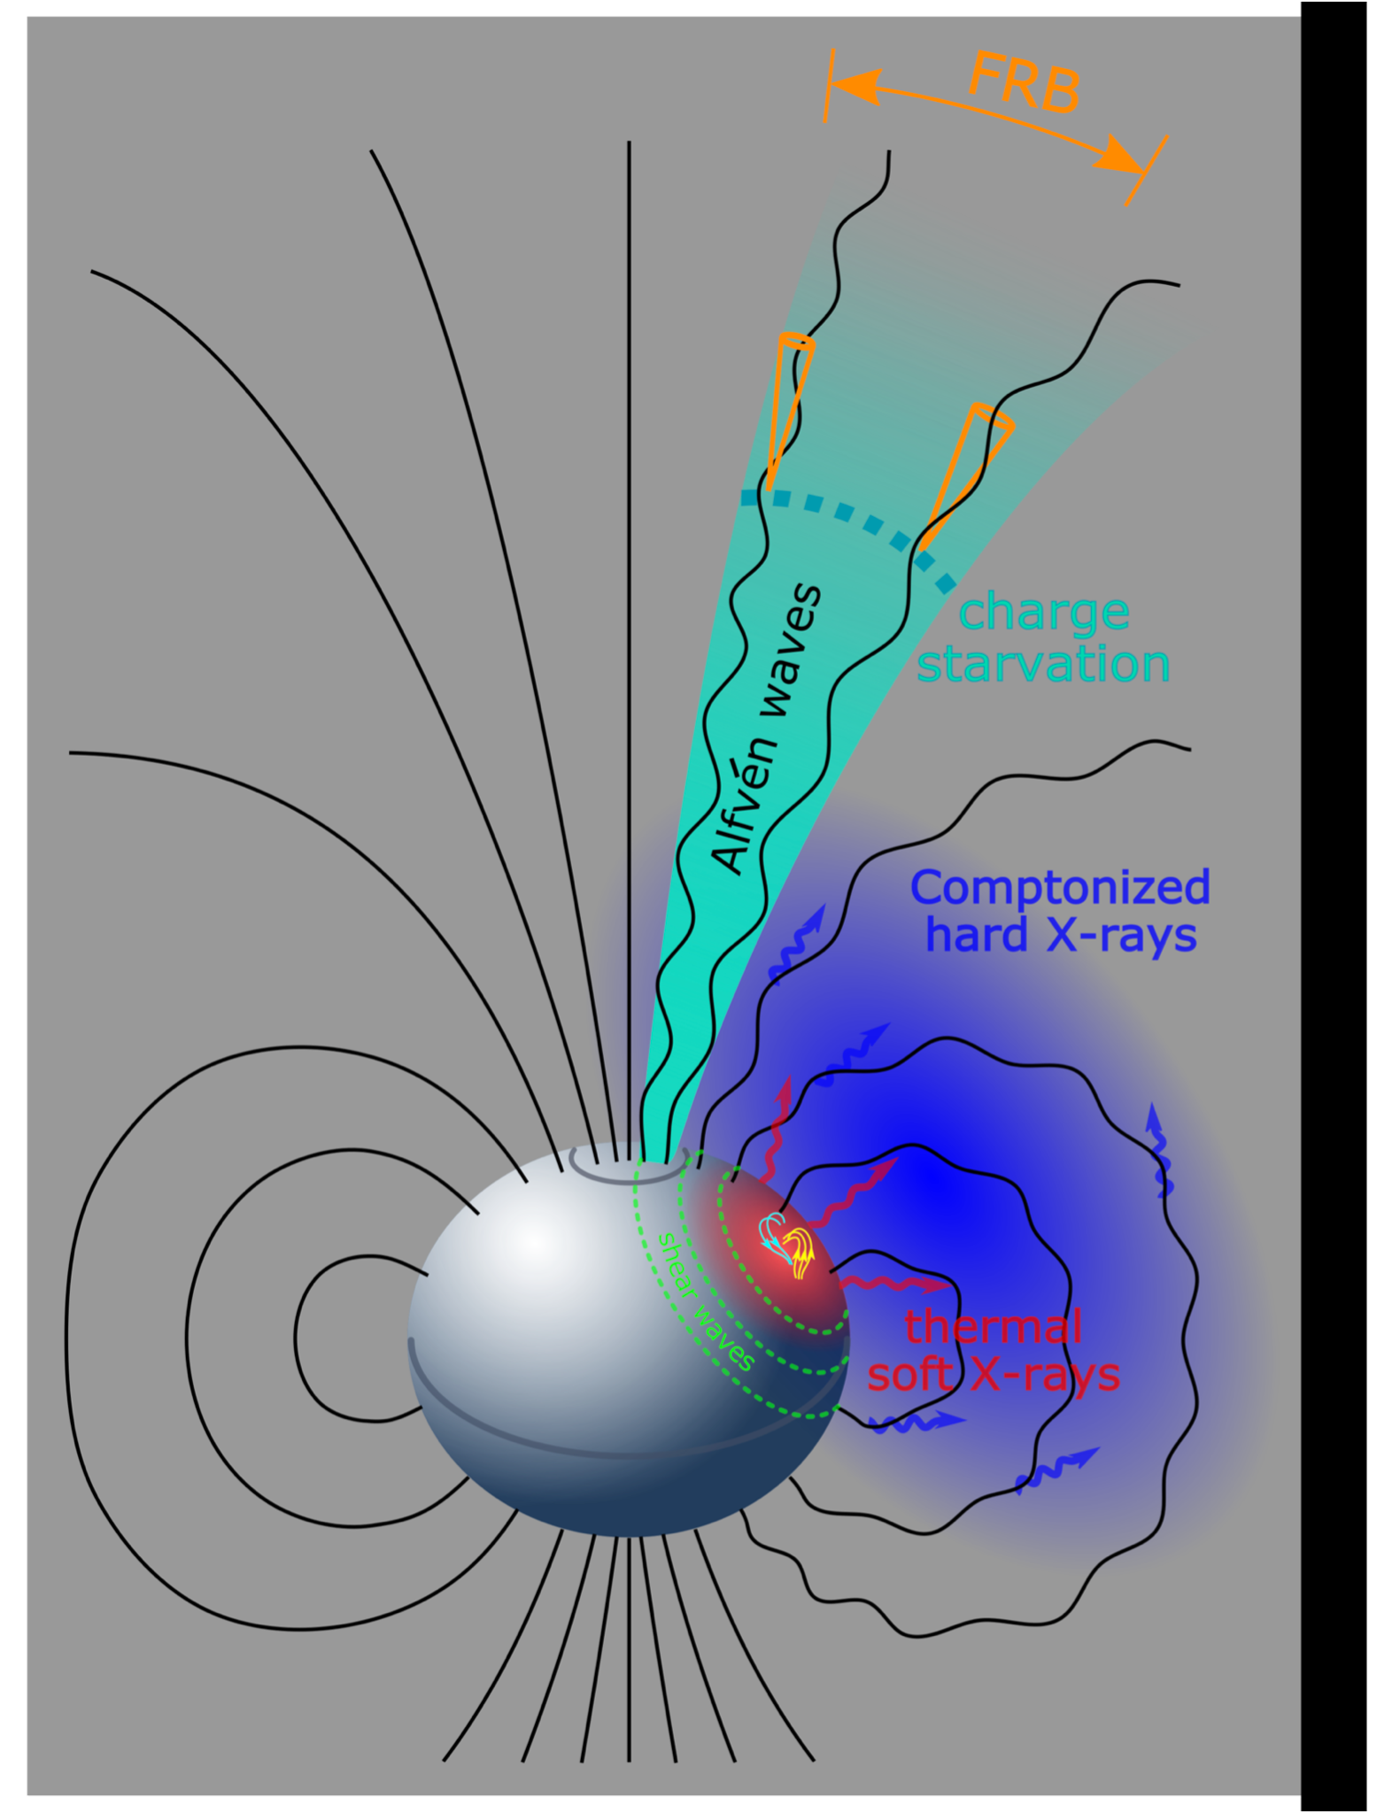
Near-field model: Alfven Wave Decay
Lu, Kumar & Zhang, 2020
Step 2: Alfven Wave charge starvation strong E-field FRB
Pros:
✫
Shear waves launch disturbance in the magnetosphere, i.e. Alfven waves
Alfven waves carry sufficient energy to power an FRB
Consistent with observations of ms-duration, X-ray counterpart, rapid variability, polarization, cluster of bursts (sub-sec periodicity)
✫
✫
Cons:
Coherent curvature emission requires charge bunches

Slide 17
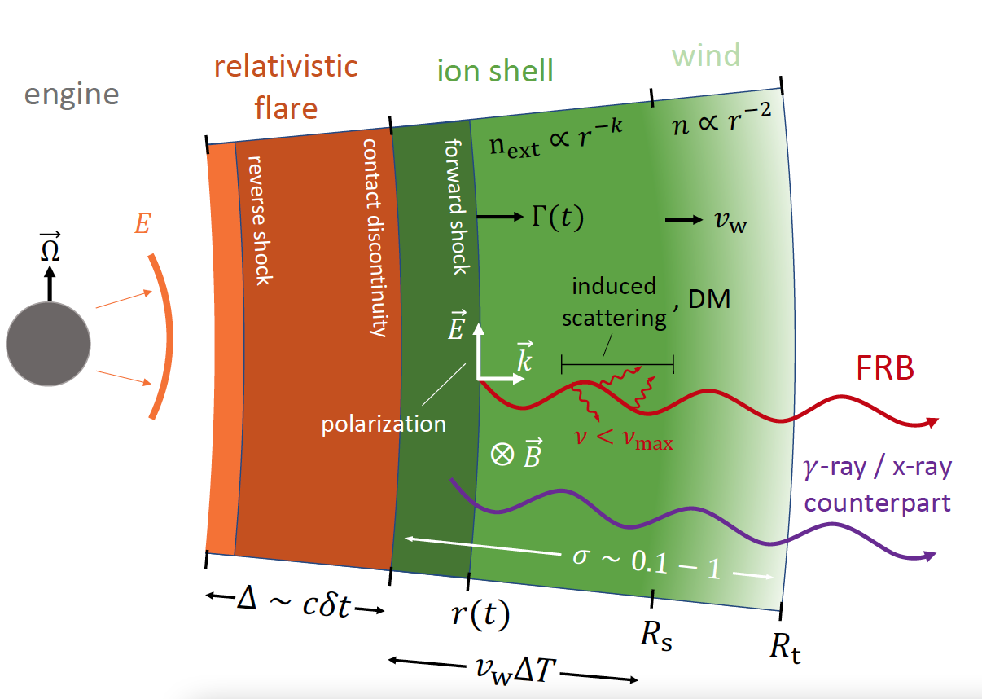
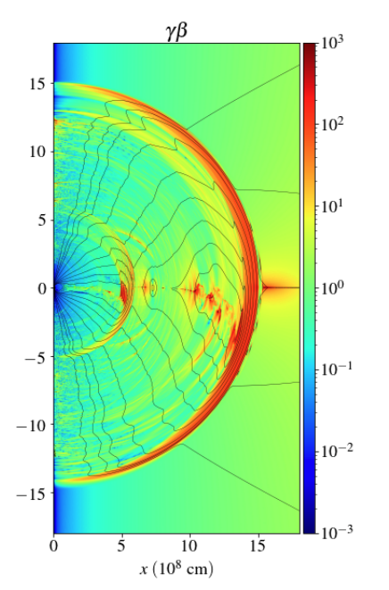
Synchrotron Maser (Far-away Model)
Metzger, Margalit & Sironi (2019)
“relativistic flare” from NS
or
plasmoid launched from the magnetosphere due to magnetic disturbance (=>Alfven waves)
Lyubarsky (2014)
Beloborodov (2017)
Plotnikov & Sironi (2019)
Metzger, Margalit & Sironi (2019)
Beloborodov (2019)
Margalit, Metzger & Sironi (2020)
Yuan et al. (2020)
Yuan et al. (2020)

Slide 18
Let us discuss what observations have to say about these two different classes of models

Slide 19
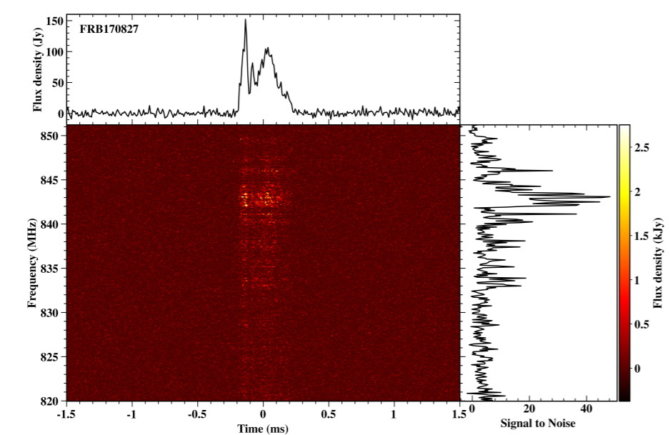





Observation: Variability time of lightcurves $→$ Source size and distance from NS
Farah et al. 2018
Variability time ~ 20 $μ$s
$t_{FRB}/δt$= 20
$$δt$$
$$t_{FRB}$$
$$t_{FRB}/δt$$
FRB 181112 15 $μ$s 0.1 ms 7 Cho et al. (2020)
FRB 180916B 4 $μ$s 2 ms 500 Nimmo et al. (2021)

Slide 20
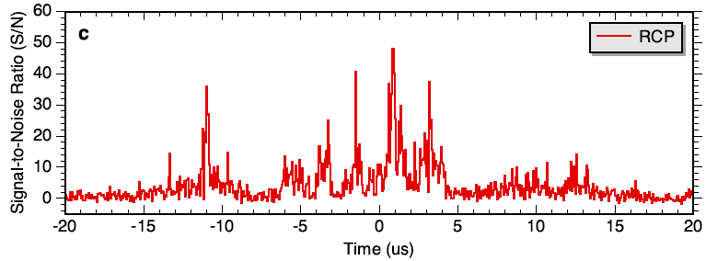

FRB 200120E -- Majid et al. 2021; Nimmo et al. 2021
This burst was in a globular cluster in M81; total duration about 30 $μs$; is has several peaks which are roughly separated by 2-3 $μs$. Variability time ~ 50 ns or t_{FRB}/$δ$t ~ 500.
The luminosity of the brightest component – 10³⁹ erg s⁻¹ – is ~ 10³ times larger than the Crab pulsar nano-shots (GPs).

Slide 21










Lightcurve variability time
Two timescales (Beniamini & Kumar, 2020)
$$γ$$
•
Duration of activity at magnetar surface: t_{act}
$$R$$
•
Curvature timescale for a relativistic
source: $t_{R}$ $=\frac{R}{2cγ^{2}}$
$$1/γ$$
$$γ$$
Variability time of observed flux: $δt ≥ t_{R}$
FRB duration: $t_{FRB}$ ≈ max(t_{act} , t_{R})
Far-away model
Near-field model
$t_{FRB}$/ $δt$ ~ 1 (holds broadly)
For R < 10⁸ cm, $γ$ = 10², t_{R} = 0.2 $μ$s
$t_{R}$ $≪ t_{FRB}$

Slide 22





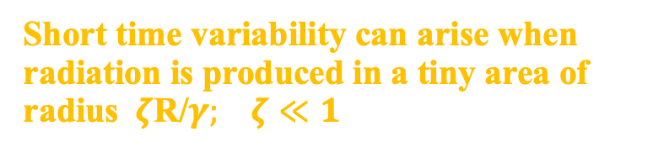
One could get short time variability for far-away models but at the expense of much reduced efficiency
Face-on view of emitting region
Short time variability can arise when radiation is produced in a tiny area of radius $ζ\text{R}\text{/}γ;$ $ζ≪1$. In this case:
$$δt ≈ ζt_{FRB}$$
$$R/γ$$
However, it comes at the cost of further reducing the efficiency by a factor:
$ε≈1/ζ2$ $≫1$
$$ζR/γ$$
Example: for $δt$ = 20 $μ$s & ${ t}_{FRB}$ = 2 ms,
the external shock model efficiency is reduced from ~10⁻⁵ to 10⁻⁹
Similar constraints apply† to the rise and decay times of FRB lightcurves (LCs)

Slide 23


It is also possible that short time variability and narrow band frequency structures in the FRB spectra are due to radio wave propagation through plasma within 10¹⁶ cm of the source e.g. Sobacchi et al. (2021)
A uniform wave packet
Fragments by plasma interactions
$$⟶$$

Slide 24
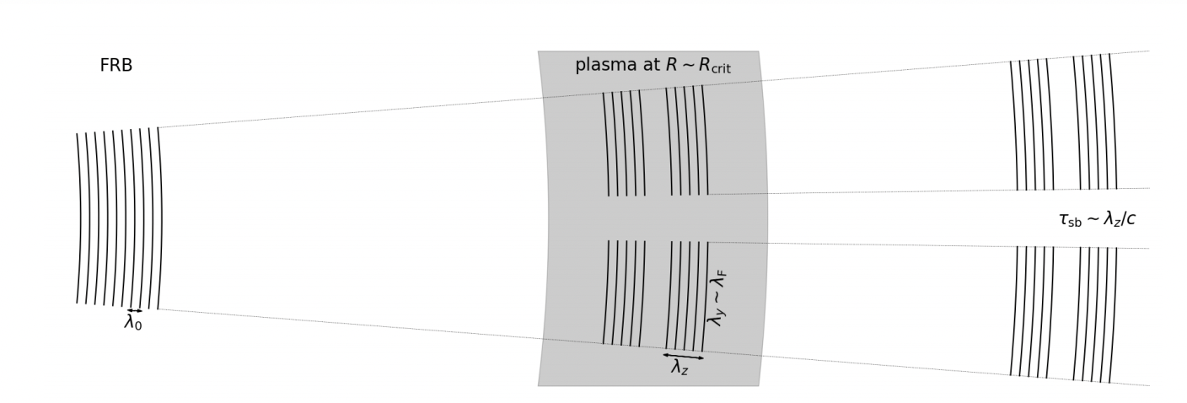



Sobacchi et al. 21
The fastest growing modes for this instability have:
$ck_{⊥}$ $≈ a_{0}ω_{p} \& ck_{∥}=max\{a_{0}ω,ω_{p}$}
Growth rate of the instability is:
$γ= a_{0}^{2}$ $ω_{p}^{2}$/$ω$
Where $a_{0}≡ \frac{qE_{w}}{m_{e}cω}; ω_{p}^{2}≡\frac{4πq^{2}n}{m_{e}}$; $ω: wave frequency; E_{w}$: wave amplitude
The shortest time variability caused by this instability is: $δt=$ max{1/$ck_{∥}$ , $θ_{d}^{2}$ R/2c}
$θ_{d}= λk_{⊥}$/2$π$ is the diffraction angle of the fragmented FRB pulse
•
$μs$ $variability$ for an FRB with L = 10⁴² erg s⁻¹ requires n $≈$ 10⁴ cm⁻³ somewhere between 10¹⁰ cm & 10¹⁶ cm
•
Whereas 10 $μs$ $variability$ can be achieved with n $≈$ 1 cm⁻³ for R < 10¹⁴ cm
•
However, not possible to get 50 ns variability for L = 10³⁹ erg s⁻¹ that was observed for FRB 200120E (a repeater found in M81 globular cluster)

Slide 25
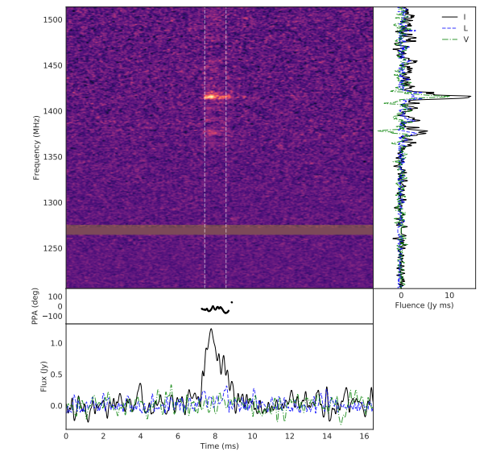

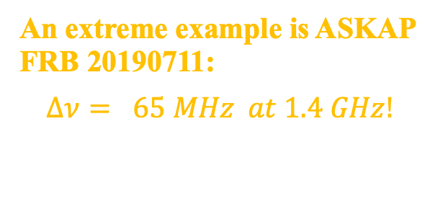
Observed Spectral properties
provide another clue for the location where the radiation is produced.
Frequency (MHz)
FRB 180301; Price+2019
Many FRBs show evidence for
$\frac{∆ν}{ν}<1$
An extreme example is ASKAP FRB 20190711:
$Δν= 65 MHz at 1.4 GHz!$
(DM = 593 pc cm⁻³ ; z = 0.52)
Frequency (MHz)
ASKAP burst 20190711; Kumar et al. 2021

Slide 26

Spectral properties
Many FRBs show evidence for
$\frac{∆ν}{ν}<1$
CHIME collaboration: Chawla – YITP FRB workshop, Feb 8, 2021
These provide clues for the location where the radiation is produced

Slide 27
Galactic FRB, CHIME 2020
This missing flux is unlikely due to scintillation
Also:
Burst from 121102 seen by VLA (2.5-3.5 GHz) but not ARECIBO (1.15-1.73 GHz)

Slide 28






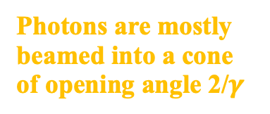
Fastest turnoff of flux with $ν$ & limit on $∆ν$/$ν$
High latitude contributions to the observed radiation sets the bandwidth of FRBs and how sharply the spectrum can decline with decreasing frequencies
$$D≈\frac{2γ}{1+γ^{2}θ^{2}}$$
To observer
Photons are mostly beamed into a cone of opening angle 2/$γ$
$$γ$$
$$γ^{−1}$$
$$θ$$
Photons escaping at larger angles have less Doppler boost and thus lower frequencies in the observer frame.
To observer
$next slide$ $⟹$

Slide 29

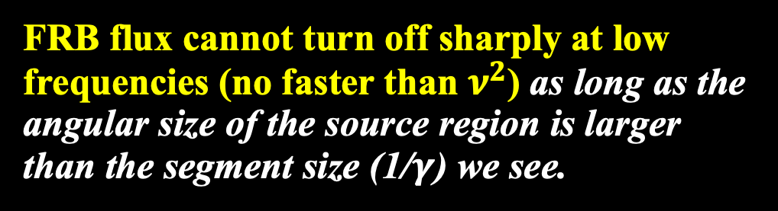

$$∴$$
FRB flux cannot turn off sharply at low frequencies (no faster than $ν^{2}$) as long as the angular size of the source region is larger than the segment size (1/$γ$) we see.
Note: the arrival of lower frequency photons – in the neutron star rest frame – is slightly delayed by 1 ms $ν_{GHz}^{−1}$ for the far-away source model with narrow intrinsic $∆ν/ν$.
Observational Questions:
What is the distribution of spectral bandwidths ($∆ν/ν)$? Does it depend on FRB luminosity and/or repetition rate?
We (or at least I) still don’t have a clear answer for the intrinsic average spectral shape of FRBs, which is important for deciding between competing models.

Slide 30
CHIME
Closely spaced bursts are hard to explain by far-away models
The two pulses of FRB 200428 were separated by 30 ms (CHIME collaboration)
FRB 121102 had several pairs of bursts separated by 17-34 ms, e.g. Hardy et al. (2017), Gourdji et al. (2019), Rajwade et al. (2020), Li et al. (2021)
Not a problem for “near-field” radiation mechanism
Lu, Kumar & Zhang (2020)
But requires fine tuning for far-away models: in order that the two shocks produce synchrotron emission between 400 MHz & 1.5 GHz frequencies.
Notes:
The figure shows upstream plasma kinetic energy luminosity L0 and Lorentz factor gamma_0 for the shock-maser model to produce GHz radiation. L0 must be proportional to gamma0^{8/3} for the observed radiation to be at ~GHz.

Slide 31
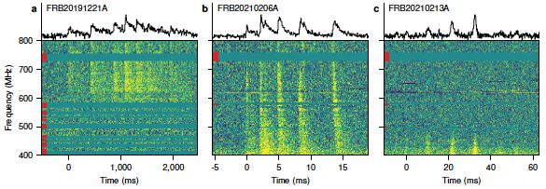
There are more cases of closely spaced bursts
9 peaks separated by 216.8 ms (high statistical significance)
2.8 ms separation (low significance)
10.7 ms separation (low significance)
Petroff et al. 2021

Slide 32
Yet another clue provided by the X-ray data:
The widths of X-ray spikes (~5 ms) and radio emission (0.6 ms) for FRB 200428 (Galactic FRB) suggest that X-rays and radio were produced at different locations.
Furthermore, X-ray spikes were delayed wrt radio by ~ 5 ms which also suggests different processes for the X-ray and radio generation.

Slide 33
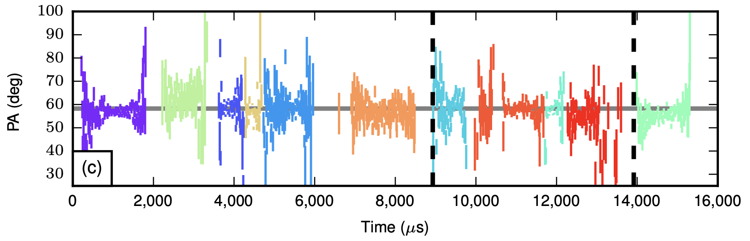
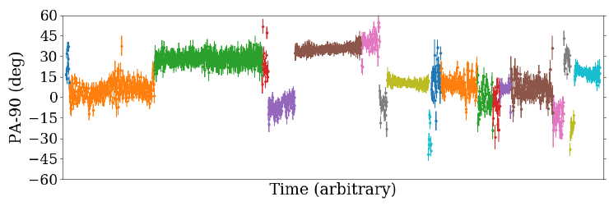
Many FRBs have 100% polarization and flat PA
FRB 121102; Michilli et al. 2018
Some have burst to burst variation of PAs
FRB 20201124A; Hilmarsson et al. 2021

Slide 34
Polarization angle swings for FRB 180301 (Luo et al. 2020)
FRB 180301; Luo et al. (2020)
PA swings suggest magnetospheric origin for radio photons

Slide 35
Diversity in the polarization properties of FRBs
Some FRBs appear to be completely unpolarized (FRB 150418), some show only circular polarization (FRB 140514).
Several FRBs show both linear as well as circular polarization (FRBs 151230, FRB 160102 from Caleb+2018)
However, both maser synchrotron and coherent curvature models predict 100% linear polarization.
Some of the diversity in polarization properties, such as non-zero circular polarization could be due to propagation effects. A 100% linearly polarized radiation can develop circular polarization when it passes through ionized medium with finite magnetic field.
However, PA swings during the burst, such as seen for 180301 (Luo et al. 2020), are likely intrinsic to the source, and that almost certainly point to magnetospheric origin of the burst.

Slide 36
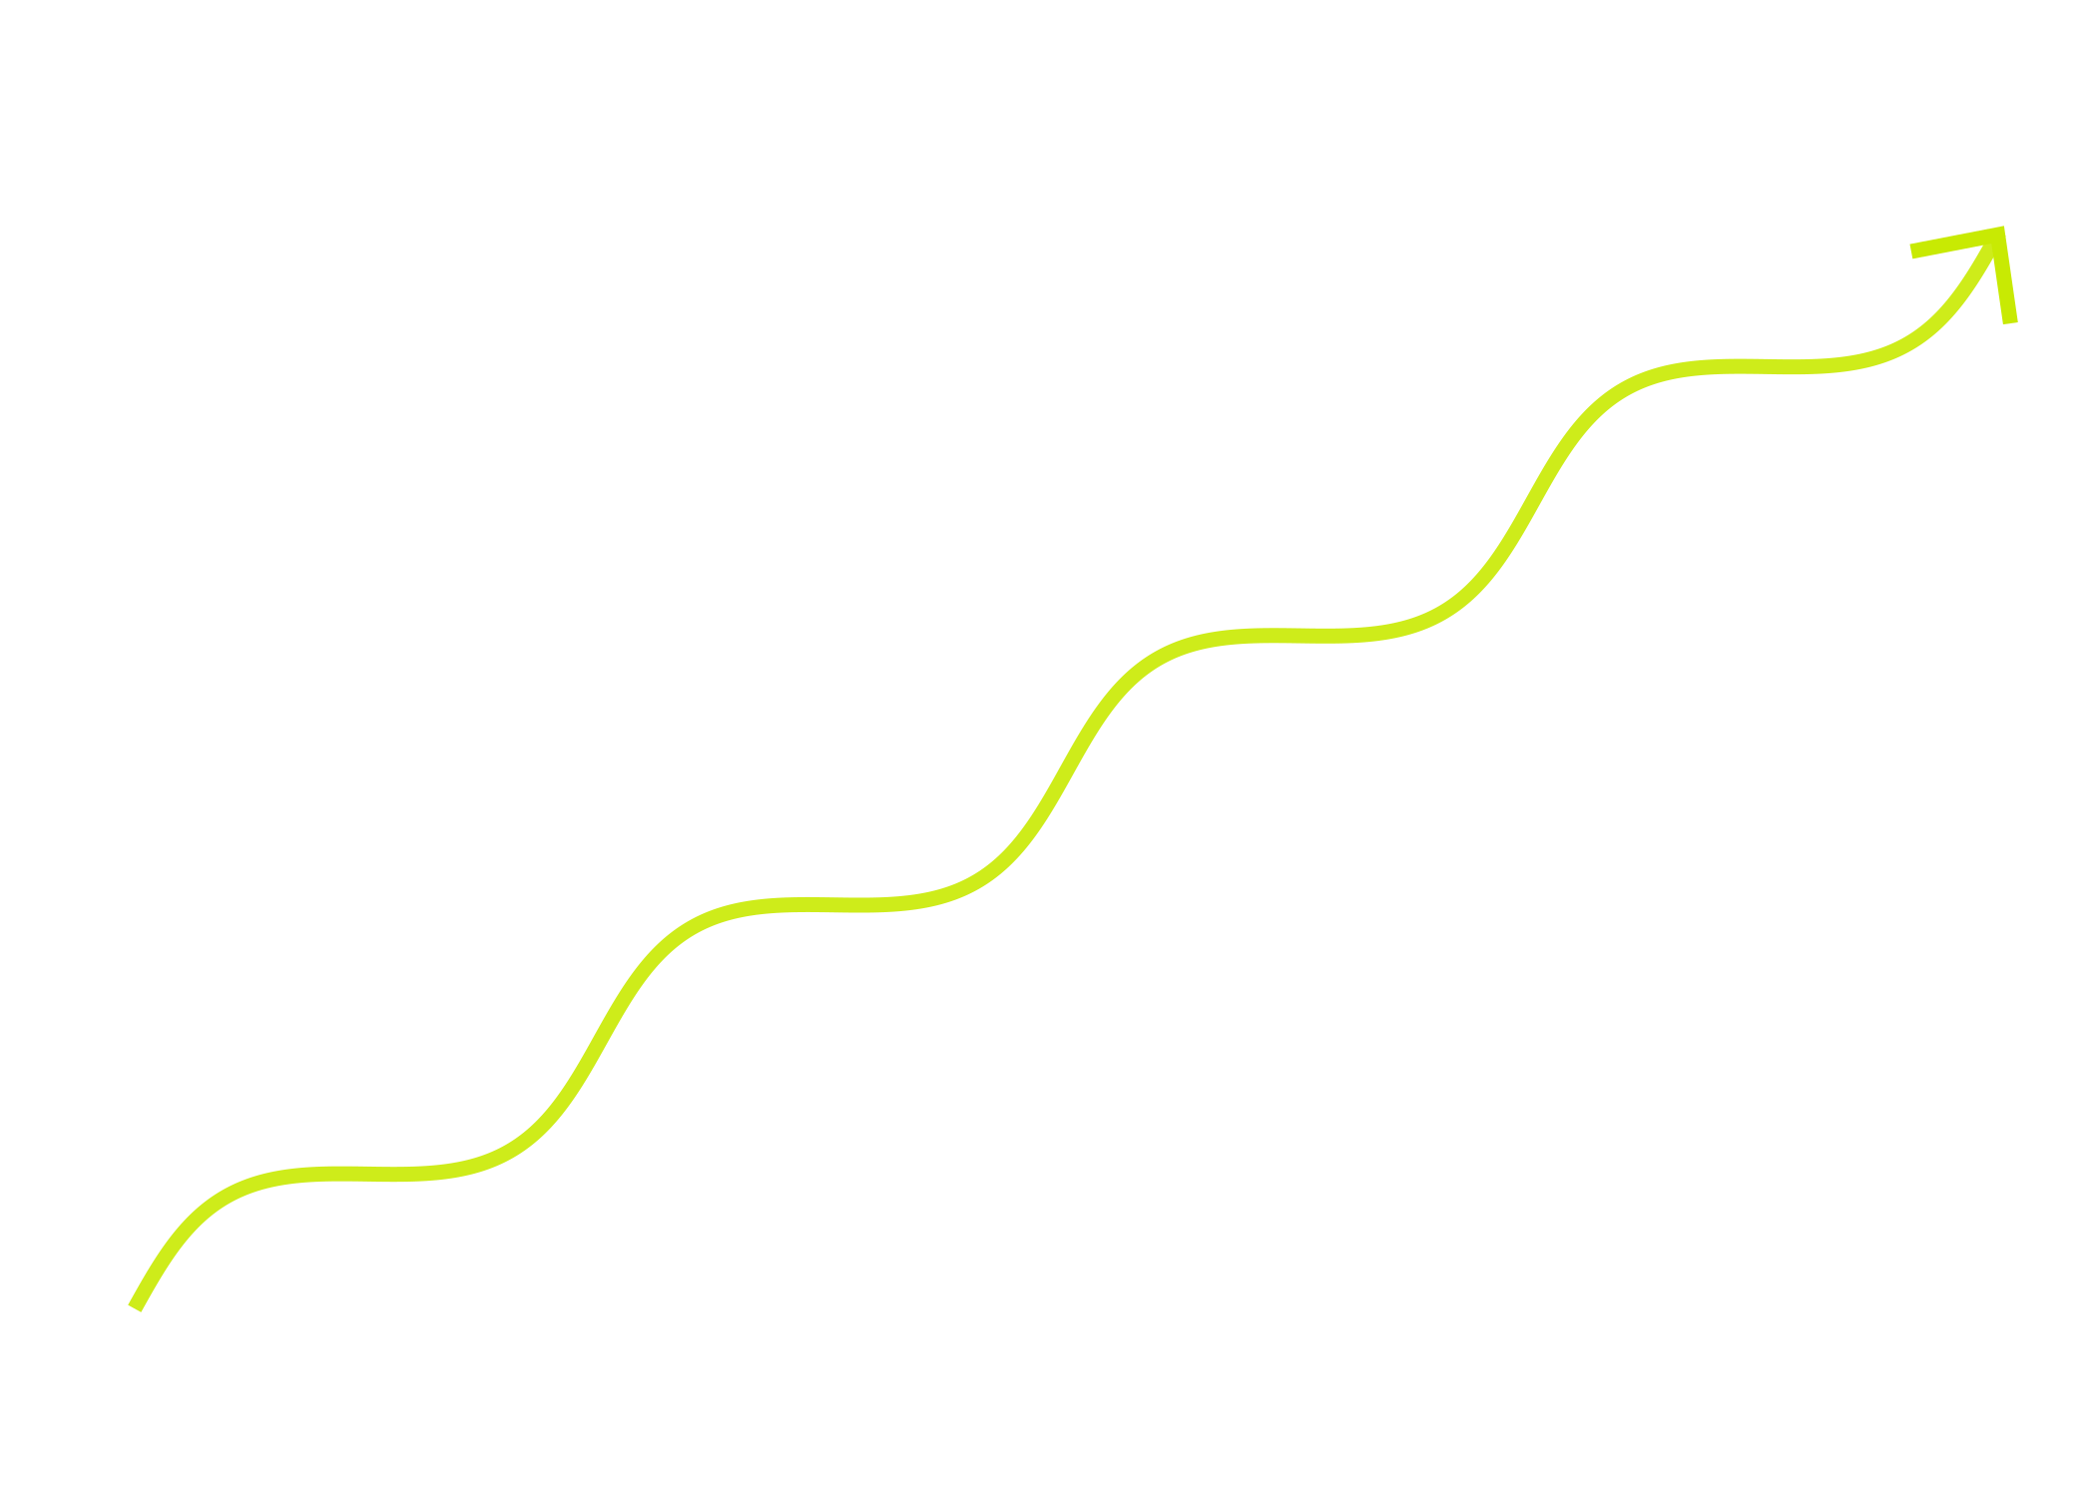


Radiation force due to induced Compton Scattering favor near-field models
•
•
•
•
Scattering probability is enhanced by the “occupation number” of the final state (n_{γ})
•
•
•
•
•
•
•
•
•
•
•
•
•
•
•
•
k_{B} T_{B}
_____
≈ 10³⁷
For FRB radiation, n_{γ} =
h ν
(Because of cancellations, the effective cross-section is enhanced by a factor ~ 10⁹ at R = 10¹³ cm ; declines with distance as R⁻³).
Plasma in the source region needs to be confined so that the enormous radiation pressure does not shut down the radiation process.
R < 10⁸ cm
R > 10¹³ cm
~
~
magnetic field is very strong and suppresses x-mode photon scatterings by a factor (ω_{B}/ω)² .
Photon beam size is small and scattering is not a problem.
LOFAR 150 MHz data for 20180916 with L ~ 10⁴¹ erg/s is important as $τ_{ic}∝L ν^{−3}$ & $t_{ic}^{acc}∝L^{−2} ν^{3}$
ω_{B} = 10¹⁸ B₁₂ Hz is cyclotron frequency and, and ω is FRB photon frequency
R_{de-accel} ~ 10¹² cm (E₄₂ Γ₃² n₂)^{1/3}

Slide 37
It is very hard to produce FRB radiation between ~10⁸ cm & 10¹³ cm from the magnetar surface due to the enormous induced Compton force which quickly disperses the plasma.

Slide 38

Synthesis of different clues: FRB radiation
1.
Summary: Compact source, energy produced at R < 10 R_{ns} .
Radiative acceleration provides useful constraint for some class of models as we show in the next slide.
There are three charecteristic frequecnies in the problem and the FRB energy/lumnosity requirements provide another set of stringent constrainst that I will not have the time to talk bout.
The short variability time scale for LCs (1$0 μs$) suggests that the radiation is produced in a region of size ~ 10⁵ Γ cm, and not too far away from the NS. This is further supported by closely spaced bursts, and polarization angle sweeps we see for some bursts.
2.
Missing flux at low frequencies is a clue against models such as masers in external shock.
3.
Plasma should be able to withstand the radiative acceleration due to induced-Compton
source distance from NS < 10⁸ cm or >10¹³ cm †.
Converting magnetic disturbance (Alfven waves) to generate coherent radio emission in the magnetosphere is consistent with these constraints
†
Maser process is possible near the light cylinder where cyclotron frequency ~ a few GHz – if one can avoid dispersing the plasma by the strong induced-Compton scattering force.

Slide 39
FRB radiation source within a few 10s of neutron star radii

Slide 40
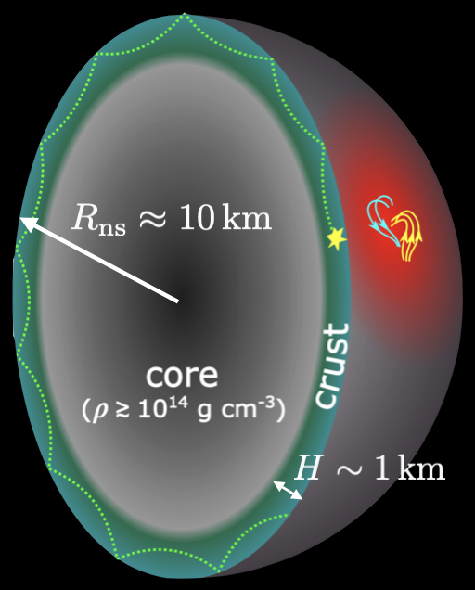
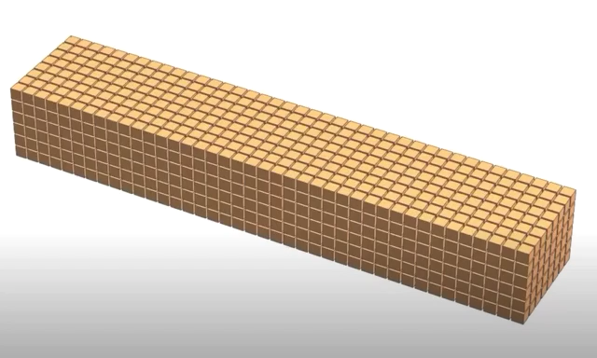

Overview of shear wave $→$ FRB
Lu, Kumar & Zhang, 2020

Slide 41
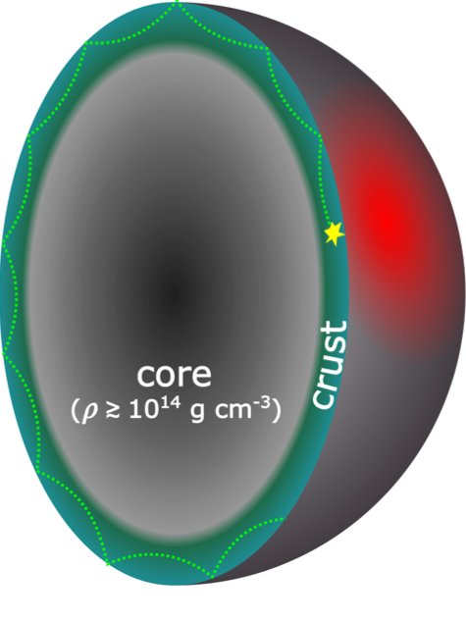

Trapped fireball: Thompson & Duncan (1995) “standard” model for SGRs
Crustal shear waves $→$ Alfven waves
Lu, Kumar & Zhang (2020)
𝝂_{shear} ~ 10⁴ Hz ~ v_{shear} /H
v_{shear} ~ 0.01 c
^{H~1 km}

Slide 42
Crustal shear waves $→$ Alfven waves
Lu, Kumar & Zhang (2020)
𝝂_{shear} ~ 10⁴ Hz ~ v_{shear} /H
v_{shear} ~ 0.01 c
^{H~1 km}

Slide 43
Particle clump formation & radiation
outside charge starvation radius

Slide 44
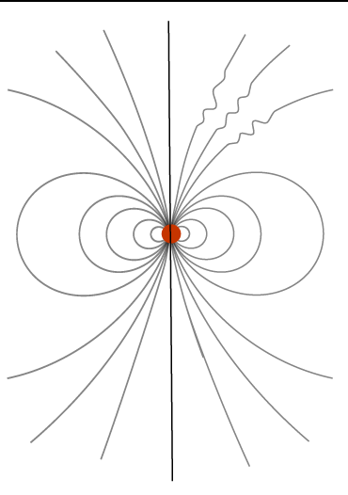
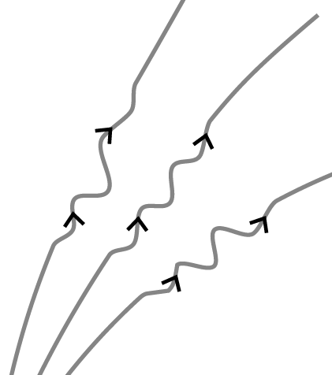
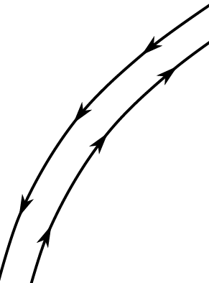
c/ω_{p}~ 1 cm
e⁻
2-stream instability
j
e⁺
Growth time for the instability ≈ 1/ω_{p}
ω_{p} : plasma frequency
~ 10 GHz

Slide 45
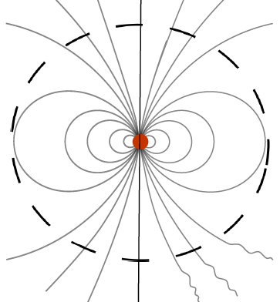
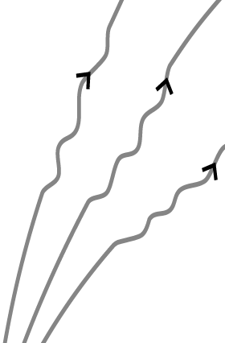
Starvation
Displacement current:
Charge
Radius
E_{d}
This electric field keeps the charge particles accelerated as they lose energy to coherent curvature radiation.

Slide 46
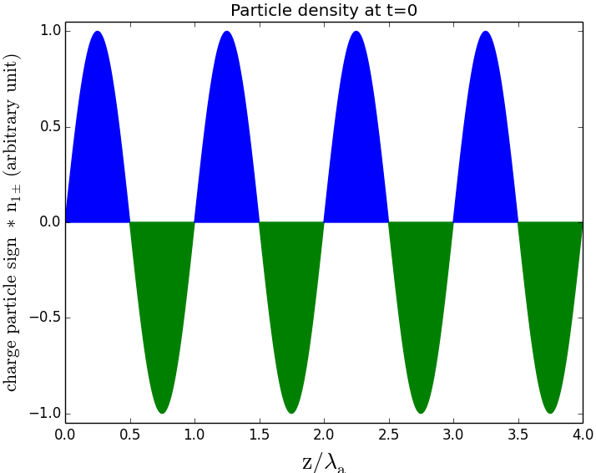
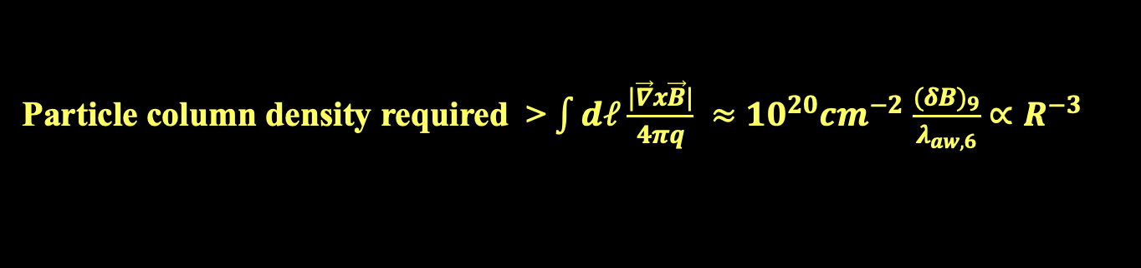
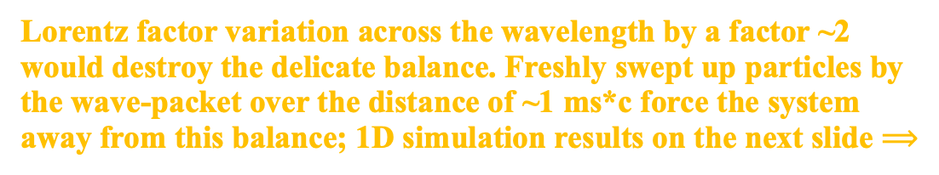

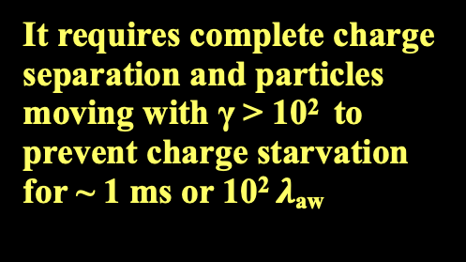
Particle advection by Alfven waves prevent charge starvation?
The work of Chen et al. (2020) suggests this possibility
Particle column density required > $\int{dℓ\frac{|\vec{∇}x\vec{B}|}{4πq}} ≈$ ${10}^{20}{cm}^{−2}$ $\frac{{(δB)}_{9}}{λ_{aw,6}}$ $∝R^{−3}$
a factor ~10⁵ larger than G-J at 10² R_{ns},; particles cannot be advected from much below the charge-starvation radius because their speed is << c
It requires complete charge separation and particles moving with γ > 10² to prevent charge starvation for ~ 1 ms or 10² $λ$_{aw}
e⁺
e⁺
e⁺
e⁺
e⁻
e⁻
e⁻
e⁻
$$z/λ_{AW}$$
Lorentz factor variation across the wavelength by a factor ~2 would destroy the delicate balance. Freshly swept up particles by the wave-packet over the distance of ~1 ms*c force the system away from this balance; 1D simulation results on the next slide $⟹$

Slide 47
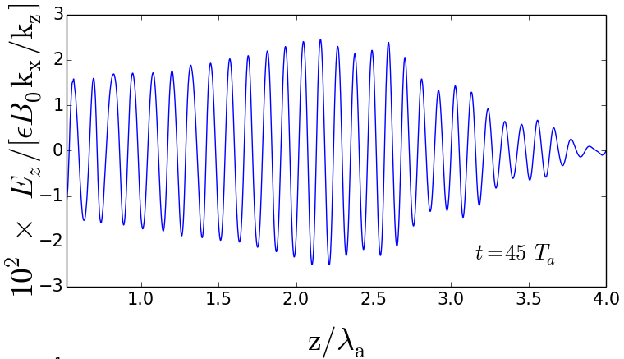
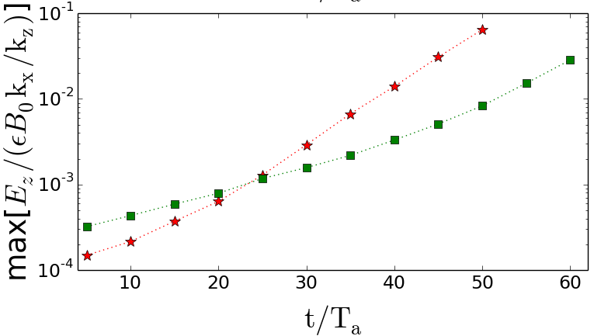



Kumar et al. 2022
1D simulation results
Alfven wave on the verge of charge starvation propagating through a low density medium
t = 45 $T_{AW}$
$$z/λ_{AW}$$
Oscillations develop on plasma length scale
Kumar et al. 2022
t$/T_{AW}$

Slide 48
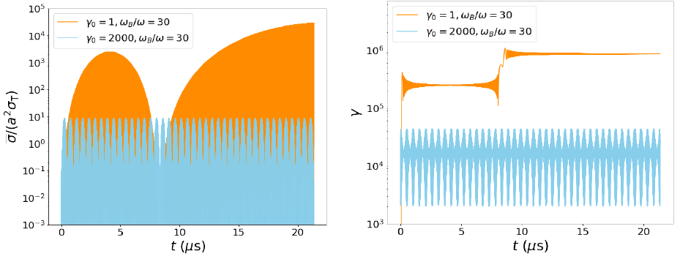
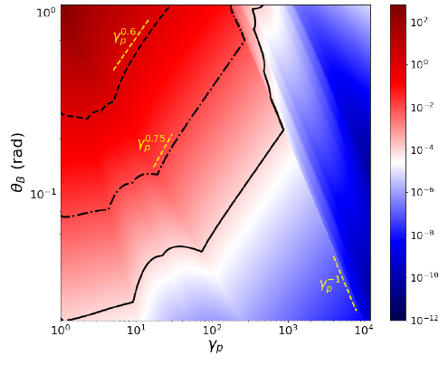


Can FRB waves escape the magnetosphere?
The cross-section is $≫ σ_{T}$ when particle is at rest ($γ_{0}=1),$ and of order a² $σ_{T}$ for $γ_{0}=$2x10³
a = 10⁴
a = 10⁴
Qu, Kumar, Zhang (2022)
Color coding is optical depth
$θ_{B}:$angle between magnetic field and photon momentum vector
$γ_{p}$: particle LF before EM the arrival of FRB pulse

Slide 49
Predictions of the model
•
Maximum FRB Luminosity ~ 10⁴⁷ erg s⁻¹
As the electric field approaches the Schwinger limit – 4x10¹³ esu – e± are pulled from vacuum, and the cascade shorts the electric field needed for accelerating particles for coherent radiation.
•
Minimum FRB frequency
The maximum wavelength of radiation for particle clumps moving with LF γ is given by the radial size of causally connected region, i.e. R/(2 γ²) ~ 300 cm R₇ (R₇/R_{B,8})² or ~ 100 R₇ MHz
λ_{max} is larger than the “peak” curvature radiation wavelength by a factor γR/(2πR_{B})
Notes:
Emphasize the physics maximum FRB luminosity and the Schwinger limit.

Slide 50
Open Questions
Why does a typical NS or a magnetar not produce FRB?
(~10⁴ Galactic NS younger than 1 Myr)
And only 1 out of ~40 magnetar in the Galaxy does?
Is it because FRBs require B above some threshold value?
Some requirement on rotation rate, age, and binarity?
Do all magnetars go through an FRB phase? What special conditions are needed for a NS/magnetar to produce an FRB?
SGR 1935 does not seem that special. This might suggest that most magnetars probably can produce FRBs.
Could this depend on the amount of “free energy” available in the magnetic field in NS interior at birth?

Slide 51
More open questions:
Radiation mechanism
Different morphology of repeaters and non-repeaters.
Weird spectral structures
Diverse polarization behavior of FRBs

Slide 52
Summary
•
The new field of FRBs is undergoing rapid advance. This is likely to continue for the next several years at least.
•
The physical constraints I have described are likely to guide our ultimate understanding of FRB radiation physics.
•
Alfven waves launched from NS surface become charge starved at some radius. e± are accelerated in this process and produce FRBs via coherent curvature radiation mechanism.

Slide 54
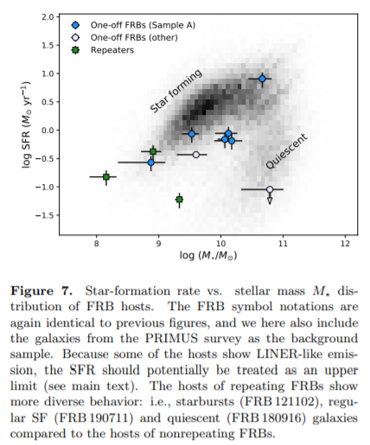
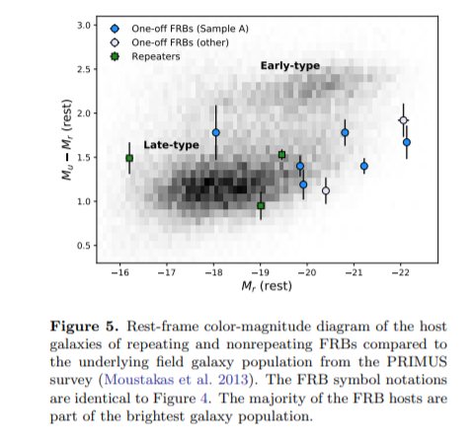
Heintz+2020

Slide 55
Insight-HXMT (X-ray) data for FRB 200428 (Li et al. 2020)
[Hard X-ray Modulation Telescope or HXMT aka Insight]
X-ray pulse duration ≈ 0.2 s (~5 ms spikes)
X-ray energy ~ 10⁴⁰ erg (can be confined in closed B-field lines)

