Slide 1
FRB Polarization, lensing & as probes of cosmology
Pawan Kumar
Outline†
•
A brief summary of polarization observations
•
Multipath propagation through magnetized medium and FRB polarization
•
Lensing of FRBs to probe stellar mass blackholes
•
FRBs to probe the reionization history of the universe
†Paz Beniamini
Kyoto, June 7, 2022

Slide 2
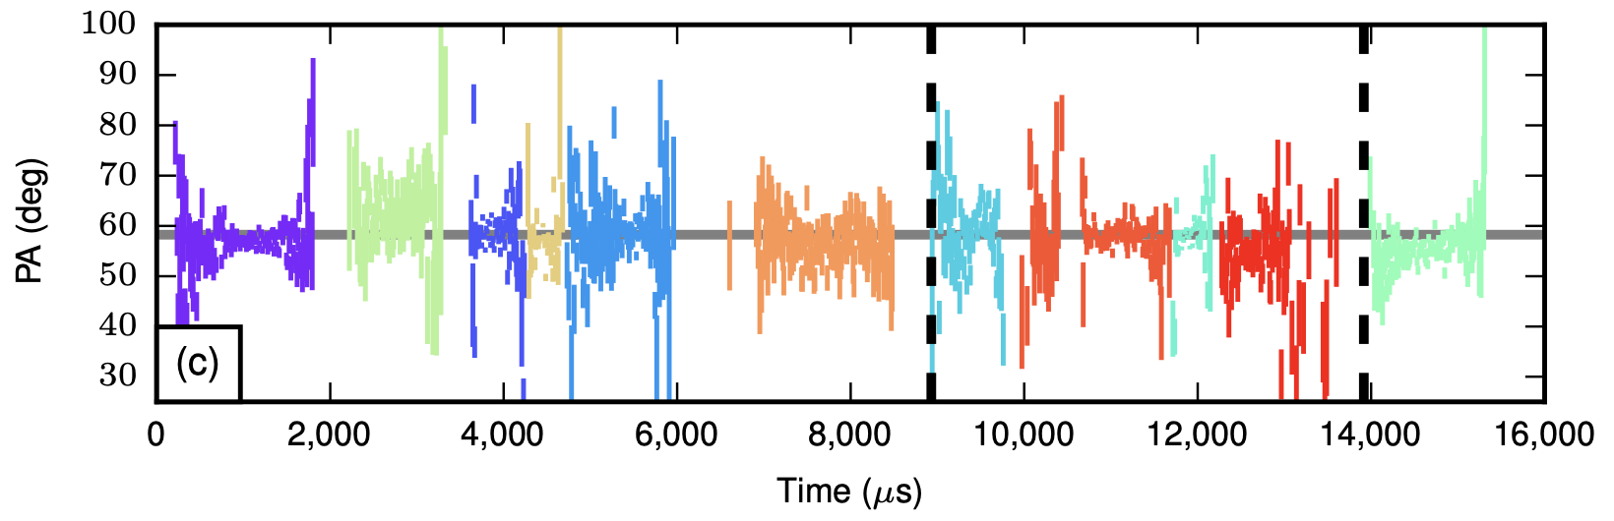
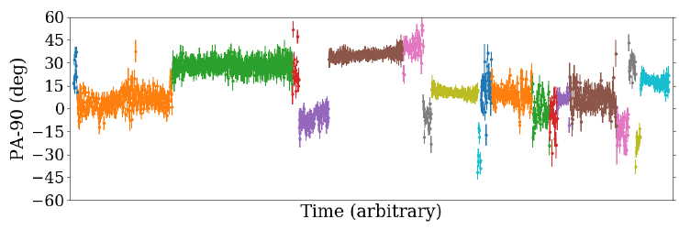
Many FRBs have 100% polarization and flat PA
FRB 121102; Michilli et al. 2018
Some have burst to burst variation of PAs
FRB 20201124A; Hilmarsson et al. 2021

Slide 3
Polarization angle swings for FRB 180301 (Luo et al. 2020)
FRB 180301; Luo et al. (2020)
PA swings suggest magnetospheric origin for radio photons

Slide 4
Fast Radio Burst Polarization
Diversity of polarization measurements:
Some with ~100% linear polarization
Some with ~30-90% linear polarization
Some with >10% circular polarization
What causes the diversity of polarization properties? Is it Intrinsic or Extrinsic?
If the FRB radio wave passes through a scattering screen that is magnetized, it could affect the FRB polarization we observe.
Understanding scintillation is crucial for disentangling source and propagation properties on polarization and spectral/temporal variability

Slide 5
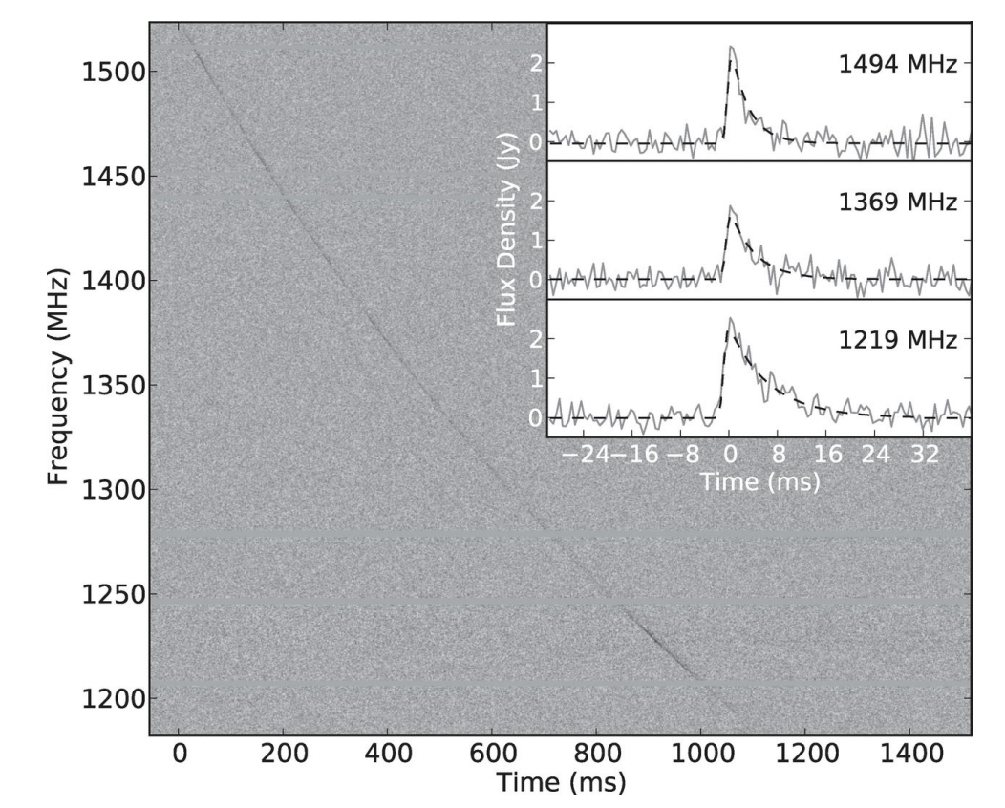
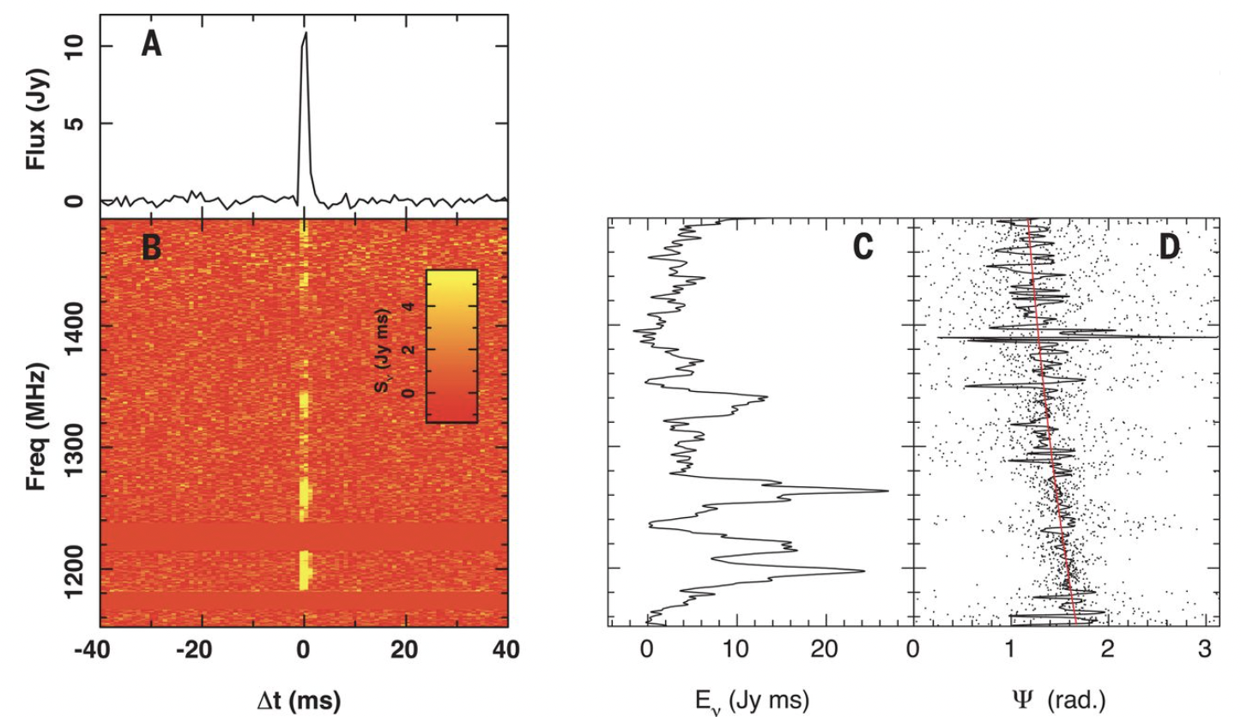


Scintillating screens –spectral and temporal variability
FRBs reaching the observer have propagated through the intervening plasma
This plasma affects FRB spectrum and lightcurve via scintillation (multi-path propagation) causing spectral decoherence, scatter broadening and temporal variability
$$φ_{2}$$
$$φ_{1}$$
Scatter broadening (FRB 110220)
Coherence bandwidth ~ 8Mhz (FRB 180924)
Petroff et al. 2019
Bannister et al. 2019
Notes:
Coherence bandwidth from the screen

Slide 6
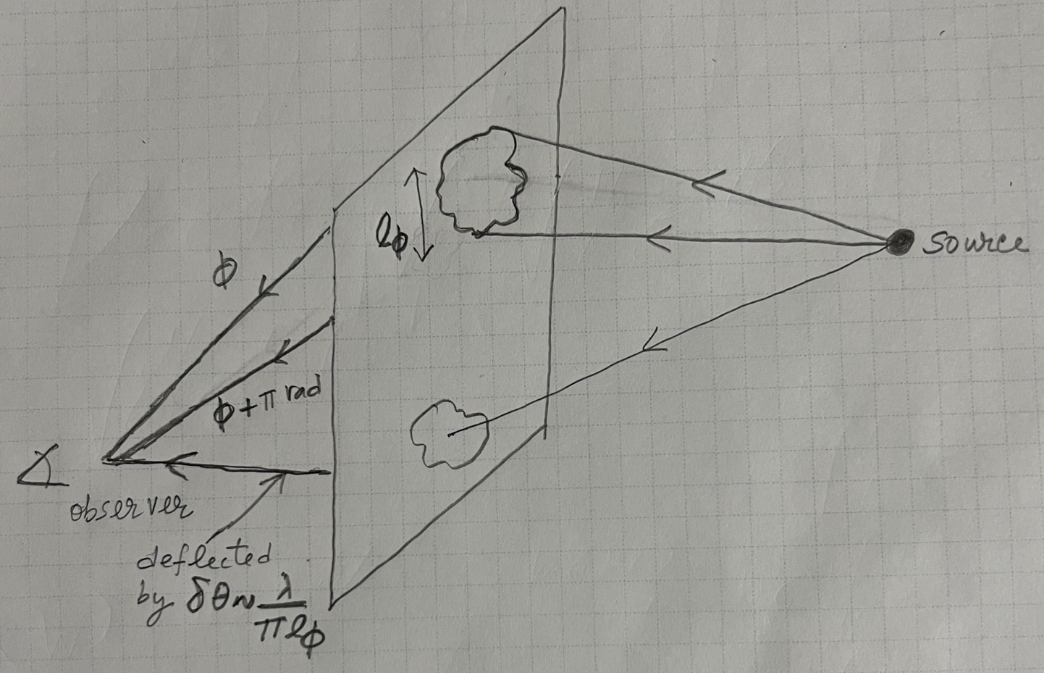

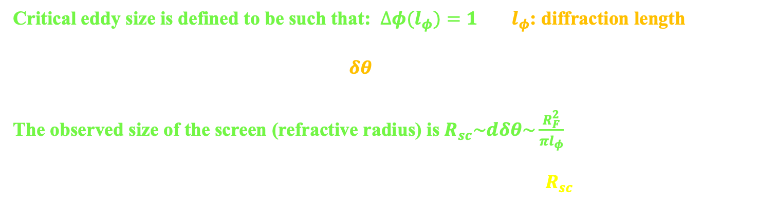

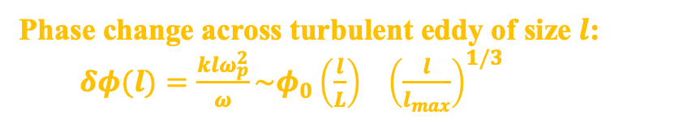

Diffractive scintillation (Kolmogoroff turbulence)
$$δn=n{\left(l/{l_{max}}\right)}^{1/3}$$
Phase change across turbulent eddy of size $l$: $δφ(l)=\frac{klω_{p}^{2}}{ω}\sim φ_{0}{\left(\frac{l}{L}\right)}^{}{\left(\frac{l}{l_{max}}\right)}^{1/3}$
Accumulated phase change through screen
of width L: $∆φ={\left(\frac{L}{l}\right)}^{1/2}δφ∝l^{5/6}$
Critical eddy size is defined to be such that: $∆φ(l_{φ})=1$ $l_{φ}$: diffraction length
Change of phase implies wave deflection $δθ\sim \frac{∇_{⊥}∆φ}{k}\sim \frac{λ}{π l_{φ}}≪1$
The observed size of the screen (refractive radius) is $R_{sc}\sim dδθ\sim \frac{R_{F}^{2}}{πl_{φ}}$
Strong scattering and multi-path propagation when $R_{F}≫l_{φ}$ (or $R_{sc}≫R_{F}≫l_{φ}$ )
Where R_{F} ~ $\sqrt{\text{d} λ}$ is Fresnel scale

Slide 7
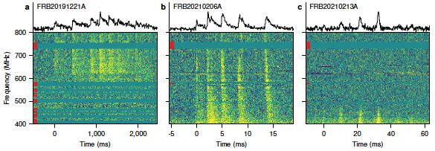

The diffraction time scale is: t_{ds} ~ $R_{sc}^{2}$/(2dc)
It follows from the expression for R_{sc} from the previous slide that t_{ds} $∝$ $λ^{4.4}$
Some examples of scatter-broadening are shown below
Petroff et al. 2021

Slide 8
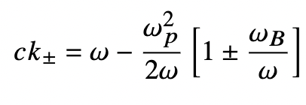
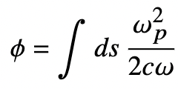
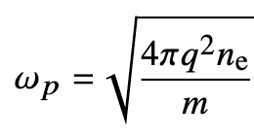
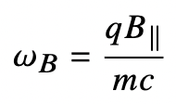
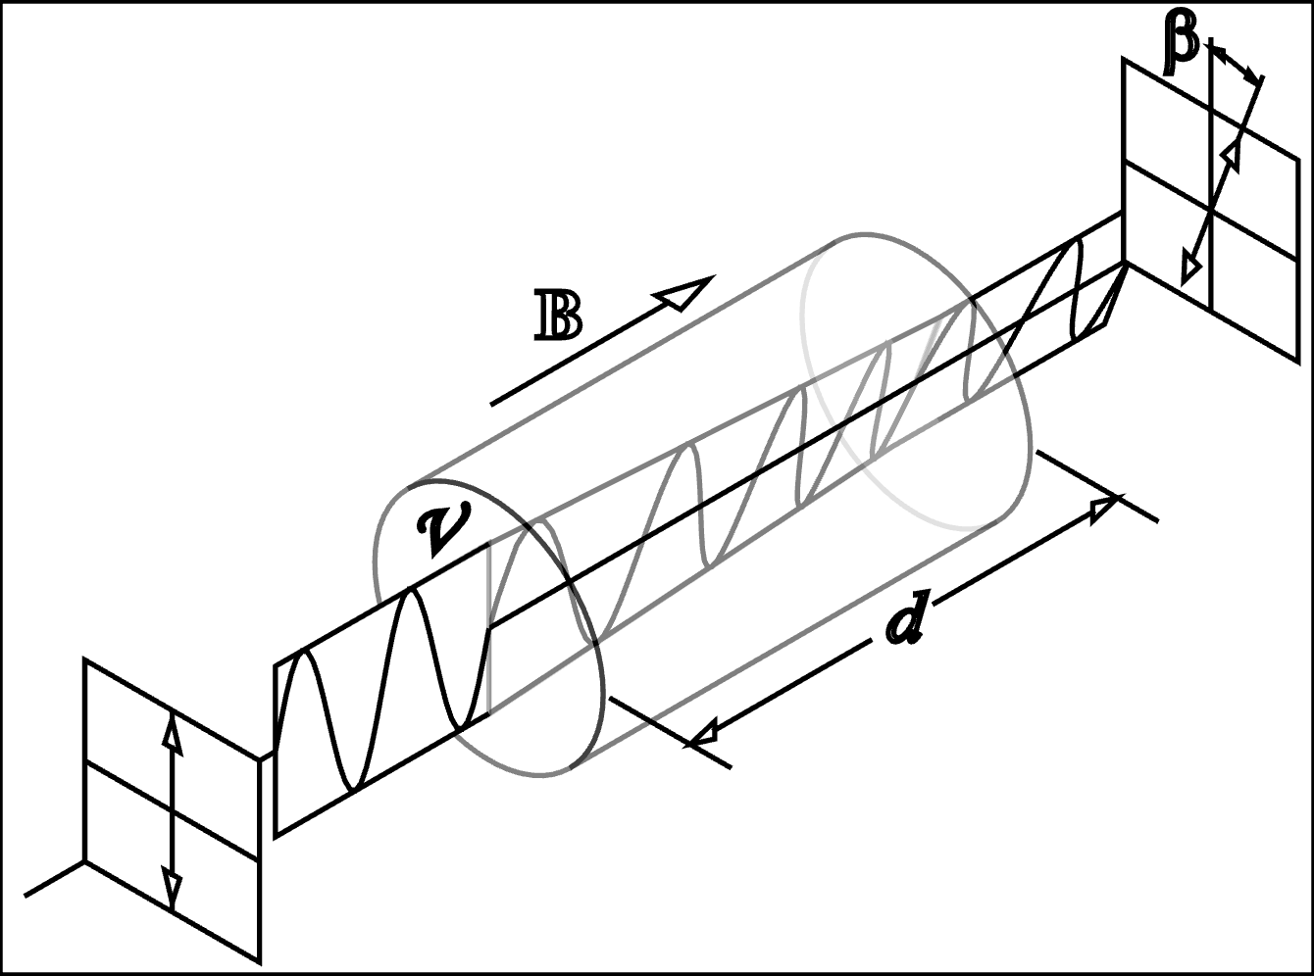
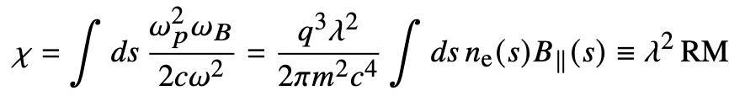

EM propagation through magnetized plasma
Left and right circular polarizations propagate with different speeds in plasma
Excess phase accumulates along line of sight through plasma
Cyclotron frequency
$$χ$$
Plasma frequency
Faraday rotation

Slide 9

Depolarization due to finite spectral resolution
Smoothly varying PA – Faraday depolarization
Consider Faraday Rotation: $χ=RM λ^{2}$
$Δχ=1$ over frequency scale $ν_{RM}=\frac{ν^{3}}{2RM c^{2}}$
Stokes parameters no longer increase with increasing bandwidth of observations.
In fact, for $N_{RM}=\frac{ν_{res}}{ν_{RM}}≫1$, almost exact cancellation leading to $Π_{lin,ν}≈{N_{RM}}^{−1}$
So in general: $Π_{lin,ν}≈{\left(\text{1+ }\frac{ν_{res}}{ν_{RM}}\right)}^{−1}$
Known frequency dependence
Can be removed with intra-channel or high frequency data
Creates no circular polarization

Slide 10
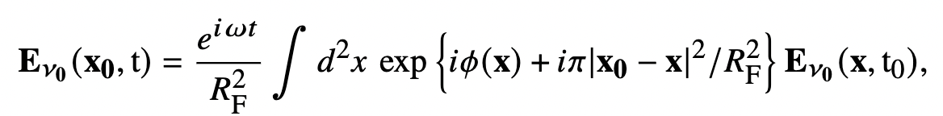



Fresnel diffraction optics
Electric field is calculated in the Fresnel diffraction limit:
Fresnel radius $R_{F}=\sqrt{λd}$ - natural visible size of screen
Electric field rotated by the screen
$$χ$$
Incoming field
Observer plane
Scintillating screen

Slide 11
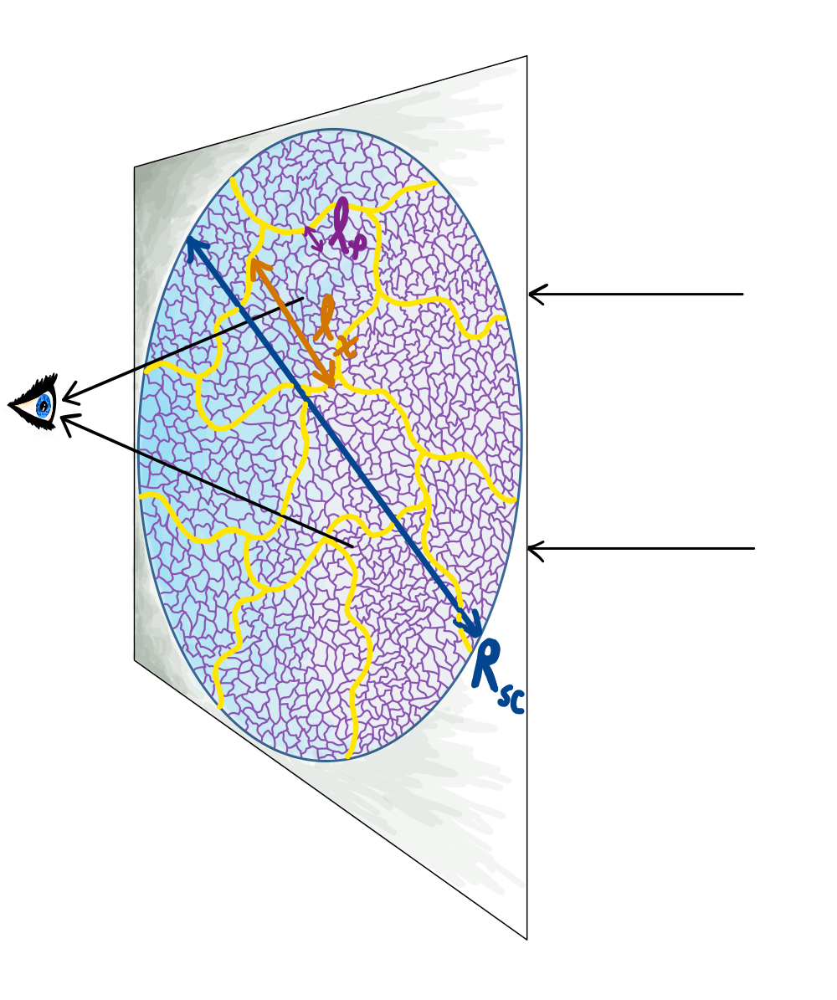
Depolarization by a scintillating screen
Linearly polarized EM wave passing through a scintillating screen undergoes different phase and PA changes from different parts of screen. The wave can:
Become partially depolarized
Incoming wave linearly polarized
Get converted to partially circularly polarized wave
Scintillating screen
This is distinct from depolarization due to large RM, or small circular polarization from “generalized Faraday rotation”

Slide 12
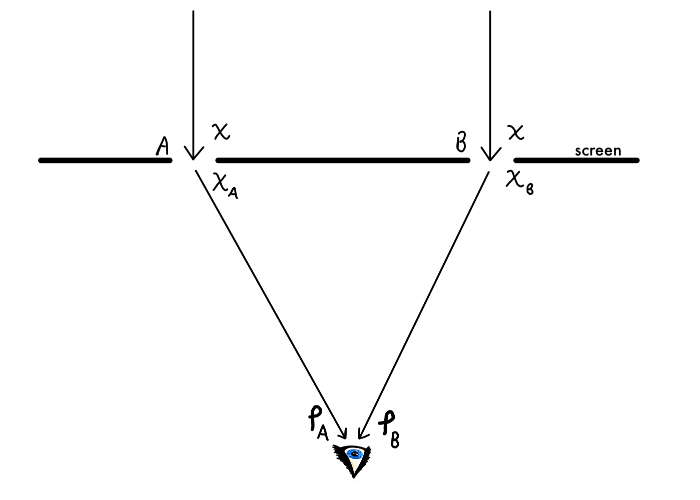
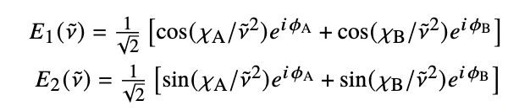
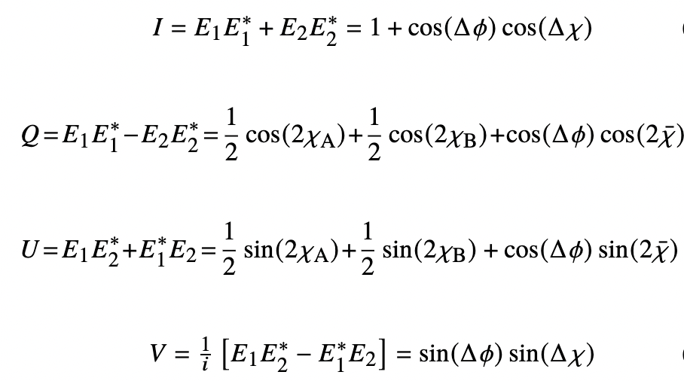
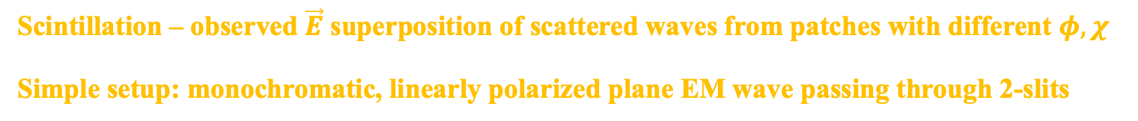
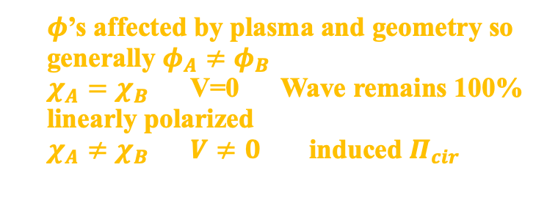
Toy model – Double slit experiment
Scintillation – observed $\vec{E}$ superposition of scattered waves from patches with different $φ,χ$
Simple setup: monochromatic, linearly polarized plane EM wave passing through 2-slits
Stokes parameters
$φ$’s affected by plasma and geometry so generally $φ_{A}≠φ_{B}$
$χ_{A}=χ_{B}$ V=0 Wave remains 100% linearly polarized
$χ_{A}≠χ_{B}$ $V≠0$ induced $Π_{cir}$

Slide 13

Scintillation in magnetized medium – generation of circular polarization
Rotation of electric field by turbulent eddy of size $l$: $δχ\sim χ_{0}{\left(\frac{l}{L}\right)}^{}{\left(\frac{l}{l_{max}}\right)}^{1/3}$
Critical eddy size when $δχ(l_{χ})=1$ ($l_{χ}$: rotation length)
Mean rotation small compared to mean phase $\frac{χ_{0}}{φ_{0}}\sim \left\langle \frac{ω_{B}}{ω}\right\rangle ≪1$
$\frac{l_{χ}}{l_{φ}}\sim {\left(\frac{ω}{ω_{B}}\right)}^{6/5}\sim {\left(\frac{3∙{10}^{8}ν_{9}{DM}_{s}}{{RM}_{s}}\right)}^{6/5}≫1$
But, as long as $l_{χ}$< $R_{sc}$ induced $Π_{cir}$ will be of the
order of $Π_{tot}$
Effect relies on fluctuations in $n_{e},B_{||}$ but is not
2nd order
Incoming wave linearly polarized

Slide 14
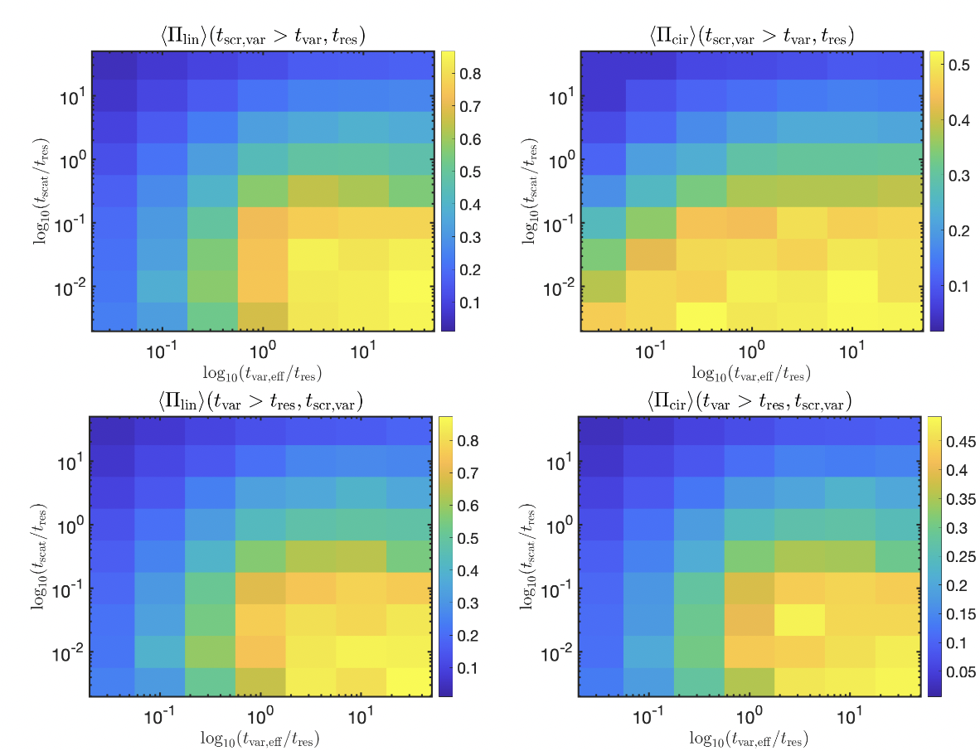


Polarization change due to a scintillating screen
source variability
screen variability
$$Π_{lin}$$
$$Π_{cir}$$
Notes:
t_{res} : temporal resolution of observation; t_{scr, var} : variability associated with the scattering screen;
t_{var} : the source temporal variability; t_{var, eff} = min(t_{var}, t_{scr, var})

Slide 15
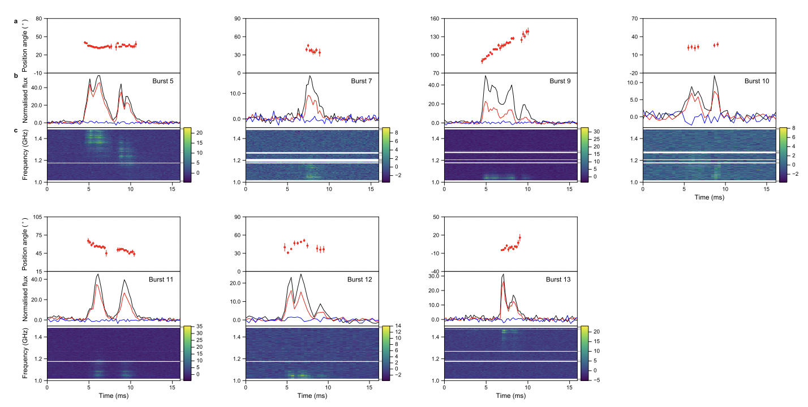
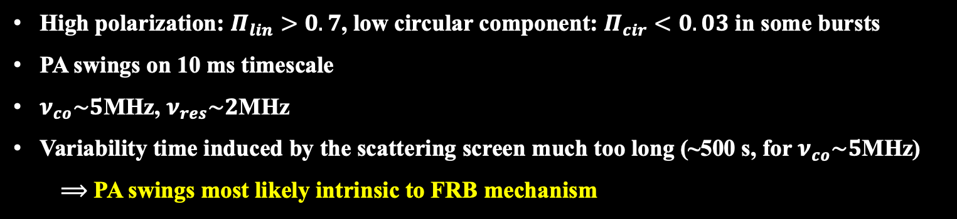
Comparison with observations - FRB 180301A
High polarization: $Π_{lin}>0.7$, low circular component: $Π_{cir}<0.03$ in some bursts
PA swings on 10 ms timescale
$ν_{co}\sim 5$MHz, $ν_{res}\sim 2$MHz
Variability time induced by the scattering screen much too long (~500 s, for $ν_{co}\sim 5$MHz)
$⟹$ PA swings most likely intrinsic to FRB mechanism
Luo et al. 2020

Slide 16
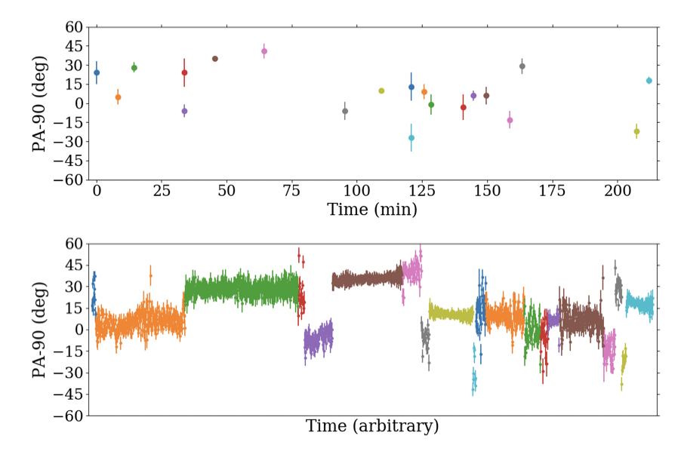
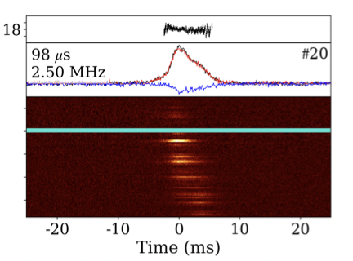
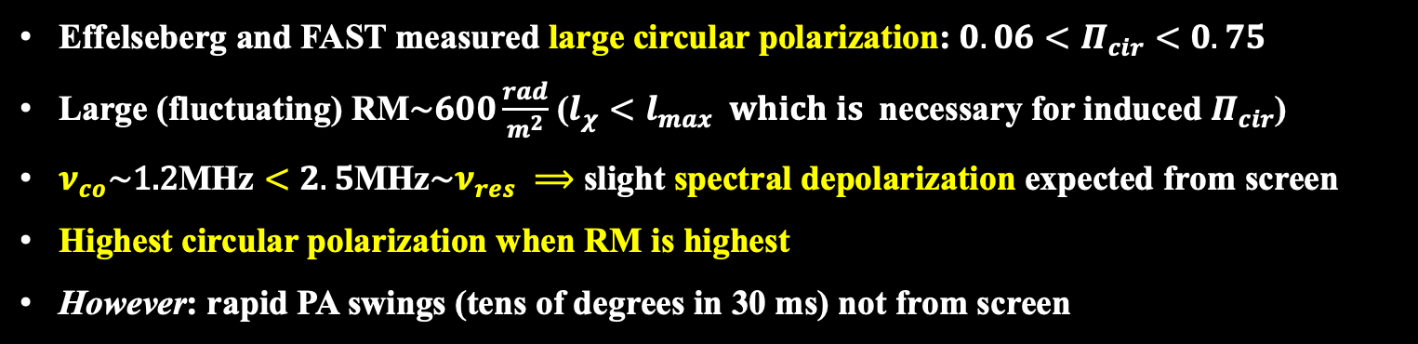
Comparison with observations - FRB 201124A
Hilmarsson et al. 2021
Effelseberg and FAST measured large circular polarization: ${0.06<Π}_{cir}<0.75$
Large (fluctuating) RM$\sim 600\frac{rad}{m^{2}}$ ($l_{χ}<l_{max} which is$necessary for induced $Π_{cir}$)
$ν_{co}\sim \text{1.2}\text{M}\text{H}\text{z}<2.5\text{M}\text{H}\text{z}\sim ν_{res} ⟹$ slight spectral depolarization expected from screen
Highest circular polarization when RM is highest
However: rapid PA swings (tens of degrees in 30 ms) not from screen

Slide 17
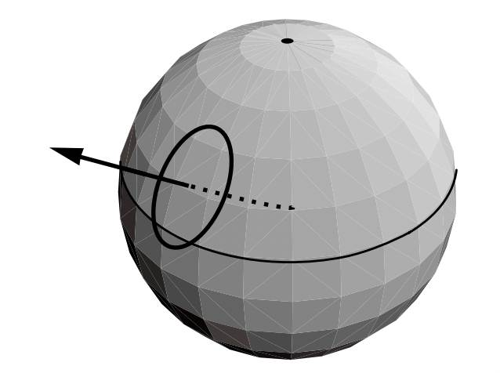
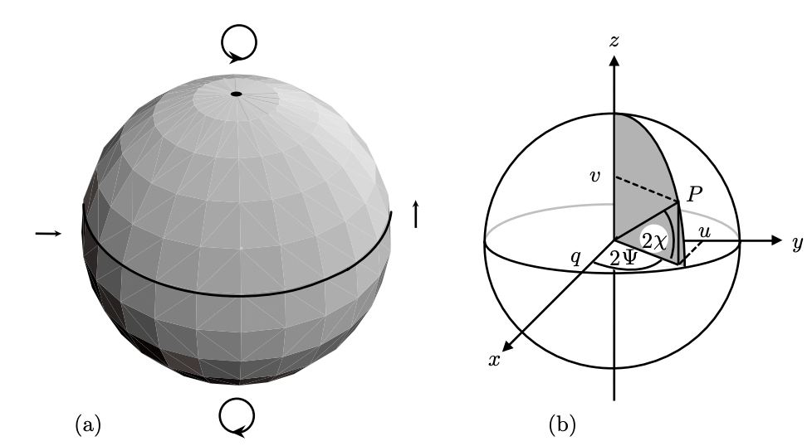
Faraday conversion (Generalized Faraday rotation)
Poincaré sphere
V
Kennet & Melrose 98
U
Q
Conversion of linear to circular polarization
It requires:
Either very strong magnetic field ($ω_{B}\sim ω$) with magnetic field reversals or
strong B and at least mildly relativistic electrons
Distinct properties from multi-path propagation such as dependence on $ν$

Slide 18
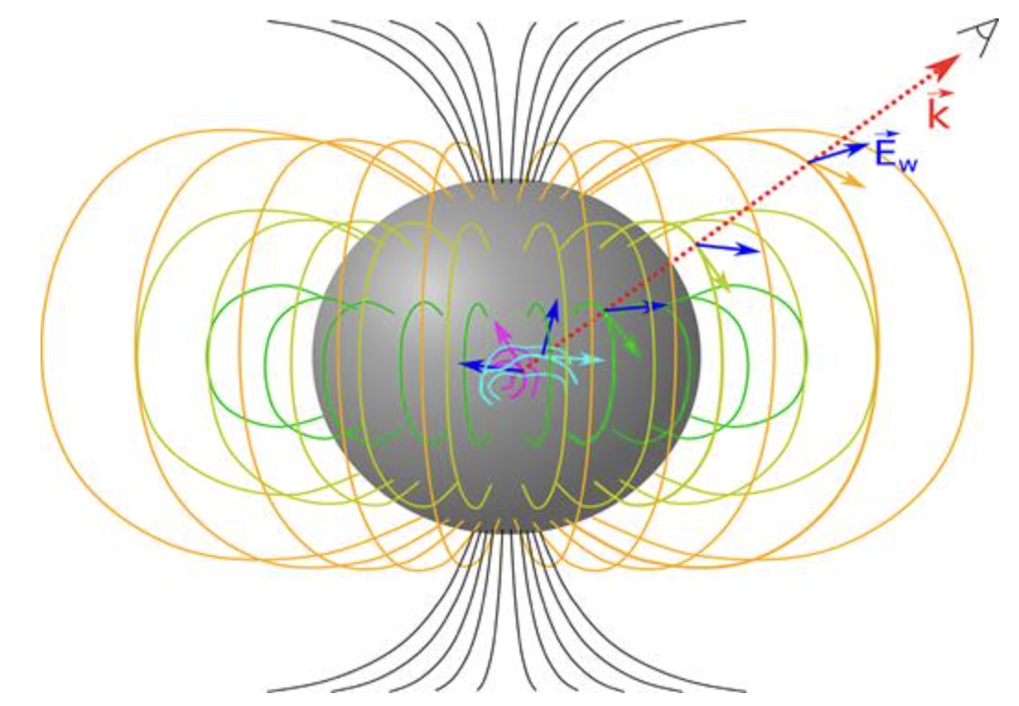

Polarization properties for different FRB models
Far-away models: (e.g. baryonic shells) very difficult to change PA within a single burst, or generally on a timescale much shorter than $R/2cΓ^{2}$
Magnetospheric models: Both constant PA and varying PA can be explained depending on orientation of magnetic axis relative to spin axis
Precession models: Almost impossible to explain constant PA.
Lu et al. 2019

Slide 19
Lensing by a point mass located in a plasma screen
.
.
.
.
.
.
.
.
.
.
.
.
.
.
.
.
.
.
.
.
.
.
.
.
.
.
.
.
.
.
.
.
.
.
.
.
.
.
.
.
.
.
.
.
.
.
.
.
.
.
.
.
.
.
.
.
.
.
.
.
.
.
.
.
.
.
.
.
.
.
.
.
.
.
.
.
.
.
.
.
.
.
.
.
.
.
.
.
.
.
.
.
.
.
.
.
.
.
.
.
.
.
.
.
.
.
.
.
.
.
.
.
.
.
.
.
.
.
.
.
.
.
.
.
.
.
.
.
.
.
.
.
.
.
.
.
.
.
.
.
.
.
.
.
.
.
.
.
.
.
.
.
.
.
.
.
.
.
.
.
.
.
.
.
.
.
.
.
.
.
.
.
.
.
.
.
.
.
.
.
.
.
.
.
.
.
.
.
.
.
.
.
.
.
.
.
.
.
.
.
.
.
.
.
.
.
.
.
.
.
.
.
.
.
.
.
.
.
.
.
.
.
.
.
.
.
.
.
.
.
.
.
.
.
.
.
.
.
.
.

Slide 20



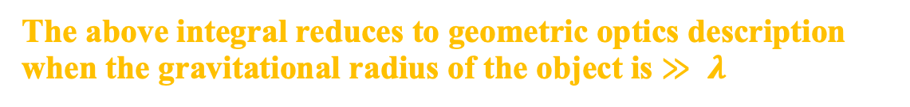
Lensing by a point mass located in a plasma screen
Beniamini & Kumar – under preparation)
The flux observed from an astronomical source when photons travel through a gravitational potential and plasma on their way to the observer is given by
where
Is the Fresnel angle
is the time delay due to travel in the gravitational potential Φ
The above integral reduces to geometric optics description when the gravitational radius of the object is $≫ λ$

Slide 21
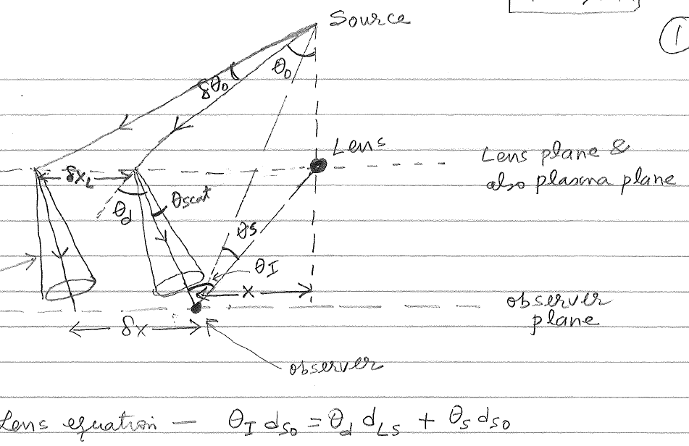

Lensing by a point mass located in a plasma screen
Lens equation:

Slide 22




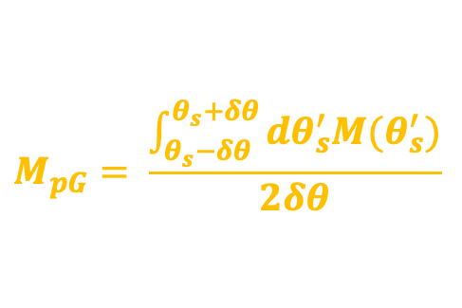


Lens equation: $θ_{I}d_{so}$= $θ_{d}d_{sL}$ + $θ_{s}d_{so}$
$θ_{d}$= $\frac{2 R_{s}}{θ_{I}d_{Lo}}$
substituting this into the lens equation it reduces to
$θ_{I}$ - $θ_{s}$= $θ_{E}^{2}/θ_{I}$ where $θ_{E}^{2}$ $≡$ $\frac{2R_{s}d_{Ls}}{d_{so}d_{Lo}}$ is Einstein angle
Image magnification: M = $\frac{θ_{I} dθ_{I}}{θ_{s}dθ_{s}}$ = $\frac{1}{1 − {\left[{θ_{E}/θ}_{I}\right]}^{4}}$
Magnification in presence of a plasma scattering screen
$$M_{pG}= \frac{\int_{θ_{s}−δθ}^{θ_{s}+δθ}{dθ_{s}^{′}M(θ_{s}^{′})}}{2δθ}$$
Where $δθ$ is the scattering angle by turbulent eddies we calculated earlier
$$δθ\sim \frac{λ}{π l_{φ}}$$
or $M_{pG}$ $≈M(max\left\{δθ,θ_{s}\right\})\left(1+ \frac{1}{3}{\left[\frac{δθ}{θ_{s}}\right]}^{2}\right)$
Limit to high magnification due to scintillation

Slide 23

Scintillation has a substantial effect on gravitational lensing magnification for lens of mass M_{lens} such that
2
M_{lens} $≤$ (2x${10}^{2}$ $M^{2}$) $M_{⨀}$ ($δθ$)₋₁₀ $d_{Lo,28}$
Magnification in absence of plasma screen

Slide 24
FRB cosmology
There were two very nice talks yesterday on this topic by
Ryuichi Takahashi
&
Ilya Khrykin
Where they described how FRBs could be used to study baryon distribution in the CGM and IGM, and effects of feedbacks etc.
So, my focus is going to be on how FRBs could be used to study the reionization of the universe at z > 6

Slide 25
Exploring the hydrogen reionization epoch using FRBs
(Beniamini, Kumar, Ma & Quataert, 2021)
Do we expect FRBs at high redshifts (z>6)?
•
UV photons for the cosmic reionization (z>6) are supplied by stars $≥10M_{⊙}$
•
About $40\%$ of massive stars produce magnetars at z=0 (Beniamini et al. 2019)
•
High z, metal poor, stars have faster rotation rates. They are likely to leave behind fast rotating compact remnants with strong magnetic fields as per the mechanism suggested by Thompson & Duncan.
•
In any case, we know that there are GRBs at z > 6, including one at 9.4 (Cucchiara et al. 2011).
These high-z GRBs have properties similar to their lower-z cousins.
GRBs require strong magnetic field & a compact object (BH or NS)
So, it is not a big stretch to assume that magnetars and FRBs should be there during the reionization epoch waiting to be discovered

Slide 26

Detectability of FRBs at z>6
The fraction of 9 FRBs with known
redshifts which would be detectable up to a redshift z. Results are shown as a
solid (dot-dashed) curve for the specific- fluence threshold of 1 Jy ms (0.1 Jy ms) at 500 MHz and assuming a spectral slope of $α$ = -1.5 (f_{ν} $∝ ν^{α}$)
Beniamini et al. 2020

Slide 27
TIME
Ocvick et al. (2021) courtesy of Shapiro
Cosmic Dawn II :
Fully-Coupled Radiation-Hydrodynamics Simulation of Galaxy Formation and the Epoch of Reionization
(“CoDa II”)
Blue regions are photo-heated, while small, bright red regions are heated by supernovae feedback and accretion shocks. The green color, on the other hand, denotes regions where ionization is ongoing and incomplete, and temperature has not yet risen to the ∼ 10⁴ K typical of fully ionized regions. Brightness indicates the gas density contrast.
Z=150
Z=5.8
Notes:
Galaxy formation in a box of size 94 comoving-Mpc on a side, which resolves all halos above ~10^8 solar masses.

Slide 28
Exploring Hydrogen Reionization Epoch
Beniamini, Kumar, Ma & Quataert (2021)
He II reionization
Number of electrons per baryon
H & He I reionization
DM_{max} depends on the reionization history
Robertson et al. (2015)
z
z
$∆{DM}_{max}=500 pc {cm}^{−3}$ $→ ∆τ_{T} ≤0.008 (better than Planck)$
Notes:
Robertson et al (2015) used observational constraints compiled to include recent IGM neutrality estimates from the observed fraction of star-forming galaxies showing Lyα emission (e.g., Stark et al. 2010) now extended to z ∼ 7 − 8 from Treu et al. (2013), Pentericci et al. (2014), and Schenker et al. (2014); the Lyα damping wing absorption constraints from GRB host galaxies by Chornock et al. (2013); and the number of dark pixels in Lyα forest observations of background quasars.

Slide 29
Beniamini, Kumar, Ma & Quataert (2020)
Planck 2020 (1-𝜎 range)

Slide 30
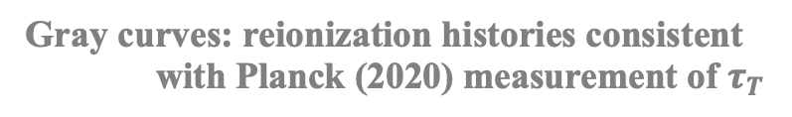
Beniamini, Kumar, Ma & Quataert (2020)
Gray curves: reionization histories consistent
with Planck (2020) measurement of $τ_{T}$
Black curves: consisten with Planck (2020) &
5900 pc cm⁻³ < DM < 6100 pc cm⁻³
Planck 2020 (1-𝜎 range)
Number of electrons per baryon

Slide 31
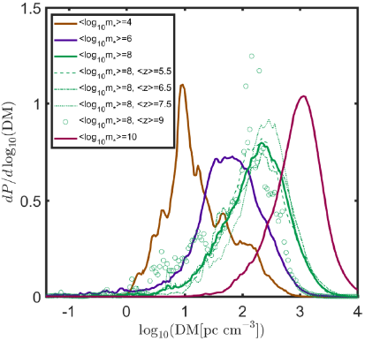
FRB host galaxy DM contribution (Beniamini et al. 2021)

Slide 32
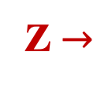
Contributions to DM from host galaxy+CGM & $δn_{e}$ of IGM
Beniamini, Kumar, Ma & Quataert (2021)
Jaroszynski (2019)
[Illustris simulations]
FIRE simulations
Z $→$

Slide 33
Exploring Hydrogen Reionization Epoch
Beniamini, Kumar, Ma & Quataert (2020)

Slide 34

Summary
1.
Change to FRB polarization due to wave propagation through magneto-ionized media is important and should be factored out in order to obtain the intrinsic polarization property of the source, and use that to constrain different FRB models.
2.
Gravitational lensing of FRBs is affected by scintillation for events involving lens mass of less than 10⁴ $M_{⨀}$ and magnification > 10.
3.
FRB could provide important input to the study of cosmic reionization epoch.

