Slide 1
Statistical modelling
of
the cosmological dispersion measure
Ryuichi Takahashi （Hirosaki U）
with Kunihito Ioka （Kyoto U）
A. Mori & K. Funahashi （Hirosaki U）

Slide 2
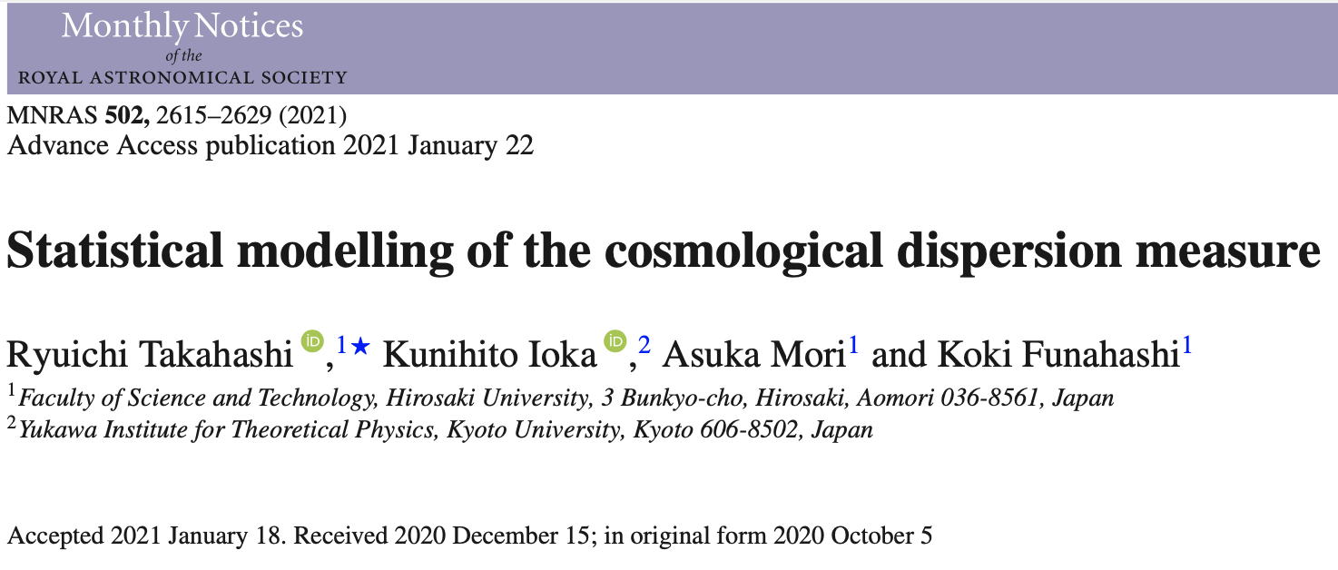

Slide 3
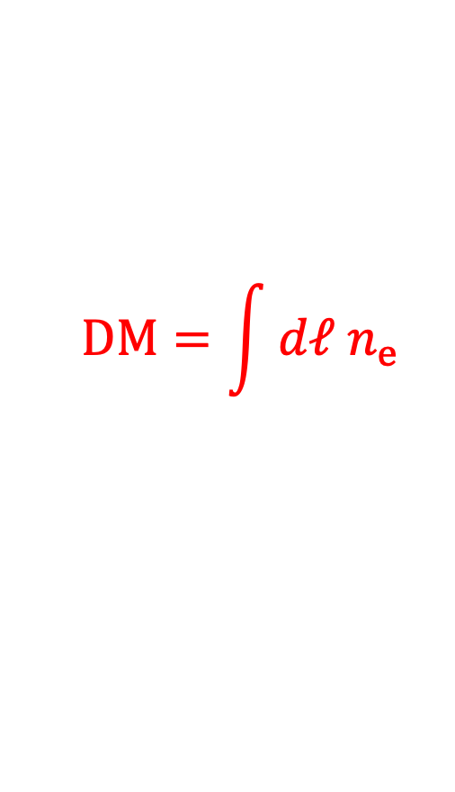
Cosmological dispersion measure （DM）
（e.g. Ioka 2003; Inoue 2004）
$$DM=\int{dℓ n_{e }}$$
： column density of free electrons
ionized gas in IGM & intervening galaxies
observer
FRB
radio signal
excluding the Milky Way & host-galaxy contributions

Slide 4
DM statistics
DM has an angular anisotropy due to
the inhomogeneous free-electron distribution
DM statistics:
mean & variance,
probability distribution function,
angular correlation function & power spectrum

Slide 5
Cosmological applications of the DM statistics
・ mean & variance of DM
can used for the DM-redshift relation
which probes
missing baryons （e.g., Macquart+ 2020）
reionization process （e.g., Ioka 2003; Inoue 2004）
cosmological parameters including dark energy
（e.g., Gao+ 2014; Zhou+ 2014; Kumar & Linder 2019）
・ angular correlation function & power spectrum of DM
can probe
free-electron clustering （Masui & Sigurdson 2015; Shirasaki+ 2017）
primordial non-Gaussianity imprinted at largest scales
（Reischke+ 2020）

Slide 6
Previous theoretical woks on the DM statistics
● analytical approach
・ halo model
（e.g., McQuinn 2014; Masui & Sigurdson 2015; Shirasaki+ 2017;
Madhavacheril+ 2019; Dai & Xia 2020）
free electrons are confined in halos
can explore the non-linear clustering
・ linear perturbation theory
（e.g., Masui & Sigurdson 2015; Shirasaki+ 2017; Rafiei-Ravandi+ 2020）
assuming free electrons exactly trace underlying dark matter
● hydrodynamic simulation approach
（e..g, Dolag+ 2015; Zhu+ 2018; Pol+ 2019; Jaroszynski 2019; Batten+ 2020;
Zhang+ 2021）
the most reliable tool to investigate the non-linear
free-electron distribution in the universe

Slide 7
Main purpose of our study
1) model the two-point statistics of DM
using the hydrodynamic simulations, IllustrisTNG300
we first measure the free-electron abundance
& the power spectrum of its spatial fluctuations
because the DM statistics are fully determined
by the free-electron statistics
we then provide an analytical model of the DM statistics
using fitting functions of the free-electron distribution
2) validate our analytical model
against mock DM measurements

Slide 8
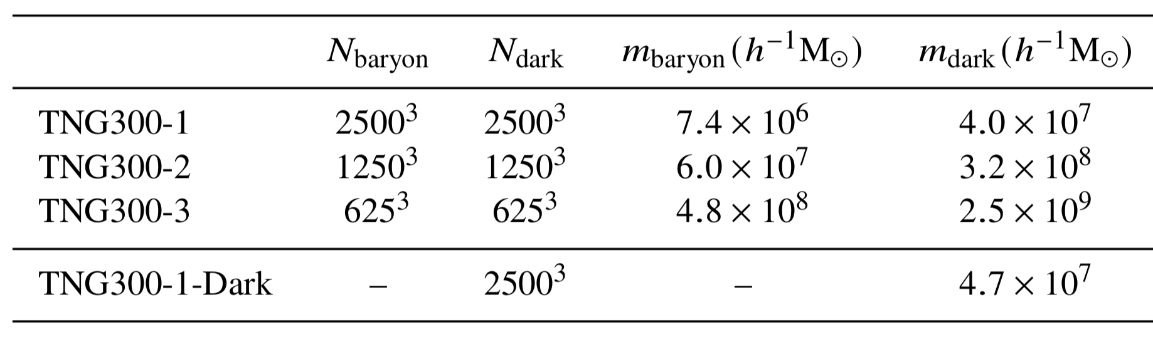
IllustrisTNG300
（e.g., Nelson+ 2018）
・ the state-of-the-art hydrodynamic simulations
・ follow gravitational evolution & astrophysical processes
（star formation, gas cooling, stellar & AGN feedback）
・ simulation data is publicly available at z=0-12
・ reproduce fee-electron distribution in the universe
hydro. runs
← dark-matter-only run
box size L=205Mpc/h (~300Mpc)

Slide 9
IllustrisTNG300
（e.g., Nelson+ 2018）
・ the state-of-the-art hydrodynamic simulations
・ follow gravitational evolution & astrophysical processes
（star formation, gas cooling, stellar & AGN feedback）
・ simulation data is publicly available at z=0-12
・ reproduce fee-electron distribution in the universe
box size L=205Mpc/h (~300Mpc)

Slide 10
free-electron fraction
=(# of free electrons)/(total # of electrons)
（high res.）
（low res.）
fe ~ 0.95 at z<1
← hydrogen reionization
redshift

Slide 11
free-electron fraction
=(# of free electrons)/(total # of electrons)
free electros are
captured by stars
（bound in atoms）
at lower z
（high res.）
（low res.）
fe ~ 0.95 at z<1
← hydrogen reionization
redshift

Slide 12
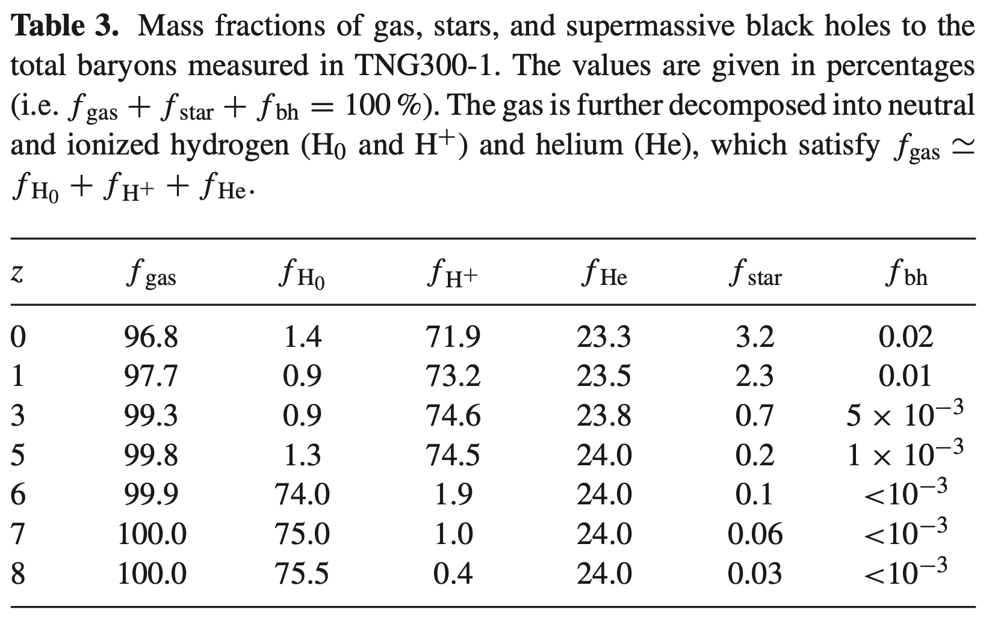

Slide 13
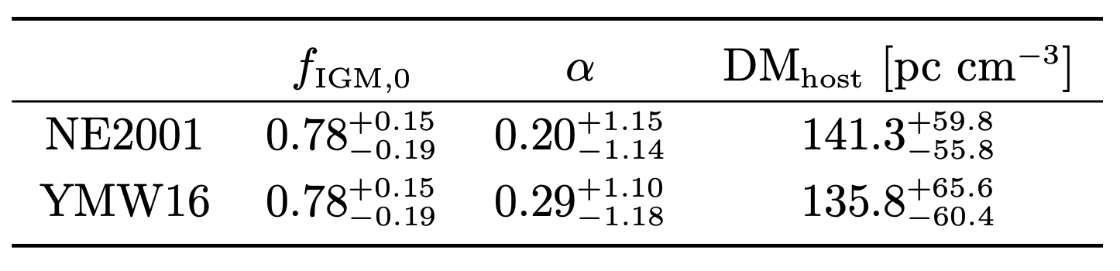

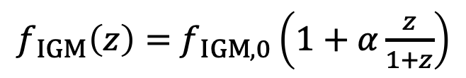
Observational constraint on the free-electron fraction
from the DM-z relation with host-galaxy identified FRBs
$f_{ IGM}\left(z\right)=$ $f_{ IGM,0}\left(1+α\frac{z}{1+z}\right)$
・ Li+ （2020） used 5 FRBs
$$f_{ IGM,0}={0.84}_{−0.22}^{+0.16}$$
・ Lin+ （2022） used 17 FRBs
cosmological parameters are fixed
$f_{ IGM}≈0.8$ & its redshift dependence α has not been detected

Slide 14
fee-electron power spectrum
dark matter P(k)
halofit
fitting curve
free electrons
← dark matter only
ratio to
dark matter P(k)
bias²
wavevector

Slide 15
fee-electron power spectrum
dark matter P(k)
halofit
strongly damped
due to stellar &
AGN feedbacks
free electrons trace
dark matter
fitting curve
free electrons
← dark matter only
ratio to
dark matter P(k)
bias²
wavevector

Slide 16
fee-electron power spectrum
dark matter P(k)
halofit
fitting curve
free electrons
our analytical model uses the two fitting functions
for the free-electron abundance & power spectrum
← dark matter only
ratio to
dark matter P(k)
bias²
wavevector

Slide 17
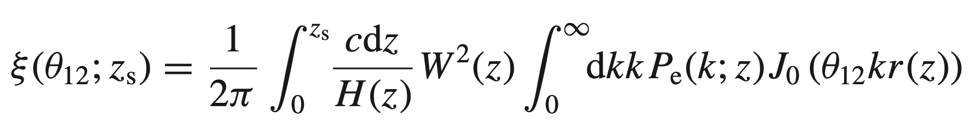
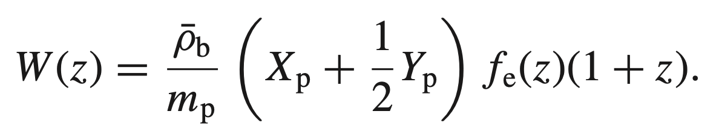
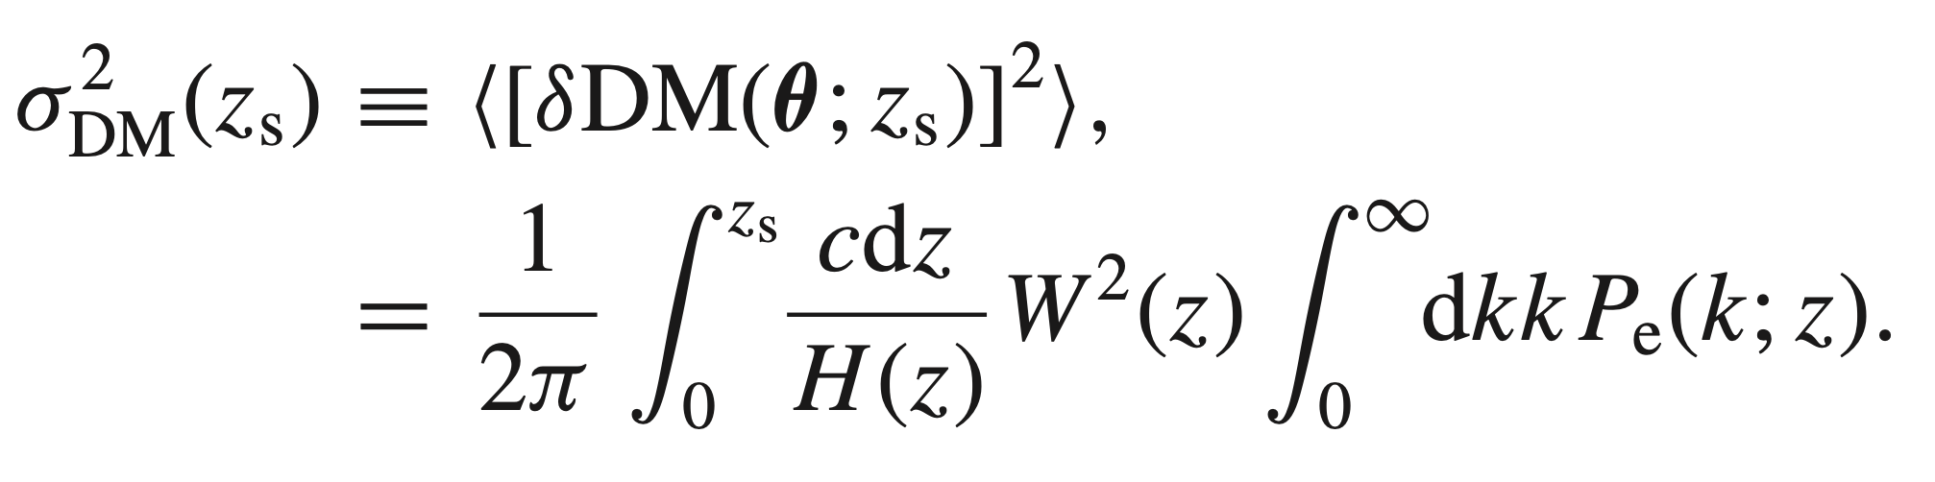
correlation function of DM
with
variance of DM

Slide 18
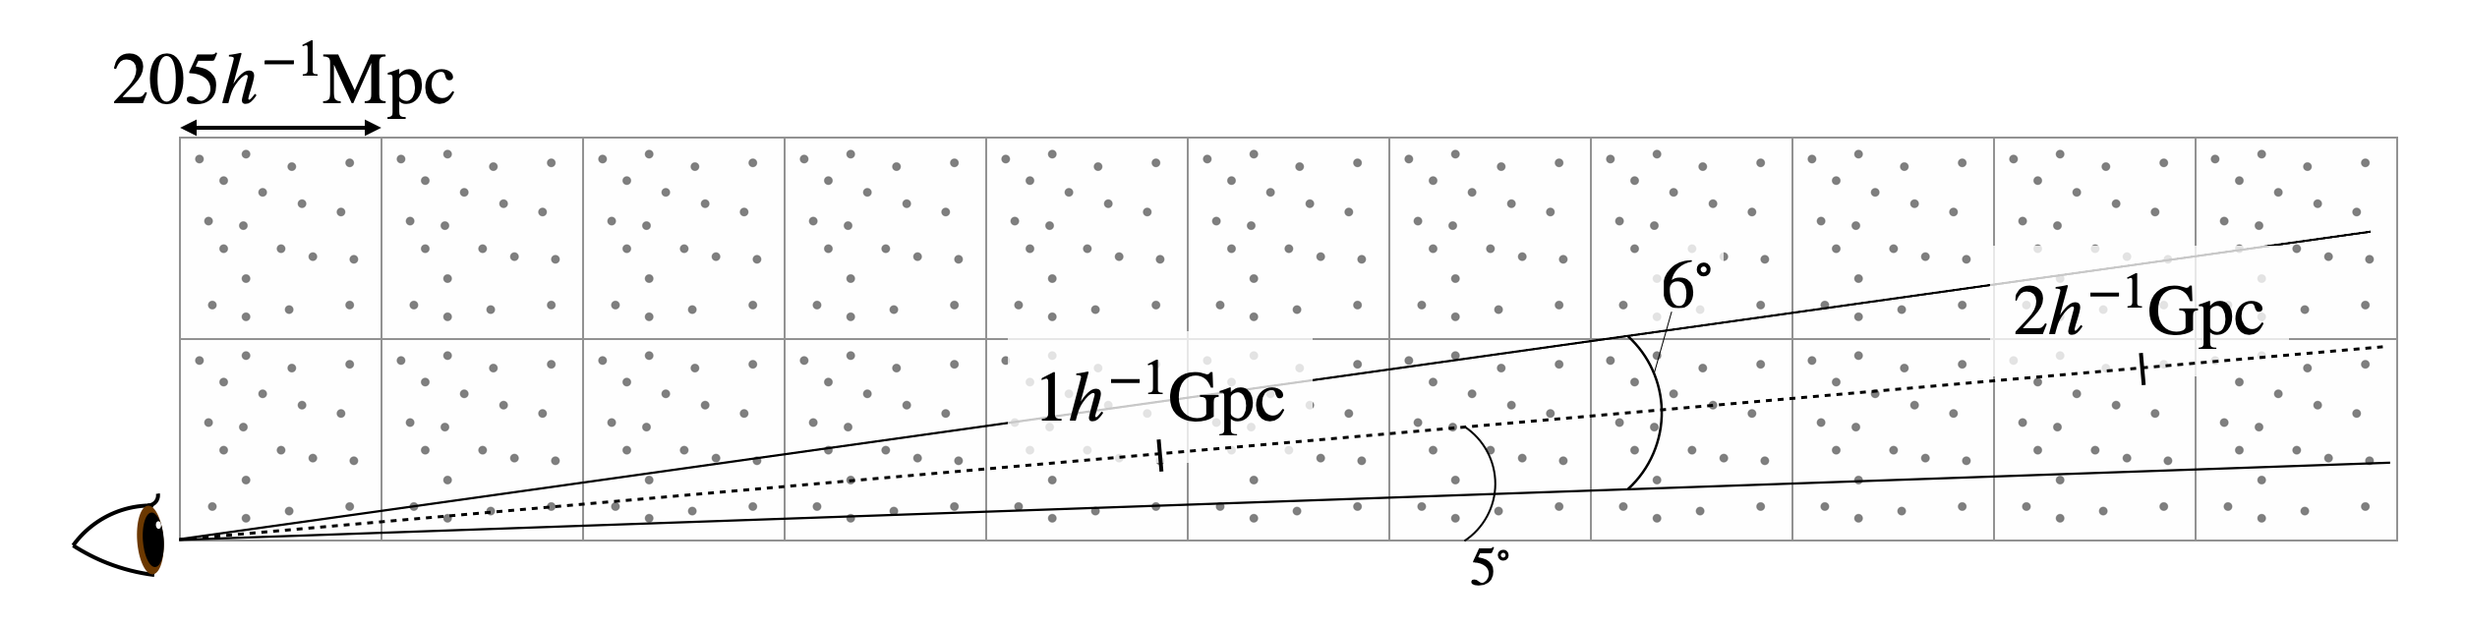
Making mock sky maps of DM
based on a standard ray-tracing technique
1. place simulation boxes along the line of sight
2. emit 5400² light rays in a field of view 6x6 deg²
(angular resolution = 4arcsec = 6deg/5400)
3. calculate free-electron column density along each ray path

Slide 19
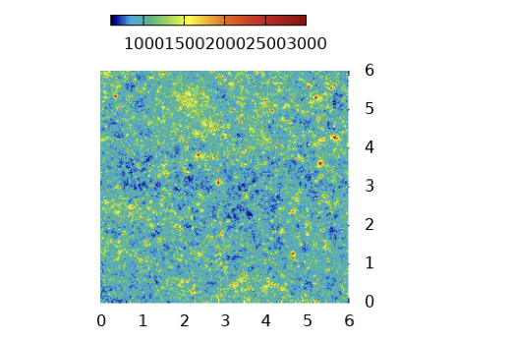
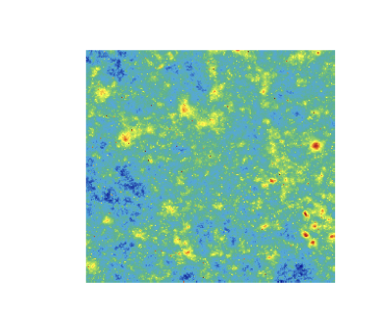
Contour map of DM at zs=1
DM
1000 2000 3000
[pc cm⁻³]
6
5
4
[deg]
2
0
4
0 2 4 6
1 2
[deg]
[deg]

Slide 20
mean & variance of DM
our analytical-model
prediction
source redshift

Slide 21
probability distribution of DM
mean DM
highly positive skew

Slide 22
probability distribution of source redshift for a given DM
~20% error
source redshift

Slide 23
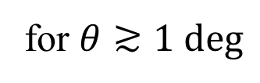
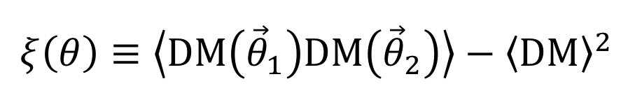
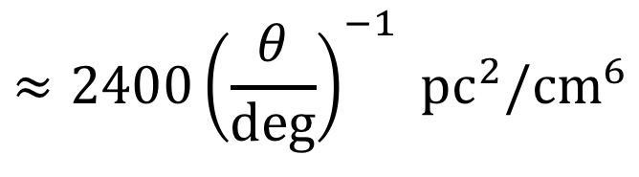

angular two-point correlation function of DM
$${DM(\vec{θ}}_{1})$$
FRB1
$$θ=\left|{\vec{θ}}_{1}−{\vec{θ}}_{2}\right|$$
FRB2
$${DM(\vec{θ}}_{2})$$
$$ξ\left(θ\right)≡\left\langle DM\left({\vec{θ}}_{1}\right)DM\left({\vec{θ}}_{2}\right)\right\rangle −{\left\langle DM\right\rangle }^{2}$$
$$≈2400{\left(\frac{θ}{deg}\right)}^{−1} {pc}^{2}/{cm}^{6}$$
for $θ≳1 deg$
$${\& z}_{s}≳0.3$$
$ξ\left(θ\right)$will be detected using thousands of FRBs

Slide 24
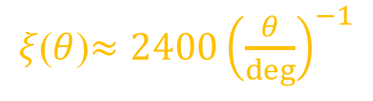

angular correlation function for full-sky measurement
shaded region:
1σ error for full-sky
determined by
survey area &
shot noise
$$σ_{DM,host}=50 pc/{cm}^{3}$$
single power-law fit
$ξ$($θ$)$≈2400{\left(\frac{θ}{deg}\right)}^{−1}$
(pc²/cm⁶)

Slide 25
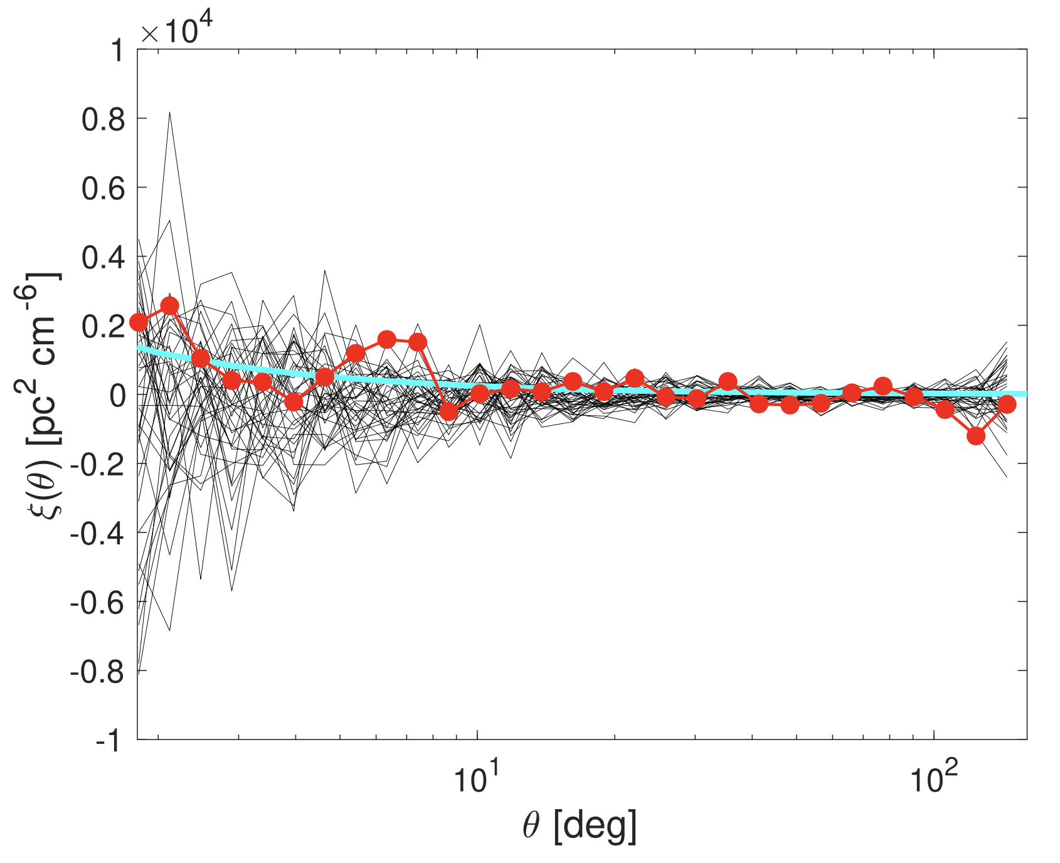
$ξ$($θ$) measured from public CHIME/FRB catalog
（Xu, Weinberg, Zhang 2021）
measurement
from 210 FRBs with DM<500 pc/cm³
our fitting formula

Slide 26

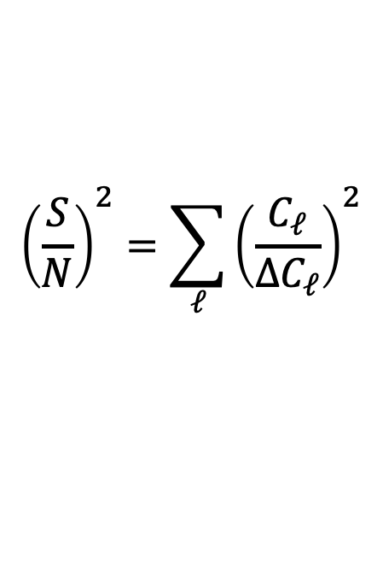
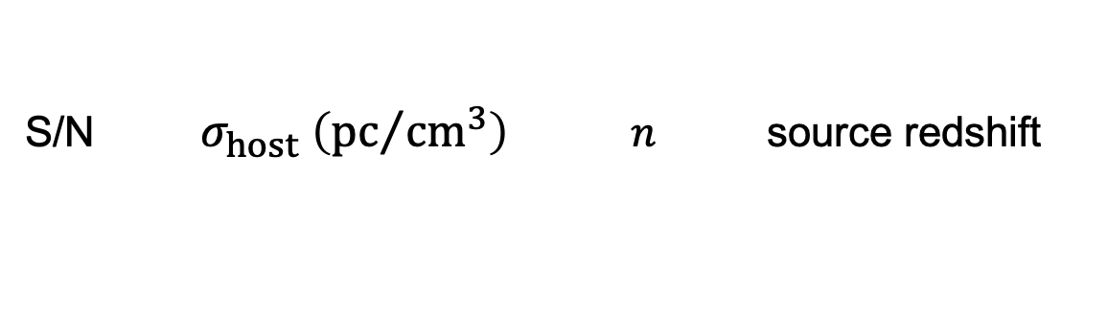
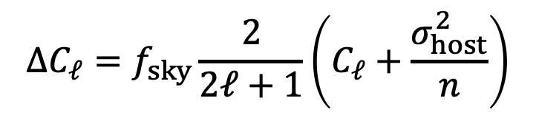

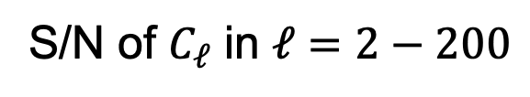

Signal-to-noise ratio （S/N） of $C_{ℓ}$ measurement
S/N of $C_{ℓ}$ in $ℓ=2−200$
$${\left(\frac{S}{N}\right)}^{2}=\sum_{ℓ}{{\left(\frac{C_{ℓ}}{{ΔC}_{ℓ}}\right)}^{2}}$$
Gaussian standard deviation
$f_{sky}$ : sky fraction of survey area
$$ΔC_{ℓ}=f_{sky}\frac{2}{2ℓ+1}\left(C_{ℓ}+\frac{σ_{host}^{2}}{n}\right)$$
$σ_{host}$ : DM variance in host galaxy
$n$ : number of FRBs
S/N $σ_{host} \left({pc}/{{cm}^{3}}\right)$ $n$ source redshift
2.3 100 500 0.4
2.5 100 500 0.7
6.9 50 500 0.4
7.7 50 500 0.7

Slide 27
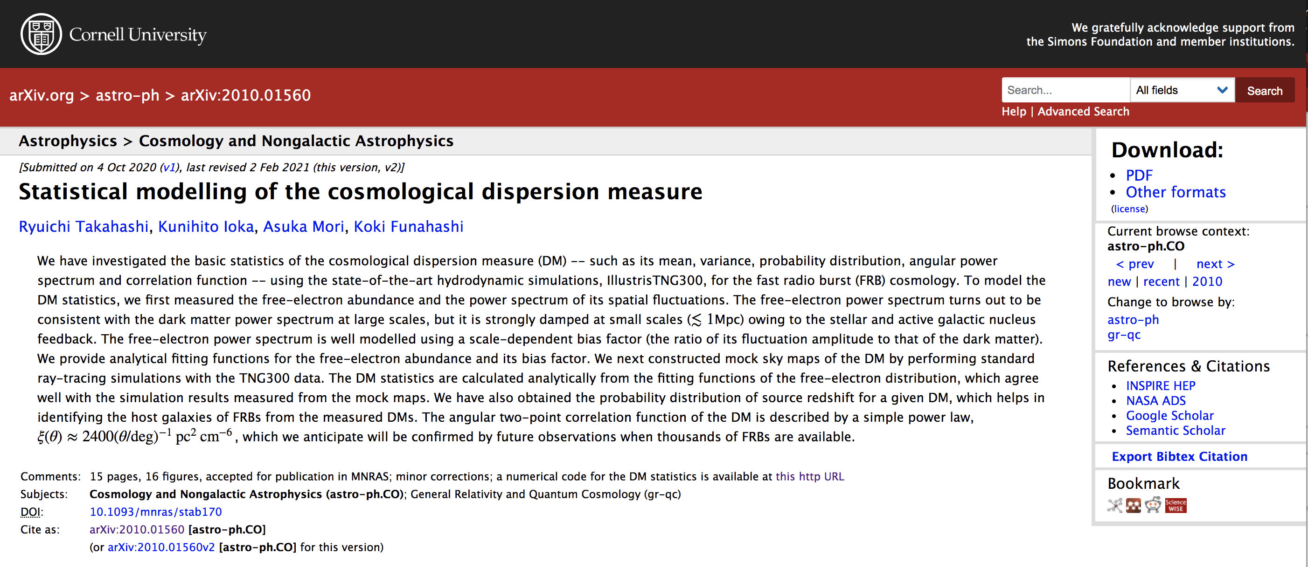
Numerical code written in C
freely available
computes
the free-electron statistics （its abundance & power spectrum）
the DM statistics （its variance, angular power spectrum
& angular correlation function）

Slide 28
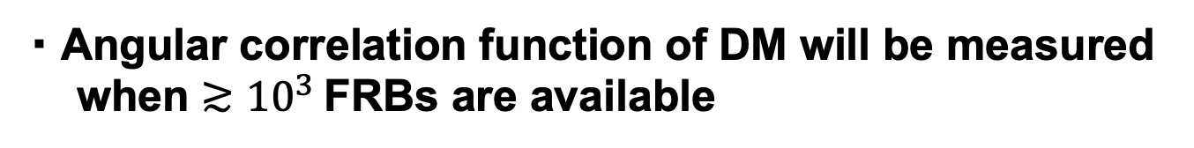
Conclusions
・ We provided an analytical two-point statistical model
of DM calibrated with IllustrisTNG300
based on free-electron abundance & its power spectrum
・ We validated it against mock DM measurements
・ Angular correlation function of DM will be measured
when $≳{10}^{3}$ FRBs are available

Slide 29
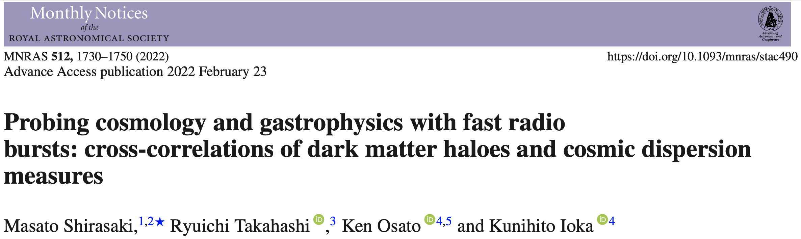


$$DM(θ)$$
FRB
$$θ$$
foreground halo
constraints on free-electron density profile of halo
& cosmological parameters

Slide 30
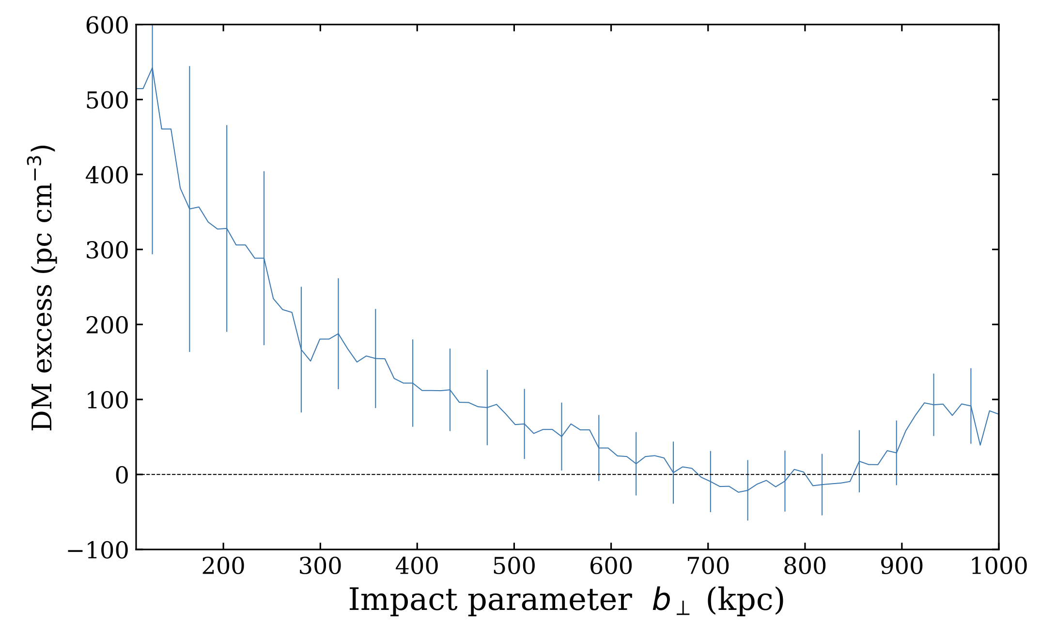
correlation of nearby galaxies (<40Mpc) and DMs from CHIME catalog
24 events intersect the galaxies with $b_{⊥}<250$ kpc
Connor & Ravi, 2107.13692

Slide 31
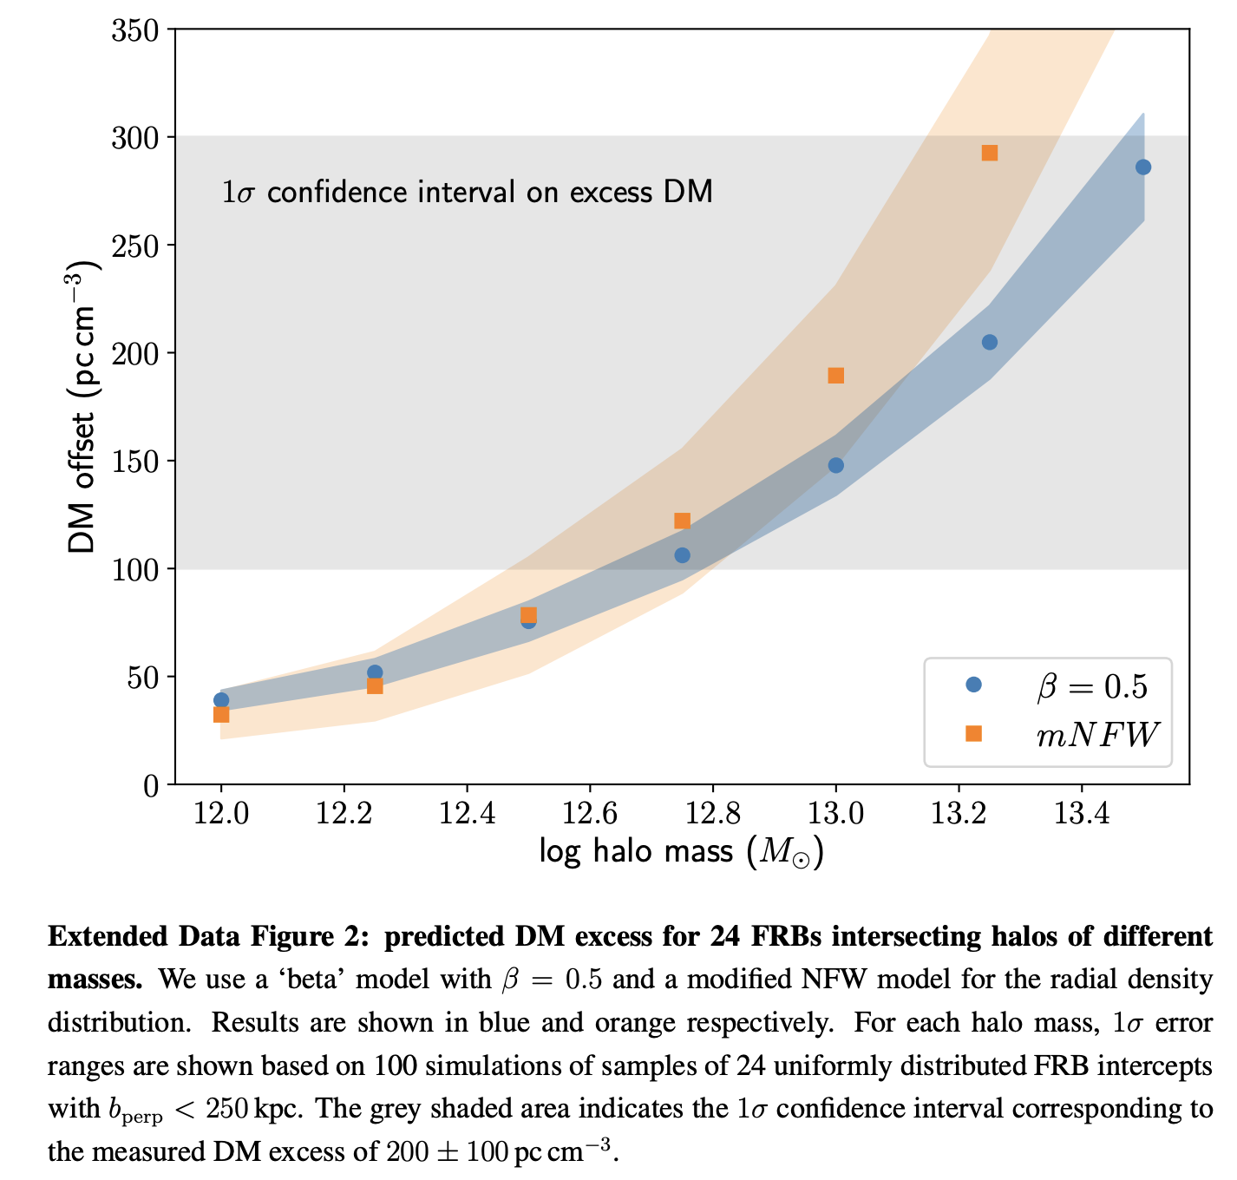
Connor & Ravi, 2107.13692
preferred mass range

Slide 32



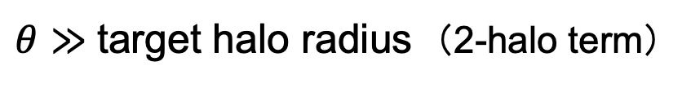
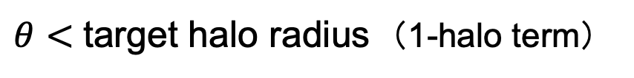
the cross correlation $ξ_{halo−DM}(θ)$ is modelled using a halo model
（Arico+ 2020）
nearby halos
$$DM(θ)$$
FRB
$$θ$$
center
target halo
$θ<$ target halo radius （1-halo term）
$ξ_{halo−DM}$is sensitive to its free-electron density profile
（i.e., gastrophysics, feedback process）
$θ≫$ target halo radius （2-halo term）
$ξ_{halo−DM}$is sensitive to halo clustering
（i.e., halo power spectrum）

Slide 33
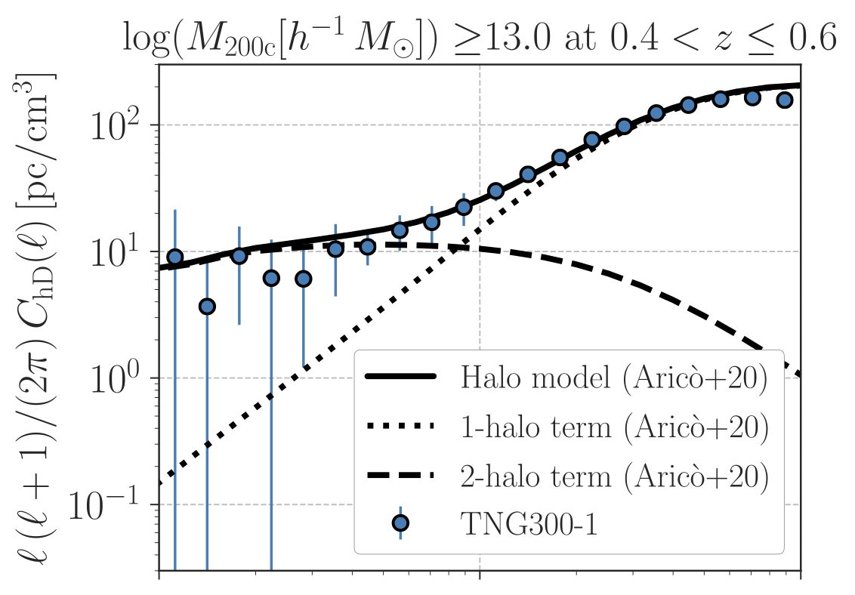
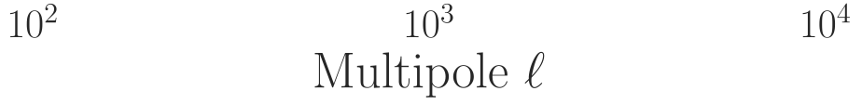
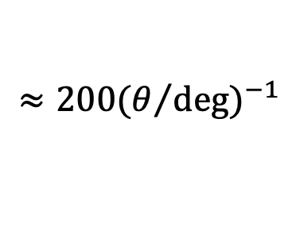
FRB at z=1
@ small scale
electron density profile
of the target halo
cross power spectrum
@ large scale
∝ halo P(k)
(← mock DM maps)
$$≈200{(θ/{deg})}^{−1}$$

Slide 34
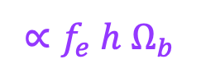
FRB at z=1
over-all amplitude ∝ DM
cross power spectrum
∝ $f_{e} h Ω_{b}$
(← mock DM maps)
$$≈200{(θ/{deg})}^{−1}$$

Slide 35
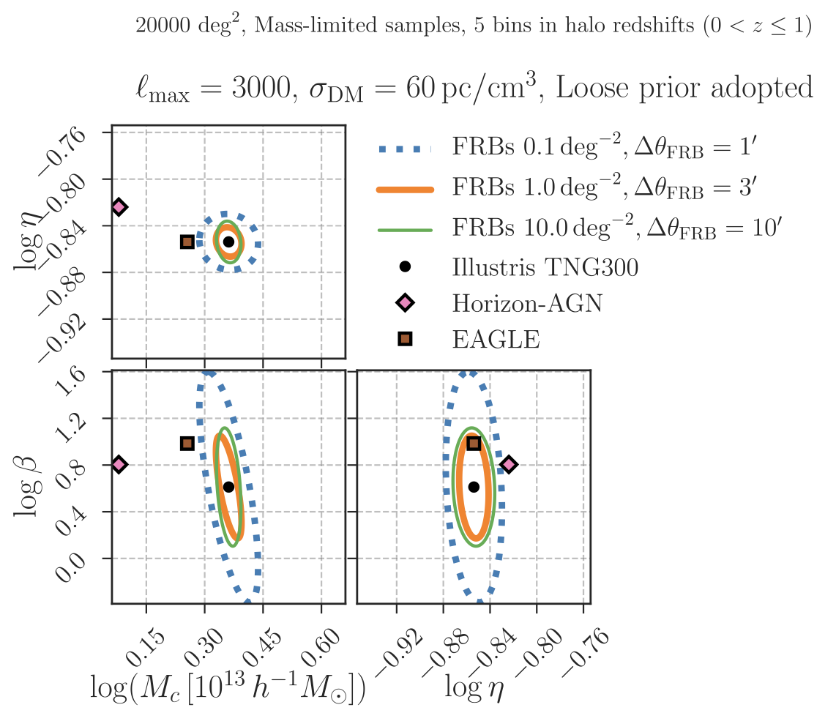

constraint on astrophysical parameters from fisher analysis
$$M_{200c}>{10}^{12}, {10}^{13} \& {10}^{14} h^{−1}M_{⊙}$$
η : distance scale of gas
expelled by feedback
Mc : halo mass for which 50% of
gas in hot & bound state
β ： mass dependence of gas
depletion by feedback

Slide 36

constraint on astrophysical parameters from fisher analysis
$$M_{200c}>{10}^{12}, {10}^{13} \& {10}^{14} h^{−1}M_{⊙}$$
η : distance scale of gas
expelled by feedback
Mc : halo mass for which 50% of
gas in hot & bound state
$ξ_{halo−DM}$ can distinguish different hydro sim predictions
of TNG300, Horizon-AGN, EAGLE
β ： mass dependence of gas
depletion by feedback

Slide 37
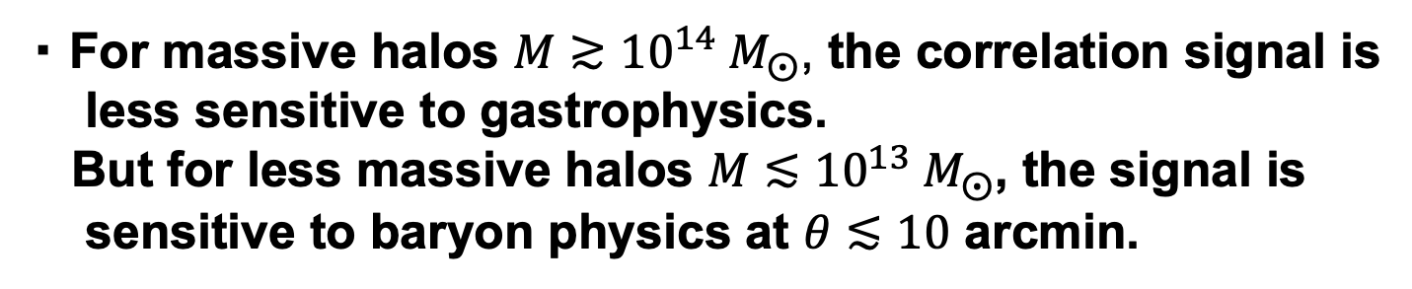
Summary of Shirasaki+ （2022）
・ They studied a cross-correlation of foreground halos and
DMs using a halo model.
・ They validated it against TNG mock measurements.
・ For massive halos $M≳{10}^{14} M_{⨀}$, the correlation signal is
less sensitive to gastrophysics.
But for less massive halos $M≲{10}^{13} M_{⨀}$, the signal is
sensitive to baryon physics at $θ≲10$ arcmin.
combined analysis of different halo masses can
provide constraints on both gastrophysics and
cosmological parameters

