Slide 1
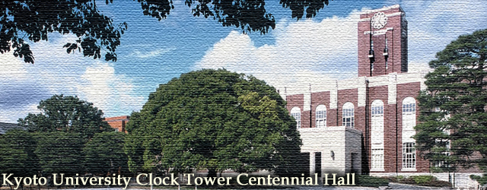
International School on Topological
Science and Topological Matters
Kyoto University & Peking University
Feb. 13-18, 2017, Kyoto (Japan)
Organiziners
Guo-qing Zheng | Okayama University
Ippei Danshita | YITP
Keisuke Totsuka | YITP
Ryuichi Shindou | Peking University
Masatoshi Sato | YITP
Jian Wei | Peking University
Yuan Li | Peking University
Chi Zhang | Peking University
Yoshiteru Maeno | Kyoto
Masatoshi Sato | Kyoto
Jian Wang | PKU
Jian Wei | PKU
Rui-Rui Du | PKU
Masashi Shiraishi | Kyoto
Jian-Hao Chen | PKU
Shuang Jia | PKU
Yuji Matsuda | Kyoto
Fa Wang | PKU
Yuan Li | PKU
NangLin Wang | PKU
Yan Zhang | PKU
Teruo Ono | Kyoto
Wei Han | PKU
Jia Li | PKU
XinCheng Xie | PKU
Norio Kawakami | Kyoto
Junren Shi | PKU
Yutaka Sasaki | Kyoto
Guo-Qing Zheng | Okayama
Ji Feng | PKU
Invited Lecturers
Haruki Watanabe | Tokyo University
Xiong-Jun Liu | Peking University
Ryuichi Shindou | Peking University
Keisuke Totsuka | YITP, Kyoto University
Invited Speakers (Partial List)
Yukio Tanaka | Nagoya
Hiroshi Okuyama | Kyoto
XinZheng Li | PKU
Koji Muraki | NTT
Chi Zhang | PKU
Yoichi Yanase | Kyoto
Dong Sun | PKU
Venue:Panasonic Auditorium, Yukawa Hall, Yukawa Institute for Theoretical Physics, Kyoto University, Kyoto, Japan
http://www2.yukawa.kyoto-u.ac.jp/~iststm/index.php

