Slide 1


Supernova dust production in confined circumstellar material
2025/10/01
Keihan workshop
@Panasonic auditorium
Yuki Takei
Yukawa Institute for Theoretical Physics (YITP)
Collaborators: Kunihito Ioka (YITP), Masaru Shibata (AEI/YITP)

Slide 2
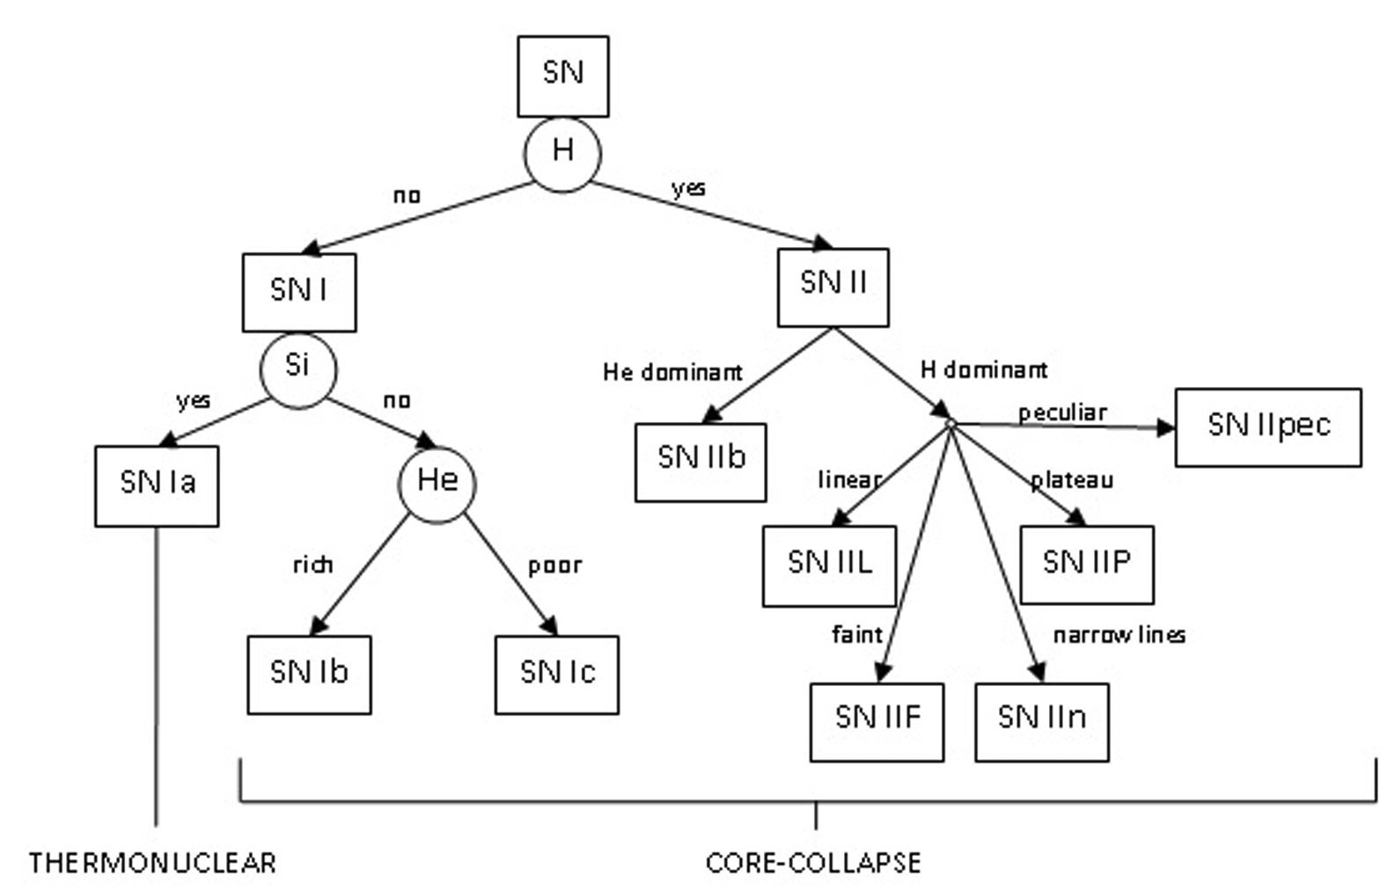
SN classification
SNe are classified based on e.g., chemical abundance and/or light curve shape
Módolo+15
Strong mass-loss
to expel the outer envelope
Weak mass-loss (?)

Slide 3
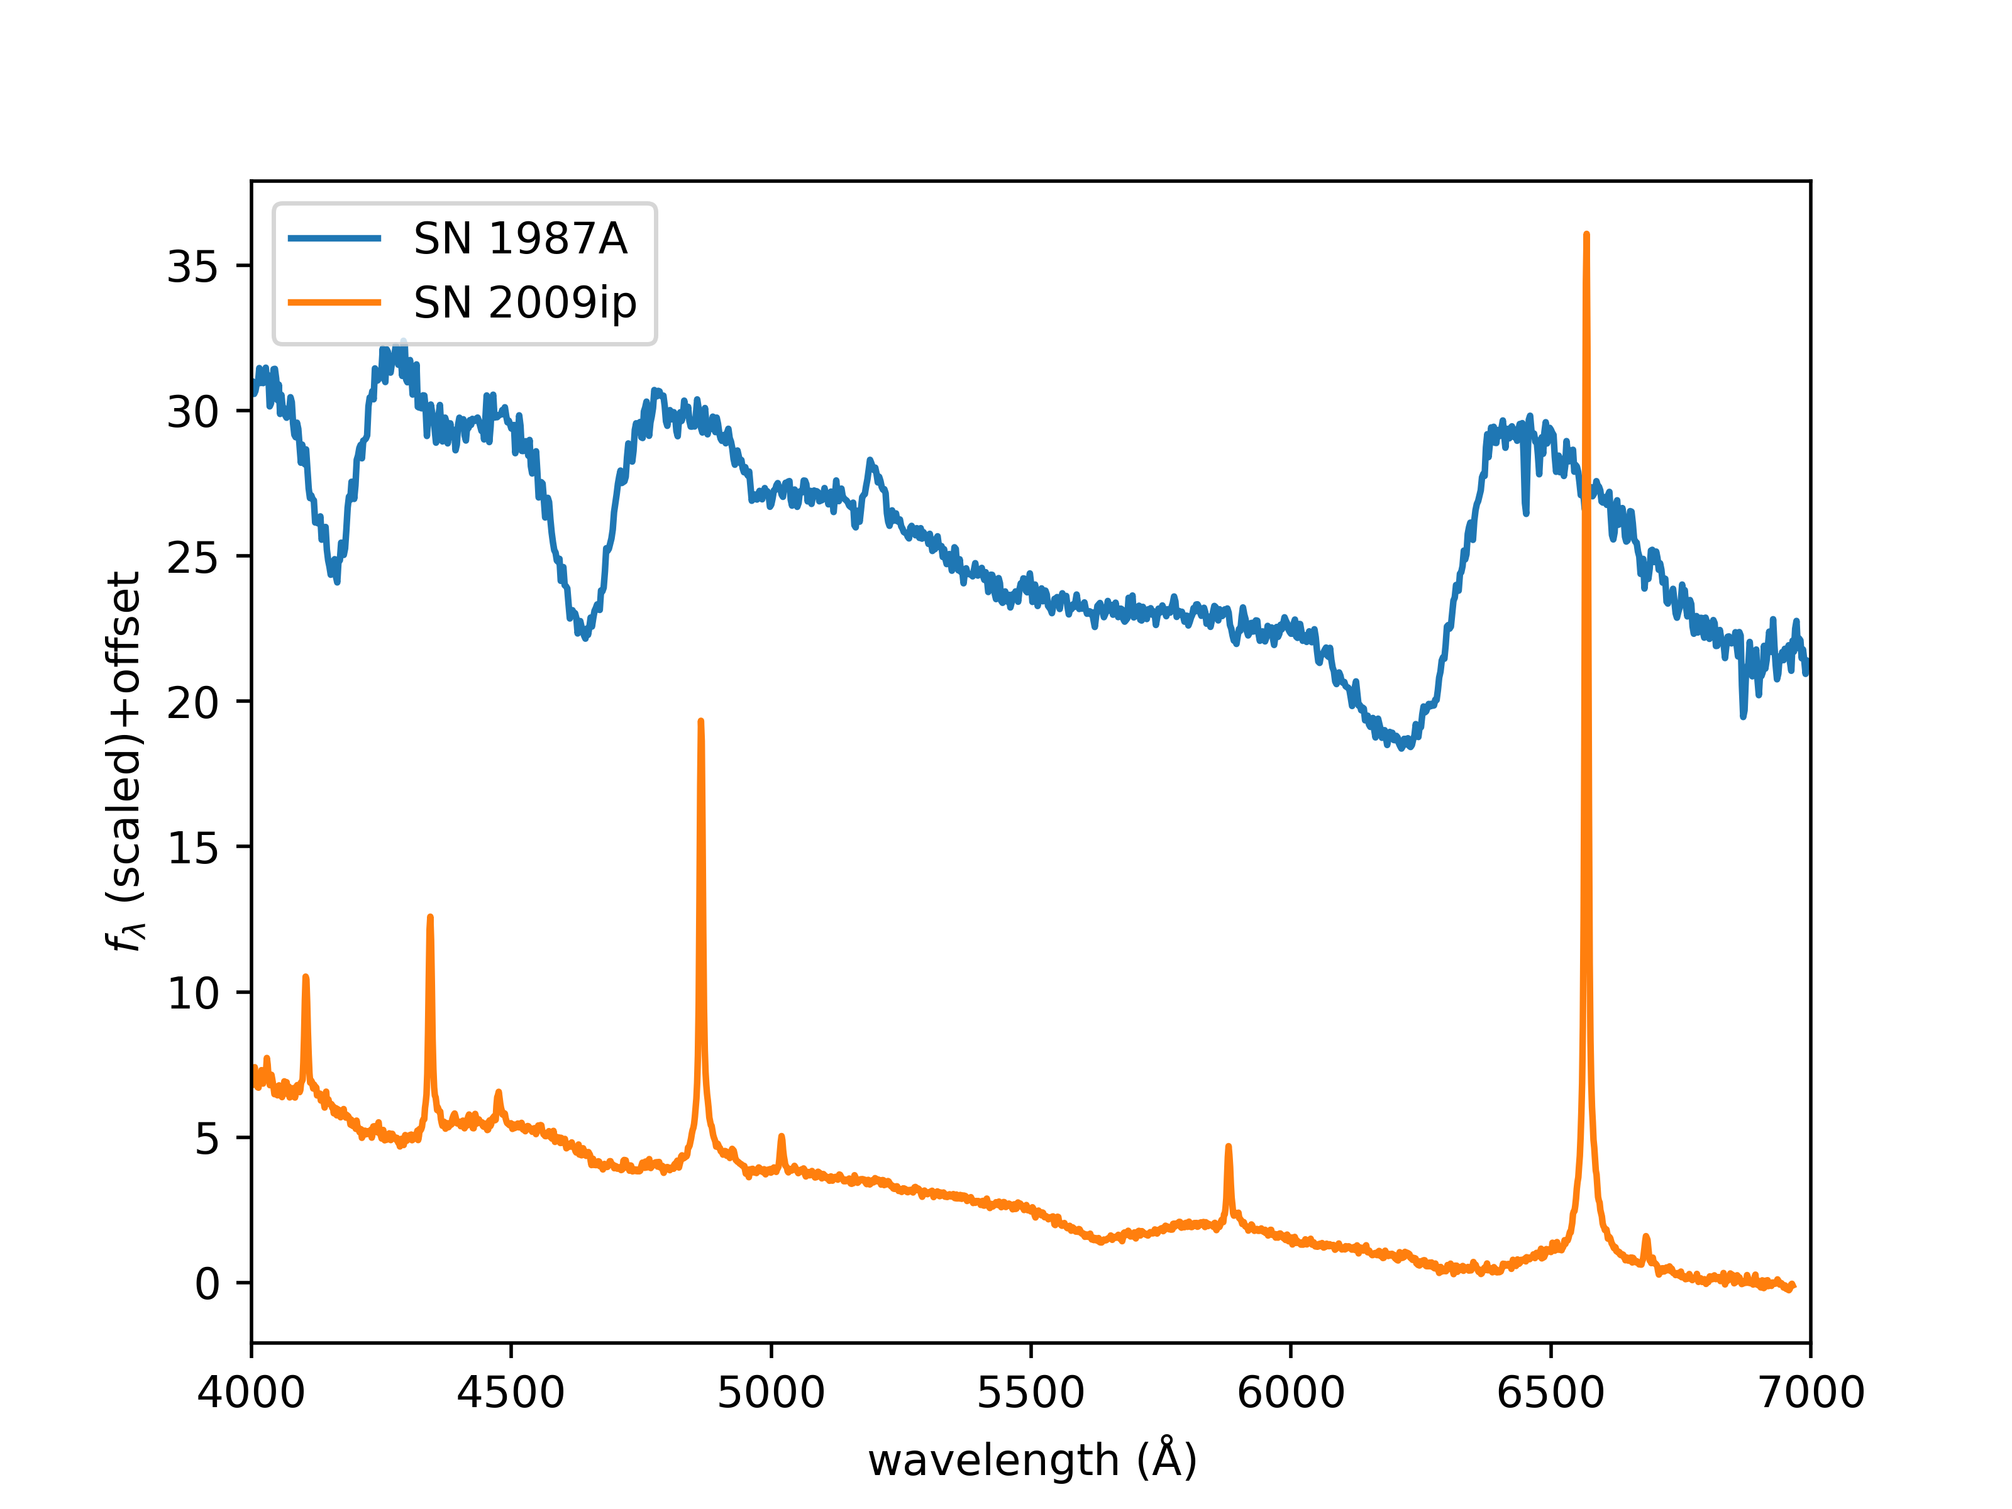
Circumstellar material (CSM)
SNe IIn show narrow hydrogen emission lines in their spectrum
Indicate the presence of the slowly-moving dense gas around the progenitor
Called CSM
Hγ
Hβ
Hα
Hδ

Slide 4
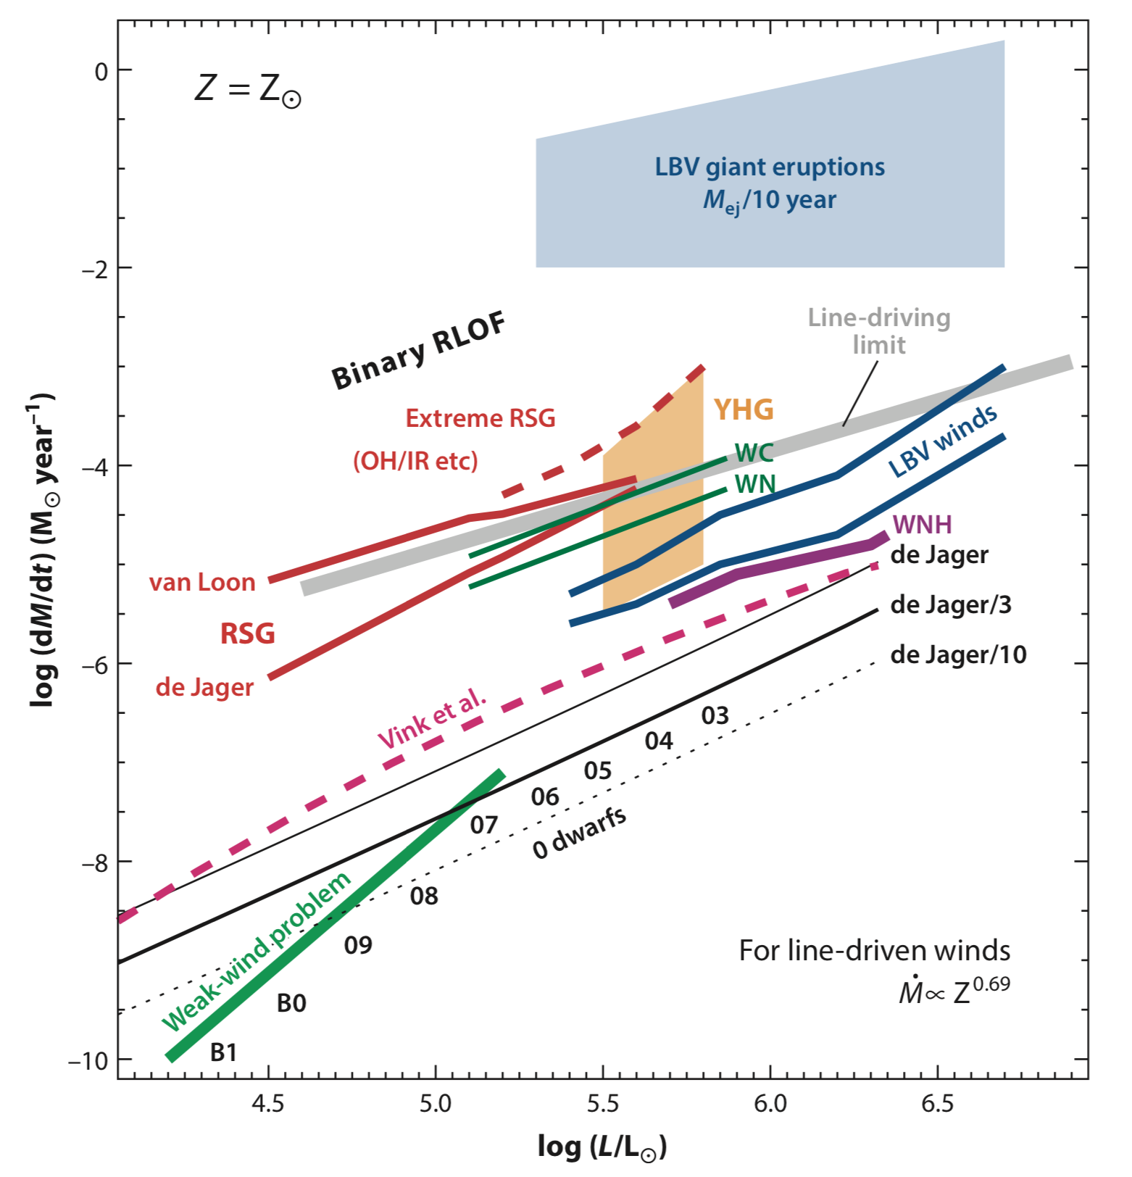

Why SNe IIn?
IIn: strong mass-loss!
Conventional stellar evolution theory:
Hydrostatic equilibrium
Type IIn
Observations of SNe IIn have revealed
the dynamical evolution stage
Smith 2014

Slide 5
Why SNe IIn?
IIn: strong mass-loss!
CSM studies can reveal the final stages of massive star evolution!
Type IIn
Smith 2014

Slide 6
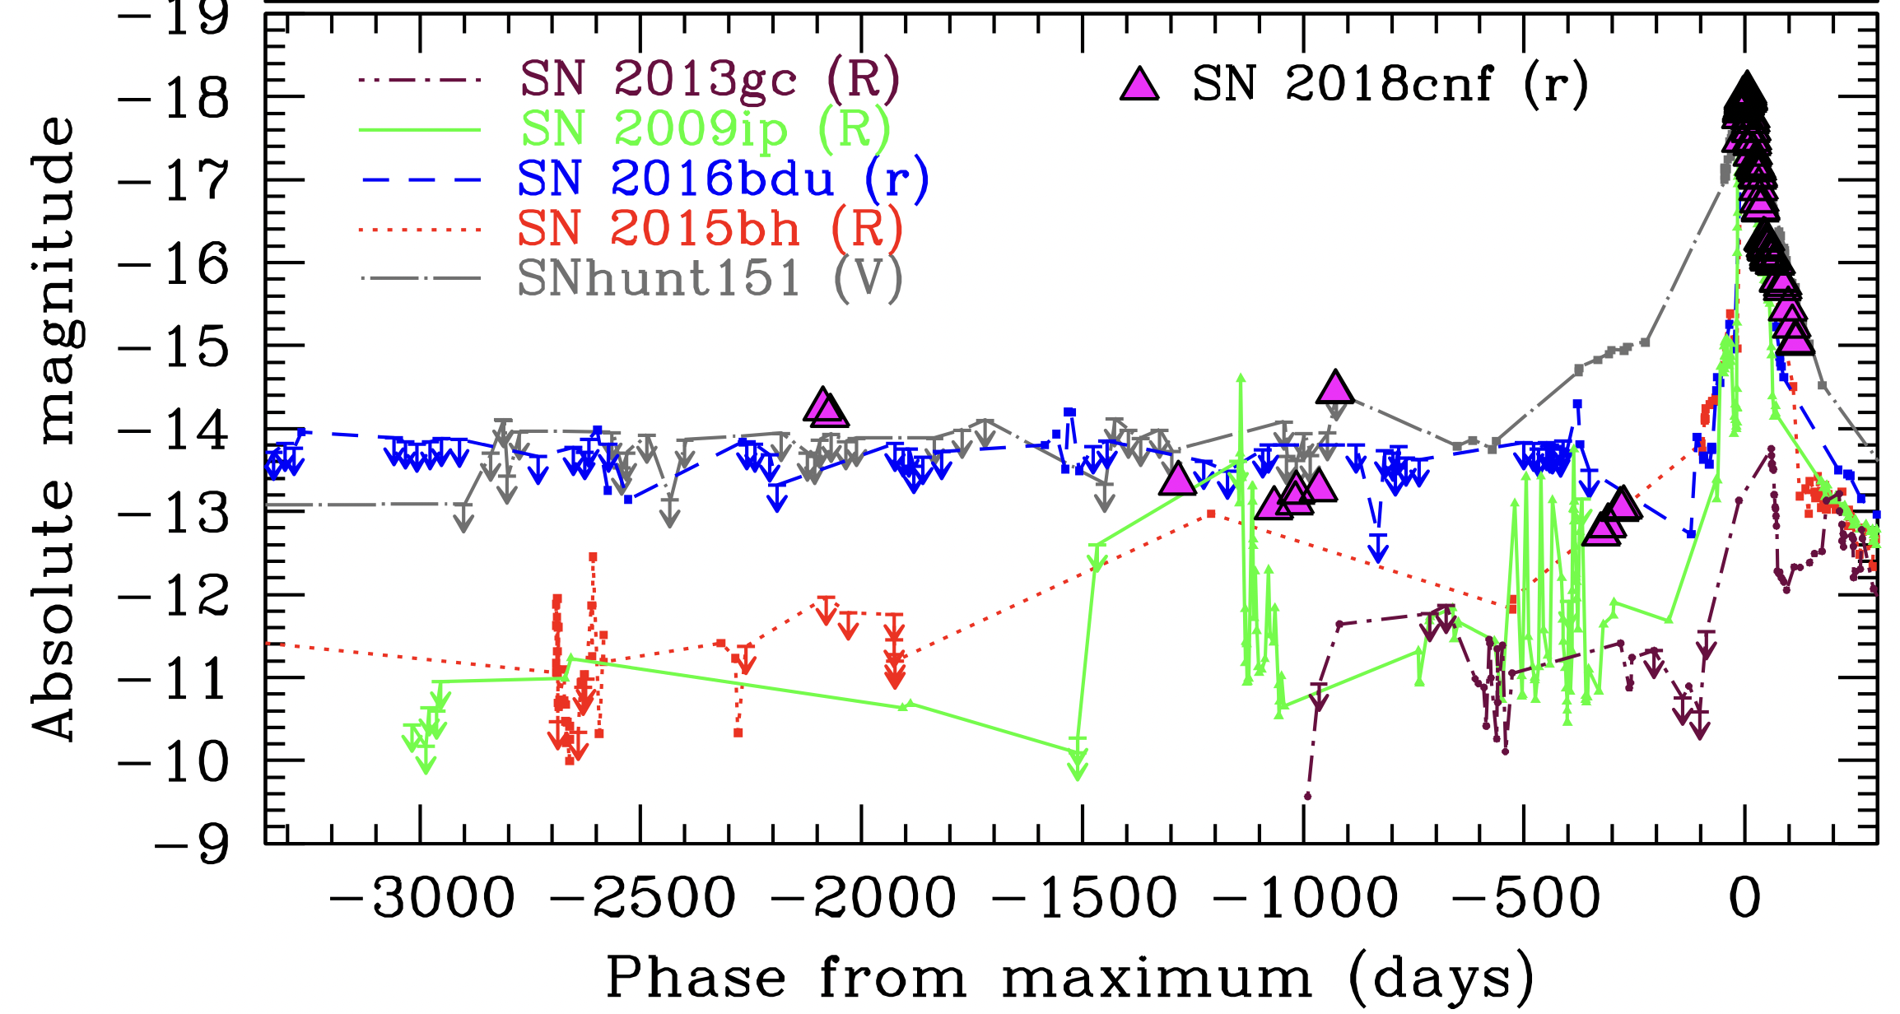
Mass eruption prior to SN
In some cases, outburst(s) are observed a few months – years before the SN explosion (e.g., Pastorello+07; Mauerhan+13)
Dense CSM
Pastorello+19
Mass eruption

Slide 7
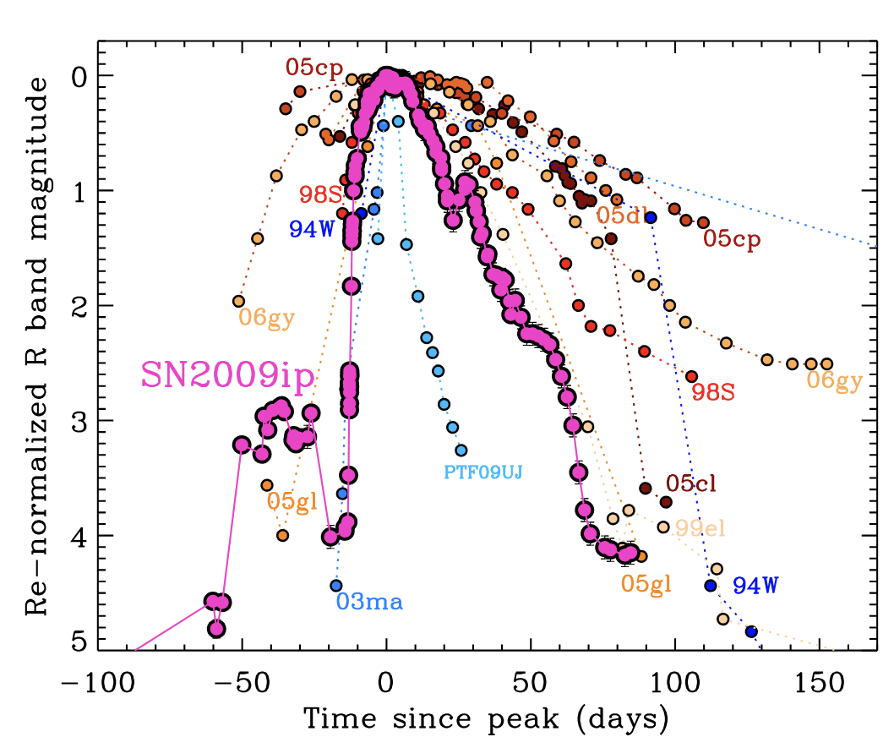
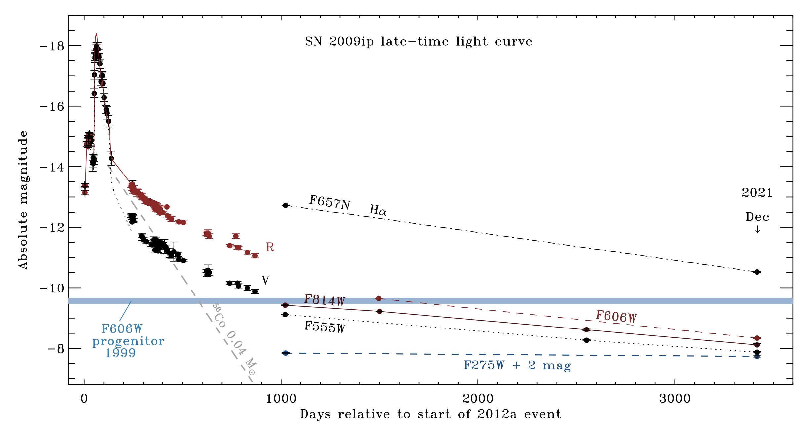
SN 2009ip (Type IIn)
Observed in 2009, but not the terminal explosion (which occurred in 2012)
Progenitor: Luminous blue variable? (Smith+10; Smith+22)
Margutti+14
Smith+22

Slide 8
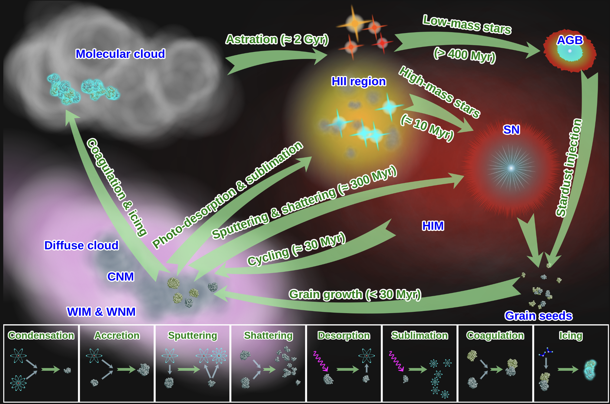
(Massive-low mass) star as a dust supplier
irfu.cea.fr/Pisp/frederic.galliano/HDR/hdrch6.html

Slide 9
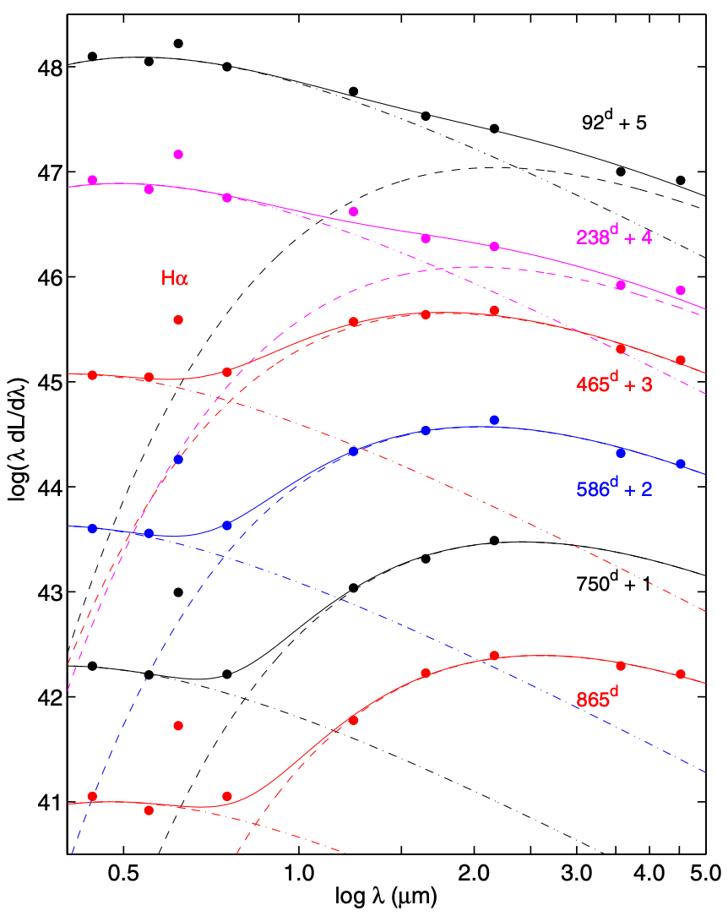
Detecting dust in SNe
Fransson+14, SN 2010jl
Basically infrared (IR) bands are used to confirm the dust formation
Infrared (IR) excess is a sign of the new dust formation
Dust component (IR bands) + SN component (optical bands)

Slide 10
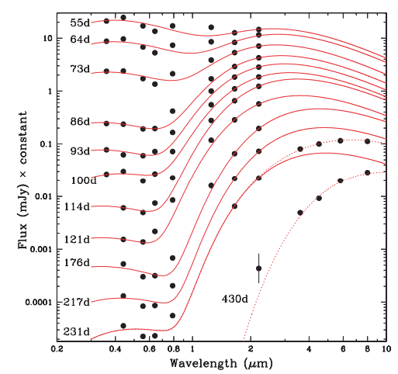
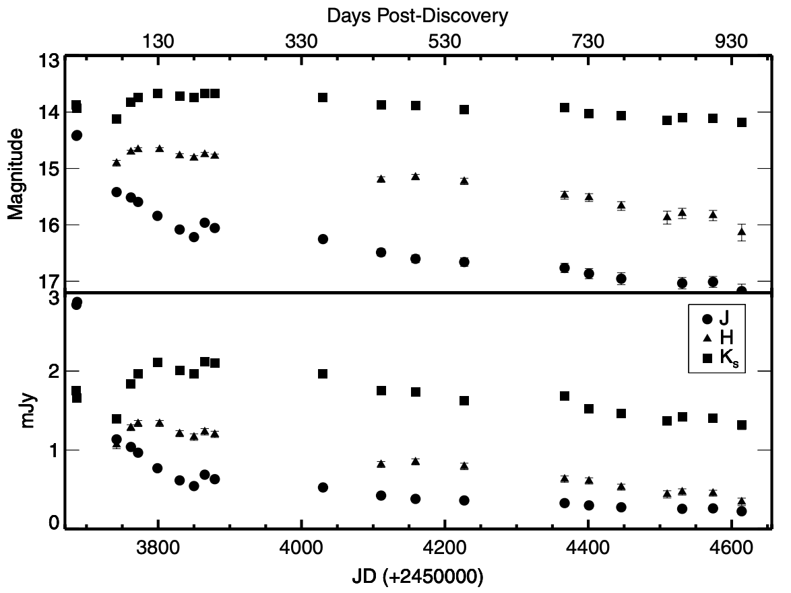
Dust formed in SNe IIn/Ibn
IR excess is observed in some SNe IIn/Ibn
IR excess indicates newly formed dust
Mattila+08, SN 2006jc (Ibn)
Fox+09, SN 2005ip (IIn)

Slide 11
Dust formed in SNe IIn/Ibn
IR excess is observed in some SNe IIn/Ibn
IR excess indicates newly formed dust
Mattila+08, SN 2006jc (Ibn)
Fox+09, SN 2005ip (IIn)
Does the presence of CSM make dust formation
more likely?

Slide 12
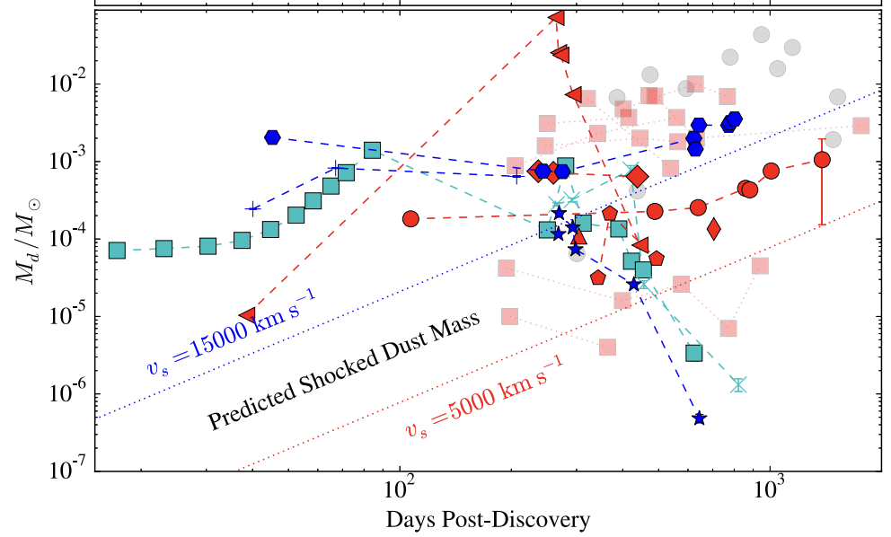
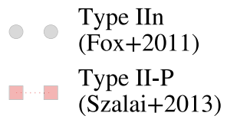

Comparison of observed dust
Compared with other SNe (such as Type IIP), the observed dust mass is larger (e.g., Fox+11; Szalai+13)
Dust mass ($M_{⊙}$)
Tinyanont+16

Slide 13
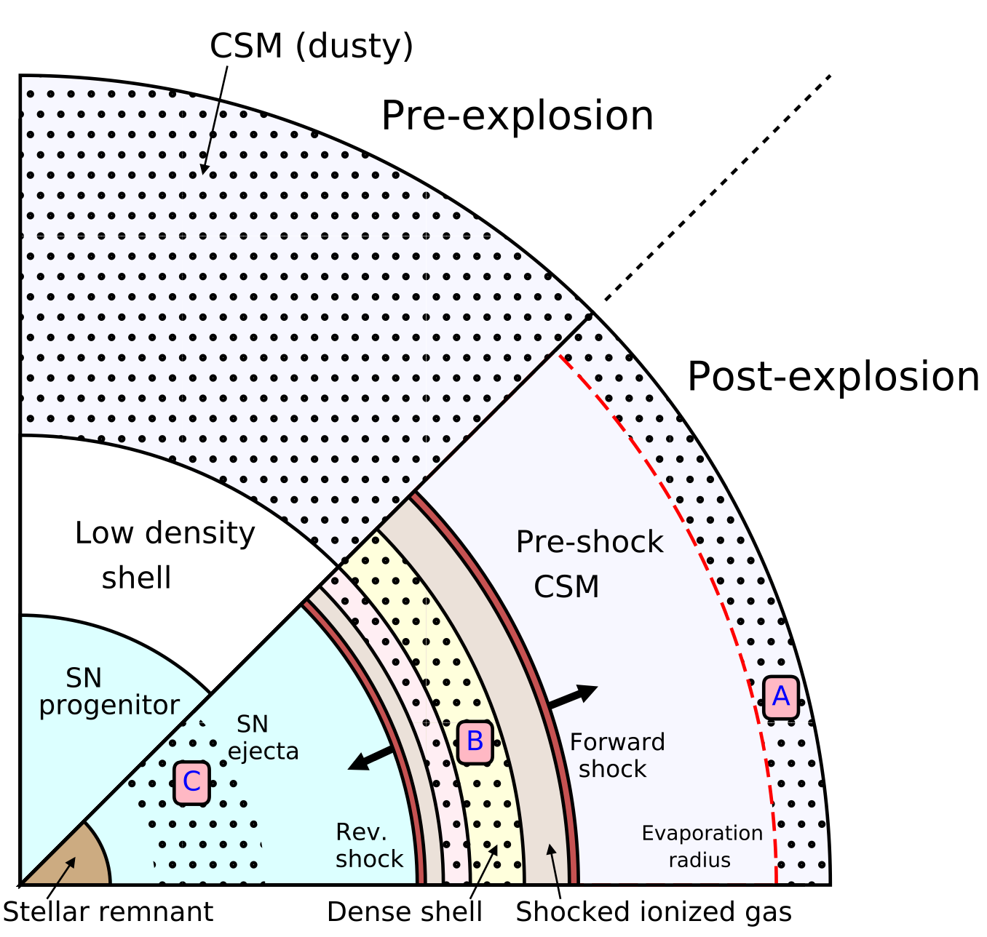
Dust formation site in SNe
(A) Pre-existing dust in the stellar wind (e.g., Bode & Evans 80)
(B) Dust formation in cold dense shell (CDS) formed in the shocked region between SN and CSM (e.g., Pozzo+04)
(C) Dust formation in SN ejecta (e.g., Todini & Ferrara 2000)
Sarangi+18
Very important!!

Slide 14

“Confined” CSM
It has been revealed that many SN II progenitors are surrounded by compact CSM with a radius of $≲$10¹⁵ cm (e.g., Förster+18; Bruch+23)
More than ~40% of SNe II?? CSM is more universal than previously thought
?
SN explosion
Dense CSM

Slide 15
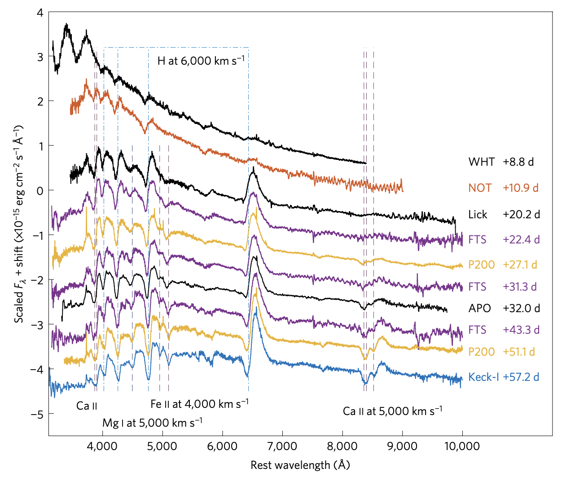
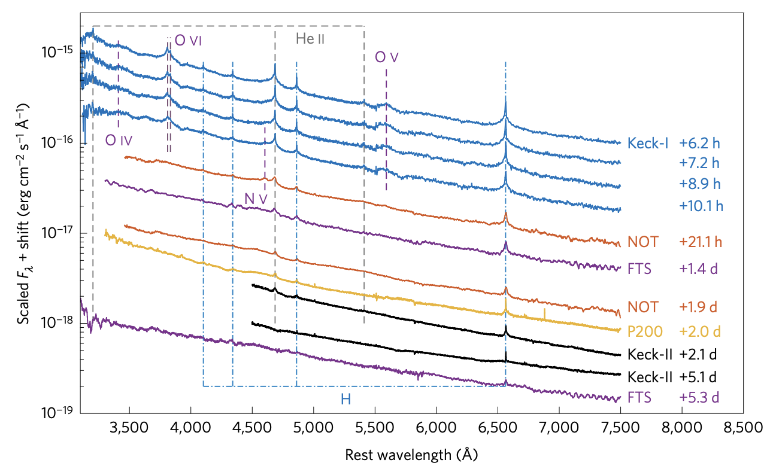
Confirmation of confined CSM
Early-time photometry/spectroscopy are utilized to identify the presence of the confined CSM (Yaron+17; Morozova+18)
Between 8 and 57 days of iPTF13dqy
Broad P-Cygni
Normal Type IIP
The first 2 days of iPTF13dqy
Narrow lines!
Yaron+17

Slide 16
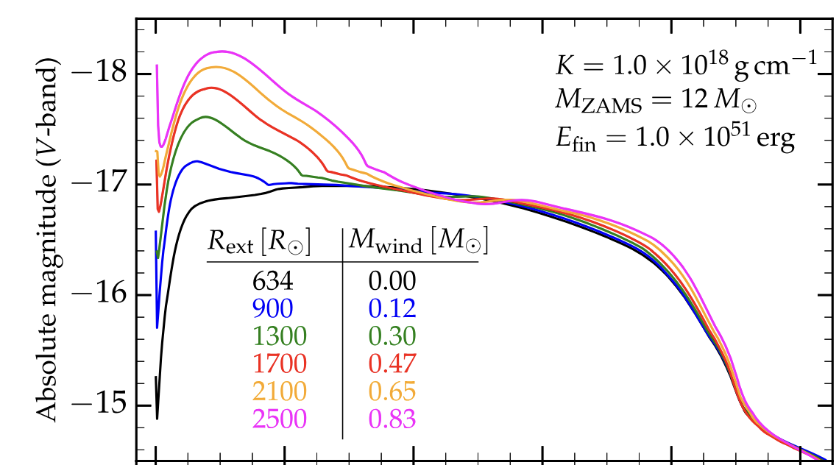
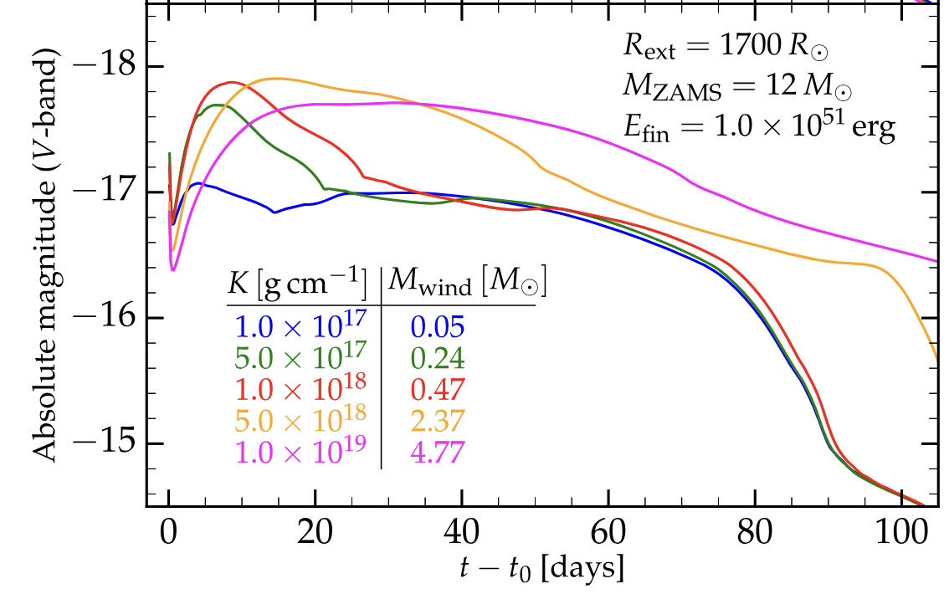
Confirmation of confined CSM
Early-time photometry/spectroscopy are utilized to identify the presence of the confined CSM (Yaron+17; Morozova+18)
Morozova+17

Slide 17
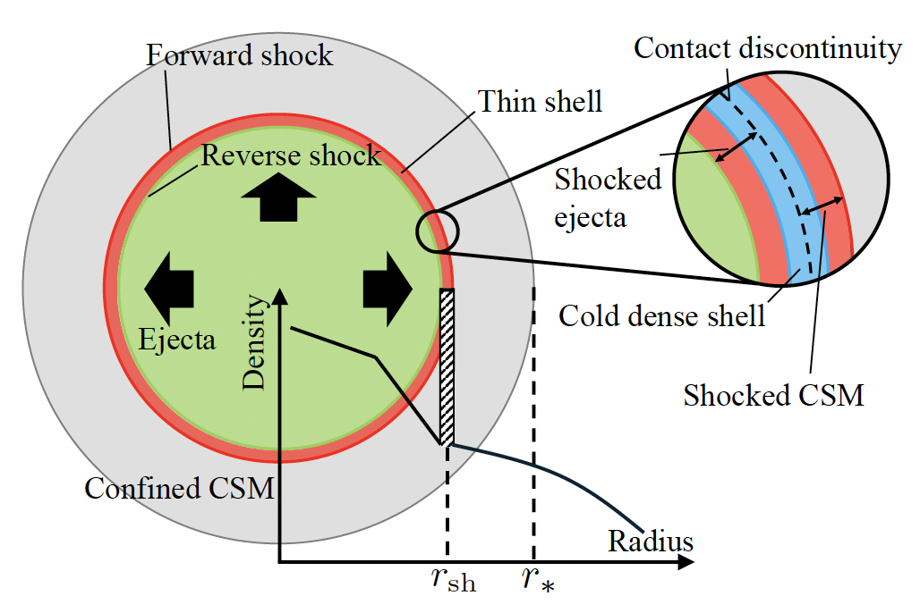
New dust formation site in confined CSM
Inspired by the dust formation in SNe IIn, we model the interaction between SN ejecta and confined CSM, and dust formation
We do not solve the dust formation itself, but evaluate the density of the CDS at the temperature below which atoms can condense into dust
We need ejecta and CSM profiles!
We simulate CSM formation…

Slide 18
CHIPS project
YT, Tsuna, Kuriyama, Ko, Shigeyama 2022
YT, Tsuna, Ko, Shigeyama 2024
https://github.com/DTsuna/CHIPS
Open-source code aimed to unveil the
Complete History of Interaction-Powered Supernovae

Slide 19
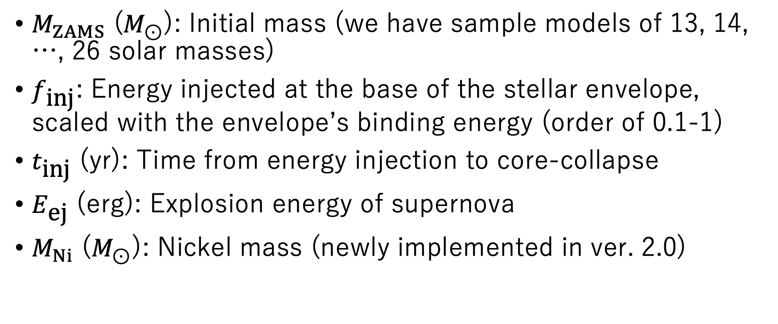
Parameters
$M_{ZAMS}$ ($M_{⊙}$): Initial mass (we have sample models of 13, 14, …, 26 solar masses)
$f_{\text{inj}}$: Energy injected at the base of the stellar envelope, scaled with the envelope’s binding energy (order of 0.1-1)
$t_{\text{inj}}$ (yr): Time from energy injection to core-collapse
$E_{\text{ej}}$ (erg): Explosion energy of supernova
$M_{Ni}$ ($M_{⊙}$): Nickel mass (newly implemented in ver. 2.0)

Slide 20
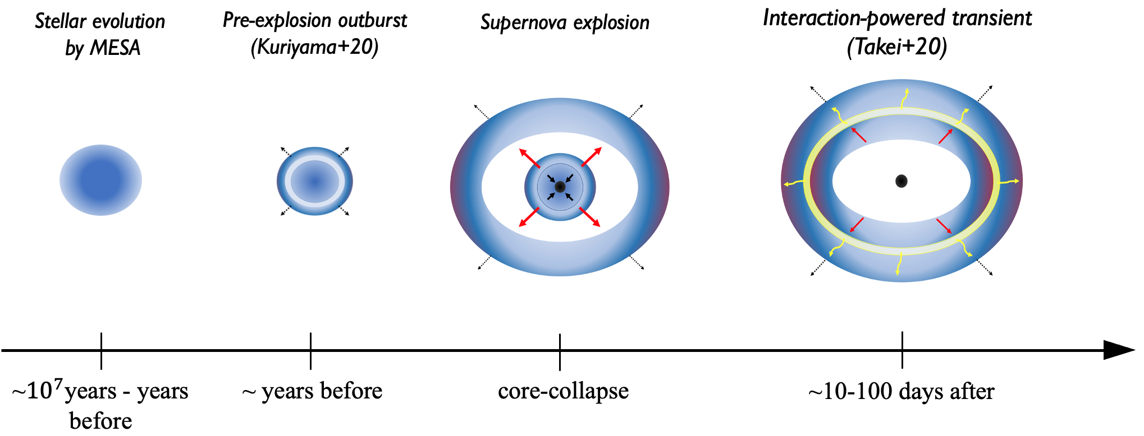
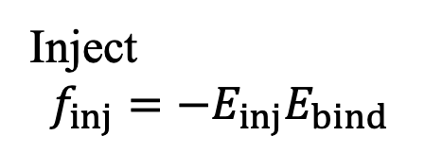
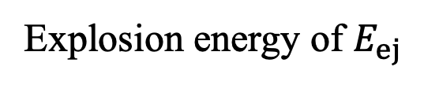
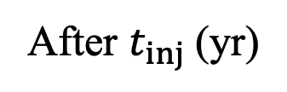
Parameters
Simulated with
MESA
CHIPS
Inject
$$f_{inj}=−E_{inj}E_{bind}$$
Explosion energy of $E_{ej}$
After $t_{inj}$ (yr)

Slide 21
Evolution of temperature/density of CDS
During the interaction between the ejecta and the CSM, T_{CDS} rapidly drops to ~10⁴K, following the cooling function
Adiabatic cooling starts after the shock passes through the CSM
Adiabatic cooling
starts
T_{CDS}
ejecta
10000
ejecta
~2000
CSM
radius
CDS
CDS

Slide 22
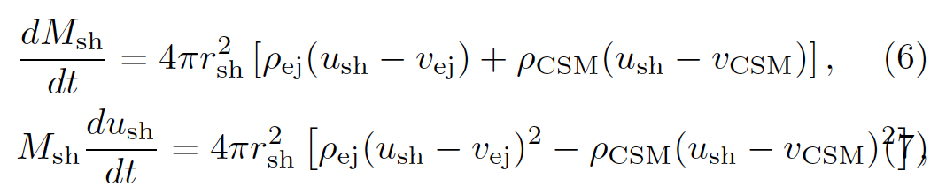
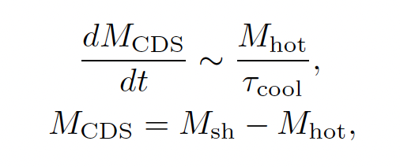

Location and mass of CDS
Determine the position by thin-shell approximation (e.g., Moriya+13)
We consider that the shock-heated shell settles into the CDS on the cooling timescale τ_{cool}
CDS
hot
density
hot
ejecta
CSM
RS
CD
FS
radius
$$M_{sh}$$

Slide 23
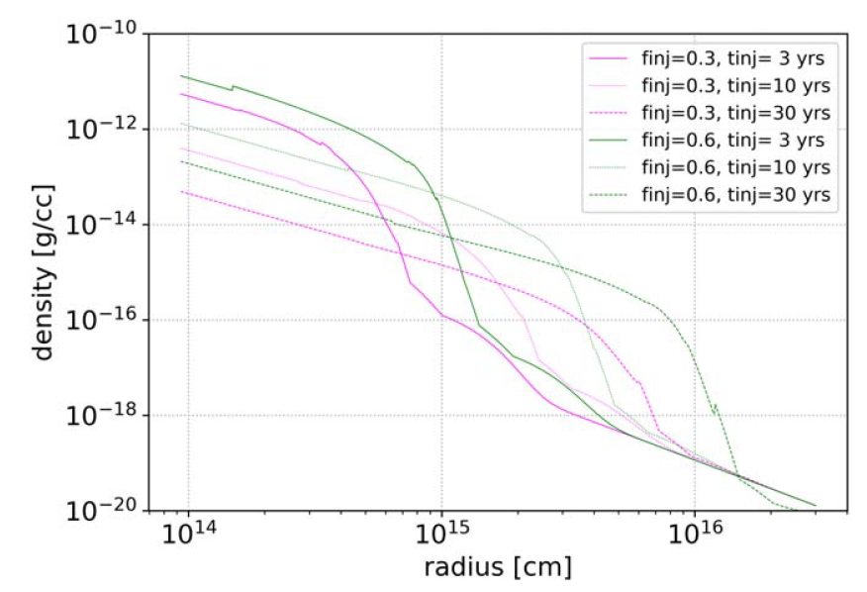
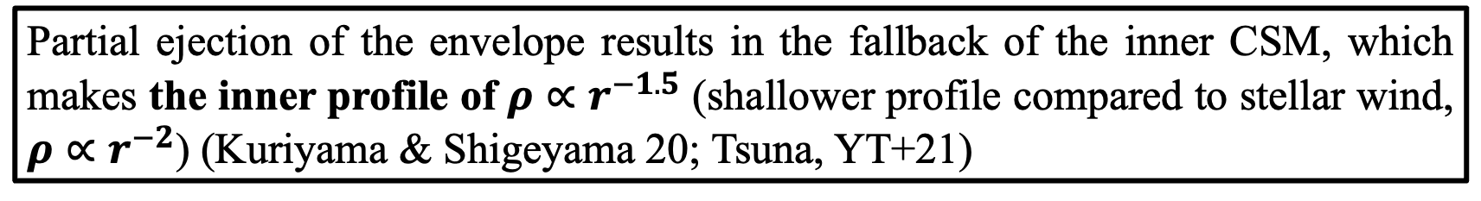

Simulation: Mass Eruption
$$ρ∝r^{−1.5}$$
Partial ejection of the envelope results in the fallback of the inner CSM, which makes the inner profile of $ρ∝r^{−1.5}$ (shallower profile compared to stellar wind, $ρ∝r^{−2}$) (Kuriyama & Shigeyama 20; Tsuna, YT+21)

Slide 24
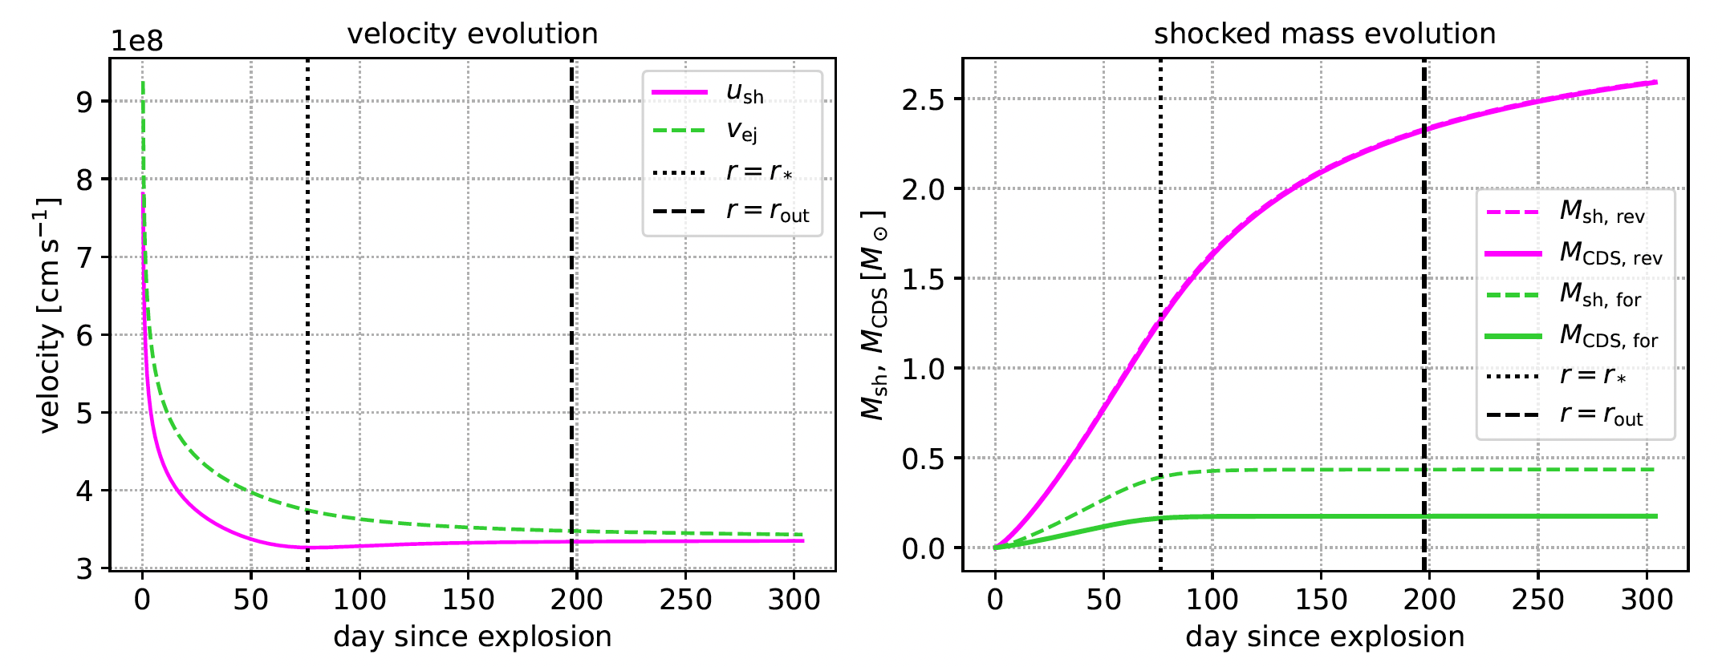
The evolution of velocity and mass of CDS

Slide 25
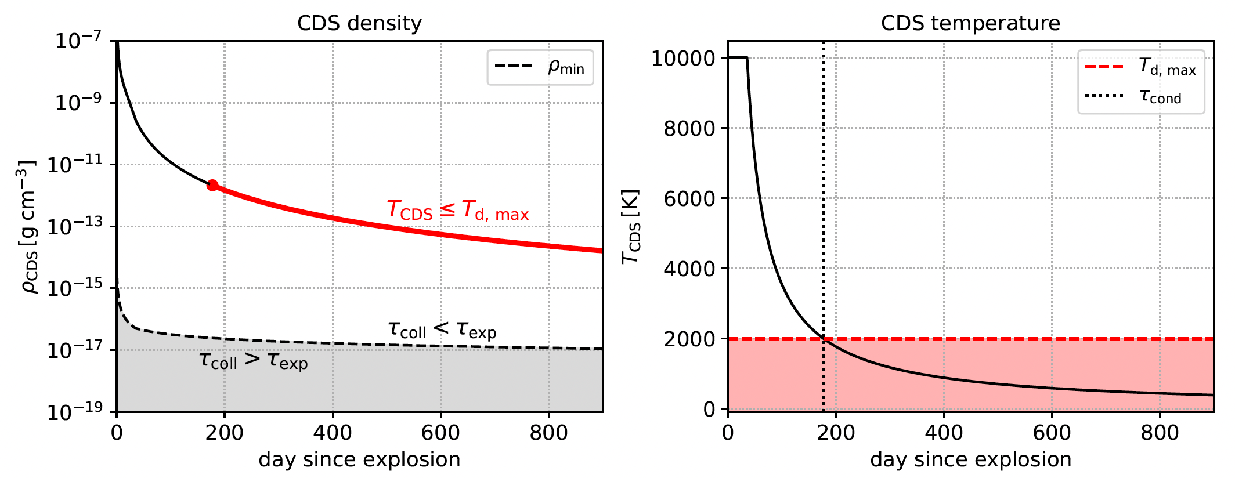
Density/temperature evolution
Assume that atoms condense into dust instantaneously here
The line where the expansion timescale equals to the atomic collision timescale
→If collisions occur on a short timescale, dust formation becomes possible

Slide 26
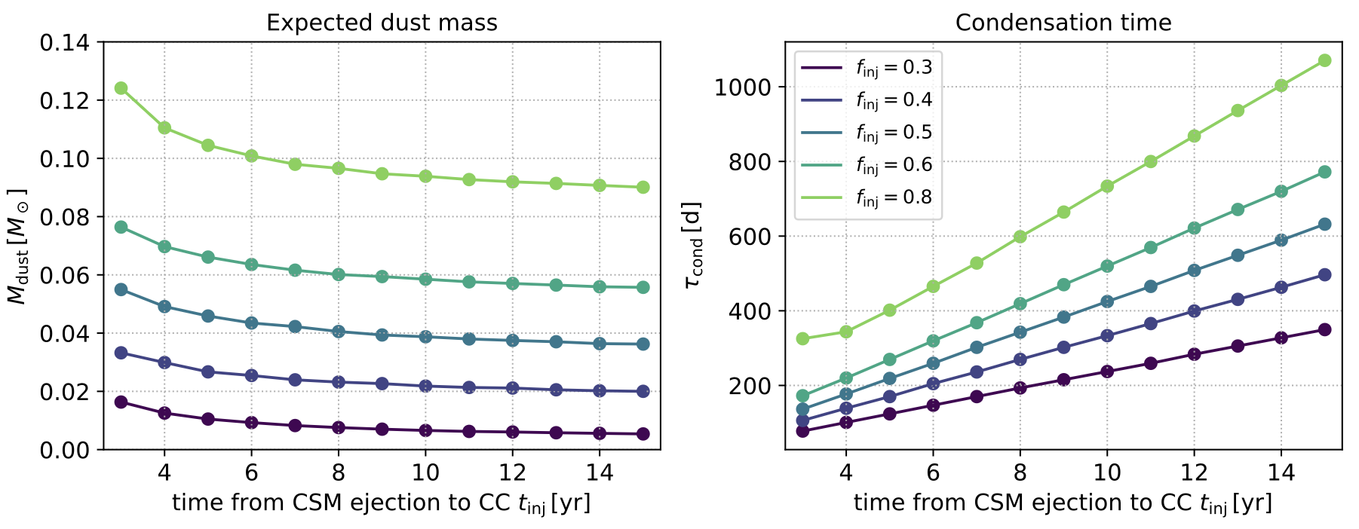
Expected dust mass
Larger CSM mass results in larger dust mass (larger f_{inj})
Longer t_{inj} → The reverse shock cannot sweep up larger ejecta mass before the interaction terminates

Slide 27
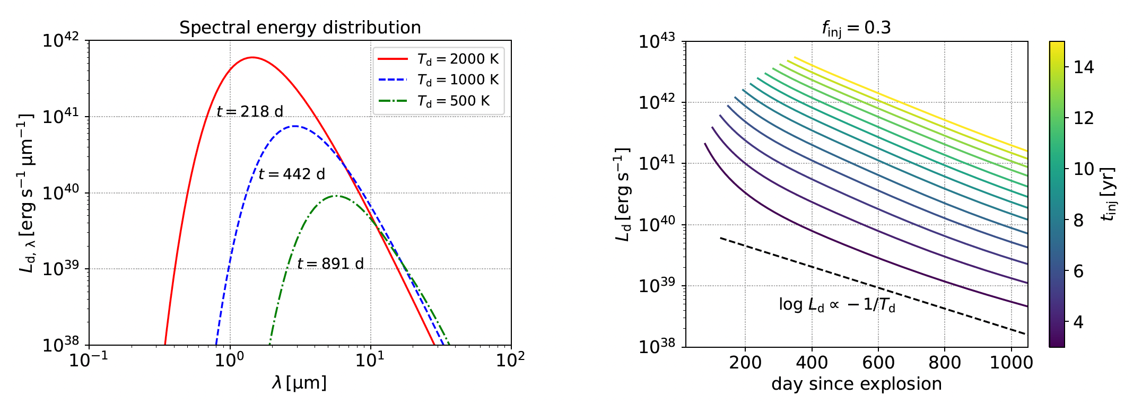

Light curves of dust emission
Dust emission at IR bands
Assuming $T_{dust}=T_{CDS}$, we calculate the dust light curves
Emissivity is much lower at longer wavelength

Slide 28
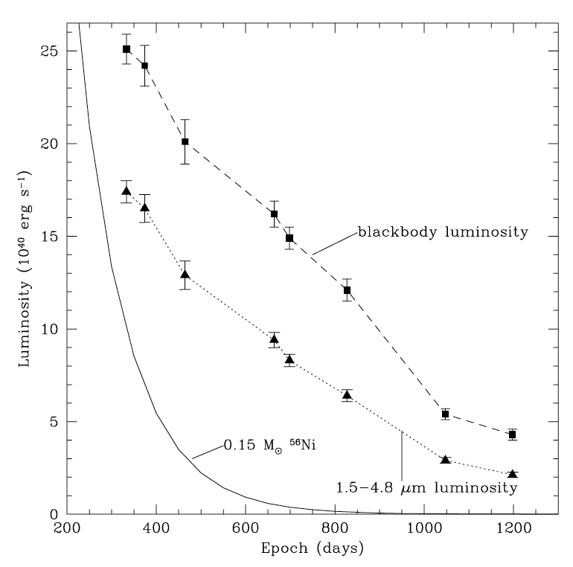
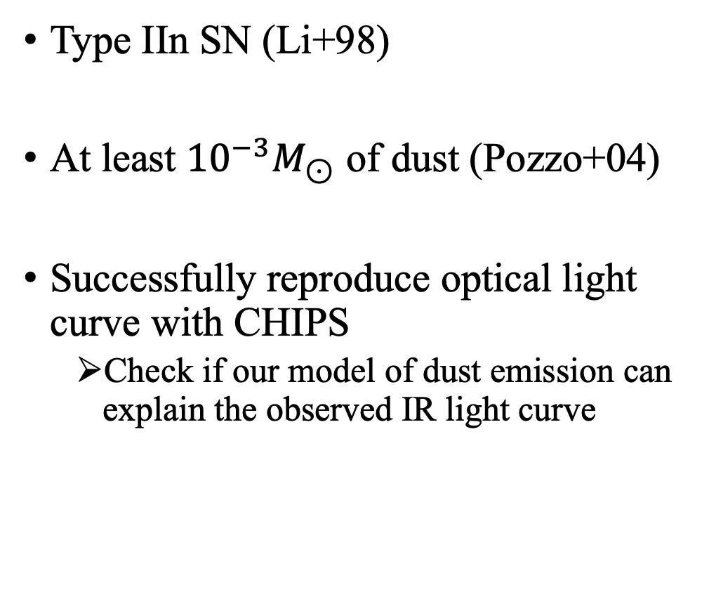
Comparison with observation: SN 1998S
Type IIn SN (Li+98)
At least ${10}^{−3}M_{⊙}$ of dust (Pozzo+04)
Successfully reproduce optical light curve with CHIPS
Check if our model of dust emission can explain the observed IR light curve
Pozzo+04

Slide 29
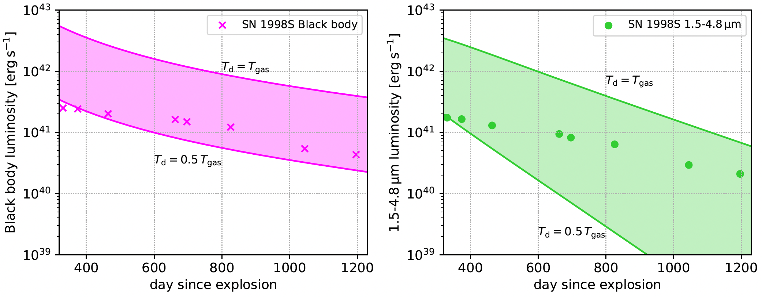
Comparison with observation: SN 1998S
Explore parameter space around the values obtained from fitting the optical light curve
Left: Black body approximation, Right: 1.5-4.8μm luminosity

Slide 30
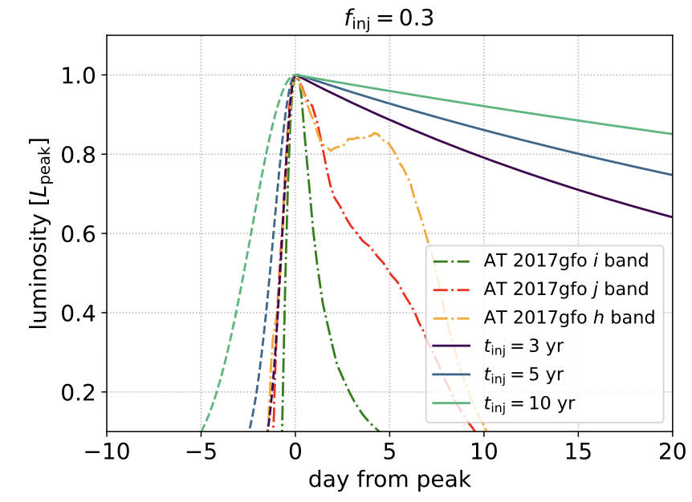
Implications for kilonova surveys
The light curve of a kilonova (KN) exhibits a rapid rise within a timescale of a few days (e.g., Kasen+13, 17)
Dust emission light curves can mimic early KNe due to light-travel-time effects
Rise phase alone is insufficient; decay must also be examined.

Slide 31
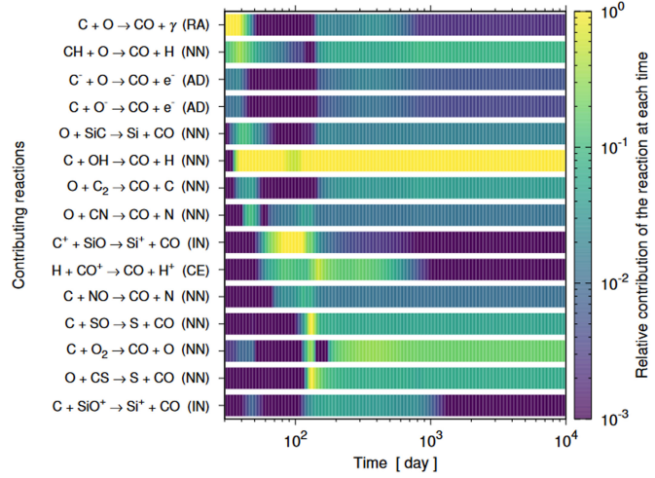
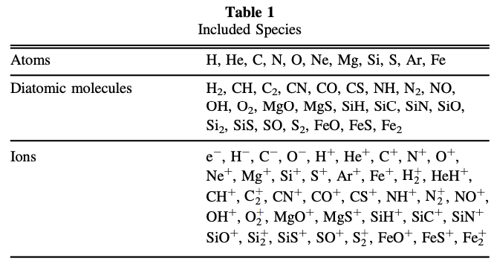
Molecular formation
We assume that all metals condense into dust
Molecules like CO can form even above ~2000 K
Detailed dust/molecule modeling is needed to estimate their contribution to the galactic dust budget
From Ono+24

Slide 32
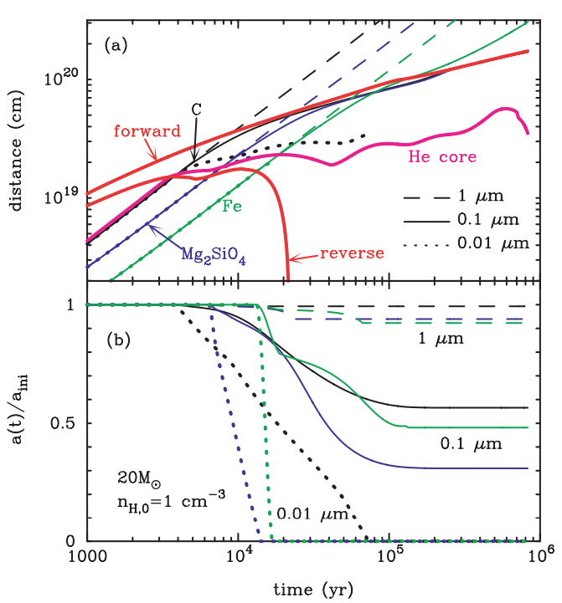
Dust survival against destruction
Dust formed in the ejecta is partially or completely destroyed by the reverse shock after the ejecta sweeps up interstellar medium (Nozawa+07)
Larger grain can survive after the destruction
The density of atoms is important for dust growth
The high density of CDS can grow up the dust??
Nozawa+07
shock

Slide 33
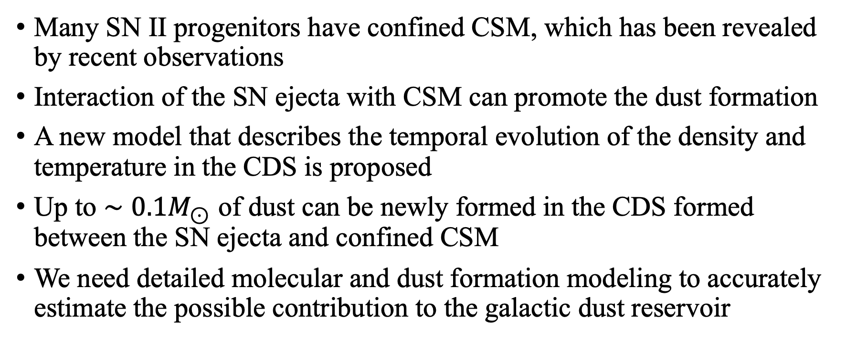
Summary
Many SN II progenitors have confined CSM, which has been revealed by recent observations
Interaction of the SN ejecta with CSM can promote the dust formation
A new model that describes the temporal evolution of the density and temperature in the CDS is proposed
Up to $∼0.1M_{⊙}$ of dust can be newly formed in the CDS formed between the SN ejecta and confined CSM
We need detailed molecular and dust formation modeling to accurately estimate the possible contribution to the galactic dust reservoir

