Slide 1
Equivariant Parameter Family of Many-Body Gapped Systems
invertible 1D
Ken Shiozaki (YITP, Kyoto)
2025/10/8@MPI Stuttgart
Based on
- KS, Niclas Heinsdorf (MPI Stuttgart & UCB Vancouver), Shuhei Ohyama (Vienna), 2305.08109.
- KS, 2507.19932.

Slide 2

Level repulsion
$$E$$
Parameter
Degeneracy of energy eigenvalues does not occur in general.

Slide 3


Level crossing
$$E$$
$$|φ_{−}(λ)⟩$$
$$|φ_{+}(λ)⟩$$
Parameter
If symmetry exists and two levels belong to different irreps, their crossing point is protected.

Slide 4




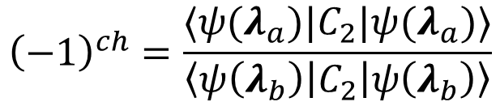


Level crossing is the Weyl point
$$E$$
$$−1$$
$$H={δλ}_{1}σ_{x}+{δλ}_{2}σ_{y}+{δλ}_{3}σ_{z}$$
= The source of the Berry curvature
$$+1$$
$$C_{2}$$
$$λ_{a}$$
$$λ_{b}$$
Parameter
Parameter
Such a protected level crossing corresponds to a Weyl point, the source of the 2-form Berry curvature, when viewed in a three-dimensional parameter space.
This is because of the fixed-point formula for the rotation symmetry:
$${\left(−1\right)}^{ch}=\frac{⟨ψ(λ_{a})|C_{2}|ψ(λ_{a})⟩}{\left\langle ψ\left(λ_{b}\right)\left|C_{2}\right|ψ\left(λ_{b}\right)\right\rangle }$$

Slide 5
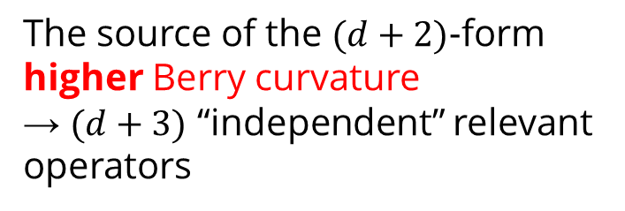
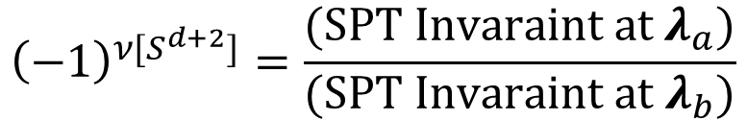

Generalization to $d$-dim quantum many-body systems
$$E$$
$$−1$$
The source of the $(d+2)$-form higher Berry curvature
→ $(d+3)$ “independent” relevant operators
$$+1$$
$$g$$
$$λ_{a}$$
$$λ_{b}$$
Parameter
Parameter
In $d$-space dimensions, SPT phase transition is the source of the $\left(d+2\right)$-form higher Berry curvature ! [HsinKapustinThorngren, 2004.10758, …]
$${\left(−1\right)}^{ν[S^{d+2}]}=\frac{(SPT Invaraint at λ_{a})}{(SPT Invaraint at λ_{b})}$$

Slide 6
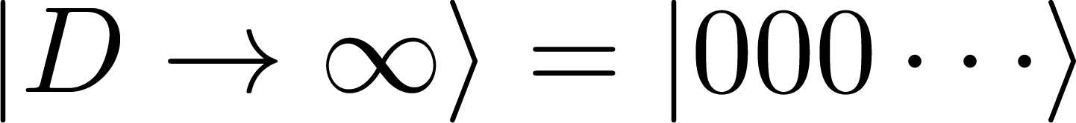

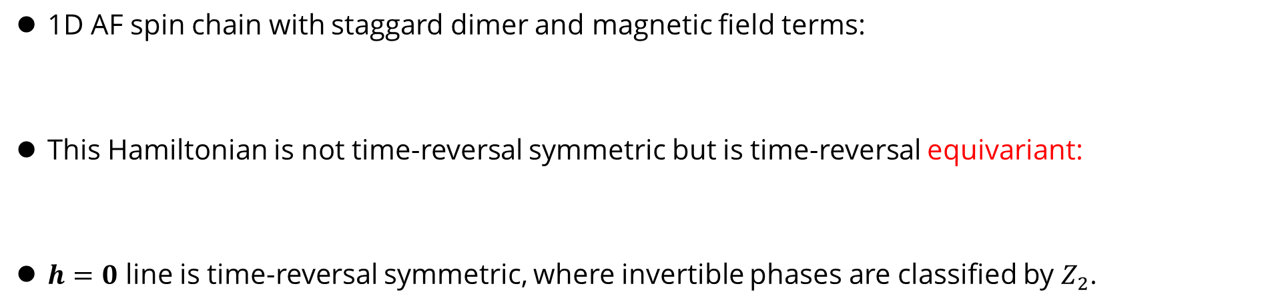



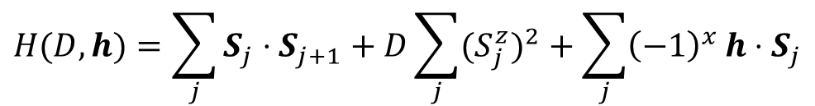

Example: 1D spin systems with TRS
1D AF spin chain with staggard dimer and magnetic field terms:
This Hamiltonian is not time-reversal symmetric but is time-reversal equivariant:
$h=0$ line is time-reversal symmetric, where invertible phases are classified by $Z_{2}$.
$$H(D,h)=\sum_{j}{S_{j}⋅S_{j+1}+D\sum_{j}{{{(S}_{j}^{z})}^{2}}}+\sum_{j}{{\left(−1\right)}^{x}}h⋅S_{j}$$
$$T H\left(D,h\right) T^{−1}=H(D,−h)$$
$$h$$
Codimension-4 defect.
The source of the 3-form higher Berry curvature
$$T$$
Haldane phase
$$D_{c}$$
Trivial phase
$$D$$

Slide 7
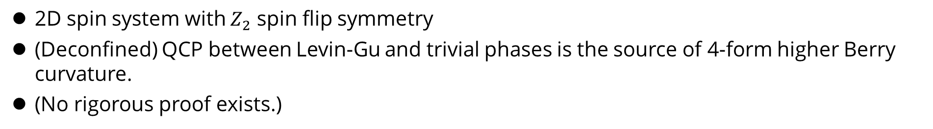



Example: 2D spin systems with $Z_{2}$ onsite symmetry
2D spin system with $Z_{2}$ spin flip symmetry
(Deconfined) QCP between Levin-Gu and trivial phases is the source of 4-form higher Berry curvature.
(No rigorous proof exists.)
$$λ_{2},λ_{3},λ_{4},λ_{5}$$
Codimension-5 defect:
The source of the 4-form higher Berry curvature
$$Z_{2}$$
Levin-Gu phase
Trivial phase
$$λ_{1}$$

Slide 8
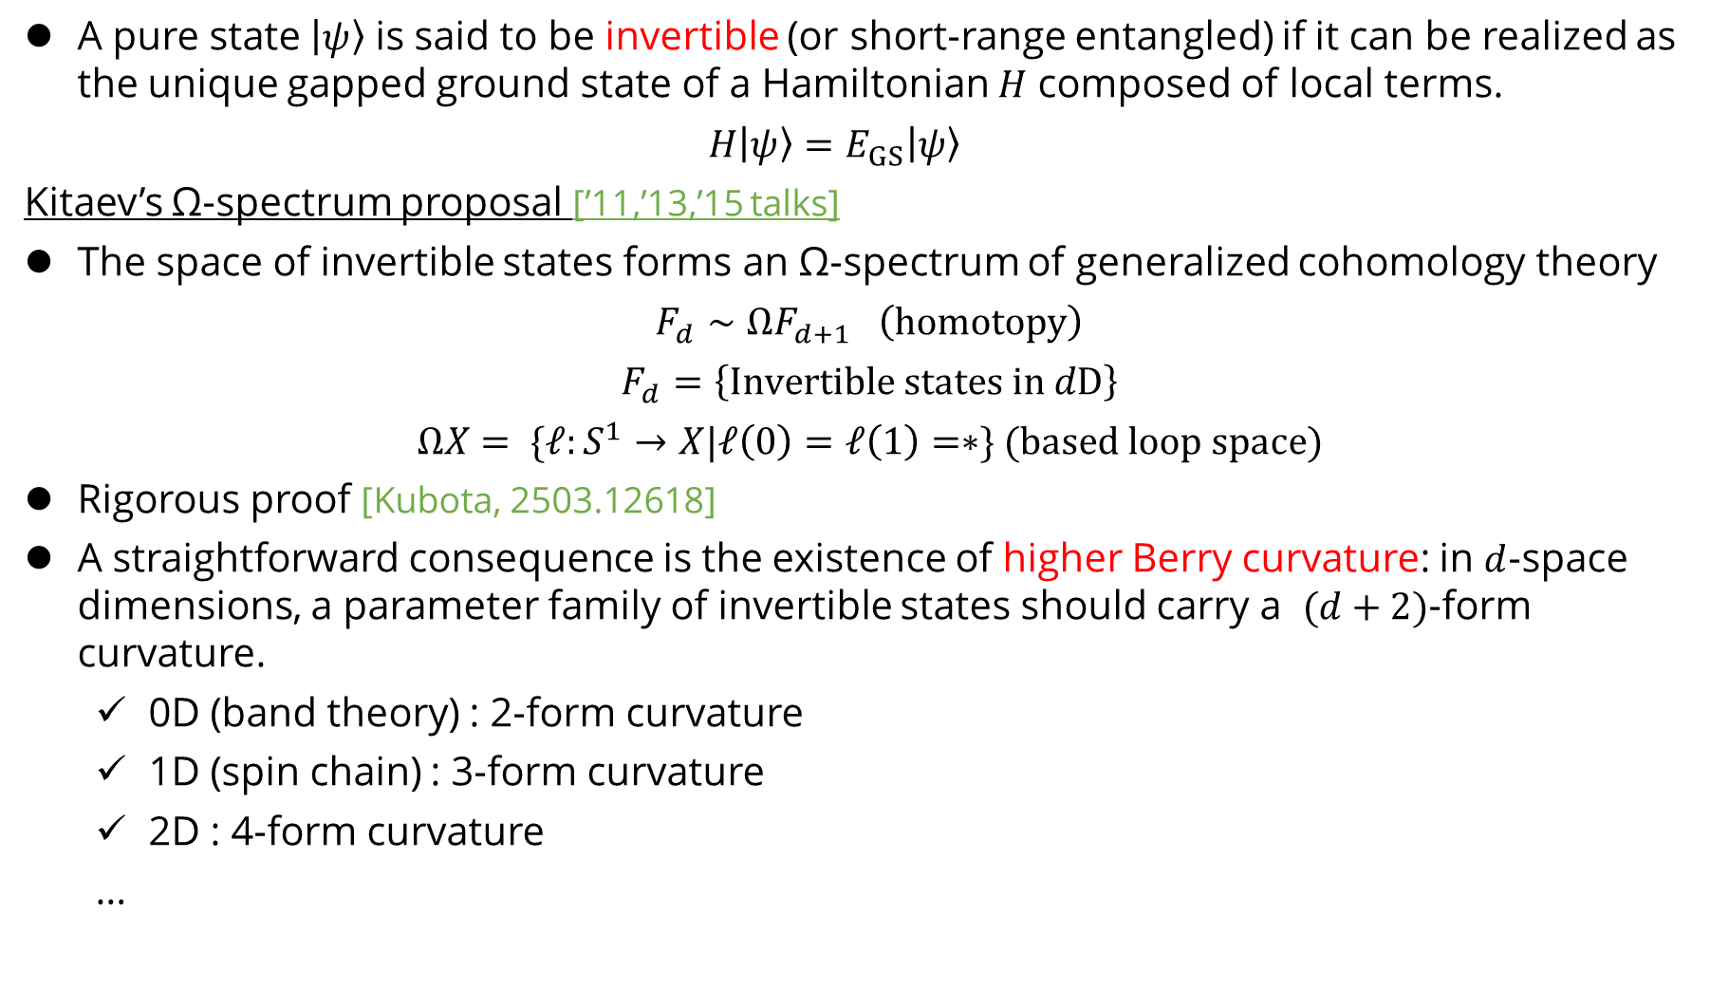
Invertible state and higher Berry curvature
A pure state $\left|ψ\right\rangle$ is said to be invertible (or short-range entangled) if it can be realized as the unique gapped ground state of a Hamiltonian $H$ composed of local terms.
$$H\left|ψ\right\rangle =E_{GS}\left|ψ\right\rangle$$
Kitaev’s Ω-spectrum proposal [’11,’13,’15 talks]
The space of invertible states forms an Ω-spectrum of generalized cohomology theory
$$F_{d}∼ΩF_{d+1} \left(homotopy\right)$$
$$F_{d}=\left\{Invertible states in dD\right\}$$
$$ΩX= \{ℓ:S^{1}→X|ℓ\left(0\right)=ℓ\left(1\right)=∗\} (based loop space)$$
Rigorous proof [Kubota, 2503.12618]
A straightforward consequence is the existence of higher Berry curvature: in $d$-space dimensions, a parameter family of invertible states should carry a $(d+2)$-form curvature.
0D (band theory) : 2-form curvature
1D (spin chain) : 3-form curvature
2D : 4-form curvature
…

Slide 9

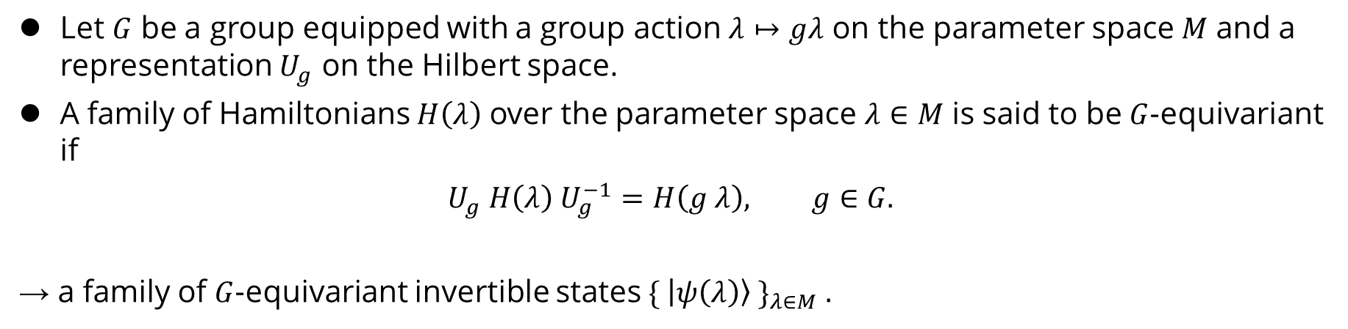

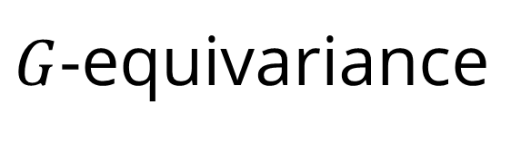





$G$-equivariance
Let $G$ be a group equipped with a group action $λ↦gλ$ on the parameter space $M$ and a representation $U_{g}$ on the Hilbert space.
A family of Hamiltonians $H\left(λ\right)$ over the parameter space $λ∈M$ is said to be $G$-equivariant if
$$U_{g} H\left(λ\right) U_{g}^{−1}=H\left(g λ\right), g∈G.$$
→ a family of $G$-equivariant invertible states $\{ \left|ψ\left(λ\right)\right\rangle \}_{λ∈M} .$
$$|ψ(λ)⟩$$
$$U_{g}$$
$$|ψ(gλ)⟩$$
$$M$$
$$λ$$
$$g$$
$$gλ$$

Slide 10






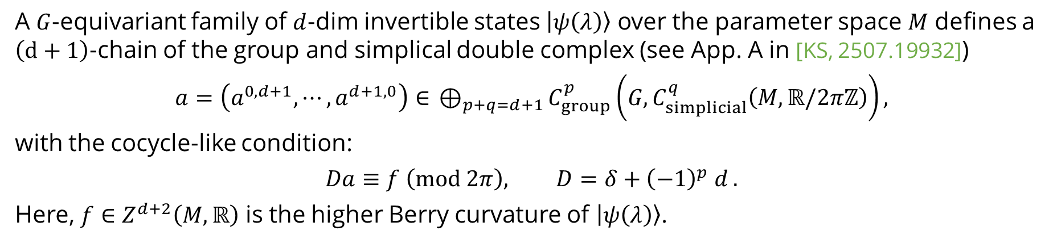
$G$-equivariant invertible family and a conjecture
A $G$-equivariant family of $d$-dim invertible states $\left|ψ\left(λ\right)\right\rangle$ over the parameter space $M$ defines a $\left(d+1\right)$-chain of the group and simplical double complex (see App. A in [KS, 2507.19932])
$$a=\left(a^{0,d+1},⋯,a^{d+1,0}\right)∈{ ⊕}_{p+q=d+1}C_{group}^{p}\left(G,C_{simplicial}^{q}\left(M,ℝ/2πℤ\right)\right),$$
with the cocycle-like condition:
$$Da≡f \left(mod 2π\right), D=δ+{\left(−1\right)}^{p} d\text{ .}$$
Here, $f∈Z^{d+2}\left(M,ℝ\right)$ is the higher Berry curvature of $\left|ψ\left(λ\right)\right\rangle$.
simplicial
Higher Berry curvature
$$q$$
$$f^{d+2}$$
Higher Berry connection
$$a^{0,d+1}$$
$$a^{1,d}$$
…
$$a^{d+1,0}$$
$$p$$
group

Slide 11

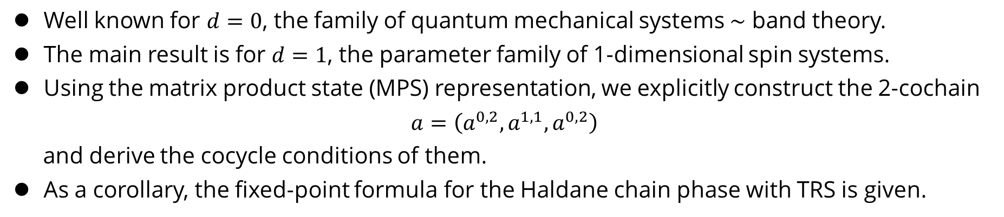




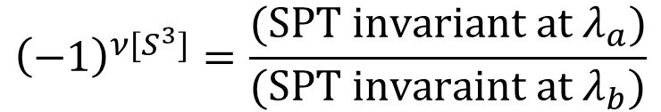
Main result [KS, 2507.19932]
Well known for $d=0$, the family of quantum mechanical systems $∼$ band theory.
The main result is for $d=1$, the parameter family of 1-dimensional spin systems.
Using the matrix product state (MPS) representation, we explicitly construct the 2-cochain
$$a=\left(a^{0,2},a^{1,1},a^{0,2}\right)$$
and derive the cocycle conditions of them.
As a corollary, the fixed-point formula for the Haldane chain phase with TRS is given.
$${\left(−1\right)}^{ν[S^{3}]}=\frac{(SPT invariant {at λ}_{a})}{(SPT invaraint at λ_{b})}$$
Topological invariant
$$h$$
Codimension-4 defect.
The source of the 3-form higher Berry curvature
$$S^{3}$$
$$T$$
Haldane phase
$$D_{c}$$
Trivial phase
$$D$$

Slide 12

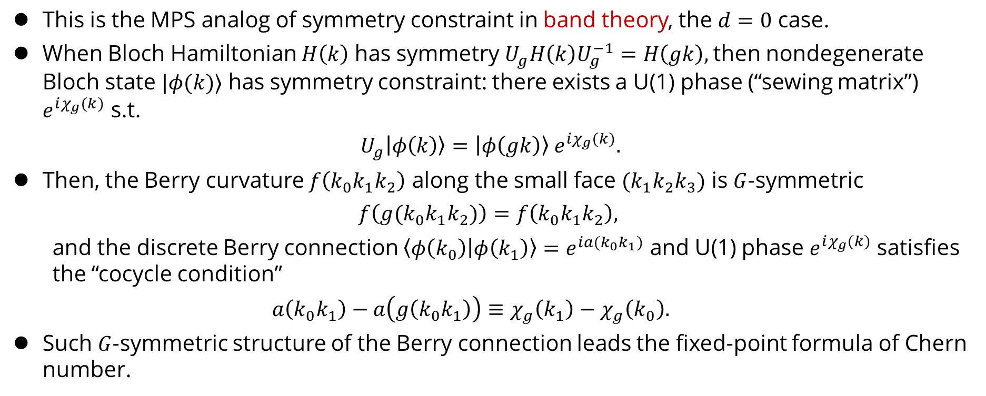

Sketch of construction (0/7)
This is the MPS analog of symmetry constraint in band theory, the $d=0$ case.
When Bloch Hamiltonian $H\left(k\right)$ has symmetry $U_{g}H\left(k\right)U_{g}^{−1}=H\left(gk\right),$then nondegenerate Bloch state $|φ(k)⟩$ has symmetry constraint: there exists a U(1) phase (“sewing matrix”) $e^{iχ_{g}(k)}$ s.t.
$$U_{g}\left|φ\left(k\right)\right\rangle =\left|φ\left(gk\right)\right\rangle e^{iχ_{g}(k)}.$$
Then, the Berry curvature $f\left(k_{0}k_{1}k_{2}\right)$ along the small face $(k_{1}k_{2}k_{3})$ is $G$-symmetric
$$f\left(g(k_{0}k_{1}k_{2})\right)=f\left(k_{0}k_{1}k_{2}\right),$$
and the discrete Berry connection $\left\langle φ\left(k_{0}\right) | φ\left(k_{1}\right)\right\rangle =e^{ia(k_{0}k_{1})}$ and U(1) phase $e^{iχ_{g}(k)}$satisfies the “cocycle condition”
$$a\left(k_{0}k_{1}\right)−a\left(g\left(k_{0}k_{1}\right)\right)≡χ_{g}\left(k_{1}\right)−χ_{g}\left(k_{0}\right).$$
Such $G$-symmetric structure of the Berry connection leads the fixed-point formula of Chern number.
$$C_{n}$$
$$f\left(k_{0}k_{1}k_{2}\right)$$

Slide 13





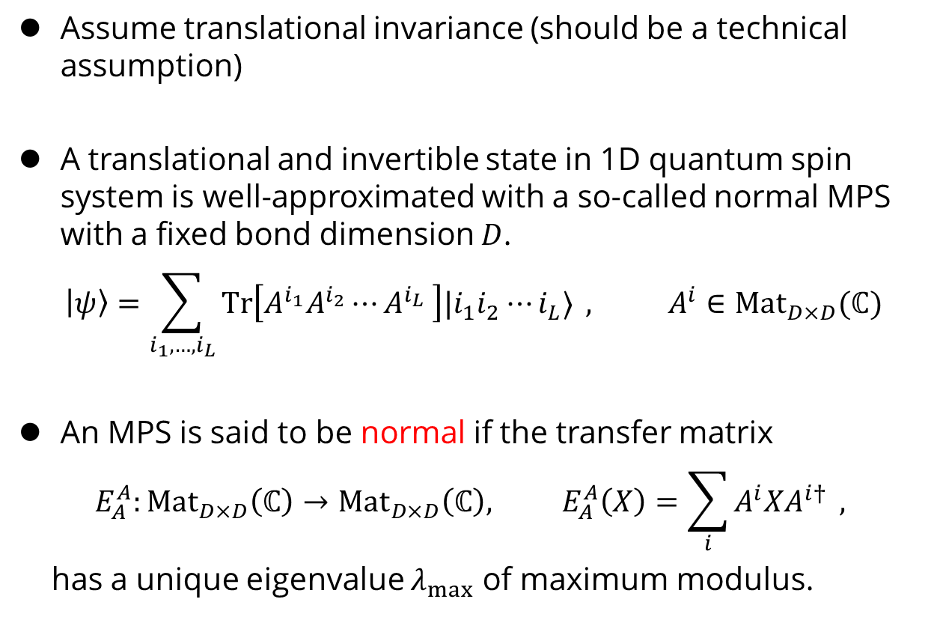









Sketch of construction (1/7)
Assume translational invariance (should be a technical assumption)
A translational and invertible state in 1D quantum spin system is well-approximated with a so-called normal MPS with a fixed bond dimension $D$.
$$\left|ψ\right\rangle =\sum_{i_{1},…,i_{L}}{Tr\left[A^{i_{1}}A^{i_{2}}⋯A^{i_{L}} \right]|i_{1}i_{2}⋯i_{L}⟩ }, A^{i}∈Mat_{D×D}(ℂ)$$
An MPS is said to be normal if the transfer matrix
$$E_{A}^{A}:Mat_{D×D}\left(ℂ\right)→Mat_{D×D}\left(ℂ\right), E_{A}^{A}\left(X\right)=\sum_{i}{A^{i}XA^{i†} },$$
has a unique eigenvalue $λ_{max}$ of maximum modulus.
$$i_{1}$$
$$i_{2}$$
$$i_{L}$$
$$A$$
$$A$$
$$⋯$$
$$A$$
$$E_{A}^{A}$$
$$A^{∗}$$
$$X$$
$$X$$
$$A$$
Spectrum of $E_{A}^{A}$
$$λ_{max}$$

Slide 14




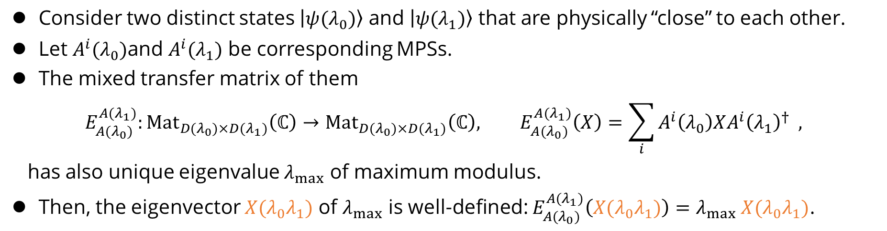






Sketch of construction (2/7)
Consider two distinct states $\left|ψ(λ_{0})\right\rangle$ and $\left|ψ(λ_{1})\right\rangle$ that are physically “close” to each other.
Let $A^{i}(λ_{0})$and $A^{i}(λ_{1})$ be corresponding MPSs.
The mixed transfer matrix of them
$$E_{A(λ_{0})}^{A(λ_{1})}:Mat_{D(λ_{0})×D(λ_{1})}\left(ℂ\right)→Mat_{D(λ_{0})×D(λ_{1})}\left(ℂ\right), E_{A(λ_{0})}^{A(λ_{1})}\left(X\right)=\sum_{i}{A^{i}\left(λ_{0}\right)XA^{i}{\left(λ_{1}\right)}^{†} },$$
has also unique eigenvalue $λ_{max}$ of maximum modulus.
Then, the eigenvector $X(λ_{0}λ_{1})$ of $λ_{max}$ is well-defined: $E_{A(λ_{0})}^{A(λ_{1})}\left(X(λ_{0}λ_{1})\right)=λ_{max} X(λ_{0}λ_{1})$.
$${A(λ_{1})}^{∗}$$
$$A(λ_{0})$$
$${A^{i}(λ}_{0})$$
Spectrum of $E_{A(λ_{0})}^{A(λ_{1})}$
$${A^{i}(λ}_{1})$$
$$λ_{max}$$
$$λ_{0}$$
$$M$$
$$X(λ_{0}λ_{1})$$
$$λ_{1}$$

Slide 15

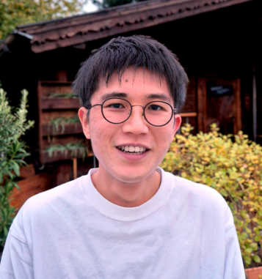



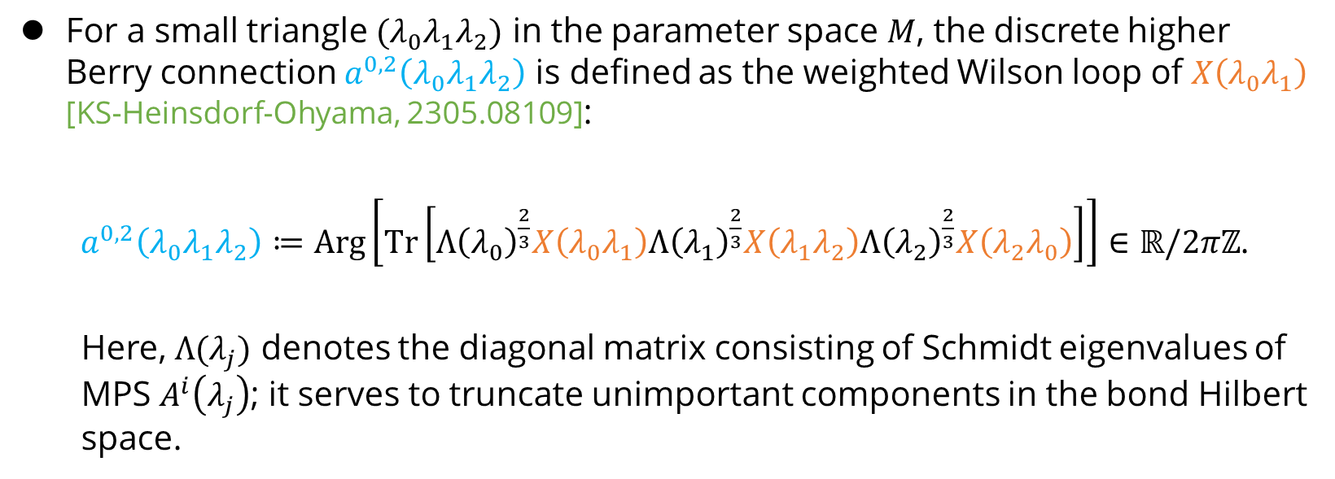





Sketch of construction (3/7)
For a small triangle $(λ_{0}λ_{1}λ_{2})$ in the parameter space $M$, the discrete higher Berry connection $a^{0,2}\left(λ_{0}λ_{1}λ_{2}\right)$ is defined as the weighted Wilson loop of $X\left(λ_{0}λ_{1}\right)$ [KS-Heinsdorf-Ohyama, 2305.08109]:
$a^{0,2}\left(λ_{0}λ_{1}λ_{2}\right)≔Arg\left[Tr\left[Λ{\left(λ_{0}\right)}^{\frac{2}{3}}X\left(λ_{0}λ_{1}\right)Λ{\left(λ_{1}\right)}^{\frac{2}{3}}X\left(λ_{1}λ_{2}\right)Λ{\left(λ_{2}\right)}^{\frac{2}{3}}X\left(λ_{2}λ_{0}\right)\right]\right]∈ℝ/2πℤ$.
Here, $Λ(λ_{j})$ denotes the diagonal matrix consisting of Schmidt eigenvalues of MPS $A^{i}\left(λ_{j}\right)$; it serves to truncate unimportant components in the bond Hilbert space.
$$λ_{2}$$
$$X(λ_{0}λ_{2})$$
$$X(λ_{1}λ_{2})$$
$$M$$
$$a^{0,2}\left(λ_{0}λ_{1}λ_{2}\right)$$
$$λ_{0}$$
$$X(λ_{0}λ_{1})$$
$$λ_{1}$$

Slide 16







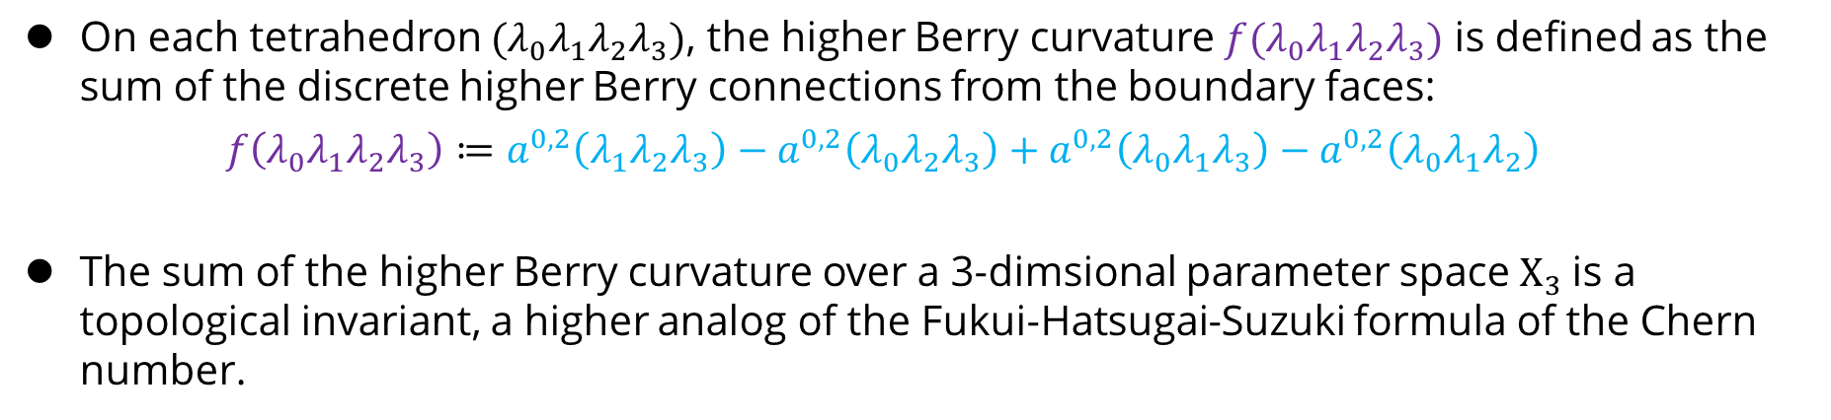






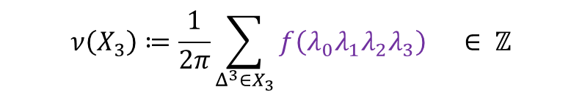



Sketch of construction (4/7)
On each tetrahedron $(λ_{0}λ_{1}λ_{2}λ_{3})$, the higher Berry curvature $f(λ_{0}λ_{1}λ_{2}λ_{3})$ is defined as the sum of the discrete higher Berry connections from the boundary faces:
$$f\left(λ_{0}λ_{1}λ_{2}λ_{3}\right)≔a^{0,2}\left(λ_{1}λ_{2}λ_{3}\right)−a^{0,2}\left(λ_{0}λ_{2}λ_{3}\right)+a^{0,2}\left(λ_{0}λ_{1}λ_{3}\right)−a^{0,2}\left(λ_{0}λ_{1}λ_{2}\right)$$
The sum of the higher Berry curvature over a 3-dimsional parameter space $X_{3}$is a topological invariant, a higher analog of the Fukui-Hatsugai-Suzuki formula of the Chern number.
$$λ_{3}$$
$$ν\left(X_{3}\right)≔\frac{1}{2π}\sum_{Δ^{3}∈X_{3}}{f\left(λ_{0}λ_{1}λ_{2}λ_{3}\right)} ∈ ℤ$$
$$X(λ_{2}λ_{3})$$
$$X(λ_{1}λ_{3})$$
$$X(λ_{0}λ_{3})$$
$$a^{0,2}\left(λ_{0}λ_{2}λ_{3}\right)$$
$$a^{0,2}\left(λ_{1}λ_{2}λ_{3}\right)$$
$$X_{3}$$
$$f\left(λ_{0}λ_{1}λ_{2}λ_{3}\right)$$
$$λ_{2}$$
$$a^{0,2}\left(λ_{0}λ_{1}λ_{3}\right)$$
$$X(λ_{0}λ_{2})$$
$$X(λ_{1}λ_{2})$$
$$a^{0,2}\left(λ_{0}λ_{1}λ_{2}\right)$$
$$λ_{0}$$
$$X(λ_{0}λ_{1})$$
$$λ_{1}$$

Slide 17
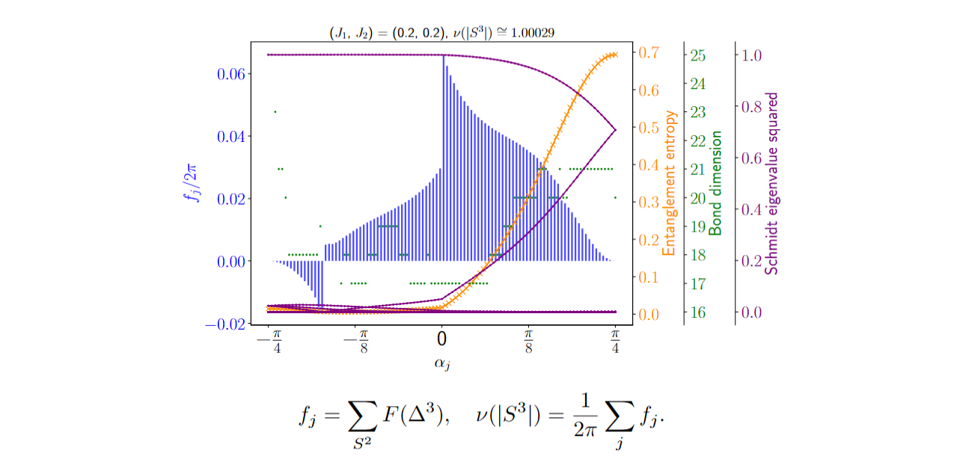
DMRG calculation of higher Berry curvature
Our formula is straightforwardly implemented in DMRG calculation! [KS-Heinsdorf-Ohyama, 2305.08109]
Ex: Spin 1/2 AF Heisenberg + staggered AF + staggered magnetic field

Slide 18

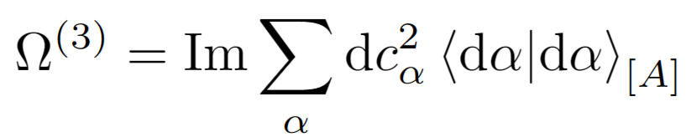



Other definitions of 1D higher Berry curvature
Original proposal in [Kapustin-Spodyneiko 2001.03454] :
Correlation functions of local Hamiltonian terms & coarse geometry technology
Based on local Hamiltonian terms
Schmidt decomposition formula [Sommer-Wen-Vishwanath 2405.05316, cf. Ohyama-Ryu 2405.05327] :
Schmidt eigenvalue contribution
Berry curvature of each Schmidt state
$${\left|α\right\rangle }_{[A]}$$
$$c_{α}$$
$${\left|α\right\rangle }_{[B]}$$
A
B

Slide 19





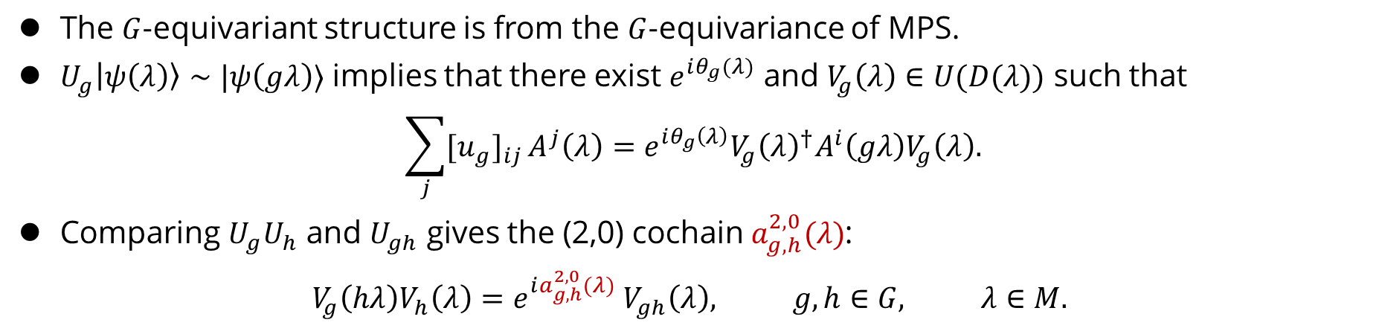









Sketch of construction (5/7)
The $G$-equivariant structure is from the $G$-equivariance of MPS.
$U_{g}\left|ψ\left(λ\right)\right\rangle ∼|ψ\left(gλ\right)⟩$ implies that there exist $e^{iθ_{g}(λ)}$ and $V_{g}\left(λ\right)∈U(D(λ))$ such that
$$\sum_{j}{{{[u}_{g}]}_{ij}}A^{j}\left(λ\right)=e^{iθ_{g}\left(λ\right)}V_{g}{\left(λ\right)}^{†}A^{i}\left(gλ\right)V_{g}\left(λ\right).$$
Comparing $U_{g}U_{h}$ and $U_{gh}$ gives the (2,0) cochain $a_{g,h}^{2,0}(λ)$:
$$V_{g}\left(hλ\right)V_{h}\left(λ\right)=e^{ia_{g,h}^{2,0}(λ)} V_{gh}\left(λ\right), g,h∈G, λ∈M.$$
$$A^{i}(λ)$$
$$V_{gh}(λ)$$
$$A^{i}\left(ghλ\right)$$
$$a_{g,h}^{2,0}(λ)$$
$$V_{h}(λ)$$
$$A^{i}\left(hλ\right)$$
$$V_{g}(hλ)$$
$$gh$$
$$λ$$
$$ghλ$$
$$M$$
$$h$$
$$hλ$$
$$g$$

Slide 20

















Sketch of construction (6/7)
The $G$-equivariance of the mixed transfer matrix leads the (1,1)-cochain $a_{g}^{1,1}\left(λ_{0}λ_{1}\right):$
$$V_{g}\left(λ_{0}\right)X\left(λ_{0}λ_{1}\right)V_{g}{\left(λ_{1}\right)}^{†}=e^{ia_{g}^{1,1}\left(λ_{0}λ_{1}\right)}X(gλ_{0}gλ_{1})$$
$$A^{i}(λ_{0})$$
$$V_{g}(λ_{0})$$
$$A^{i}\left(gλ_{0}\right)$$
$$A^{i}\left(λ_{1}\right)$$
$$a_{g}^{1,1}\left(λ_{0}λ_{1}\right)$$
$$A^{i}\left(gλ_{1}\right)$$
$$V_{h}(λ)$$
$$V_{g}(λ_{1})$$
$$g$$
$$λ_{0}$$
$$gλ_{0}$$
$$X(λ_{0}λ_{1})$$
$$X(gλ_{0}gλ_{1})$$
$$M$$
$$λ_{1}$$
$$g$$
$$gλ_{1}$$

Slide 21





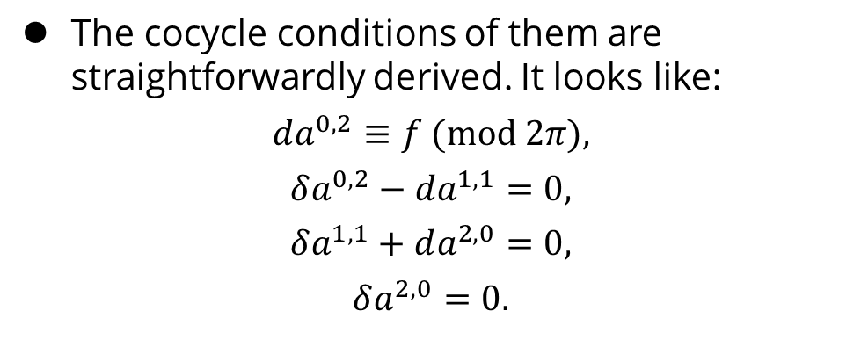







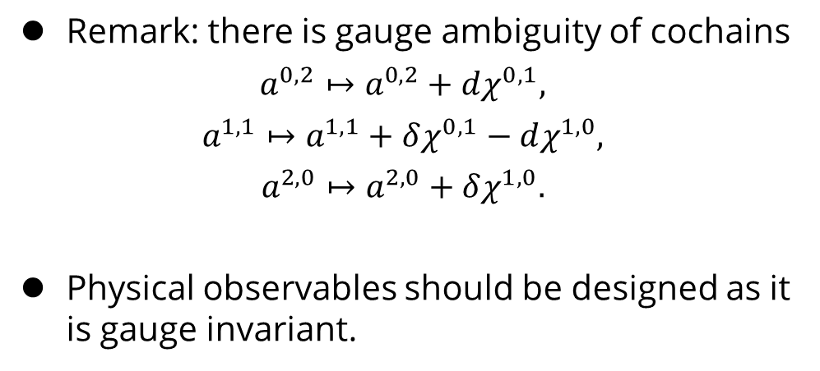

Sketch of construction (7/7)
The cocycle conditions of them are straightforwardly derived. It looks like:
$$da^{0,2}≡f (mod 2π),$$
$$δa^{0,2}−da^{1,1}=0,$$
$$δa^{1,1}+da^{2,0}=0,$$
$$δa^{2,0}=0.$$
simplicial
Higher Berry curvature
$$q$$
$$f$$
Higher Berry connection
$$a^{0,2}$$
$$a^{1,1}$$
Remark: there is gauge ambiguity of cochains
$$a^{0,2}↦a^{0,2}+dχ^{0,1},$$
$$a^{1,1}↦a^{1,1}+δχ^{0,1}−dχ^{1,0},$$
$$a^{2,0}↦a^{2,0}+δχ^{1,0}.$$
Physical observables should be designed as it is gauge invariant.
$$a^{2,0}$$
$$p$$
group
simplicial
$$q$$
$$a^{0,2}$$
$$χ^{0,1}$$
$$a^{1,1}$$
$$χ^{1,0}$$
$$a^{2,0}$$
$$p$$
group

Slide 22
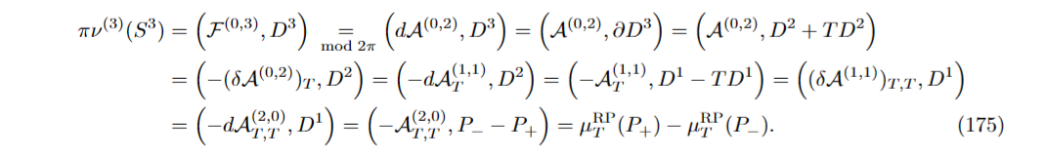
Fixed point formula for spin chain with TR-equivariance
One-line proof (see [KS, 2507.19932] for the detail) :
$${\left(−1\right)}^{ν[S^{3}]}=\frac{(SPT invariant {at λ}_{a})}{(SPT invaraint at λ_{b})}$$
Topological invariant
$$h$$
Codimension-4 defect.
The source of the 3-form higher Berry curvature
$$S^{3}$$
$$T$$
Haldane phase
$$D_{c}$$
Trivial phase
$$D$$

Slide 23
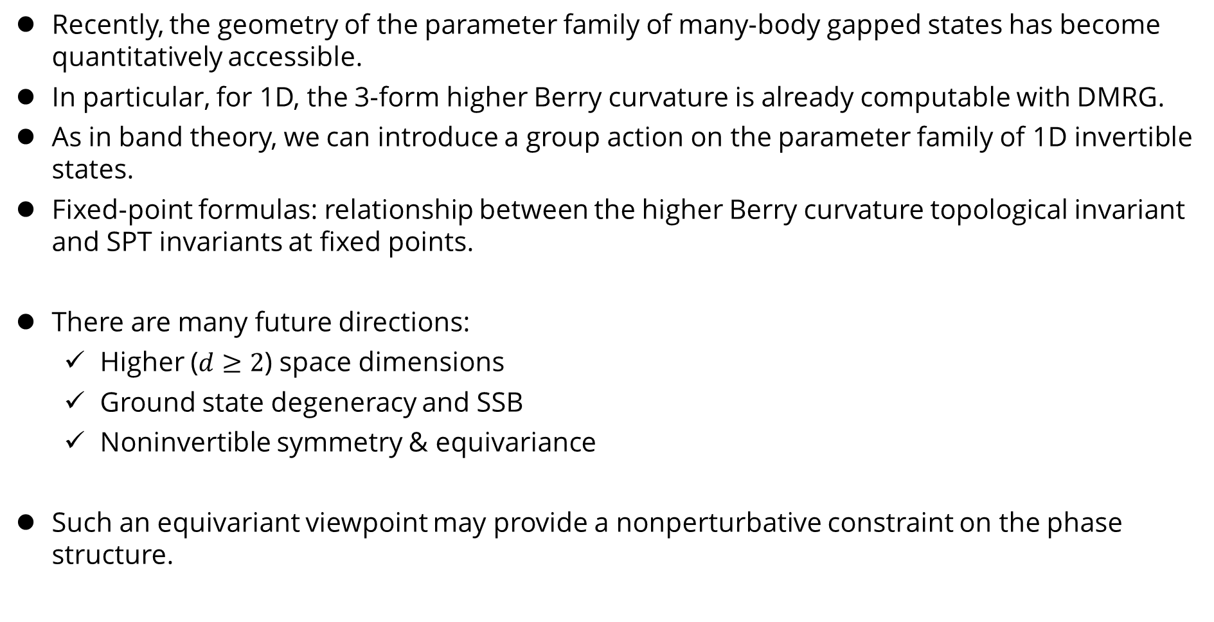
Summary [KS, 2507.19932]
Recently, the geometry of the parameter family of many-body gapped states has become quantitatively accessible.
In particular, for 1D, the 3-form higher Berry curvature is already computable with DMRG.
As in band theory, we can introduce a group action on the parameter family of 1D invertible states.
Fixed-point formulas: relationship between the higher Berry curvature topological invariant and SPT invariants at fixed points.
There are many future directions:
Higher ($d≥2$) space dimensions
Ground state degeneracy and SSB
Noninvertible symmetry & equivariance
Such an equivariant viewpoint may provide a nonperturbative constraint on the phase structure.

