Slide 2
Symmetries, Dirac electrons and band flattening
Ady Stern (Weizmann)
With Yarden Sheffer (Weizmann) and Raquel Queiroz (Columbia)
With Ari Turner (Technion) and Erez Berg (Weizmann)

Slide 3
Further subjects I’ll be happy to discuss:
A new set-up for Majorana fermions
Electron hydrodynamics
And, before we start -

Slide 4
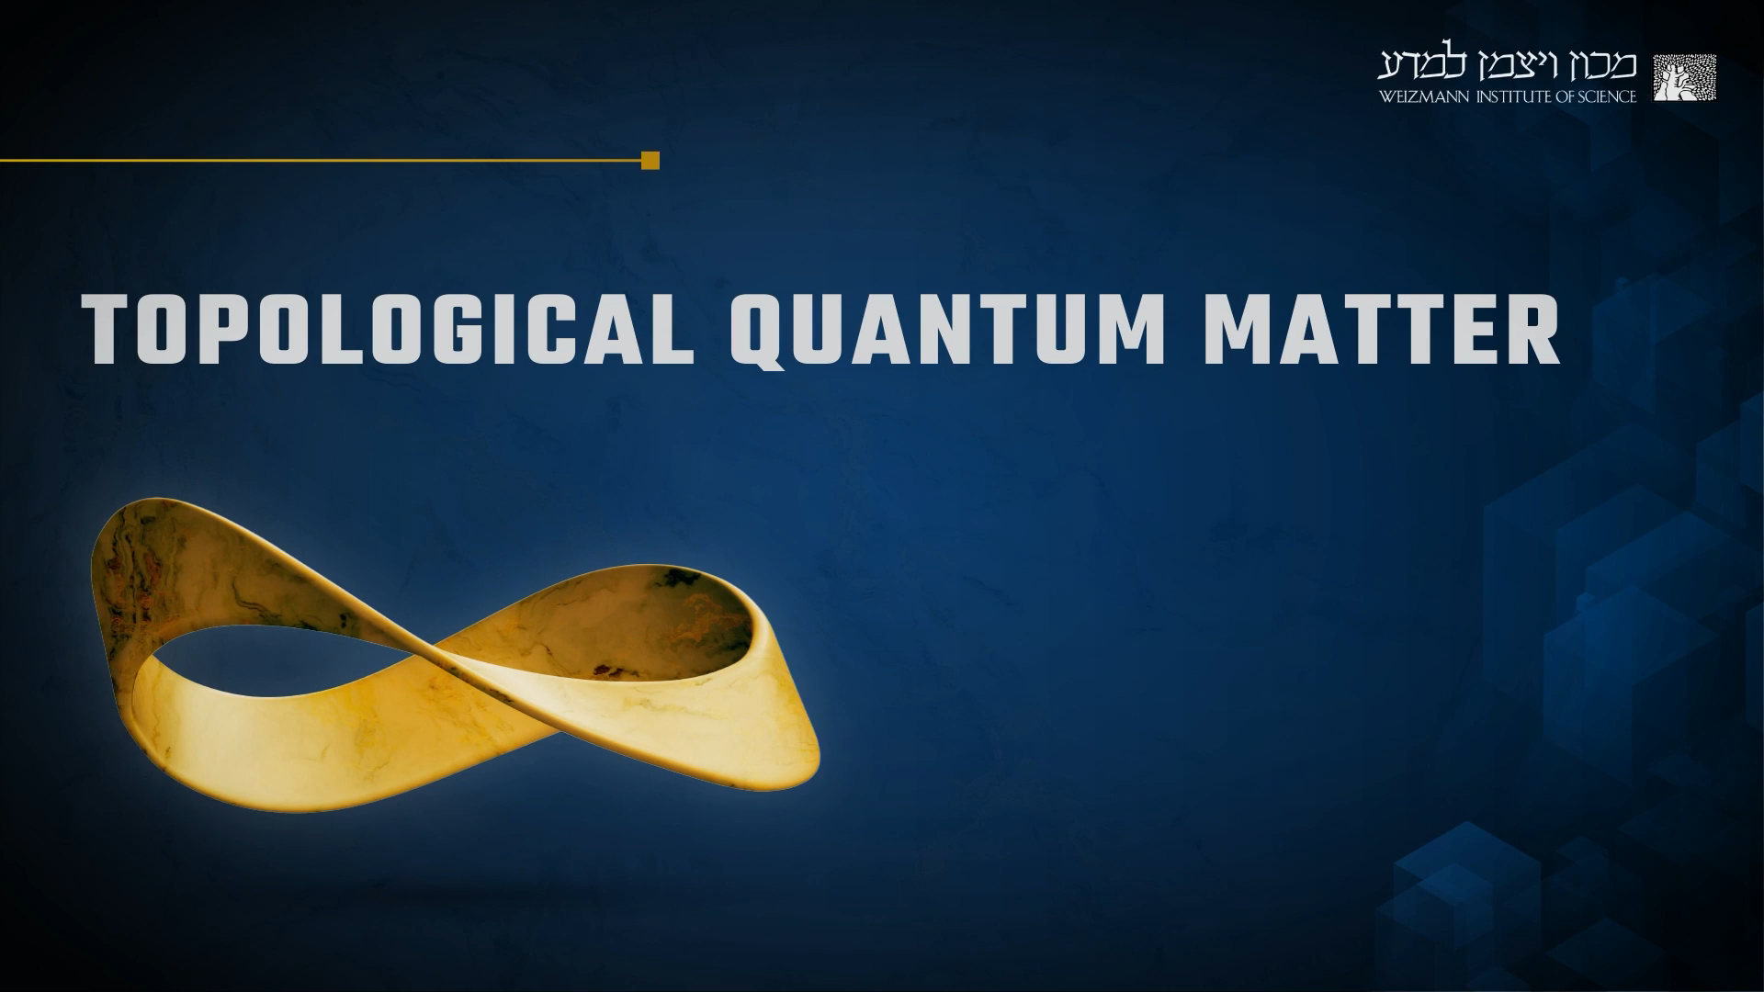
1. The Quantum Hall effect
2. Topological superconductivity
3. Topological universe on a graphene sheet
4. Topological insulators
5. Topological classification
6. Gapless topological phases
7. Material prediction
8. States of topological Order
9. Experimental tools
On EDX, CampusIL & Youtube tqm.course@Weizmann.ac.il
Search for Topological quantum matter Weizmann online

Slide 5
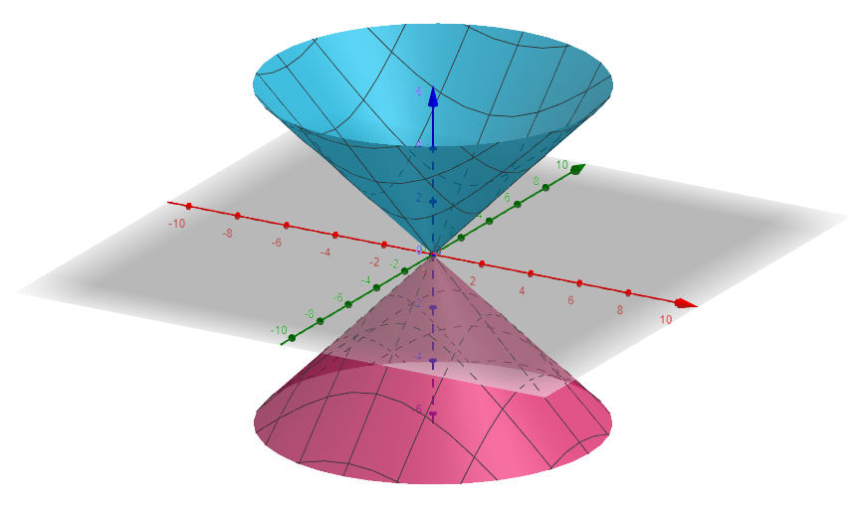
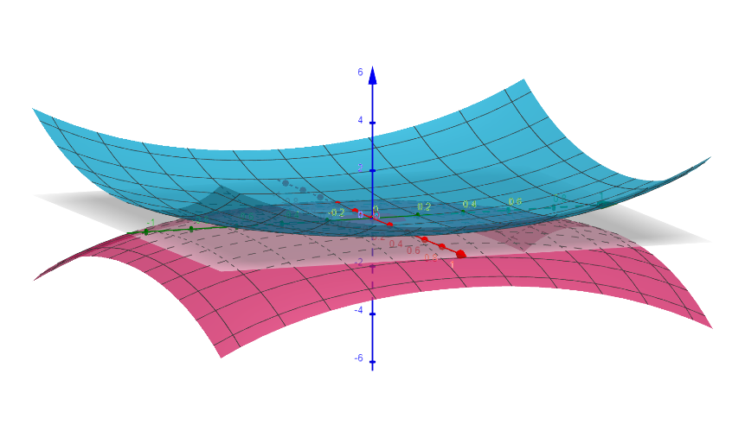
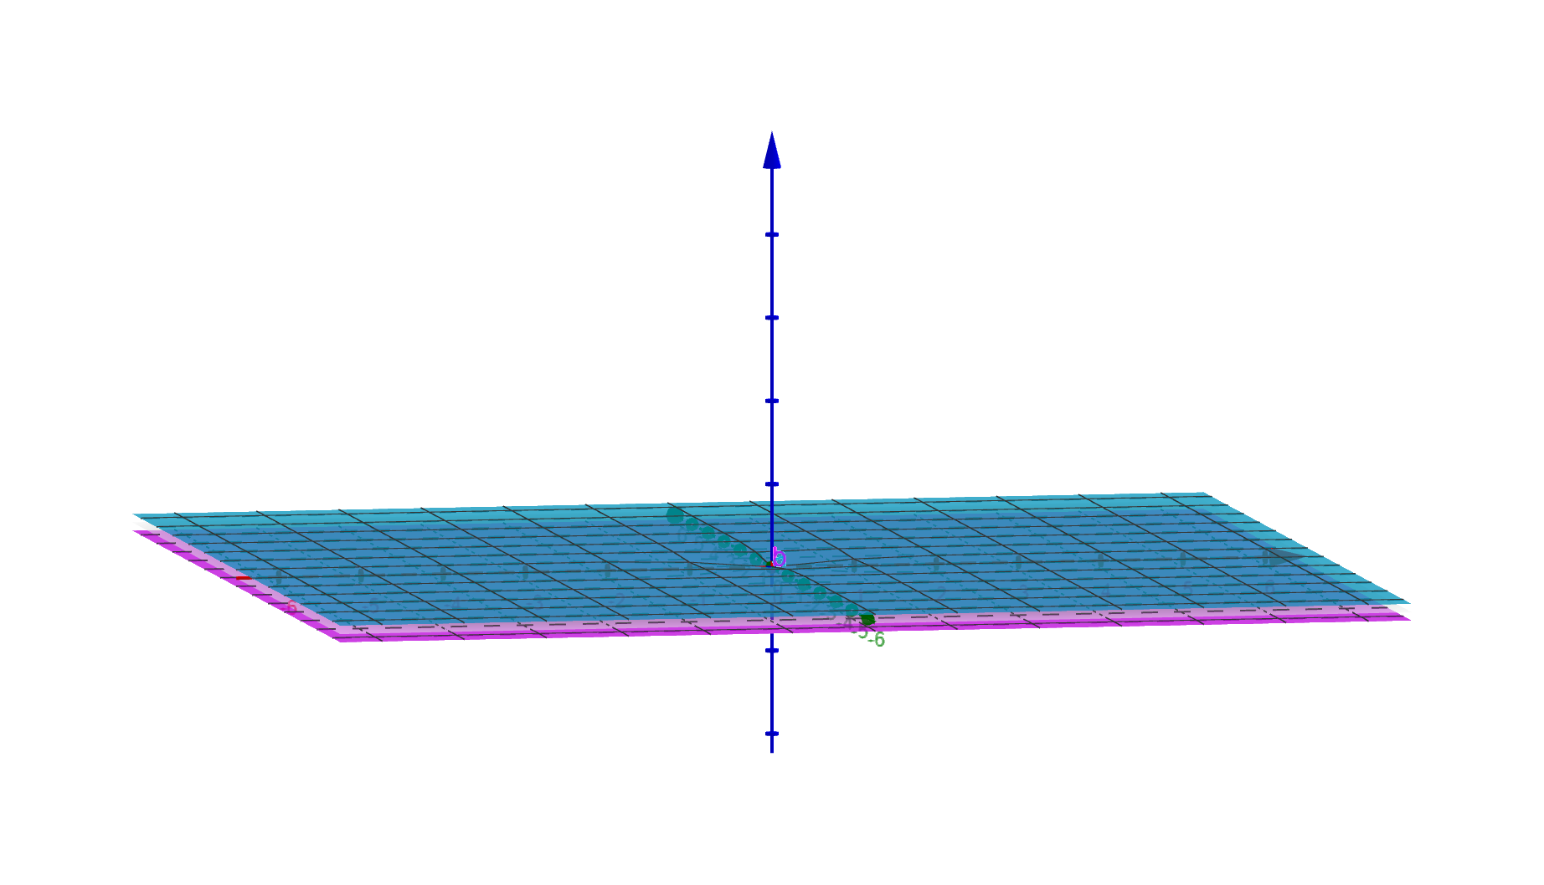
The problem:
Start with a Dirac cone
Add a perturbation
Get a flat Dirac cone
(Bistrizer Macdonald,2011)
Get a flat band
    (Tarnopolsky et al, 2019)

Slide 6
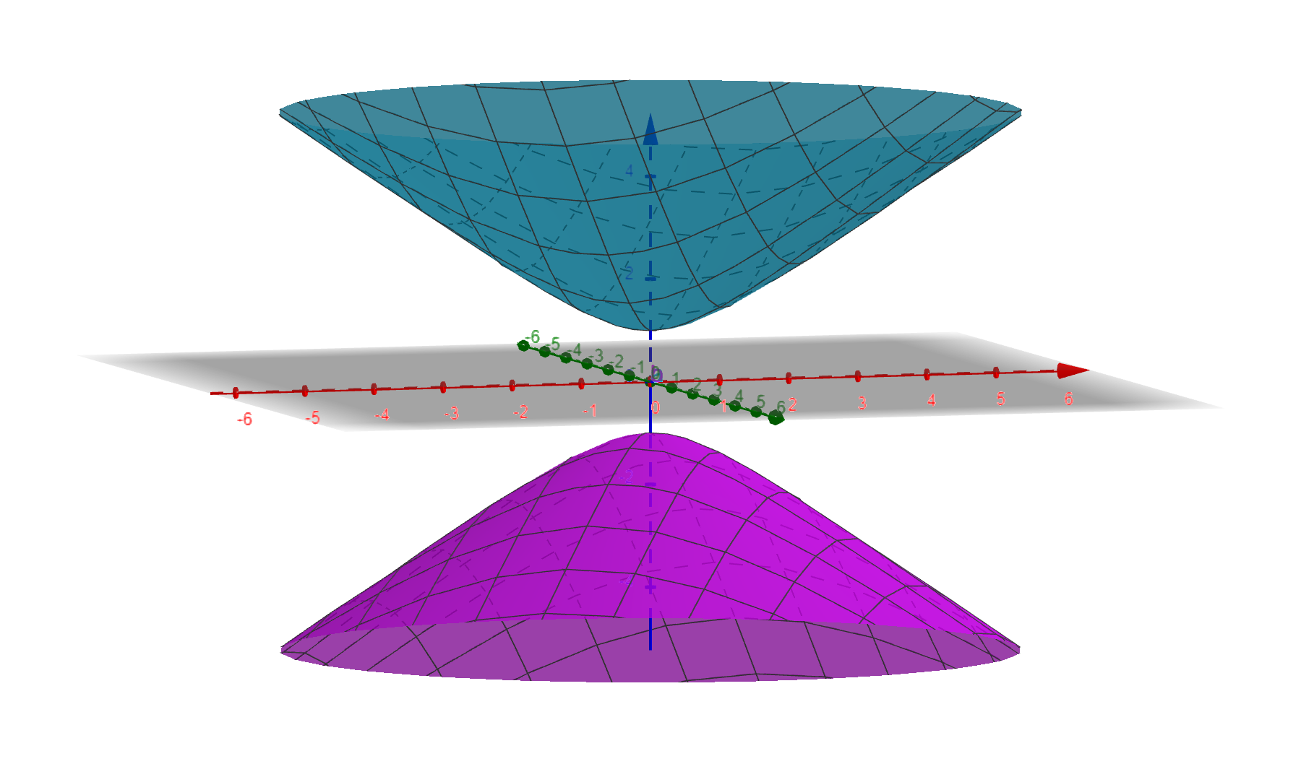
The problem:
Start with a Dirac cone
Add a perturbation
Get a symmetric gapped spectrum

Slide 7
Flattening the Dirac velocity

Slide 8
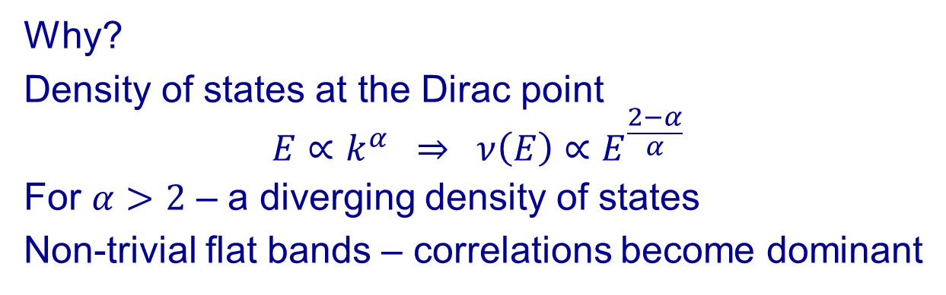
Why?
Density of states at the Dirac point
$$E∝k^{α} ⇒ ν\left(E\right)∝E^{\frac{2−α}{α}}$$
For $α>2$ – a diverging density of states
Non-trivial flat bands – correlations become dominant

Slide 9
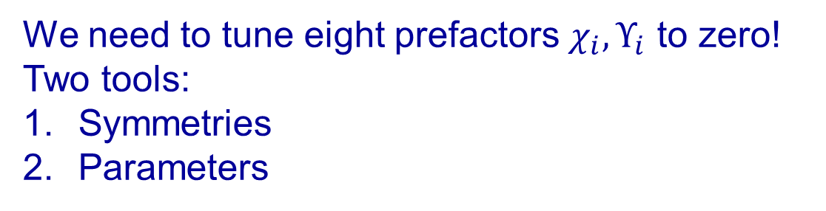
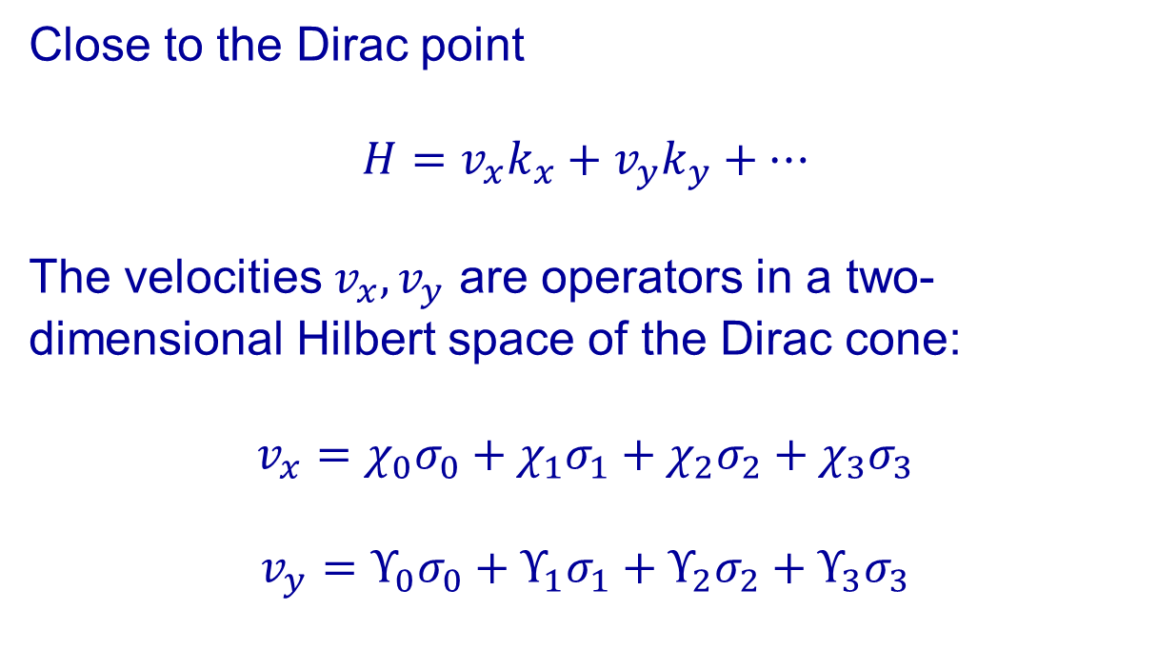
Close to the Dirac point
$$H=v_{x}k_{x}+v_{y}k_{y}+…$$
The velocities $v_{x},v_{y}$ are operators in a two-dimensional Hilbert space of the Dirac cone:
$$v_{x}=χ_{0}σ_{0}+χ_{1}σ_{1}+χ_{2}σ_{2}+χ_{3}σ_{3}$$
$$v_{y}=Υ_{0}σ_{0}+Υ_{1}σ_{1}+Υ_{2}σ_{2}+Υ_{3}σ_{3}$$
We need to tune eight prefactors $χ_{i},Υ_{i}$ to zero!
Two tools:
Symmetries
Parameters

Slide 10
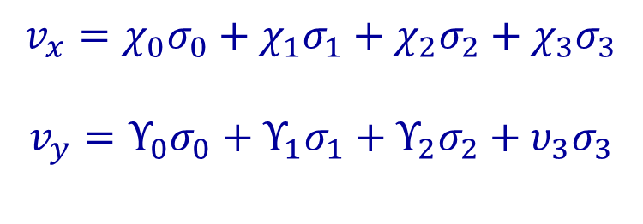
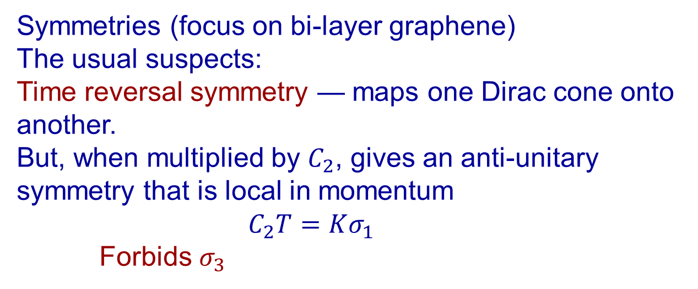
Symmetries (focus on bi-layer graphene)
The usual suspects:
Time reversal symmetry — maps one Dirac cone onto another.
But, when multiplied by $C_{2}$, gives an anti-unitary symmetry that is local in momentum
    $$C_{2}T=Kσ_{1}$$
    Forbids $σ_{3}$
$$v_{x}=χ_{0}σ_{0}+χ_{1}σ_{1}+χ_{2}σ_{2}+χ_{3}σ_{3}$$
$$v_{y}=Υ_{0}σ_{0}+Υ_{1}σ_{1}+Υ_{2}σ_{2}+υ_{3}σ_{3}$$

Slide 11
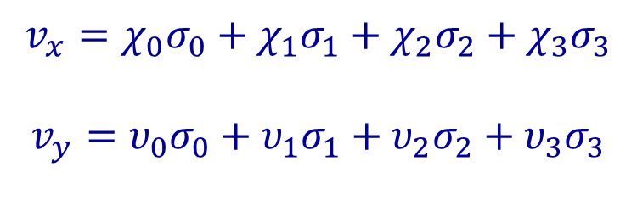
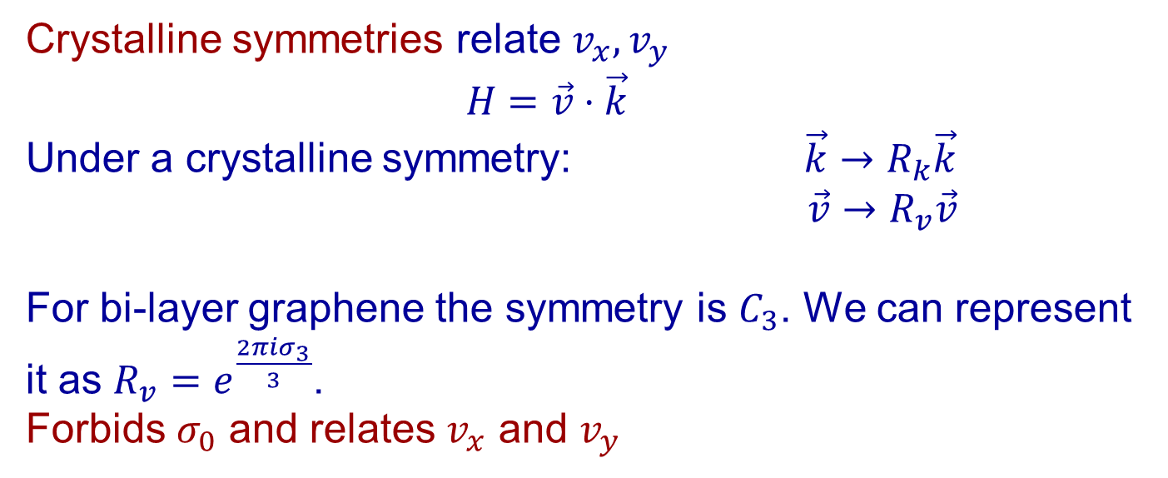
Symmetries (focus on bi-layer graphene)
$$v_{x}=χ_{0}σ_{0}+χ_{1}σ_{1}+χ_{2}σ_{2}+χ_{3}σ_{3}$$
$$v_{y}=υ_{0}σ_{0}+υ_{1}σ_{1}+υ_{2}σ_{2}+υ_{3}σ_{3}$$
Crystalline symmetries relate $v_{x},v_{y}$
$H=\vec{v}⋅\vec{k}$
Under a crystalline symmetry: $\vec{k}→R_{k}\vec{k}$
$\vec{v}→R_{v}\vec{v}$
For bi-layer graphene the symmetry is $C_{3}$. We can represent it as $R_{v}=e^{\frac{2πiσ_{3}}{3}}$.
Forbids $σ_{0}$ and relates $v_{x}$ and $v_{y}$

Slide 12
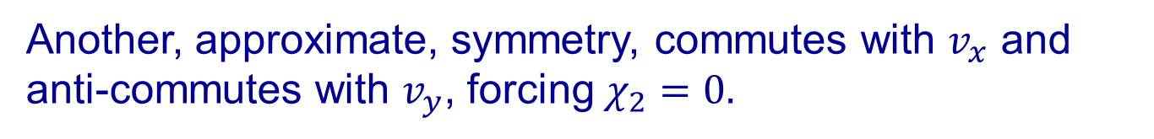

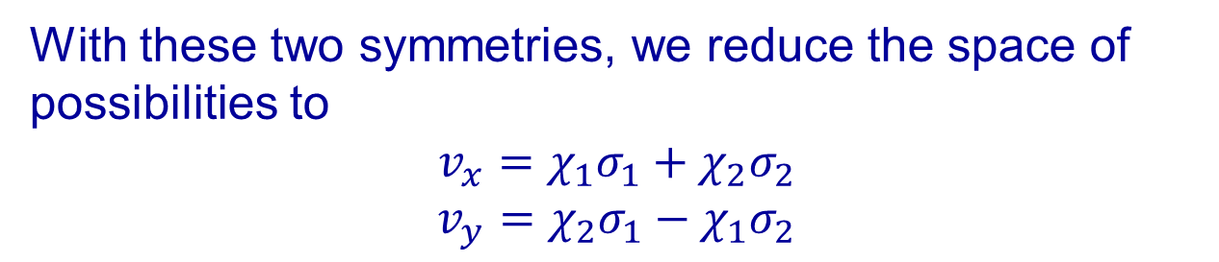



With these two symmetries, we reduce the space of possibilities to
$$v_{x}=χ_{1}σ_{1}+χ_{2}σ_{2}$$
$$v_{y}=χ_{2}σ_{1}−χ_{1}σ_{2}$$
The parameter(s) explore cuts in the plane of $χ_{1},χ_{2}$
$$χ_{1}$$
$$χ_{1}$$
$$χ_{2}$$
$$χ_{2}$$
Another, approximate, symmetry, commutes with $v_{x}$ and anti-commutes with $v_{y}$, forcing$χ_{2}=0.$

Slide 14
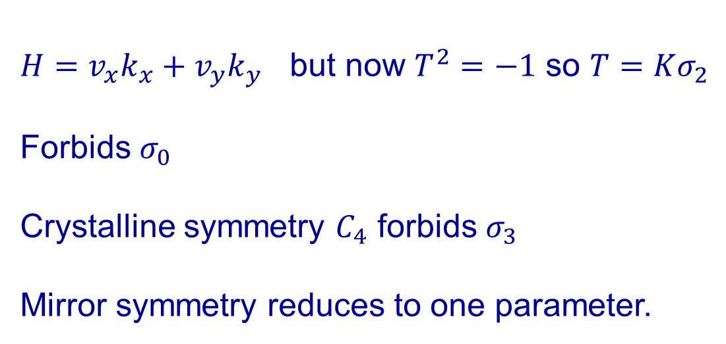
A Dirac cone on the surface of a 3D topological insulator
(Cano 2021)
Motivation – fully symmetric gapped surface state of a 3DTI – the T-Pfaffian
$H=v_{x}k_{x}+v_{y}k_{y}$ but now $T^{2}=−1$ so $T=Kσ_{2}$
Forbids $σ_{0}$
Crystalline symmetry $C_{4}$ forbids $σ_{3}$
Mirror symmetry reduces to one parameter.
Flattening the cone $H=v_{0}(σ_{1}k_{x}+σ_{2}k_{y})+U(r)$

Slide 15
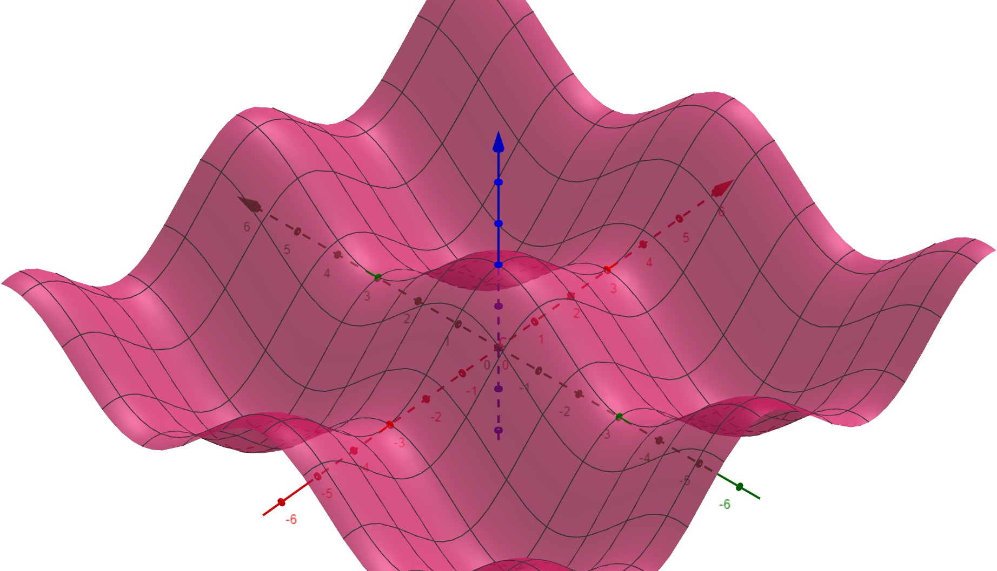
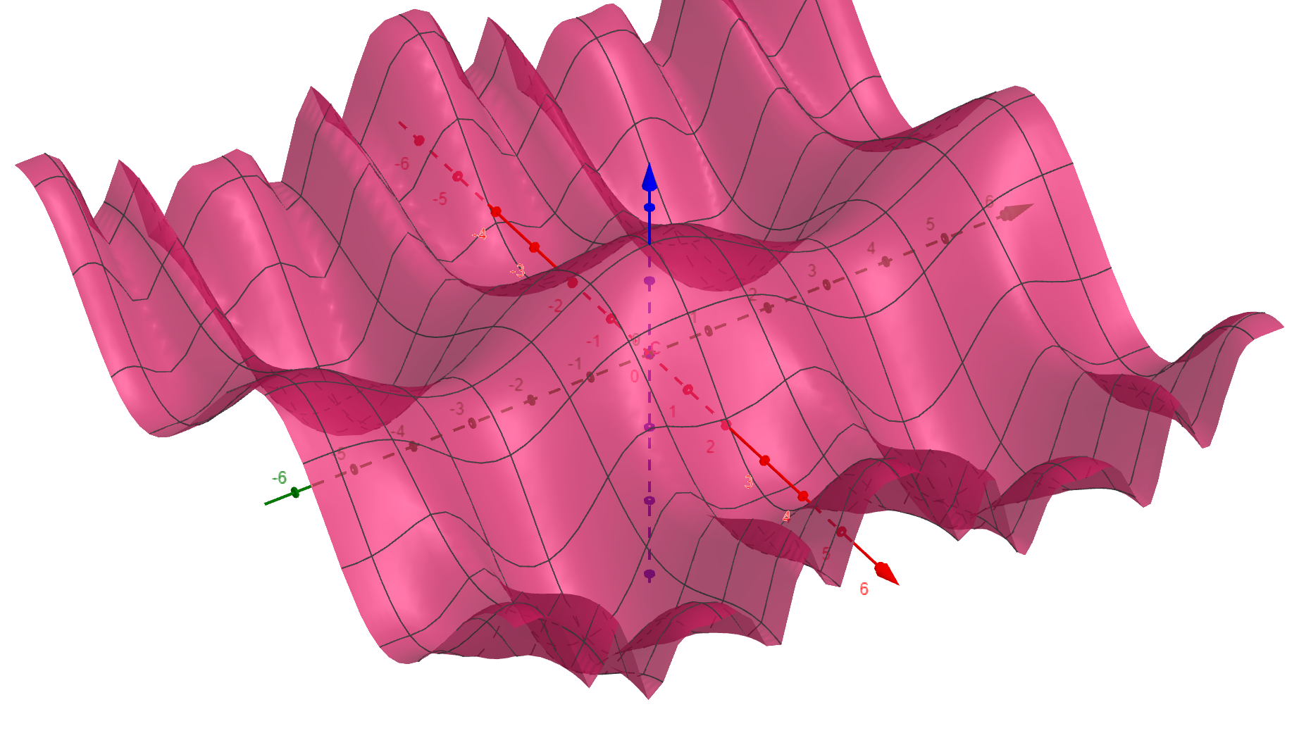
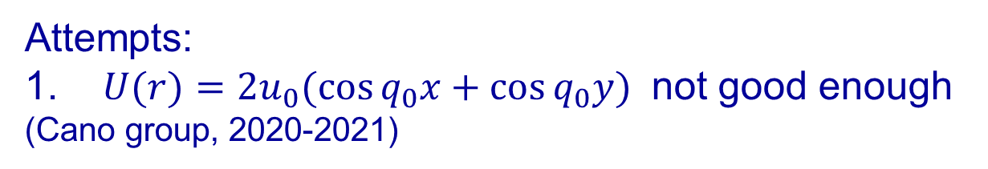
Attempts:
1. $U(r)={2u}_{0}(\cos{q_{0}x+\cos{q_{0}y}) }$ not good enough
(Cano group, 2020-2021)
2. Break $C_{4}$ to $C_{2}: U\left(r\right)=2(u_{x}\cos{q_{0}x+u_{y}\cos{q_{0}y}) }$
3. $U\left(r\right)={2u}_{1}(\cos{q_{0}x+\cos{q_{0}y})+{2u}_{2}\cos{q_{0}x\cos{q_{0}y}}}$

Slide 16
$C_{2}$-symmetric perturbation (Surface acoustic waves)

Slide 17
So far, A recipe for flattening a Dirac cone (eliminating the linear term in the dispersion) –
Identify the most general velocity operators consistent with the symmetries of the problem.
Introduce a perturbation to fine tune these operators to zero.

Slide 18
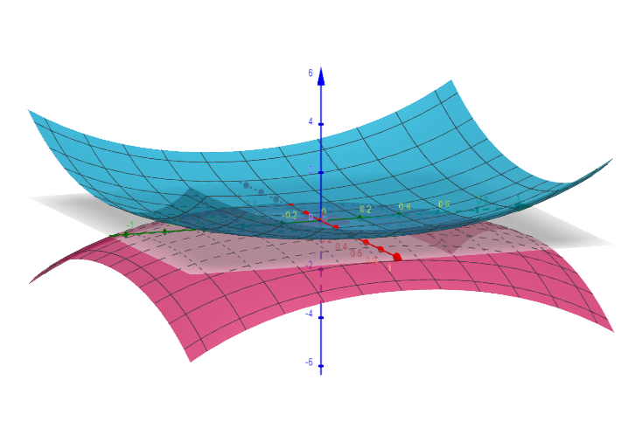
How do we get perfectly flat bands?

Slide 19
Three issues:
What symmetry classes allow for perfectly flat bands?
Adding a perpendicular magnetic field
A new model for fine tuned perfectly flat bands

Slide 20
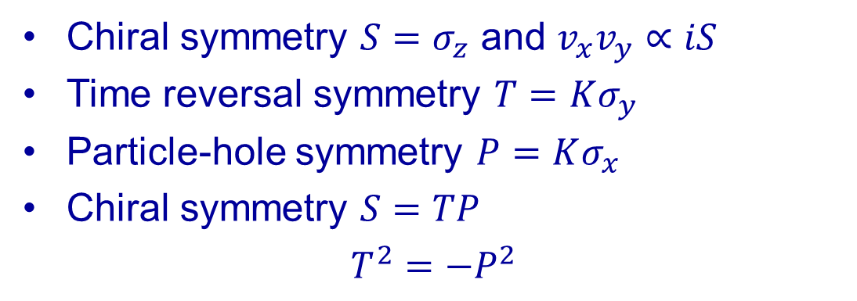
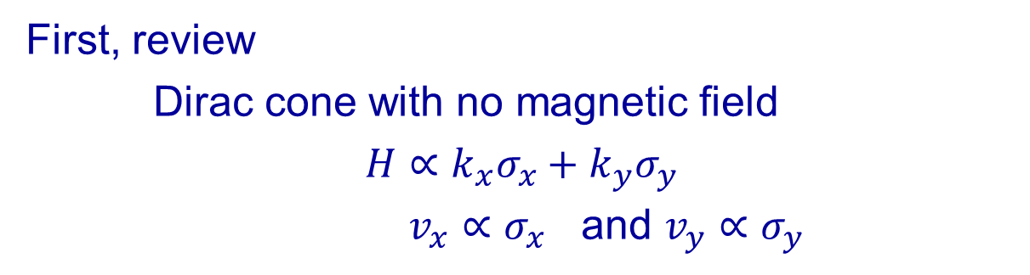
Symmetry classes allowing perfectly flat bands
Known flat bands, very different from one another:
Atomic insulators
2. Landau levels (in particular, of Dirac electrons)
First, review
Dirac cone with no magnetic field
$$H∝k_{x}σ_{x}+k_{y}σ_{y}$$
$v_{x}∝σ_{x}$ and $v_{y}∝σ_{y}$
Chiral symmetry $S=σ_{z}$ and $v_{x}v_{y}∝iS$
Time reversal symmetry $T=Kσ_{y}$
Particle-hole symmetry $P=Kσ_{x}$
Chiral symmetry $S=TP$
$$T^{2}=−P^{2}$$

Slide 21
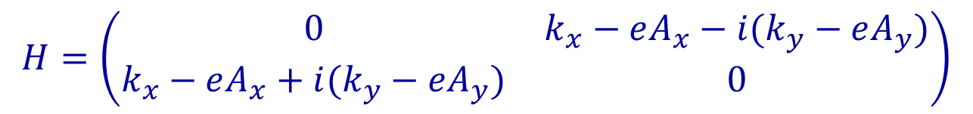
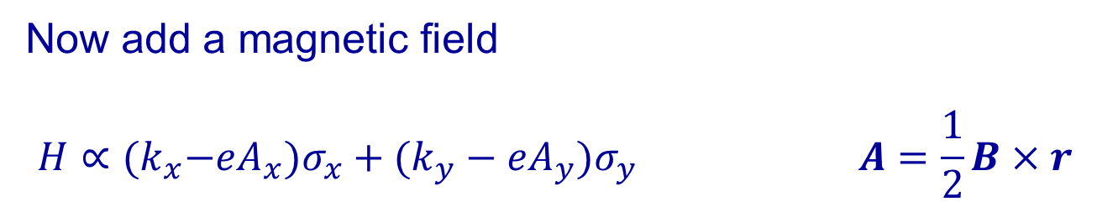
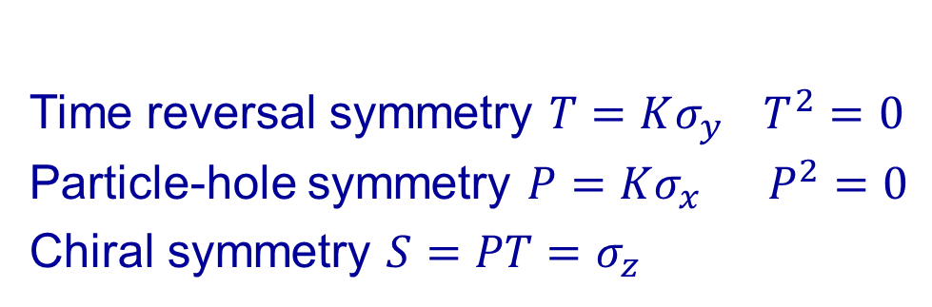
Now add a magnetic field
$$H∝{(k}_{x}−eA_{x})σ_{x}+(k_{y}−eA_{y})σ_{y} A=\frac{1}{2}B×r$$
$$H=\left(\begin{matrix}0 & k_{x}−eA_{x}−i(k_{y}−eA_{y}) \\ k_{x}−eA_{x}+i(k_{y}−eA_{y}) & 0\end{matrix}\right)$$
Time reversal symmetry $T=Kσ_{y}$ $T^{2}=0$
Particle-hole symmetry $P=Kσ_{x}$ $P^{2}=0$
Chiral symmetry $S=PT=σ_{z}$

Slide 22

For a uniform magnetic field
$$H=\left(∂_{\overline{z}}+\frac{z}{2ℓ_{B}^{2}}\right)σ_{+}+h.c.$$
$$\left(∂_{\overline{z}}+\frac{z}{2ℓ_{B}^{2}}\right)ψ=0$$
$$ψ=f\left(z\right) e^{−\frac{{\left|z\right|}^{2}}{4ℓ_{B}^{2}}} |σ_{z}=−1〉$$

Slide 23
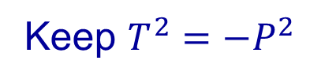
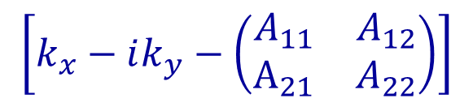

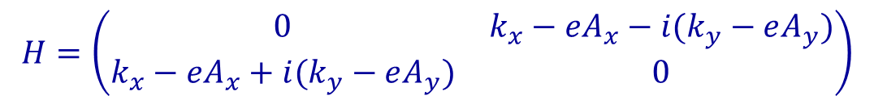
Combining the Landau level spirit with time reversal symmetry requires a larger Hamiltonian
(bi-layer graphene, two coupled 3DTIs)
$$H=\left(\begin{matrix}0 & k_{x}−eA_{x}−i(k_{y}−eA_{y}) \\ k_{x}−eA_{x}+i(k_{y}−eA_{y}) & 0\end{matrix}\right)$$
$k_{x}−eA_{x}−i\left(k_{y}−eA_{y}\right) ⟹$
$$\left[k_{x}−ik_{y}−\left(\begin{matrix}A_{11} & A_{12} \\ A_{21} & A_{22}\end{matrix}\right)\right]$$
Non-abelian gauge field
Keep $T^{2}=−P^{2}$
larger number of bands (Ledwith et al. 2022)

Slide 24
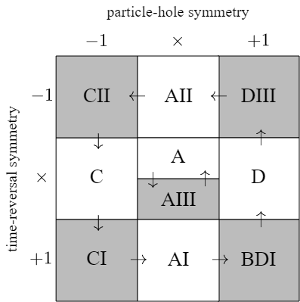
As it turns out, only $CI$ and $AIII$ allow for solutions.

Slide 25
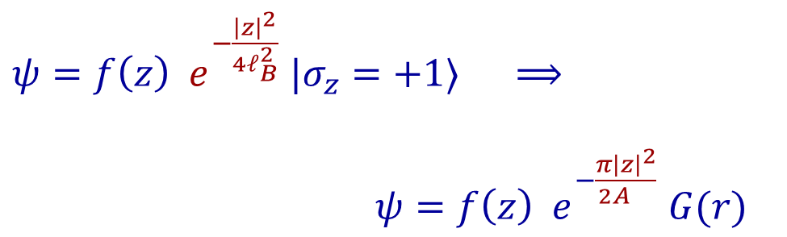
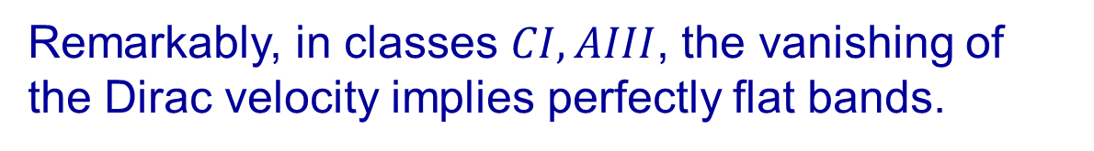
Remarkably, in classes $CI, AIII$, the vanishing of the Dirac velocity implies perfectly flat bands.
$ψ=f\left(z\right) e^{−\frac{{\left|z\right|}^{2}}{4ℓ_{B}^{2}}} |σ_{z}=+1〉$ $⟹$
$ψ=f\left(z\right) e^{−\frac{π{\left|z\right|}^{2}}{2A_{}}} G(r)$
Like a Landau level with one flux quantum per unit cell
Two Chern bands of opposite Chern numbers

Slide 26

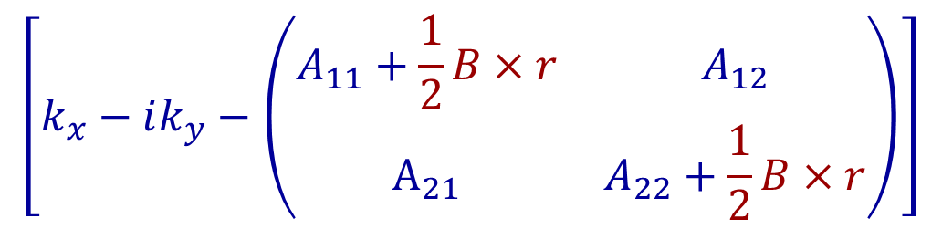
Adding a magnetic field
$$\left[k_{x}−ik_{y}−\left(\begin{matrix}A_{11}+\frac{1}{2}B×r & A_{12} \\ A_{21} & A_{22}+\frac{1}{2}B×r\end{matrix}\right)\right]$$
Only modifies the Gaussian decay
The bands do NOT acquire a width.
The effective magnetic field (and the number of states) grows for one Chern band and shrinks for the other.
$$B_{1}=\frac{Φ_{0}}{A^{2}}+B$$
$$B_{2}=\frac{Φ_{0}}{A^{2}}−B$$

Slide 27
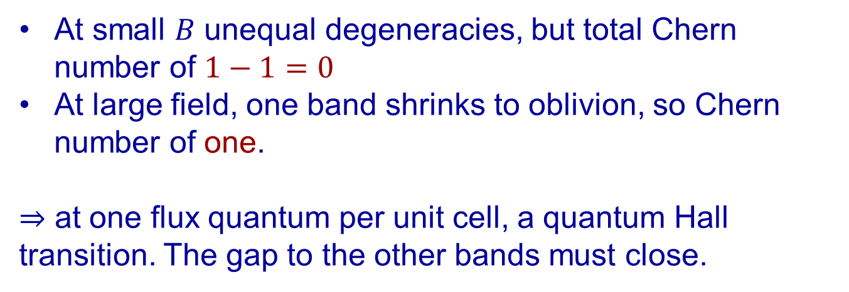
At small $B$ unequal degeneracies, but total Chern number of $1−1=0$
At large field, one band shrinks to oblivion, so Chern number of one.
$⇒$ at one flux quantum per unit cell, a quantum Hall transition. The gap to the other bands must close.

Slide 28
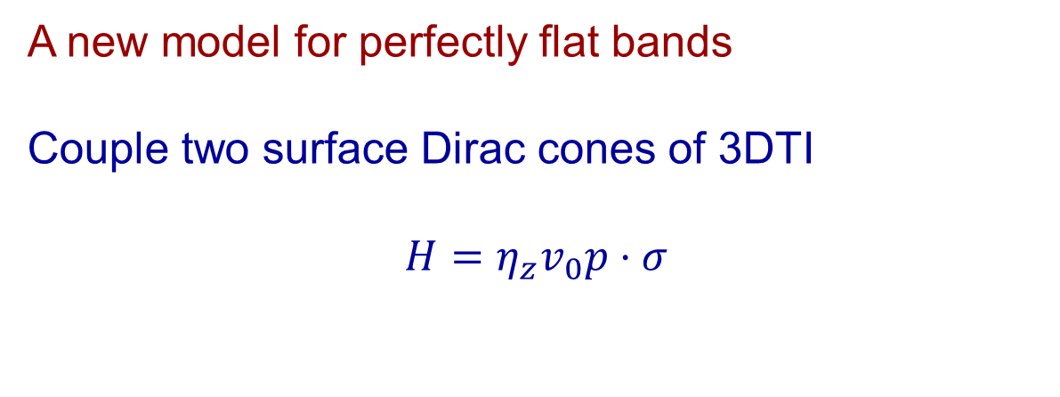
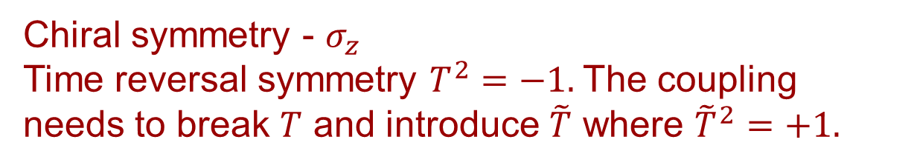
A new model for perfectly flat bands
Couple two surface Dirac cones of 3DTI
$$H=η_{z}v_{0}p⋅σ$$
Chiral symmetry - $σ_{z}$
Time reversal symmetry $T^{2}=−1.$The coupling needs to break $T$ and introduce $\tilde{T}$ where ${\tilde{T}}^{2}=+1.$
$$H_{tun}={ (η}_{+}e^{iA_{z}(r)}+η_{−}e^{−iA_{z}(r)}) u\left(r\right)⋅σ$$
Parallel magnetic field
Spin-dependent tunneling

Slide 29
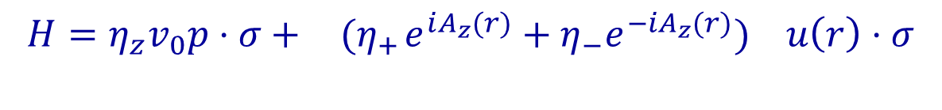
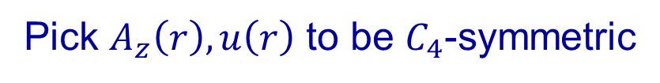
$$H=η_{z}v_{0}p⋅σ+{ (η}_{+}e^{iA_{z}(r)}+η_{−}e^{−iA_{z}(r)}) u\left(r\right)⋅σ$$
The effective time reversal is $\tilde{T}=TR_{z}=Kη_{x}σ_{x}$
Pick $A_{z}\left(r\right), u\left(r\right)$ to be $C_{4}$-symmetric

Slide 30
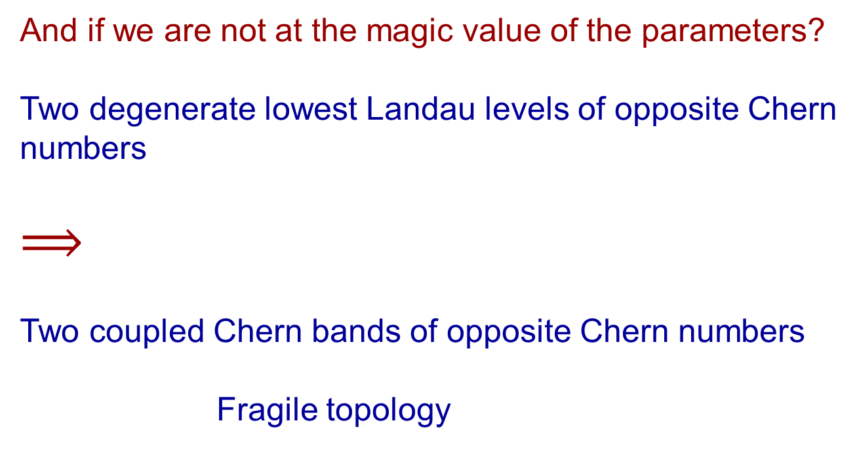
And if we are not at the magic value of the parameters?
Two degenerate lowest Landau levels of opposite Chern numbers
$$⟹$$
Two coupled Chern bands of opposite Chern numbers
Fragile topology
Can they be gapped without breaking any symmetry?

Slide 31


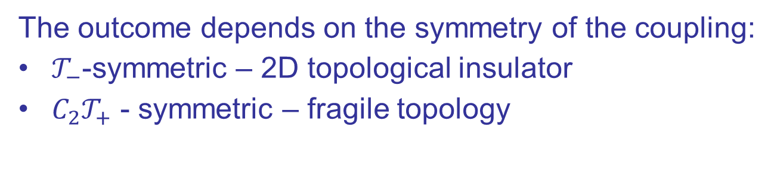


Coupling two Chern bands with opposite Chern numbers
Take two pairs of Chern bands:
$$C=−1$$
$$C=+1$$
$$C=+1$$
$$C=−1$$
The outcome depends on the symmetry of the coupling:
$𝒯_{−}$-symmetric – 2D topological insulator
$C_{2}𝒯_{+}$ - symmetric – fragile topology

Slide 32
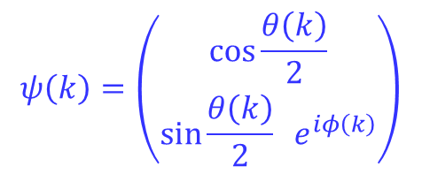
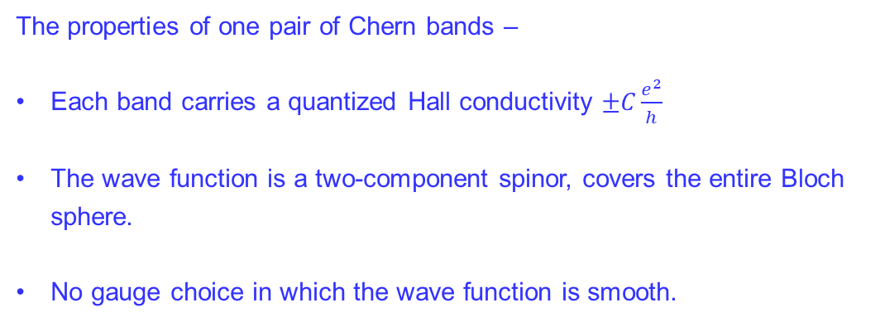
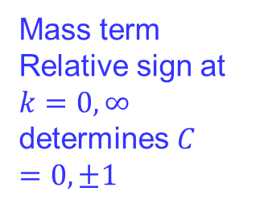
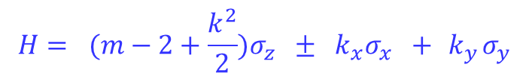
The properties of one pair of Chern bands –
Each band carries a quantized Hall conductivity $±C\frac{e^{2}}{h}$
The wave function is a two-component spinor, covers the entire Bloch sphere.
No gauge choice in which the wave function is smooth.
$$H=(m−\cos{k_{x}−\cos{k_{y}})σ_{z} ± \sin{k_{x}σ_{x} +\sin{k_{y}σ_{y}}}}$$
The essence may be seen close to the $Γ$-point.
$$H= (m−2+\frac{k^{2}}{2}{)σ_{z} ± k_{x}σ_{x} +{ k}_{y}σ_{y}}$$
Mass term
Relative sign at $k=0,∞$ determines $C=0,±1$
Dirac point
The relative sign determines the sign of the Chern number
$$ψ\left(k\right)=\left(\begin{matrix}\cos{\frac{θ\left(k\right)}{2}} \\ \sin{\frac{θ\left(k\right)}{2}} e^{iφ\left(k\right)}\end{matrix}\right)$$

Slide 33
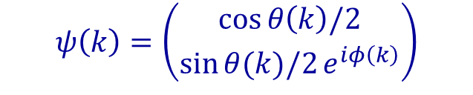
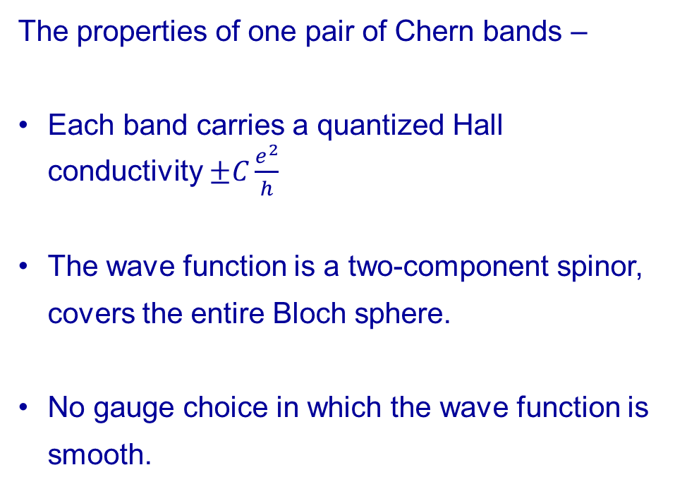
The properties of one pair of Chern bands –
Each band carries a quantized Hall conductivity $±C\frac{e^{2}}{h}$
The wave function is a two-component spinor, covers the entire Bloch sphere.
No gauge choice in which the wave function is smooth.
$$ψ\left(k\right)=\left(\begin{matrix}\cos{θ\left(k\right)/2} \\ \sin{θ(k)/2}e^{iφ\left(k\right)}\end{matrix}\right)$$
Now – couple the two filled bands, keeping $C_{2}𝒯_{+}$symmetry

Slide 34
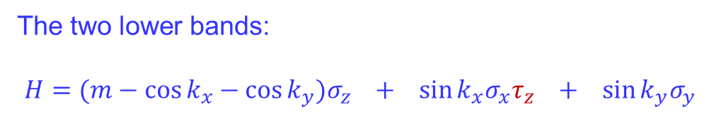
The two lower bands:
$$H=(m−\cos{k_{x}−\cos{k_{y}})σ_{z} + \sin{k_{x}σ_{x}τ_{z} +\sin{k_{y}σ_{y}}}}$$
The properties of two coupled Chern bands of opposite Chern number
No quantized Hall conductivity.
No total “vorticity” of the wave function
The outcome depends on the symmetries obeyed by the coupling
If the coupling satisfies time reversal symmetry $𝒯_{−}$ , we get a 2D topological insulator

Slide 35
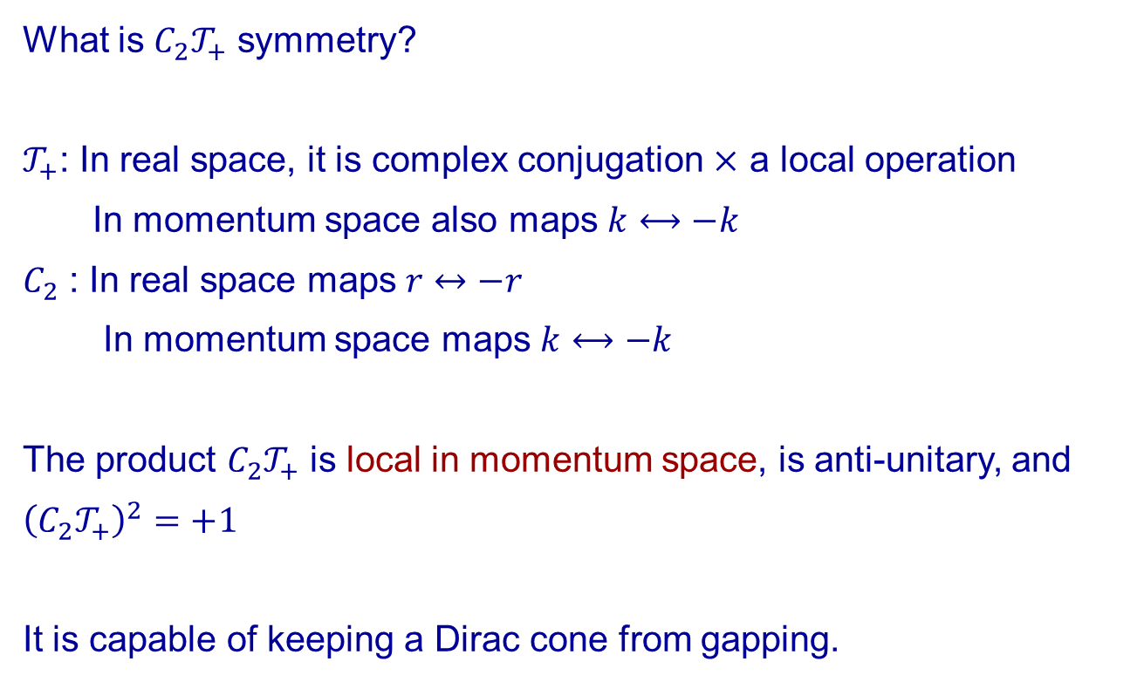
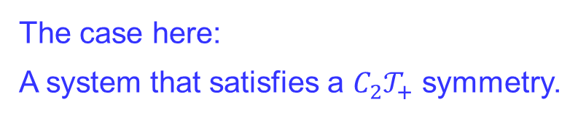
The case here:
A system that satisfies a $C_{2}𝒯_{+}$ symmetry.
What is $C_{2}𝒯_{+}$ symmetry?
$𝒯_{+}$: In real space, it is complex conjugation $×$ a local operation
In momentum space also maps $k⟷−k$
$C_{2}$ : In real space maps $r↔−r$
In momentum space maps $k⟷−k$
The product $C_{2}𝒯_{+}$ is local in momentum space, is anti-unitary, and ${\left(C_{2}𝒯_{+}\right)}^{2}=+1$
It is capable of keeping a Dirac cone from gapping.

Slide 36
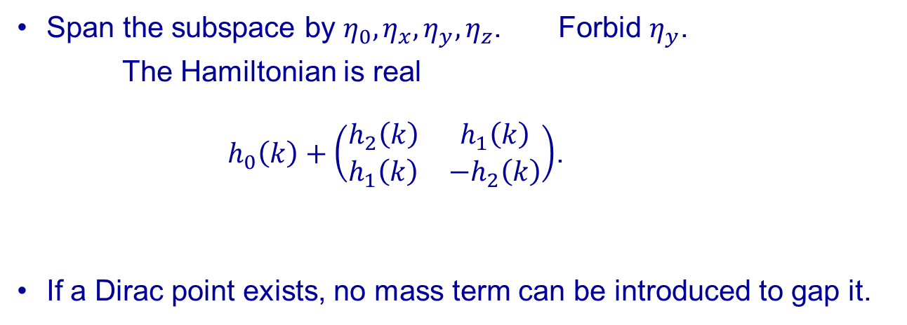
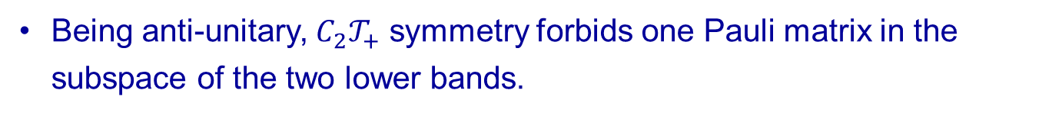
Being anti-unitary, $C_{2}𝒯_{+}$ symmetry forbids one Pauli matrix in the subspace of the two lower bands.
Span the subspace by $η_{0},η_{x},η_{y},η_{z}$. Forbid $η_{y}$.
The Hamiltonian is real
$h_{0}\left(k\right)+\left(\begin{matrix}h_{2}\left(k\right) & h_{1}\left(k\right) \\ h_{1}\left(k\right) & −h_{2}\left(k\right)\end{matrix}\right)$.
If a Dirac point exists, no mass term can be introduced to gap it.

Slide 37


$h_{0}\left(k\right)+\left(\begin{matrix}h_{2}\left(k\right) & h_{1}\left(k\right) \\ h_{1}\left(k\right) & −h_{2}\left(k\right)\end{matrix}\right)$.
Winding points of the $\left(h_{1}\left(k\right),h_{2}(k)\right)$ vector around a point $k_{0}$ - may originate from two sources:
    $h\left(k_{0}\right)=0$ – Dirac point
    Singularity in the basis vectors of the two lower bands.
$⟹$ When the pair of bands carries opposite Chern numbers, Dirac points are unavoidable. May be moved around, may be merged to a quadratic band touching.

Slide 38

The two Dirac cones may be merged, but not gapped.
We consider them merged to a quadratic band touching.

Slide 39




How can the Dirac points be gapped:
Breaking of $C_{2}𝒯_{+}$ - allows for a mass term
Adding a third band (even if trivial !)
$$H=\left(\begin{matrix}\frac{k^{2}}{2m_{1}}cos{2φ} & \frac{k^{2}}{2m_{1}}sin{2φ} & 0 \\ \frac{k^{2}}{2m_{1}}sin{2φ} & −\frac{k^{2}}{2m_{1}}cos{2φ} & 0 \\ 0 & 0 & ε_{0}+k^{2}/m\end{matrix}\right)$$
$$H=\left(\begin{matrix}\frac{k^{2}}{2m_{1}}cos{2φ} & \frac{k^{2}}{2m_{1}}sin{2φ} & \operatorname{kcos}{φ} \\ \frac{k^{2}}{2m_{1}}sin{2φ} & −\frac{k^{2}}{2m_{1}}cos{2φ} & \operatorname{ksin}{φ} \\ k\cos{φ} & k\sin{φ} & ε_{0}+k^{2}/m\end{matrix}\right)$$

Slide 40
And now turn interactions on

Slide 41

The rules of the game:
We are allowed to:
Change the band structure at the non-interacting level, keeping all symmetries.
Introduce all interactions we need, avoiding spontaneous symmetry breaking.
We need interactions to
form a new band of low-momentum fermions all constructed from our available two bands
To make these new fermions interact with the electrons close to the $Γ$ point, and gap them.

Slide 42

A source of inspiration – bound states in semi-conductors
Excitons – one electron + one hole, bosonic, not what we want
Trions – 2 electrons + one hole
$$ε_{ex}=ε_{e}+ε_{h}−ε_{b}$$
Change the band structure to:
Two electron pockets
One hole pocket

Slide 43




The trion forming interaction
$$−u\sum_{i=1,2}{∫dr ψ_{h}^{+}\left(r\right)ψ_{h}\left(r\right)ψ_{e,i}^{+}\left(r\right)ψ_{e,i}\left(r\right)}$$
Trion energy $2ε_{e}+ε_{h}−2ε_{b}$
We need the trion energy to be negative, and the exciton energy to be positive, so
$$ε_{e}+\frac{1}{2}ε_{h}<ε_{b}<ε_{e}+ε_{h}$$
Need a threshold level of interaction

Slide 44


Coupling the trions to the electrons
$$H=\left(\begin{matrix}\frac{k^{2}}{2m_{1}}cos{2φ} & \frac{k^{2}}{2m_{1}}sin{2φ} & \cos{φ} \\ \frac{k^{2}}{2m_{1}}sin{2φ} & −\frac{k^{2}}{2m_{1}}cos{2φ} & \sin{φ} \\ \cos{φ} & \sin{φ} & ε_{0}+k^{2}/m\end{matrix}\right)$$

Slide 45


Twisted bi-layer graphene
Our gapping procedure
At the single particle level:
Merge the two Dirac cones to a quadratic band touching
Deform the band to have two electrons and one hole valleys
At the interaction level:
Form a trion band
Couple the trion band to the electrons
For a twisted bi-layer graphene, the Dirac points are pinned by $C_{3}$ symmetry

Slide 46


Nucleating pairs of Dirac cones of opposite chiralities at the $M$- points allow for turning the $K,K′$ points into quadratic touching points at the cost of introducing quadratic touching points at $M.$

Slide 47

Summary
The combination of symmetries and fine tuning of parameters opens the way for flattening of Dirac bands.
A way to analyze the role of the symmetries.
Perfectly flat bands may be created by in classes $CI$ and $AIII.$ A recipe for creating them.
Fragile topology lives up to its name – a pair of fragile bands may be gapped by interactions.
Put differently, a featureless insulator may be constructed in a half filled pair of fragile bands.

