Slide 1
ハドロン・クォーククロスオーバーの量子シミュレーションの提案
2021年12月7-10日, 基研研究会「核力に基づいた原子核の構造と反応」
HT, S. Tsutsui, T. M. Doi, and K. Iida, arXiv:2012. 037627
HT, S. Tsutsui, T. M. Doi, and K. Iida, Phys. Rev. A 104, 053328 (2021).
S. Akagami, HT, and K. Iida, Phys. Rev. A 104, L041302 (2021).
田島裕之
東大理, Liang研 (April, 2021~)
共同研究者
筒井翔一朗(理研), 土居孝寛(阪大RCNP), 赤神青空(高知大), 飯田圭(高知大)

Slide 2
Outline
Introduction
Formalism
Results
Summary

Slide 3
Outline
Introduction
Formalism
Results
Summary

Slide 4
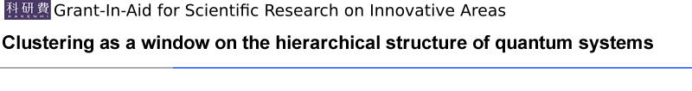
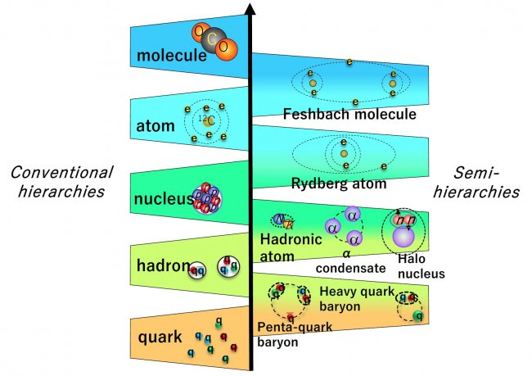
Hierarchical structure of quantum systems
What is the origin of clusters? ➡ Interaction
http://be.nucl.ap.titech.ac.jp/cluster/eng/Introduction.html

Slide 5
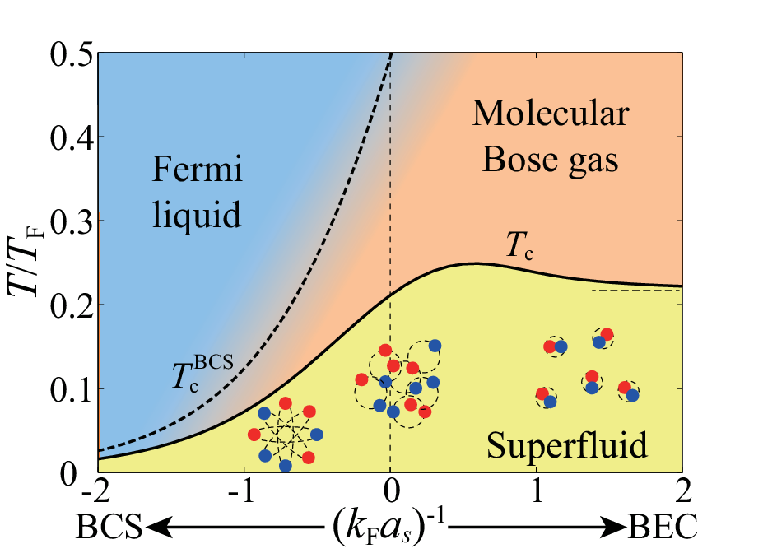
BCS-BEC crossover
Most fundamental case in quantum many-body systems:
Two-body clusters undergo a crossover from Cooper pairs to dimers
Quantum effect
Clustering
Cooper pair
(BCS state)
Dimer
(BEC at low T)
Fermi sea
Weak-coupling
Interaction strength
Strong-coupling
Review: Y. Ohashi, HT, and P. van Wyk, Prog. Part. Nucl. Phys. 111, 103739 (2020).

Slide 6
BCS-BEC crossover
Most fundamental case in quantum many-body systems:
Two-body clusters undergo a crossover from Cooper pairs to dimers
Review: Y. Ohashi, HT, and P. van Wyk, Prog. Part. Nucl. Phys. 111, 103739 (2020).

Slide 7
Why pairs or dimers?
The quantum cluster formation is related to the internal degrees of freedom and Pauli’s exclusion principle
e.g. Spin-1/2 fermions with s-wave interaction
“attraction”
“Pauli’s exclusion principle”
➡Cooper pair or dimer
“Trimer”
“Tetramer”

Slide 8
Why pairs or dimers?
The quantum cluster formation is related to the internal degrees of freedom and Pauli’s exclusion principle
e.g. Spin-1/2 fermions with s-wave interaction
“attraction”
“Pauli’s exclusion principle”
➡Cooper pair or dimer
Three-color fermions (e.g. quarks)
Fermi sea
“Trimer”
“Tetramer”
“Baryon”
“Cooper triple”

Slide 9
Three-body crossover?
BCS-BEC crossover (from Cooper pairs to dimers)
Novel Crossover from Cooper triples to trimers
Two-component Fermi gas
Increasing interaction
Three-component Fermi gas
Increasing interaction

Slide 10
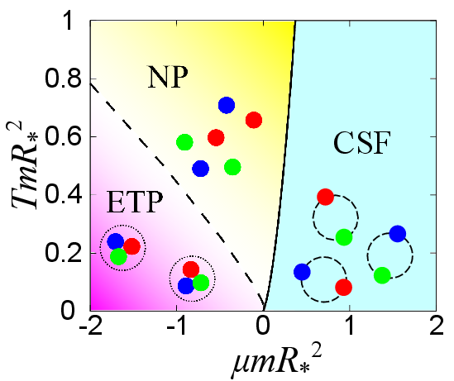
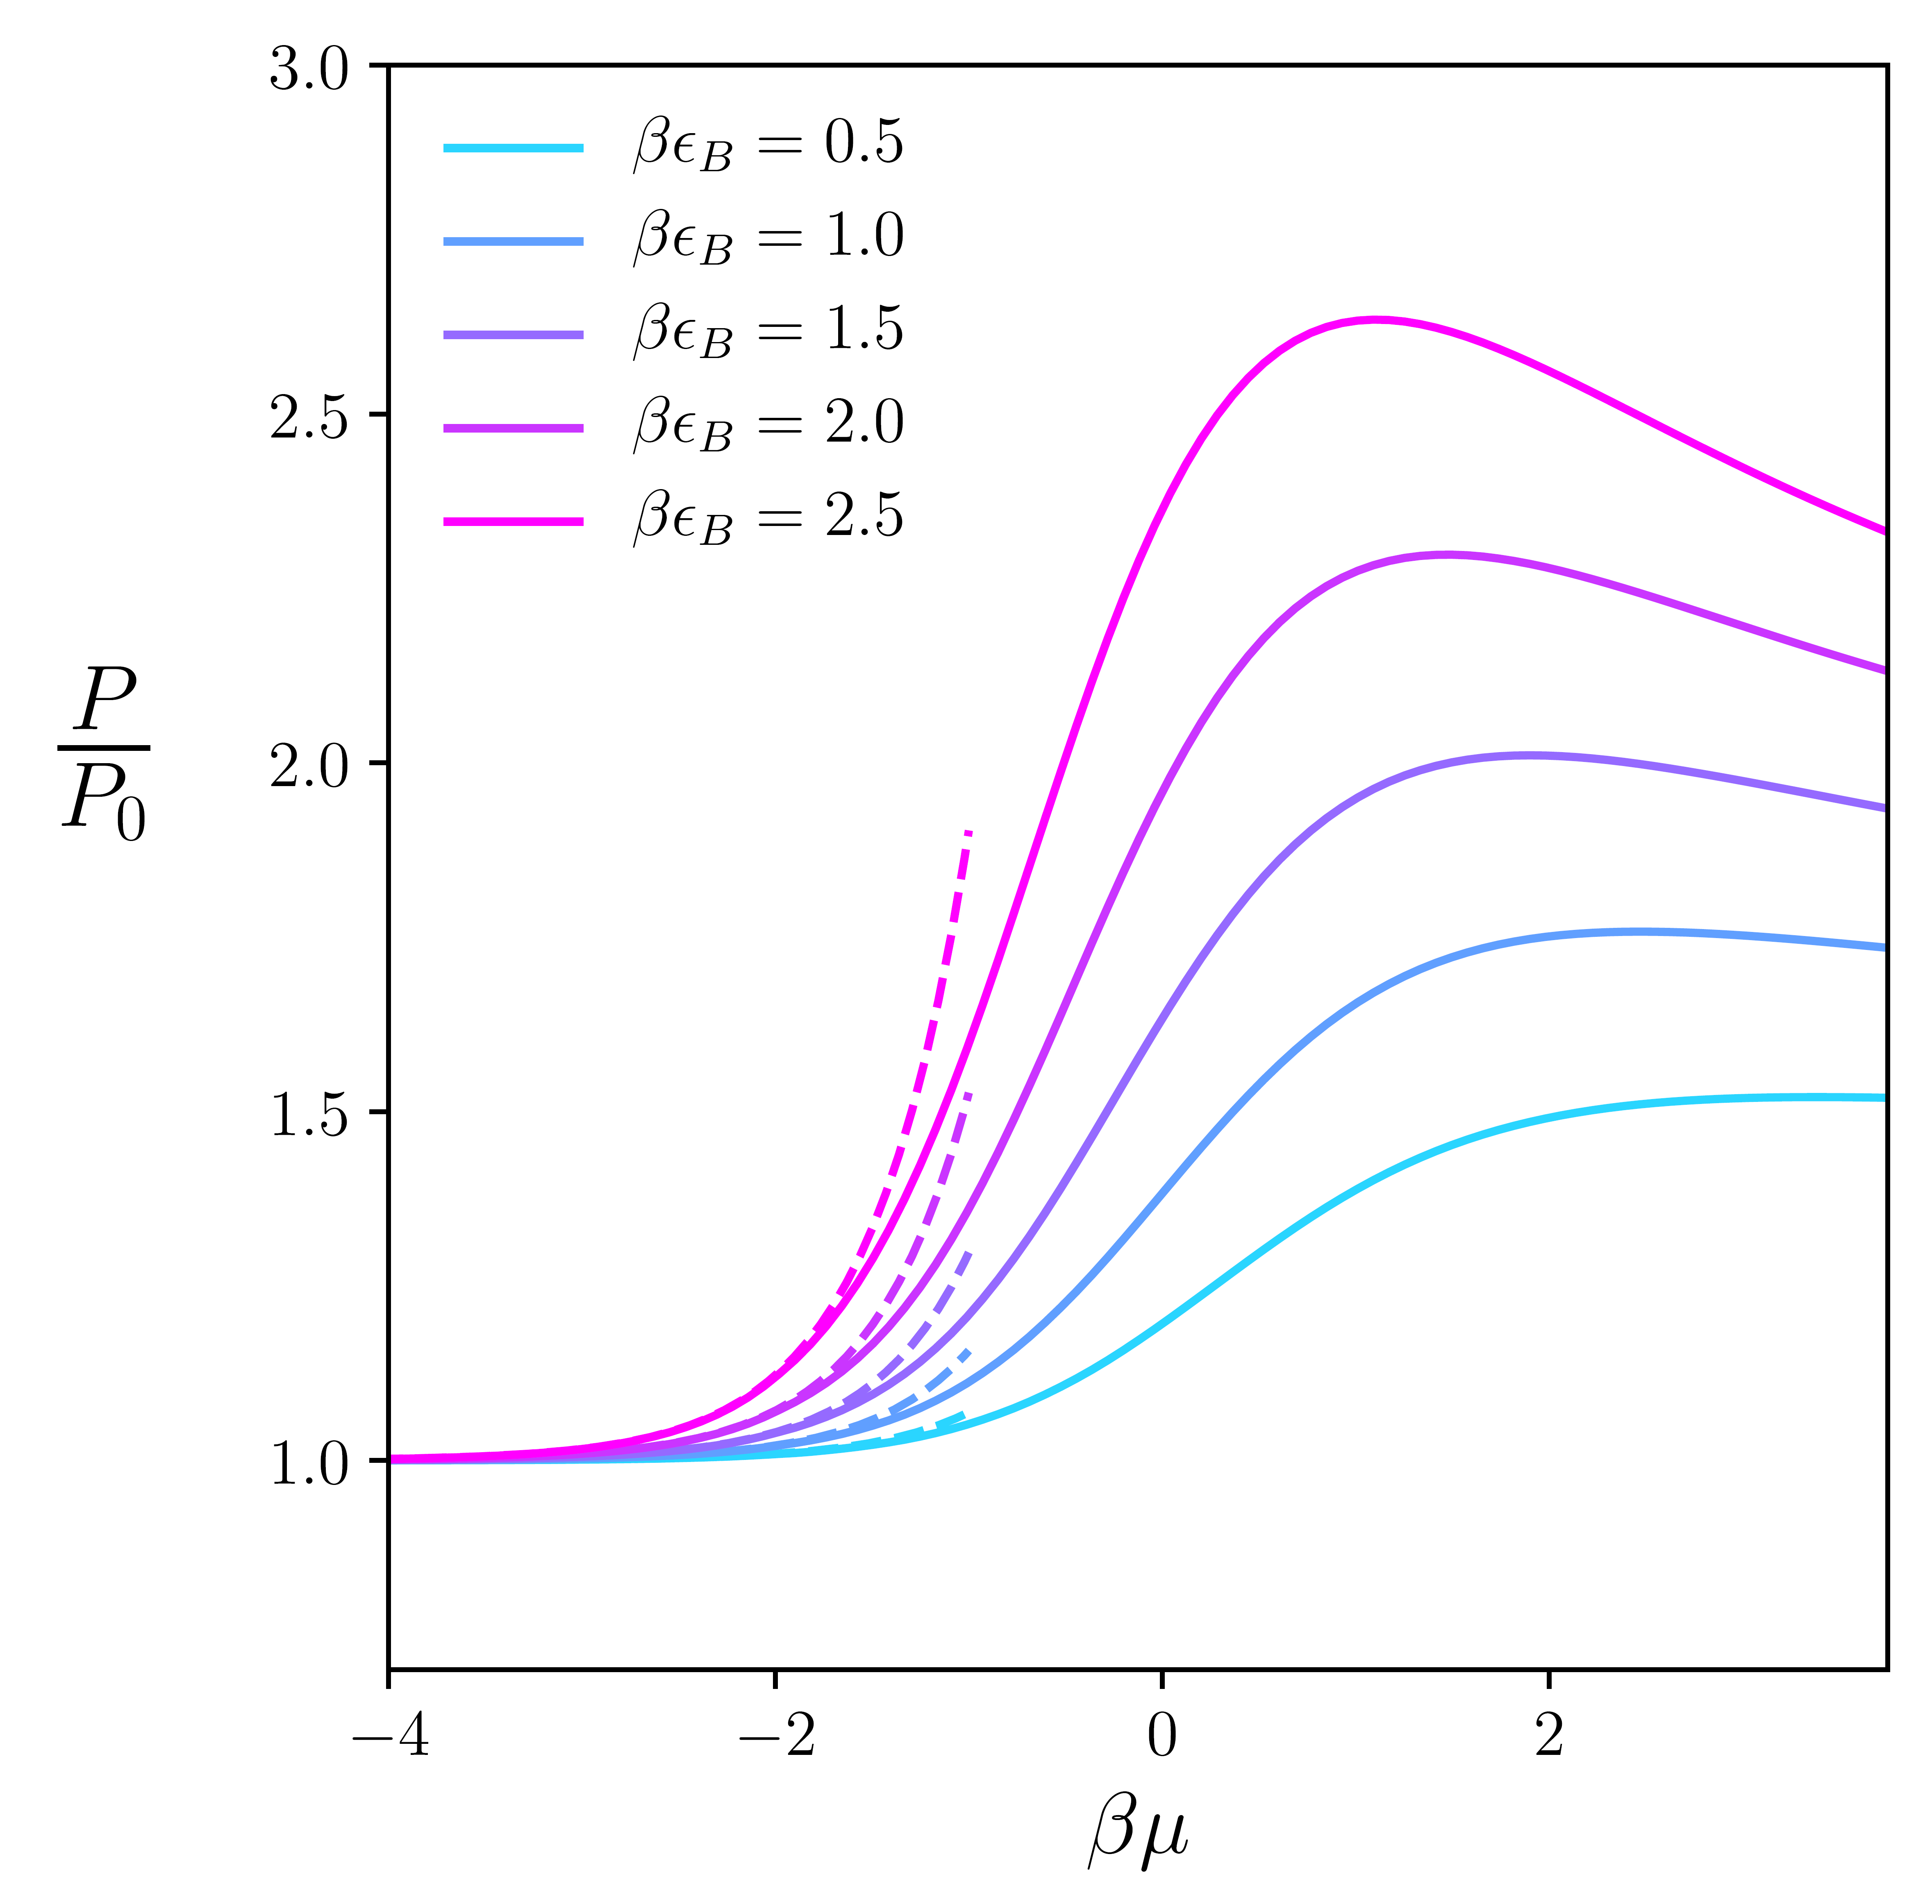

Many-body physics in three-color fermions
Finte-density QCD phase diagram
Grand-canonical phase diagram in SU(3) Fermi gases
？
HT and P. Naidon, New J. Phys. 21, 073051 (2019).
Trimer resonance (exp.)
Quark-hadron continuity
EOS (1D worldline QMC)
$$∼T^{∗}$$
G. Baym, et al., Rep. Prog. Phys. 81, 056902 (2018).
J. R. Williams, et al., Phys. Rev. Lett. 103, 130404 (2009).
J. McKenny, et al., Phys. Rev. A 102, 023313 (2020).

Slide 11
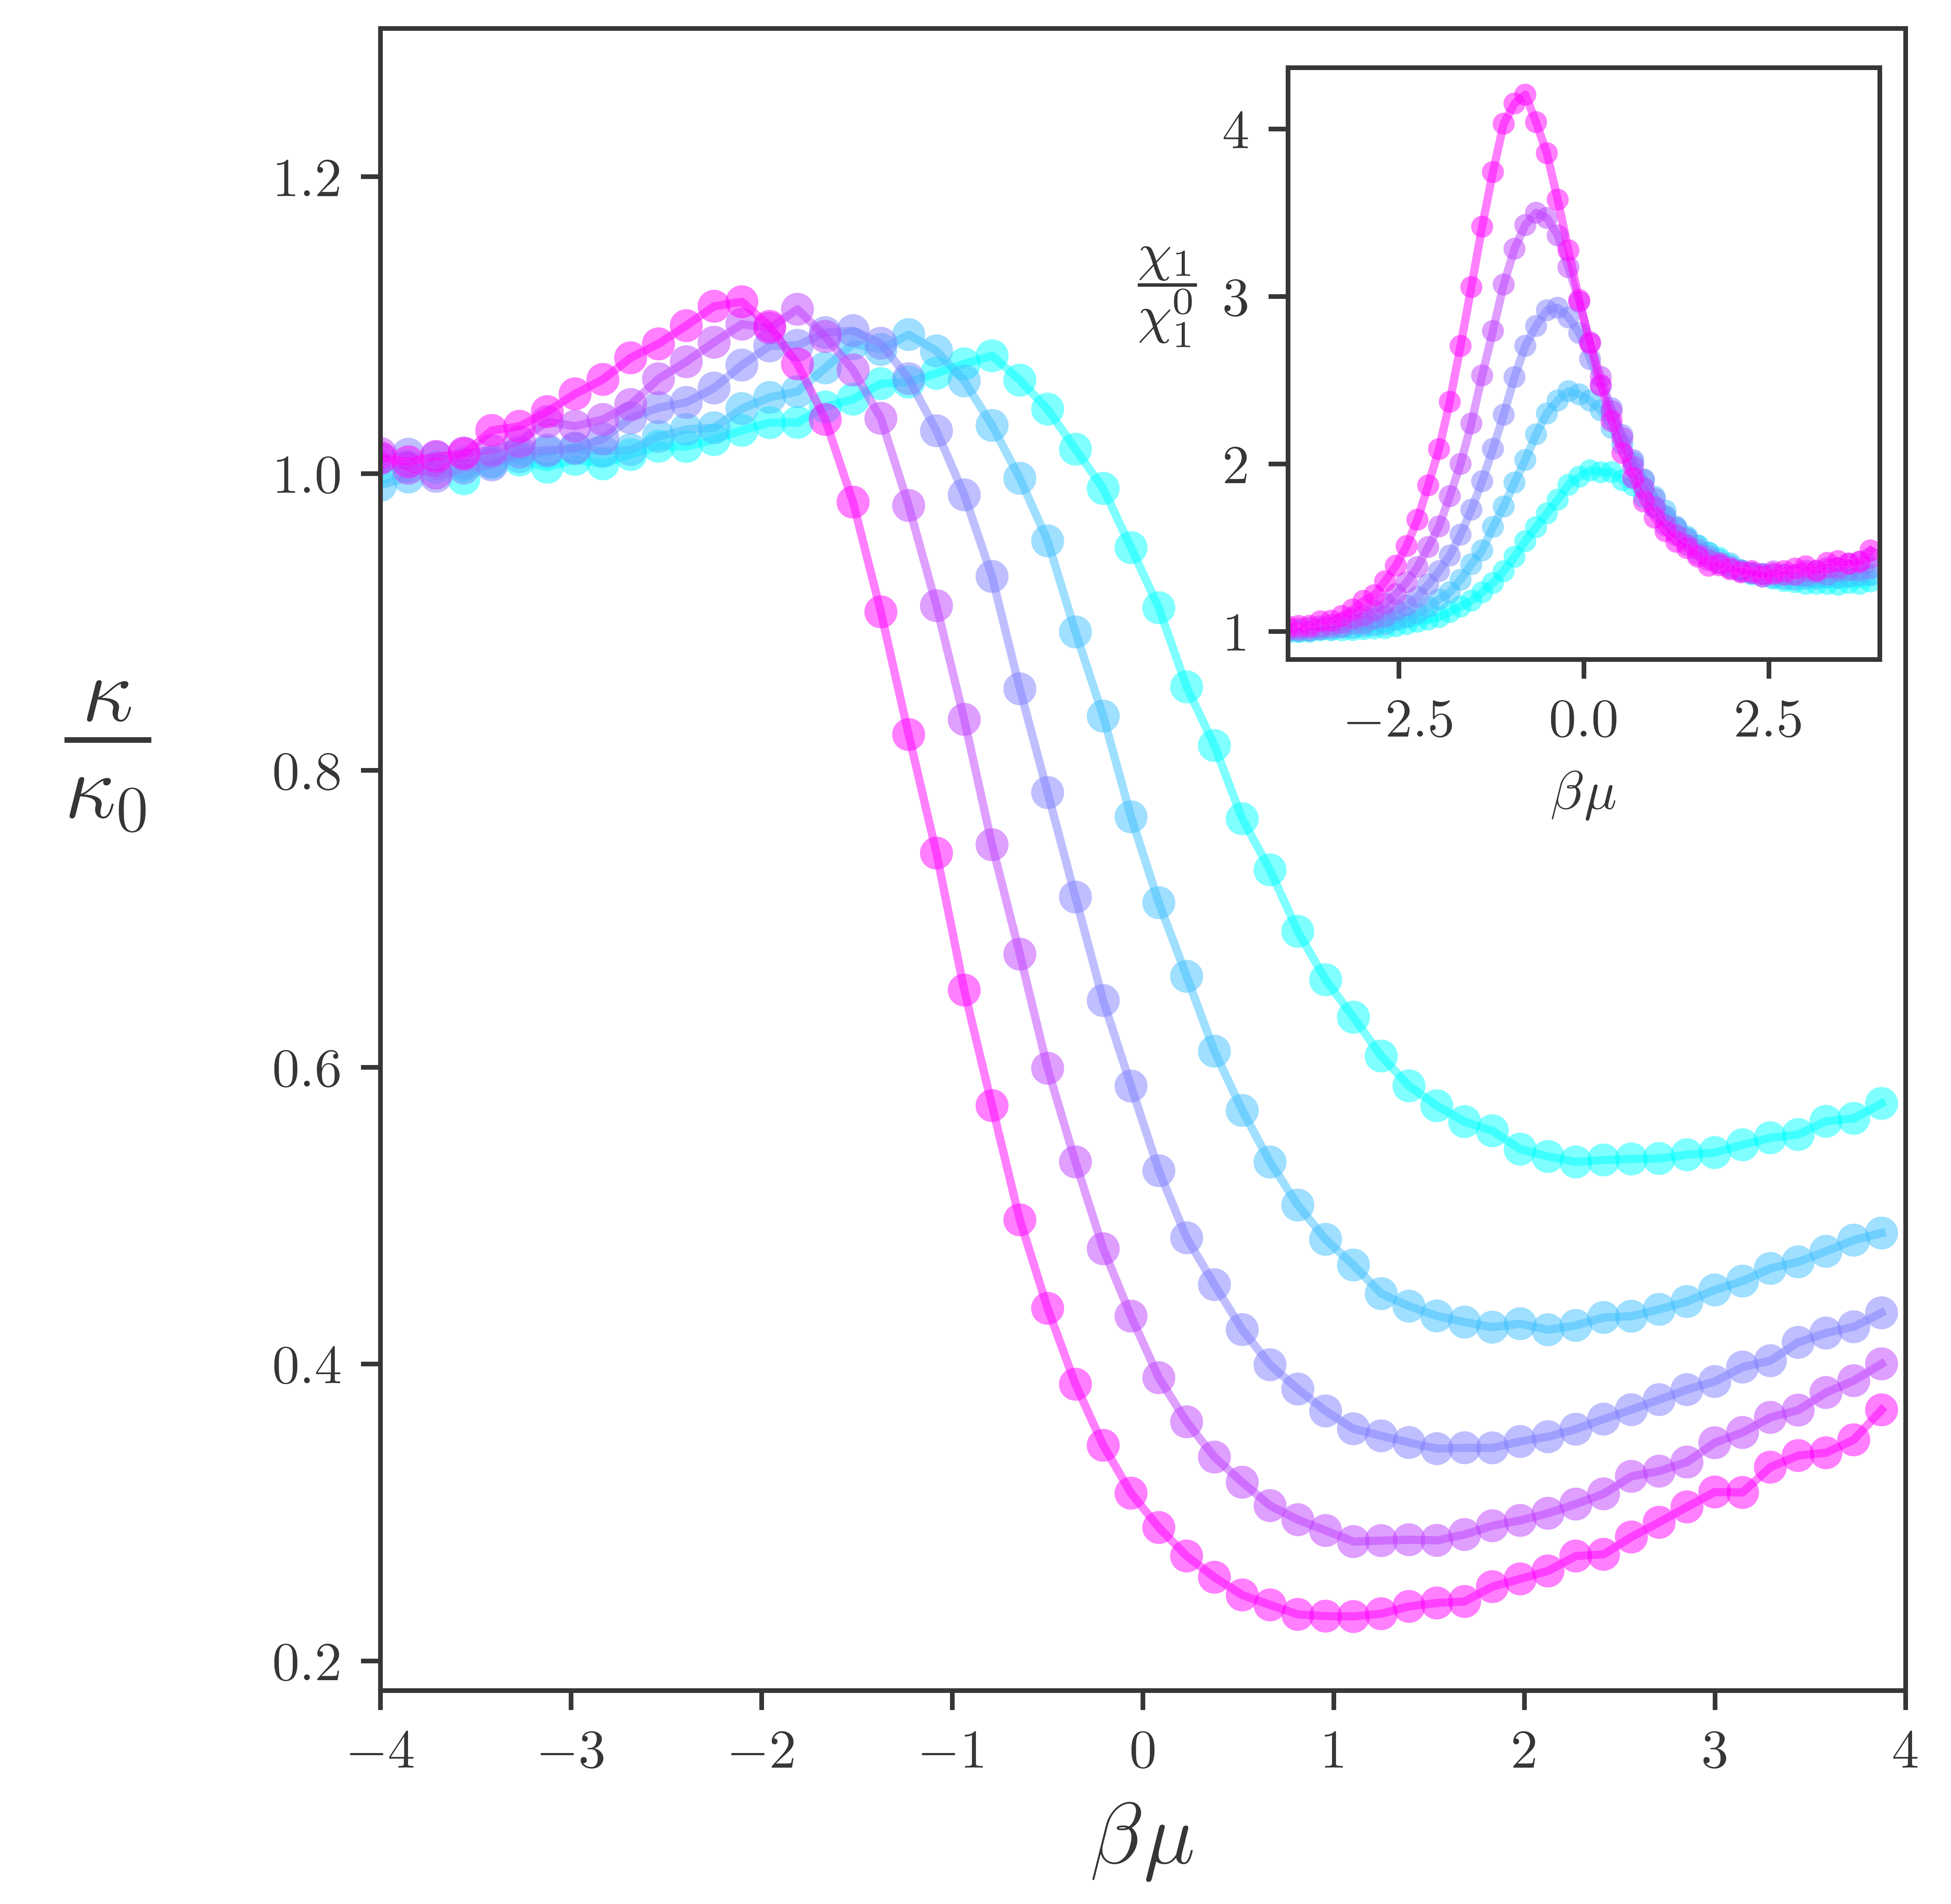


A quantum simulator for finite-density QCD
We consider a one-dimensional three-component Fermi gas where the three-body interaction is geometrically enhanced.
Similarities with dense QCD: Three colors, asymptotic freedom, sound-velocity peak
QCD matter
Atomic system in this study
Three-quark interaction (flux dist.)
Scaling anomaly and asymptotic freedom
$$\frac{∂g_{3}}{∂lnΛ}=\frac{m}{\sqrt{3π}}g_{3}^{2}$$
“Running 3body coupling”
Nucl. Phys. B 119, 751 (2003).
Phys. Rev. Lett. 120, 243002 (2018).
Sound velocity in quarkyonic matter
Compressibility (Quantum Monte Carlo)
$${mc}_{s}^{2}=\frac{1}{ρκ}$$
Phys. Rev. Lett. 122, 122701 (2019).
Phys. Rev. A 102, 023313 (2020).

Slide 12
In this talk…
We investigate a novel crossover from bound trimers (BT) to Cooper triples (CT) in a three-component Fermi gas with three-body interaction.
We discuss an analogy between the BT-CT crossover and the hadron-quark crossover.
Paper: HT, S. Tsutsui, T. M. Doi, and K. Iida, arXiv:2012.03627
Increasing density
“Trimer”
“Cooper triple”
Related topics
・Cooper triples with only two-body interactions.
・Possible condensation of Cooper triples
HT, S. Tsutsui, T. M. Doi, and K. Iida, Phys. Rev. A 104, 053328 (2021).
S. Akagami, HT, and K. Iida, Phys. Rev. A 104, L041302 (2021).

Slide 13
Outline
Introduction
Formalism
Results
Summary

Slide 14


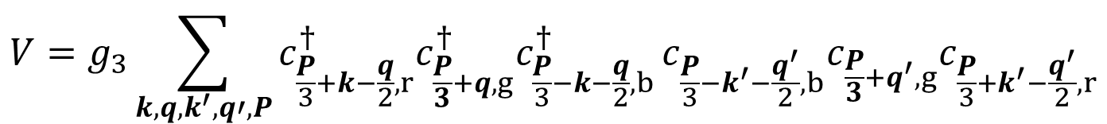





Three-component Fermi gas
Hamiltonian:
$$H=H_{0}+V$$
One-body term
$ξ_{k,i}=\frac{k^{2}}{2m}−μ_{i}$: non-rela. kinetic energy
$$H_{0}=\sum_{k,i}{ξ_{k,i}c_{k,i}^{†}}c_{k,i}$$
$i=r,g,b$: pseudo-color (hyperfine states)
$c_{k,i},{ c}_{k,i}^{†}$: fermionic annihilation/creation operator
Three-body interaction
$$V=g_{3}\sum_{k,q,k^{′},q′,P}{c_{\frac{P}{3}+k−\frac{q}{2},r}^{†}c_{\frac{P}{3}+q,g}^{†}c_{\frac{P}{3}−k−\frac{q}{2},b}^{†}}c_{\frac{P}{3}−k^{′}−\frac{q^{′}}{2},b}c_{\frac{P}{3}+q^{′},g}c_{\frac{P}{3}+k^{′}−\frac{q^{′}}{2},r}$$
$g_{3}<0$ : three-body attraction
Scale invariant ($g_{3}∝1/m$)

Slide 15
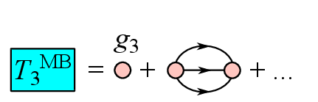
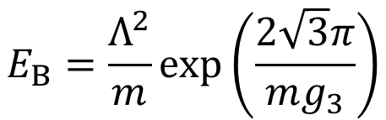
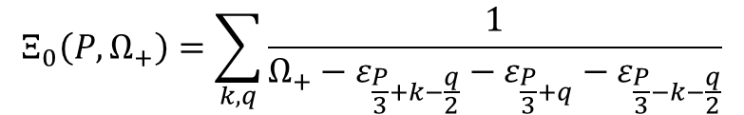
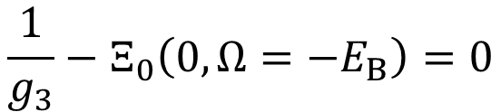

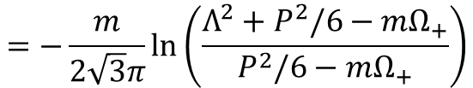
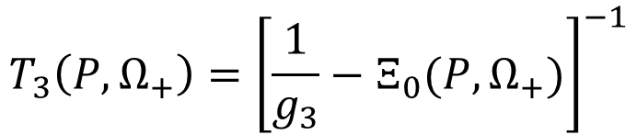

Three-body T-matrix
T₃
$$T_{3}\left(P,Ω_{+}\right)={\left[\frac{1}{g_{3}}−Ξ_{0}(P,Ω_{+})\right]}^{−1}$$
$Ξ_{0}$: Three-body propagator in vacuum
$$Ξ_{0}\left(P,Ω_{+}\right)=\sum_{k,q}{\frac{1}{Ω_{+}−ε_{\frac{P}{3}+k−\frac{q}{2}}−ε_{\frac{P}{3}+q}−ε_{\frac{P}{3}−k−\frac{q}{2}}}}$$
$$=−\frac{m}{2\sqrt{3}π}ln\left(\frac{Λ^{2}+P^{2}/6−mΩ_{+}}{P^{2}/6−mΩ_{+}}\right)$$
$Λ$: cutoff
Three-body binding energy
(Scale anomaly)
$$E_{B}=\frac{Λ^{2}}{m}exp\left(\frac{2\sqrt{3}π}{mg_{3}}\right)$$
$$\frac{1}{g_{3}}−Ξ_{0}\left(0,Ω=−E_{B}\right)=0$$

Slide 16
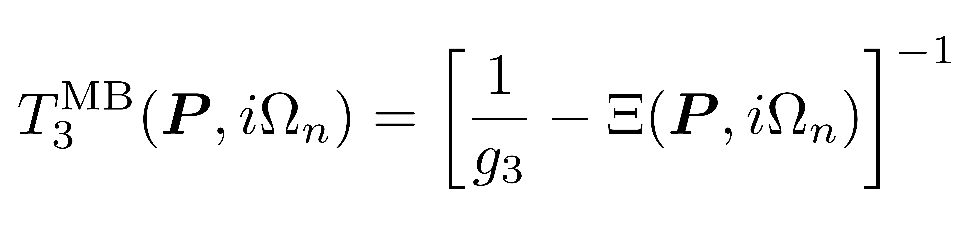

In-medium three-body T-matrix
HT, S. Tsutsui, T. M. Doi, and K. Iida, arXiv:2012.03627
$Ξ$: In-medium three-particle (three-hole) propagator
$Ω_{n}=\left(2n+1\right)πT$: Fermion Matsubara frequency
In-medium three-body equation

Slide 17
Outline
Introduction
Formalism
Results
Summary

Slide 18
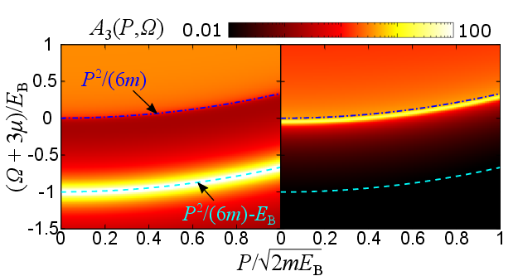
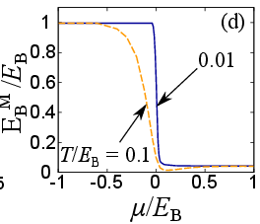


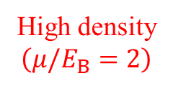
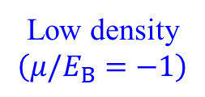
Three-body spectral function
HT, S. Tsutsui, T. M. Doi, and K. Iida, arXiv:2012.03627
・Three-body binding is suppressed by medium corrections regardless of the scale anomaly.
・The three-body pole survives even at high density, indicating the presence of Cooper triples.
In-medium three-body spectral function
In-medium three-body binding energy
$$A_{3}\left(P,Ω\right)=−ImT_{3}^{MB}(P,Ω_{+})$$
Three-body problem
Low density
$$\left(μ/E_{B}=−1\right)$$
High density
$$\left(μ/E_{B}=2\right)$$
$$E_{B}^{M}/E_{B}≃0.04$$

Slide 19




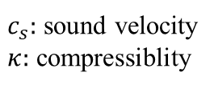
Grand-canonical phase diagram and implication for hadron-quark crossover
HT, S. Tsutsui, T. M. Doi, and K. Iida, arXiv:2012.03627
We found that the sound-velocity peak can be obtained near the region where Cooper triples start to appear from the comparison with QMC results.
Grand-canonical phase diagram
Compressibility minimum in QMC
$${mc}_{s}^{2}=\frac{1}{ρκ}$$
$$κ/κ_{0}$$
$c_{s}:$ sound velocity
$κ:$ compressiblity
J. McKenny, et al., Phys. Rev. A 102, 023313 (2020).
$$βμ$$
Cooper triple and quarkyonic matter*
* Large N_{c}-limit
Method: diagrammatic approach
$$μ≫E_{B}≫E_{B}^{M}$$
Phys. Rev. Lett. 122, 122701 (2019).

Slide 20
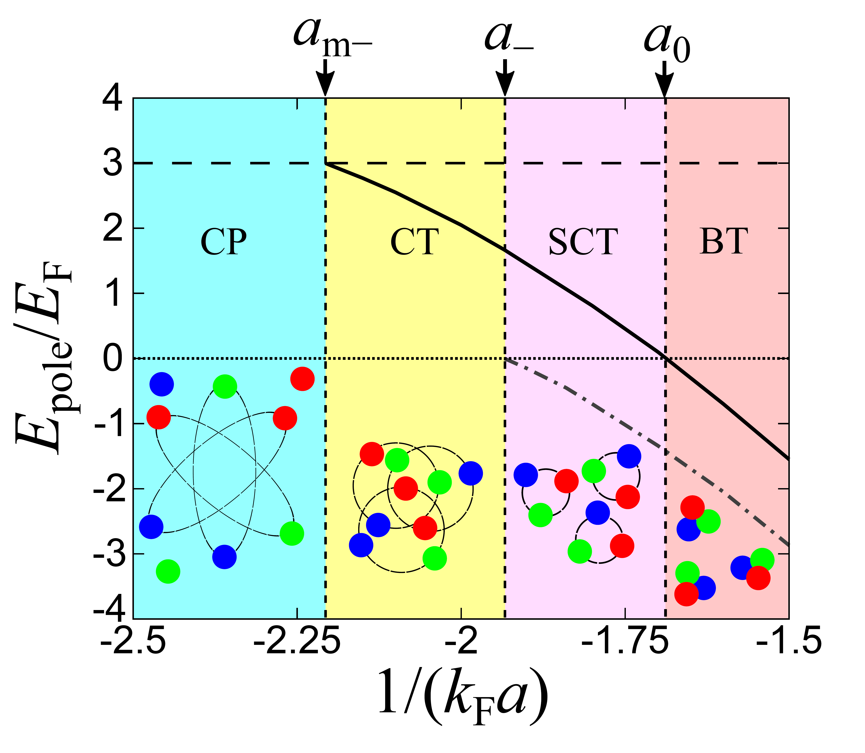

The case with only two-body interactions in three dimensions
HT, S. Tsutsui, T. M. Doi, and K. Iida, Phys. Rev. A 104, 053328 (2021).
・The CT-BT crossover occurs without three-body attractions in three dimensions.
・Emergence of Cooper triples can be detected by the shift of triatomic resonance ($a_{−}→a_{m−}$)
CT-BT crossover near the triatomic resonance (only two-body interaction)
In-medium three-body energy
Range parameter
$$(k_{F}r_{Λ}=0.127)$$
Inverse scattering length
CP: Cooper pair, CT: Cooper triple, SCT: Squeezed Cooper triple, BT: Bound trimer
Method: variational approach of clusters on the top of Fermi sea

Slide 21
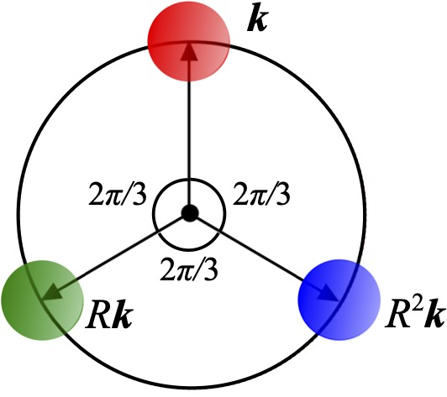
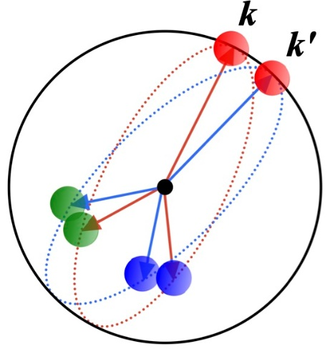

Possible “condensation” of Cooper triples
S. Akagami, HT, and K. Iida, PRA 104, L041302 (2021).
Cooper triples can condense at the zero c.o.m. momentum regardless of its Fermi-Dirac statistics due to the internal degrees of freedom associated with relative momenta of constituent fermions.
Schematic phase diagram
based on the Cooper problem
Creation/annihilation operator of triples
Two-body attraction
$$\left|k\right|, \left|k^{′}\right|≃k_{F}$$
BCS-type wave function for Cooper-triple condensation
Three-body attraction

Slide 22
Outline
Introduction
Formalism
Results
Summary

Slide 23
Summary
We have discussed a novel crossover from bound trimers (BT) to Cooper triples (CT) across the hierarchical structures in multi-component fermionic systems.
As a quantum simulator of hadron-quark crossover, we have investigated BT-CT crossover in a one-dimensional three-component Fermi gas with three-body interaction.

Slide 24
Summary
We have discussed a novel crossover from bound trimers (BT) to Cooper triples (CT) across the hierarchical structures in multi-component fermionic systems.
As a quantum simulator of hadron-quark crossover, we have investigated BT-CT crossover in a one-dimensional three-component Fermi gas with three-body interaction.
From Cooper pairs to dimers

Slide 25
Summary
We have discussed a novel crossover from bound trimers (BT) to Cooper triples (CT) across the hierarchical structures in multi-component fermionic systems.
As a quantum simulator of hadron-quark crossover, we have investigated BT-CT crossover in a one-dimensional three-component Fermi gas with three-body interaction.
From Cooper pairs to dimers
From Cooper triples to trimers

Slide 26
Summary
We have discussed a novel crossover from bound trimers (BT) to Cooper triples (CT) across the hierarchical structures in multi-component fermionic systems.
As a quantum simulator of hadron-quark crossover, we have investigated BT-CT crossover in a one-dimensional three-component Fermi gas with three-body interaction.
From Cooper pairs to dimers
From Cooper triples to trimers
From Cooper quartets to tetramers
G. Yixin, HT, and H. Liang, arXiv:2112.05349
“Alpha particle”

Slide 27
Appendix

Slide 28
Variational approach for clusters on the top of Fermi sea
Usual Cooper problem (Cooper pair)
Cooper triple wave function
HT, S. Tsutsui, T. M. Doi, and K. Iida, Phys. Rev. A 104, 053328 (2021).

Slide 29
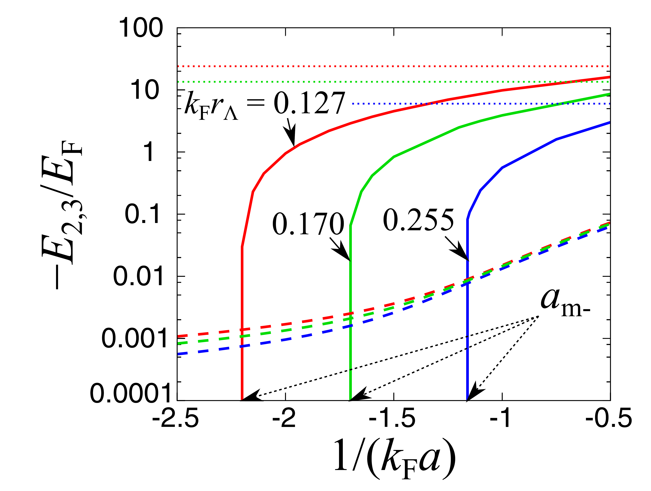
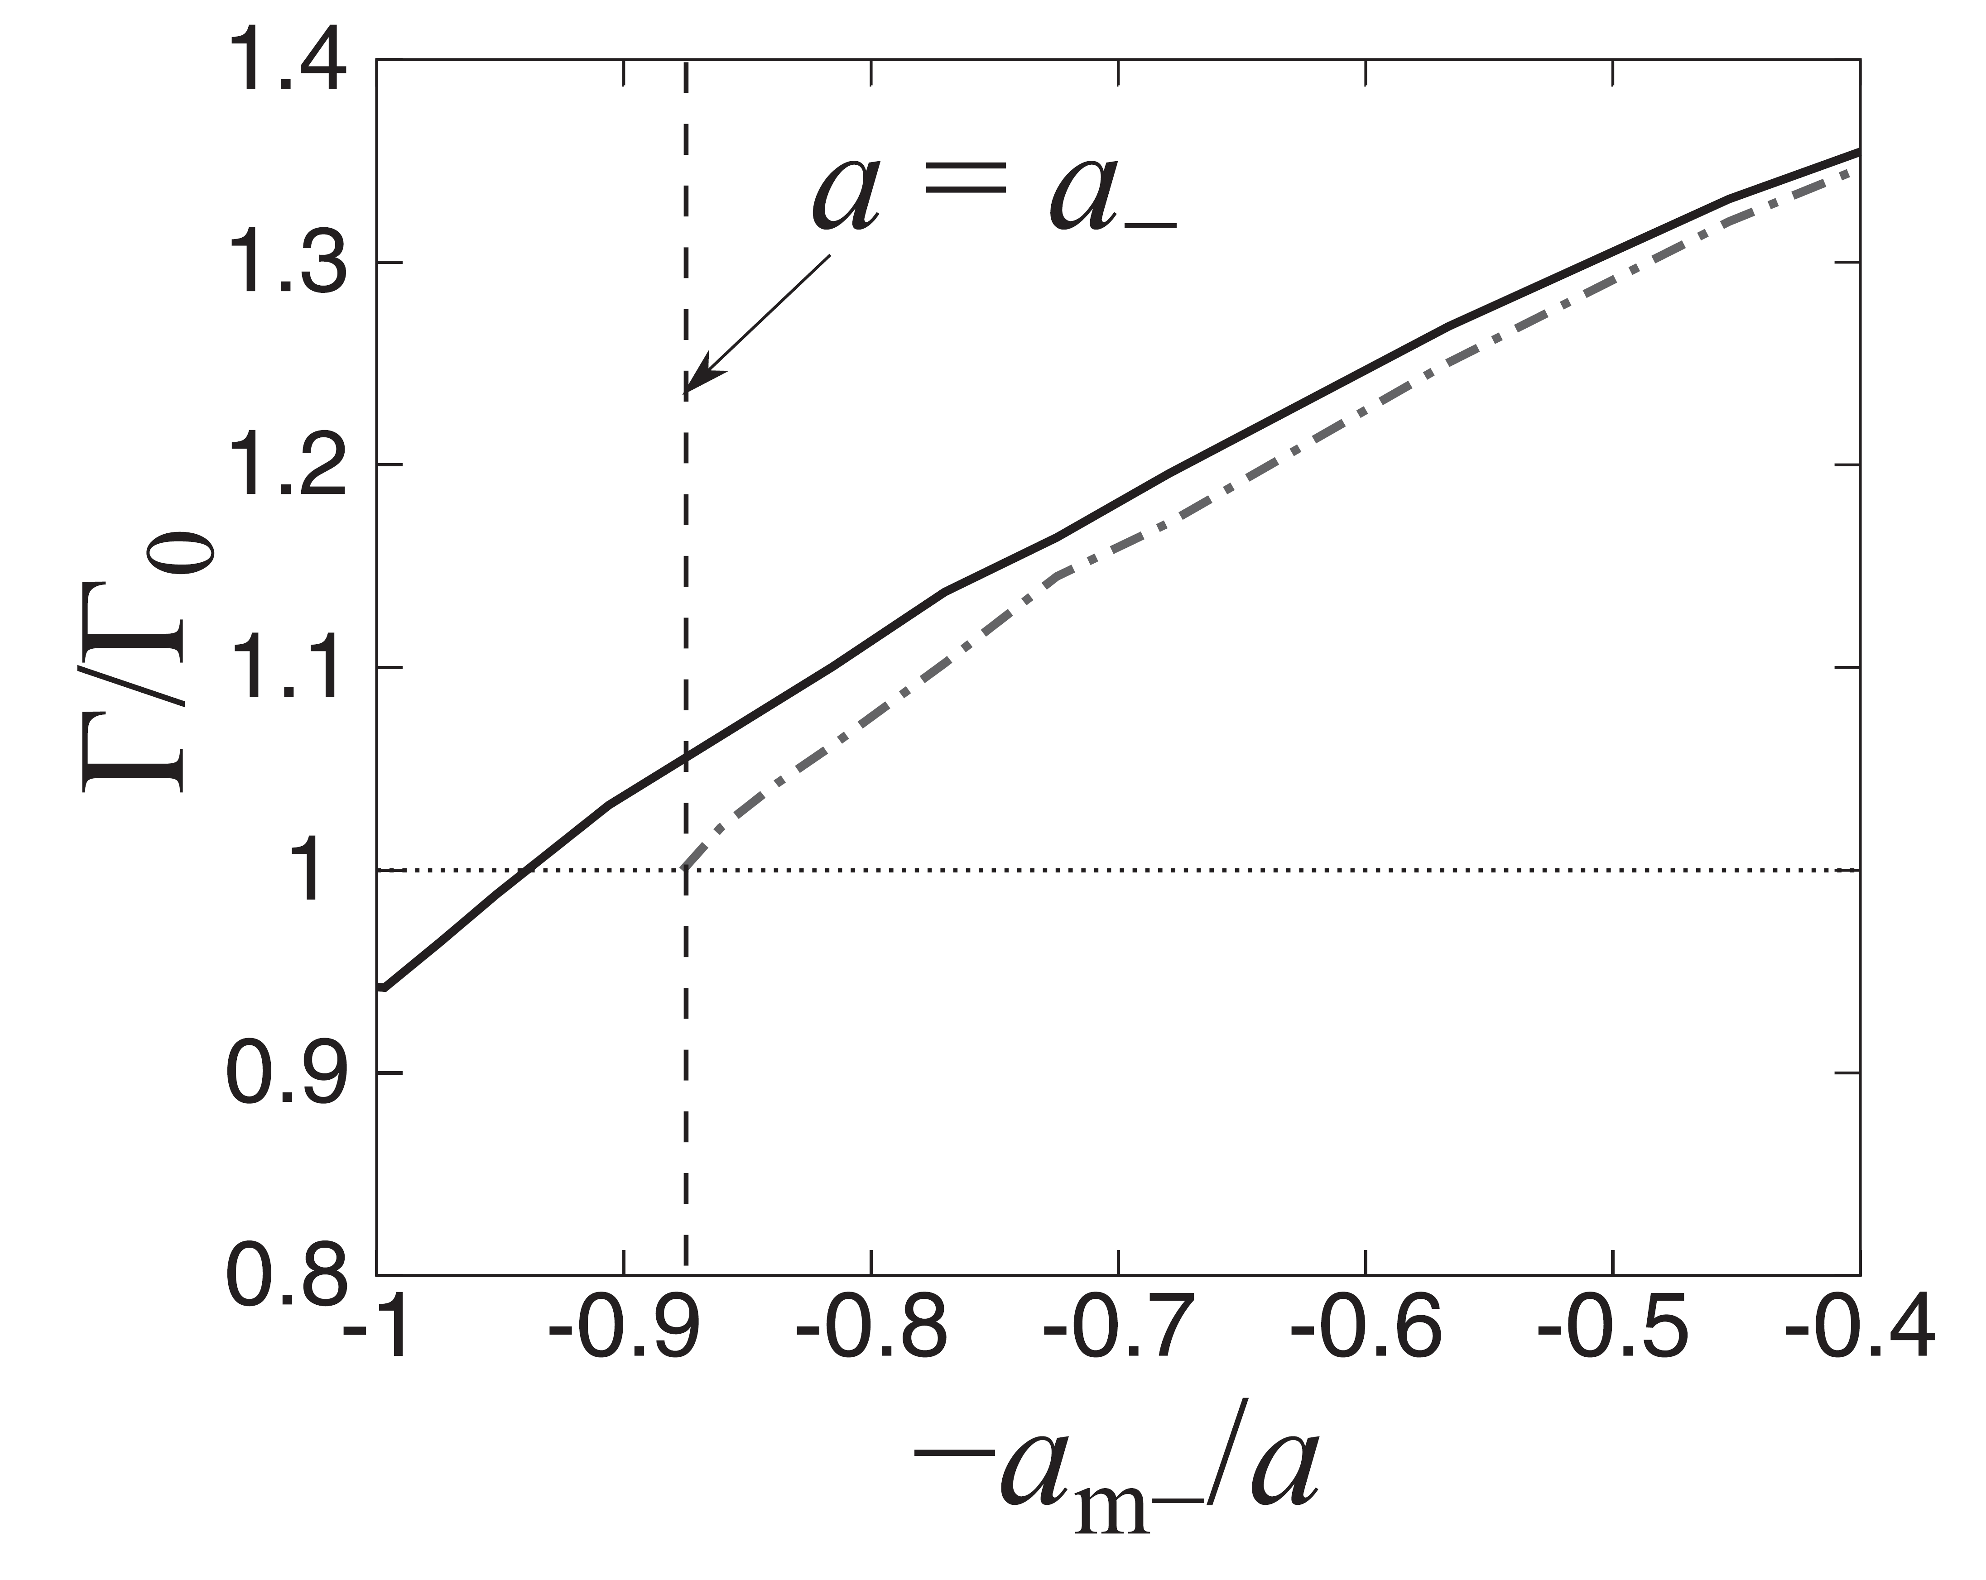
Results of variational study in 3D
HT, S. Tsutsui, T. M. Doi, and K. Iida, Phys. Rev. A 104, 053328 (2021).
Competition between pair and triple formations
Three-body decay rate

Slide 30
Details of Cooper-triple condensation
S. Akagami, HT, and K. Iida, PRA 104, L041302 (2021).
Effective Hamiltonian
Ground-state energy
Order parameter
Asymptotic behavior

Slide 31
Compressibility minimum
H. Tajima, S. Tsutsui, T. M. Doi, and K. Iida, arXiv:2012.03627
Why does the sound velocity (compressiblity) take maximum (minimum) near T*?
➡ Rapid decrease of in-medium three-body binding energy
3D with only 2b force
Compressibility (QMC)
Mclerran-Reddy-like model
J. McKenny, et al., Phys. Rev. A 102, 023313 (2020).

Slide 32
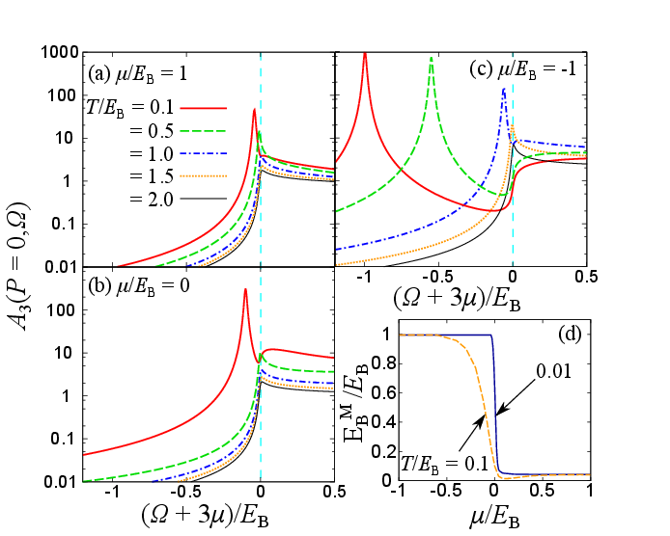
Temperature dependence of the zero-momentum three-body spectra

Slide 33
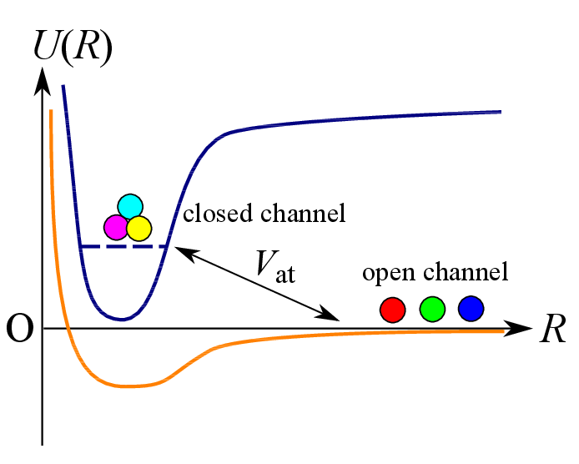
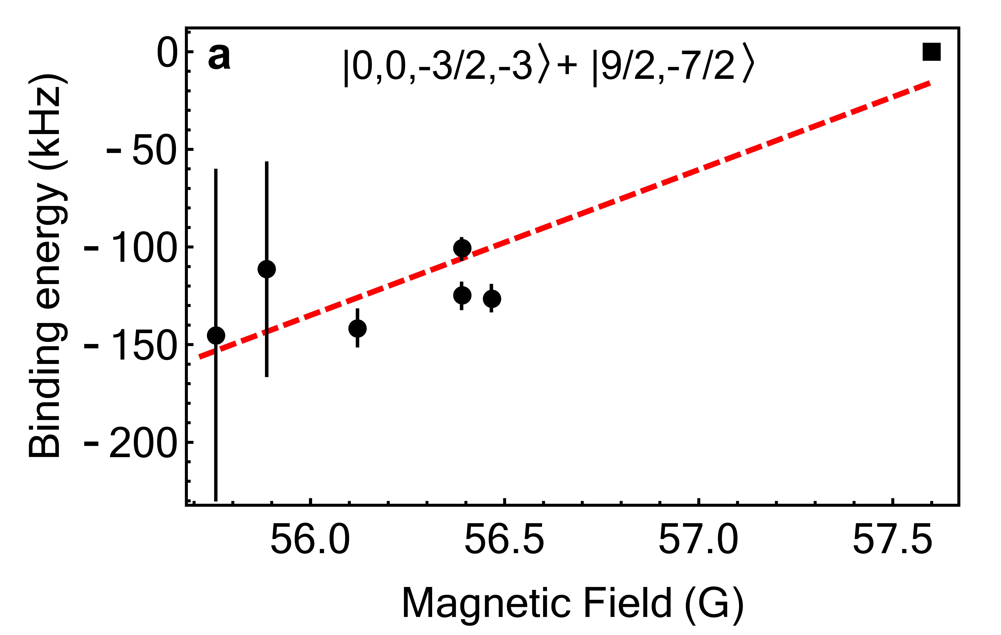
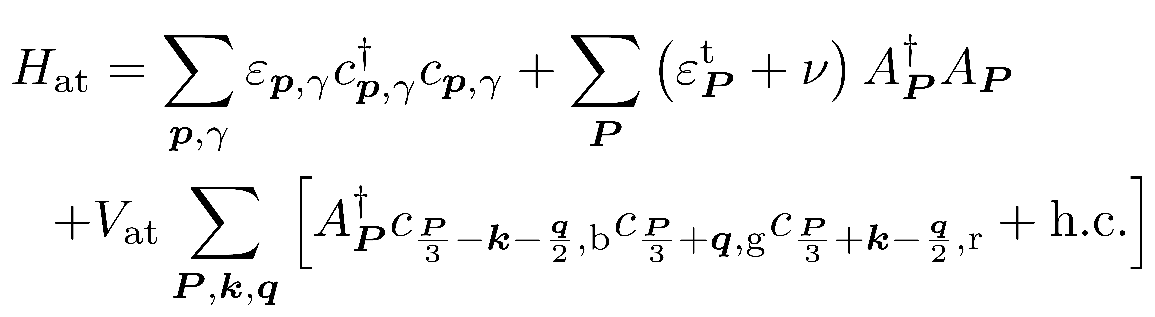
Atom-trimer resonance
HT, S. Tsutsui, T. M. Doi, and K. Iida, arXiv:2012.03627 (2020).
Photoassociation of trimers
PRA 103, 022820 (2021).
arXiv:2104.11424
Optical control of interactions
PRL 122, 040405 (2019)

Slide 34
Mediated three-body interaction
S. Akagami, HT, and K. Iida, PRA 104, L041302 (2021).
:Medium (fourth-component atom)

