Slide 1
Holographic complexity in (hybrid) de Sitter spacetime
Based on
arXiv:2302.03584 [hep-th], in collaboration with R. Auzzi, G. Nardelli, and G. Pedde Ungureanu
arXiv:2303.05025 [hep-th], in collaboration with T. Anegawa, N. Iizuka, and S. K. Sake
Nicolò Zenoni (group B01)
Osaka University
April 4th, 2023

Slide 2
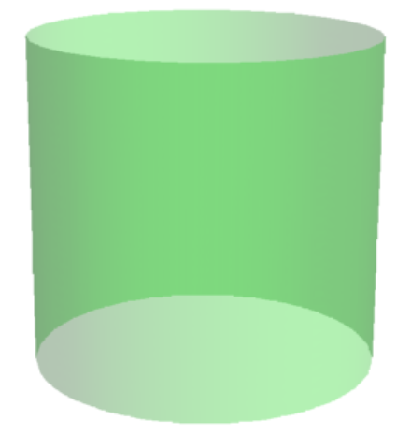
AdS/CFT
[J. M. Maldacena, 1997]
Theory of gravity
in anti-de Sitter (AdS)
Conformal Field Theory (CFT)
on the AdS boundary
Gravity in
(d+1)-dimensional
AdS
d-dimensional CFT
(no gravity)
boundary
Quantum information may unveil how the bulk emerges from the boundary!

Slide 3
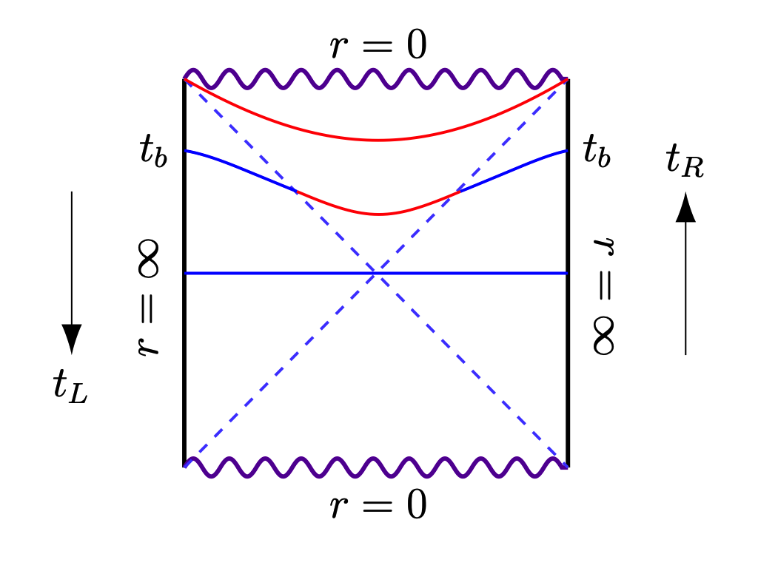
The volume of the ERB
: ${ds}^{2}=\left\{\begin{aligned}−\left(\frac{r^{2}}{L_{AdS}^{2}}+1−\frac{ω^{d−2}}{r^{d−2}}\right) {dt}^{2}+\frac{{dr}^{2}}{\frac{r^{2}}{L_{AdS}^{2}}+1− \frac{ω^{d−2}}{r^{d−2}}}+r^{2}{dΩ}_{d−1}^{2} \\ −\frac{r^{2}−r_{h}^{2}}{L_{AdS}^{2}} {dt}^{2}+\frac{L_{AdS}^{2} {dr}^{2}}{r^{2}−r_{h}^{2}}+r^{2}{dθ}^{2}\end{aligned}\right.$
for $d>2$
Eternal two-sided BH
in AdS_{d+1} spacetime
for $d=2$
The volume $V$ of maximal $d$-dimensional surfaces gives:
$$\lim_{t_{b}→∞}{\frac{dV}{dt_{b}}}=\frac{16πGL_{AdS}^{2}}{d−1}M$$
Linear growth
at late times!
$M$: black hole mass
Which quantity in the dual CFT represents the growth of the ERB?
Boundary time: $t_{b}=t_{R}=−t_{L}$

Slide 4
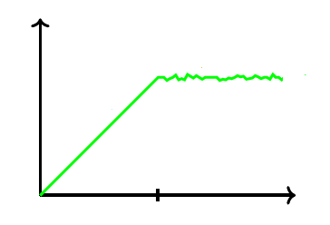
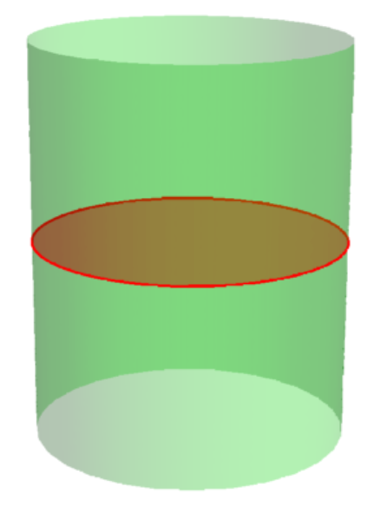
Computational complexity
Complexity is the minimum number of simple operations required to build a quantum state
$$𝒞(U)$$
Target state
Reference state
$$U=u_{k}…u_{1}$$
Chaotic quantum circuit of $n$ qubits
$$t$$
$$e^{n}$$
Evolution of the ERB
inside an AdS_{d+1} black hole
Evolution of complexity of the dual state in CFT_{d}
t
$$𝒞_{V}(B)=\max_{∂Σ=B}{\frac{V\left(Σ\right)}{ G L_{AdS}}}$$
Complexity = Volume
(CV) conjecture
[L. Susskind, 2014]
CFT₂
$$Σ$$
$$B$$
AdS₃

Slide 5
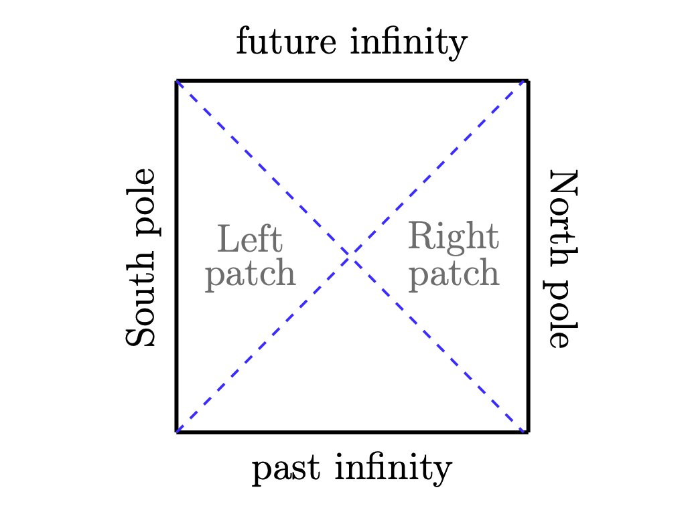
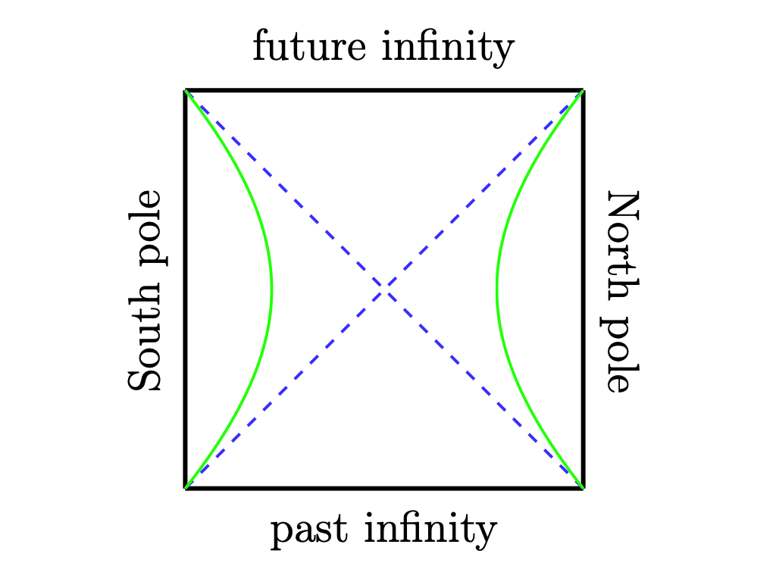
A probe of cosmological horizons?
It is tempting to employ holographic tools to studying cosmological horizons
$$B$$
$$B$$
The stretched horizon acts as a holographic screen!
$$𝒞_{V}(B)=\max_{∂Σ=B}{\frac{V\left(Σ\right)}{ G L_{dS}}}$$
CV conjecture
in dS

Slide 6
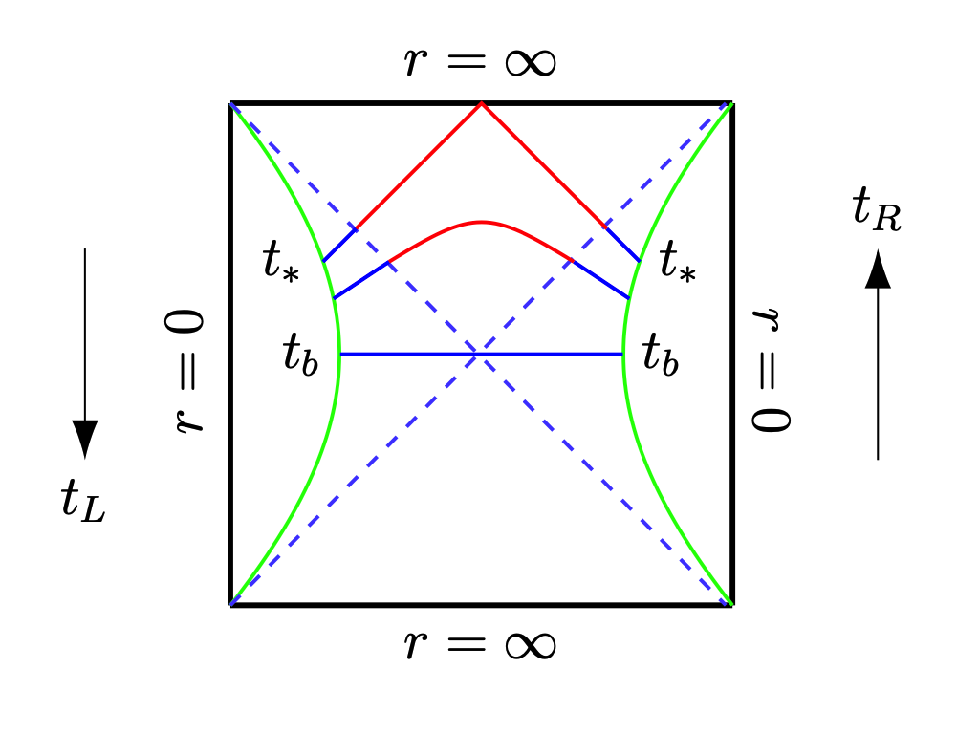
Volume complexity in dS
Pure dS_{d+1} spacetime: ${ds}^{2}=−\frac{{L_{dS}^{2}−r}^{2}}{L_{dS}^{2}} {dt}^{2}+\frac{L_{dS}^{2} {dr}^{2}}{L_{dS}^{2}−r^{2}}+r^{2}{dΩ}_{d−1}^{2}$
for $d>1$
Volume complexity $C_{V}$ gives [E. Jørstad et al., 2022]:
$$\lim_{t_{b}→t_{∗}}{\frac{d𝒞_{V}}{dt_{b}}}≈\frac{2 f\left(d\right){ L}_{dS}^{2(d−1)}Ω_{d−1}}{G {\left(t_{∗}−t\right)}^{d}}$$
Hyperfast growth
at a critical time!
$$\lim_{t_{b}→t_{∗}}{𝒞_{V}}≈\frac{2 f\left(d\right) L_{dS}^{2(d−1)}Ω_{d−1}}{{G (d−1)\left(t_{∗}−t\right)}^{d−1}}$$
Complexity diverges
at a critical time!
Boundary time: $t_{b}=t_{R}=−t_{L}$
Volume complexity probes the expansion of dS!

Slide 7
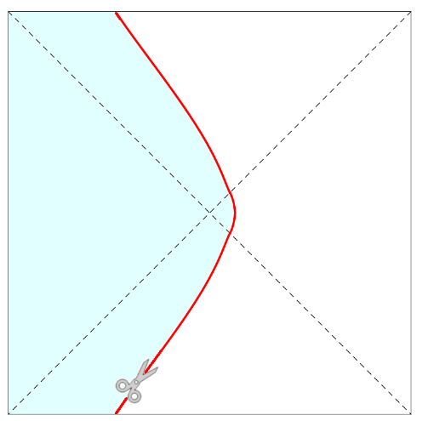
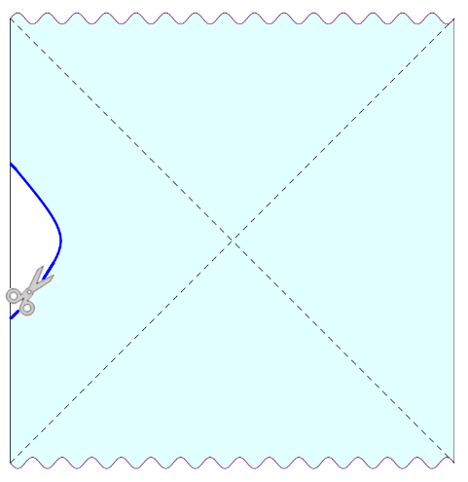
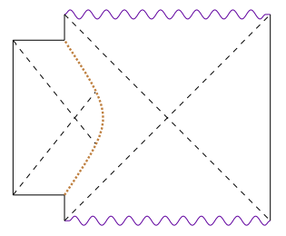
A "Frankenstein" geometry
An alternative way of investigating dS holography is to exploit the AdS timelike boundary,
by embedding dS_{d+1} into AdS_{d+1} [B. Freivogel et al., 2005]
$$r=R(τ)$$
$$\overline{R}$$
$$P_{o}$$
$$r=R(τ)$$
$$P_{i}$$
dS
AdS black hole
dS bubble in AdS
The full extremal surface is obtained by gluing along the bubble surface
an AdS part attached to the boundary and a dS part
Refraction-like condition: $P_{o}$, $P_{i}$, and $\overline{R}$ must be chosen so that the full surface has maximal volume

Slide 8
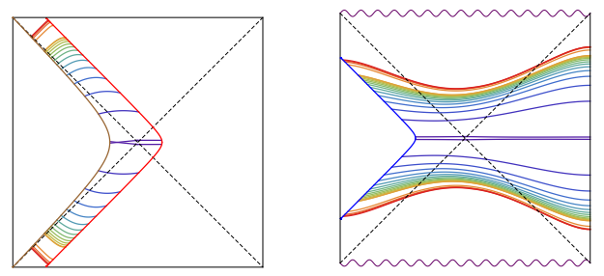
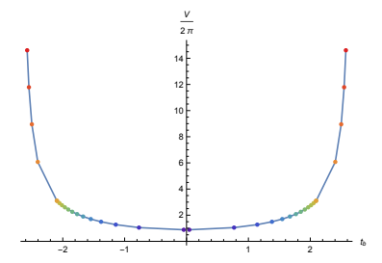
Hybrid holography?
If we introduce the stretched horizon, maximal surfaces extend beyond the cosmological horizon
1. The dS stretched horizon time is fixed as $t_{b}=−t_{L}$
2. The AdS boundary time is fixed as $t_{b}=−α_{t} t_{R}$
$$\frac{𝒞_{V}}{2π}$$
$$\frac{d𝒞_{V}}{dt_{b}} →∞$$
$$α_{t}=−1$$
$$t_{b}$$
As in
pure dS!
dS
AdS black hole
$$\frac{𝒞_{V}}{2π}$$
$$\frac{d𝒞_{V}}{dt_{b}}→∞$$
$$α_{t}=1$$
$$t_{b}$$

Slide 9
A probe of expansion
When the maximal surface is anchored at the stretched horizon,
both in pure dS and in the hybrid dS geometry
volume complexity probes the dS inflationary expansion
TAKE
AWAY
Is this also true in the dS₂ case?
[E. Jørstad et al., 2022,
S. Chapman et al., 2021]
$$\lim_{t_{b}→t_{∗}}{\frac{d𝒞_{V}}{dt_{b}}}= \frac{const}{\sqrt{t_{∗}−t}}$$
Hyperfast growth
at a critical time!
$$\lim_{t_{b}→t_{∗}}{𝒞_{V}}= 𝒪(1)$$
Complexity
remains finite!

Slide 10
The two-dimensional puzzle
dS₂ is a solution of Jackiw-Teitelboim gravity,
and can be built by (half) dimensional reduction starting from dS₃ [A. Svesko et al., 2022]:
${ds}^{2}=−f(r) {dt}^{2}+\frac{{dr}^{2}}{f(r)}+r^{2} {dθ}^{2}$, $f\left(r\right)=\frac{{L_{dS}^{2}−r}^{2}}{L_{dS}^{2}}$
dS₃ spacetime
dimensional reduction
$${ds}^{2}=−f\left(r\right) {dt}^{2}+\frac{{dr}^{2}}{f(r)}+L_{dS}^{2} {φ(r)}^{2} {dθ}^{2}$$
Dilaton: replaces the
higher-dimensional
transverse sphere!
dS₂ spacetime
Volume contains information just on the metric, but dilaton is important!

Slide 11
Dilaton matters
Volume is not invariant under Weyl field redefinition of the metric:
$$g_{μν}→Ω\left(φ\right) g_{μν}$$
$$V$$
$\frac{dV}{dt_{b}} →∞$,
$$V→∞$$
To illustrate this, we can choose
$$Ω\left(φ\right)=φ^{w}$$
It is possible to reproduce the same result
as in dS₃ spacetime!
$$t_{b}$$
$$t_{∗}$$
Don’t forget dilaton!

Slide 12
Thank you
for your
attention!

Slide 13
Complexity = refined volume
Volume contains information just on the metric, but dilaton is important!
$$V(P)=2\int_{r_{st}}^{r_{max}}{\frac{1}{\sqrt{f\left(r\right)+P^{2}}}dr}$$
$$t_{b}\left(P\right)=−\int_{r_{st}}^{r_{max}}{\frac{P}{f\left(r\right)\sqrt{f\left(r\right)+P^{2}}}dr}$$
Also, volume is not invariant under Weyl-like field redefinition of the metric: $g_{μν}→Ω\left(φ\right) g_{μν}$
$$V_{ref}$$
$W→∞$,
$$V_{ref}→∞$$
$$V_{ref}(P)=2\int_{r_{st}}^{r_{max}}{\frac{Ω\left(φ\right)}{\sqrt{Ω\left(φ\right) f\left(r\right)+P^{2}}}dr}$$
$$t_{b}\left(P\right)=−\int_{r_{st}}^{r_{max}}{\frac{P}{f\left(r\right)\sqrt{Ω\left(φ\right) f\left(r\right)+P^{2}}}dr}$$
With the choice $Ω\left(φ\right)=φ^{w}$,
it is possible to reproduce the same result
as in dS₃ spacetime!
$$t_{b}$$
$$t_{∗}$$

