Slide 1

Geometric Resolution of Schwarzschild Horizon
  YITP Workshop,
  April 4 2023
  Pierre Heidmann

Slide 2

Black Hole Puzzles
???
Black holes are at the center of theoretical conflicts between GR and QM
1

Slide 3
Black Hole Puzzles
Black holes are at the center of theoretical conflicts between GR and QM
Singularity
1

Slide 4
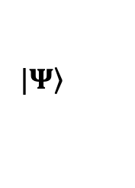

Black Hole Puzzles
$$|\left.Ψ\right\rangle$$
Black holes are at the center of theoretical conflicts between GR and QM
Singularity
Horizon $⇒$ Information Paradox
1

Slide 5
Black Hole Puzzles
$$|\left.Ψ\right\rangle$$
$$|\left.Ψ\right\rangle$$
Black holes are at the center of theoretical conflicts between GR and QM
Singularity
Horizon $⇒$ Information Paradox
1

Slide 6
Black Hole Puzzles
Black holes are at the center of theoretical conflicts between GR and QM
Singularity
Horizon $⇒$ Information Paradox
1

Slide 7
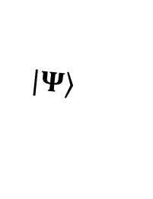
Black Hole Puzzles
$$|\left.Ψ\right\rangle$$
???
Black holes are at the center of theoretical conflicts between GR and QM
Singularity
Horizon $⇒$ Information Paradox
1

Slide 8
Black Hole Puzzles
Black holes are at the center of theoretical conflicts between GR and QM
Microscopic Description of BH entropy
Singularity
Horizon $⇒$ Information Paradox
1

Slide 9


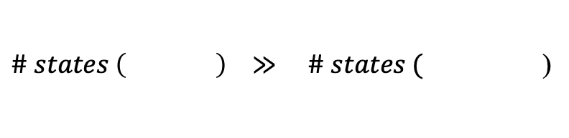


Black Hole Puzzles
Black holes are at the center of theoretical conflicts between GR and QM
Microscopic Description of BH entropy
Singularity
Horizon $⇒$ Information Paradox
!
$\# states \left( \right) ≫ \# states ($)
$${(e}^{{10}^{90}})$$
$${(e}^{{10}^{88}})$$
1

Slide 10
Black Hole Puzzles
Black holes are at the center of theoretical conflicts between GR and QM
Microscopic Description of BH entropy
Singularity
Horizon $⇒$ Information Paradox
What are the new degrees of freedom from Quantum Gravity that make black holes and solve the horizon problem?
1

Slide 11





Supersymmetric Paradigm
$$⊃$$
$$+$$
$$+$$
$$+…$$
Part of the $e^{S}$ microstates of SUSY BH can be described by Gravitational Solitons
Topological deformations
Coherent states of quantum gravity
Resolve the singularity & horizon into smooth microstructure
Extra compact dimensions
EM Flux
Do coherent QG states extend beyond supersymmetry? Can they resolve horizons of non-extremal BH?
2

Slide 12
Vacuum solitons in gravity
Charged solitons in gravity
Solitons that resolve Schwarzschild horizon
Some gravitational properties

Slide 13

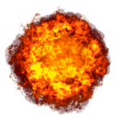

On Solitons in Gravity
Soliton:
  ``perpetual’’ state of a non-linear theory
  $∼$ fundamental particle but regular
Existence in 4d General Relativity?
  $S=∫d^{4}x \sqrt{−g} R$
  Smooth & horizonless
  Pure deformation of spacetimes
  Finite energy & stable
Serini 1918, Einstein, Pauli ‘41, Breitenlohner, Maison, Gibbons ‘87
4

Slide 14

On Solitons in Gravity
Soliton:
  ``perpetual’’ state of a non-linear theory
  $∼$ fundamental particle but regular
Existence in 4d General Relativity?
  $S=∫d^{4}x \sqrt{−g} R$
  Smooth & horizonless
  Pure deformation of spacetimes
  Finite energy & stable
Serini 1918, Einstein, Pauli ‘41, Breitenlohner, Maison, Gibbons ‘87
?
4

Slide 15
On Solitons in Gravity
Soliton:
  ``perpetual’’ state of a non-linear theory
  $∼$ fundamental particle but regular
Existence in 4d General Relativity?
  $S=∫d^{4}x \sqrt{−g} R$
  Smooth & horizonless
  Pure deformation of spacetimes
  Finite energy & stable
Serini 1918, Einstein, Pauli ‘41, Breitenlohner, Maison, Gibbons ‘87
No!
?
4

Slide 16
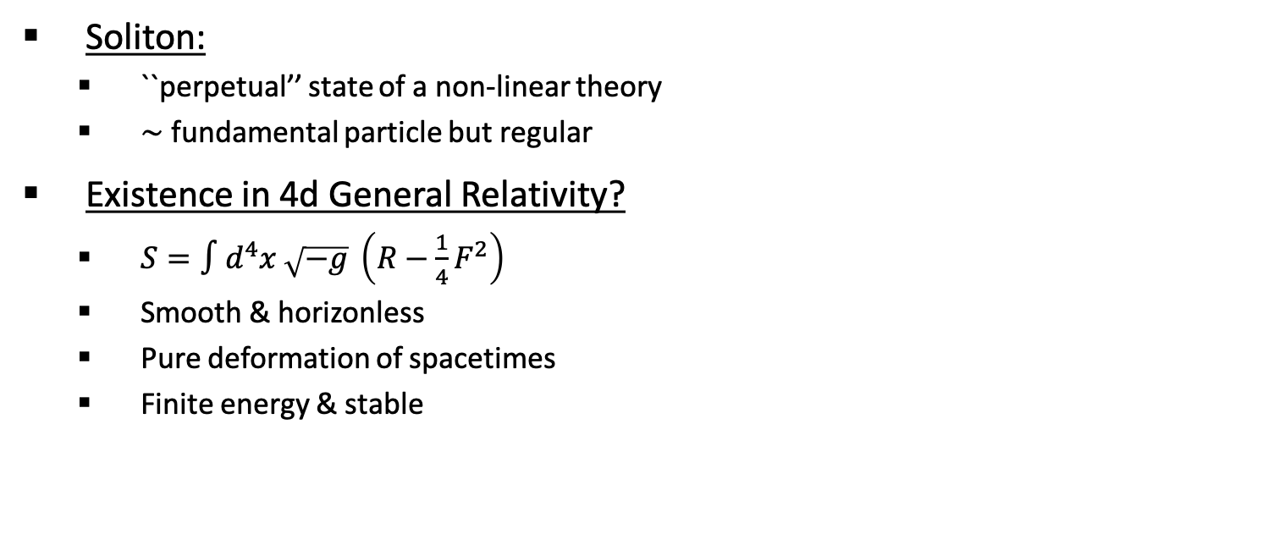
On Solitons in General Relativity
Soliton:
  ``perpetual’’ state of a non-linear theory
  $∼$ fundamental particle but regular
Existence in 4d General Relativity?
  $S=∫d^{4}x \sqrt{−g} \left(R−\frac{1}{4}F^{2}\right)$
  Smooth & horizonless
  Pure deformation of spacetimes
  Finite energy & stable
Serini 1918, Einstein, Pauli ‘41, Breitenlohner, Maison, Gibbons ‘87
No!
No-go Theorem: There are no Gravitational Solitons in 4d GR
?
4

Slide 17



Solitons with extra compact dimensions
Gravity with extra compact dimensions:
  4d spacetime + a compact dimension in vacuum
  Deformation of the circle $⇒$ Deformation of the 4d spacetime
  Topological Soliton: state of gravity produced by the degeneracy of the circle
$$=$$
$$r$$
5

Slide 18
Solitons with extra compact dimensions
Gravity with extra compact dimensions:
  4d spacetime + a compact dimension in vacuum
  Deformation of the circle $⇒$ Deformation of the 4d spacetime
  Topological Soliton: state of gravity produced by the degeneracy of the circle
$$=$$
$$=$$
$$r$$
5
c

Slide 19


Solitons with extra compact dimensions
Gravity with extra compact dimensions:
  4d spacetime + a compact dimension in vacuum
  Deformation of the circle $⇒$ Deformation of the 4d spacetime
  Topological Soliton: state of gravity produced by the degeneracy of the circle
c
Degeneracy of the circle
$$=$$
$$r$$
$$r_{B}$$
5

Slide 20
Solitons with extra compact dimensions
Gravity with extra compact dimensions:
  4d spacetime + a compact dimension in vacuum
  Deformation of the circle $⇒$ Deformation of the 4d spacetime
  Topological Soliton: state of gravity produced by the degeneracy of the circle
c
Degeneracy of the circle
$$=$$
$$r$$
Spacetime ‘‘bubble of nothing’’
Witten ‘81
$$r_{B}$$
5

Slide 21
Solitons with extra compact dimensions
Gravity with extra compact dimensions:
  4d spacetime + a compact dimension in vacuum
  Deformation of the circle $⇒$ Deformation of the 4d spacetime
  Topological Soliton: state of gravity produced by the degeneracy of the circle
c
Degeneracy of the circle
$$=$$
This is the gravitational phase of matter we are looking for!
5

Slide 22

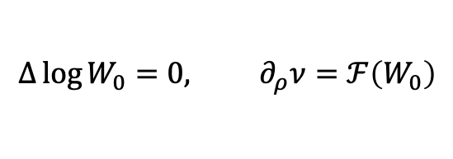
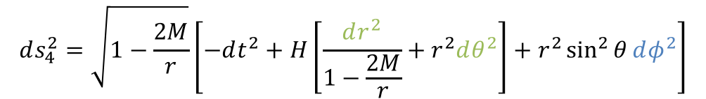
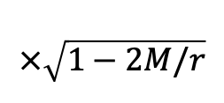



Solution Generating Technique
$$Δ\log{W_{0}}=0, ∂_{ρ}ν=ℱ\left(W_{0}\right)$$
Challenge: Einstein equations
Weyl formalism in 4d GR:
Generalized Weyl formalism
Weyl 1917
$$ds_{4}^{2}=−W_{0} dt^{2}+\frac{1}{W_{0}}\left[e^{2ν}\left(dρ^{2}+dz^{2}\right)+ρ^{2}dφ^{2}\right]$$
Emparan, Reall ‘02
$$z$$
$$φ$$
$$ρ$$
6
$$ds_{4}^{2}=\sqrt{1−\frac{2M}{r}}\left[−dt^{2}+H\left[\frac{dr^{2}}{1−\frac{2M}{r}}+r^{2}dθ^{2}\right]+r^{2}\sin^{2}{θ}dφ^{2}\right]$$
$$×\sqrt{1−2M/r}$$

Slide 23

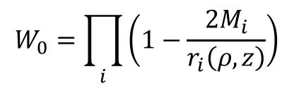

Solution Generating Technique
$$Δ\log{W_{0}}=0, ∂_{ρ}ν=ℱ\left(W_{0}\right)$$
Challenge: Einstein equations
Weyl formalism in 4d GR:
Generalized Weyl formalism
Weyl 1917
Linear Einstein Equations!
$$ds_{4}^{2}=−W_{0} dt^{2}+\frac{1}{W_{0}}\left[e^{2ν}\left(dρ^{2}+dz^{2}\right)+ρ^{2}dφ^{2}\right] ⇒$$
$$W_{0}=\prod_{i}{\left(1−\frac{{2M}_{i}}{r_{i}\left(ρ,z\right)}\right)}$$
Emparan, Reall ‘02
$$z$$
$${2M}_{i}$$
$$φ$$
$$ρ$$
6
$$ds_{4}^{2}=\sqrt{1−\frac{2M}{r}}\left[−dt^{2}+H\left[\frac{dr^{2}}{1−\frac{2M}{r}}+r^{2}dθ^{2}\right]+r^{2}\sin^{2}{θ}dφ^{2}\right]$$
$$×\sqrt{1−2M/r}$$

Slide 24




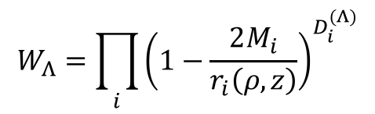
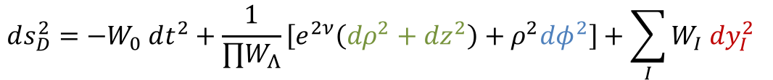
Solution Generating Technique
$$Δ\log{W_{0}}=0, ∂_{ρ}ν=ℱ\left(W_{0}\right)$$
Challenge: Einstein equations
Weyl formalism in 4d GR:
Generalized Weyl formalism
Weyl 1917
Linear Einstein Equations!
$$ds_{4}^{2}=−W_{0} dt^{2}+\frac{1}{W_{0}}\left[e^{2ν}\left(dρ^{2}+dz^{2}\right)+ρ^{2}dφ^{2}\right] ⇒$$
$$W_{Λ}=\prod_{i}{{\left(1−\frac{2M_{i}}{r_{i}\left(ρ,z\right)}\right)}^{D_{i}^{(Λ)}}}$$
Emparan, Reall ‘02
$$ds_{D}^{2}=−W_{0} dt^{2}+\frac{1}{{∏W}_{Λ}}\left[e^{2ν}\left(dρ^{2}+dz^{2}\right)+ρ^{2}dφ^{2}\right]+\sum_{I}{W_{I} dy_{I}^{2}}$$
$y_{1}$-Circle:
$y_{2}$-Circle:
$$z$$
$$z$$
$$z$$
$${2M}_{i}$$
$$φ$$
$$ρ$$
6
$$ds_{4}^{2}=\sqrt{1−\frac{2M}{r}}\left[−dt^{2}+H\left[\frac{dr^{2}}{1−\frac{2M}{r}}+r^{2}dθ^{2}\right]+r^{2}\sin^{2}{θ}dφ^{2}\right]$$
$$×\sqrt{1−2M/r}$$

Slide 25
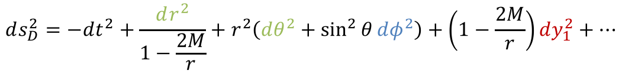






Solution Generating Technique
$$Δ\log{W_{0}}=0, ∂_{ρ}ν=ℱ\left(W_{0}\right)$$
Challenge: Einstein equations
Weyl formalism in 4d GR:
Generalized Weyl formalism
Weyl 1917
Linear Einstein Equations!
$$ds_{4}^{2}=−W_{0} dt^{2}+\frac{1}{W_{0}}\left[e^{2ν}\left(dρ^{2}+dz^{2}\right)+ρ^{2}dφ^{2}\right] ⇒$$
$$W_{Λ}=\prod_{i}{{\left(1−\frac{2M_{i}}{r_{i}\left(ρ,z\right)}\right)}^{D_{i}^{(Λ)}}}$$
Emparan, Reall ‘02
$$ds_{D}^{2}=−W_{0} dt^{2}+\frac{1}{{∏W}_{Λ}}\left[e^{2ν}\left(dρ^{2}+dz^{2}\right)+ρ^{2}dφ^{2}\right]+\sum_{I}{W_{I} dy_{I}^{2}}$$
$y_{1}$-Circle:
$y_{2}$-Circle:
Contains the bubble of nothing
$$z$$
$$z$$
$$z$$
$$ds_{D}^{2}=−dt^{2}+\frac{dr^{2}}{1−\frac{2M}{r}}+r^{2}\left(dθ^{2}+\sin^{2}{θ}dφ^{2}\right)+\left(1−\frac{2M}{r}\right)dy_{1}^{2}+…$$
Regularity: $2M=R_{y_{1}}$
$$2M$$
$$φ$$
$$ρ$$
6
$$ds_{4}^{2}=\sqrt{1−\frac{2M}{r}}\left[−dt^{2}+H\left[\frac{dr^{2}}{1−\frac{2M}{r}}+r^{2}dθ^{2}\right]+r^{2}\sin^{2}{θ}dφ^{2}\right]$$
$$×\sqrt{1−2M/r}$$

Slide 26

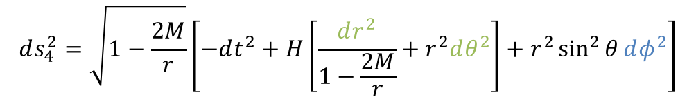
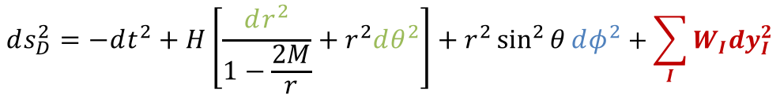
Solution Generating Technique
$$Δ\log{W_{0}}=0, ∂_{ρ}ν=ℱ\left(W_{0}\right)$$
Challenge: Einstein equations
Weyl formalism in 4d GR:
Generalized Weyl formalism
Weyl 1917
Linear Einstein Equations!
$$ds_{4}^{2}=−W_{0} dt^{2}+\frac{1}{W_{0}}\left[e^{2ν}\left(dρ^{2}+dz^{2}\right)+ρ^{2}dφ^{2}\right] ⇒$$
$$W_{Λ}=\prod_{i}{{\left(1−\frac{2M_{i}}{r_{i}\left(ρ,z\right)}\right)}^{D_{i}^{(Λ)}}}$$
Emparan, Reall ‘02
$$ds_{D}^{2}=−W_{0} dt^{2}+\frac{1}{{∏W}_{Λ}}\left[e^{2ν}\left(dρ^{2}+dz^{2}\right)+ρ^{2}dφ^{2}\right]+\sum_{I}{W_{I} dy_{I}^{2}}$$
$y_{1}$-Circle:
$y_{2}$-Circle:
Contains the bubble of nothing
$$z$$
$$z$$
$$z$$
$$ds_{D}^{2}=−dt^{2}+\frac{dr^{2}}{1−\frac{2M}{r}}+r^{2}\left(dθ^{2}+\sin^{2}{θ}dφ^{2}\right)+\left(1−\frac{2M}{r}\right)dy_{1}^{2}+…$$
And smooth bound states of bubbles
$$2M$$
$$ds_{D}^{2}=−dt^{2}+H\left[\frac{dr^{2}}{1−\frac{2M}{r}}+r^{2}dθ^{2}\right]+r^{2}\sin^{2}{θ}dφ^{2}+\sum_{I}{W_{I}dy_{I}^{2}}$$
$$φ$$
$$ρ$$
6
$$ds_{4}^{2}=\sqrt{1−\frac{2M}{r}}\left[−dt^{2}+H\left[\frac{dr^{2}}{1−\frac{2M}{r}}+r^{2}dθ^{2}\right]+r^{2}\sin^{2}{θ}dφ^{2}\right]$$
$$×\sqrt{1−2M/r}$$

Slide 27
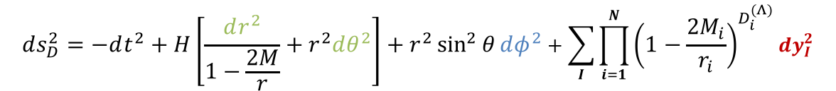
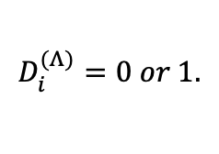








Vacuum Topological Solitons
$$Δ\log{W_{0}}=0, ∂_{ρ}ν=ℱ\left(W_{0}\right)$$
Class of Vacuum Topological Solitons induced by the degeneracy of compact directions
  Reduction to 4d: Singular BH with scalars of mass $\frac{1}{2}M=\frac{1}{2}∑M_{i}$
Bah, PH ‘20
$$ds_{D}^{2}=−dt^{2}+H\left[\frac{dr^{2}}{1−\frac{2M}{r}}+r^{2}dθ^{2}\right]+r^{2}\sin^{2}{θ}dφ^{2}+\sum_{I}{\prod_{i=1}^{N}{{\left(1−\frac{2M_{i}}{r_{i}}\right)}^{D_{i}^{(Λ)}}}dy_{I}^{2}}$$
$$D_{i}^{(Λ)}=0 or 1.$$
accounts for interaction between internal bubbles of different kinds
Sizes of internal bubbles constrained by bubble equations in terms of radii of extra dimensions $R_{y_{I}}$
$y_{1}$-Circle:
$y_{2}$-Circle:
$$z$$
$$z$$
$$z$$
$$2M_{i}$$
$$…$$
$$2M$$
7
$$×\sqrt{1−2M/r}$$

Slide 28


Vacuum Topological Solitons
$$Δ\log{W_{0}}=0, ∂_{ρ}ν=ℱ\left(W_{0}\right)$$
Class of Vacuum Topological Solitons induced by the degeneracy of compact directions
  Reduction to 4d: Singular BH with scalars of mass $\frac{1}{2}M=\frac{1}{2}∑M_{i}$
Bah, PH ’20 ‘21
$$ds_{D}^{2}=−dt^{2}+H\left[\frac{dr^{2}}{1−\frac{2M}{r}}+r^{2}dθ^{2}\right]+r^{2}\sin^{2}{θ}dφ^{2}+\sum_{I}{\prod_{i=1}^{N}{{\left(1−\frac{2M_{i}}{r_{i}}\right)}^{D_{i}^{(Λ)}}}dy_{I}^{2}}$$
$$D_{i}^{(Λ)}=0 or 1.$$
accounts for interaction between internal bubbles of different kinds
Sizes of internal bubbles constrained by bubble equations in terms of radii of extra dimensions $R_{y_{I}}$
$$ds_{4}^{2}=\sqrt{1−\frac{2M}{r}}\left[−dt^{2}+H\left[\frac{dr^{2}}{1−\frac{2M}{r}}+r^{2}dθ^{2}\right]+r^{2}\sin^{2}{θ}dφ^{2}\right]$$
+ bunch of scalar fields
$y_{1}$-Circle:
$y_{2}$-Circle:
$$z$$
$$z$$
$$z$$
$$…$$
$$2M$$
$$∼$$
7
$$×\sqrt{1−2M/r}$$

Slide 29


Instability of Vacuum Solitons
But… Stability issue!
  Bubble of nothing mediates the decay of Kaluza-Klein vacuum spacetimes: it grows indefinitely or collapses
  Another ingredient is required…
Witten ‘81, Gross, Perry, Yaffe ‘82
$$z$$
$$z$$
Grav. Potential
$$2M$$
$$M$$
8

Slide 30


Instability of Vacuum Solitons
But… Stability issue!
  Bubble of nothing mediates the decay of Kaluza-Klein vacuum spacetimes: it grows indefinitely or collapses
  Another ingredient is required: Electromagnetic flux!
Witten ‘81, Gross, Perry, Yaffe ‘82
$$→ E_{flux}∼∫F^{2}∼\frac{Q^{2}}{r^{2}}$$
$$z$$
$$z$$
Contraction-resistant term
Grav. Potential
$$Q$$
$$2M$$
$$M$$
Expectation: meta-stable Gravitational Solitons with compact dimensions and EM flux could exist!
Question: Can we actually construct them? What is their physics?
8

Slide 31
Vacuum solitons in gravity
Charged solitons in gravity
Solitons that resolve Schwarzschild horizon
Some gravitational properties

Slide 32





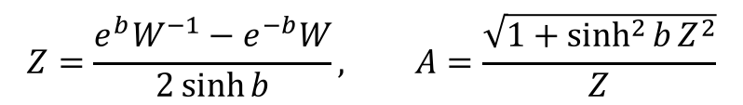
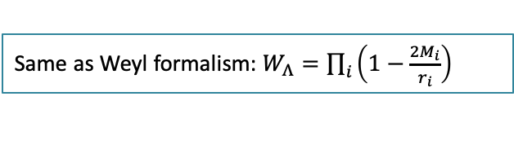
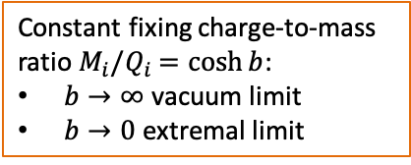

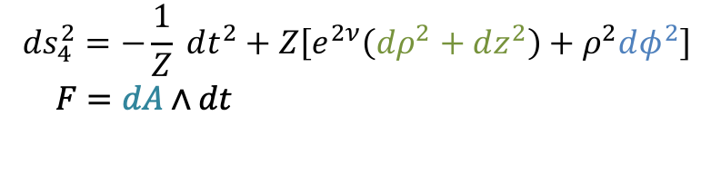
Electrostatic Ernst Formalism in 4d
Challenge: Einstein Maxwell equations
Electrostatic Ernst formalism in 4d:
Solution-generating techniques:
  Inverse scattering: Generic solutions with an arbitrary number of sources (BH here) induced by a mass parameter $M_{i}$ and a charge $Q_{i}$
Ernst ‘68
$$ds_{4}^{2}=−\frac{1}{Z} dt^{2}+Z\left[e^{2ν}\left(dρ^{2}+dz^{2}\right)+ρ^{2}dφ^{2}\right]$$
$$F=dA∧dt$$
$$⇒$$
Non-linear Ernst equations
but integrable!
Ruiz, Manko, Martin ‘95
Charged Weyl formalism: Linear solutions for an arbitrary number of sources with $M_{i}/Q_{i}=cst$
$$z$$
$$Q_{i}$$
$${2M}_{i}$$
Bah, PH ’20, ‘21
$$Z=\frac{e^{b}W^{−1}−e^{−b}W}{2\sinh{b}}, A=\frac{\sqrt{1+\sinh^{2}{b}Z^{2}}}{Z}$$
Same as Weyl formalism: $W_{Λ}=\prod_{i}{\left(1−\frac{2M_{i}}{r_{i}}\right)}$
Constant fixing charge-to-mass ratio $M_{i}/Q_{i}$ $=\cosh{b}$:
$b→∞$ vacuum limit
$b→0$ extremal limit
$$φ$$
$$ρ$$
9

Slide 33





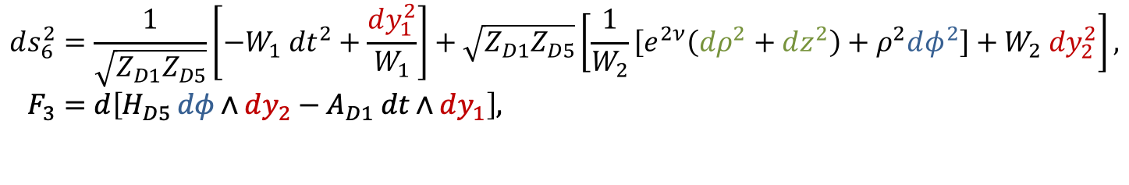




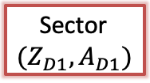
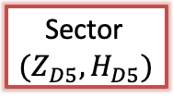
Generalized Ernst Formalism
Classification of higher-dimensional frameworks with specific gauge fields for which EOM admit a decomposition in set of Ernst Equations:
  M-theory on $T^{6}×S^{1}$ with M2-M2-M2-KKm flux
  Type IIB on $T^{4}×S^{1}×S^{1}$ with D1-D5-P-KKm flux
  D1-D5 system on $S^{1}×S^{1}$ and rigid $T^{4}$
PH ‘21
$$ds_{6}^{2}=\frac{1}{\sqrt{Z_{D1}Z_{D5}}}\left[−W_{1} dt^{2}+\frac{dy_{1}^{2}}{W_{1}}\right]+\sqrt{Z_{D1}Z_{D5}}\left[\frac{1}{W_{2}}\left[e^{2ν}\left(dρ^{2}+dz^{2}\right)+ρ^{2}dφ^{2}\right]+W_{2} dy_{2}^{2}\right],$$
$$F_{3}=d\left[H_{D5} dφ∧dy_{2}−A_{D1} dt∧dy_{1}\right],$$
$y_{1}$-Circle:
$y_{2}$-Circle:
$$z$$
$$z$$
$$z$$
Sector $(Z_{D1},A_{D1})$
$$Q_{D1},Q_{D5}$$
Ernst equations
Solve each sector independently and build Topological Solitons supported by flux induced by degeneracy of compact dimensions
$$M_{i}$$
$$q_{D1i}$$
$$q_{D5i}$$
Sector $(Z_{D5},H_{D5})$
$$2M$$
Sector $W_{1}$
Weyl equations
Sector $W_{2}$
Bah, PH ’20, ’21, ’22, ‘23; PH ’21;
Bah, Weck, PH ‘22
$$ρ$$
$$φ$$
10

Slide 34
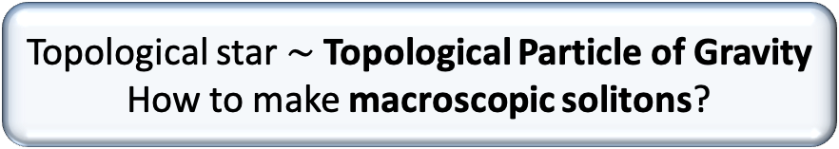

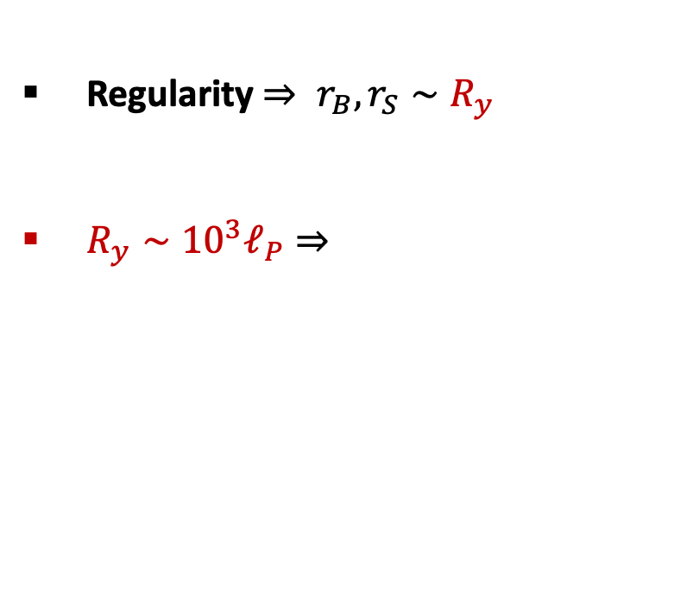
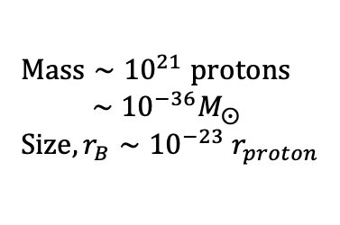
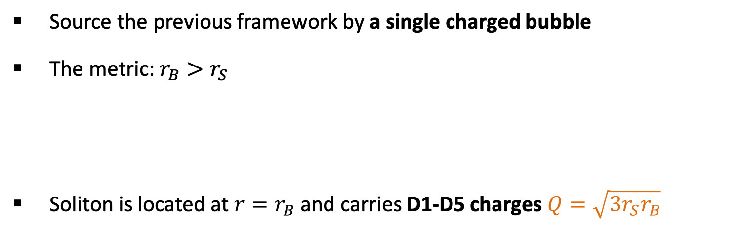
A Topological Star
Source the previous framework by a single charged bubble
The metric: $r_{B}>r_{S}$
Soliton is located at $r=r_{B}$ and carries D1-D5 charges $Q=\sqrt{3r_{S}r_{B}}$
Bah, PH PRL ’20
$$ds^{2}=−\left(1−\frac{r_{S}}{r}\right)dt^{2}+\left(1−\frac{r_{B}}{r}\right)dy^{2}+\frac{dr^{2}}{\left(1−\frac{r_{S}}{r}\right)\left(1−\frac{r_{B}}{r}\right)}+r^{2}\left[dθ^{2}+\sin^{2}θ dφ^{2}\right]$$
Extra Dimension
Sphere
Regularity $⇒ r_{B},r_{S}∼R_{y}$
$R_{y}∼{10}^{3}ℓ_{P}⇒$
Extra dimension size
$Mass∼{10}^{21} protons$
$∼{10}^{−36}M_{⨀}$
$Size, r_{B}∼{10}^{−23} r_{proton}$
$$Q$$
$$r$$
Topological star $∼$ Topological Particle of Gravity
How to make macroscopic solitons?
$$r_{B}$$
$$r_{S}$$
Sphere
y-circle
11
Stotyn, Mann ‘11, Bah, PH PRL ‘20

Slide 35
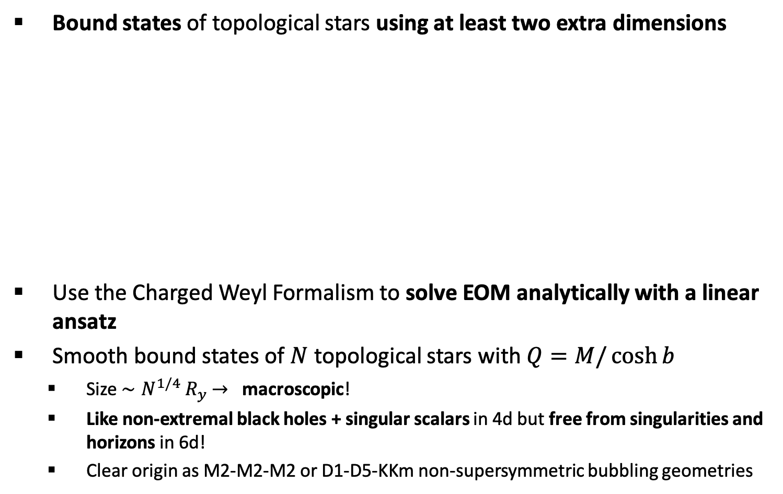

Bubble Bag Ends
Bound states of topological stars using at least two extra dimensions
Use the Charged Weyl Formalism to solve EOM analytically with a linear ansatz
Smooth bound states of $N$ topological stars with $Q=M/\cosh{b}$
  Size $∼N^{1/4}{ R}_{y}$ $→$ macroscopic!
  Like non-extremal black holes + singular scalars in 4d but free from singularities and horizons in 6d!
  Clear origin as M2-M2-M2 or D1-D5-KKm non-supersymmetric bubbling geometries
Bah, PH ’20, ’21, ‘22; PH ‘21
size?
$$Q$$
Sphere
y₁-circle
y₂-circle
12

Slide 36
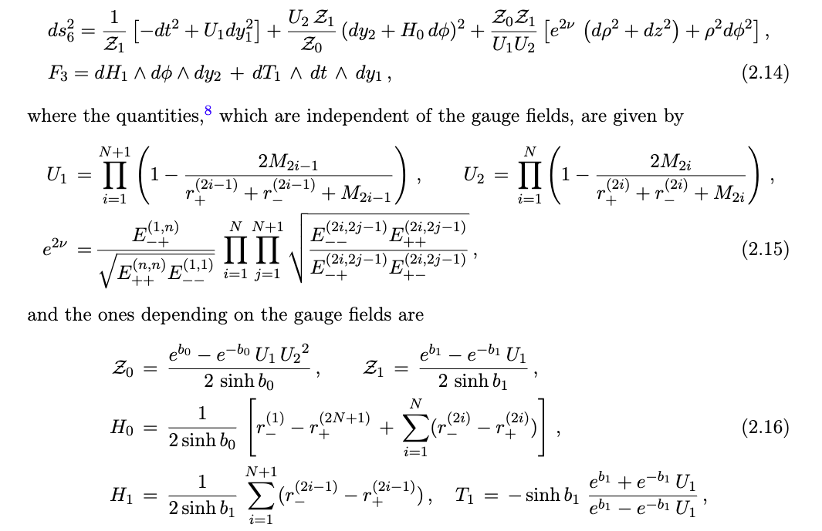
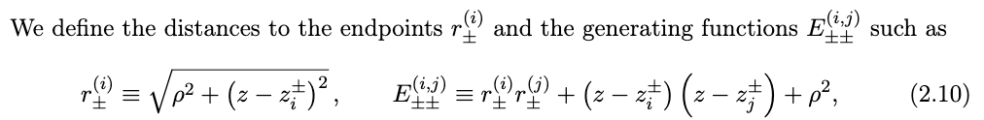
Bubble Bag Ends
Bah, PH ’21
But…. The geometries still have non-zero total charges
13

Slide 37
Vacuum solitons in gravity
Charged solitons in gravity
Solitons that resolve Schwarzschild horizon
Some gravitational properties

Slide 38







Resolving Schwarzschild?
How to resolve Schwarzschild arbitrarily close to its horizon using extra dimensions and flux?
Brane Flux
$$×$$
$$×$$
Non-trivial gauge field profiles , $A_{I},$ in 4d
Non-trivial scalar profiles, $Φ_{I},$ in 4d
$$Φ_{I}, A_{I}$$
$$0$$
$$r−2M$$
14

Slide 39

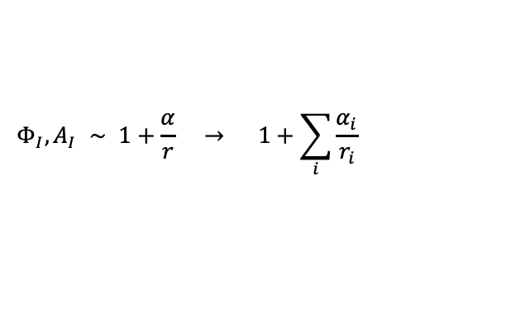
Resolving Schwarzschild?
How to resolve Schwarzschild arbitrarily close to its horizon using extra dimensions and flux?
Brane Flux
$$×$$
$$×$$
Non-trivial gauge field profiles , $A_{I},$ in 4d
Non-trivial scalar profiles, $Φ_{I},$ in 4d
Extremal SUSY BH have already scalar and gauge field tails
$$Φ_{I}, A_{I}$$
$$Φ_{I}, A_{I} ∼ 1+\frac{α}{r} → 1+\sum_{i}{\frac{α_{i}}{r_{i}}}$$
$∼$ vacuum solution
How to proceed for Schwarzschild?
$$0$$
$$ε$$
$$r−2M$$
Bah, PH ’23
14

Slide 40
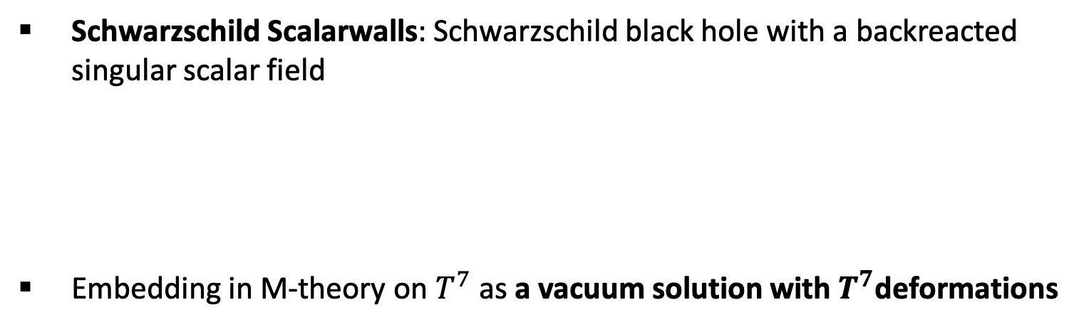

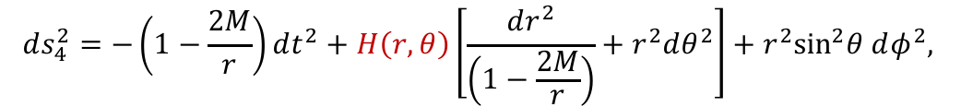
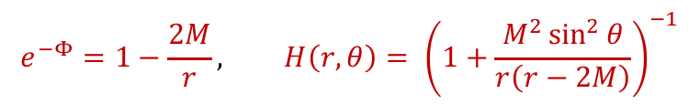
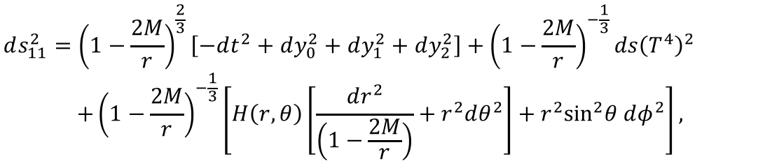
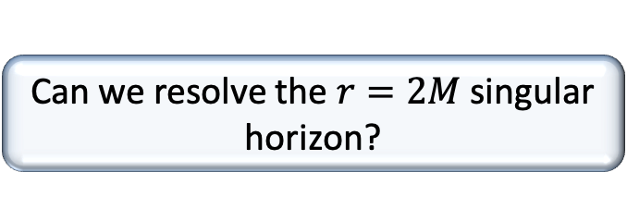
Schwarzschild Scalarwalls
Schwarzschild Scalarwalls: Schwarzschild black hole with a backreacted singular scalar field
Embedding in M-theory on $T^{7}$ as a vacuum solution with $T^{7}$deformations
Bah, PH ’23
$$ds_{4}^{2}=−\left(1−\frac{2M}{r}\right)dt^{2}+H\left(r,θ\right)\left[\frac{dr^{2}}{\left(1−\frac{2M}{r}\right)}+r^{2}dθ^{2}\right]+r^{2}\sin^{2}θ dφ^{2},$$
$$e^{−Φ}=1−\frac{2M}{r}, H\left(r,θ\right)= {\left(1+\frac{M^{2}\sin^{2}{θ}}{r\left(r−2M\right)}\right)}^{−1}$$
$$ds_{11}^{2}={\left(1−\frac{2M}{r}\right)}^{\frac{2}{3}}\left[−dt^{2}+dy_{0}^{2}+dy_{1}^{2}+dy_{2}^{2}\right]+{\left(1−\frac{2M}{r}\right)}^{−\frac{1}{3}}ds{\left(T^{4}\right)}^{2}$$
$${+\left(1−\frac{2M}{r}\right)}^{−\frac{1}{3}}\left[H\left(r,θ\right)\left[\frac{dr^{2}}{\left(1−\frac{2M}{r}\right)}+r^{2}dθ^{2}\right]+r^{2}\sin^{2}θ dφ^{2}\right],$$
$$×$$
Can we resolve the $r=2M$singular horizon?
15

Slide 41
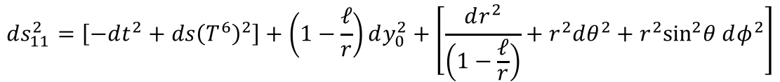
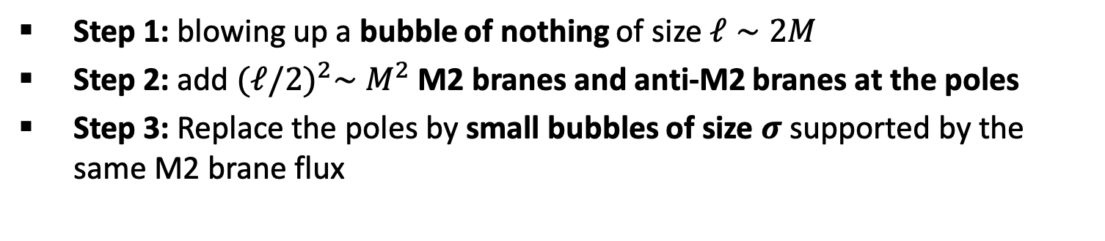

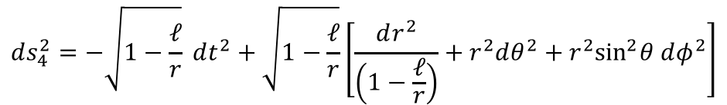


Geometric Resolution
Step 1: blowing up a bubble of nothing of size $ℓ∼2M$
Step 2: add ${(ℓ/2)}^{2}∼M^{2}$ M2 branes and anti-M2 branes at the poles
Step 3: Replace the poles by small bubbles of size $σ$ supported by the same M2 brane flux
$$ds_{11}^{2}=\left[−dt^{2}+ds{\left(T^{6}\right)}^{2}\right]+\left(1−\frac{ℓ}{r}\right)dy_{0}^{2}+\left[\frac{dr^{2}}{\left(1−\frac{ℓ}{r}\right)}+r^{2}dθ^{2}+r^{2}\sin^{2}θ dφ^{2}\right]$$
$$ds_{4}^{2}=−\sqrt{1−\frac{ℓ}{r}} dt^{2}+\sqrt{1−\frac{ℓ}{r}}\left[\frac{dr^{2}}{\left(1−\frac{ℓ}{r}\right)}+r^{2}dθ^{2}+r^{2}\sin^{2}θ dφ^{2}\right]$$
+ scalar $∼1−\frac{ℓ}{r}$
Red. on $T^{7}$
$$ℓ$$
Sphere
y₀-circle
y_{I}-circle
16

Slide 42
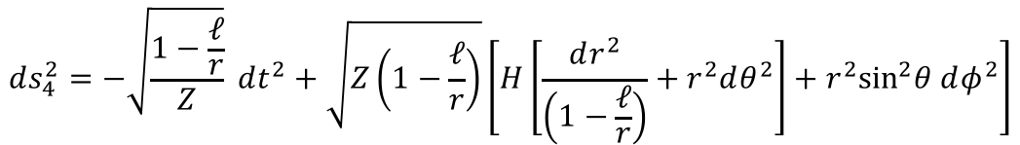




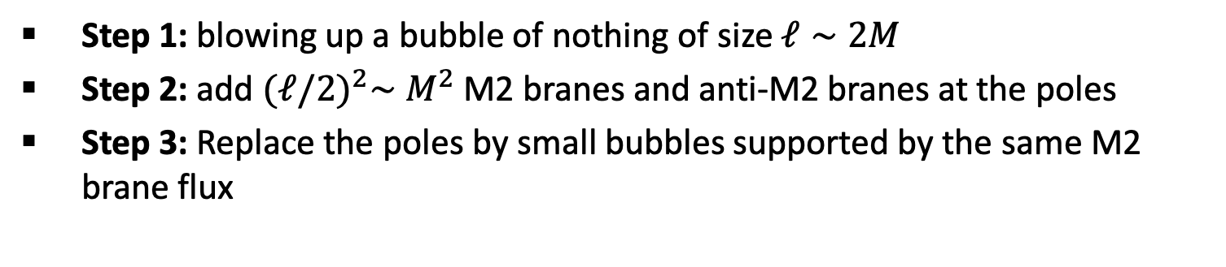
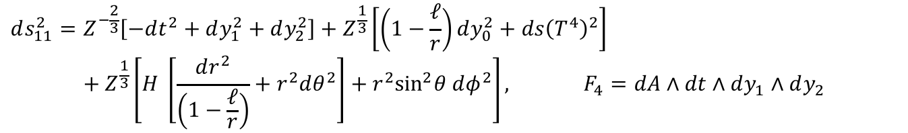


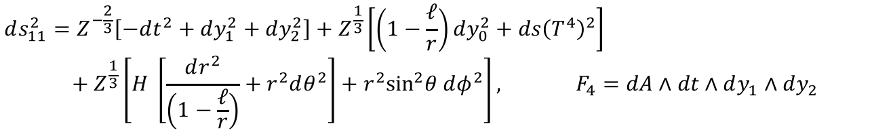
Geometric Resolution
$$ds_{11}^{2}=Z^{−\frac{2}{3}}\left[−dt^{2}+dy_{1}^{2}+dy_{2}^{2}\right]+Z^{\frac{1}{3}}\left[\left(1−\frac{ℓ}{r}\right)dy_{0}^{2}+ds{\left(T^{4}\right)}^{2}\right]$$
$${+ Z}^{\frac{1}{3}}\left[H \left[\frac{dr^{2}}{\left(1−\frac{ℓ}{r}\right)}+r^{2}dθ^{2}\right]+r^{2}\sin^{2}θ dφ^{2}\right], F_{4}=dA∧dt∧dy_{1}∧dy_{2}$$
Step 1: blowing up a bubble of nothing of size $ℓ∼2M$
Step 2: add ${(ℓ/2)}^{2}∼M^{2}$ M2 branes and anti-M2 branes at the poles
Step 3: Replace the poles by small bubbles supported by the same M2 brane flux
$Z∼{\left(1−\frac{ℓ}{r}\right)}^{−1}$for $r≳2M+R_{y_{0}}$
$$ds_{11}^{2}=Z^{−\frac{2}{3}}\left[−dt^{2}+dy_{1}^{2}+dy_{2}^{2}\right]+Z^{\frac{1}{3}}\left[\left(1−\frac{ℓ}{r}\right)dy_{0}^{2}+ds{\left(T^{4}\right)}^{2}\right]$$
$${+ Z}^{\frac{1}{3}}\left[H \left[\frac{dr^{2}}{\left(1−\frac{ℓ}{r}\right)}+r^{2}dθ^{2}\right]+r^{2}\sin^{2}θ dφ^{2}\right], F_{4}=dA∧dt∧dy_{1}∧dy_{2}$$
$A∼0$ for $r≳2M+R_{y_{0}}$
$$ds_{4}^{2}=−\sqrt{\frac{1−\frac{ℓ}{r}}{Z}} dt^{2}+\sqrt{Z\left(1−\frac{ℓ}{r}\right)}\left[H\left[\frac{dr^{2}}{\left(1−\frac{ℓ}{r}\right)}+r^{2}dθ^{2}\right]+r^{2}\sin^{2}θ dφ^{2}\right]$$
+ scalars
Red. on $T^{7}$
$${−q}_{M2}$$
$$δ_{ph}∼R_{y_{0}}$$
$$ℓ$$
$$∼$$
$$q_{M2}$$
Sphere
y₀-circle
y₁-circle
17

Slide 43


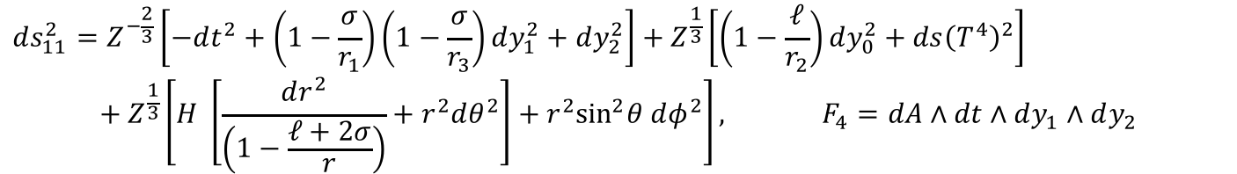

Geometric Resolution
$$ds_{11}^{2}=Z^{−\frac{2}{3}}\left[−dt^{2}+dy_{1}^{2}+dy_{2}^{2}\right]+Z^{\frac{1}{3}}\left[\left(1−\frac{ℓ}{r}\right)dy_{0}^{2}+ds{\left(T^{4}\right)}^{2}\right]$$
$${+ Z}^{\frac{1}{3}}\left[H \left[\frac{dr^{2}}{\left(1−\frac{ℓ}{r}\right)}+r^{2}dθ^{2}\right]+r^{2}\sin^{2}θ dφ^{2}\right], F_{4}=dA∧dt∧dy_{1}∧dy_{2}$$
Step 1: blowing up a bubble of nothing of size $ℓ∼2M$
Step 2: add ${(ℓ/2)}^{2}∼M^{2}$ M2 branes and anti-M2 branes at the poles
Step 3: Replace the poles by small bubbles supported by the same M2 brane flux
$$ds_{11}^{2}=Z^{−\frac{2}{3}}\left[−dt^{2}+\left(1−\frac{σ}{r_{1}}\right)\left(1−\frac{σ}{r_{3}}\right)dy_{1}^{2}+dy_{2}^{2}\right]+Z^{\frac{1}{3}}\left[\left(1−\frac{ℓ}{r_{2}}\right)dy_{0}^{2}+ds{\left(T^{4}\right)}^{2}\right]$$
$${+ Z}^{\frac{1}{3}}\left[H \left[\frac{dr^{2}}{\left(1−\frac{ℓ+2σ}{r}\right)}+r^{2}dθ^{2}\right]+r^{2}\sin^{2}θ dφ^{2}\right], F_{4}=dA∧dt∧dy_{1}∧dy_{2}$$
First example of topological solitons that resolve the horizon of a Schwarzschild black hole + a scalar tail
$$σ$$
$${−q}_{M2}$$
$$ℓ$$
$$∼$$
$$σ$$
$$q_{M2}$$
Sphere
y₀-circle
y₁-circle
18

Slide 44
Vacuum solitons in gravity
Charged solitons in gravity
Solitons that resolve Schwarzschild horizon
Some gravitational properties

Slide 45



Lensing and Gravitational Wave Signatures
Two experiments allow to probe the near-environment of black holes.
Gravitational lensing:
Gravitational wave emission:
What are the gravitational characteristics of topological solitons compared to those of a black hole?
?
BH and TS do not emit light but scatter light rays
?
After the gravitational merger, the final state relaxes by emitting a ringdown gravitational wave signal.
19

Slide 46
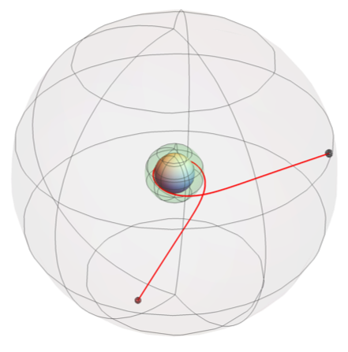

Gravitational Lensing and Imaging
Topological Soliton $→$ intense spacetime deformation $⇒$ intense lensing
Photons follow geodesic trajectories
Like black holes, they are circumscribed by an photon ring ($∼$ shadow) where light can be trapped.
However, incoming photons do not fall into a horizon ($≠$shadow) but bounce on the soliton after a chaotic trajectory
Topological Soliton
Light ray
Photon Ring
Bah, Berti, PH ’22
19

Slide 47



Imaging Topological Solitons
What do Topological solitons look like in the sky?
  Build a ray tracing code
  Shoot 10⁶ light rays from a celestial sphere
  Reconstruct the picture as seen from a distant observer
Bah, Berti, PH ’22
Flat Space:
Schwarzschild:
Photon Rings match with Schwarzschild Shadow in size and scattering properties
20

Slide 48






Imaging Topological Solitons
Use a star patch for more ``arty’’ imaging
Incoming light endures high redshift and chaotic trajectories $→$ intensity should be suppressed beyond the probe limit
Bah, Berti, PH ’22
Flat Space:
Schwarzschild:
21

Slide 49





Imaging Topological Solitons
Imaging from a bright accretion disk $→$ $∼$EHT
Bah, Berti, PH ’22
Flat Space:
Schwarzschild:
Expectation:
blurred and faded cloud should emerge from inside the shadow
22

Slide 50
Gravitational Wave Signal
Gravitational waves are governed by quasi-normal modes
For a static black hole, the fundamental modes localize at the shadow and are determined by its scattering properties
Topological solitons replace the horizon by a smooth microstructure with stable photon rings. How does it affect quasi-normal modes?
  Fundamental modes localize at the microstructure
  Black hole modes are part of the spectrum
  but cavity effect on their decay time
Shadow
Signal
Black Hole
time
Bah, Berti, Speeney, PH ’23
23

Slide 51
Gravitational Wave Signal
Gravitational waves are governed by quasi-normal
For a static black hole, the fundamental modes localize at the shadow and are determined by its scattering properties
Topological solitons replace the horizon by a smooth microstructure with stable photon rings. How does it affect quasi-normal modes?
  Fundamental modes localize at the microstructure
  Black hole modes are part of the spectrum
  but cavity effect on their decay time
Echoes in the long-term signal
Short-term signal is identical to black hole signal but with a damping tail
Photon ring
Signal
Topological
Star
time
time
Signature of topological microstructure in GW signal
Bah, Berti, Speeney, PH ’23
23

Slide 52


Conclusion and Outlook
  Fundamental states of Quantum Gravity that manifest as Topological Solitons in Gravity exist. Their phenomenology and fundamental role open a window into new astrophysics and black hole physics.
  Solitons in Anti-de Sitter spacetimes and application to holography?
  General phase space of topological solitons? Spinning solitons? Chern-Simons interactions?
  Physical observables for future experiments?
  General aspect of stability and existence?
  Nucleation in the early universe (dark matter?) or late stage of matter collapse (BH)?
Thank you for your attention
Bah, PH ’22;
Houppe, PH ‘22
Bah, Berti, PH ’22; Bah, Berti, Speeney, PH ‘23
Bah, Dey, PH ‘21

