Slide 1
チャーム・ボトムの「ハドロン原子核物理」の最近の展開
安井 繁宏
Tokyo Institute of Technology東京工業大学
原子核三者若手夏の学校2017@国立オリンピック記念青少年総合センター, 21-25 Aug. 2017

Slide 2
“More Is Different”
P. W. Anderson, Science Vo. 177, p. 394 (1972)
“More Flavor Is Different”
S. Yasui (2017)

Slide 3

Japan

Slide 4

Japan
Tokyo Institute of Technology

Slide 5
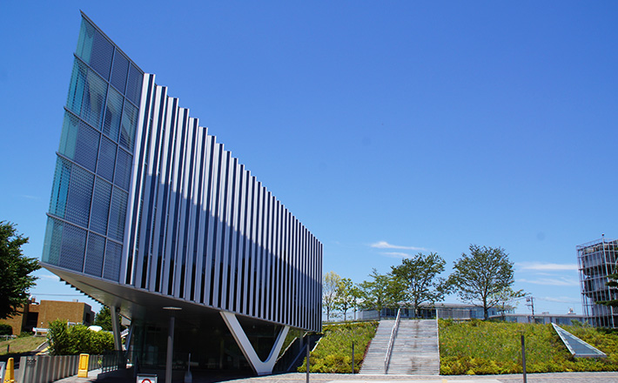
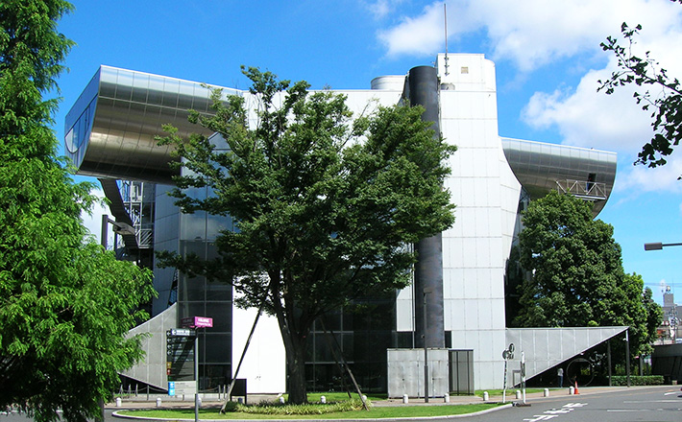
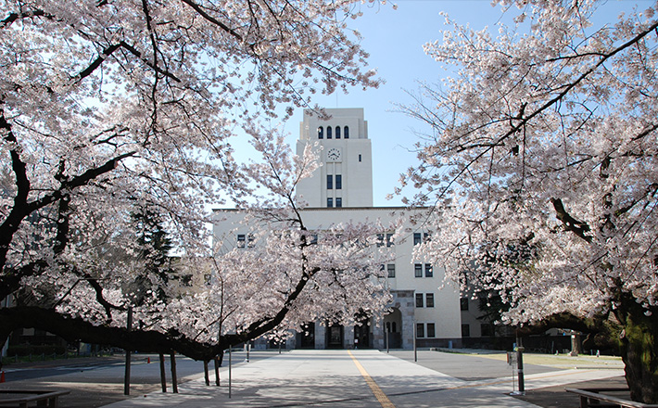
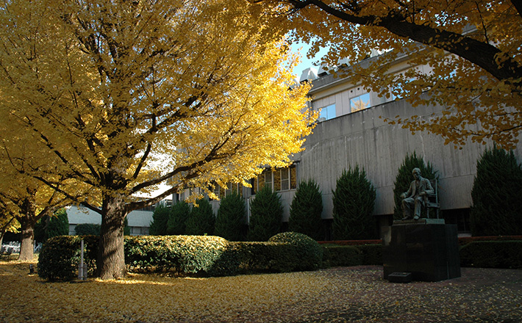
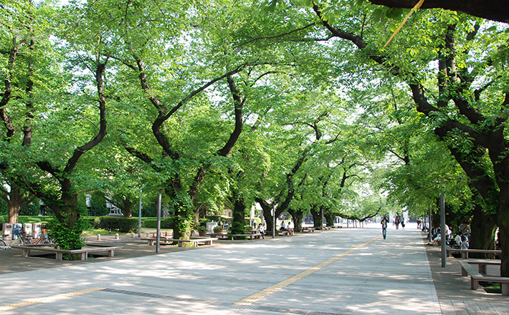
Cafeteria
Library
Photos of Tokyo Tech
↓Museum
(replica of Nobel
prize medal)

Slide 6
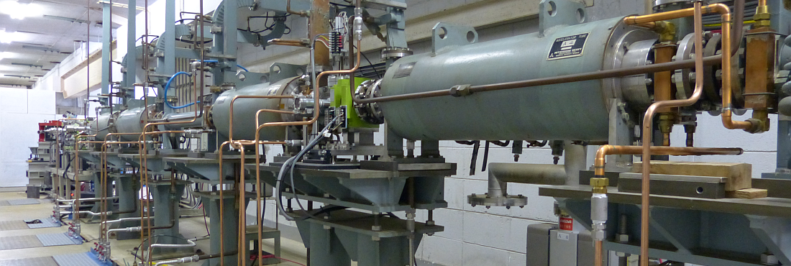
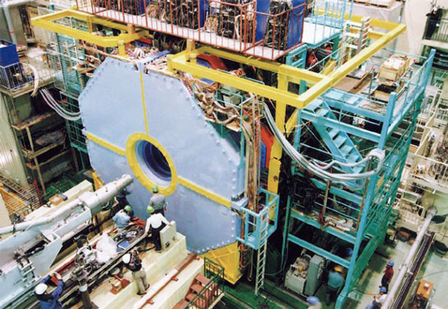
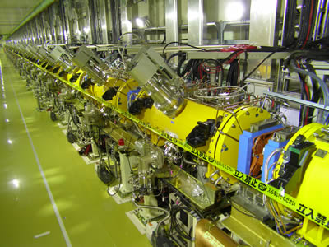
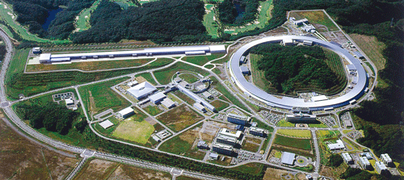
ELPH
(Research Center for Electron Photon Science)
Japan
KEK (BelleI&II)
J-PARC
(Japan Proton Accelerator Research Complex)
Tokyo Institute of Technology
S-Pring 8
(Super Photon ring-8 GeV)

Slide 7
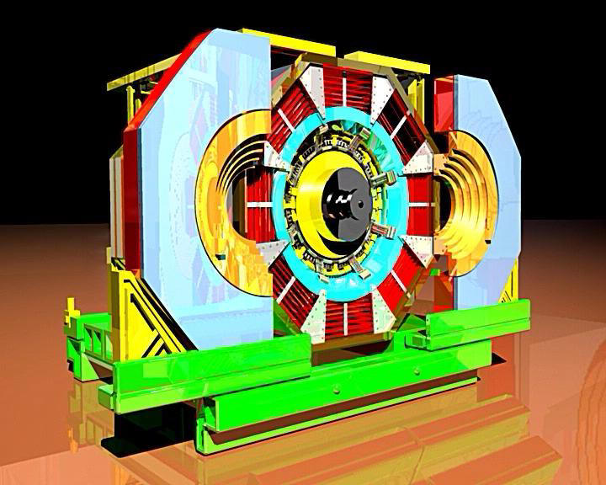
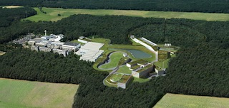
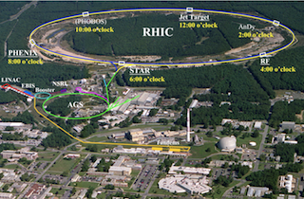
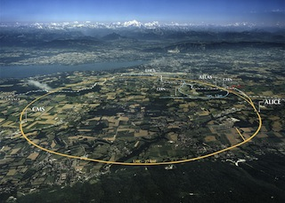


GSI-FAIR
BNL-RHIC
BES
CERN-LHC
Japan

Slide 8
List of related review papers
Exotic heavy hadrons
・ The new heavy mesons: A status report:
E. S. Swanson, Phys. Rep. 429, 243 (2006)
・ Charmonium:
M. B. Voloshin, Prog. Part. Nucl. Phys. 61, 455 (2008)
・ Heavy quarkonium: progress, puzzles, and opportunities:
N. Brambilla et al., Eur. Phys. J. C71, 1534 (2011)
・ QCD and strongly coupled gauge theories: challenges and future perspectives:
N. Brambilla et al., Eur. Phys. J. C74, 2981 (2014)
・ The hidden charm pentaquark and tetraquark states:
H.-X Chen, W. Chen, X. Liu, S.-L. Zhu, Phys. Rep. 639, 1 (2016)
・ Exotic hadrons with heavy flavors: X, Y, Z, and relates states:
A. Hosaka, T. Iijima, K. Miyabayashi, Y. Sakai, S. Yasui, PTEP 2016, 062C01 (2016)
・ Heavy-Quark QCD Exotica:
R. F. Lebed, R. E. Mitchel, E. S. Swanson, Prog. Part. Nucl. Phys. 93, 143 (2017)
・ Multiquark resonances:
A. Esposito, A. Pilloni, A. D. Plolsa, Phys. Rep. 668, 1 (2017)
Exotic hadrons from heavy ion collisions
・ Exotic hadrons from heavy ion collisions:
S. Cho et al. [ExHIC collaboration], Prog. Part. Nucl. Phys. 95, 279 (2017)
Heavy hadrons in nuclear matter
・ Heavy hadrons in nuclear matter:
A. Hosaka, T. Hyodo, K. Sudoh, Y. Yamaguchi, S. Yasui, Prog. Part. Nucl. Phys. 96, 88 (2017)

Slide 9
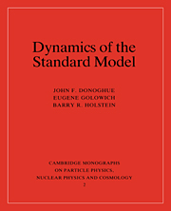
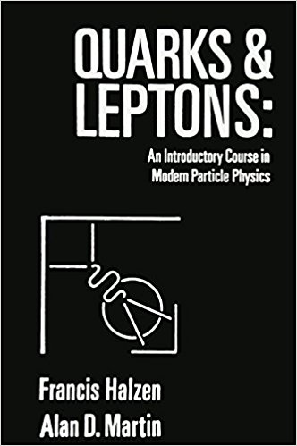


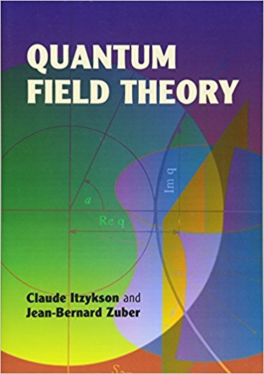
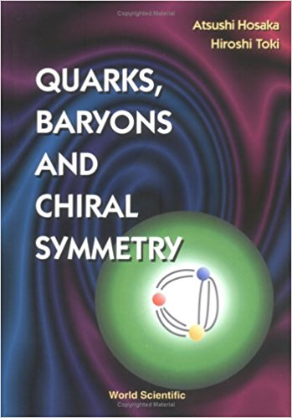
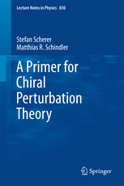
Recommended text books (hadron phenomenology)

Slide 10
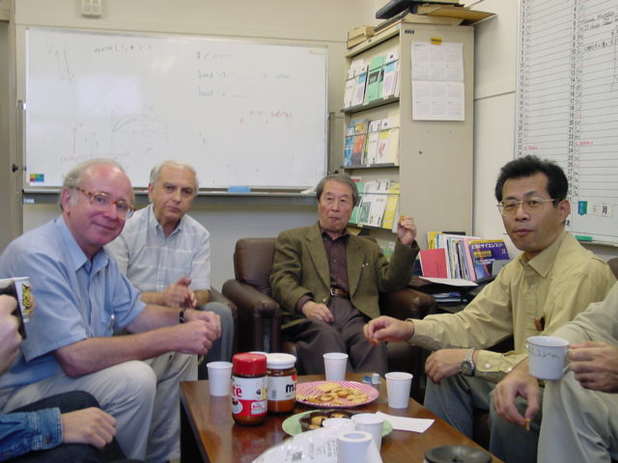
How to study physics？
(Message by Prof. V. A. Miransky)
D. Ebert
V. A. Miransky
H. Toki
Y. Nambu

Slide 11
How to study physics？
(Message by Prof. V. A. Miransky)
① Study hard.
D. Ebert
V. A. Miransky
H. Toki
Y. Nambu
② Study hard.
③ Study hard.

Slide 13
Start

Slide 14
Keywords
Tetraquark
Exotic
Spectroscopy
Heavy quark symmetry
Charm
XYZ
Heavy hadron effective theory
Bottom
Spin
Pentaquark

Slide 15
Content
1. Introduction
2. Theoretical framework for heavy hadrons
2.1 Heavy quark symmetry
2.2 Heavy hadron effective theory
3. Heavy exotic hadrons -X, Y, Z hadrons-
3.1 What does “exotic” mean?
3.2 X(3872)
3.3 Y(4260)
3.4 Z_{c}(3900)
3.5 Z_{b}(10610) and Z_{b}(10650)
3.6 P_{c}(4380) and P_{c}(4450): charm pentaquark
3.7 T_{cc} -new possible exotic hadrons-
3.8 Brief summary
4. Heavy hadrons at extreme conditions
4.1 Productions in relativistic heavy ion collisions
4.2 Properties of heavy hadrons in nuclear matter
5. Summary

Slide 16
Content
1. Introduction
2. Theoretical framework for heavy hadrons
2.1 Heavy quark symmetry
2.2 Heavy hadron effective theory
3. Heavy exotic hadrons -X, Y, Z hadrons-
3.1 What does “exotic” mean?
3.2 X(3872)
3.3 Y(4260)
3.4 Z_{c}(3900)
3.5 Z_{b}(10610) and Z_{b}(10650)
3.6 P_{c}(4380) and P_{c}(4450): charm pentaquark
3.7 T_{cc} -new possible exotic hadrons-
3.8 Brief summary
4. Heavy hadrons at extreme conditions
4.1 Productions in relativistic heavy ion collisions
4.2 Properties of heavy hadrons in nuclear matter
5. Summary

Slide 17
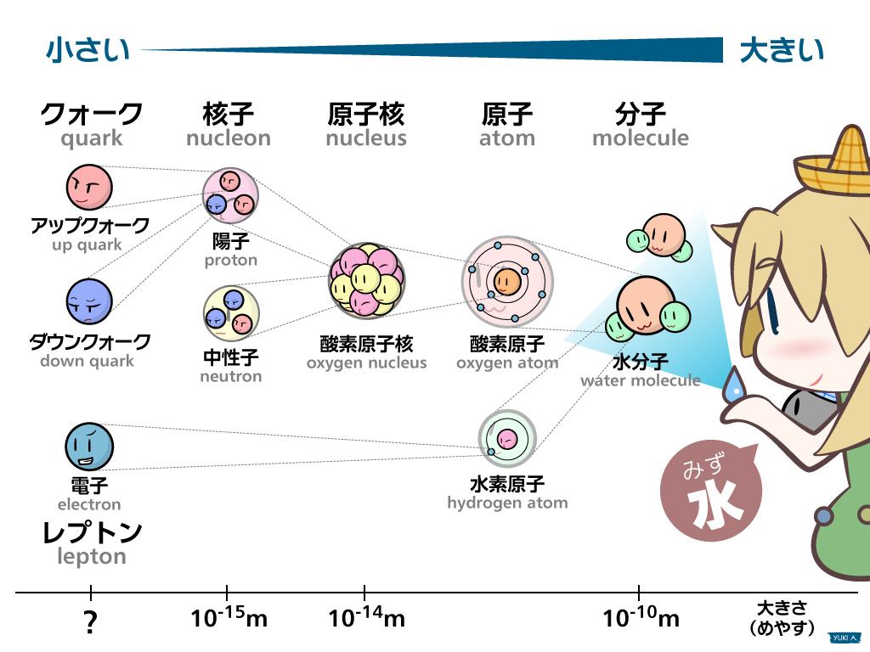
物質とは？
HiggsTan.com

Slide 18
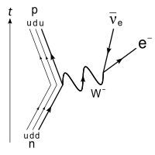
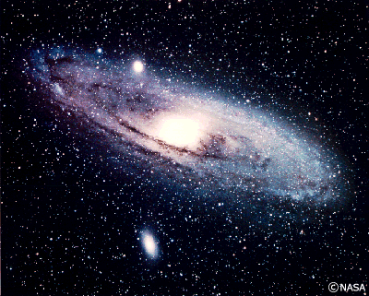
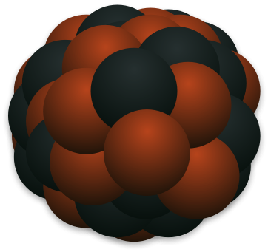
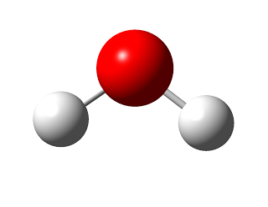
力とは？
万物の理論？？
大統一理論？
電弱力
強い力
電磁気力
弱い力
重力
原子核・ハドロン
原子・分子
ニュートリノ
天体・宇宙

Slide 19
Modern view of Nature
1. Introduction
Matter and Field
Newton equation od motion
ma = F

Slide 20
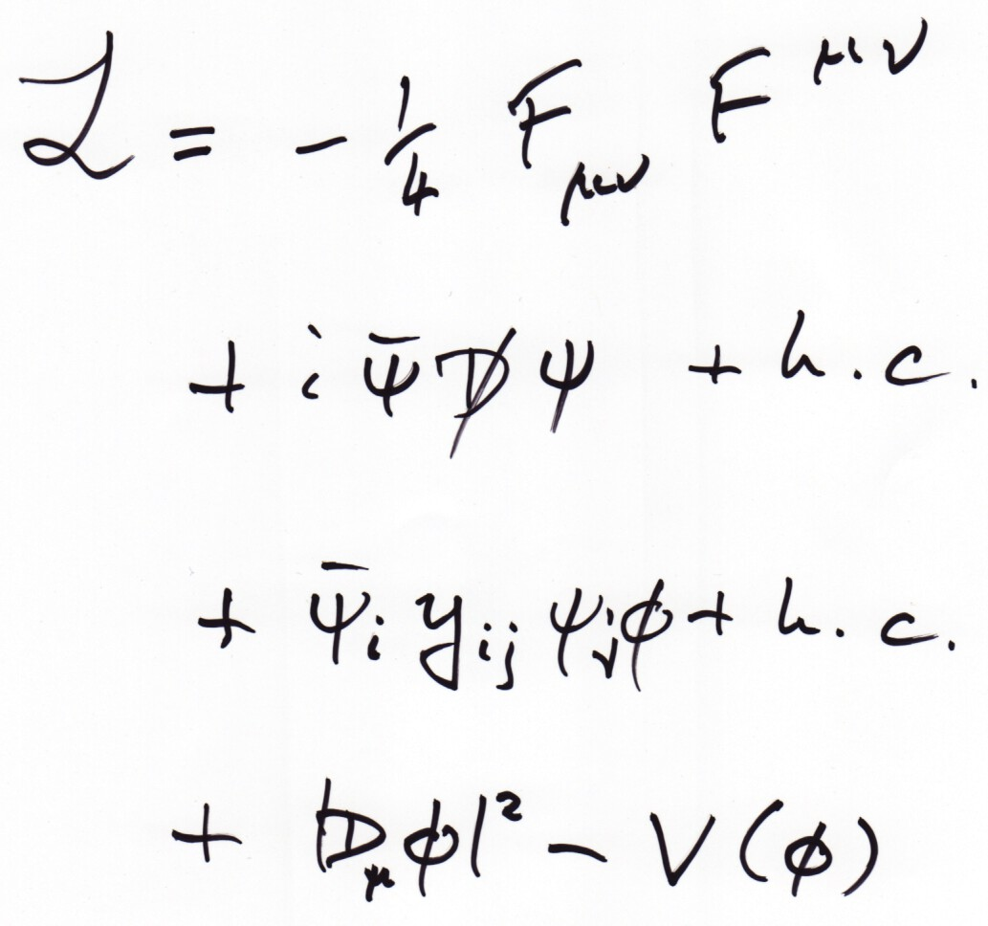
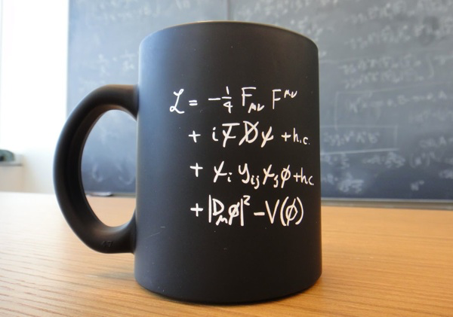
1. Introduction
Basic laws of fundamental particles
Force (gauge field)
Matter (fermion field)
Fermion Mass (coupling to Higgs)
Origin of Mass (Higgs)

Slide 21
1. Introduction
原子
原子核
1000倍-10000倍
原子核
〜10⁻¹⁰ m
〜10⁻¹⁵-10⁻¹⁴ m

Slide 22
1. Introduction
単位の話
1 mm = 10⁻³ m
1 μm = 10⁻⁶ m
1 nm = 10⁻⁹ m
1 pm = 10⁻¹² m
1 fm = 10⁻¹⁵ m
ミリメートル
マイクロメートル
ナノメートル
ピコメートル
ハドロン・原子核
の典型的大きさ
フェムトメートル

Slide 23
1. Introduction
単位の話
（ちょっとややこしい）
陽子の質量 = 1.672621898 x 10⁻²⁷ kg
E = mc²
エネルギー = 質量x光速²
→ 1.672621898 x 10⁻²⁷ kg
x (299792458 m/s)²
= 1.49 x 10⁻¹⁰ J
1 eV = 1.6021766208 x 10⁻¹⁹ J
= 9.37 x 10⁸ eV
= 937 MeV
1 MeV=10⁶ eV

Slide 24
1. Introduction
基本問題
核子間に働く力(核力)とは？
？
中性子
陽子

Slide 25
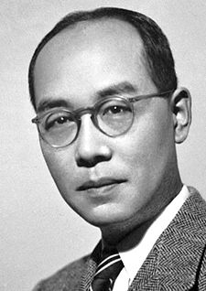
1. Introduction
電気力と核力の性質の違い
電気力
電子
核力
湯川秀樹
（1907-1981）
光子 (フォトン)の交換
・ほどほどの強さ
・無限に遠くまで届く
中性子
陽子
陽子
中間子(メソン)の交換
・かなり強い(電気力の100倍以上)
・短い距離しか届かない (数fm以下)

Slide 26
1. Introduction
中性子
陽子
中間子(メソン)の交換
原子核はメソン交換による力(核力)で核子(陽子・中性子)が集まってできた物質である。

Slide 27
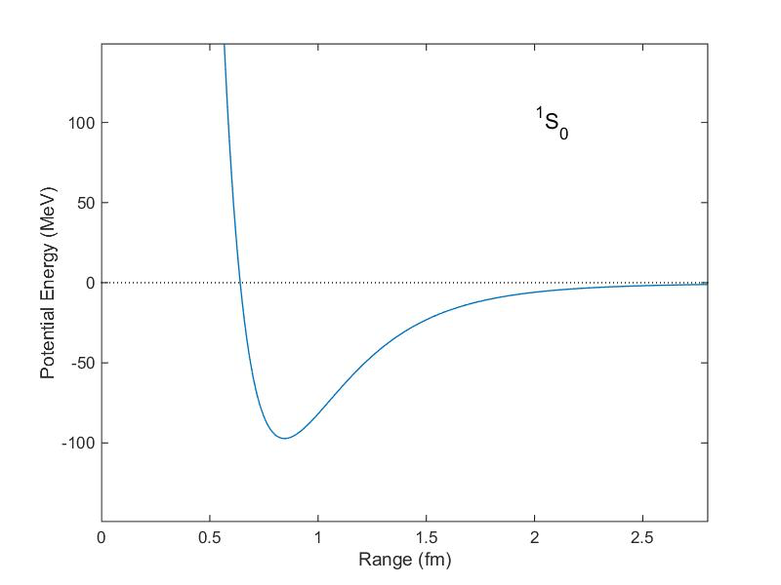
1. Introduction
Δr
中性子
斥力
（短距離）
陽子
中間子(メソン)の交換
Potential Energy [MeV]
引力
（長距離）
ρ, ω, σ, ...
π
π
π
斥力芯
重いメソン(ρ,ω,σ,...)の交換
軽いメソン(π)の交換
Δr [fm]
1 fm = 10⁻¹⁵ m

Slide 28

1. Introduction
π, ρ, ω, σ, ...って何？
(パイ) (ロー) (オメガ) (シグマ)
クォークqと反クォークq
の束縛状態
反クォーク
π, ρ, ω, σ, ...
クォーク

Slide 29

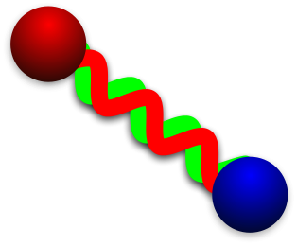

1. Introduction
From nucleus to quark
1 MeV = 10⁶ eV
1 GeV = 10⁹ eV
Condensed matter, Chemistry, Biology
〜10⁴ K
Plasma
Nuclear & Hadron
Elementary Particle
1 μeV
1 meV
1 eV
1 keV
1 MeV
1 GeV
1 TeV
〜 100 keV
surface vibration/rotation
〜 100 MeV
excited hadron
〜 100 GeV
quark
Nucleus
Hadron
proton/neutron
(baryon)
Quark
pion
(meson)
Gluon
Quark

Slide 30
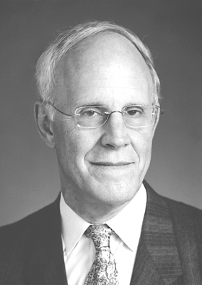


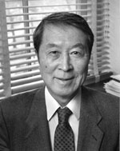
1. Introduction
From nucleus to quark
1 MeV = 10⁶ eV
1 GeV = 10⁹ eV
Condensed matter, Chemistry, Biology
〜10⁴ K
Plasma
Nuclear & Hadron
Elementary Particle
1 μeV
1 meV
1 eV
1 keV
1 MeV
1 GeV
1 TeV
〜 100 keV
surface vibration/rotation
〜 100 MeV
excited hadron
〜 100 GeV
quark
D. Gross
(1941-)
F. Wilczek
(1951-)
H. D. Politzer
(1949-)
Nucleus
Hadron
Superfluidity/Superconductivity
proton/neutron
(baryon)
Asymptotic freedom
Quark
Rotational symmetry
pion
(meson)
Color confinement
Gluon
Meson exchange
(Yukawa theory)
Chiral symmetry breaking
Quark
H. Yukawa
(1907-1981)
Y. Nambu
(1921-2015)
There is “physics” behind a variety of phenomena.
Can we understand nucleus/hadron by quarks and gluons?

Slide 31


1. Introduction
Questions
・How do quarks compose hadrons?
quarks
hadrons
・What is the efficient way to investigate
quark structure of hadrons?

Slide 32



1. Introduction
How do quarks move?
ma = F
Gluon
gluon
quark
quark
HiggsTan.com
gluon

Slide 33
1. Introduction
“Law of motion” of quarks and gluons
Quantum Chromodynamics
(QCD)
ψ_{f}: quark field (flavor f)
A_{μ}(F): gluon field
g_{s}: coupling between
quarks and gluons

Slide 34
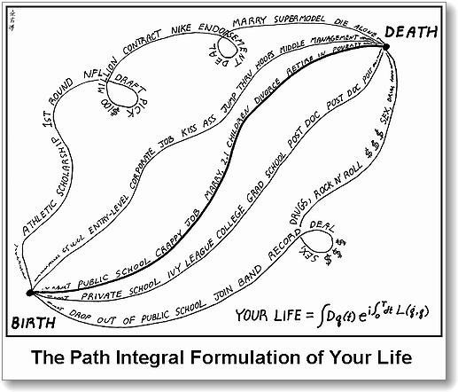
1. Introduction
“Law of motion” of quarks and gluons
?
Summation over all the possible values of ψ_{f} and A_{μ} from initial to final states.
Free quarks
Confined quarks

Slide 35
1. Introduction
Why is hadron physics difficult?
Answer: strong coupling in low energy
← Break-down of
perturbation
Quarks are “visible”.
Confined quarks
Perturbation is applicable.
(asymptotic freedom)
Hadron Physics
(Quarks are NOT visible.)
free quarks
0.01
0.1
(=10 MeV)
(=100 MeV)
Non-perturative effects in low energy.
Origin of a variety of matter states?

Slide 36
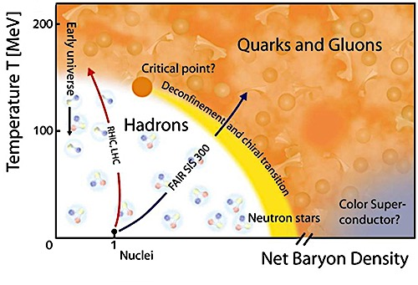

1. Introduction
Fundamental 4 Questions in Hadron Physics
① Why are quarks confined?
② What is hadron interaction?
QCD
Confined quarks
Nuclear force
③ Why is chiral symmetry broken?
④ What is phase diagram?

Slide 37
1. Introduction
Properties of QCD
① Color charge (red, blue, green)

Slide 38
1. Introduction
Color charge (review)
QED
QCD
U(1) symmetry
SU(3) symmetry
T₈
quark q
electron e⁻
T₃
-e
“Minus sign”
T₈
positron e⁺
antiquark q
T₃
+e

Slide 39
1. Introduction
Color charge (review)
Hadrons are colorless (white: T₃=T₈=0)
meson (qq)
baryon (qqq)
+
+

Slide 40
1. Introduction
Properties of QCD
① Color charge (red, blue, green)
② Gluon exchange in inter-quark
Time
gluon
quark
proton
neutron
proton
neutron

Slide 41
1. Introduction
Properties of QCD
① Color charge (red, blue, green)
② Gluon exchange in inter-quark
③ Asymptotic freedom (small coupling at high energy)
④ “Structure” of QCD vacuum
- quarks are confined
- chiral symmetry is broken
“Big problem” of strong interaction!!

Slide 42

1. Introduction
“Structure” of QCD vacuum?
Many particles in QCD vacuum!
HiggsTan.com
”Non-perturbative vacuum”
(Condensate by interaction is realized by stability of energy.)

Slide 43
1. Introduction
“Structure” of QCD vacuum?
Many particles in QCD vacuum!
HiggsTan.com
”Non-perturbative vacuum”
(Condensate by interaction is realized by stability of energy.)

Slide 44
1. Introduction
“Structure” of QCD vacuum?
Many particles in QCD vacuum!
HiggsTan.com
”Non-perturbative vacuum”
(Condensate by interaction is realized by stability of energy.)

Slide 45
1. Introduction
“Structure” of QCD vacuum?
Many particles in QCD vacuum!
“Vacuum”
in field theory
≠ Empty

Slide 46
1. Introduction
“Structure” of QCD vacuum?
Many particles in QCD vacuum!
Stable
“Vacuum”
in field theory
=
Most
State

Slide 47
1. Introduction
“Structure” of QCD vacuum?
What happens in QCD vacuum?
“Dynamical breaking of chiral symmetry”

Slide 48
1. Introduction
“Structure” of QCD vacuum?
What happens in QCD vacuum?
“Dynamical breaking of chiral symmetry”
Empty space
Speed of light
〜 0 MeV
Chiral symmetry restored

Slide 49
1. Introduction
“Structure” of QCD vacuum?
What happens in QCD vacuum?
“Dynamical breaking of chiral symmetry”
Empty space
QCD vacuum
< speed of light
Speed of light
〜 0 MeV
〜 300-400 MeV
Chiral symmetry restored
Chiral symmetry broken
Chiral symmetry is broken dynamically by interaction.

Slide 50
1. Introduction
Nambu-Jona-Lasinio model (3 min. review)
① NJL Lagrangian
② Chiral symmetry
U(1)_{V}:
U(1)_{A}:
NJL Lagrangian is invariant under chiral symmetry.
③ Mean-field approximation
④ Generation of dynamical mass of fermion
Finite mass breaks U(1)_{A} symmetry
→ Chiral symmetry breaking in ground state
Review papers:
U. Vogl, W. Weise, Prog. Part. Nucl. Phys. 27, 195 (1991)
S. P. Kulevansky, Rev. Mod. Phys. 64, 649 (1992)
T. Hatsuda, T. Kunihiro, Phys. Rep. 247, 221 (1994)
⑤ Solving gap equation
→ m〜 300-400 MeV

Slide 51
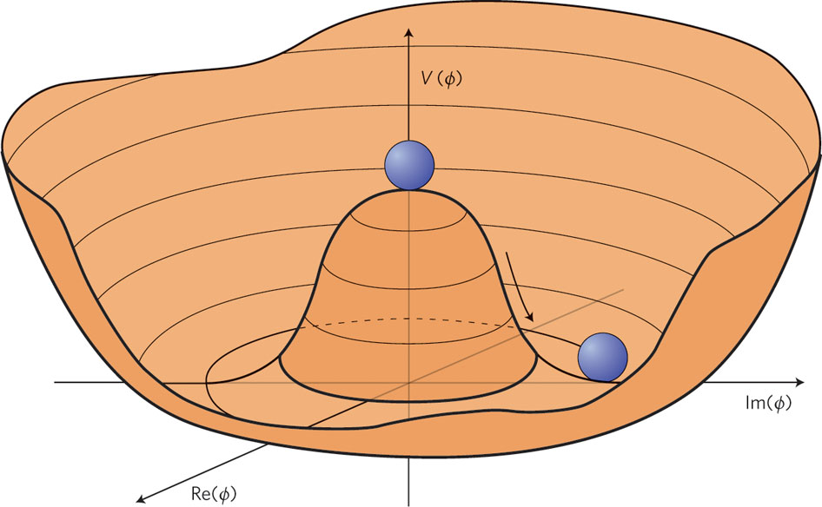
1. Introduction
“Structure” of QCD vacuum?
What happens in QCD vacuum?
Zero-mass boson exists
in vacuum with dynamically
broken symmetry
(Nambu-Goldstone (NG) boson)
Origin of light pion mass!
(m_{π}=140 MeV << m_{N}=940 MeV)
π
L. Álvarez-Gaumé, J. Ellis, Nature Physics 7, 2–3 (2011)

Slide 52
1. Introduction
“Structure” of QCD vacuum?
What happens in QCD vacuum?
Zero-mass boson exists
in vacuum with dynamically
broken symmetry
(Nambu-Goldstone (NG) boson)
Origin of light pion mass!
(m_{π}=140 MeV << m_{N}=940 MeV)
〜1fm
〜1fm
1/m_{π}〜1.5fm
Exchange of
virtual π(qq)
Inter-hadron
interaction
at long-range
Hadron (proton)
Hadron (neutron)
π exchange interaction is dominant at long distance.

Slide 53
1. Introduction
Main subject in this lecture:
Formation mechanism of hadrons by quarks
HADRON
quarks
hadrons

Slide 54
1. Introduction
Quark
Anti-Quark
2

Slide 55
1. Introduction
Quark
Quark
Quark
3

Slide 56
1. Introduction
Quark
Anti-Quark
Quark
Anti-Quark
4

Slide 57
1. Introduction
Quark
Anti-Quark
5
Quark
Quark
Quark

Slide 58
1. Introduction
Quark
Quark
Quark
Quark
Quark
Quark
6

Slide 59
1. Introduction
To be continued

Slide 60
1. Introduction
Variety of Hadrons
2
3
4
5
6

Slide 61
1. Introduction
Variety of Hadrons
meson
baryon
tetraquark
pentaquark
hexaquark

Slide 62
1. Introduction
Quiz: how many hadrons were discovered?
about 3
about 30
about 300
①
②
③
proton,
neutron,
pion,
that’s all!
I may have seen
Δ, ω, ρ, etc. somewhere...
Do we need
so many hadrons?

Slide 63


1. Introduction
about 300
Table of hadrons
Particle Data Group

Slide 64

1. Introduction
Flavors
HiggsTan.com
electric
charge
1st
2nd
3rd
up
charm
top
Q=+2/3
2 MeV
1300 MeV
173000 MeV
down
strange
bottom
Q=-1/3
5 MeV
100 MeV
4200 MeV

Slide 65
1. Introduction
Flavors
HiggsTan.com
electric
charge
1st
2nd
3rd
up
charm
top
Q=+2/3
2 MeV
1300 MeV
173000 MeV
down
strange
bottom
Q=-1/3
5 MeV
100 MeV
4200 MeV

Slide 66
1. Introduction
Heavy
Charm/bottom quarks
m_{c}/m_{u,d} = 200-400
m_{b}/m_{u,d} = 900-1400

Slide 67



1. Introduction
What is “exotic”?
1. Difference from (conventional) quark model
meson
baryon
tetraquark
pentaquark
normal hadron
Exotic hadron
“Quark model”

Slide 68
1. Introduction
What is “exotic”?
2. Quantum numbers (charge, J^{PC})
meson
tetraquark
or
cc^{bar}
cc^{bar}qq^{bar}

Slide 69
1. Introduction
What is “exotic”?
2. Quantum numbers (charge, J^{PC})
meson
tetraquark
or
cc^{bar}
cc^{bar}ud^{bar}
Electric charge
0
+1

Slide 70
1. Introduction
What is “exotic”?
2. Quantum numbers (charge, J^{PC})
meson
tetraquark
or
cc^{bar}
cc^{bar}qq^{bar}
Exotic J^{PC}
E⁺⁻, O⁻⁺
prohibited
allowed

Slide 71
1. Introduction
about 20
Quiz: How many X, Y, Z are discovered so far?
Normal hadron
about 300

Slide 72
1. Introduction
Tables of X, Y, Z discovered so far.
N. Brambilla, et al., Eur. Phys. J. C74, 2981 (2014)

Slide 74
1. Introduction
Productions of hadrons

Slide 75
1. Introduction
Conventional rule of naming
Hadrons whose properties are different from quark model.
J^{PC}=1⁻⁻
Electrically charged (±)

Slide 76
1. Introduction
Conventional rule of naming
However, all XYZ are “X” in Particle Data Group.

Slide 77
1. Introduction
What are structures of ?
c
c
D⁽*⁾
D⁽*⁾
u
d
Compact multiquark
Hadronic molecule
gluonic excitation modes
c
c
“string excitation”
Σ, Π, Δ, Φ, ...
(S, P, D, F, ...)
Kinematic effect

Slide 78

1. Introduction
Brief review of early “exotic hadron” studies
Cnfucius (孔子)
(551BC-479BC)

Slide 79

1. Introduction
Classical Papers of Exotic Heavy Hadrons

Slide 80
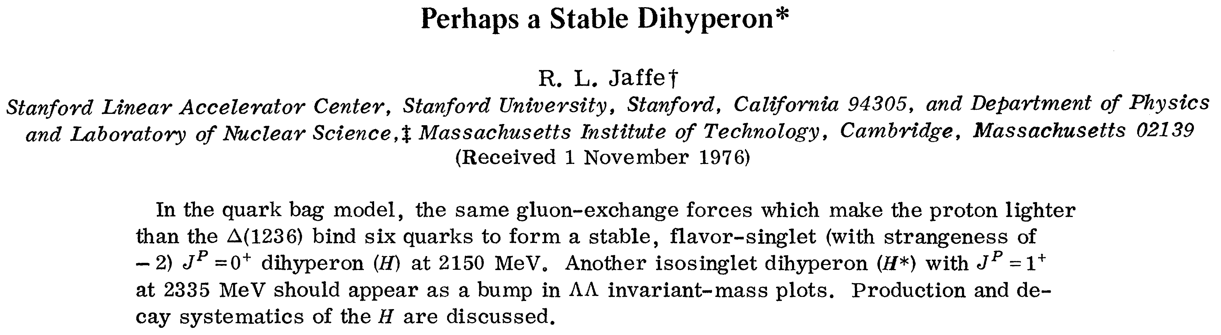
1. Introduction
Classical Papers of Exotic Heavy Hadrons

Slide 81
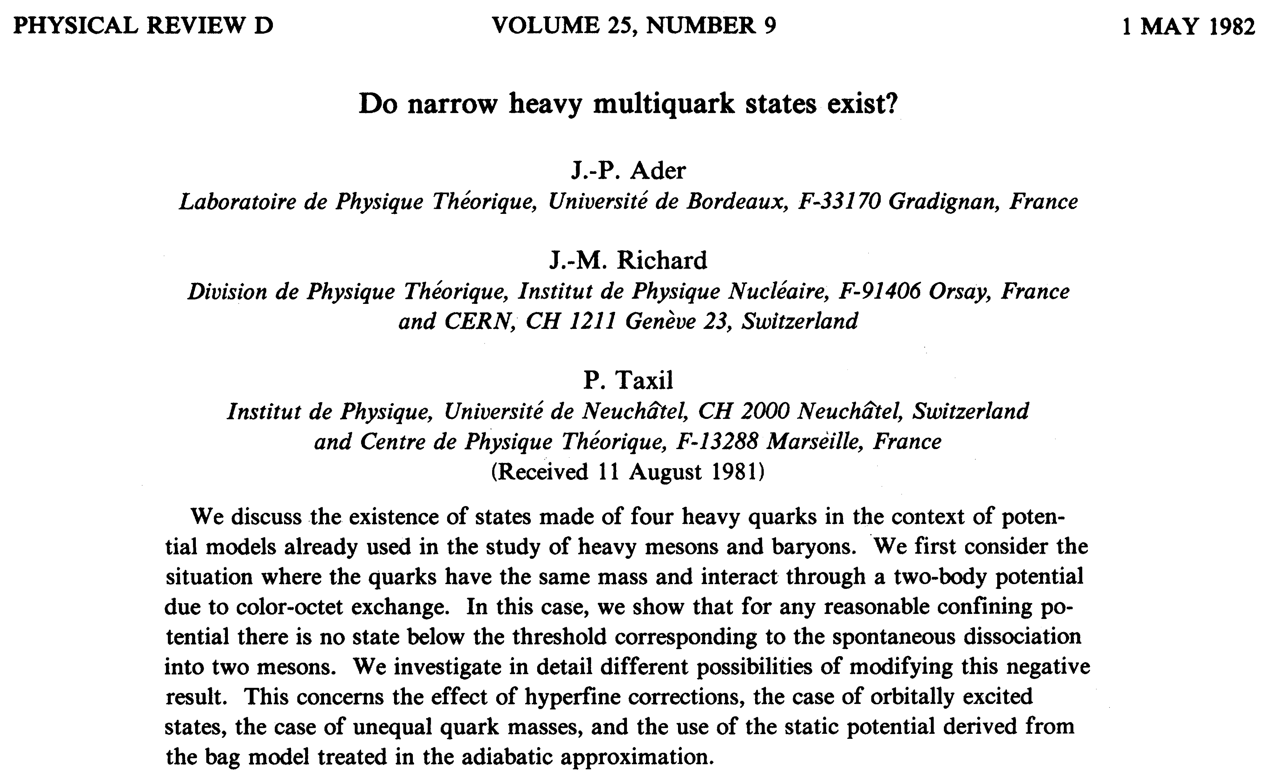
1. Introduction
Classical Papers of Exotic Heavy Hadrons

Slide 82
1. Introduction
Classical Papers of Exotic Heavy Hadrons

Slide 83
1. Introduction
Analysis method based on QCD
QCD sum rules
M.A. Shifman, A.I. Vainshtein, V.I. Zakharov, Nucl. Phys. B147, 385 (1979), ibid. 448 (1979)
L. J. Reinders, H. Reubinstein, S. Yazaki, Phys. Rep. 127, 1 (1985)
Correlation function
ρ(s)
peak
continuum state
s
Lattice QCD
S. Aoki et al., Phys. Rev. Lett. 84, 238 (2000)
S. Durr et al., Science 322, 1224 (2008)

Slide 84
1. Introduction
Hadron models
... since early days
A variety of hadron models have been used up to now.
They are very useful to calculate some physical quantities
and to provide concrete pictures of hadron dynamics.

Slide 85
1. Introduction
Hadron models
... since early days
Quark model
A. De. Rujula, H. Georgi, S. L. Gkashow, Phys. Rev. D12, 147 (1975)
inter-quark potential:
m: dynamical quark mass
(300-400 MeV)
Color Coulomb potential
Confinement (linear) potential

Slide 86
1. Introduction
Hadron models
... since early days
Quark model
Bag model
A. De. Rujula, H. Georgi, S. L. Gkashow, Phys. Rev. D12, 147 (1975)
A. Chodos, et al., Phys. Rev. D9, 3471 (1974)
inter-quark potential:
Massless quark (no chiral
symmetry breaking inside bag)
m: dynamical quark mass
(300-400 MeV)
bag
Bag pressure B (energy density
outside bag)
Color Coulomb potential
Confinement of quark by
boundary condition
Confinement (linear) potential
QCD vacuum

Slide 87
1. Introduction
Hadron models
... since early days
Quark model
Bag model
A. De. Rujula, H. Georgi, S. L. Gkashow, Phys. Rev. D12, 147 (1975)
A. Chodos, et al., Phys. Rev. D9, 3471 (1974)
inter-quark potential:
Massless quark (no chiral
symmetry breaking inside bag)
m: dynamical quark mass
(300-400 MeV)
bag
Bag pressure B (energy density
outside bag)
Color Coulomb potential
Confinement of quark by
boundary condition
Confinement (linear) potential
QCD vacuum
String model
R. Giles, S.-H H. Tye, Phys. Rev. Lett. 37, 1175 (1976)
q
Excitation of ”gluon”
Flux tube model
Constituent gluon model
...
q
→ Later example

Slide 88
1. Introduction
Hadron models
... since early days
Quark model
Bag model
A. De. Rujula, H. Georgi, S. L. Gkashow, Phys. Rev. D12, 147 (1975)
A. Chodos, et al., Phys. Rev. D9, 3471 (1974)
inter-quark potential:
Massless quark (no chiral
symmetry breaking inside bag)
m: dynamical quark mass
(300-400 MeV)
bag
Bag pressure B (energy density
outside bag)
Color Coulomb potential
Confinement of quark by
boundary condition
Confinement (linear) potential
QCD vacuum
String model
Diquark model
R. Giles, S.-H H. Tye, Phys. Rev. Lett. 37, 1175 (1976)
M. Ida, R. Kobayashi, Prog. Thor. Phys. 36, 846 (1966)
A pair of quarks = diquark
Baryon = quark+diquark
H-dibaryon = diquark×3 (?)
q
Excitation of ”gluon”
strong attraction
color 3_{c}^{bar}
Flux tube model
Constituent gluon model
...
q
→ Later example

Slide 89
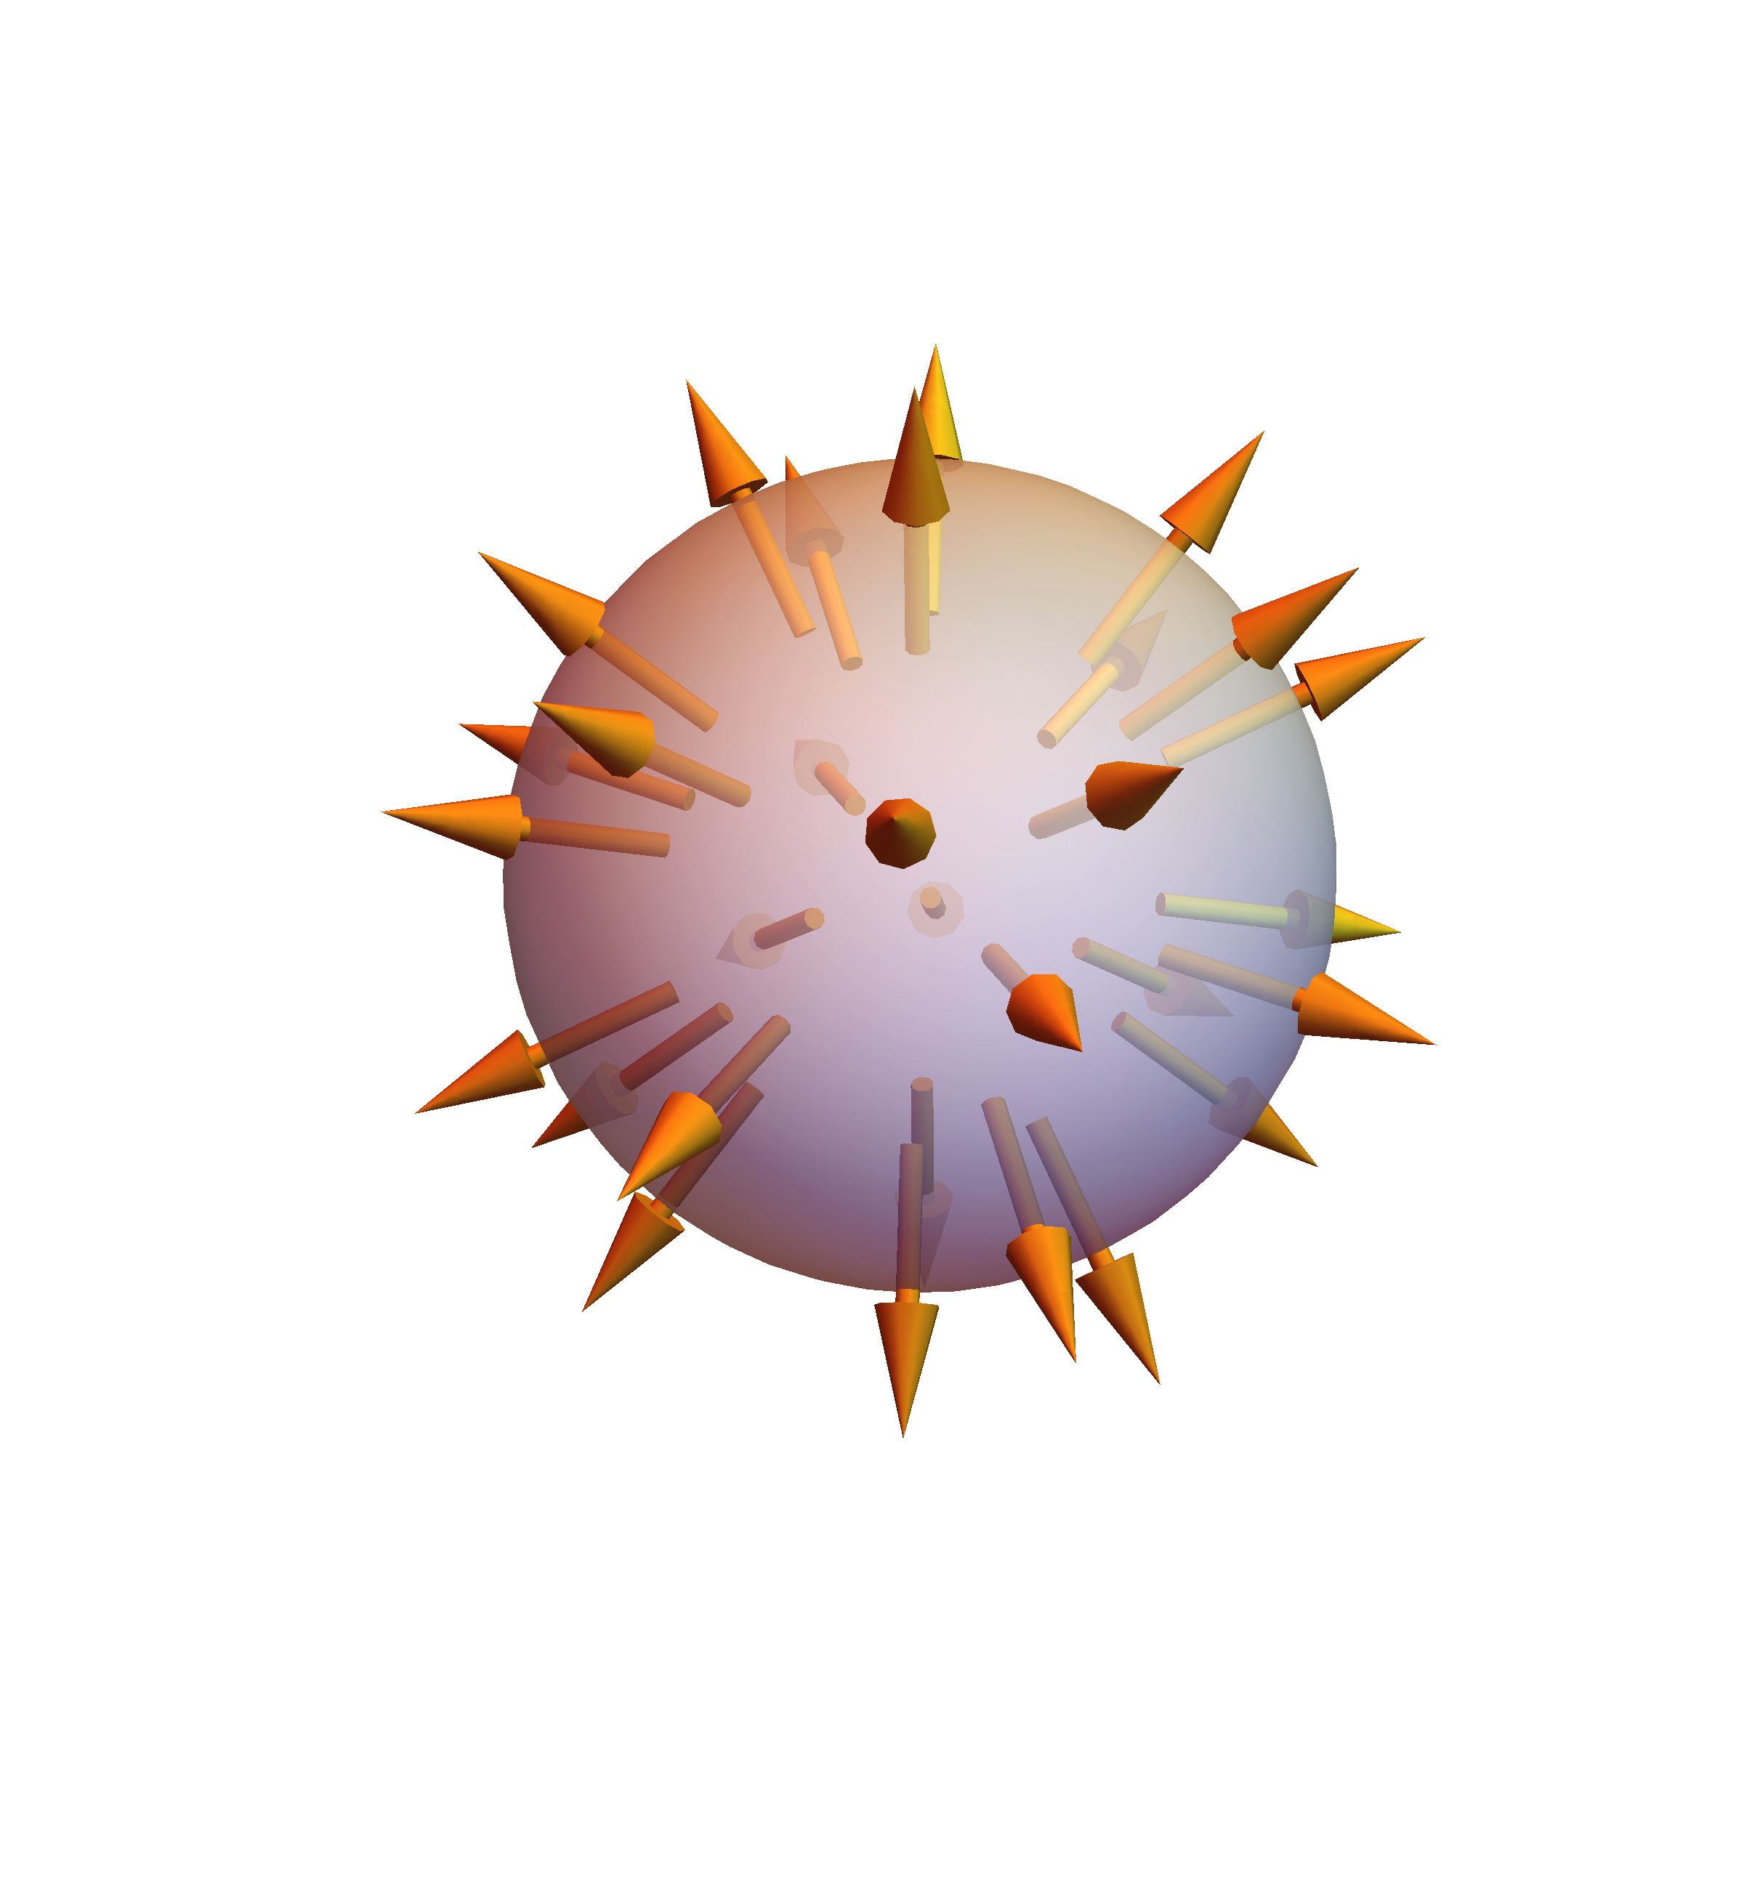
1. Introduction
Hadron models
... since early days
Quark model
Bag model
A. De. Rujula, H. Georgi, S. L. Gkashow, Phys. Rev. D12, 147 (1975)
A. Chodos, et al., Phys. Rev. D9, 3471 (1974)
inter-quark potential:
Massless quark (no chiral
symmetry breaking inside bag)
m: dynamical quark mass
(300-400 MeV)
bag
Bag pressure B (energy density
outside bag)
Color Coulomb potential
Confinement of quark by
boundary condition
Confinement (linear) potential
QCD vacuum
String model
Diquark model
R. Giles, S.-H H. Tye, Phys. Rev. Lett. 37, 1175 (1976)
M. Ida, R. Kobayashi, Prog. Thor. Phys. 36, 846 (1966)
A pair of quarks = diquark
Baryon = quark+diquark
H-dibaryon = diquark×3 (?)
q
Excitation of ”gluon”
strong attraction
color 3_{c}^{bar}
Flux tube model
Constituent gluon model
...
q
→ Later example
Skyrme model
T. H. R. Skyrme, Nuclear Physics 31, 556, (1962)
Describing fermion in terms of boson
(nucleon) (π)
Topological quantity: R³(S²)→SU(2)(S²)
= baryon number
Soliton solution: dynamically stable
G. S. Adkins, C. R. Nappi, E. Witten,
Nucl. Phys. B228, 552 (1983)

Slide 90
1. Introduction
Hadron models
... since early days
Quark model
Bag model
A. De. Rujula, H. Georgi, S. L. Gkashow, Phys. Rev. D12, 147 (1975)
A. Chodos, et al., Phys. Rev. D9, 3471 (1974)
inter-quark potential:
Massless quark (no chiral
symmetry breaking inside bag)
m: dynamical quark mass
(300-400 MeV)
bag
Bag pressure B (energy density
outside bag)
Color Coulomb potential
Confinement of quark by
boundary condition
Confinement (linear) potential
QCD vacuum
String model
Diquark model
R. Giles, S.-H H. Tye, Phys. Rev. Lett. 37, 1175 (1976)
M. Ida, R. Kobayashi, Prog. Thor. Phys. 36, 846 (1966)
A pair of quarks = diquark
Baryon = quark+diquark
H-dibaryon = diquark×3 (?)
q
Excitation of ”gluon”
strong attraction
color 3_{c}^{bar}
Flux tube model
Constituent gluon model
...
q
→ Later example
Skyrme model
Hadron molecule model
T. H. R. Skyrme, Nuclear Physics 31, 556, (1962)
Hadrons are fundamental degrees of freedom
Describing fermion in terms of boson
(nucleon) (π)
N
N
π
π
deuteron:
σ meson:
Topological quantity: R³(S²)→SU(2)(S²)
= baryon number
Soliton solution: dynamically stable
Λ(1405):
K
N
+
π
Σ
N(1535):
η
N
G. S. Adkins, C. R. Nappi, E. Witten,
Nucl. Phys. B228, 552 (1983)
R. H. Dalitz, S. F. Tuan, Phys. Rev. Lett. 2, 425 (1959)

Slide 91
1. Introduction
Hadron models
... since early days
Quark model
Bag model
A. De. Rujula, H. Georgi, S. L. Gkashow, Phys. Rev. D12, 147 (1975)
A. Chodos, et al., Phys. Rev. D9, 3471 (1974)
inter-quark potential:
Massless quark (no chiral
symmetry breaking inside bag)
m: dynamical quark mass
(300-400 MeV)
bag
Bag pressure B (energy density
outside bag)
Color Coulomb potential
Confinement of quark by
boundary condition
Confinement (linear) potential
QCD vacuum
String model
Diquark model
R. Giles, S.-H H. Tye, Phys. Rev. Lett. 37, 1175 (1976)
M. Ida, R. Kobayashi, Prog. Thor. Phys. 36, 846 (1966)
A pair of quarks = diquark
Baryon = quark+diquark
H-dibaryon = diquark×3 (?)
q
Excitation of ”gluon”
strong attraction
color 3_{c}^{bar}
Flux tube model
Constituent gluon model
...
q
→ Later example
Skyrme model
Hadron molecule model
T. H. R. Skyrme, Nuclear Physics 31, 556, (1962)
Hadrons are fundamental degrees of freedom
Describing fermion in terms of boson
(nucleon) (π)
N
N
π
π
deuteron:
σ meson:
Topological quantity: R³(S²)→SU(2)(S²)
= baryon number
Soliton solution: dynamically stable
Λ(1405):
K
N
+
π
Σ
N(1535):
η
N
G. S. Adkins, C. R. Nappi, E. Witten,
Nucl. Phys. B228, 552 (1983)
R. H. Dalitz, S. F. Tuan, Phys. Rev. Lett. 2, 425 (1959)

Slide 92
1. Introduction
Diquark
Meson
Diquark
q
q
q
q
color singlet
color anti-triplet/sextet
There is no asymptotic state...

Slide 93
1. Introduction
Diquark
Light-light diquark
S=1
+
+ 50 MeV
(repulsion)
- 150 MeV
(attraction)
S=0
→ Diquarks in color superconductivity and Bose-Einstein condensate in quark matter ?

Slide 94
1. Introduction
Diquark
Light-light diquark
The place where we may see diquarks...
① Scalar meson J^{P}=0⁺
② Charm baryon (C=1)
③ Exotic hadrons: mass spectrum of colorful state
④ Double charm baryon (C=2)

Slide 95
1. Introduction
Diquark
Light-light diquark
① Scalar meson J^{P}=0⁺
Naive quark model
qq^{bar}(p wave)
Diquark model
(qq)(qq)^{bar}(s wave)
Hadron
molecule
Exp.
m_{u}〜m_{d}＜m_{s}
R. L. Jaffe, PRD 15, 267 (1977), bid. 281 (1977)
a₀(980)
ss^{bar}
UD^{bar}
UU^{bar}-DD^{bar}
DU^{bar}
KK^{bar}
I=0, 1
I=0
f₀(980)
UU^{bar}+DD^{bar}
s quark mass
Mass
κ(800)
us^{bar}
ds^{bar}
DS^{bar}
US^{bar}
πK
I =1/2
I =1/2
s quark mass
f₀(600)
ud^{bar}
uu^{bar}-dd^{bar}
du^{bar}
SS^{bar}
ππ
I=0
I=0, 1
uu^{bar}+dd^{bar}
U=ds, D=su, S=ud
Diquark qq
(flavor antisymmetric)

Slide 96
1. Introduction
Diquark
② Charm baryon (C=1)
Light-light diquark
HQS doublet
S=1
repulsive
HQS doublet
Q
2502
5828
58 MeV
(repulsion)
52 MeV
(repulsion)
HQS doublet
HQS doublet
175 MeV
(attraction)
157 MeV
(attraction)
HQS singlet
S=0
HQS singlet
attractive
Q

Slide 97
1. Introduction
Diquark
② Charm baryon (C=1)
Quark model calculation by
T. Yoshida, E. Hiyama, A. Hosaka, M. Oka, K. Sadato,
Phys. Rev. D92, 114029 (2015)

Slide 98
1. Introduction
Diquark
② Charm baryon (C=1)
5 Ω_{c}

Slide 99
1. Introduction
R.L. Jaffe, Phys. Rev. D72, 074508 (2005)
③ Exotic hadrons: mass spectrum of colorful state
J = 1
J = 0
Ex. Λ_{c} [qq]_{J=0}c
Σ_{c}^{(*)}[qq]_{J=1}c
Ex. X(5568) [sud]_{J=?}b ?
Ex. ???

Slide 100
1. Introduction
Diquark
Heavy-heavy diquark
④ Double charm baryon (C=2)
Q
Q
Q
Deeply bound subcomponent
B.E. (Coulomb) ~α_{s}(m_{Q})m_{Q}
Ξ_{cc}
D, D*
J.-M. Richard, “DOUBLE CHAM PHYSICS” ISN 02-97

Slide 101
1. Introduction
Diquark
Heavy-heavy diquark
④ Double charm baryon (C=2)
T. Cohen, P. M. Hohler,
Phys. Rev. D74, 094003 (2006)
Q
Q
Deeply bound subcomponent
B.E. (Coulomb) ~α_{s}(m_{Q})m_{Q}
Ξ_{cc}
J.-M. Richard, “DOUBLE CHAM PHYSICS” ISN 02-97

Slide 102
1. Introduction
Diquark
Heavy-heavy diquark
④ Double charm baryon (C=2)
LHCb Collaboration, arXiv:1707.01621 [hep-ex]

Slide 103
1. Introduction
Diquark
Heavy-heavy diquark
Quark model calculation by
T. Yoshida, E. Hiyama, A. Hosaka, M. Oka, K. Sadato,
Phys. Rev. D92, 114029 (2015)
④ Double charm baryon (C=2)
← 3621 MeV [LHCb]
[SELEX]

Slide 104
1. Introduction

Slide 105
1. Introduction
more about
Heavy Hadrons

Slide 106
1. Introduction
more about
Heavy Hadrons
Charmonium
cc

Slide 107
1. Introduction
Charmonium
cc

Slide 108
1. Introduction
Charmonium
cc
χ_{c}
χ_{c}
χ_{c}
h _{c}
2
η_{c}
J /ψ
1
0
2⁺⁺
mass: 3556 MeV
width: 1.9 MeV
1⁺⁺
mass: 3511 MeV
width: 0.84 MeV
0⁺⁺
mass: 3415 MeV
width: 10 MeV
1⁺⁻
mass: 3525MeV
width: 0.7 MeV
1⁻⁻
mass: 3097 MeV
width: 93 keV
0⁻⁺
mass: 2983 MeV
width: 32 MeV
J^{PC}

Slide 109
1. Introduction
Charmonium
cc
c
Angular momentum L
c
Parity (-1)^{L}
Parity -1
Parity +1
Total spin S=0 or 1
J^{PC}
☑︎ Total angular momentum J=L, L ±1
☑ Total parity P=(+1)(-1)(-1)^{L}=(-1)^{L+1}
☑ C parity (charge conjugate): C=(-1)^{L+S}
Proof:

Slide 110
1. Introduction
J^{PC}
J ... total momentum spin (0, 1/2, 1, 3/2, ...)
P ... parity (±)
C ... charge conjugate (±)

Slide 111
1. Introduction
J^{PC}
QQ
(quark and antiquark) case ...
J ... total momentum spin (0, 1, ...)
P ... parity (±)
(-1)^{L+1}
C ... charge conjugate (±)
(-1)^{L+S}

Slide 112
1. Introduction
J^{PC}
QQ
(quark and antiquark) case ...
L
0
2n (n≥1)
2n-1 (n≥1)
S
0
1
0
1
0
1
J
0
1
2n
2n, 2n±1
2n-1 2n-2, 2n-1, 2n
P
-1
-1
+1
C
+1
-1
+1
-1
-1
+1
J^{PC}
0⁻⁺
1⁻⁻
E⁻⁺
E⁻⁻, O⁻⁻
O⁺⁻
O⁺⁺, E⁺⁺
E⁺⁻ and O⁻⁺ cannot be possible for QQ^{bar}.

Slide 113
1. Introduction
J^{PC}
QQ
(quark and antiquark) case ...
L
0
2n (n≥1)
2n-1 (n≥1)
S
0
1
0
1
0
1
J
0
1
2n
2n, 2n±1
2n-1 2n-2, 2n-1, 2n
P
-1
-1
+1
C
+1
-1
+1
-1
-1
+1
J^{PC}
0⁻⁺
1⁻⁻
E⁻⁺
E⁻⁻, O⁻⁻
O⁺⁻
O⁺⁺, E⁺⁺
E⁺⁻ and O⁻⁺ cannot be possible for QQ^{bar}.

Slide 114
1. Introduction
J^{PC}
QQ
(quark and antiquark) case ...
L
0
2n (n≥1)
2n-1 (n≥1)
S
0
1
0
1
0
1
J
0
1
2n
2n, 2n±1
2n-1 2n-2, 2n-1, 2n
P
-1
-1
+1
C
+1
-1
+1
-1
-1
+1
J^{PC}
0⁻⁺
1⁻⁻
E⁻⁺
E⁻⁻, O⁻⁻
O⁺⁻
O⁺⁺, E⁺⁺
E⁺⁻ and O⁻⁺ cannot be possible for QQ^{bar}.

Slide 115
1. Introduction
J^{PC}
QQ
(quark and antiquark) case ...
L
0
2n (n≥1)
2n-1 (n≥1)
S
0
1
0
1
0
1
J
0
1
2n
2n, 2n±1
2n-1 2n-2, 2n-1, 2n
P
-1
-1
+1
C
+1
-1
+1
-1
-1
+1
J^{PC}
0⁻⁺
1⁻⁻
E⁻⁺
E⁻⁻, O⁻⁻
O⁺⁻
O⁺⁺, E⁺⁺
E⁺⁻ and O⁻⁺ cannot be possible for QQ^{bar}.

Slide 116
1. Introduction
J^{PC}
QQ
(quark and antiquark) case ...
L
0
2n (n≥1)
2n-1 (n≥1)
S
0
1
0
1
0
1
J
0
1
2n
2n, 2n±1
2n-1 2n-2, 2n-1, 2n
P
-1
-1
+1
C
+1
-1
+1
-1
-1
+1
J^{PC}
0⁻⁺
1⁻⁻
E⁻⁺
E⁻⁻, O⁻⁻
O⁺⁻
O⁺⁺, E⁺⁺
Note: E⁺⁻ and O⁻⁺ are impossible for QQ^{bar}.

Slide 117
1. Introduction
Charmonium
cc
χ_{c}
χ_{c}
χ_{c}
h _{c}
2
η_{c}
J /ψ
1
0
2⁺⁺
mass: 3556 MeV
width: 1.9 MeV
1⁺⁺
mass: 3511 MeV
width: 0.84 MeV
0⁺⁺
mass: 3415 MeV
width: 10 MeV
1⁺⁻
mass: 3525MeV
width: 0.7 MeV
1⁻⁻
mass: 3097 MeV
width: 93 keV
0⁻⁺
mass: 2983 MeV
width: 32 MeV
J^{PC}

Slide 118
1. Introduction
Charmonium
cc
L=0
χ_{c}
χ_{c}
χ_{c}
h _{c}
2
η_{c}
J /ψ
1
0
2⁺⁺
mass: 3556 MeV
width: 1.9 MeV
1⁺⁺
mass: 3511 MeV
width: 0.84 MeV
0⁺⁺
mass: 3415 MeV
width: 10 MeV
1⁺⁻
mass: 3525MeV
width: 0.7 MeV
1⁻⁻
mass: 3097 MeV
width: 93 keV
0⁻⁺
mass: 2983 MeV
width: 32 MeV
S=0
J=0, P=-1, C=(-1)^{L+S}=+1

Slide 119
1. Introduction
Charmonium
cc
L=0
χ_{c}
χ_{c}
χ_{c}
h _{c}
2
η_{c}
J /ψ
1
0
2⁺⁺
mass: 3556 MeV
width: 1.9 MeV
1⁺⁺
mass: 3511 MeV
width: 0.84 MeV
0⁺⁺
mass: 3415 MeV
width: 10 MeV
1⁺⁻
mass: 3525MeV
width: 0.7 MeV
1⁻⁻
mass: 3097 MeV
width: 93 keV
0⁻⁺
mass: 2983 MeV
width: 32 MeV
S=1
J=1, P=-1, C=(-1)^{L+S}=-1

Slide 120
1. Introduction
Charmonium
cc
L=1
χ_{c}
χ_{c}
χ_{c}
h _{c}
2
η_{c}
J /ψ
1
0
2⁺⁺
mass: 3556 MeV
width: 1.9 MeV
1⁺⁺
mass: 3511 MeV
width: 0.84 MeV
0⁺⁺
mass: 3415 MeV
width: 10 MeV
1⁺⁻
mass: 3525MeV
width: 0.7 MeV
1⁻⁻
mass: 3097 MeV
width: 93 keV
0⁻⁺
mass: 2983 MeV
width: 32 MeV
S=0
J=1, P=+1, C=(-1)^{L+S}=-1

Slide 121
1. Introduction
Charmonium
cc
L=1
χ_{c}
χ_{c}
χ_{c}
h _{c}
2
η_{c}
J /ψ
1
0
2⁺⁺
mass: 3556 MeV
width: 1.9 MeV
1⁺⁺
mass: 3511 MeV
width: 0.84 MeV
0⁺⁺
mass: 3415 MeV
width: 10 MeV
1⁺⁻
mass: 3525MeV
width: 0.7 MeV
1⁻⁻
mass: 3097 MeV
width: 93 keV
S=1
0⁻⁺
mass: 2983 MeV
width: 32 MeV
S=1
S=1
J=0,1,2,P=+1,C=(-1)^{L+S}=+1

Slide 122
1. Introduction
Bottomonium
bb
χ_{b}
χ_{b}
χ_{b}
h _{b}
2
η_{b}
Υ
1
0
2⁺⁺
mass: 9912 MeV
width: ???
1⁺⁺
mass: 9893 MeV
width: ???
0⁺⁺
mass: 9859 MeV
width: ???
1⁺⁻
mass: 9899 MeV
width: ???
1⁻⁻
mass: 9460 MeV
width: 54 keV
0⁻⁺
mass: 9399 MeV
width: 10 MeV

Slide 123
1. Introduction
Charmonium Mass Spectrum
cc
Quark model
Cf. T. Barnes, S. Godfrey, E. S. Swanson, Phys. Rev. D72, 054026 (2005)
c
inter-quark potential
V(r)
c
Coulomb pot.
Spin-spin pot.
L-S pot.
Tensor pot.
Confinement pot.
Tensor operator
δ function

Slide 124
1. Introduction
?
T. Barnes, S. Godfrey, E. S. Swanson,
Phys. Rev. D72, 054026 (2005)
c
c
Not consistent with
quark model
prediction

Slide 125
1. Introduction
Quarkonium Mass Spectrum
QQ
We need to understand
heavy-light mesons.
Scattering states
open threshold (ex. DD^{bar})
mass

Slide 126
1. Introduction
Names of heavy-light mesons
D meson
D meson
Charm
pseudoscalar
D⁰ cu
D⁰ cu
+2/3 -2/3
-2/3 +2/3
D⁺ cd
D⁻ cd
+2/3 +1/3
-2/3 -1/3

Slide 127
1. Introduction
Names of heavy-light mesons
D* meson
D* meson
Charm
vector
D^{*0} cu
D^{*0} cu
+2/3 -2/3
-2/3 +2/3
D^{*-} cd
D^{*-} cd
+2/3 +1/3
-2/3 -1/3

Slide 128
1. Introduction
Names of heavy-light mesons
B meson
B meson
Bottom
pseudoscalar
B⁻ bu
B⁺ bu
-1/3 -2/3
+1/3 +2/3
B⁰ bd
B⁰ bd
-1/3 +1/3
+1/3 -1/3

Slide 129
1. Introduction
Names of heavy-light mesons
B* meson
B* meson
Bottom
vector
B^{*-} bu
B^{*+} bu
-1/3 -2/3
+1/3 +2/3
B^{*0} bd
B^{*0} bd
-1/3 +1/3
+1/3 -1/3

Slide 130
1. Introduction
Experiment ⇄ Theory
Hadron Spectroscopy
Production
Mass
Decay
mass
mass
HQS

Slide 131

Do you have questions?

