Slide 1
Content
1. Introduction
2. Theoretical framework for heavy hadrons
2.1 Heavy quark symmetry
2.2 Heavy hadron effective theory
3. Heavy exotic hadrons -X, Y, Z hadrons-
3.1 What does “exotic” mean?
3.2 X(3872)
3.3 Y(4260)
3.4 Z_{c}(3900)
3.5 Z_{b}(10610) and Z_{b}(10650)
3.6 P_{c}(4380) and P_{c}(4450): charm pentaquark
3.7 T_{cc} -new possible exotic hadrons-
3.8 Brief summary
4. Heavy hadrons at extreme conditions
4.1 Productions in relativistic heavy ion collisions
4.2 Properties of heavy hadrons in nuclear matter
5. Summary

Slide 2
2. Theoretical framework for heavy hadrons
Heavy-light
meson

Slide 3
2. Theoretical framework for heavy hadrons
D meson
D meson
D* meson
D* meson
B meson
B meson
B* meson
B* meson

Slide 4
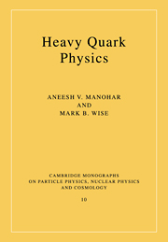
2. Theoretical framework for heavy hadrons
Heavy quark effective theory
Heavy Quark Physics
A. V. Manohar and M. W. Wise
Cambridge University Press 2000

Slide 5
2. Theoretical framework for heavy hadrons
Heavy quark effective theory

Slide 6
2. Theoretical framework for heavy hadrons
・Heavy mass of charm hadron
m_{c}=1.3 GeV and m_{b}=4.7 GeV
・Heavy Quark Symmetry (HQS)
Hadron spin = light quark spin x heavy quark spin

Slide 7
2. Theoretical framework for heavy hadrons
Heavy quark effective theory
Separating QCD Lagrangian to heavy quark part and light quark part

Slide 8
2. Theoretical framework for heavy hadrons
Heavy quark effective theory
① On-mass-shell part and off-mass-shell part
y
The heavy quark
is at rest!
heavy quark
(mass m_{Q})
on-mass-shell condition
off-mass-shell condition
x
② Effective field heavy quark (positive-energy and negative-energy)
Q:
Q^{bar}:
Projection operator
rest frame

Slide 9
2. Theoretical framework for heavy hadrons
Heavy quark effective theory
3 steps to get HQ effective Lagrangian
① Expressing L_{heavy} in terms of Q_{v} (heavy quark) and Q_{v} (anti heavy quark).
no m_{Q} for Q_{v}
(m_{Q} was absorbed in Q_{v})
② Eliminating Q_{v} (anti heavy quark) by using equation of motion.
③ We get HQ effective Lagrangian!

Slide 10
2. Theoretical framework for heavy hadrons
Heavy quark effective theory
HQ effective Lagrangian (N_{h} heavy flavors)
1. Velocity rearrangement
2. Radiative corrections
3. Heavy quark spin symmetry (m_{Q}→∞)

Slide 11
2. Theoretical framework for heavy hadrons
Heavy quark effective theory
HQ effective Lagrangian (N_{h} heavy flavors)
1. Velocity rearrangement
① Superposition of various v^{μ}
⑤ Transformation of Lagrangian
y
② Change of v^{μ} and k^{μ}
y’
heavy quark
(mass m_{Q})
③ Condition of v² = 1
x
x’
④ Transformation of Q_{v}
⑥ Invariance of HQ effective Lagrangian
: invariant for changing v^{μ}
We can choose any v-frame.

Slide 12
2. Theoretical framework for heavy hadrons
Heavy quark effective theory
HQ effective Lagrangian (N_{h} heavy flavors)
2. Radiative corrections
Tree level:
Leading logarithmic approximation:
Figure: M. Neubert, Subnucl. Ser. 34, 98 (1997)
(arXiv:9610266 [hep-ph])

Slide 13
2. Theoretical framework for heavy hadrons
Heavy quark effective theory
HQ effective Lagrangian (N_{h} heavy flavors)
3. Heavy quark spin symmetry (m_{Q}→∞)
① Leading order of 1/m_{Q}
Where is γ^{μ} matrix?
② Heavy quark spin (HQS) transformation
Lagrangian L₀ is invariant for HQS:
③ HQS is a conserved quantity.
Q
or
spin up down

Slide 14
2. Theoretical framework for heavy hadrons
Heavy quark symmetry
Heavy Hadron
Mass Spectrum
Heavy Quark Symmetry
(HQS)
Correspondence
Q
or
mass
spin up down

Slide 15
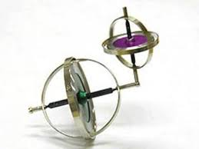
2. Theoretical framework for heavy hadrons
Heavy quark symmetry
“Qq^{bar}“ meson
j
Q
spin
q
S =1/2
HQS (S=1/2)
conserved
Spin J
conserved
Light spin j
conserved!
→ Mass degeneracy for J=j±1/2

Slide 16
2. Theoretical framework for heavy hadrons
Heavy quark symmetry
“Qqq” baryon
Q
spin
q
q
HQS (S=1/2)
conserved
Spin J
conserved
Light spin j
conserved!
→ Mass degeneracy for J=j±1/2

Slide 17


2. Theoretical framework for heavy hadrons
Heavy quark symmetry
J = 1
→ HQS doublet
P⁽*⁾=(P,P*)
J = 0
j=1/2
@large m_{Q}
ρ
K*
D*
770 MeV
B*
890 MeV
2010 MeV
5325 MeV
Qq
630 MeV
390 MeV
140 MeV
45 MeV
5280 MeV
B
1870 MeV
D
Qq
500 MeV
K
140 MeV
π

Slide 18

2. Theoretical framework for heavy hadrons
Heavy quark symmetry
J = 3/2
→ HQS doublet
Σ_{Q}⁽*⁾=(Σ_{Q},Σ_{Q}*)
J = 1/2
j=1
@large m_{Q}
Δ
Σ*
Σ_{c}*
Σ_{b}*
1230 MeV
1385 MeV
2520 MeV
5830 MeV
290 MeV
195 MeV
65 MeV
Σ_{b}
20 MeV
Qq
Σ_{c}
5810 MeV
Σ
1190 MeV
2455 MeV
Qq
940 MeV
1115 MeV
2286 MeV
5619 MeV
N
Λ_{c}
Λ_{b}
Λ
Qq
→ HQS singlet
(Λ_{Q})
J = 1/2
j=0
@large m_{Q}

Slide 19
2. Theoretical framework for heavy hadrons
Heavy quark symmetry
“Q^{bar}q” meson + “qqq” baryon
q
q
Q
spin
q
π,ρ,ω,...
q
HQS (S=1/2)
conserved
Spin J
conserved
Light spin j
conserved!
→ Mass degeneracy for J=j±1/2
Some theoretical studies will be presented later.

Slide 20
2. Theoretical framework for heavy hadrons
Heavy quark symmetry
Heavy hadron mass spectrum (example)
light spin j’
total spin J’=j’±1/2
HQS doublet
j’=j+L
S =1/2
HQS doublet
mass
light spin j
total spin J=j±1/2
HQS singlet
Deacy width:
N. Isgur and M. B. Wise, Phys. Rev. Lett. 66, 1130 (1991)
Cf. NLO of 1/m_{Q}: S. Yasui, Phys. Rev. D91, 014031 (20015)

Slide 21
2. Theoretical framework for heavy hadrons
Heavy hadron effective theory
Heavy Quark Effective Theory
Heavy Hadron Effective Theory
G. Burdman, J.F. Donoghue, Phys. Lett. B280, 287 (1992)
M.B. Wise, Phys. rev. D45, 2188 (1992)
T.-M Yan et al., Phys. Rev. D46, 1148 (1992)
Q
Q
q
q
q
q
q
q
q
π,ρ,ω,...
heavy quark
q
Heavy Hadron
q
q
Cf. “Phenomenology of heavy meson chiral Lagrangians” (review)
R. Casalbuoni et al., Phys. Rep. 281, 45 (1997)
gluon
q

Slide 22

2. Theoretical framework for heavy hadrons
Heavy hadron effective theory
Let us construct “heavy hadron effective theory”
based on the heavy quark effective theory!
HHET/HQET
HQS

Slide 23
2. Theoretical framework for heavy hadrons
Heavy hadron effective theory
Let us construct “heavy hadron effective theory”
based on the heavy quark effective theory!
HHET/HQET
HQS
Heavy-light meson:
Qq^{bar}:

Slide 24
2. Theoretical framework for heavy hadrons
Heavy hadron effective theory
Heavy-light meson:
Qq^{bar}:
① Constructing effective field
spin up
spin down
Q:
at rest frame
q^{bar}:
rest frame
v-frame
spin 0:
spin 1:
polarization vector:

Slide 25
2. Theoretical framework for heavy hadrons
Heavy hadron effective theory
SU(2) spin doublet representation of fermion and antifermion (review)
① SU(2) operator
② Special property
③ Fermion (2) and antifermion (2*)
2≠2* ???
④ Unitary transformation
⑤ Transformation of 2* representation
2:
=
2*:

Slide 26
2. Theoretical framework for heavy hadrons
Heavy hadron effective theory
① Constructing effective field (cont’d)
spin 0:
(pseudoscalar)
spin 1:
(vector)
Symmetries of effective fields
: SU(2) HQS
: U(N_{f})_{V}
“Superposed” field of spin 0 and 1

Slide 27
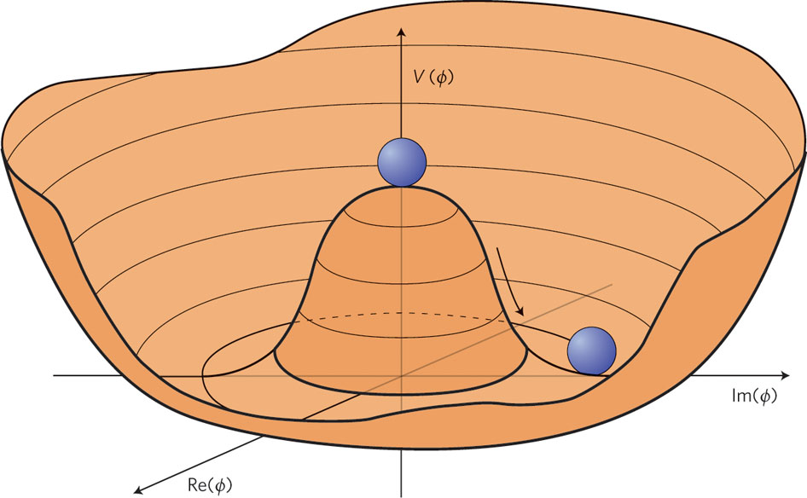
2. Theoretical framework for heavy hadrons
Heavy hadron effective theory
② Constructing effective Lagrangian (leading order of m_{Q}→∞)
chiral covariant derivative:
invariant under HQS
and chiral symmetry
Non-linear chiral transformation
Non-linear rep. of π field:
Vector current:
Axial-vector current:
(even # of π)
(odd # of π)
Example of vertex structure (axial-vector coupling)
We will see details later.
D*
D
D*
time
π
π
π
D
D*
D*

Slide 28
2. Theoretical framework for heavy hadrons
Heavy hadron effective theory
③ Including NLO of 1/M
Cf. “velocity-rearrangement” O(1/m_{Q}) in HQET
y
Lorentz boost: v^{μ}→V^{μ}
y’
heavy hadron
(mass M)
x
x’
Lorentz boost: v^{μ}→V^{μ} up to O(1/M)
Effective field including O(1/M)
M. E. Luke, A. V. Manohar, Phys. Lett. B286, 348 (1992)
N. Kitazawa, T. Kurimoto, Phys. Lett. B323, 65 (1994)
S.Yasui, K.Sudoh,Phys.Rev.C88,015201(2013)

Slide 29
2. Theoretical framework for heavy hadrons
Heavy hadron effective theory
③ Including NLO of 1/M (cont’d)
“covariant” transformation
Lorentz boost:
✓ construction of interaction term
invariant under velocity rearrangement
Possible form of current:
: Gamma matrices
Example of axial-vector current
LO:
unknown coupling
NLO:
unknown couplings
← HQS breaking term (g₂)

Slide 30
2. Theoretical framework for heavy hadrons
Experiment ⇄ Theory
Hadron Spectroscopy
Production
Mass
Decay
mass
mass
HQS

Slide 31
2. Theoretical framework for heavy hadrons

Slide 32

Do you have questions?

