Slide 1
@原子核三者夏の学校, 2025 August 6th
２つの量子AIが会話をすると
量子ゼノン効果は起きるのか？
堀田昌寛 （東北大学）

Slide 2
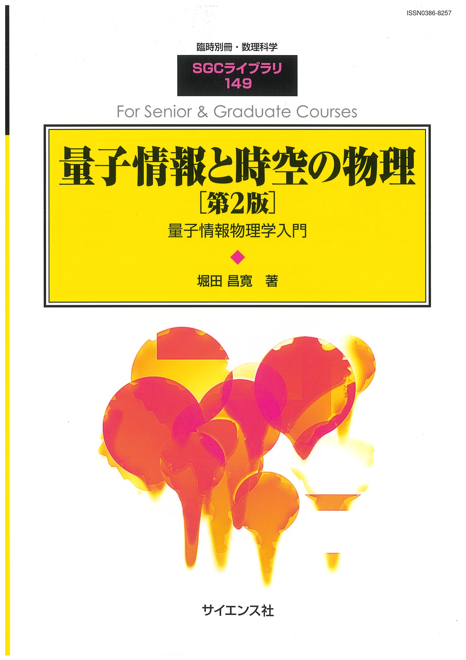
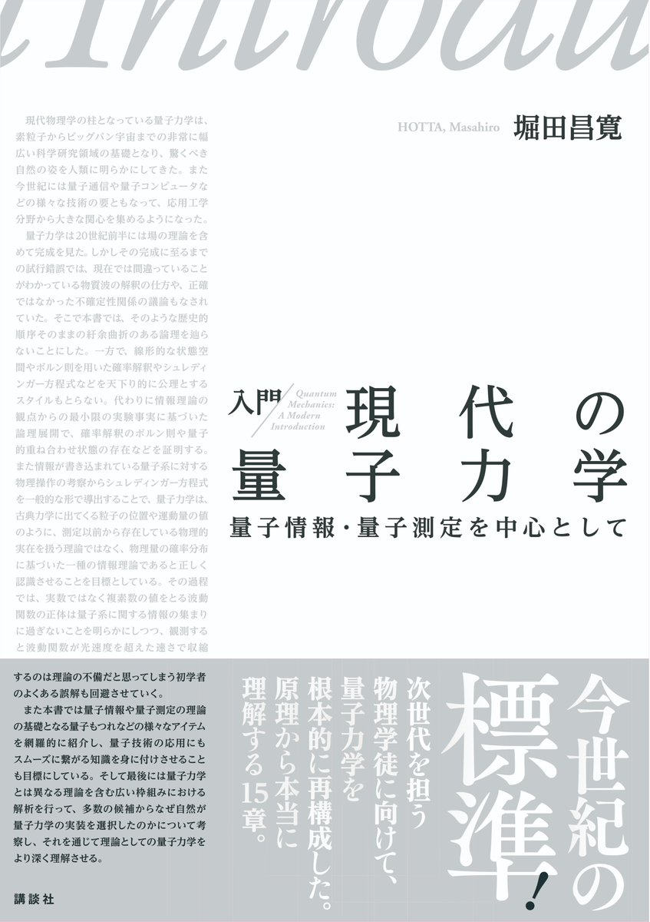

Slide 3
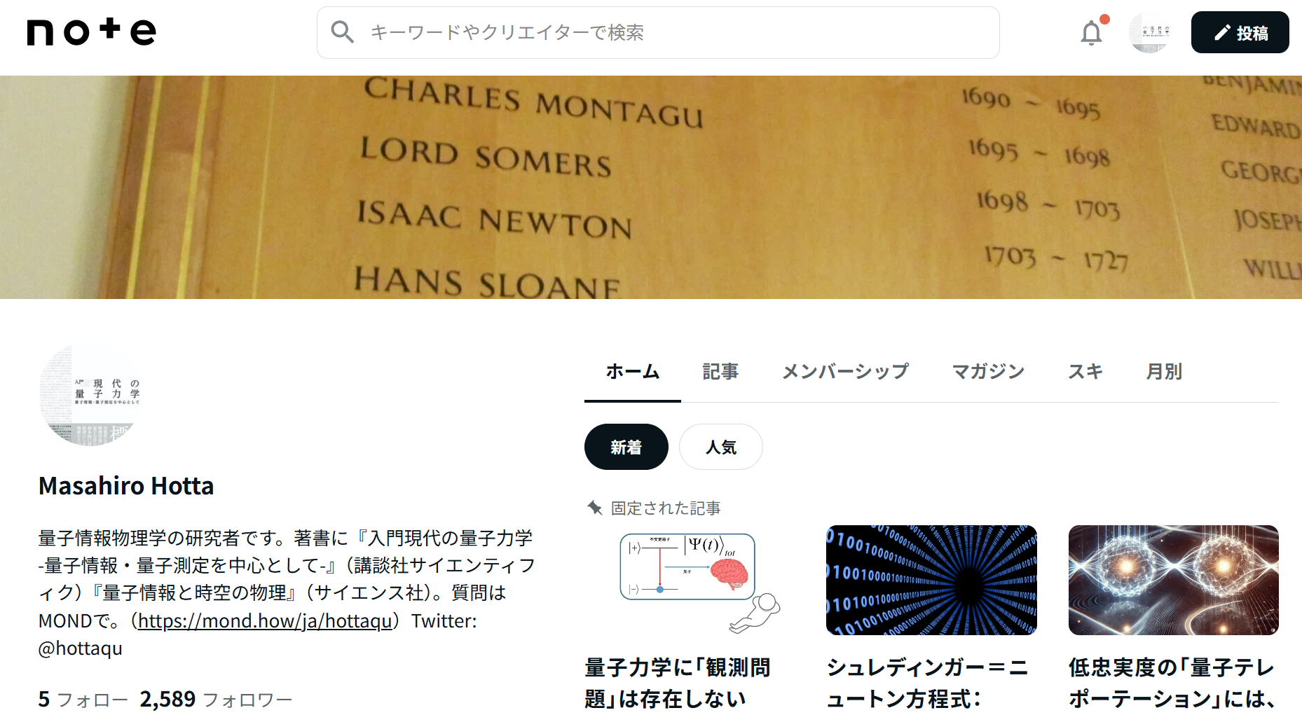

Slide 4
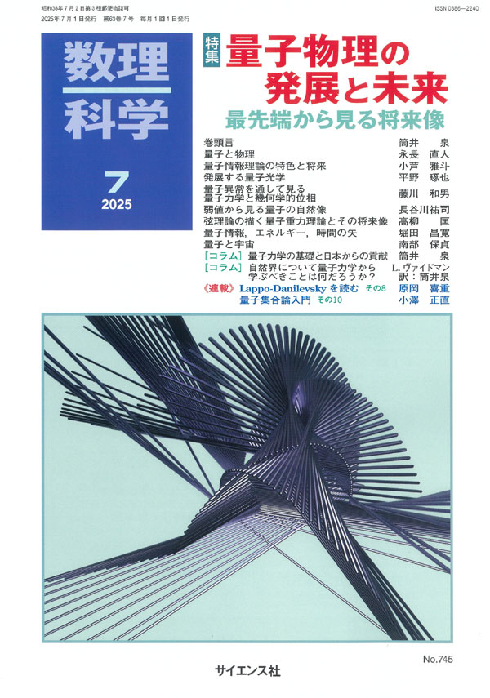
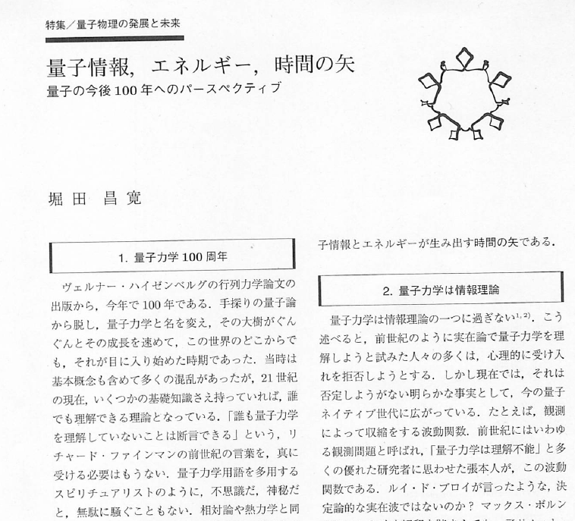

Slide 5
Conversations between quantum AIs do not cause
the quantum Zeno effect in them
Masahiro Hotta
Tohoku University
Based on
M. Hotta and M. Morikawa,
Phys. Rev. A69, 052114 (2004);
Phys. Lett. A326, 32 (2004).

Slide 6

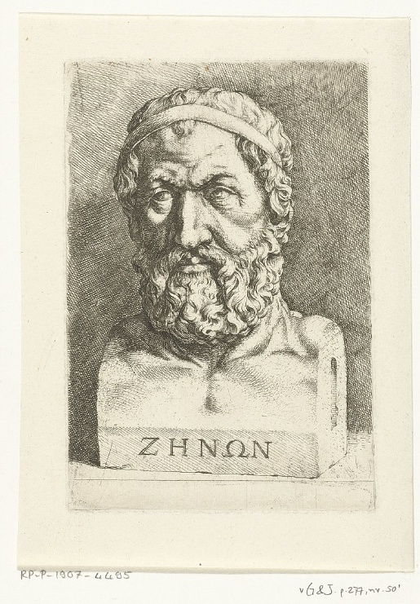
“A flying arrow never moves.”
Classical Zeno Paradox
Zeno of Elea

Slide 7

Quantum Zeno Paradox as an observer effect
“A continuously watched quantum system never evolves in time.”
Misra and Sudarshan, J. Math. Phys. 18, 756–763 (1977).
Q

Slide 8




A watched pot never boils
in QM.
Quantum watchdog effect

Slide 9
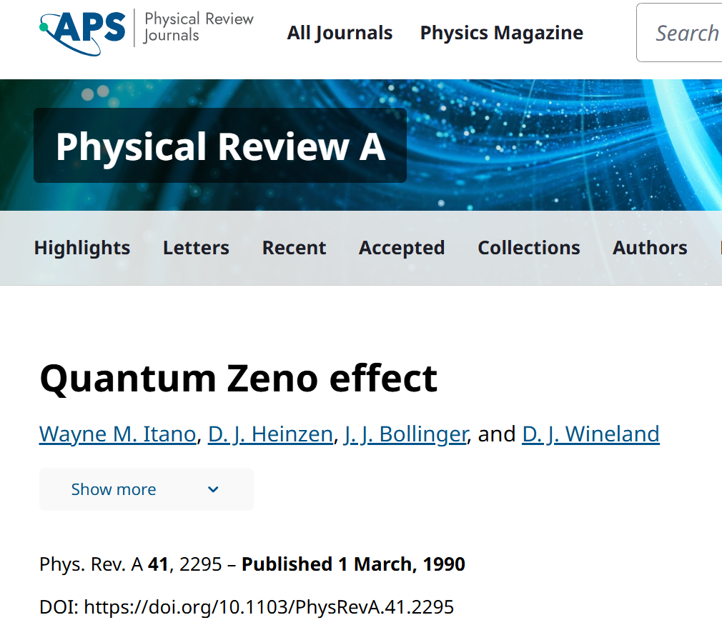
The experiment of quantum Zeno effect in 1990

Slide 10
Many reviews of quantum Zeno effect are available.
〇 “Quantum Zeno effect at 45”,
I. Georgescu, Nature Reviews Physics,4, page289 (2022).
〇 “Quantum Zeno effect by general measurements”,
K. Koshino and A. Shimizu, Phys. Rept. 412, 191-275 (2005).
〇 ….
The quantum Zeno effect can be applied to eliminate errors in quantum computation.

Slide 11
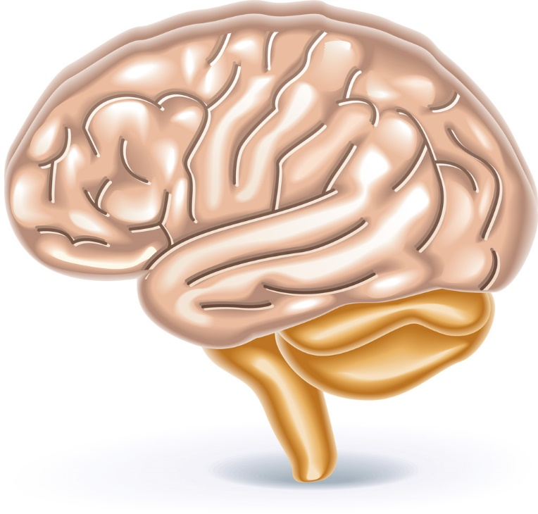
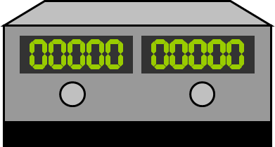
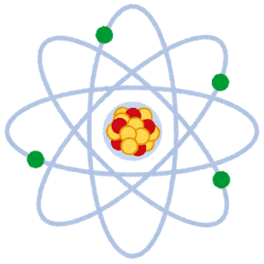
Consciousness collapses wave functions in quantum mechanics. (von Neumann, 1932)
Information flow
Consciousness as the end of “von Neumann chain”

Slide 12
A natural question arises:
Should an observer be concerned about the quantum Zeno paradox caused by their own consciousness when continuously observing a quantum system?

Slide 13


Another Zeno paradox may appear.
Max Tegmark, arXiv:1401.1219
When two quantum AIs engage in conversation, does the quantum Zeno effect occur, causing both to freeze as they direct their consciousness toward each other?

Slide 14
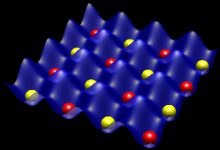
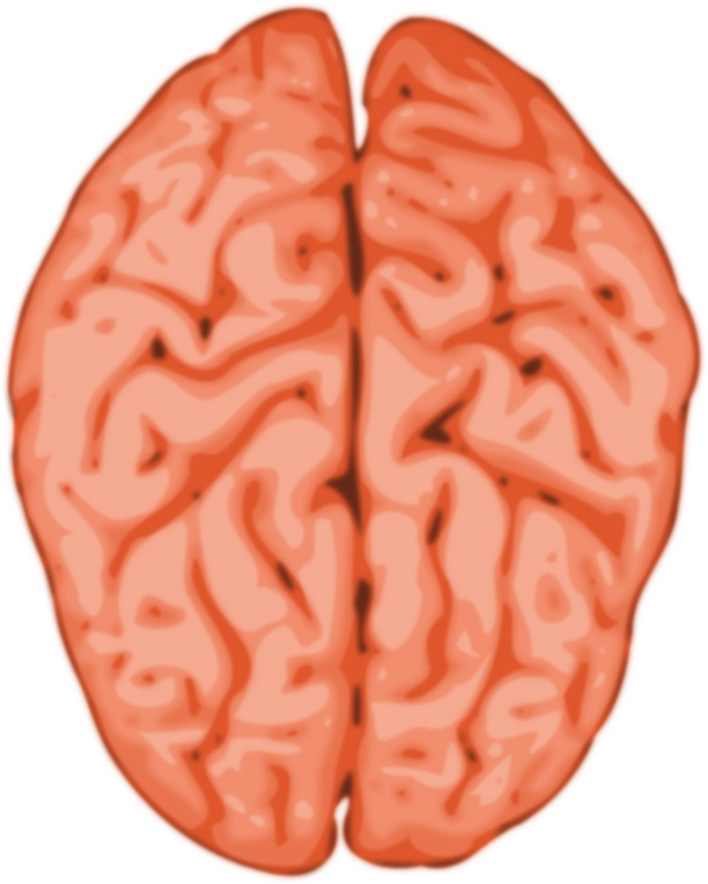
Quantum Left Brain
arXiv:1401.1219
Does integration of information for consciousness of quantum computers (QAIs) cause the quantum Zeno paradox?
arXiv:1401.1219
arXiv:1401.1219
(Tegmark, arXiv:1401.1219)
VLR
The left watches the right, and the right watches the left.
Will the quantum brain black out by the quantum Zeno effect?
Tegmark suggests ‘YES’.
Quantum Right Brain

Slide 15
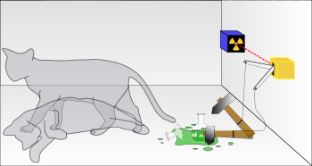
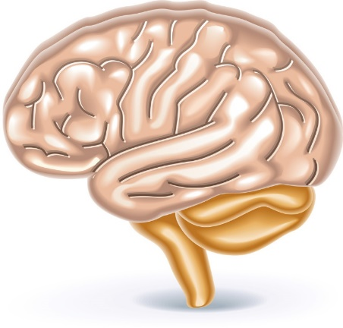
Contents of This Talk
Quanutum Zeno Effects by Direct Frequent Measurements
II. Surviving Schrӧdinger’s Cat Paradox by Quantum Zeno Effects
III. Impossibility of Quantum Zeno Effects by Indirect Measurements
IV. Summary
Fig. Wikipedia

Slide 16
I. Quantum Zeno Effects by Direct Frequent Measurements

Slide 17
Survival Probability of an Unstable State

Slide 18
Perform continuously projective measurements. Then the system evolution freezes! (Misra and Sudarshan)
Projective measurement
at time Δt:
Emergence probability of 0:
Emergence probability of 1:
Return to
the initial state!

Slide 19
Repeat the same measurements at time nΔt and take the zero limit of Δt. Then the quantum Zeno effect happens.
Survival probability after the continuous measurement:
The system at time t is always found in the initial state:
the time evolution is frozen completely by the continuous measurement!

Slide 20
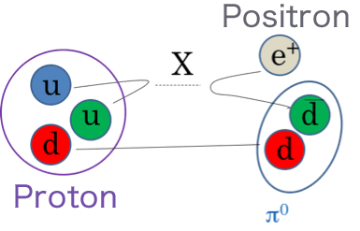
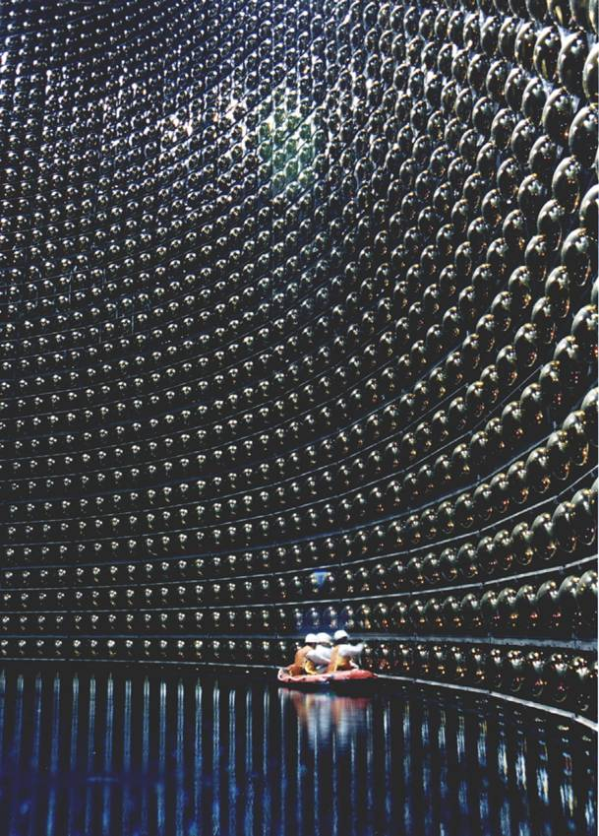
C. Bernardini, L. Miani and M. Testa,
Phys. Rev. Lett. 71, 2687 (1993)
Could the reason why proton decay has not been observed in KAMIOKANDE be the quantum Zeno effect, which is induced by continuously monitoring the decay and prolongs the proton's lifetime!?

Slide 21
There is a possibility that exponential-law decays prevent the quantum Zeno effect in quantum field theory.
Due to the renormalization in quantum field theory,
survival probabilities of unstable particles do not have the initial power-law behaviors.
Finite dimensional unstable systems
Survival
probability
Particle decay in quantum field theory
Time

Slide 22
For successive projective (ideal) measurements,
The survival probability is not affected by the measurements, and no Zeno effect happens.
Does this resolve the quantum Zeno paradox in proton decays?
No, unfortunately…

Slide 23
If not ideal but general measurements are adopted, various kinds of Zeno effects, including ordinary quantum Zeno effects and anti-Zeno effects, are caused for exponentially decaying systems.
“Quantum Zeno Effect for Exponentially Decaying Systems”
K. Koshino and A. Shimizu, Phys. Rev. Lett. 92, 030401 (2004)
Quantum Zeno Case
Survival
probability
Ideal Measurement Case
Anti Zeno Case
Time

Slide 24
Of course, the quantum Zeno paradox of general measurements should be resolved for general unstable quantum systems like quantum tunneling of quantum dots in condensed matter physics.

Slide 25
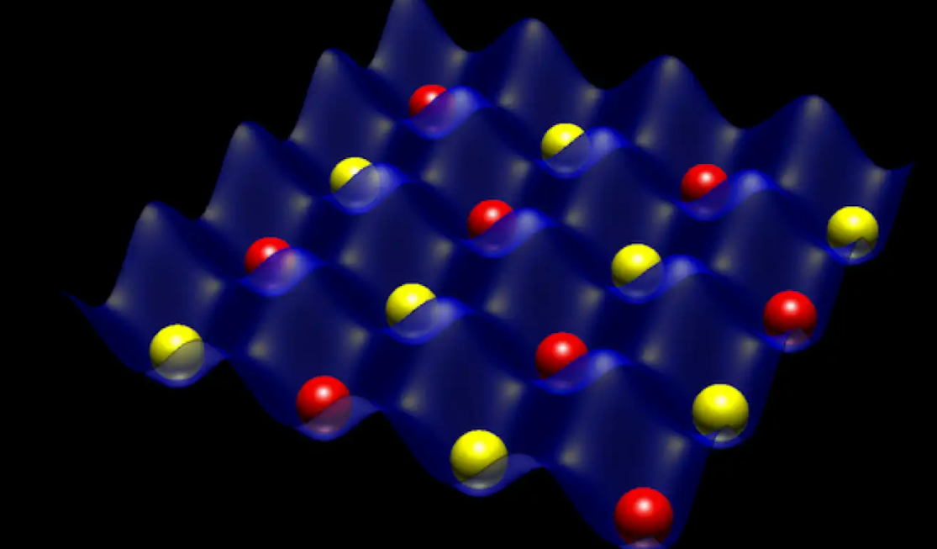
Does continuous monitoring generate “measurement induced phase transition”?

Slide 26
Anyway, ideal measurements are difficult to realize in ordinary situations. In practice, only general indirect measurements are feasible, and these measurements appear to influence the dynamics of the monitored quantum systems as well.
Therefore, the quantum Zeno paradox must be resolved in a unified way, even in general cases!

Slide 27
Taking account of this realistic aspect, the quantum Zeno paradox becomes serious again even for the Schrӧdinger’s cat experiment.
Quantum Zeno Effect?

Slide 28
II. Surviving Schrӧdinger’s Cat Paradox
by Quantum Zeno Effects

Slide 29
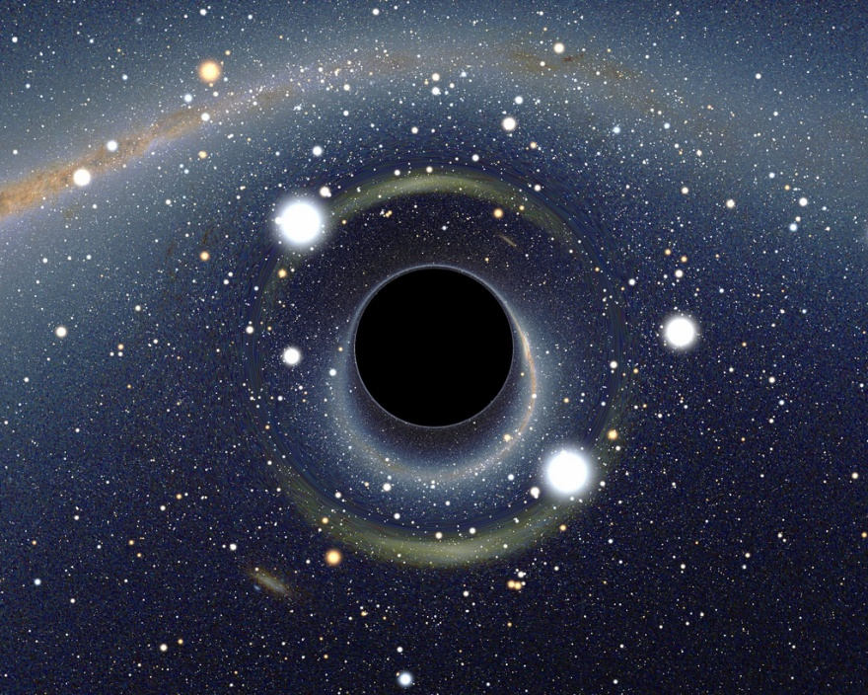

At present, postulating a cat in a pure state is not
as implausible as postulating a black hole in one!
😉
NASA

Slide 30
At the initial time t=0, the unstable atom is in the excited state and the cat is alive.
Unstable atom

Slide 31
Eventually, the system evolves in a superposition of
two macro quantum states:
Fig. Wikipedia

Slide 32
Alive cat state
Dead cat state
Very small contributions
Excited state of particle
Ground state of particle
Watching the cat is a negative-result measurement of the particle decay.
If so, watching the cat continuously may cause the quantum Zeno effect and prevent the particle decay!?
Can the cat remain alive as long as the consciousness of the observer watching it is maintained!?
Do ordinary passive observations of quantum systems really affect their dynamics in such a way??

Slide 33
Let us explicitly analyze many successive measurements of the cat.
Interval time between two successive measurements
Decay time of the unstable atom

Slide 34



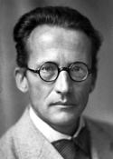
t=0
Unstable atom

Slide 35
Unstable atom

Slide 36
t=Δt
Unstable atom

Slide 37
Unstable atom

Slide 38
t=2Δt
Unstable atom

Slide 39
Unstable atom

Slide 40
t=3Δt
Unstable atom

Slide 41
Unstable atom

Slide 42
t=4Δt
Unstable atom

Slide 43
Unstable atom

Slide 44
t=10000000000000000000Δt
Unstable atom
My cat is not dead!?

Slide 45
Can the cat stay alive as long as the observer who’s watching it remains conscious?
⇒ Totally not true!
M. Hotta and M. Morikawa,
Phys. Rev. A69, 052114 (2004);
Phys. Lett. A326, 32 (2004).

Slide 46
III. Impossibility of Quantum Zeno Effects
by Indirect Measurements

Slide 47
A key to resolve the paradox is one-way dynamics in indirect measurement situations.
From a though experiment of Unruh-DeWitt particle detectors, we are able to get insight about that.

Slide 48
Unruh-DeWitt Particle detector
Does the quantum Zeno effect happen and cease the decay of the unstable atom? => No!
Causality prevents the effect to take place.
Rindler horizon
Gamma ray
Unstable atom

Slide 49
One-Way Dynamics:
The gamma ray passes through the horizon, but cannot go back to the atom across the horizon again.
A system in a microstate with low entropy evolves into macrostates with high entropy. After that, the system cannot be in a microstate again, with almost certainty.

Slide 50



One-Way Dynamics Structure
Core zone subHilbert space:
Wave zone subHilbert space:
⇒
In other words,

Slide 51
Wave zone states do not evolve to the core zone.

Slide 52
Theorem (Hotta-Morikawa,2004)
Survival probability of any state of the core zone subHilbert space is
not affected by measurements for the wave zone subHilbert space.
excited state
unstable atom
ground state

Slide 53
Theorem (Hotta-Morikawa,2004)
Survival probability of any state of the core zone subHilbert space is
not affected by measurements for the wave zone subHilbert space.
Gamma ray detector
excited state
unstable atom
Gamma ray emission
ground state

Slide 54
Many successive projective measurements for the wave zone subHilbert space
Survival probability after N times measurements
At each time, a projective measurement is performed to check if the state of the system belongs to the wave zone subHilbert space.

Slide 55
At

Slide 56
Lemma
⇒

Slide 57
From the lemma,

Slide 58
At
Already decayed.

Slide 59
From the lemma,

Slide 60
At
Already decayed.

Slide 61
From the lemma,

Slide 62
Survival probability of the initial state after N measurements:

Slide 63
NO ZENO EFFECT!

Slide 64
Comment: Wallentowitz and Toschek (2005) gave a wrong criticism!
They argued nontrivial one-way dynamics is impossible.
Trivial dynamics, only.

Slide 65
However, the assumption they used holds only for finite dimensional systems!
This is not necessarily satisfied for open quantum systems in infinite dimensions.
Mathematically rigorous proof : M. Ozawa, Defense of "Impossibility of distant indirect measurement of the quantum Zeno effect“, Phys. Lett. A 356, 411-413 (2006).
Actually, we have nontrivial models with exact one-way dynamics!

Slide 66
Remark
No kind of Zeno effect occurs, even in case of general measurement, as long as one-way dynamics is realized.
M. Hotta and M. Morikawa, Phys. Lett. A326, 32 (2004).

Slide 67
Wave Zone
Wave Zone
Core Zone
or
Ｘ
and

Slide 68
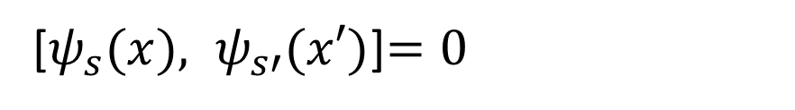
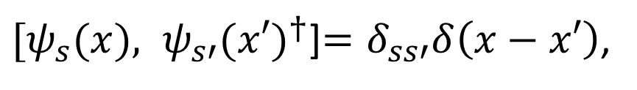
Exact Solvable Model with One-Way Dynamics
(Hotta-Morikawa, 2004)
$[ψ_{s}(x), ψ_{s′}(x′)^{†}$]$=δ_{ss′}δ\left(x−x′\right)$,
[$ψ_{s}(x), ψ_{s′}(x′)$]$=0$

Slide 69
It turns out that consciousness does not affect the evolution of the unstable atom at all, since the degrees of freedom belong to the wave zone.

Slide 70

Wave Zone
Wave Zone
Core Zone
or
Detector
and

Slide 71
Does continuous monitoring generate “measurement induced phase transition”?
No!

Slide 72
Direct measurement interaction generates “measurement induced phase transition”.
Detector Probe

Slide 73
Two quantum AIs can engage in conversation without causing both to freeze even if they direct their consciousness toward each other via one-way dynamics!

Slide 74
In order to reproduce quantum Zeno effects, it is necessary that reflection waves must be generated by detectors and go back to the decayed atom to re-excite it.
Detector
Detector
x
Re-excited
Reflection Wave
Reflection Wave

Slide 75
In general, particle absorption measurements are accompanied by one-way dynamics structures.
Decay Signal
Absorption-Type Measurement
Unstable atom
Decay Signal

Slide 76
Even if detectors generate reflection waves to the particle position, …
Detector
In a decay into three particles, measurements which fail to tag more than one particle generate one-way dynamics structures.
=> No quantum Zeno effects
Reflection wave
Parent particle
Reflection wave
Detector
Reflection wave
If all the particles are observed and reflection waves are generated by all the detectors, weak Zeno effects can be possible.
Reflection wave
Weak Zeno effects
are allowed.

Slide 77
OK! That’s good!
But why were we wrong about whether the cat could survive by the quantum Zeno effect?

Slide 78
Core zone state
Wave zone state
Small,
but crucial contribution to avoid quantum Zeno effects!
decayed
alive
Another Core Zone State

Slide 79
Even if we observe the alive cat,
the post-measurement state is not the initial excited state!
alive
This amplitude is very tiny, but the accumulated contributions generate the one-way dynamics structure to avoid Zeno effects!

Slide 81
A spin-off for particle physicists

Slide 82
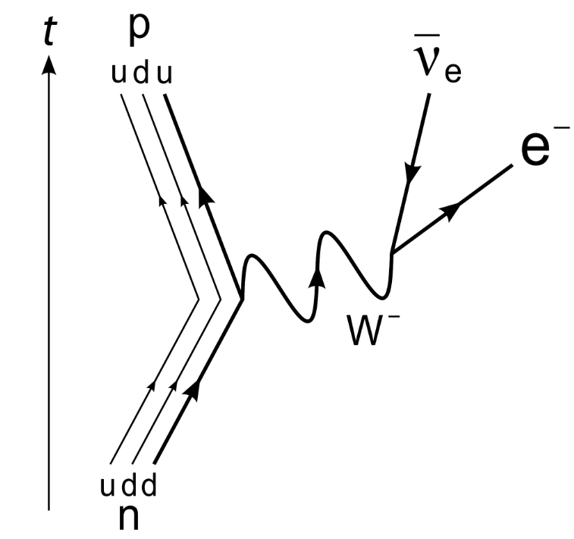
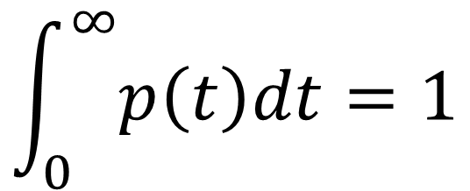

How do you compute the probability distribution of the decay time?
$$\int_{0}^{∞}{p\left(t\right)dt}=1$$
$$t=0$$

Slide 83



Slide 84
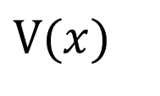
$$V(x)$$

Slide 85


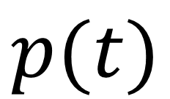
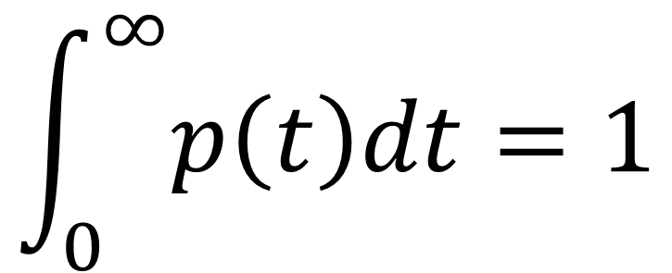
$$p(t)$$
$$\int_{0}^{∞}{p\left(t\right)dt}=1$$
$$t$$

Slide 86
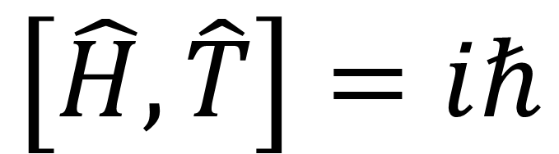
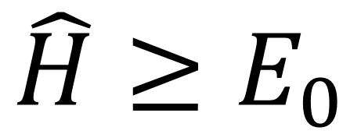
$$\hat{H}≥E_{0}$$
In quantum mechanics, the time self-adjoint operator does not exist due to the boundedness of the Hamiltonian..
$$\left[\hat{H},\hat{T}\right]=iℏ$$

Slide 87


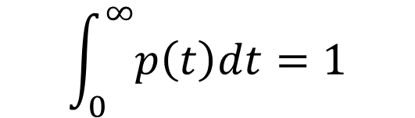
One-way dynamics introduces an arrow of time. In this sector, time becomes a physical observable, allowing us to compute the time probability distribution beyond the exponential decay law.
$$p(t)$$
$$\int_{0}^{∞}{p\left(t\right)dt}=1$$
$$t$$

Slide 88
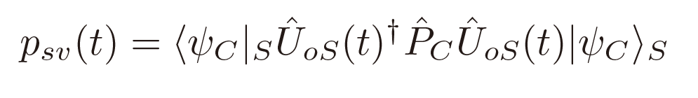
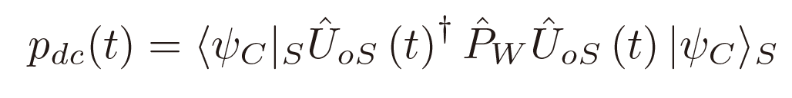
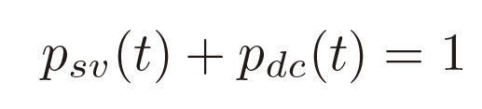
Survival Probability of a Core-Zone State:
Decay Probability:

Slide 89
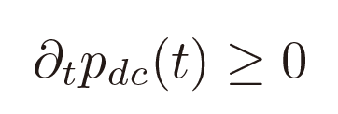
One-way dynamics ensures the monotonicity in time of the decay probability:

Slide 90




Slide 91
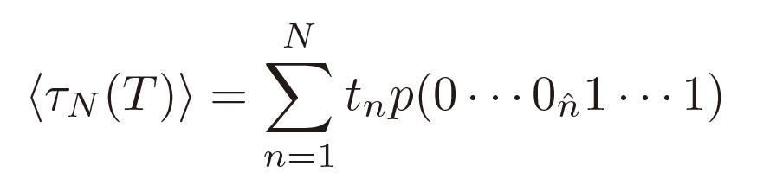
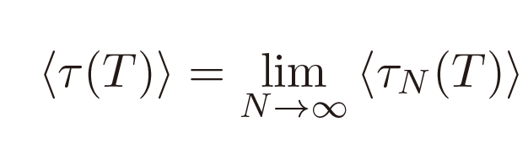

Slide 92
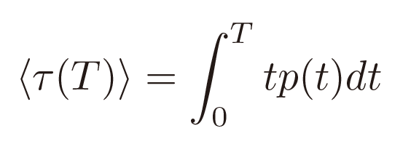
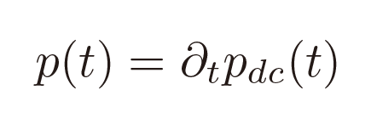
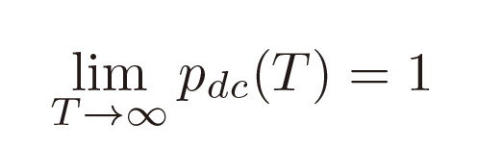
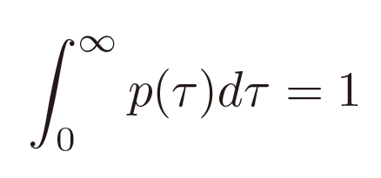

Slide 93
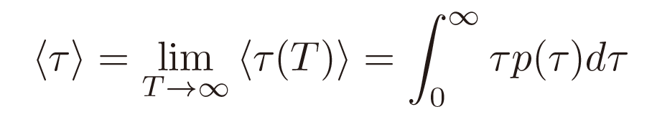
Expectation value of lifetime of the decaying state
The decay-time probability distribution of an unstable particle should also be rigorously formulated in the same way!
Unstable Particle
Decay Signal

Slide 94
Summary
No Zeno effects are caused by indirect measurements by consciousness. The quantum Zeno paradox does not arise in quantum AIs if one-way dynamics structures are realized.

Slide 95
まとめ
意識による間接測定では、いかなるゼノン効果も生じない。量子AI同士の会話でも一方向性ダイナミクスが実現していれば、量子ゼノンのパラドクスも起きない。

