Slide 1
Black Holes and the Fluctuation Theorem
Susumu Okazawa (総研大, KEK)
with Satoshi Iso and Sen Zhang, arXiv:1008.1184
+ work in progress

Slide 2
1. Introduction [1/3]
Backgrounds
Black hole thermodynamics
Hawking radiation – classical gravity + quantum field
– Planck distribution with temperature
Motivations
We want to investigate non-equilibrium nature of black holes
– cf. Einstein’s theory of Brownian motion, fluctuations are important
– Analyzing an asymptotically flat BH as a thermodynamically unstable system
– Information loss problem
– Refining “The Einstein Equation of State” [Jacobson ‘95]
– Applications for gauge/gravity duality

Slide 3
1. Introduction [2/3]
Method
The fluctuation theorem [Evans, Cohen & Morris ‘93]
– Roughly speaking, non-equilibrium fluctuations satisfy
– violation of the second law of thermodynamics
– A bridge between microscopic theory with time reversal symmetry
and the second law of thermodynamics
Advantages
The theorem includes fluctuation around equilibrium (linear response theory)
The theorem is applicable to (almost) arbitrary non-equilibrium process
– In particular unstable systems and steady states
– Evaporating BHs can be treated

Slide 4
1. Introduction [3/3]
Plan
2. The Langevin eq. and the Fokker-Planck eq. [2]
- fundamental tools to study non-equilibrium physics
3. The Fluctuation Theorem [3]
- give a proof and review a first experimental evidence
4. Black Hole with Matter [3]
- show an effective EOM for scalar
5. The Fluctuation Theorem for BH [5] ← Main Topic
- show our results, the fluctuation thm for BH w/ matter, Green-Kubo relation for thermal current
6. Summary and Discussions [3]

Slide 5
2. The Langevin eq. and The Fokker-Planck eq. [1/2]
The Langevin eq. : EOM of particle with friction and noise.
The Fokker-Planck eq. : EOM of particle’s probability distribution.
The Langevin equation is a phenomenological (or effective) equation of motion
with friction and thermal noise.
The Fokker-Planck equation can be obtained from the Langevin equation.
: conditional probability to see a event
which starts from the value , .

Slide 6
2. The Langevin eq. and The Fokker-Planck eq. [2/2]
This eq. has the stationary distribution : .
“the Boltzmann distribution”
The solution of the Fokker-Planck equation can be represented by a path integral.
The “Lagrangian” is called “the Onsager-Machlup function”.
[Onsager, Machlup ‘53]
Most probable path:
“Onsager’s principle of minimum energy dissipation”
“dissipation function” , “entropy production” time reversed sym.

Slide 7
3. The Fluctuation Theorem [1/3]
We consider a externally controlled potential .
Simple example:
The probability to see a trajectory ,
Reversed trajectory with the reversely controlled potential.
We will call “forward protocol” and “reversed protocol” .
Cancellation occur except for time reversed sym. violated term.

Slide 8
3. The Fluctuation Theorem [2/3]
We assume the initial distribution is in a equilibrium (i.e. Boltzmann distribution) .
We defined
which is called “dissipative work” or “entropy production”.
We establish the fluctuation theorem.
Negative entropy production always exists.
The Jarzynski equality [Jarzynski ‘97]:
By Using , we obtaine “the second law of thermodynamics” as a corollary.
There exists a trajectory that violates the second law.

Slide 9
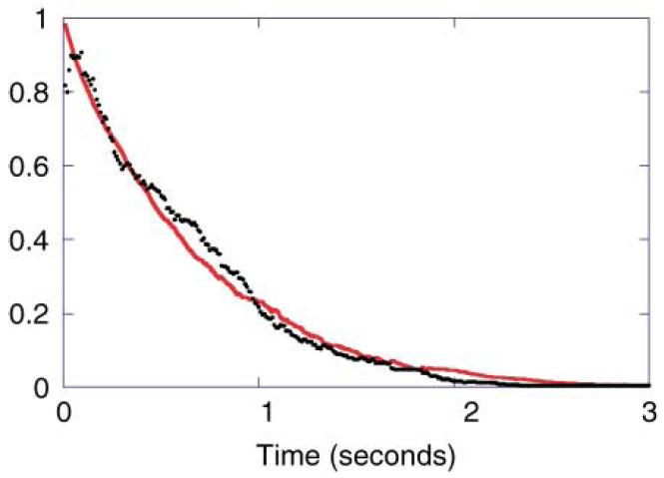
3. The Fluctuation Theorem [3/3]
The first experimental evidence. [Wang, Sevick, Mittag, Searles & Evans (2002)]
Potential by an optical tweezer
Brownian motion
particle
Force
Viscous fluid , temp. T

Slide 10
Plan
2. The Langevin eq. and the Fokker-Planck eq. [2]
- prepare fundamental tools to study non-equilibrium physics
3. The Fluctuation Theorem [3]
- give a proof and review a first experimental evidence
4. Black Hole with Matter [3]
- show an effective EOM for scalar
5. The Fluctuation Theorem for BH [5] ← Main Topic
- show our results, the fluctuation thm for BH w/ matter, Green-Kubo relation for thermal current
6. Summary and Discussions [3]

Slide 11
4. Black Hole with Matter [1/3]
We will consider a spherically symmetric system. Back-reactions are neglected.
Scalar field in maximally extended Schwarzschild BH:
We expand a solution in region R of as,
which satisfy , ingoing boundary condition.
We connect the solution to region L to satisfy
is equivalent to Kruskal positive frequency modes,
is equivalent to Kruskal negative frequency modes.
Set the values : , .
Schwinger-Keldysh propagators. [Son, Teaney ’09]
L
R

Slide 12
4. Black Hole with Matter [2/3]
It is possible to cast the propagators into the form
when we use the bases
The method is called “retarded-advanced formalism”. [for review Calzetta, Hu ’08]
We introduce an auxiliary field ,
We obtain the effective equation of motion for ,
Langevin equation. Friction and noise absorption and Hawking radiation

Slide 13
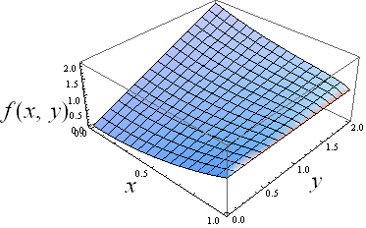
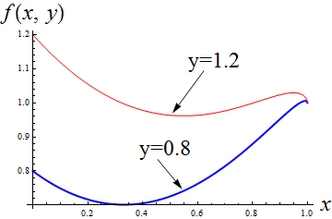
4. Black Hole with Matter [3/3]
Black holes in an asymptotically flat spacetime are thermodynamically unstable.
Rough estimates about stability of radiation in a box: [Gibbons, Perry ‘78]
Change of variables:
For given E, V (given y), maximize the entropy.
If , which corresponds to the radiation.
If , which corresponds to the black hole in thermal equilibrium.

Slide 14
5. The Fluctuation Theorem for BH [1/5]
We consider a black hole in a box. This system is thermodynamically stable.
The Fokker-Planck equation for the scalar field
in black hole background is as follows: .
Instead, we consider a discrete model for simplicity.

Slide 15
5. The Fluctuation Theorem for BH [2/5]
We can construct a path integral representation for the discrete model.
We choose the initial distribution as a stationary distribution.
In this case, it is a equilibrium distribution i.e.
Here, we introduce a externally controlled potential .
Since , ,
we can reinterpret the entropy production as
This quantity fluctuates due to Hawking radiation and externally controlled potential.

Slide 16
5. The Fluctuation Theorem for BH [3/5]
We establish the fluctuation theorem for black holes with matters. [Iso, Okazawa, Zhang ‘10]
We also establish the Jarzynski type equality.
From the above, an inequality gives the generalized second law.
To satisfy the Jarzynski equality, entropy decreasing trajectory must exist.
A violation of the generalized second law.
Next: we examine steady state case.

Slide 17
5. The Fluctuation Theorem for BH [4/5]
For the purpose to make steady states, we introduce artificial thermal bath at the wall.
The path integral representation becomes
The key property:
The system reaches a steady state in late time. Entropy production becomes the form

Slide 18
5. The Fluctuation Theorem for BH [5/5]
When we denote , one can prove the fluctuation theorem
The theorem can be recast in the relation of the generating function.
n-th cumulant : . Expansion:
We get the relations from the GF.
the Green-Kubo relation and non-linear response coefficients.
In our case, for
we obtain

Slide 19
8. Summary and Discussion [1/3]
The fluctuation theorem for black holes with matters
- Violation of the second law
The Jarzynski type equality
- The generalized second law
The steady state fluctuation theorem
- Green-Kubo relation, non-linear coefficients

Slide 20
8. Summary and Discussion [2/3]
Future directions
We want to import more from non-equilibrium physics
– Are there any study about the system which has negative specific heat?
– e.g. evaporating liquid droplet
We expect the Onsager reciprocal relation
– for example “thermoelectric effect”: the Seebeck effect the Peltier effect
thermocouple solid state refrigerator
– Reissner-Nordstrom BH with charged matter may provide a reciprocal relation
(But, reciprocal relation will be violated by non-equilibrium fluctuations)
metal A
metal A
metal B
metal B

Slide 21
8. Summary and Discussion [3/3]
Including the back reaction
– Energy conservation:
– Modification of the Fokker-Planck equation
– Analyzing asymptotically flat black holes (without box i.e. as an unstable system)
Application of the method to gauge/gravity duality
– Stochastic string model [de Boer, Hubeny, Rangamani, Shigemori ‘08, Son, Teaney ‘09]
– Fluctuation theorem for a heavy quark in QGP
Can we refine Jacobson’s idea by using the fluctuation theorem?

Slide 23
Backup
Definitions.

